Slide 1
How to Tame a Snake
Vadim Ptitsyn
RHIC fest, July 9th 2026

Slide 2
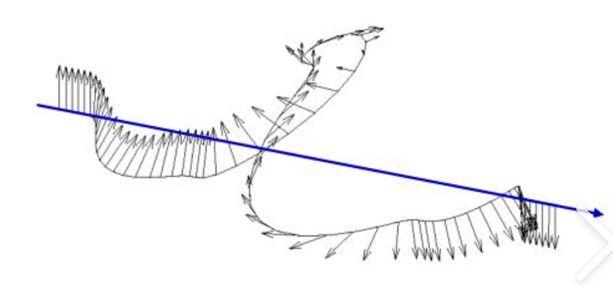
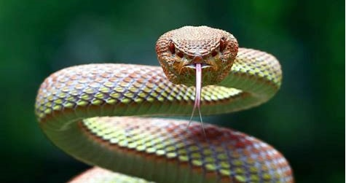
Snakes
Siberian Snake is a special type of snake, very different from usual one.
There is no entry in Wikipedia.
From Wikipedia: Snakes are elongated legless reptiles of the suborder Serpentes
Siberian Snake is not poisonous. It brings only benefits, especially to physicists. Inhabits only very special areas called particle accelerators, and only if the accelerator uses polarized beams.
Snakes inhabit nearly every environment on Earth except Antarctica
Snake taming is considered an ancient art form in many cultures
It came out that taming the Siberian Snake is also a kind of art. We mastered this art during commissioning and first operation years of RHIC.

Slide 3



Why Siberian?
Original concept was proposed in Budker Institute in Novosibirsk (Russia):
Ya.S. Derbenev and A.M.Kondratenko,
Soviet Physics Reports, 20, p 562 (1976).
Full Siberian Snake rotates spin by 180 degrees around some axis in horizontal plane.
Spin tune becomes independent on energy, usually chosen to be ½;
spin tune spread is considerably reduced too
Invention of the Siberian Snake opened a way for achieving highly polarized proton beams at the energies of tens of GeV and higher.
Ya. Derbenev
(Novosibirsk)

Slide 4
Spin Rotation: Helical Dipole
B_{y}
B_{x}
Paraxial helical dipole field (without magnet edges):
λ
Compared with common dipole the helical dipole has
an additional parameter, Helicity R, which can be +1 or -1
Actual helical field is intrinsically nonlinear,
as well as contains longitudinal off-axis component:
But, for initial evaluation of the spin and particle motion near the helical magnet axis, the paraxial helical field is a good approximation.

Slide 5
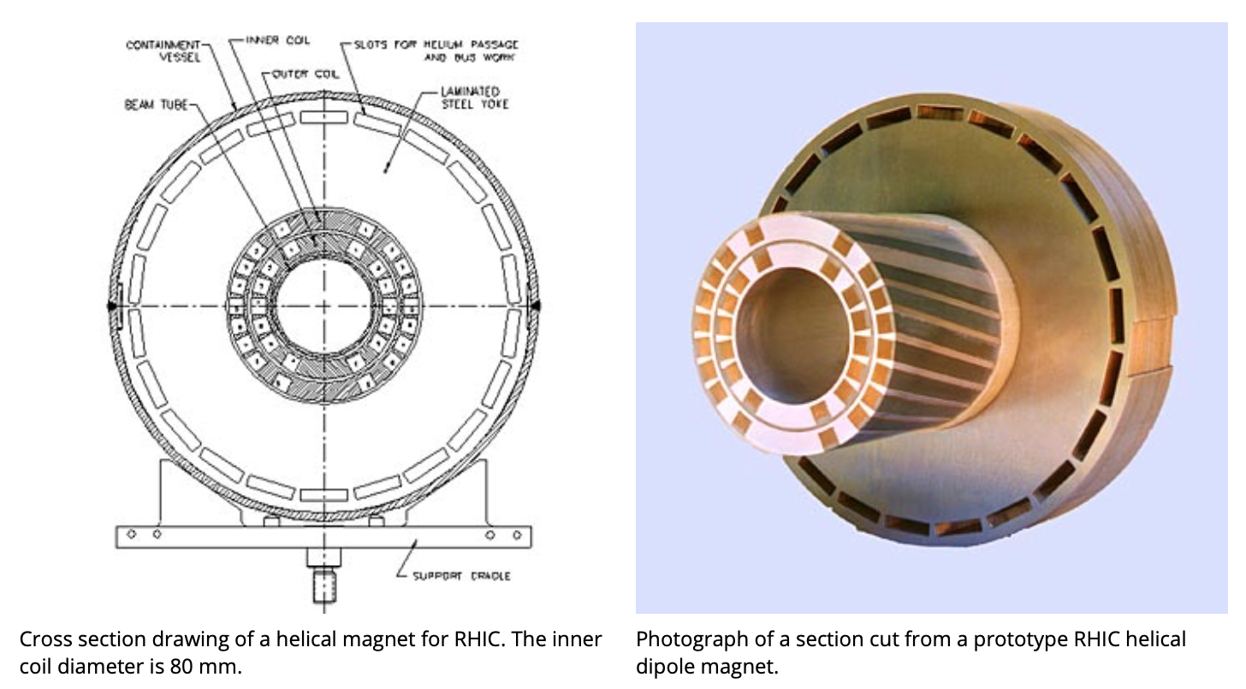
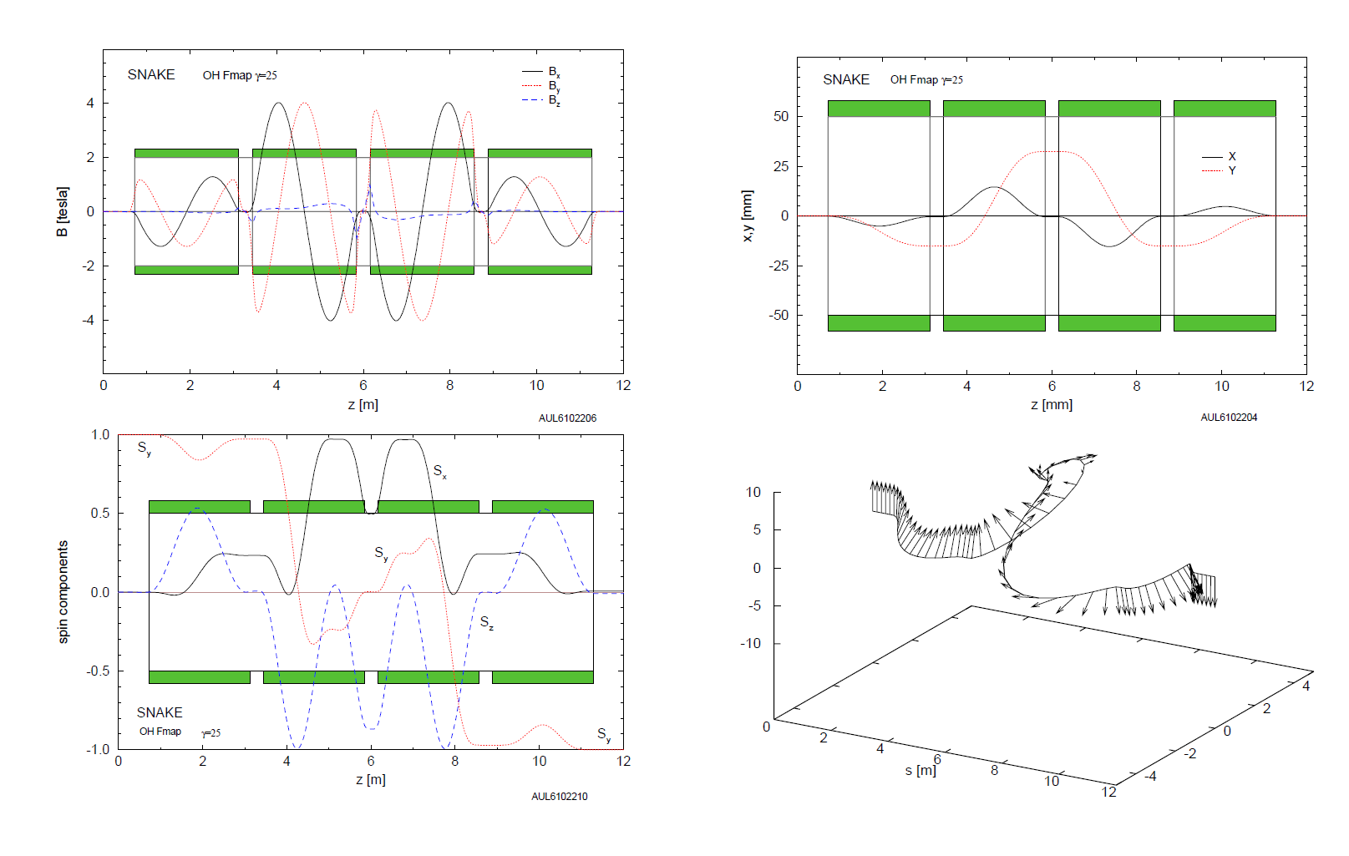
RHIC Helical Siberian Snake
The RHIC is based on sequence of 4 SC helical magnets.Each magnet 2.4m long, up to 4T field. Vertical field orientation at the center.
Two power supplies: for inner helicies and outer helicies
Due to field symmetry the beam orbit is restored at the exit of the Snake, and the spin rotation axis is automatically in horizontal plane.
By adjusting power supply currents one can select any orientation of spin rotation axis in the horizontal plane and ensure 180 degree spin rotation.
Spin and orbit inside the Snake

Slide 6
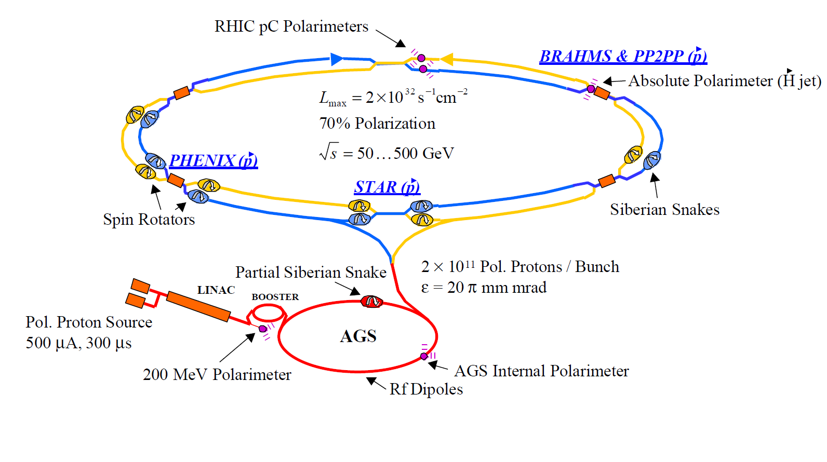
RHIC Complex in early operation years
Two Snakes per ring was installed
in RHIC following design studies.

Slide 7
Run 1: commissioning of one Siberian Snake in Blue ring
Mid-September 2000
Injection energy: γ = 25.936; Gγ = 46.5
Before trying to run the Snake, proton-Carbon CNI polarimeters were commissioned and notable polarization ~20% was measured at the injection .
Only power supplies for one Snake were available at the time!
The single snake was tuned to give a rotation of 180° about the axis which is close to the longitudinal axis. In this configuration, the stable spin direction should be in the horizontal plane.
Stable spin is not vertical !
So, we needed first to inject beam with vertically oriented spins, and then turn on the Snake. The polarization adiabatically converted from the vertical into horizontal plane.

Slide 8
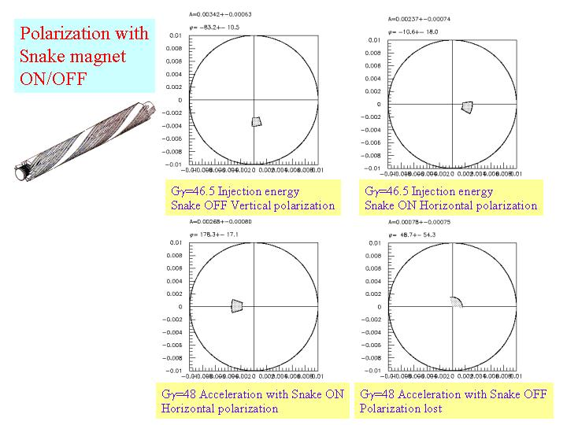
First Acceleration with Siberian Snake
Polarized beam was accelerated from Gγ = 46.5 (24.3 GeV) to Gγ = 48 (25.1 GeV) with and without the Snake.
Working point (0.11,0.13);
6 proton bunches with alternating polarization
With the Snake:
the polarization
preserved!
Without the Snake:
the polarization
lost!
During the beam acceleration the spin flipped sign at the polarimeter as expected!

Slide 9
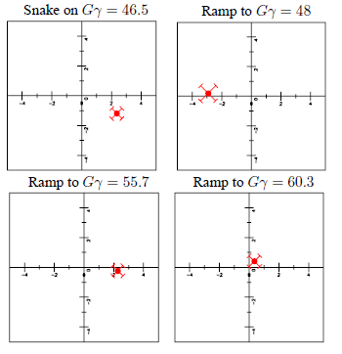
Run 1: Acceleration to higher energies
With one Snake the polarization preservation up to Gγ = 55.7 (29.1 GeV).
Strong intrinsic resonance at Gγ~58 destroyed polarization
Vertical orbit rms > 0.5 mm

Slide 10
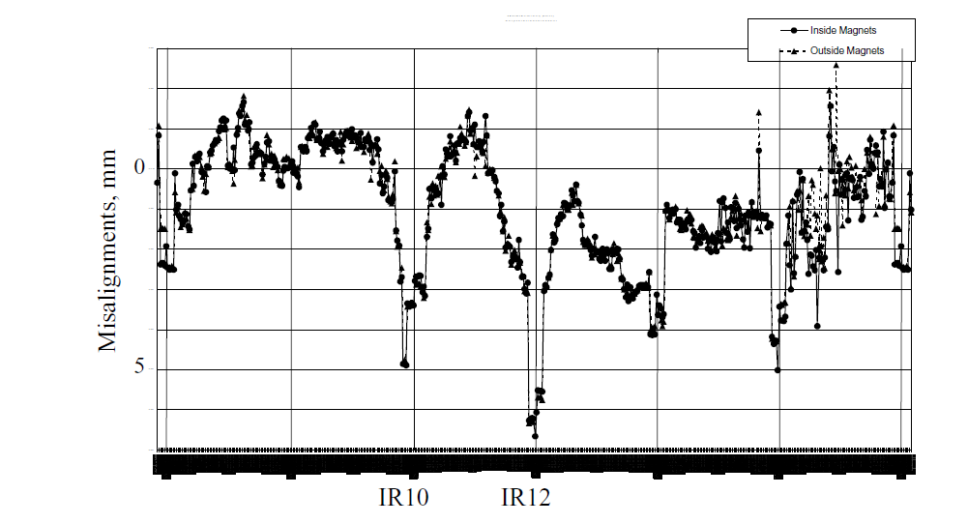
Run 2: Commissioning of Two Snake Configuration
In 2001 all Snake power supplies were installed. Full Snake configuration were ready for the Run-2.
All four Siberian Snakes ( two in Blue and two in Yellow) were successfully ramped up to achieve goal spin rotation axis (+- 45o, 4T field in inner magnets).
Acceleration to 100 GeV with two Snakes per ring led to demonstration the average store polarization up to 17%, maximum polarization ~25%.
Note that the polarization from AGS was at max 30%, due to use of back-up main field power supply, with slower ramp rate.
Betatron tunes are in the box: [0.21,0.235]
Remarkable that the 100 GeV polarization was achieved in machine which had vertical misalignments like this:

Slide 11
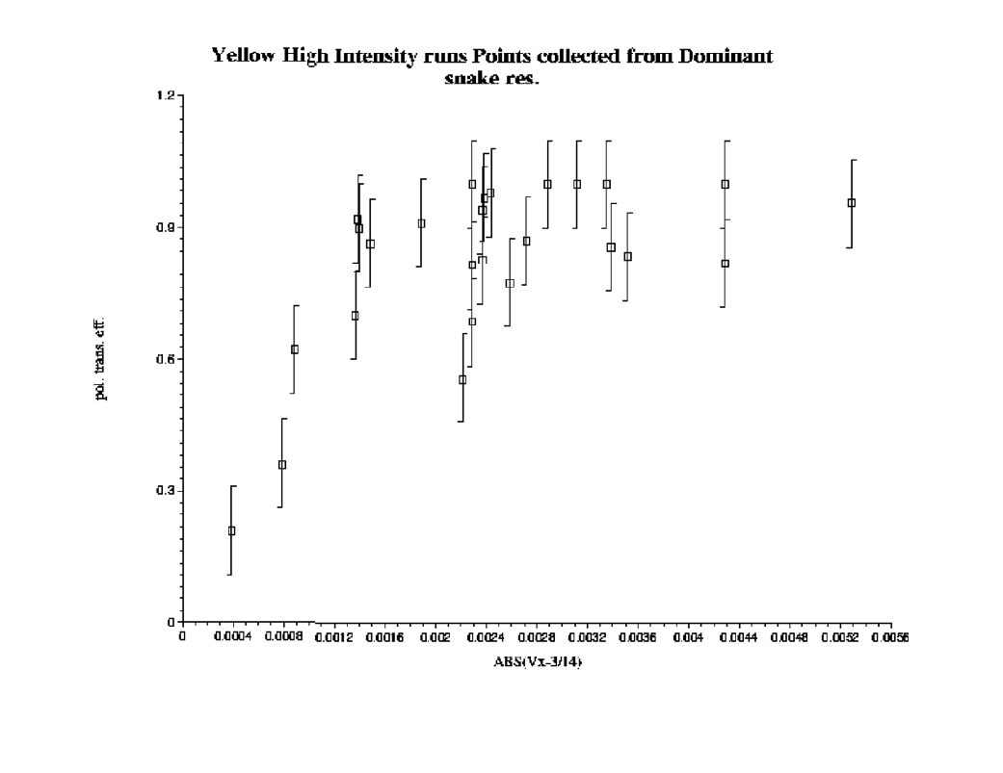
Run 2: First Observation of High-Order Spin Resonances in RHIC
During acceleration we learnt that some betatron tune should be avoided, in spite that they are far away from standard first-order spin resonance (0.5)
After the run Vahid Ranjbar used logged data for comprehensive analysis of polarization losses on the ramp at various tunes. The high-order resonances (m>1) became well visible in the data.
The spin resonance caused by
betatron coupling
Conclusion: Snakes need help from better orbit and tune control
develop tune feedback and decoupling feedback, using PLL-based tune measurement system;
develop orbit feedback to achieve the orbit control on the ramp below 0.1mm rms (on BPMs). The RHIC orbit was drifting over day (24h orbit variation)

Slide 12
Major Milestones in Several Following Runs
Run-3, 4, 5, 6: steady improvement of polarization at 100 GeV
Reaching 57% average store polarization in Run-6.
This was due to advances in all areas:
polarized source, injectors and RHIC
First acceleration beyond 100 GeV -> 205 GeV in Run-5. demonstrating 30% polarization at the store.
First acceleration to 250 GeV in Run-6,
demonstrating 45% average store polarization

Slide 13
RHIC Remarkable Achievement
Continuing effort for many years to improve RHIC polarization
at 250-255 GeV:
Extensive simulation studies (led by F. Meot)
Theoretical and experimental studies of RHIC spin resonances
(M.Bai, V. Ranjbar, …)
And, of course, considerable amount of work done by operators in the control room
RHIC at 255 GeV: ~57% average store polarization;
That is remarkable achievement!
It opened way for us to plan further polarization advances in the EIC
with the goal of achieving 70% polarization.

Slide 14
Final Points:
RHIC was first accelerator (and collider) where Siberian Snakes were used to deliver polarized beams for actual high-energy physics experiments.
Siberian Snakes in RHIC have been complete success, allowing for further studies to uncover the mystery of the proton spin
Taming the Siberian Snakes was really enjoying enterprise.
In the same time we learnt a lot about importance of avoiding higher-order spin resonances with precise orbit/tune/decoupling feedbacks on the ramp. o
And, of course, we want more Snakes!
EIC Hadron Ring plans to use six Snakes.

