Slide 1
Collisions, Correctors, Collimators and Crystals
Angelika Drees
RHIC fest, July 9th 2026

Slide 2

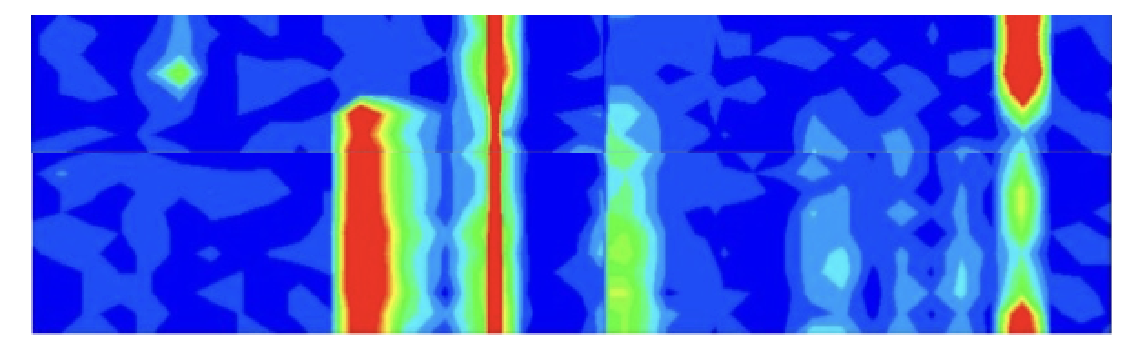
Circulating beam in 1999!!!
Circulating beam did not include (yet)
Acceleration
Collisions
Collimators (crystals or otherwise)
It did include correctors to steer around obstacles:
Note: no BPMs were hurt in this measurement (only loss monitors) ;)

Slide 3
Collisions & Correctors

Slide 4
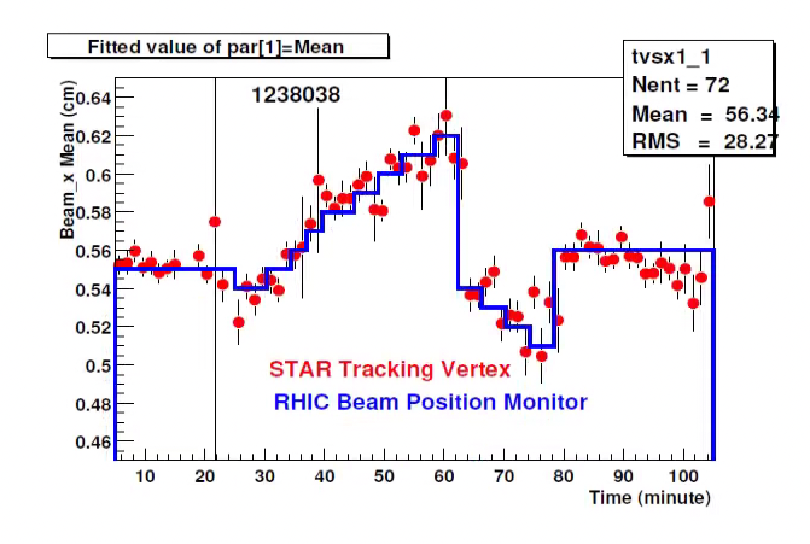
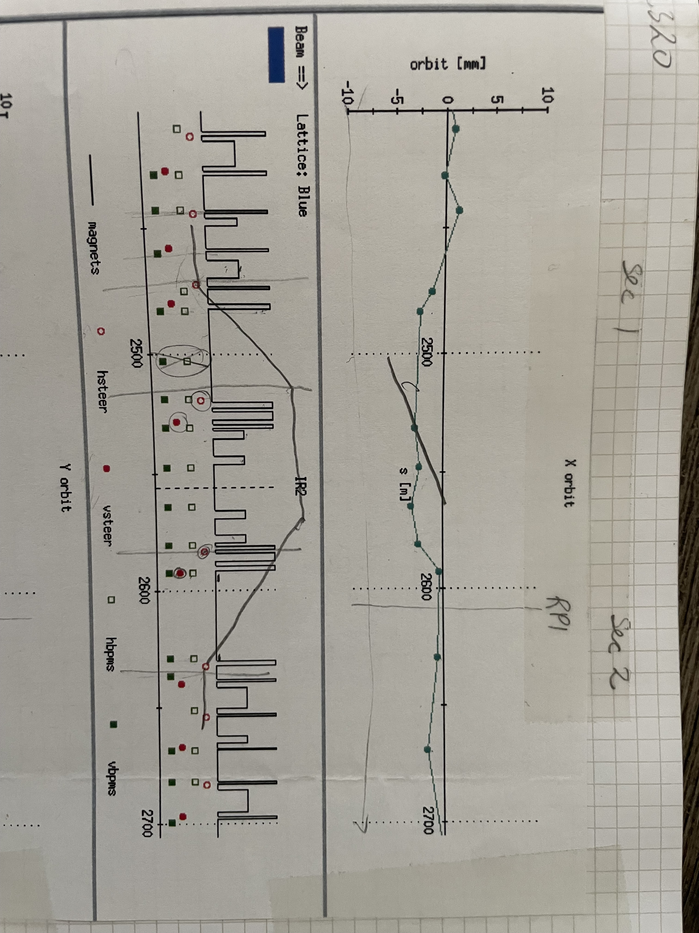
Collision: Steering and Optimization
4-bumps across the IPs:
4 correctors (Q5,Q3 – Q2,Q4)
Confirmed by experimental detector
Used for optimization as well as the (infamous) vernier scans(*).
(*) step by step sweep of one beam across the other in both planes while monitoring the collision rates

Slide 5
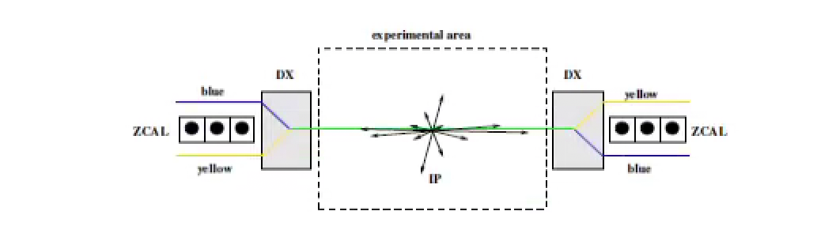
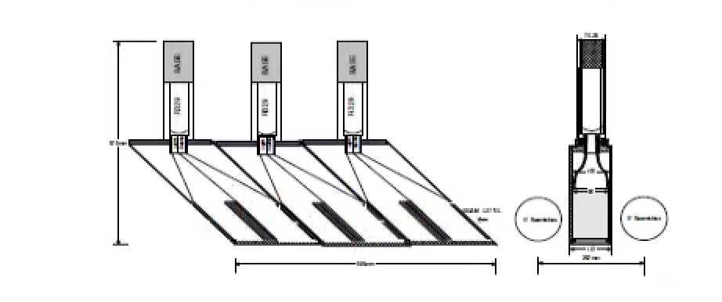
Machine-Detector collaboration:
ZDC = Zero Degree Calorimeter (or ZCAL)
ZDC are common to all experiments.
The ZDCs are used
to monitor collision rates, support steering
Book-keeping
Vernier scans are used to calibrate the ZDC and measure the cross sections

Slide 6
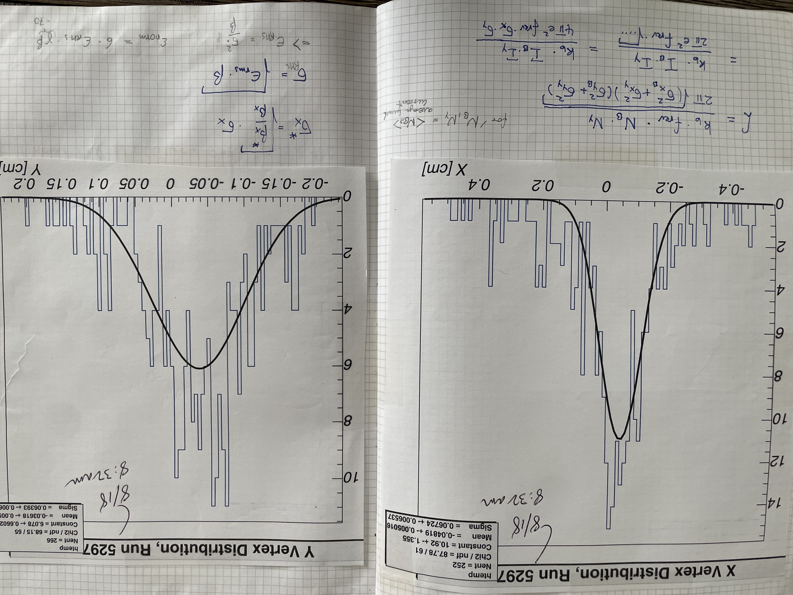
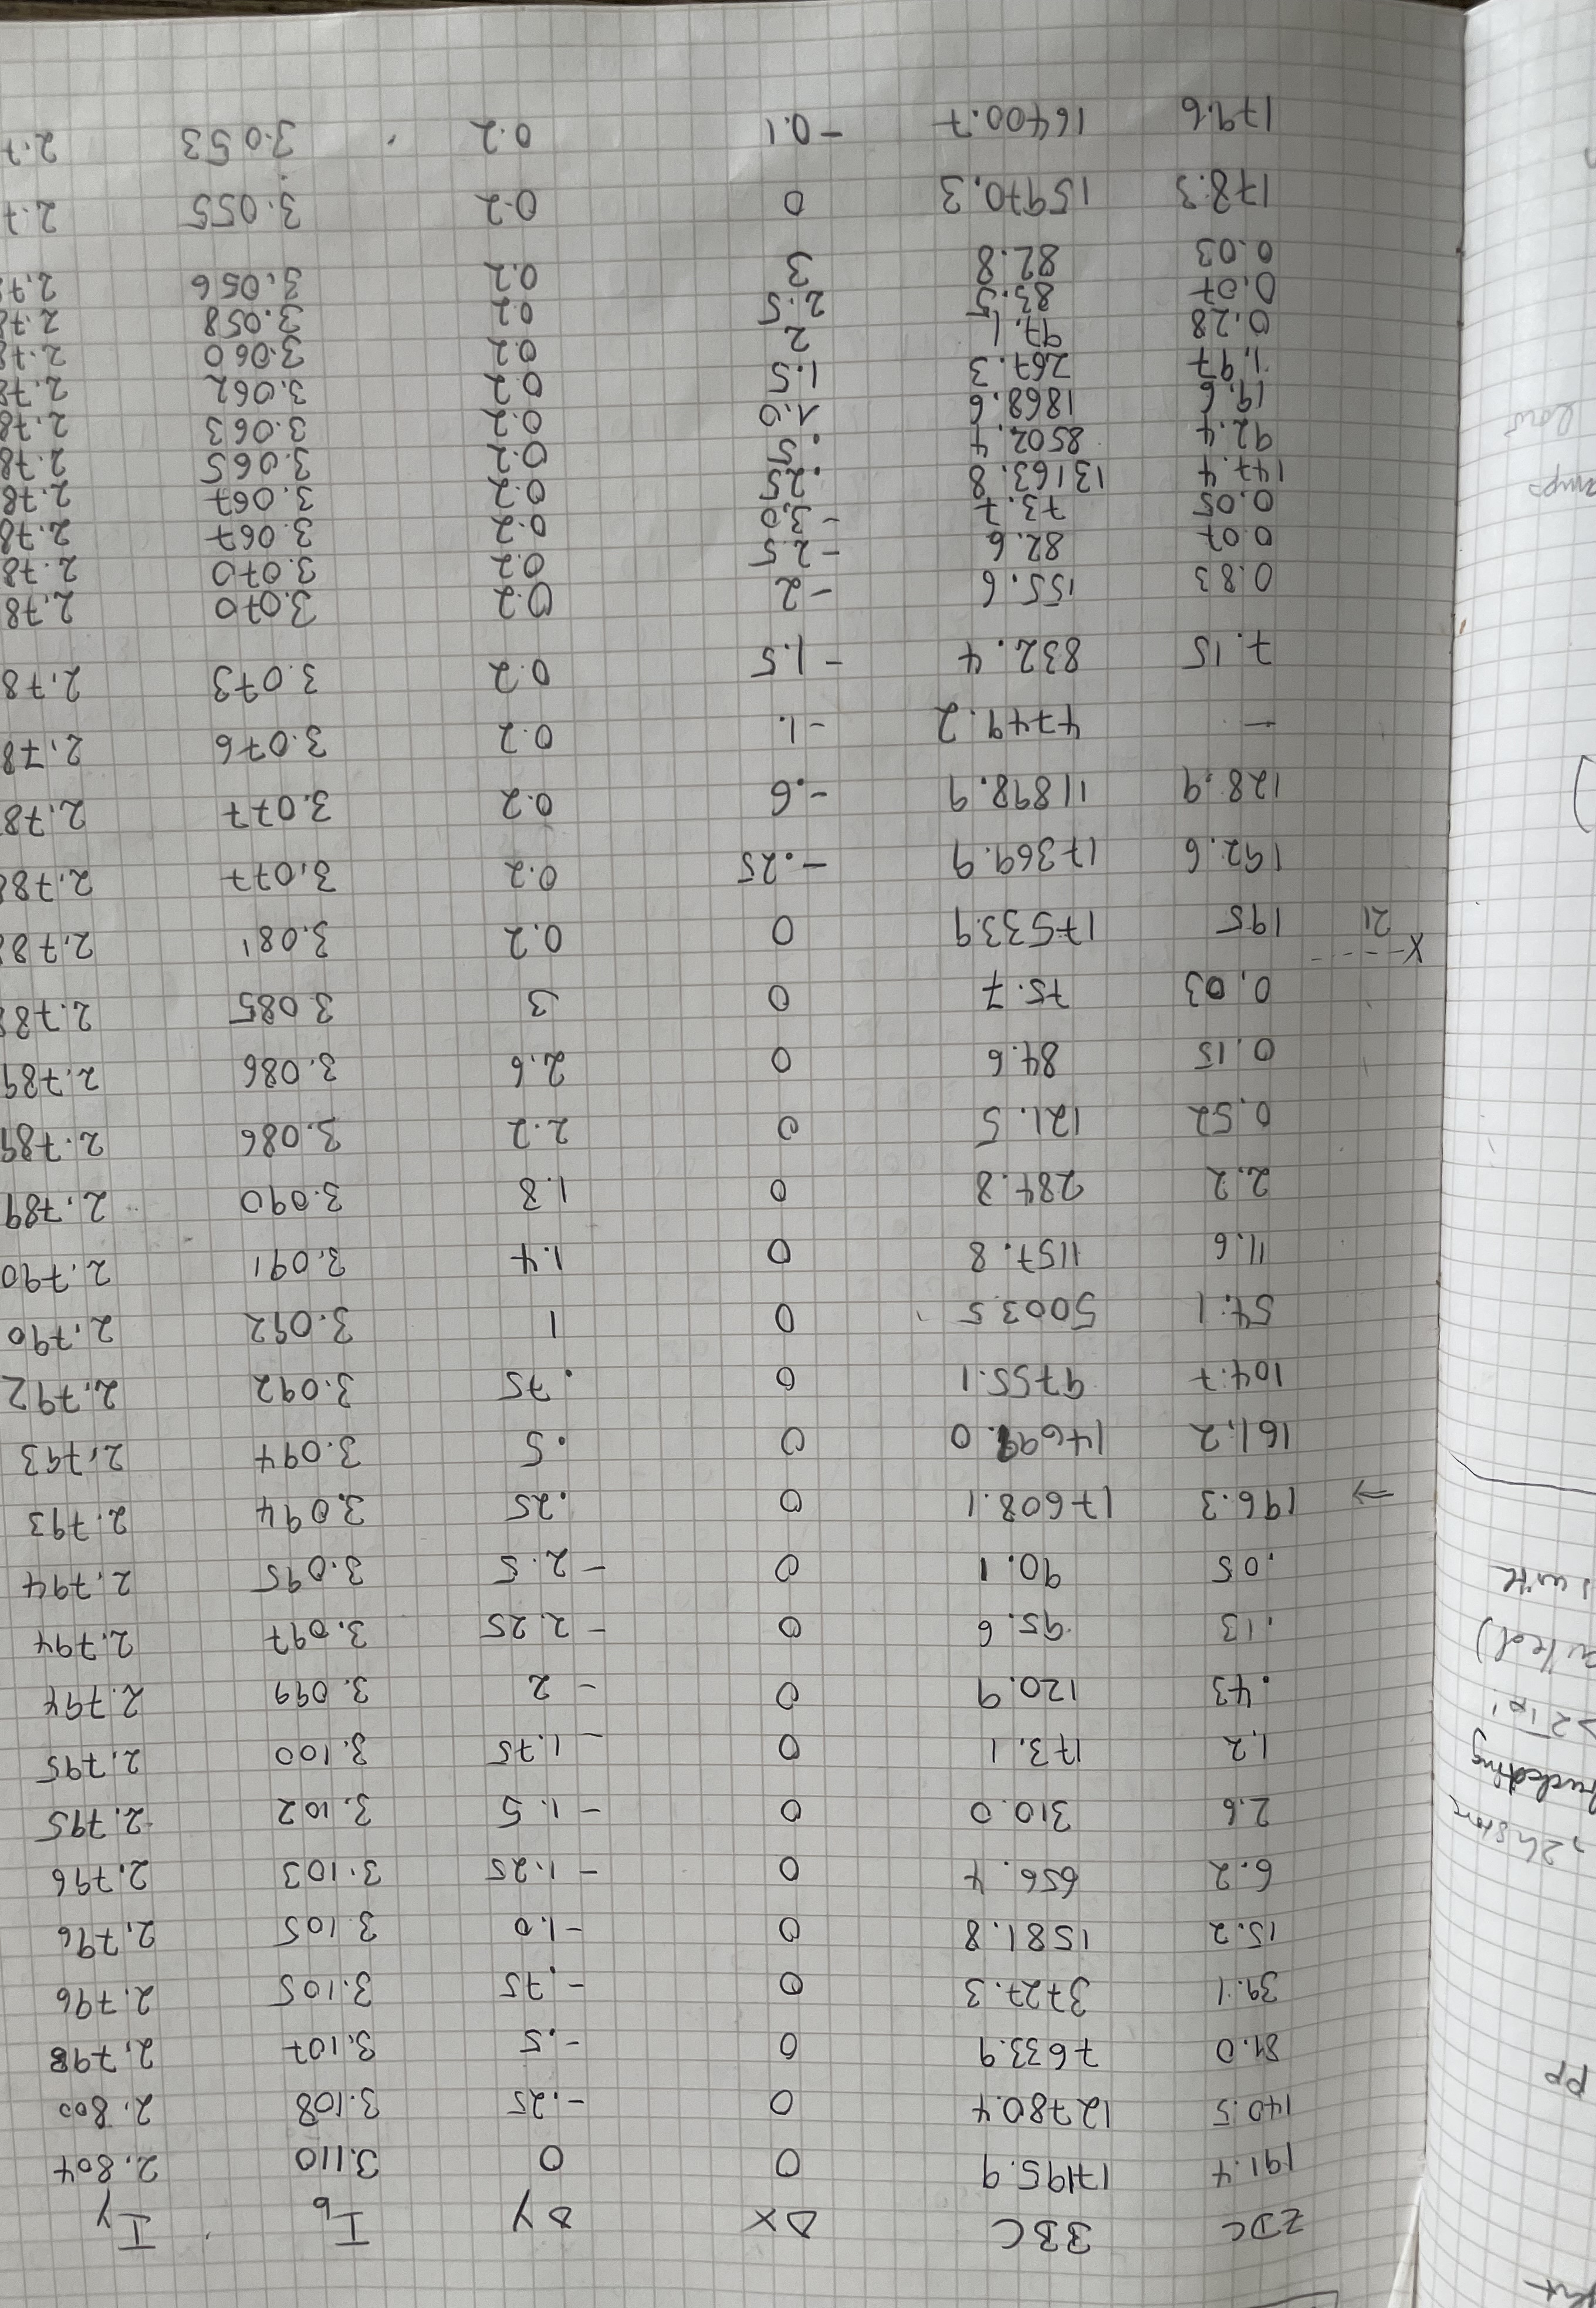
Vernier Scans: done in every RHIC run
Reminder: In a “vernier scan” (or Van-der-Meer scan) one beam is swept across the other step-by-step while monitoring the collision rates
Manual steering and “data taking”
Scans and fits (1 Gauss):
Distance between the two beams
Early
Days

Slide 7
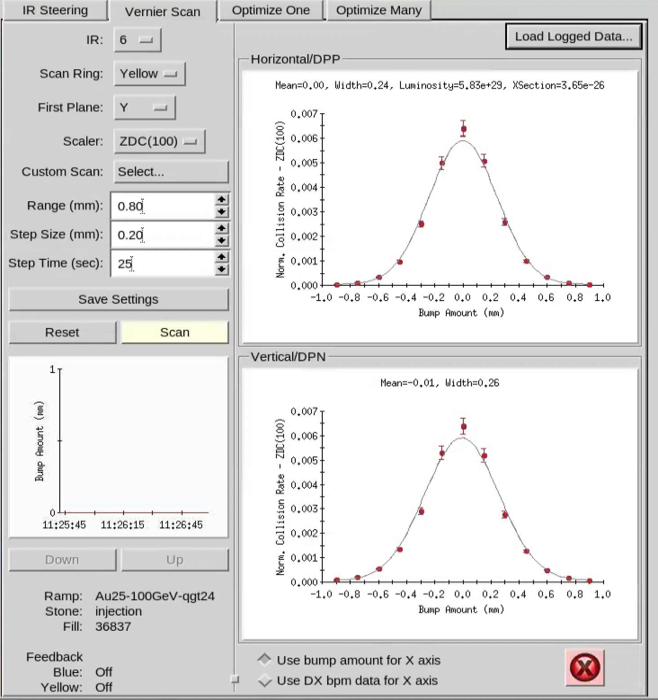
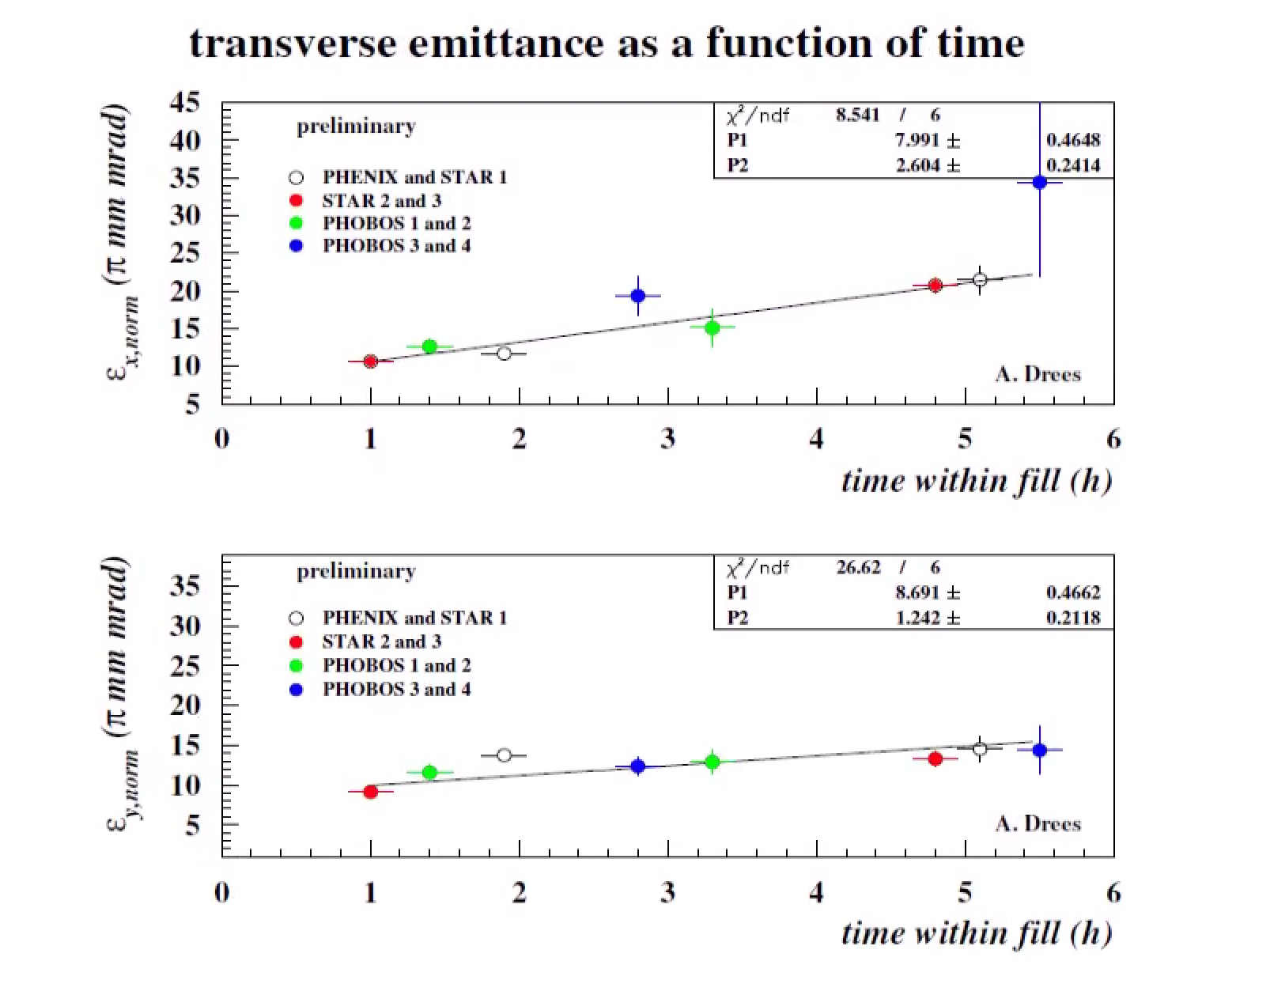
Vernier Scans (LISA(*) enters the stage)
LISA
Lisa was used to
Optimize (all IRs)
Keep reduced max. rates
Steer
Vernier scans
In 2000 (the first physics run) 8 scans were performed. In total over the years and for all experiments, several hundred scans were performed and analyzed. Vernier scans were used early to measure transverse emittances and confirm IPM results. LISA automated the process.
(*) “Luminosity and Interaction
Region Steering Application”

Slide 8
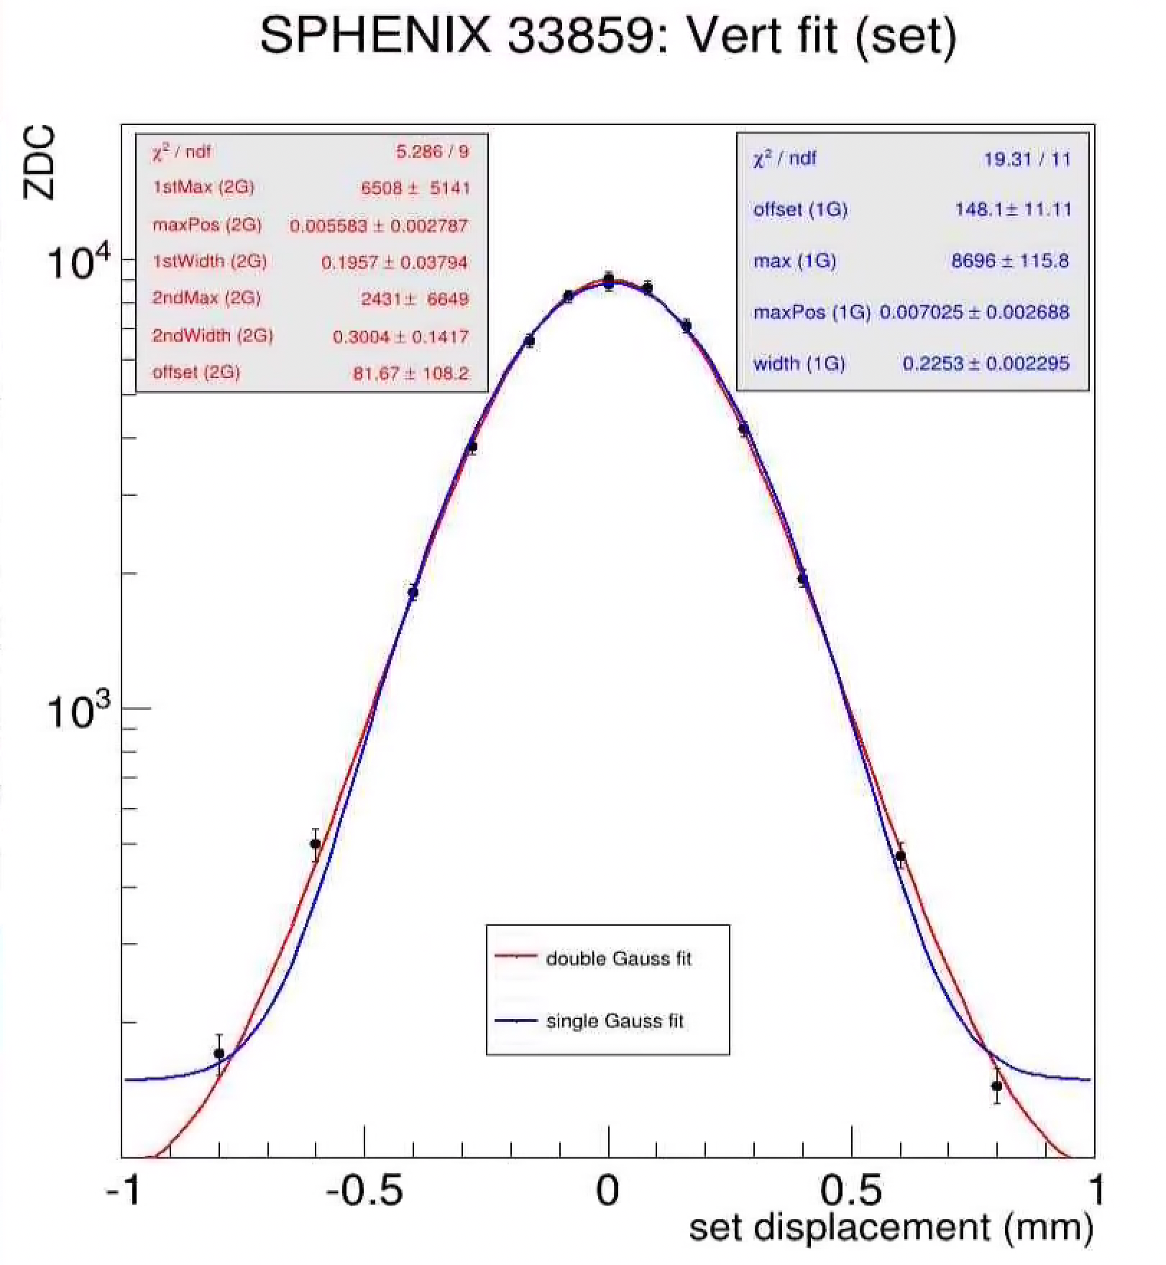
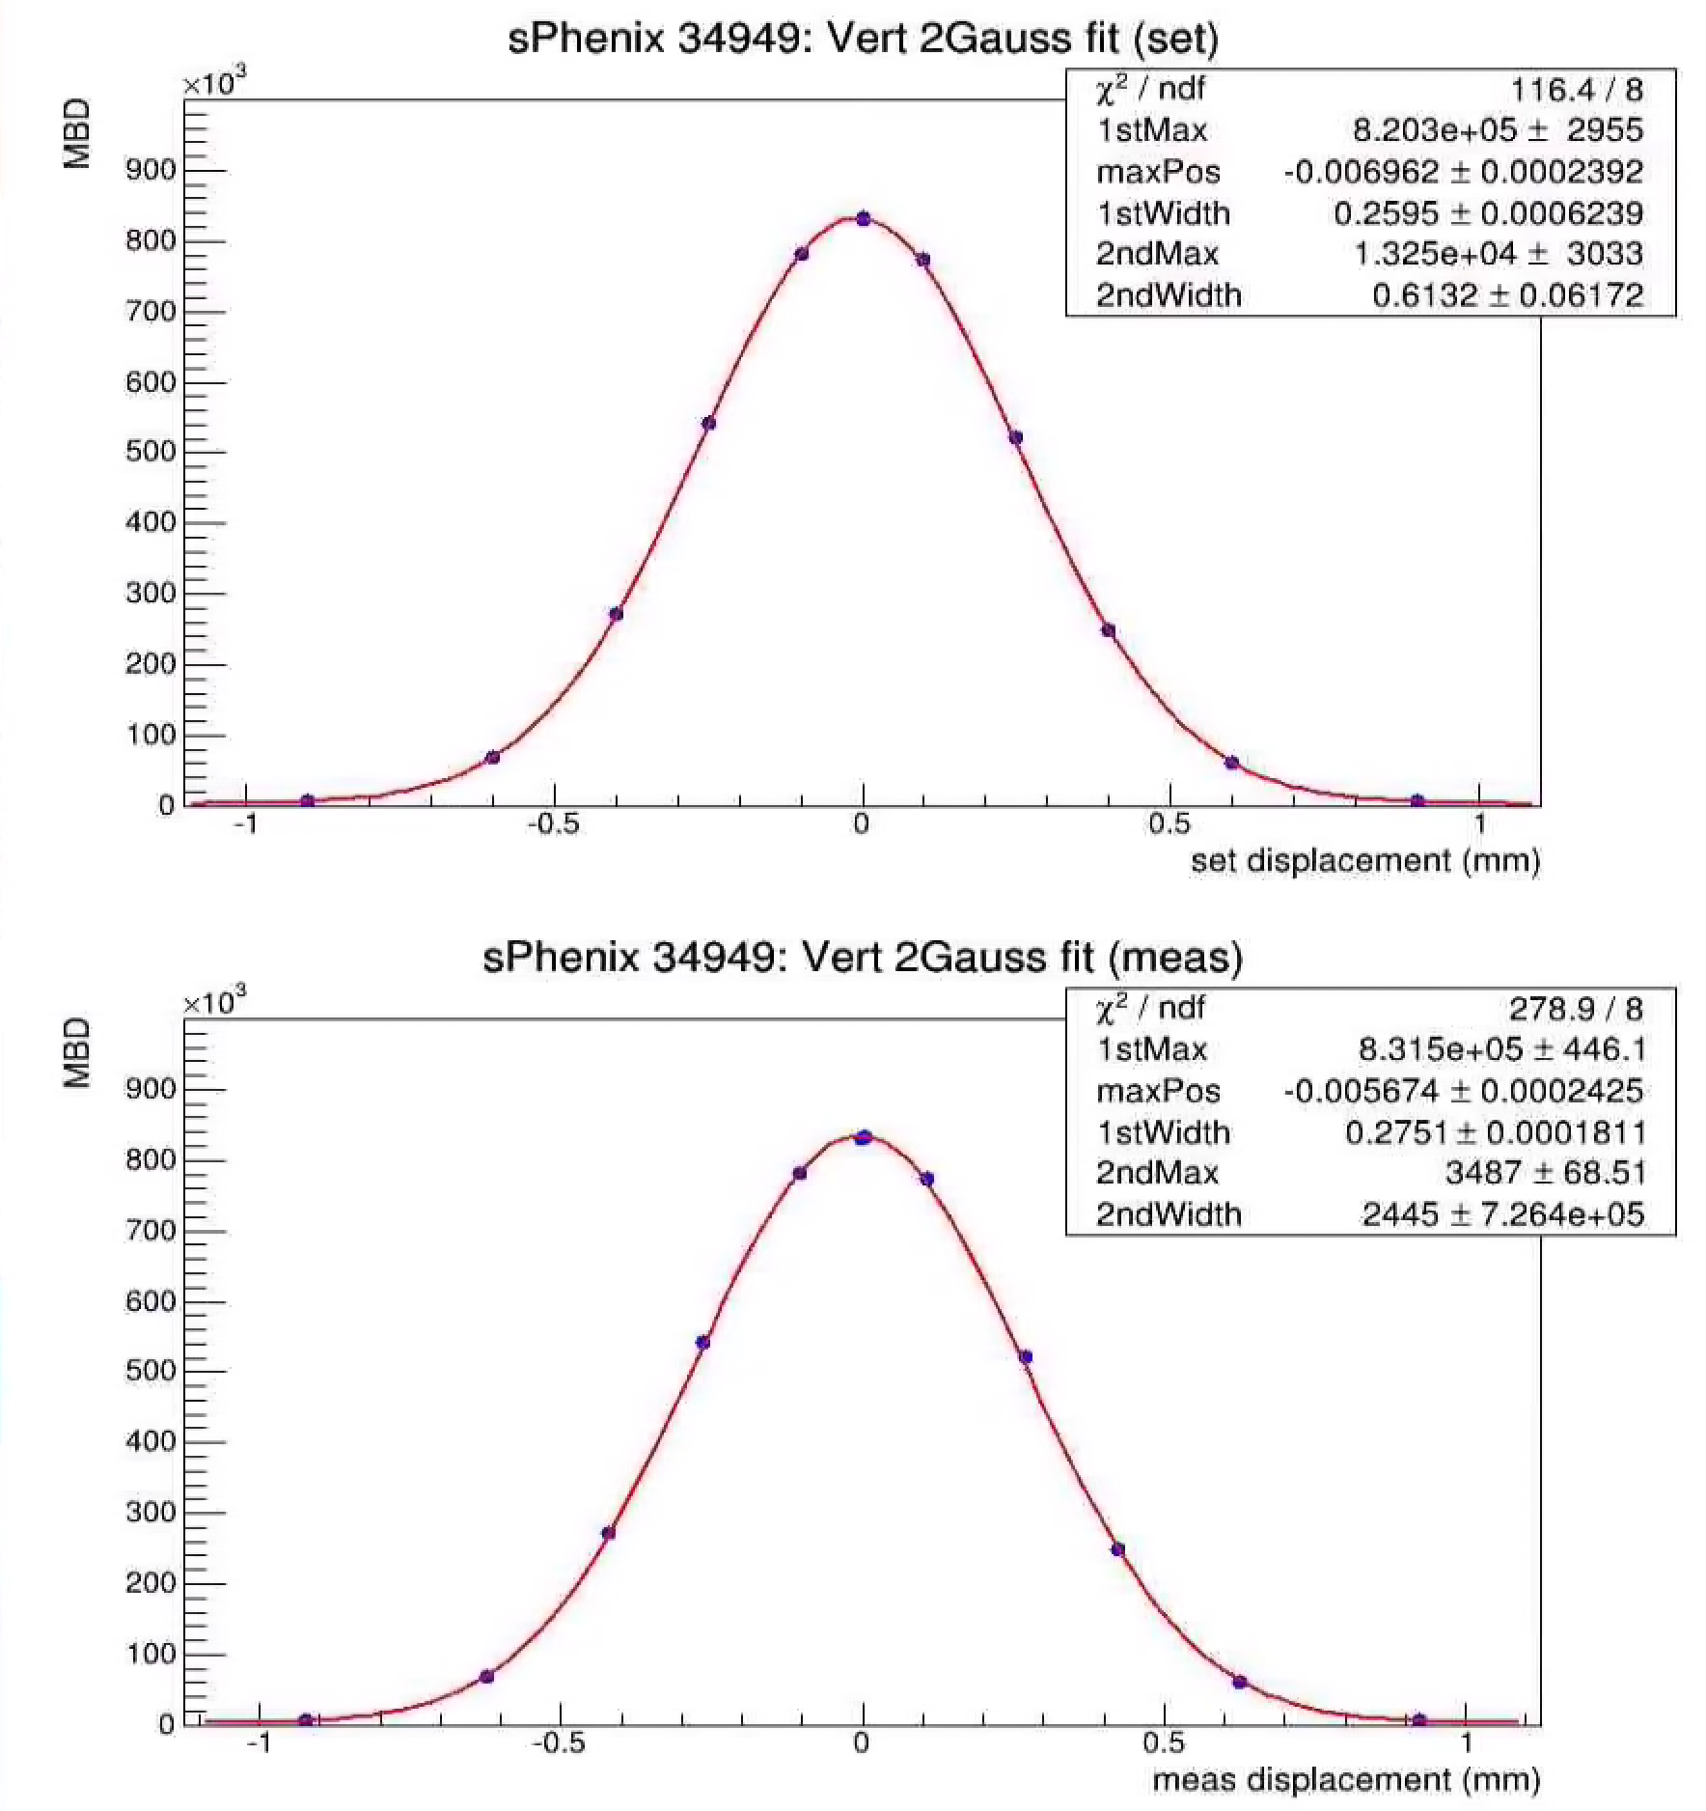
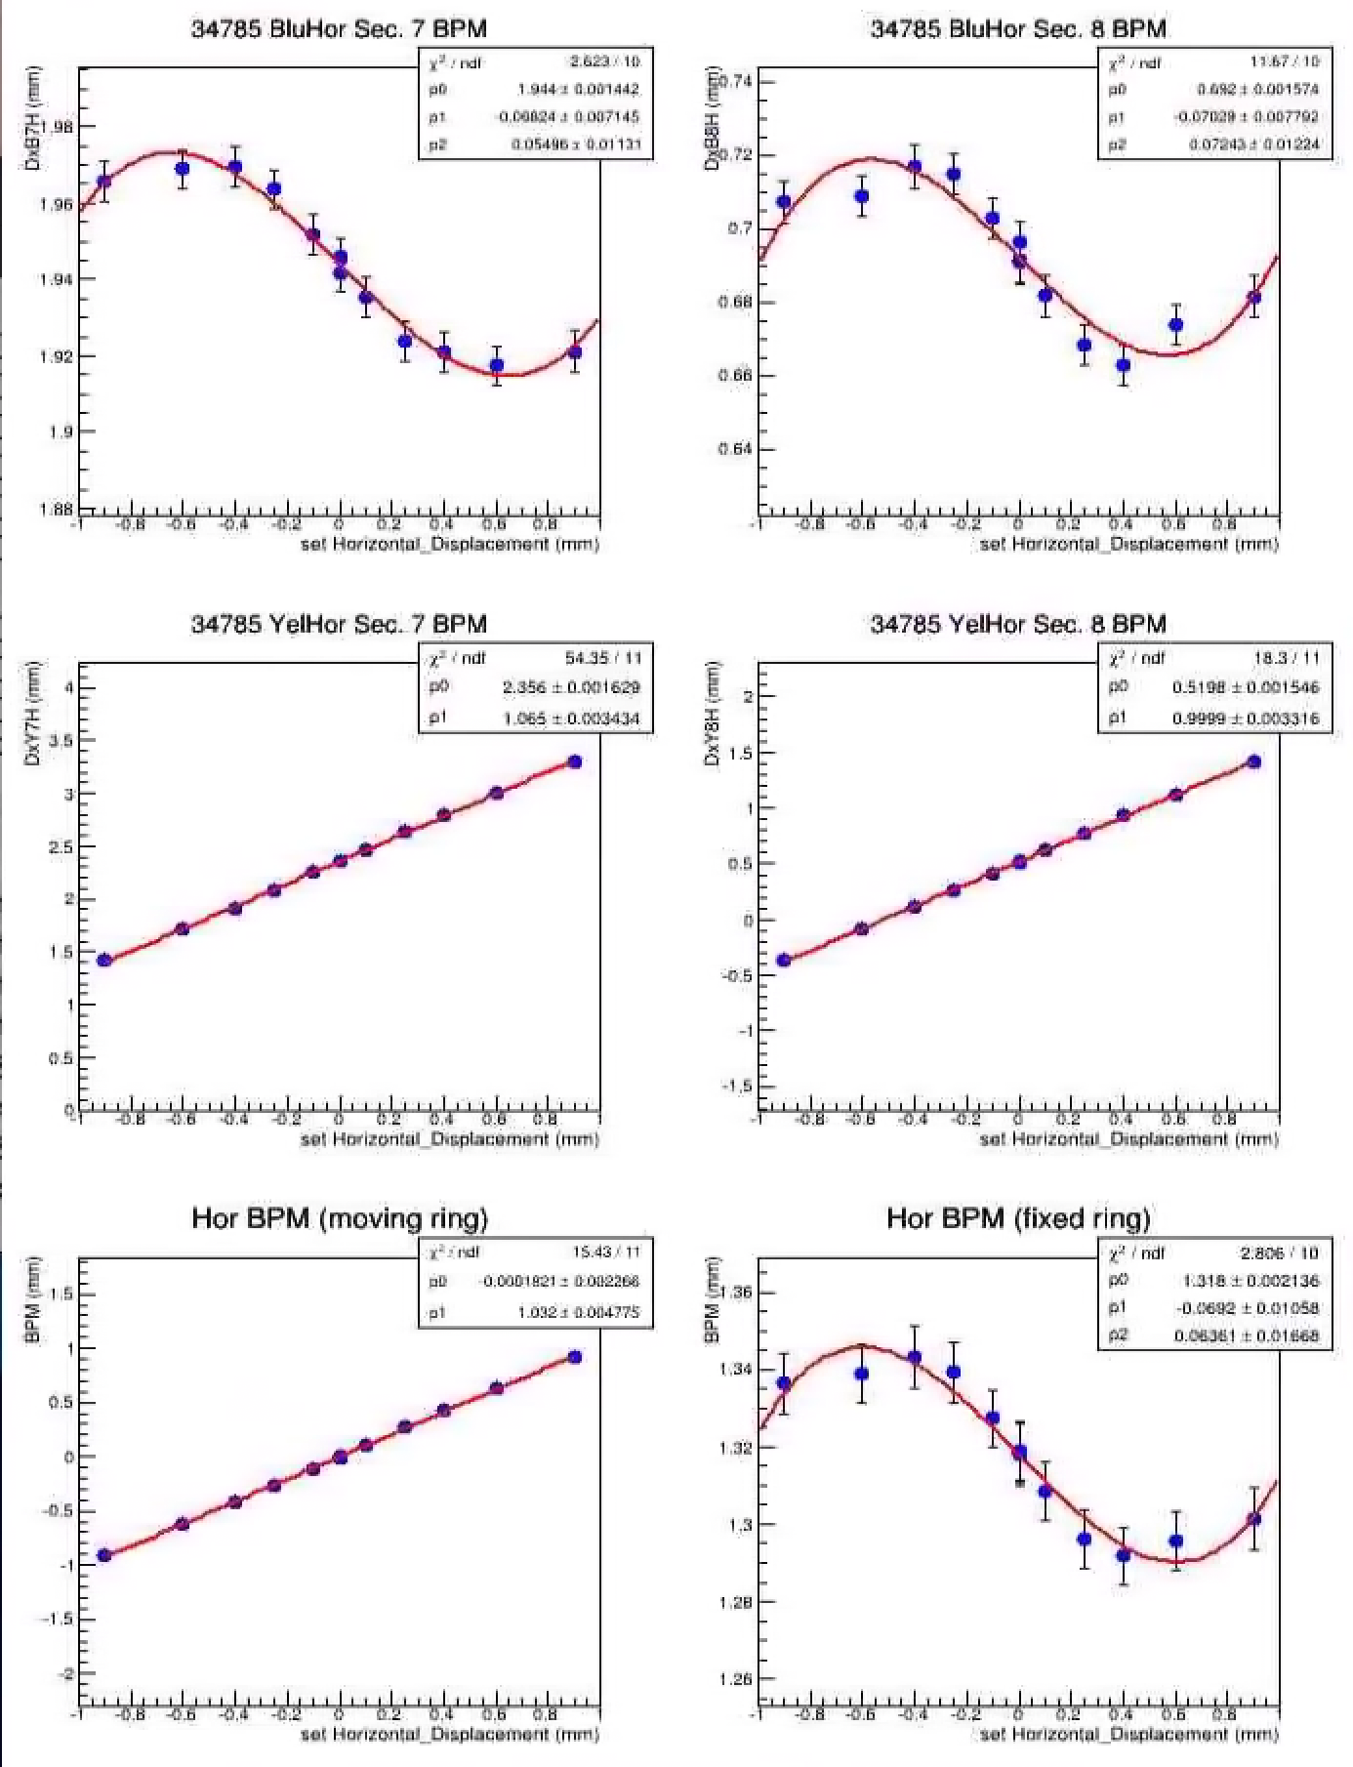
Getting more sophisticated
Vernier scans were routinely used to calibrate experimental detectors (ZDC, BBC, MBD, VPD). They were done in every RHIC run (except for the lowest energies) and measured the effective cross section. Numerous publications were based on them.
Additional Functionalities:
  Single and dual Gauss fit functions
  Measured vs. set separation of beams, both beams or one, chosing from beam current monitors etc.

Slide 9
Collimators & Crystals

Slide 10
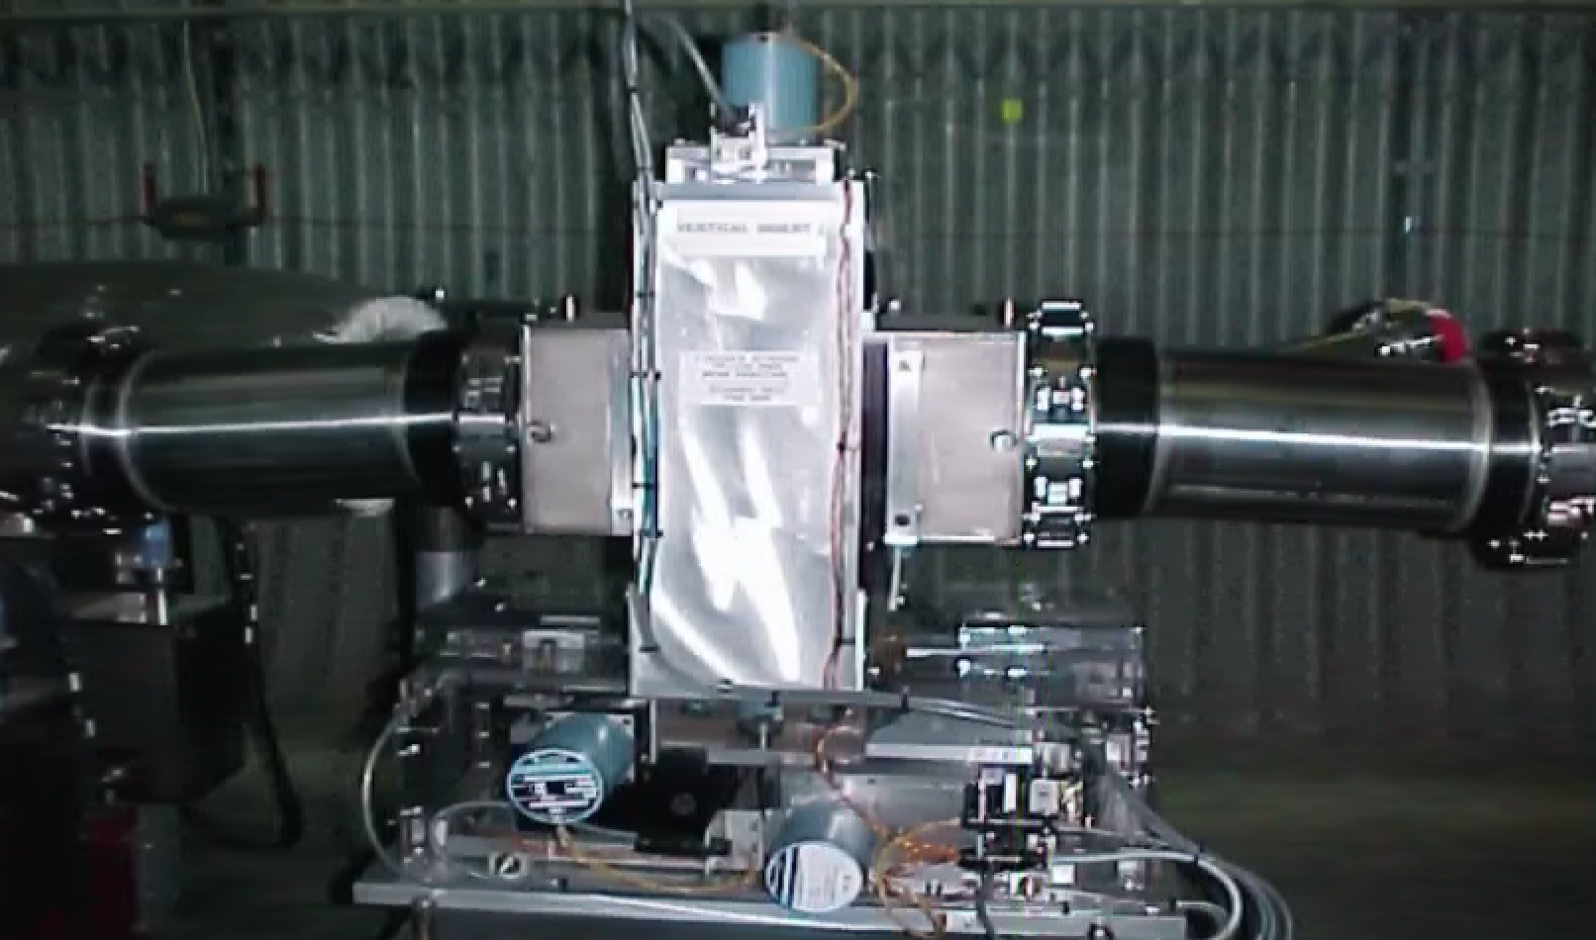
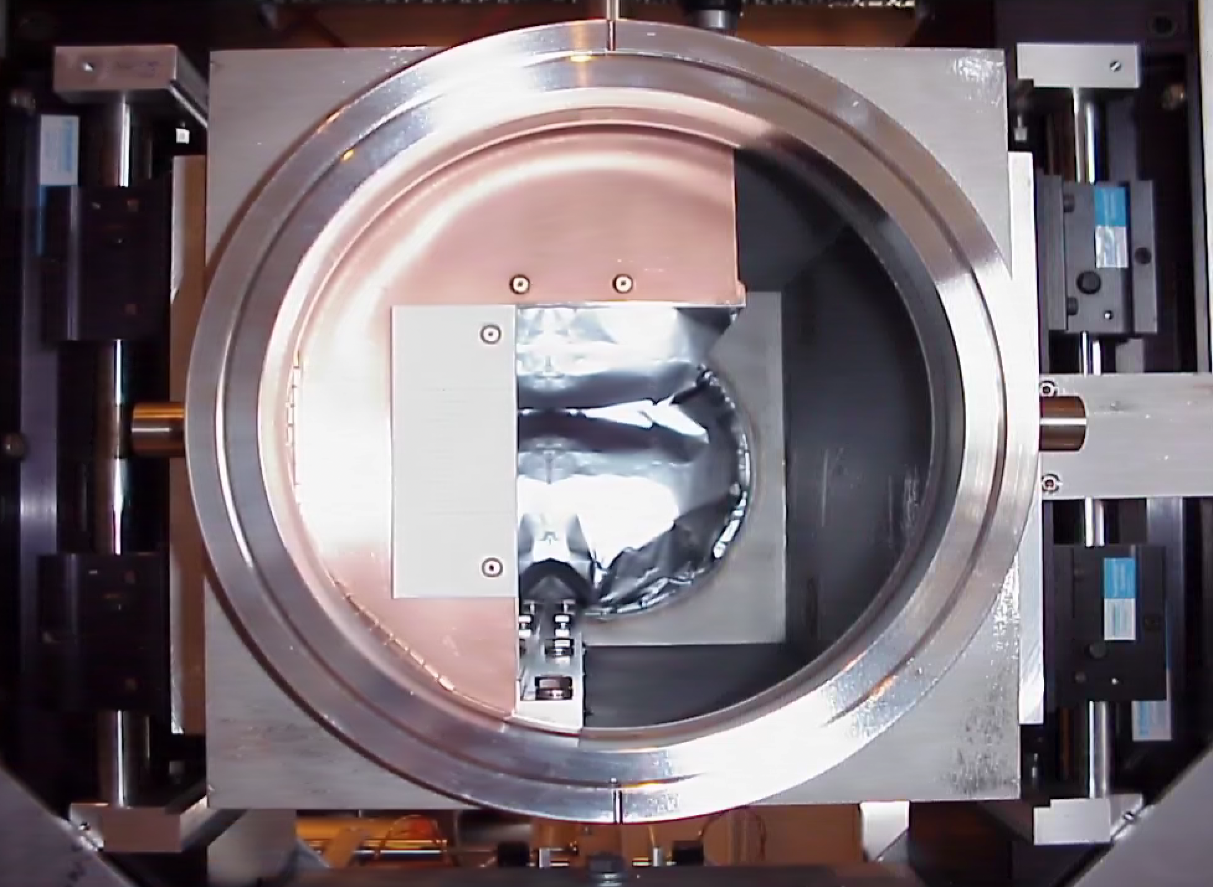
Collimators
Originally, RHIC was equipped with a single stage collimation system that was HORIZONTAL and VERTICAL at once (L-shape). Not the best decision in the long run.
They were located in IR8, close to the outgoing triplets under liners to prevent ground activation.
The collimators were about 45 cm long copper jaws that can be moved laterally and could be rotated as well in both planes
Motion is achieved by moving the entire collimator vessel with step-motors. Resolution is on the micrometer level.

Slide 11
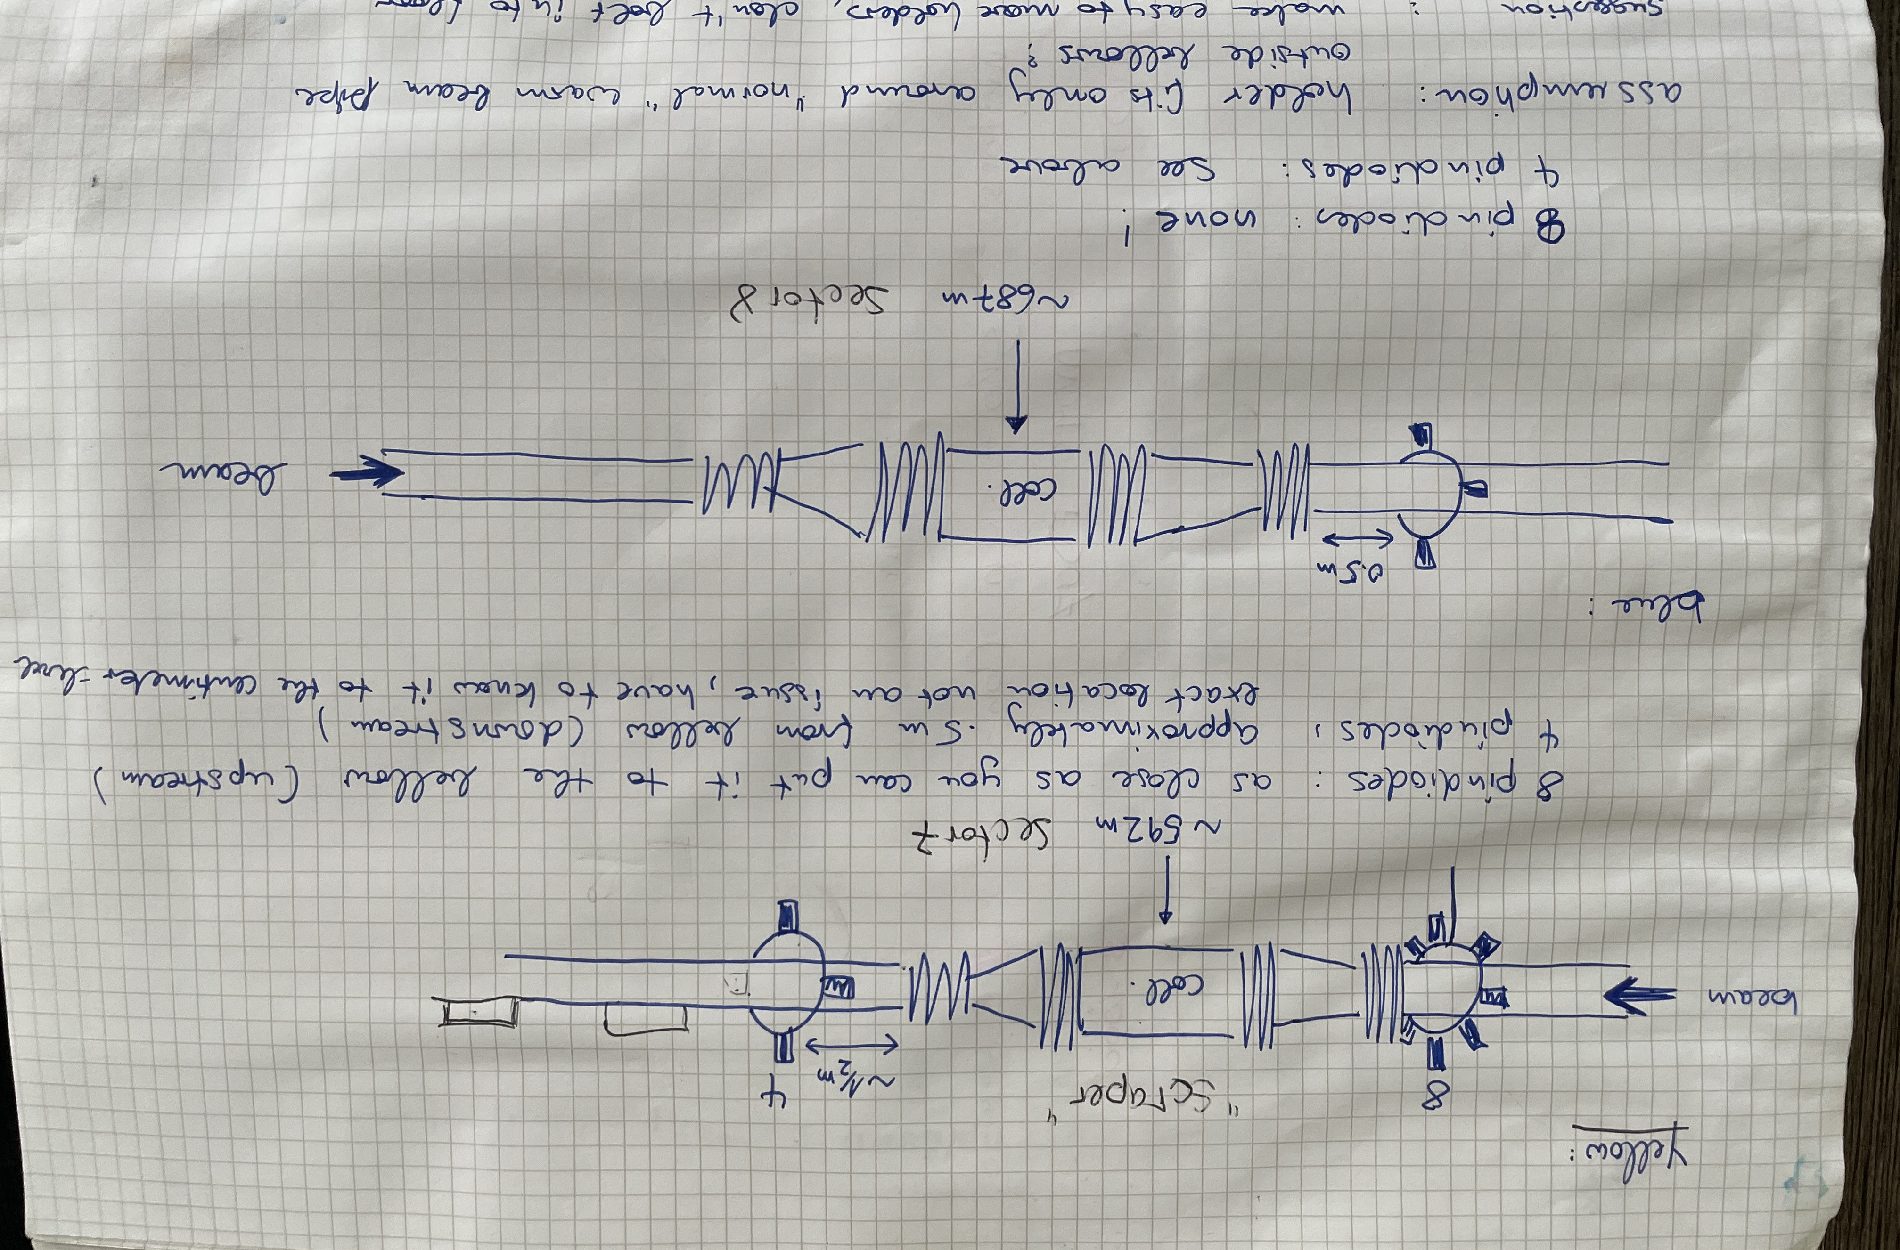
Added beam instrumentation
Soon, additional dedicated loss monitors were installed down-stream of the collimators (the primaries and later also of the secondaries): Pin Diodes
Pin Diodes are later also added to other equipment (such as stochastic cooling tanks).
Pin Diodes at the collimators are eventually upgraded to provide bunch by bunch loss monitoring.
They are used to set the collimators, originally fill by fill, later only once per run/species and on demand.
Collimators were moved automatically at the beginning of a store and adjusted further as needed.

Slide 12
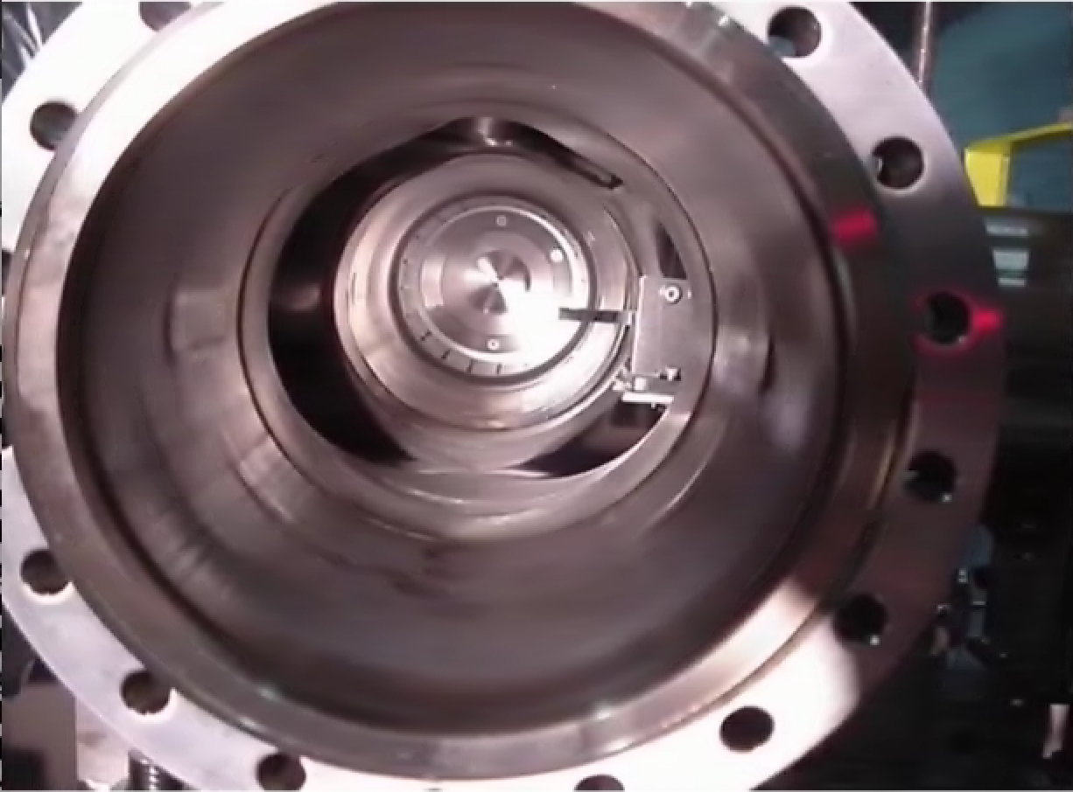
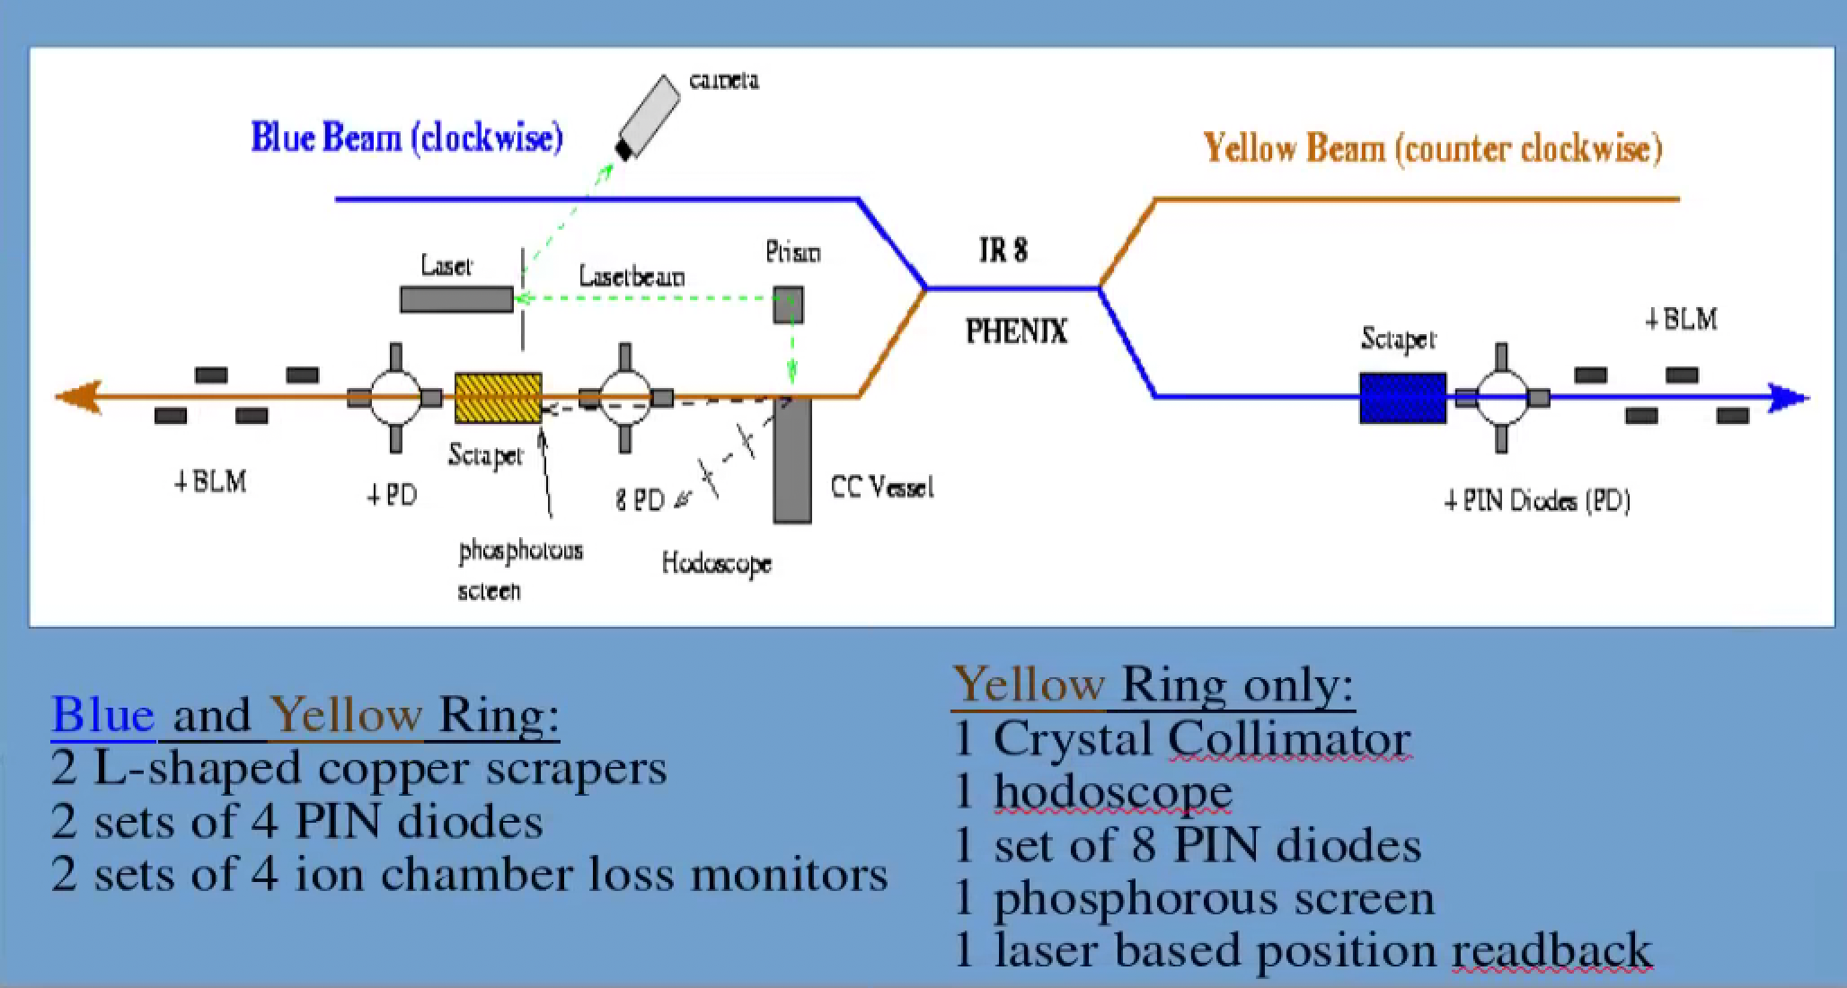
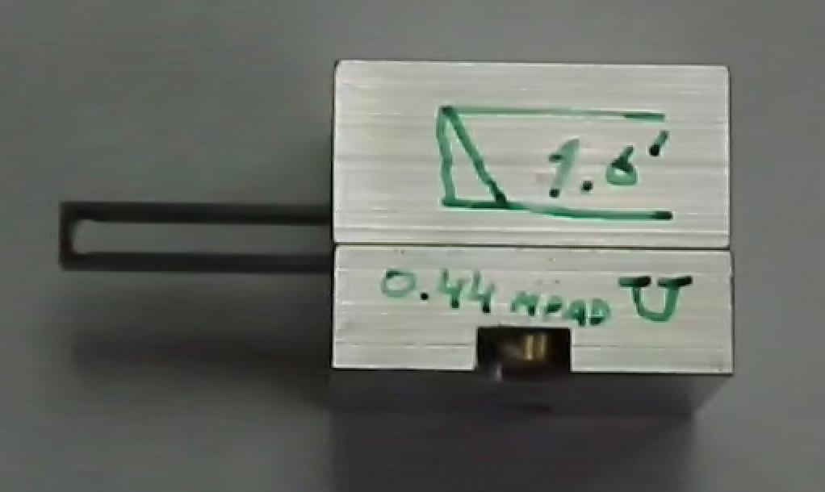
The Crystal
Bent O-shaped crystal (from St. Petersburg)

Slide 13
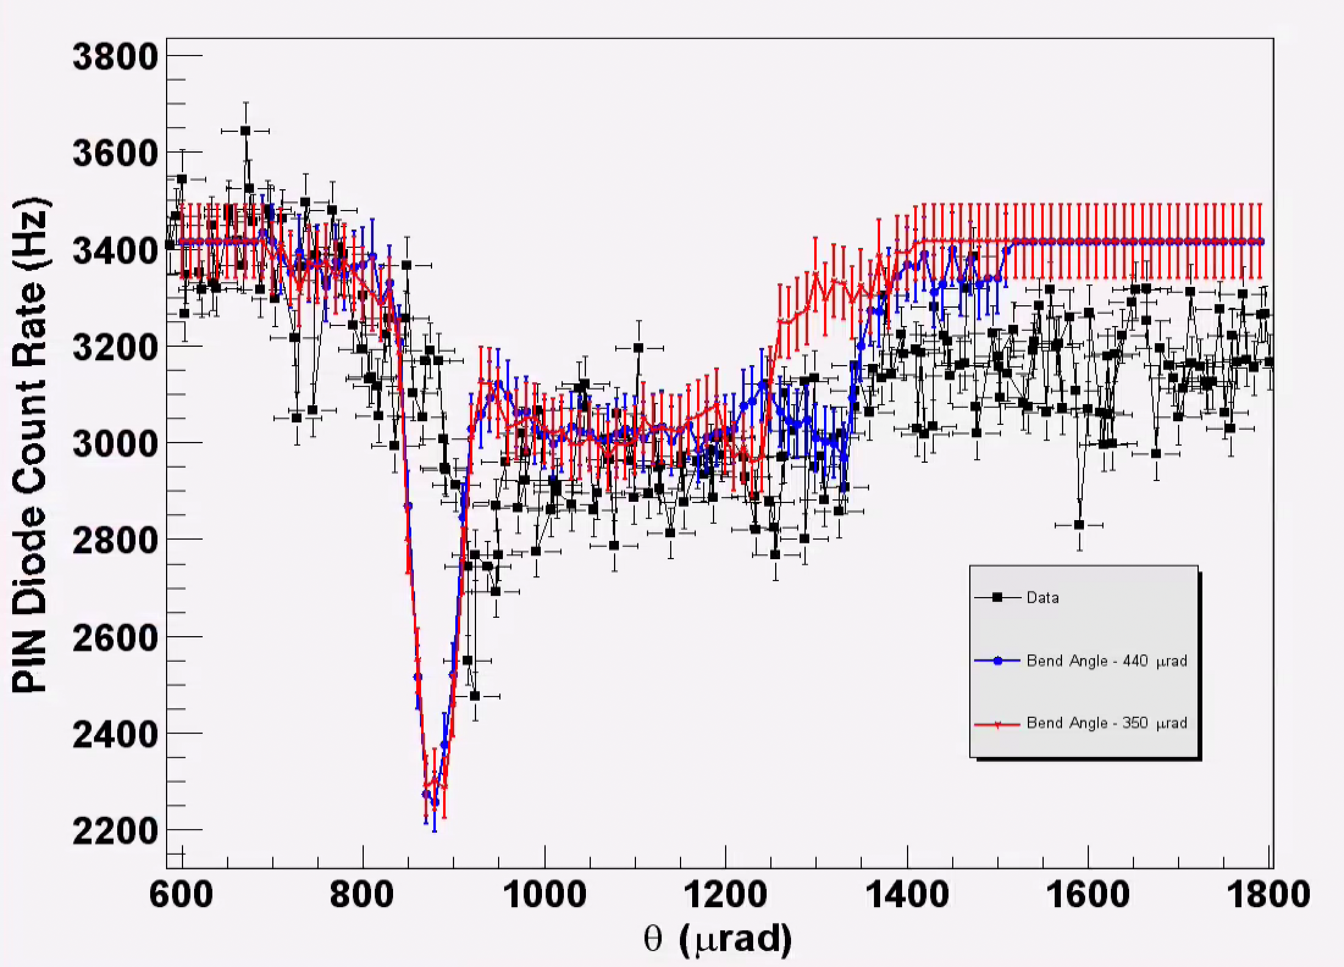
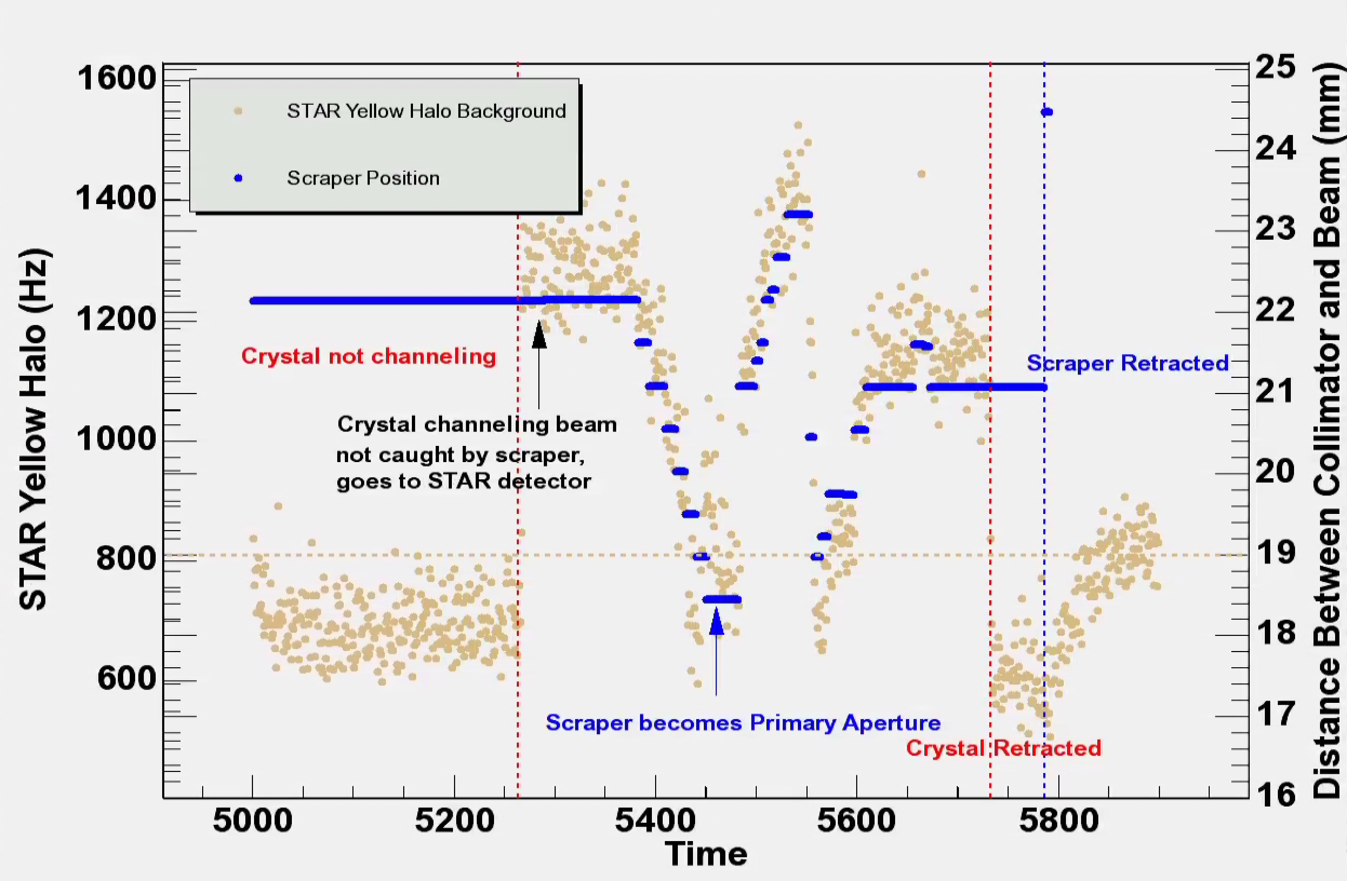
Crystal Collimator in RHIC
Channeling is observed
Crystal does not improve collimation efficiency
Note: crystal collimation will be employed for HL-LHC (and could still be considered for the EIC)

Slide 14
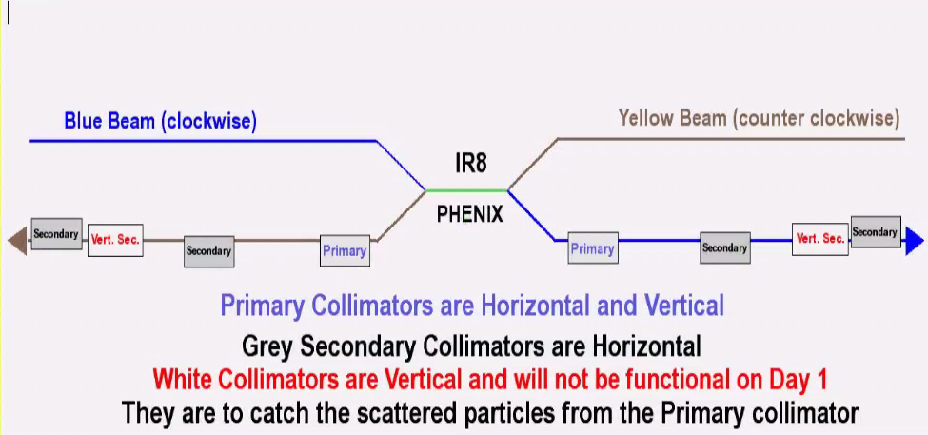
Conventional 2-Stage System (2003+):
2004:
Collimator control software (manager)
Collimation during ramps is added
Collimator motion fully automated for injection, store, collision, gap cleaning, dump and up to 3 ramps
Beta functions (dropping toward the secondaries) and non optimized phase advances were limiting the performance.

Slide 15
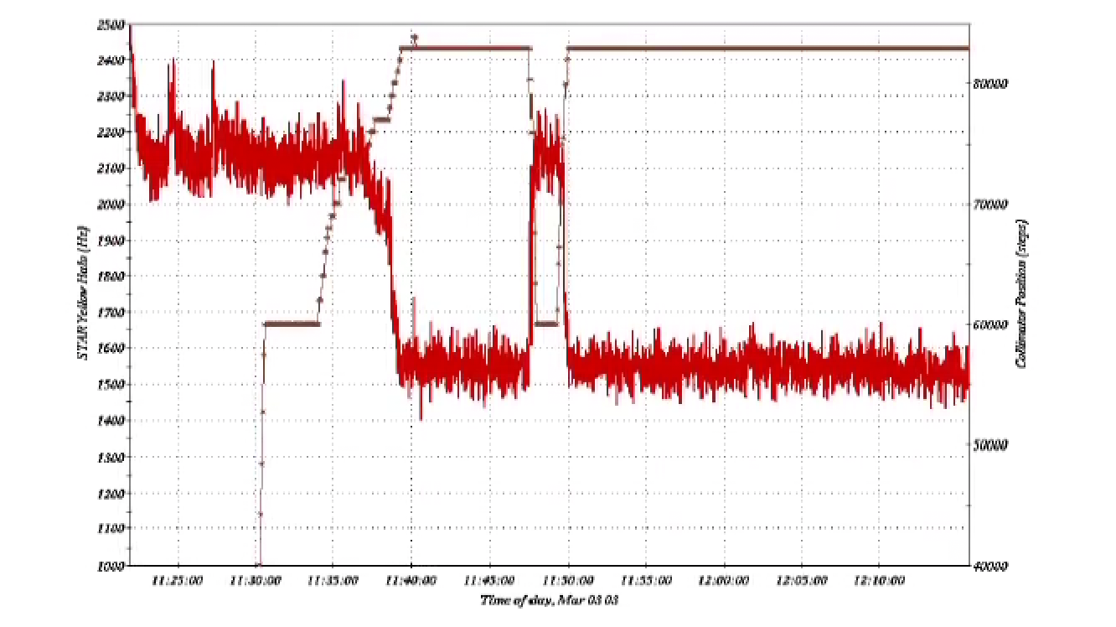
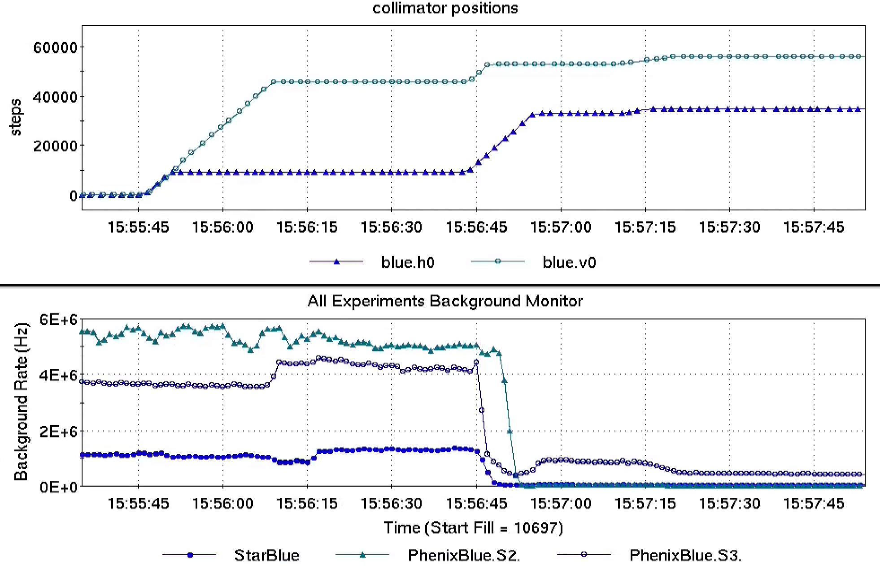
Collimation efficiency: it varies
Phase advances vary significantly between protons and HI operation and other lattices (such as IBS suppression)
2002
2009

Slide 16
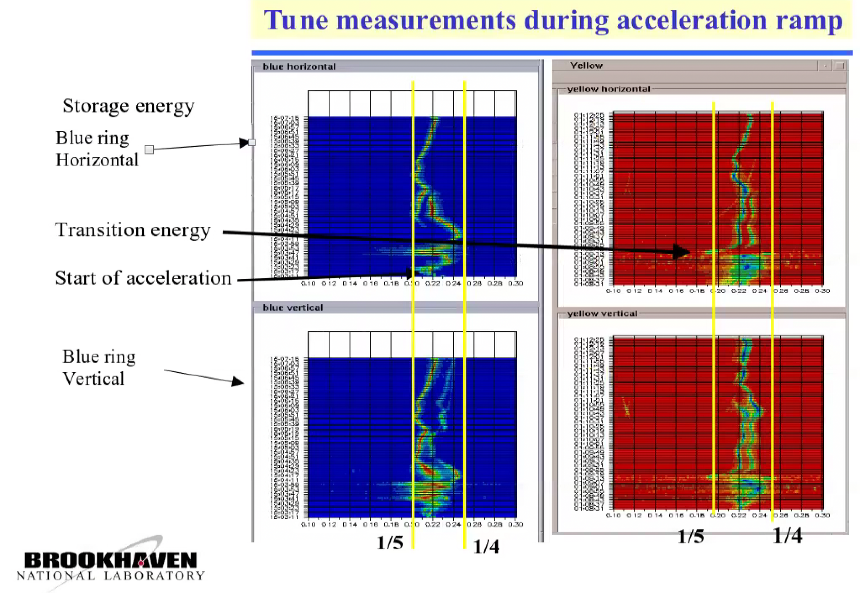
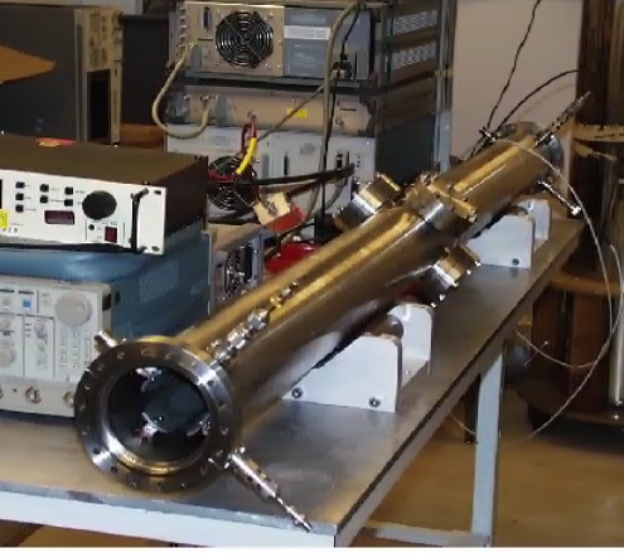
Another waterfall image used during early RHIC operation:
Tunes measured by the ARTUS(*) tune meter
Based on stripline kickers (used in ‘bang-bang’ mode), vertical and horizontal separately
Dedicated tune meter BPM
One bunch kick only
Ramps: one bunch, typically bunch#61, was sacrificed for the measurement
(*) also known as “Angelika’s RHIC TUne meter System”
Stripline kicker

Slide 17
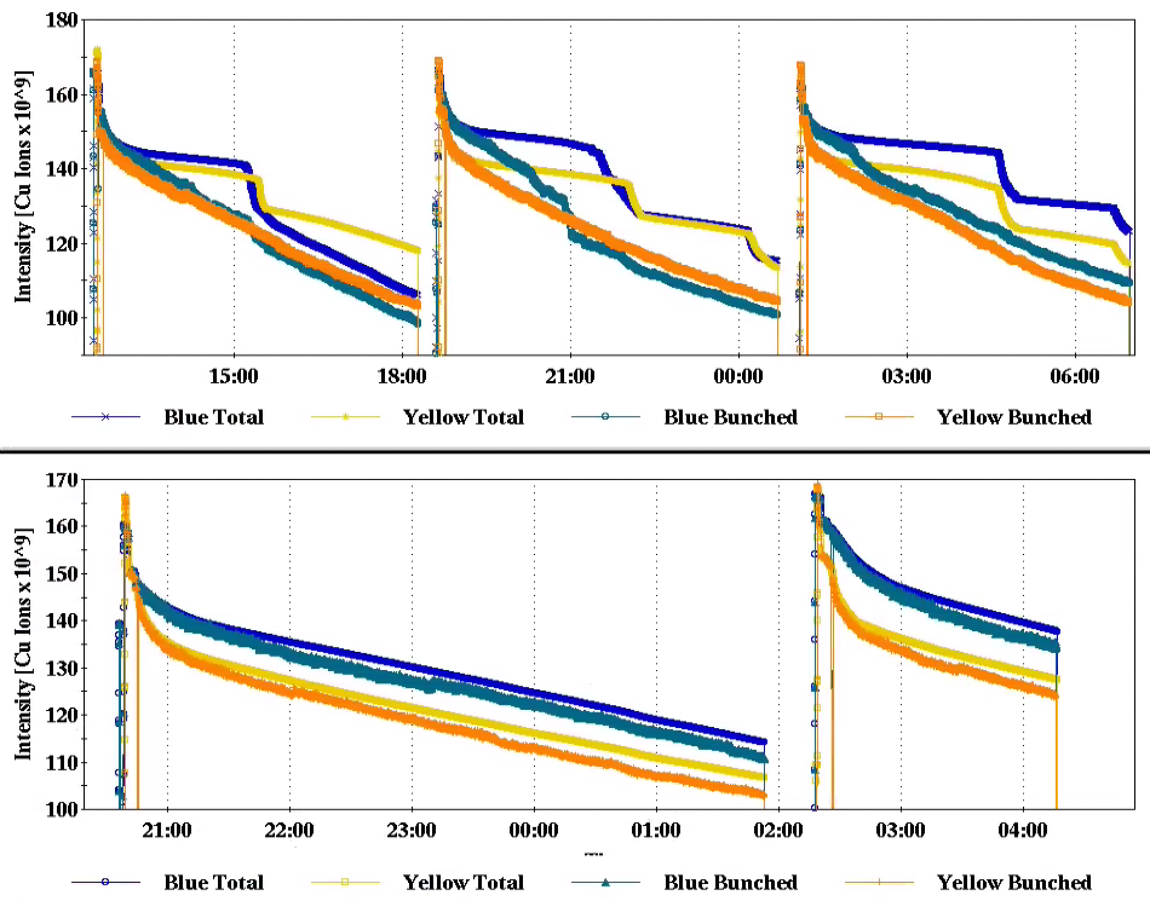
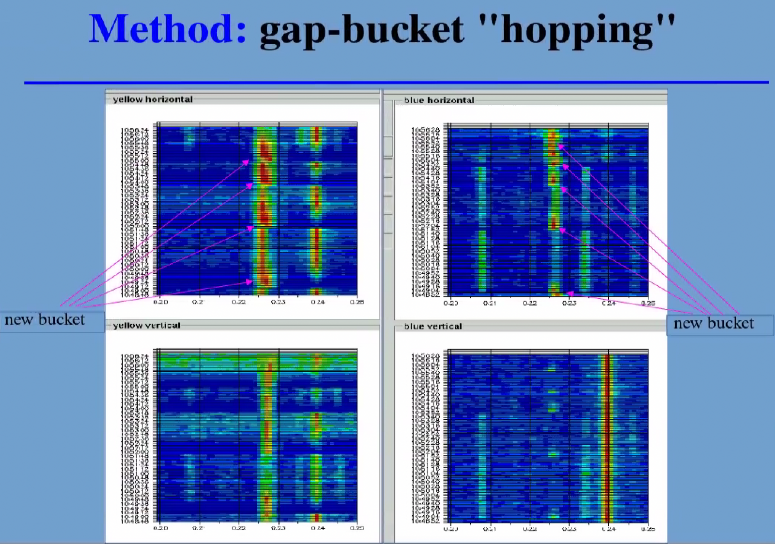
ARTUS + collimators = gap cleaner
Or: 1 + 1 = 3
Note: ARTUS also served as an injection damper
Removal of debunched beam:
Optimized by sweeping the abort gap (+ tune scans)
In use for over 20 years of RHIC running (including the years of stochastic cooling!)

Slide 18
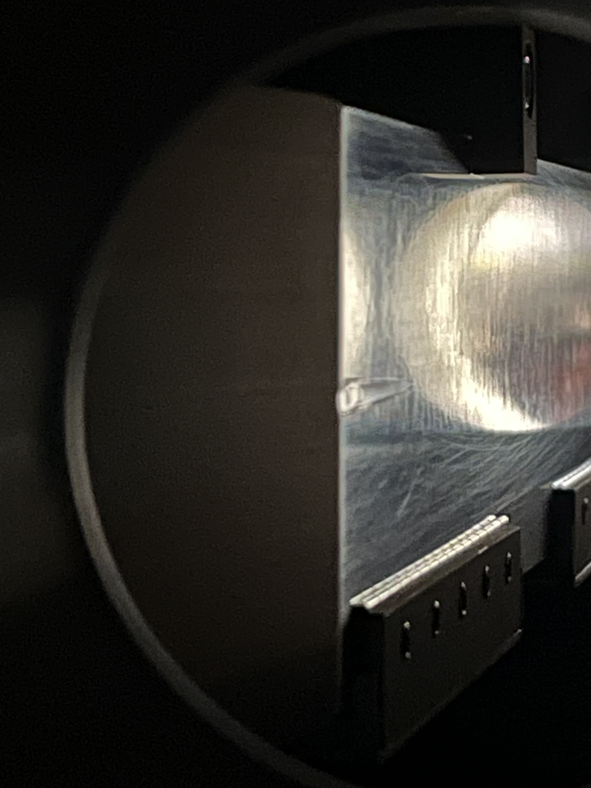
And then there were pre-fires(*) …
Masks were added one arc away from the aborts
  Upstream of IP8 (yellow) and upstream of IP12 (blue)
The masks did get hit (and damaged) in an abort system prefire in 2015
Spray from the mask damaged the PHENIX detector (perhaps more than the prefire alone) ☹
Ultimately, one destroyed quench diode later, this led to the mechanical switches and delayed aborts.
  Delayed aborts were used until the very end of RHIC operation
(*) a pre-fire is a spontaneous and asynchronous firing of one of the five abort system kickers

Slide 19
To Summarize
We made a lot of improvements after ‘Day 1’
We tried (new) things ‘outside the box’
We executed new math: 1+1=3
We had fun!

