Slide 1
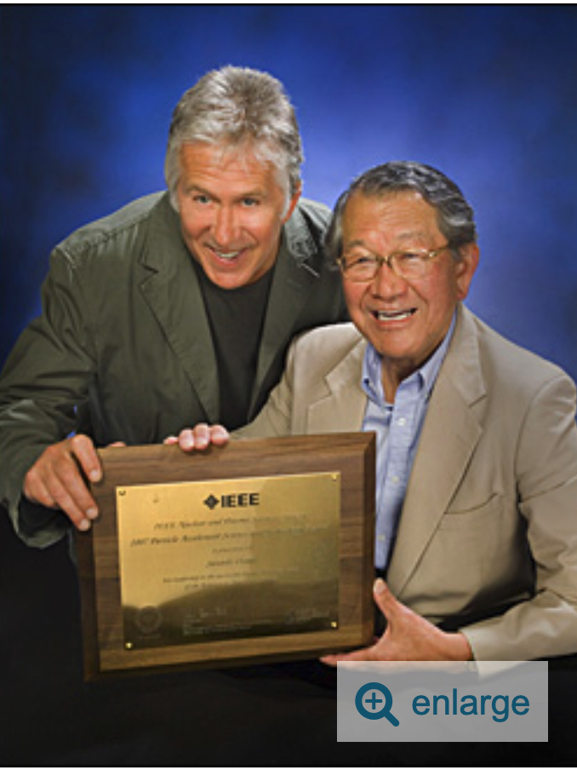
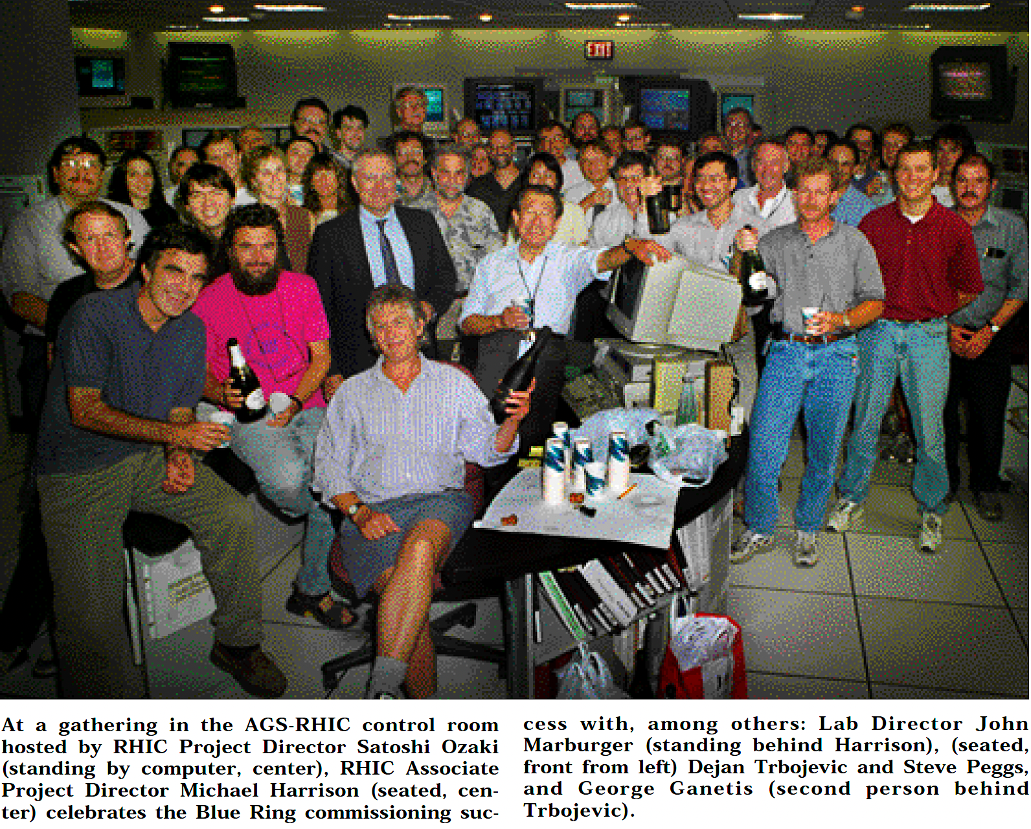
Building and Commissioning RHIC
Dr. Dejan Trbojevic
Brookhaven National Laboratory

Slide 2
LAYOUT
Covering the time-line from 1992-2001:
My involvement in building and commissioning RHIC
Arrival to the beautiful Long Island 1992 to join RHIC (34 years ago)
  Lattice of the MAIN injector at FNAL without transition
  RHIC lattice without Transition Energy γ_{t}
Building new Relativistic Heavy Ion Collider
RHIC startup - first attempts with the beam
  Successful Sextant commissioning – without BPM signals
  First Test Run
    Satoshi is asking for collisions - Pat Thompson and I on the owl shift tunning the yellow ring while the beam was moving in the blue ring.
    Aperture problems with skewed bellows in the ‘dummies’ positions
RHIC Head Commissioner 1999 – First collisions
  RHIC retreat September 17, 2000
  A plan for the next Run with system commissioners
  Regular weekly meetings with system commissioners' reports
  Dry run – February 2001
  Head Commissioner of the Run 2000 first collisions

Slide 3
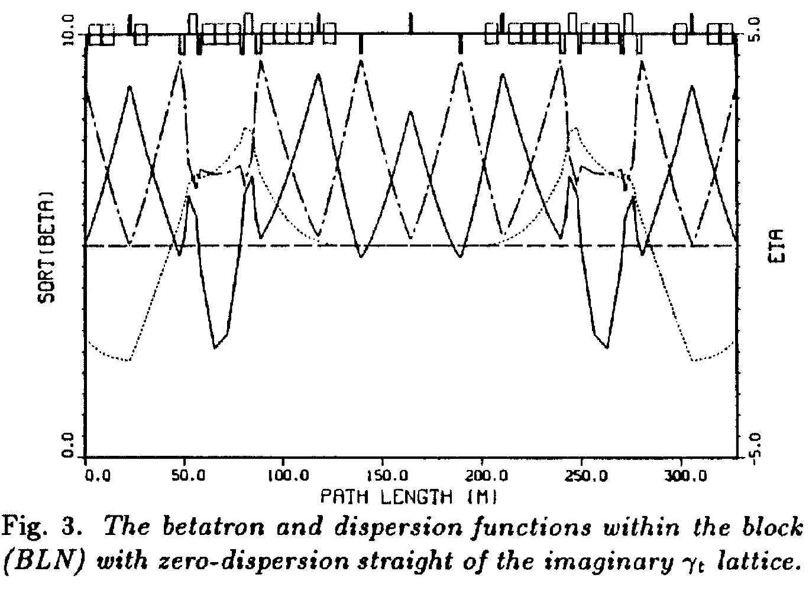
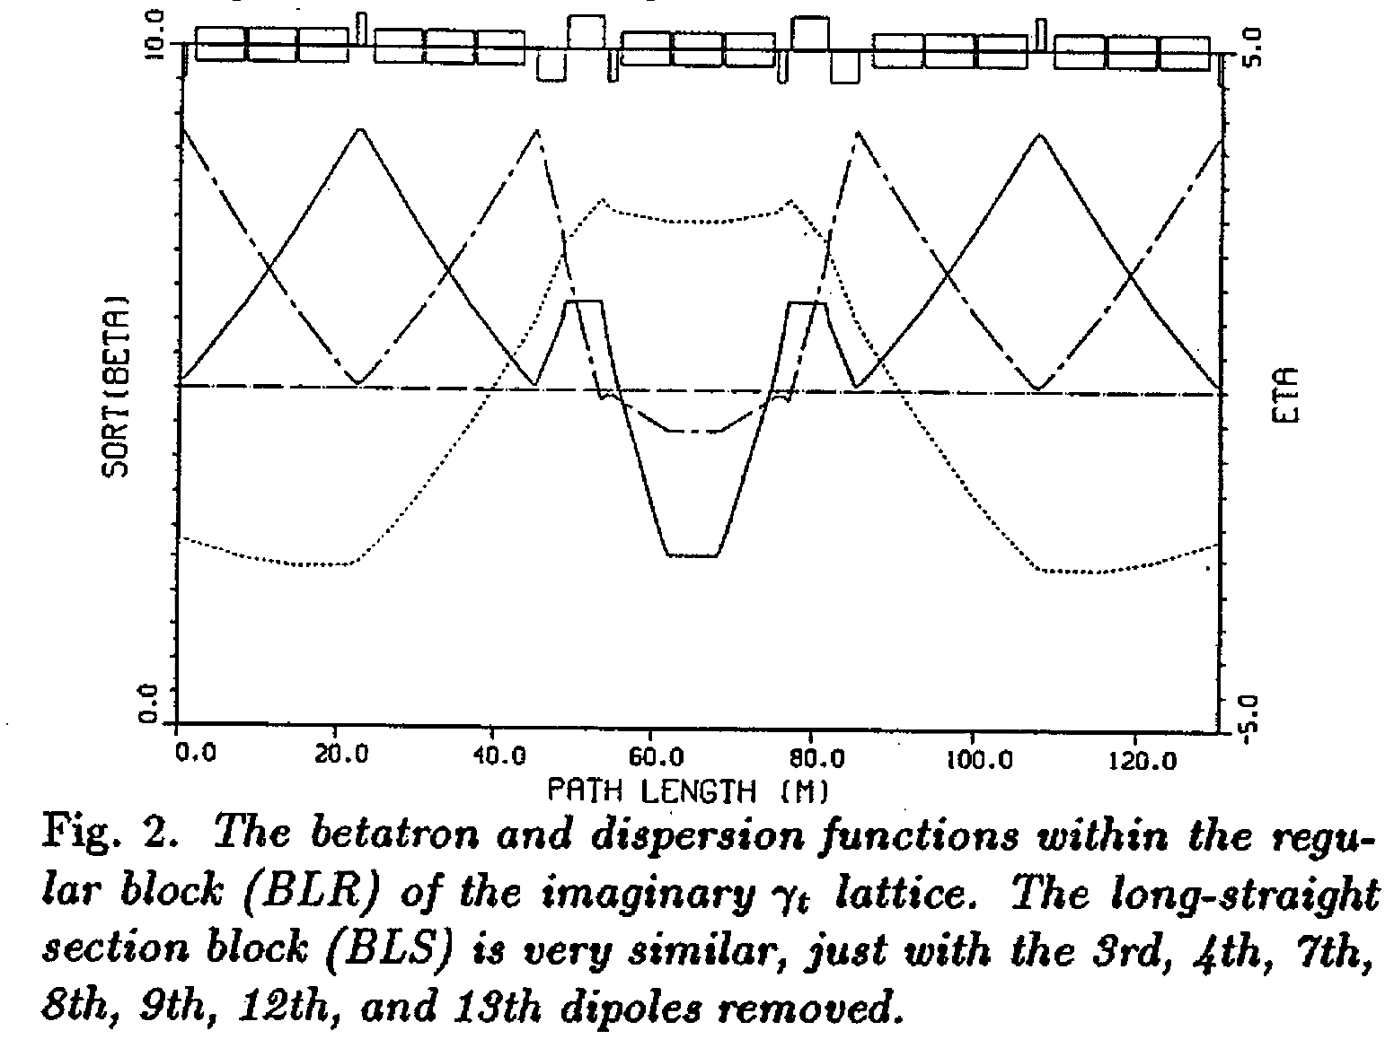
1. Main Injector Lattice Without Transition
Dejan Trbojevic and King-Yuen Ng along with S.Y. Lee, designed an award-winning Transitionless Lattice for the Fermilab Main Injector. By creating a ring where the momentum compaction factor becomes zero or imaginary, they eliminated beam degradation caused by transition crossing. [1, 2]

Slide 4
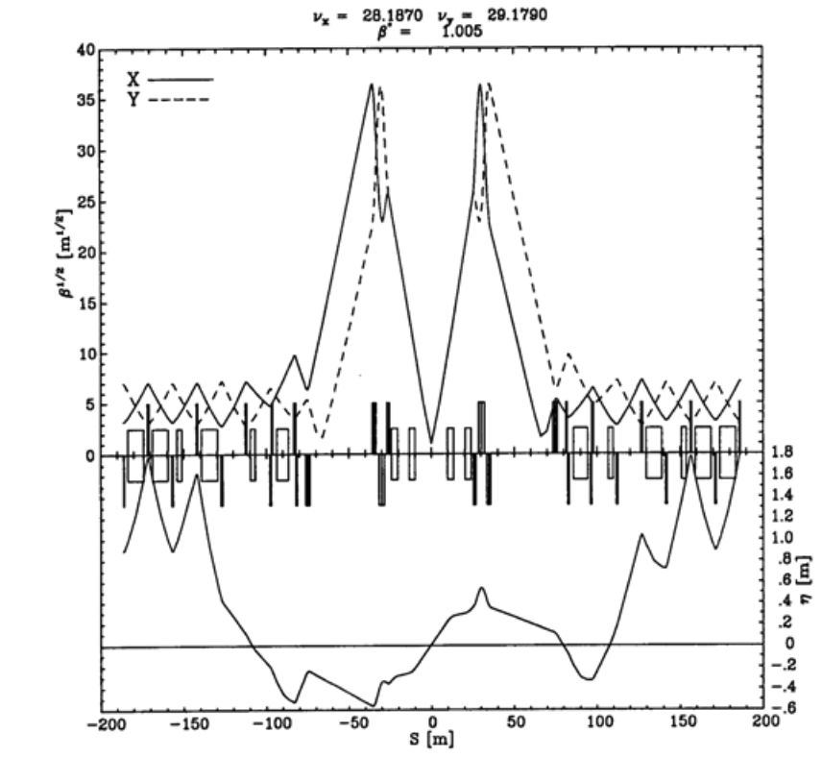
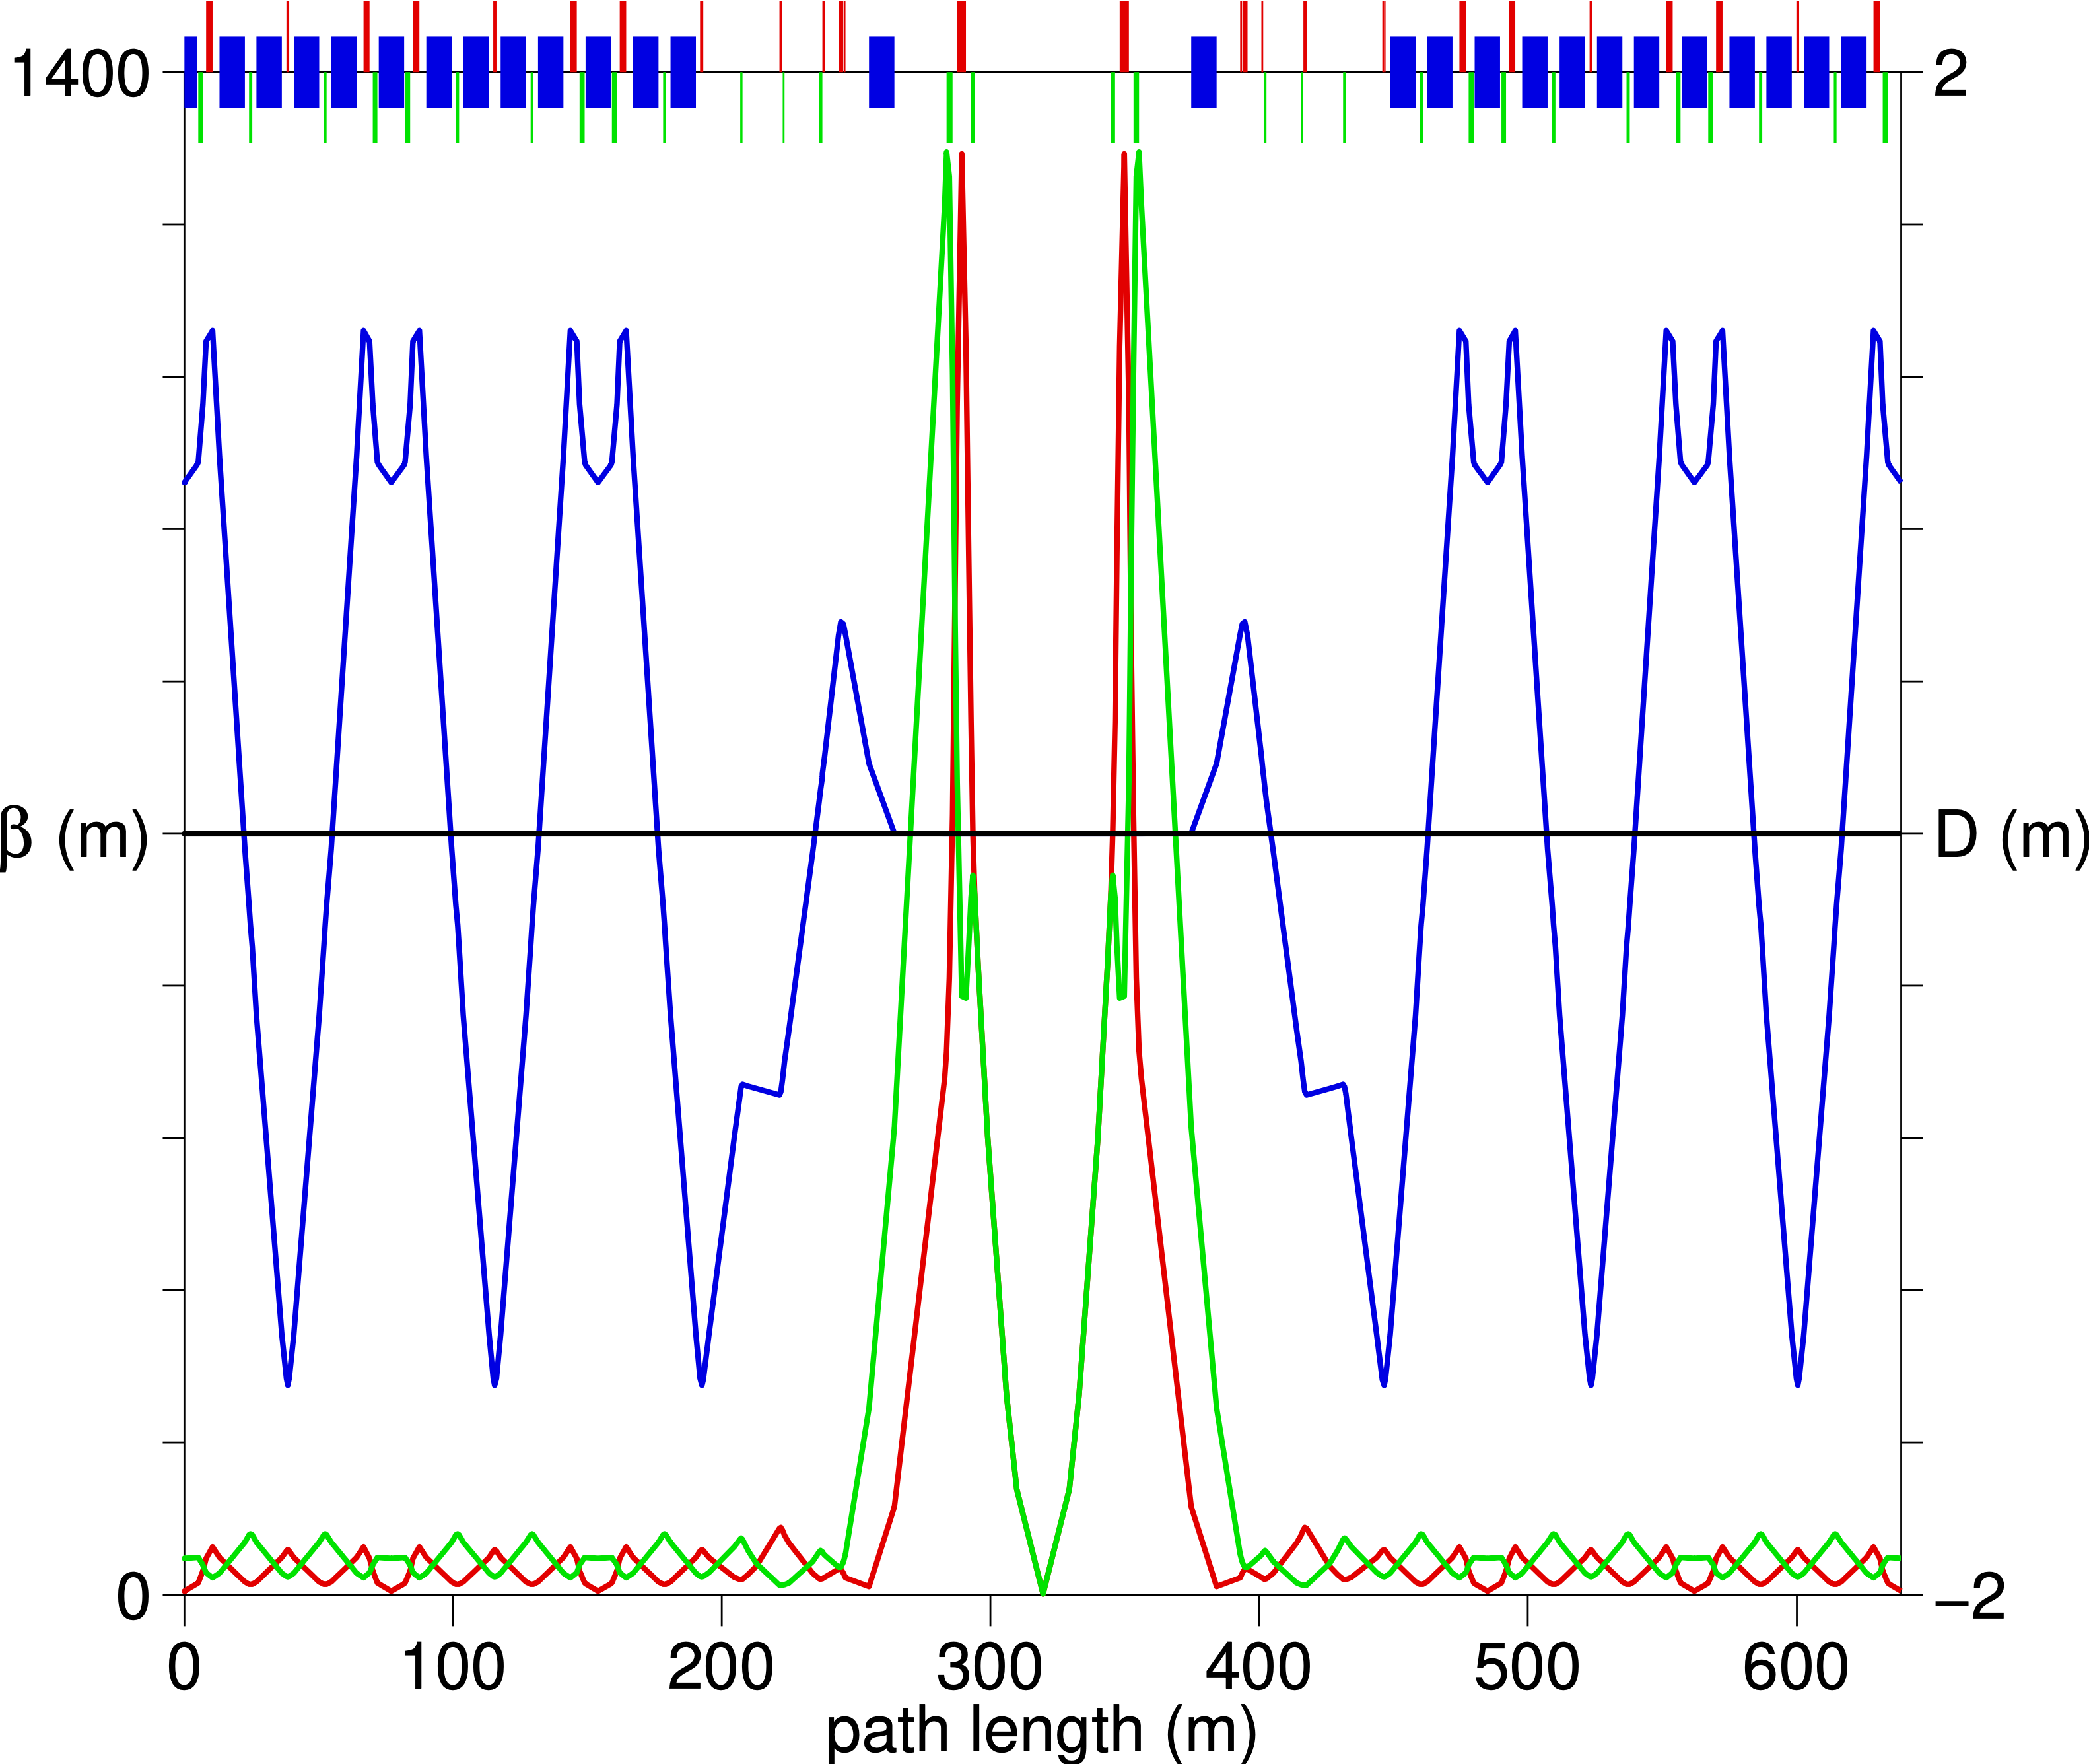
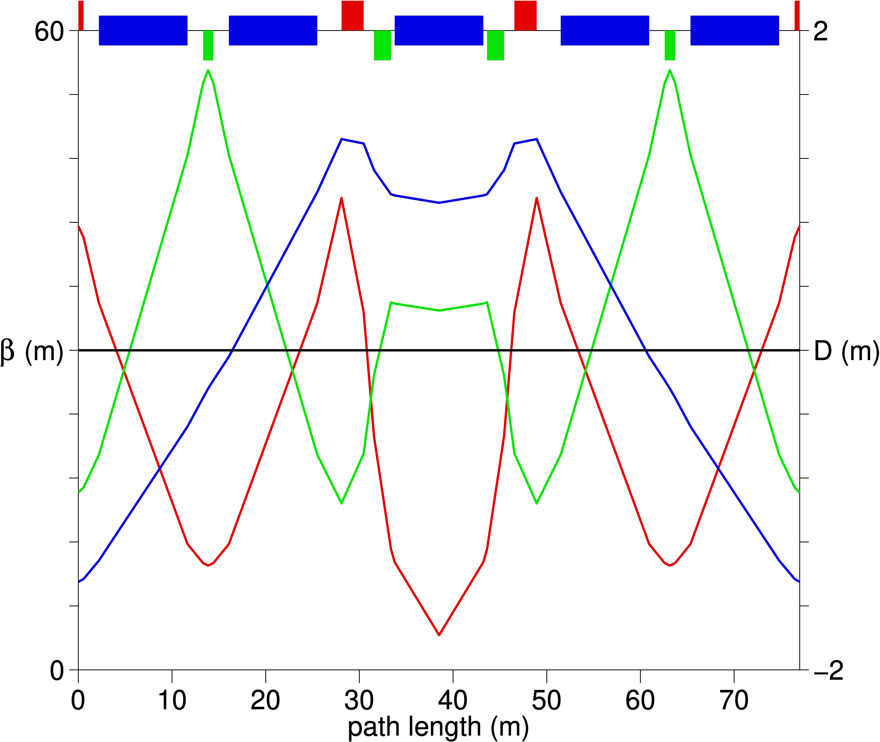
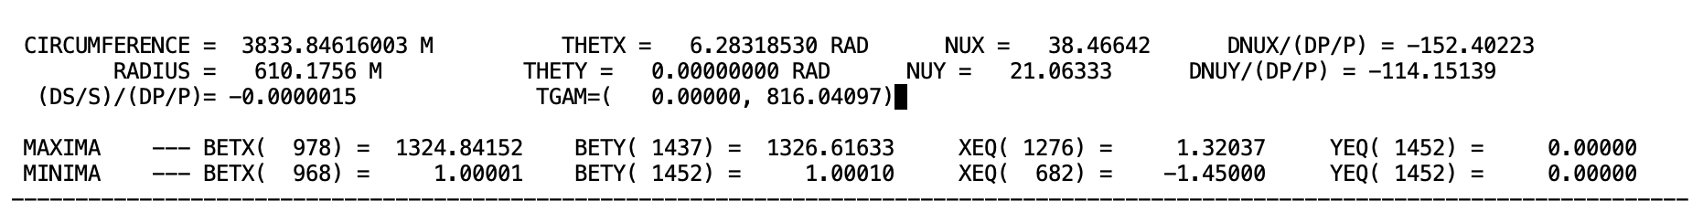
  1.RHIC lattice without Transition Energy γ_{t}
Dr. Dejan Trbojevic and E.D. Courant designed a "transition-free" lattice concept for the Relativistic Heavy Ion Collider (RHIC) to bypass the beam instabilities and particle losses that occur when beams reach transition energy. Their design methodology uses imaginary transition energy eliminating the need for accelerators to cross the transition energy during the ramping process. [1, 2]

Slide 5
2. Building RHIC
  Testing, measuring, surveying magnets (multipole corrections–Ramesh Gupta)
  Drafting Department was providing 3D drawings-slots – James Cammarata
  How to align the magnet cold mass – fiducials survey
  Electron welding the interfaces between magnets – John Kohler
  Walking around the ring with Mike Harrison every Friday afternoon
  Determine the BPM position in the cryostat – Pete Cameron’s antenna
  Loss Monitors commissioning and calibration with Andrew Wittkower
  I got a job from Mike Harrison to copy Fermilab design of the Permit System
  From Peggs a request to designed the Octupole harmonic corrections
  Designed the gamma-t transition jump
  Consider that magnets shrink as they get cold
  Surveying the magnets – out and in the tunnel – Frank Karl
  Colloidal Cell invention by Mike Goldman
  Vacuum system with Kimo Welch (rule: wear always white clean coats)
  Power supplies commissioning with George Ganetis, Carl Schultheiss,
  Decoupling correction system with Steve Peggs, Steven Tepikian
  Alignment of the high beta quadrupoles with Frank Karl

Slide 6
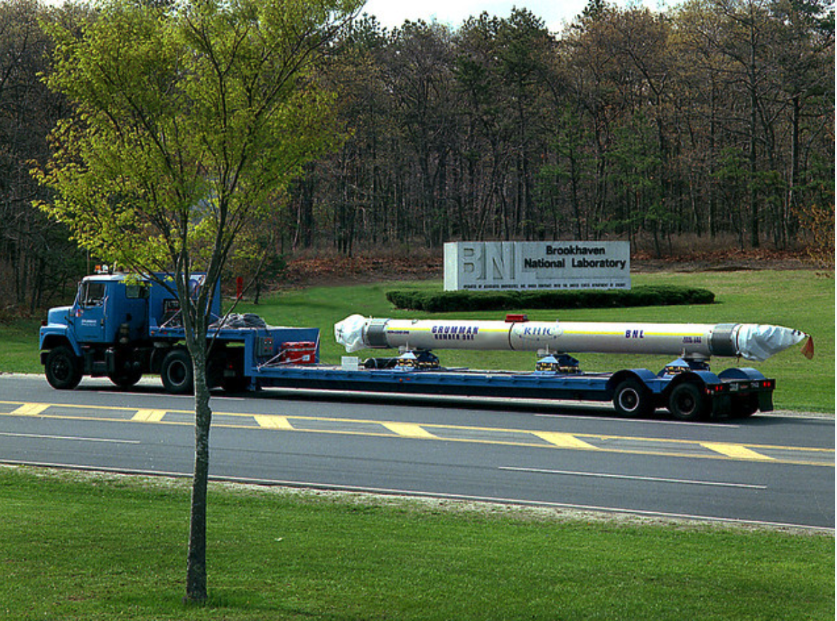
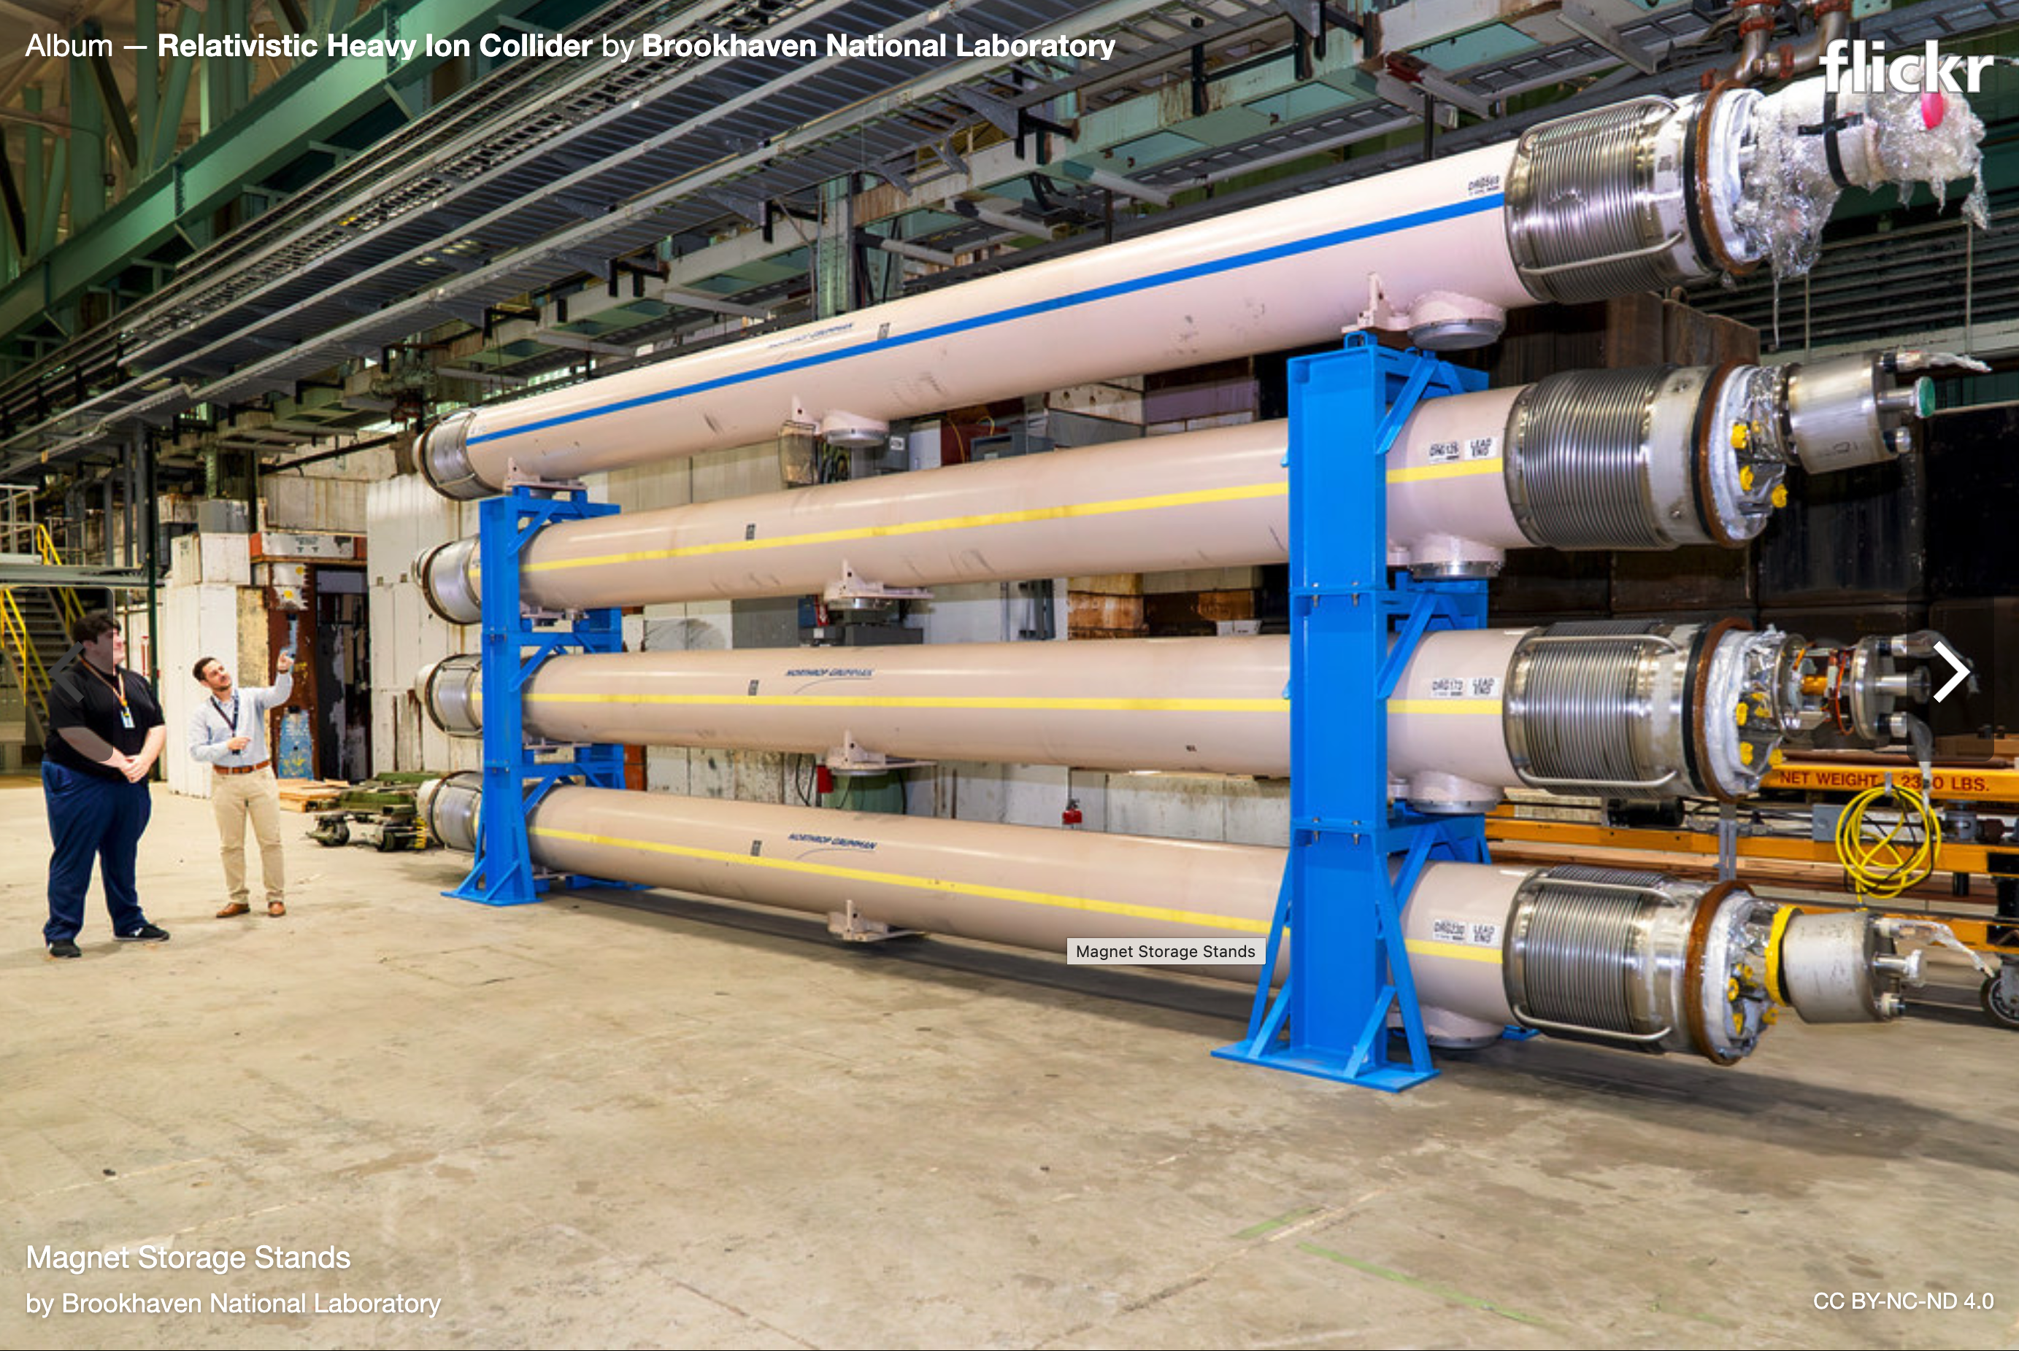
2.1 Building and testing magnets (Northrop-Grumman)
Magnet Acceptance Committee
Magnets at 4K had quench limit tests, then 30% magnetic multipoles measurements @ Magnet Facility, surveyed warm with the fiducials.
Magnet Data Base – magnet facility, surveyors → to RHIC SYBASE
  The pre-surveying of every element in the RHIC accelerator is executed with a portable Leica ManCat system using a Compaq 486c portable computer and T3000. The dipole aperture center is located by a combination of the optical survey of the four fiducials with the mechanical survey during production.
Setting the magnet “slots” in the tunnel
CQS assemblies
First magnet arriving to BNL

Slide 7
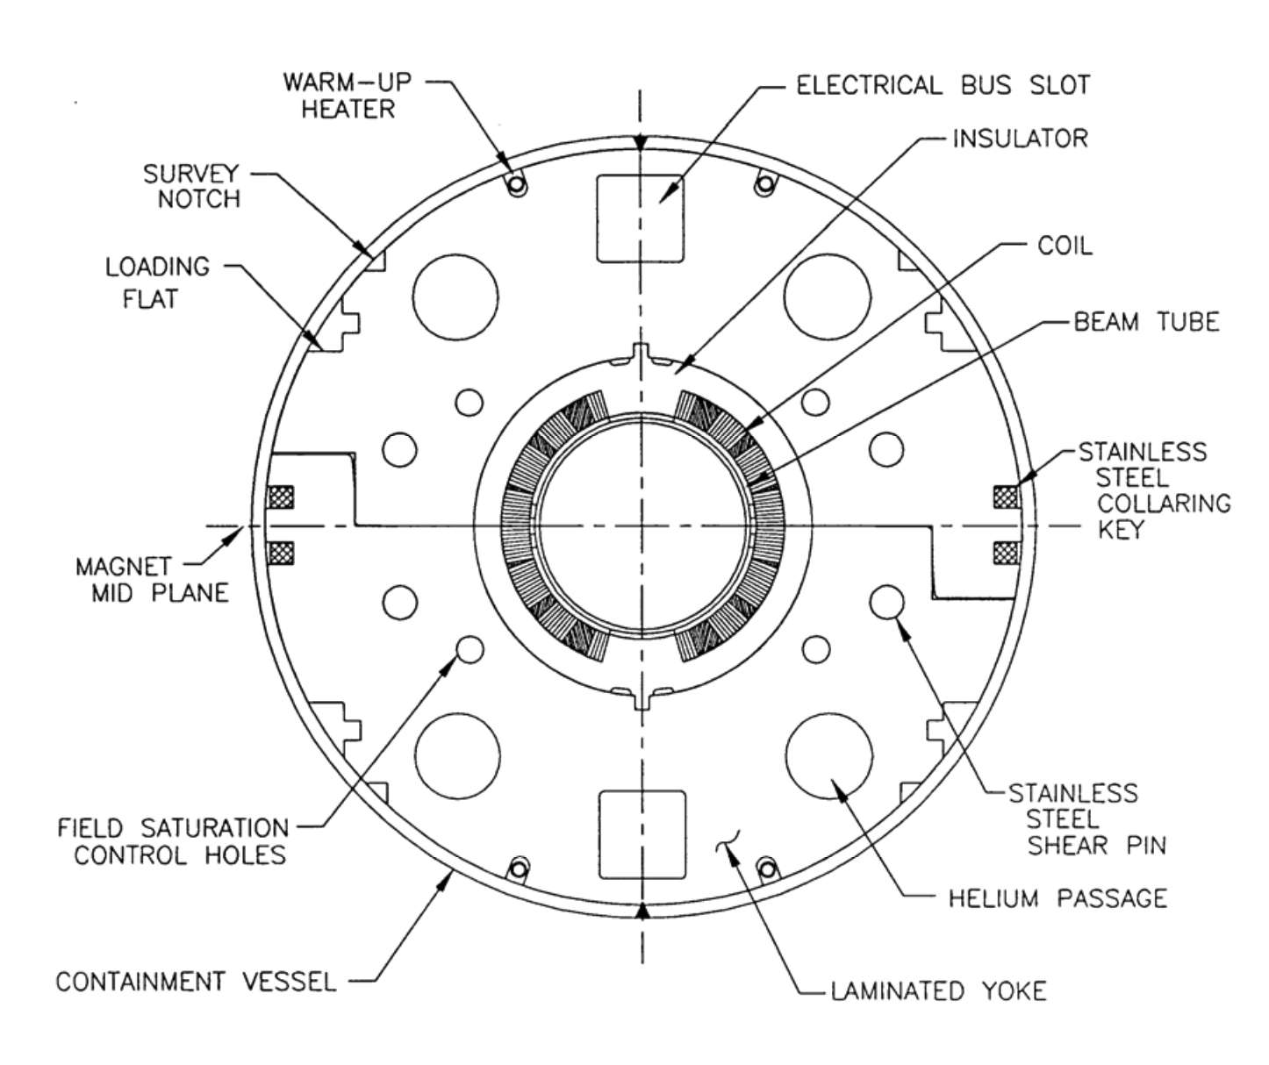
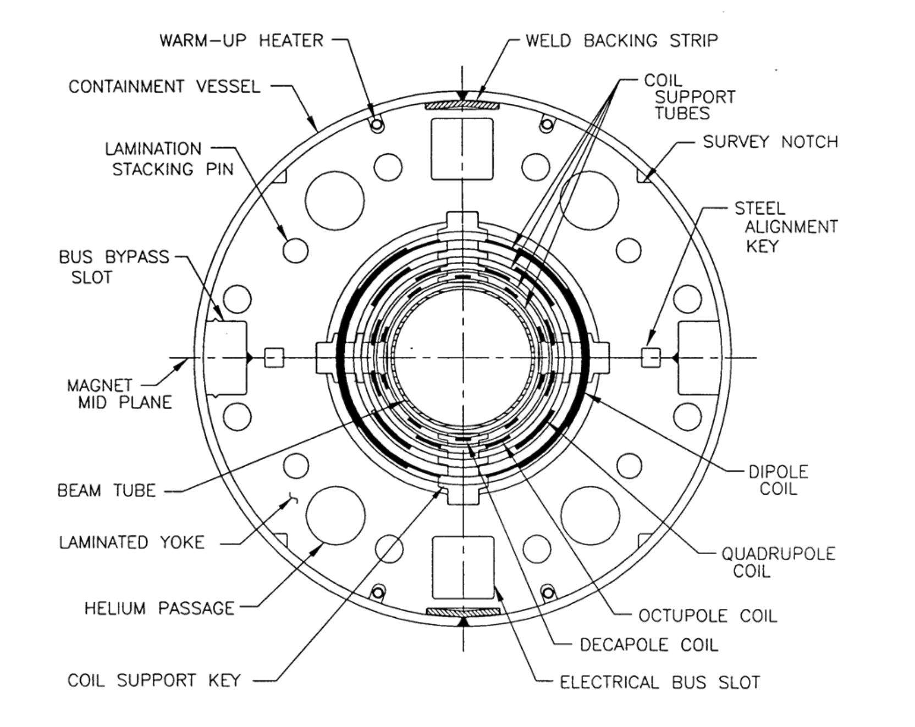
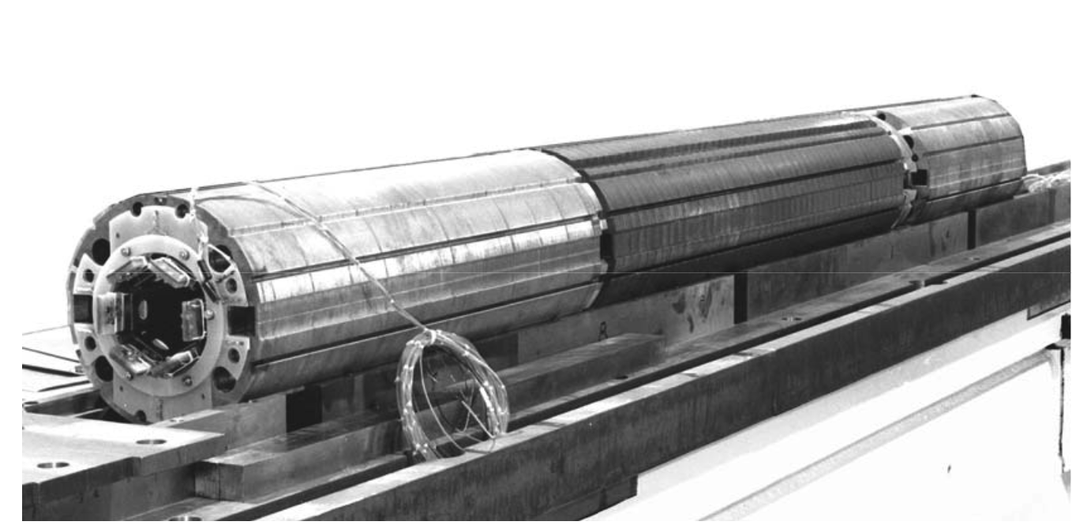
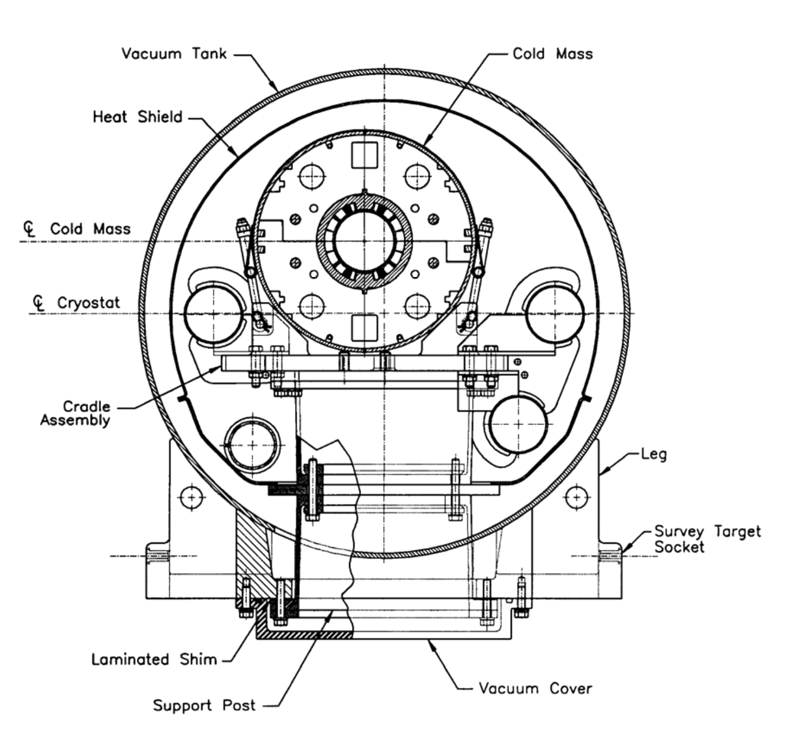
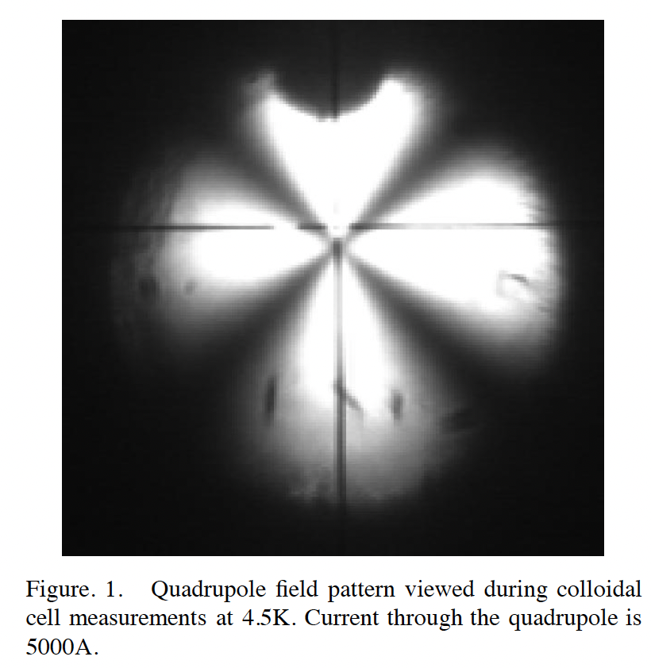
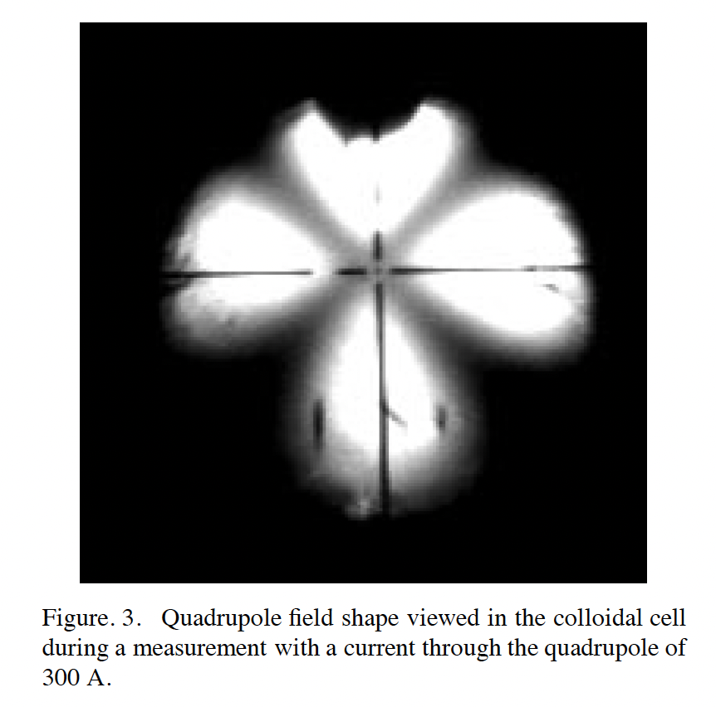
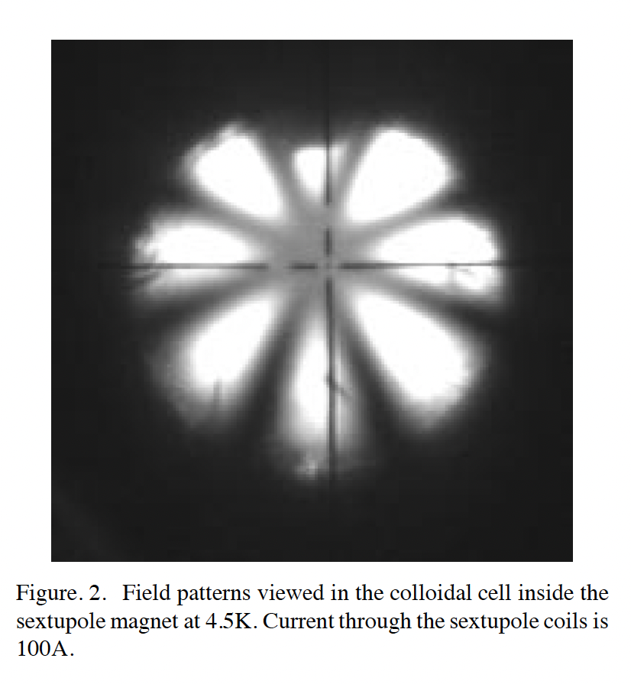
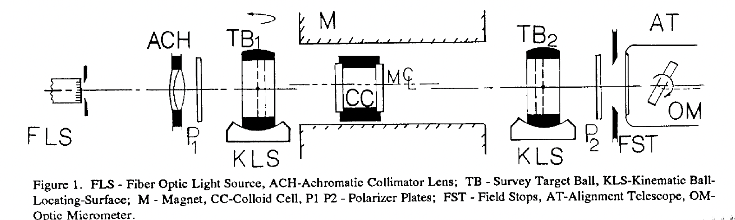
2.1 Placement of the magnets in tunnel
a
b
Fiducial
c
d
The BPM position with respect to the outside fiducials is determined by direct measurement of the center with a pulsed antenna. A high frequency signal of 50 MHz is sent to a rod placed close to the center of the BPM. The BPM plates provide signals which determine the position of the rod with respect to the plates. Part of the rod outside the CQS vacuum flange has two fiducials.

Slide 8
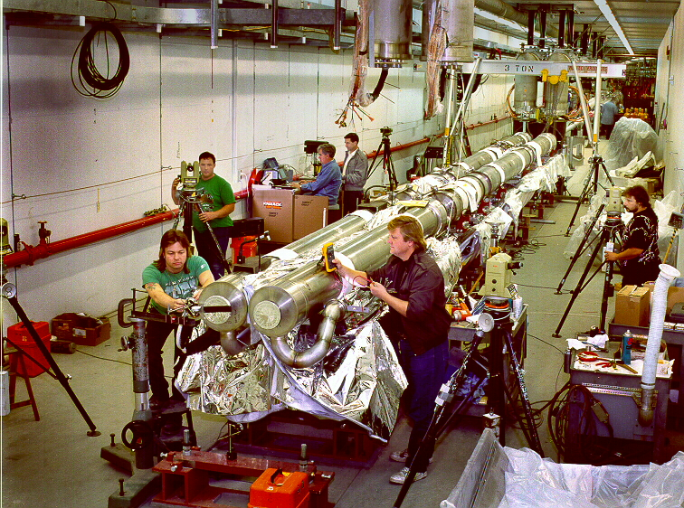
Alignment of the Interaction Region Magnets

Slide 9
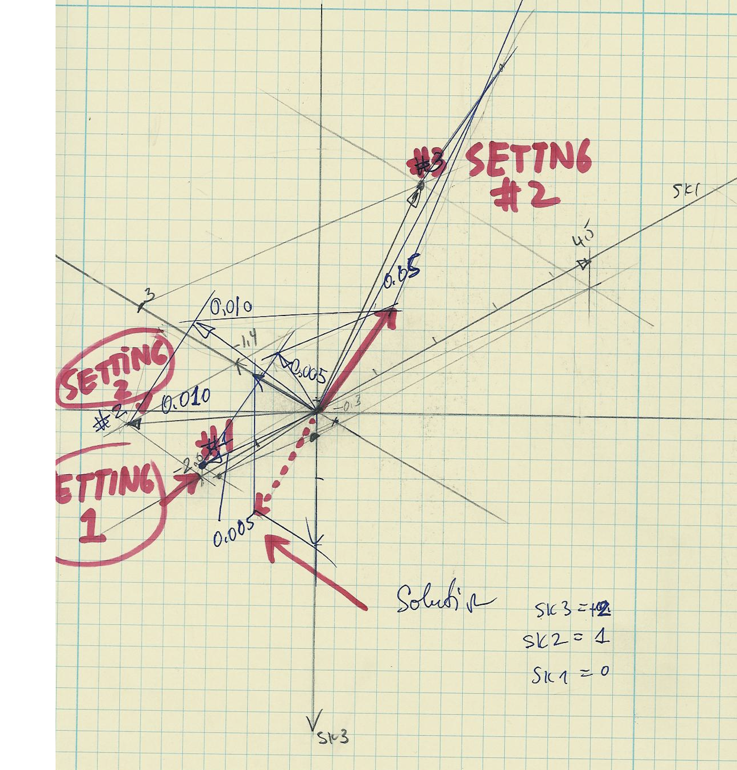
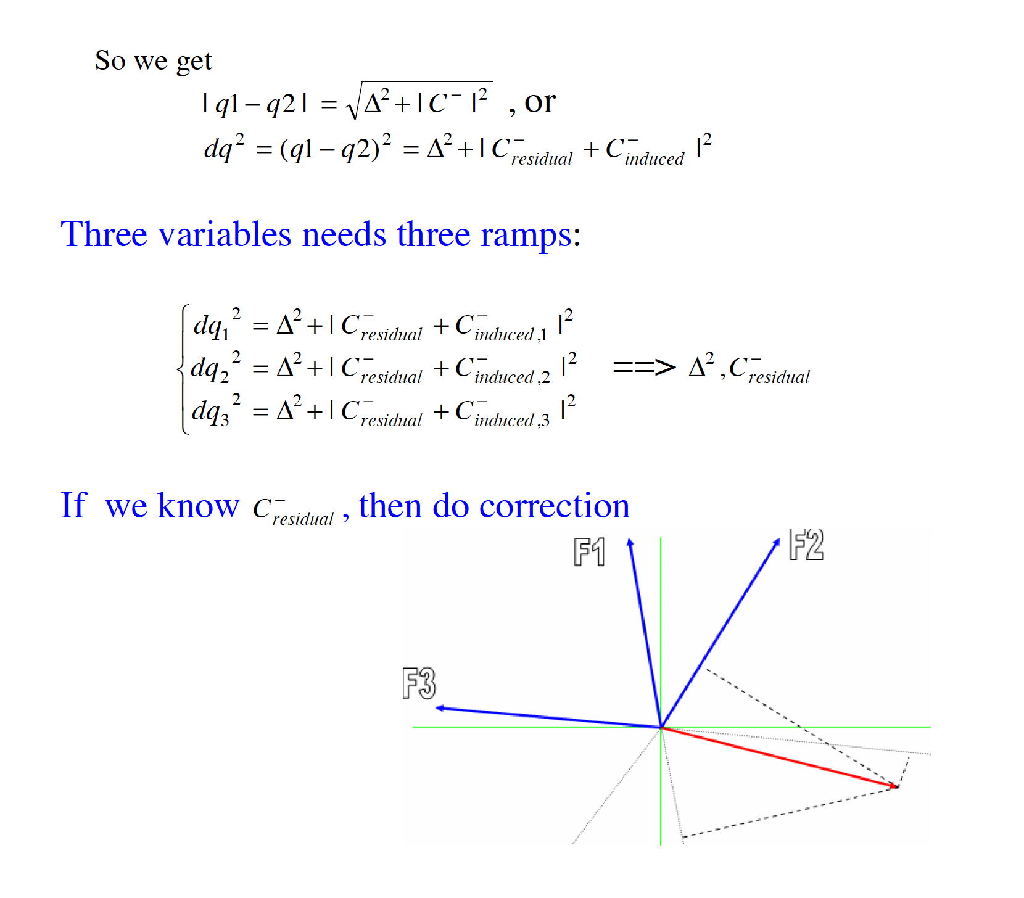
Decoupling Corrections

Slide 10
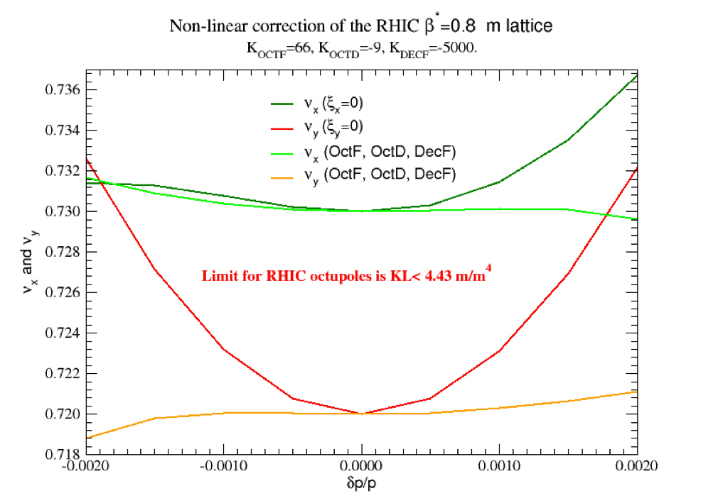
Octupole Harmonic Corrections

Slide 11
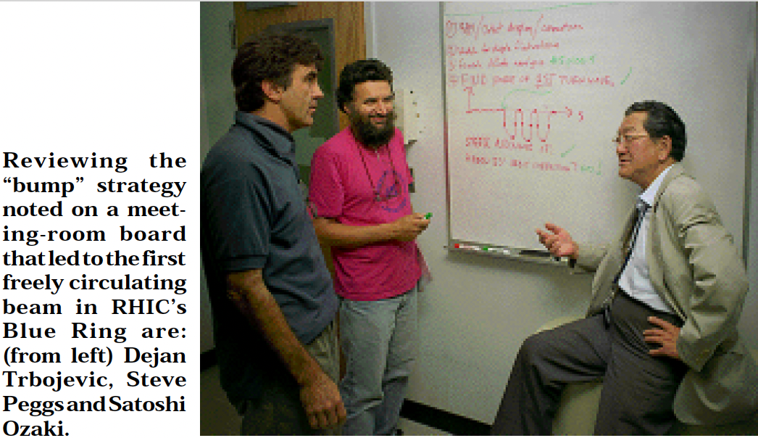
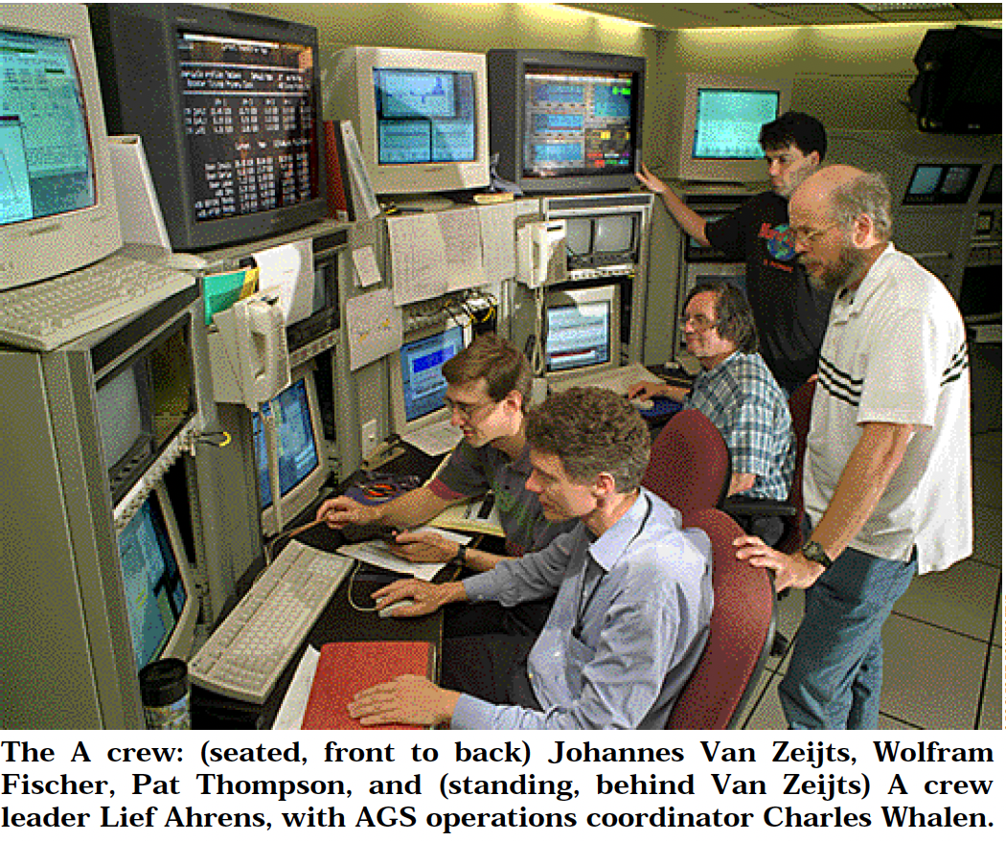
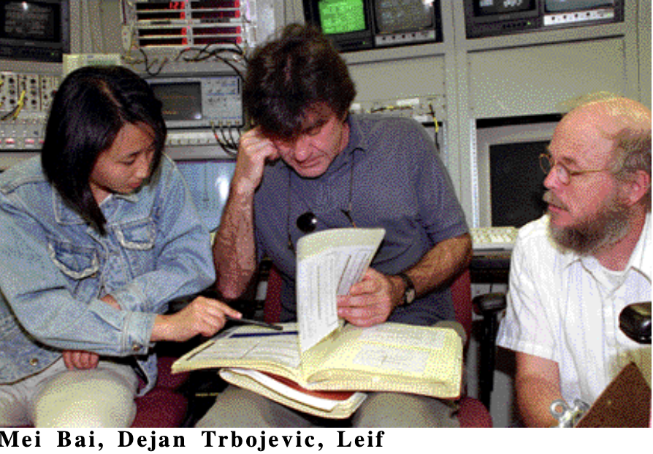
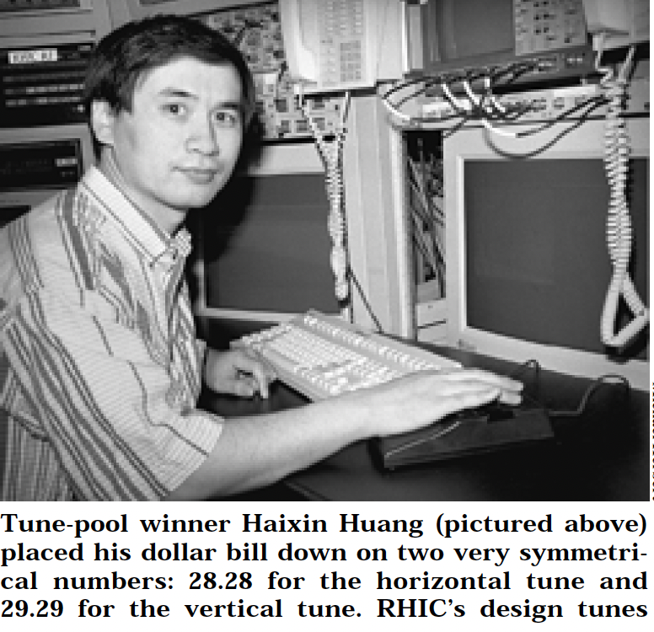
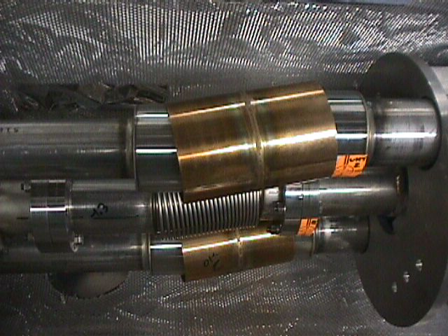
3. RHIC startup - First Attempts with the Beam
Ahrens
Dummy sections moved
sideways during high pressure
test of He process lines.
He process lines
Beam pipe

Slide 12
4. RHIC Project Building Proclaimed Over
RETREAT: Summary of Summer 1999 Issues
Successes:
  Injector (Tandem, Booster, AGS) worked well and reliably
  RHIC refrigerator operated well
  All RHIC magnets are superconducting and were tested up to 40 % of operating field
  Beam circulated in both rings despite severely restricted aperture ( ~ 45 minutes in Blue, ~ 1000 turns in Yellow)
  Beam was captured and accelerated in Blue
  Beam instrumentation (loss monitor, beam position monitors, beam profile monitor) worked well
All dummy inter-connects (192) have been opened and repair is in process and on schedule for completion by Jan. 8. 2000
Major problems:
  Very limited aperture caused by distorted beam tube bellows
  Beam loss during magnet ramping caused by magnet hysteresis (and maybe lag) effect
  Incomplete system integration of PS control
  Corroding components in cryogenic system

Slide 13
4. Retreat in summer 1999 analysis of the First Run
RHIC magnets transfer functions
Improve:
Magnet control during ramping
  Injector kicker strength marginal
  Reduced AGS-to-RHIC transfer energy by 15%
  Beam at end of AGS-to-RHIC transfer line not stable
  Replace pulsed AGS closed orbit extraction bumps with DC bumps; test during g-2 run
  Frequent power supply trips caused be insufficient cooling of equipment alcoves in RHIC tunnel
  Install AC in all 18 alcoves; complete by Jan.15
DIPOLE (DRG)
TRIPLETT QUADRUPOLE (QRI)
Solid: DC
Dashed: 83 A/s
DOWN
Solid: DC
Dashed: 83 A/s
DOWN
UP
UP
Deviation @ 500A
Hysteresis: 0.003
Lag: 0.001
Deviation @ 500A
Hysteresis: 0.007
Lag: 0.010
What was working well in the previous run
Loss monitor system
Wall current monitors
Single ionization profile monitor
DCCT ’s - current transformers
Schottky detector - showed us fantastic possibilities

Slide 14
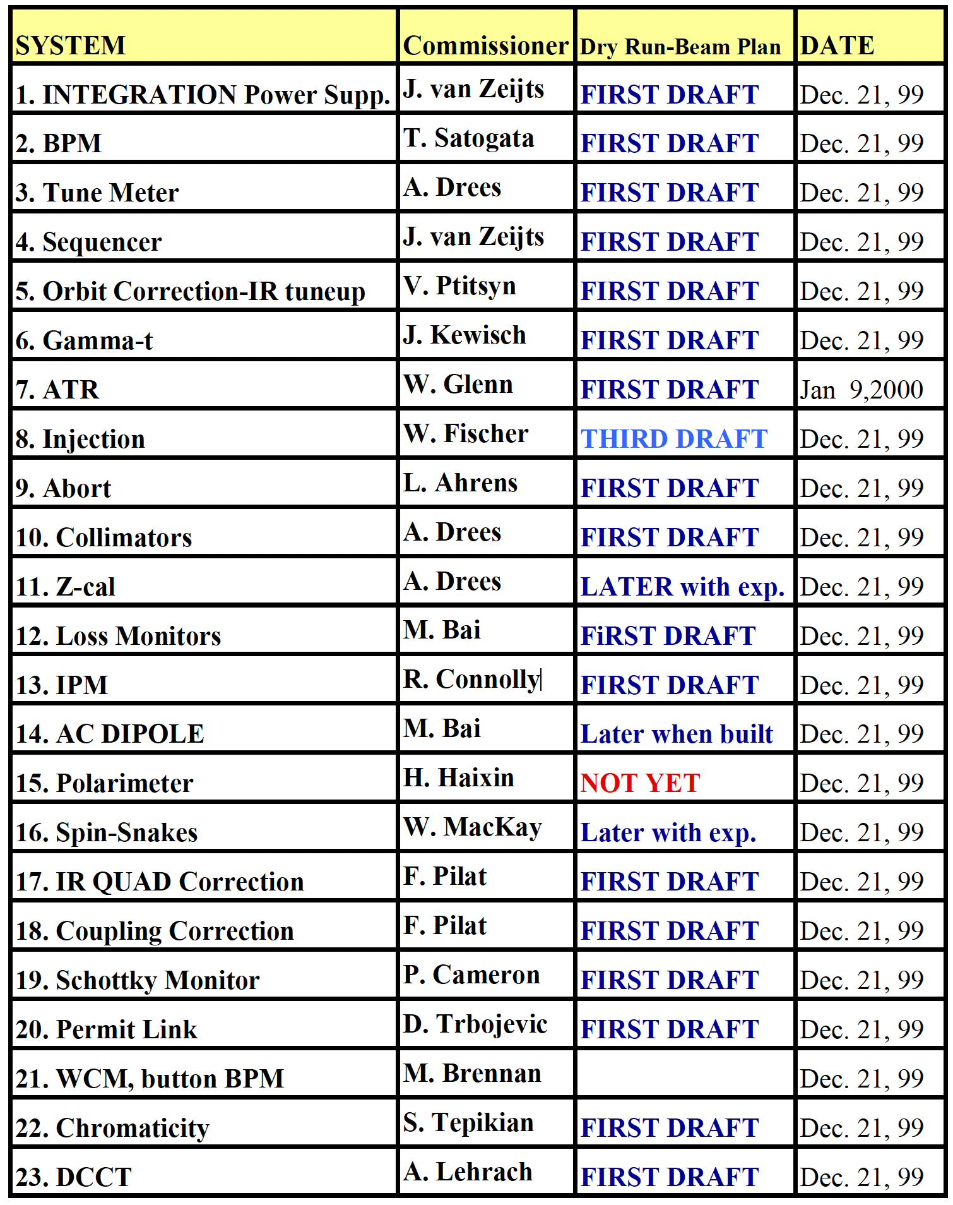
4. Preparation for the 2000 run
Monday, 11:15 AM, October 11, 99 System Commissioner’s Meeting
BPM System : Todd Satogata
TUNE-METER : Angelika Drees
Orbit Correction - IR and Luminosity Tune up Vadim Ptitsyn
Sequencer - Johannes Van Zeijts
ATR - Woody Glenn
Abort System: Leif Ahrens
Permit Link: Dejan Trbojevic
IR and coupling Correction: Fulvia Pilat
Collimators : Angelika Drees
Z-cal : Angelika Drees
IPM : Roger Connolly
Schottky Monitor - Peter Cameron
Loss Monitors , RF Dipole : Mei Bai
Wall Current Monitor, DCCT, … RF instrumentation

Slide 15
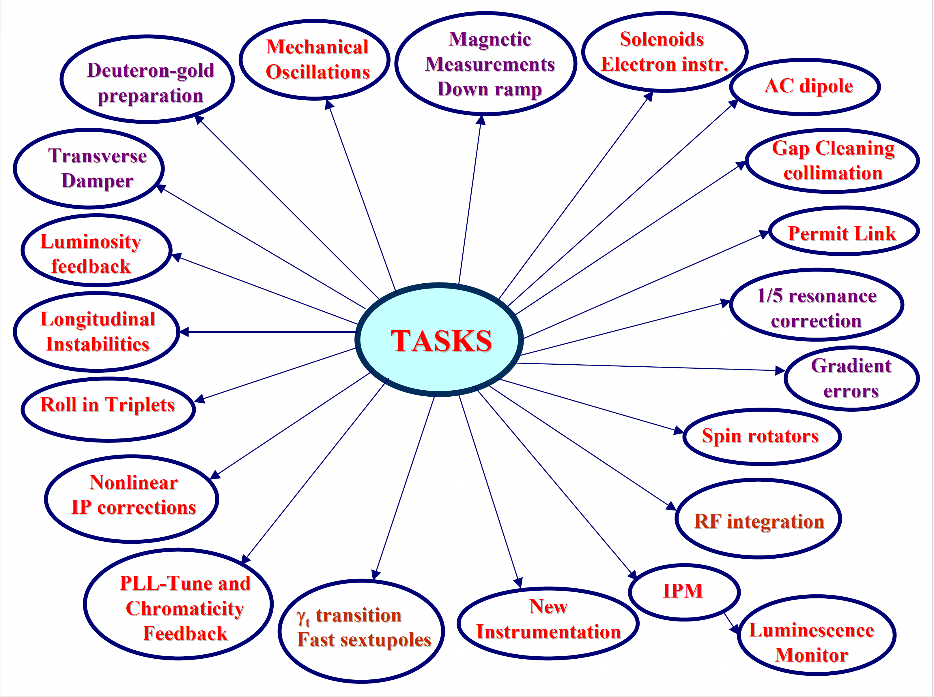
System Commissioners

Slide 16
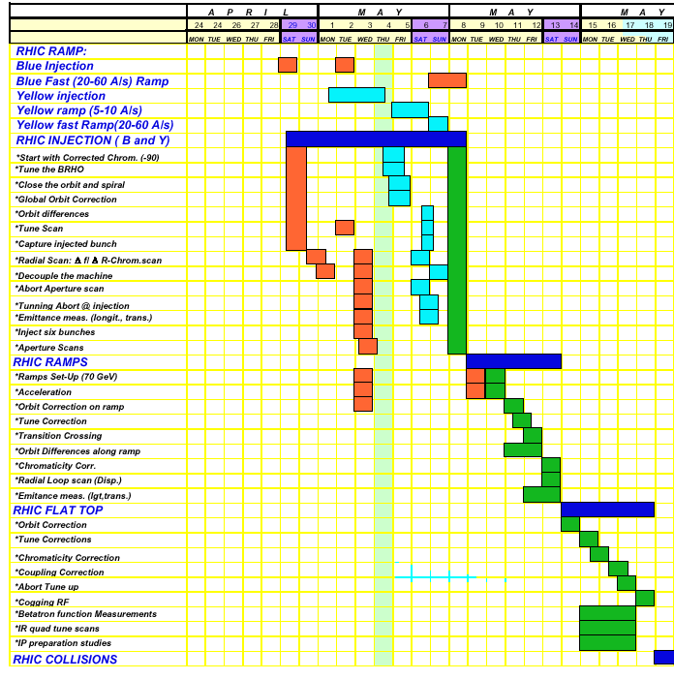
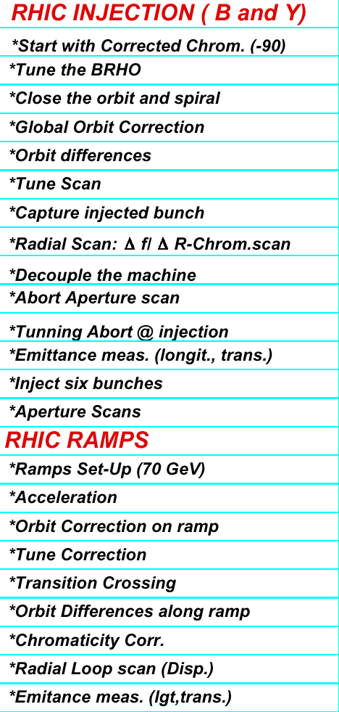
Commissioning Plan

Slide 17
4. RHIC Commissioning Plan for 2000 (February 14, 2000)
Beam in Tandem, Booster, and AGS
ATR beam to the W-dump:
3. ATR to X and Y arcs:
Commissioning of the Quench Protection System
Injection into RHIC
6. RF System Commissioning
7. Measure the Momentum aperture
8. Tuning the Abort at Injection
9. Meas. transverse and longitudinal emittances
10. Coupling Correction
11. Ramps and Acceleration
12. Cross transition, go for 70 GeV
13. Measure Difference orbits along the ramp
14. Measure the dispersion function along the RAM
15. Orbit correction along the ramp
16. Tune measurements and correction along the ramp
17. Measure chromaticity along the ramp
18. Tune the abort along the ramp
19. Measure momentum aperture before and after transition
20. Coupling measurements and correction
21. Improve efficiency along the ramp
22. FLAT TOP – STORE CONDITIONS:
23. Preparation for establishing collisions.

Slide 18
Parameters and goals for RHIC RUN2000
  60 bunches per ring ✓
  5×10⁸ Au/bunch ✓
  Longitudinal emittance: 0.3 eVs/nucleon/bunch ✓
  Transverse emittance at storage: 15 π μm (norm, 95%) ✓
  Initial storage energy: γ = 70 [66 GeV/nucl.] ✓ (This energy is below the lowest quench of any DX magnet)
  Lattice at injection and acceleration: β*= 3 m @ 2, 4, 8, and 12 o’clock
  β*= 8 m @ 6 and 10 o’clock
  Lattice at storage and collision: β*= 3 m @ 2, 4, 8, and 12 o’clock
  β*=2- 8 m @ 6 and 10 o’clock
  Luminosity: 2×10²⁵ cm⁻² s⁻¹ ✓
  Integrated luminosity: a few (μb) ⁻¹ ✓

Slide 19
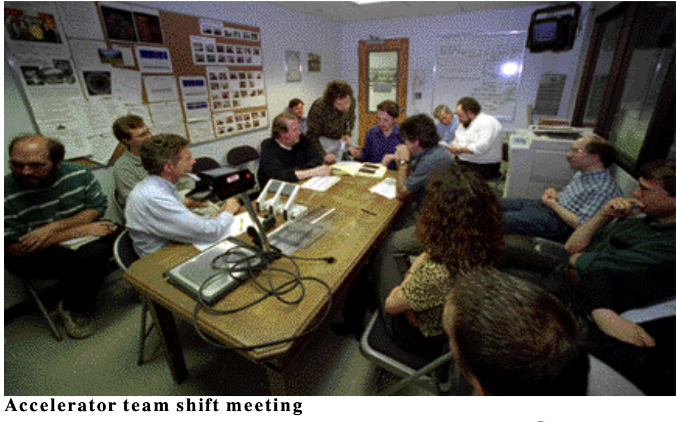
The Run meetings at the time were within the small AGS room

Slide 20
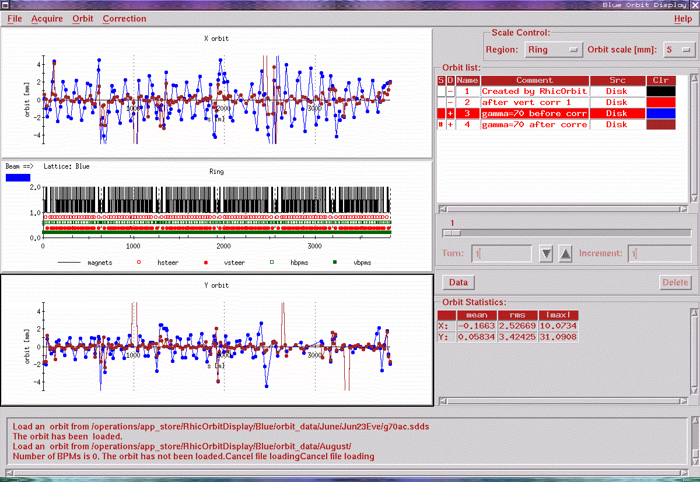
4. Typical closed orbits at injection - Blue Ring

Slide 21
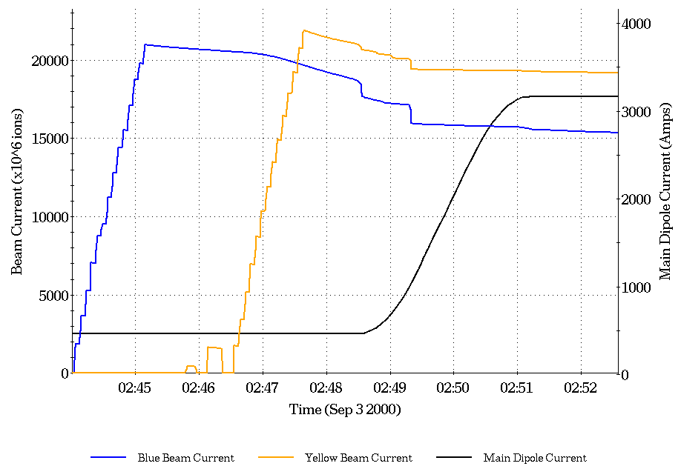
4.3 RHIC Injection and Acceleration before first collisions
(3.6×10⁸ Au/bunch)
Blue intensity
Yellow intensity
Main dipole
current
“pilot” bunch

Slide 22
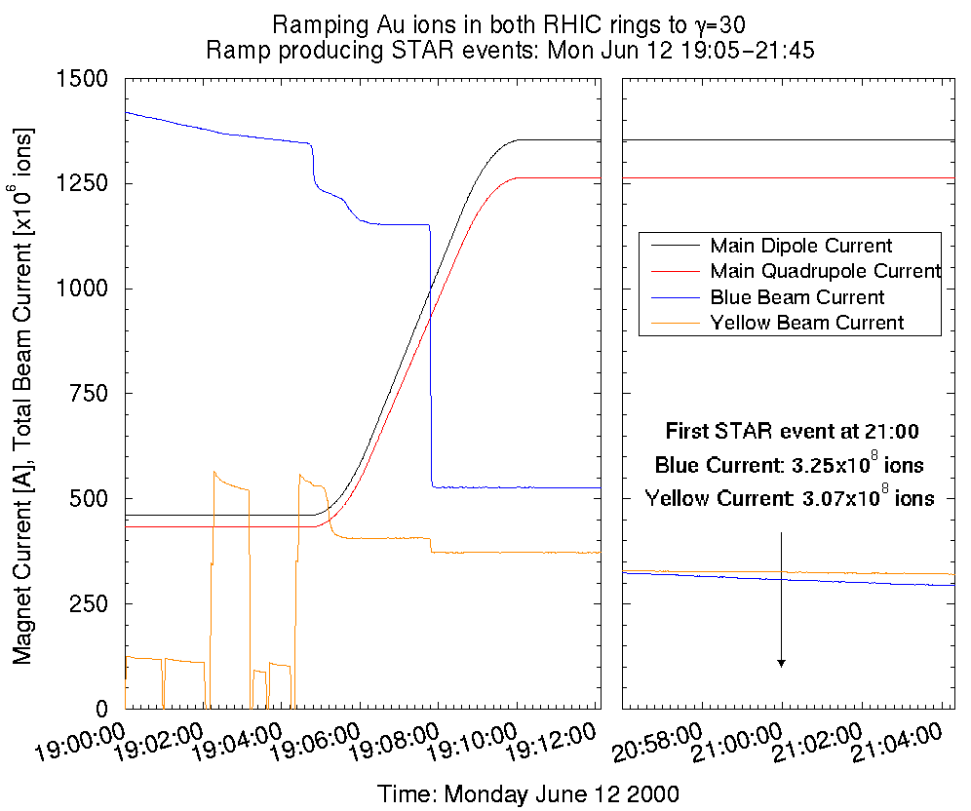
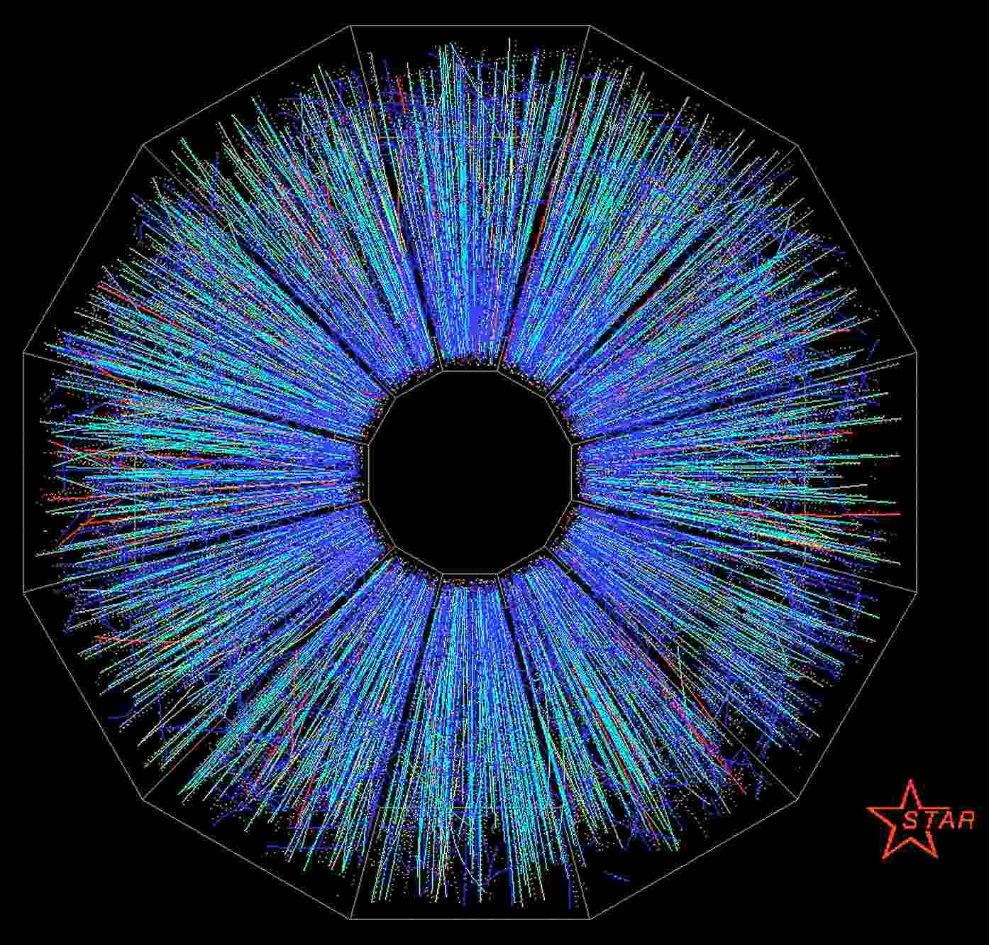
Ramp to first collision

Slide 23
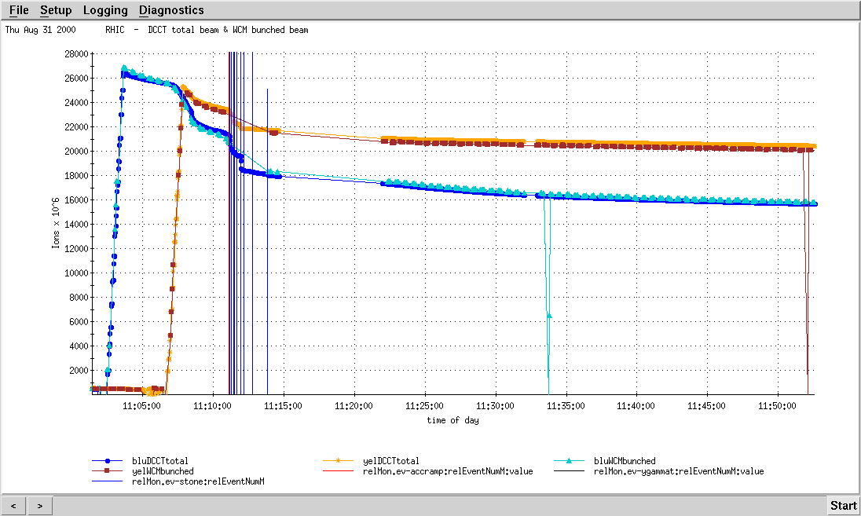
RHIC Ramp run 2000
Storage energy
Total Yellow current
Bunched Yellow current
Total Blue current
Bunched blue current
BLUE
Fill 55
bunches
Transition energy
YELLOW
Fill 55
bunches

Slide 24
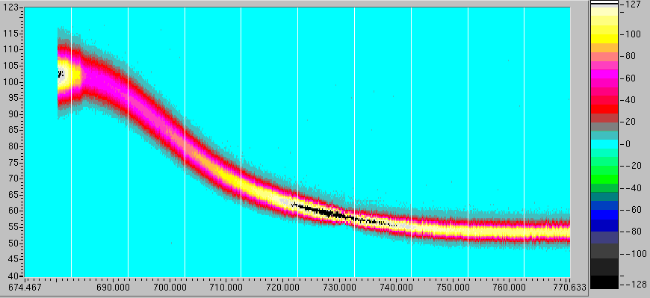
Accelerating a gold bunch in Commissioning RHIC
Bunch length [ns]
Injection
Transition energy
Storage energy

Slide 25
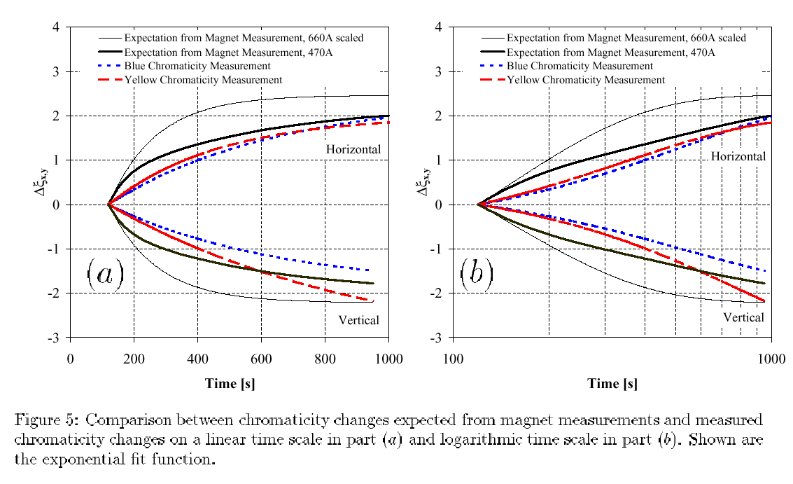
Comparison between beam and magnet measurements 2000
MAGNET MEASUREMENTS
BEAM MEASUREMENTS

Slide 26
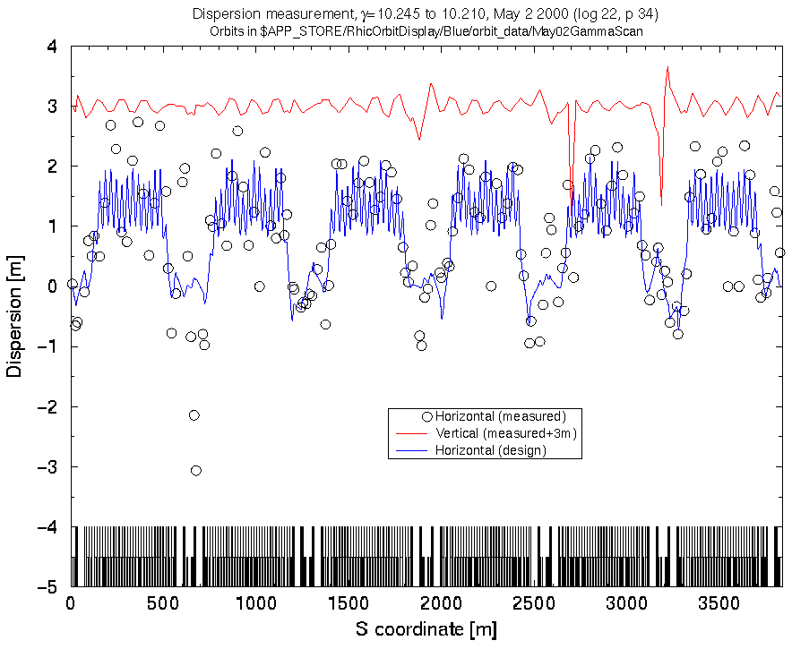
Power supply Q89 with wrong polarity found from the dispersion measurements
Horizontal Dispersion
Function - Design
Horizontal Dispersion
Function - Measured-o

Slide 27
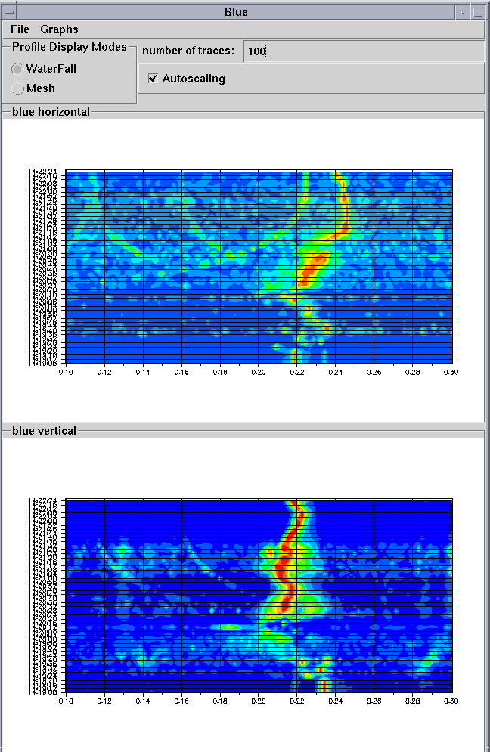
Tune measurements during acceleration ramp
Blue ring
Horizontal
Storage energy
Transition energy
Start of acceleration
Blue ring
Vertical

Slide 28
Results from the Commissioning 2000 Run
  RUN2000 RHIC commissioning and first operation was very successful
  Full design Au luminosity and collisions of polarized protons are planned for RUN2001
    Phase Lock Tune Feedback
    γ_{t} jump for the gold ions fully commissioned
    Commissioning of the bent-crystal channeling collimation
    Beta-squeeze with all power supplies installed

