Slide 1
Decoupling, non-linear corrections and other strange activities
Fulvia Pilat, ORNL
RHICfest, BNL, July 9-10 2026

Slide 2
outline
Local linear and non-linear corrections at RHIC
APEX program (Accelerator Physics Experiments)
RHIC Retreats
RHIC operations
Down memory lane….(pictures)

Slide 3
IR local linear and non-linear corrections
A method was developed to measure and correct operationally the coupling and non-linear effects of the final focusing magnets, that gives access to the multi-pole errors effects by applying closed orbit bumps, and by analyzing the resulting tune and orbit shifts.
This technique has been tested, demonstrated and used in operations at RHIC
The concept was initially proposed by JP Koutchouk of CERN and then developed by V.Ptitsyn and myself, with significant contributions from P. Cameron (PLL) and S. Binello (application development).

Slide 4
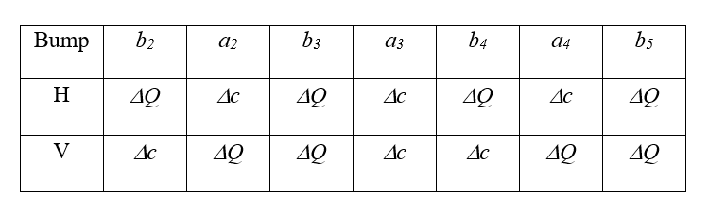
A local orbit excursion through a region with nonlinear fields generates feed-down effects to lower order field harmonics. The most useful observables come from the feed-down to the zero and first order harmonics, which affect respectively the beam closed orbit and betatron tunes
The tune shifts measured arise either from the feed-down to the normal gradient or from the repelling effect of linear coupling
In order to simplify the identification of individual multipoles from the observed tune shifts, the measurements conditions should be such that the tune shifts produced by coupling are negligible compared with the tune shifts from the normal gradient change → coupling must be well corrected: local correction at the IR + correction of global residual coupling
Normal and skew tune shifts can be calculated analytically order by order

Slide 5
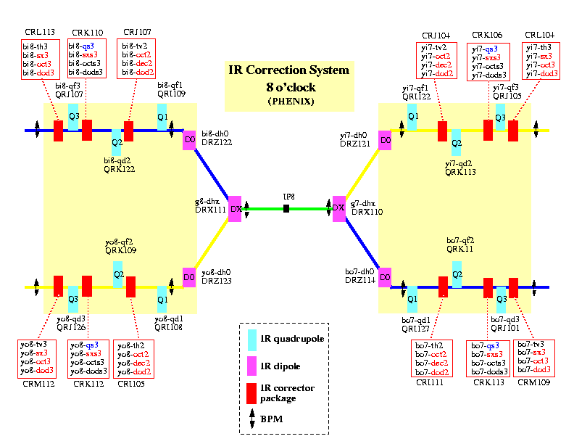
IR correction technique and results
An operational environment was developed at RHIC to implement local IR corrections with the IR bump technique
Only the PLL offer the continuous tune signal and the resolution required to make the measurement practical.
The PLL, a 245 MHz system, in high-resolution mode gives tune data at 100 Hz and the resolution can be better than 5x10⁻⁵

Slide 6
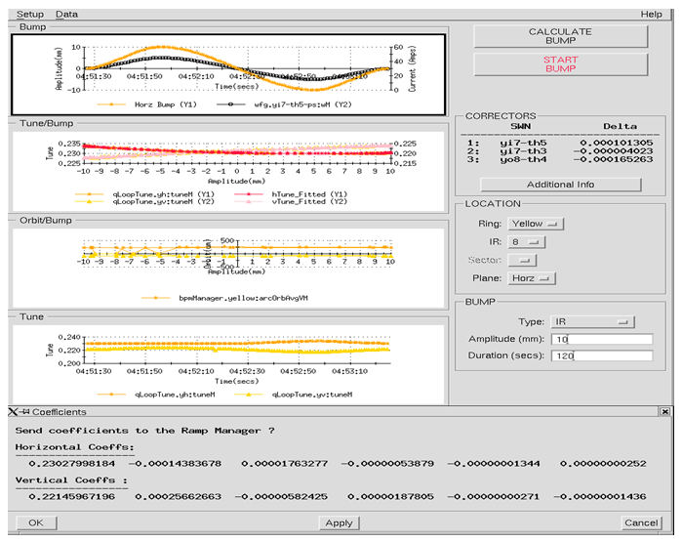
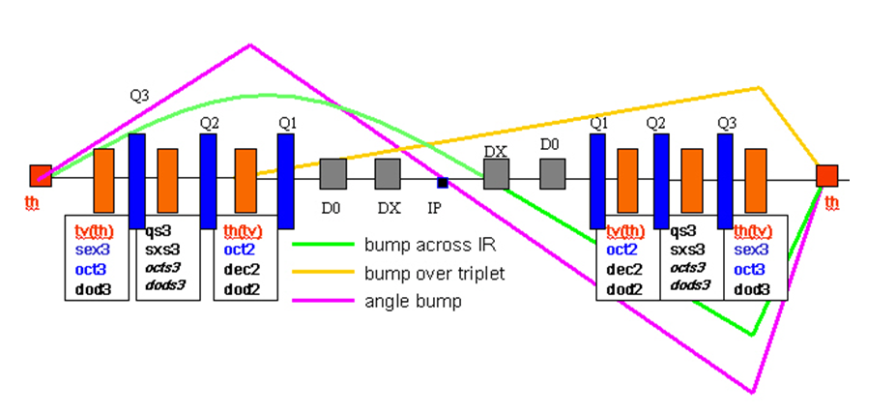
IR bump application
A control room application was developed to set-up IR bumps and to collect and analyze data for IR corrections.
The application provides communication to power supply and ramp managing software for IR bump set-up and activation, reads in and plots PLL and orbit data in real time and allows online data analysis to support operational corrections.

Slide 7
Operational conditions
The 2 rings must be anti-cogged, i.e. longitudinally separated, by at least 3 RF buckets to avoid beam-beam effects
Measurements are performed at the beginning of a store, when the transverse emittance is smaller, giving larger amplitude available for the bumps. Typically, we used dedicated ramps of 6 bunches (instead of the 45-56 typically used for operations) as this is enough for good PLL measurements but not enough overall beam intensity to risk dangerous quenches in case of accidental beam loss.
Both rings must be well de-coupled, with coupling corrected to a minimum tune separation DQ_{min} < 0.002.
The horizontal and vertical fractional tunes are separated before the measurements by 0.01-0.012 to further minimize coupling effects. If the tunes get too close during the bump (<0.002-0.003), that can interfere with the PLL lock in high-resolution mode.
Good overall orbit correction with horizontal and vertical orbit rms < 1mm
Good centering of the orbit in the IR triplets, to insure symmetry during the measurement. Typically, local orbit adjustments in the IR regions are necessary prior to the measurement and correction to reach a residual orbit error of 1-2 mm in the IR magnets, a practical limit so far due to BPM alignment.

Slide 8
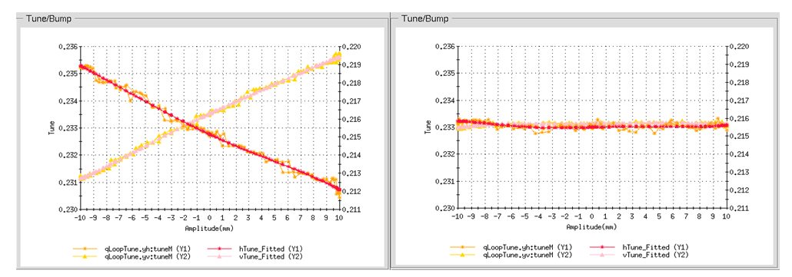
Results: sextupole and skew sextupole corrections
Correction of sextupole effect in IR8
Normal and skew sextupole correction were done operationally from 2002 on (after demonstration of the technique in 2001)
Measured improvements in:
Beam lifetime (in operations)
Dynamic aperture by 10-15% (during dedicated APEX experiments)

Slide 9
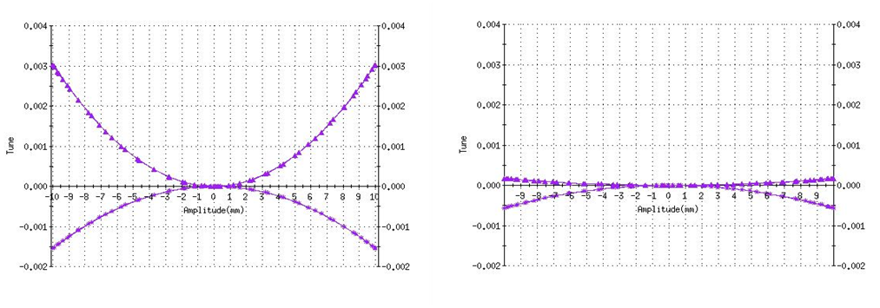
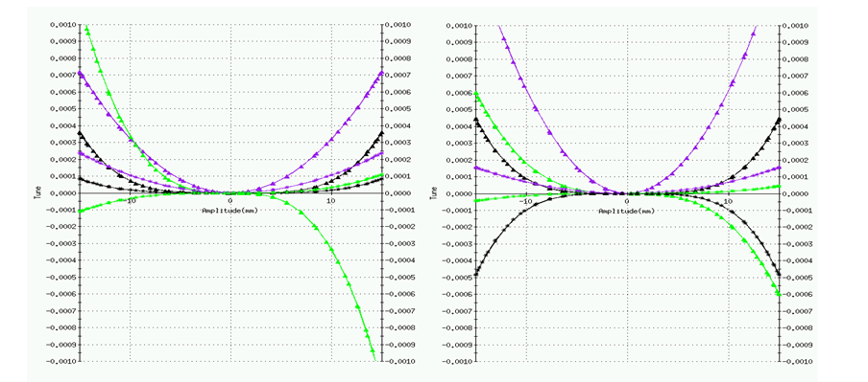
Results: higher orders
To help in the correction) of orders higher than sextupole, we added the capability of online fitting and plotting the polynomial coefficients
Octupole coefficients before and after correction
The left plot shows the residual coefficients for the horizontal tune, (purple: octupole, green: decapole, black: dodecapole) after correction of the sextupole (linear) term.
The plot on the right shows the change in the higher order harmonics after we powered up the yi7-dod3 dodecapole in IR8

Slide 10
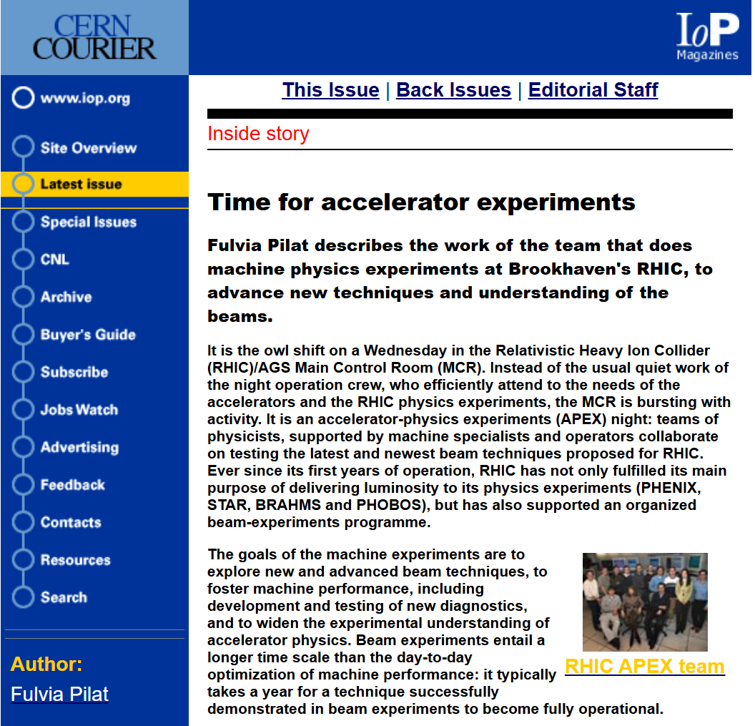
APEX: Accelerator Physics EXperiments
Program started officially in 2002
12 h of beam time – weekly
Yearly and weekly planning
Formal experiment proposal
Approval by ad-hoc Committee
Yearly APEX Workshop
APEX program 2003:
AC dipole M. Bai
Beam-beam W. Fischer
Chromaticity experiments S. Tepikian
Collimation A. Drees
Flattop studies V. Ptitsyn
Pressure rise S.Y.Zhang
Stochastic cooling M. Blaskiewicz
Transition studies (alpha-1) C. Montag
Transverse instabilities M. Blaskiewicz

Slide 11
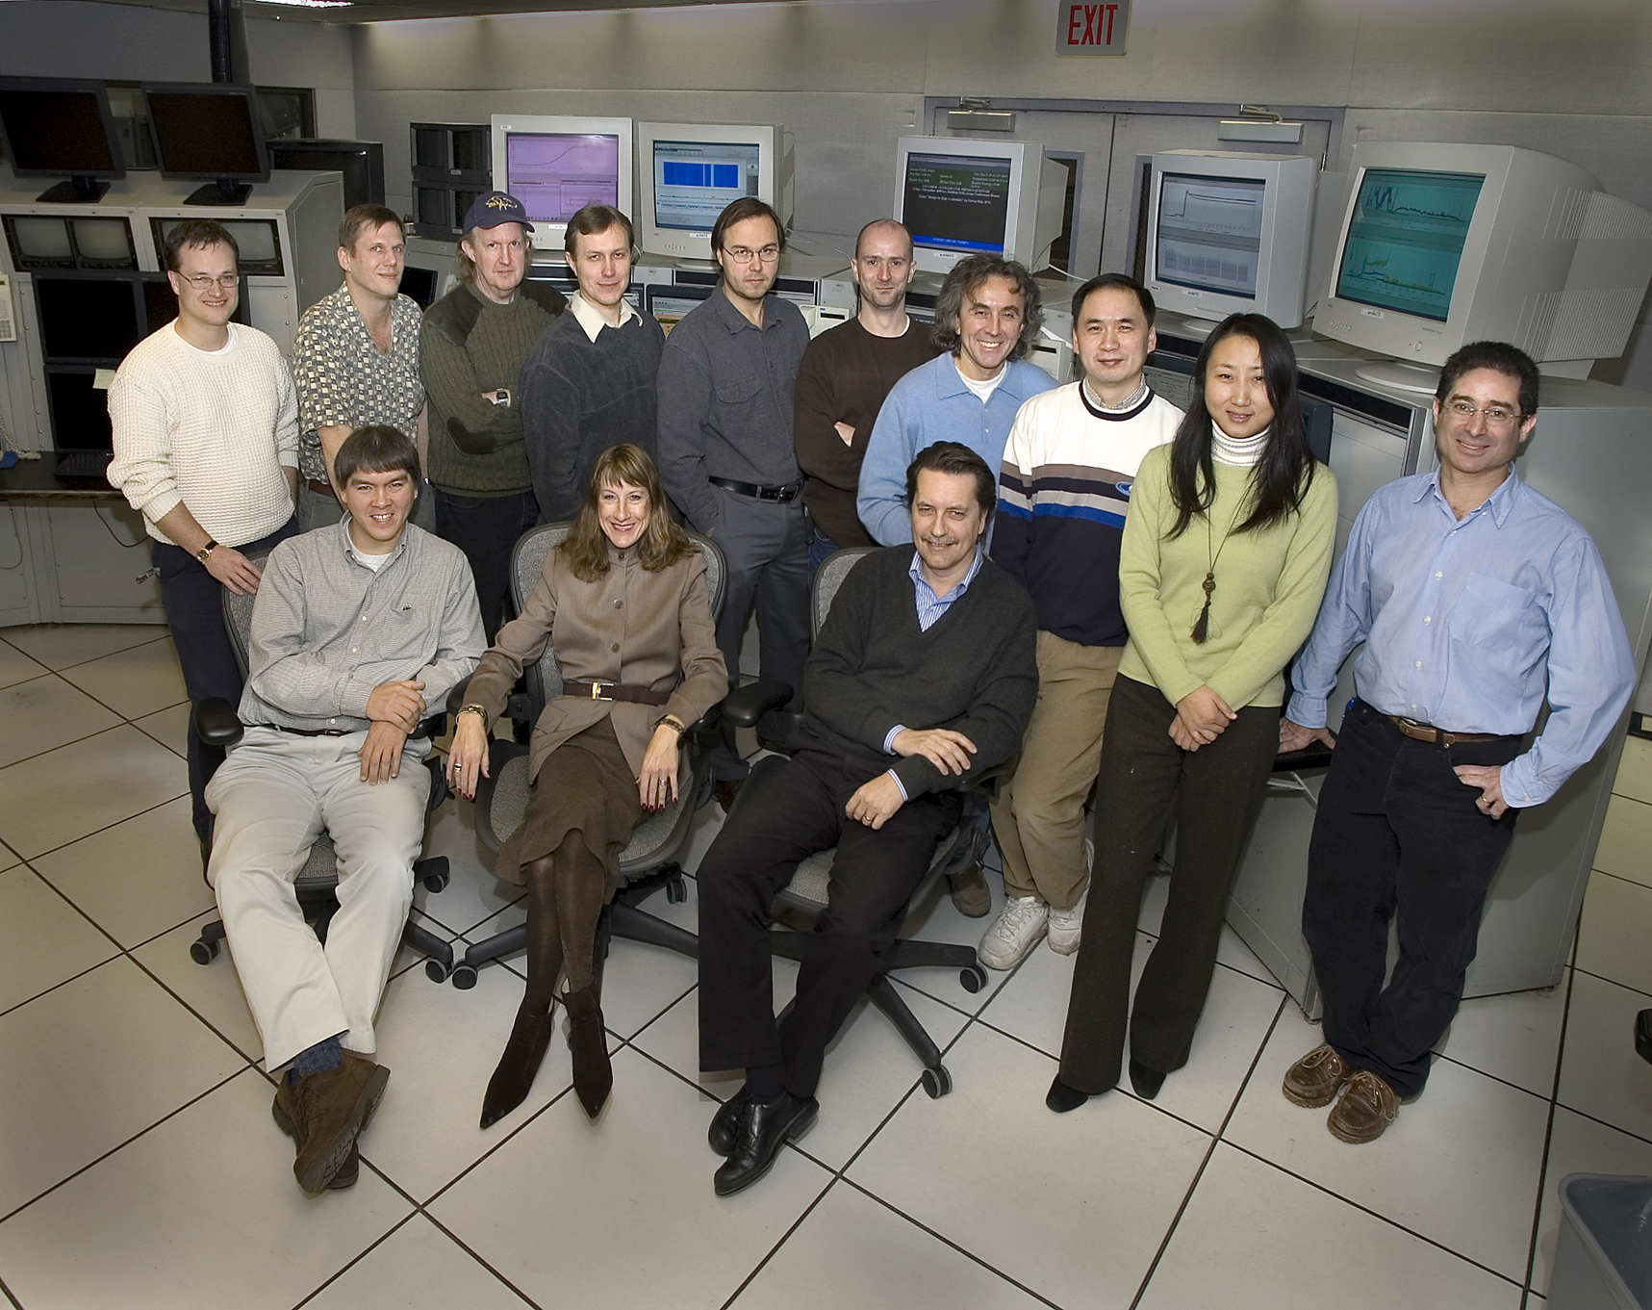
The APEX gang

Slide 12



RHIC Retreats
The RHIC (Relativistic Heavy Ion Collider) Retreats are annual planning meetings held by Brookhaven National Laboratory (BNL). They bring together scientists, physicists, and engineers to review machine performance, analyze scientific data, and plan future beam operations.
Historically, these retreats were vital strategy sessions. Experts would look at how the machine ran, talk about problems that happened, and make plans for the next physics experiments.
2-3 days
2-4 hours away from BNL (Gurneys in Montauk, Shelter Island, Mystic CT…..), later at BNL
By invitation only, mostly RHIC/AGS and experiments staff

Slide 13
RHIC Operations
I had the privilege of leading the RHIC/AGS Operations from 2005-2010
By far and large, the best operations and maintenance team I worked with (and I worked in the control rooms of CERN, LANL, SSC, JLAB, ORNL and FNAL….)
Also, the wittiest operations group ever and best haiku writers!

Slide 14
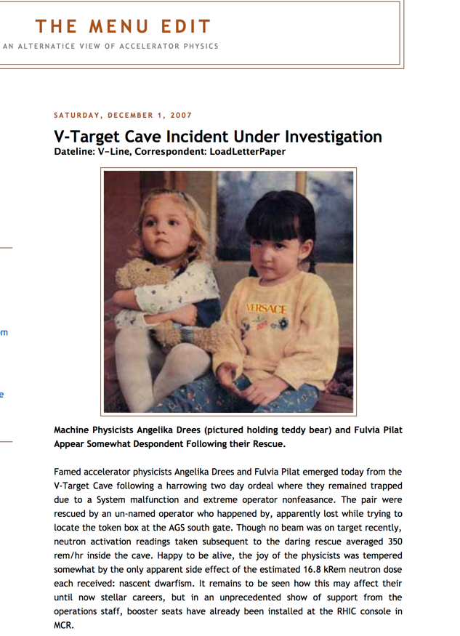
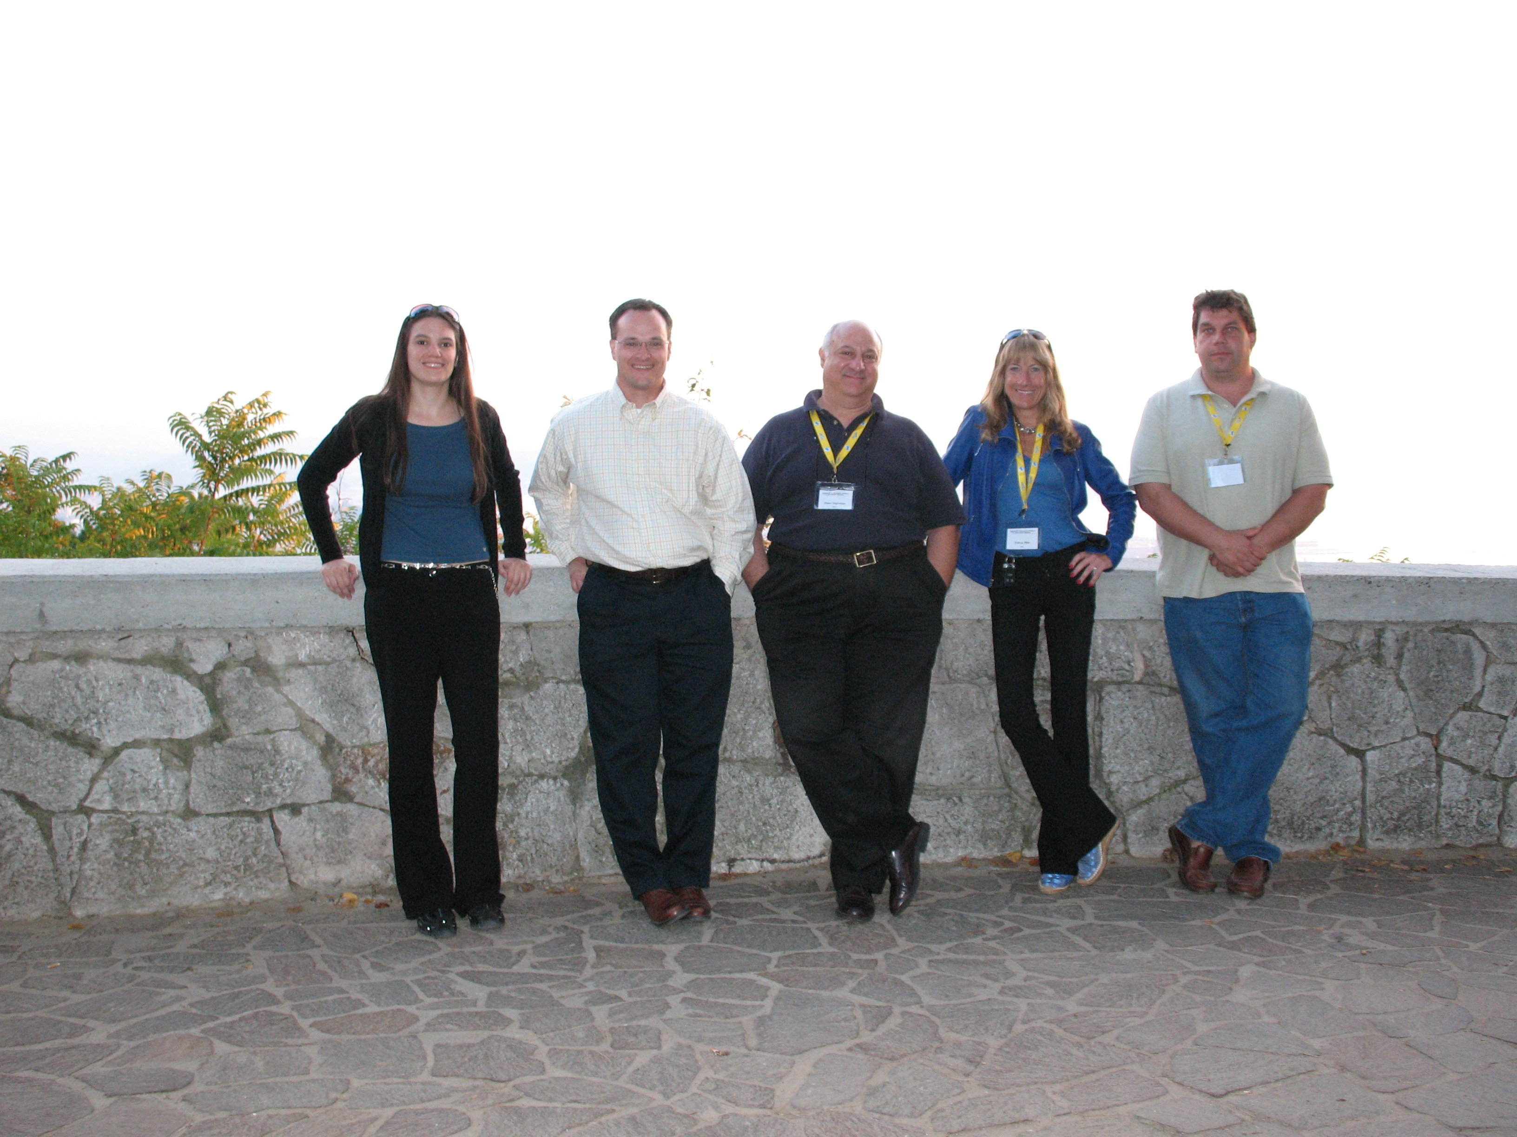
WAO Trieste 2007

Slide 15
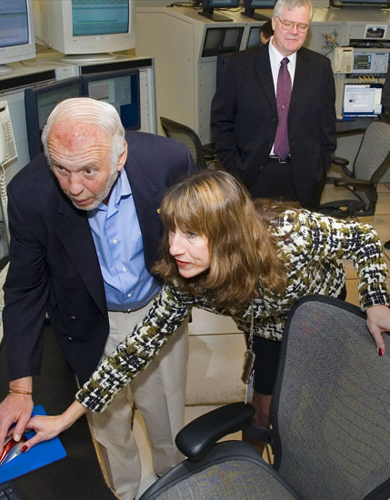
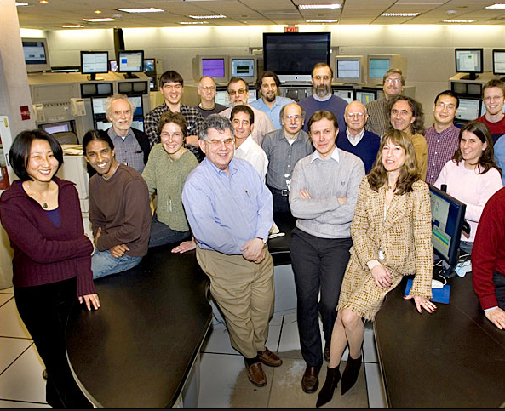
Great work and team !!!!!!!!

