Slide 1
Two Rings, One MCR, No Sleep: RHIC Early Commissioning
Mei Bai
July 9, 2026
RHIC Fest

Slide 2
The Early Commissioning of RHIC
First Gold collisions
“We are crossing into a new frontier of scientific inquiry!”
Quest of the new WP
The high-wire act of tune-swing
2000
2004
1999
2001-2002
The start of commissioning
The hurdles we managed to get the beam circulated in Blue ring
First PP collisions
The start of RHIC spin physics

Slide 3
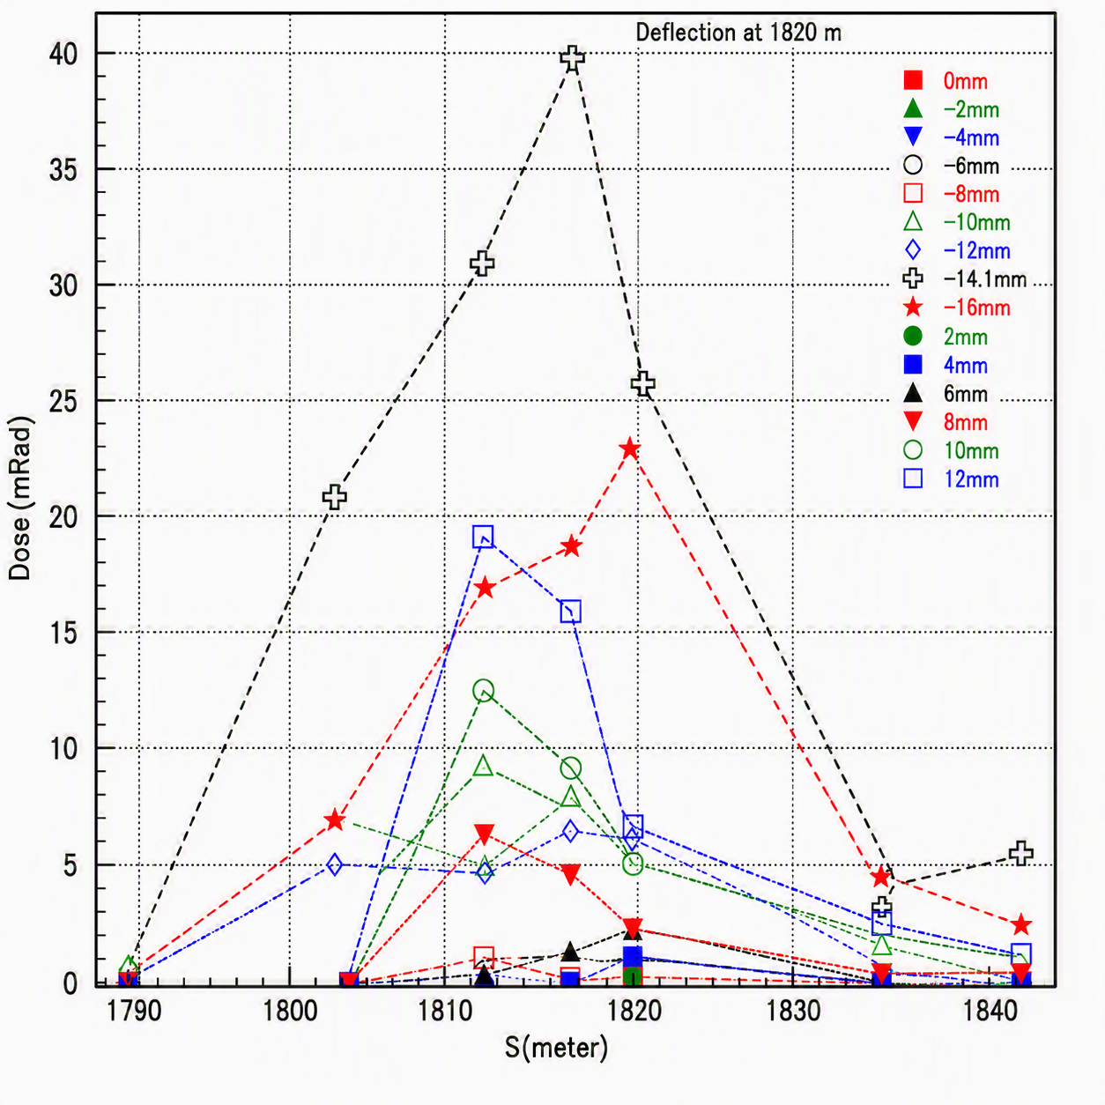
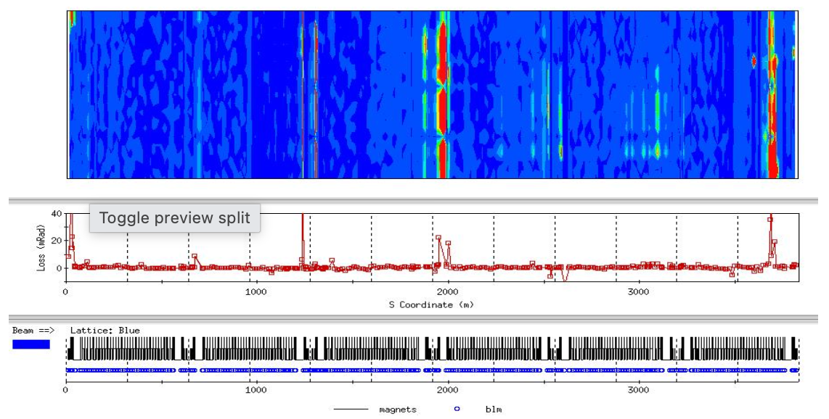
The start of commissioning: struggle to the circulating
The hurdles we managed
Locate the obstruction
Tuning the first turn with BLMs
The 1st turn loss map of blue ring
Loss pattern around Q6 of sector 11
P. Thompson, et al, AIP Conf. Proc. 546, 313–321 (2000)

Slide 4
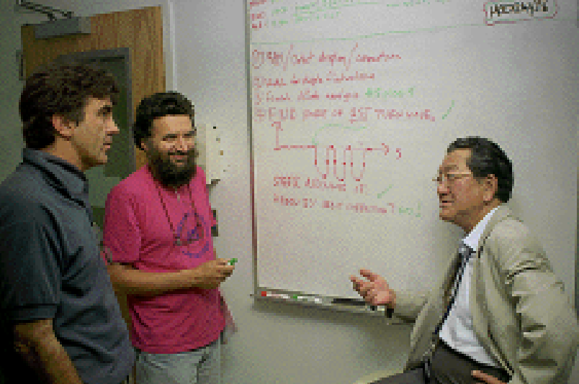
The start of commissioning: struggle to the circulating
The triumph orbit bump to steer the beam around the obstruction
What is drawn on the board?

Slide 5
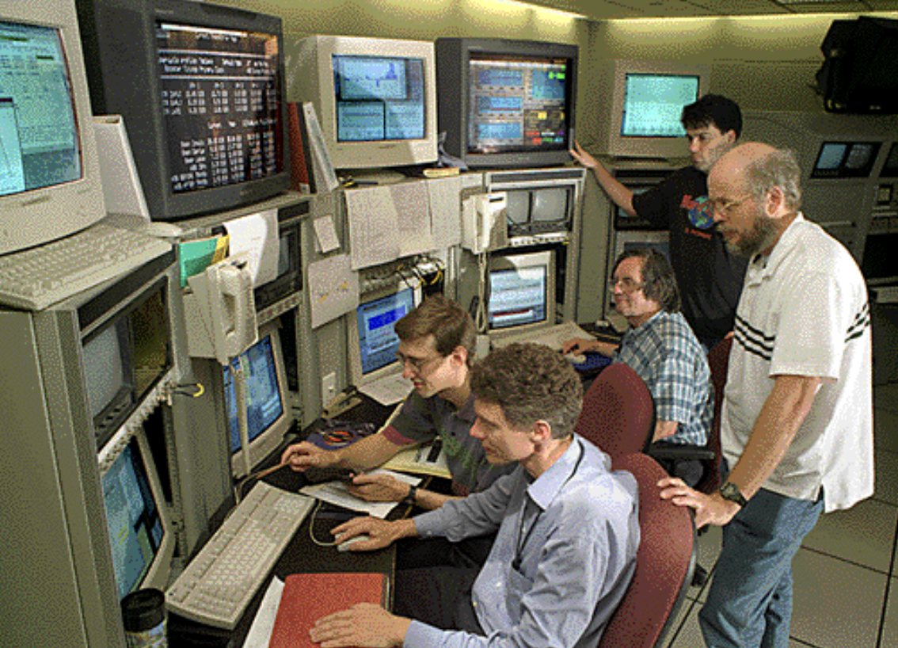
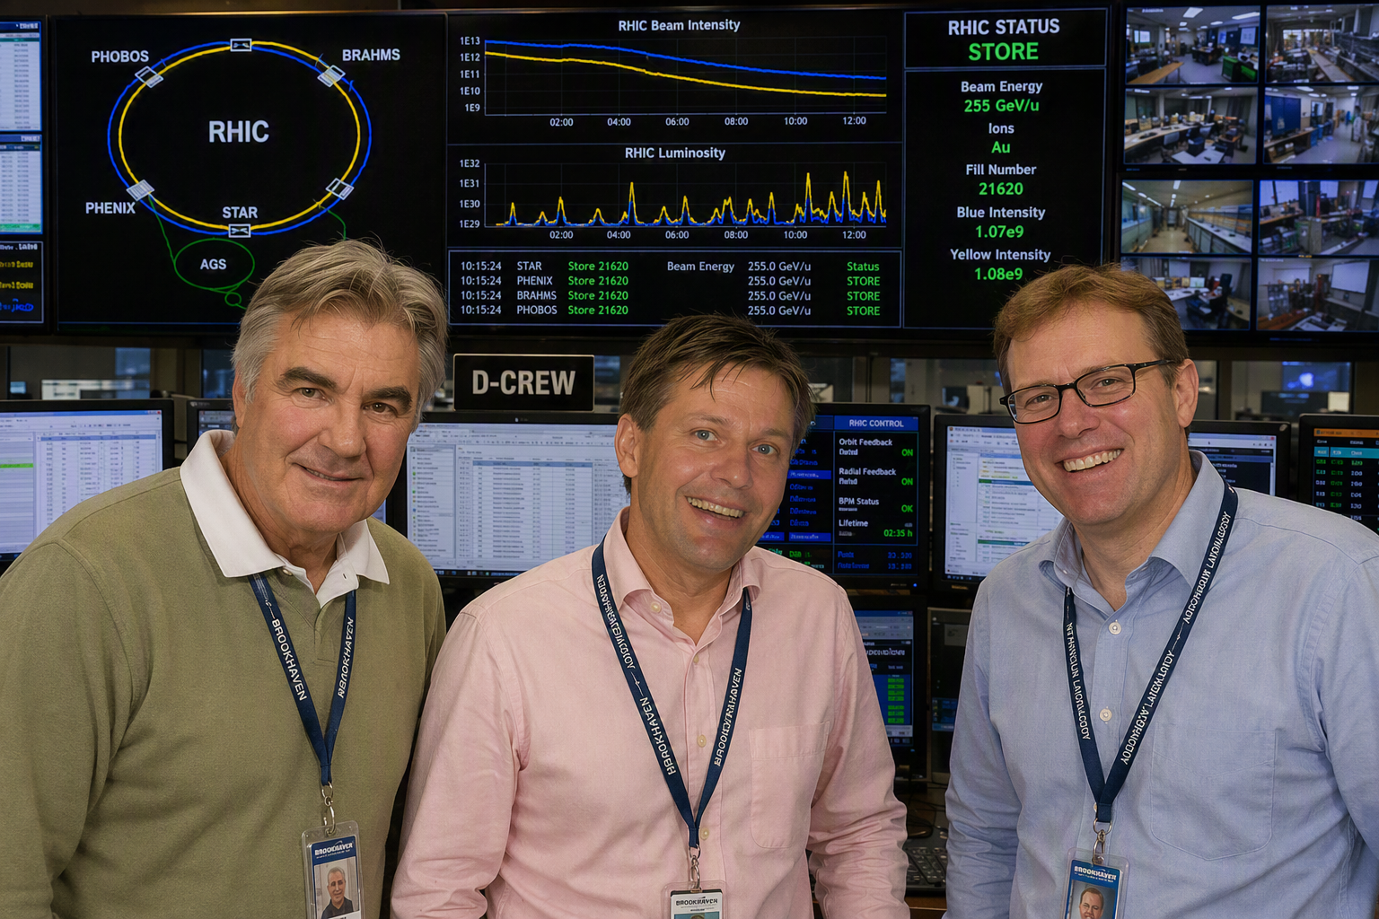
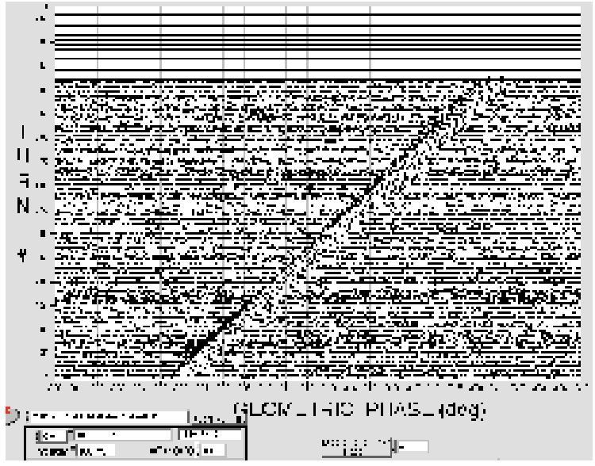
The start of commissioning: struggle to the circulating
A-crew perfected the match of injection and
D-crew instituted the local orbit bump
The first circulating in Blue Ring!
A-crew
D-crew
AI generated with public profile photos

Slide 6
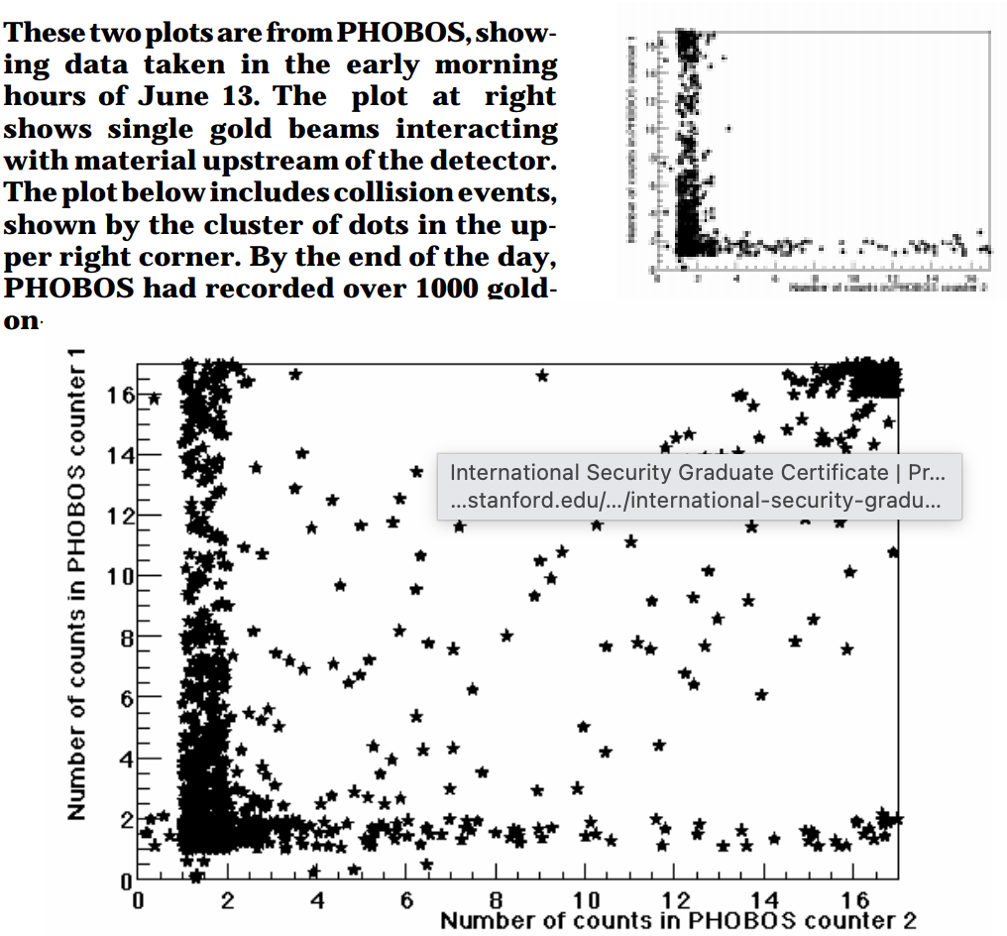
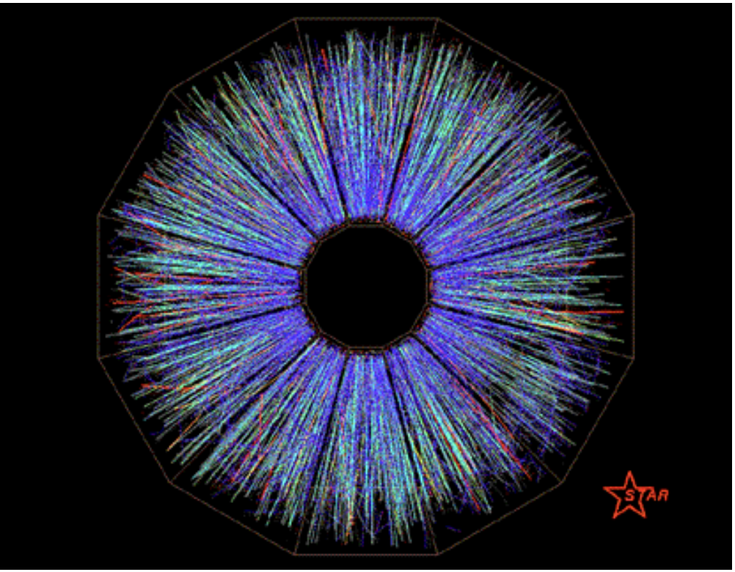
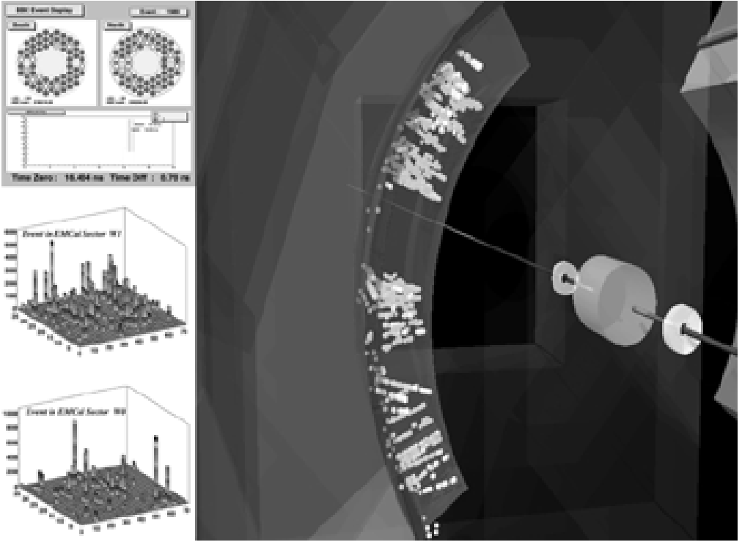
RHIC Begins the World’s Highest Energy Heavy-Ion Collisions
“We are crossing into a new frontier of scientific inquiry!”
The 1st collision: Monday night, June 12, 2000, at exactly 9:00 PM EDT
But getting there wasn't without struggles…
https://www.bnl.gov/bnlweb/pubaf/bulletin/files/2000/20000616.pdf
6

Slide 7
Beyond the First Collisions: Operational Hurdles
Besides the milestones of achieving first collisions, we also encountered and learned from the first set of beam-induced real magnet quenches
event | date | time | location (from mag voltage) | location (from loss monitor) | probable associated "operator" action
1 | 19Aug00 | 01.14.48 | B3QFQ2 | g3-lm1 b3-lm0 | "ramp2inj" "operator" error
2 | 27Aug00 | 23.04.10 | Y7QFQ3 | (no data) | corrector saturation program problem (Fulvia’s quench)
3 | 29Aug00 | 04.50.24 | B11QFQ2 | g11-lm1 | access to ring: no dump, rf off, PASS. Abort to quad \phi_x=4.75
4 | 30Aug00 | 08.41.51 | Y7QFQ3 | y7-lm3.1 y7-lm4 | corrector saturation program problem
5 | 3Sep00 | 00.15.47 | B3QFQ3 | b3-lm3 | (? blue snake at full power ?)
L. Ahrens, C-A/AP/31
Notes:
RHIC superconducting magnets are single layer coil

Slide 8
Beyond the First Collisions: Operational Hurdles
Lessons learned:
Protection against de-bunching: Loss of all RF cavities must trigger an immediate pulling of the permit link.
Abort Gap Management: Strict beam management inside the abort gap is required to maintain a safe operating margin.
BLM Threshold Optimization: Beam Loss Monitor (BLM) thresholds must be carefully balanced to prevent frequent beam aborts while still protecting against magnet quenches.
Desired Diagnostics: dedicated magnet quench flag, alongside closed-orbit and intensity logging for the final second before an event.
turn event | quench link pulled | intensity ions (×10¹⁰) blue | intensity ions (×10¹⁰) yellow | quench channel | quench/permit ado
1 | blue | 1.00 | 0.75 | 4b-qd1 | 4b-time.A
2 | yellow | 1.40 | 0.80 | 8b-ad2 | 8b-ps1
3 | blue | 1.90 | 0.00 | 12a-ad1 | 12a-ps1.A
4 | yellow | 1.10 | 1.10 | 8b-ad2 | 8b-ps1
5 | blue | 1.30 | 1.30 | 4b-ad1 | 4b-time.A
L. Ahrens, C-A/AP/31
Notes:
RHIC superconducting magnets are single layer coil

Slide 9
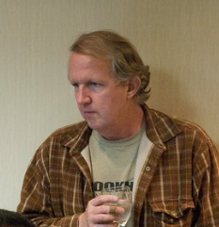
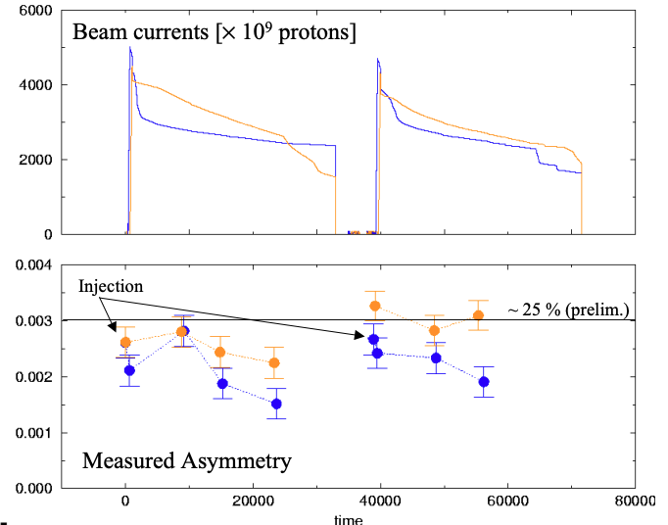
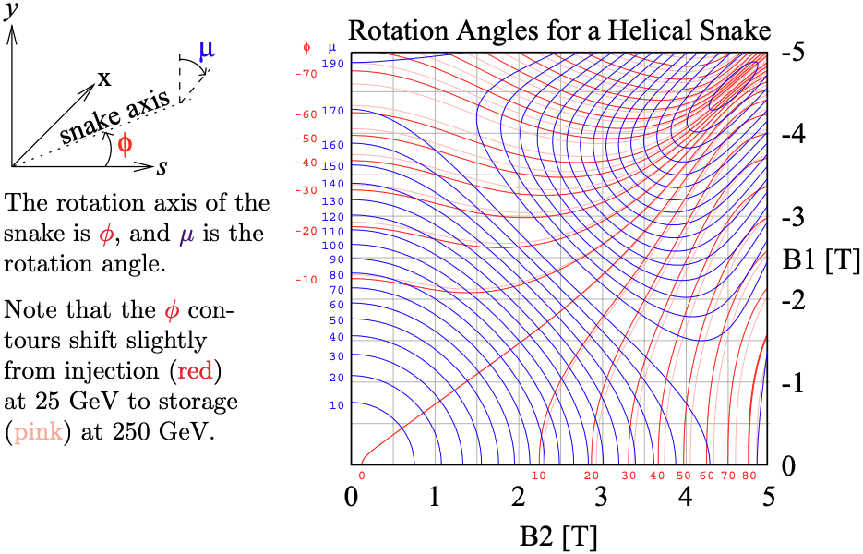
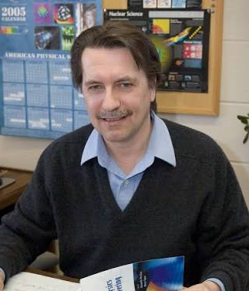
The Start of Spin Era
The first pp collision
The delicacy of RHIC Helical Snakes

Slide 10
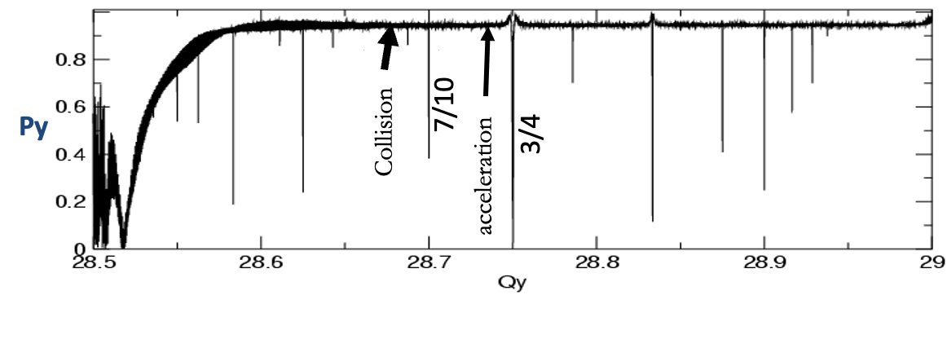
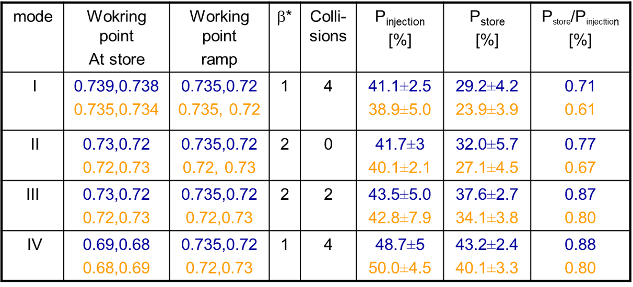
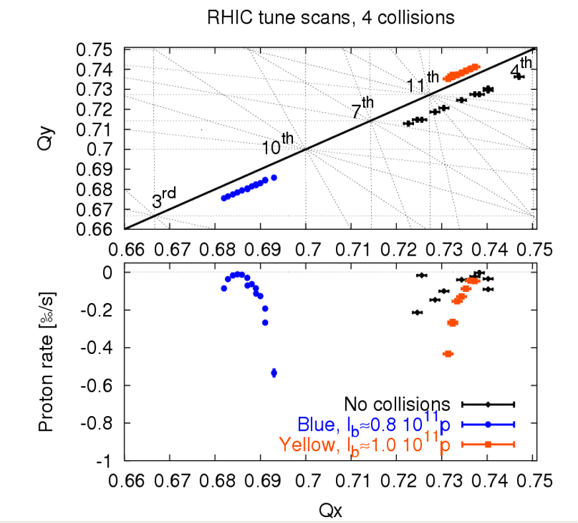
The polarized proton: duck-down to avoid depolarization!
PP working point development 2004
Clearly shows the benefit of store working point below 7/10 resonance
good for Beam lifetime,
but bad for polarization

Slide 11
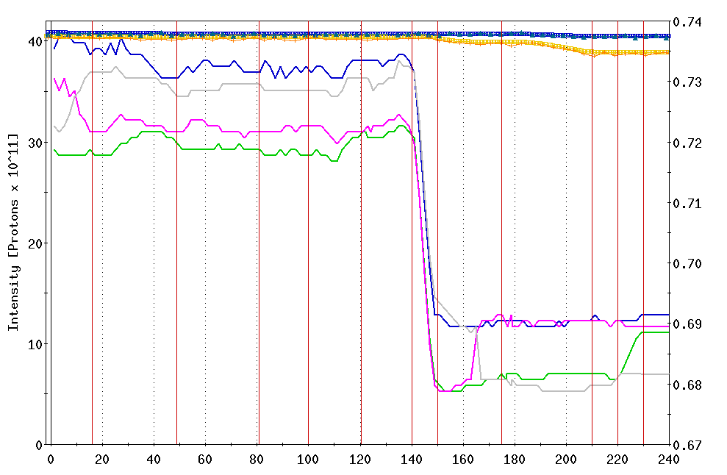
The polarized proton: duck-down to avoid depolarization!
PP 2004
Yellow tunes
Blue tunes
No beam loss while crossing
7th order resonance at 0.717
Measured betatron tune
Other than the desired tune
swing from (0.72,0.73) to
(0.68,0.69), No significant
tunes variations along the ramp
flattop
β*=2m
β*=1m
Time from the beginning of the ramp [s]

Slide 12
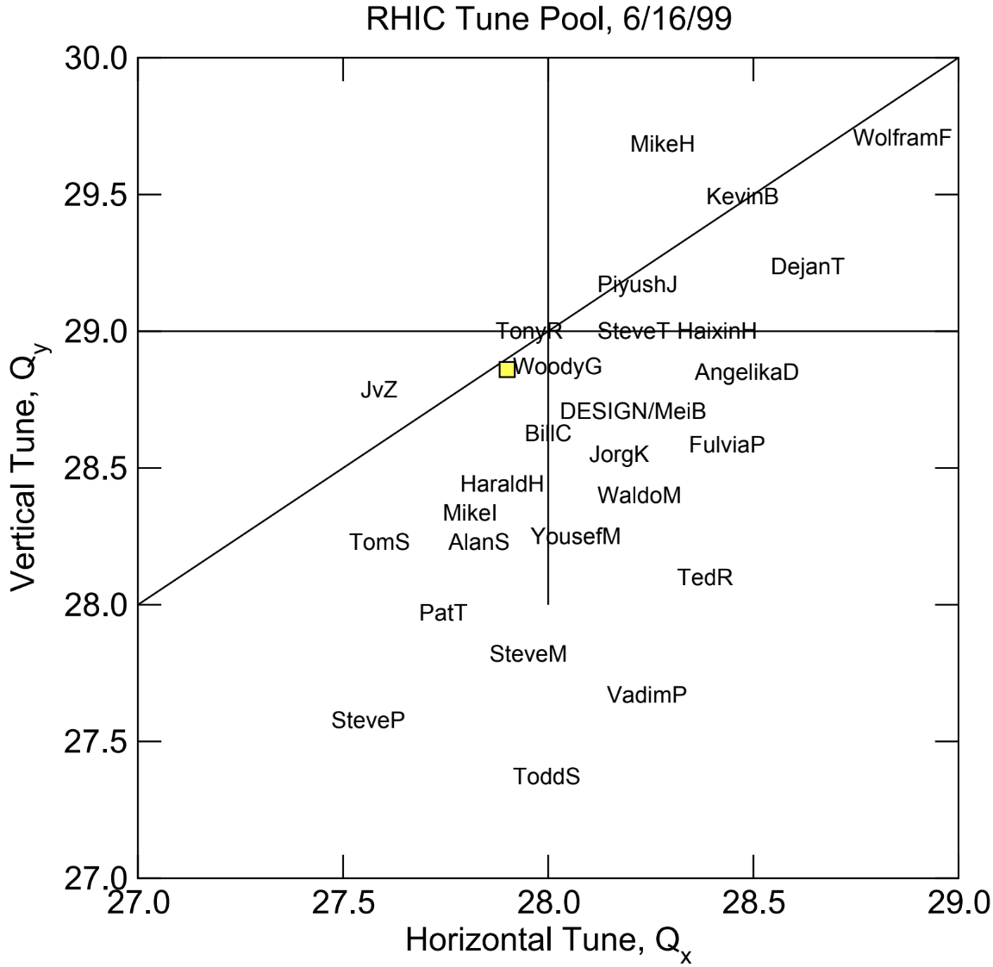
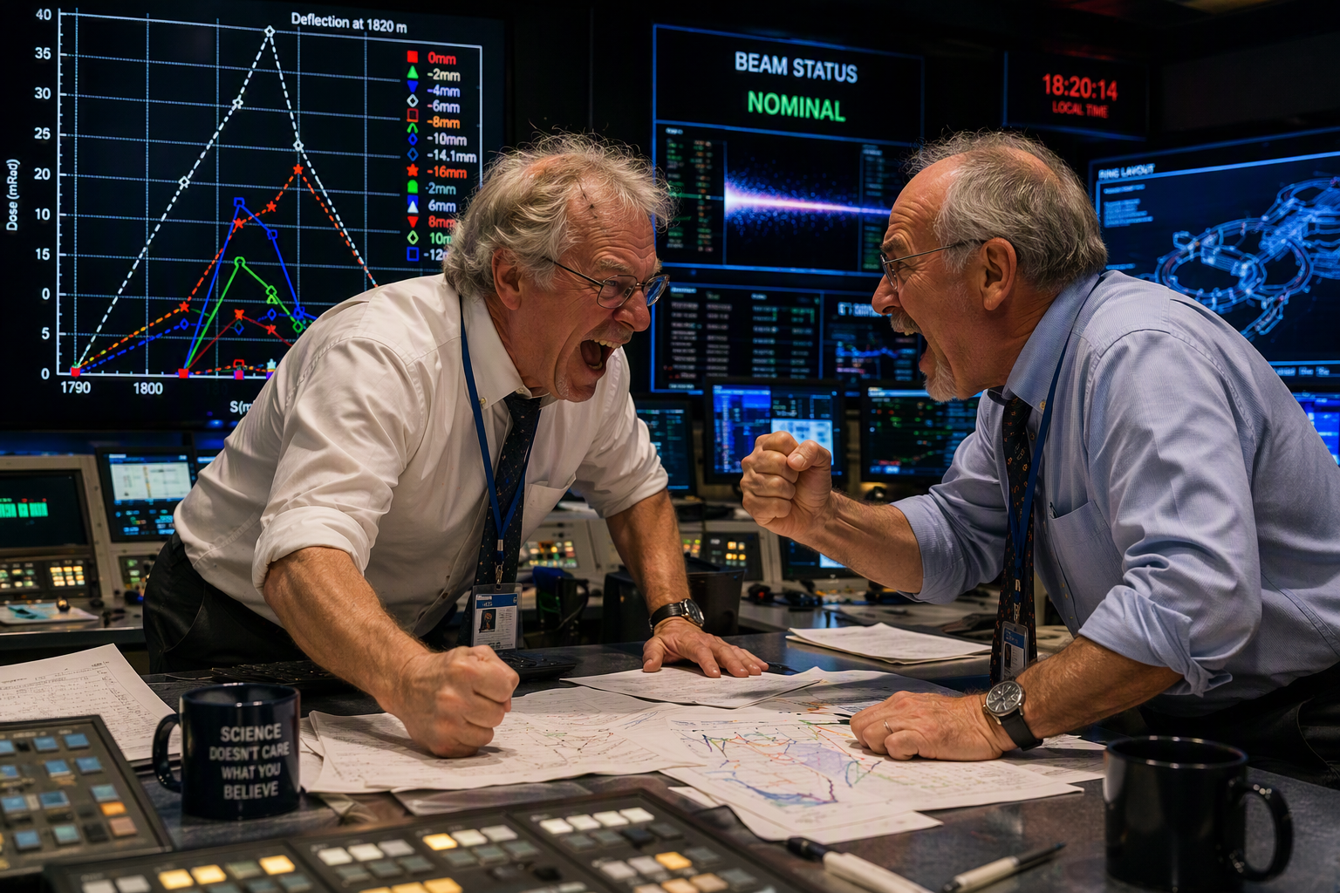
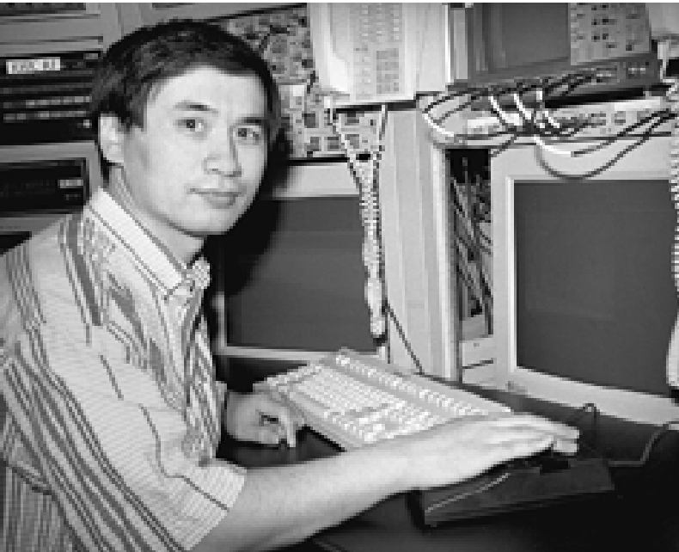
Those memorable moments
One of the many tense and exciting moments in MCR!
Place the right bet!
The winner!
AI generated

Slide 13
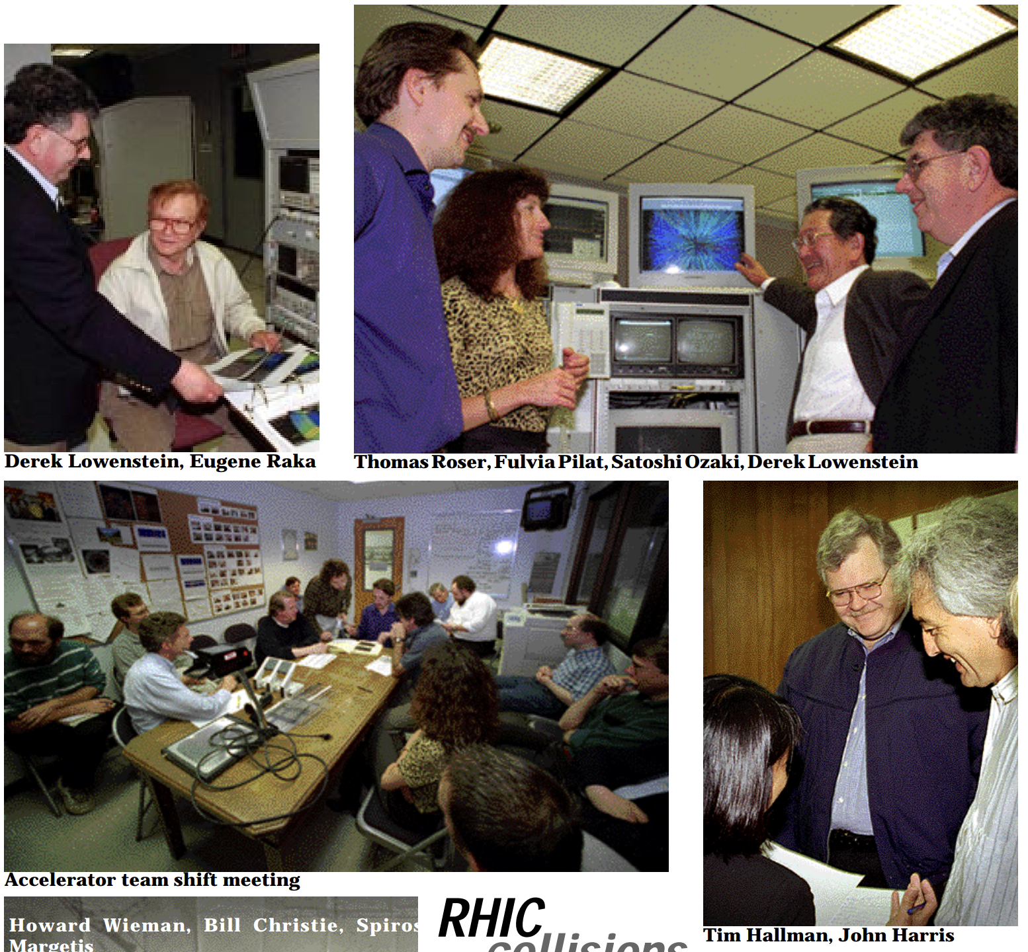
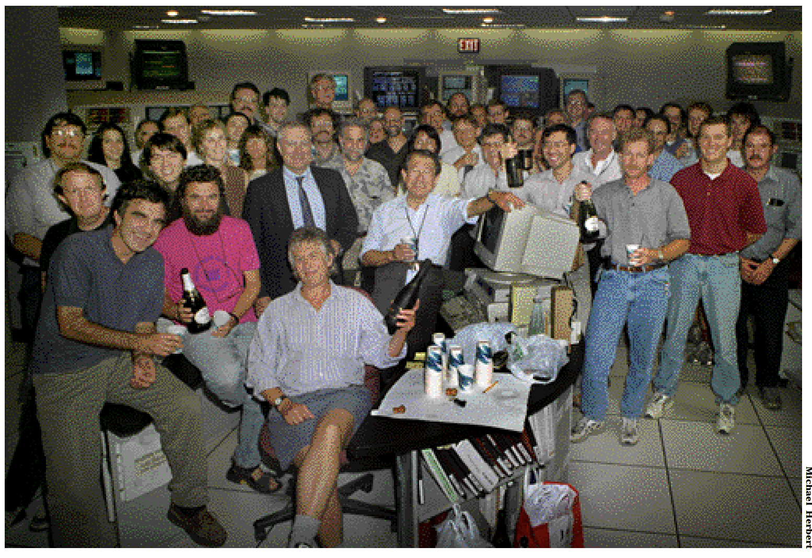
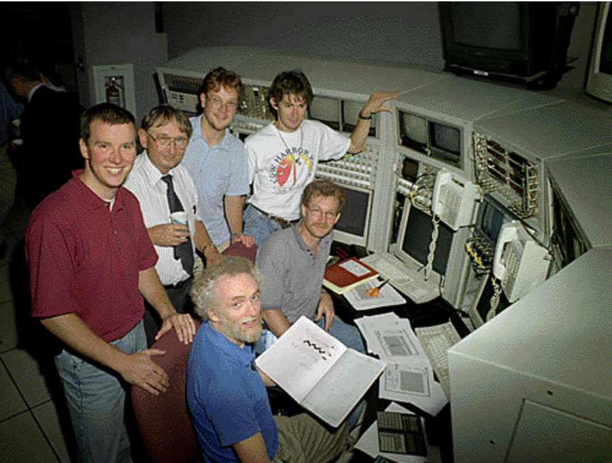
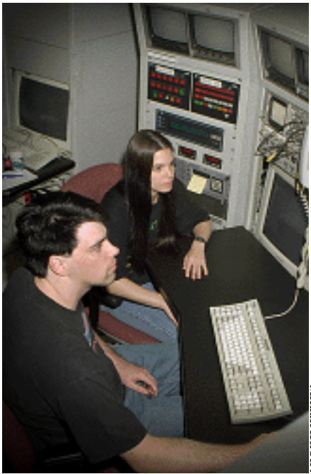
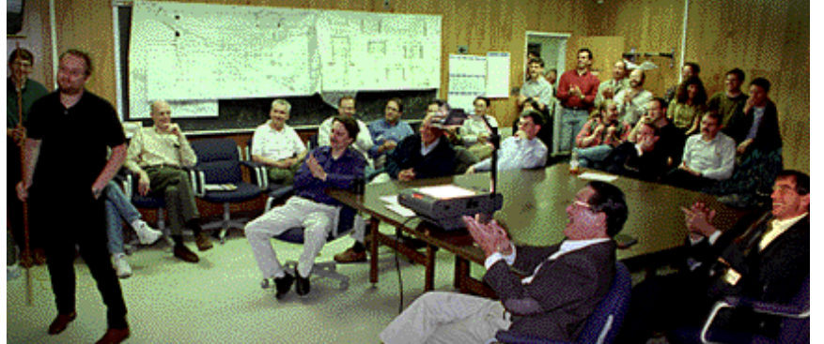
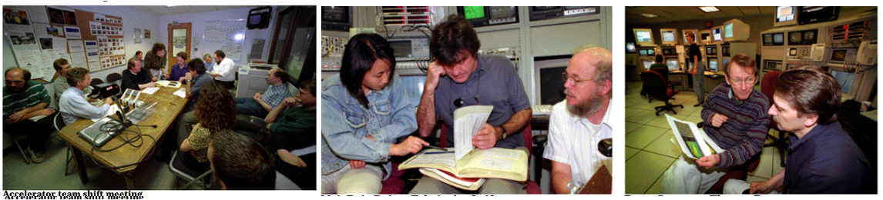
The amazing team

