Slide 1
First Orbit, First Collisions
Reminiscences of RHIC Construction and Commissioning
Summary Template
from RHIC Retreat 2003
Biased: Gleaned from presentations/discussions
(Only occasional shouting)
Diverse: Vibrant discussions throughout Retreat
  Future: Count 5 minutes/talk for discussions
  Impressive preparation so close to run end!
Brief: 30 minutes to cover 2.5 days (plus!)
Written summary necessary: Mid-July?
(Serves me right for using PowerPoint…)
Summary First Page
from RHIC Retreat 2003

Slide 2
First Orbit, First Collisions
Reminiscences of RHIC Construction and Commissioning
Summary Template
from RHIC Retreat 2003
Biased: Gleaned from memories, photos, internet
(Only occasional shouting)
Diverse: Vibrant company throughout RHICFest
  Future: Count 7-ish years for first EIC collisions
  Impressive preparation so close to RHIC end!
Brief: 15 minutes to cover years and years
Written summary necessary: Book/movie deal?
(Serves me right for using PowerPoint…)
Still true
Updated for RHICFest!!
Still true

Slide 3
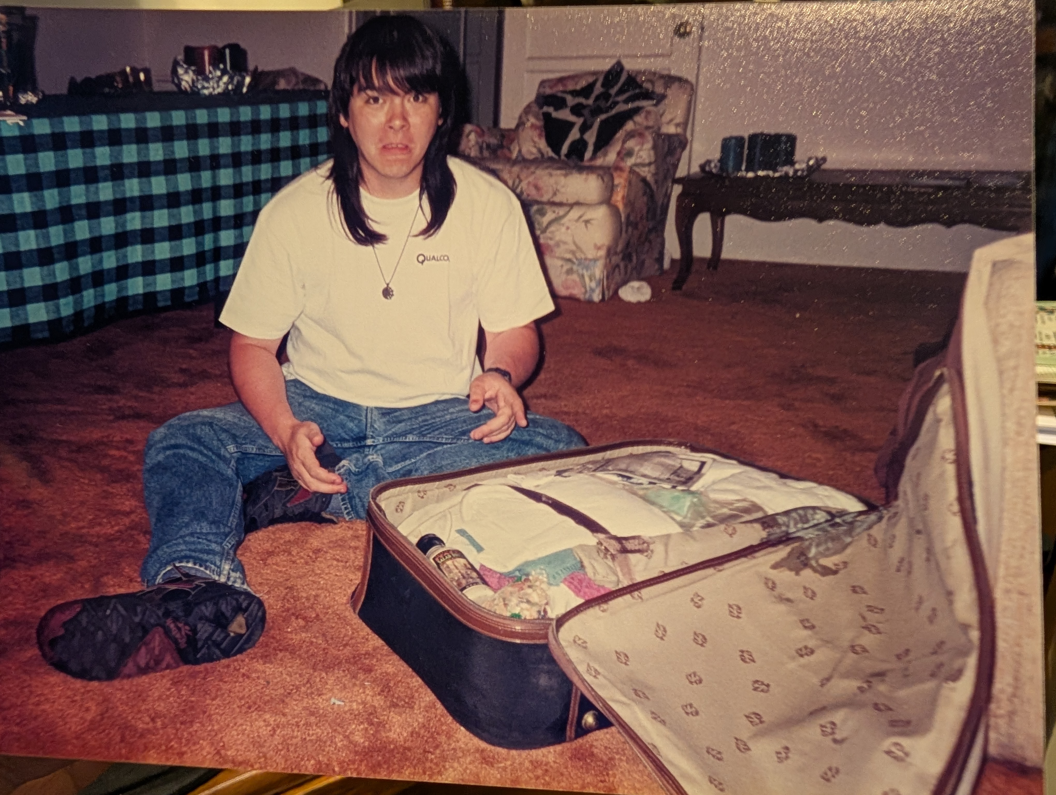
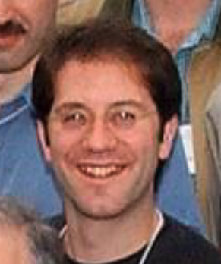
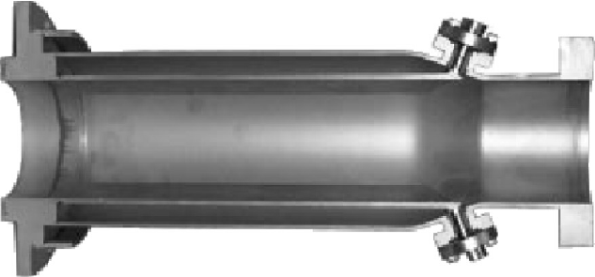
Coming to BNL in 1993
Todd’s feeling
unpacking at
BNL
No pics of 1005 (not photogenic)
But memories!
Tom
Shea
Followed Peggs, Trbojevic, Harrison from FNAL
RHIC BPMs and orbits became
a big part of my life for the next
dozen years...

Slide 4
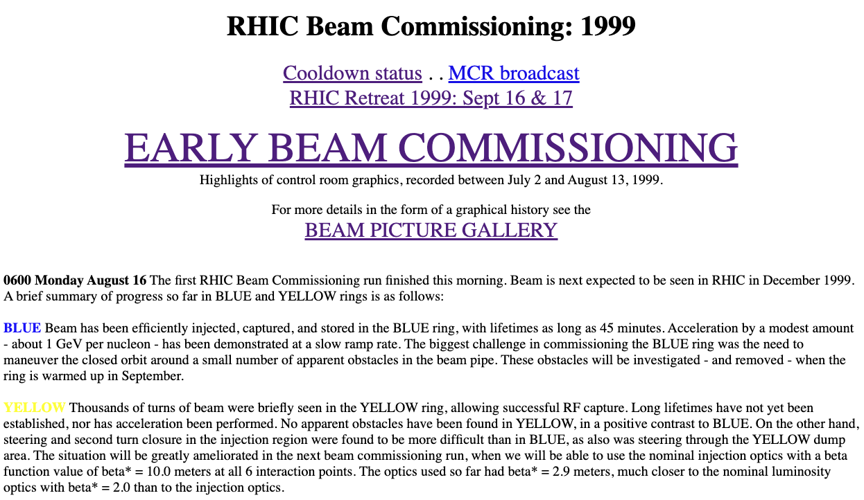
Tonight We’re Gonna Party Like It’s...
https://web.archive.org/web/20020716074910/http://www.agsrhichome.bnl.gov/RHIC/YearZero/

Slide 5
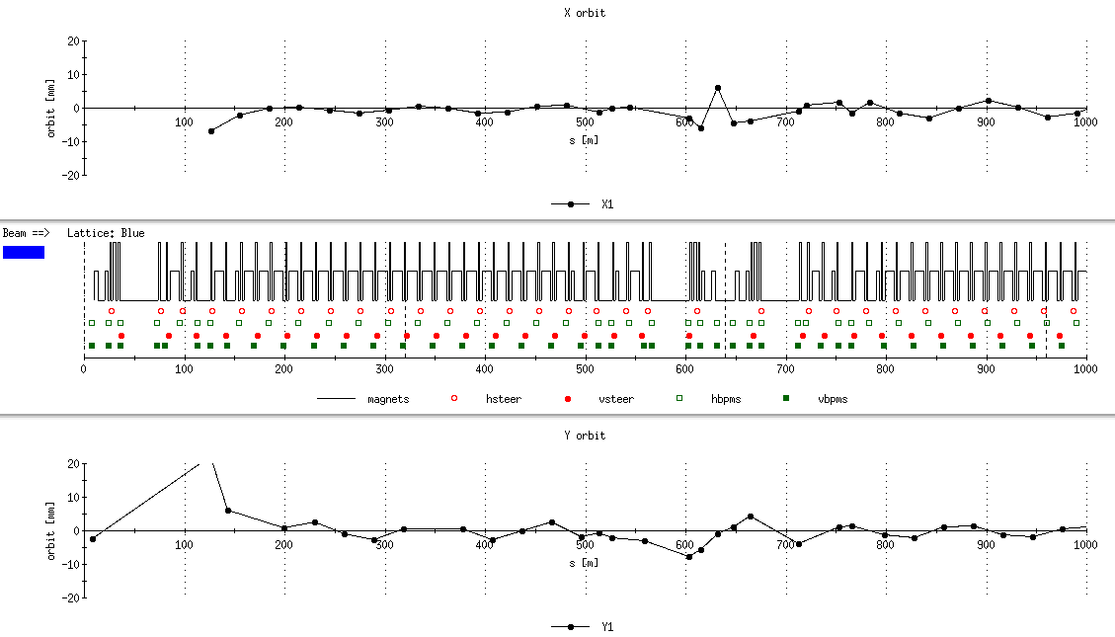
First Orbit... Dispersive Beam Motion
injection lambertson
Beam injected on 4th turn of 1024-turn BPM buffer

Slide 6
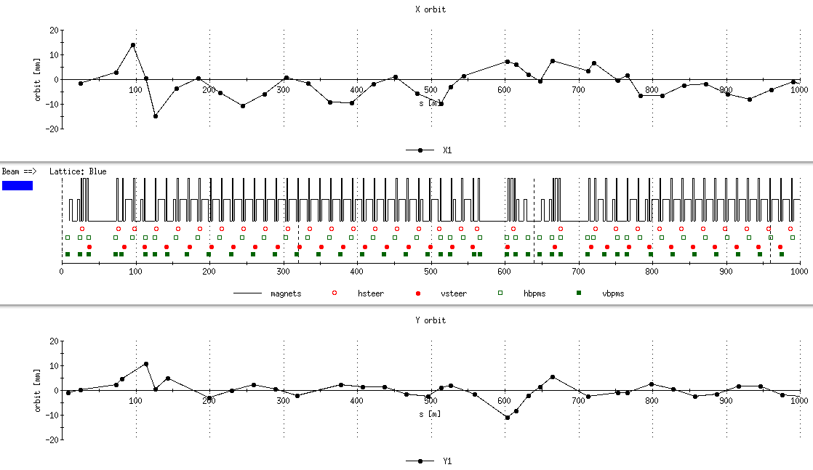
First Orbit...

Slide 7
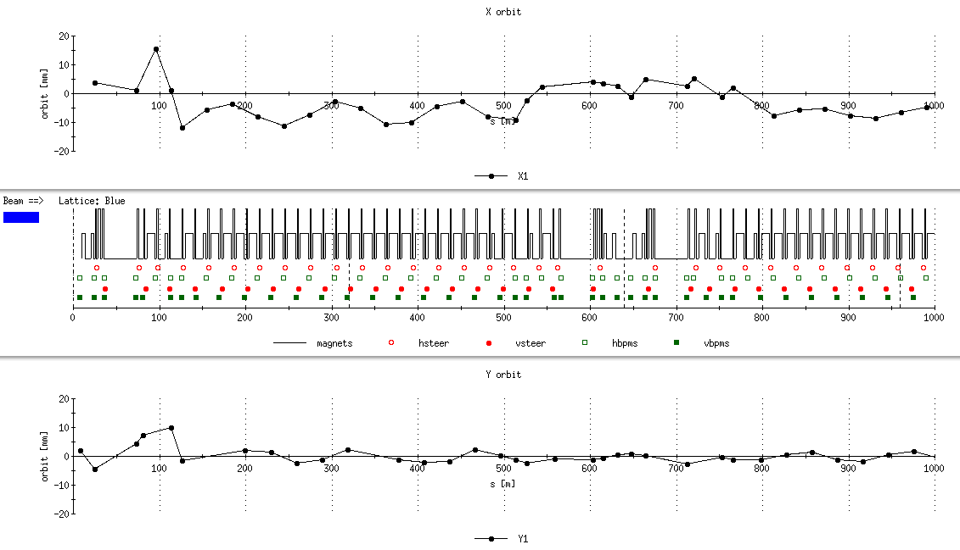
First Orbit...

Slide 8
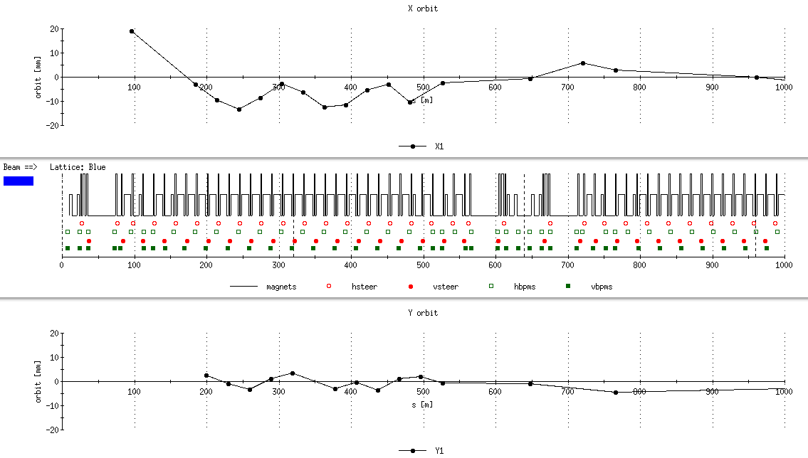
First Orbit... ? Four turns
Horizontal dispersive motion: energy-loss obstructions (kinked bellows)

Slide 9
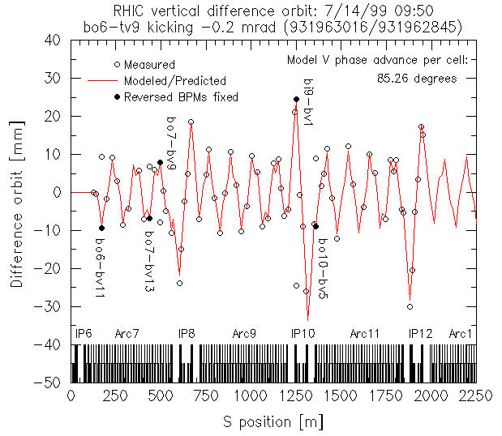
Reversed BPMS, (mostly) Good Optics
Integer
tune
correct!

Slide 10
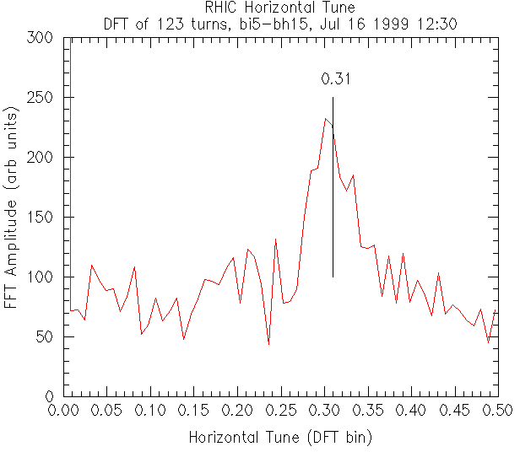
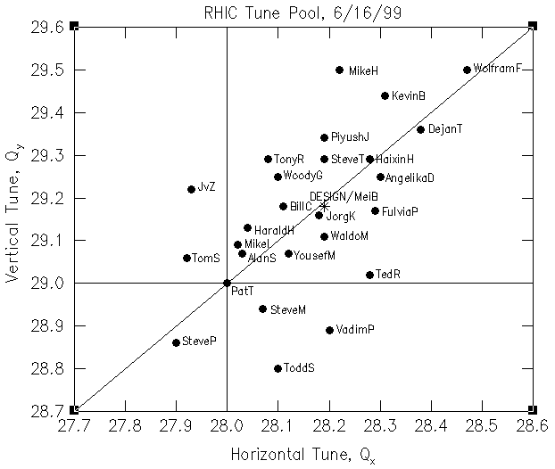
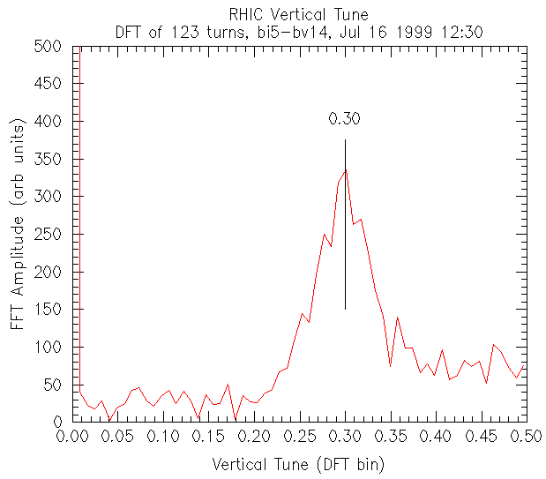
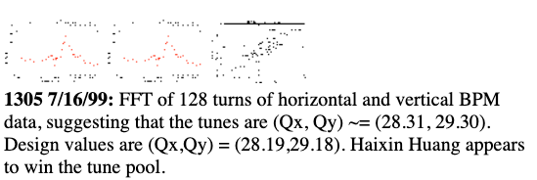
The Tune Pool

Slide 11
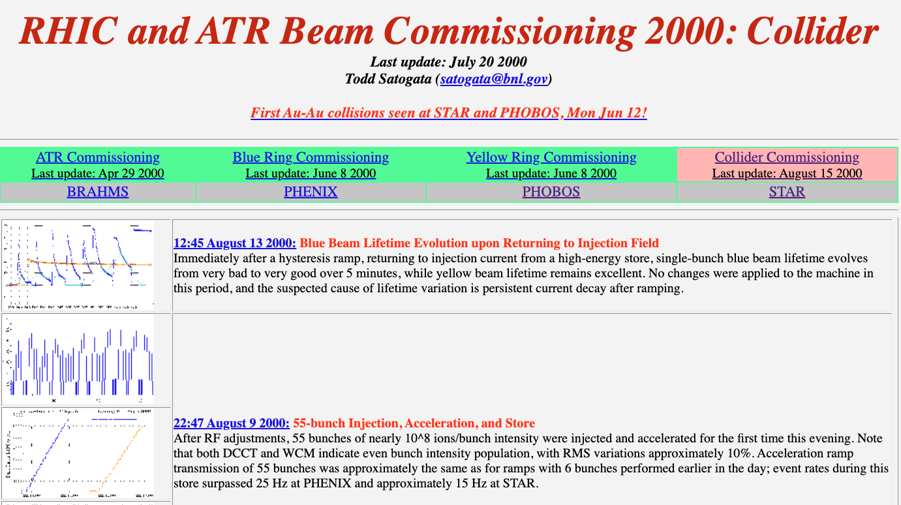
First Collisions

Slide 12
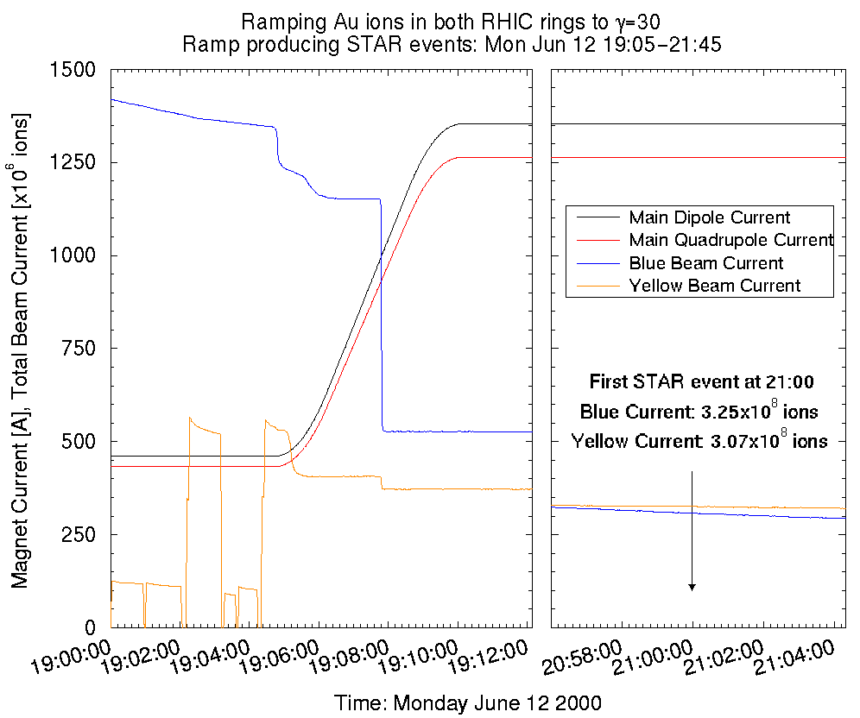
First Collisions (press release)

Slide 13
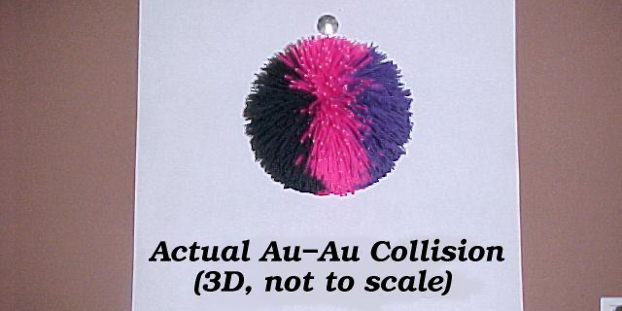
The Best RHIC Collision Scale Model
Often used as a visual aid in RHIC Summer Sundays and other tours

Slide 14
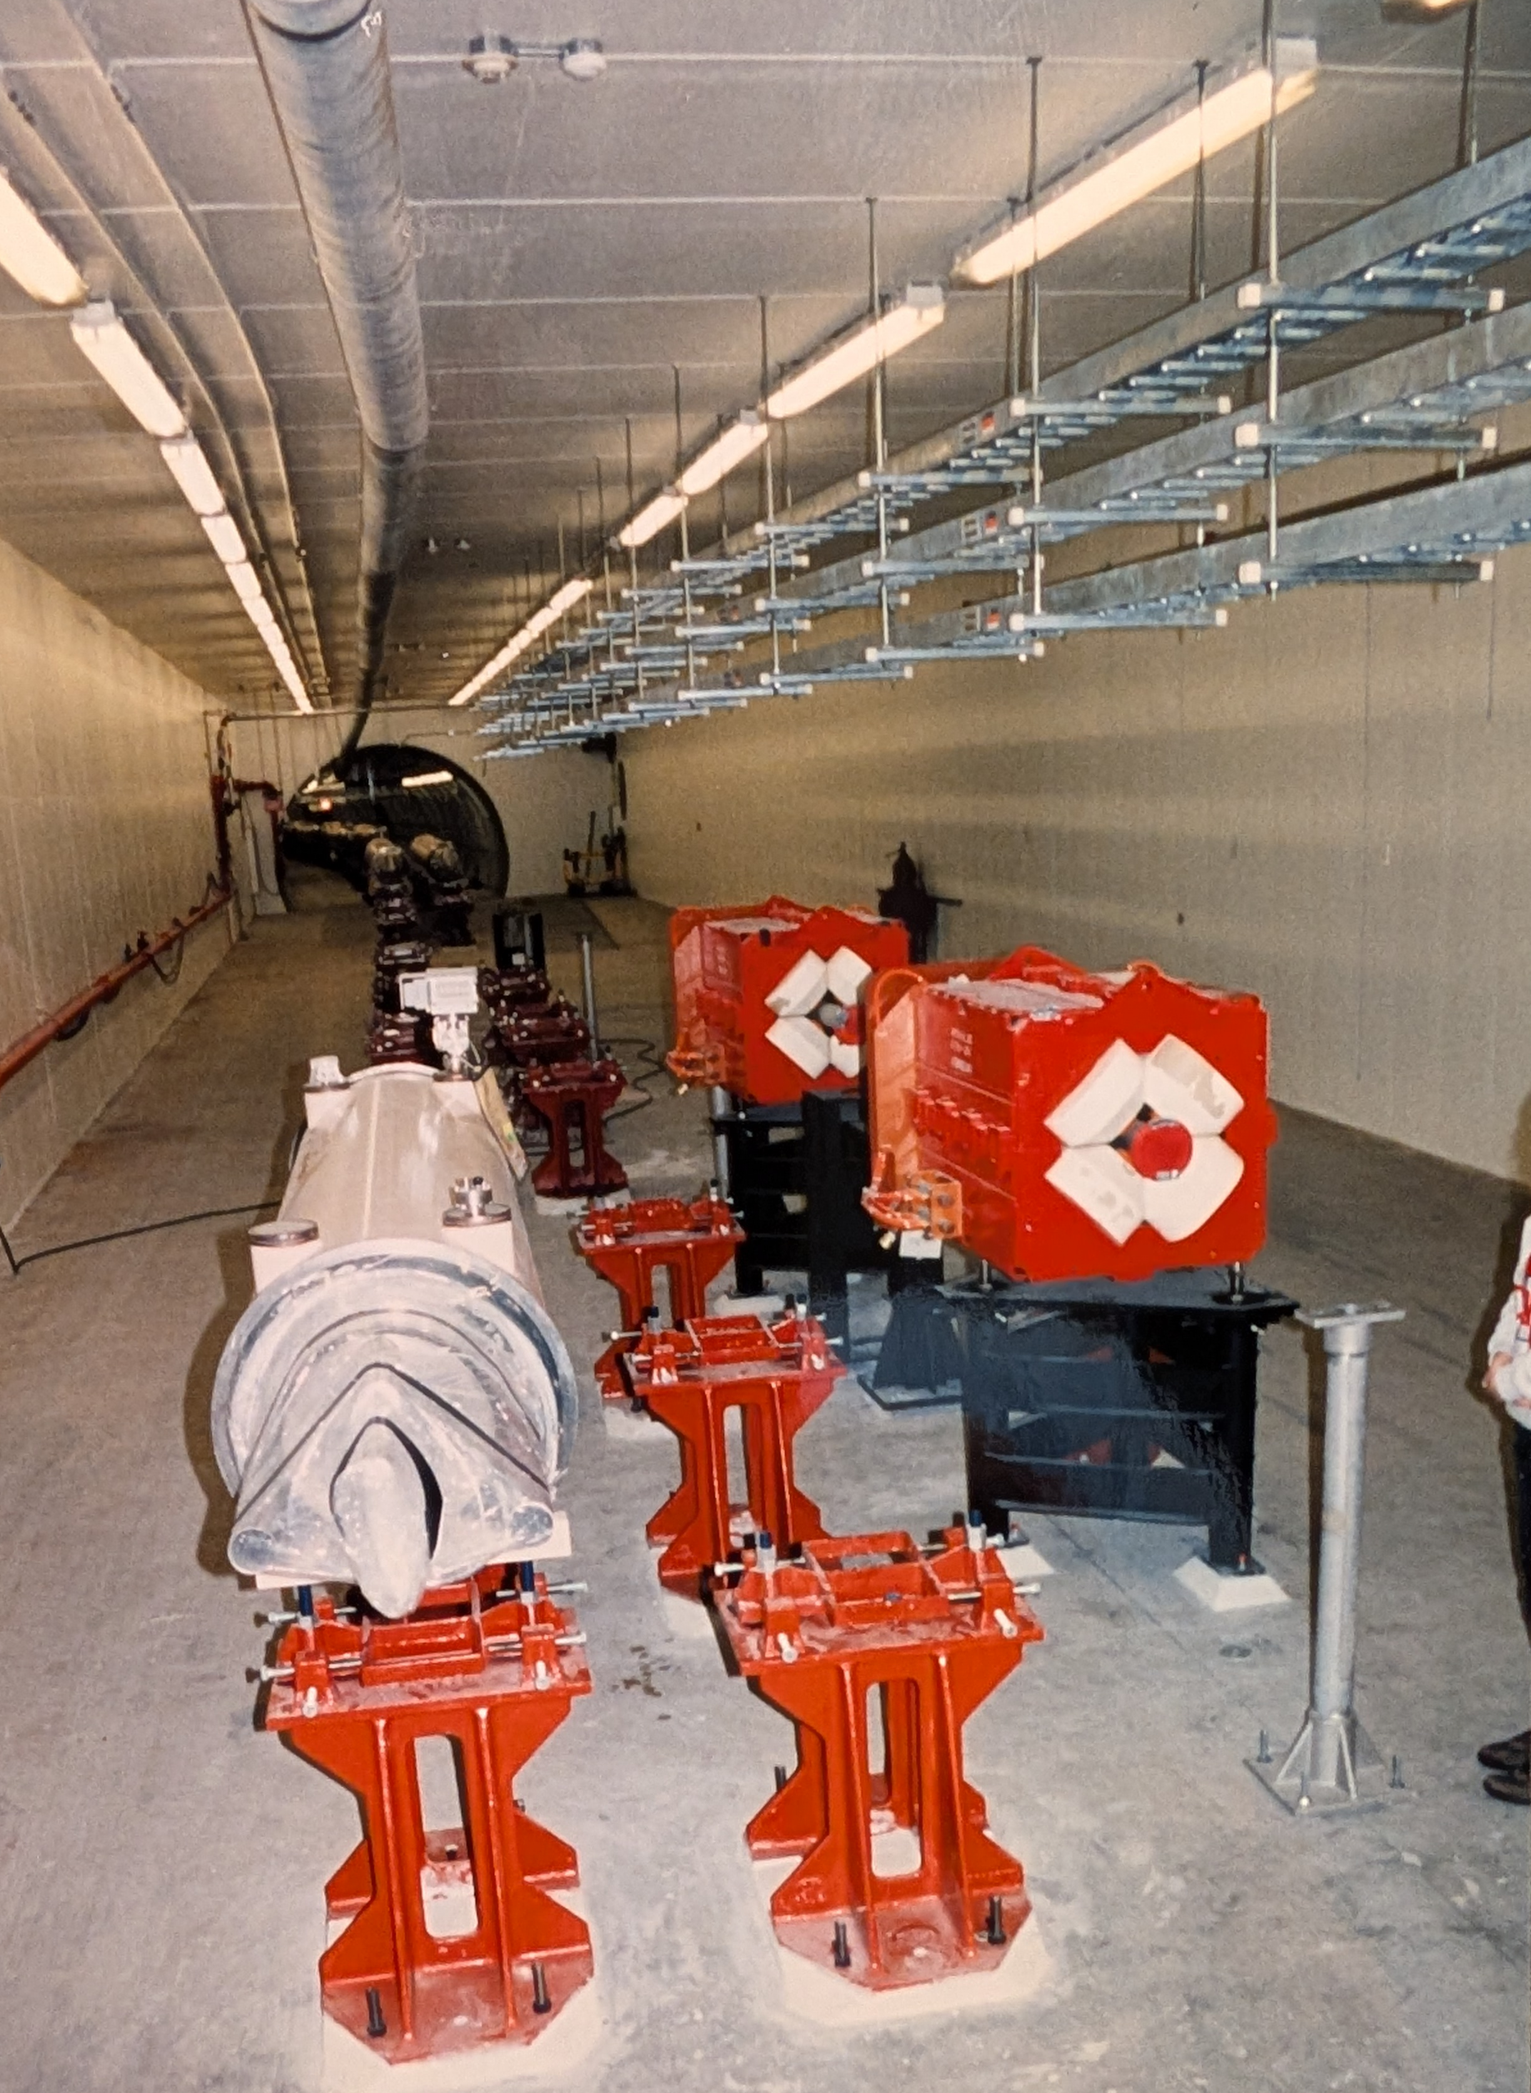

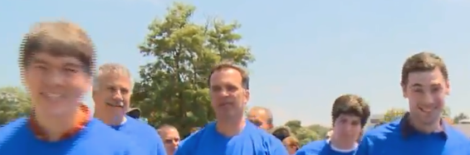
Assorted Undocumented Memories
Rollerblading in tunnel
The Peter Paul Meeting
Fridge contamination; “pretty” He venting
PASS gate races
”Best ramp eeeeever!”
  and “@#*$@#’ $*@&!”
RAP “zoo” (FNAL cartoons, SSC trees)
2-page tech notes
The lure of Big Quant $$
  Mark Rhodes-Brown and Renaissance
Collide The Ions walk

Slide 15
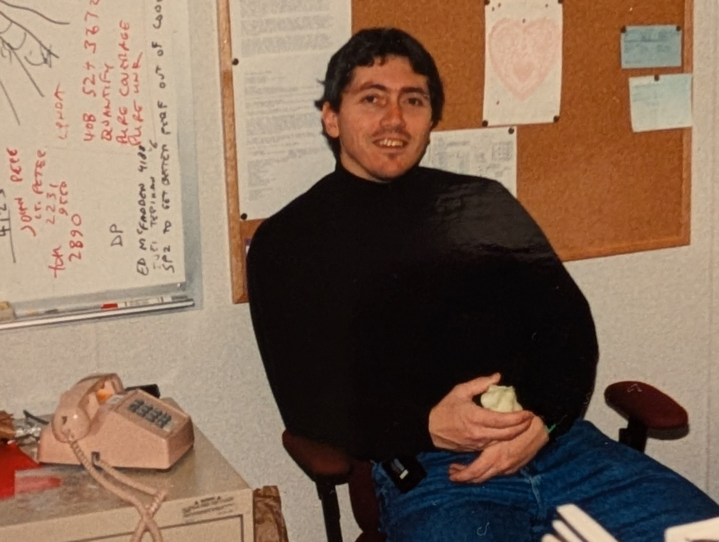
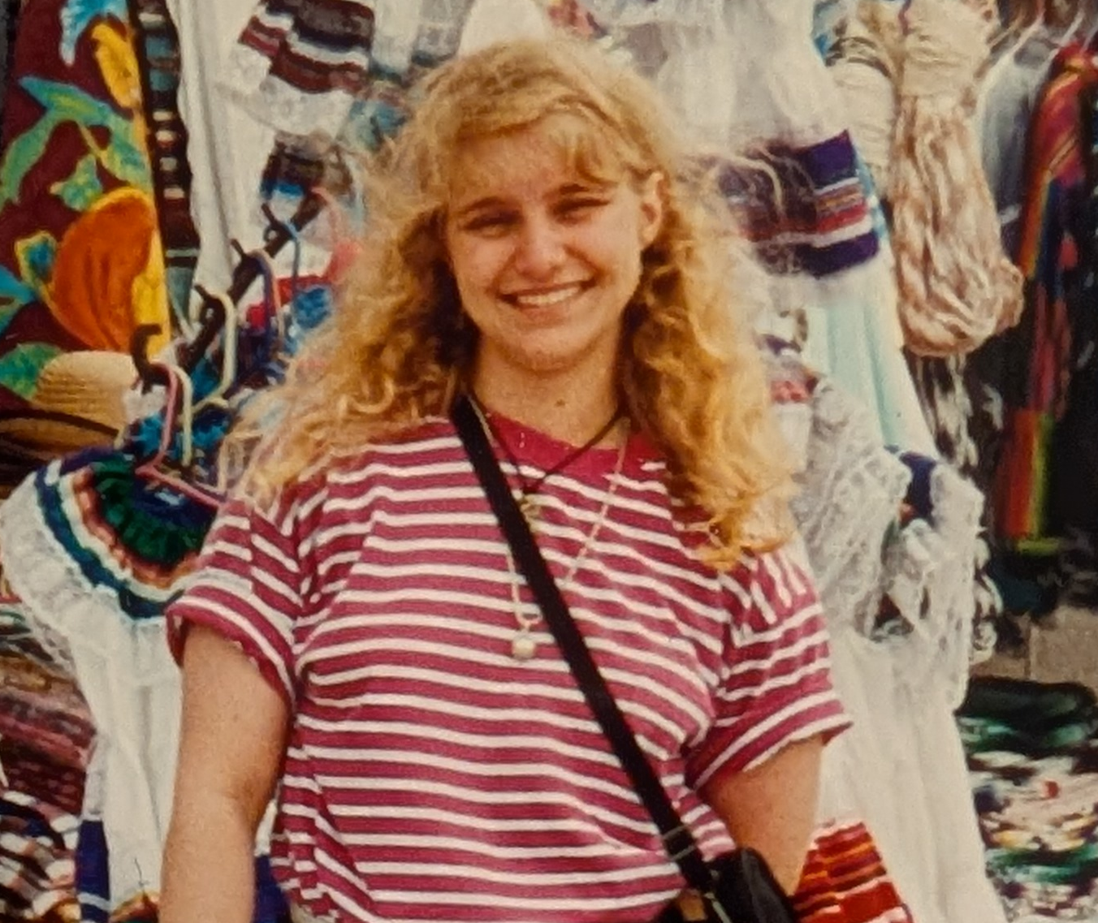

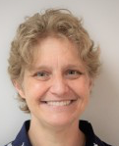
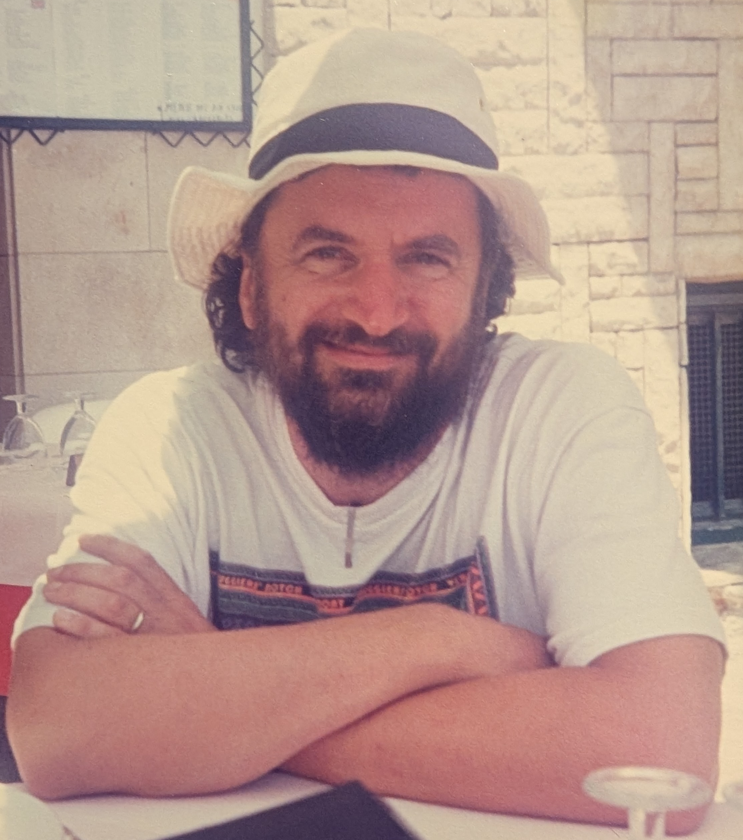
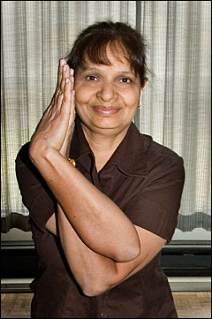
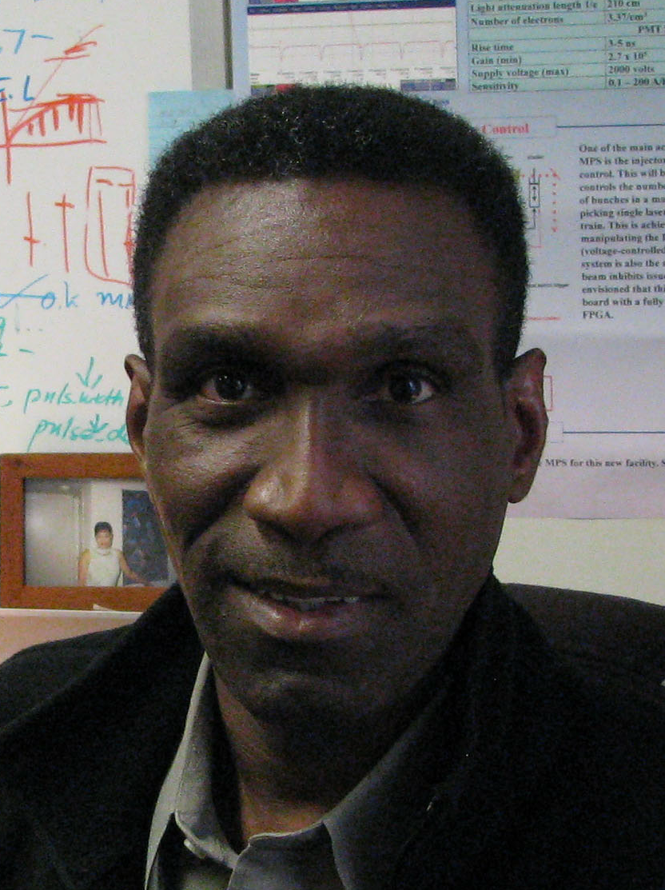
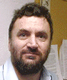
Assorted Documented Friends
Rich
Casella
Betsy
Scholl
Rhianna
Bianco
Ila
Campbell
Arden
Warner

Slide 16
In Case There’s Time

Slide 17
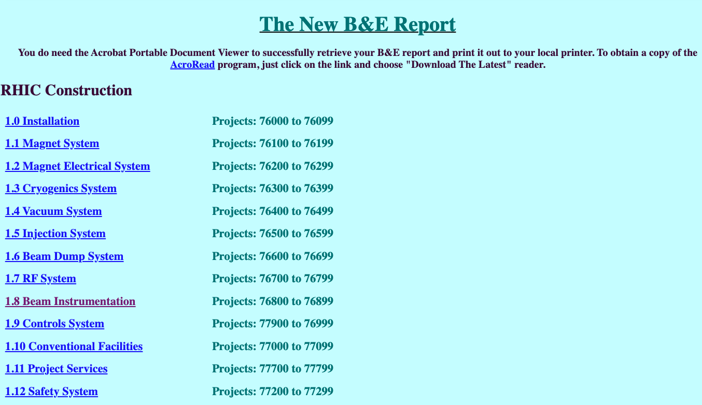
It’s Amazing What We Kept In The Open (1)

Slide 18
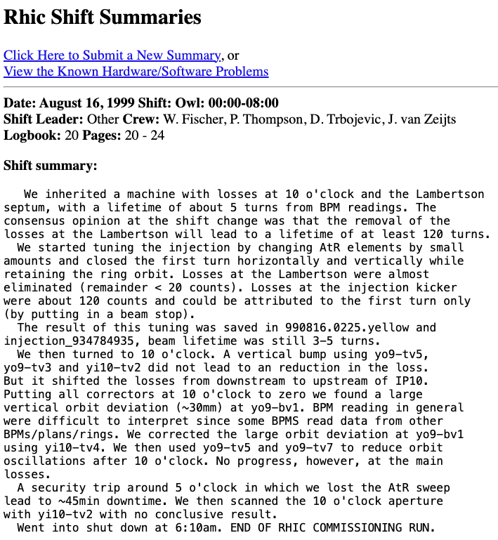
It’s Amazing What We Kept In The Open (2)

