Slide 1
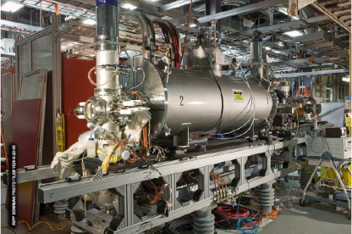
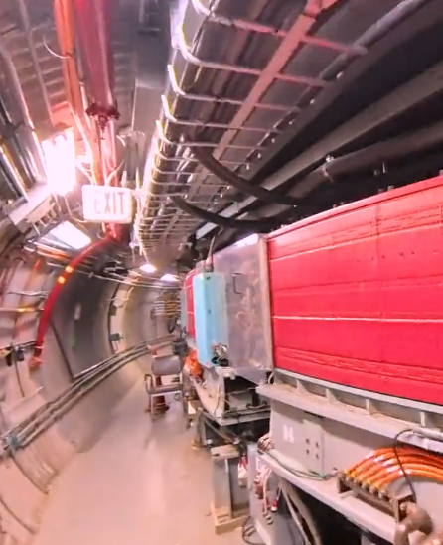
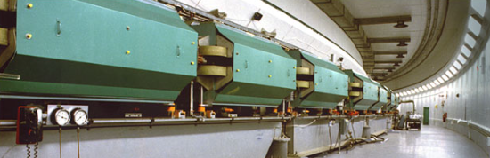
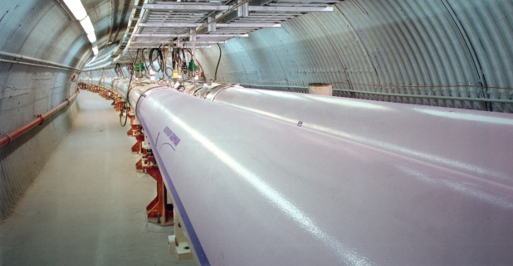
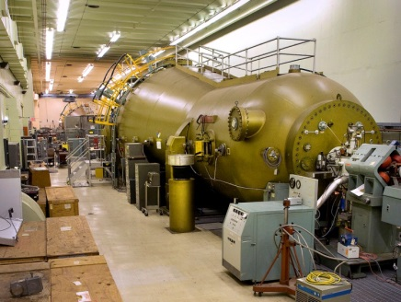
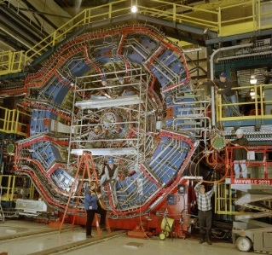
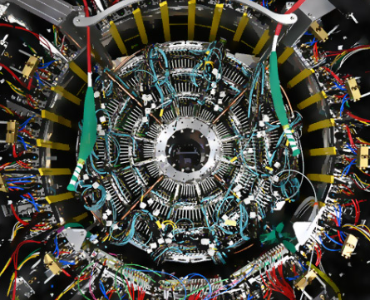
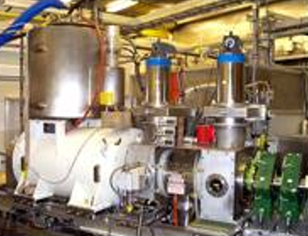
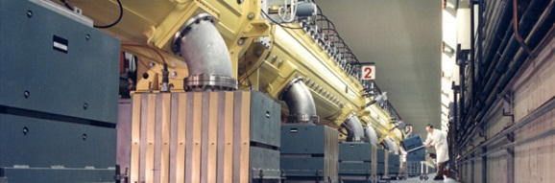
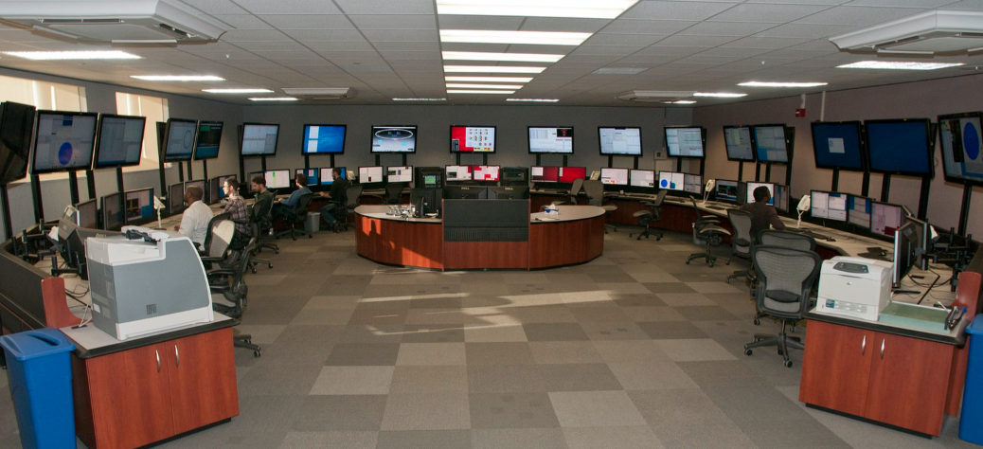
RHIC Celebration
Operational Performance and
Reflections on Recent Developments
Performance over the Past 25 Years
Advances in Accelerator Science
Further Optimizations
Some Lessons Learned
Recent RHIC Runs
Performance Summary and Legacy
Michiko Minty
10 July 2026

Slide 2
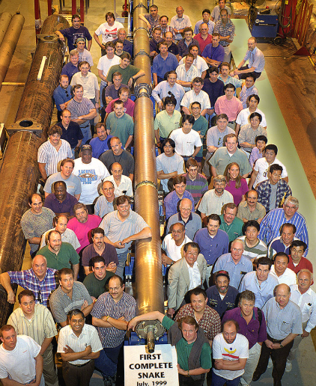

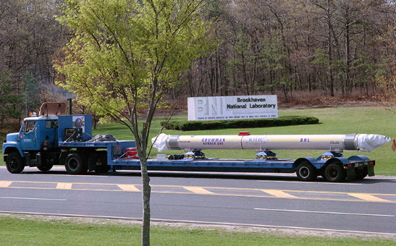

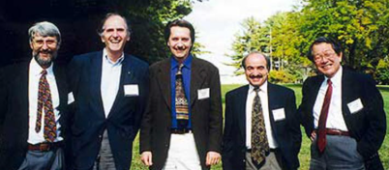
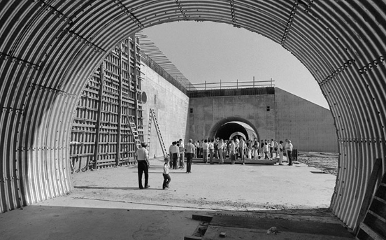
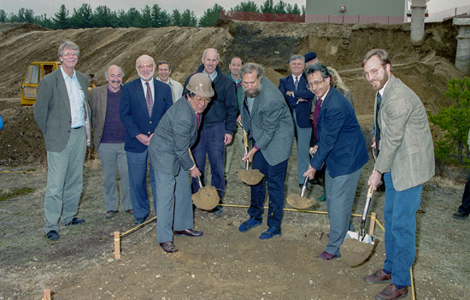
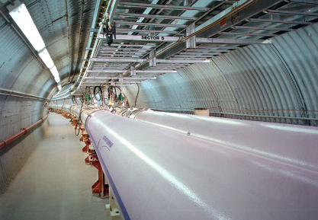
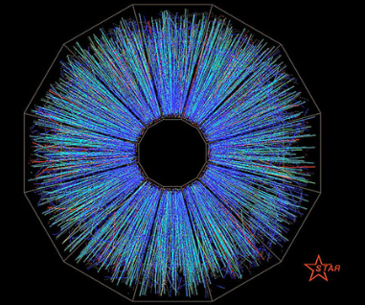
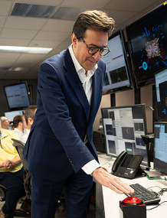
Timeline recap
collider installation begins
first Siberian
snake magnet
RHIC dedication ceremony
first p↑+p↑
collisions
1991
1995
2000
2026
1994
1999
2001
start of RHIC
construction
groundbreaking
for STAR
SC magnet
cold
first Au+Au
collisions
RHIC operations
conclude
RHIC Celebration 9-10 July 2025, M. Minty
Notes:
2000 – honorable DOE Secretary of Energy Bill Richardson
2026 – honorable DOE Secretary of Energy Chris Wright

Slide 3
Performance over the past 25 years
RHIC Celebration 9-10 July 2025, M. Minty

Slide 4

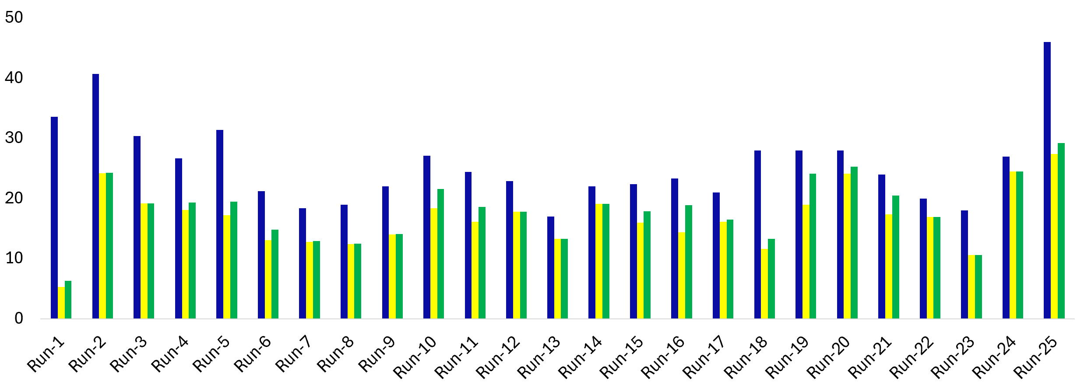
A quarter-century of collisions at RHIC
(milestones and new capabilities in bold blue)
BES-I, Au+Au
(diverse energies)
100 GeV p↑+p↑
100 GeV p↑+Au
100 GeV p↑+Al
commissioning
100 GeV Au+Au
100 GeV Cu+Cu
100 GeV p↑+p↑
200 GeV p↑+p↑
100 GeV d+Au
100 GeV p↑+p↑
250 GeV p↑+p↑
100 GeV h+Au
100 GeV Zr+Zr / Ru+Ru
250 GeV p↑+p↑
250 GeV p↑+p↑
100 GeV Au+Au
100 GeV Au+Au
100 GeV p↑+p↑
250 GeV p↑+p↑
100 GeV Au+Au
d+Au (diverse energies)
BES-II,Au+Au
(diverse energies) 100 GeV O+O
sPHENIX era
100 GeV Au+Au
100 GeV p↑+p↑
+ BES cont’d
+ 100 GeV O+O
100 GeV p↑+p↑
100 GeV d+Au
100 GeV p↑+p↑
250 GeV p↑+p↑
100 GeV p↑+p↑
250 GeV p↑+p↑
100 GeV p↑+p↑
100 GeV U+U
100 GeV Cu+Au
100 GeV Au+Au
100 GeV p↑+p↑
RHIC Celebration 9-10 July 2025, M. Minty

Slide 5
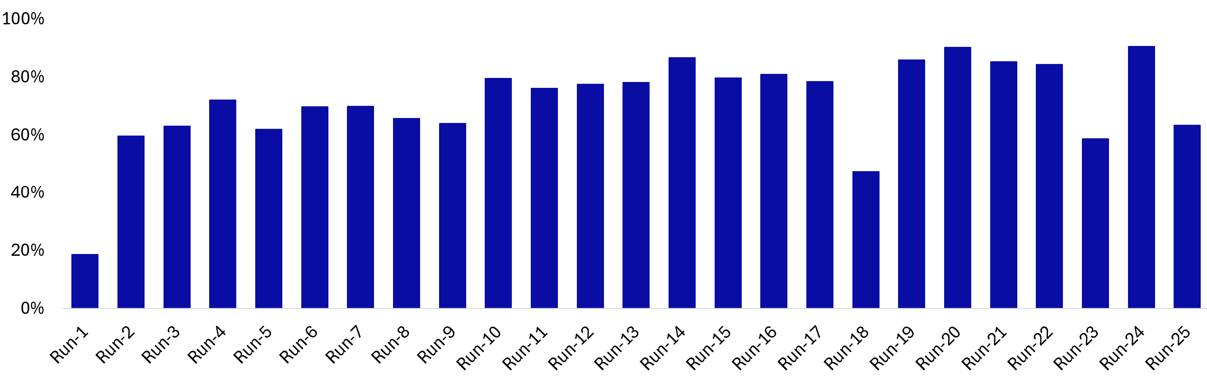
Timeline of Accelerator Science Innovations at RHIC
sPHENIX mapping and feedthrough failure
magnet wiring short
LEReC commissioning
Ratio weeks delivering physics to “cryo-weeks”
Tune/coupling feedback development
Electron Lenses
RF-based Electron Cooling
sPHENIX era
Bunched-Beam Stochastic Cooling
Model and Optics Improvements
Instrumentation improvements
Operational orbit, 10 Hz, ‘x-mean’, tune and coupling feedback
RHIC Celebration 9-10 July 2025, M. Minty

Slide 6
Advances in Accelerator Science
RHIC Celebration 9-10 July 2025, M. Minty

Slide 7
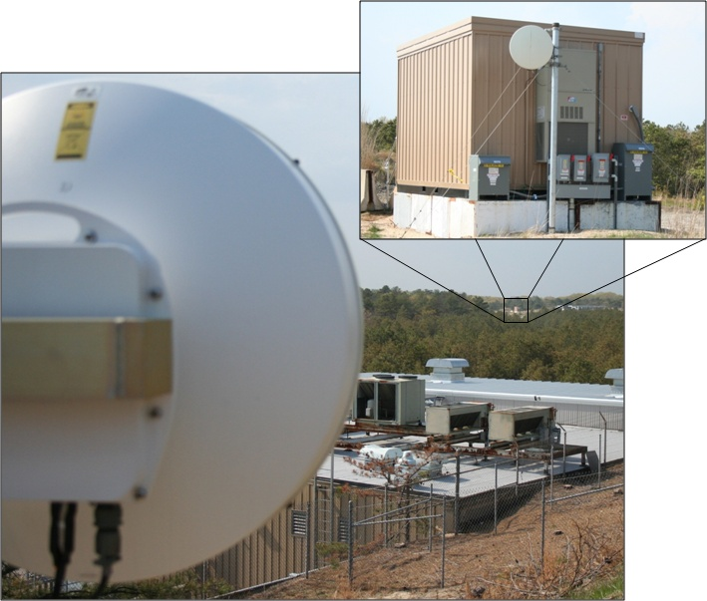
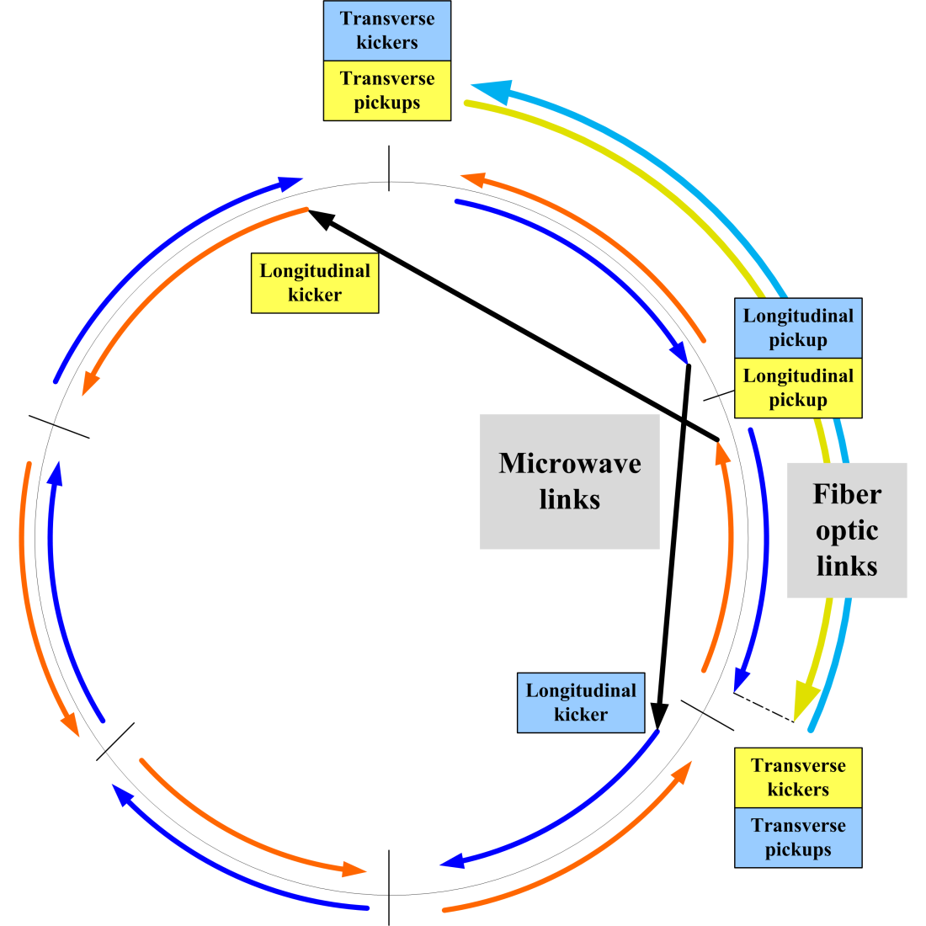
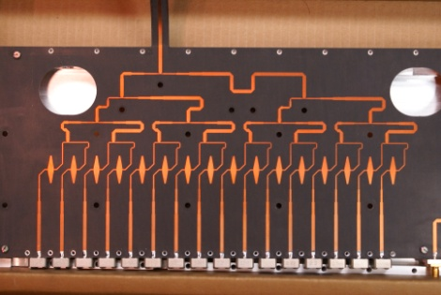
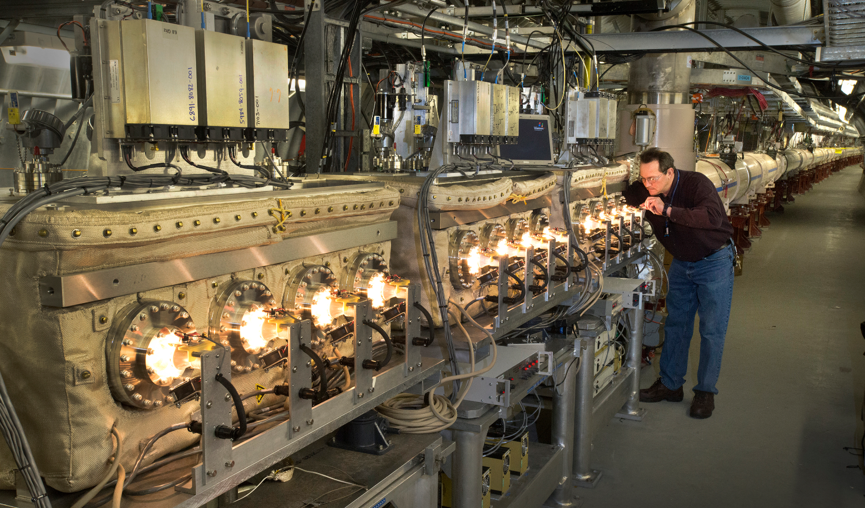
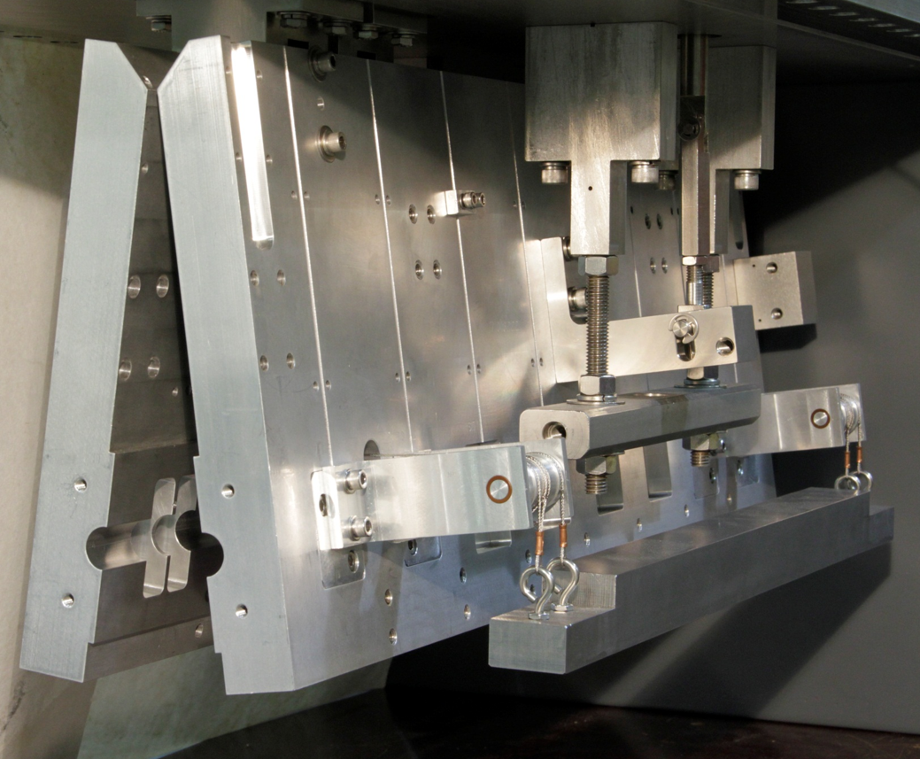
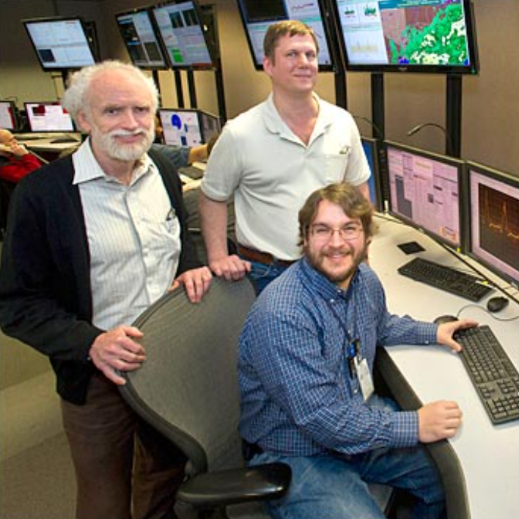
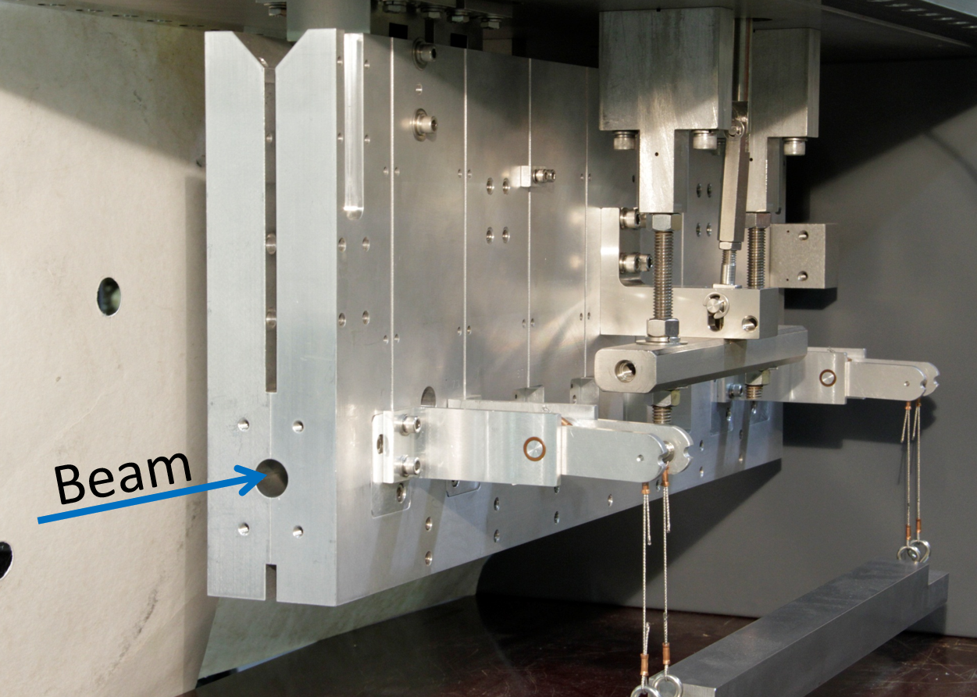
Three-dimensional (3D) bunched-beam stochastic cooling
Purpose
counteract intrabeam scattering and
cool beams’ emittances
layout
Key innovations
high-frequency Schottky signal detection (in the presence of signals from coherent collective motion)
free-space microwave transmitters and receivers for high feedback gain
high-precision ‘variable-aperture’ kickers
microwave link
pickups
kickers
pickups
kickers
M. Blaskiewicz, J.M. Brennan, K. Mernick, “Three-dimensional stochastic cooling in [RHIC]”, PRL (2010)
RHIC Celebration 9-10 July 2025, M. Minty
Notes:
Conceptual map – K. Mernick, 2012 RHIC Retreat
Photo – M. Myers, https://www.bnl.gov/newsroom/news.php?a=111606
Photo – M. Blaskiewicz, J.M. Brennan, K. Mernick, https://www.bnl.gov/newsroom/news.php?a=23039

Slide 8
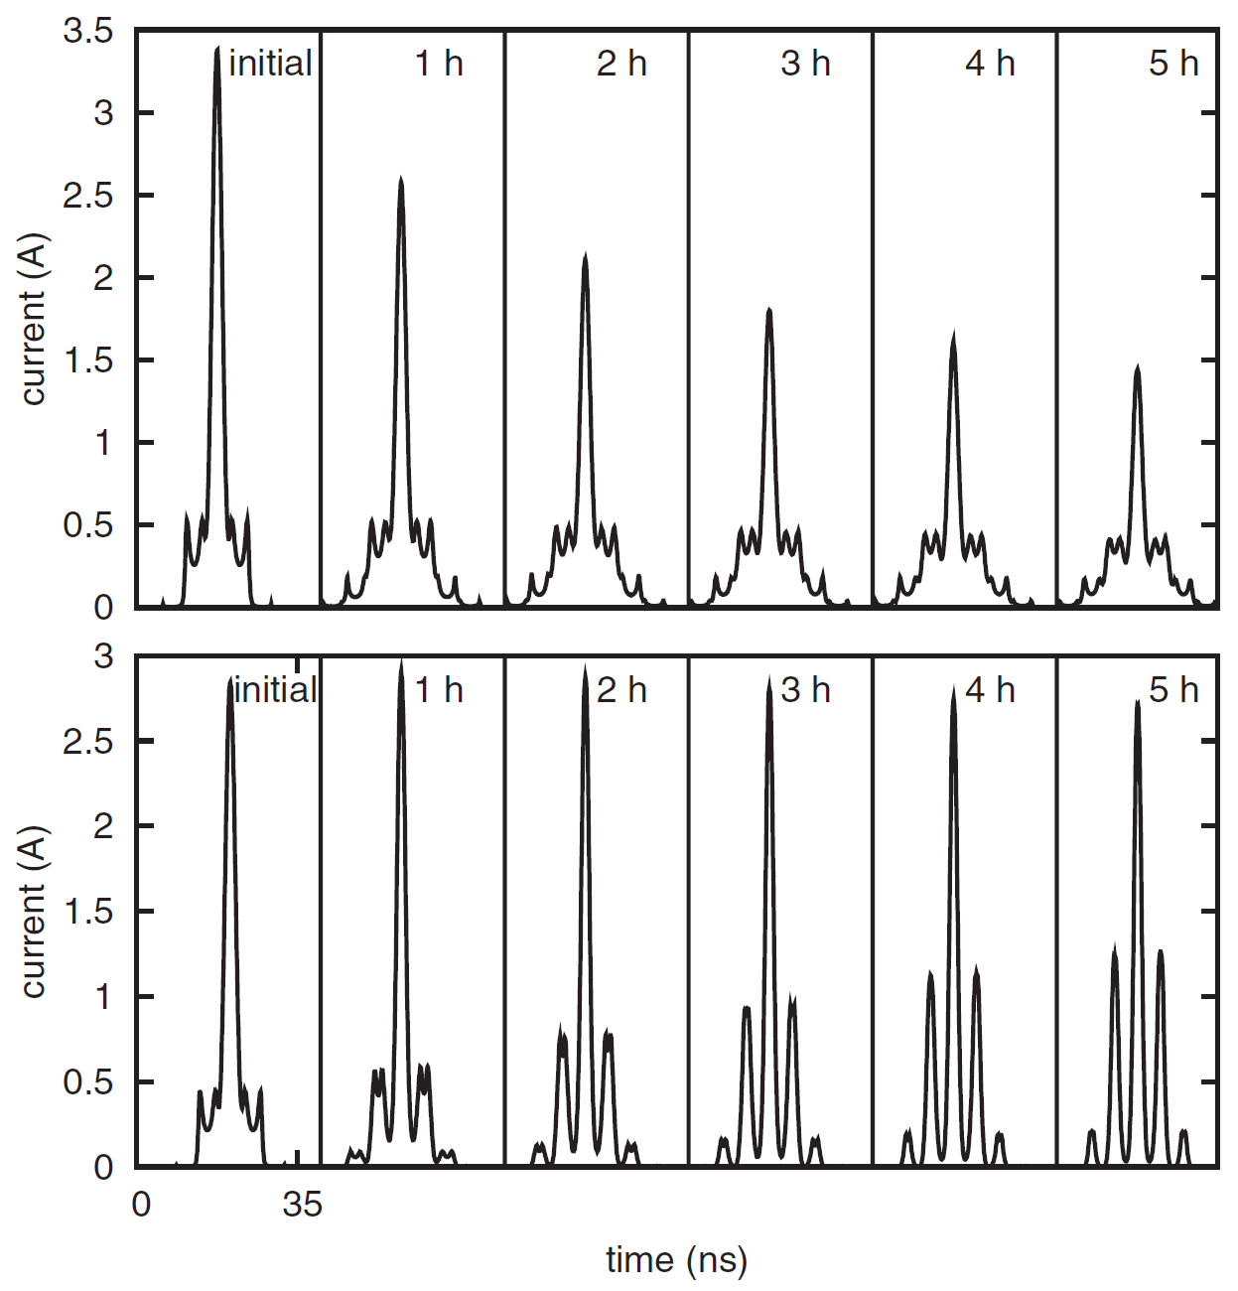
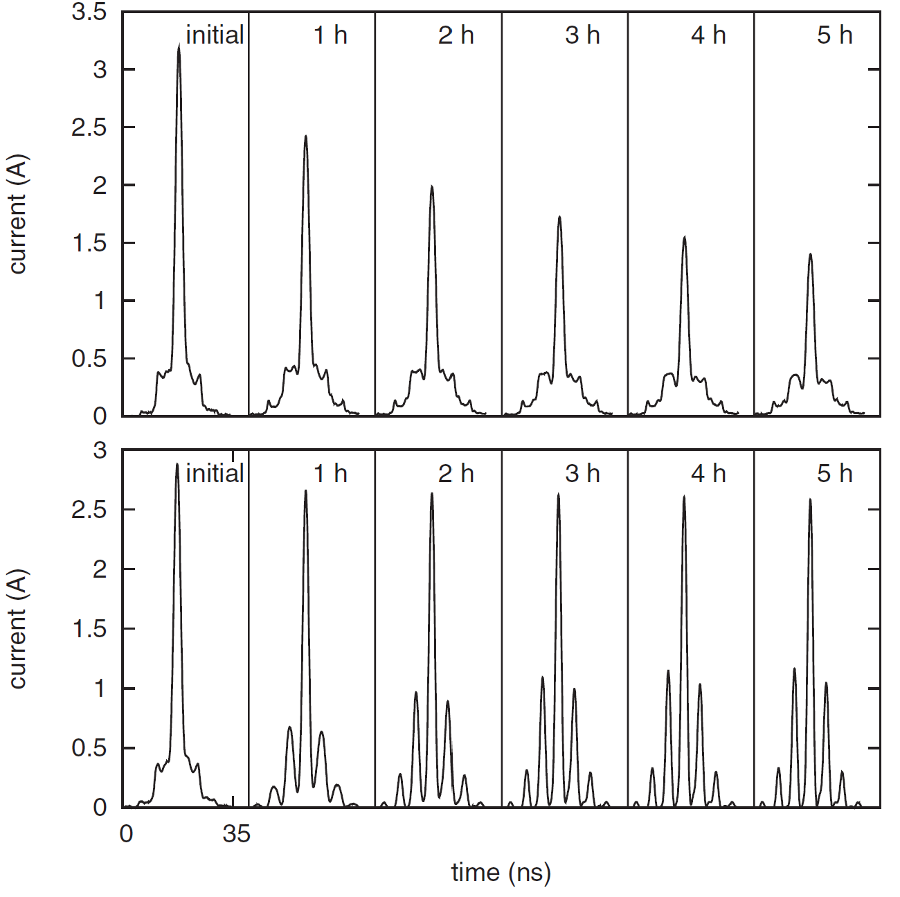
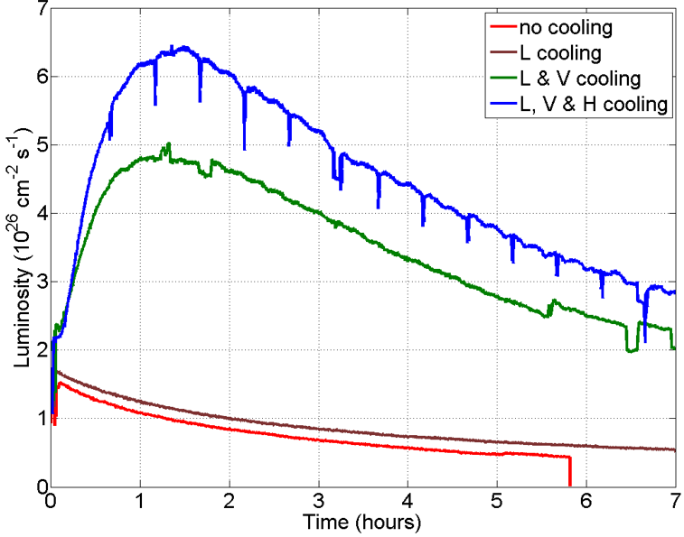
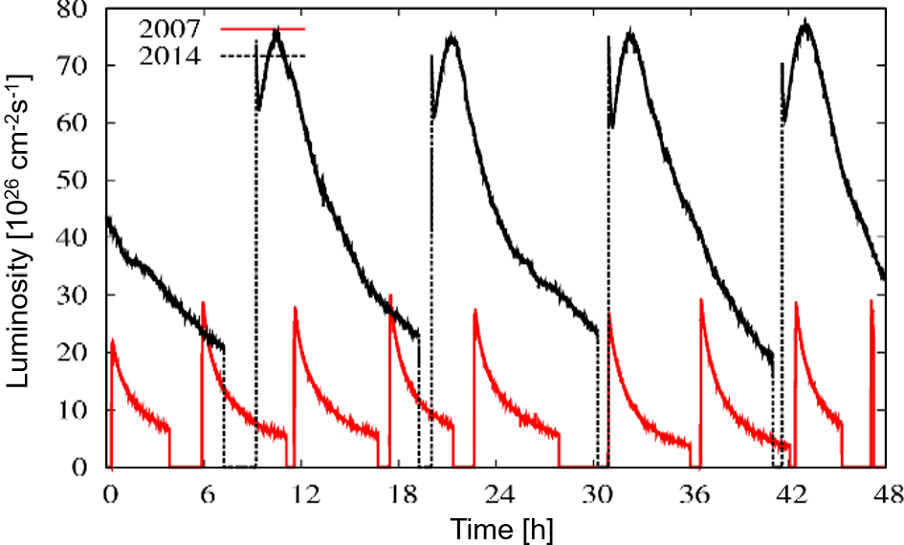
First proof-of-principle with longitudinal stochastic cooling
simulations, 100 GeV/n Au
measurements, 100 GeV/n Au
w/o SC
w/o SC
current [A]
current [A]
M. Blaskiewicz, J.M. Brennan, F. Severino, “Operational stochastic cooling in [RHIC]”, PRL (2008).
w/ SC
w/ SC
current [A]
current [A]
time [ns]
time [ns]
Full 3D bunched-beam stochastic cooling
100 GeV/n U+U
100 GeV/n Au+Au
luminosity [10²⁶ cm⁻²s⁻¹]
luminosity [10²⁶ cm⁻²s⁻¹]
Y. Luo et al., “Burn-off dominated uranium and asymmetric copper-gold operation in RHIC”, PAC (2013).
M. Blaskiewicz, J.M. Brennan, K. Mernick, “Three-dimensional stochastic cooling in [RHIC]”, PRL (2010).
time [h]
time [h]
Full-energy Au+Au average luminosity almost 50 times design
RHIC Celebration 9-10 July 2025, M. Minty
Notes:
M. Blaskiewicz, J.M. Brennan, F. Severino, “Operational stochastic cooling in [RHIC]”, PRL (2008)
K. Mernick, 2012 RHIC retreat

Slide 9
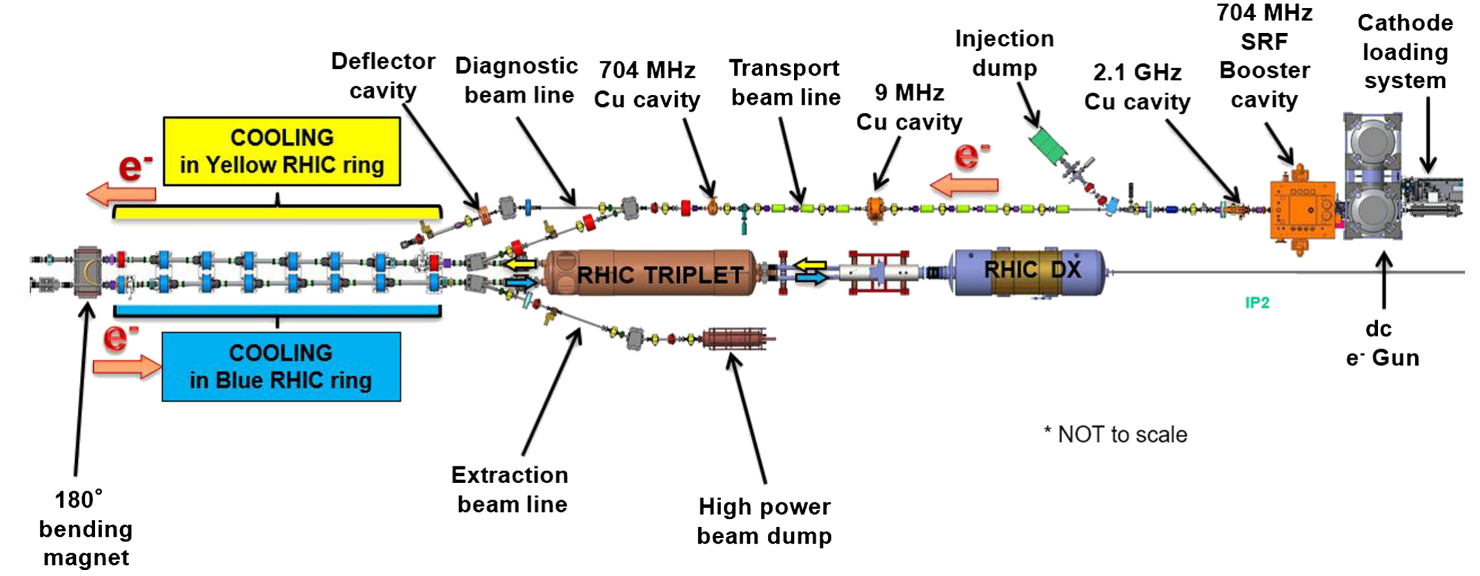
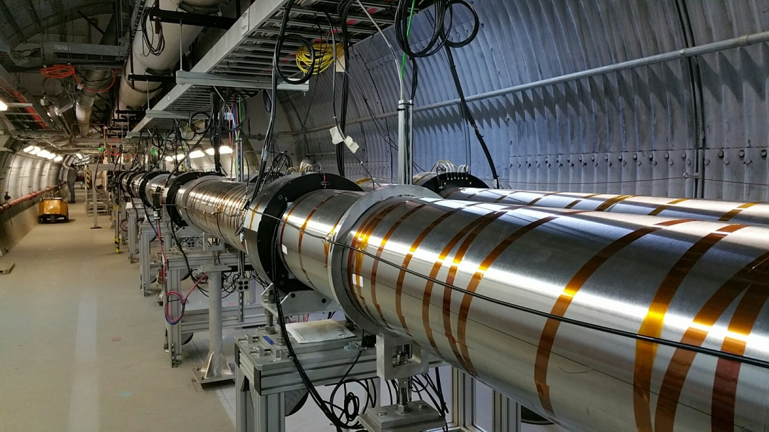
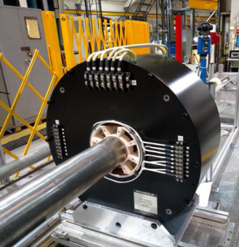
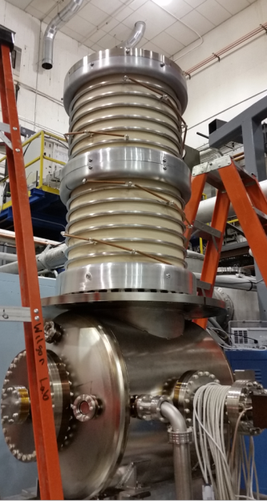
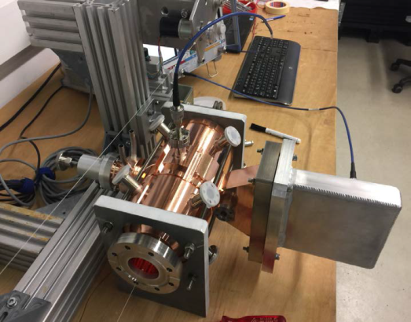
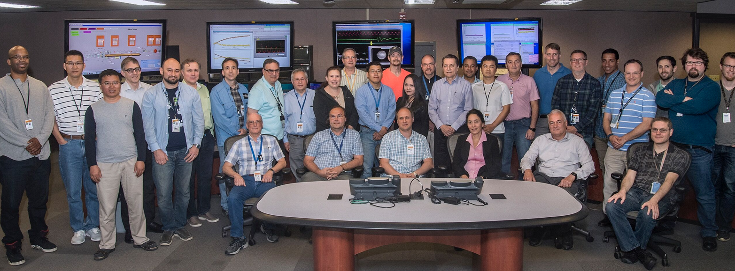
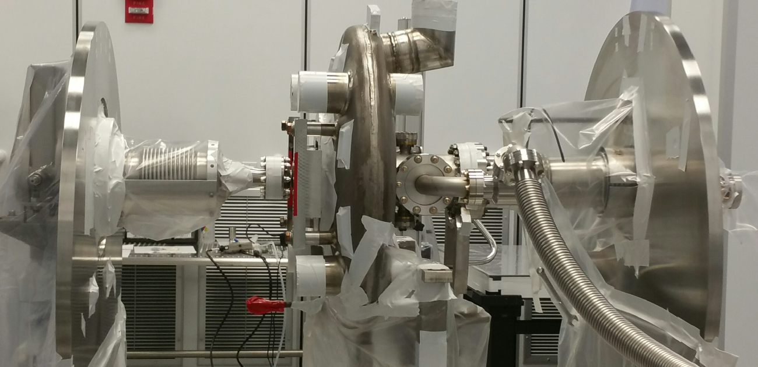
RF-Based Electron Cooling
Purpose
mitigate strong intrabeam scattering and cool beams’ emittances at low energy including during collisions
Key innovations
RF-accelerated electron bunches
non-magnetized electron beam (~30 mA) with low emittance, low energy spread, and high current
single electron beam cools both (counter-rotating) ion beams
electron cooling with colliding beams
cooling region
solenoid
A. Fedotov et al., “Experimental demonstration of hadron beam cooling using radio-frequency accelerated bunches”,
PRL (2020)
2.1 GHz NC cavity
704 MHz SC booster
gun
RHIC Celebration 9-10 July 2025, M. Minty

Slide 10
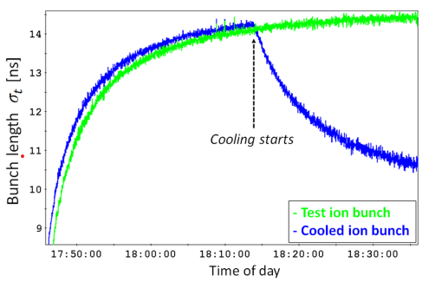
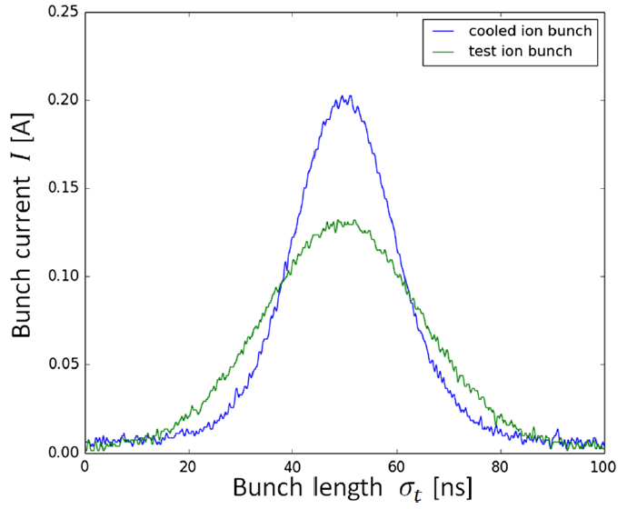
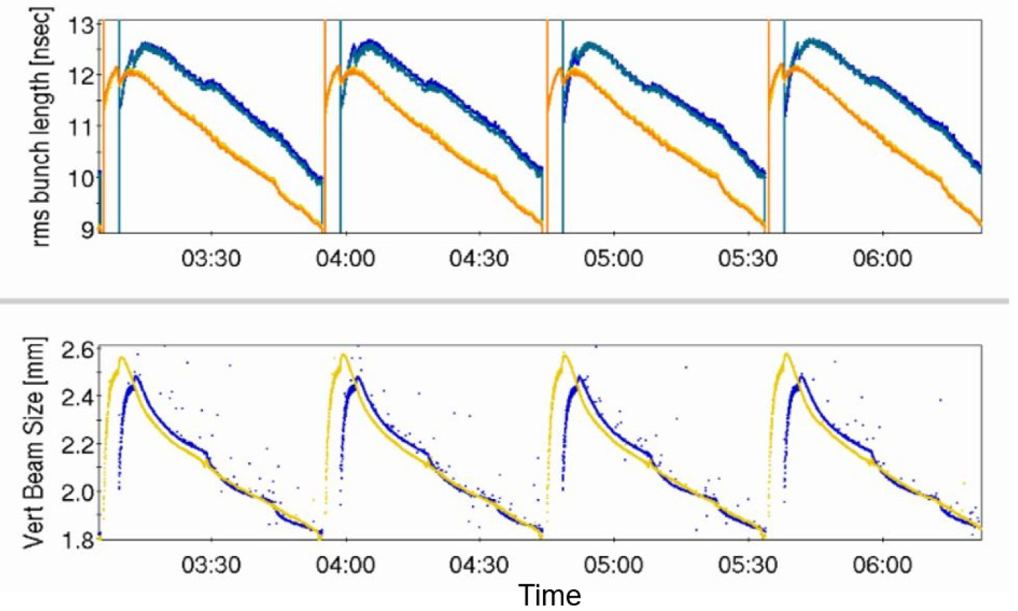
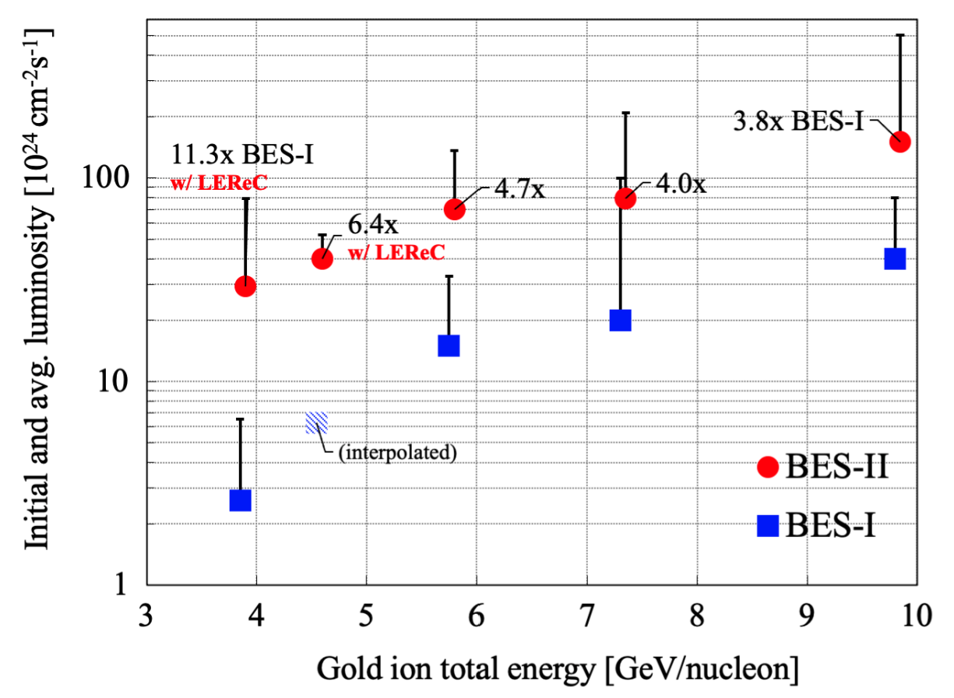
First proof-of-principle with RF-based electron cooling
S. Seletskiy et al., “Accurate setting of electron energy for demonstration of first hadron beam cooling with RF accelerated electron bunches”, PRAB (2019).
bunch length σ_{t} [ns]
bunch current I [A]
time of day
bunch length σ_{t} [ns]
Routine operations: 2 MeV electrons, 4.6 GeV/n Au ions
Luminosity w/ and w/o cooling (2019 - 2021)
rms bunch
length [ns]
initial and average luminosity [10²⁴ cm⁻²s⁻¹]
vertical beam
size [mm]
time of day
Au ion total energy (GeV/n)
RF-based electron cooling extends applicability to high energies; planned for the future Electron-Ion Collider (EIC)
RHIC Celebration 9-10 July 2025, M. Minty

Slide 11
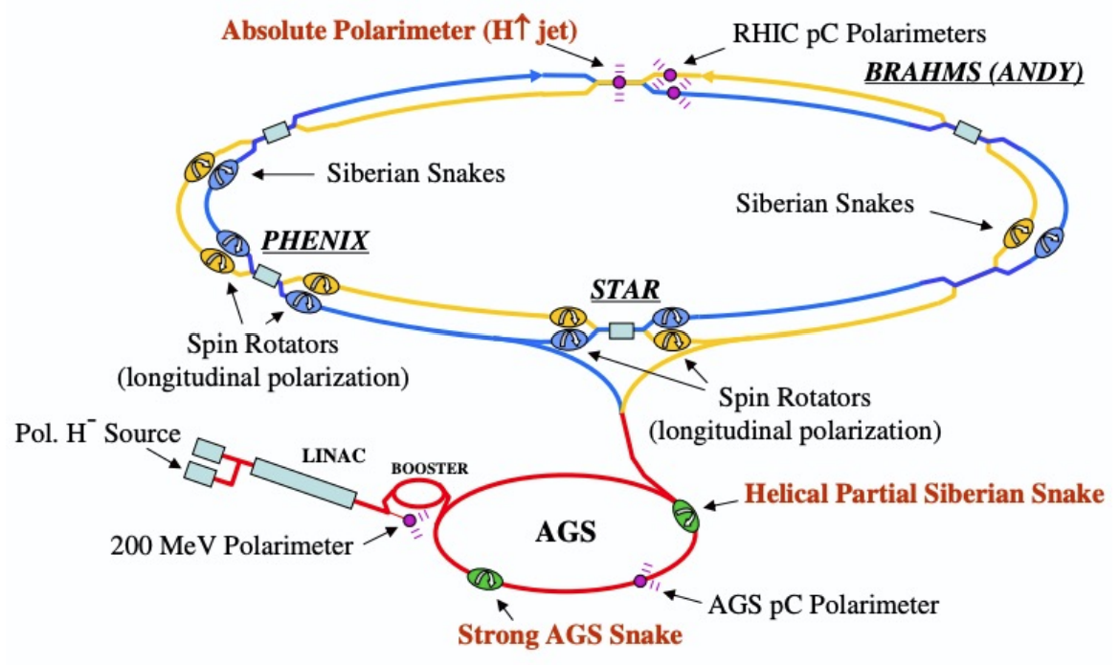
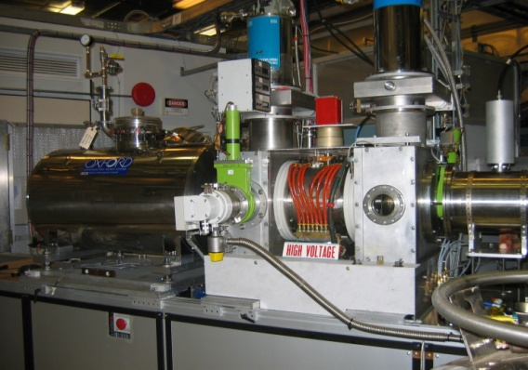
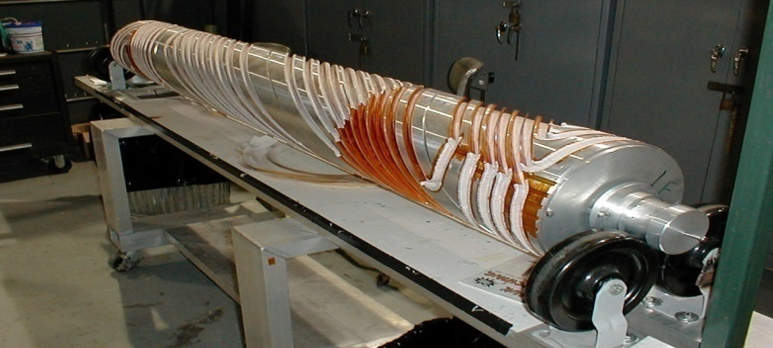
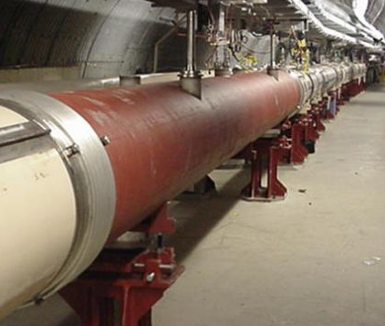
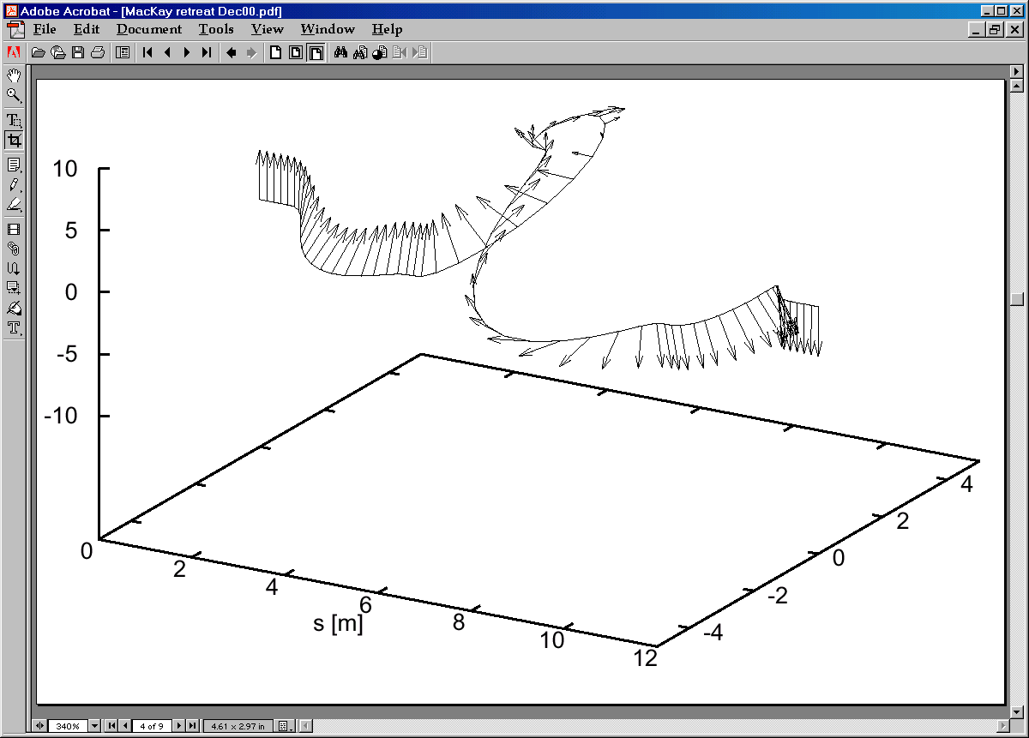
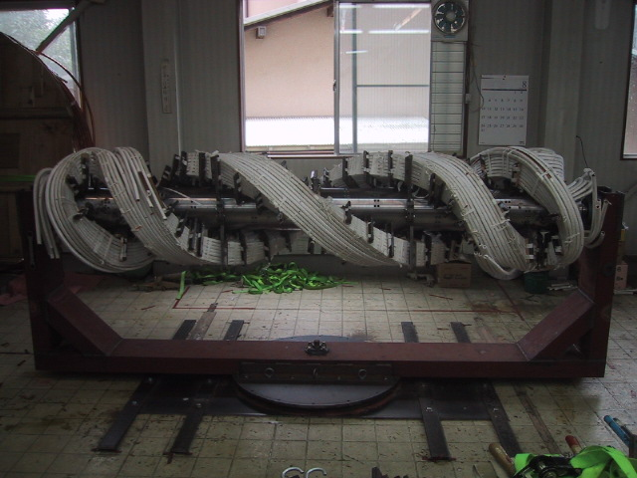
Polarized Protons
Purpose
Generate, accelerate, and collide protons with highest polarization
Key innovations
high-intensity polarized source
full and partial Siberian Snakes
diverse polarimetry
enhanced spin tracking simulations
T. Roser et al., “Polarized proton collider at RHIC (BNL, 2006).
A. Zelinski et al., “The RHIC polarized H- source”, Rev. Sci. Instrum. (2016).
E. Willen et al., “A helical magnet design for RHIC”, PAC (1997).
F. Méot et al., “RHIC optics and spin dynamics with snakes and rotators”, PRAB (2022).
high-intensity polarized H- source
Siberian Snakes in the AGS
M. Bai et al., “First polarized proton collisions at a beam energy of 250 GeV in RHIC”, PAC (2009)
Siberian Snakes in RHIC
2.6 m
RHIC Celebration 9-10 July 2025, M. Minty
Notes:
Source - 1.8E12 protons/pulse, 83% polarization
RHIC snake: each contains four 2.4m long 4 Tesla SC helical dipoles
4 total Siberian Snakes (2 per ring) and eight 2.4m total spin rotators (4 per ring)

Slide 12
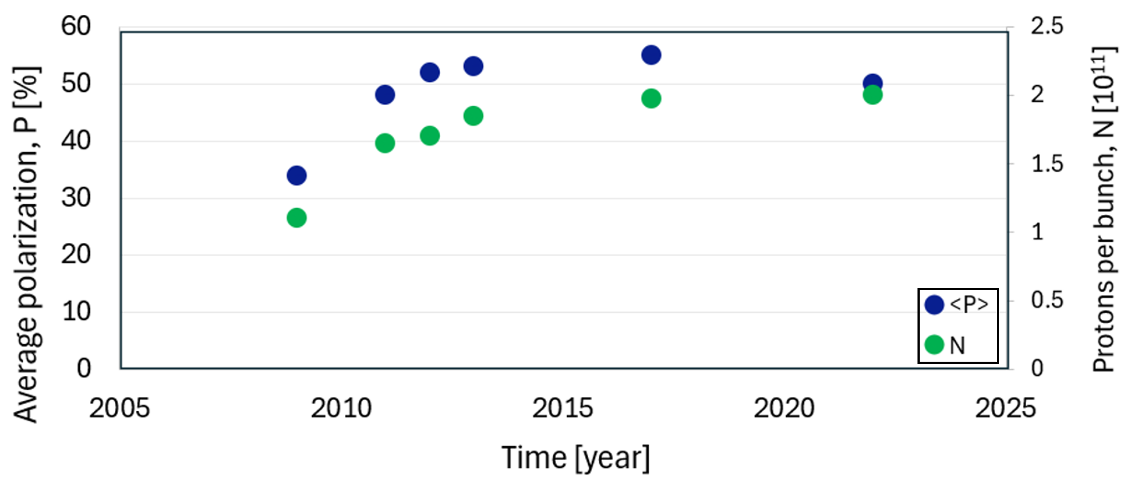
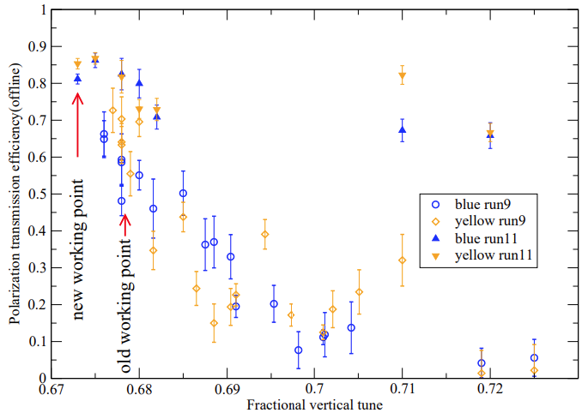

Polarization evolution in RHIC at 250 GeV
polarization transmission efficiency
average polarization, P [%]
protons/bunch [10¹¹]
fractional vertical tune
time [year]
Key advances
2006: additional partial Siberian Snake in the AGS
2011: horizontal “tune jumps” in the AGS
2008 – 2012: advances in beam control
2013 – 2015: advances in lattice modelling and implementation
fractional tunes
time [s]
Highest proton polarizations ever achieved
RHIC Celebration 9-10 July 2025, M. Minty

Slide 13




Head-on Beam-Beam Compensation with Electron Lenses
Purpose
Beam-beam tune spread compensation
6 T SC solenoid
Key innovations
large thermionic cathode, high DC current (1A), low-noise electron beam
magnetized transport with high-field SC solenoids
precision alignment between beams
operation in a high-energy collider
Novel alignment detector
W. Fischer et al., “Operational Head-on Beam-Beam Compensation with Electron Lenses in [RHIC], PRL 115, 264801 (2015)
RHIC Celebration 9-10 July 2025, M. Minty

Slide 14


S. White, W. Fischer, Y. Luo, “Optics solutions for pp operation with electron lenses at 100 GeV”, BNL-105550-2014-IR (C-A/AP/519)
W. Fischer et al., “Operational Head-on Beam-Beam Compensation with Electron Lenses in [RHIC], PRL 115, 264801 (2015)
PHENIX
(IP8)
STAR
(IP6)
E-Lenses
Δφ=π
β [m]
η [m]
s [m]
horizontal tune
Lenses, lattice and lattice implementation, and high beam intensities nearly doubled the peak and average luminosities in p↑+p↑ collisions at 100 GeV.
RHIC Celebration 9-10 July 2025, M. Minty

Slide 15
Further Optimizations
RHIC Celebration 9-10 July 2025, M. Minty

Slide 16










Instrumentation
y_{new}
Beam Position
y_{old}
y_{after}
BPM Data Delivery
y_{before}
before
after
suppression of variations due to 10 Hz mechanical vibrations
x_{before}
x_{old}
x_{after}
position [mm]
x_{new}
acquisition time [s]
faster and deterministic data delivery from BPMs
time [hr:min]
time [hr:min]
time [hr:min]
Tune and Coupling
|C⁻|
Emittances
sc off
sc on
sc on
channel by channel calibrations implemented
before
after
Δ
before
|C⁻|
after
Δ
beam emittances
(top) after calibration
(bottom) and with measured beta functions
RHIC Celebration 9-10 July 2025, M. Minty
Notes:
(not mentioned – BPM data transmission integrity testing), no errors after >100,000 acquisitions (1 acquisition = ~650 BPMs * 1024 values)

Slide 17






Orbit Feedback
Purpose reduce actions of tune/coupling feedbacks, improve reproducibility
Key elements accuracy in BPM average orbit measurements, data delivery, coding
time of day:
23:50
10:20
14:30
17:40
22:55
magnetic field errors - including power
supply variations, bit limitations, response
time and magnet alignment errors
Run-09
~400 μm
Run-09
acceleration
start
y_{rms} (μm)
no
feedback
(unavoidable) persistent currents and
hysteresis effects
y_{rms} (μm)
thermal effects
end
Run-11
with
feedback
250 GeV
acceleration
start
collisions
y_{rms} (μm)
~20 μm
time [s]
time [s]
Significant reduction in time needed to establish new modes of operation (species and/or energies) and improved operational reproducibility
RHIC Celebration 9-10 July 2025, M. Minty

Slide 18




Local and global coupling
Purpose (initial motivation) improve polarization using dispersion-free steering;
secondary, localized coupling correction
C. Liu et al, “Simultaneous global coupling and dispersion correction in RHIC”, NIM (2014)
Key elements accuracy in BPM average orbit measurement, accelerator
reproducibility (from feedbacks), coding
local skew quad strengths, courtesy
A. Marusic (Run-12)
measured orbit response matrix,
courtesy
T. Summers
(Run-10)
measured orbit response matrix,
courtesy
T. Summers
(Run-12)
R₃₄
R₁₄
R₁₄’s ~ 0
y-COR
R₁₂
R₃₂
R₃₂’s ~ 0
x-COR
y-BPM
x-BPM
Local (IR) and global coupling improved and independent.
RHIC Celebration 9-10 July 2025, M. Minty
Notes:
Methodology applied for local coupling correction: F. Pilat, “Correction of triplet skew quadrupole errors in RHIC”, RHIC/AP/58 (1995)
Skew quad strengths after implementation of corrections: A. Marusic (unpublished)
ORM measurements: T. Summers (unpublished)

Slide 19


Optics Measurement and Correction during Beam Acceleration
Purpose investigate discrepancies between emittances measured at injection and store energies
Key elements careful orchestration of data acquisitions and data delivery using interleaved
average orbit BPM measurements (for orbit feedback)
turn-by-turn BPM measurements (for optics measurements)
1.
Δ~20%
trigger 1 Hz event
for orbit feedback
4.
1 Hz event for
orbit feedback
ping beam in vertical plane, acquire TBT BPM data, deliver data
5.
ping beam in horizontal plane,
acquire TBT BPM data,
deliver data
β (m)
2.
acquire and
deliver BPM
data for orbit
feedback
time (s)
0
200
1000
time (ms)
Error in emittance measurement dominated by knowledge of beta-functions
3.
trigger turn-by-turn BPM
data acquisition
RHIC Celebration 9-10 July 2025, M. Minty

Slide 20
Orbit, tune/coupling, beam-centering + chromaticity feedback
Purpose
absolute polarimeter calibration
Key elements
sinusoidal rf frequency modulation with zero crossings aligned with time of BPM acquisition
for orbit feedback
action of tune/coupling feedback used to infer chromaticity
~25 units of chromaticity correction during deceleration (compare with catastrophic beam loss tolerance – during acceleration – of typically 2-3 units)
RHIC Celebration 9-10 July 2025, M. Minty

Slide 21
Some Lessons Learned
RHIC Celebration 9-10 July 2025, M. Minty

Slide 22




Operational Improvements : trajectory and tune modulation
beam position
Fourier transform beam position
Run-09, 250 GeV p
+/- 5 mm
Fourier transform betatron tune
beam loss
Run-08, C. Montag
betatron tunes
Orbits at IP
Run-09, 250 GeV p
00
00
0.01
100 μrad
700 μm
250 GeV, β*=0.7m
65 μm beam size (1σ)
5 mm bunch length (1σ)
60 μm displacement
at 1σ
Run-09, 250 GeV p
DX BPMs – blue beam
DX BPMs – yellow beam
RHIC Celebration 9-10 July 2025, M. Minty
Notes:
Envelope modulation due to beat frequencies
2009_November_12_APEXwkshp_10hz.pdf

Slide 23







Operational Improvements : 10 Hz feedback
Purpose stabilize trajectories
maximize beam-beam tune-spread
Key elements custom BPM signal processing, high-speed data distribution
(1 Gbps ethernet), FPGA-based real-time processing (Xilinx),
new air-core correctors
7/10
2/3
0.034
air-core correctors
beam position
feedback off
feedback on
feedback off
feedback on
feedback off
feedback on
luminosity
BPM electronics
beam loss
(1 s, +/- 1250 μm full scale)
(1 s, +/- 1250 μm full scale)
R. Michnoff, C. Liu, R. Hulsart, K. Mernick, P. Thieberger et al, “RHIC 10 Hz global orbit feedback system”, PAC (2011)
RHIC Celebration 9-10 July 2025, M. Minty

Slide 24



Operational Improvements : timing setup (modified starting in Run-11)
Motivation: beam loss/abort crossing transition (coincidentally)
Diagnosis: “race condition in beam sync encoder”
3) set phase as needed
for beam sync link encoder
2) phase shift to center
beam on WCM
1) phase rf
as desired
WCM
Follow-ups:
hardware modifications to reduce race condition phase range
new procedure for initial timing setup
CAVITY
BEAM
Substantial impact on operational efficiency (time to physics)
RHIC Celebration 9-10 July 2025, M. Minty
Notes:
M. Minty, “Developments in Beam Instrumentation and Control”, RHIC Retreat (2012)
Diagnosis and this new approach to setup for all devices triggered by V124: A. Marusic

Slide 25





Operational Improvements : multi-year spontaneous emittance blow-up resolved
Inoperable conditions in Run-11
BBQ-Auto-2011 E-log (with automatic downloads of DSA spectra for all fills) → blue ring, present at injection
emittance
Run-11
2/7/2011
intensity
emittance
K. Mernick, 2/9/11
→ in horizontal plane only
0
intensity
Run-8
Quest to isolate source (disconnecting equipment, one-by-one) identified broken wire connecting thyratron to magnet feed-through
RHIC Celebration 9-10 July 2025, M. Minty
Notes:
Y: RHIC → Run11 → noise → RHIC_Run11_noise_hunt.ppt

Slide 26
Recent RHIC Runs
RHIC Celebration 9-10 July 2025, M. Minty

Slide 27





Run18 – Isobar Runs,⁹⁶Zr⁴⁰⁺ + ⁹⁶Zr⁴⁰⁺ / ⁹⁶Ru⁴⁴⁺ + ⁹⁶Ru⁴⁴⁺
RC: G. Marr
Support from DOE, ORNL, and RIKEN for rare source material and target preparation
Store-by-store species changes, luminosity-leveled
ZDC cndc rate [kHz]
ZrO₂ during sintering at RIKEN (Japan)
1 week
Separation of Ru isotopes at ORNL
Testament to the flexibility and efficiency of collider operations.
RHIC Celebration 9-10 July 2025, M. Minty
Notes:
G.J. Marr et al, “Ion collider precision measurements with different species”, IPAC19
W. Fischer, C-AD MAC-15 (Nov, 2018)

Slide 28

Run18 – Run21 : Beam Energy Scan II era
RC: C. Liu
LEReC: A. Fedotov (PI), D. Kayran (beam
commissioning), S. Seletskiy (cooling com-
missioning/MPS), X. Gu (gun commissioning)
BESII scoreboard
LEReC commissioning
with LEReC
with LEReC
all goals achieved or exceeded
RHIC Celebration 9-10 July 2025, M. Minty

Slide 29






Last full-energy (0.5 TeV c.o.m.) p↑+p↑ : Run22
RC: V. Schoefer
STAR forward detector upgrade
Run-22 delivered figure of merit
(Unusual) challenges: two RHIC snake magnets damaged, innovative solutions developed to determine all 3 degrees of freedom of stable spin direction)
Run-22 delivered luminosity
Began construction of AGS skew quad scheme for correcting horizontal partial snake resonances (PI: V. Schoefer)
  forward program: 107%
  mid-rapidity: ~98%
RHIC Celebration 9-10 July 2025, M. Minty
Notes:
Z. Wang, for the STAR collaboration, “STAR Forward Detector Upgrade Status and Performance”, talk at Quark Matter 23: https://indico.cern.ch/event/1139644/papers/5541589/files/12918-ZhenWang_QM_proceeding_v6.pdf
C. Gagliardi for the STAR collaboration, “The STAR Forward Upgrade”, talk at SPIN2023, https://indico.jlab.org/event/663/contributions/13448/attachments/10378/15543/STAR_Forward_Upgrade_SPIN-2023.pdf
V. Schoefer et al, “RHIC Polarized Proton Operation in Run 22”, IPAC22, https://www.rhichome.bnl.gov/RHIC/Runs/RhicRun22pp.pdf
V. Schoefer, “Using betatroncoupling to suppress horizontal intrinsic spin resonances driven by partial snakes”, PRAB 24, 031001 (2021)

Slide 30

sPHENIX era: Run23 – Run25
Run-23 (Au+Au, √s_{NN}=200 GeV ) 5/1/23 - 8/4/23 (early end)
RHIC repairs, preparation and sPHENIX upgrades for Run-24
sPHENIX installation completed
2023
Jan | Feb | Mar | Apr | May | Jun | Jul | Aug | Sep | Oct | Nov | Dec
CAD prep completed
CAD support for sPHENIX
sPHENIX upgrades completed
Run-24 ( p↑+p↑, √s_{NN} ~200 GeV ) 4/15/24 - 10/1/24
Preparation for Run-25
2024
Jan | Feb | Mar | Apr | May | Jun | Jul | Aug | Sep | Oct | Nov | Dec
CAD repairs and prep completed
Run-24 ( Au+Au, √s_{NN}=200 GeV), 10/1/24 - 10/21/24
Run-25 ( Au+Au, √s_{NN}=200 GeV ), 3/24/25 – 12/8/25
2025
Jan | Feb | Mar | Apr | May | Jun | Jul | Aug | Sep | Oct | Nov | Dec
Run-25 ( p↑+p↑, √s_{NN} ~200 GeV )
12/8/25 – late Jan 2026
2026
Added FXT for STAR (at 9.6, 9.65, and 13.5 GeV/u), 3 days dedicated for CeC, O+O at √s_{NN} ~200 GeV End or RHIC: 6 February 2026
RHIC Celebration 9-10 July 2025, M. Minty

Slide 31






Run23 (Au+Au)
RC: T. Shrey
Run24 (p↑+p↑, Au+Au)
RC: K. Hock
  Met sPHENIX requirements and collided beams for STAR with wide variety of beam conditions (# bunches, bunch intensities, crossing angles with leveling…)
Siberian Snake repaired
sPHENIX “Big Splash” event
  Early run-end
current lead failure
  Met p↑+p↑ goals at sPHENIX and STAR.
  Background crisis during last 2 weeks with Au+Au
  - task force initiated (A. Drees)
  - resolution (K. Hock)
RHIC Celebration 9-10 July 2025, M. Minty

Slide 32








Run25 (Au+Au, p↑+p↑, O+O, CeC) RC: T. Shrey
M. Blaskiewicz, K. Smith, K. Mernick, S. Polizzo, F. Severino, Q. Wu, A. Zaltsman
  Longest run with 3 interventions (splice, 69 kV, dump vacuum)
  SC 56 MHz cavity
>15% increase in lumi within +/- 10 cm
cavity OFF
1.36E9 ions/bunch
cavity ON
0.95E9 ions/bunch
~2800
~3500
  Run25 – All physics goals met including flurry of End-of-RHIC activities!
RHIC Celebration 9-10 July 2025, M. Minty

Slide 33
Recent Accelerator Physics Experiments (APEX)
APEX coordinators:
H. Huang (C-AD) and Y. Luo (EIC)
APEX Beam Time (hours)
experiments to inform EIC design
and/or operation
experiments to inform EIC design and beam cooling studies
focus: beam cooling studies
(minimal APEX during BES-II and pandemic)
APEX workshop held January 2025 https://indico.bnl.gov/event/26073/. Featured:
comprehensive review of EIC-related requests for final year of RHIC operations
detailed plans for experiments
RHIC Celebration 9-10 July 2025, M. Minty

Slide 34
Performance Summary and Legacy
RHIC Celebration 9-10 July 2025, M. Minty

Slide 35


Au + Au
p↑+p↑
100 GeV/n
courtesy W. Fischer
courtesy W. Fischer
integrated nucleon-pair luminosity [pb⁻¹]
Integrated luminosity [pb⁻¹]
time [weeks in physics]
time [weeks in physics]
RHIC was the first heavy ion collider and first polarized proton collider.
Collider technologies developed and used operationally:
ions 3D bunched-beam stochastic cooling
RF-based electron cooling
p↑ sources, Siberian Snakes and rotators,
polarimetery, resonance mitigation, and codes
head-on beam-beam compensation with electron lenses
supplemented by precise beam control and advances in accelerator modeling
RHIC Celebration 9-10 July 2025, M. Minty

Slide 36


Two examples from recent Accelerator Physics Experiments
purpose extend the energy reach of the EIC
purpose enable collisions with flat beams
challenges off-momentum linear optics correction
challenges generation (with stochastic cooling),
coupling control, and acceleration
31GeV/n, Au
horizontal
orbit [mm]
emittance ratio
100 GeV/n, Au
horizontal
orbit [mm]
emittance [μm]
s [m]
time [h]
G. Robert-Demolaize et al., “Large radial shift experiments in RHIC and their implications for EIC design”, NIMA (2025).
Y. Luo et al., “Experimental demonstration of accelerating a beam with large transverse emittance ratio in the [RHIC] for the [EIC]”, PRL (2026).
RHIC’s legacy includes major advances in collider technology and operational methodologies which also inform the design and development of next-generation facilities, including the future Electron-Ion Collider.
RHIC Celebration 9-10 July 2025, M. Minty

Slide 37
Acknowledgements
The work presented here is the result of the exceptional initiatives, innovations, and accomplishments of the RHIC accelerator physics, controls, operations, engineering, and technical staff, whose collective achievements were (partially) summarized here.
Run coordinators merit special recognition, these are: W.W. MacKay, S. Peggs, T. Roser, D. Trbojevic, T. Satogata, H. Huang, W. Fischer, M. Bai, F. Pilat, V. Ptitsyn, K.A. Drees, C. Gardner, C. Montag, K. Brown, G. Marr, V. Schoefer, Y. Luo, V. Ranjbar, G. Robert-Demolaize, C. Liu, X. Gu, A. Fedotov, D. Kayran, K. Hock, and T. Shrey. The achievements described here also relied critically on the contributions of machine specialists A. Marusic, B. Lepore, and K. Zeno.
This report was supported by Brookhaven Science Associates, LLC under Contract No. DE-SC0012704 with the U.S. Department of Energy.
RHIC Celebration 9-10 July 2025, M. Minty

