Slide 1
Superconducting Magnets
“Unsung Heroes”
Mike Anerella
July 10, 2026

Slide 2
Agenda
History – “pre-RHIC”
Actual Heros
Full Inventory
RHIC Magnet Highlights – “Success Stories”
  8 cm Dipoles
  13cm Quadrupoles
  8 cm, 13 cm Correctors
  CQS magnets
  18 cm DX Dipole
“Aftermarket Devices”
  Helical Magnets
  AGS Cold Snake
  E-Lens Solenoid

Slide 3
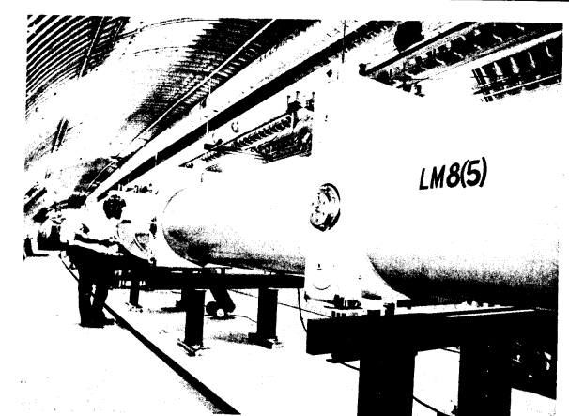
Circa 1983
History “pre-RHIC”
In production as of 1982
36 magnets built & tested
10 last magnets met all field quality requirements
6 dipoles + 2 quadrupoles tested in “String Test”
Cancelled after CERN discovered W and Z bosons
IsaBelle – CBA
(Colliding Beam Accelerator)
Important technological developments, e.g., All-Kapton coil insulation (was epoxy/fiberglass)
Mechanical structure maturation
BNL Staff Kept Intact
SSC (Superconducting Super Collider)
RHIC

Slide 4
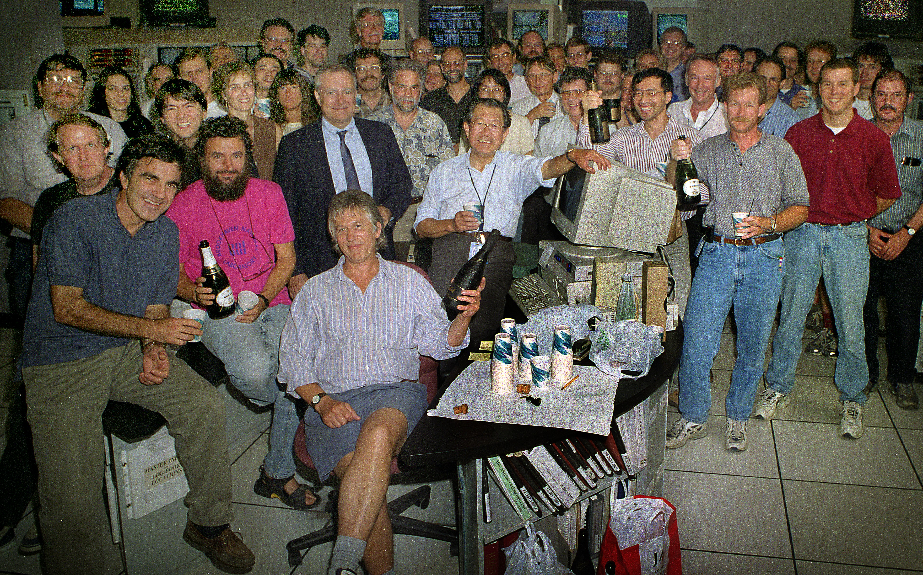
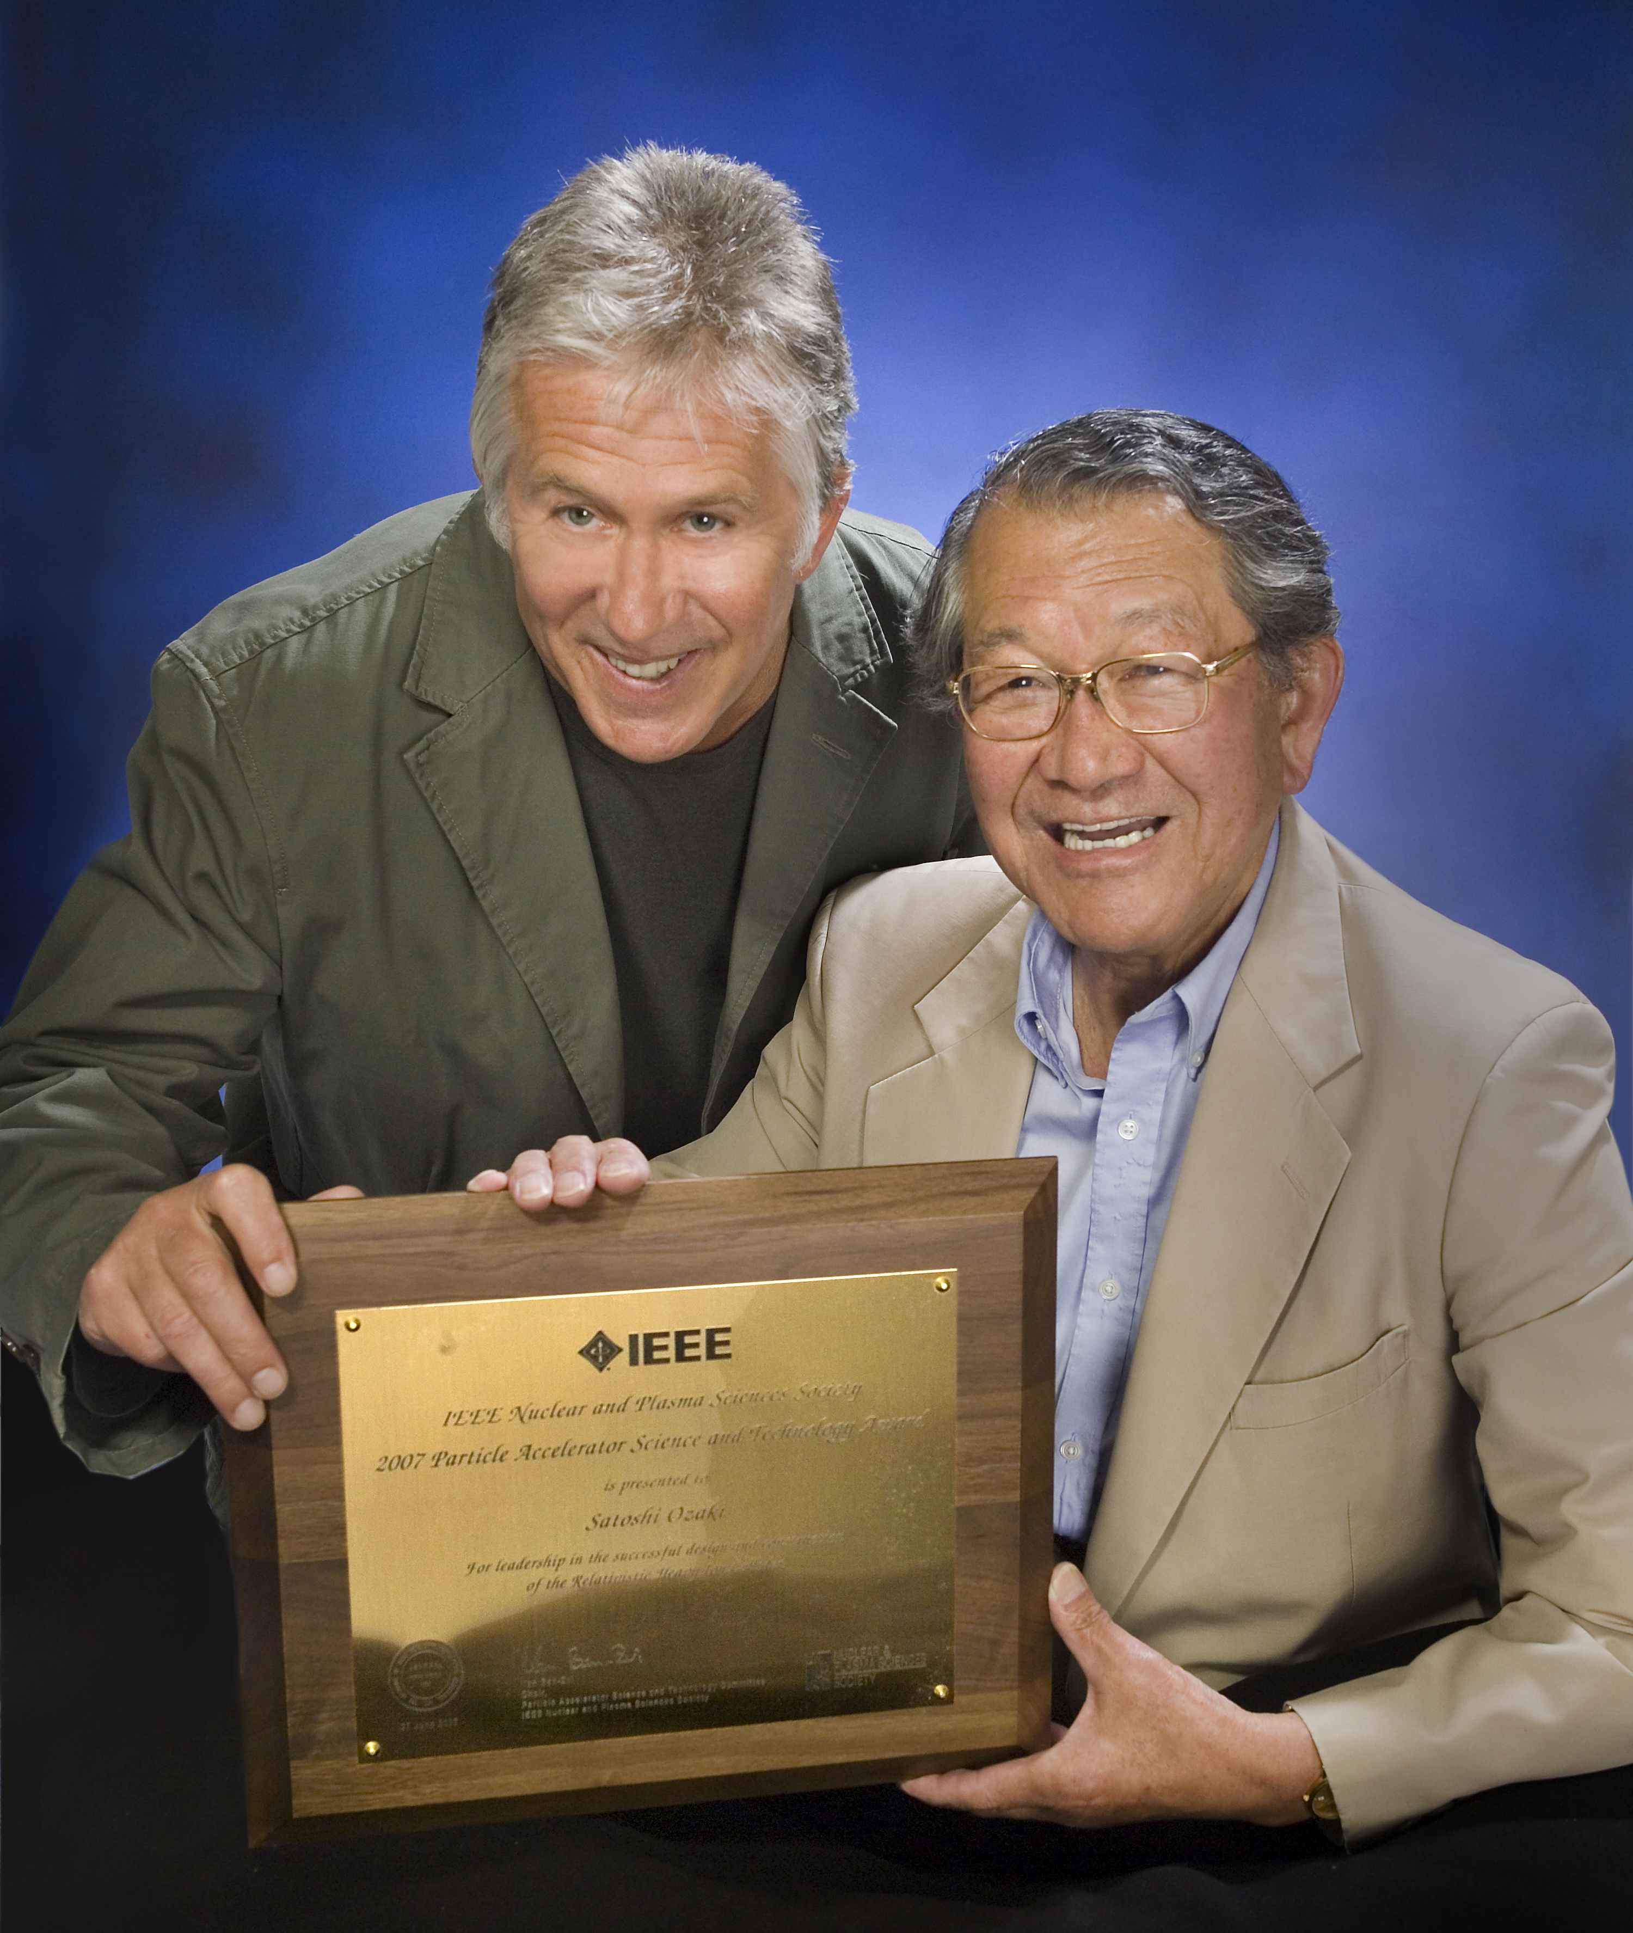
Actual Heros
Mike
Harrison
Satoshi
Ozaki

Slide 5
Full Inventory
REGULAR 8 cm ARC COMPONENTS
Dipoles 264
Quadrupoles 276
Sextupoles 276
Correctors 276
INSERTION COMPONENTS
Standard Aperture (8 cm) Magnets
- Dipoles (D5I, D5O, D6, D8, D9) 96
- Quadrupoles (Q4-Q9) 144
- Trim quadrupoles (@ Q4, Q5, Q6) 72
- Sextupoles at Q9 12
- Correctors 144
Intermediate Aperture (10 cm) Magnets
- Dipoles (D0) 24
- Helical Dipoles 12 (after RHIC)
Intermediate Aperture (13 cm) Magnets
- Quadrupoles (Q1-Q3) 72
- Correctors 72
Large Aperture (18 cm) Magnets
- Dipoles (DX) 12
TOTALS
Dipoles 408
Quadrupoles 492
Trim quadrupoles 72
Sextupoles 288
Correctors 492
Total magnets 1752

Slide 6
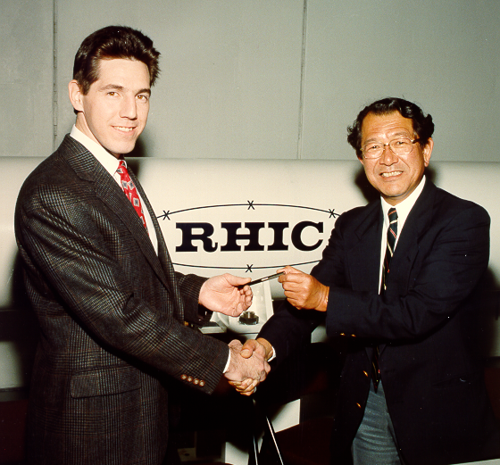
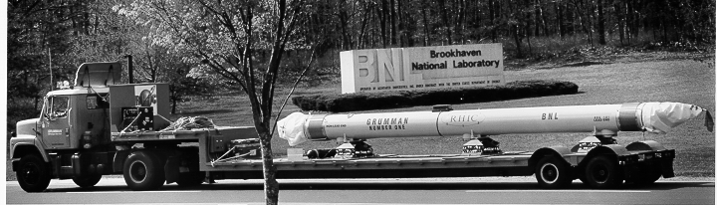
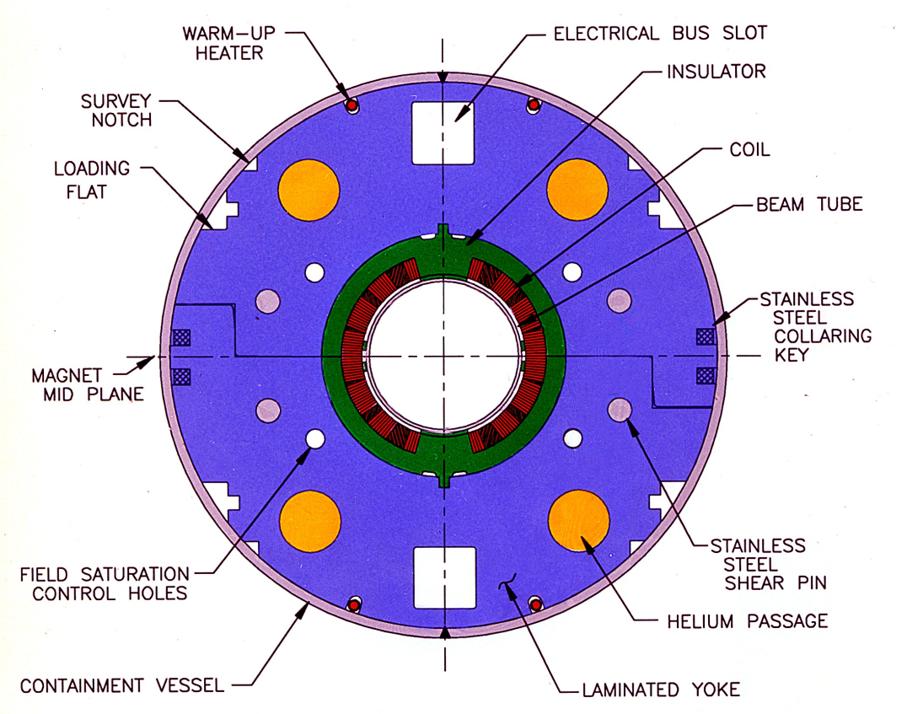
Magnet Highlights – 8cm Dipoles
Contract signing
80 mm coil ID, 3.5 Tesla
Single layer coil
Plastic spacer, no SST collar (cheap, reliable electrical insulation + mechanical support)
Yoke as collar and return flux both
Magnet #1 delivered to BNL
BNL designs & builds 12 preproduction magnets
Northrop-Grumman (NGC) wins “build to print” contract for 373 dipole magnets (4 lengths)
  NGC comes to watch 11th BNL magnet construction
  NGC personnel “hands-on” (help) build 12th BNL magnet
  BNL reviews & approves all NGC tooling designs (weekly meetings at BNL)
  BNL (ALL of SMD, as needed) travels to NGC as needed:
    Assists with tooling setup & commissioning
    Guides / teaches fabrication & testing methods
    Reviews & edits production assembly procedure documents
GENIUS contract for 373 magnets ($42.7M):
Phase 1 – tooling + 30 10m magnets, “Cost Plus Fixed Fee” (overran budget $12M→$25M)
Phase 2 – 268 10m magnets, “Fixed Price Incentive Fee” - $85,000 per magnet !!!
Phase 3 – 75 shorter magnets (3 lengths), “Fixed Price Incentive Fee”
Change Control: > 300 change proposals evaluated. Excluding admin, costs REDUCED
Underran labor in Phase 2 & Phase 3
Increasing Overheads: BNL responsible. Added ~ $3M
Results:
Cold testing of incoming magnets reduced to <10% (after initial 30)!
ZERO magnet failures in 27 years of operation!

Slide 7
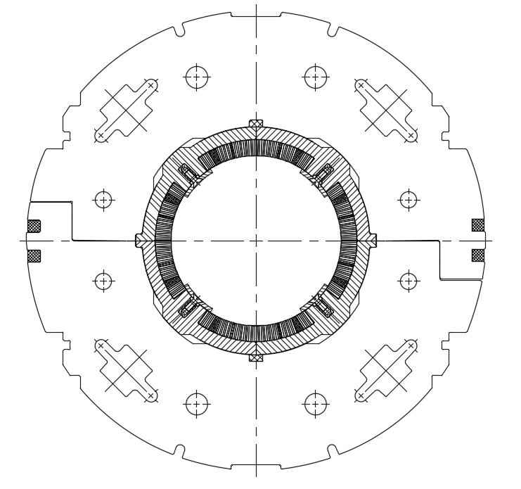
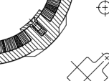
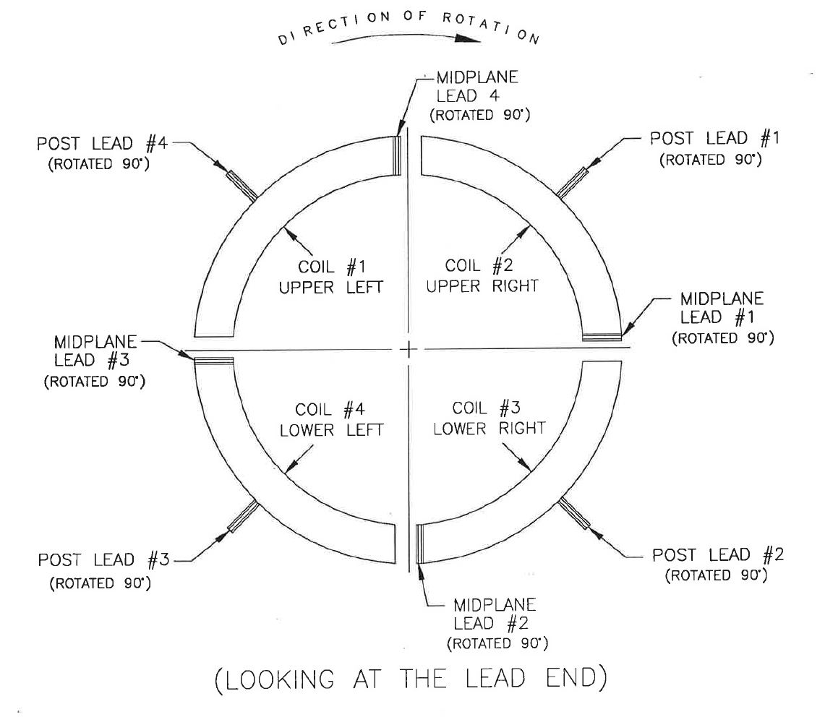
Magnet Highlights – 13cm Quadrupoles
130 mm coil ID, 48.1 T/m, 1.44, 3.40, 2.10 m lengths
Single layer coil
Plastic spacer, no SST collar (cheap, reliable electrical insulation + mechanical support)
Yoke as collar and return flux both
New technology – “tuning shims”
  Variable iron thicknesses in 8 locations
  Initial measurements, adjustments at room temperature
  Final adjustment possible after cold test (saturation)
“Spiral Lead Assembly”
  Quadrupole coils have 8 exiting leads, disrupt field uniformity on one end
  “please rotate them 90 degrees at the halfway point to balance the effect”
    Puts leads in series with axial Lorentz force mechanical support
10⁻⁵ field uniformity – best in the world to date in accelerator magnets
8 x tuning shim locations
Spiral Lead Assembly
Corrects local a₅, b₅

Slide 8
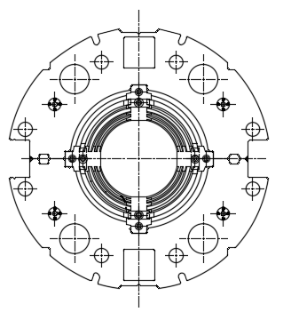
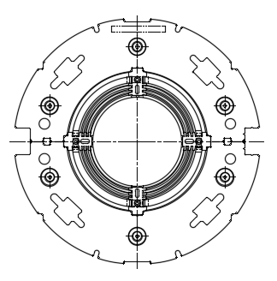
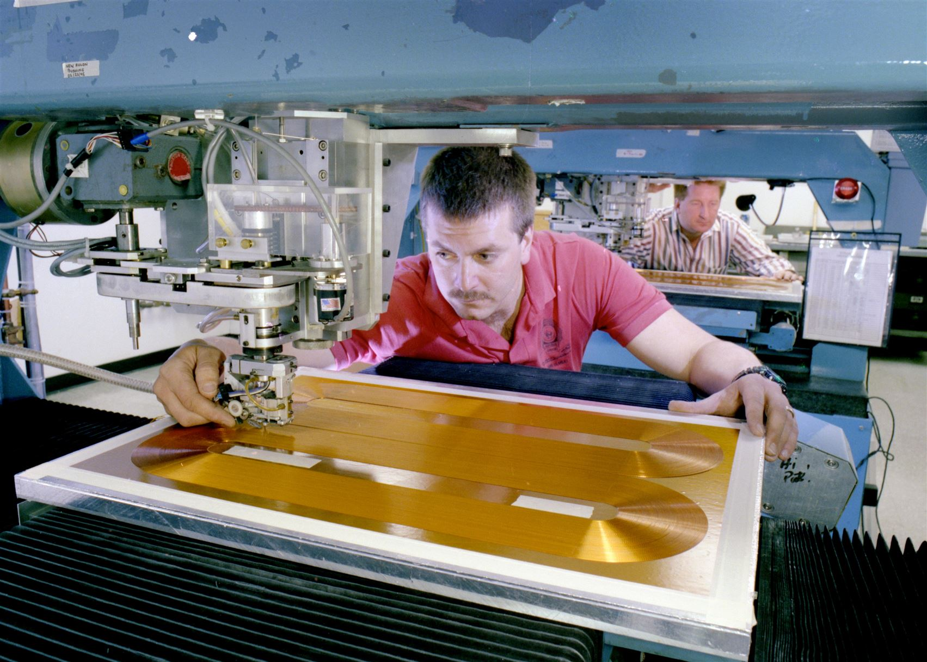
Magnet Highlights – 8cm & 13cm Correctors
8 cm
Superconducting “printed circuit” technology (later wrapped around tubes)
1468 coils fabricated – dipoles, quadrupoles, sextupoles, octupoles, decapoles, dodecapoles
10 different coil assembly types
concentric tubes in iron yokes
Coils supported & aligned at tube ends (13cm, individual coil alignment)
In time, 5 machines operated by one (!) single person
Only one (1!) failure, in 2003.
aperture (mm) | model | qty | coils per unit | total coils
80 | crb | 96 | 4 | 384
80 | crc | 132 | 4 | 528
80 | crd | 70 | 1 | 70
80 | cre | 70 | 1 | 70
80 | crf | 32 | 4 | 128
130 | I | 12 | 4 | 48
130 | J | 12 | 4 | 48
130 | K | 24 | 4 | 96
130 | L | 12 | 4 | 48
130 | M | 12 | 4 | 48
 | Total | 472 |  | 1468
13 cm

Slide 9
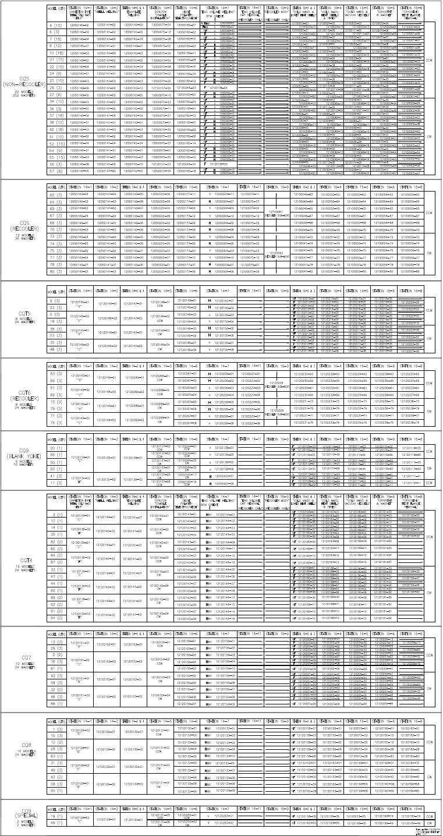
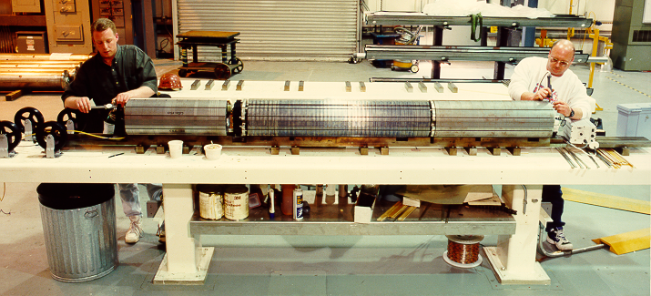
Magnet Highlights – CQS Magnets
CQS – CQT - CQ
Corrector – Quadrupole
Sextupole
Trim Quad
Nothing
420 built
94 Different Models! (not possible to outsource)
Drawings, procedures for all 94 models
Daily work planning meetings
Work spread across 4 buildings
Production at ONE PER DAY!
Master configuration chart

Slide 10
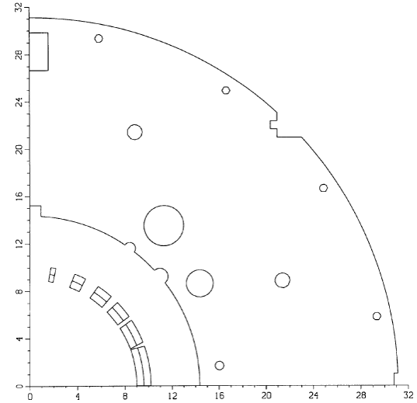
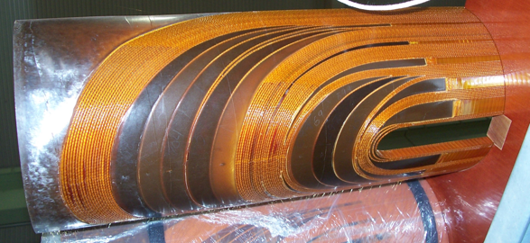
Magnet Highlights – 18cm DX Dipoles
  18cm aperture Cosθ NbTi, 4.3T @4.6K
  1 layer coil, 70 71 turns, 11.68mm 36 strand Rutherford cable
  641mm O.D., 3.7M magnetic length
  Largest, Most difficult magnet in RHIC:
    200 MPa coil azimuthal preload
    440 kN axial coil preload
  DOE: “Do not leave this for last”. We did. Critical Path for RHIC .
  Many coils destroyed themselves enroute to RHIC (17 lost to produce 28 acceptable) – coils ends “buckled” inwards
    After curing
    After collaring (also “shot” end saddle off the coil end)
    During initial prototype cold test
    Install supports on beam pipe – FIXED! All good, 12 more + 1 spare

Slide 11
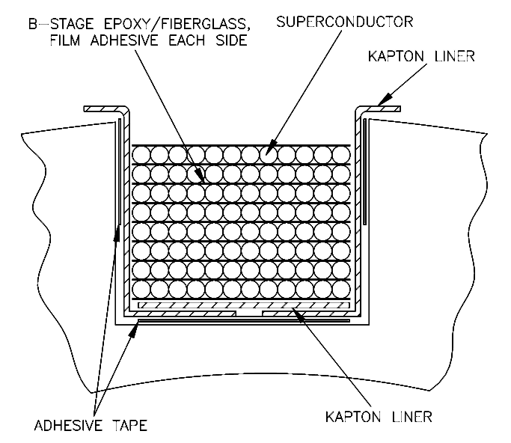
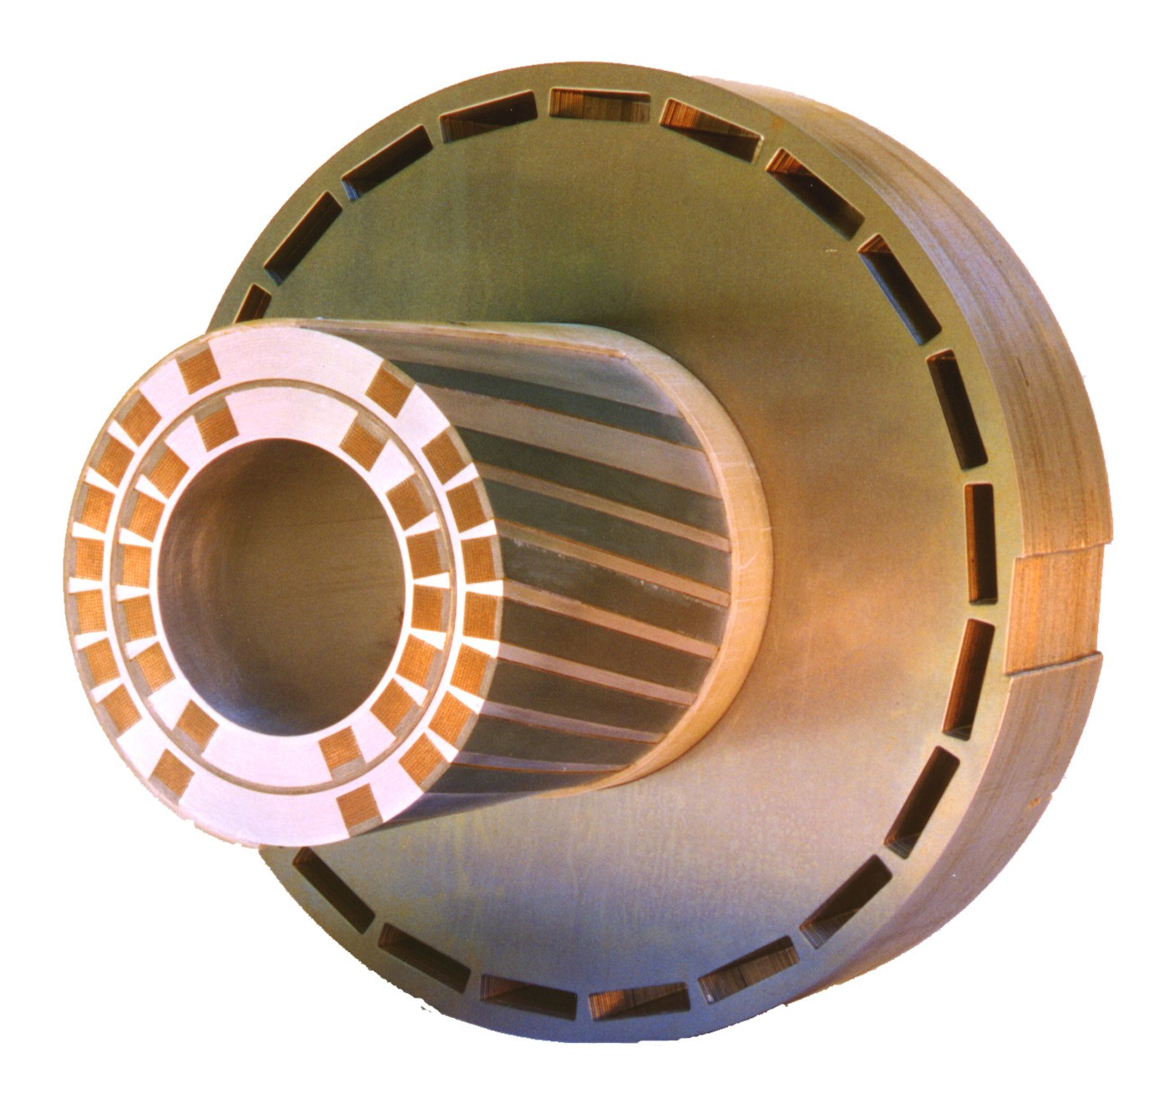
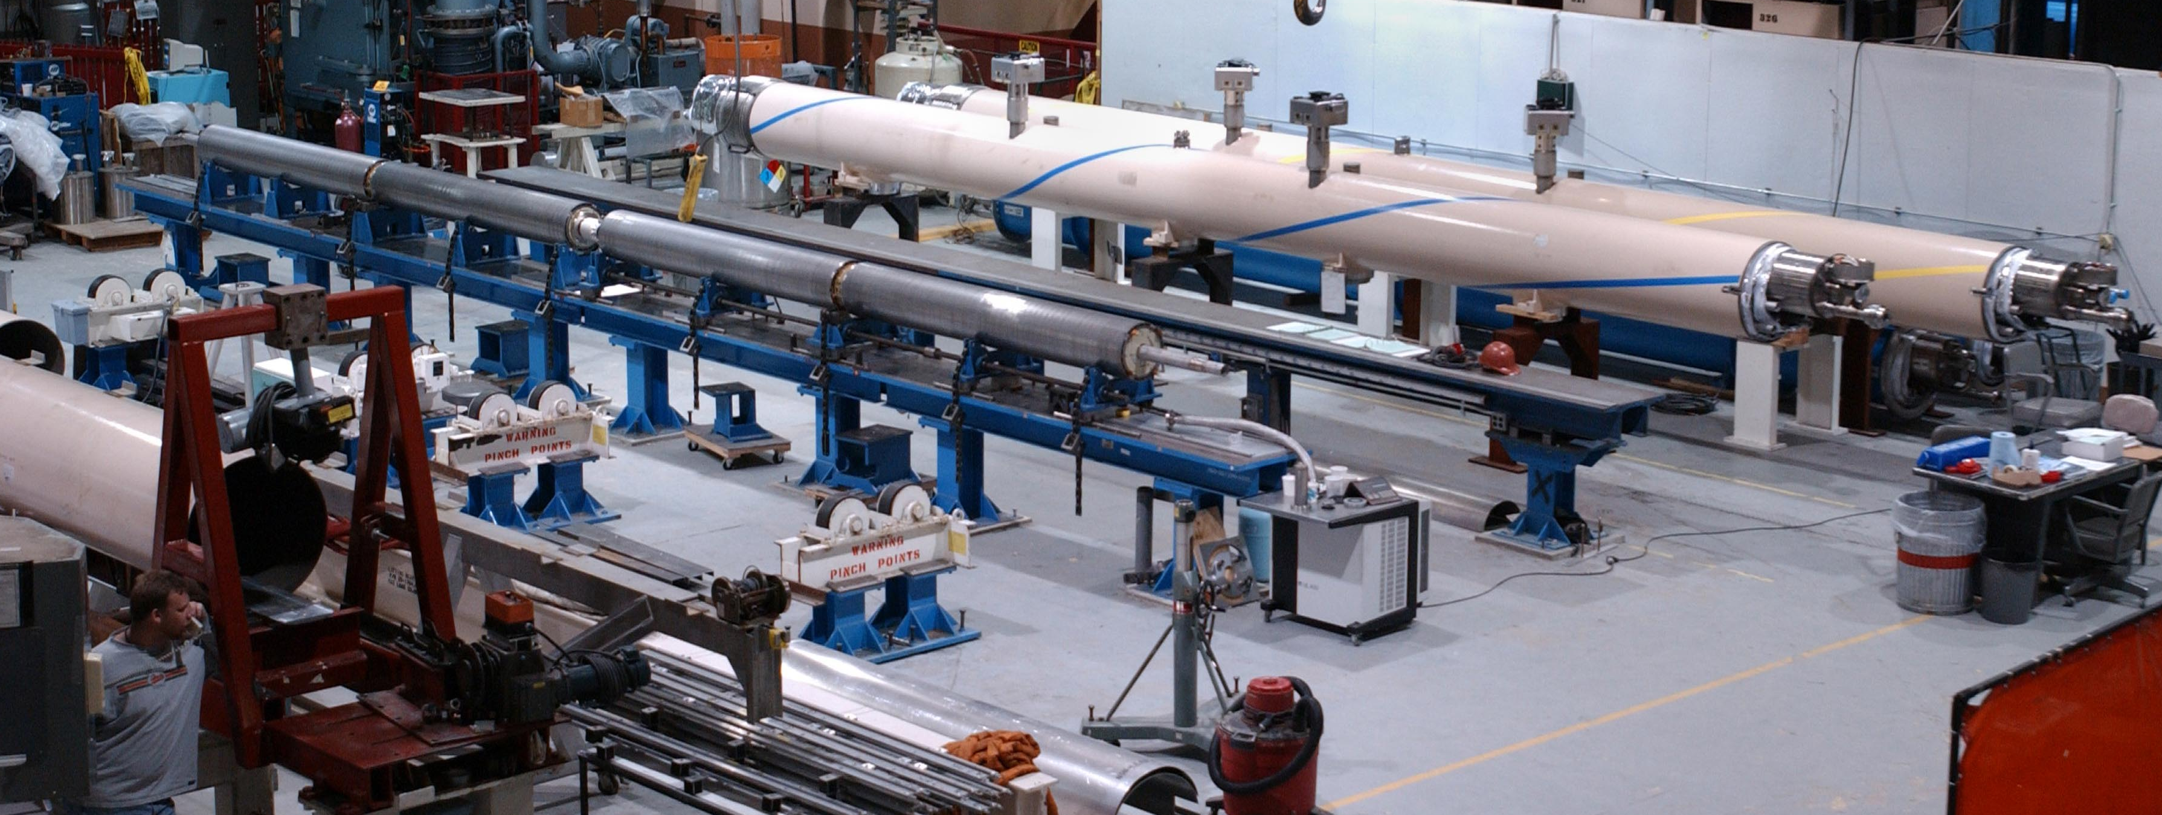
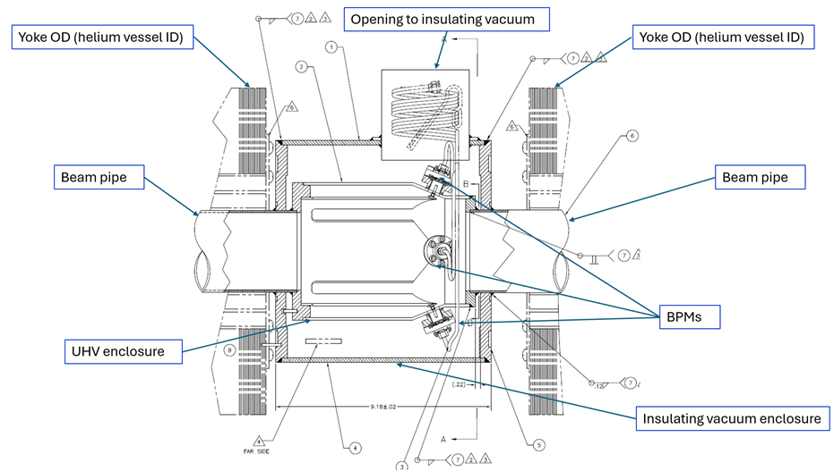
Aftermarket Magnet #1 – Helical (Riken)
12 magnets x 4 magnetic elements x 2 coils = 96 coils, all hand-wound
(4) Snakes – all right-hand helix
(8) Spin Rotators – 2 left-hand, 2 right-hand helices
4Tesla field, 100 mm aperture
355.6 mm yoke
7 x 0.33 mm strand NbTi 2.5:1.0 cu:sc
Production facility, then and now (rebuilds for EIC)
REPAIRS:
1st magnet copper exiting leads too short, thermal issue – fixed in RHIC tunnel, redesigned for subsequent magnets
Failed exiting lead in outer coil; returned, replaced, in 2003
Failed coil due to POWER DIP, returned, replaced in 2023
BPMs between magnetic elements

Slide 12
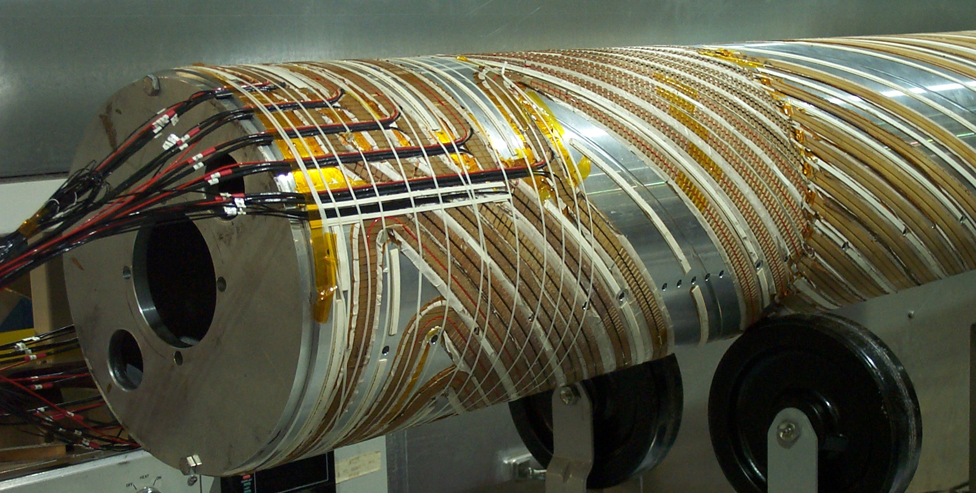
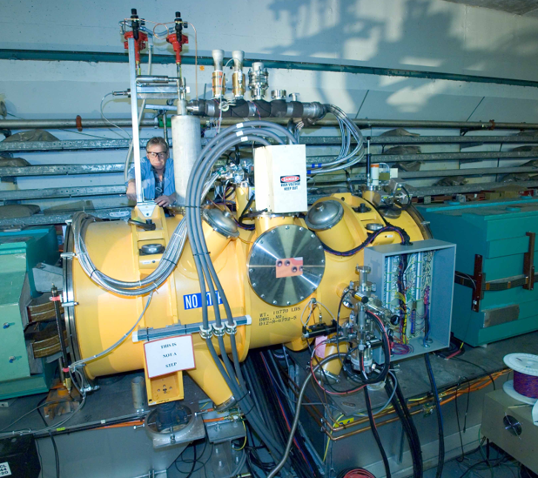
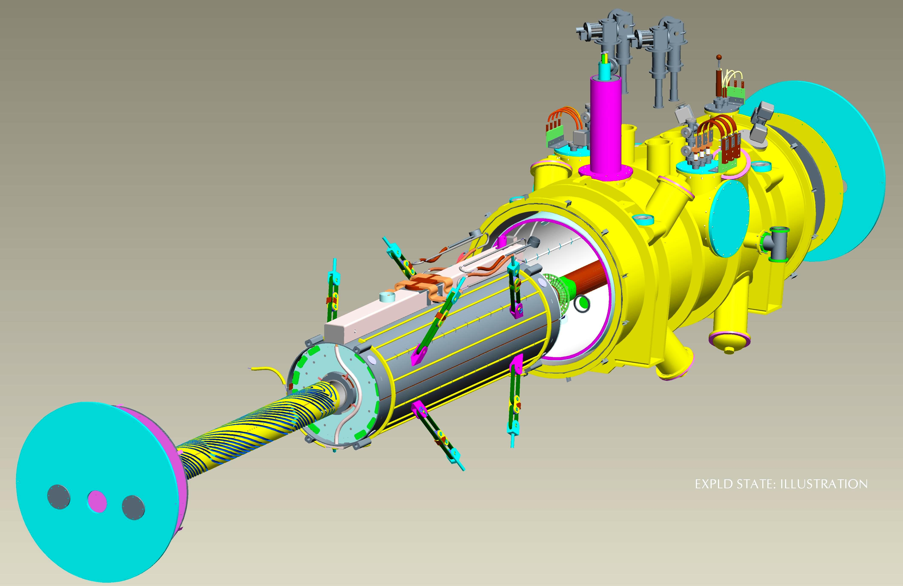
Aftermarket Magnet #2 – AGS Snake
3Tesla field, 203 mm coil ID
High temp s/c (HTS) power leads
Stand-alone cryogenics – 3 4 5 (?) cryocoolers
Helium fill / vent / recondensing system
Variable pitch s/c main coils in 3-D CNC pattern
Direct wind s/c solenoid and correctors on beam tube
Self-contained “plug-in” cryostat
Working flawlessly since installation
(Almost) thought to have developed an electrical problem
Loose aluminized mylar touching HTS leads, easily fixed
Constant stress/position low heat leak supports
Low inductance internal heat shield

Slide 13
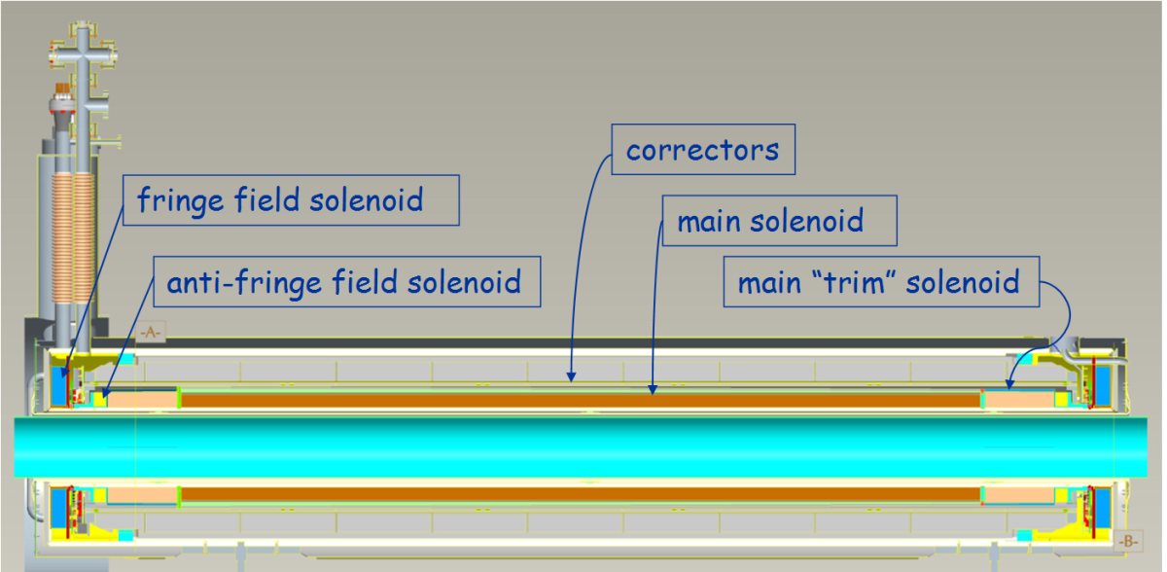
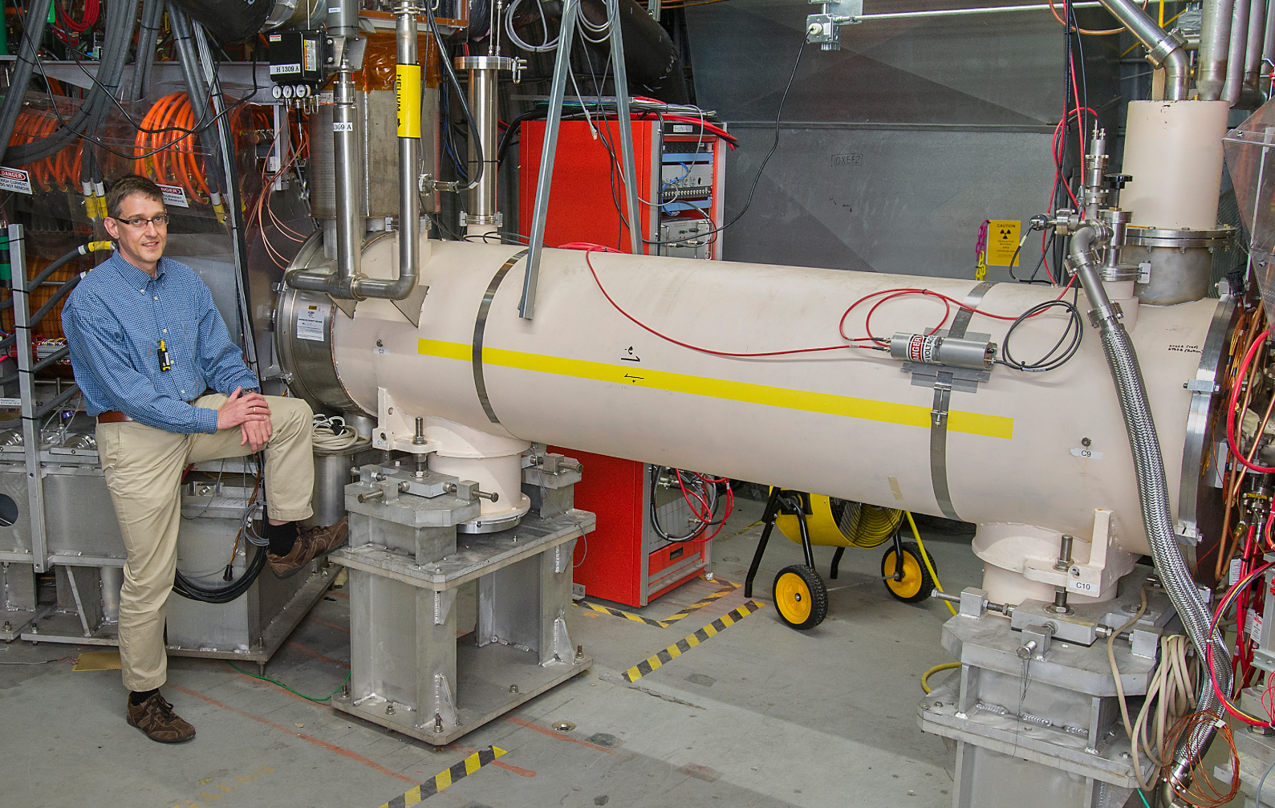
6 Tesla field, 200 mm Coil ID
6 x 10 ⁻³ field uniformity from 1T to 6T
± 50 microns field axis straightness, 1T to 6T
17 separate circuits:
  1 2.5m main solenoid – 22 layers!
  2 fringe field solenoids
  2 anti-fringe field solenoids
  5 0.5m vertical correctors
  5 0.5m horizontal correctors
  1 2.5m vertical corrector
  1 2.5m horizontal corrector
Helium vessel cooled by liquid bath Outer heat shield actively cooled from 4K boil-off, coil support tube is inner helium vessel, inner shield conductively cooled
Budget issues – cost savings:
“no bids” from industry
Incremental budgets from 3 sources (thank you, Stephanie LaMontagne)
Surplus RHIC cryostats
Surplus IsaBelle (!) SST helium vessel
Surplus RHIC support posts
Aftermarket Magnet #3 – e-Lens Solenoids (2)
Construction Issues (all unit 1)
After 22 layers, electrical short in layer 1
Unwire, use 20 layers, OK
FF coil reversed forces (!)
Broke free during testing. Fixed, added structure, OK
Thermal short in aperture
Drill holes blindly between main coil & anti-FF coil add new inner helium vessel (DX beam pipe!), OK
Magnets tested to 6.4T, 6.6T
“Beam-Beam Compensation Scheme Doubles Proton-Proton Collision Rates at RHIC”

Slide 14
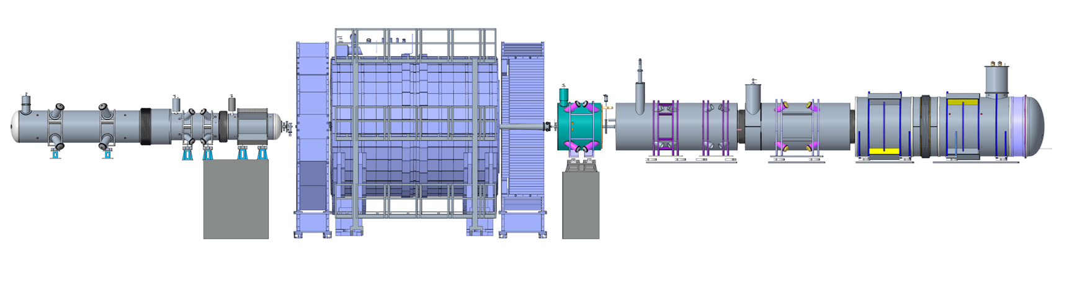
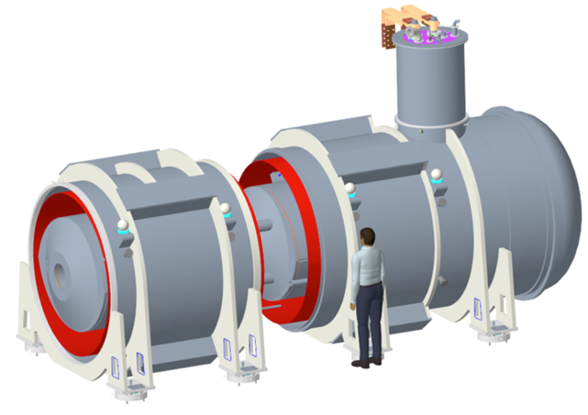
And Now On To EIC!
EIC Interaction Region
REAR SIDE
FORWARD SIDE
FC-1
B0ApF
Q1ApF
Q1BpF
Q1eF
EPIC DETECTOR
RC-3
Q2pR
ESR corr
RC-2
Q1BpR
Q2eR
RC-1
Q1ApR
Q1eR
FC-3
B1pF
Skew
quad
B0pF Q0eF
Q2pF
ESR
corr
FC-4
B1ApF
28 unique magnetic elements
8 separate cryostats (up to 2.3 m Diameter) – already lots of fun…

Slide 15
Thank you for your attention

