Slide 1
Ion Sources: Enabling 25 Years of RHIC Operations (2000–2025) and the Path to the EIC
Deepak Raparia
RHICfest
July 10, 2026

Slide 2
Acknowledgements
Contributors:
J. Alessi, G. Atoian, E. Beebe, C. Carlson, B. Coe, A. Cannavo , C. Ianzano, S. Ikeda, A. Kponou, T. Kanesue, S. Kondrashev, T. Kubley, T. Lehn, V. Lodestro, G. London, M J. Maxwell (JLAB), R. Milner (MIT), S. Pikin, A. Poblaguev, J. Ritter, R. Schoepfer, B. Snyder D. Steski, A. Sukhanov, P. Thieberger, S. Trabocchi, R. Vorbach, N.B. Wuerfel (MIT). A. Zelenski
Collaborators
Retired
D. Raparia, CAD Seminar 24/09/13

Slide 3
Outlines
Introduction
Light and Heavy ions
-Tandem
-EBIS
Polarized
-OPPIS
-He-3 in progress
Conclusions

Slide 4
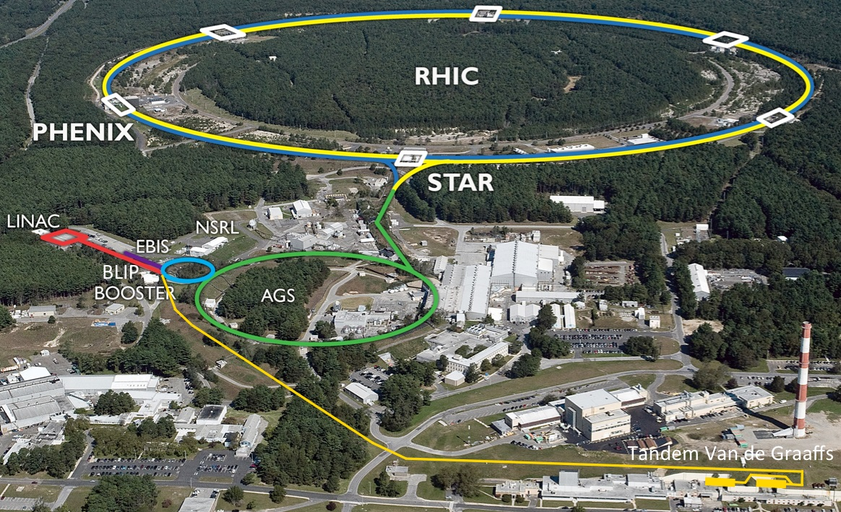

Slide 5
Evolution of RHIC Sources
Three sources supported one collider.
Each source solved a different challenge
Year | Source
2000 | Tandem begins RHIC operation
2001 | First polarized proton collisions (OPPIS)
2012 | EBIS as primary heavy-ion injector
2025 | Final RHIC operations
2026 | Transition to EIC era- addition of Pol He-3

Slide 6
Tandem

Slide 7
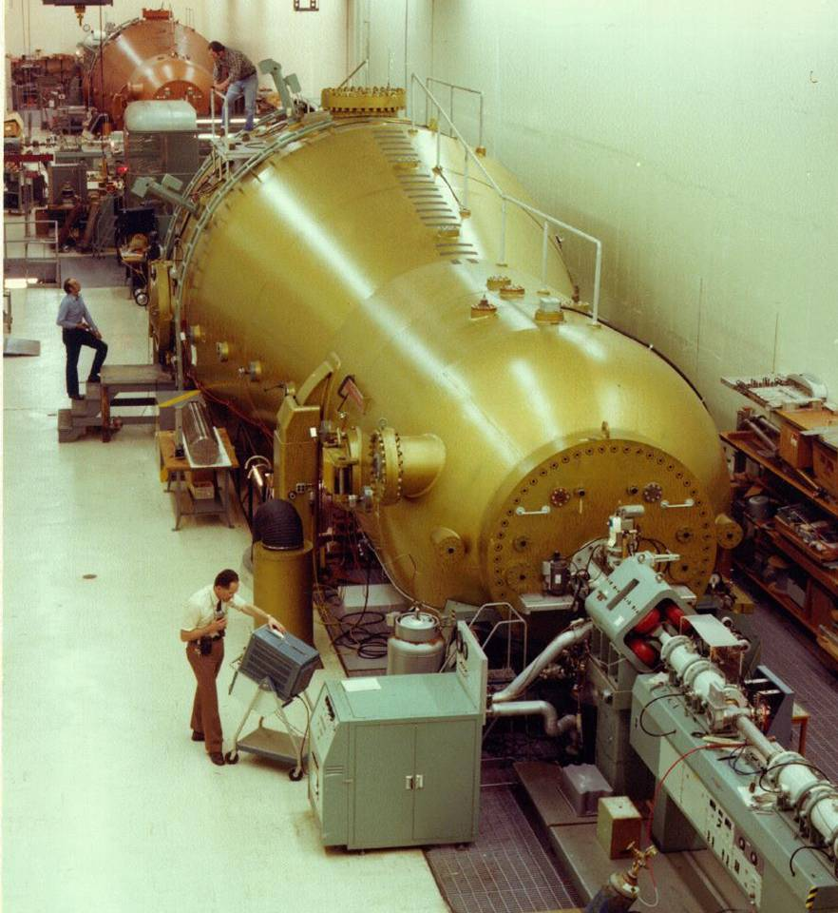
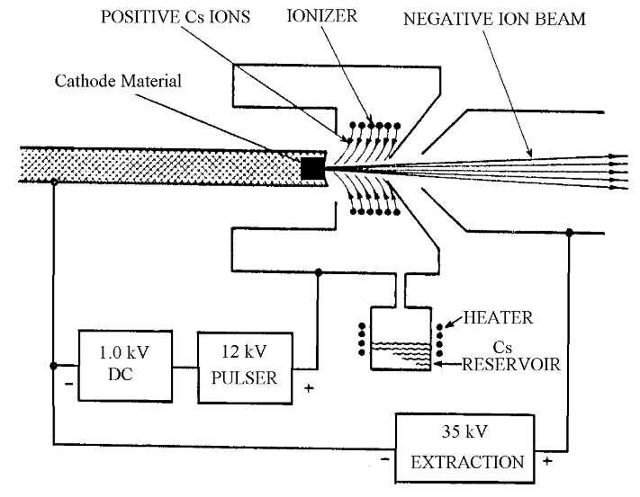

BNL Tandem Van de Graaffs
Commissioned 1970
D. Steski
1983: P. Thieberger et al. demonstrated that the Tandem could produce pulsed beam using a Cs Sputter Ion Source
RHICfest: Raparia 260710

Slide 8
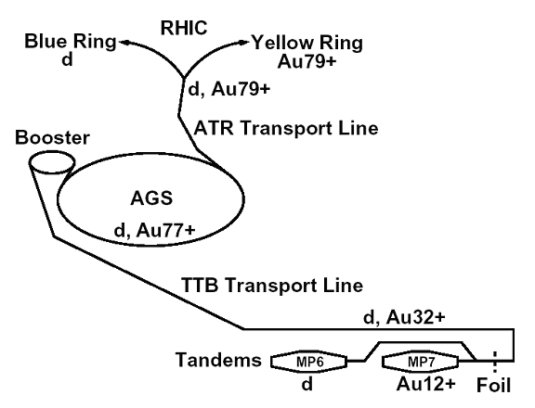
HITL and TtB direct injection into AGS and Booster
D. Steski
May 19, 1986, Oxygen beam circulated in AGS
1992: first acceleration of Au beam in the Booster and AGS
RHICfest: Raparia 260710

Slide 9
Highlights
D. Steski
Tandem begins operation. 1970
First heavy ions from Tandem to AGS via HITL 1986
Booster replaces direct HITL injection 1991
First circulating Au beam (1999)
2000 First RHIC Au+Au collisions
Collision of asymmetric masses d-Au using both MP6 and MP7 (2003, 2008, 2016, 2021)
Cu-Cu collisions (2005)
Isobar experiment ⁹⁶Ru from Tandem ⁹⁶Zr from EBIS (2018)
Final ion beam O-O supplied from Tandem (2026)
RHICfest: Raparia 260710

Slide 10
EBIS

Slide 11
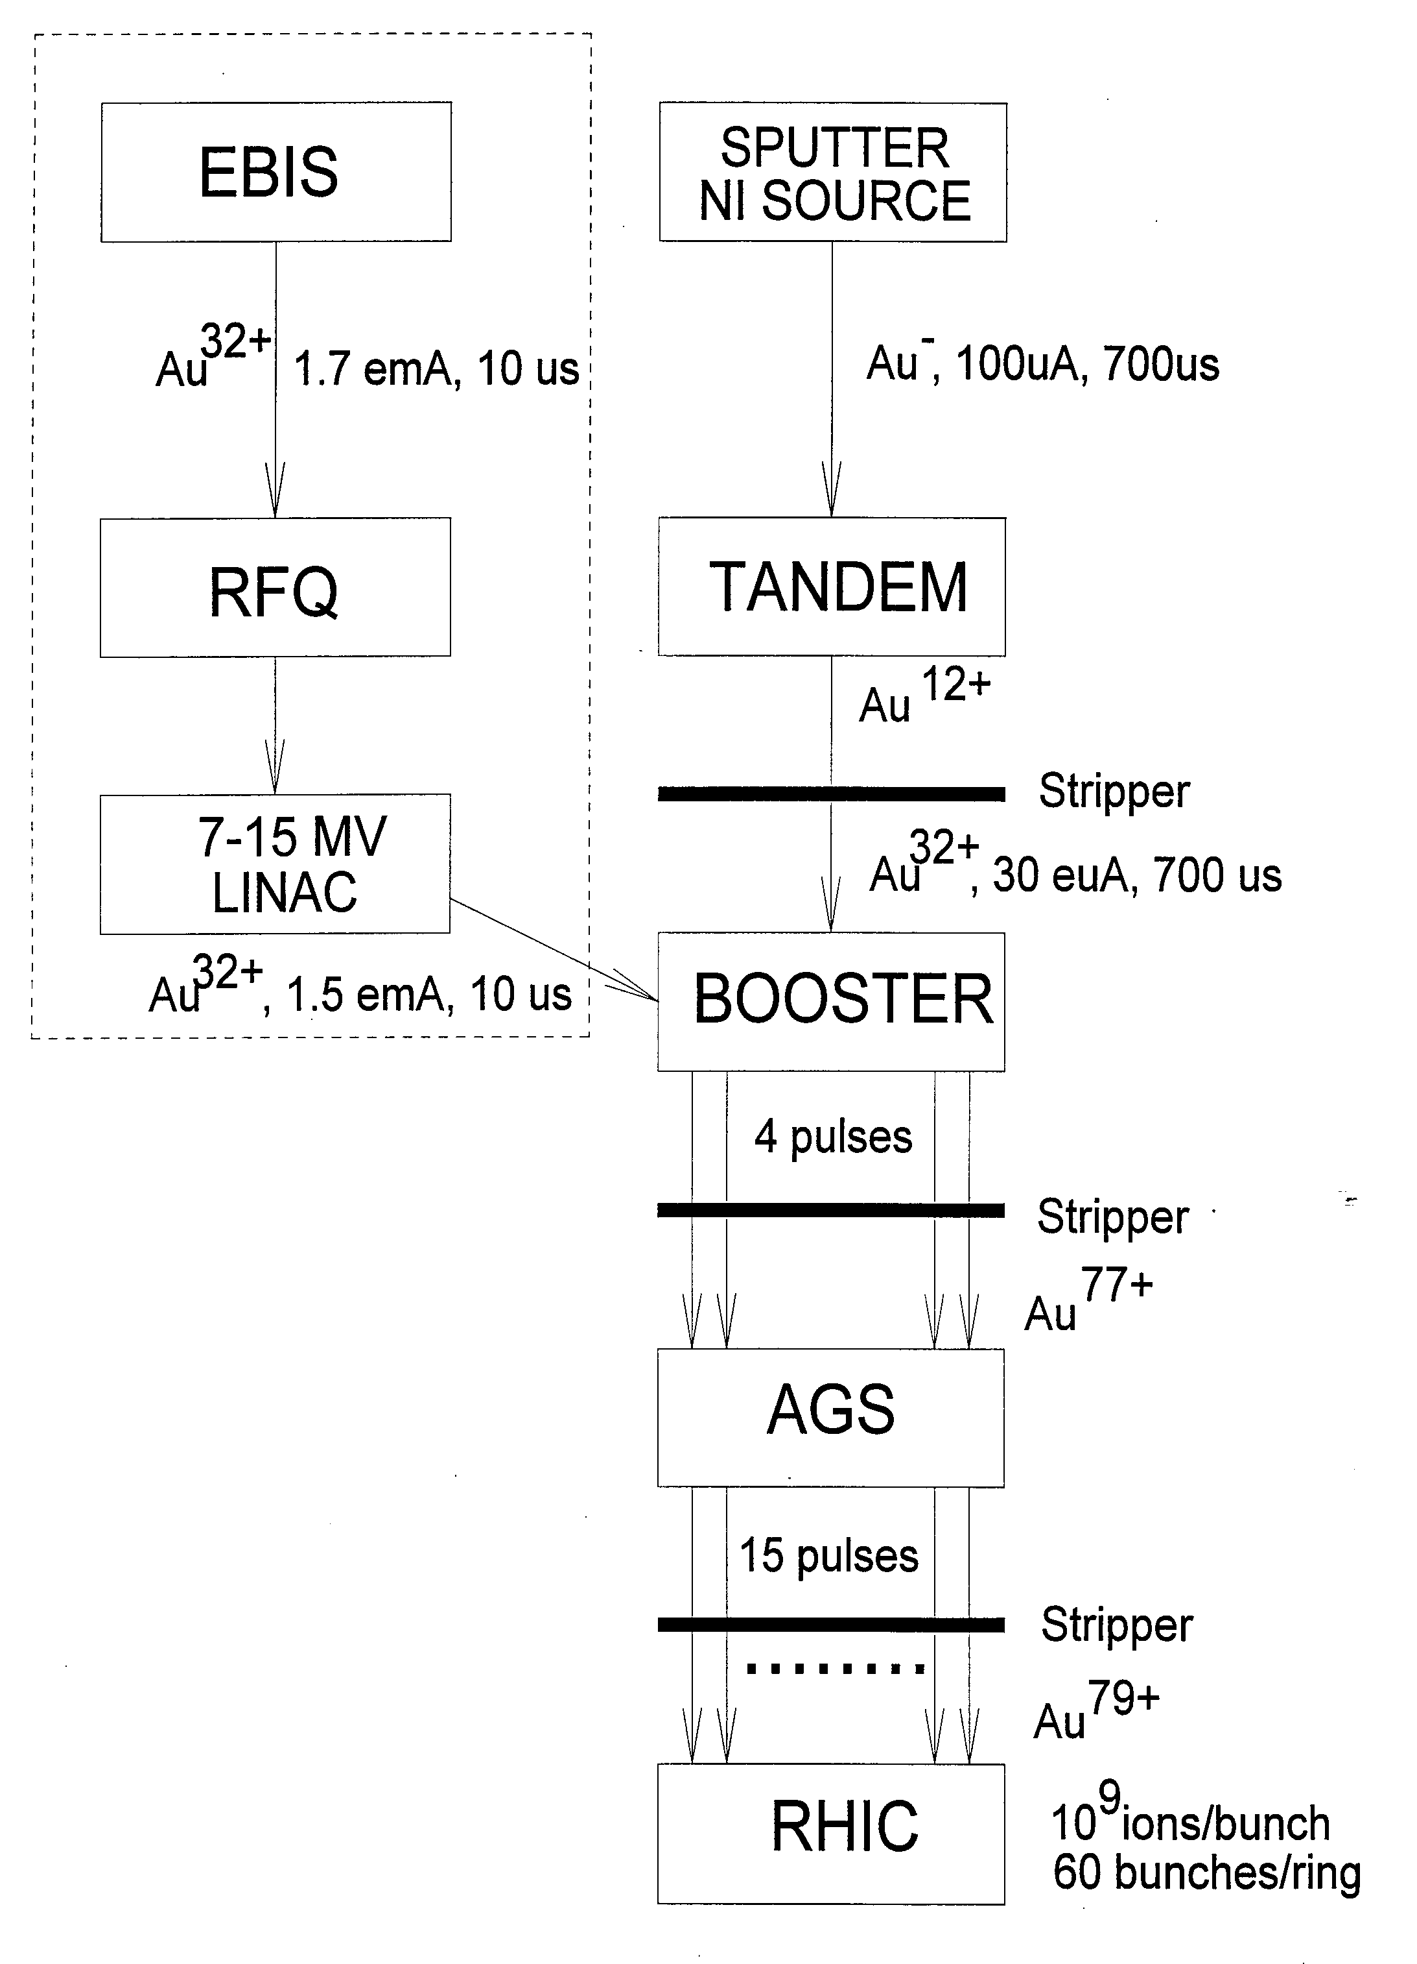
Tandem as preinjector
860 m transport line to Booster
Stripping foils at terminal and high energy
  lead to intensity & energy spread variations
Injection over > 40 turns is required
Limitations on ion species (must start with
negative ions)
High maintenance, manpower
Low Momentum spread
Higher beam current
Advantages of the new preinjector:
Simple, modern, low maintenance
Lower operating cost
Can produce any ions (U, He³↑)
Higher Au injection energy into Booster
Fast switching between species
Short transfer line to Booster (30 m)
Few-turn injection
No stripping needed before the Booster
Expect future improvements to lead to
higher intensities

Slide 12
EBIS as Preinjector
1979
1994
RHICfest: Raparia 260710

Slide 13
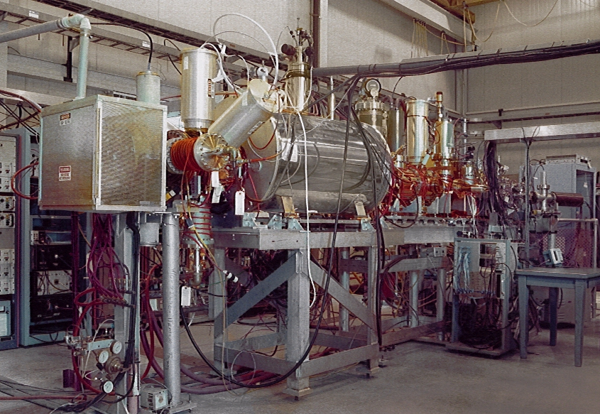
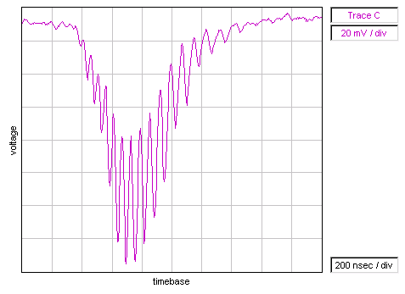
EBIS Test Stand
RHICfest: Raparia 260710

Slide 14
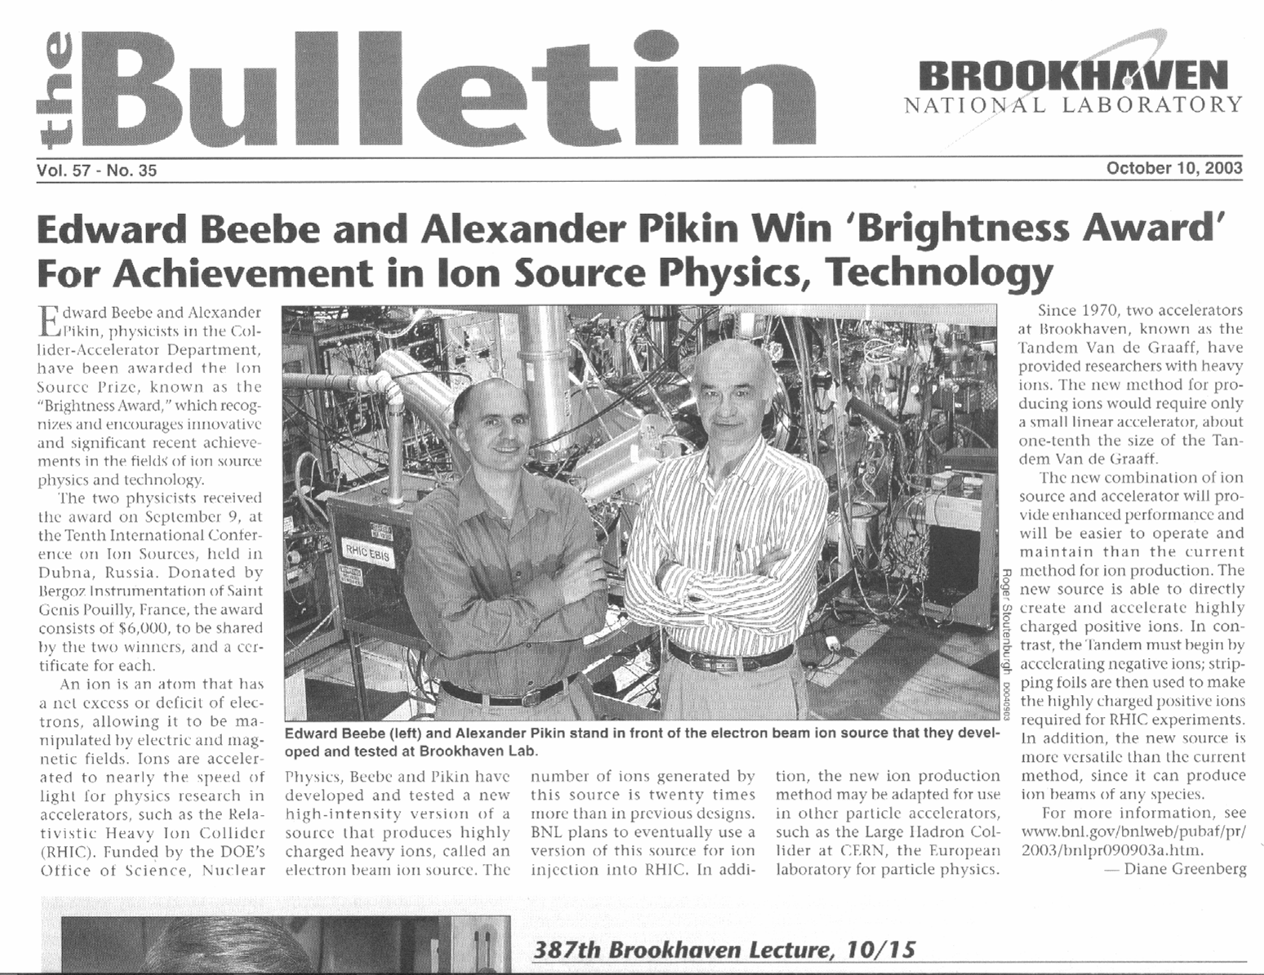
Received at 10th International Conference on Ion Sources (Dubna)

Slide 15
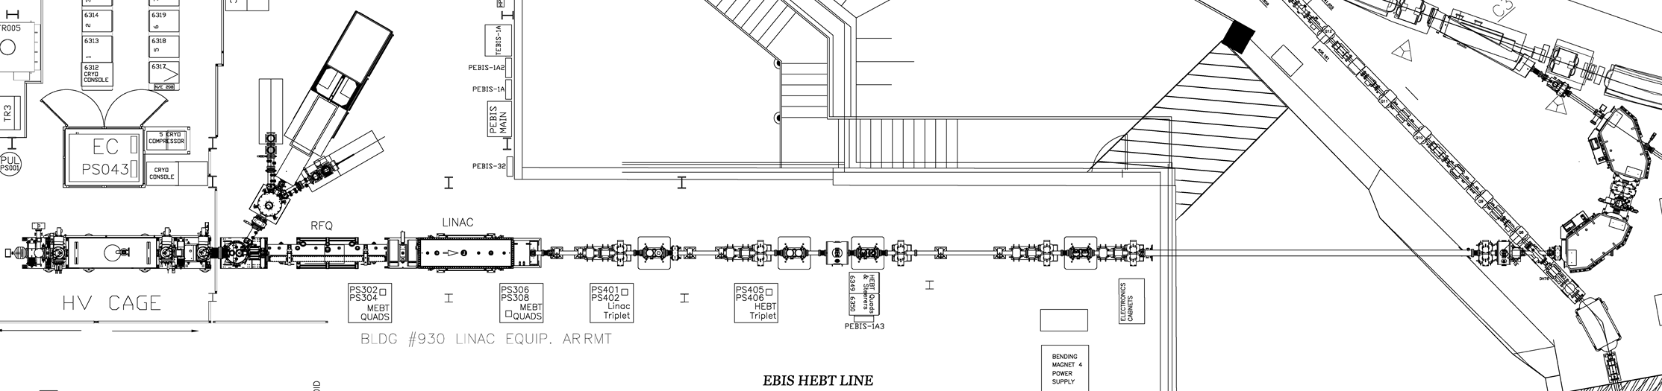
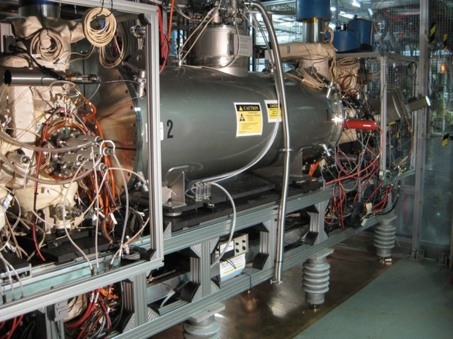
EBIS Preinjector (2 MeV/u)
LION
BOOSTER
HCIS
HCIS2
BNL Science and Technology Award
BIG BEND
EBIS
RFQ
IH LINAC
BEAM TRANSPORT LINE
17 keV/u
300 keV/u
2 MeV/u
LION
Ions | He - U
Q / m | ≥1/6
Current | > 1.5 emA (20 μs)
Pulse length | 10-40 μs
Rep rate | 5 Hz
Output energy | 2 MeV / u
Time to switch species | 1 second
HCIS1
HCIS2
EBIS
TOF
RFQ
IH LINAC
RHICfest: Raparia 260710

Slide 16
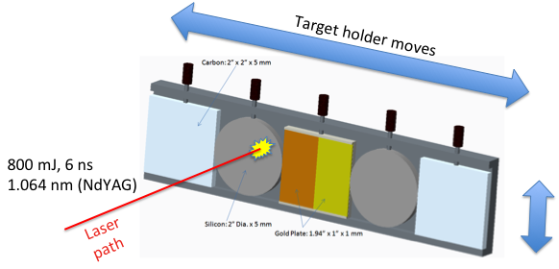
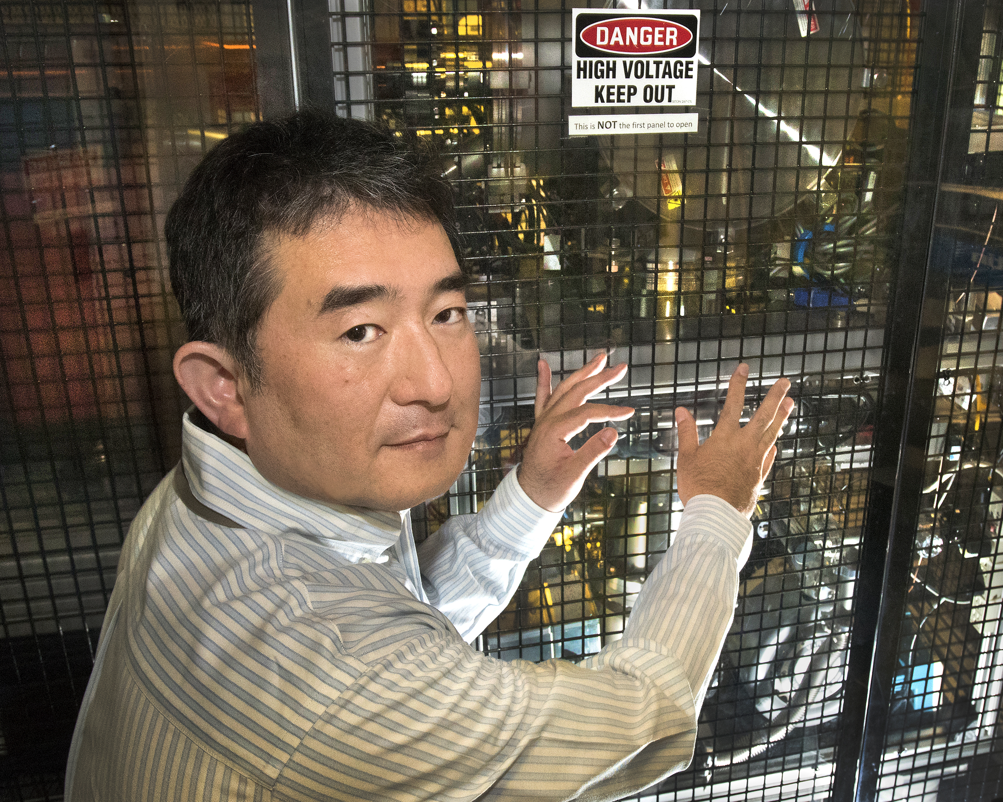
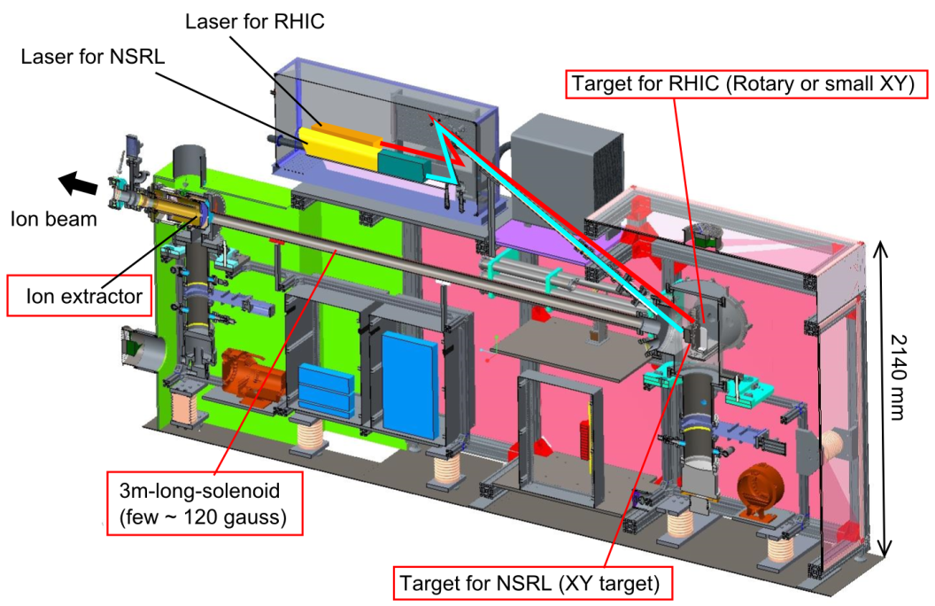
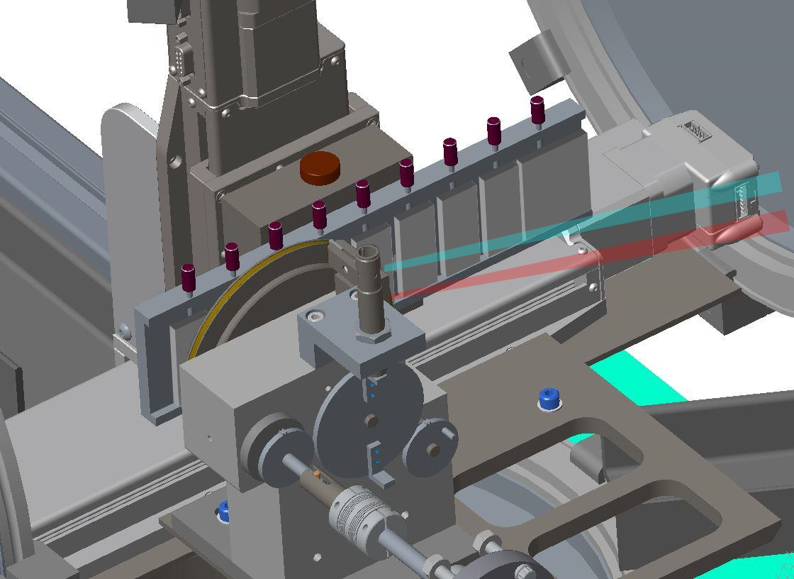
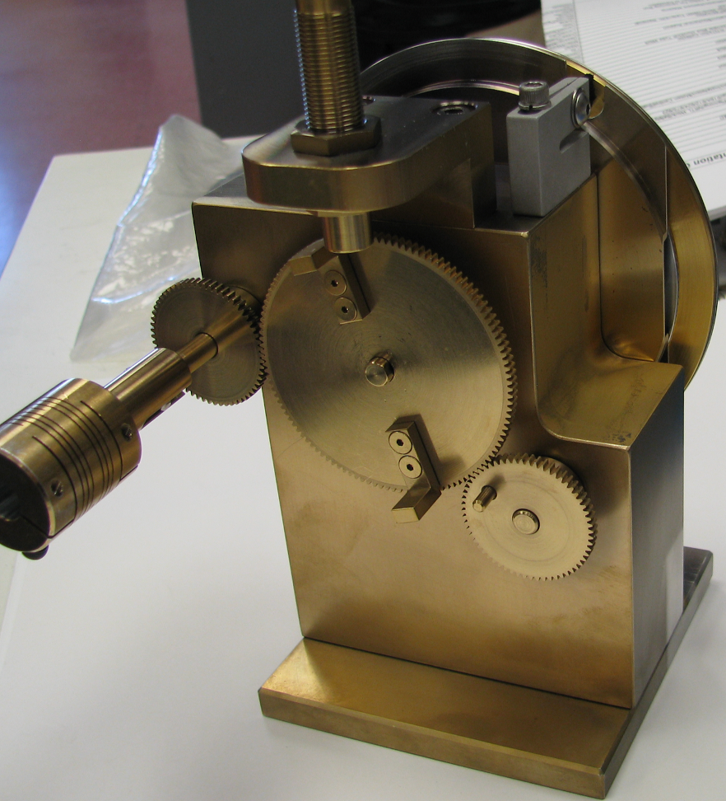
LION (Low charge state LIS)
M. Okamura, T. Kanesue, S. Ikeda , C.J, John (Halinski)
Successful operation since 2014
Target for NSRL
2016 Science & Technology Award
Target for RHIC
(Rotating Au, 2.2 mm/5 sec)
Fast species switching - within several seconds (positions of target materials)
Keep high vacuum - good for EBIS operation
Controllable beam current - solenoid plasma guide control without effecting pulse timing
Good emittance - beams extracted from cold plasmas
Robust operation - since commissioning, almost no down time
RHICfest: Raparia 260710

Slide 17
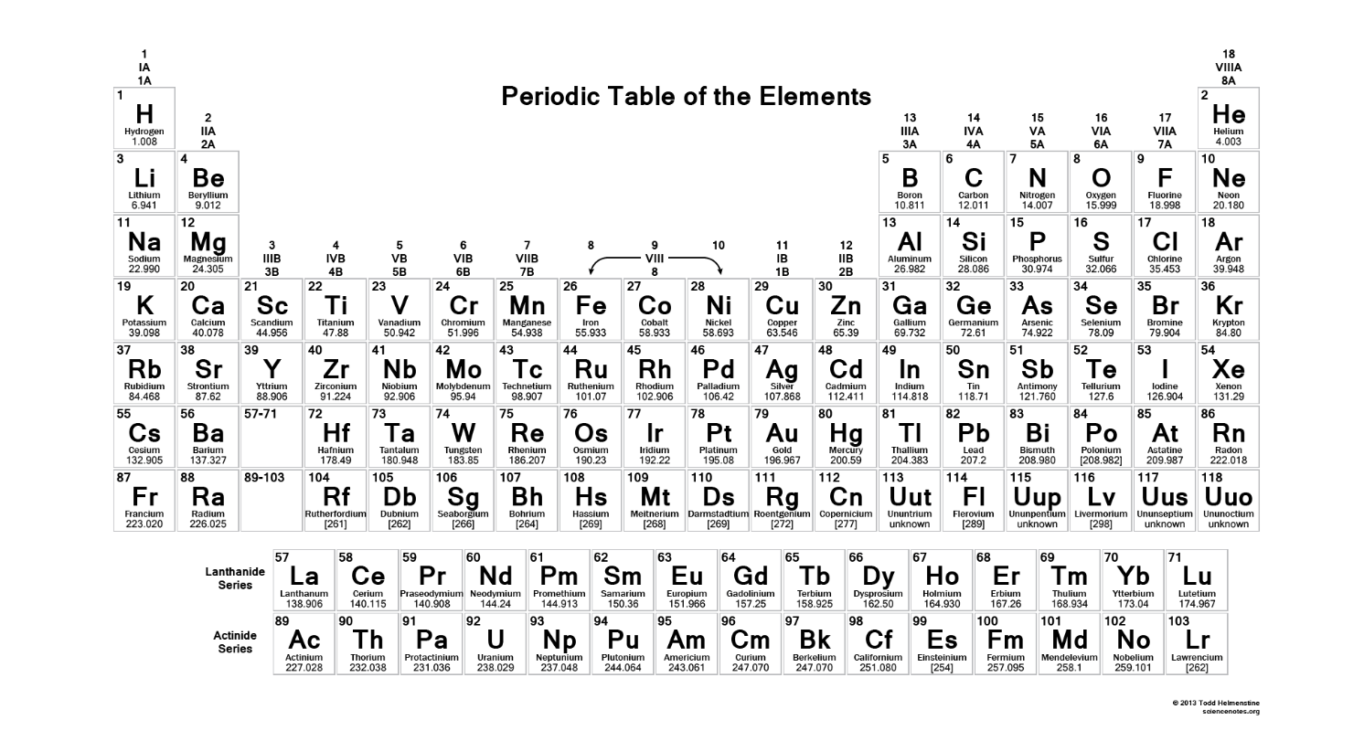
EBIS beams run to date on RHIC EBIS
D, ³He²⁺, ⁴He^{1+,2+}, Li³⁺, C^{5+,6+}, O⁷⁺, Ne⁵⁺, Al⁵⁺, Si^{11+,12+}, Ar¹¹⁺, Ca¹⁴⁺, Ti¹⁸⁺, Fe^{20+,24+}, Cu¹¹⁺, Kr¹⁸⁺, ⁹⁰Zr¹⁵⁺, ⁹⁶Zr¹⁶⁺, Nb¹⁶⁺, Xe²⁷⁺, Ta³⁸⁺, ¹⁸⁴W³¹⁺, Au³²⁺, Pb³⁴⁺, ²³²Th³⁹⁺, U³⁹⁺
1 second switching between species (2, or more), alternating
<30 second switching among almost any 10, if loaded into external sources
RHICfest: Raparia 260710

Slide 18
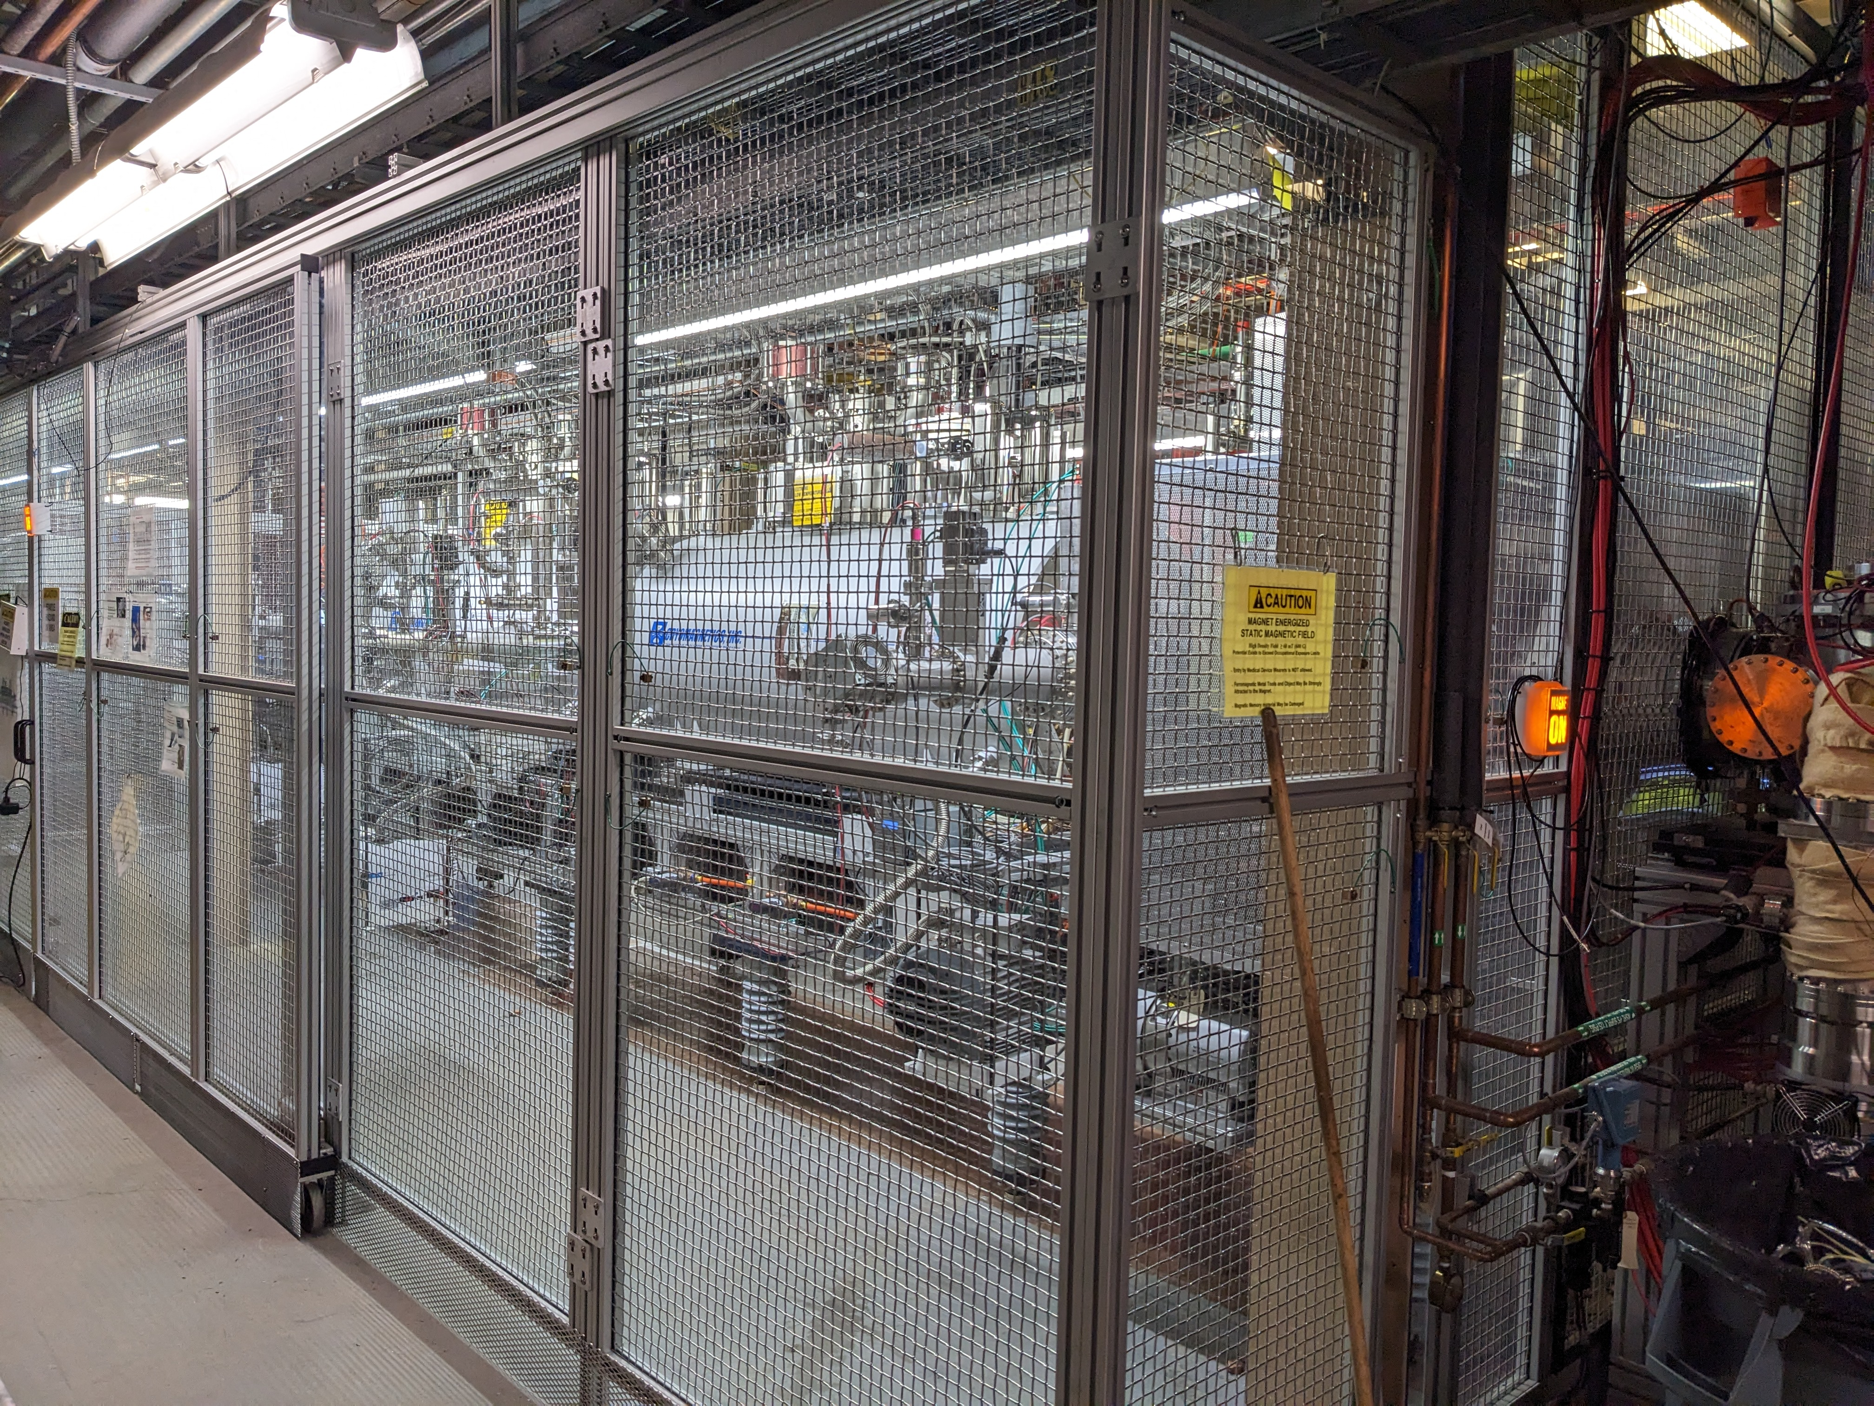
Extended EBIS
E. Beebe, B. Coe, S. Ikeda, T. Kanesue, S. Pikin, S. Kondrashev, D. Raparia, J. Ritter, R. Schoepfer , R. Vorbach
Dual Trap Regions: EEBIS introduced a pioneering design, making it the world's first ion source with two trapping regions. This innovative configuration enhances ionization and trapping processes, demonstrating the potential for significant advancements in ion source technology.
Efficient Gas Delivery: The integration of a pulse valve enables precise and efficient gas supply directly into the trapping regions. This optimization improves overall functionality, contributing to the successful operation of EEBIS.
External drift tube construction with differential pumping stages and custom pump out manifold to provide space for gas reservoir high field polarization cell
An innovative pulsed valve: Valve operating on the Lorentz force mounted to the gas ionization cell drift tube via a compact insulator
Polarized He-3: High field 3He polarization cell and purification system (tested in a separate solenoid)
RHICfest: Raparia 260710

Slide 19
Timeline of EBIS
29 Jun 2010 — First EBIS beam transported to Booster
2 Jul 2010 — First EBIS beam circulating in Booster
2011 — First EBIS Au and U beams commissioned through AGS and RHIC
2012 — First RHIC physics run using EBIS ions (U+U, Cu+Au)
2023 --- EBIS upgrade with two solenoid
2026 -- He-3, gas cell installation and commissioning
Highest Au intensity 2e-9 per bunch in RHIC in 2016
RHICfest: Raparia 260710

Slide 20
OPPIS

Slide 21
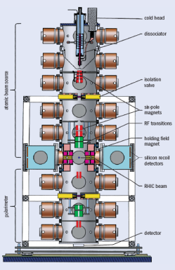
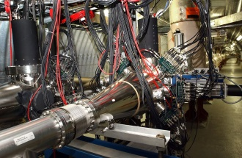
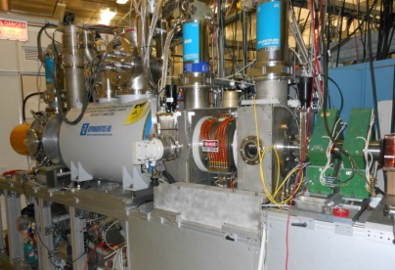
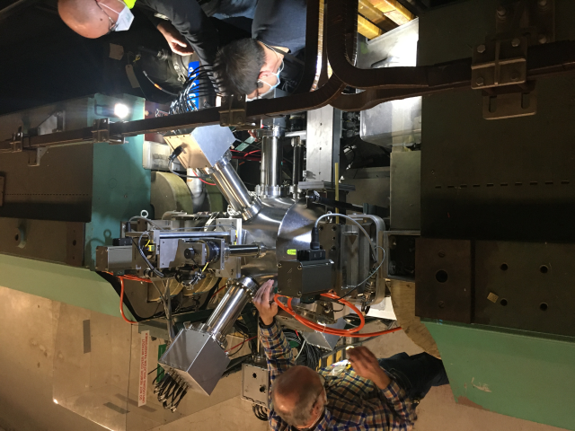
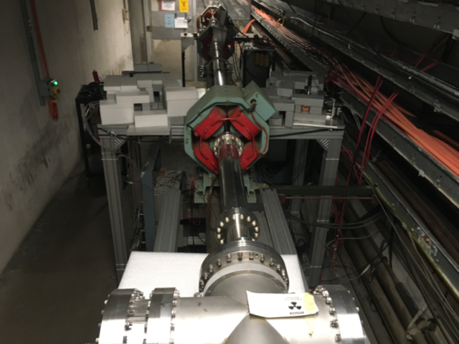
Polarization facilities at RHIC
The world’s only polarized proton collider: 60% proton polarization , L _{max}=1.6×10³² s⁻¹cm⁻²; 50<√s <510 GeV
Absolute H-jet
polarimeter
RHIC pC “CNI” polarimeters
Siberian Snakes
RHIC
Siberian Snakes
PHENIX
STAR
H- polarize source OPPIS
Spin Rotators
AGS pC “CNI” polarimeter
BOOSTER 2.5 GeV
LINAC
AGS 24 GeV
200 MeV polarimeter
Strong and Partial
Siberian Snakes
RHICfest: Raparia 260710

Slide 22
BNL pulse polarized H⁻ source (1982)
Atomic Beam
Pulse Ground state atomic beam line with an RF Disassociator (pulse), Nozzle thermalized at 100 K
Sextupole for electron polarized beam
RF transition for polarization transfer to Nuclear Pulse to pulse basis
Density of H⁰ beam 2-3 10¹¹ atoms /cm³
Charge Exchange
Surface ionization of cesium on a hot porous
Tungsten button , 30KeV 15 mA Cs⁺
Neutralized by cesium vapor (pulse)
6-10 particle mA,30 cm long
Charge exchange ionization
H↑ +Cs⁰ -> H⁻ ↑+ Cs⁺
H⁻ ↑ , 25 uA, 75% polarization,
emittance 0.065 pi cm mrad
500 𝜇s
J. Alessi , etal, “ A 25 uA Pulsed Polarized H- ion source, 6th internation Symp. On high energy Spin Physics, France, 9/12-19, 1984

Slide 23
OPPIS evolution
G. Atoian, A. Cannavo, T. Lehn, V. Lodestro, A. Kponou, D. Raparia, J. Ritter, B. Snyder, A. Zelenski
The OPPIS polarized proton source for RHIC.
The OPPIS technique for polarized H− ion beam production was developed in the early 1980s at KEK (Japan), INR(Russia), LAMPF (USA), and TRIUMF (Canada).This particular OPPIS has a long development history. In the 1980s, it was first developed at KEK. In the 1990s, it was transferred to TRIUMF for further upgrades for RHIC in collaboration with INR. In 2000, it was brought to BNL
The source has been upgraded several times and continuously improves polarization, intensity and emittance.
Prior to Run-12, the ECR-type source was used to generate the primary proton beam.
In 2012, the ECR-source was replaced by a high-brightness OPPIS source FABS-type (Fast Atomic Beam Source).
Unlike the ECR-type source, the FABS-type source operates in pulsed mode and is located outside the SCS magnet.
In 2022, the length LEBT was reduced by about 5feet, and modified part of OPPIS (FABS, Rb-cell and Na-cell) and the extractor-transformer system.
This new source has enabled improvements in beam parameters such as current density, emittance, and stability.
RHICfest: Raparia 260710

Slide 24
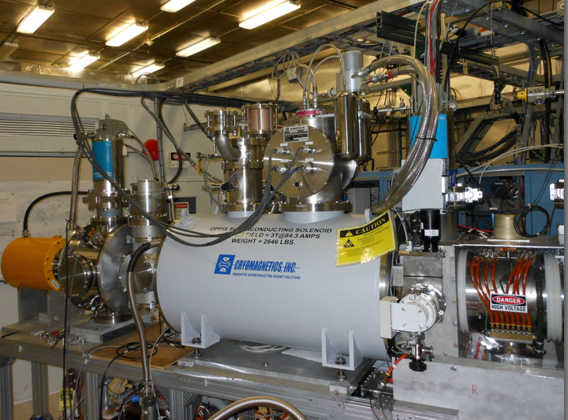
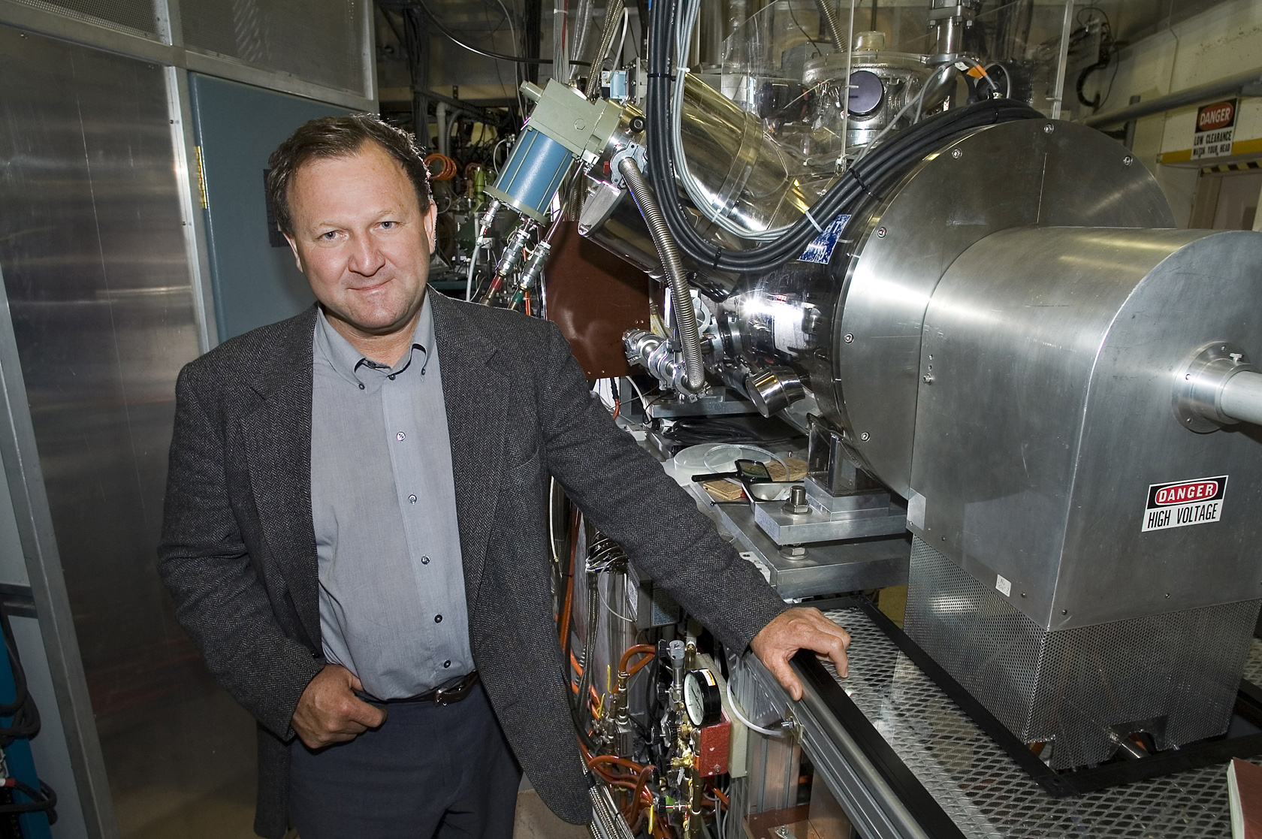
OPPIS in 2012
81-85% polarization @200 MeV , 0.5 mA
Anatoli Zelenski Science and Technology Award in 2004.
Anatoli Zelenski 2006 Veksler Award from the Russian Academy of Sciences
Anatoli Zelenski won the Brightness Award in 2019 for his development of the high-current, optically pumped polarized H− ion source (OPPIS).
RHICfest: Raparia 260710

Slide 25
OPPIS Layout
OPPIS: Six steps: (1) Atomic beam, FABS, (2) Ionization of atomic beam, He-Cell, (3) Rb-electron polarization, Rb-Cell, (4) Rb-electron transfer to H, Rb-cell (5) nuclear polarization, Sona Transition and (6) ionization, Na cell
95%
60%
70%
8%
D. Raparia, CAD Seminar 24/09/13
RHICfest: Raparia 260710

Slide 26
Spin-Exchange polarization in P-Rb Collisions
Laser-795 nm
Optical pumping
Rb: NL(Rb) ~10¹⁴ cm-2
Na-jet ionizer cell:
NL(Na)~ 3•10¹⁵ cm-2
Rb⁺
Rb
Proton
source
H⁺
H⁰
Sona
transition
Ionizer
cell
H⁻
1.5 kG field
Н⁺ He cell
Superconducting solenoid 2.5T
Charge-exchange collisions:σ ~10¹⁴ cm2
Electron to proton polarization transfer
Laser beam is a primary source of angular momentum:
10 W (795 nm) 4•1019 hν/sec 2 A, H⁰ equivalent intensity.
RHICfest: Raparia 260710

Slide 27
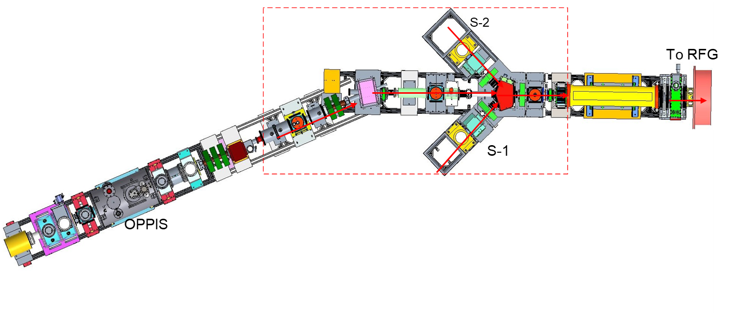
Optically Polarized proton source (OPPIS)
G. Atoian, A. Cannavo, T. Lehn, V. Lodestro, A. Kponou, D. Raparia, J. Ritter, B. Snyder, A. Zelenski
Extractor 35kV
SCS Magnet 23.7⁰ Spin rotator
Spin transfer: longitudinal→ transverse(horizontal)→ vertical
Ionization Na-cell
Solenoid
Switching Magnet (50 ms)
Sona transition
Magnet
23.7⁰
Spin rotator
Correction coil system
Neutralization Ru-cell
RFQ
To LINAC
Neutralization H-cell
Deceleration 3-grids ~3-4keV
Acceleration
4-grids
(5-7) keV
Ionization He-cell
MEBT
LEBT
Plasmatron
SCS
Laser room
Prob laser
Pumping laser
RHICfest: Raparia 260710

Slide 28
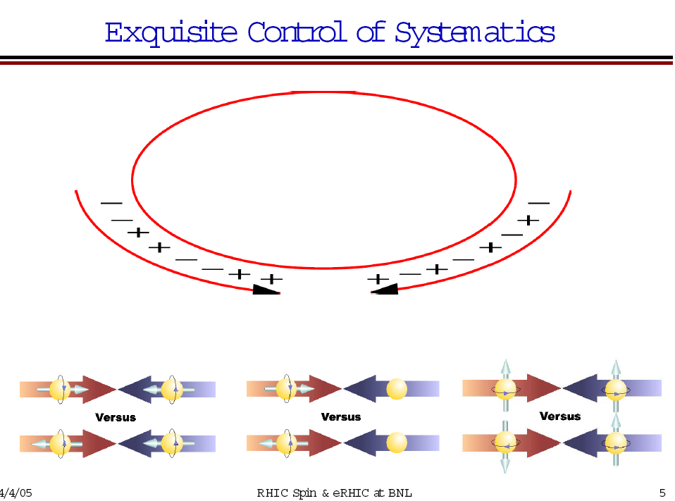
Polarized beams in RHIC
OPPIS
9∙10¹¹(maximum 40∙10¹¹) polarized H⁻ /pulse.
410 𝞵A X 350 𝞵 s
LINAC
7.6∙10¹¹ polarized H⁻ /pulse at 200 MeV, P=80-82%
410 𝞵 A X 350 𝞵 s
Scraping in Booster
Booster
2.75∙10¹¹ protons /pulse at 2.3 GeV
AGS
2.5∙10¹¹ p/bunch, P ~65%
RHIC
~2∙2 10¹¹ p/bunch, P~60-65% at 100GeV
P ~ 50% at 250 GeV
Notes:
28

Slide 29
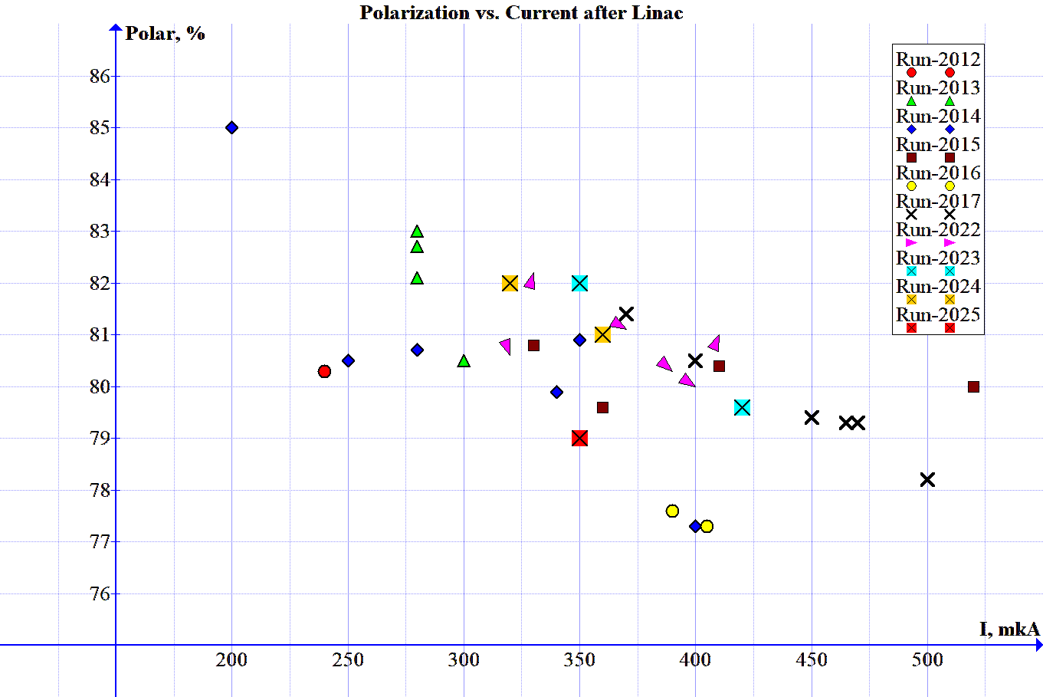
Beam performance at 2012-2026
G. Atoian, A. Cannavo, T. Lehn, V. Lodestro, A. Kponou, D. Raparia, J. Ritter, B. Snyder, A. Zelenski
Run-2026
AGS Pol Study 2025
RHICfest: Raparia 260710

Slide 30
Comparative Summary
Parameter | Tandem | OPPIS | EBIS
Mission | Heavy ions | Polarized protons | Heavy ions
First RHIC use | 2000 | 2001 | 2012
Technology | Electrostatic | Optical pumping | Electron beam ion source
Major legacy | First RHIC beams | First polarized collider | Multi-species collider
RHICfest: Raparia 260710

Slide 31
Polarized He-3

Slide 32
Polarized ³He⁺⁺ Source development
J. Alessi, G. Atoian, E. Beebe, C, Ianzano, S. Ikeda, S. Kondrashev, J. Maxwell, M. Musgrave, R. Milner, M. Okamura, A. Poblaguev, D. Raparia, J. Ritter, A. Sukhanov, N. B. Wuerfel, A. Zelenski,
U. S. Department of Energy
Office of Science | Nuclear Physics FY 2018
Research and Development for Next Generation Nuclear Physics Accelerator Facilities
… A doubly polarized electron-ion collider (EIC) is the best way to examine the internal structure of the proton and neutron. The technology to accelerate polarized proton beams has been well established at RHIC. However, studying the structure of the neutron requires the acceleration of polarized ³He⁺⁺, which carries ~90% of its polarization in the neutron, and to match the unprecedented statistical precision an EIC will provide, it is indispensable to have high precision measurements of the hadron beam polarization. For this reason, development of a polarized ³He ion beam has been identified as an R&D priority by the EIC Advisory Committee in 2009 and the Office of Nuclear Physics Community Review in 2017.
In 2003 A. Zelenski, J. Alessi proposed a production polarized ³He⁺⁺ beam in EBIS.
(A. Zelenski, J. Alessi, “Proposal of production of polarized ³He⁺⁺ beam in EBIS” , ICFA Beam Dynamics Newsletter 30, p.39, (2003)
Polarized ³He⁺⁺ source is a part of the ongoing EBIS upgrade project.
The development of the polarized ³He ion source is being done as a collaboration between BNL and Massachusetts Institute of Technology (MIT).
RHICfest: Raparia 260710

Slide 33
The ³He⁺⁺ Source at BNL
Requirement
Intensity ~ 5∙10¹¹ ³He⁺⁺ ions in 40 us pulse ~5.0 mA-peak
Maximum polarization > 70%
Compatibility with the operational EBIS for heavy ion physics.
Spin flip for every source pulse in the beam transport line.
Polarized ³He⁺⁺ production
³He polarization by optical pumping and metastability-exchange technique inside the EBIS in high (5.0T) magnetic field. No polarization losses in ³He⁺ state.
EBIS is used for efficient ionization and accumulation of polarized 3He⁺⁺ ions to the full capacity of about (2.5-5.0)∙10¹¹ , ³He⁺⁺ ions.
RHICfest: Raparia 260710

Slide 34
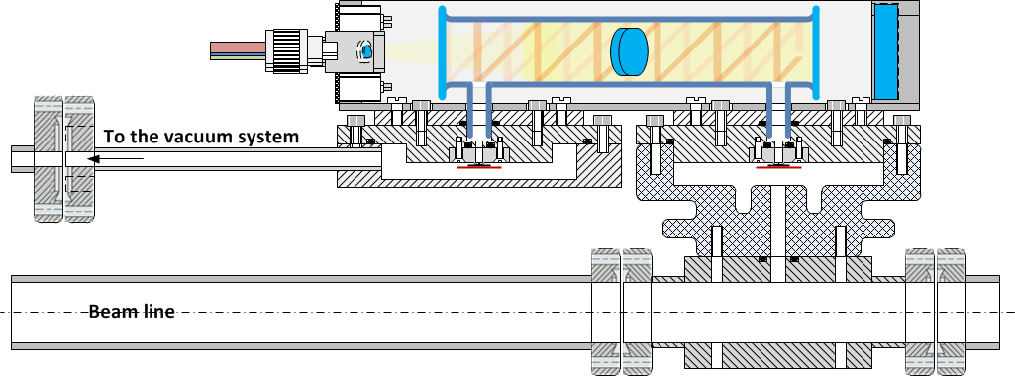
³He-cell inside the EBIS SC Solenoid-1
Procedure to polarize the ³He gas at high magnetic field:
Prepare the ³He gas for polarization by the purification system; Valve1-open/ Valve2-close
Polarize the ³He gas inside the glass-cell by a MEOP technique; Valve1-close/ Valve2-close
Continually control the polarization of the injected ³He gas by using the Optical Probe polarimeter;
Inject a polarized ³He portions into drift tube (beam line) through the pulsed valve ( ~2-3*10¹² atoms/pulse); Valve1-close/ Valve2-open
Ionize the polarized atoms of ³He by electron beam (~10 A).
³He-cell
Rf –discharge
To the purification system
³He Injection pulse Valve2
³He Filling Valve1
HV isolator
e-beam ~10A
Drift tube (20-40 kV)

Slide 35
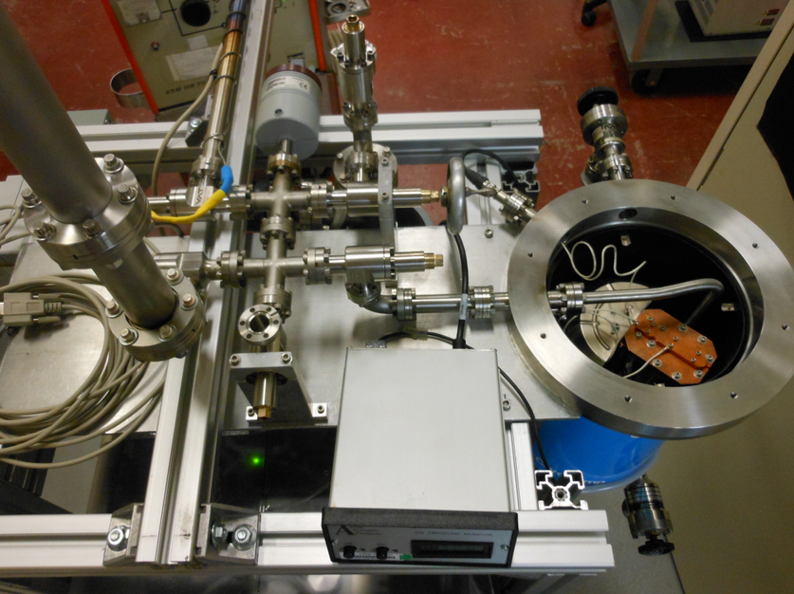
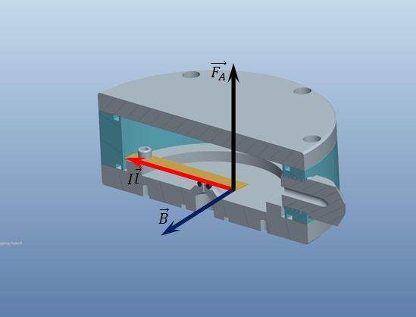
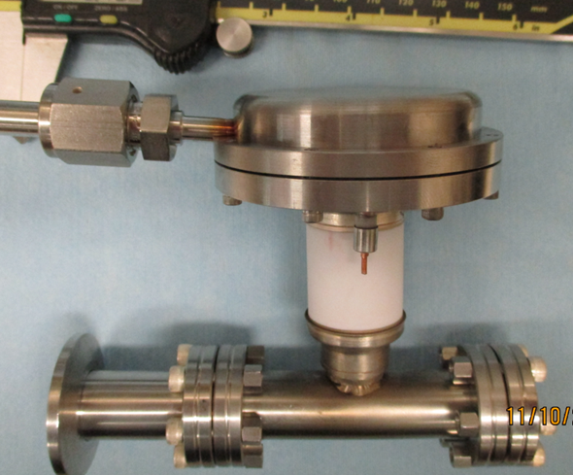
^{Innovations}
Modified Cryo-pump for 3He
purification and storage
Fast Pulsing Gas Valve
The pump also absorbs quite a significant amount of ³He gas (of about 100 scc).
The absorbed gas is released by the pump vessel heating ~20K.
Lorentz (Laplace) force moves the flexible conducting plate in the high (~ 3-5 T) magnetic field.
For I=10 A, L=5 cm, F=2.5 N. Current pulse duration ~100-500 us
RHICfest: Raparia 260710

Slide 36
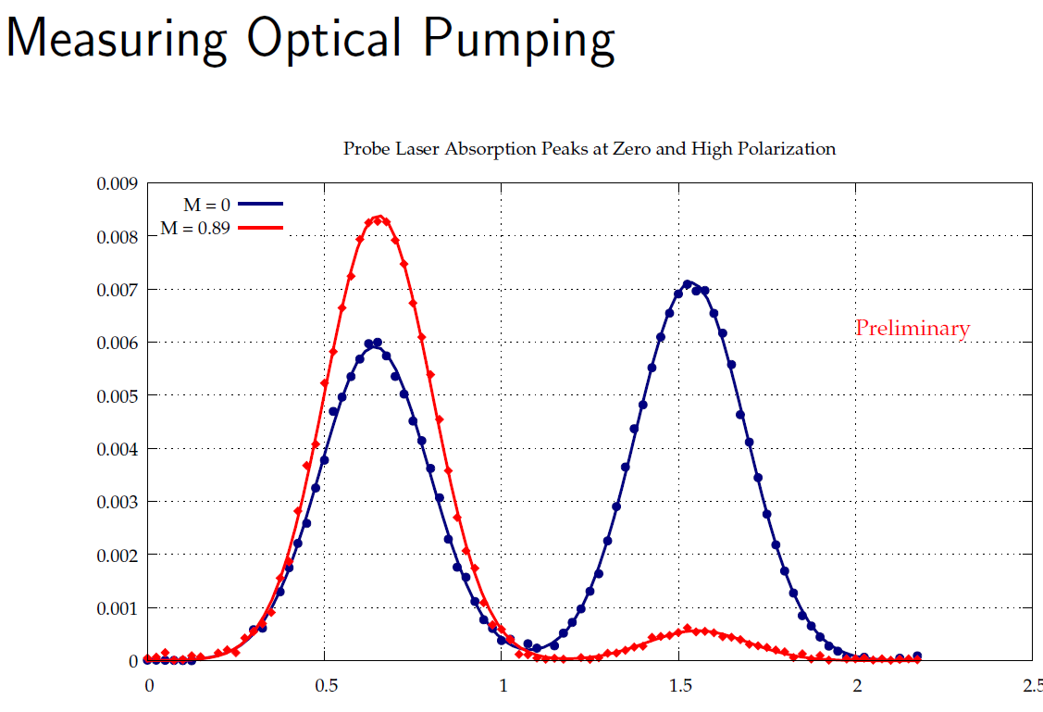
Polarization Measurements by the Probe Laser Absorption
Open cell
Closed cell
Polarization build-up time .
0-4 min: Valve open
5-27 min: valve closed
29 min: laser off and valve opened
(3 Torr valve closed)
89% polarization in. sealed
³He cell at 3 Torr pressure
RHICfest: Raparia 260710

Slide 37
Current setup in the Test Lab
Open cell
Closed cell
We achieved higher (65%)
RHICfest: Raparia 260710

Slide 38
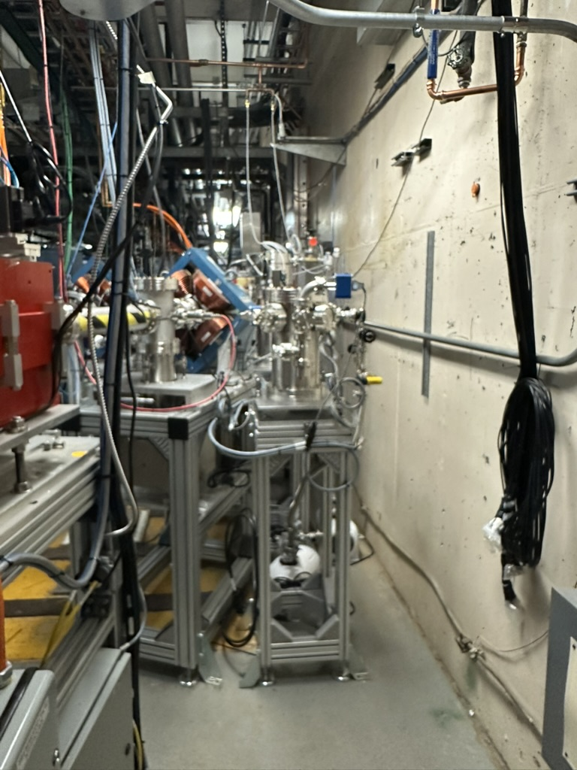
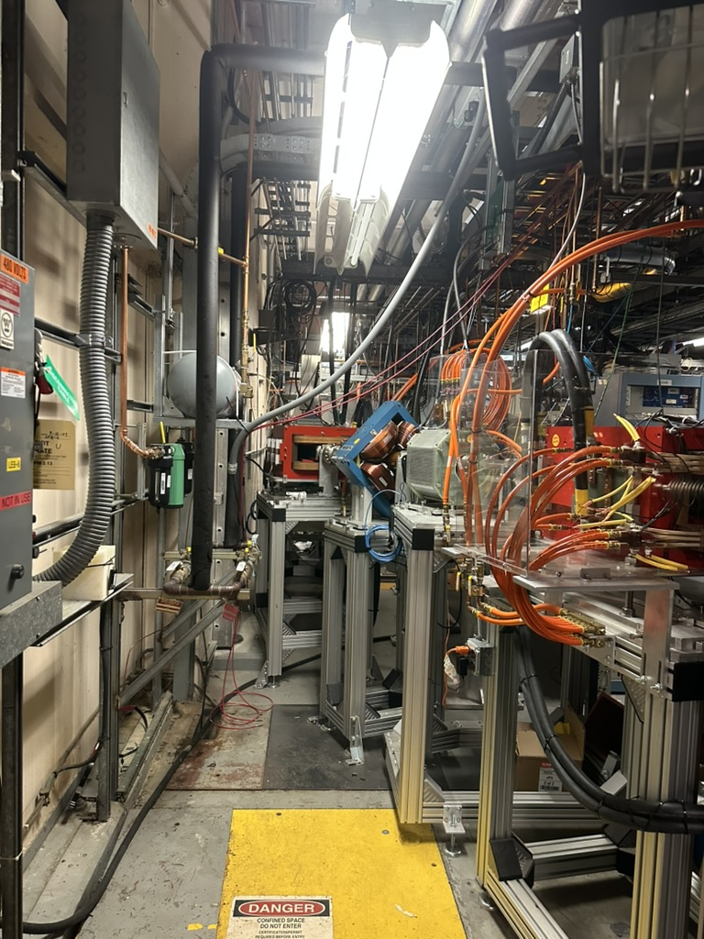
³He⁺⁺ Spin-Rotator in the at 6.0 MeV Beam Energy
After acceleration by EBIS LINAC, the polarized ³He⁺⁺ beam will have an energy of 6MeV with a longitudinal spin direction.
The longitudinal polarization of beam is at first rotated to transverse direction using the 21.5 deg bending magnet (Dipole-1) and after
The Spin- solenoid will change the spin direction to the vertical . It is a pulsed solenoid with reversible field to enable spin-flip on an EBIS pulse-by-pulse basis.
Vertically polarized beam will return to the straight HEBT line by the system of dipole magnets.
Chicane has been commissioned with He-4 with about 90% transmission
The polarimeter will be install in the straight section after the Dipole-3 magnet. measurement of polarization with a standard configuration of left/right symmetric Si-strip detectors).
2
3
1
4
RHICfest: Raparia 260710

Slide 39
Conclusions & Outlook
25 Years of RHIC Ion Sources
Heavy-ion injector evolution
Tandem Van de Graaffs successfully launched the RHIC heavy-ion program (2000–2011).
EBIS replaced the Tandems in 2012, providing greater flexibility, reliability, and support for all RHIC and NSRL ion species.
Extended EBIS (EEBIS) represents the second generation of the RHIC heavy-ion injector, with increased trap capacity, internal gas injection, and improved infrastructure for future operation.
Polarized proton program
OPPIS enabled RHIC to become the world’s first polarized proton collider.
Continuous upgrades over more than two decades established the world’s highest-intensity polarized H⁻ source.
Legacy
RHIC successfully accelerated virtually every ion species from protons to uranium.
The combined Tandem, OPPIS, and EBIS programs enabled 25 years of world-leading nuclear and spin physics.
RHICfest: Raparia 260710

Slide 40
Looking Forward
Electron-Ion Collider (EIC)
Development and commissioning of the polarized ³He²⁺ source based on the Extended EBIS are underway.
The high-field optical-pumping polarization cell will be installed inside the upstream 5 T solenoid following completion of RHIC operations, enabling production of polarized ³He beams for the EIC.
EEBIS will remain the primary heavy-ion injector for NSRL while serving as the platform for the future polarized ³He program.
From the Tandem era, through EBIS, to the future polarized ³He source for the EIC, Brookhaven ion sources have continuously evolved to meet the scientific needs of each new generation of nuclear physics.
RHICfest: Raparia 260710

Slide 41
Backup slides

Slide 42
RHIC Species Timeline
2000 Au
2001 Au + p↑
2003 d+Au
2005 Cu+Cu
2012 U+U, Cu+Au
2014 3He+Au
2015 p+Au, p+Al
2018 Ru+Ru, Zr+Zr
2025 Final RHIC operations

Slide 43
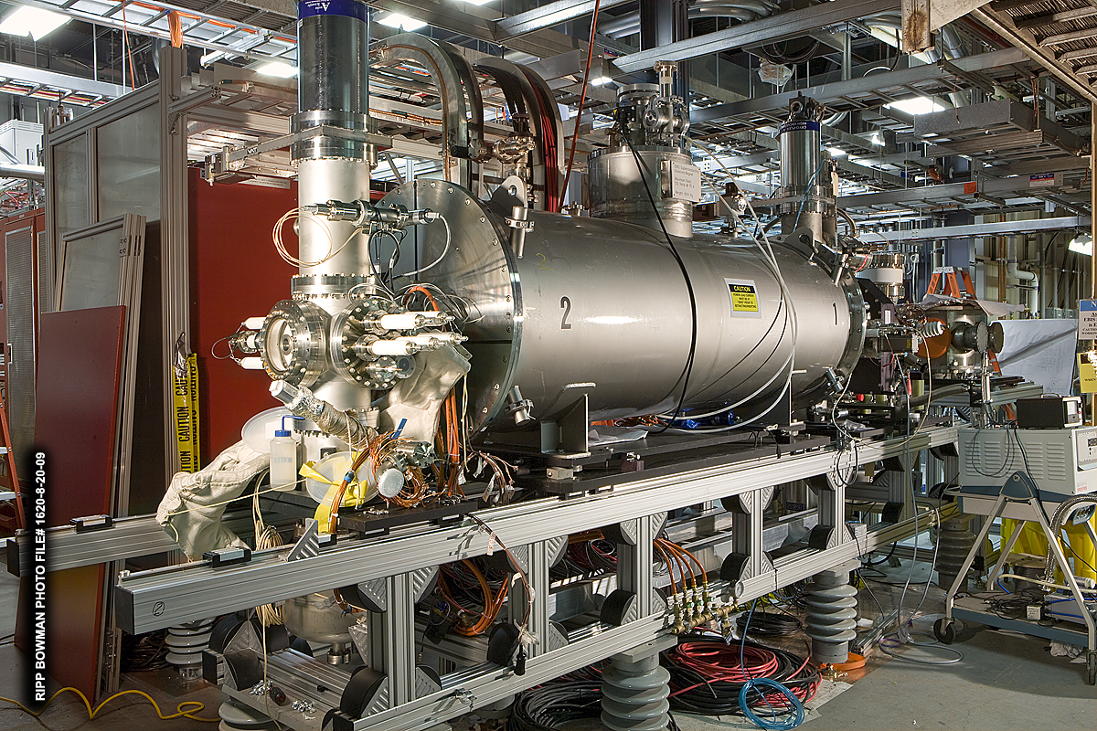
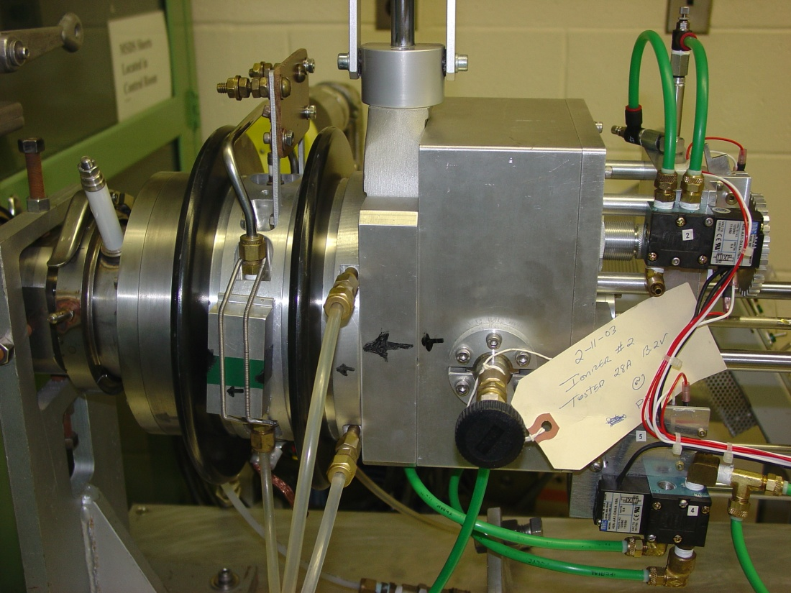
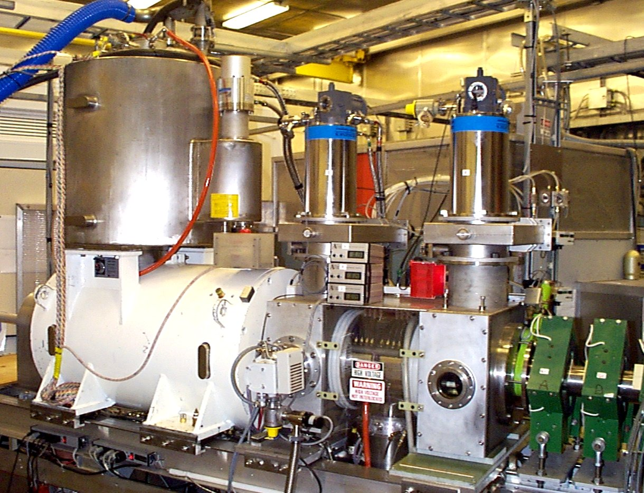
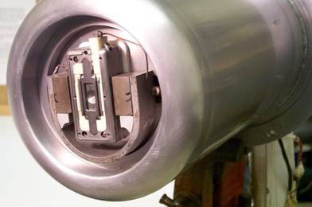
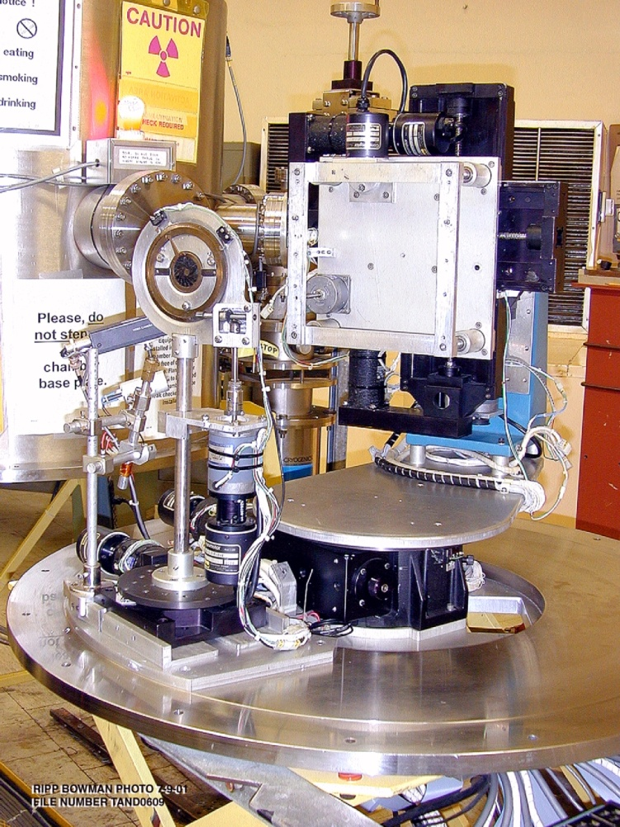
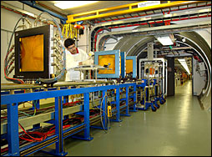
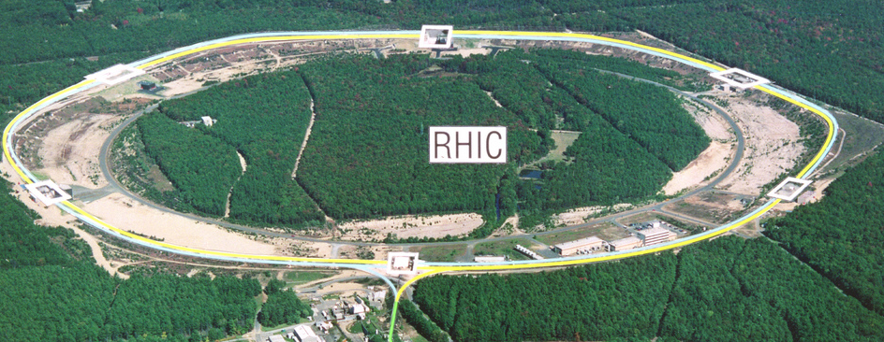
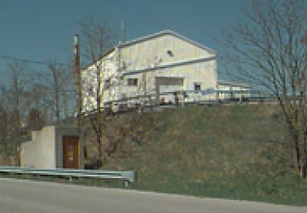
All sources can serve all users simultaneously
EBIS (Heavy Ion Linac)
Cs sputter (Tandem)
OPPIS (Linac)
Magnetron (Linac)
#Charge 5e11/s
#ion 1e10/s
#H- 1e12/s
#H- 2.5e15/s
H to U,
Au, Fe, etc.
H-
H-
Relativistic Heavy Ion Collider
NASA Space Radiation Lab
Brookhaven Linac Isotope Producer
Single Event Upset
Laser Ion sources for the new application
D. Raparia, CAD Seminar 24/09/13

Slide 44
EBIS commissioning timeline
Date | Milestone
June 19, 2010 | First beam accelerated through the RFQ/Linac.
June 24, 2010 | Beam transported around the bend after the Linac.
June 29, 2010 | First beam from EBIS transported to the Booster (He⁺). The slide explicitly states “He¹⁺ – first beam from EBIS transported to Booster (June 29).”
June 30 – July 2, 2010 | Helium beam circulated in the Booster during commissioning.
July 2, 2010 | First beam from EBIS circulating in the Booster. The slide explicitly states “First beam from EBIS circulating in the Booster (7/2/10)!”
August 17, 2010 | Au³²⁺ transported to the middle of the bend at CD-4 intensity.
August 29, 2010 | Fe²⁰⁺ transported to the middle of the bend at CD-4 intensity.
RHICfest: Raparia 260710

Slide 45
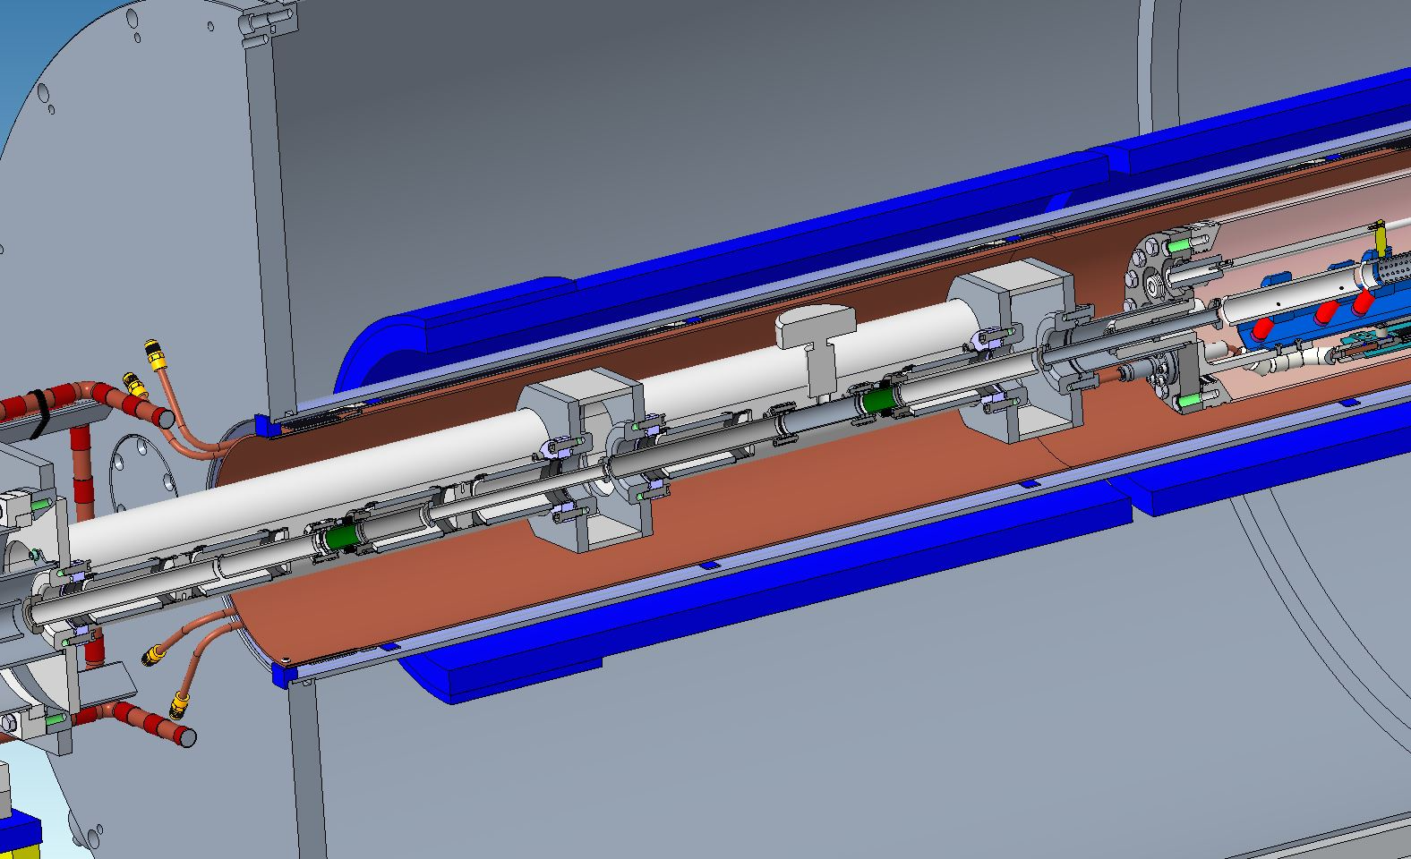
Extended EBIS
Long Trap
Gas Trap
Short Trap

Slide 46
RHIC Discoveries Enabled by Its Ion Sources
Ion Source | Species Delivered | Physics Enabled
Tandem (2000–2011) | Au, Cu, d | Heavy-ion collisions
OPPIS (2001–2025) | Polarized p | Spin physics
Tandem + EBIS | d, p, ³He, Al, Au,Ru | Small-system collisions
EBIS (2012–2025) | U, Zr, ³He, Au, Al | Precision heavy-ion program
From the first QGP discovery to proton spin measurements and small-system collectivity, RHIC’s scientific achievements were enabled by the evolution of its ion sources: Tandem → OPPIS → EBIS.
RHICfest: Raparia 260710

Slide 47
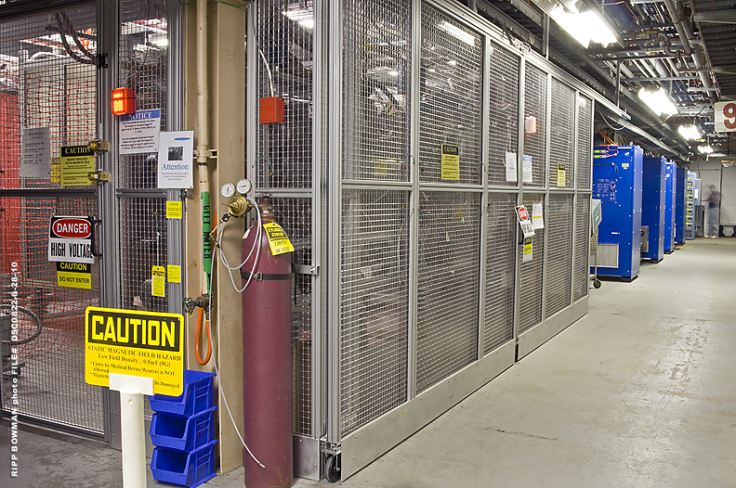
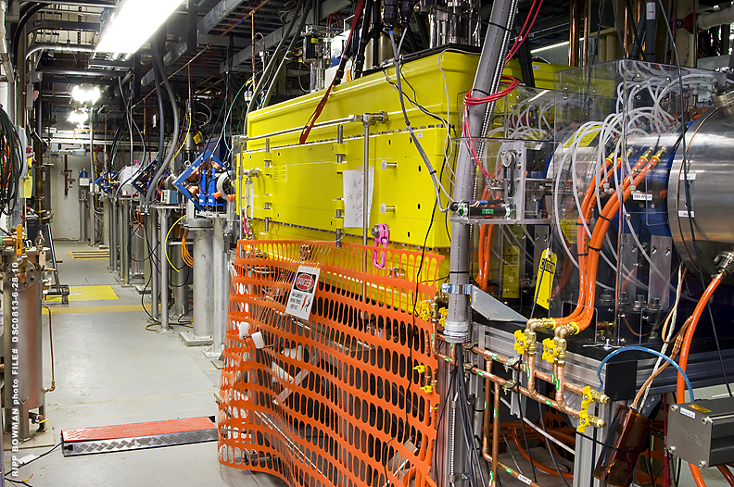
EBIS inside the high voltage cage

Slide 48
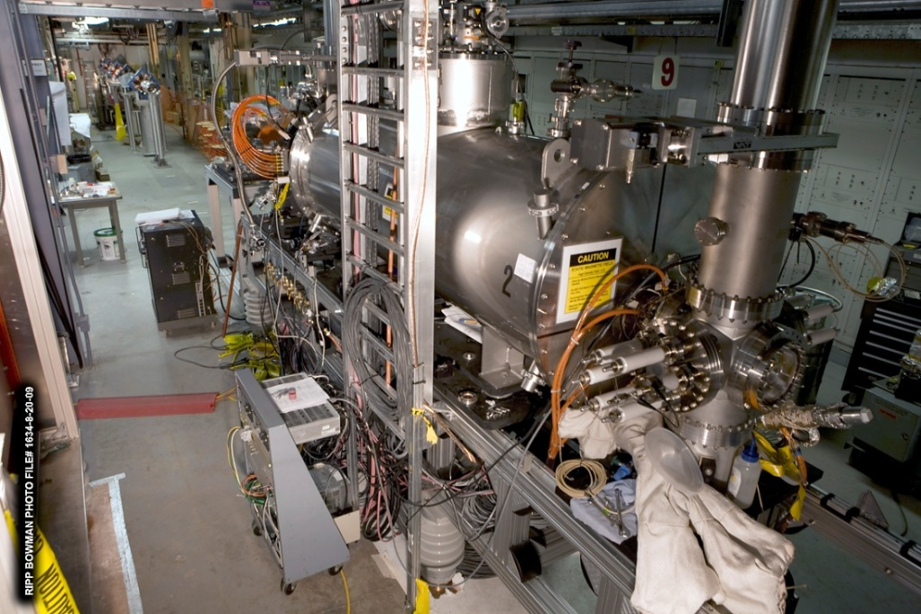
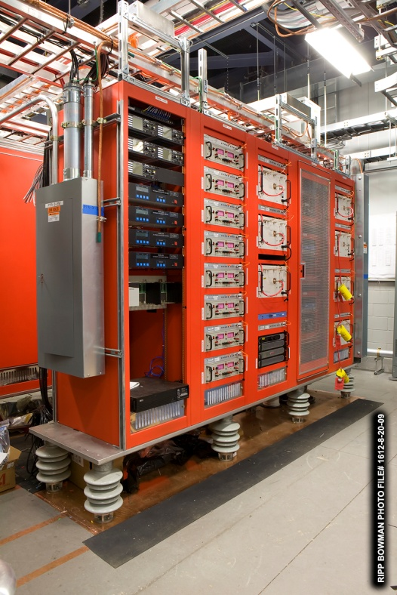
EBIS during installation
11 Racks of power supplies for EBIS, all pulsing to 100 kV along with the EBIS, during ion extraction.

Slide 49

EBIS Status

Slide 50
Principle of EBIS Operation
10A, 10-20 keV
Radial trapping of ions by the space charge of the electron beam.
Axial trapping by applied electrostatic potentials at ends of trap.
The total charge of ions extracted per pulse is ~ (0.5 – 0.8) x ( number electrons in the trap ~1.0∙10¹² )
Ion output per pulse is proportional to the trap length and electron current.
Ion charge state increases with increasing confinement time.
Output current pulse is independent of species or charge state!
D. Raparia, CAD Seminar 24/09/13
Notes:
50

Slide 51
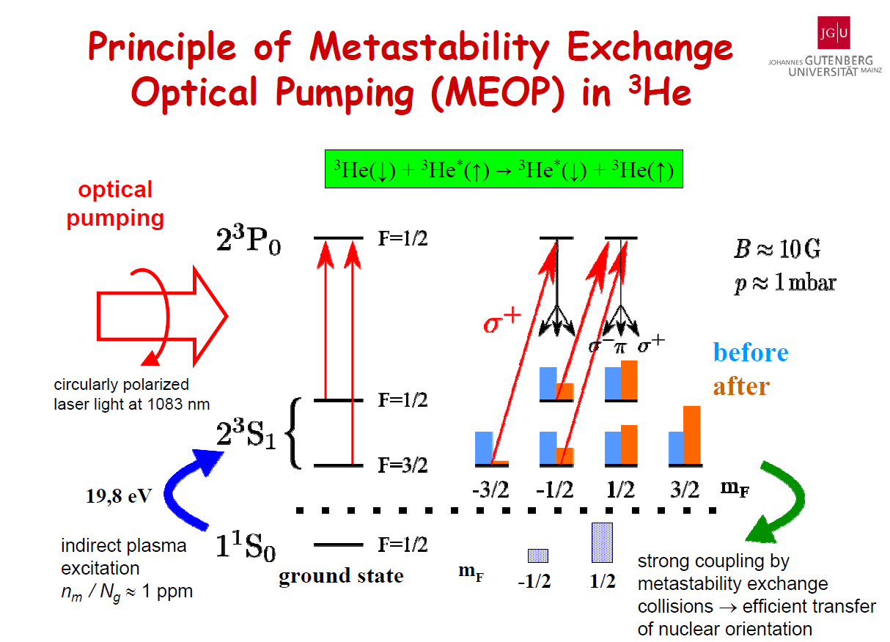
Circular polarized
Laser light at 1083 nm
D. Raparia, CAD Seminar 24/09/13

Slide 52
Optical Pumping and Probe Lasers Layout
laser-Keopsys 10 W 1083 nm- fiber laser
Pumping laser
Probe laser, Toptica, DL-100, diode laser
Detector
D. Raparia, CAD Seminar 24/09/13

