Slide 1
Radio Frequency Systems
Freddy Severino & Kevin Mernick on behalf of the RF Group over the years
RHICfest
July 10, 2026

Slide 2
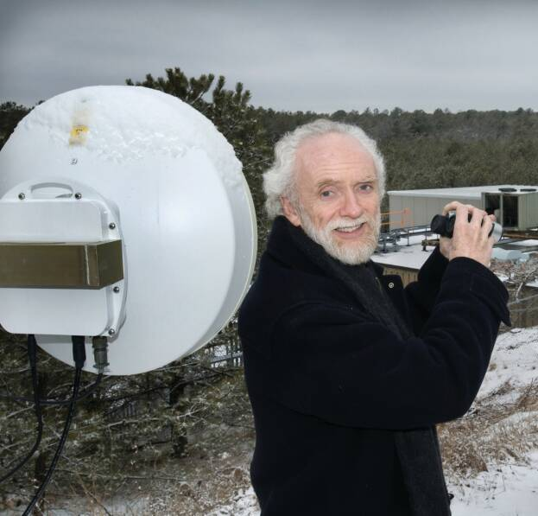
Outline
The Early Years
  Identifying and Fixing Problems
Pushing the Intensity
  A Constant Struggle Effort
A Well-Oiled Machine
  Digital LLRF
  New Cavities
  Efficient, Flexible, High-Intensity Operation
  This talk could probably also be titled
  “A Bunch of Good Ideas that Mike Brennan Had”

Slide 3
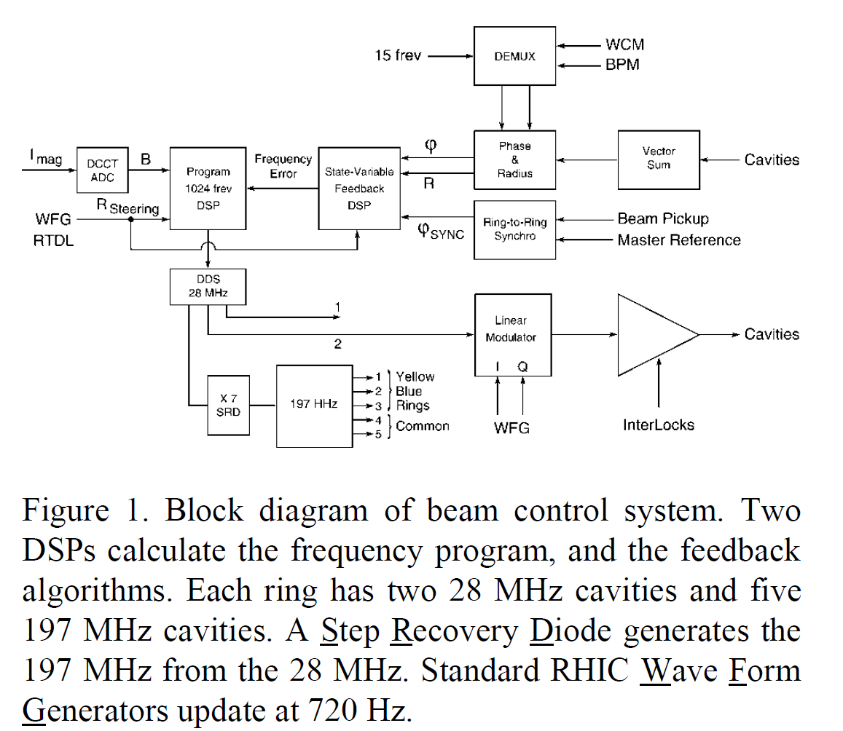
Early LLRF Experience
Initial system was largely a digitally-controlled analog system with many modules
Phase data scrambled to DSP and other glitches
Ring-to-ring synchro complications
No closed loop amplitude/phase control on cavities
Noise in RF drive

Slide 4
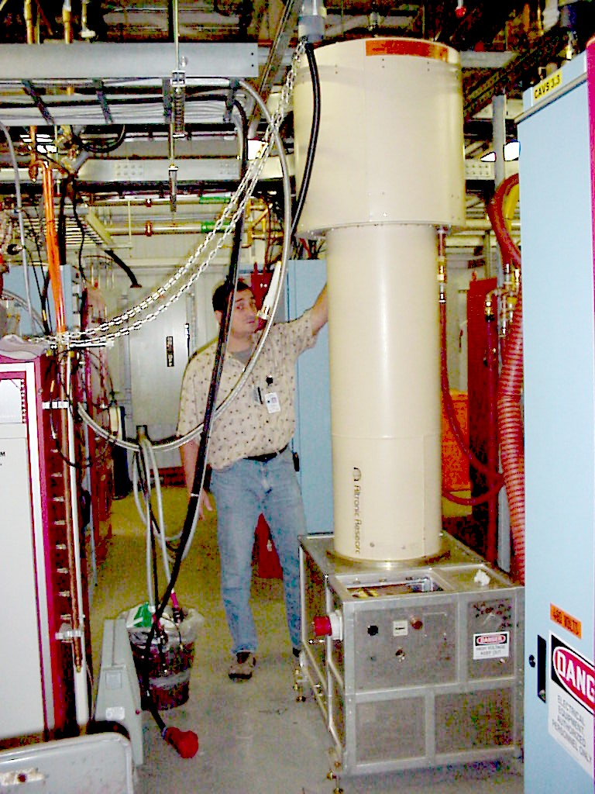
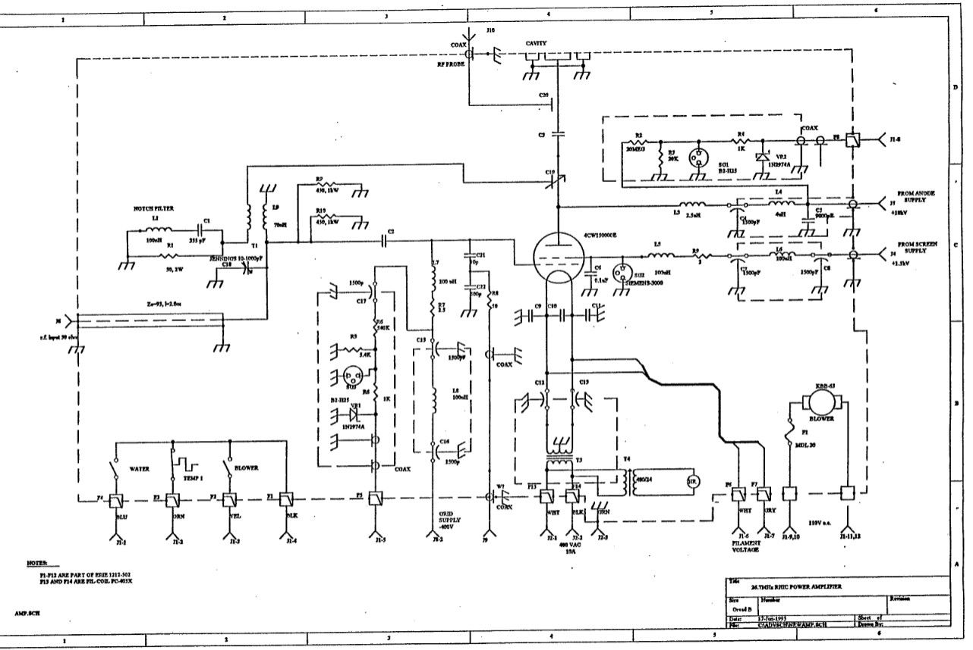
Early HLRF Experience
Direct RF feedback around cavities
Upgrades to tetrode PAs
Debugging and upgrades to driver amplifiers
Experience dealing with operational issues
  Multipacting
  Vacuum bursts
  Tuners
  …

Slide 5
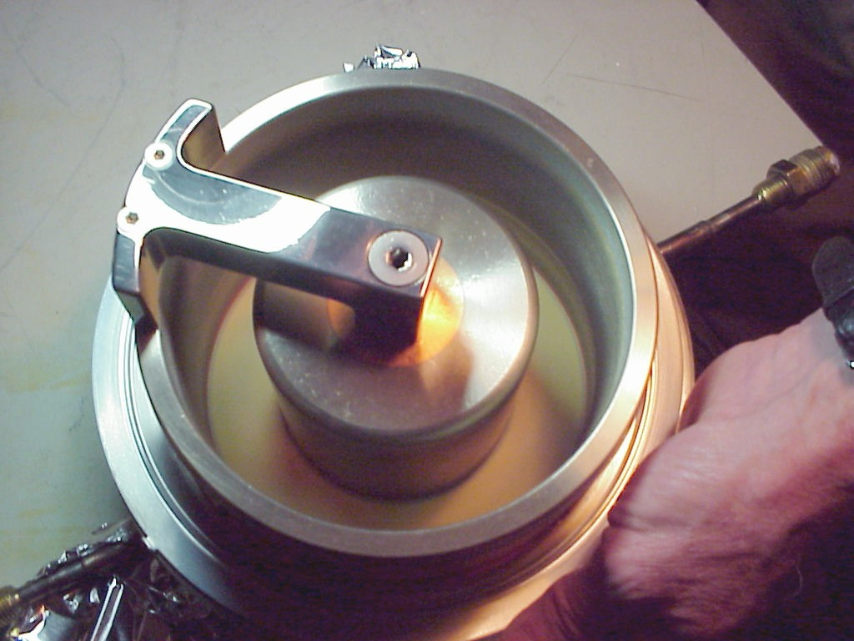
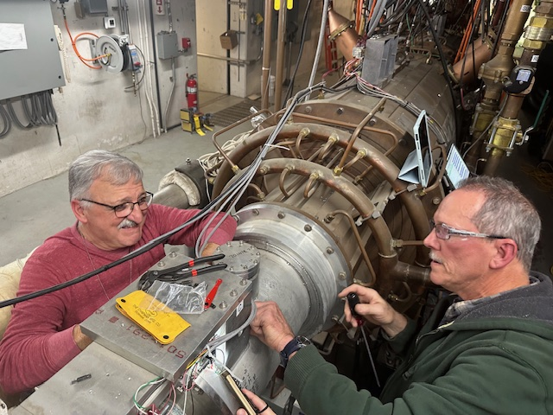
Early Cavity Experience
Major issue encountered early in RHIC operation was with storage (197 MHz) cavity windows
Rebuild of accelerating (28 MHz) cavity tuners due to wear from constant motion from thermal cycles
Beam loading of 197 MHz cavities before/during rebucketing
  Nick Laloudakis and Mike Myers working on 28 MHz tuner.
  This is a later rebuild. Like many things, there were multiple iterations.

Slide 6
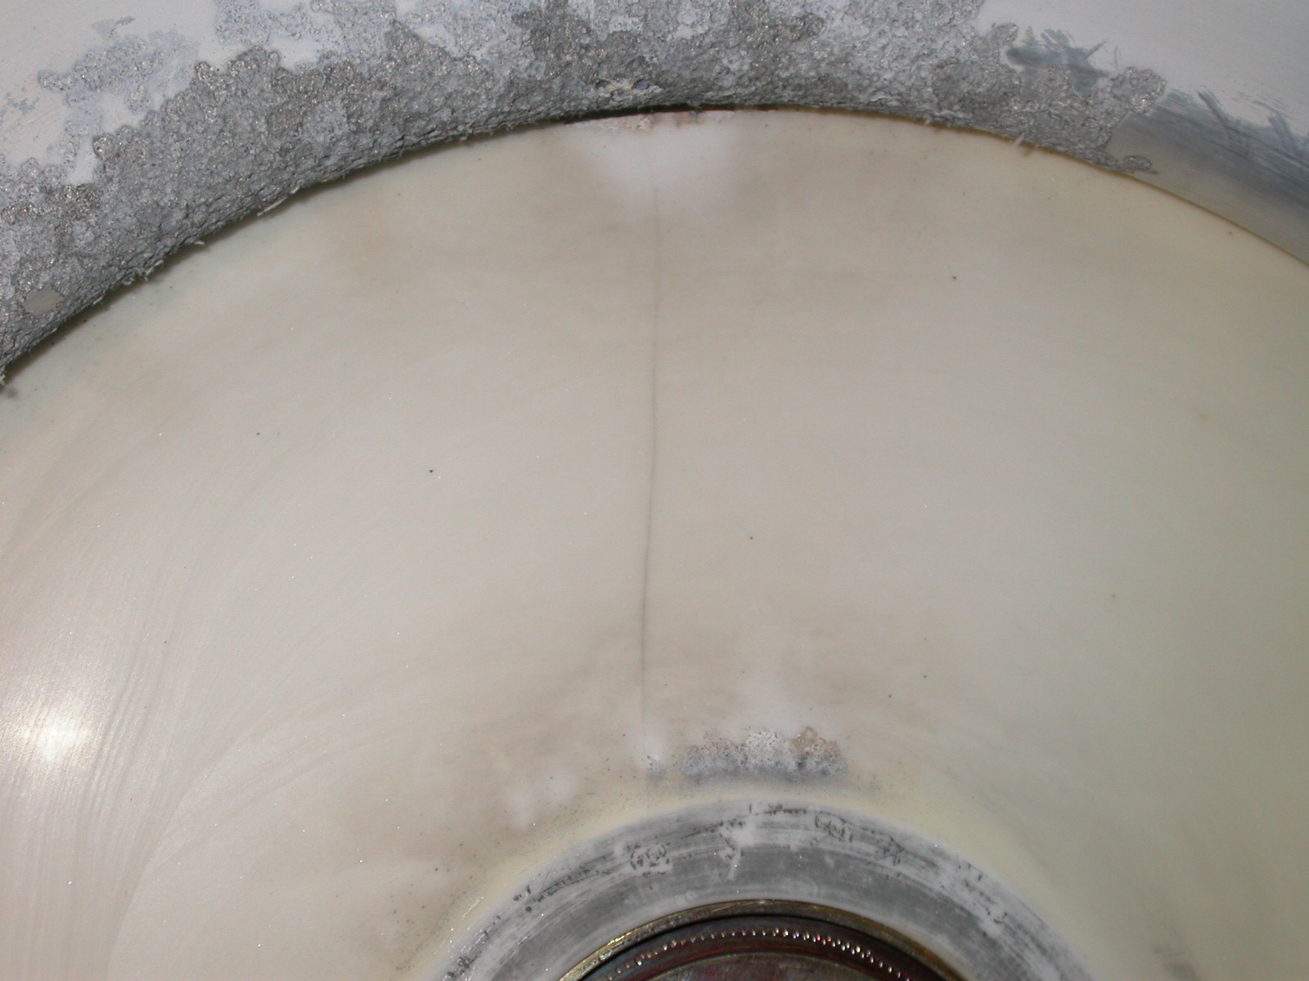
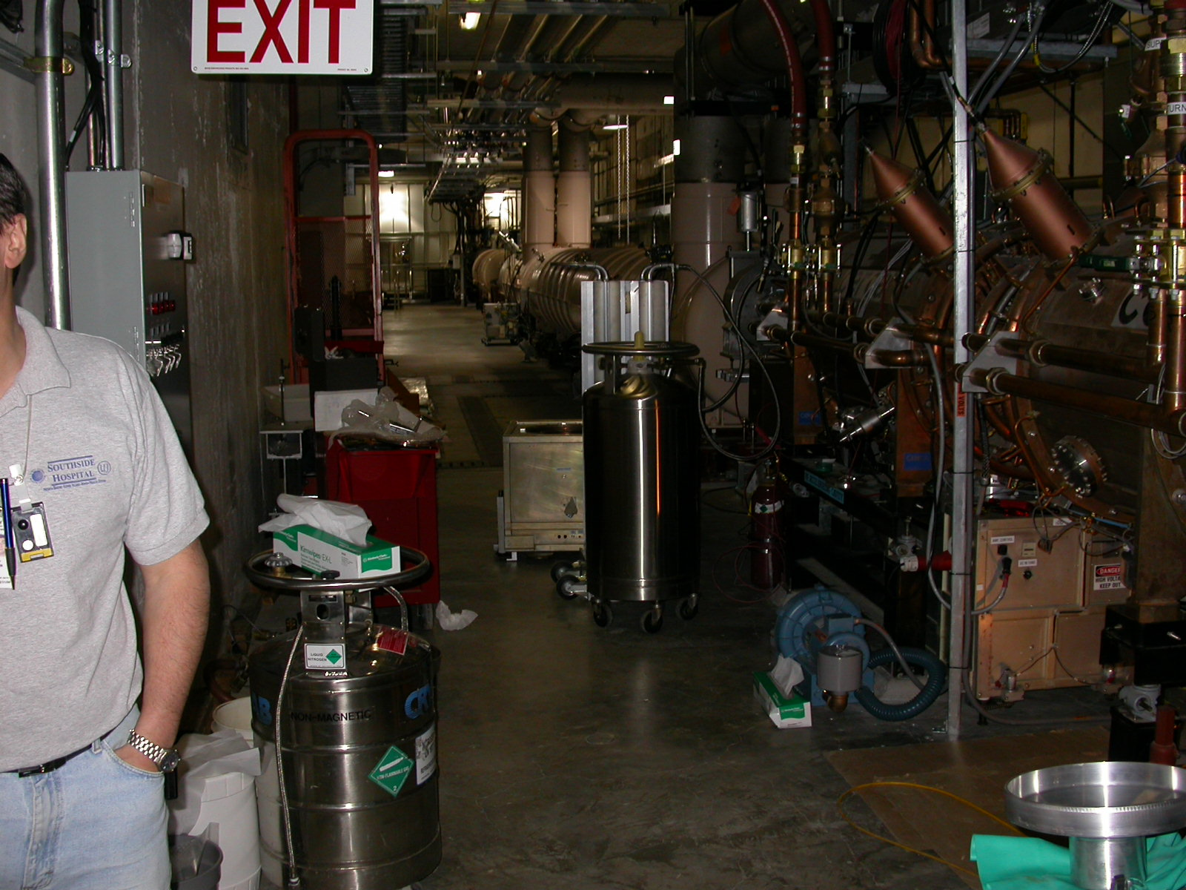
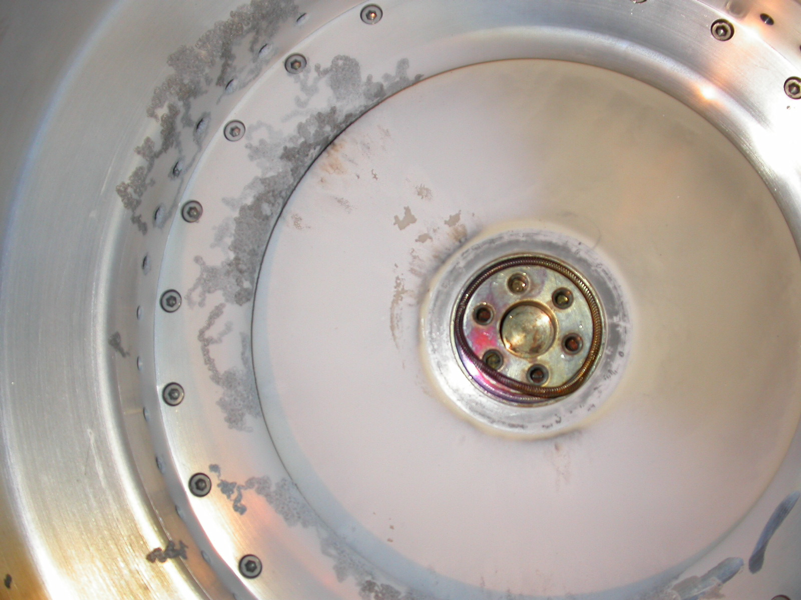
Early Cavity Experience
  Cracked ceramic
  This is the closest thing I could find to a picture of Alex working

Slide 7
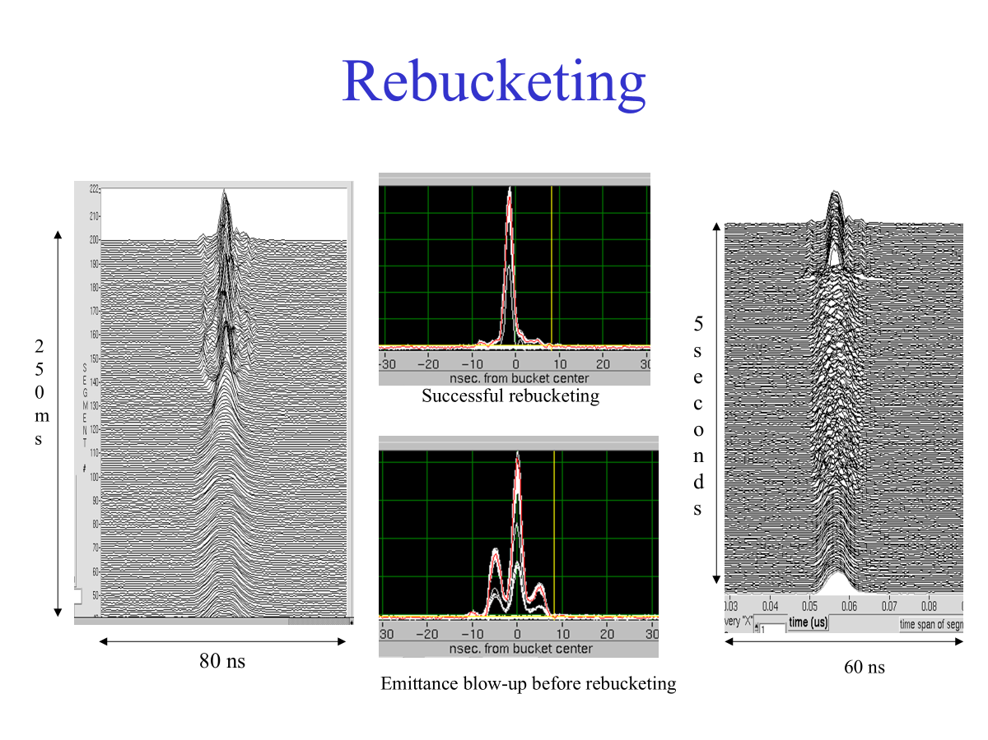
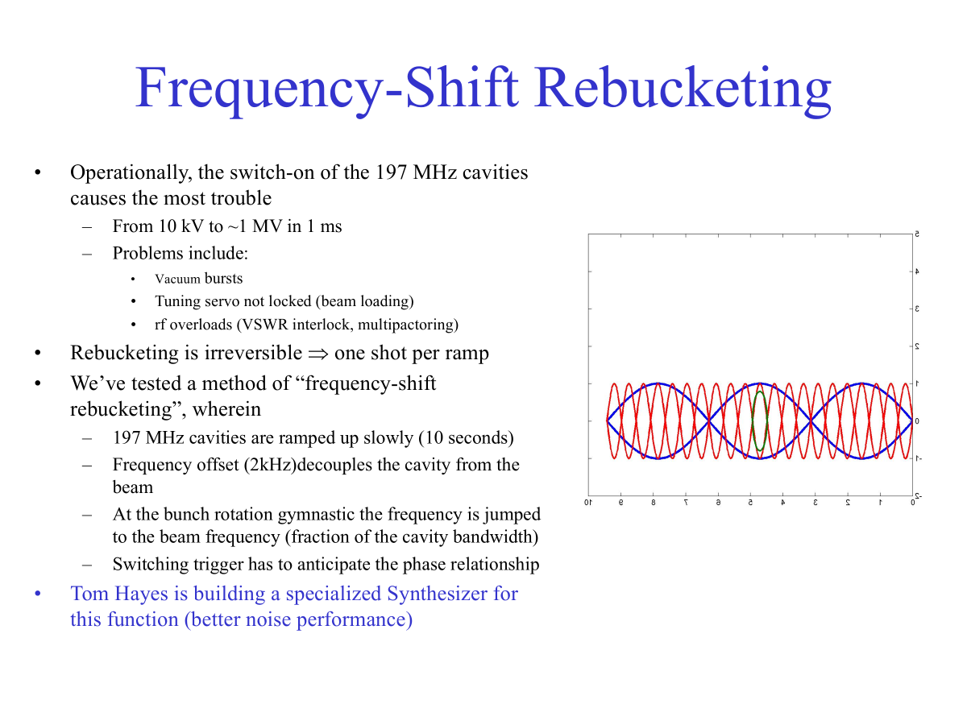
Rebucketing
Mike Brennan, RHIC Retreat 2003
  The 4 common storage cavities were also removed and relocated (2 each) to the blue and yellow rings due to the heavy beam loading around 2009 - 2010

Slide 8
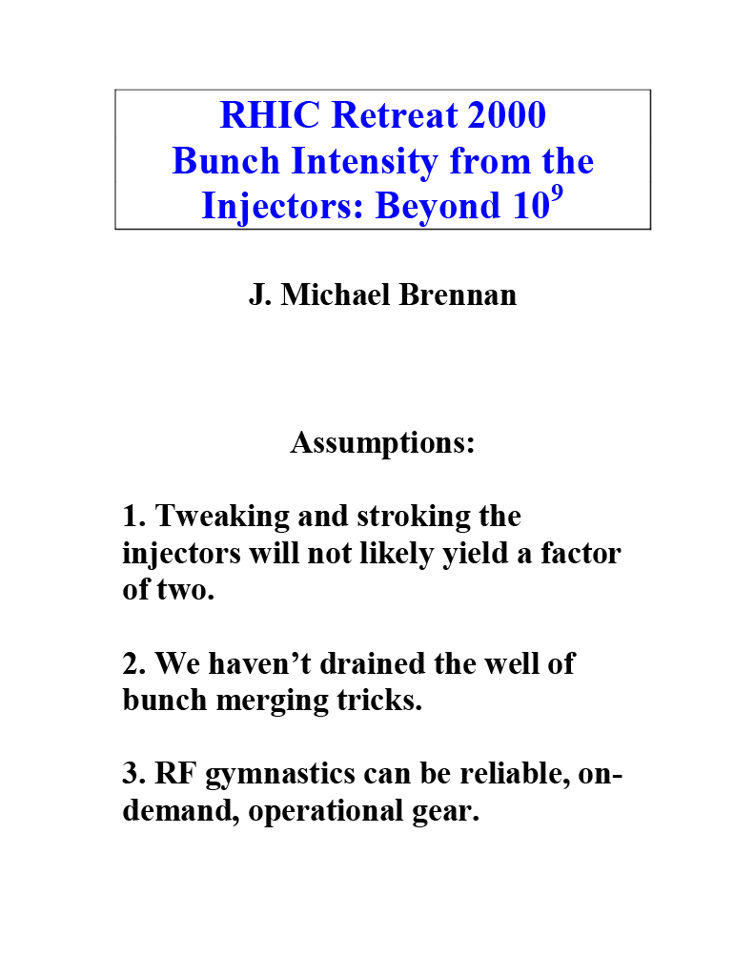
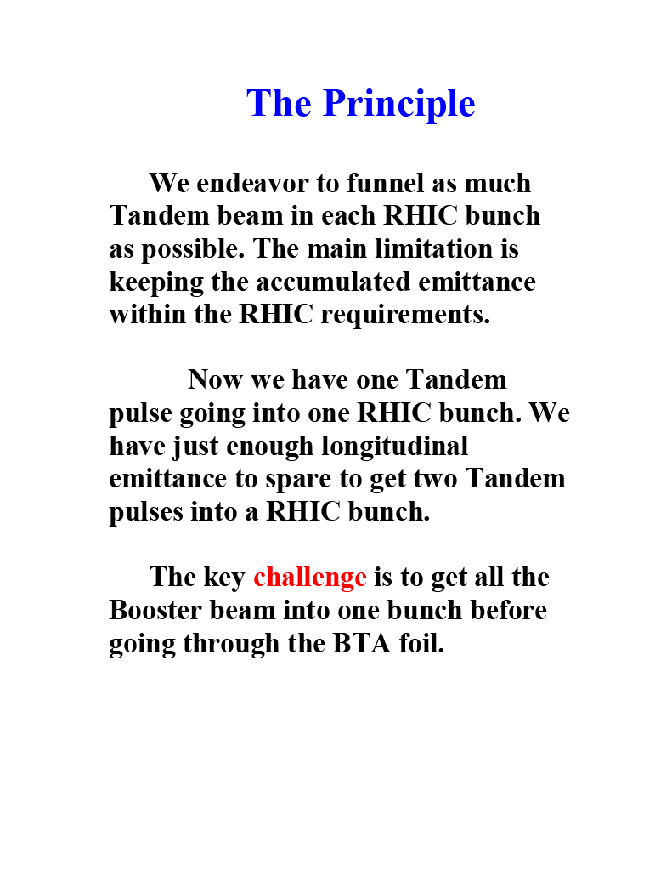
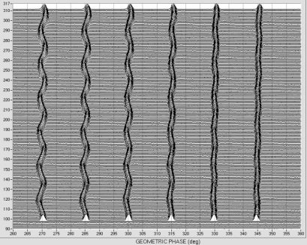
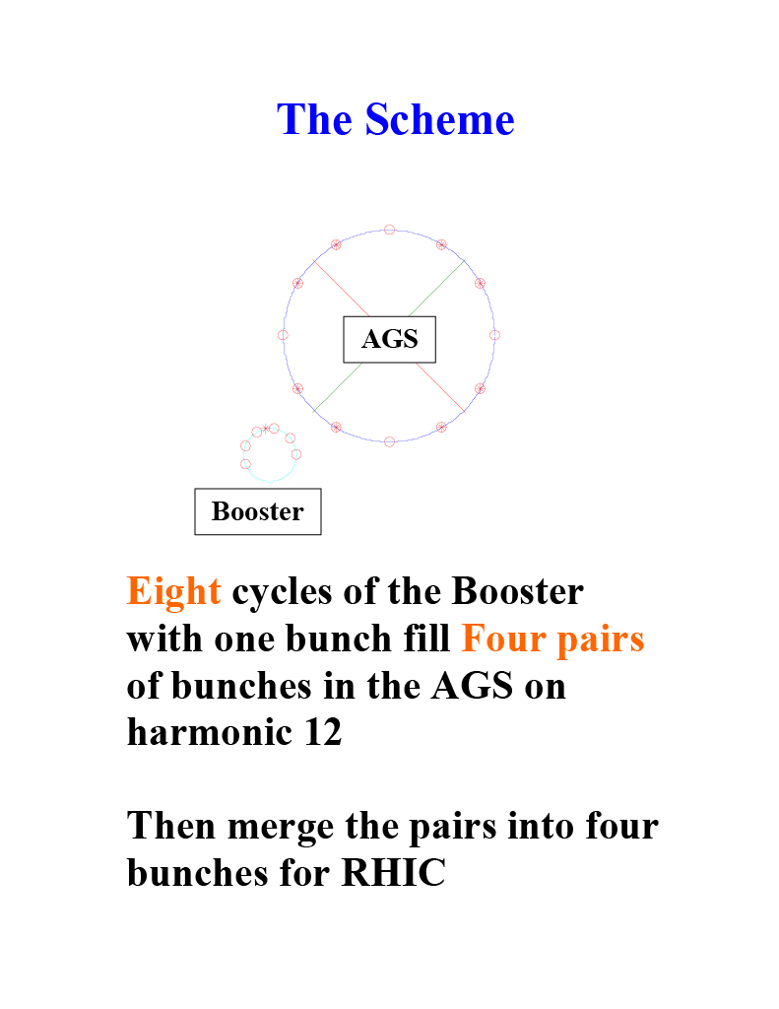
Injector Merges
Single bunch transfer ameliorates residual emittance growth induced by the frequency mismatch that necessarily exists with multi-bunch transfers using a stripping foil.
Bunches are frequency matched to AGS RF, but their incoming spacing (phase) remembers the Booster frequency. --Kevin Smith, RHIC Retreat 2012
Mike Brennan, RHIC Retreat 2000

Slide 9
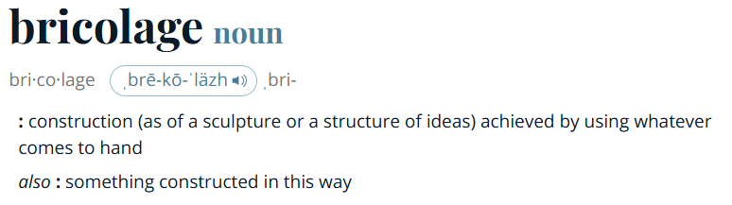
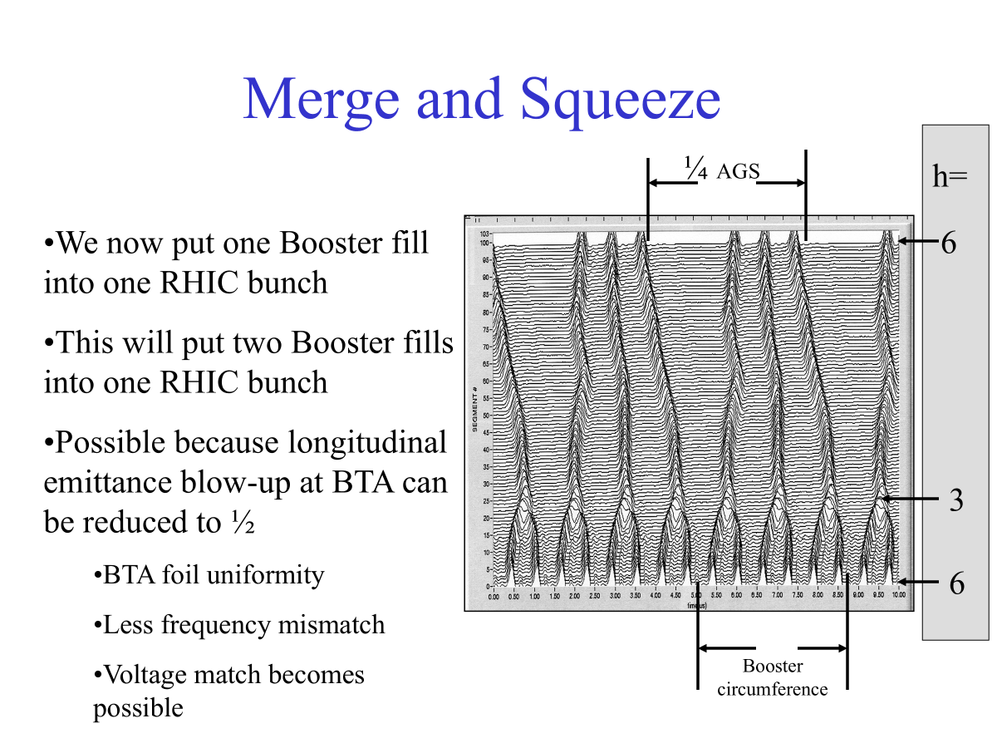
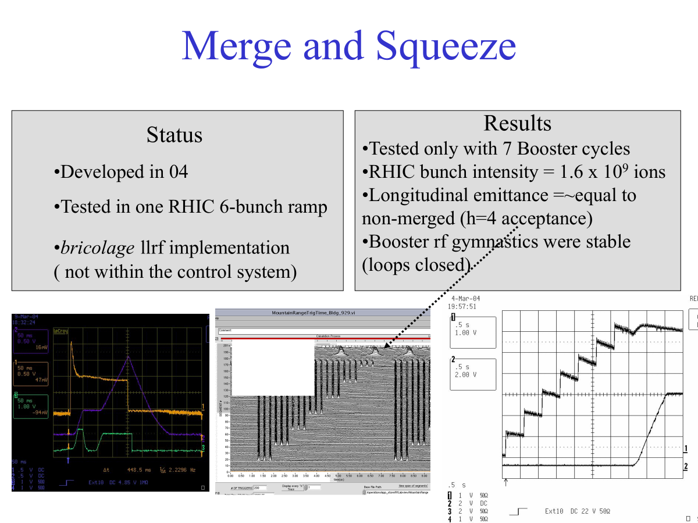
Injector Merges (2)
  Things I’m still learning from Mike:
Mike Brennan, RHIC Retreat 2006
“Bricolage.” Merriam-Webster.com Dictionary, Merriam-Webster, https://www.merriam-webster.com/dictionary/bricolage. Accessed 8 Jul. 2026.
  Merges would become routinely configurable after Booster and AGS LLRF upgrades ~2013

Slide 10
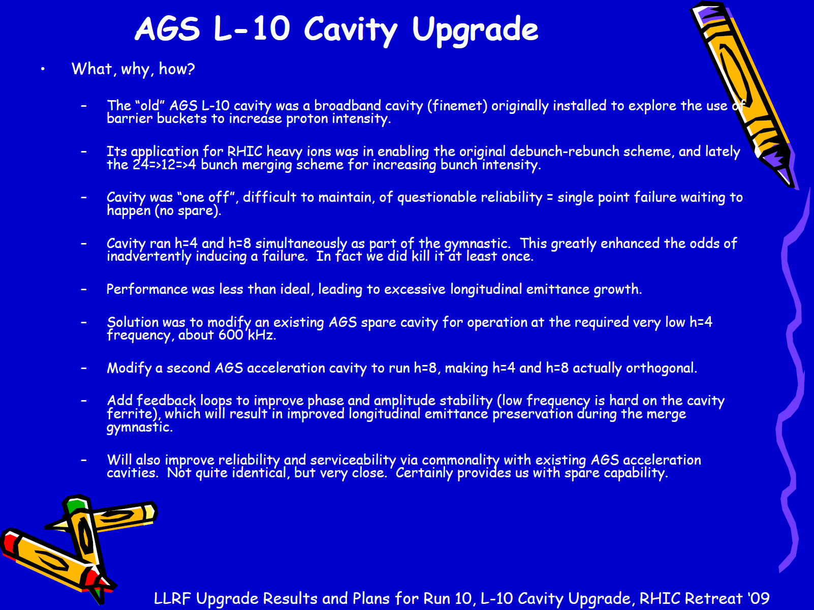
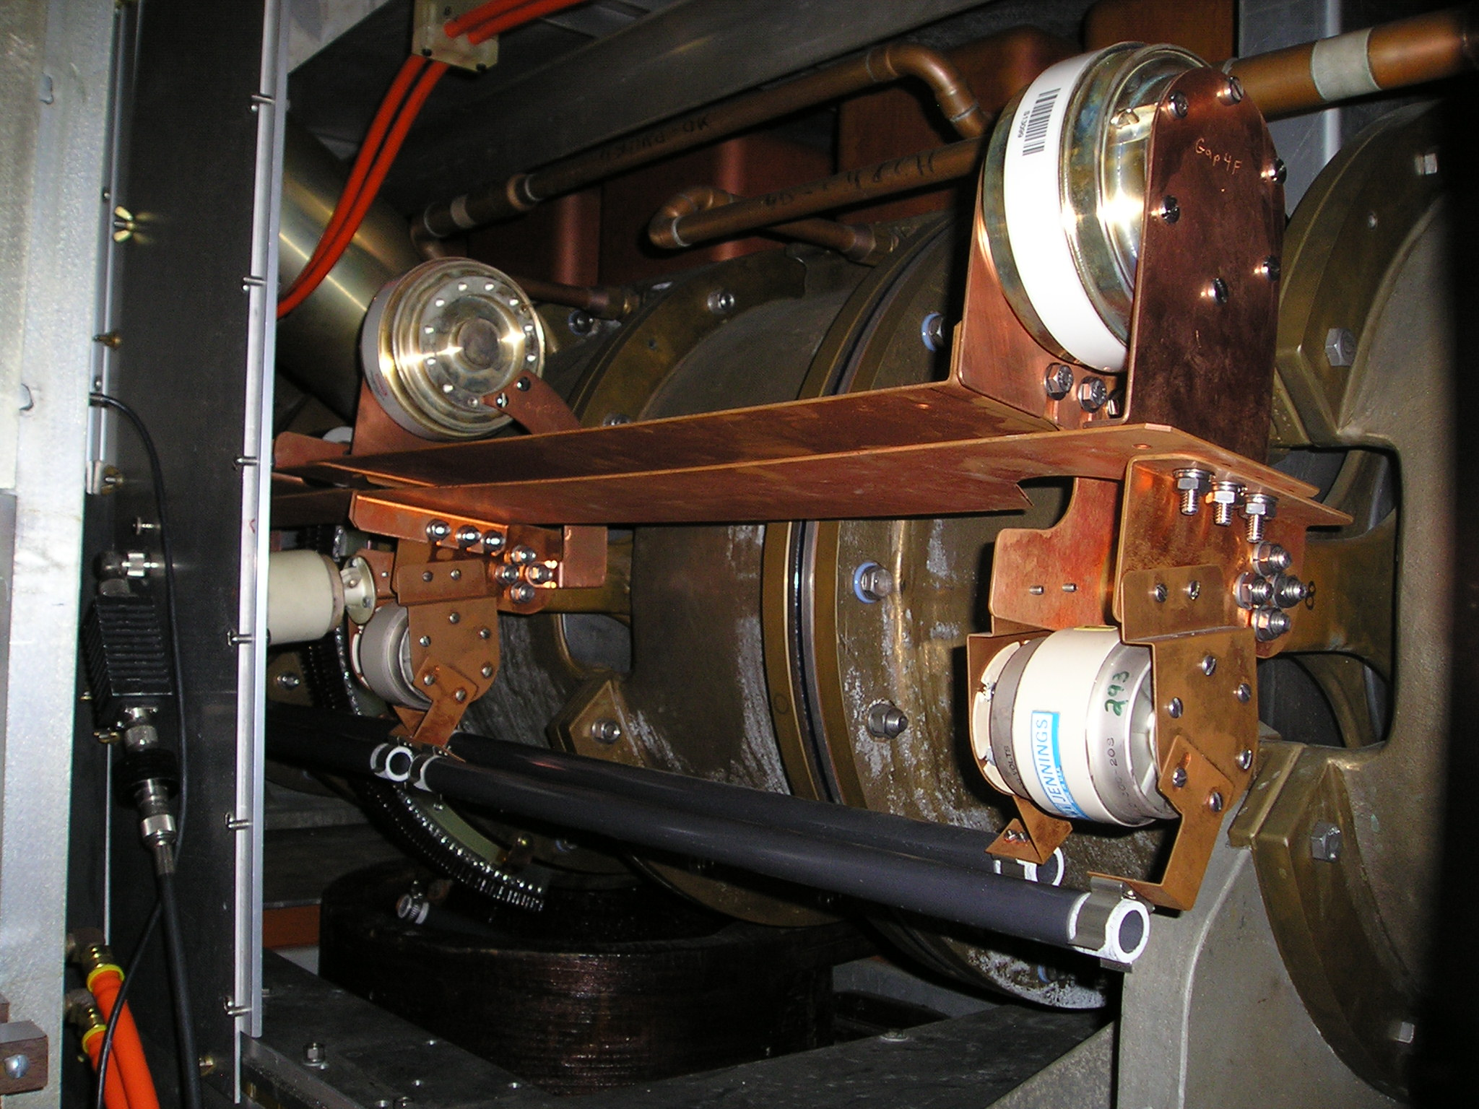
L10 Cavity
  Richard Spitz
Kevin Smith, RHIC Retreat 2009

Slide 11
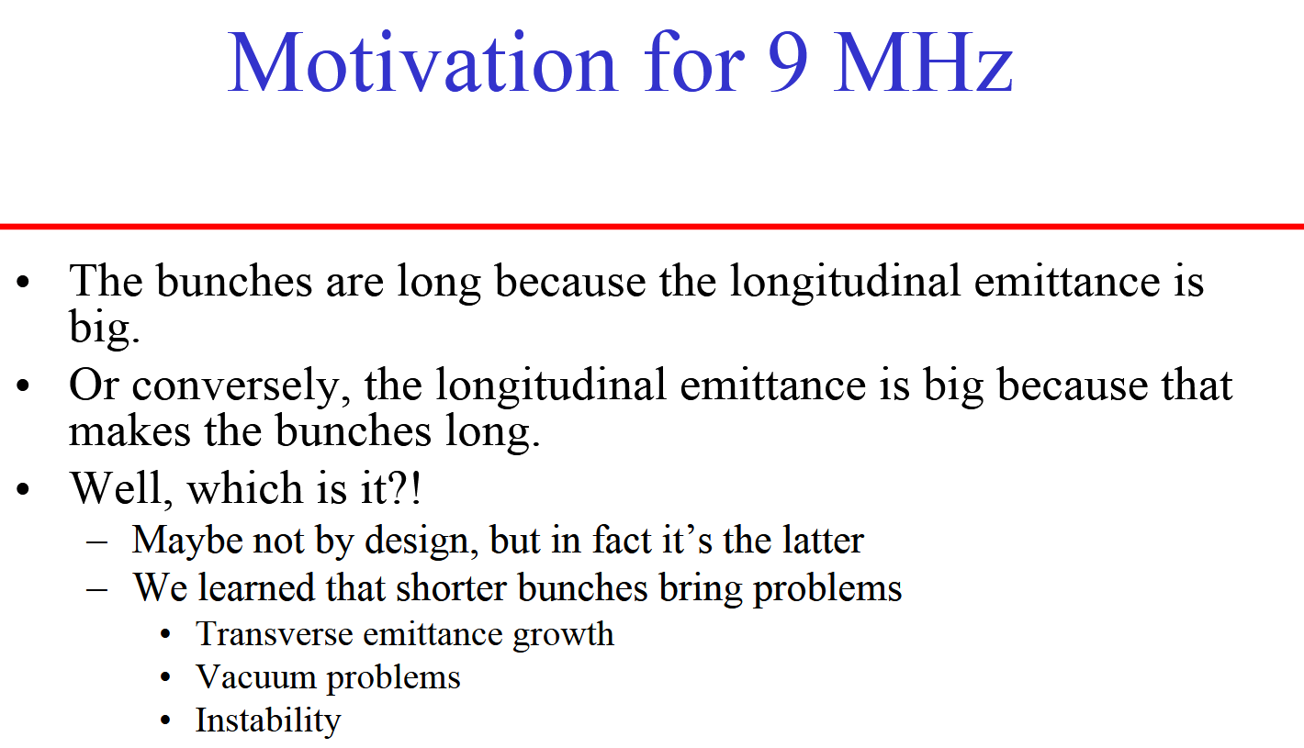
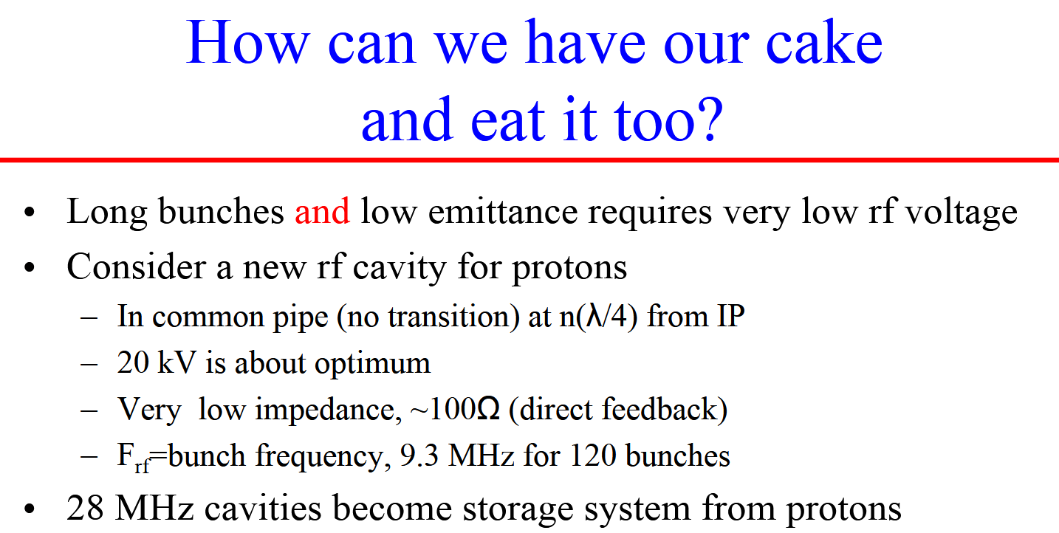
9 MHz Cavities
As intensity and number of bunches increased, needed proton bunches to be long on the ramp to prevent e-cloud
Initially accomplished by mismatch of injected beam in 28 MHz, but this irreversibly blew up the longitudinal emittance
9 MHz cavities allowed long bunches with low longitudinal emittance, which could then be rebucketed to provide short bunches for collision
Proposed in 2006, tested in 2009, operational in 2011+
Mike Brennan, “Shorter Proton Bunches,” RHIC Retreat 2006
Mike Brennan, “9 MHz Cavity for Protons,” RHIC Retreat 2007

Slide 12
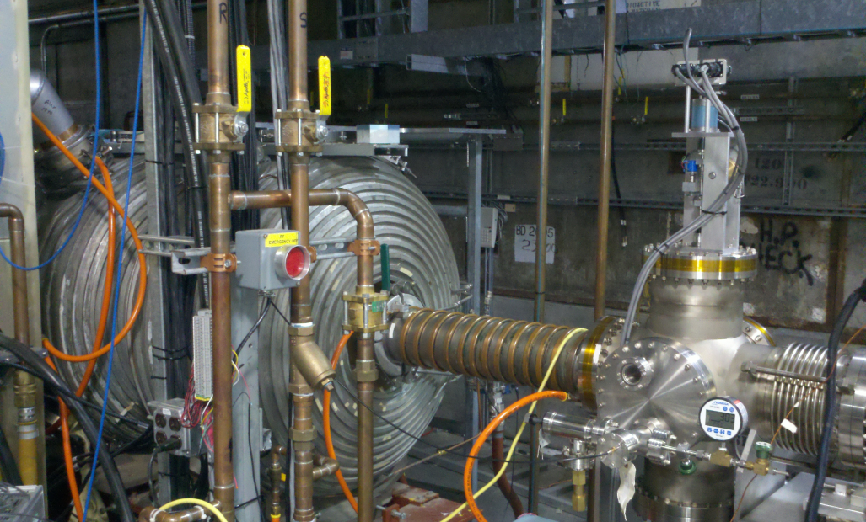
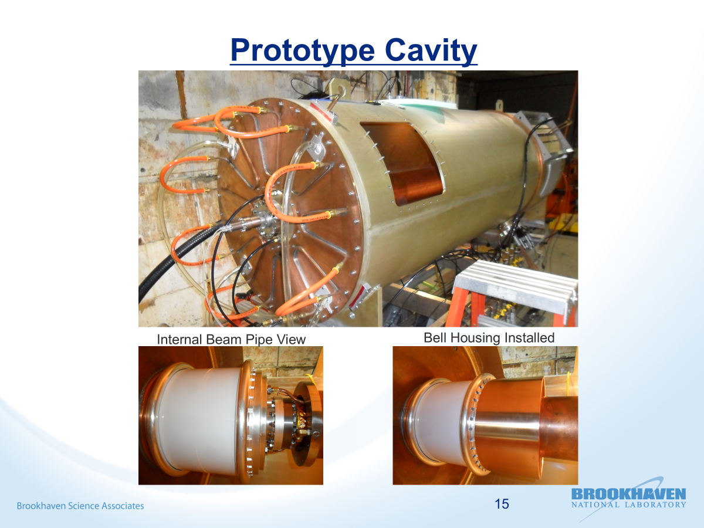
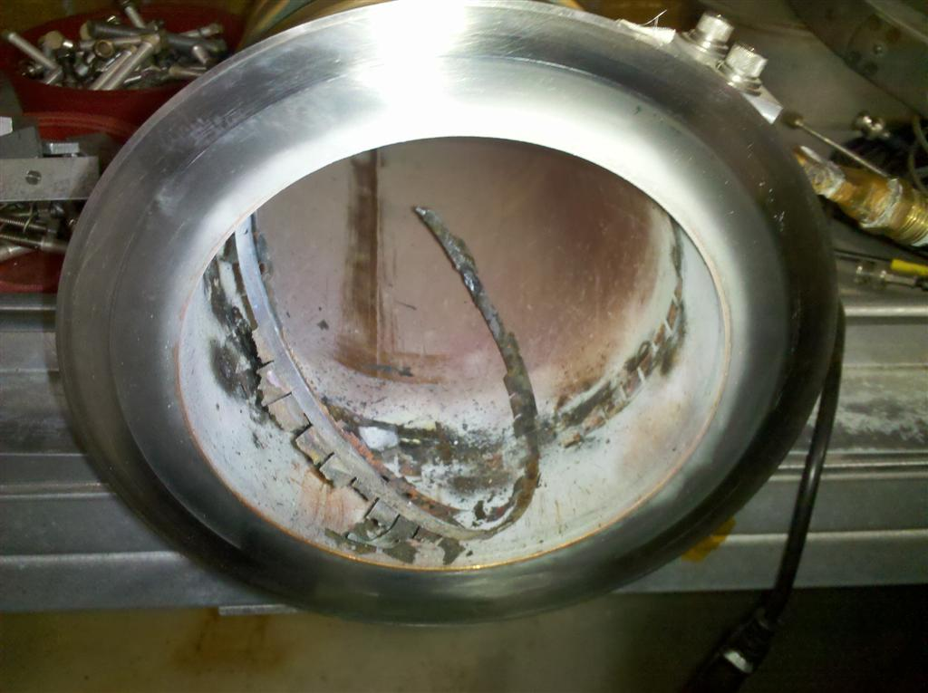
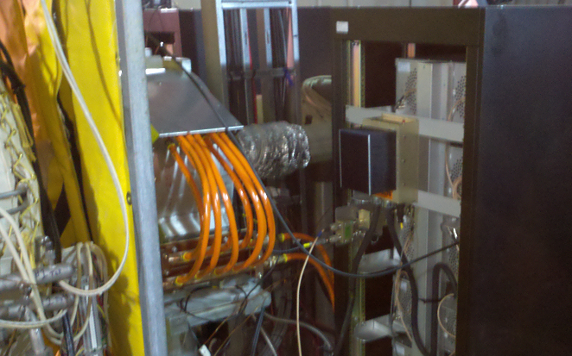
9 MHz Cavities (2)
Common 9 MHz cavity
2009 common cavity only
2011 common & bouncers
2012-13+ upgrade & stable operation
Replacement with dedicated blue/yellow 9 MHz cavities for BES-II / LEReC era (and later)
Burned up spring fingers, 2011
9 MHz bouncer cavity

Slide 13
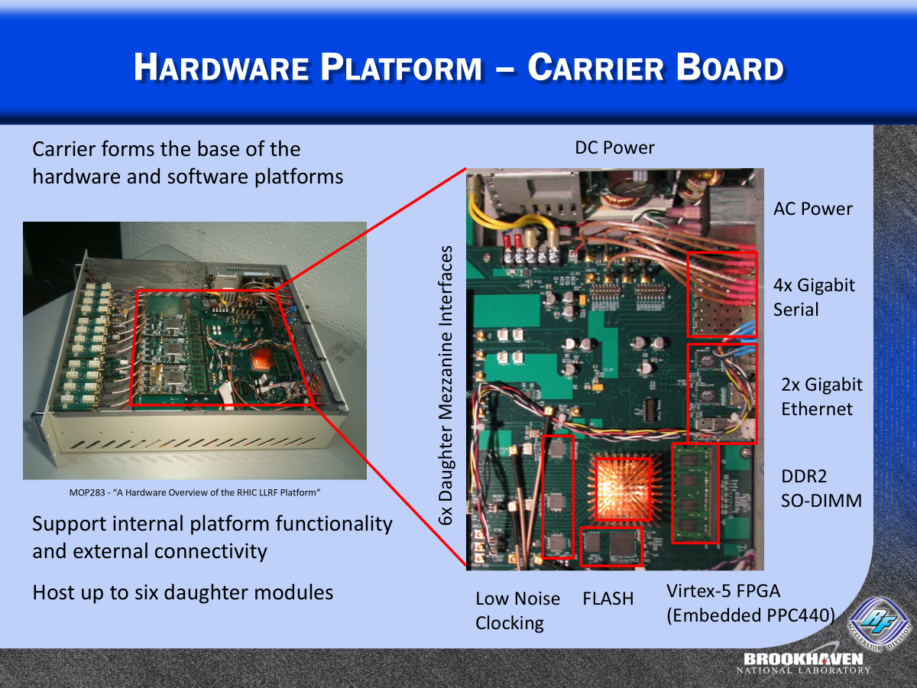
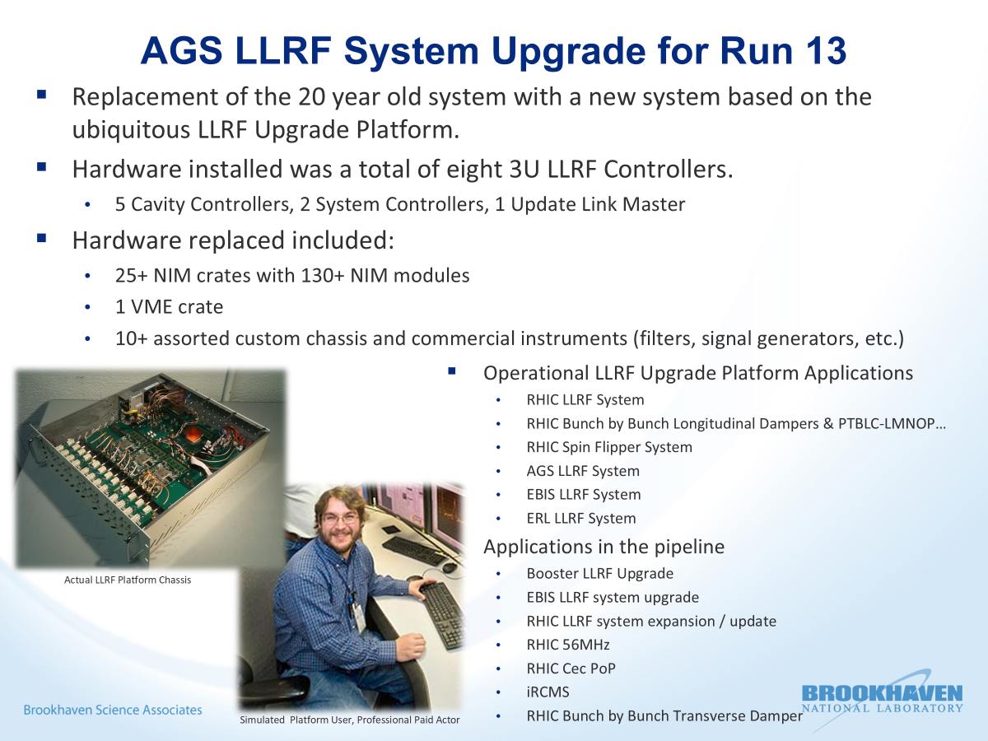
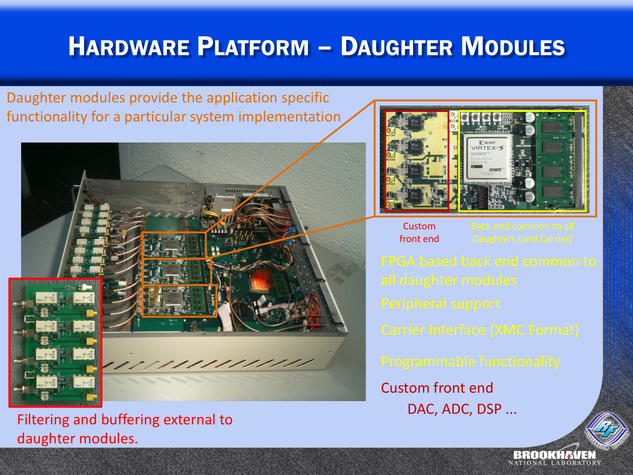
Digital LLRF Upgrade
Kevin Smith, RHIC Retreat 2013
Kevin Smith, LLRF Workshop 2011

Slide 14
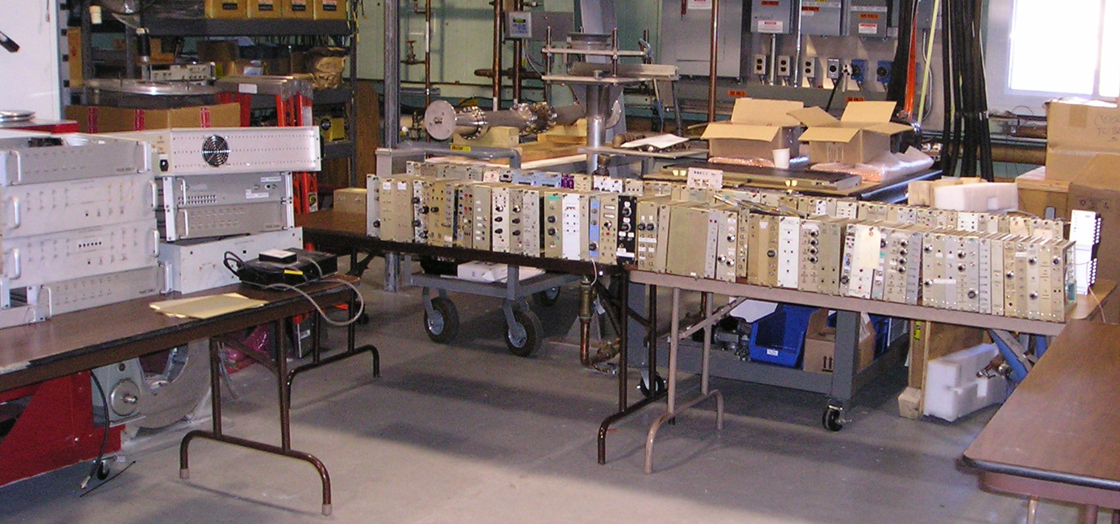
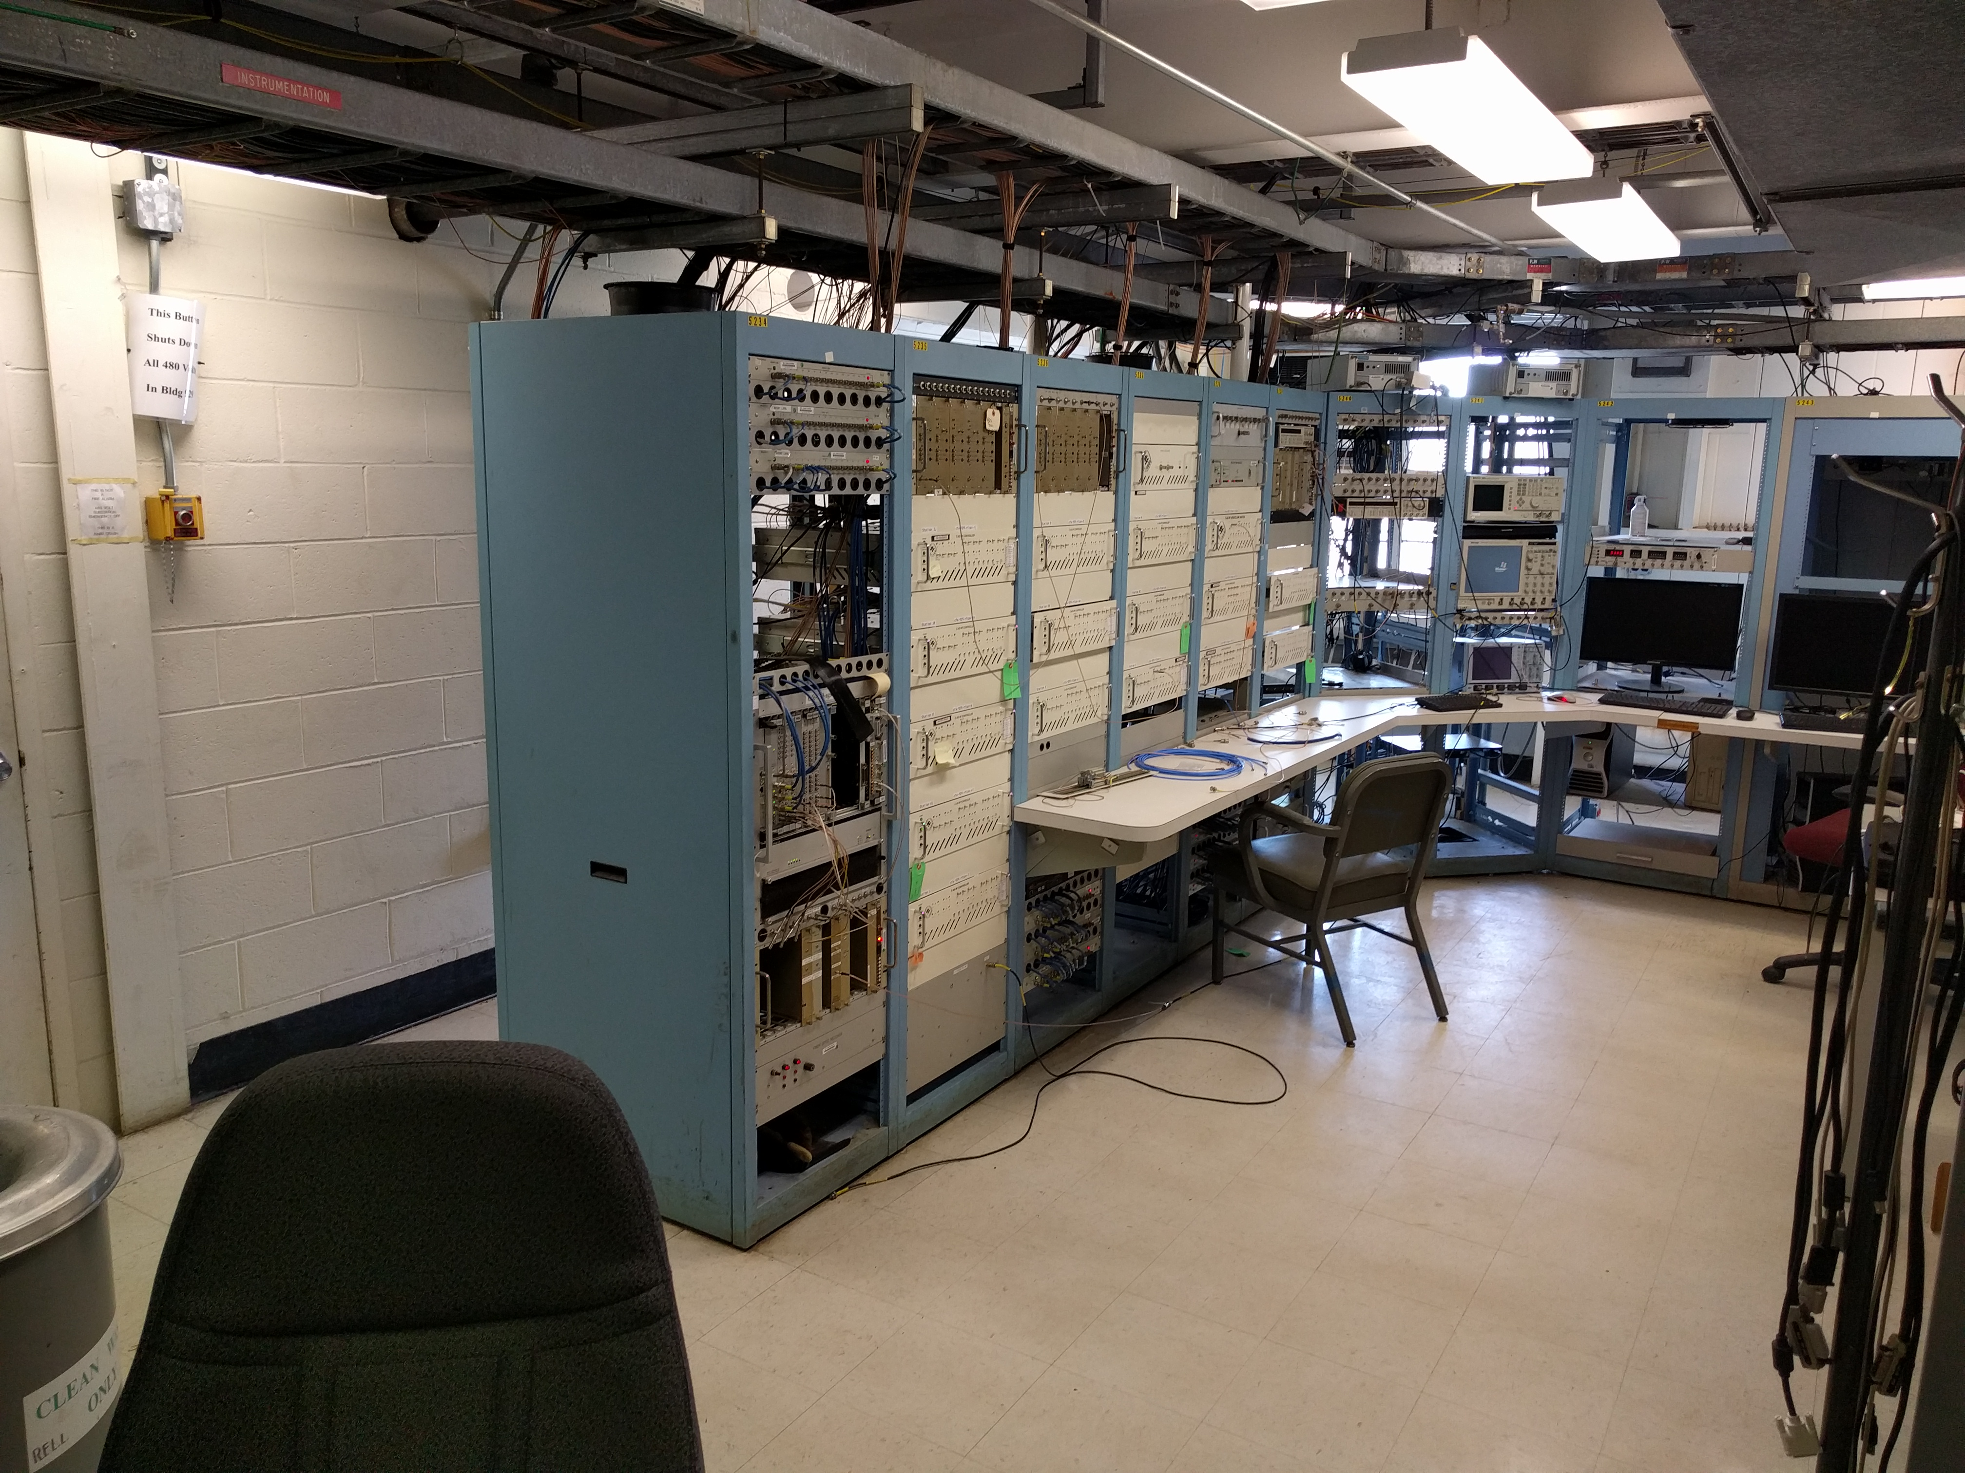
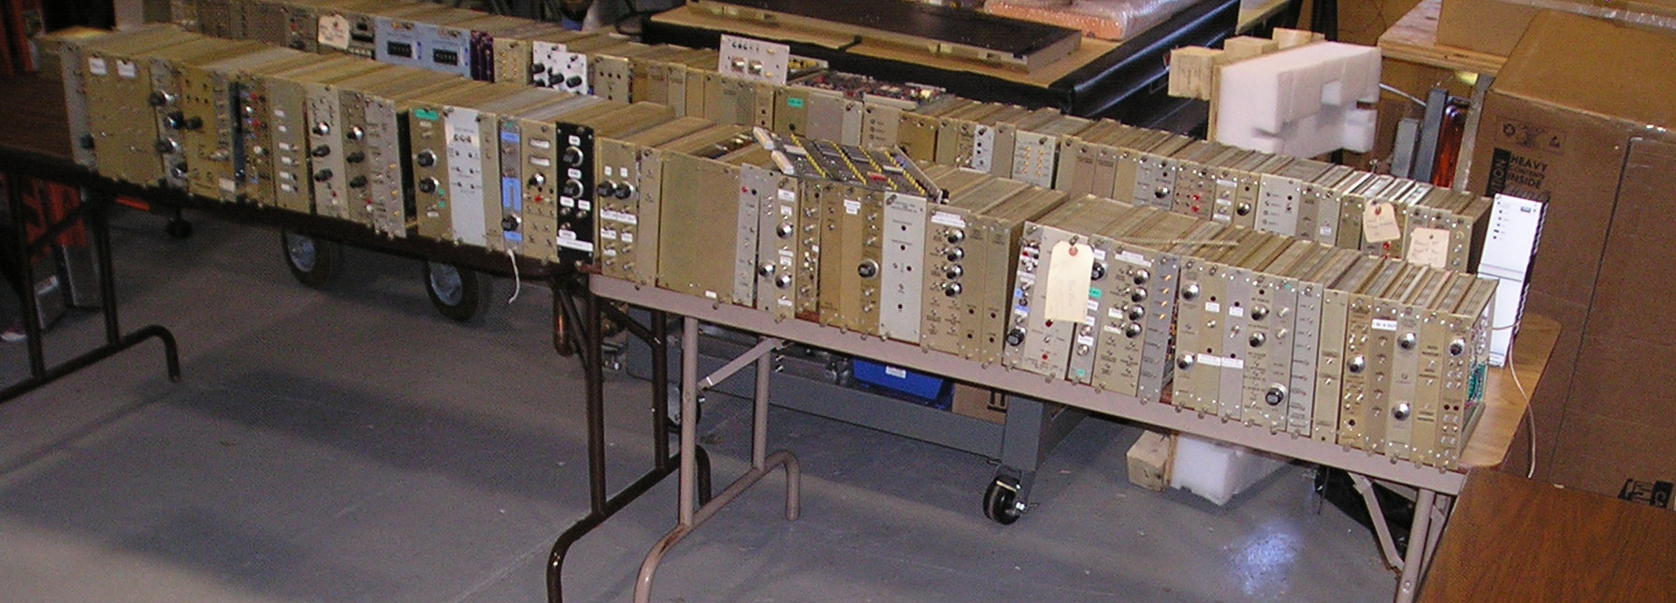
Digital LLRF Upgrade (2)
Tighter integration enabled new applications, significantly reduced hardware, sped up development

Slide 15
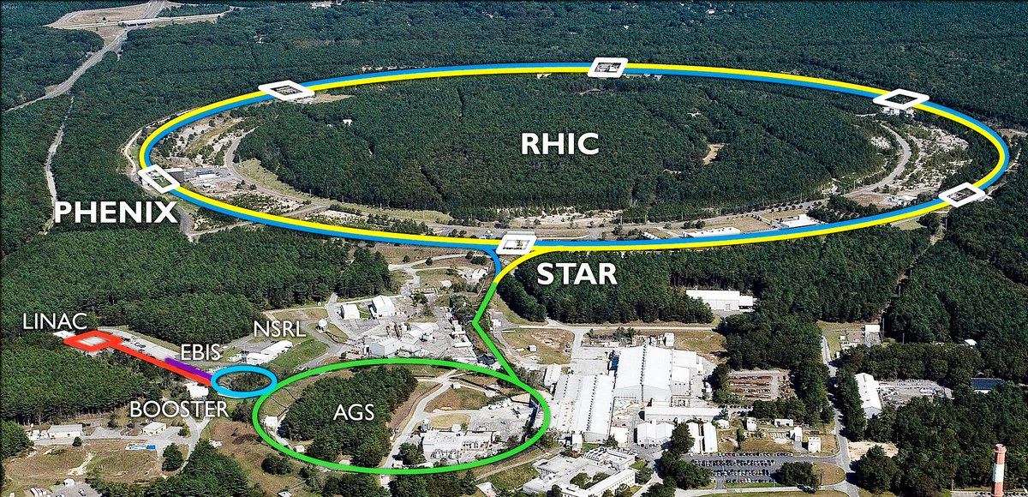
C-AD Complex LLRF Installation
LEReC
CeC
17+1
26+3
2
RF
Systems Linked via Update Link
13+1
5+1
LEReC LLRF
CeC-PoP LLRF
BBB Long. Damper
~4
6+1
RHIC LLRF
Standalone Systems
BBB Trans. Damper
13+1
EBIS LLRF
AGS LLRF
H- Linac LLRF
SRF Test Facility LLRF
Booster LLRF
LLRF Lab
  ~100 installed systems

Slide 16
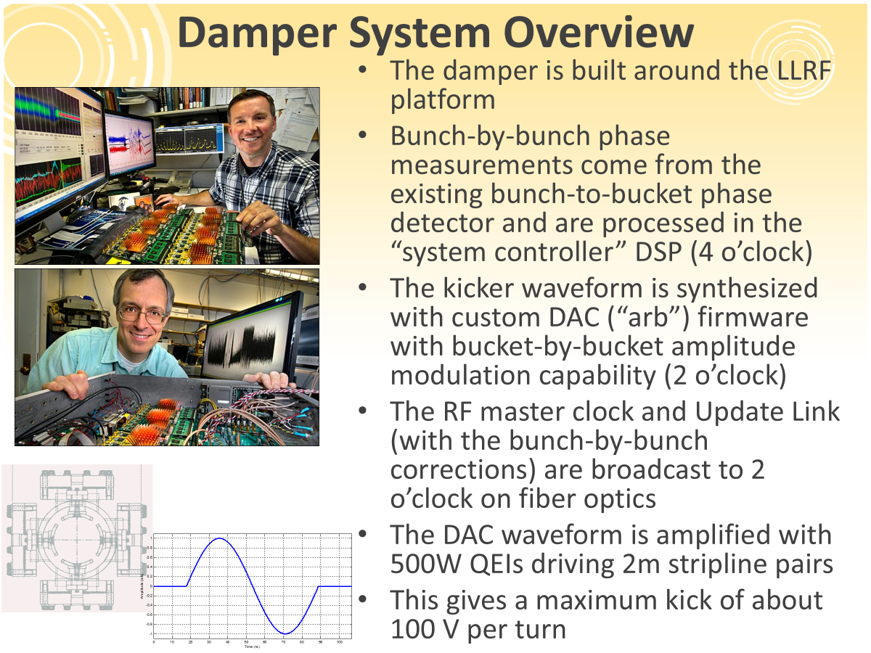
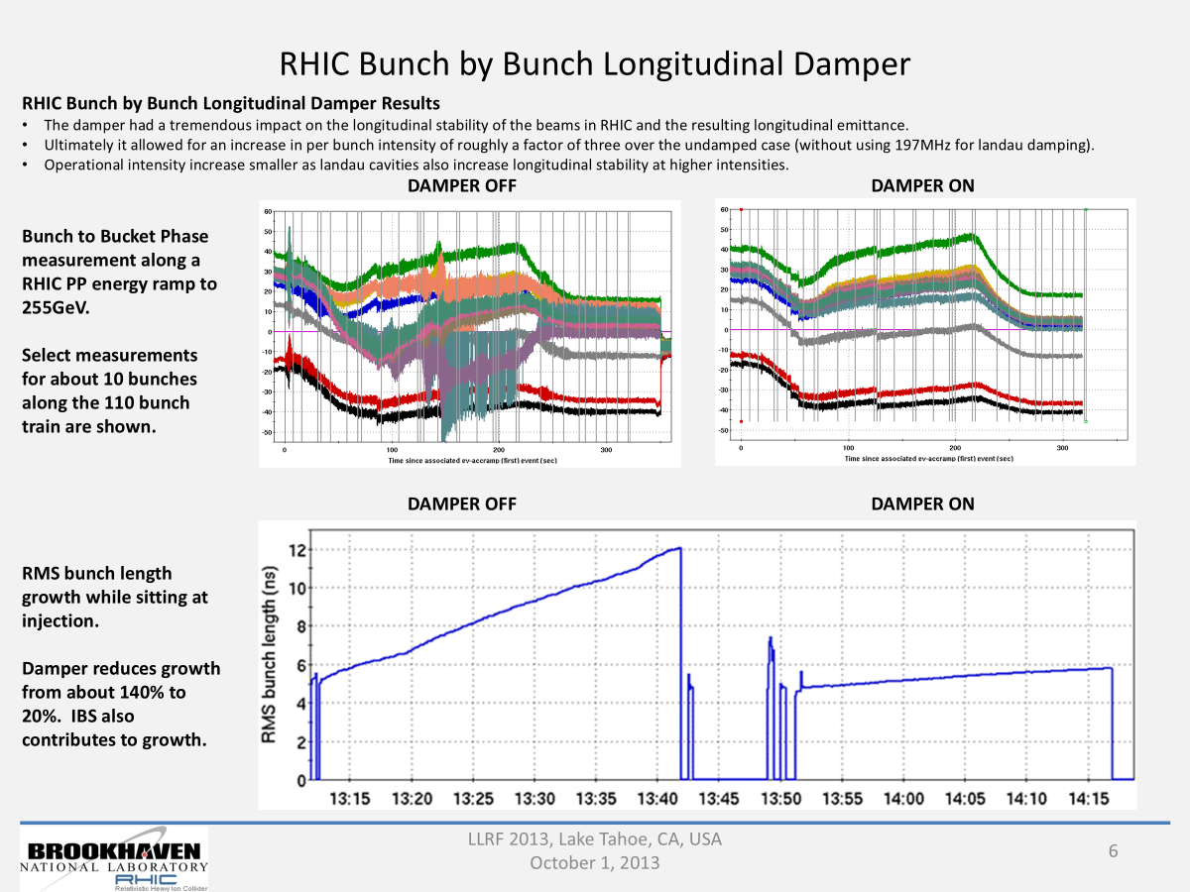
Bunch-by-bunch damper
Distributed system made possible by LLRF upgrade (pickup @ 4:00, kicker @ 2:00)
Kevin Mernick, RHIC Retreat 2013
Kevin Smith, LLRF Workshop 2013

Slide 17
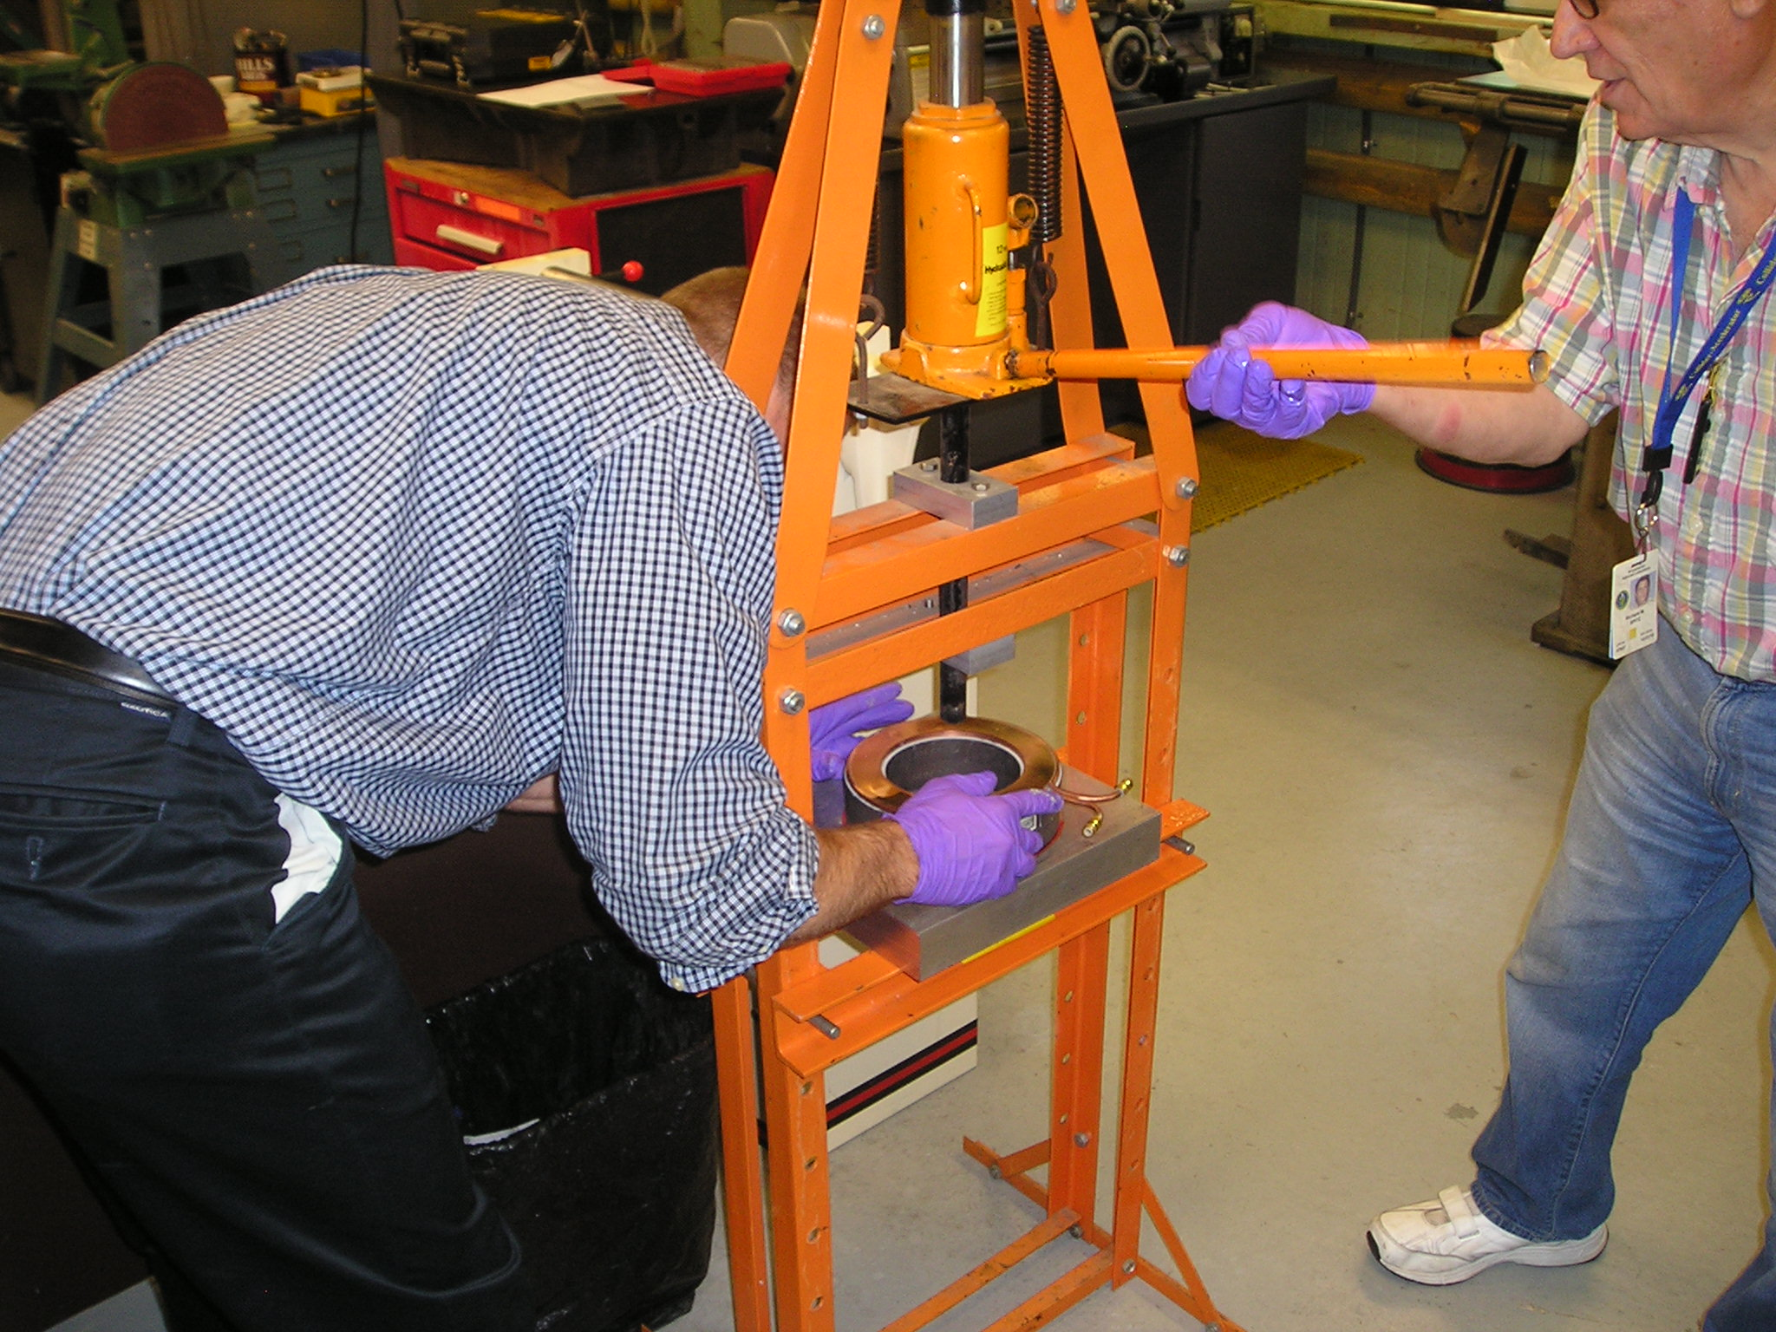
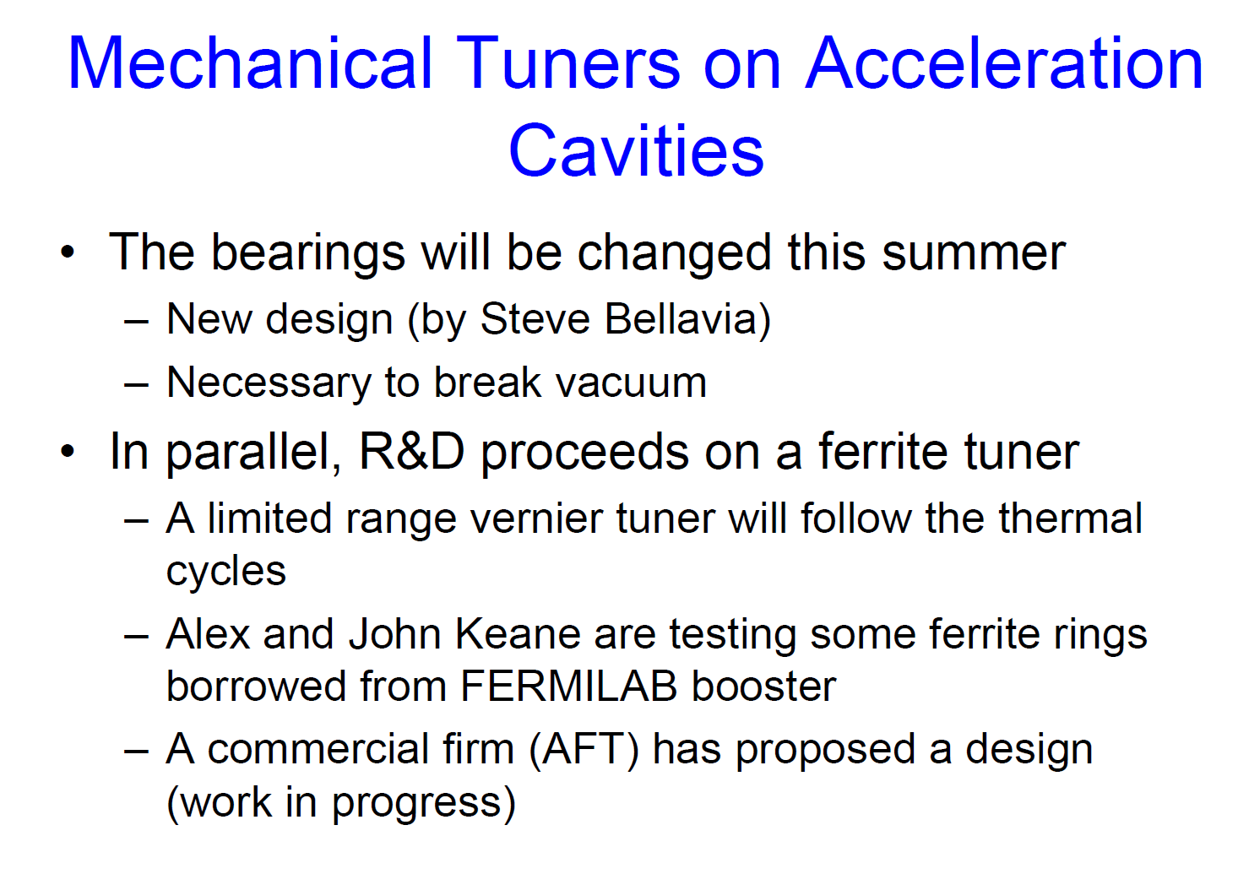
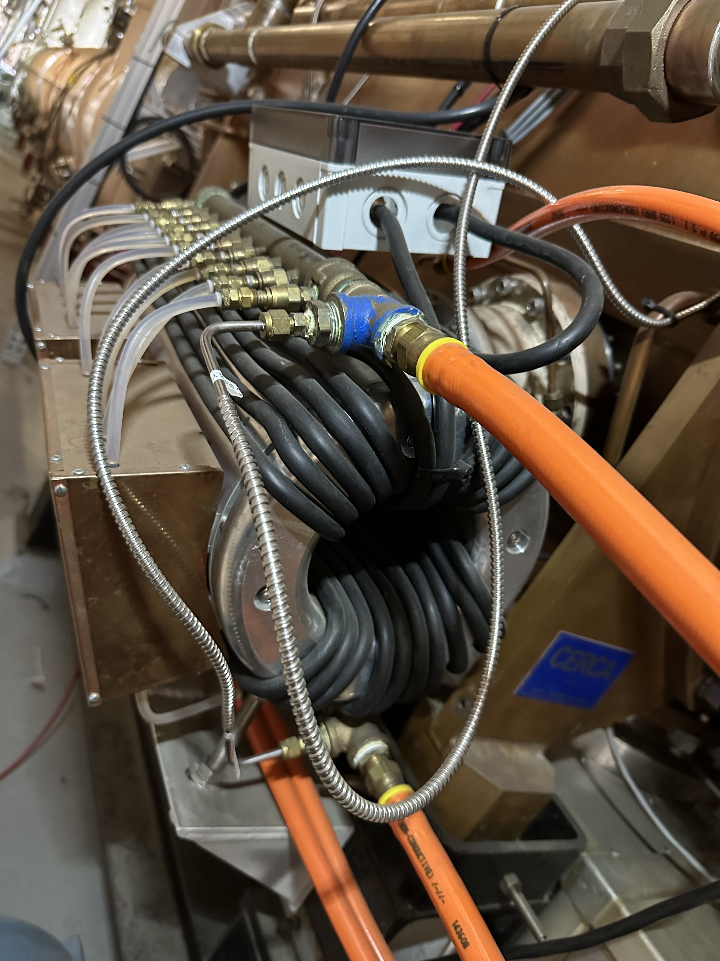
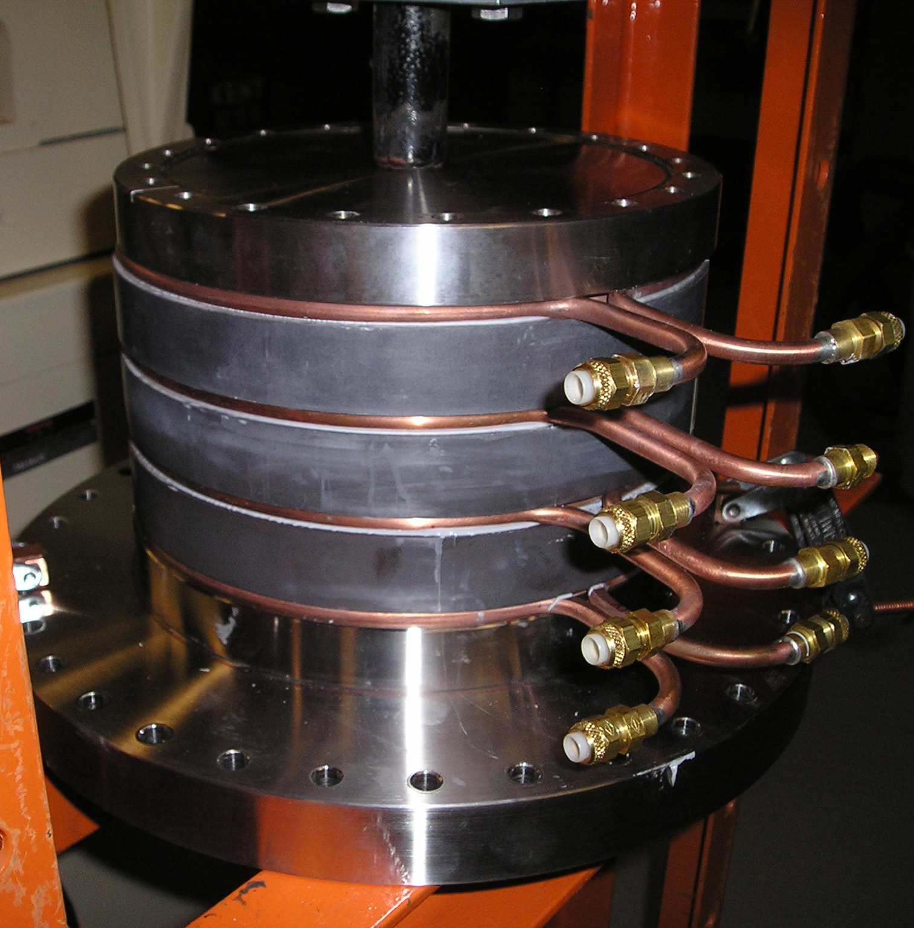
28 MHz Ferrite Tuners
Sal Polizzo, Richard Spitz
Mike Brennan, RHIC Retreat 2005
Reduced wear from thermal cycles
Provided fast tuner response at transition and rebucketing
Operational from Run15 on

Slide 18
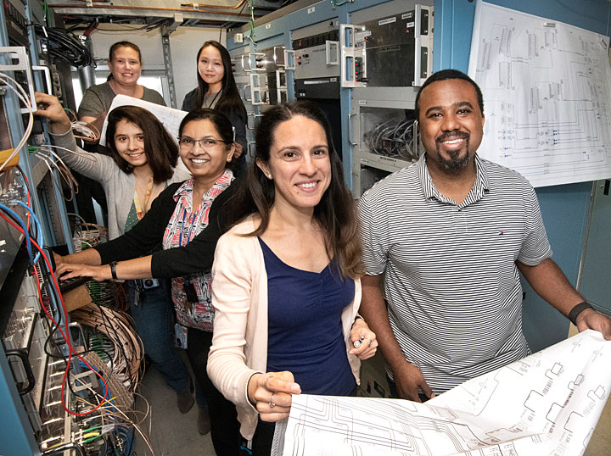
Other Developments
Landau cavities
  First used one of the 197 MHz storage systems (h = 2520)
  Then ~2004 an unmodified CERN 200 MHz system (h = 2563)
  Then ~2012 a dedicated 201.5 MHz system (h = 2580)
  Various enhancements to fight beam loading and support higher intensity
56 MHz SRF cavity
CeCPoP experiment support
Beam Energy Scan 2 and LEReC
  6 new RHIC 9 MHz cavities
  5 (later 6) RF cavities for LEReC e- accelerator
  Support and diagnostics for various LEReC
    subsystems (laser timing, energy diagnostics,
    energy feedback, etc.)
And many more

Slide 19
RF Group Through the Years
plus a few mechanical “friends”
R. Anderson
T. Artusa
D. Baudier
D. Bianco
O. Biletskyi
M. Blaskiewicz
M. Brennan
J. Brodowski
C. Brutus
J. Butler
A. Campbell
F. Carlino
K. Chen
R. Connolly
Z. Conway
J. DeLong
S. Deonarine
R. DiFranco
H. Dorr
N. Duong
S. Ellard
J. Errante
S. Farooq
K. Figueroa
W. Fischer
J. Fite
J. Genco
B. Gingrich
D. Goldberg
J. Greco
J. Guercio
H. Hahn
T. Hammil
P. Harvey
T. Hayes
F. Heistermann
K. Hernandez
M. Hoffmann Wallner
D. Holmes
A. Hubert
J. Joseph
T. Juarez
J. Keane
R. Kellermann
B. Kellwick
C. Klassert
P. Koello
P. Kolb
R. Kuruca
S. Kwiatowski
N. Laloudakis
T. Le
W. Legaz
D. Livoti
V. LoDestro
M. McCooey
K. Mernick
P. Moore
M. Myers
S. Naase
G. Narayan
G. Nembhard
J. Neto
C. Neyland
E. Onillon
T. Orobello
B. Palacios
R. Perez
S. Polizzo
C. Ramirez Lockward
A. Ratti
M. Rivera
K. Rogers
J. Rose
S. Seberg
T. Seda
F. Severino
K. Smith
M. Sowinski
R. Spitz
S. Valentino
K. Vetter
M. Witte
Q. Wu
B. Xiao
T. Xin
C. Xu
W. Xu
S. Yuan
A. Zaltsman
S. Zheng
C-AD from 1999 – present
C-AD/EIC from 1999 - present

Slide 20
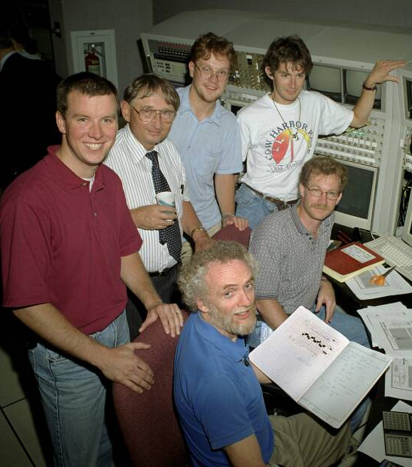
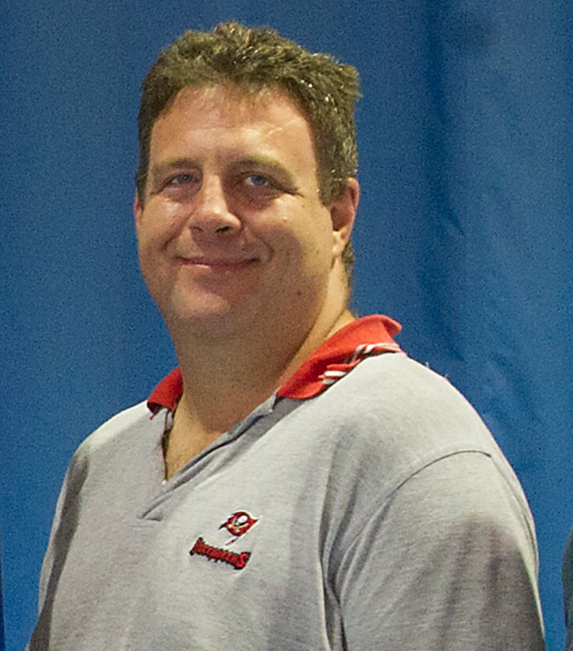
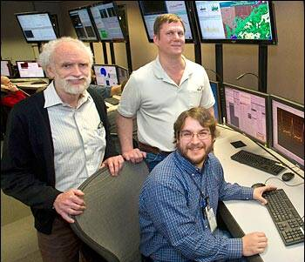
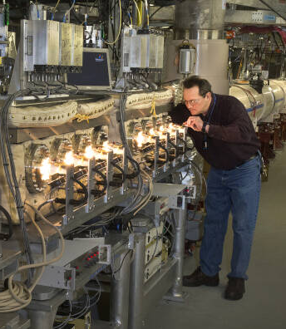
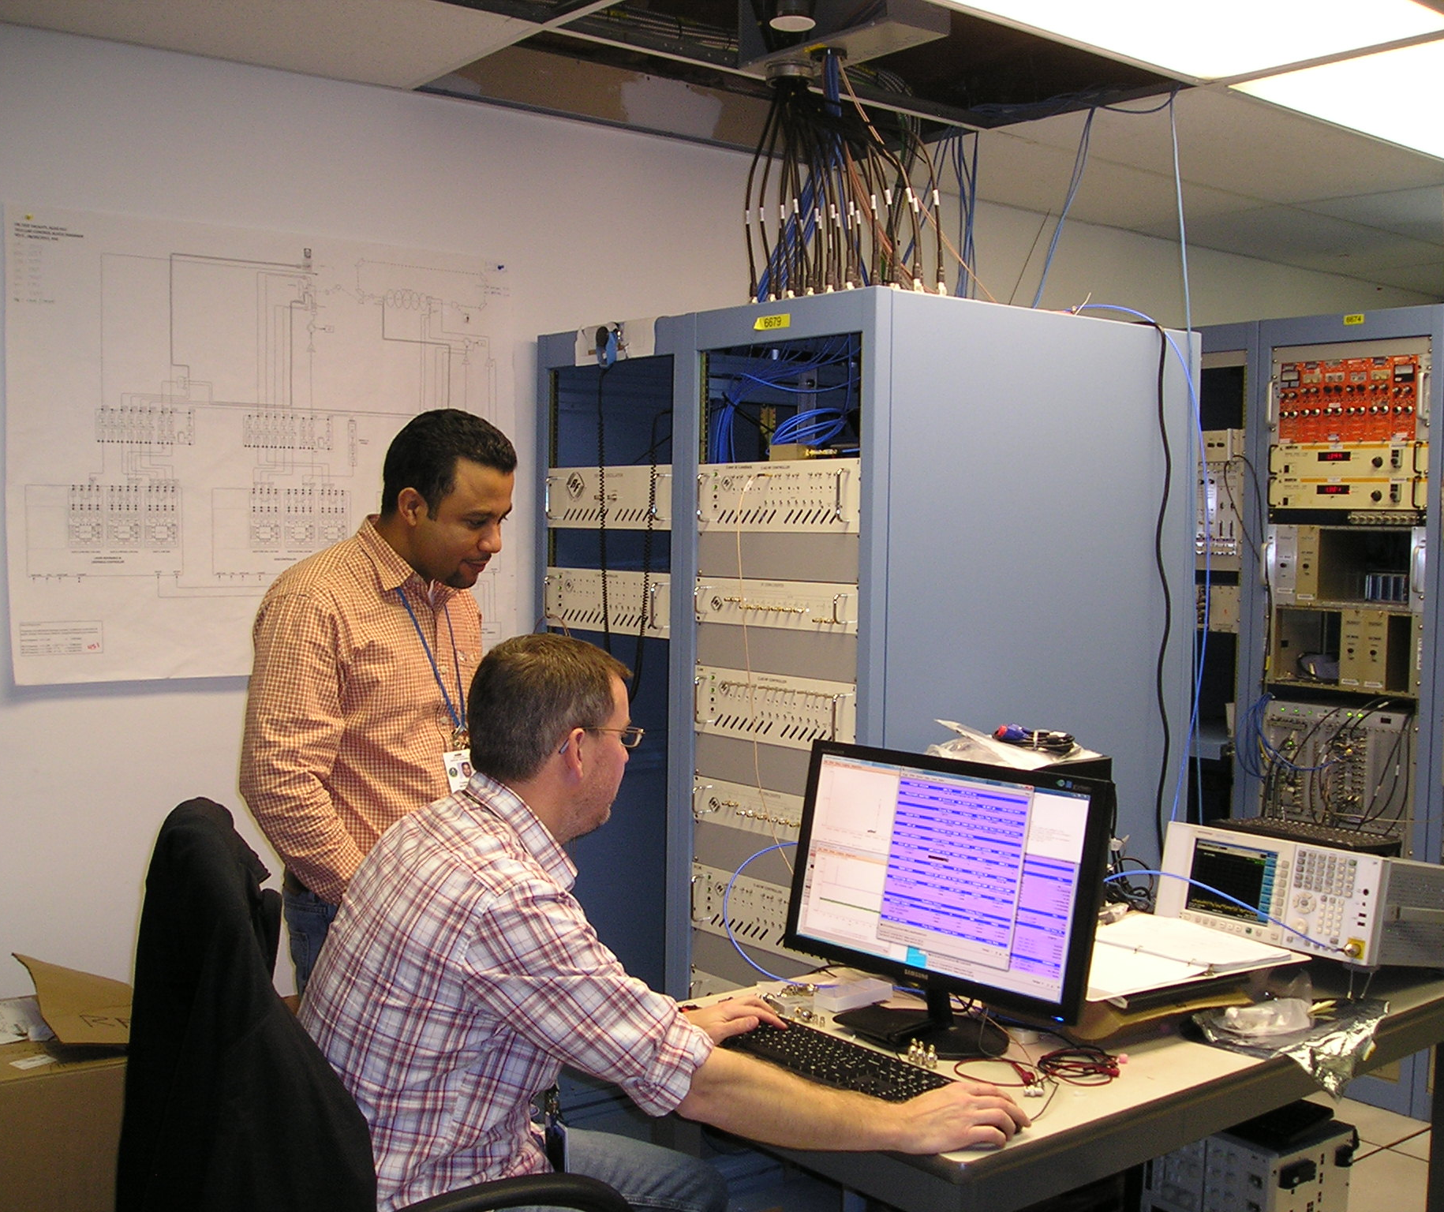
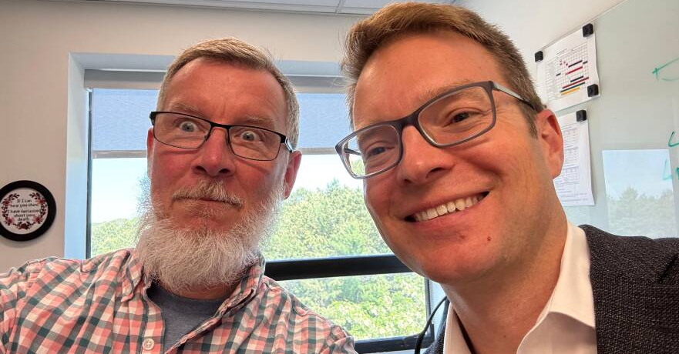
M. Brennan,
M. Blaskiewicz,
K. Mernick
John Butler,
2013 Open B Volleyball Champion,
Super Tech
K. Smith, P. Paul,
A. Campbell, E. Onillon, J. DeLong, M. Brennan
F. Severino,
K. Smith
K. Smith, Z. Conway
M. Myers

Slide 21
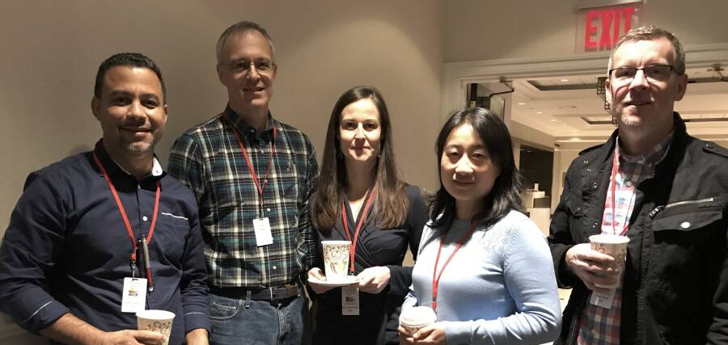
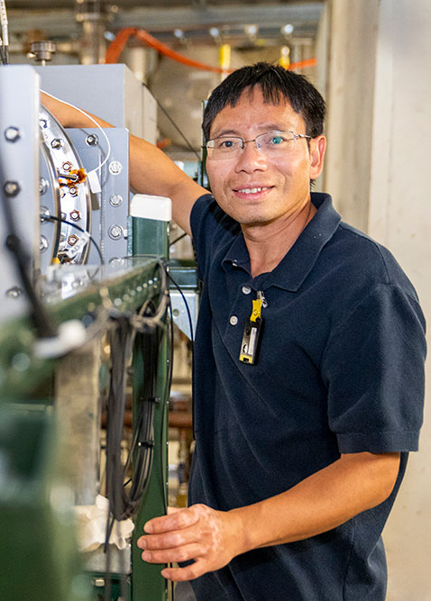
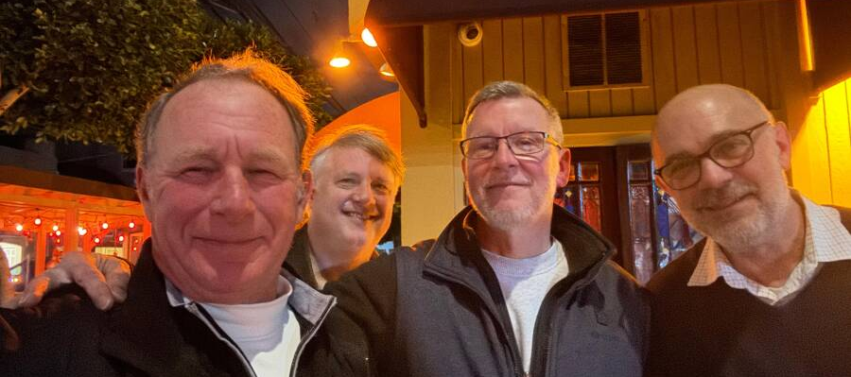
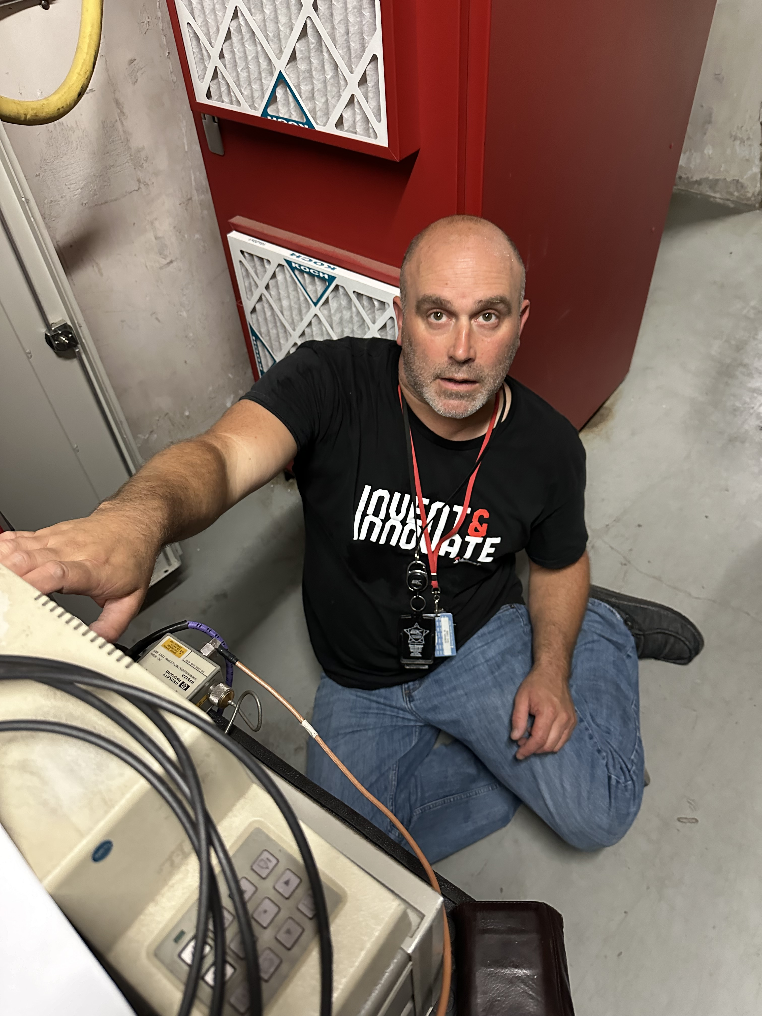


W. Fischer
W. Legaz
T. Orobello
S. Farooq
R. Connolly
R. Anderson
R. Kuruca
V. LoDestro
M. McCooey
J. Neto
J. Guercio
J. Jobin
J. Genco
B. Palacios
H. Dorr
D. Bianco
D. Baudier
D. Livoti
C. Neyland
B. Kellerman
T. Artusa
F. Carlino
R. DiFranco
D. Goldberg
K. Hernandez
P. Harvey
P. Moore
S. Yuan
S. Deonarine
T. Xin
F. Severino, T. Hayes, S. Verdu Andres, Q. Wu, K. Smith
W. Xu
M. Sowinski
J. DeLong, J. Byrd (LBNL/ANL), K. Smith, A. Ratti
B. Xiao
C. Ramirez Lockward

Slide 22








K. Smith, 2012 Engineering Award
F. Severino, 2016 Engineering Award
T. Hayes, 2012 Engineering Award
A. Zaltsman, 2009 Engineering Award
M. Blaskiewicz, 2007 S&T Award
2010 APS Fellow
F. Severino, 2009 Luminary Award
S. Seberg, 2011 Brookhaven Award
J. Rose (NSLS-II), 2015 Engineering Award

Slide 23




G. Narayan, 2025 Engineering Award
N. Laloudakis, 2025 Outstanding Technician Award
K. Mernick, 2018 Engineering Award
S. Polizzo, 2018 Engineering Award

Slide 24



A Tour of the RHIC RF

