Slide 1
Perspective on RHIC Controls Evolution
Kevin Brown
Sev Binello, Mike Costanzo, Ted D’Ottavio, James Jamilkowski, John Morris, Seth Nemesure, Todd Satogata

Slide 2
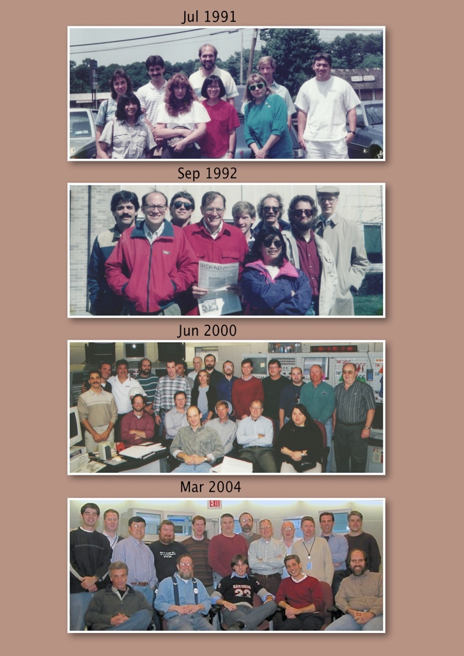
Ann Dunbar, Ted D’Ottavio, John Morris, Larry Hoff, Rich Casella
Agnes Abola, Cindy Griffiths, Sharon Yen, Sue Kennell
Ted D’Ottavio, Stuart Mandell, Rich Casella, Tom Clifford,
Larry Hoff, Agnes Abola, Ken Reece, Roger Katz, Don Barton
Ted D’Ottavio, Bob Olsen, Joe Piacentino, John Morris,
Seth Nemesure, Sev Binello, Don Baron, Heather Hartmann,
Al Marusic, Bart Frak, Jon Laster, Ed Koropsak, ??, Phil Pape,
Roger Lee,
Roger Katz, Joe Skelly, Don Shea, Larry Hoff, Tom Clifford,
Sue Kennell
Daniel Ottavio, Joe Skelly, Wenge Fu, Kerry Unger, Jon Laster,
Joe P., Al Marusic,
Tom Clifford, Roger Lee, Johannes van Zeijts, Bob Olsen,
Charles Whalen,
Sev Binello, Roger Katz, Bart Frak, Ted D’Ottavio, John Morris

Slide 3
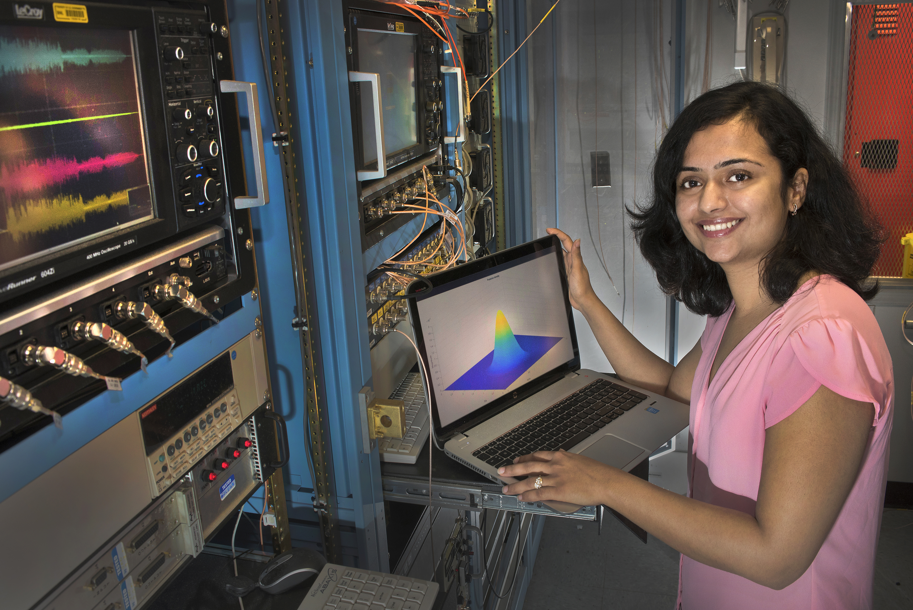
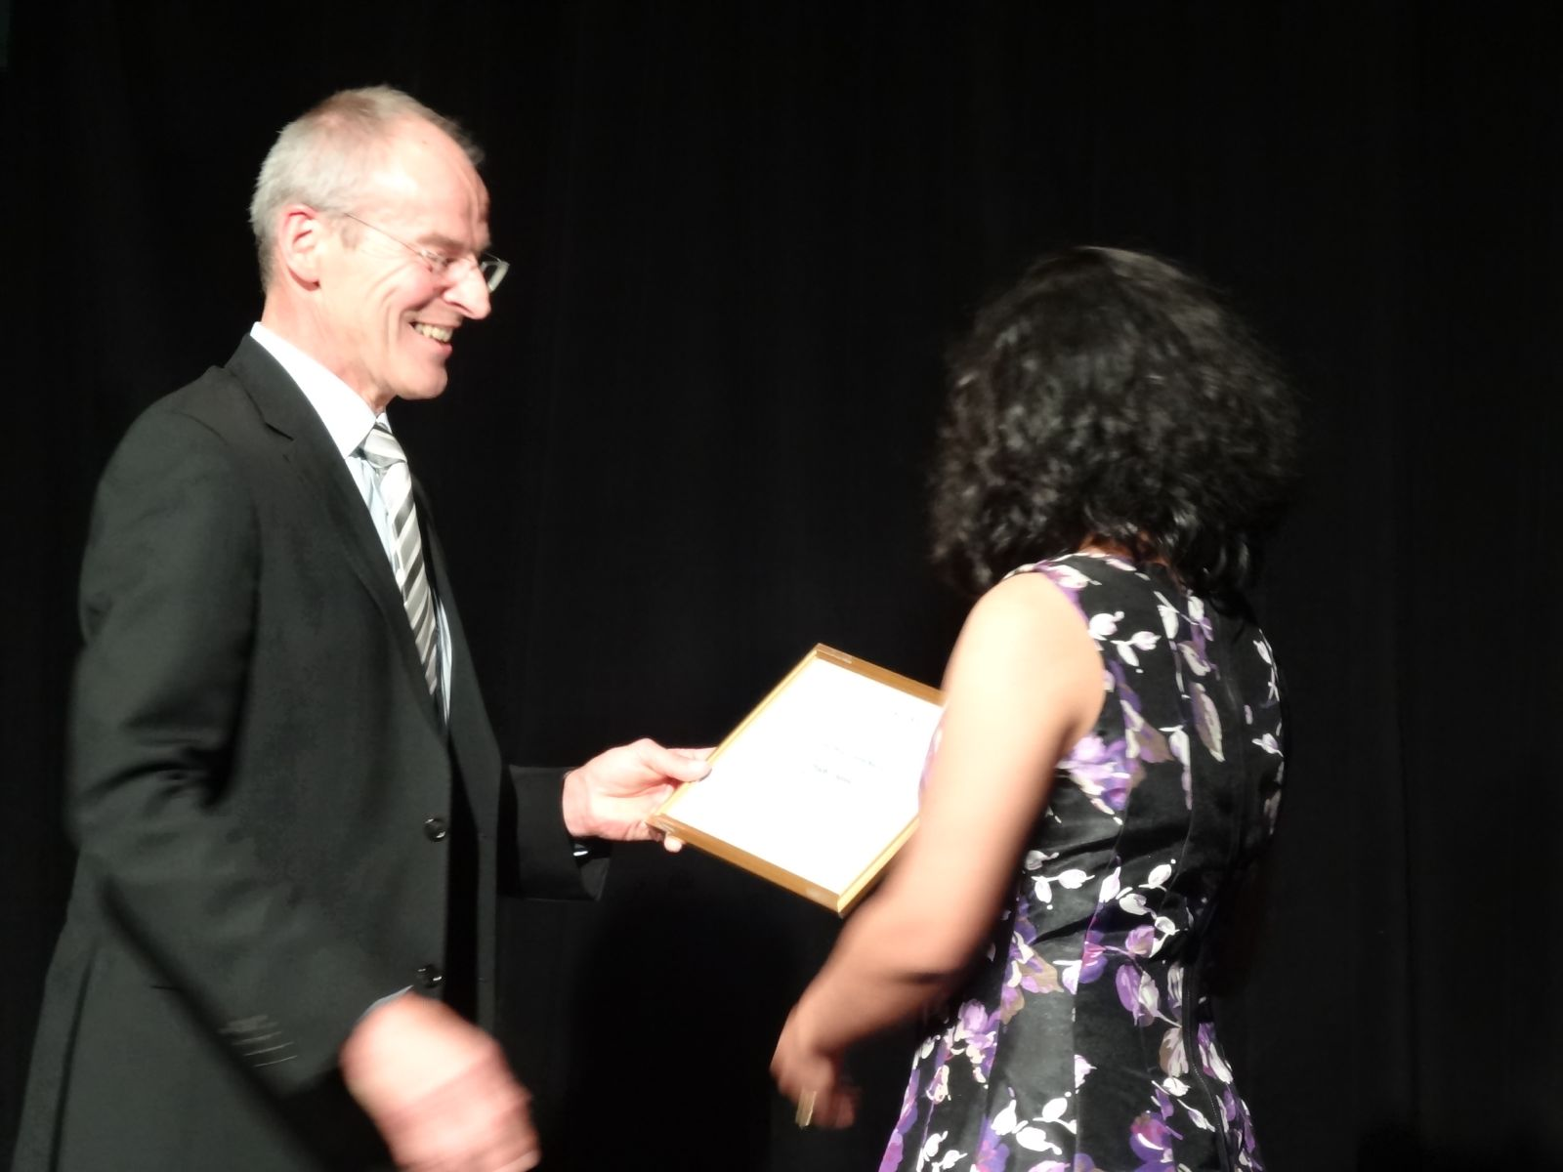
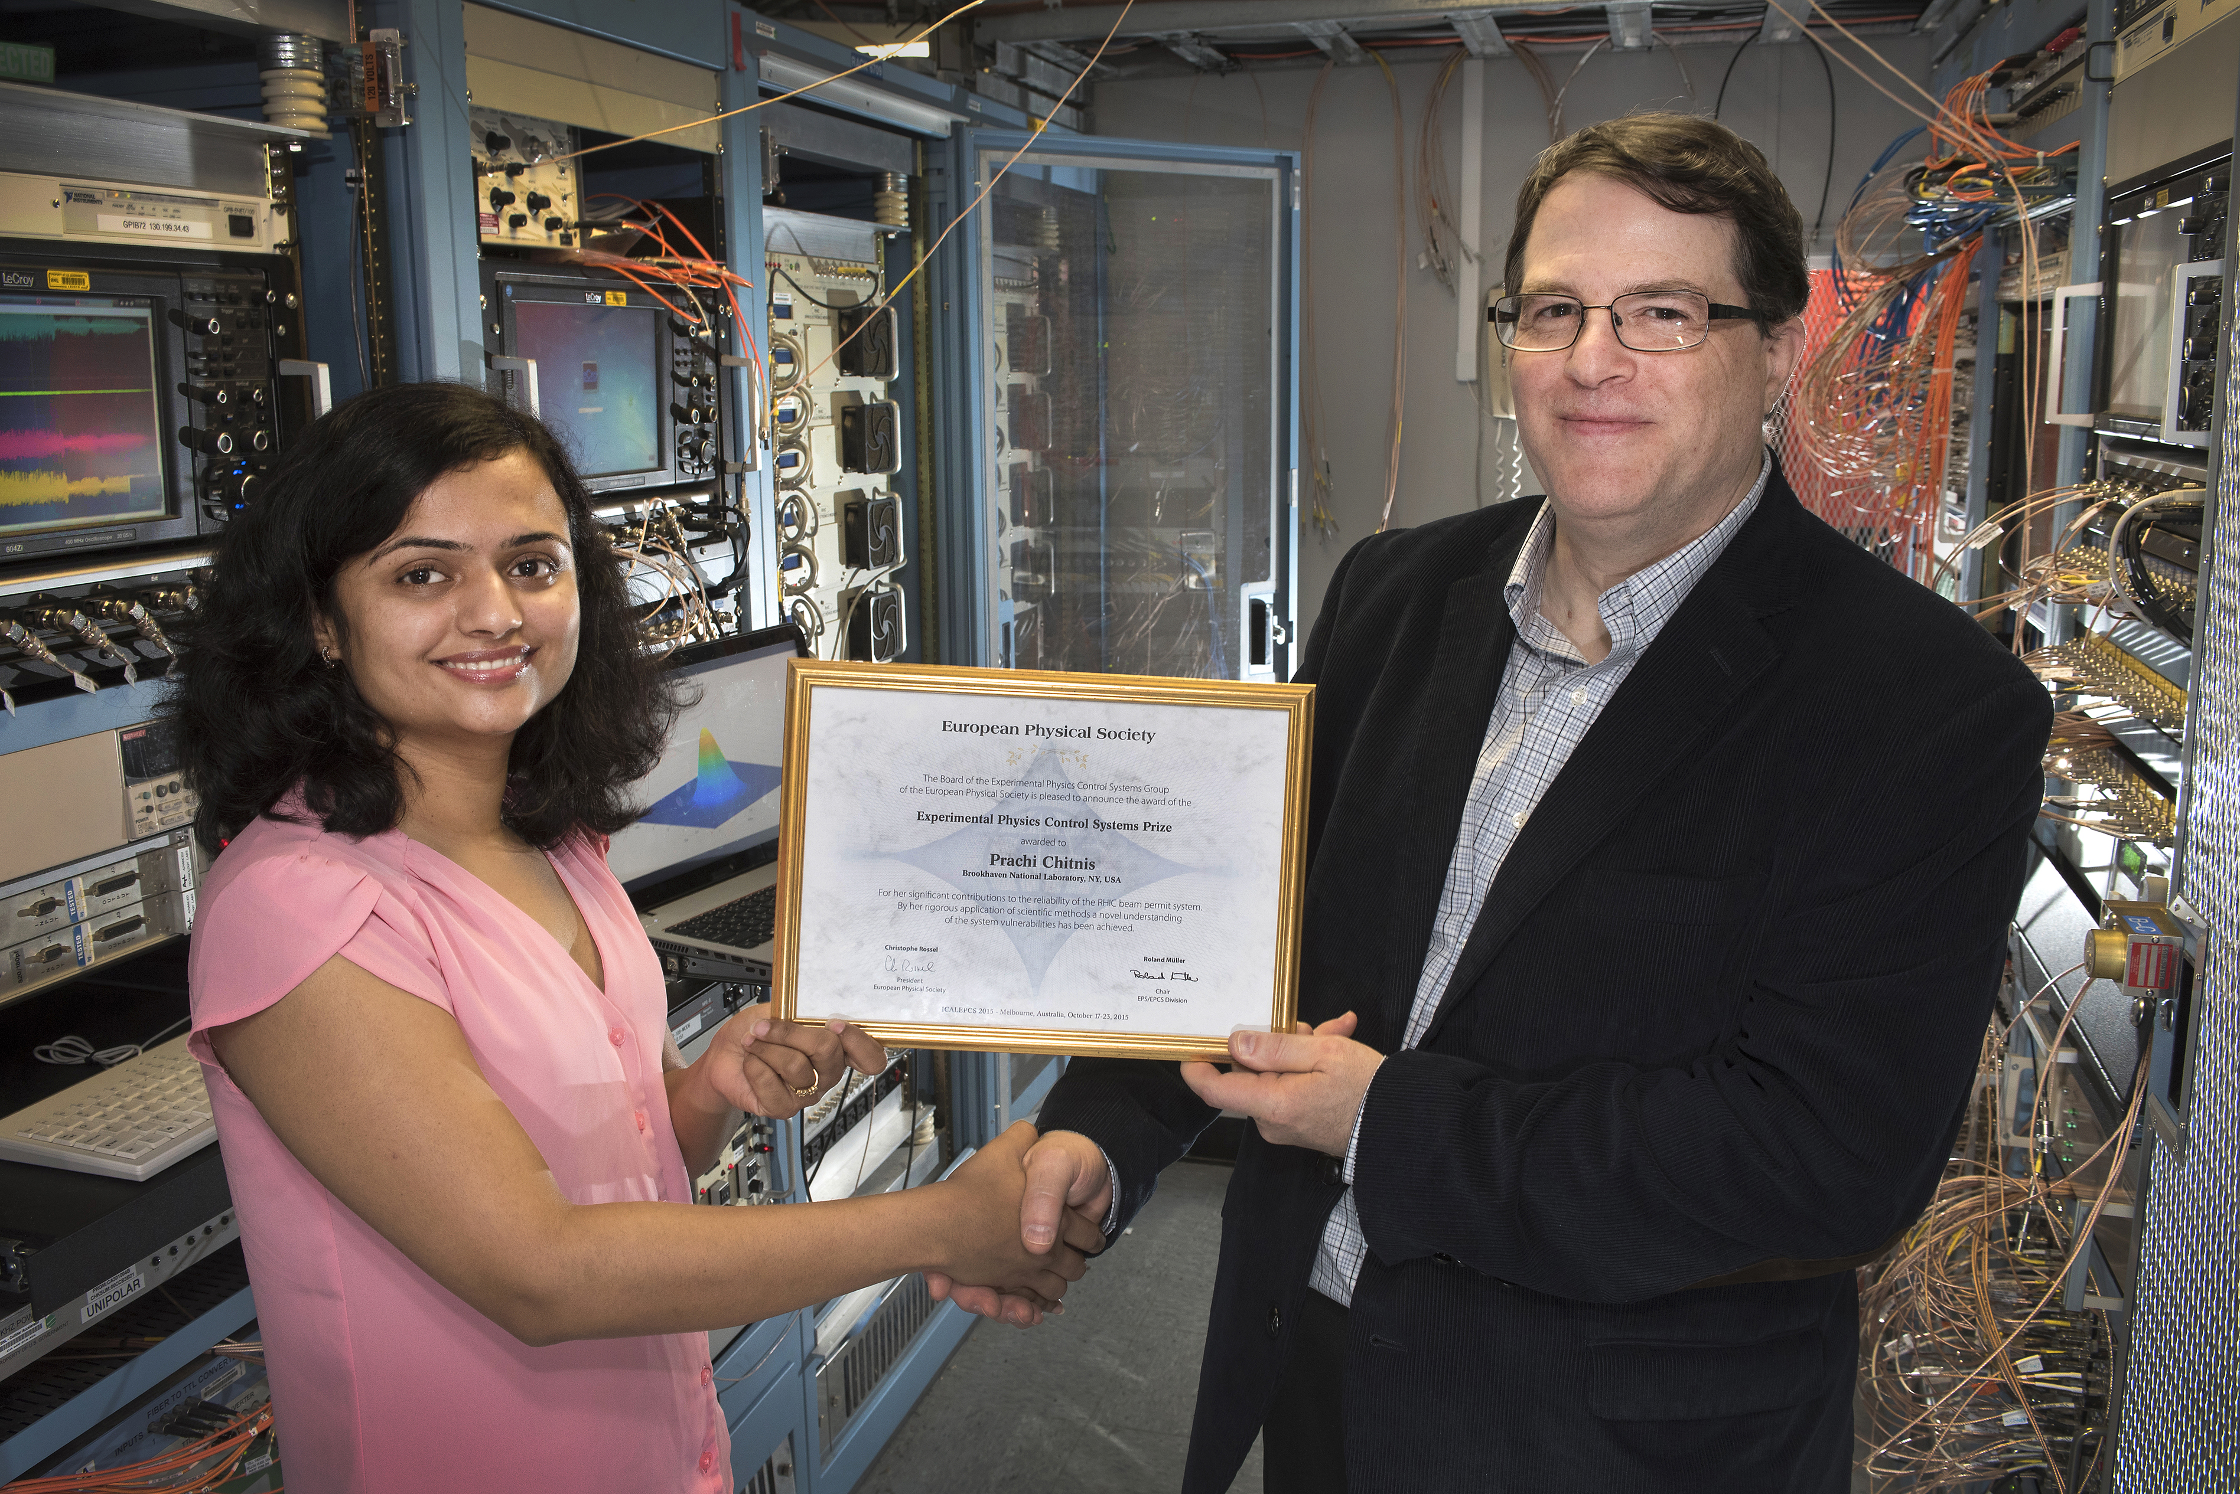
2015
Controls Group PhD Student
Prachi Chitnis wins
European Physical Society
Experimental Physics Control Systems
Prize, presented at the 2015 ICAPECS
Notes:
Bessy – Roland Muller, HZB, IEC Chair, EPS representative

Slide 4

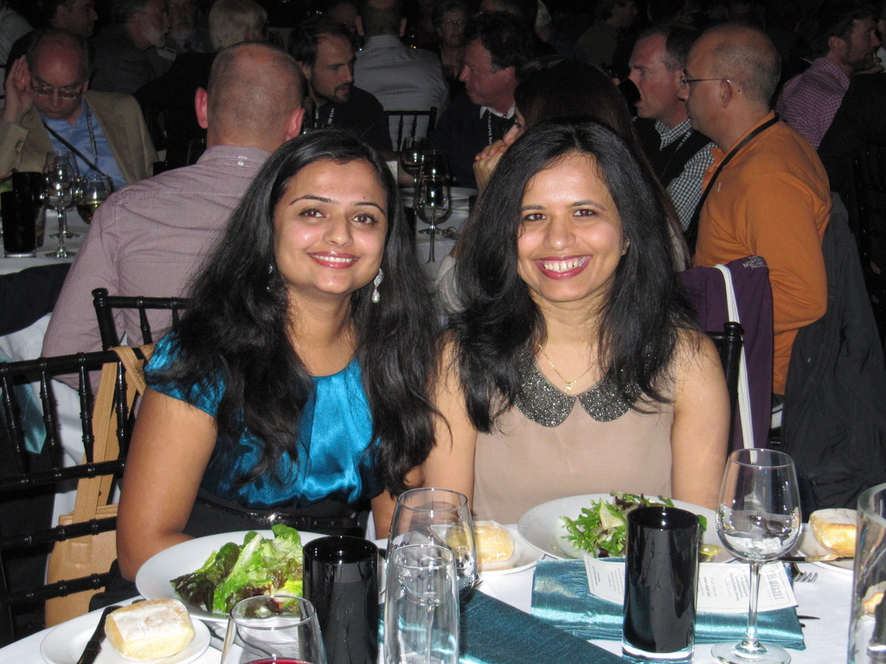
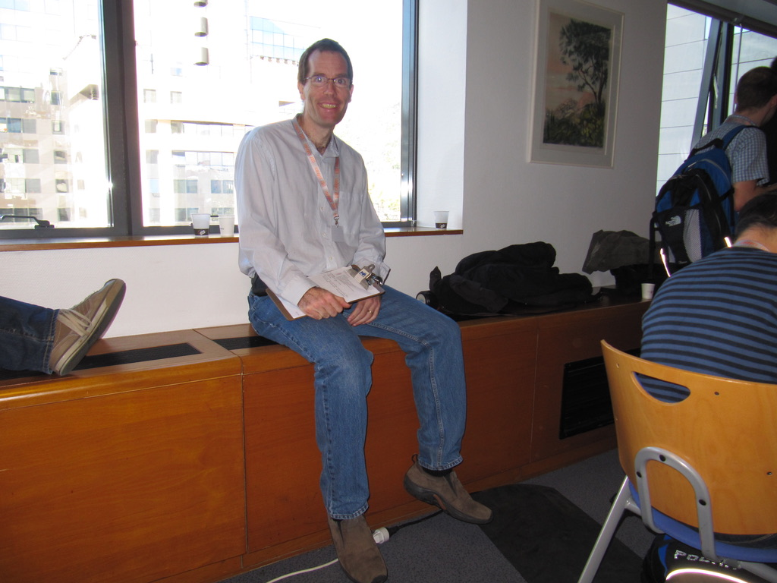
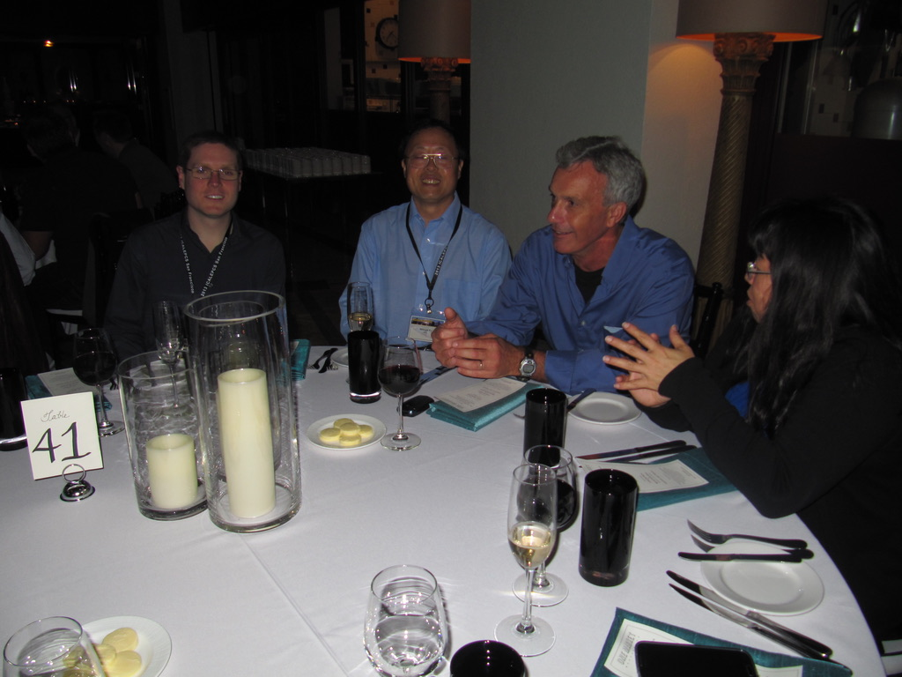
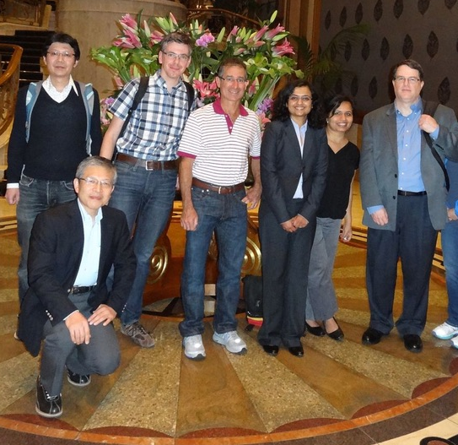
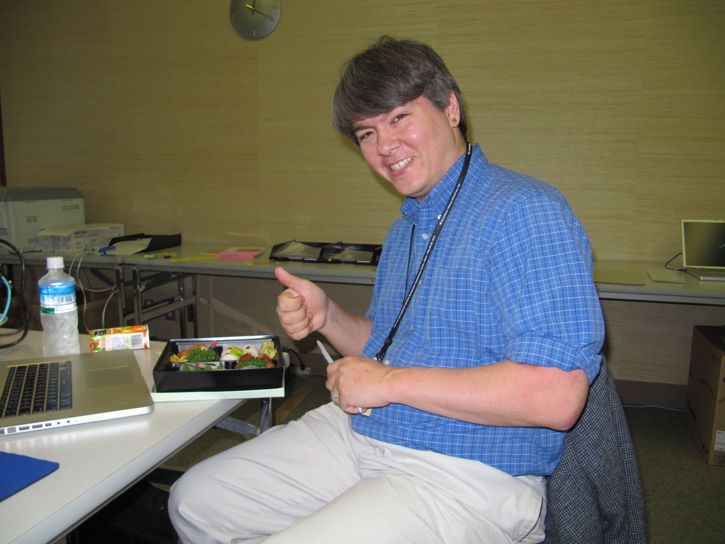
Notes:
Top Left: Andy Goetz, ESRF, Larry, Jim, Bart. Bottom Middle: Kazuro Furukawa, KEK, Rob, Prachi, Prerana

Slide 5
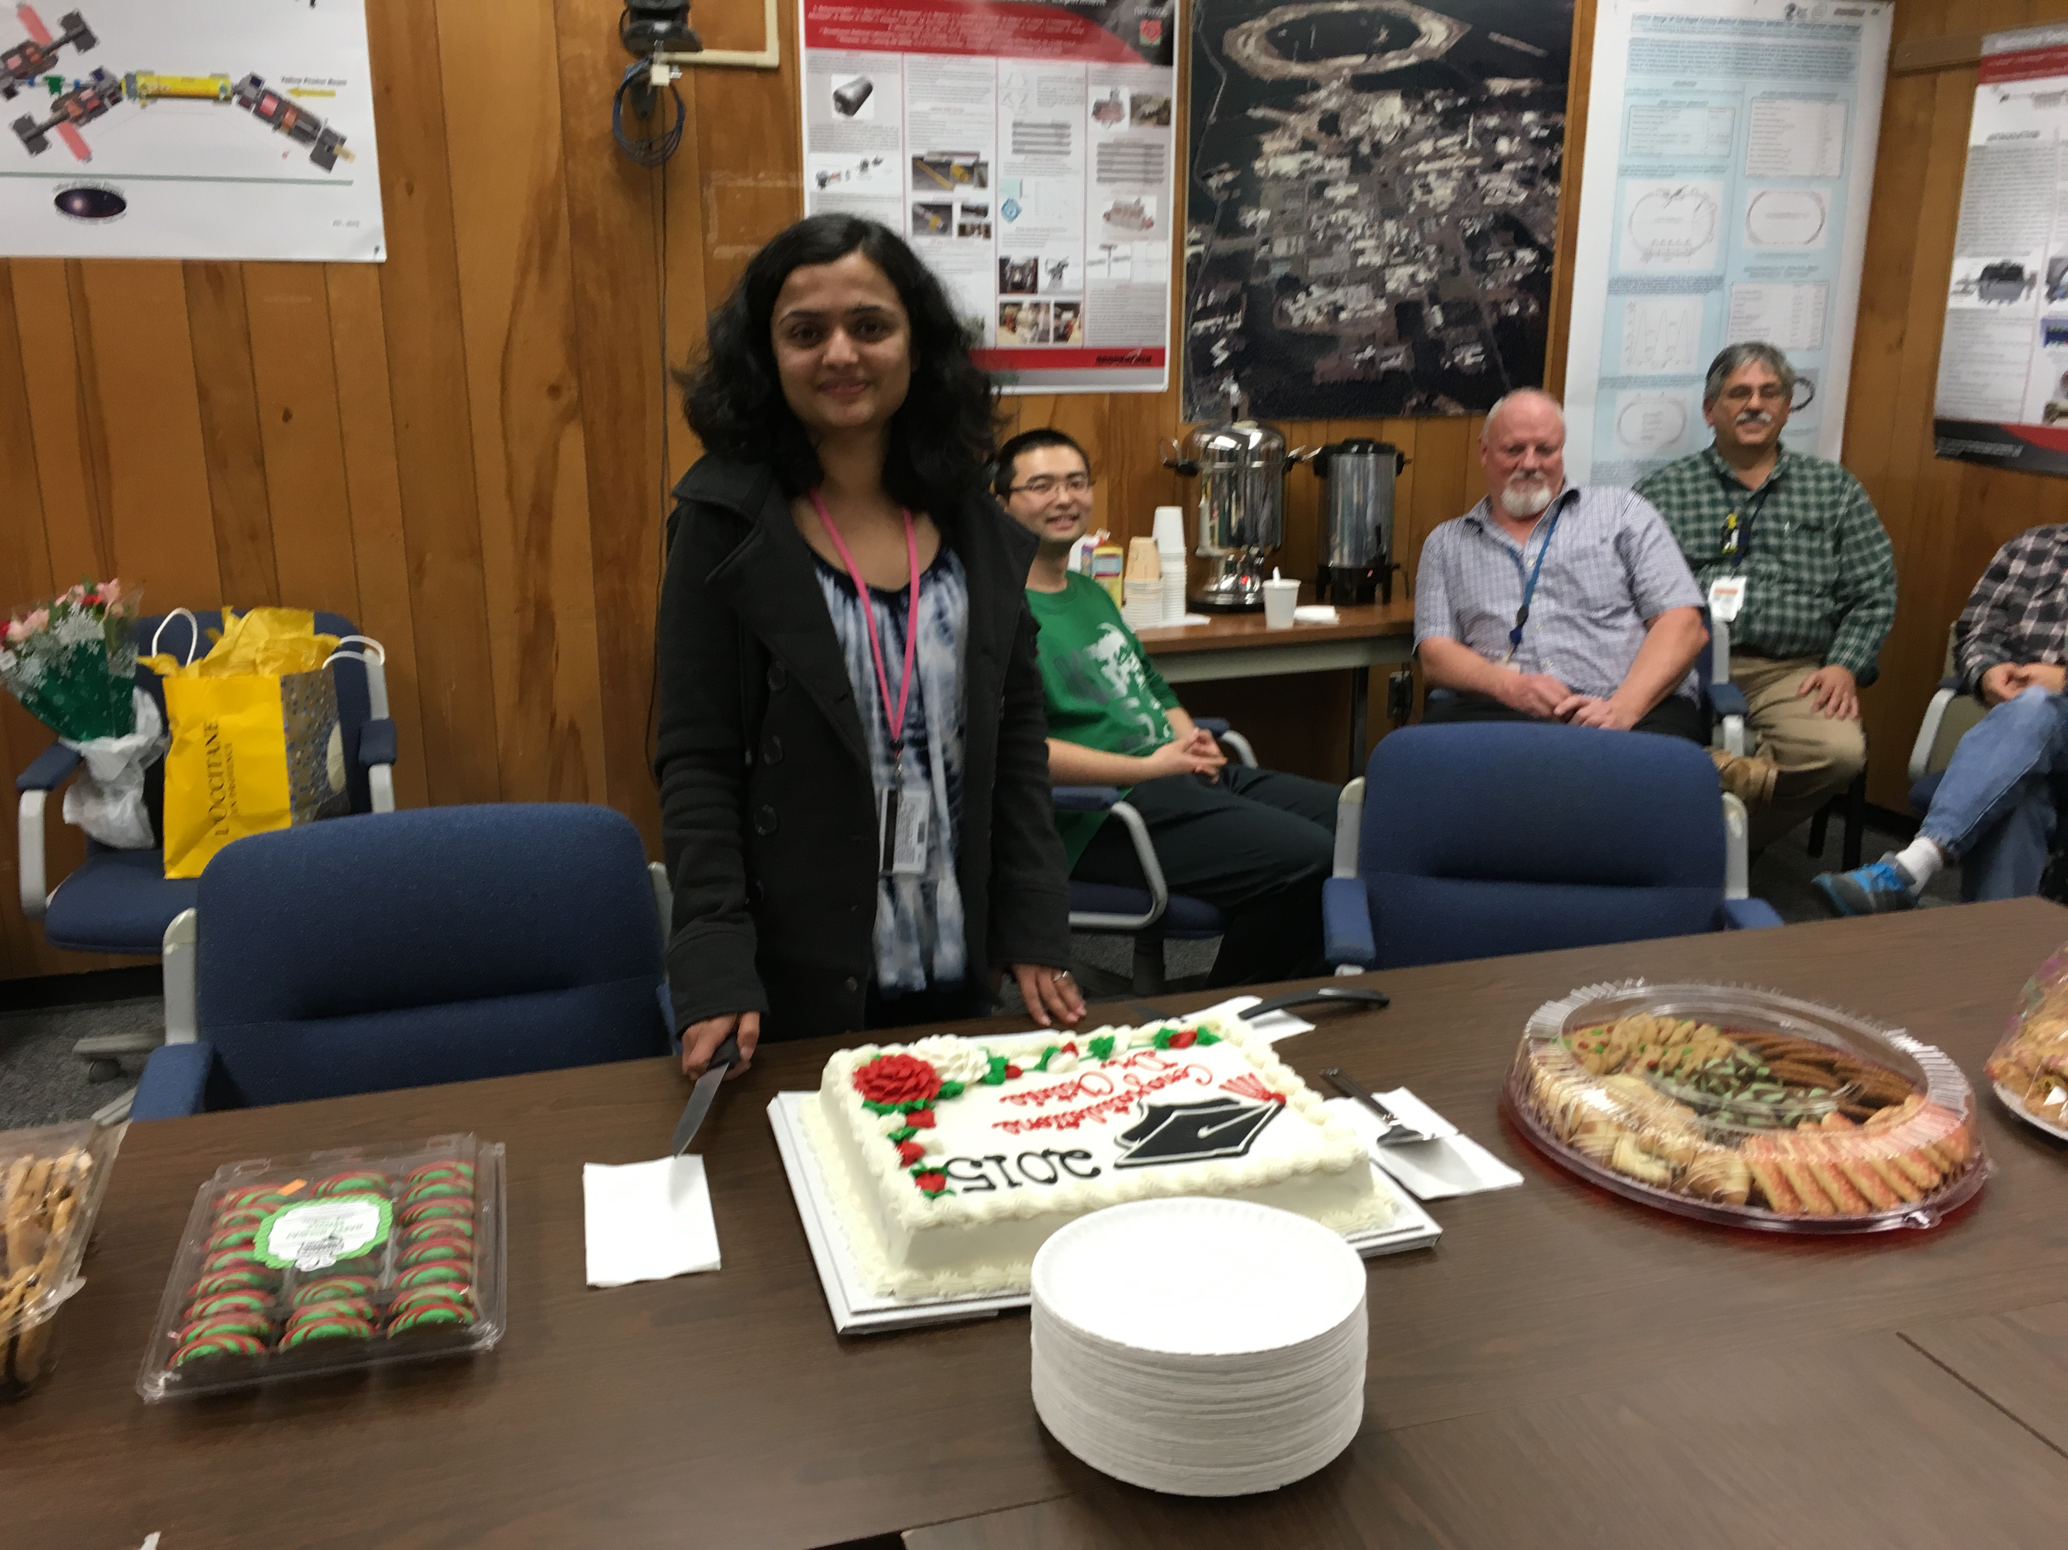
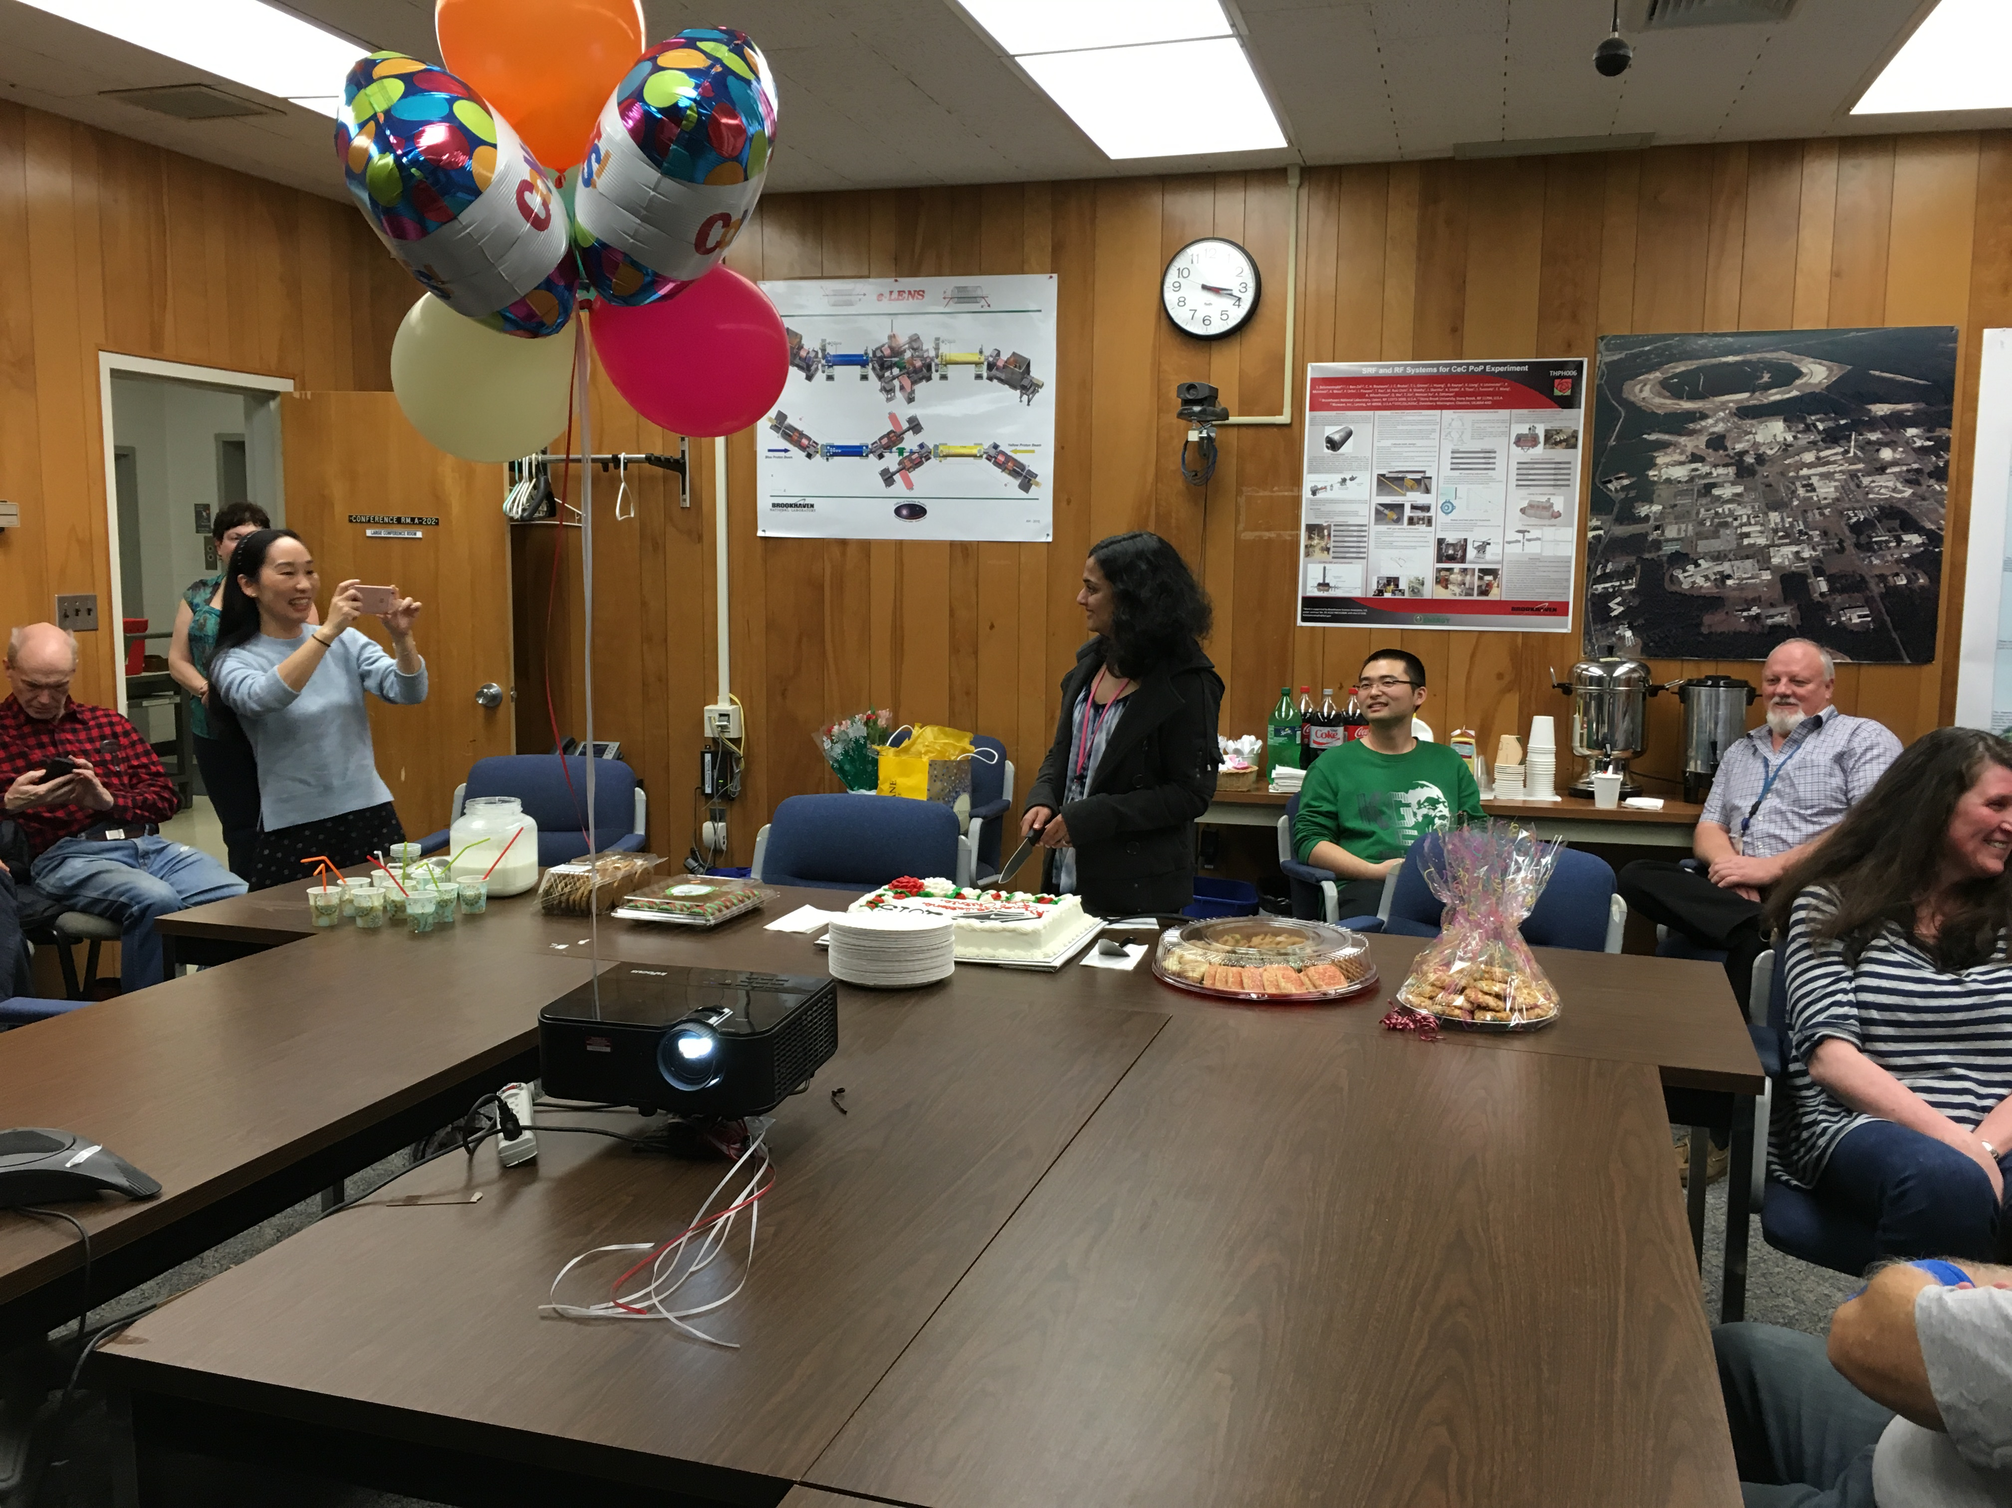
Charlie Theisen, Bob Lambiase

Slide 6
Controls Hardware Architecture, 2000
Data storage rate
0.5 GB/day
Console level computers are disked Sun™ workstations running the Solaris™ operating system.
768MB of memory and a 9GB disk
380,000 control points
Measurements made during RHIC commissioning indicate the present system rarely requires more than 15Mb/s on an inter-switch connection.
160 VME front-ends

Slide 7
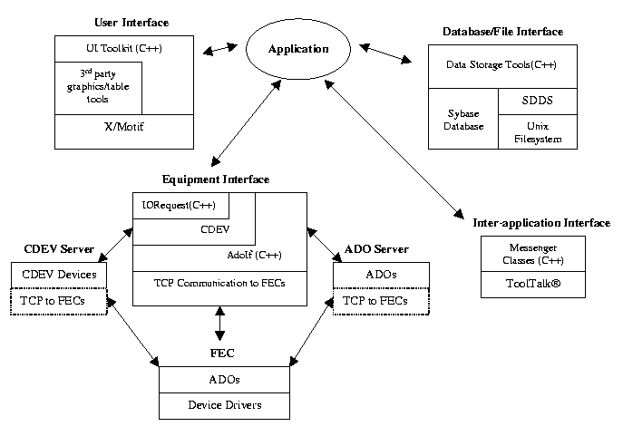
Controls Software Architecture, 2000
Applications
Generic Control = pet (parameter edit tool)
Generic Data Display = GPM
Data Logging = SDDS
Alarm System
Save/Restore
PS Diagnostics
Post Mortem
+ custom apps
What’s missing?
LogView (used sddsview)
Tape
Ramp Manager
Ramp Editor

Slide 8
The Team (2000)
D.S. Barton, S. Binello, W. Buxton, T. Clifford, T. D’Ottavio, H. Hartmann, L.T. Hoff, R. Katz, S. Kennell, T. Kerner, J. Laster, R.C. Lee, A. Marusic, R. Michnoff, J. Morris, B.R. Oerter, R. Olsen, J. Piacentino Jr., J.F. Skelly
A. Abola, R. Casella, C. Conkling Jr.*, B. Culwick, B. Frak, W. Fu, K. Johnson, T. Kahn, G. Maldonado, B. Martin, S. Nemesure, N. Schumburg, S. Sathe, D. Shea, P. Stein, C. Trahern, G. Utz, R. Warkentien

Slide 9
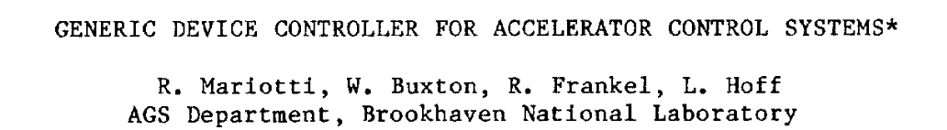
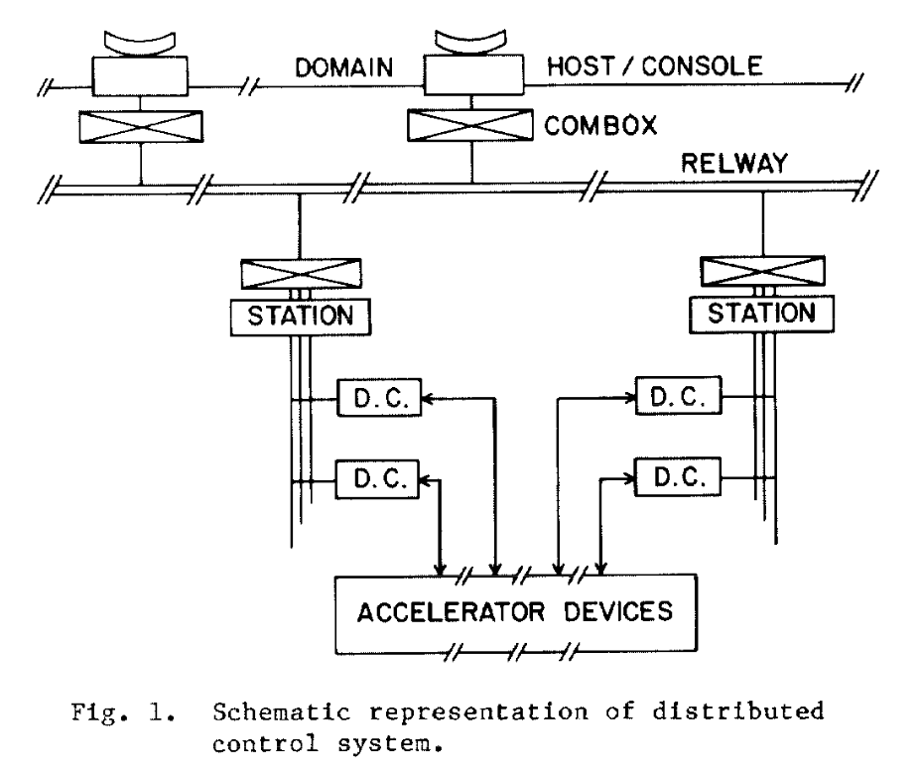
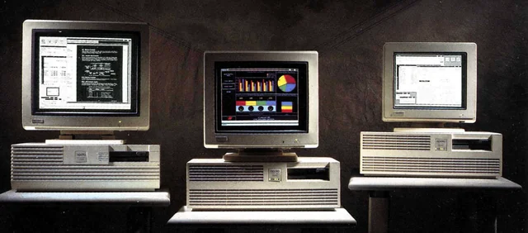
Let’s go backwards in time - 1987
The Tandem, not AGS were first to use Workstations!
Early spreadsheet like app – like pet
Alarm displays (first time!)
Save/Restore
Mux control
Device Database
Apollo Workstations in 1986

Slide 10
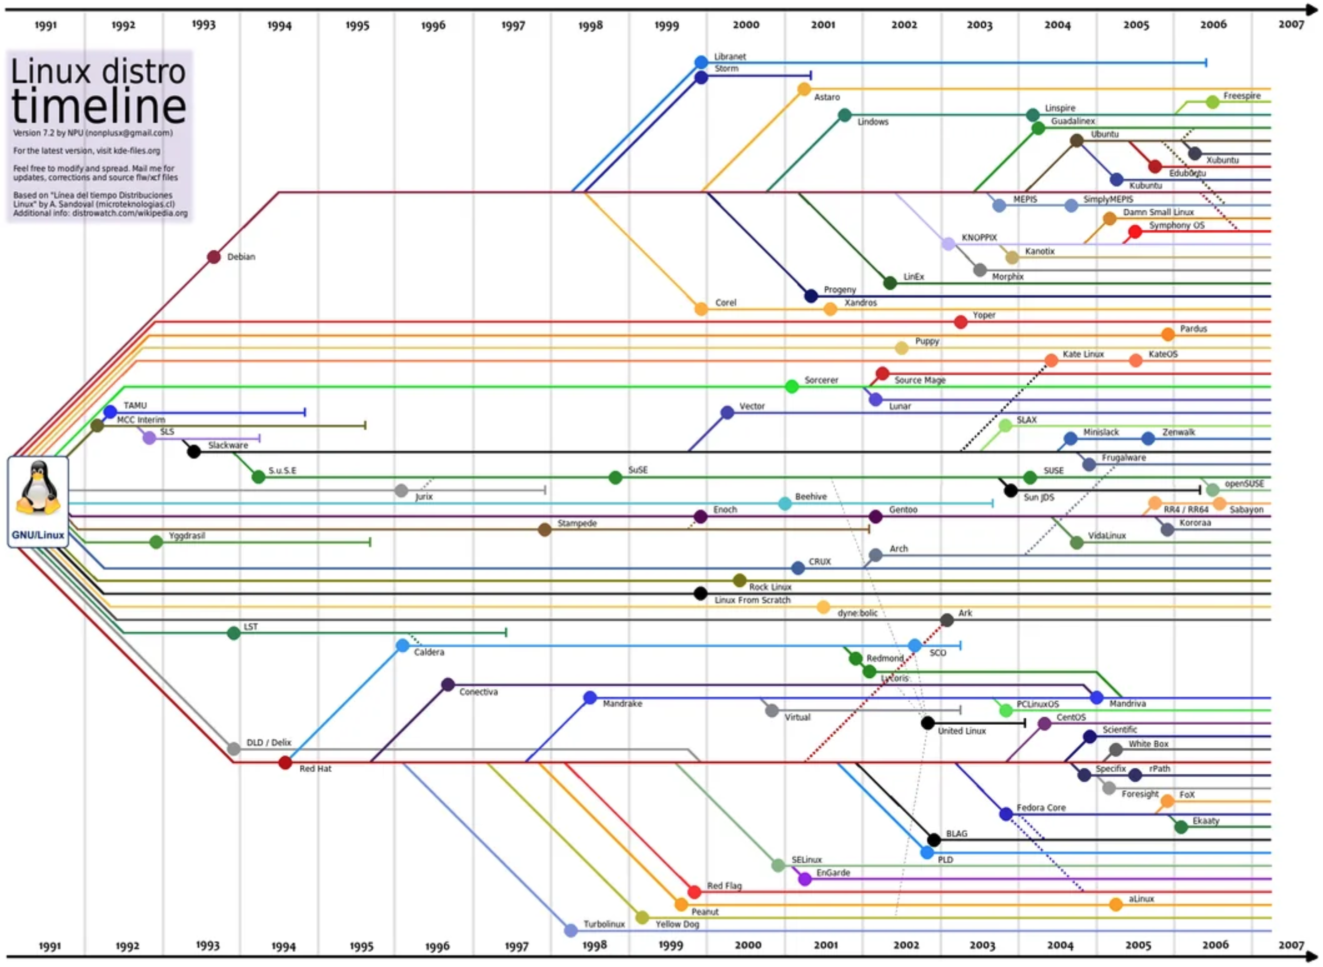
LINUX?
Controls O/S history
1980’s PDP10 DEC
1986 - Apollo WS
1990’s Sun WS (Unix)
2000 - RH Linux
Red Hat

Slide 11
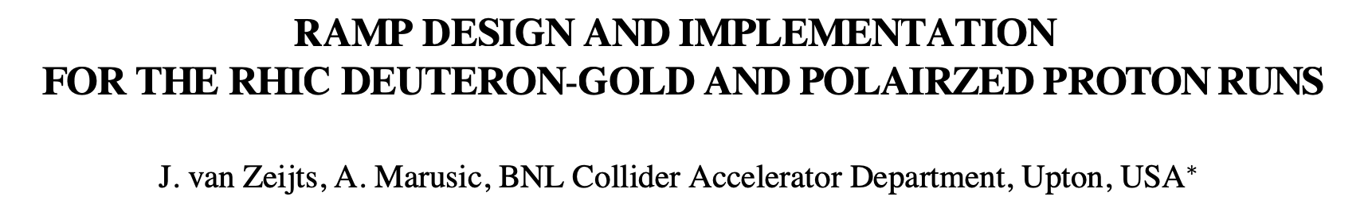
The Paradigm shift - 2003
Ramp Design with 1st and 2nd derivatives zero at start of ramp
β* ramp and β* squeeze
WFG manager
Early Online Model
Early Sequencer (since 2001)

Slide 12
Data Written per year
Total for 25 years > 10 pbyte

Slide 13
Comments from some Friends

Slide 14
Ted D’Ottavio
In the early days of RHIC Controls design work, I remember Tom Clifford organizing a series of meetings to review the designs of a couple of other control systems. How does it work? How does it differ from Logical Devices? Would it work for RHIC? In the end, there was a thirst, primarily by Tom and Larry Hoff, to create something even better. Eventually, ADOs were born.
Looking back, the things about ADOs that seemed ahead of its time:
Data is organized in an object-oriented manner. And the object is usually a physical device like a BPM or a power supply. You could argue that Logical Devices were also object-oriented, but ADOs were A) much more flexible in their design, and B) actually realized as software objects in the FEC (ultimately in C++).
The actual C++ ADO object code that ran on the FEC was constructed using a program called adogen from ADO templates (rad files) that ADO developers built. This created a level of completeness and uniformity in the code that would not have been achieved otherwise.

Slide 15
Ted D’Ottavio (cont.)
Looking back at application and server development over the 25 years of RHIC, there were so many changes. Here are some of the highlights that come to mind.
Virtually all software developed for RHIC at the start was in C++. Tools for accessing ADOs were pretty straightforward as they were object models accessing other object models.
The pet application was, in a way, a RHIC version of the spreadsheet program used for controlling Logical Devices. Yet, it was, and needed to be, much more flexible in the types of pages that could be designed because of the flexibility of the ADO model. I give Don Shea a lot of credit for the design and implementation. Tom Clifford came up with the idea of ADO templates which really helped to give pet pages a more uniform look.
The use of Gpm for both RHIC and the Injectors really pushed the idea that we needed tools to transparently access both ADOs and LDs. This led to the use of CDEV for this purpose and the tools layered on top of it. Ultimately these tools were used for a RHIC-enabled version of Gpm, as well as an upgraded pet that could be used for all devices in controls.
It was Johannes van Zeijts that extended the use of CDEV to CDEV servers. His early version of the RHIC RampManager showed everyone how it could be done. A wave of CDEV servers followed. They were more flexible than ADO managers and extended the types of servers that could be built.
RHIC applications benefited from increasingly powerful sets of tools for building user interfaces, accessing control system devices, and interacting with database tables. First in C++, then extended to java and python.
Logging data became increasingly important as there was more and more demand for storing and retrieving data. Roger Lee and John Morris were key players in building logging servers and keeping them reliable. And demands for features in LogView seemed endless for a time.
Maybe the biggest surprise was how tape and tape sequences became such a critical part of Operations. They were clearly the right way to orchestrate RHIC stores. Kudos to Todd Satogata and Johannes, who both pushed for the idea, and Bart Frak for the initial implementation. I think this system, more than any other, gave Operations the feeling that they could make a difference in the success of RHIC.

Slide 16
Jim Jamilkowski
I remember working with Todd, Vadim, Fulvia, and George on the PS checkout during the commissioning phase where we were running Todd's scripts to do most of the work. Fast forward a bit, and we were implementing TAPE Sequencer routines for operations. Orbit/Ramp/Modeling controls followed a similar trajectory with effort from Johannes and Todd, and later Al, Guillaume, John, etc.
Developing the orbit and tune feedback systems were probably a profound set of milestones in the transition from more manual tuning to automation. The BBQ and V301 BPMs were important pieces of that, which connects us to the Instrumentation side.

Slide 17
Seth Nemesure
I was part of a transition between the ‘old-timers’ and the injection of youth into controls over the years. From about 1998, when I joined through the early oughts, xemacs was the editor of choice and ClearCase was our advanced version control system. It was a significant upgrade over CVS and RCS. C/C++ was our programming language of choice, with Motif the standard for user interface development. There were some outliers, such as Johannes introducing TCL Tk, but that never evolved into more than a nuisance trying to maintain Oppis code after Johannes left.
In the early 2000s, we began Java application development and user interfaces with the swing framework thanks in part to the onboarding of Bart Frak and Dan Ottavio. This was also the time where we were introduced to the modern editor as some of us began using the Eclipse and NetBeans IDEs.
In the 2010s, Java development was part of our core development environment. Services such as the data server, elog, Dashboard, and messaging system were developed using J2EE. Java development was exclusively done using Eclipse and IntelliJ (a JetBrains product) IDEs at this time.
Later in the 2010s, Python was introduced into our ecosystem during the onboarding of Phil Dyer and Sam Clark. Web applications (StartUp, Directory service) and PyQt user interfaces had become the standard. This was also the time when we transitioned our version control from ClearCase to Git (Gitlab).
Today we still have a couple of Controls folks holding on to development using xemacs and ClearCase but we’re working on breaking that habit.

Slide 18
Todd Satogata
I always thought that a few things were really exciting about the RHIC control system:
ADOs (fully object-oriented design, built in house) rather than (distributed database) EPICS, including value typing abstractions and some level of self-describing data. Though not really fully SDS-based in the end, ADO Value learned a lot from lessons of SDS, and in turn influenced e.g. APS SDDS. ADO standards also allowed us to templatize and code-generate a lot of ADO code; automatic code generation was fairly new for distributed control systems in accelerators at the time.
Fully hierarchical design, with switched ethernet at 100 Mbit/s on fiber and VxWorks on VME. This I think was fairly cutting-edge vs older large-scale control system designs at FNAL, CERN (LEP), and DESY (HERA). Event links on fiber infrastructure was imho a great project investment.
In the same vein, I think we were early adopters (though not cutting-edge) with respect to middle-layer abstractions, e.g. things like ADO servers that republished data as physics objects (e.g. the Orbit server).
My impression is that ADOs ended up being a winning bet against a
growing standard; EPICS wasn't ready to deal with a large scale
slow-ramping complex at the time. My impression is also that the
fiber investment was a bet *for* a growing standard in the sense
that we were doing it just as large-scale fiber infrastructure
investment was taking off, so we could be early adopters leveraging
growing economies of scale.
All the data correlation task force etc work was really made
possible by the combined ADO and fiber network decisions, since
we could then think about timestamps as abstractions while still
having the rigor of hardware generation and fast data distribution.
I'd be interested to learn whether the accelerator hardware fiber
decision helped drive the experimental data fiber decision or vice
versa, since the high-volume data coming from the detectors going
to RCF also really depended on fiber bandwidth.

Slide 19
Others who wish to share – please do!

