Slide 1


RHIC Operations Perspective Retrospective
Legacy and Lessons from the past,
for this quasi-quadranscentennial Retreat
Gregory Marr
First RHIC Operator (?), Machine Specialist…
Present Group Leader, C-AD Main Control Room Operations

Slide 2

In the beginning…
Goal: spend < 1 minute per RHIC Run talking about the last quarter century of Operations.
The End

Slide 3

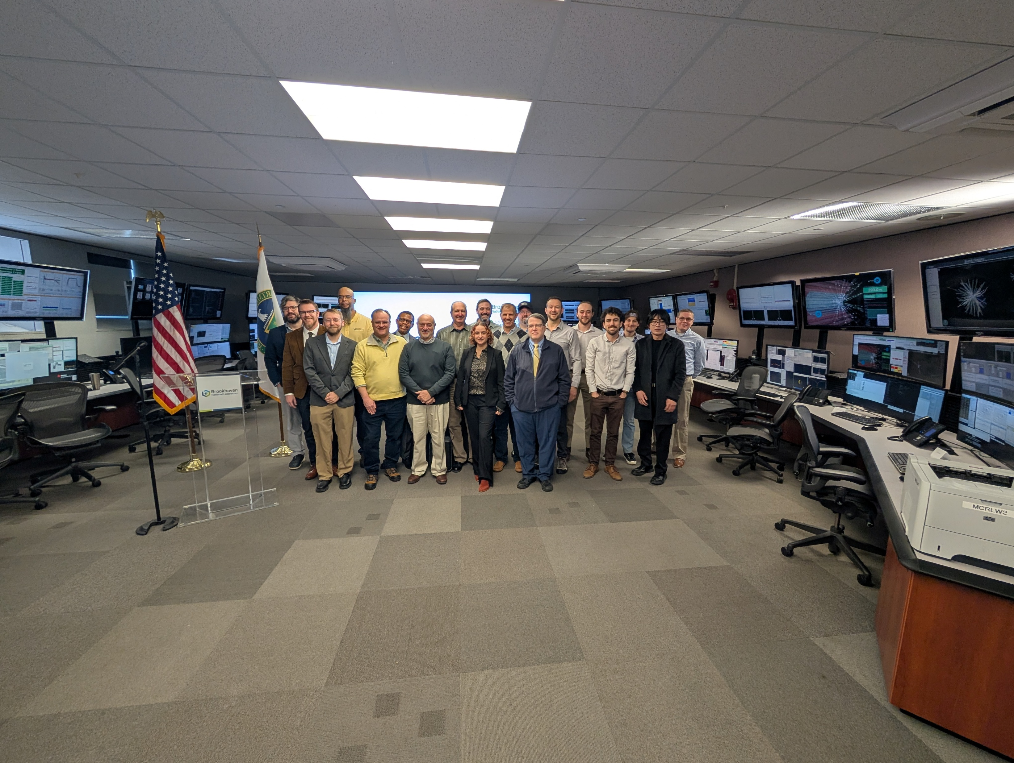
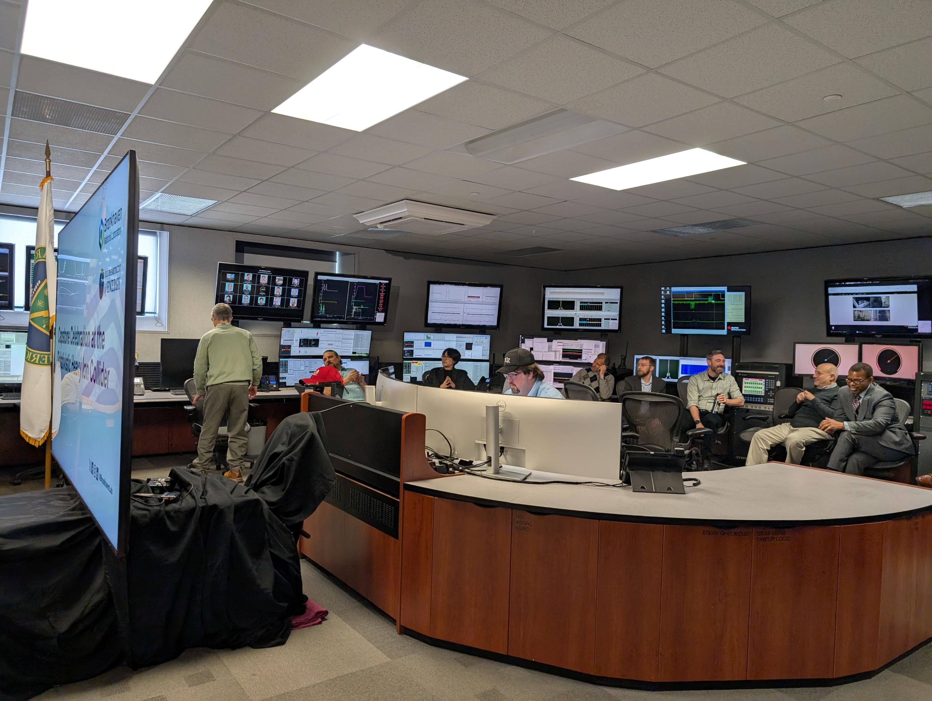
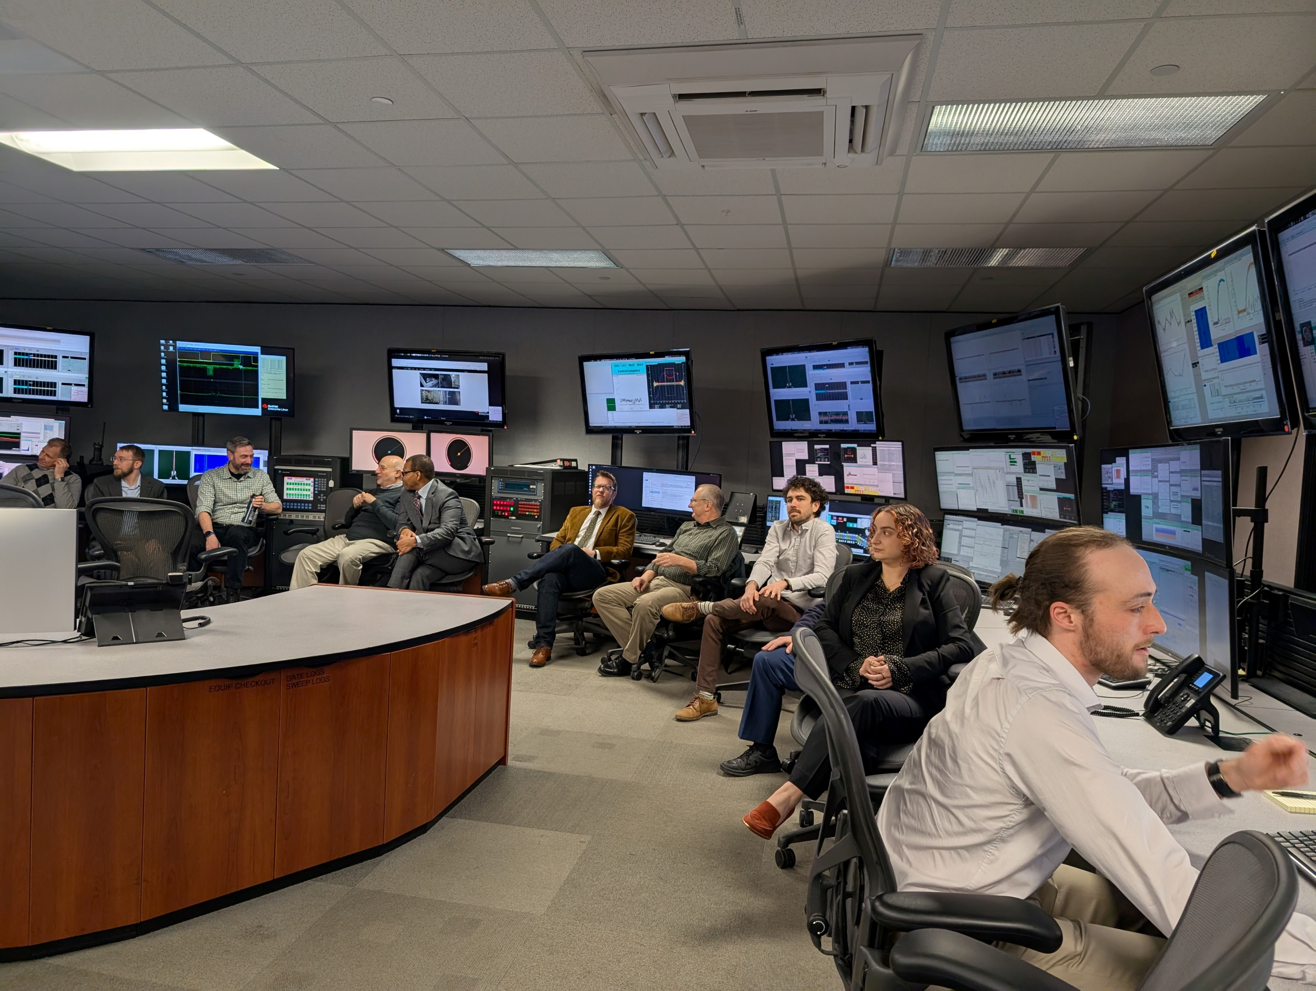

Slide 4
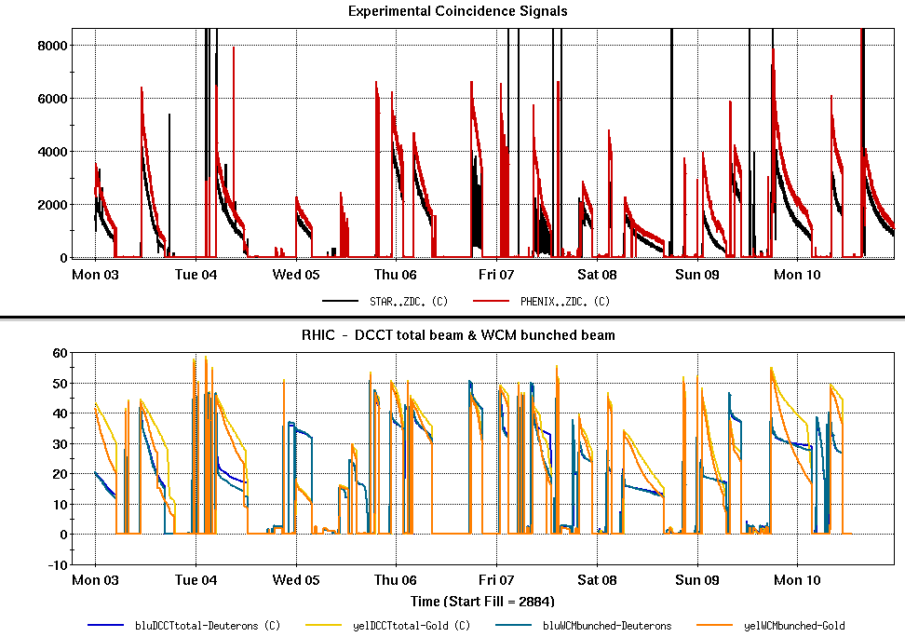
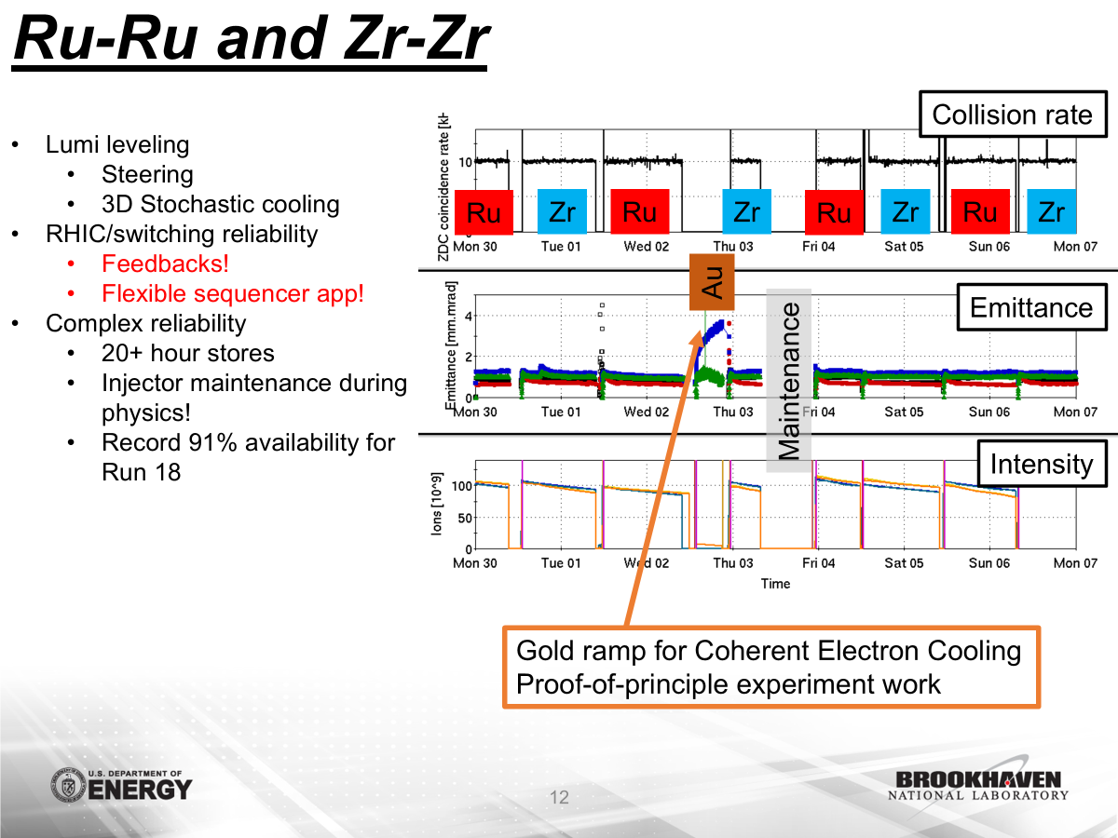
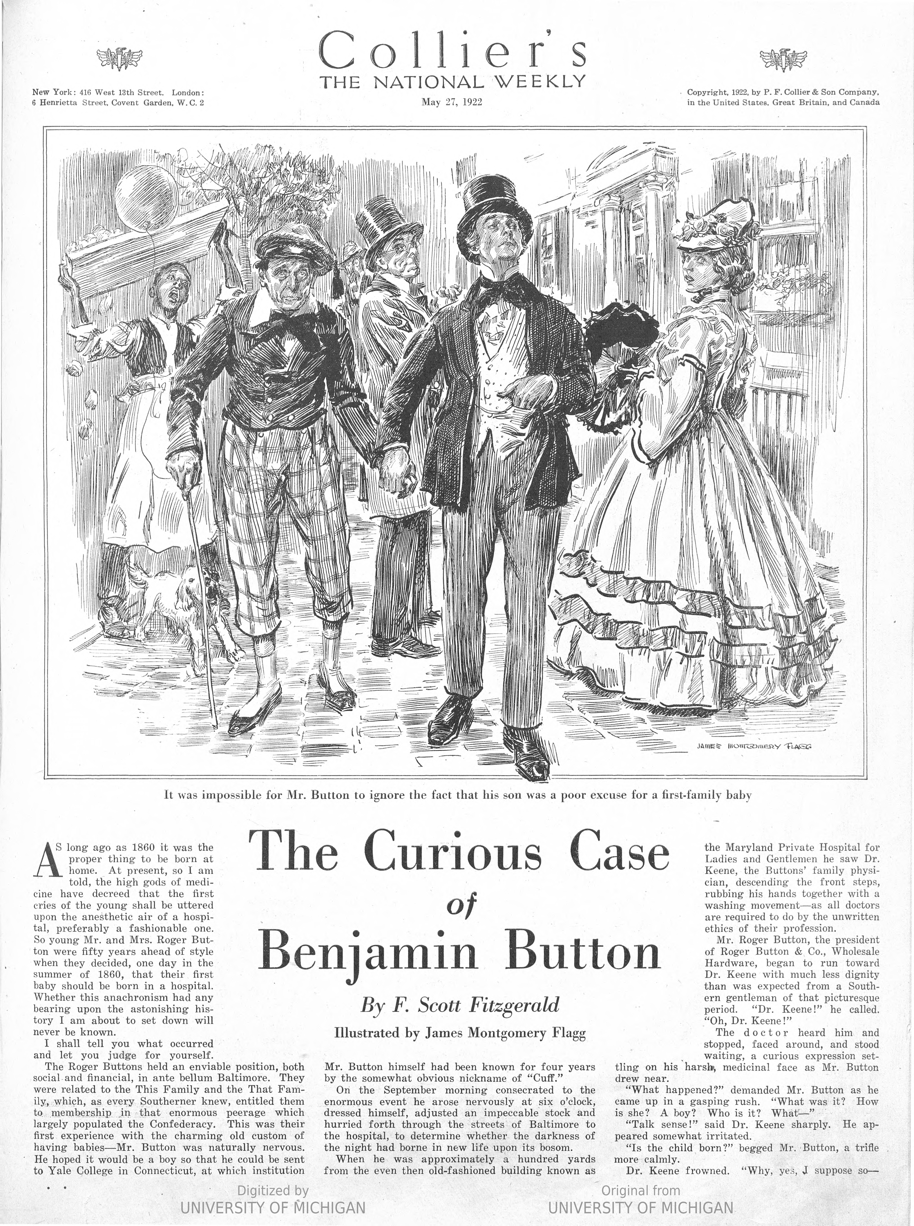

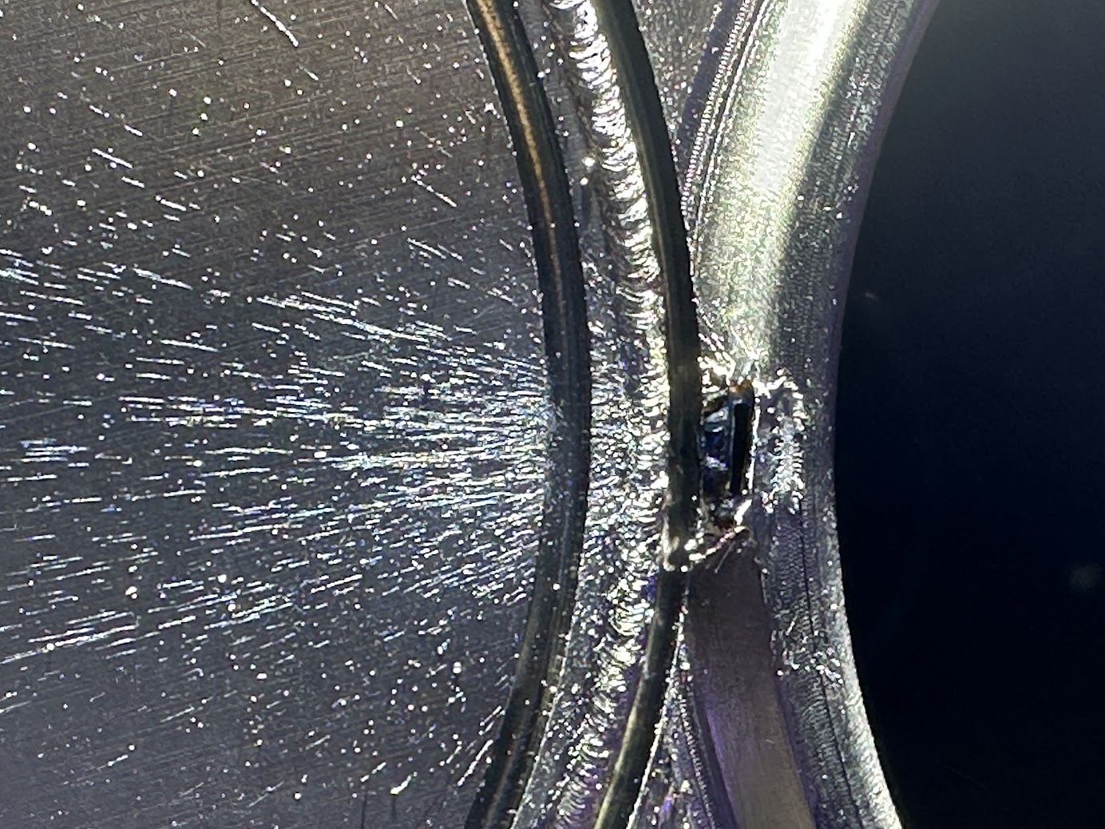
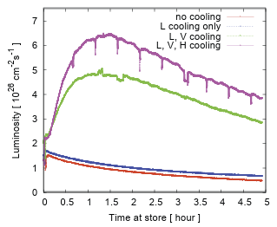
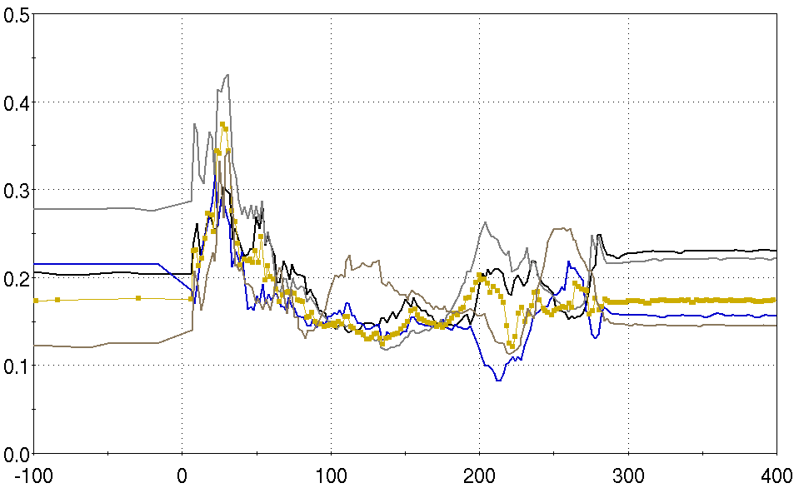
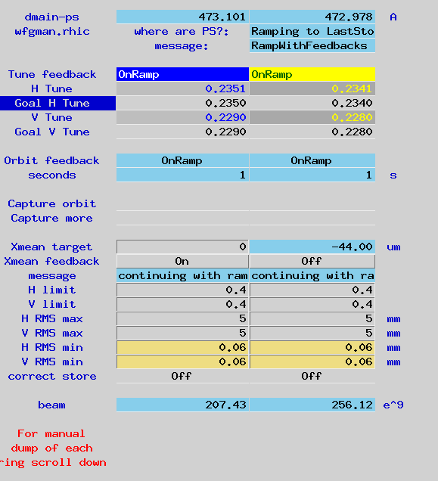
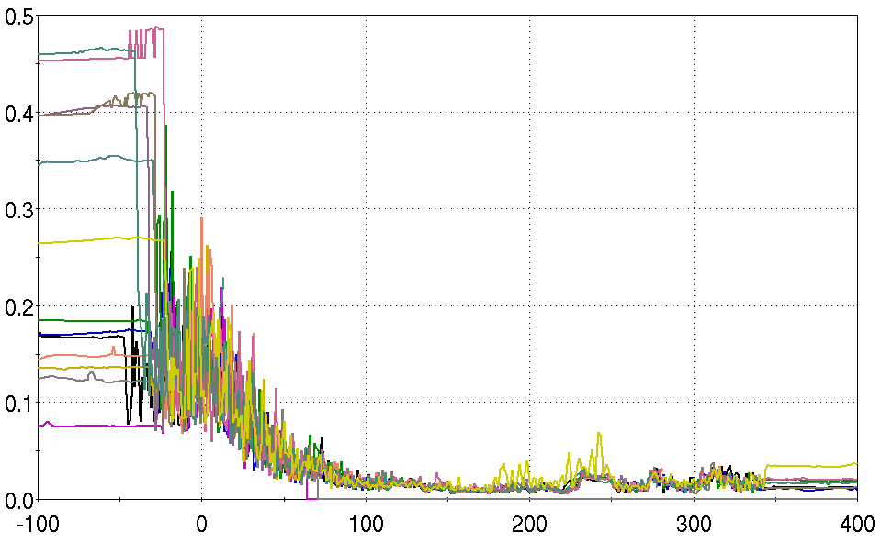
Moments in Time: new territory
“The Wheel of Time turns, and ages come and pass, leaving memories that become legend. Legends fade to myth, and even myth is long forgotten when the Age that gave it birth comes again… There are neither beginnings or endings to the turning of the Wheel of Time. But it was a beginning.” –R. Jordan, 1990
d+Au, Run 3
RHIC abort prefire system schematic (conceptual)
ORNL Making Ru-96 for my favorite Run
Courtesy V. Schoefer, APEC 2018
Enriching the U+U collision rates
Hooray cooling!!
Defeat of Hella (actual)
because, Feedback! EVERY ramp!!
so easy, a pet page can do it

Slide 5
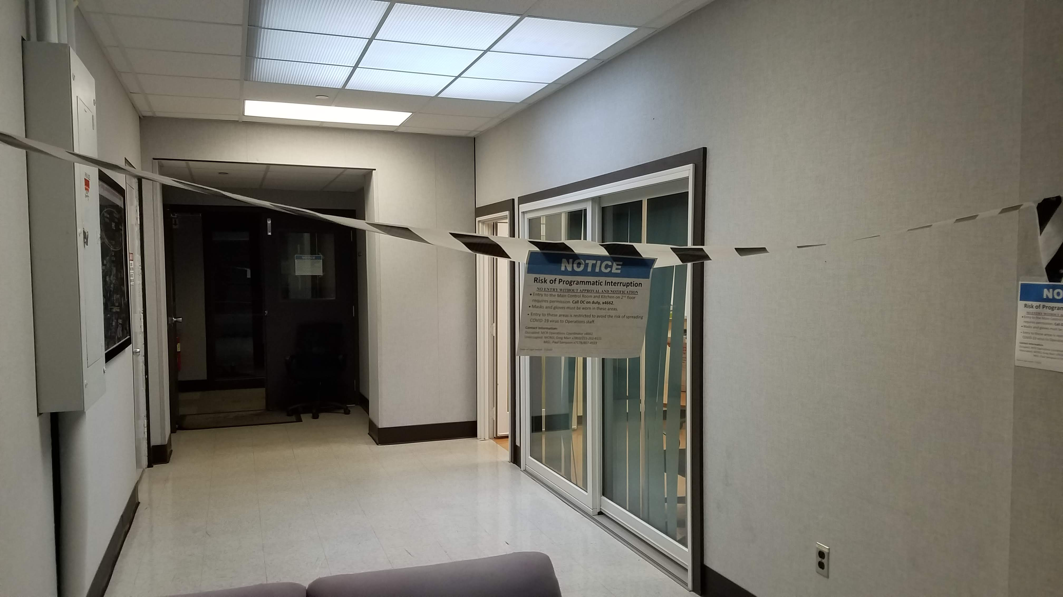
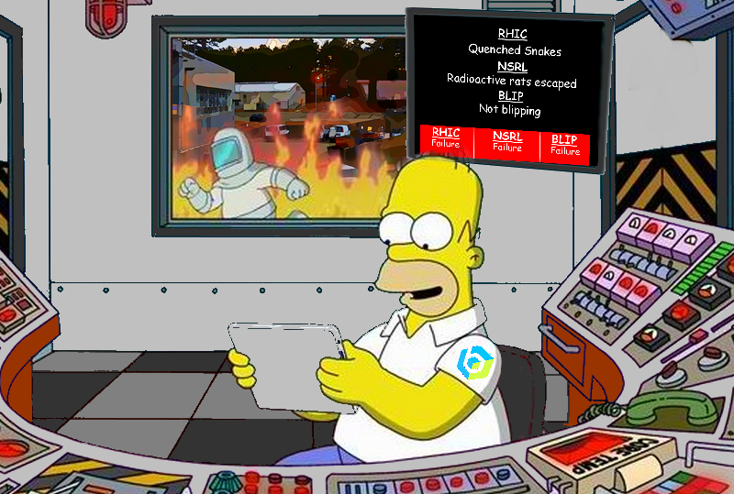
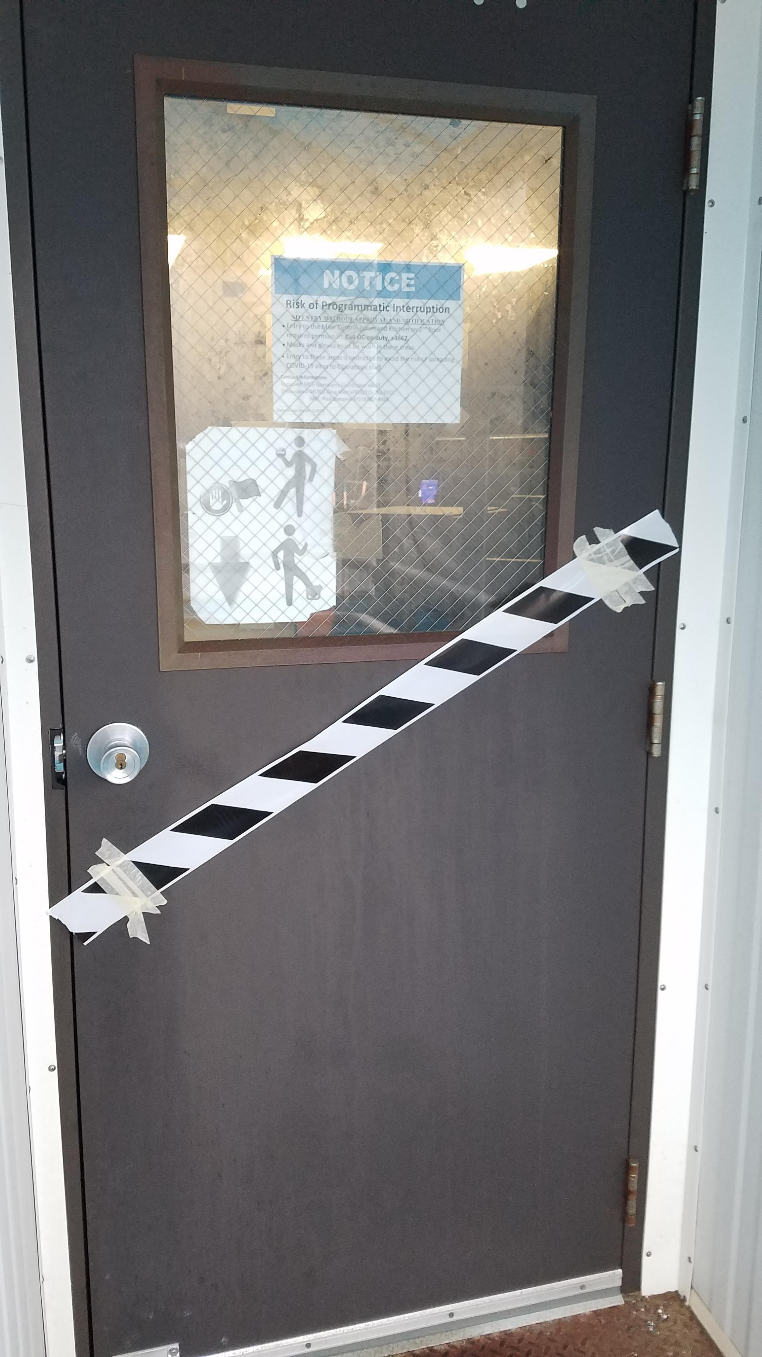
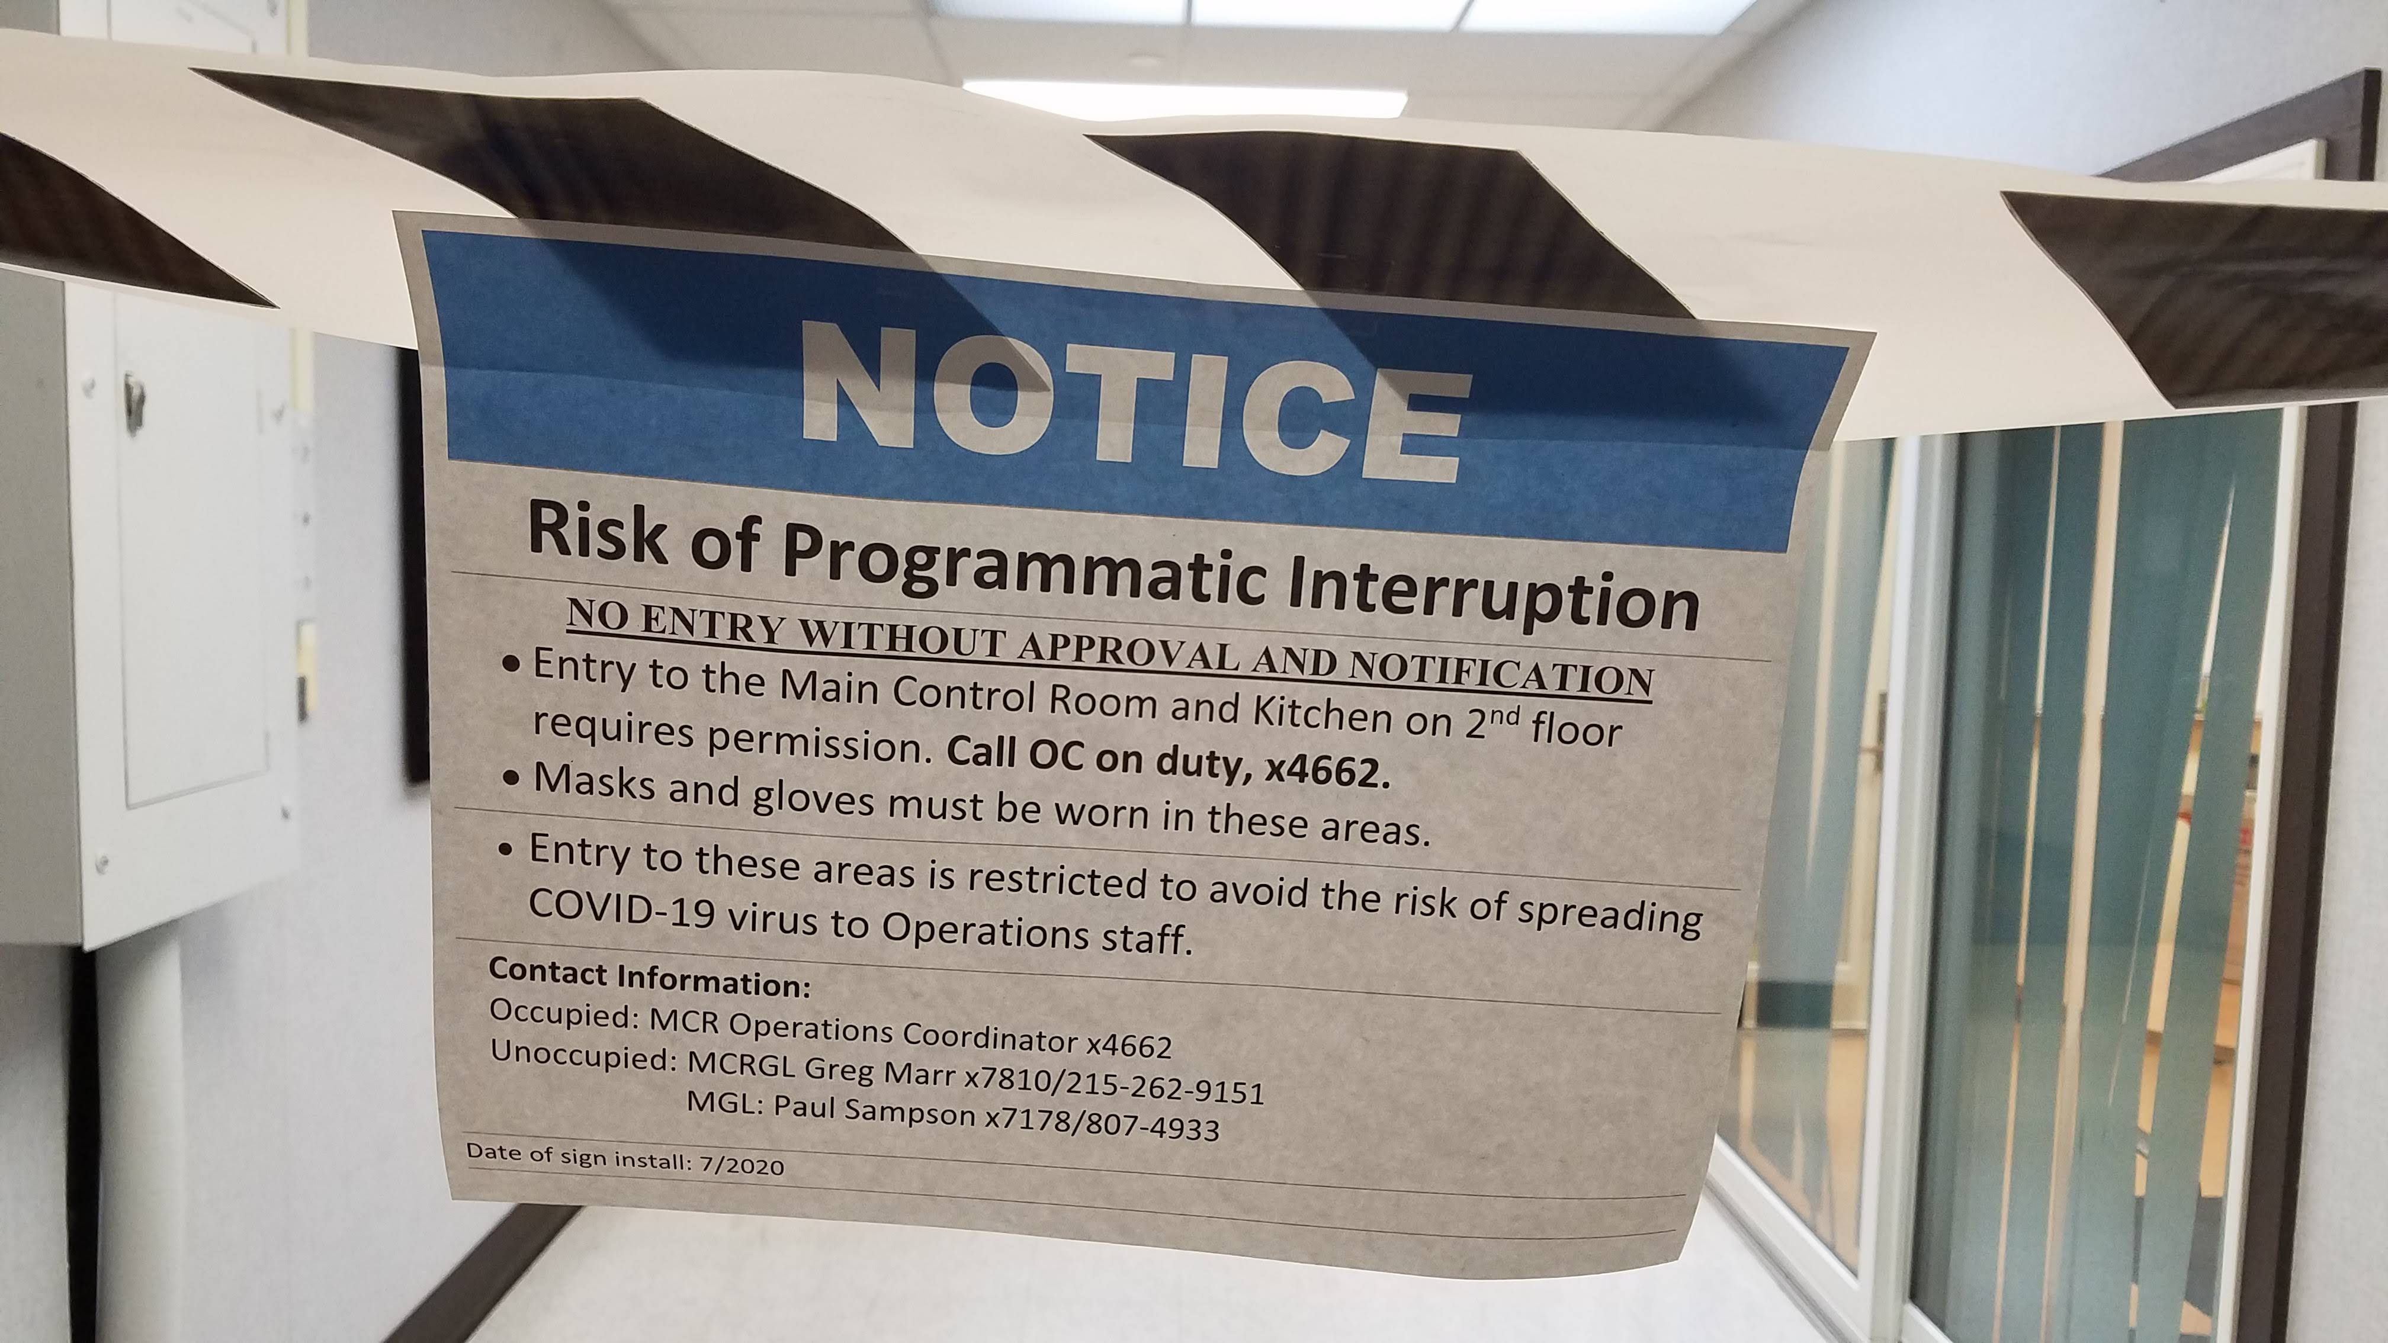
Moments in Time: lonely days…
The return after COVID was quite a burden for the essential personnel on site.
On the bright side, our restart of the Collider was almost entirely remote operation.
Shrey Control Room
Manorville, NY

Slide 6
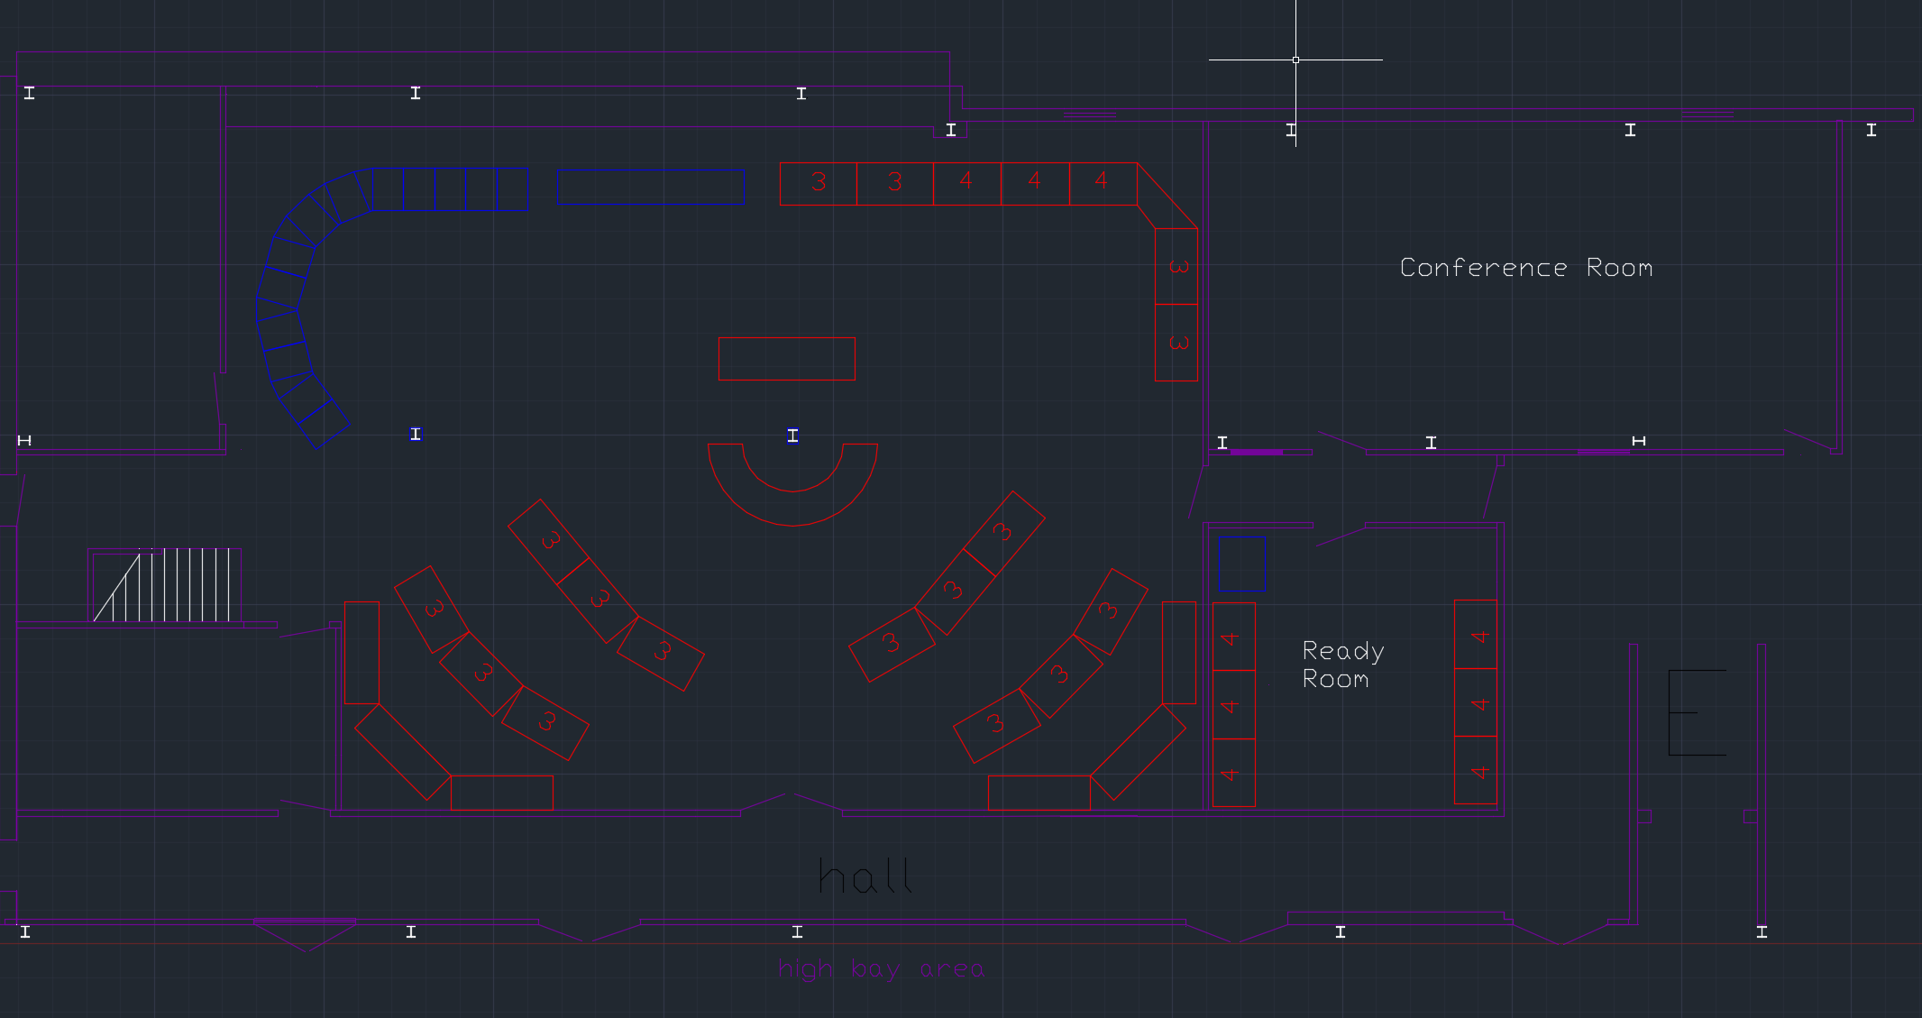

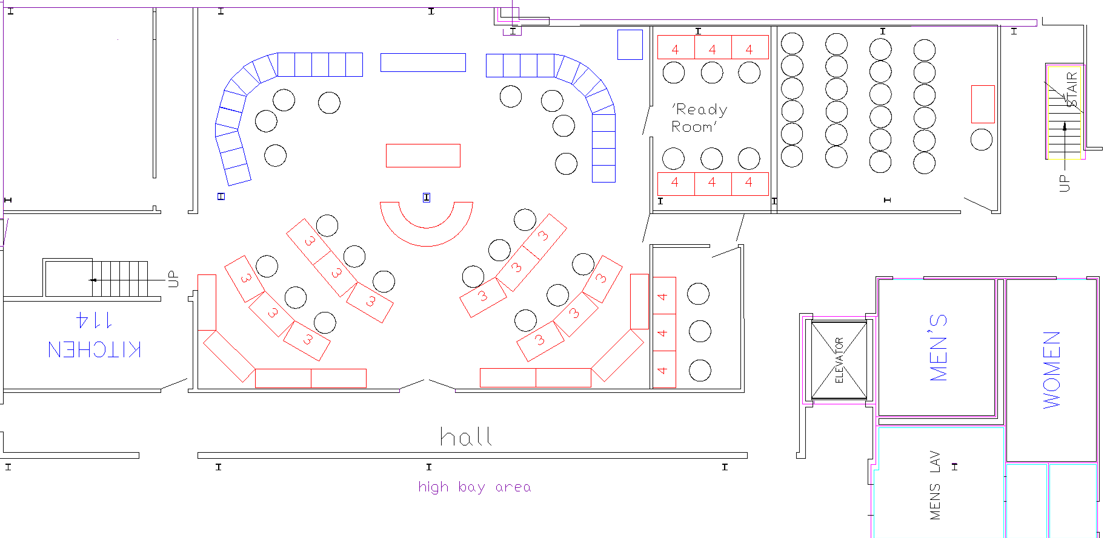
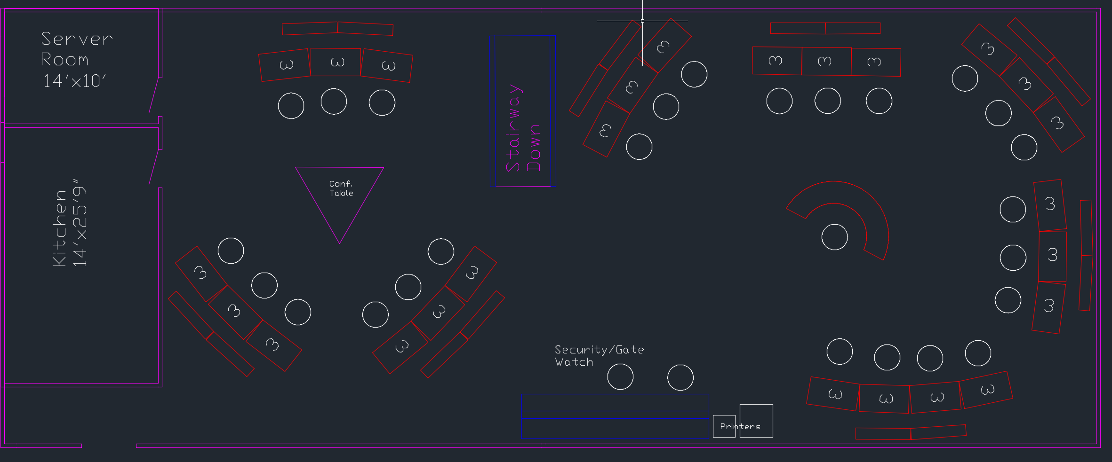
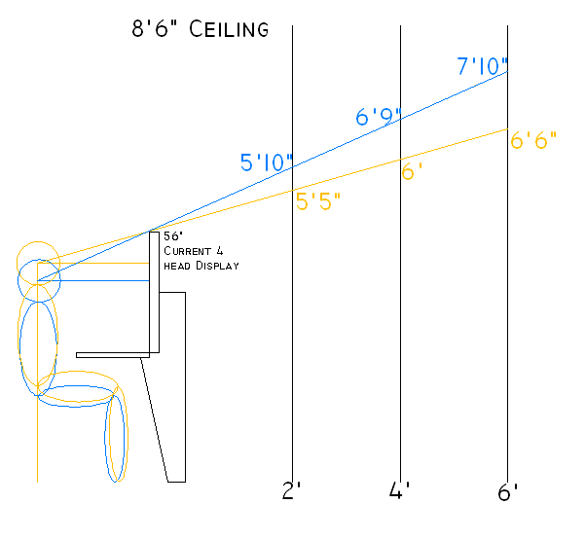
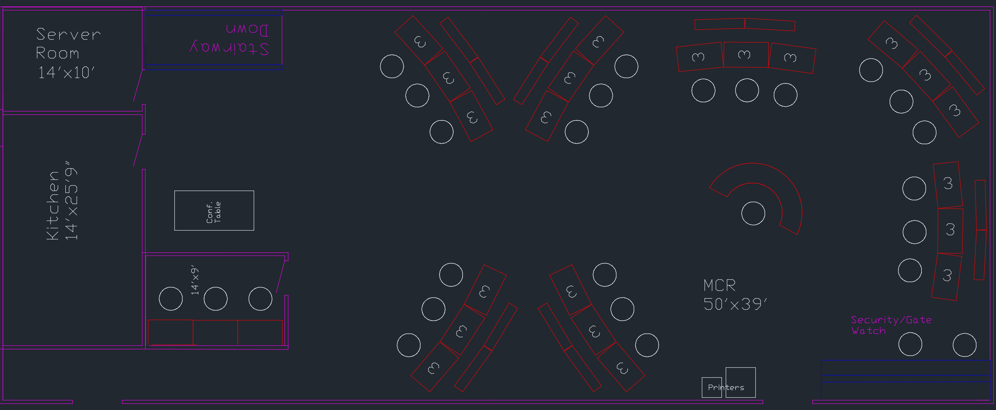
Moments in Time: new plans. MANY plans

Slide 7
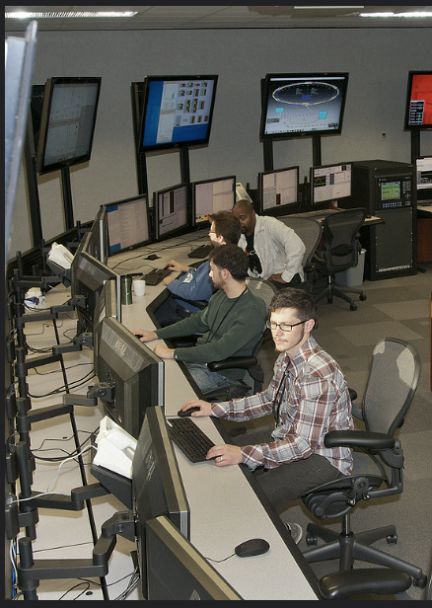
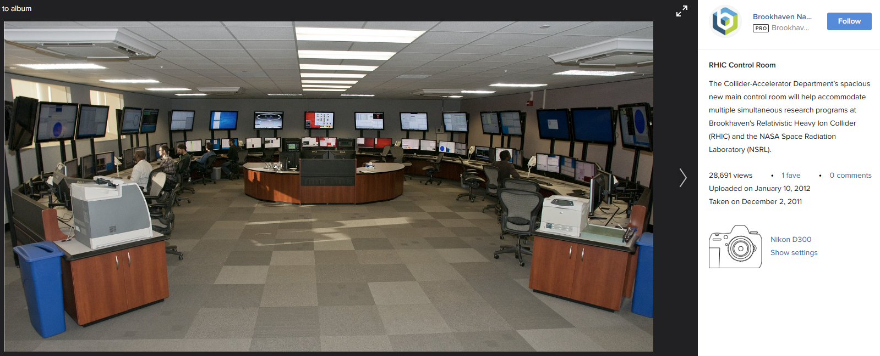
Moments in Time: new digs
Lots of space to collaborate!
HVAC you can control!
Kitchen proximate!
Better than Shrey home office.
Pro: new MCR has windows now.
Con: MCR offices no longer have windows.
…we’ll take it

Slide 8

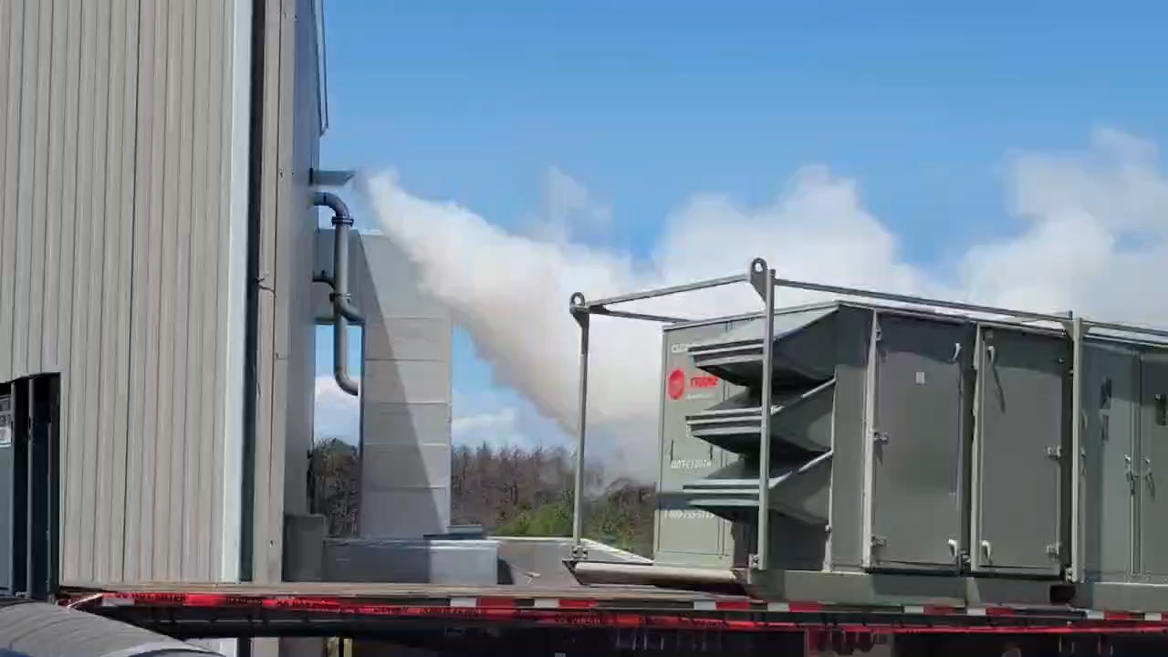
ivus
And now, for the RHIC Fest
Decades of individual experience, to say nothing of the collective hindsight, affords way too many I-told-you-so’s to list in this short time; we won’t go there.
…much.

Slide 9




Tilt-a-whirl, ad nauseum
“The Menu Edit”, Summer Shutdown Issue
Dark Side:
There are countless instances of grappling with suboptimal systems. While I’m proud to say we have worked with many to make improvements that kept the facility running as optimal as can be, I’m less proud to say that we still make do with many items that never got better.
Recent example: MS Teams Phones (or, insert other system here)
Bright side: SAG
Following the tepid adherence to the “Action Please” system, the Software Assessment Group became a proven avenue to crowdsource MCR software/hardware issues and prioritize improvements. As a result, we made headway on a great many headaches!
Bright side: ACS
Remember current loops? The “watchmen’s box”? The P.A.S.S. acronym use to have a much worse connotation, but iterative improvements got us far away from last century’s high doses from failed V-Target cave sweeps… and saved RHIC time too
We hate these (phones).
We had no idea! Give us a list
We can’t do your list
DIY or suffer
Time passes…

Slide 10

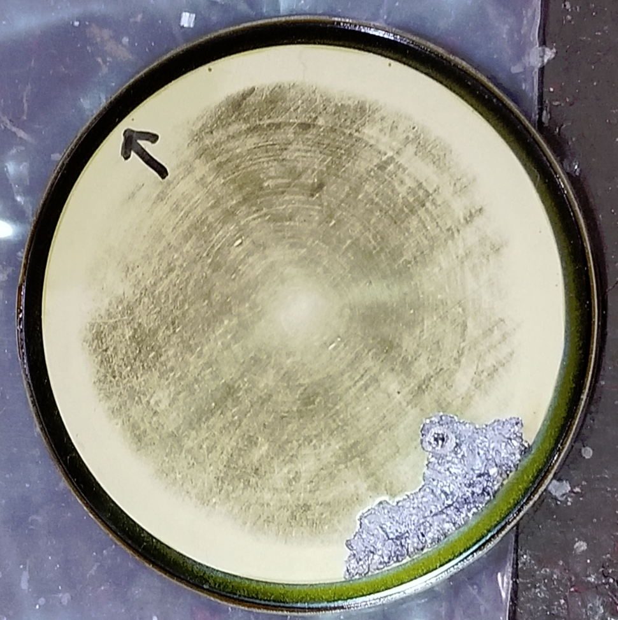
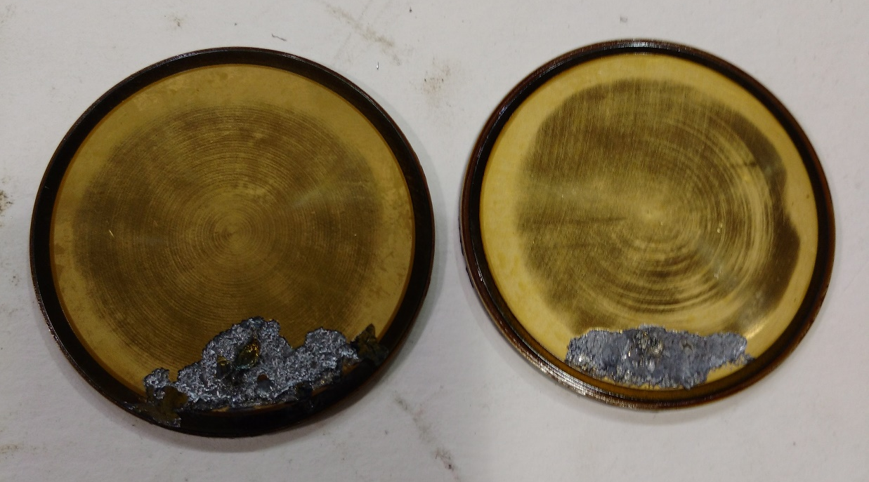





Past headaches, revisited
…is there any escape??
distant
Injection kickers were a long-
term disappointment. Couldn’t
meet design parameters with
given space, $ and technology; proving their impact with beam data came too late to decide if juice would be worth the squeeze (VHS, C-A/AP Note #606, 2018)
Some things need too much thinking (e.g. Lambertson drives). If the smart guy says it can’t be done… we don’t try. Still, I can’t help but feel we could have innovated more, for the work engineers & techs put in to it.
  Over-engineering/programming is part of our results, far exceeding original design
Junk in the alcoves: still a bad idea
Wish the RMMPS current limit would go away (ODH-1 and other personnel safety issues)
UPS & power dip resilience at the design stage and component level?
recent
Don’t forget about the AGS
extraction bump(s) PS. Glad to hear
of upgrades!
Good time for chronic instrument, vacuum repairs, etc. especially in long-forgotten corners (staff resources)
Summer running: it’s better when you’re prepared, but still the best time to schedule a long shutdown
Blown sweeps still detract from our efficient running
Meeting attendance: the bane of busy work, noted as far back as Retreat 2018
  Maybe bring back coffee? Snacks?
Did I mention Teams phones?

Slide 11
Data, documentation: it ain’t over
Plenty of cleanup and organization upcoming to compartmentalize, preserve and package the RHIC era data, statistics, documents
  Browse a web directory. Or LogView branch.
  Completing recent performance stats, re-vetting old; establishing baseline performance record for future reference.
The more you look, the wider (deeper?) the rabbit hole…

Slide 12
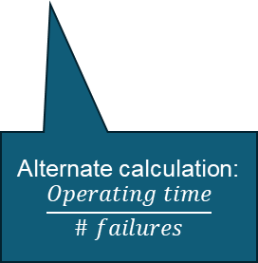
Calculated after initial delay, ignores 3/26-5/31
What if every long maintenance (4) were scored as failure?
Alternate calculation:
$$\frac{Operating time}{\# failures}$$
Counting everything 3/26/25-2/18/26. Anomalously generous?
Diving deeper…

Slide 13
Repair bus short, Yellow ring
Diode failure
Lots of IR2 work
Scoring maintenance over the years

Slide 14
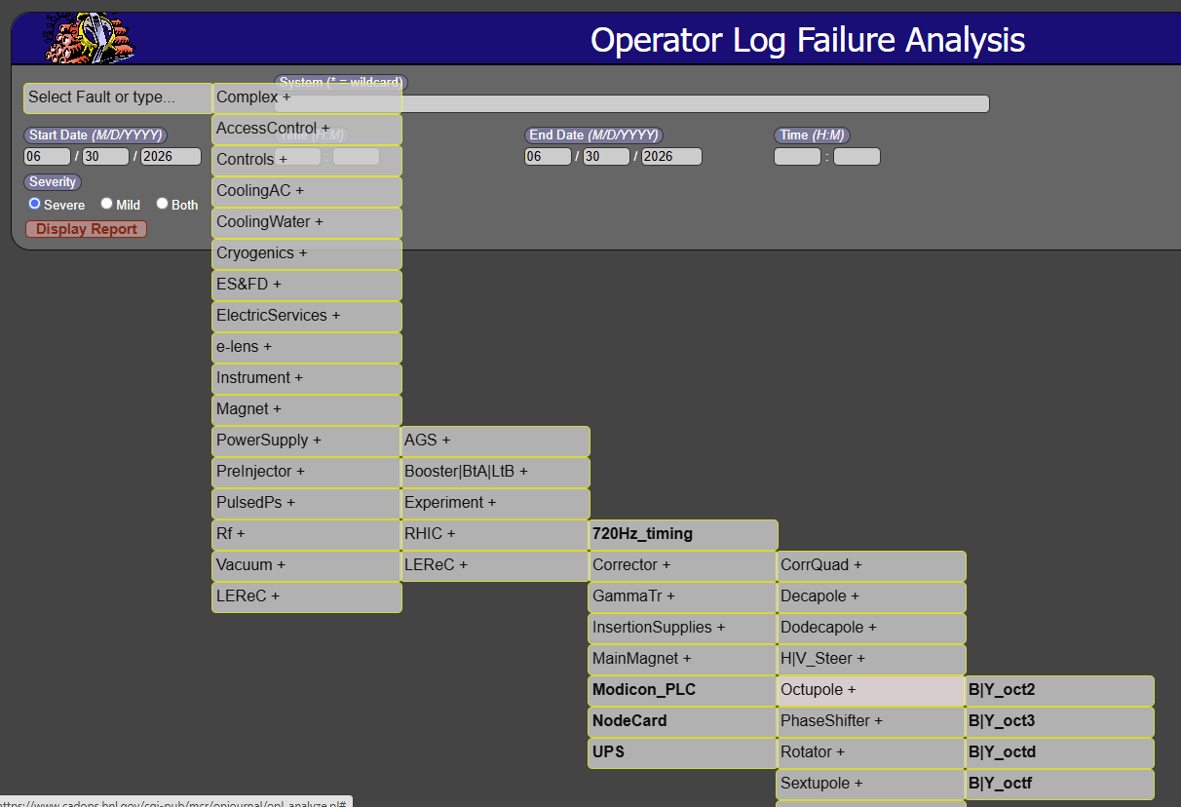
How did we do?
Ultimately, our performance metrics rest upon our failure tracking data.
  Note to self: revamp failure tracking tools for the future. Better categories, flexibility to slice and dice from many directions, …
Old Perl scripts

Slide 15
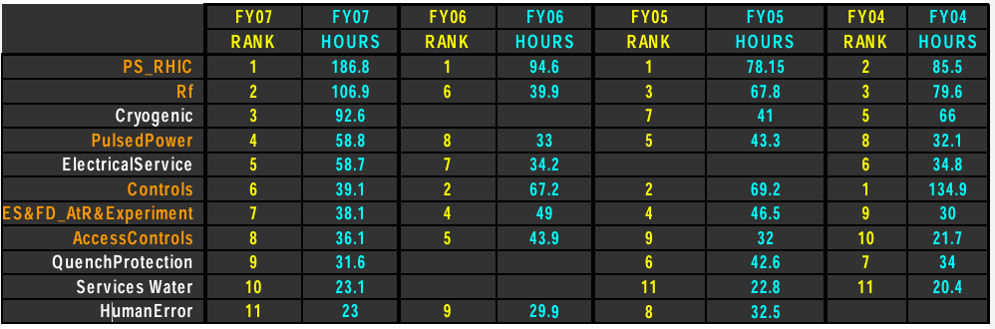
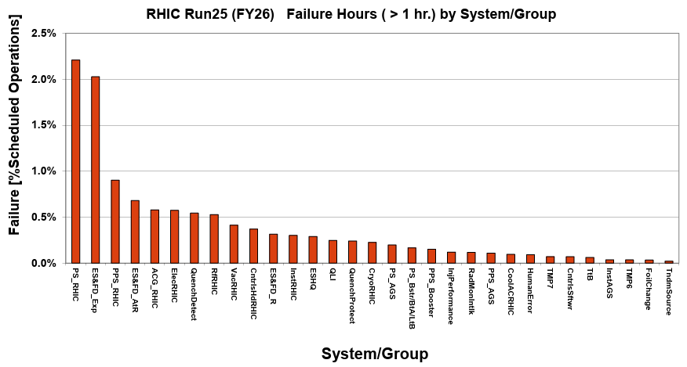


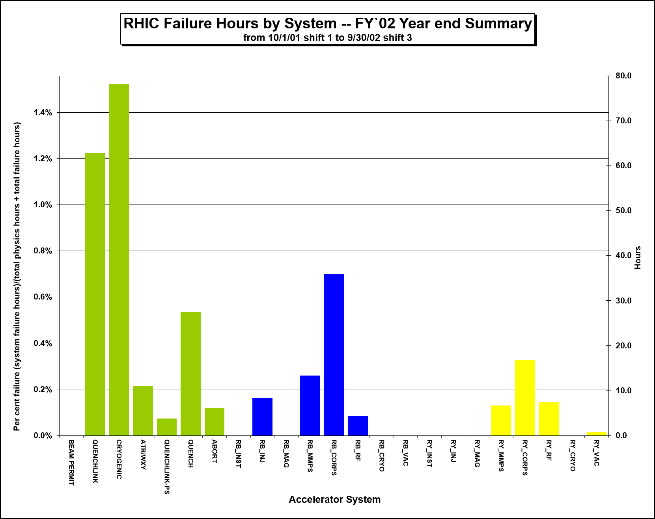
…and how did you do?
While data shows a fairly constant failure rate over the decades, it belies the aggressive efforts to improve many systems and processes.
  It’s always something: new failures fill the gaps of previous corrective measures
    Which means: it could have been worse
    “Proactive” (periodic, preventive, predictive, etc.) Maintenances need our attention, but the “Reactive” Maintenance will come again.
Evolving analysis & reporting methods

Slide 16
Complex: QLI, QD, QPA, Permit, BLM, human error, emergency response
ElectricServices: power dip or distribution
ES&FD: AtR, experiment equipment (including access)

Slide 17
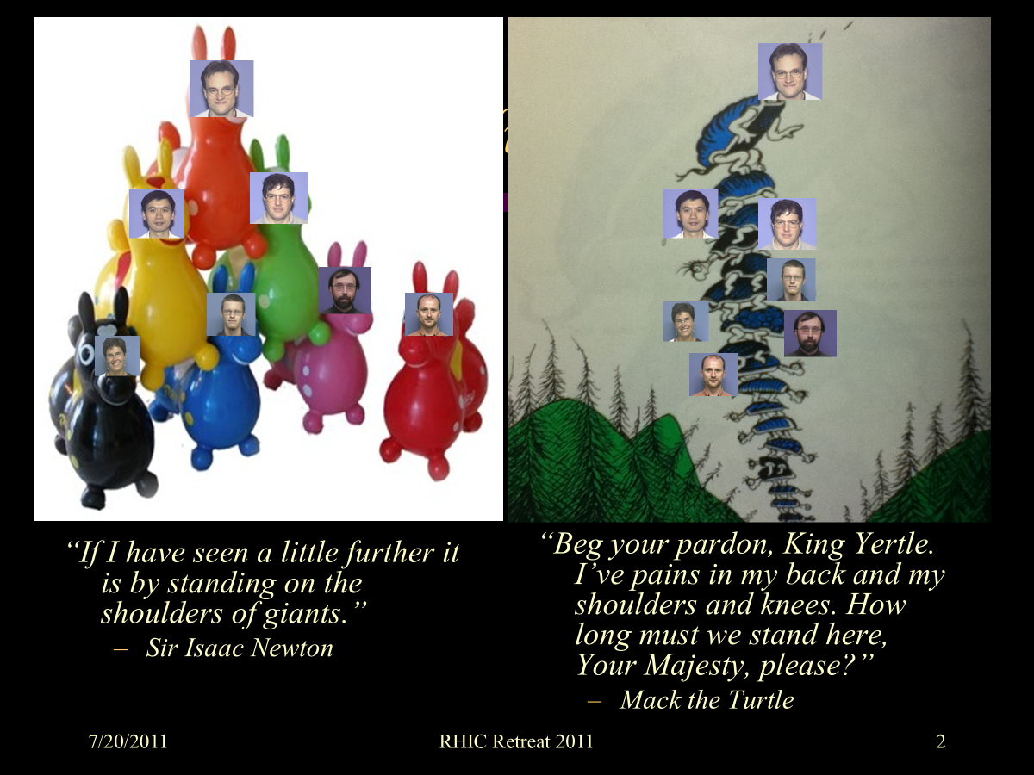
Legacy
We were able to accomplish much that carries us into the future

Slide 18




Automation!
To accomplish anything with RHIC early on, ADO pet cell clicks become a written recipe.
Recipe → shell script → tcl GUI for experts →configurable, programmable interface with short learning curve that you
can’t imagine how you
survived with out it.
Hooray for TAPE!
The “Mode Switch” was barely a concept for the injectors at the dawn of RHIC, and it required better archiving -- which Controls delivered.
We essentially went from:
to
No, not that tape

Slide 19




Yes, Automation! And…
Extending the buy-in beyond the MCR still remains very difficult.
Elog, Wiki, alarms,
Messenger, TAPE…
many great products
to keep advertising.
PostMortem analyses and similar
complex automation bring us one step
closer to the AI and ML benefits we
will (likely, probably) eventually realize,
but presently fear
  Robots in the tunnel?
AI-generated MCR logo
needs work

Slide 20
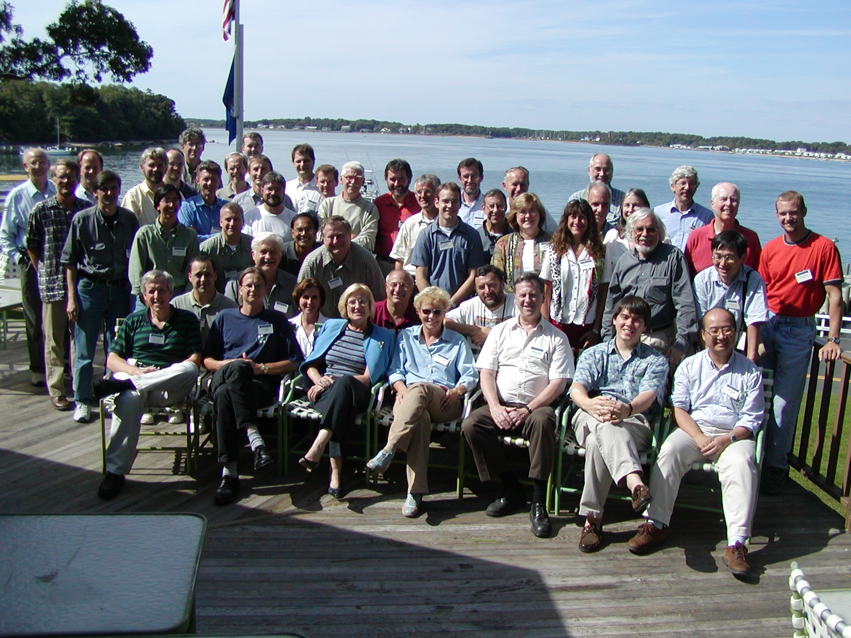
…versatility
Remote operation was a godsend – in later years – for efficient troubleshooting
As directed by Wolfram et al., our focus on maximizing integrated luminosity led us to examine time in store; in turn, optimization of turnaround time and analysis of failed ramps prompted new strategies and operational needs.
Great tools from great people helped MCR stay ahead of RHIC growth and increased flexibility (complexity)
Shelter Island, 2002: not remote enough, or not enough remote?
“It’s like learning to drive at the Indy 500.” –D. Lowenstein
“Where is the beam?” –T. Roser
“The only way to learn how to do this is to do it.” -W. Fischer

Slide 21

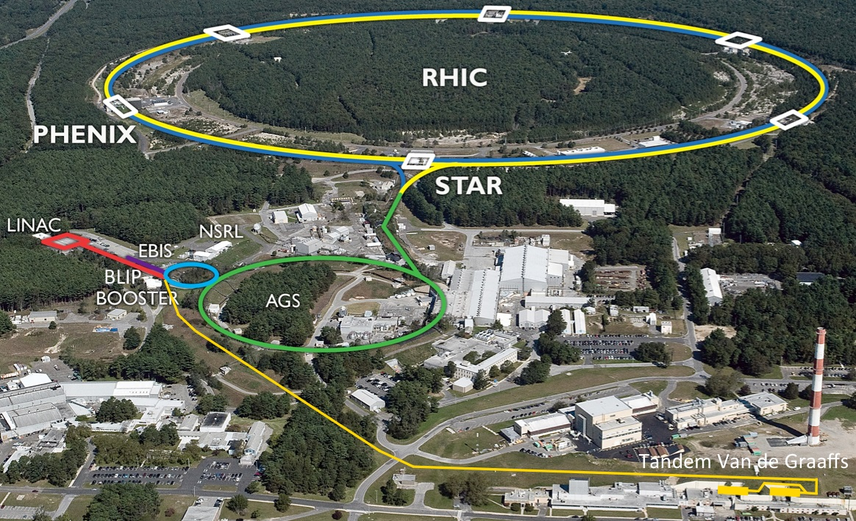

Yes, versatility!
PHOBOS
eLens
LEReC
e⁻
Zr
AnDY
Au
Cu
e⁻
p↑
³He
BRAHMS
CeC
d
A one-trick proton pony from mid-20th century
has evolved over decades and continues to grow as the accelerators continue to deliver what the experiments can dream.
Even electrons…
O
O
Au
Ru
U
H₂
D₂
D
H
O
Si
H
Al
Li
Cl
Au
Nb
p↑
Ca
C
p
Fe
Tb
Ti
Fe
Si
Bi
p
He
Ti
Ar
Ne
C
O
Ta
p
Xe
Fe
Kr
p↑
p
Si
³He
U
Zr
Al
Au
Th
Au
Ge
Ca
I
Li
Cr
Nb
F
O
Zr
Au
Ti
Mg
B
Ru
Cu
d
Fe
Ag
C
Si
H
Ni
Br
Notes:
Advancing our abilities to quickly save or restore machine configurations repeatedly.
GCR sim runs 33 different setups in the Booster (species, energy, intensity)

Slide 22

Conclusion
“There are no endings, and never will be endings, to the turning of the Wheel of Time."
But it was an ending.” – B. Sanderson/R. Jordan, 23 years later

Slide 23

Future:
“I know what you need”
Over the course of RHIC years, MCR Operators have a proven track record of specialization; growth within – and up – the ranks of the Control Room, C-AD, and beyond.
5 (Shrey, Hock, Schoefer, Marr, Brown) Run Coordinator roles during 10 of 25 Runs
Lateral contributions via careers in AP, ACS, Controls, Cryo, Instrumentation, EIC…
Lawyers, pilots, engineers, inventors, and of course accelerator experts worldwide
We are indebted to ALL the Support Groups for their diligence in responding to our constant barrage of call-ins, complaints and questions. At the very least MCR gained knowledge; often we were able to effect improvements that paid off to RHIC performance.
As many systems were relinquished from the experts’ hands for us to manage, our involvement escalated as far up as the SME level which allowed us to offer some relief to others.
Permit System, Feedback/Feed Forward, Ramp design/development, APEX, MD, and much more…
Over time, MCR Start-Up improved when Specialists ran the show
We look forward to contributing our institutional experience, insight, and lessons learned, to help avoid repeating pitfalls in the future and continue innovating for excellent, adaptable accelerator performance.

Slide 24
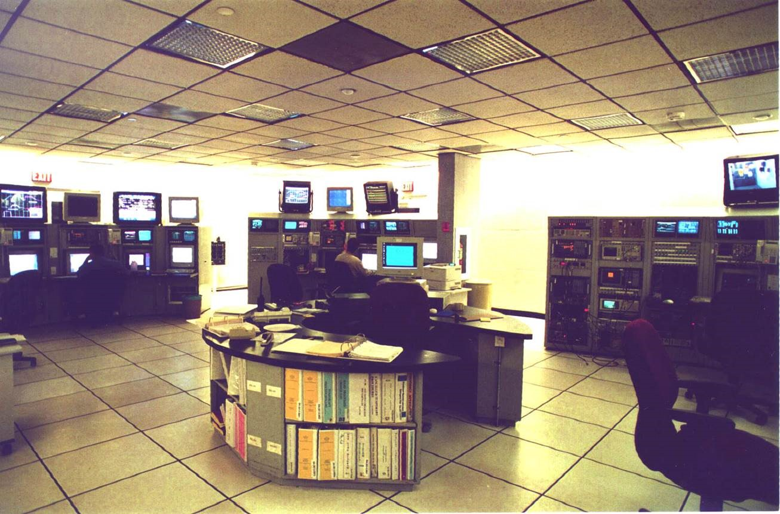
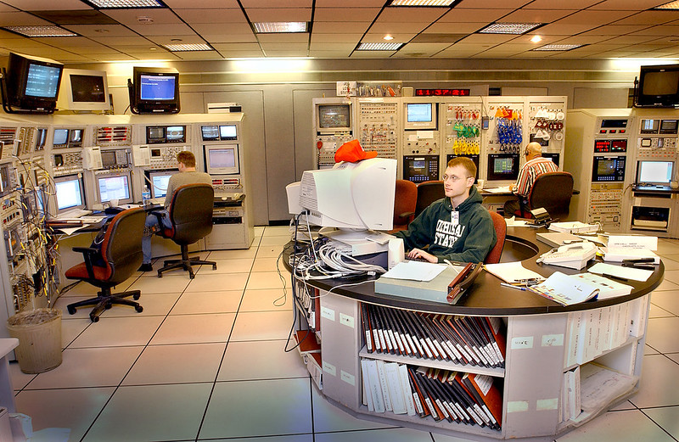
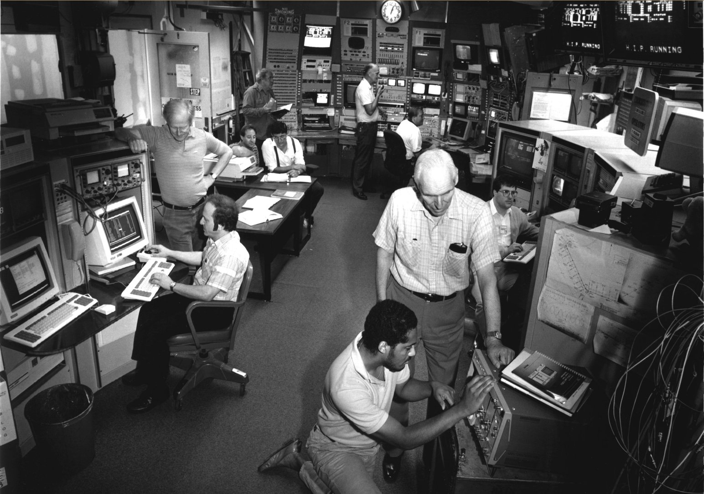
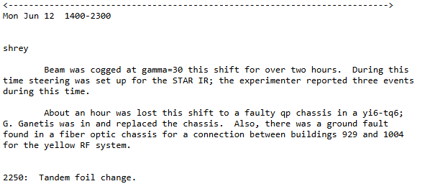
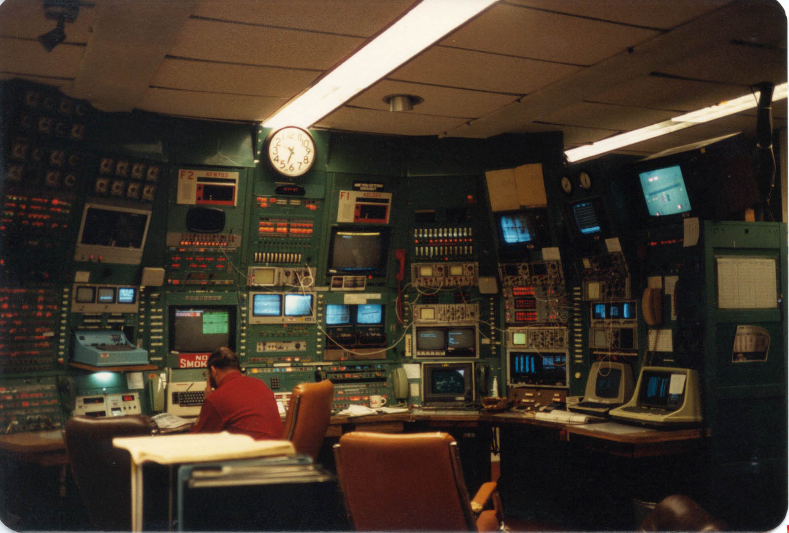
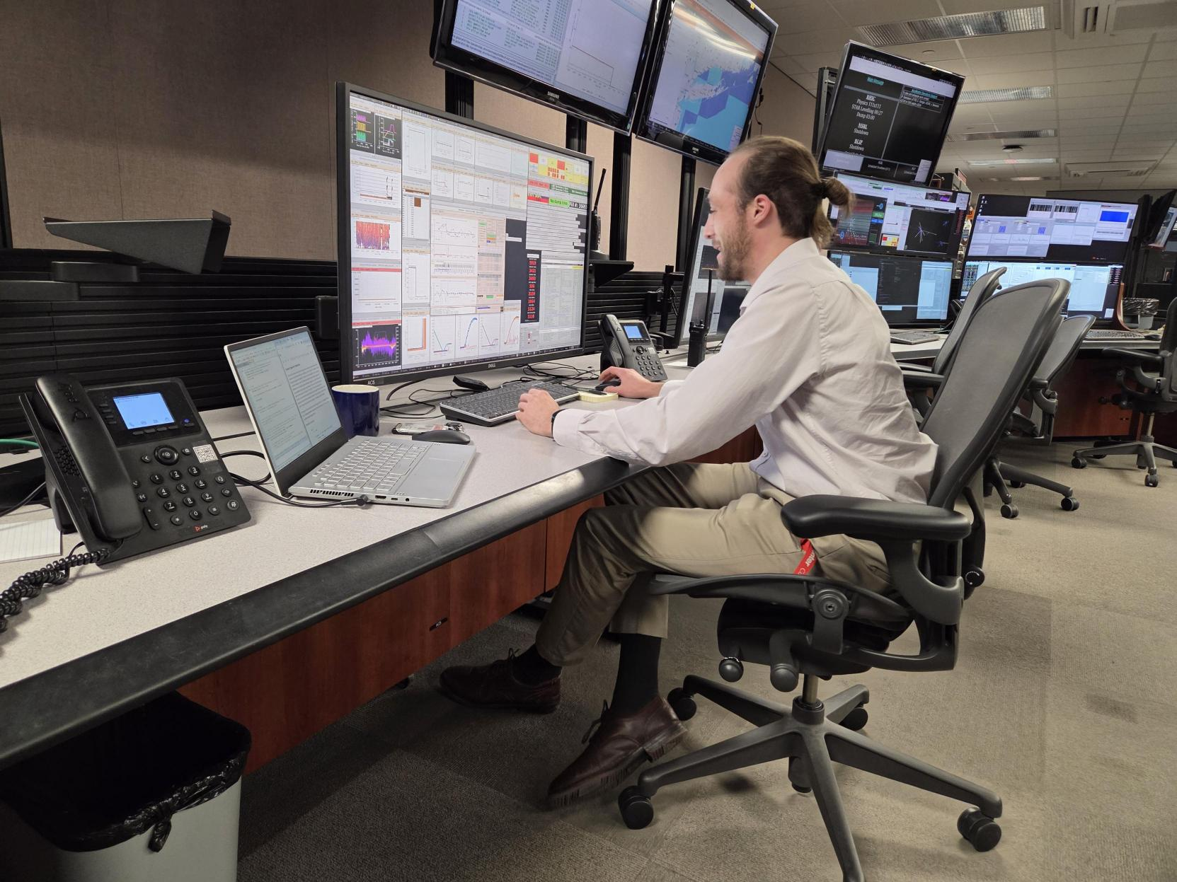
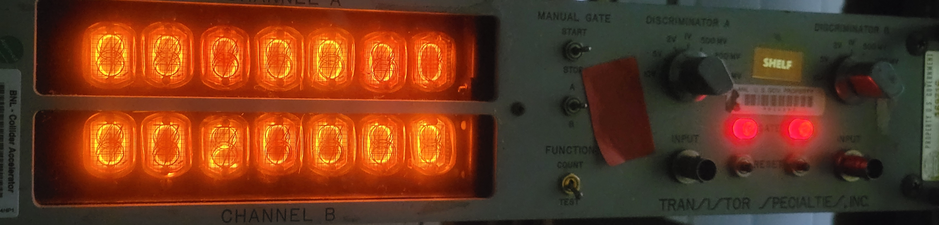
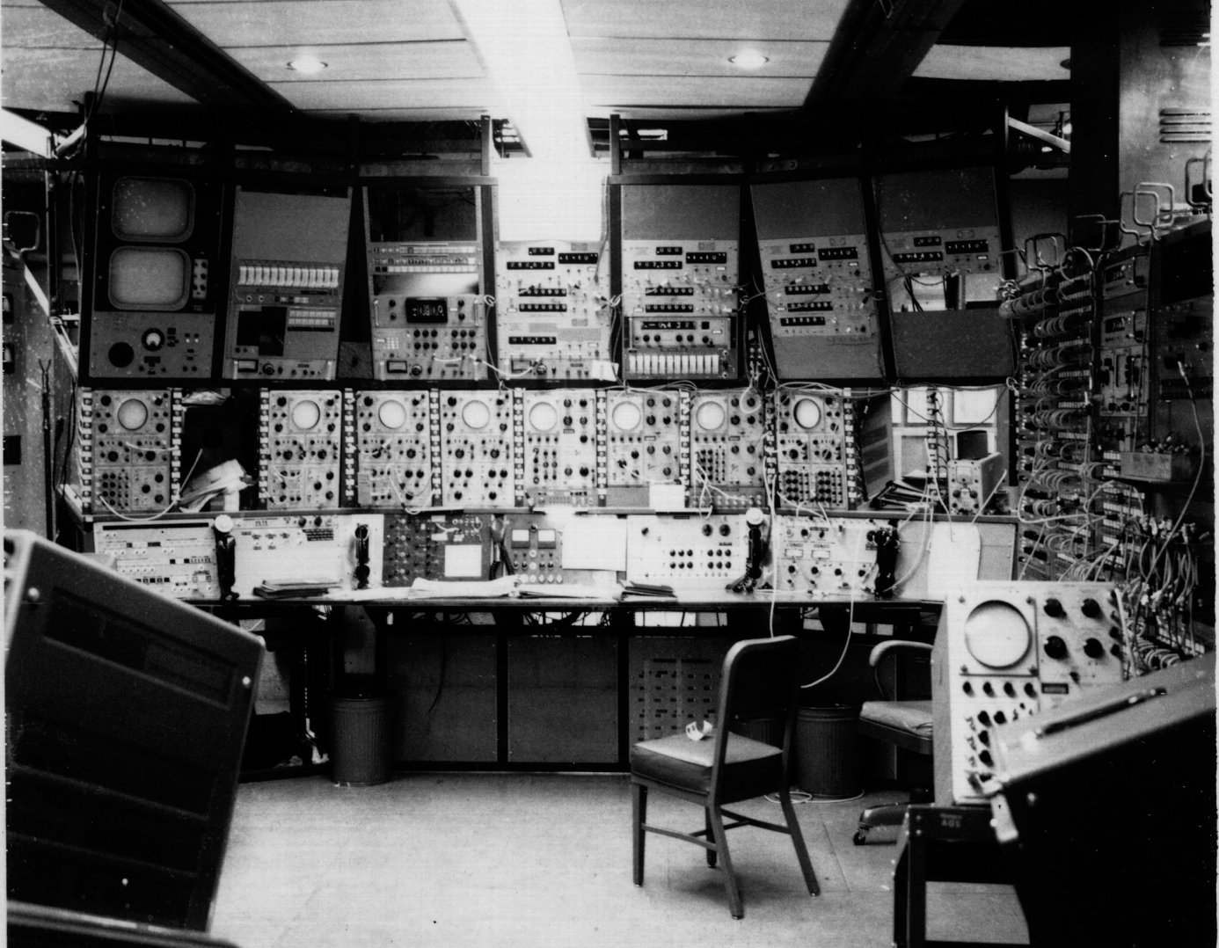

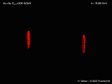
We’ve come a long way, folks…
https://www.cadops.bnl.gov/AGS/Operations/Shiftlogs/Oldruns/HeavyIons_rhic_au_fy00/shiftlog-00.06.12-23.10.26
1989
2000
1998
1987
A favorite relic
2026
1964

Slide 25
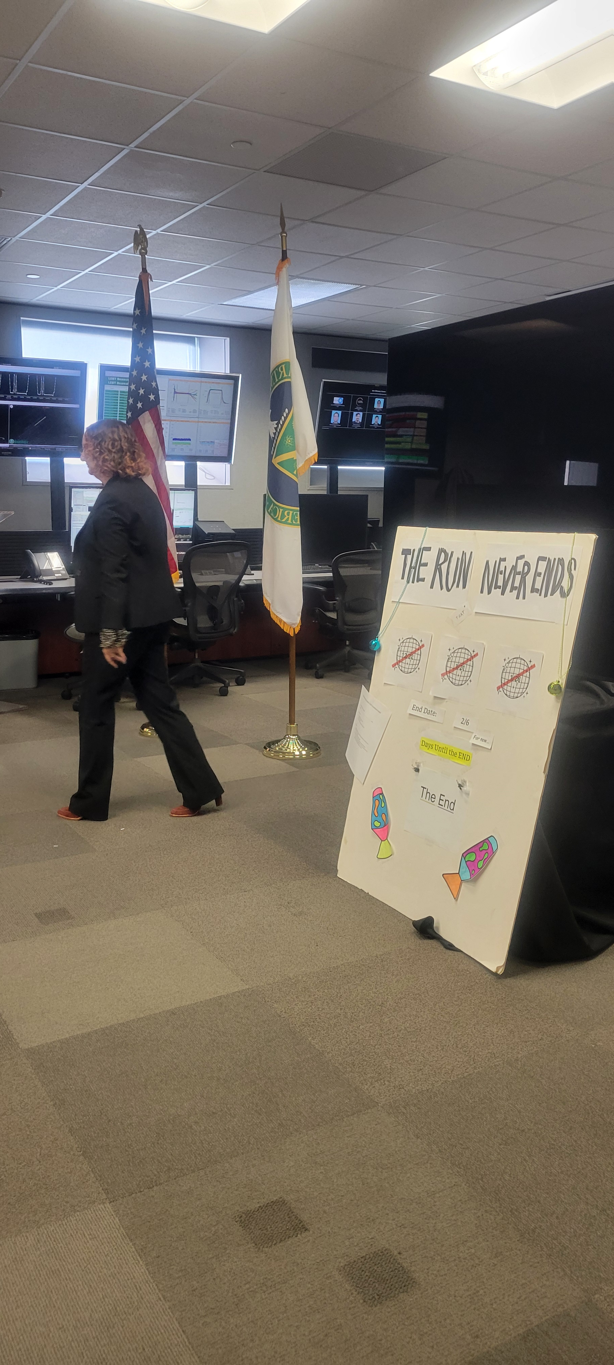
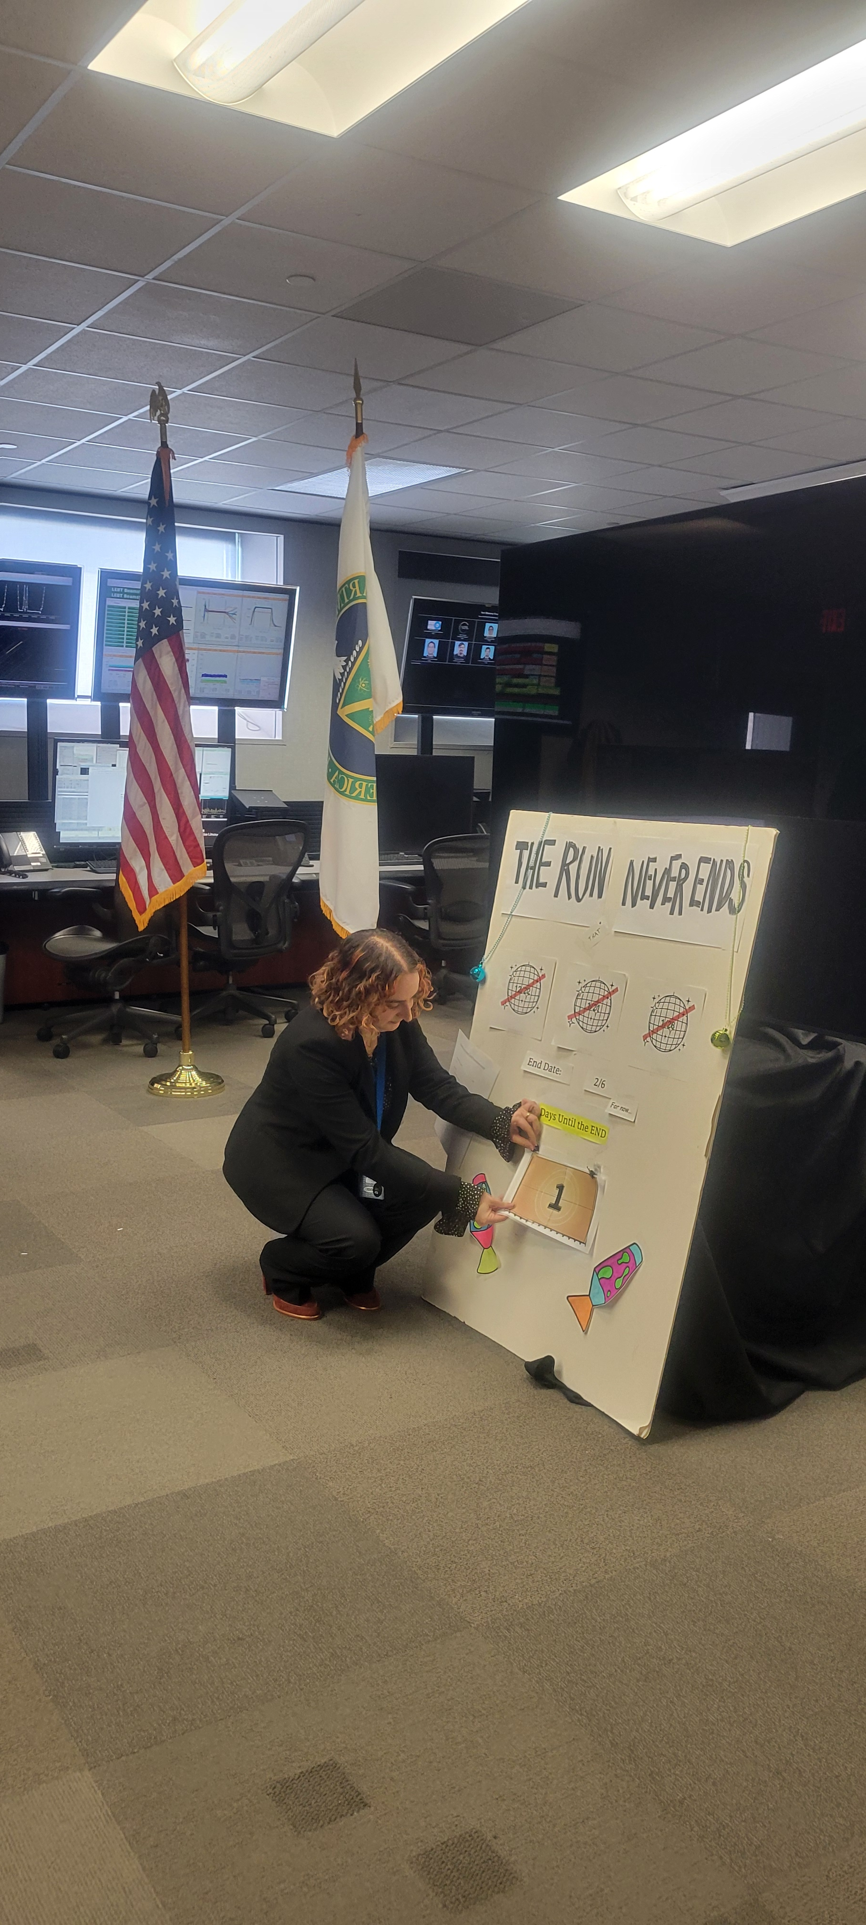
Thank you!

