Slide 1

Date July 10, 3:25pm

Slide 2
RHIC CRYOGENICS
Roberto THAN
Acknowledgement page
RHIC CRYOGENICS DESIGN: Dan BROWN, Jim RANK, Chou LAC, Jack SONDERICKER, Dean CAMPBELL, Jim OSTERLUND, Austin GWILT, Willam DEVITO, K.C. WU, Jim BENSON, Alonzo WERNER Sr., Mike HARRISON, plus many others not mentioned. Those that stayed on for operations are named in operations.
RHIC CRYOGENICS OPERATIONS
Russel FEDER, Roberto THAN, Joseph TUOZZOLO, Andy MCNERNEY, Michael IAROCCI
Dewey LEDERLE, Anthony NICOLETTI
Eric O’CONNER, Andrew WEISMANN, Chintan SHETH, Pratik PATEL, Ashish SHUKLA, Kenneth HWANG, Ed QUIMBY, Ahmed SIDI-YEKHLEF, Lin JIA, L. WANG, Y.FARAH, Gregory CITVER,
Bernard YATAURO, Andreas WARKENTIEN, R. PICINICH
Nicholas STIVALA, Nicholas SCOTT, Jovanny ALAMO, Josiah GRUBBS, Kenneth RIKER, Thomas WOZNIAK, Jeffery STEWART, Louis TENREIRO, Gary POLONSKI, Daniel MARTIN,
Mark SARDZINSKI, Matthew DIETRICH, Alonso WERNER, George MEADE, Frank CULLEN, Glen ANDERSON, Mark MCNEIL, Willem DEJONG, Chris SALAT, C. WHITE, John STEHLE, James BIANCAROSA, D. MILLDANTRI, S. SAKRY, E. VARRICHIO, G. HERBST, R. OVERTON, William MCKEON
Thomas TALLERICO, Ann REUTER
Patrick TALTY, Brian VAN KUIK, Adam ZARCONE, Yi ZHANG, Dieter ZANTOPP, R. PRIEST
Leonard MASI, W. KOLLMER
Nils DANIELSON, David NACE II, Ryan WEISS, James CURLEY, John MOORE, Ron MEIER, David DERRYBERRY, Warren HIRZEL,C. Dudley, Will THEMANN, L. MAZARAKIS, M. O’DONNELL, K. SAWICKI
Thanks to all who have served the RHIC Cryogenics group over the years! July 10, 2026.
Date July 10, 3:25pm

Slide 3
CENTRAL PLANT IMPROVEMENTS
HELIUM (Story of)
COLLIDER PROJECTS

Slide 4
IMPROVEMENTS & PROJECTS
CENTRAL PLANT IMPROVEMENTS
Helium Use
10:00: E-LENS SC SOLENOIDS {@4.5K}
56MHZ STORAGE CAVITY {@4.3K} 4:00
CEC 2:00 {112MHz@4.4K} + {704MHz@2.0K}
LEReC 2:00
SPHENIX 8:00
912 PLANT & LVTF Vertical Test Facility ➔ 39” Dewar for 56MHz
912 ERL
Notes:
Will go over the central plant improvements done over the years.
I thought it would be interesting to helium production and cost.
Recap some designs implemented for the cryo systems for the experiments.

Slide 5
CENTRAL PLANT IMPROVEMENTS
Rao Ganni (Jlab)
Gas Management & Plant Control
Controls: CRISP SCADA (VaxVMS)➔HMI to Modern SCADA:Indusoft(➔Aveva)
Stop using Mechanical Bearing Cold Compressor 4.3K to 4.6K
  Repiping because of no cold compressor operation
Stop using Liquid helium circulator pumps on the Magnet lines
  New control logic to “forced” flow through magnets without circulating pumps
Add MLI to coldbox 5 liquid helium vessels
Cold End Upgrade (Expander turbine 7 +HXs) to match RHIC Loads
Corrector flow control ➔ 3 sizes of orifices to Needle valves
Reduce LN2 use from 11 to 5 trucks /week for magnet rings 80K mode cooling during shutdown
Add bulk liquid helium truck offload line into coldbox #5 midpot
Flow balancing HX: HP inlet valves

Slide 6
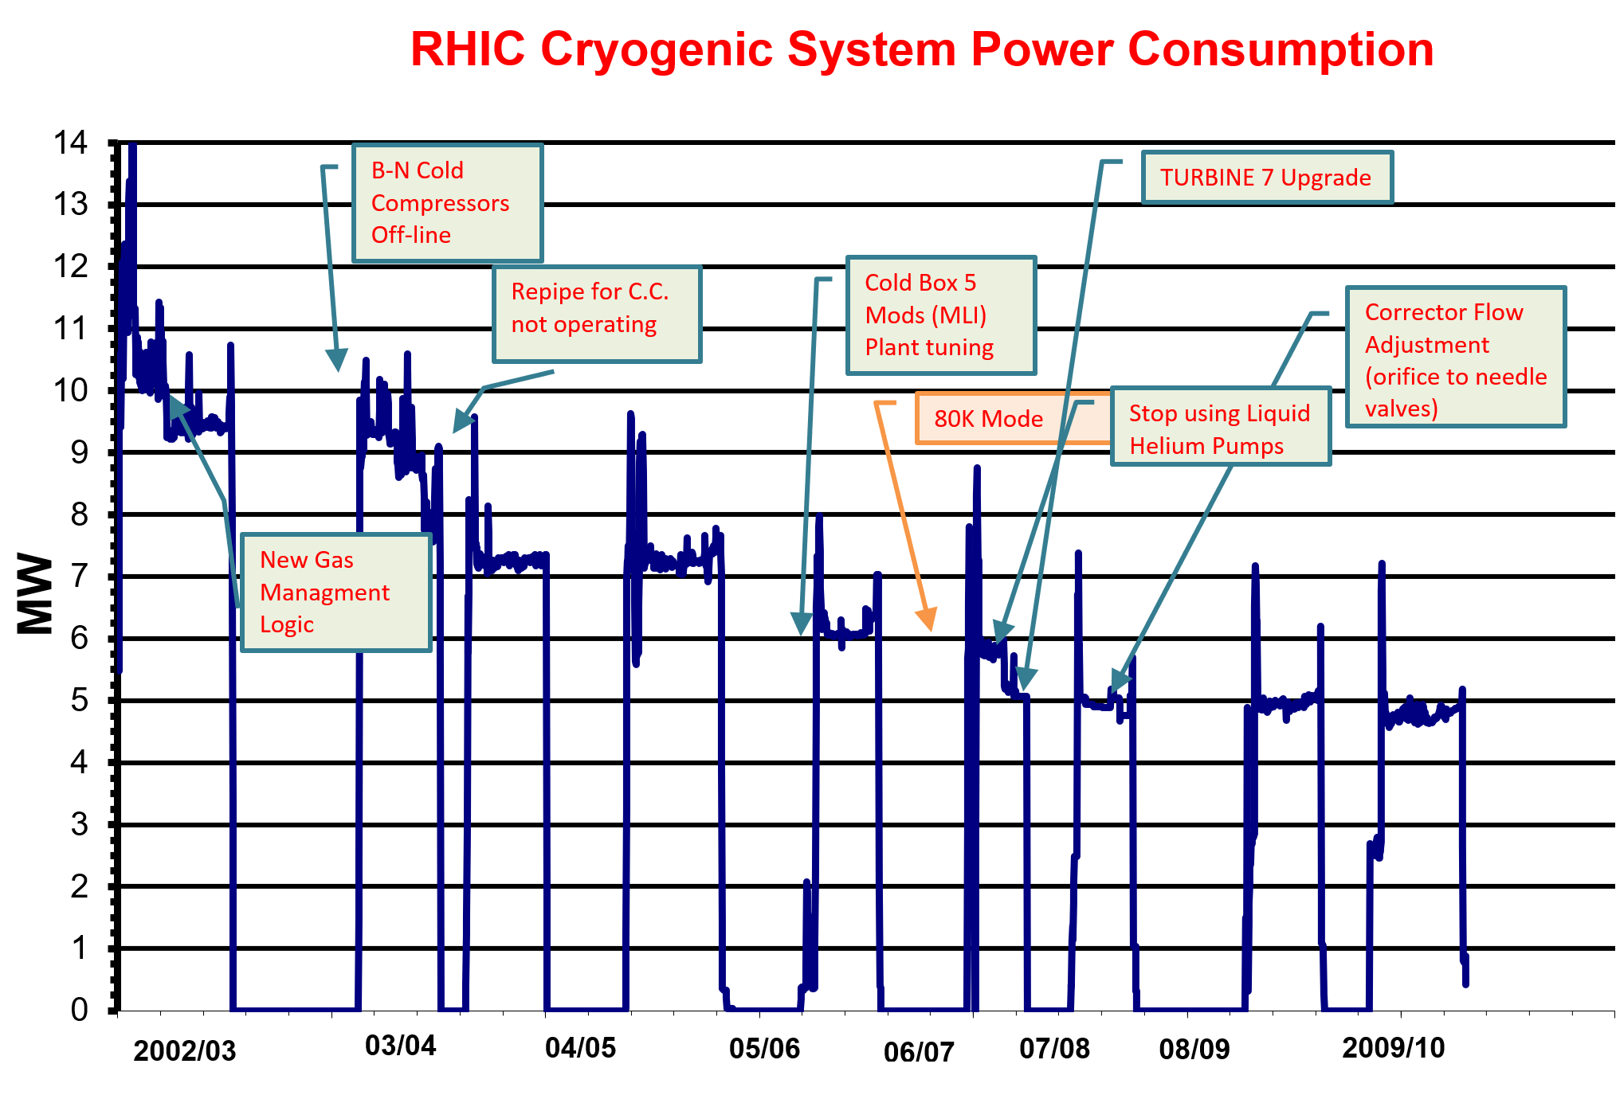
POWER CONSUMPTION TIMELINE
6.4MW
E-lens: 2011-2012
56MHz:2012-2014
CEC: 2012-2015
LEREC: 2015-2017
sPHENIX:2015-2023

Slide 7
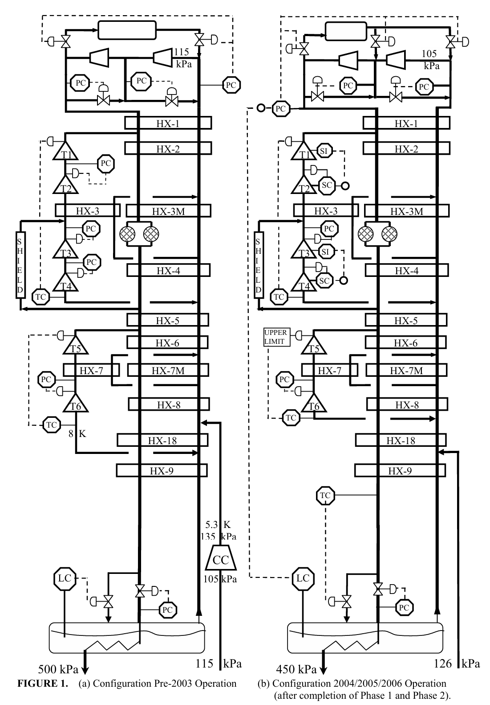
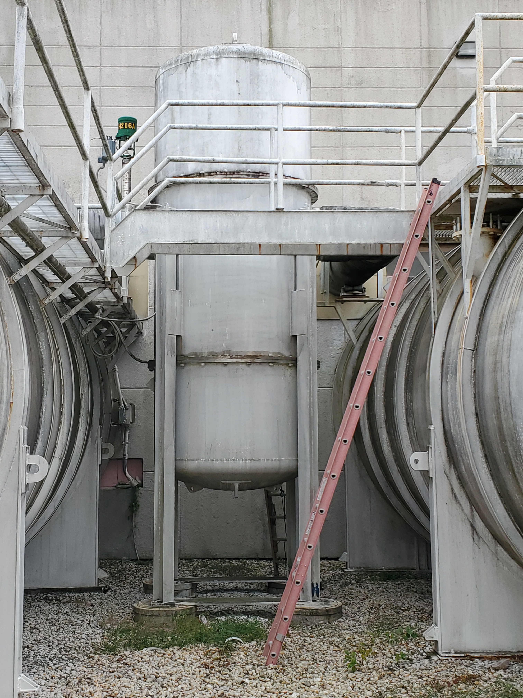
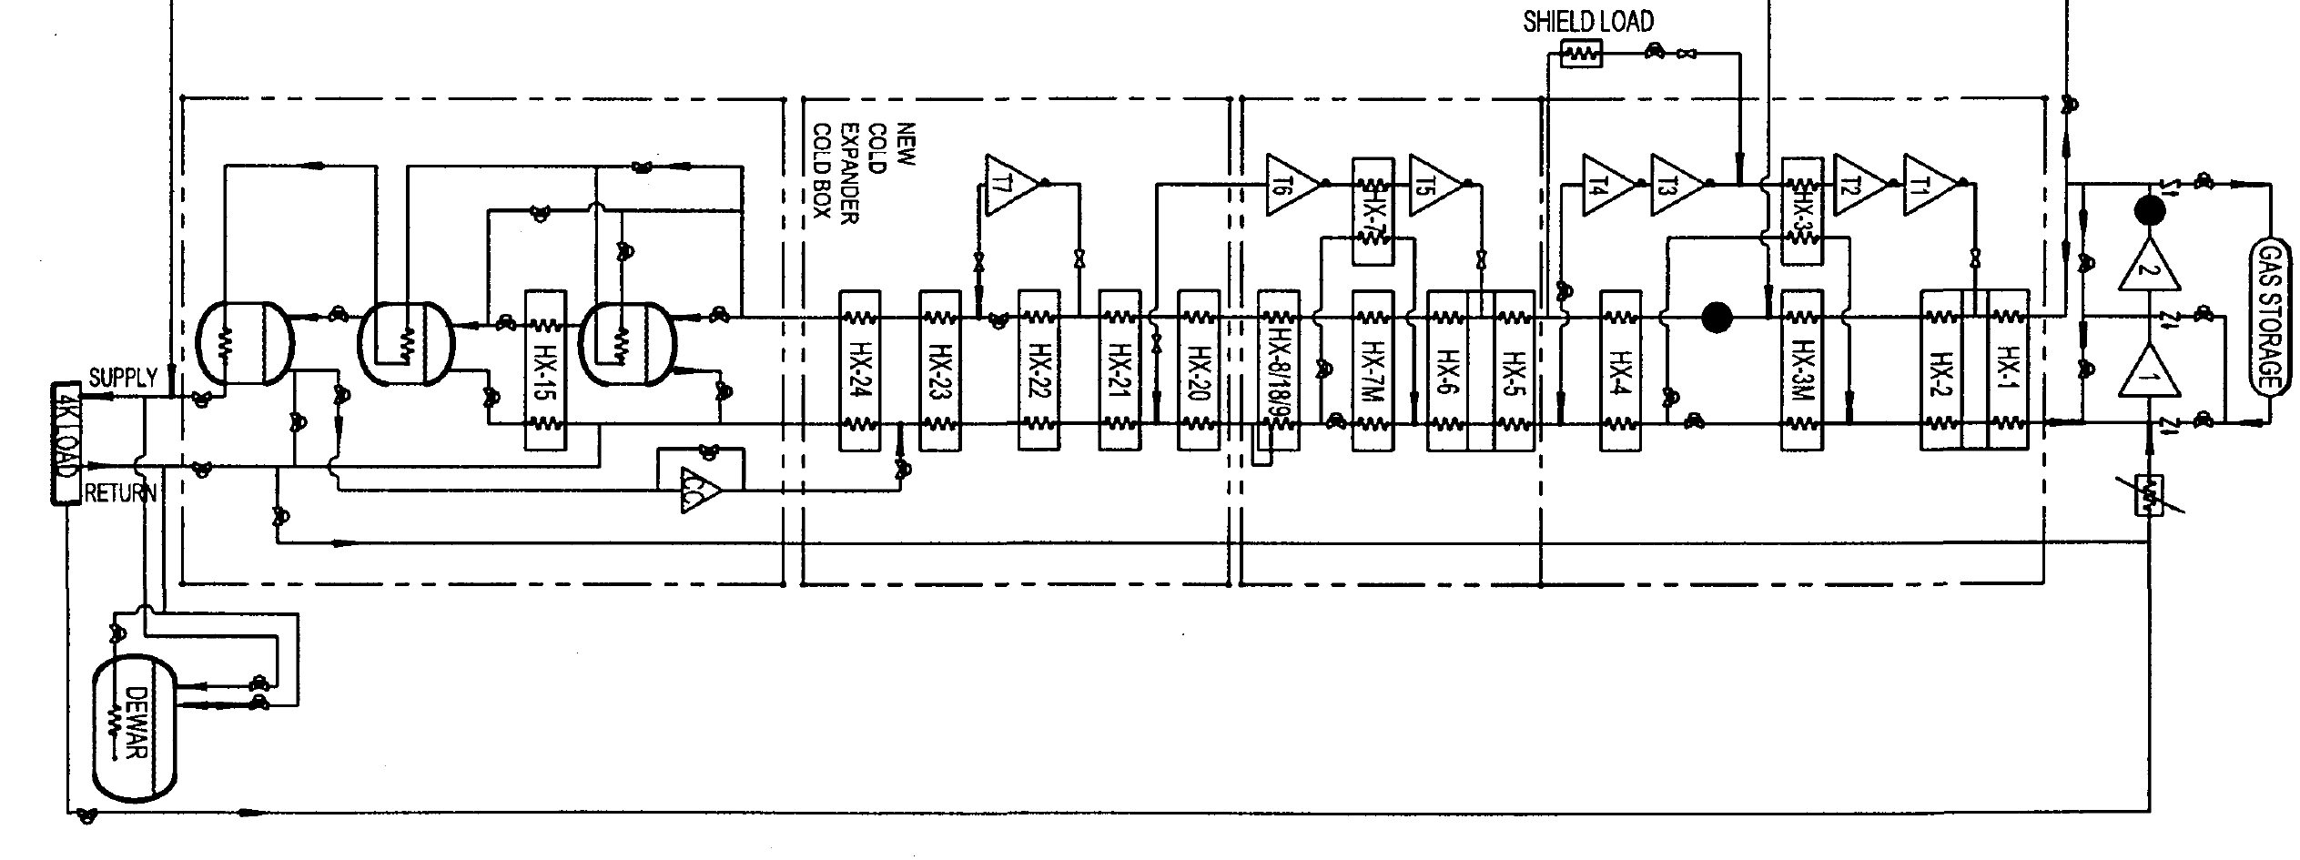
COLD END
Expander T7 &HXS
DeActivate
Cold Compressor
4.25K ➔ 4.65K

Slide 8
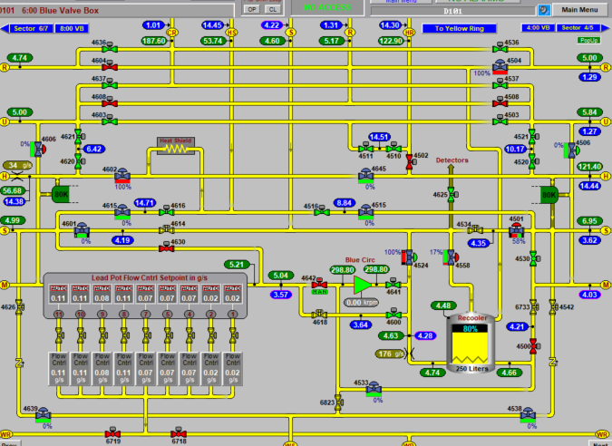
Forced Flow Supercritical Helium
Liquid Helium Pumps

Slide 9
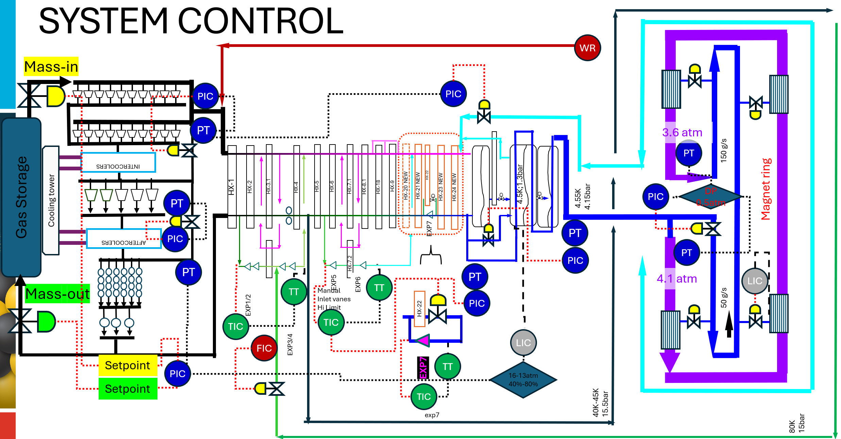
STOP USE OF LIQUID HELIUM CIRCULATOR

Slide 10
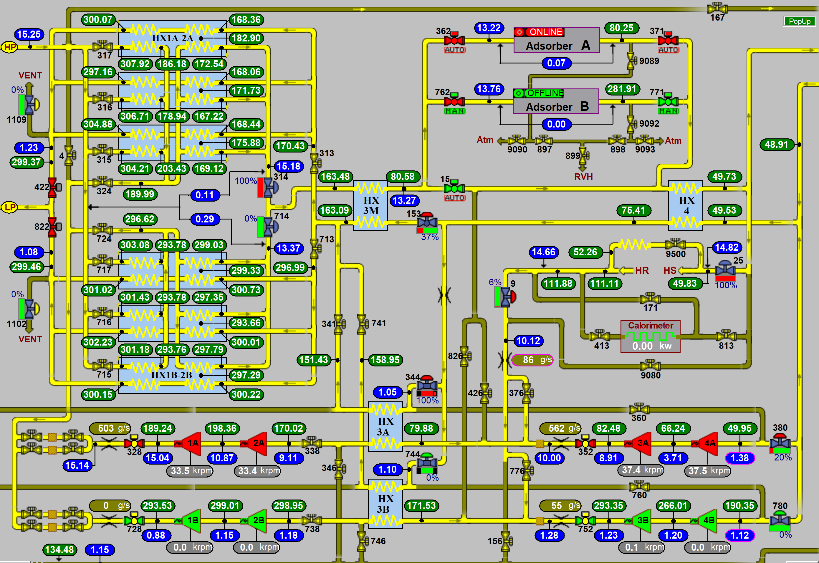

Slide 11
HELIUM SOURCING
Federal Helium Reserves
Helium Stewardship Act of 2013

Slide 12
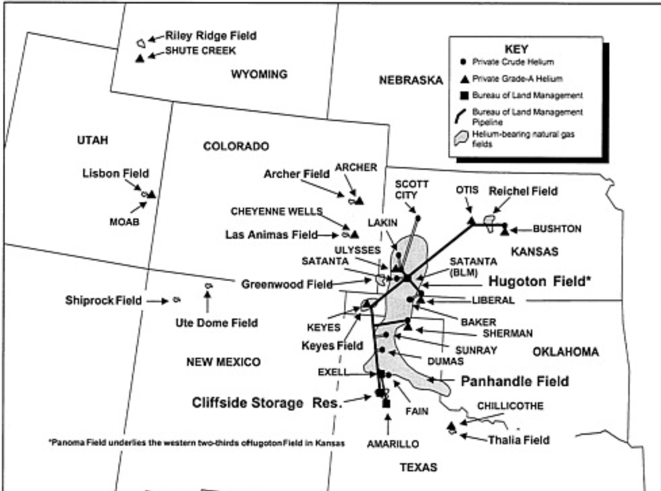
HELIUM EXTRACTION IN USA
CRUDE
HELIUM
PIPELINE
CLIFFSIDE STORAGE

Slide 13
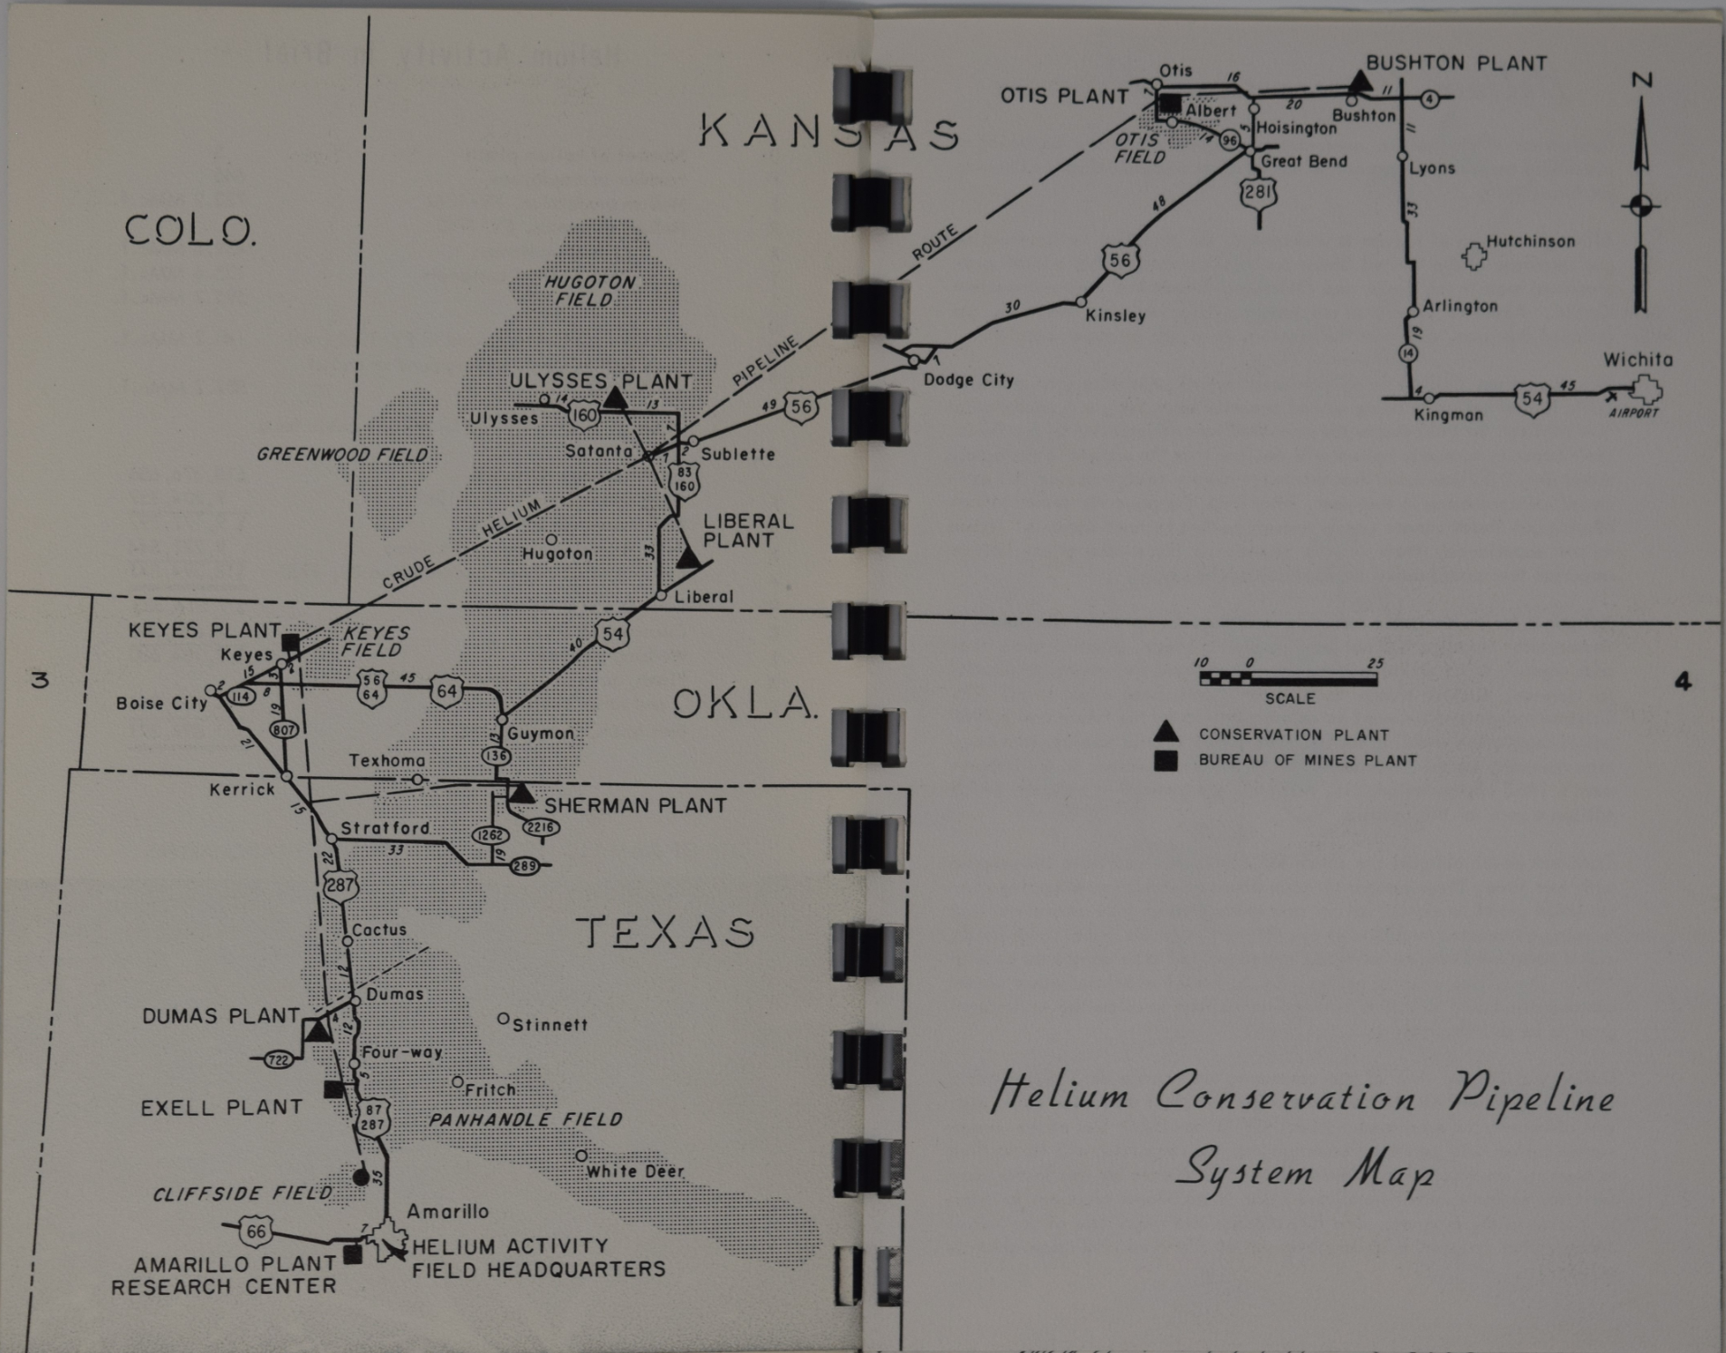
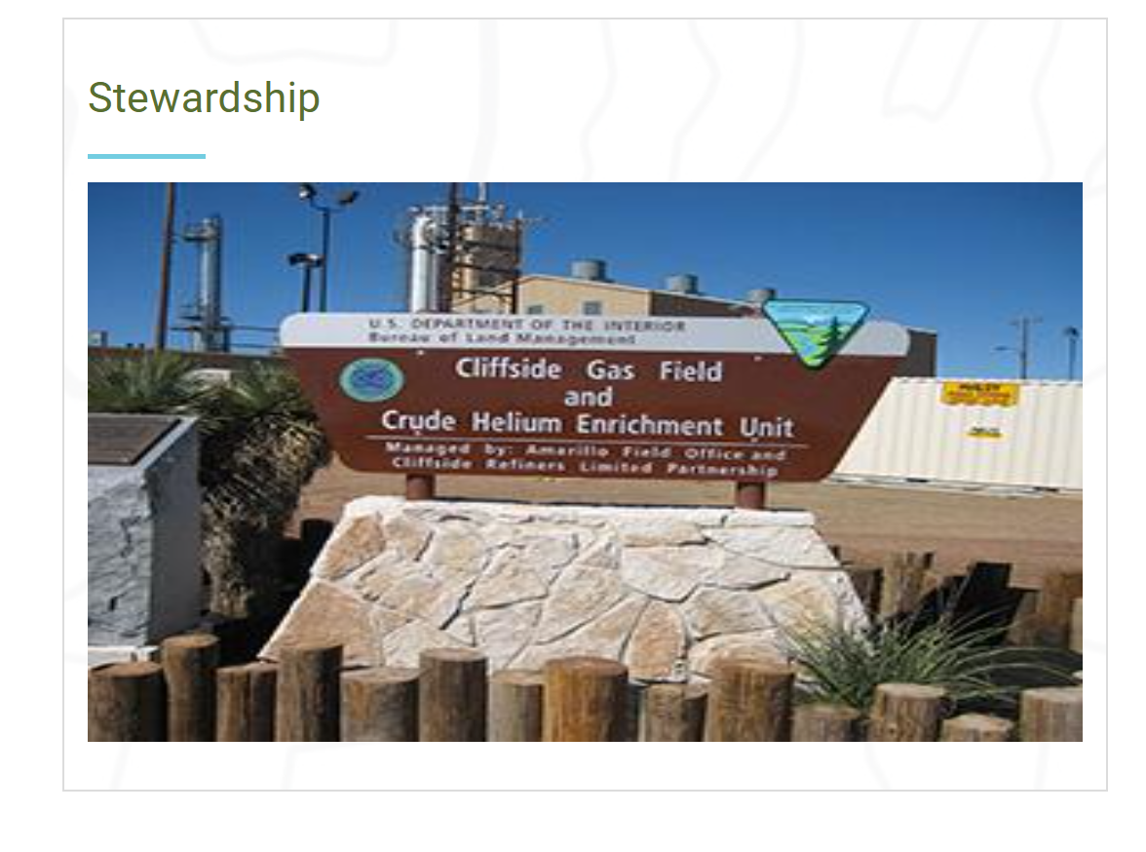
Federal Helium Reserves @ Cliffside Field

Slide 14
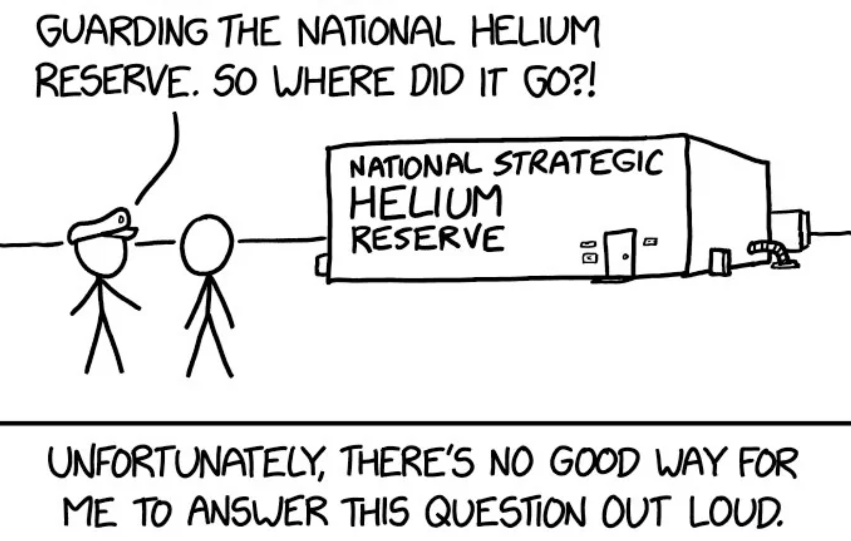
EST.1996
HELIUM
FOR SALE
2013
Helium Stewardship Act

Slide 15
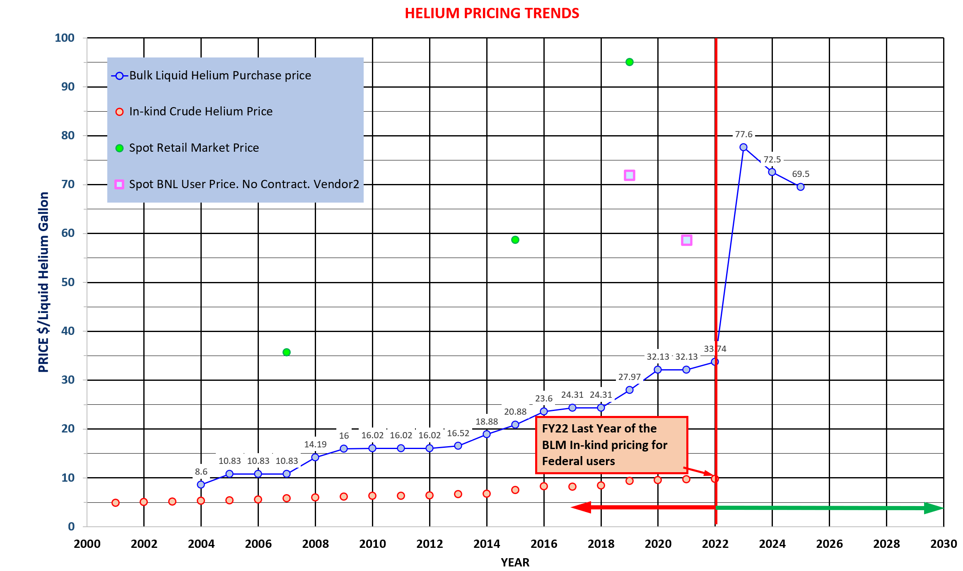

Slide 16
HELIUM PRODUCTION & PRICE
 | 2005 x Million Sm³ | 2010 x Million Sm³ | 2020 x Million Sm³ | 2025 x Million Sm³
Helium from Natural Gas | 84 | 75 | 76 | 74
Withdraw from storage | 50 | 53 | 7 | N/A
Helium Sales | 134 | 128 | 83 | 81
Imports | - | - | 7 | 8
Exports | 49 | 77 | 50 | 38
Consumption, Apparent | 85 | 51 | 40 | 51
Federal User Crude He price | $5.45/Liq.Gal | $6.47/Liq.Gal | $10/Liq.Gal | No more
Federal user purchase price | $10.8/Liq.Gal | $16/Liq.Gal | $32/Liq.Gal | $69.5/Liq Gal.
USA DOMESTIC NEW HELIUM OPERATION 2025 | STATE
2 {LittleWater, WestPecos} | New Mexico
1 {Las Animas} | Colorado
1 {Fort Dodge} | Kansas
1 {KevinDome} | Montana

Slide 17
WORLD HELIUM PRODUCTION
[x Million Sm³] | 2024 | 2025
USA | 80 | 81 + New
QATAR | 11 | 11
RUSSIA | 17 | 18
ALGERIA | 11 | 11
CANADA | 3 | 3 [1 new coming]
POLAND | 3 | 3
CHINA | 3 | 3
SOUTH AFRICA |  | New (0.5) ➔ 5
AUSTRALIA | 4 (2021) 1 (2023) | 2025 (Darwin field depleted)

Slide 18
Projects around Collider Circle

Slide 19
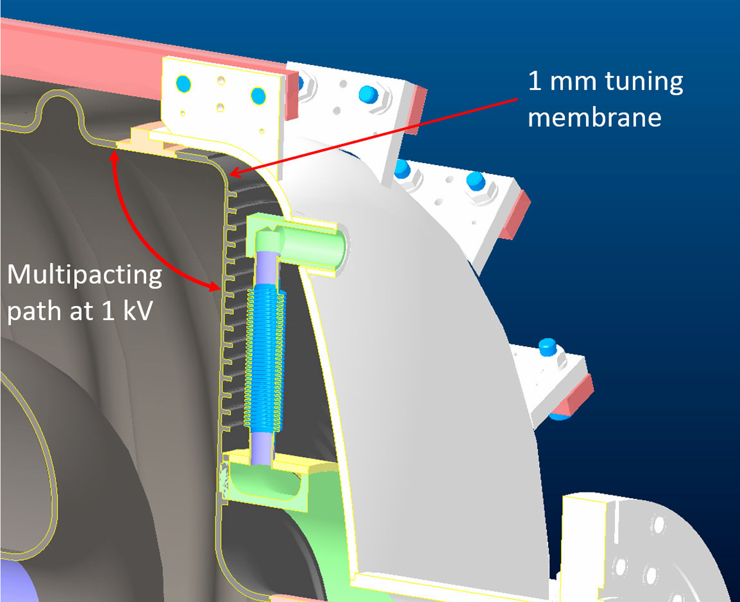
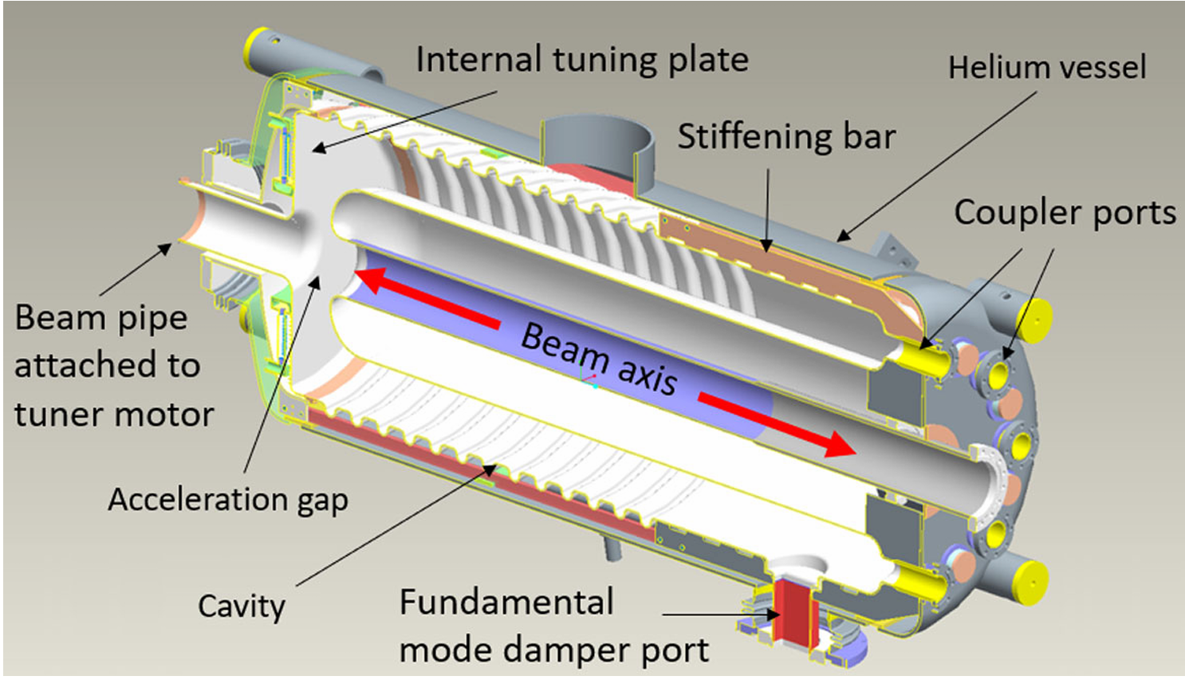
4:00: 56MHz QWR CAVITY {@4.4K}
Large: Folded QWR
Low design pressure! ➔ 5 PSIG RELIEF!
Requirements: ± 1Hz. ➔ 5Hz?
STIFF CAVITY, except the “tuning plate”
Bath cooled @ 4.4K
MICROPHONICS
Isolation using a condenser / boiler

Slide 20
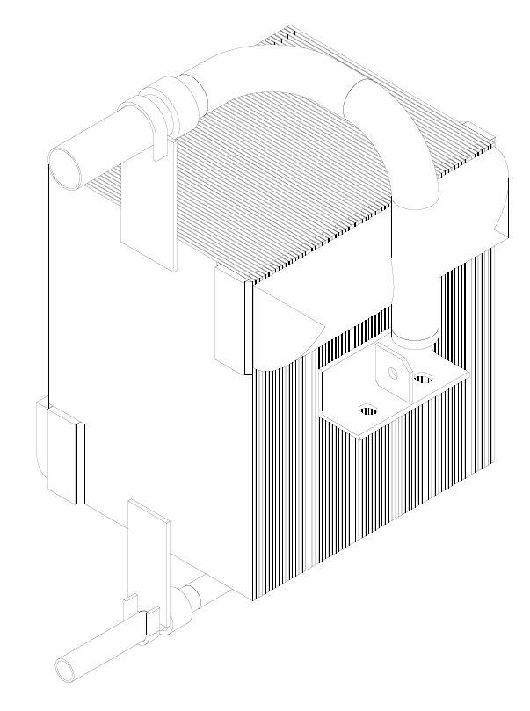
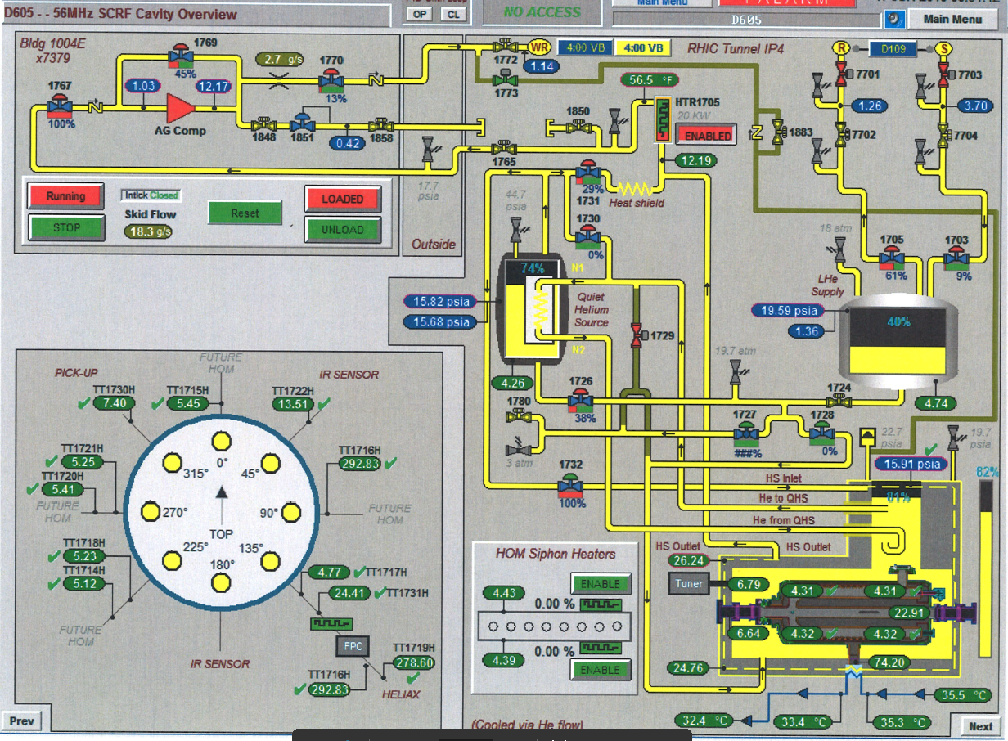
4:00: 56MHz QWR CAVITY {@4.4K}
Vapor inlet
Condenser fully submerged in Liquid Helium
Liquid outlet

Slide 21
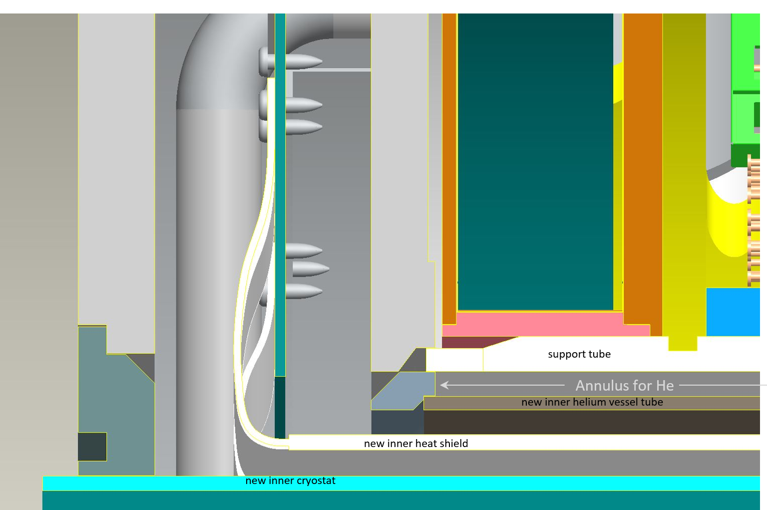
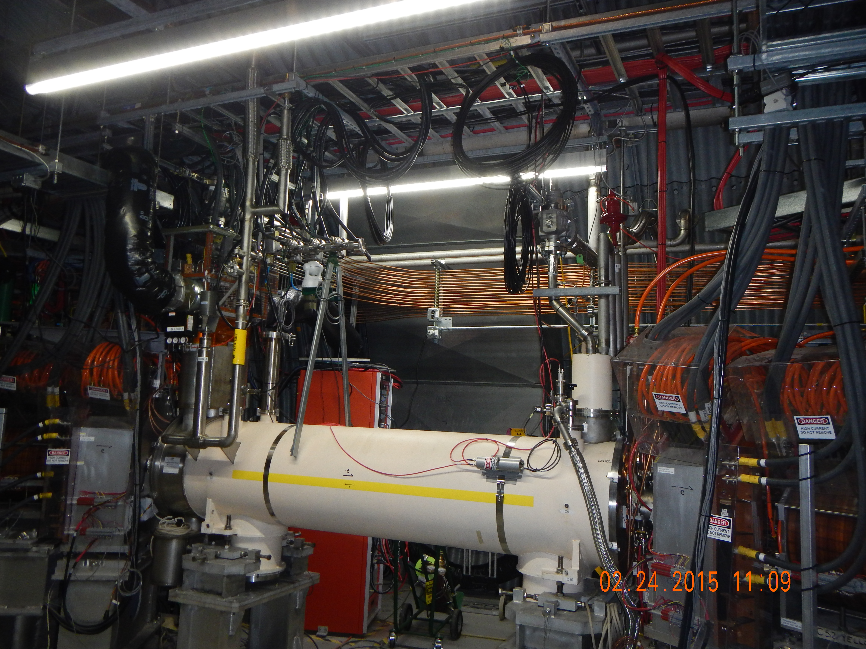
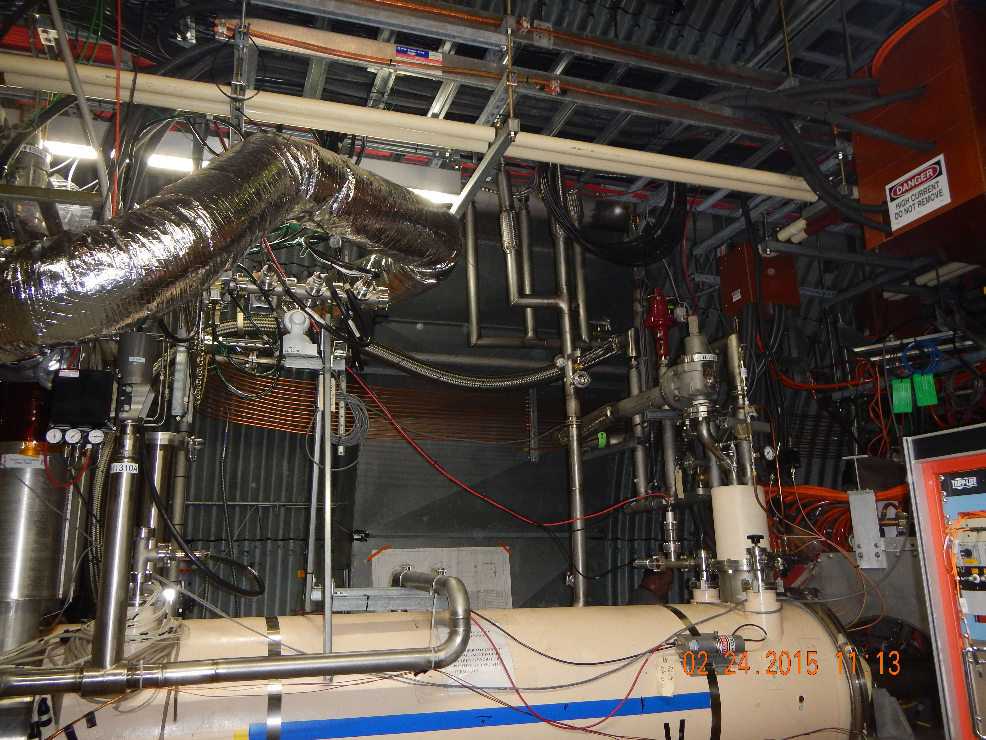
10:00: E-LENS SC SOLENOIDS {@4.5K}
Bath cooled @ 4.4K
5 Tesla
Blue solenoid had a bad layer: bypassed.
Added inside diameter annular gap channel for cooling.

Slide 22
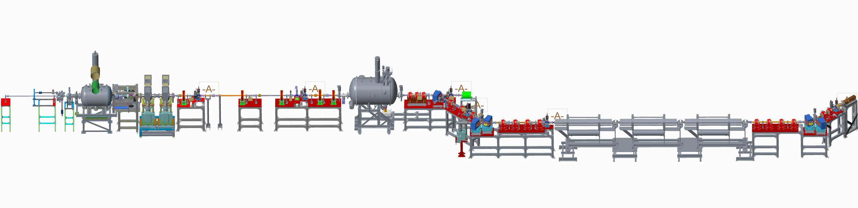
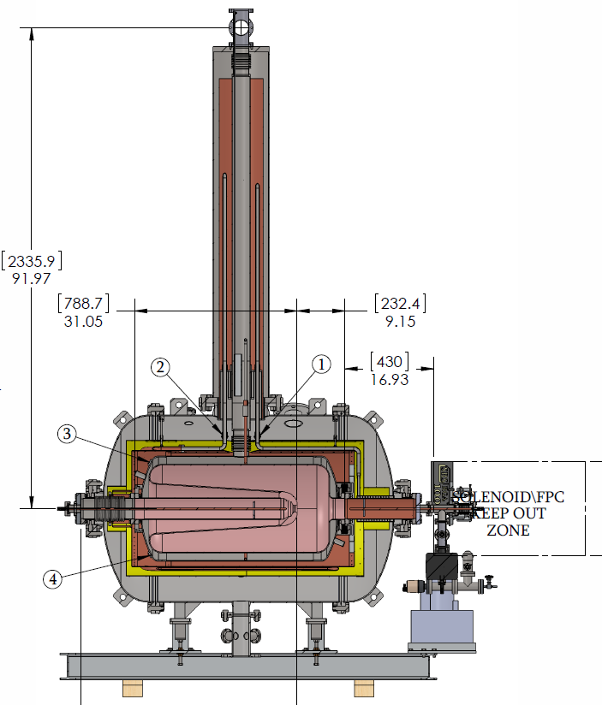
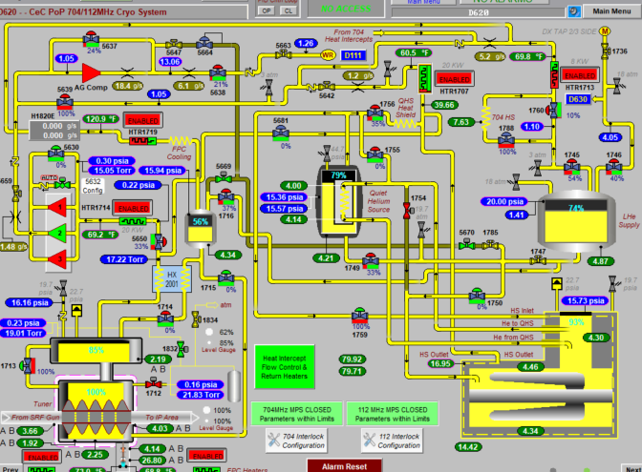
CEC
112MHz
704MHz
112MHz
4.4K: Isolate from rest of cryo system using Condenser/Boiler
{Same as 56MHz}
Cold Cathode
Power coupler: Coaxial
Water Blowdown system to get water out if cooling water fails
704MHz 5-Cell: 2.0K

Slide 23
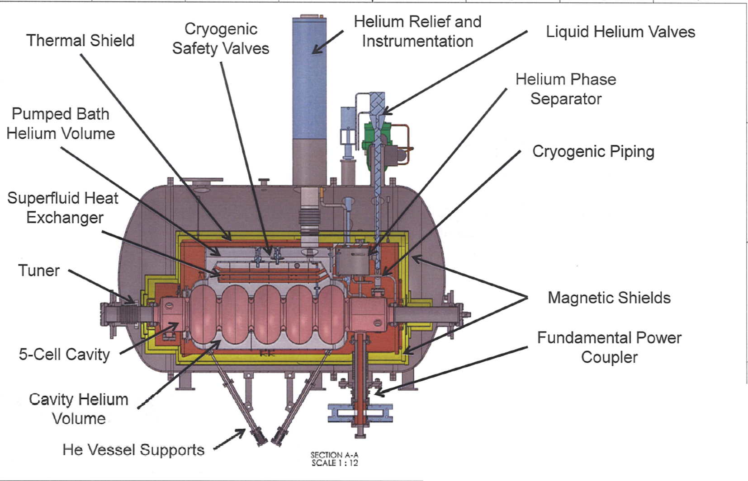
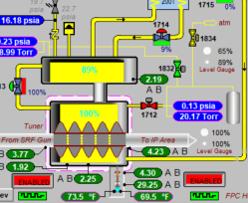
704MHz @ 2K

Slide 24
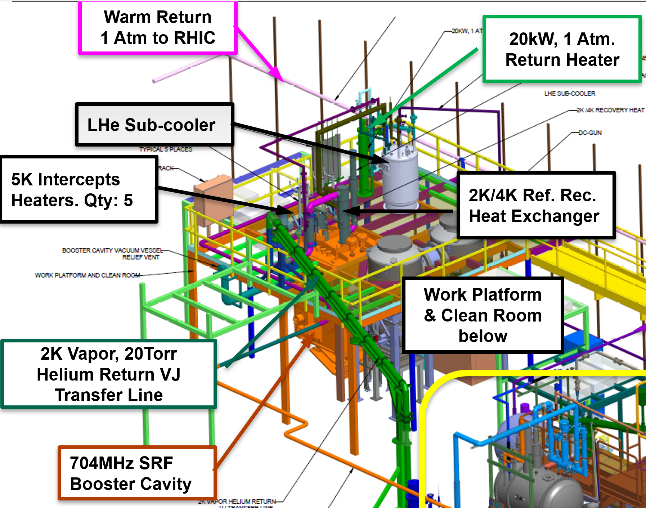
LEREC: 2K 704MHz ½-Cell
704MHz ½-Cell

Slide 25
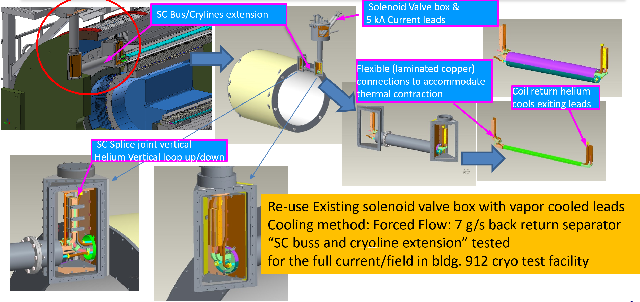
sPHENIX

Slide 26
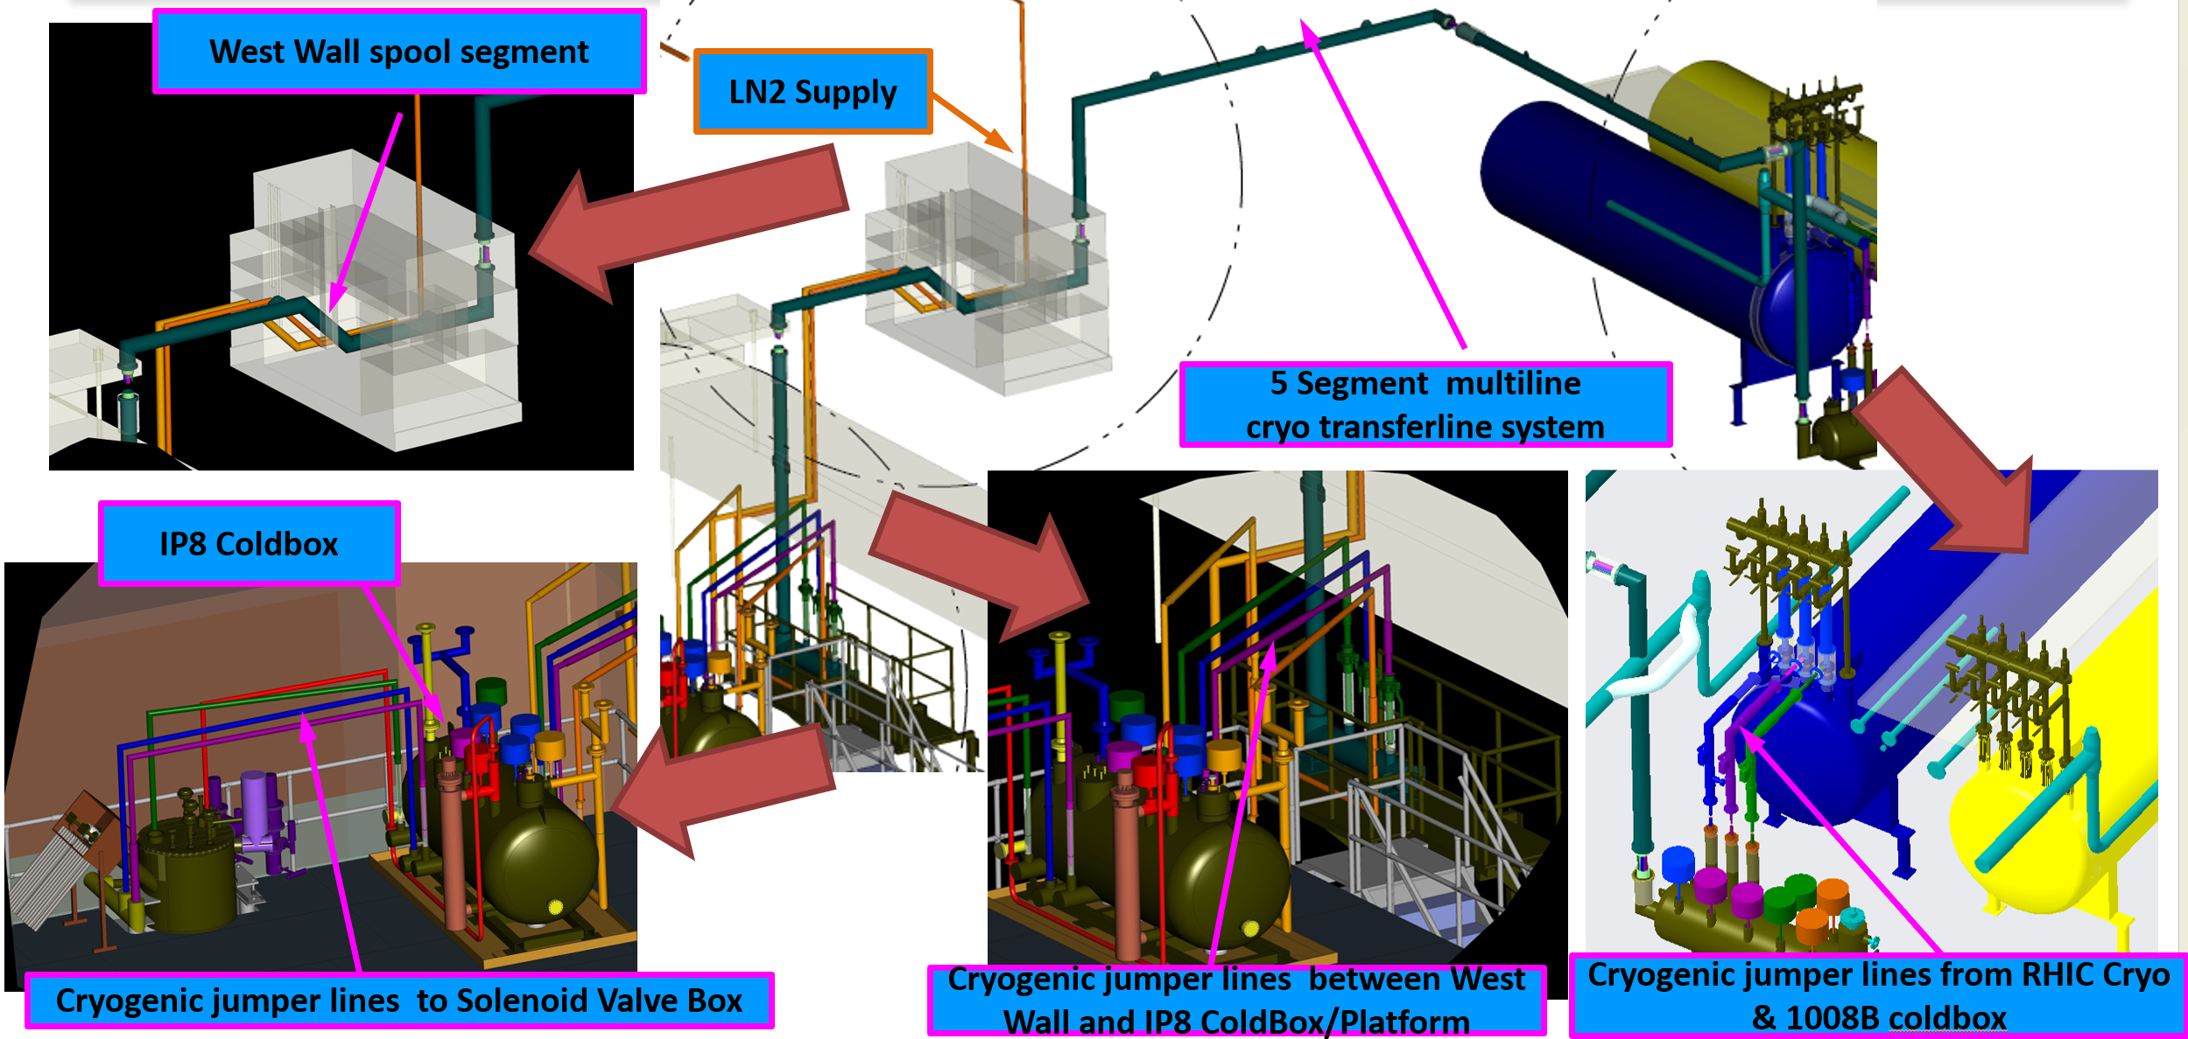
sPHENIX

Slide 27
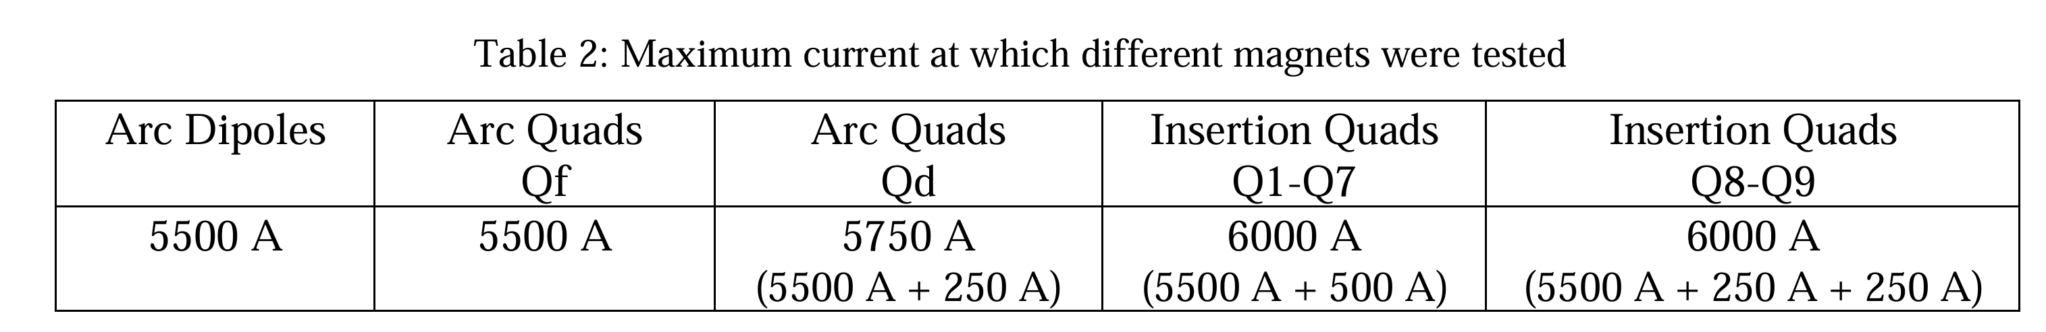
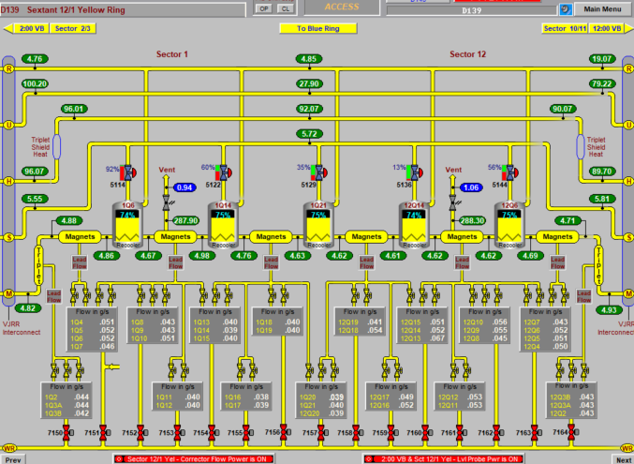
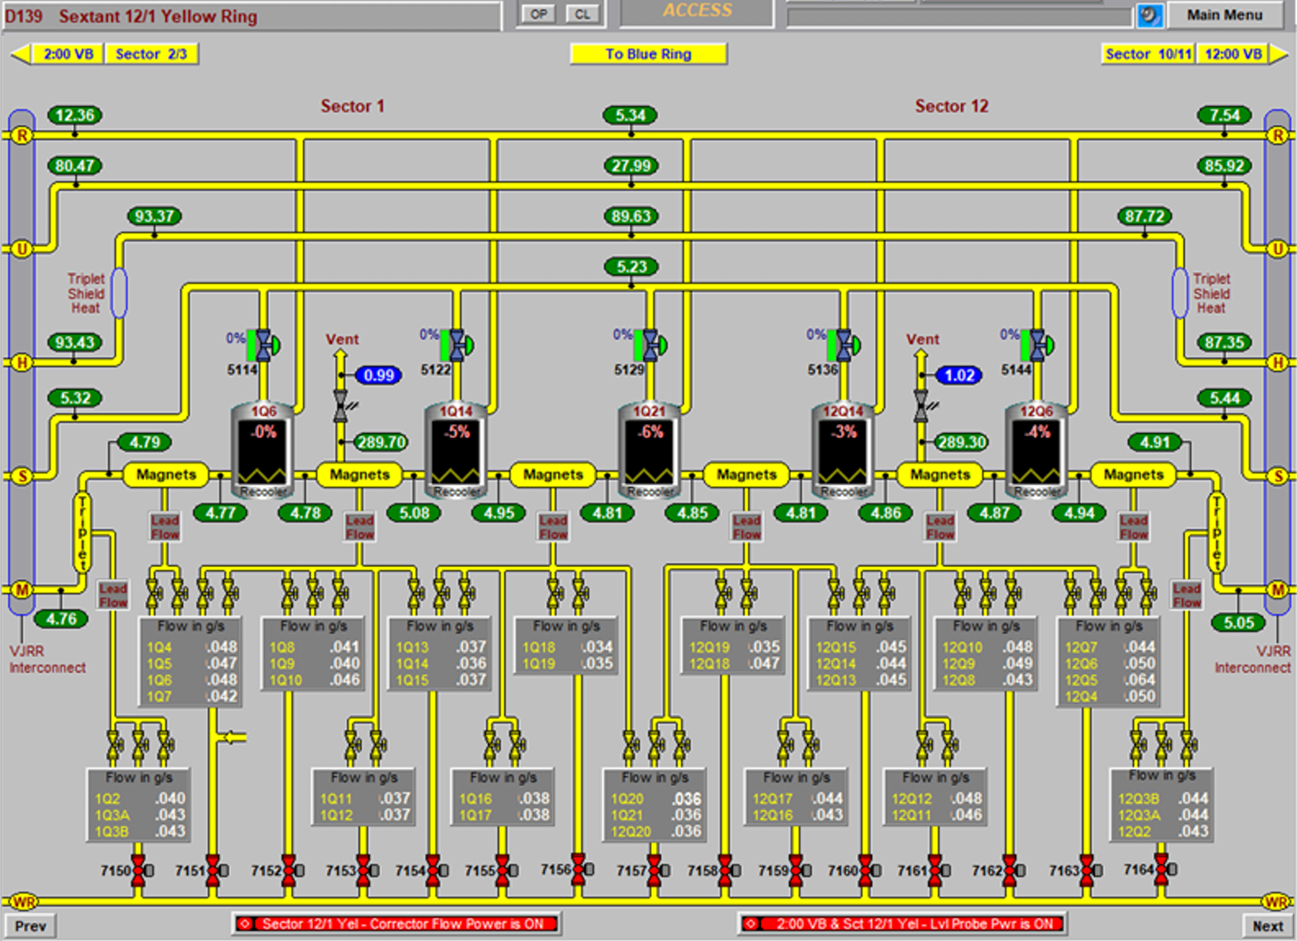
HIGH CURRENT TEST

Slide 28
The End

