Slide 1
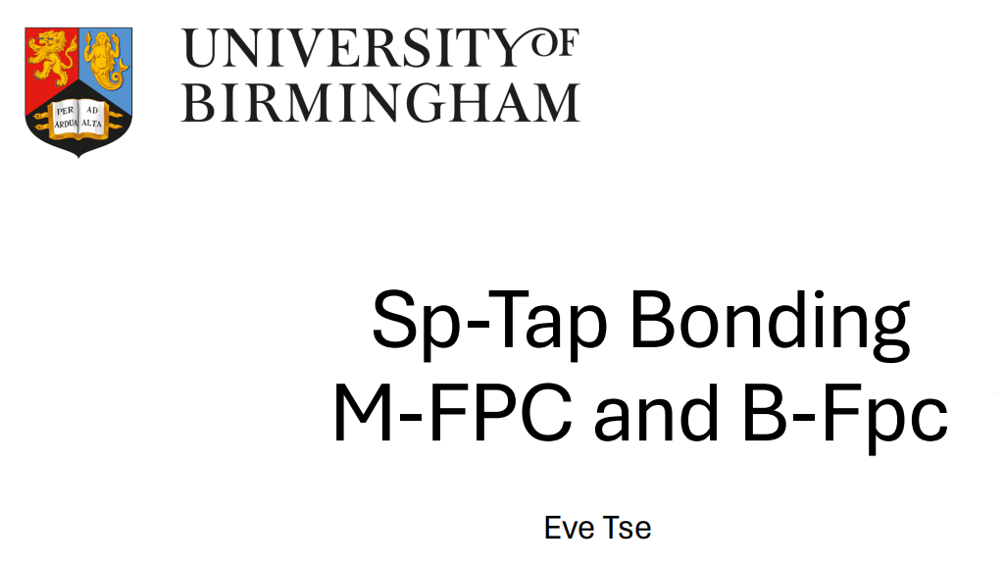
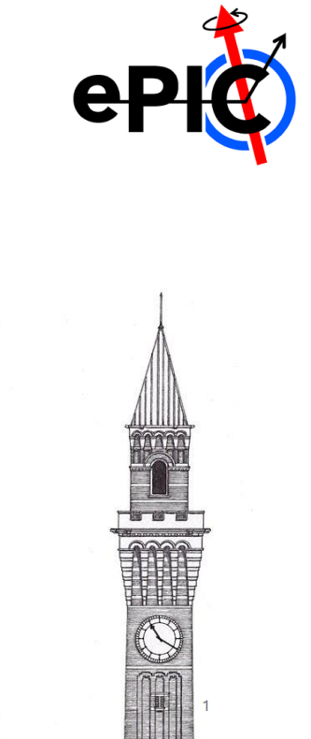
SVT DSC meeting Tue, 14th April 2026

Slide 2
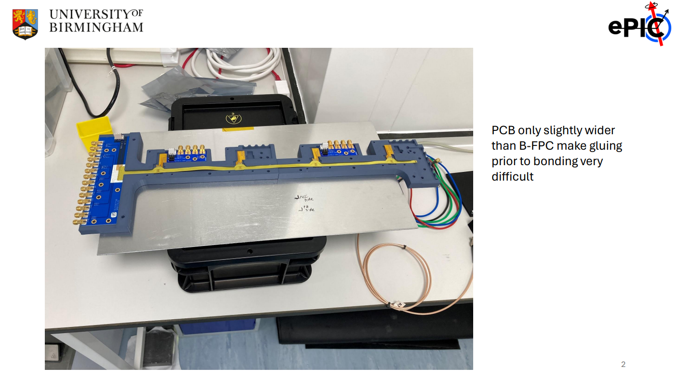
Bond pads taken up whole width of B-FPC &
Glue can get onto bond pads and jig easily
Pos 1
Pos 3
Gluing spots

Slide 3
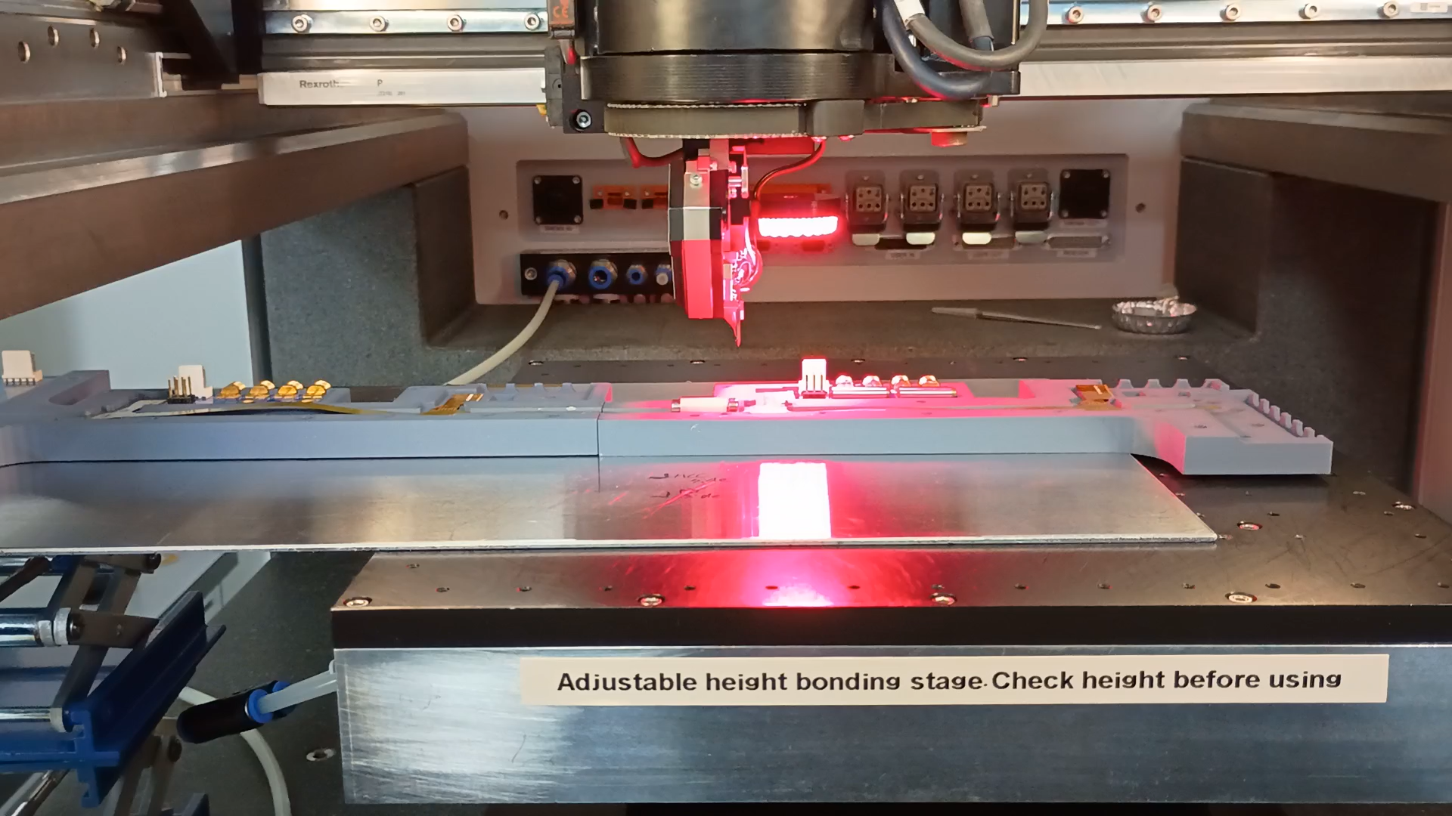
B-FPC Bonding Challenge

Slide 4
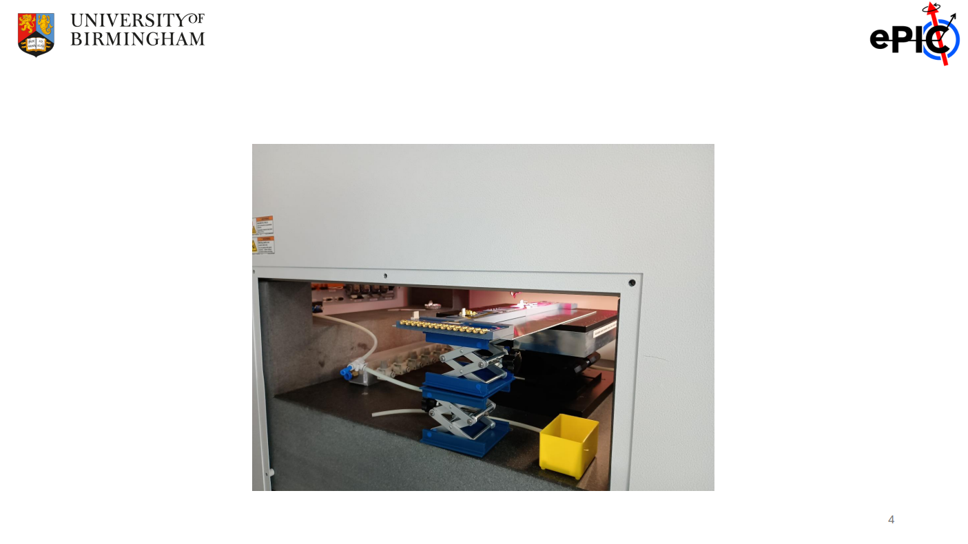
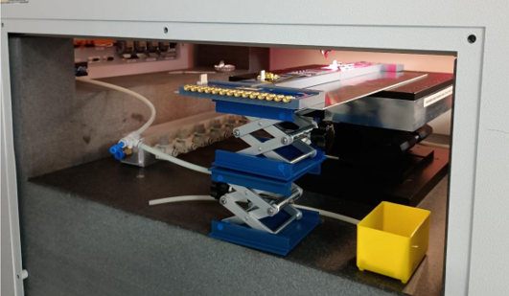
- Side Panel of the wirebonder needs to be removed - Extra support structure needs to be installed to hold the rest of free hanging FPC while bonding

Slide 5
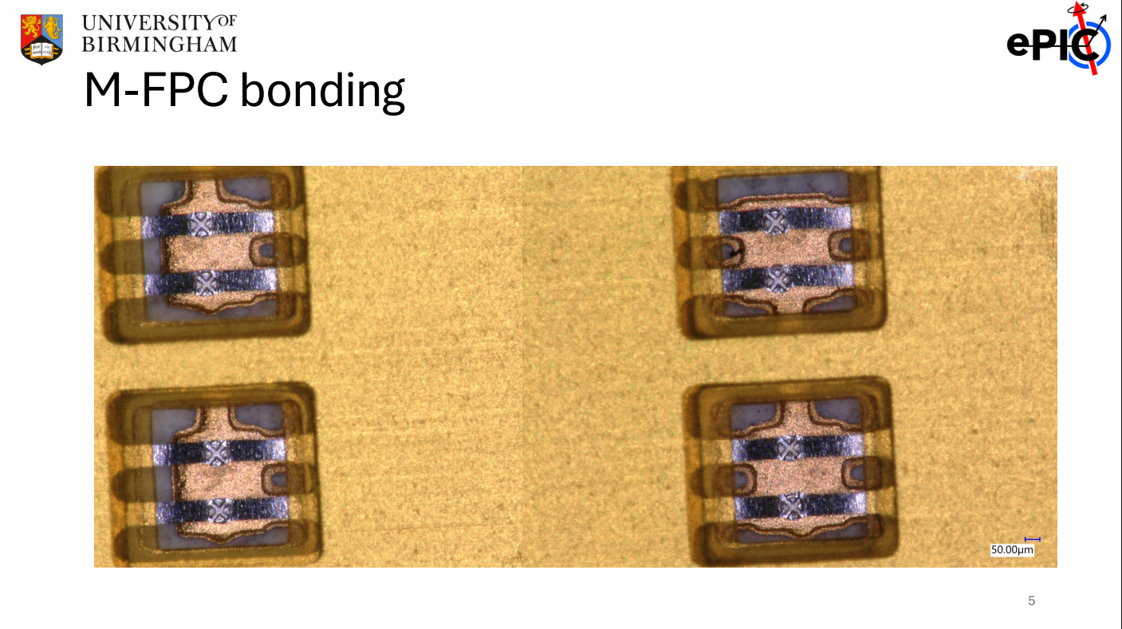
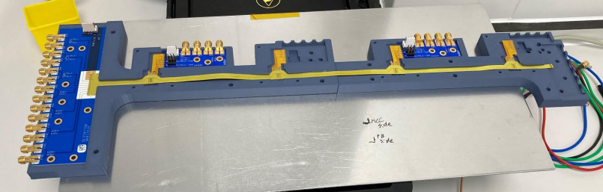
Easier gluing, better results (Pictures for all the rest of the bonds are included in back-up slides)

Slide 6
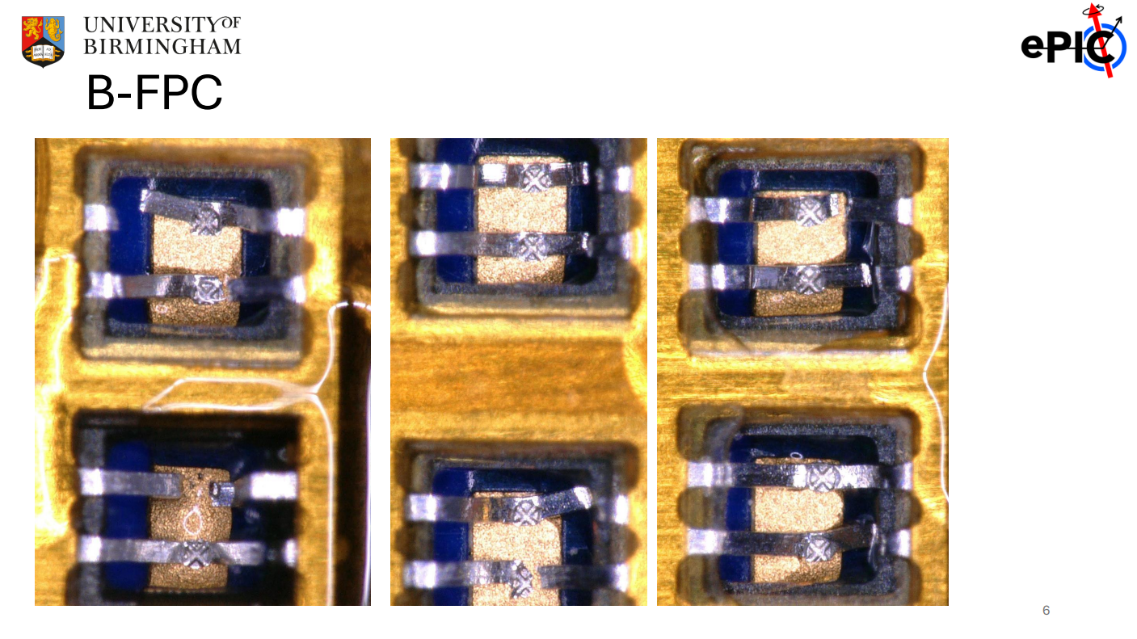
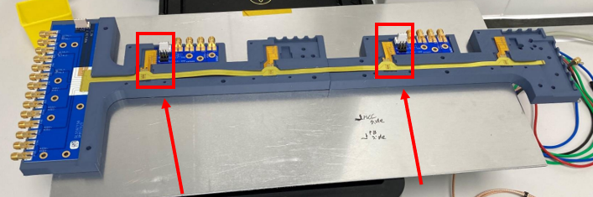
More challenging gluing, less guaranteed (Pictures for all the rest of the bonds are included in back-up slides)

Slide 7


Slide 8


Slide 9
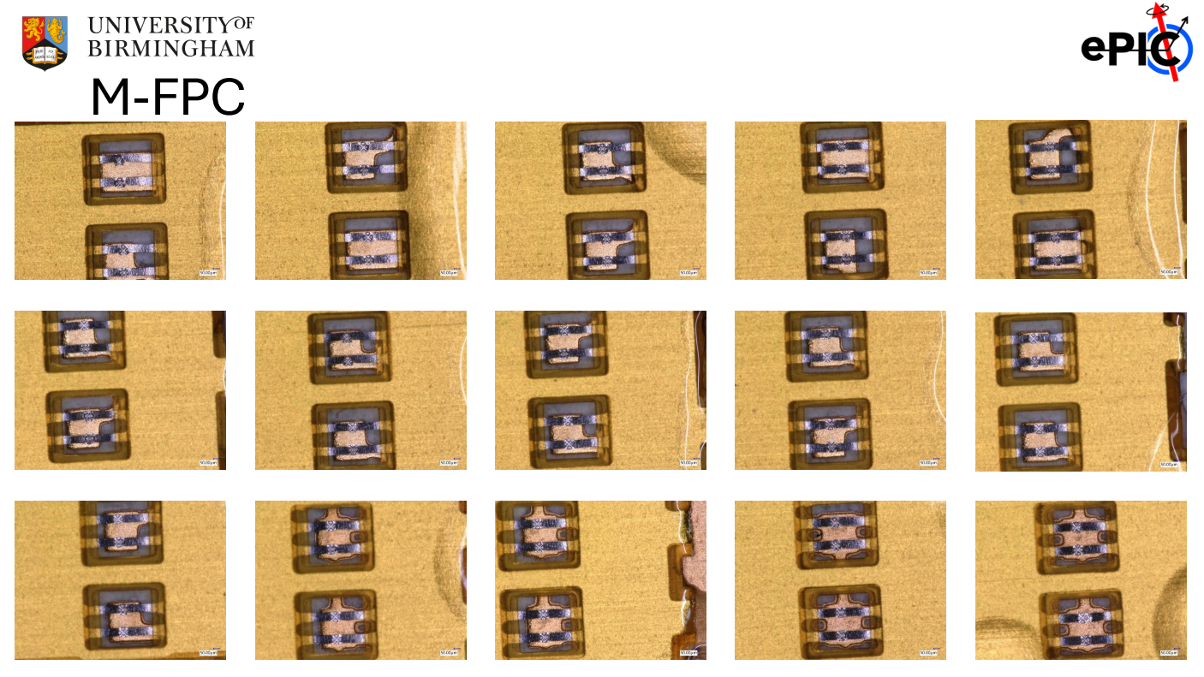

Slide 10
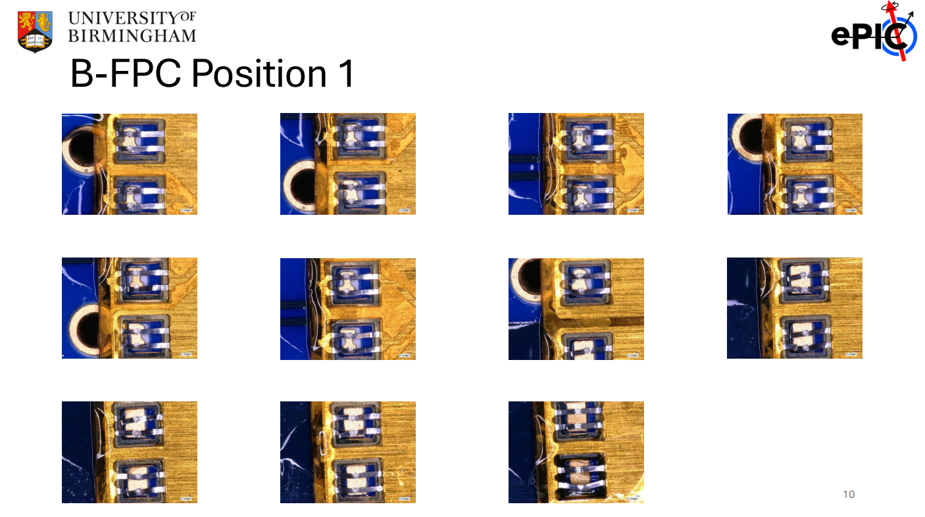
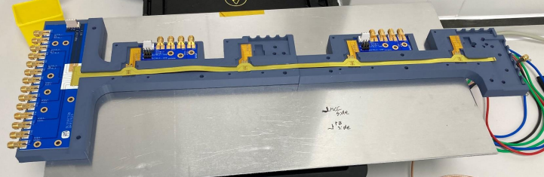

Slide 11
