Slide 1
Leaving today…
I’ll get on the road after this meeting…
I’ll be back in business on Thursday (will miss tomorrow’s meeting for a retirement party)
I accomplished my goal to have everything in a state that my physical presence is no longer necessary for the time being.
I put a travel application in for April, remains to be seen what happens. The earliest I could come is 4/19)
I had the Run Control and all set up, tested is last night. Make sense only if we are indeed running with 4 RCDAQs
I also made our Korean friends happy this morning I guess – their H2GCROC readout with rcdaq works now

Slide 2
Remaining “MLP” construction sites
Backups and data offloads
The MPOD control software (didn’t get around to it, and it’s easier to do this from home/BNL where I can test it with an MPOD before I unleash it on you)
H2GCROC start sequence is port dependent (KCU0 and KCU1, that is) – totally minor thing but still has to be done right – I know what to do
As we get closer to beam, we’ll still have tons of polishing to do, but that’s just that, polishing
We should have some meeting during the gap to get everything set up

Slide 3
Run Control
I could not fully take out all sPHENIX dependencies – it is linked with our GL1/timing system libs but we don’t use them ( the –x flag)
Run Control Setup – execute this (rc_setup.sh )
#! /bin/bash
# this is still linked with the sPHENIX gl1/gm support.
# The -x will make it not use that.
rc_server -x localhost:{0,1,2,3} > $HOME/logs/rc.log 2>&1 < /dev/null &
sleep 3
# we make the rc runnumber persistent
rc_client rc_setrunnumberApp runnumber_dispenser.sh
# and we reduce the individual rcdaqs' autonomy since RC is now calling the shots
rc_client rc_set_runcontrolmode 1

Slide 4
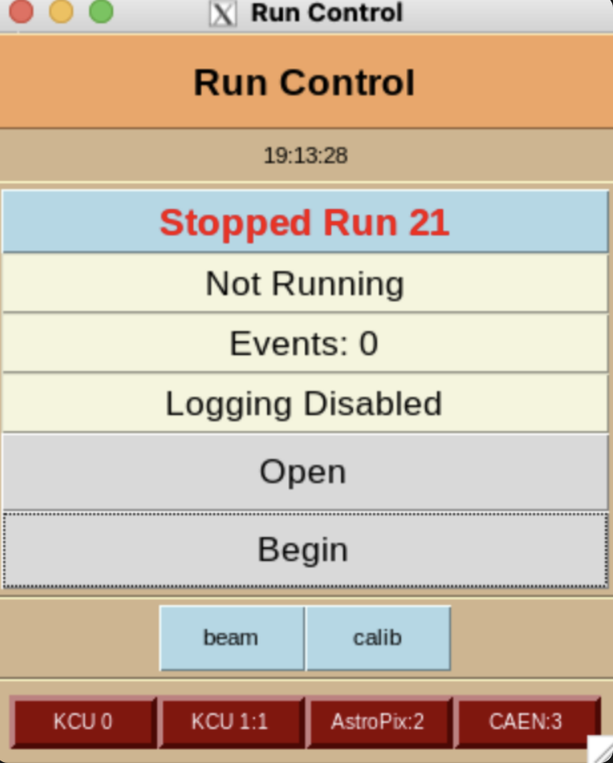
Run Control
Run Control topology
rcdaq servers
rc_server
The rc_server issues commands just like rcdaq_client does, just to all the assorted rcdaq instances at once
“daq_begin” becomes “rc_begin”, and so on

Slide 5
Run Control
Type “rc_client" to see all commands …
$ rc_client
help show this help text
rc_status [-s] [-l] display status [short] [long]
rc_accurate_status displays status with accurate event numbers
rc_open enable logging
rc_hostlist show the active hostlist
rc_get_names show the DAQ-names of the RCDAQ constituents
rc_get_gtm_name n show the name of vGTM n
rc_begin [run-number] start taking data for run-number, or auto-increment
rc_end end the run
rc_close disable logging
rc_set_pause n raise the GL1 register 7 to pasue - 1 on, 0 off
rc_get_pause get the reg 7 status
rc_gtm_prerun execute a dry run of the GTM(s) to push the modebits out
rc_set_maxevents nevt set automatic end at so many events
rc_set_runcontrolmode flag set rcdaqs to run control mode (1=on)
rc_setrunnumberfile file define a file to maintain the current run number, "None" to reset
rc_setrunnumberApp file define an App that dispenses run numbers, "None" to reset
rc_setrunnumberfile file define a file to maintain the current run number
rc_set_runtype type activate a predefined run type
rc_get_runtype [-l] list the active runtype (if any)
rc_set_runtimelimit [minutes] set the desired run length in minutes. Run ends automatically.
rc_get_runtimelimit show the run time limit nad time left
rc_get_endats [-l] a convenient way to get the convert/endat values for all vGTMs
rc_get_gtmlist in case of GTM local running, list the involved vGTMs
rc_add_host [hostname] add a host to client
rc_remove_host [hostname] remove a host from client
rc_add_hostlist [list-file] add a list of hosts to client
rc_remove_hostlist [list-file] remove a list of host from client
rc_set_mqtt_host <host> [port] set up the MQTT host/port for the DB interaction, or "none" to remove
rc_get_mqtt_host show the MQTT database interaction setting
rc_fullstatus Allow GUIs to make just one call to obtain all info they need
rc_add_beginrun_command [command] add a command to the list that gets executed at rc_begin
rc_add_endrun_command [command] add a command to the list that gets executed at rc_end
rc_remove_beginrun_command [command] remove this command from the list that gets executed at rc_begin
rc_remove_endrun_command [command] remove this command from the list that gets executed at rc_end
rc_show_beginrun_commands show the commands that get executed at rc_begin
rc_show_endrun_commands show the commands that get executed at rc_end
rc_clear_beginrun_commands clear the list of commands executed at rc_begin
rc_clear_endrun_commands clear the list of commands executed at rc_end
rc_list_runtypes [-l] list defined run types [ -l for paths]
rc_shutdown terminate the rc backend
RunControl doesn’t start any rcdaq servers, just controls existing ones

Slide 6
Run Control
Some important commands
$ rc_client
help show this help text
rc_status [-s] [-l] display status [short] [long]
rc_hostlist show the active hostlist
rc_get_names show the DAQ-names of the RCDAQ constituents
rc_begin [run-number] start taking data for run-number
rc_end end the run
rc_close disable logging
rc_setrunnumberApp file define an App that dispenses run numbers, "None" to reset
rc_add_host [hostname] add a host to client
rc_remove_host [hostname] remove a host from client

Slide 7
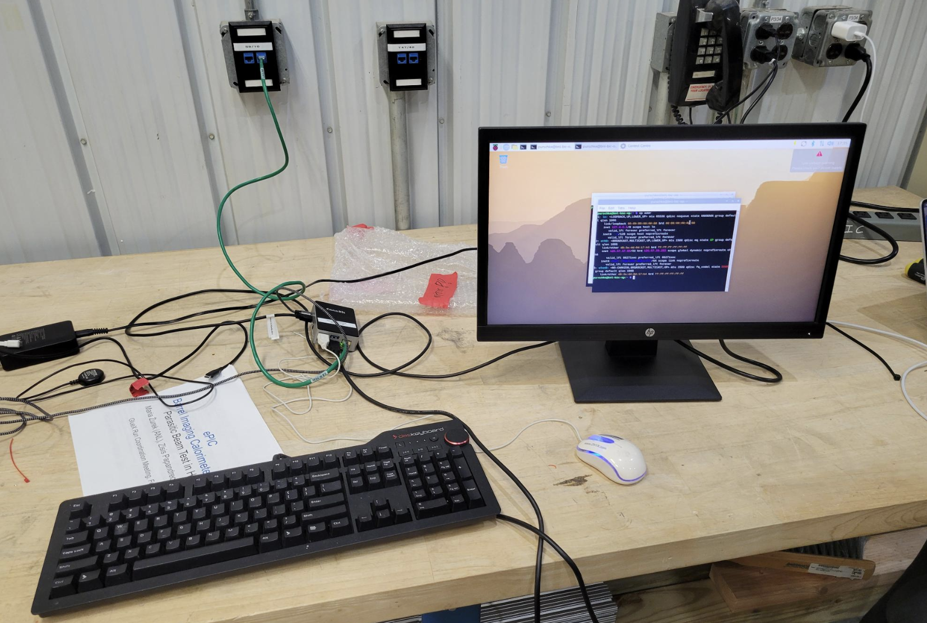
What I’m leaving behind
The bnl-daq machine. It can stay here long-term, can eventually, opportunistically come back (not BNL-property tagged)
I brought a Pi over to EEL as an operator station. Would be nice if it wouldn’t “walk” and eventually come back to me. Has a mini-HDMI -> HDMI cable.
It can take a large high-res monitor. Has a mep account the way we know it.
But I don’t have a spare USB charger (USB-C) with enough juice, and it also needs a mouse and a keyboard. Mouse in the pic is mine.
We are using Pis as operator stations in many places, better than most PCs.
So this is good-bye…

