Slide 1
Run Numbers
We would run into an issue that some rcdaqs have a large number of run numbers used up already (like 221 for the CAEN).
As we progress, and hit a run number already used, rcdaq won't start as it will refuse to overwrite an existing file.
I made it so that the rcdaqs now all use the central "runnumber_dispenser", so each run number is unique and only increments
I jumped the numbers it dishes out to 250.
So don't be alarmed if your next run number "jumps" (has already happened)

Slide 2
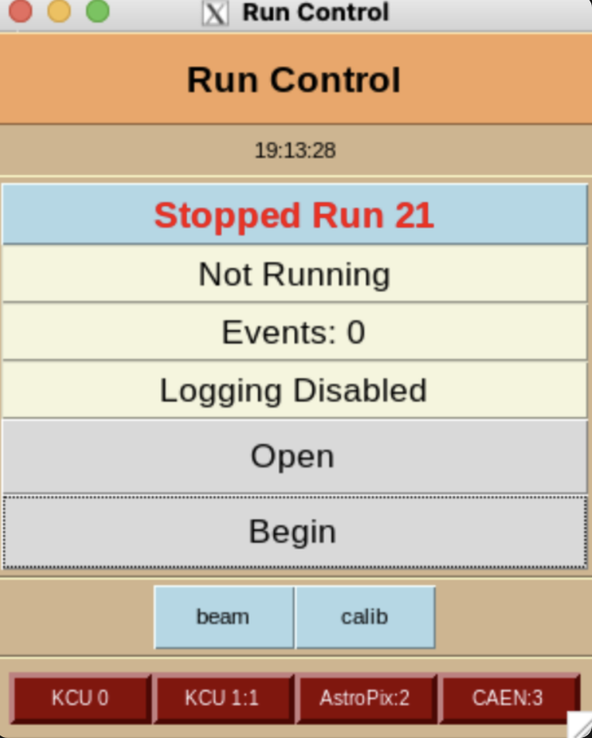
Run Control
Run Control topology
rcdaq servers
rc_server
The rc_server issues commands just like rcdaq_client does, just to all the assorted rcdaq instances at once
“daq_begin” becomes “rc_begin”, and so on

Slide 3
Run Control
I could not fully take out all sPHENIX dependencies – it is linked with our GL1/timing system libs but we don’t use them ( the –x flag)
Run Control Setup – execute this (rc_setup.sh )
#! /bin/bash
# this is still linked with the sPHENIX gl1/gm support.
# The -x will make it not use that.
rc_server -x localhost:{0,1,2,3} > $HOME/logs/rc.log 2>&1 < /dev/null &
sleep 3
# we make the rc runnumber persistent
rc_client rc_setrunnumberApp runnumber_dispenser.sh
# and we reduce the individual rcdaqs' autonomy since RC is now calling the shots
rc_client rc_set_runcontrolmode 1

Slide 4
Run Control Mode
Keep in mind that when running under run control, the rcdaqs get the “run control mode” enabled, so they don't make their own run numbers (and their autonomy is reduced in other ways, b/c RC is now the boss).
In run control mode (see, e.g. for the CAEN) with
rcdaq will not make its own run numbers, so a standard “daq_begin” (without run number parameter) will fail
Relieve it from run control mode by
$ RCDAQHOST=:3 daq_status -l
carbon:3 - running
Run Number: 221
Event: 23327
Run Volume: 559.319 MB
< lines deleted >
Run Control Mode enabled
$ daq_begin
carbon:3 - No automatic Run Numbers in Run Control Mode
$ RCDAQHOST=:3 daq_set_runcontrolmode 0

Slide 5
Run Control
Type “rc_client" to see all commands …
$ rc_client
help show this help text
rc_status [-s] [-l] display status [short] [long]
rc_accurate_status displays status with accurate event numbers
rc_open enable logging
rc_hostlist show the active hostlist
rc_get_names show the DAQ-names of the RCDAQ constituents
rc_get_gtm_name n show the name of vGTM n
rc_begin [run-number] start taking data for run-number, or auto-increment
rc_end end the run
rc_close disable logging
rc_set_pause n raise the GL1 register 7 to pasue - 1 on, 0 off
rc_get_pause get the reg 7 status
rc_gtm_prerun execute a dry run of the GTM(s) to push the modebits out
rc_set_maxevents nevt set automatic end at so many events
rc_set_runcontrolmode flag set rcdaqs to run control mode (1=on)
rc_setrunnumberfile file define a file to maintain the current run number, "None" to reset
rc_setrunnumberApp file define an App that dispenses run numbers, "None" to reset
rc_setrunnumberfile file define a file to maintain the current run number
rc_set_runtype type activate a predefined run type
rc_get_runtype [-l] list the active runtype (if any)
rc_set_runtimelimit [minutes] set the desired run length in minutes. Run ends automatically.
rc_get_runtimelimit show the run time limit nad time left
rc_get_endats [-l] a convenient way to get the convert/endat values for all vGTMs
rc_get_gtmlist in case of GTM local running, list the involved vGTMs
rc_add_host [hostname] add a host to client
rc_remove_host [hostname] remove a host from client
rc_add_hostlist [list-file] add a list of hosts to client
rc_remove_hostlist [list-file] remove a list of host from client
rc_set_mqtt_host <host> [port] set up the MQTT host/port for the DB interaction, or "none" to remove
rc_get_mqtt_host show the MQTT database interaction setting
rc_fullstatus Allow GUIs to make just one call to obtain all info they need
rc_add_beginrun_command [command] add a command to the list that gets executed at rc_begin
rc_add_endrun_command [command] add a command to the list that gets executed at rc_end
rc_remove_beginrun_command [command] remove this command from the list that gets executed at rc_begin
rc_remove_endrun_command [command] remove this command from the list that gets executed at rc_end
rc_show_beginrun_commands show the commands that get executed at rc_begin
rc_show_endrun_commands show the commands that get executed at rc_end
rc_clear_beginrun_commands clear the list of commands executed at rc_begin
rc_clear_endrun_commands clear the list of commands executed at rc_end
rc_list_runtypes [-l] list defined run types [ -l for paths]
rc_shutdown terminate the rc backend
RunControl doesn’t start any rcdaq servers, just controls existing ones

Slide 6
Run Control
Some important commands
$ rc_client
help show this help text
rc_status [-s] [-l] display status [short] [long]
rc_hostlist show the active hostlist
rc_get_names show the DAQ-names of the RCDAQ constituents
rc_begin [run-number] start taking data for run-number
rc_end end the run
rc_close disable logging
rc_setrunnumberApp file define an App that dispenses run numbers, "None" to reset
rc_add_host [hostname] add a host to client
rc_remove_host [hostname] remove a host from client

Slide 7
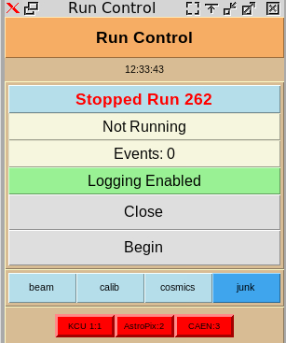
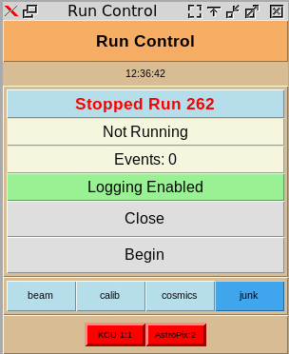
Run Control
The startup script I showed a minute ago lines up all 4 RCDAQs
From last night, we Bobae went to first 2, then 3, this is what is is an hour ago –
Just to show this, I removed the CAEN:
I then added it again..
(base) mep@carbon:~$ rc_hostlist
localhost:1 localhost:2 localhost:3
(base) mep@carbon:~$ rc_remove_host localhost:3
(base) mep@carbon:~$ rc_hostlist
localhost:1 localhost:2
(base) mep@carbon:~$

Slide 8
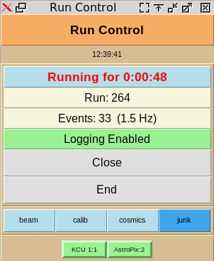
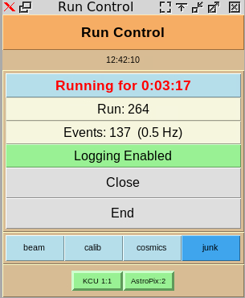
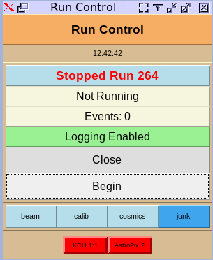
Starting and ending runs
As with RCDAQ, in RunControl you can either give commands, or click on the GUI
I have been going on at length about stateless GUIs, so you can any number of them
Here I’m using the command to start:
And I click on the GUI to end again -
(base) mep@carbon:~$ rc_begin
carbon:1 - Run 264 started
carbon:2 - Run 264 started
(base) mep@carbon:~$

Slide 9
Backups
Last night I backed up all data files we have taken so far to BNL for safekeeping
Only select few would be able to access them there, so it’s just a backup
I’ll do this each night
I also made a backup of the carbon system disk, just in case (this is sort of static unless we install more software)
I also back up the entire home disk, can do every day, too.

