Slide 1
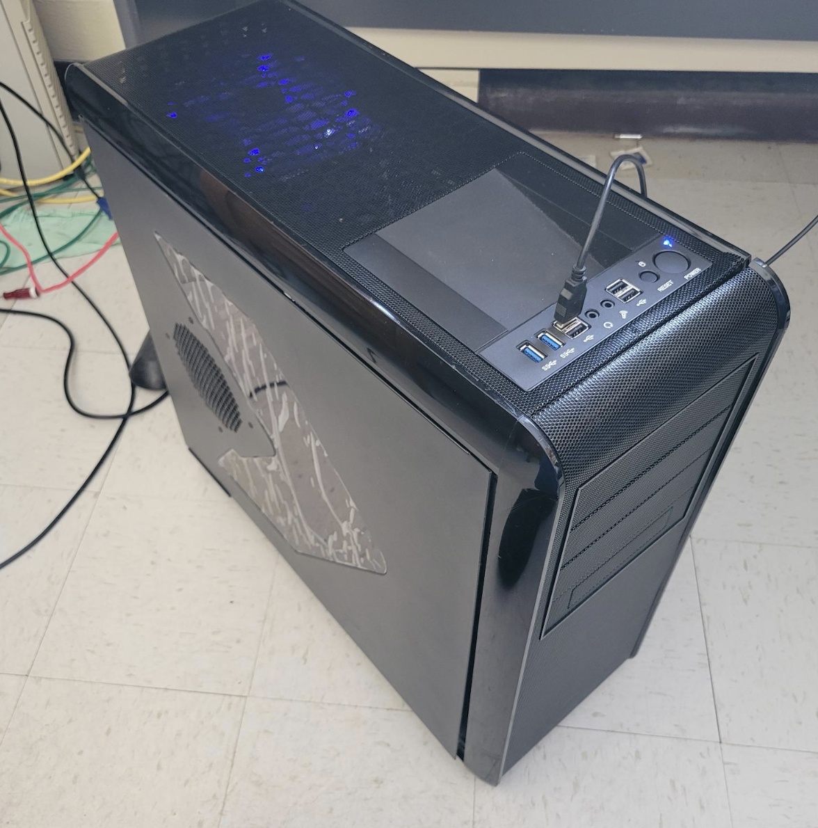
Computing and DAQ infrastructure
We will take what Alexander termed the “monster PC”
currently in the EmCal (Sean’s) lab as “eicdaqcern” aka 192.168.60.122
Has 4x8TB disks for 23TB usable
Alexander asked to move it to 2-198, will do after some hardware additions, easier to work on it where it is now
All software that is on the magnet test machine is on there, too
Not sure about the status of the Dream – I haven’t touched that in years
I’ll add a 4-port Gig ethernet card, will pack a single one, too
It still needs a CAEN PCIe interface
But other than that it’s ready to go.
Vnc is there, I switched to a different windows manager (icewm)
Less eye-candy, but less finnicky and amenable to multiple servers

Slide 2
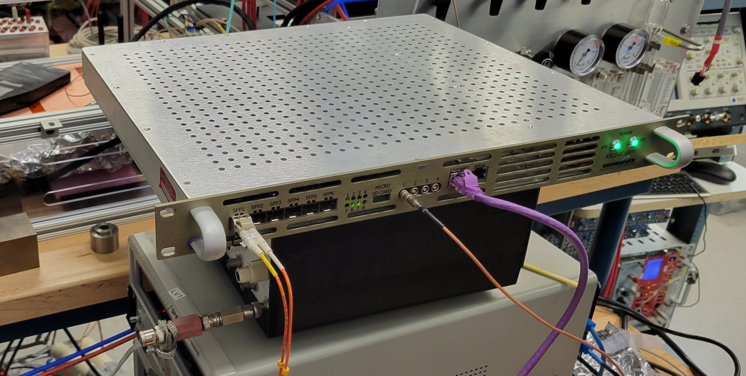
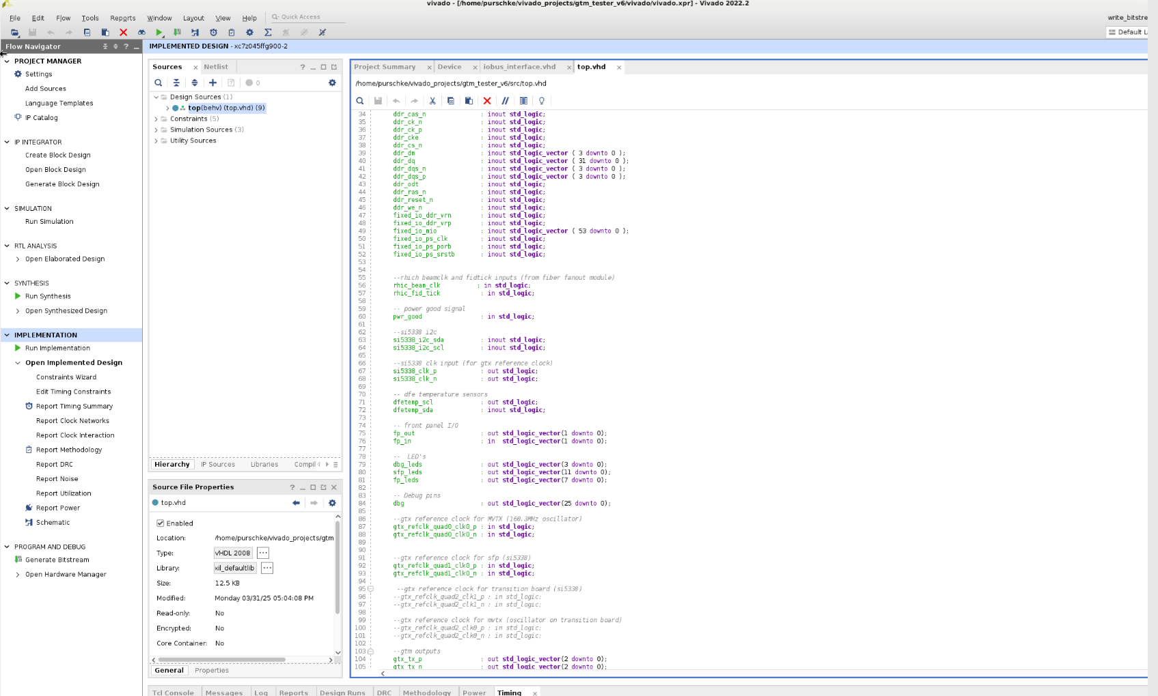
Busy latch
I have a number of sPHENIX “GL1/GTM” prototypes, BNL-grown 1U FPGA boards
Those look like the best and easiest path to getting a meaningful busy latch
They have 2 built-in TTL ins and outs, and many (>50) 3.3V-grade headers.
They are Zynq-based, meaning that the FPGA has built-in ARM CPUs that run Linux
The CPU has access to registers in the FPGA fabric to configure / take action
I have in the past modified existing firmware so it does what I need
So far I have only found time to “warm up” my SDK again so I can get started (re-built one of my earlier mods)
The idea is that a signal sets a busy latch, busy latch going high is sending our trigger, latch is getting reset by RCDAQ when readout is complete
I have made “almost working” firmware, needs a few enhancements to be able to set the initial conditions, like preset high, or take it low with a command
And then I need to see how fast we can go with this, that is, measure the latency to programmatically reset the latch.

