Slide 1

DESY Test Beam
Strip Sensor
Satoshi YANO
Hiroshima University

Slide 2
Desy Test Beam @ Dec. 2025
Schedule: Dec. 15 ~ 21
Goal: first real strip-type sensor + full-size pixel-type sensor
  Measurement of timing and positioning resolution
  HV-scan for strip type sensor
DUT readout: 2 x CAEN DT5742 (500MHz, 5GS/s, 16ch)
  No timing reference detector
  Time differences between sensors for timing resolution measurement
Telescope: DESY MIMOSA26 tracker (6layer, σ~2um)

Slide 3
Setup for Strip-Type AC-LGAD
EUDRBs
Telescope DAQ PC
DUT DAQ PC
20 mm
DIGITIZER
DIGITIZER
32 mm
~11 mm
~4 mm
BUSY
AC-LGAD
TRIGGER
Scintillator
AC-LGAD
Scintillator
AC-LGAD
Scintillator
Wire-Bonded Area
MIMOSA Area Tracker
COINCIDENCE
Used fully independent DAQ is used
Synchronized them by NIM Modules
TLU
TRIGGER

Slide 4
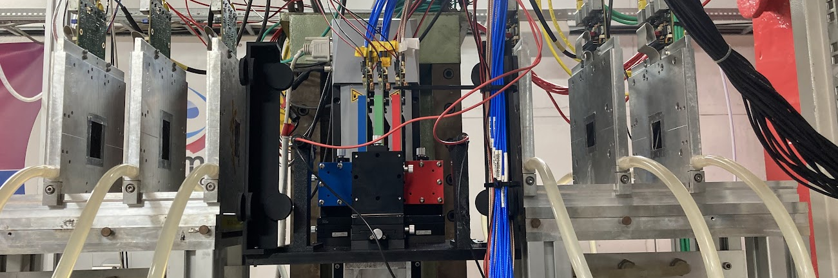
Beam
TRIGGER2＆3
MIMOSA26
DUT
MIMOSA26
TRIGGER1

Slide 5
Readout Strategy
2 configurations are used for focusing on hit position resolution and timing resolution measurements
  Timing resolution(pattern-2): use three sensors with 10 (5+5) channels each
  Positioning resolution (pattern-3): use two sensors with 15 (7+8) channels each readout
  (Rough) Timing reference: Trigger raw signal into each digitizer
Pattern-2
Timing Measurement
Digitizer1
Pattern-3
Positioning Measurement
Digitizer1
7 rows
5 rows
Digitizer0
Digitizer0
8 rows
5 rows
Beam penetrates one digitizer
↓
Remove jitter between two digitizers
One sensor readout by one digitizer
↓
Remove mis-calibration between two digitizer

Slide 6
Clustering
Exclude event with the leading strip on edge
  Hit beam outside of the acceptance
  Timing calibration is not enough for timing resolution measurement
    Trigger signal is used as timing reference
Timing Window
Cut for leading strip
After leading strip cut

Slide 7
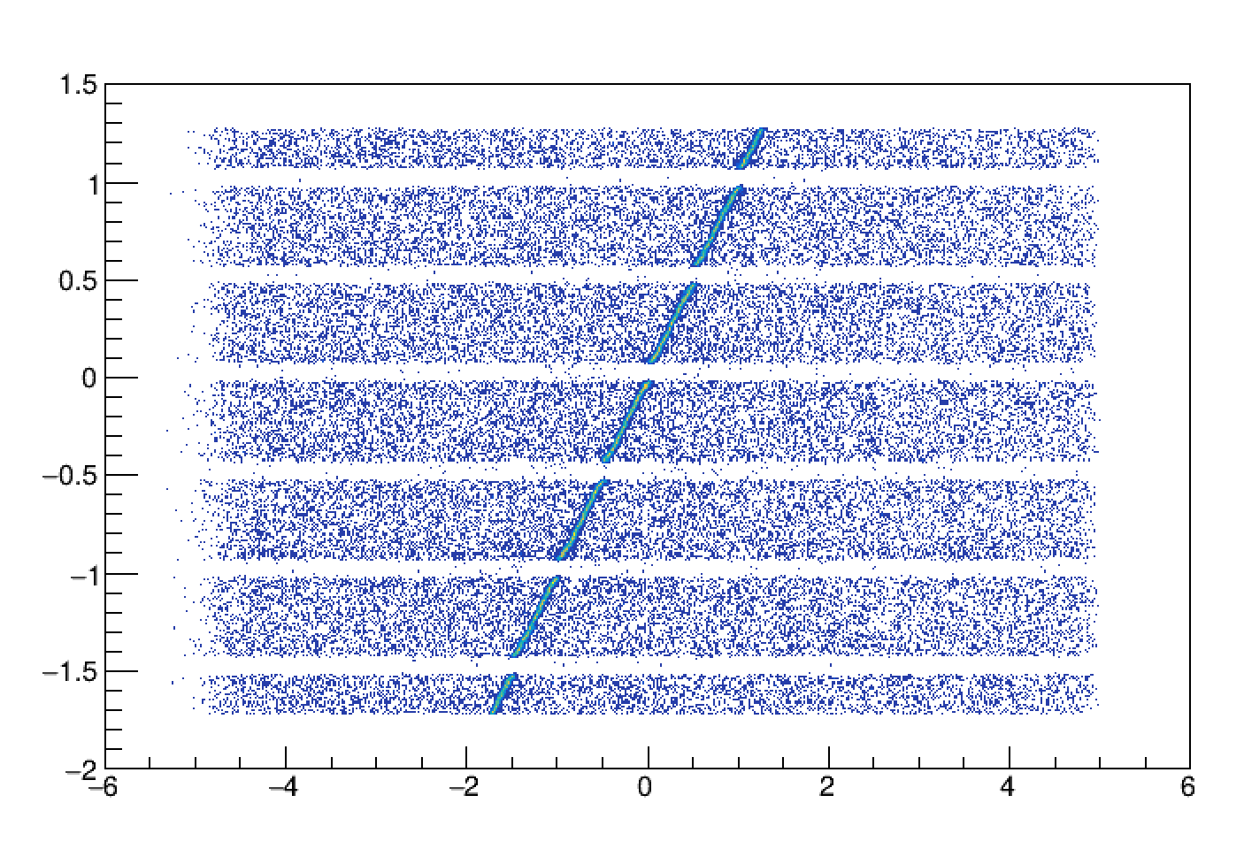
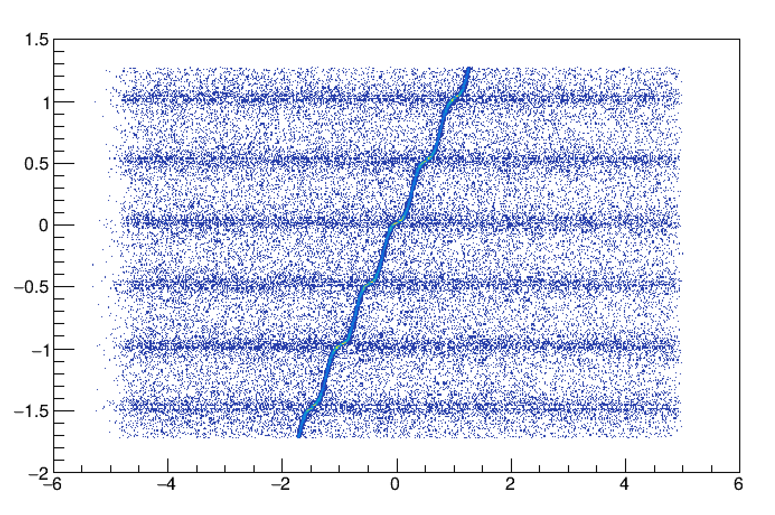
Simple Hit Position Reconstruction
Weighted and Squared-weighted method has been performed
Top-2 amplitude (leading and sub-leading) strips are used
Weighted
Squared-Weighted
ACLGAD Rec Position [mm]
ACLGAD Rec Position [mm]
Global Track Position [mm]
Global Track Position [mm]

Slide 8
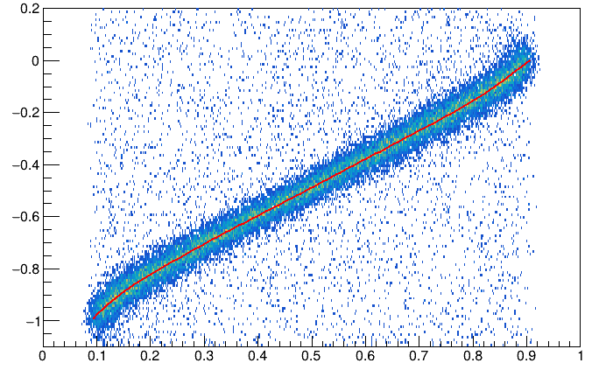
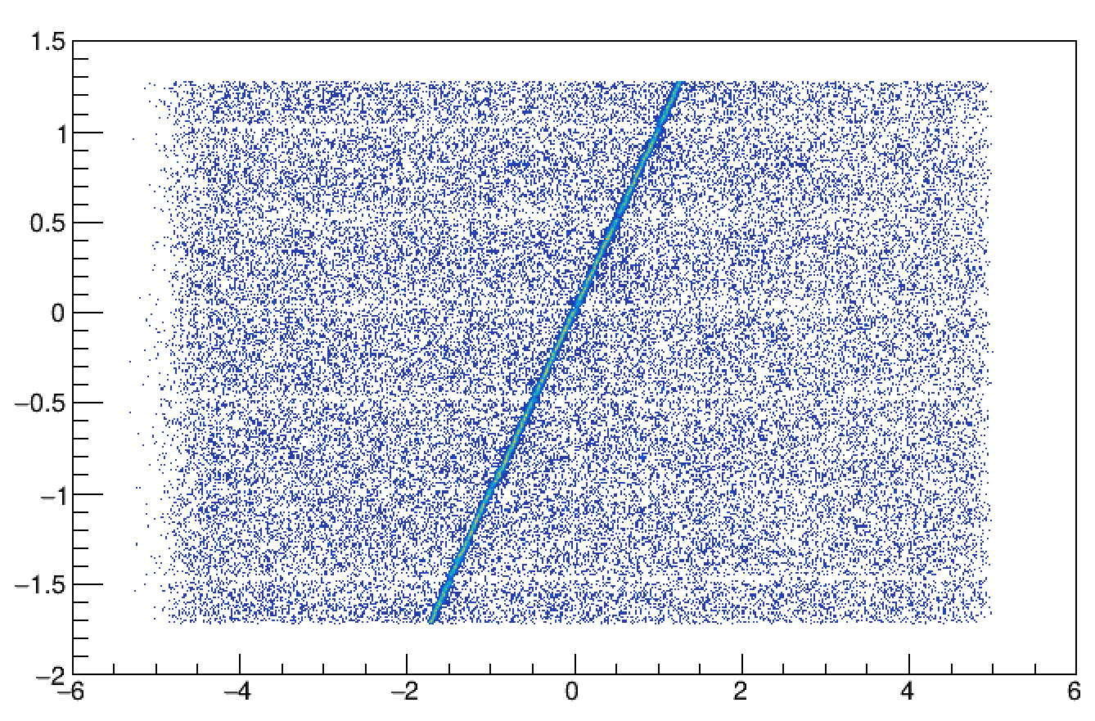
Track-Based η Correction
y_{left}
y_{track}
y_{right}
Eta v.s. utrack (leading and sub-leading strips)
  η = Q_{right} / (Q_{left} + Q_{right})
  utrack = (y_{track} - y_{right}) / strip-pitch
Q_{left}
Q_{right}
Strip Pitch
ACLGAD Rec Position [mm]
  utrack = (y_{track} - y_{right}) / strip-pitch
Sensor0
Sensor2
Each sensor eta distribution is not same
↓
Each character should be known
  η = Q_{right} / (Q_{left} + Q_{right})
Global Track Position [mm]

Slide 9
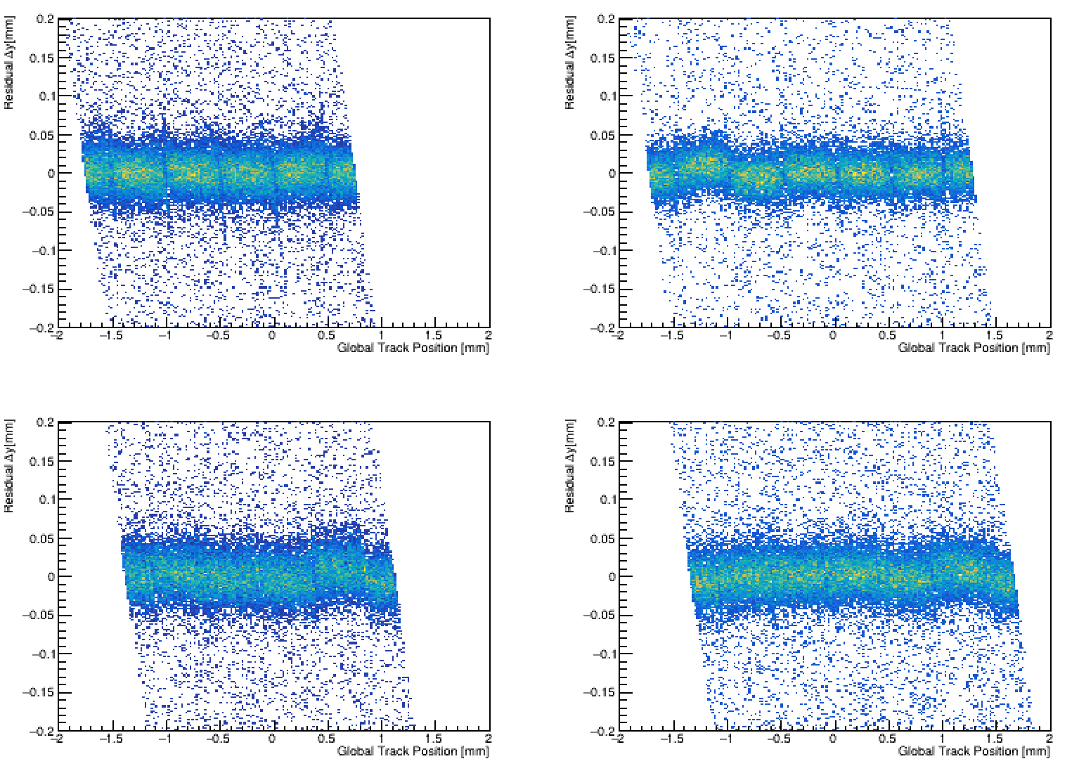
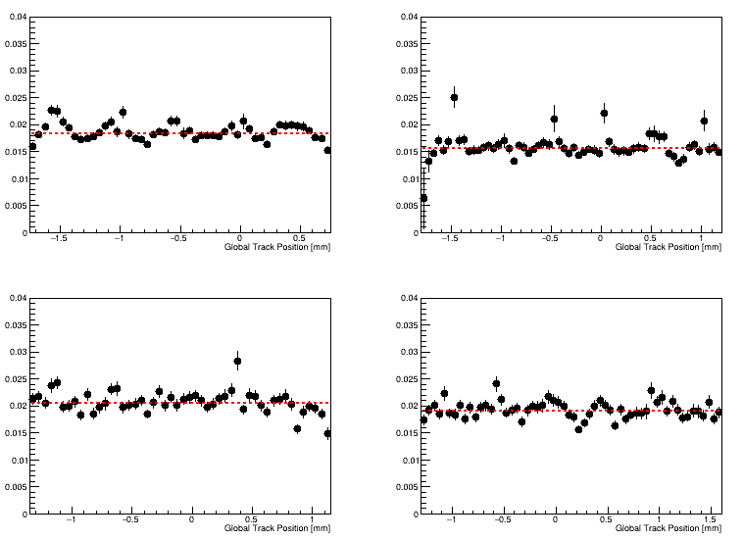
Reconstructed Hit Position
Residual (Track position – ACLGAD position) as a function of global position has been calculated
  Track-Based η correction has been applied
Positioning resolution (including tracking resolution) achieves <20 um
  Sensor2 gets worse resolution due to multiple scattering by the Sensor0 and Sensor1
  Sensor#0 - col0
  Sensor#0 – col1
Sensor0, Col0
Sensor0, Col1
Δy = 18.3±0.1 um
Δy = 15.5±0.1 um
Resolution [mm]
  Sensor#1 - col0
  Sensor#1 – col1
Sensor2, Col0
Sensor2, Col1
Δy = 20.4±0.1 um
Δy = 19.0±0. 1 um
Resolution [mm]

Slide 10
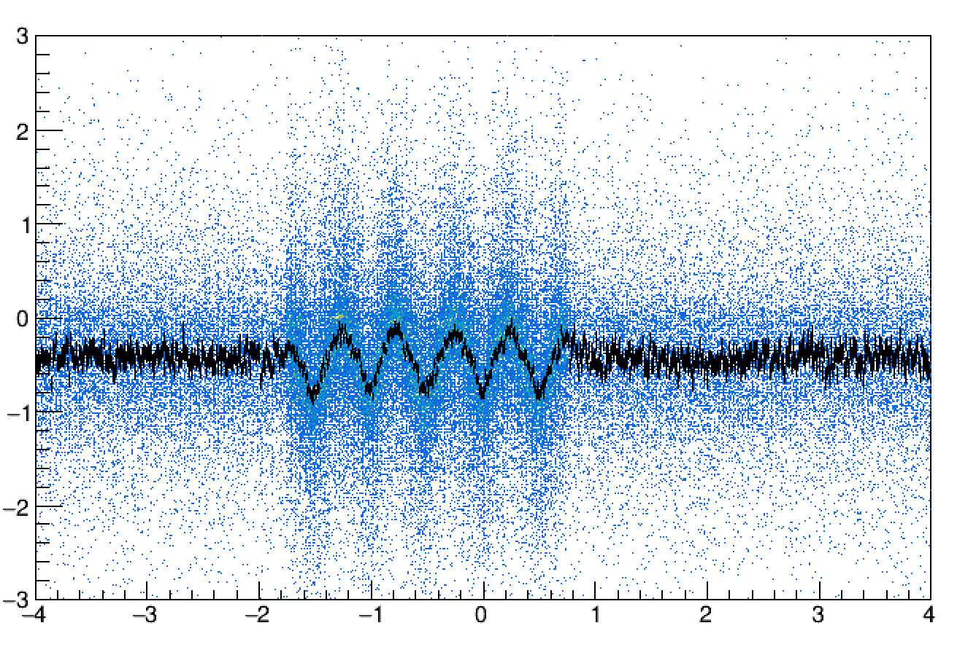
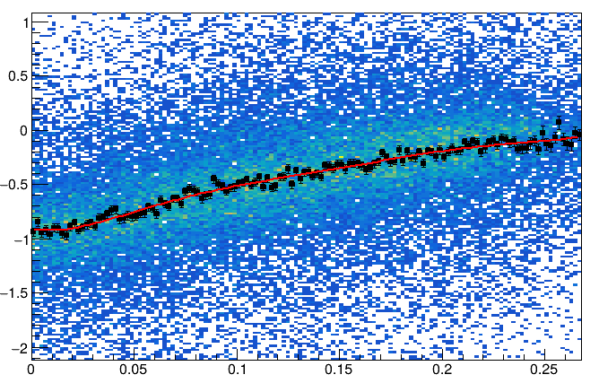
Signal Arrival Time Delay Inter Strips
y_{leading}
y_{track}
y_{sub-leading}
Signal delay is observed in row direction
  This came as a surprise to me
  Maximum 1ns delay at 250um gap between strips
TOA_{leading}
TOA_{sub-leading}
Middle of
strips
TOA_{leading} - TOA_{sub-leading} [ns]
TOA_{leading} - TOA_{sub-leading} [ns]
Y_{track} [mm]
Y_{leading} – Y_{track} [mm]

Slide 11
Summary
The positioning resolution of ~20um can be achieved
  The first layer of the sensor is better resolution due to less material
It has been found that there are individual differences in eta distribution
  To achieve equivalent performance, it is necessary to understand the eta distribution of each sensor
Signal delay between adjacent strips has been reduced to 1 ns
  Tracking performance possibly affects TOF timing resolution performance much

Slide 13
Statistics of Test-Beam @ DESY 2025
Statistics (Triggered Event)
  Nominal HV Run
    5.6 GeV
    3 Class-S Sensors: 10ch/10ch/10ch (Pattern-2)
    All 185V: ~2x10⁶
  HV Scan Run
    5.6 GeV
    3 Class-S Sensors: 10ch/10ch/10ch (Pattern-2)
    Side 185V + Middle 175V/160V/150V: ~2x10⁶ each
  Positioning Measurement Run
    5.6 GeV
    2 Class-S Sensors: 15ch/15ch (Pattern-3)
    185V: ~2x10⁶
  Class-C Sensor Run
    5.6 GeV
    3 Class-S Sensors: 10ch/10ch/10ch (Pattern-2)
    160V: ~2x10⁶
  Low Energy Run
    3.6 GeV
    3 Class-S Sensors: 10ch/10ch/10ch (Pattern-2)
    All 185V: ~12 x10⁶
  Low Energy HV 200V Run
    3.6 GeV
    3 Class-S Sensors: 10ch/10ch/10ch (Pattern-2)
    All 200V: ~12 x10⁶

Slide 14
News
FCFD baseline design will be changed officially
  64x2 = 128 ch / chip → 32x1 = 32 ch / chip
    4 ASICs per sensor
  Interposer will not be necessary anymore, but module structure should be still necessary for the assembly point of view
Example picture
Module≒Stavelet

Slide 15
Schedule (Calendar Year)
2026
2027
2028
2029
2030
2031
2032
2033
CD2
CD3
Install
>60%
>90%
FCFDv1.2
FCFDv2
Preproduction
10%
Production
90%
Today
CD-2: Baseline Approval (~60% maturity)
CD-3: Construction Start (~90% maturity)

Slide 16
Important Subject in JFY26
FPC: Current Maturity < 10%
  STEP1: FPC feasibility study by simulation
  STEP2: (Best guess) FPC first design (using EICROC, HGCROC or CALOROC?)
  STEP3: FPC manufacturing
  STEP4: Tets (Visual Inspection & Measurement)
FCFD: Current Maturity ~ 50%
  FCFDv1.1 (digital) is available now
  FCFDv1.2 (analog + digital) will be available this summer

Slide 17
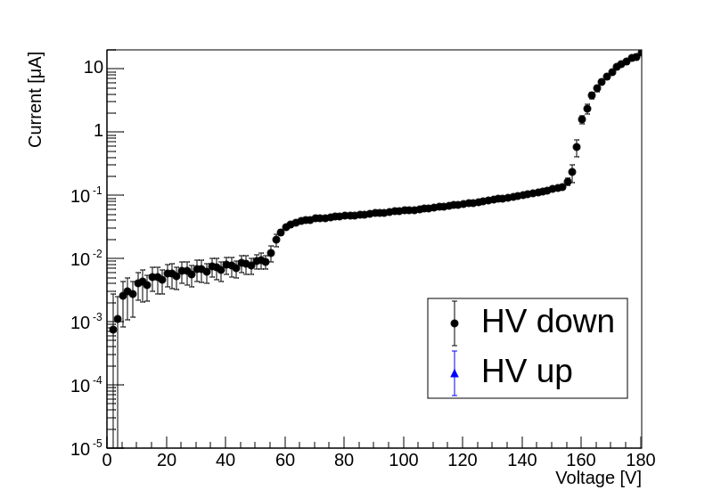
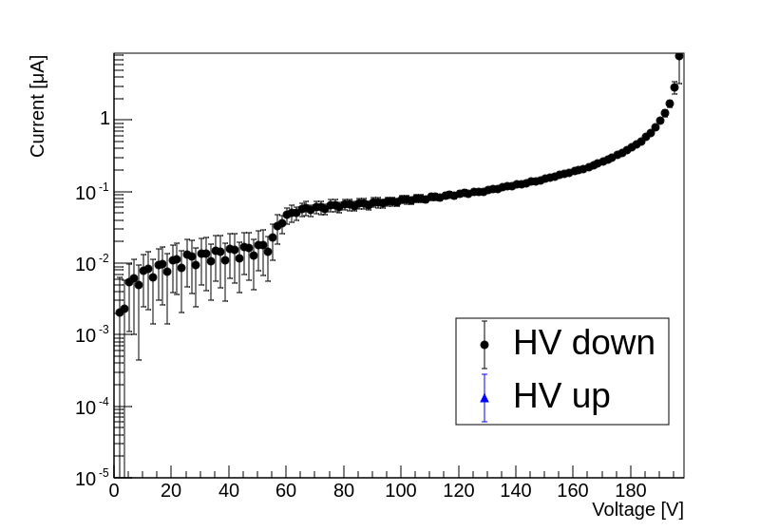
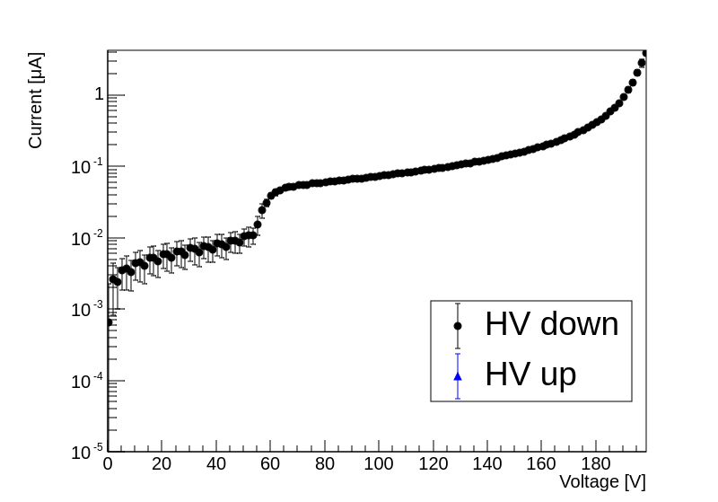
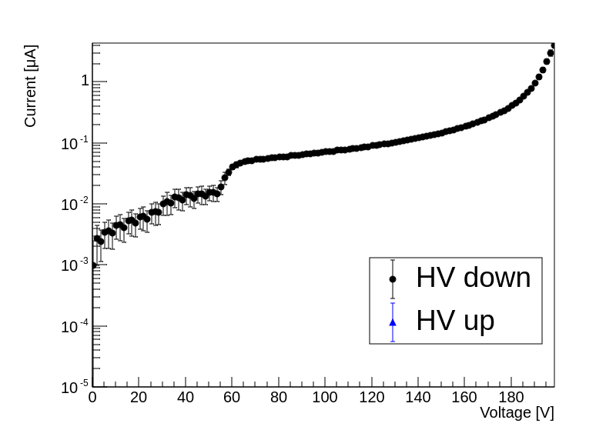
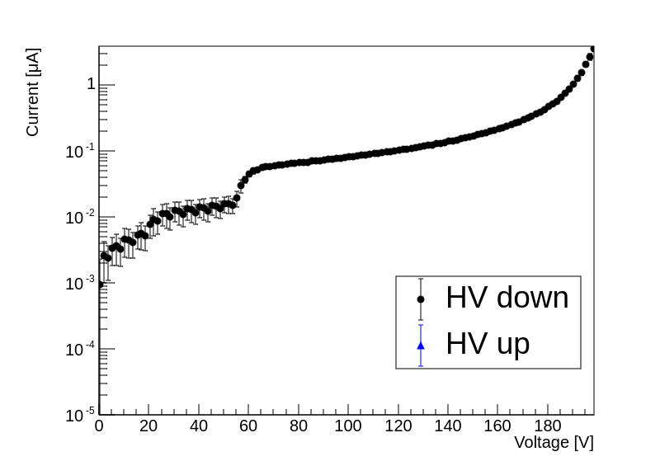
Baseline Strip Sensors
Five sensors have been bonded
Classified by voltage value at which leak current reaches 1μA
  4 Class-S (1μA @ BV>=190V)
  1 Class-C (1μA @ 160<BV<170V)
Class-C
Class-S
Class-S
Class-S
Class-S

