Slide 1
Resolution analysis of BTOF

Slide 2
Background
Currently, pixel pitch is 1/5 the physical size to mimic correct position resolution for tracking.
Wanted to increase pixel size back to physical size, but we also want position resolution to be correct.
Need to re-enable clustering algorithm.

Slide 3
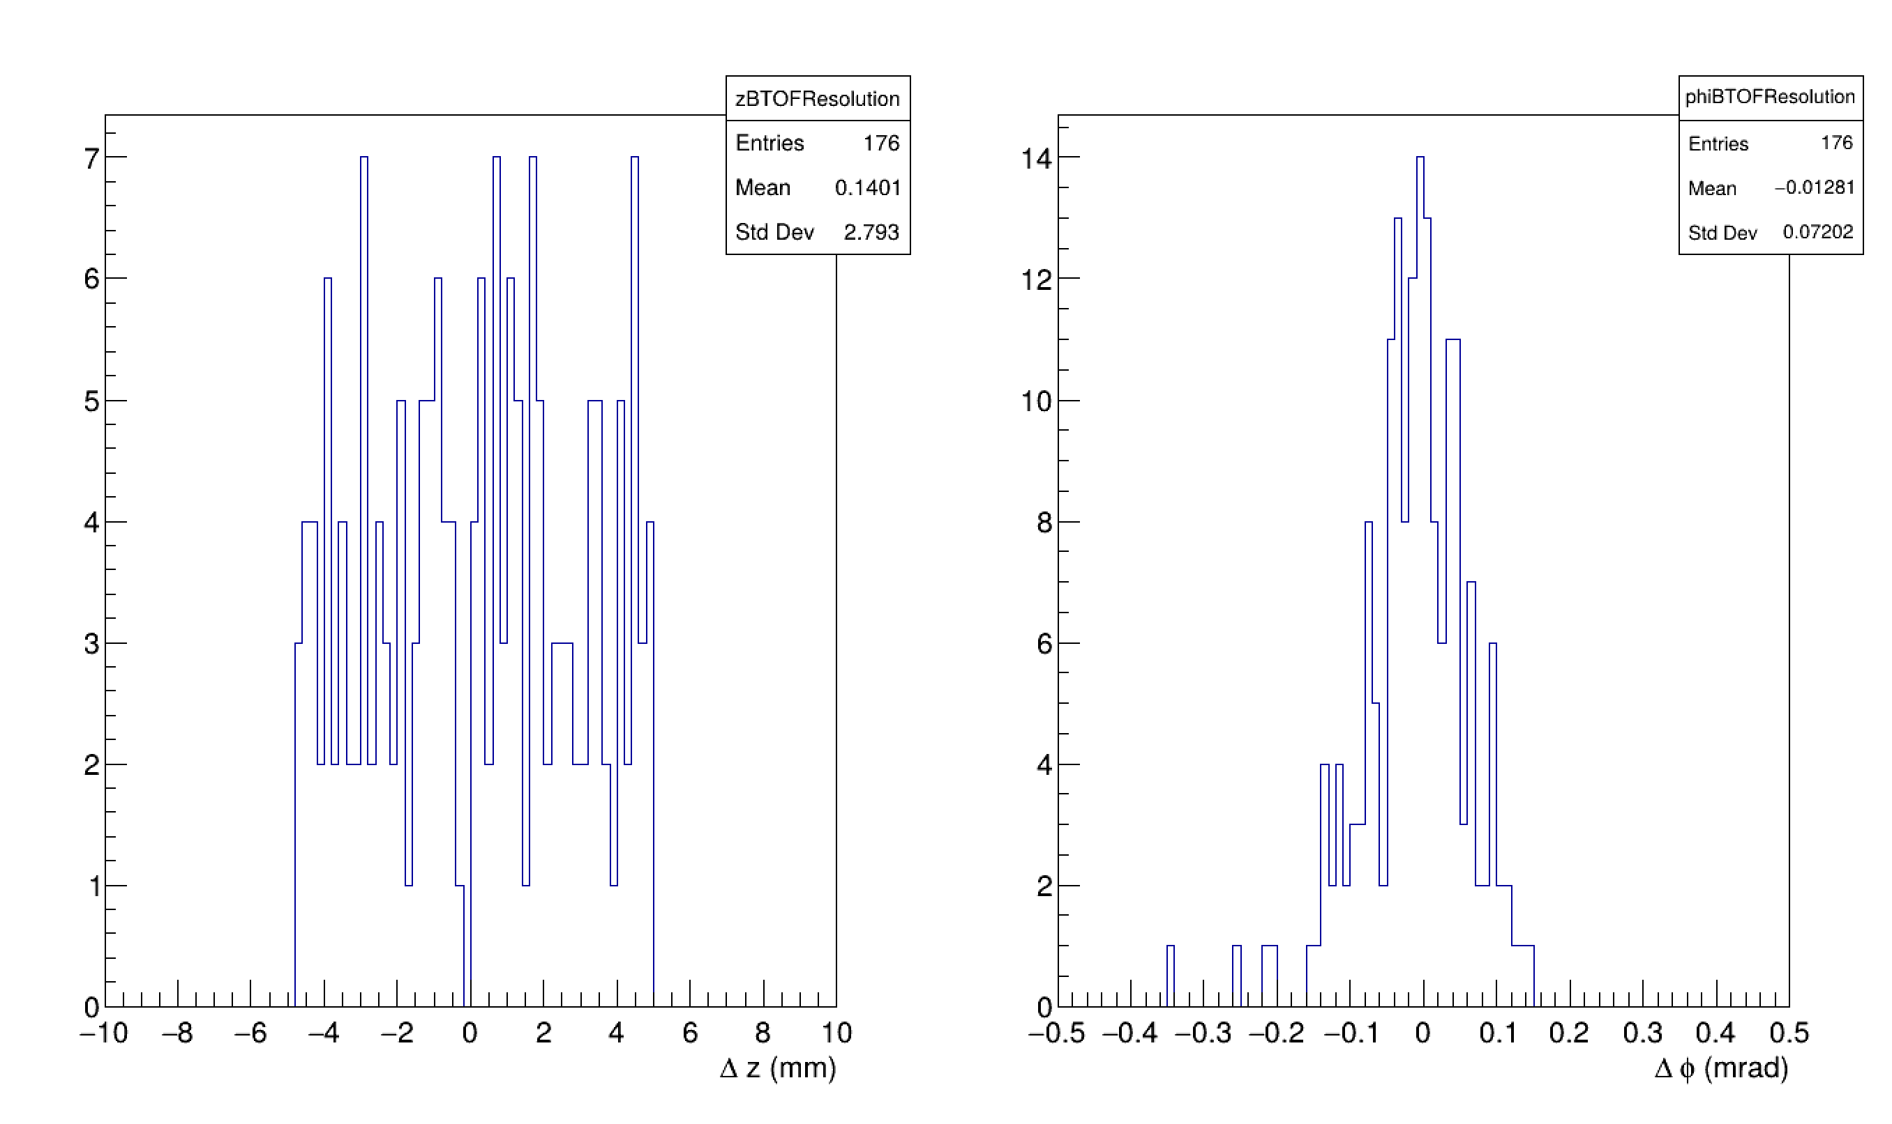
Main-branch (pixel pitch 1/5 the realistic size) No charge-sharing and clusterization
Phi resolution = 0.07 rad
Entries = 176
MC hit points = 219
Efficiency ~ 80%
Delta = MC_truth – reco

Slide 4
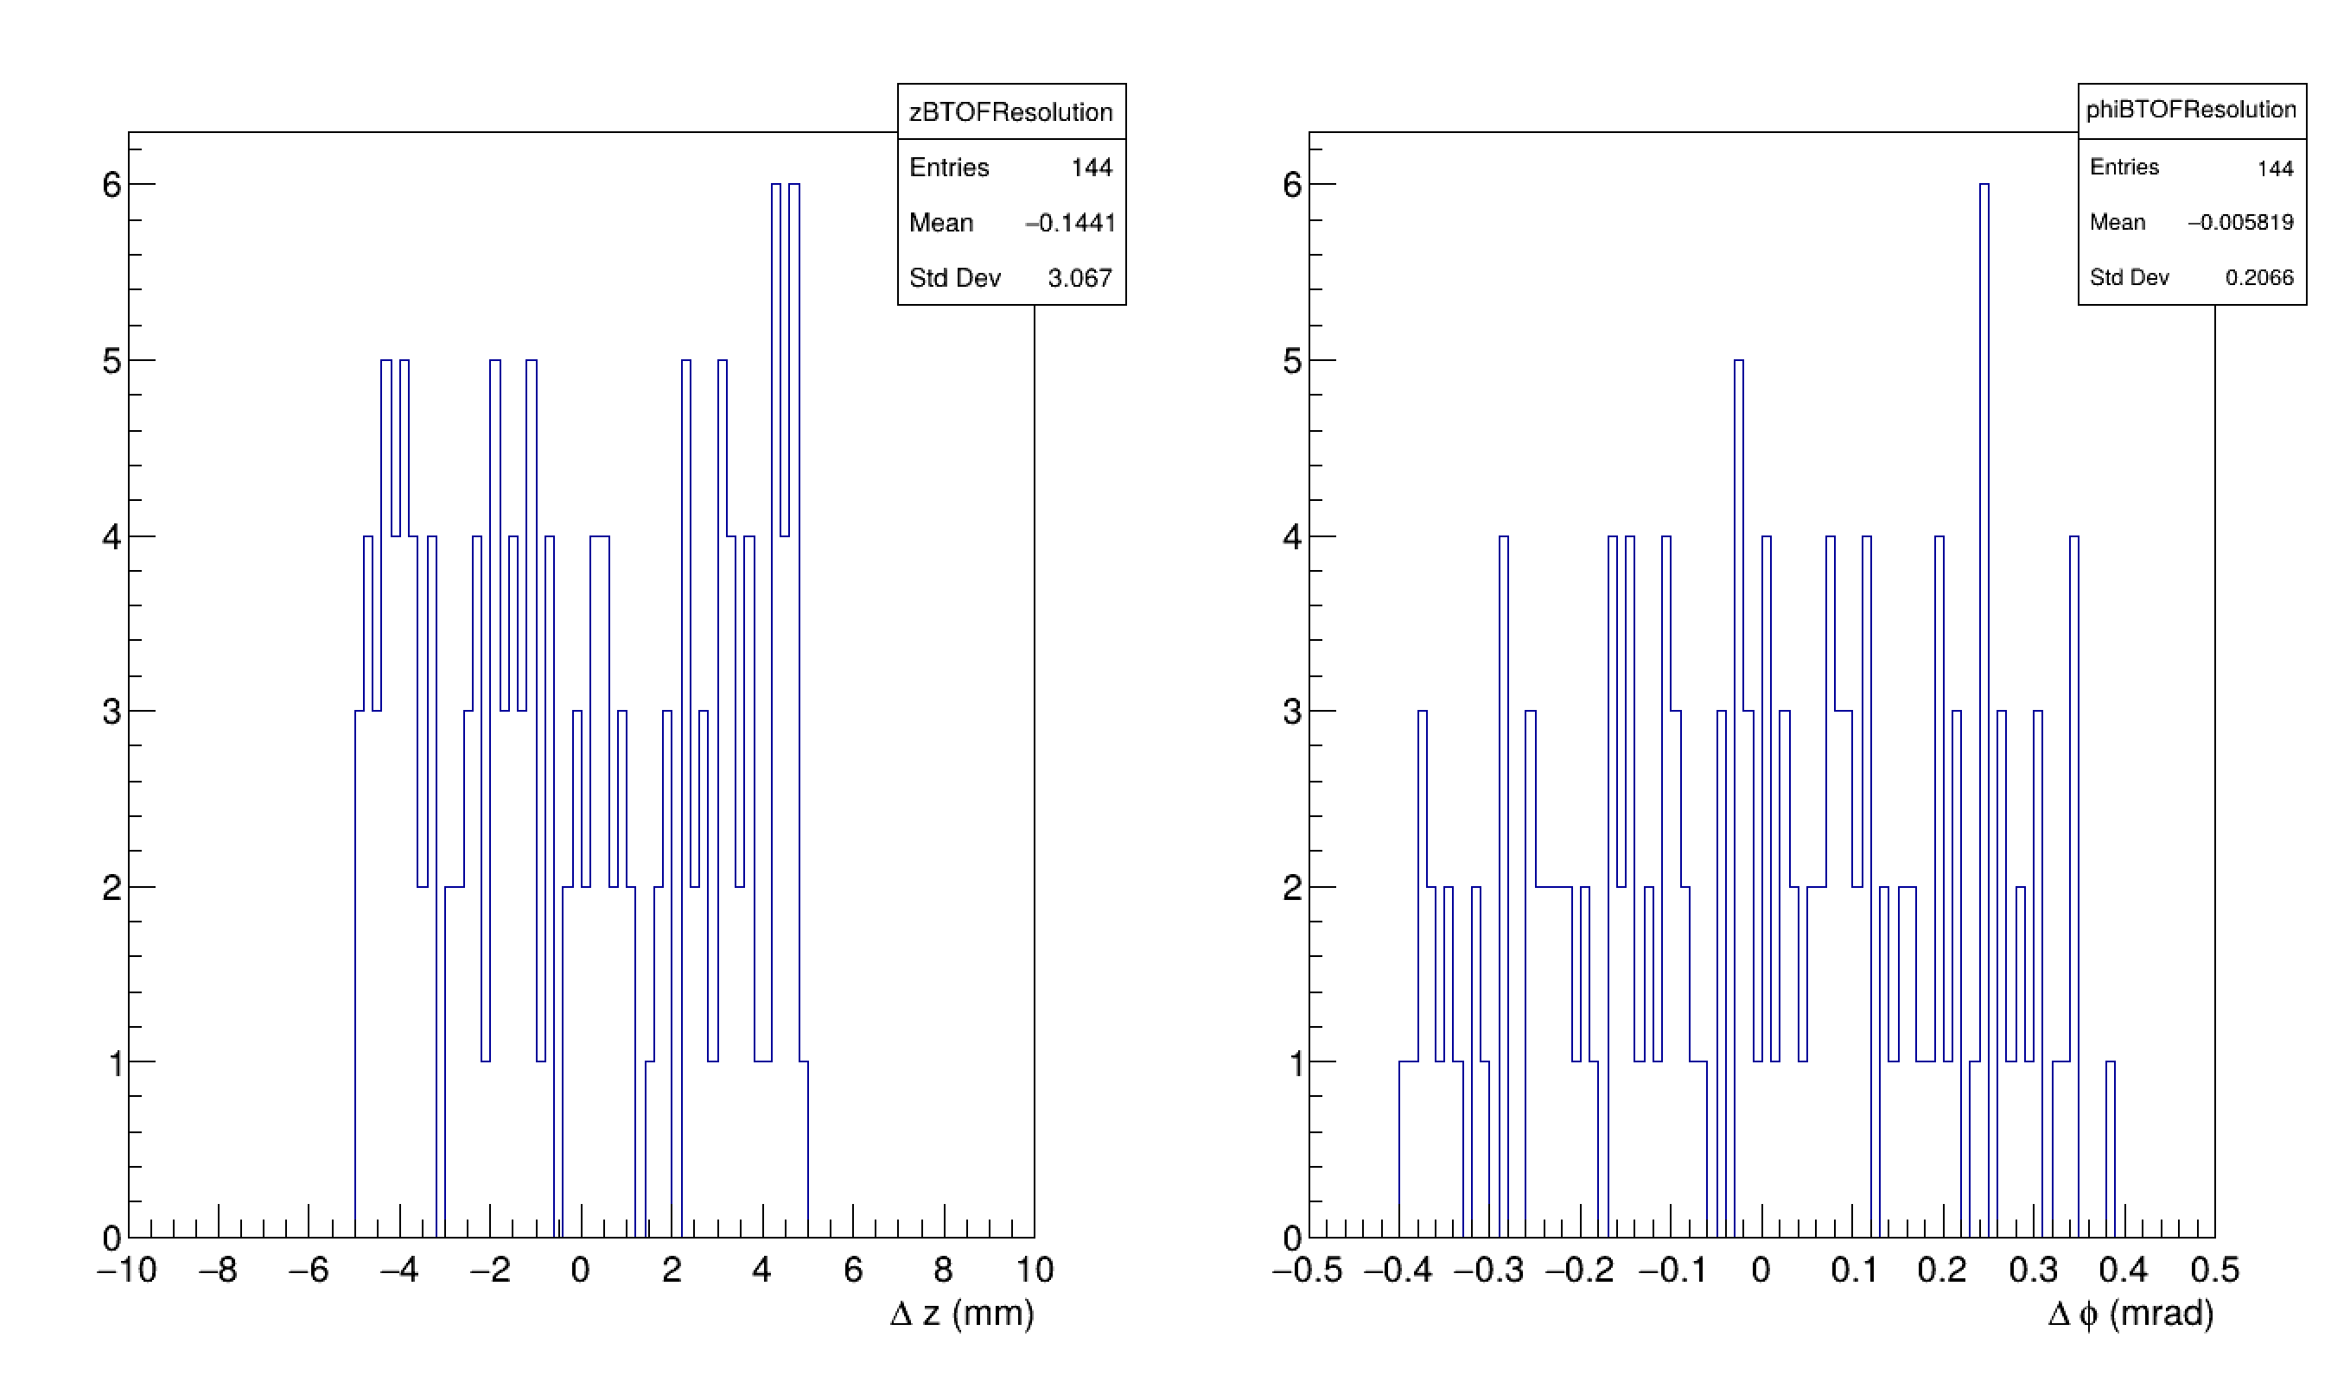
Realistic pixel size No charge-sharing and clusterization
Phi resolution = 0.23 rad
Entries = 144
MC hit points = 194
Efficiency ~ 74%

Slide 5
Re-enabling cluster algorithm
Skip over all the pulse generator and digitization.
Geant hits -> Charge sharing -> Smear by random noise (in time) -> Cluster by weighted average of pixels.
No discretization error, no hit loss due to threshold.
Charge sharing sigma x = 1*pixel pitch, sigma y = 0.5*pixel width.
No edge correction.

Slide 6
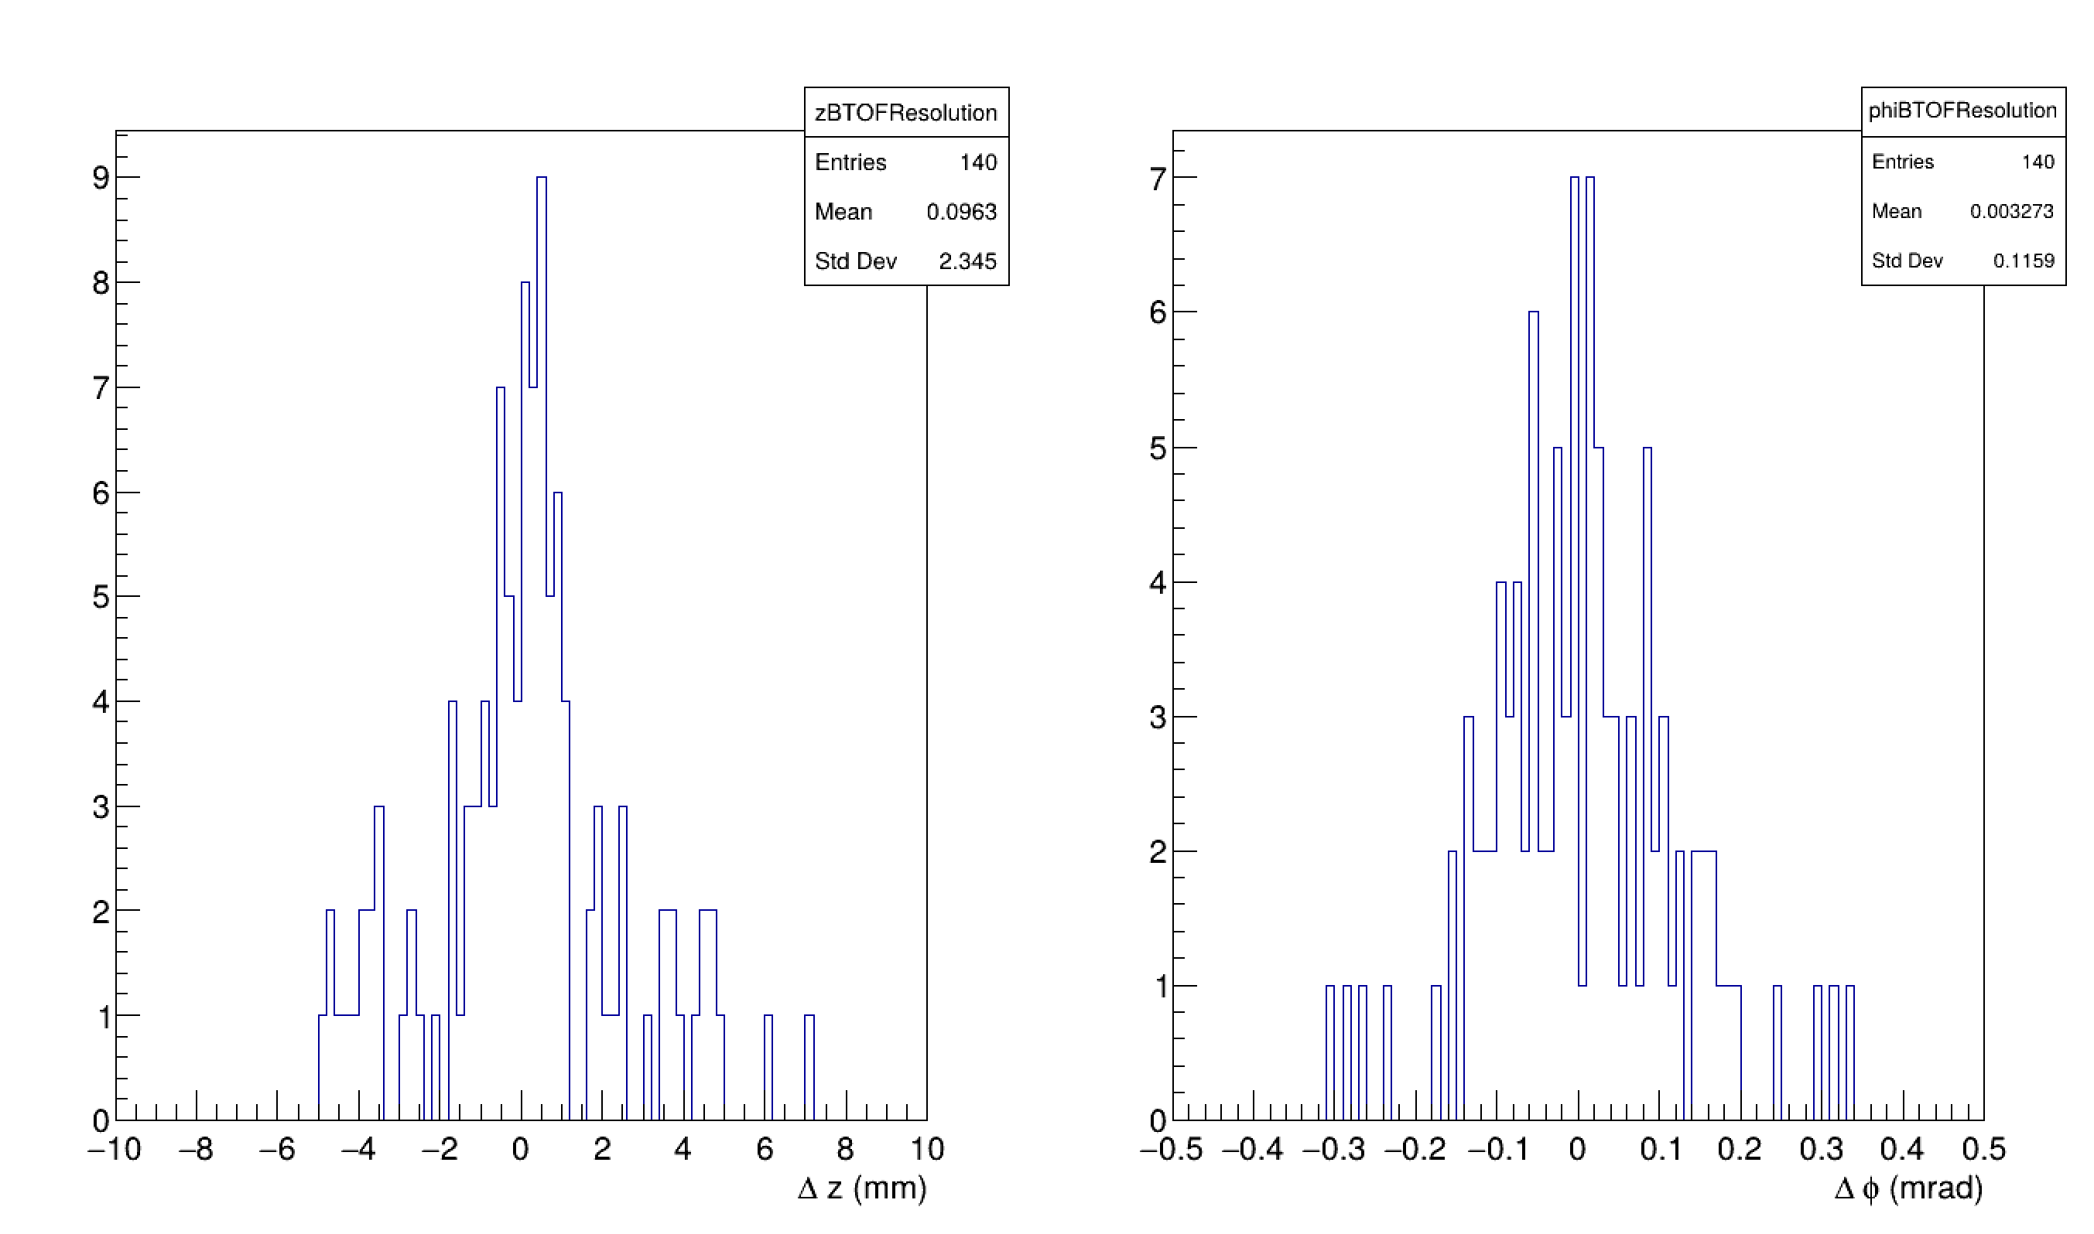
Realistic pixel size With charge-sharing and clusterization
Phi resolution = 0.12 rad
Entries = 140
MC hit points = 194
Efficiency ~ 72%
The 4 hits that are lost MAY (not confirmed) be caused by having multiple hits in the same sensor.

