Slide 1
Hall D Beam Test
March Commissioning Beam Test Preparation

Slide 2
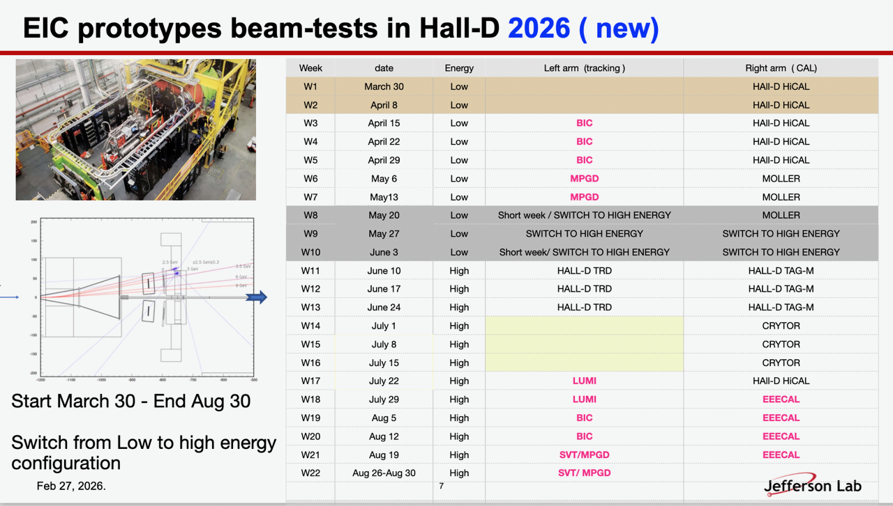

Slide 3
List of challenges and tasks to discuss
Running schedule
Beam planning for shorter period of time
Mounting of LGs and SiPM boards
Noise in ASIC1 (KCU1 and KCU0)
AstroPix data stopped after some nb of runs

Slide 4
Noise in KCU
Looks like some FM radio signal
We see the noise even without HV
We see it when switching off the Temperature sensor
Same with the fan and light leak

