Slide 1
Purdue-ANL BIC Update Outline 15 May 2026
Test article status
1m layup tooling incoming
Structural testing program (DCB, ENF, peel)
Clean vs unclean lead
Failure modes problematic for ASTM analysis
Sector handling
First test complete, encouraging
Refine method, test more realistic drawer
FEA simulation update
Use to confirm expected loads, moments
Design C support number and locations
Failure model still work in progress – validate with sub-assembly experiments
Next Steps: set up for long term plans and success
Full length (or 3m) assembly
More complete sectors
Sandwich / club sandwich
Validate sector FEAs, implement to full FEA

Slide 2
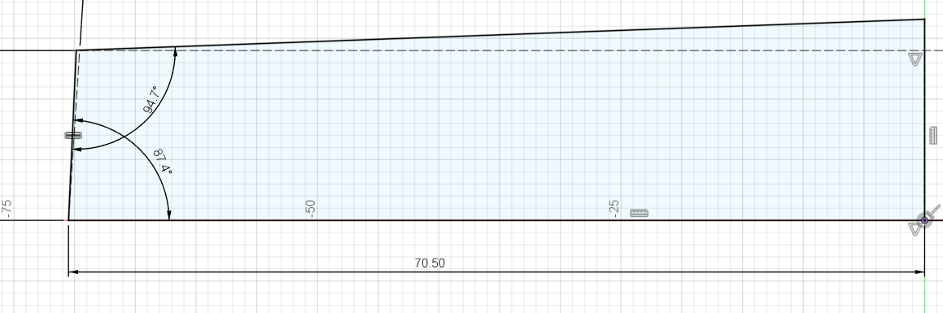
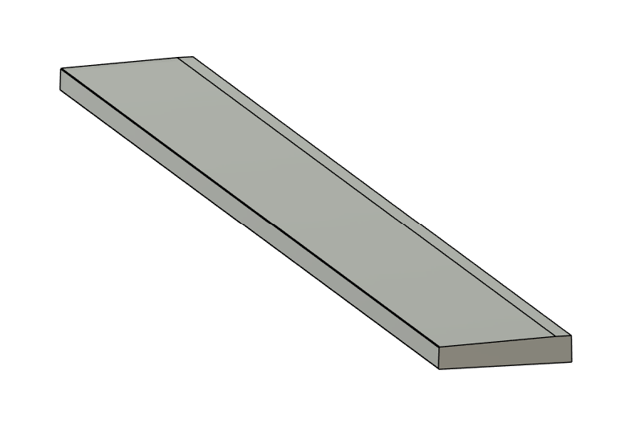
Tool Shape Compensation
0.5 mm radius
1.2 and 0.9 degree corrections
Tool length 1.05 meters
Ordered from Xometry, expected delivery by May 27
1.2 degree correction
0.9 degree correction

Slide 3
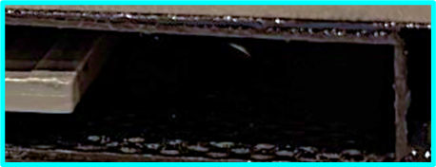
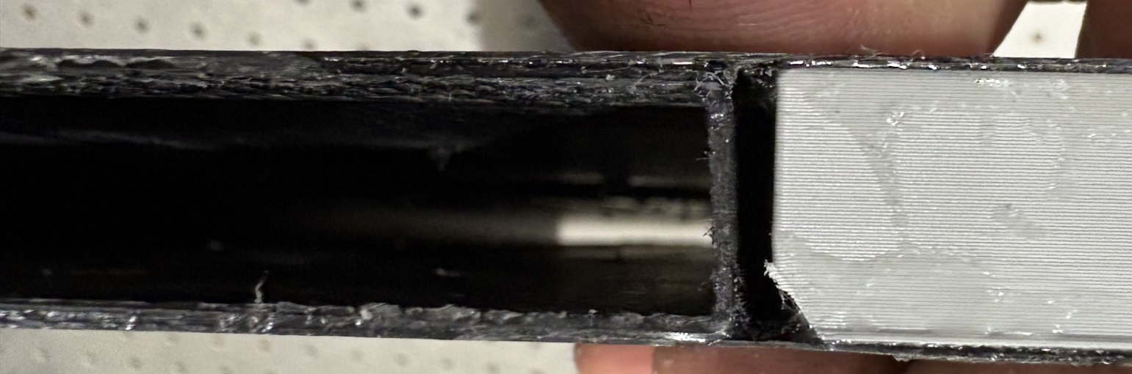
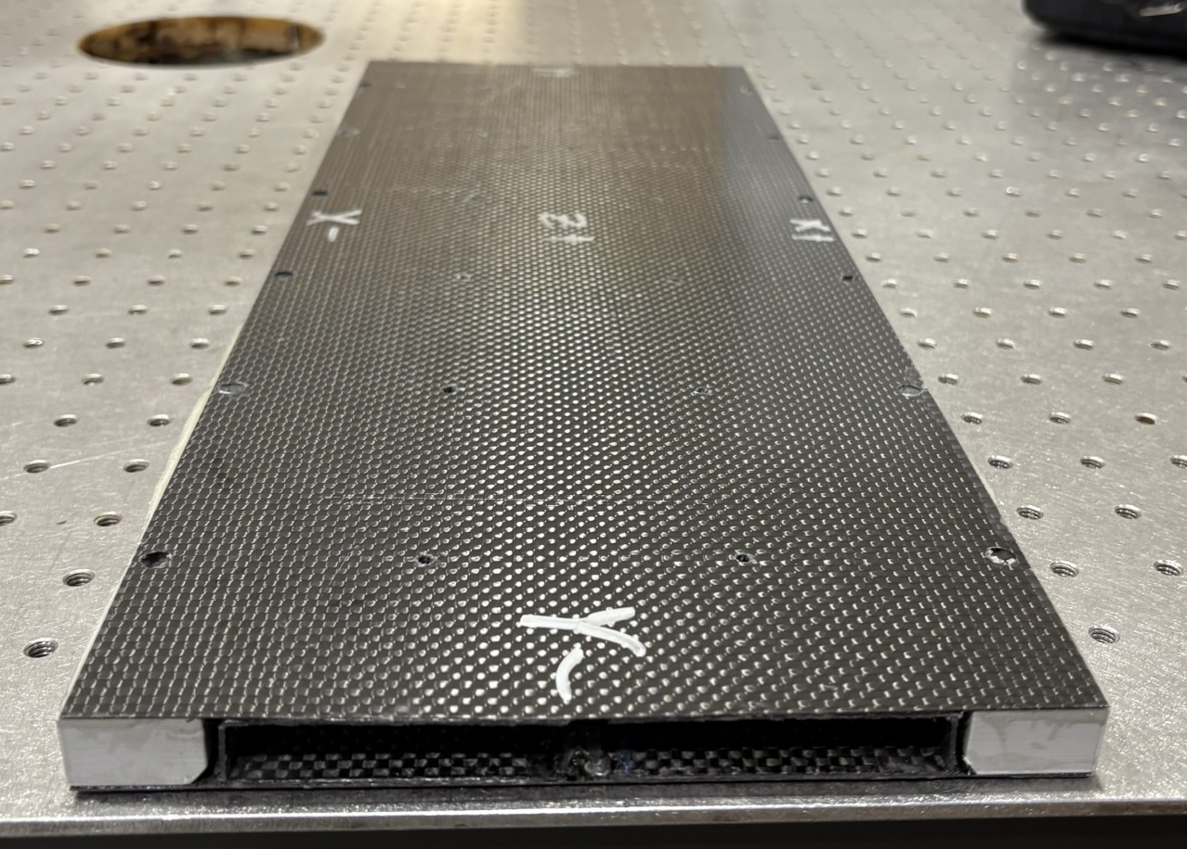
Thickness-corrected 4-part drawer
Bonded in same manner as previous drawer, only added extra clamps at the ends
Gaps due to incorrect thicknesses are better, requires further measurement to verify
Spring-in is still present, reenforcing the necessity of tool shape compensation
Laser scan analysis and thickness measurements to be done
Given to ANL for bonding to lead, possible trimming practice
Old
New

Slide 4
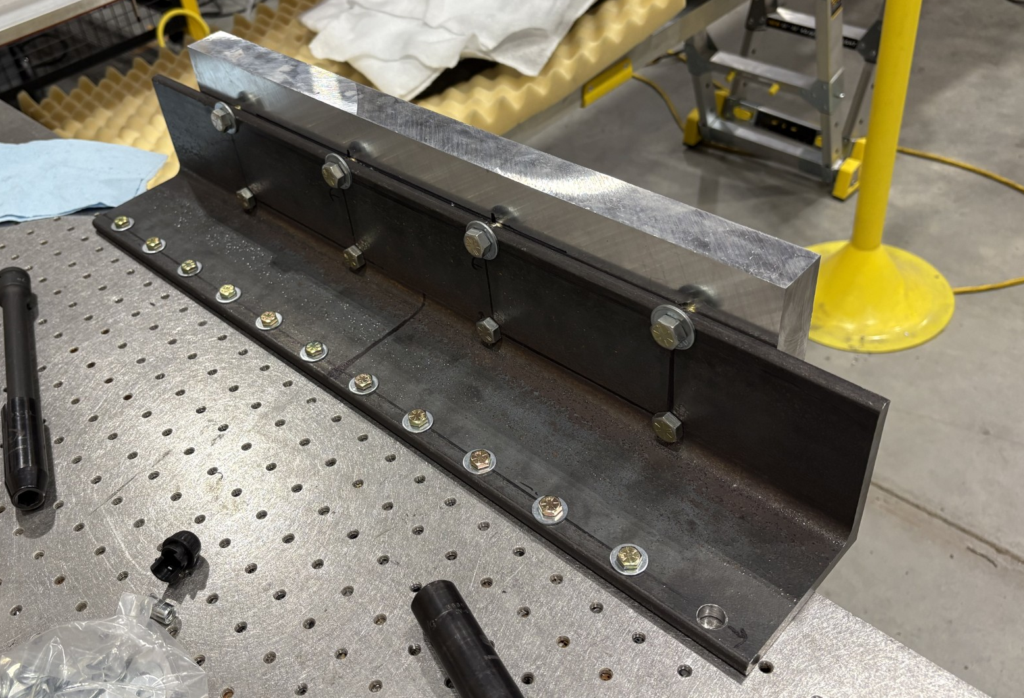
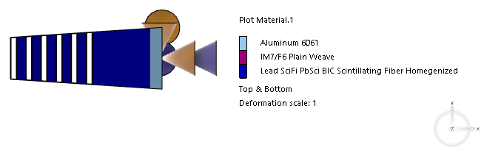
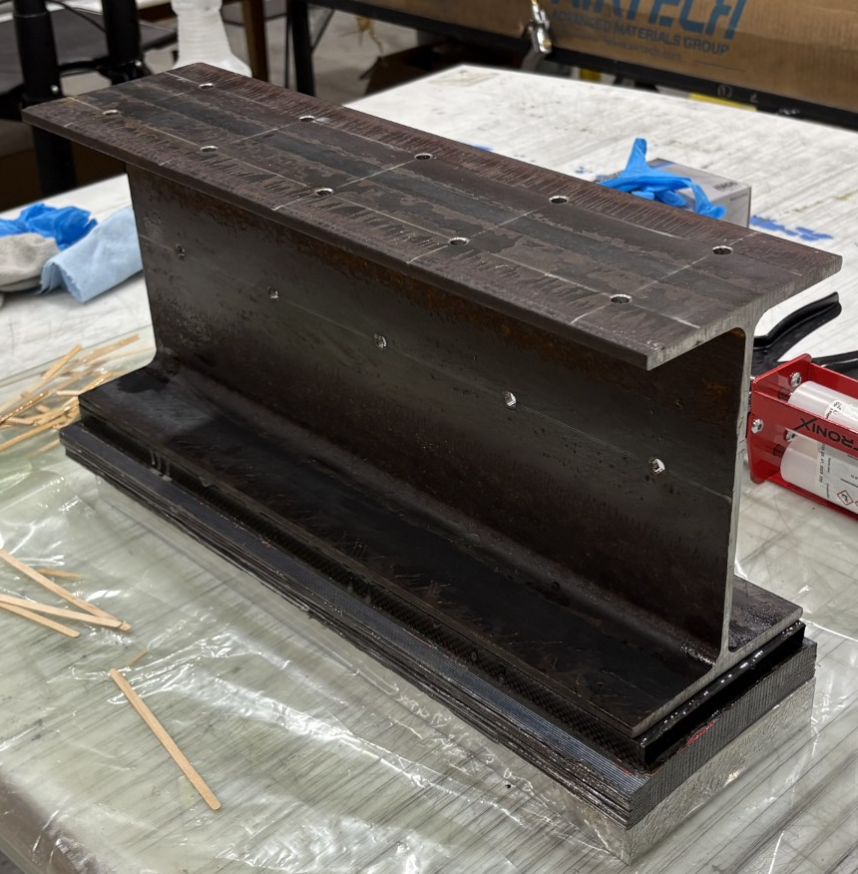
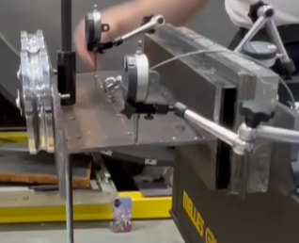
Lead + drawer loading test – What will break in 3 o’clock position?
Bond Aluminum “back” plate to lead
Bond steel I beam to drawer
Load I-beam to replicate moment and weight of real sector over 0.5 meter length
Won’t have length-induced bending moment
Full sector 804kg (1769lb) from model, lacks trays, but that’s a small %
Test until high moment interface fails (aluminum-lead or lead-CFRP)
Fail?
0.5m Truncated Test Setup
Represent only 92kg (203lb)

Slide 5
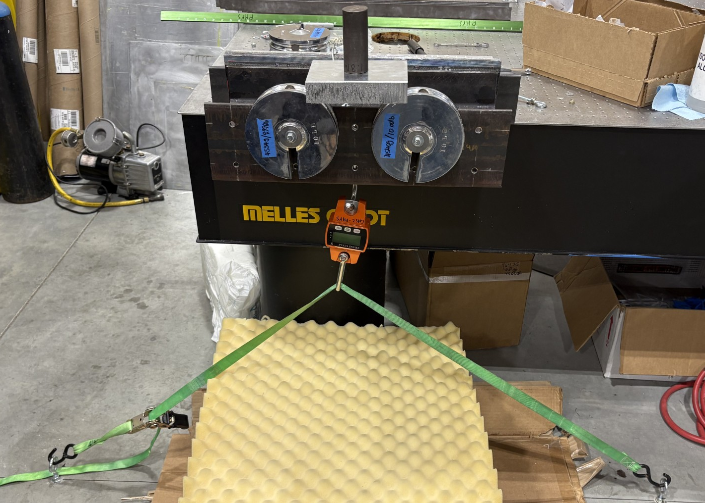
Loading Test 1-part drawer – Ratchet Strap
MM N-m
804kg (1769lb) total 4.35m BIC sector mass
0.5m section equivalent at 3 o’clock orientation:
92 kg
Minus aluminum plate - 86 kg (840N)
Moment at aluminum-lead interface - 120N-m
Weights at multiple distances to achieve load of sector-equivalent mass and moment concurrently
Loaded to 100% load and moment
Then loaded to 203% mass 205% moment
No cracking heard or seen
Sector returned to initial position after unloading
FF N
XX m
Added weight to reach desired moment-mass ratio
Hanging Scale
Notes:
85.6 kg mass used to calculate moment. Essentially all calculations were done without aluminum plate since it’s weight doesn’t add to the load at interface

Slide 6
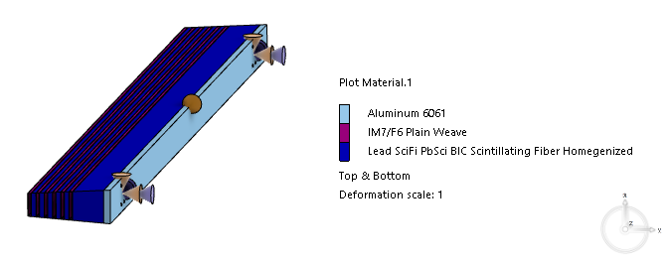
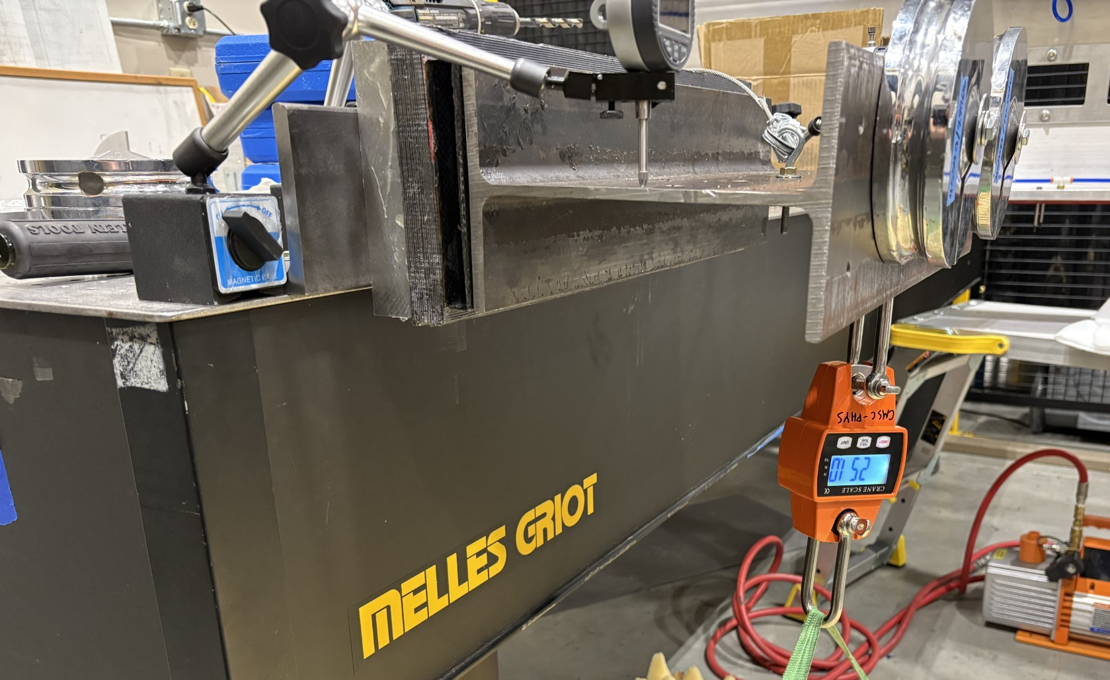
Loading Test 1-part drawer – Ratchet Strap day 2
Loaded to higher moment by applying load further out
267 kg (2619 N) at farther hole
+31.1 kg base load = 348% mass, 504% moment
No audible or visible cracking
Not comfortable loading more with strap
MM N-m
FF N
XX m

Slide 7
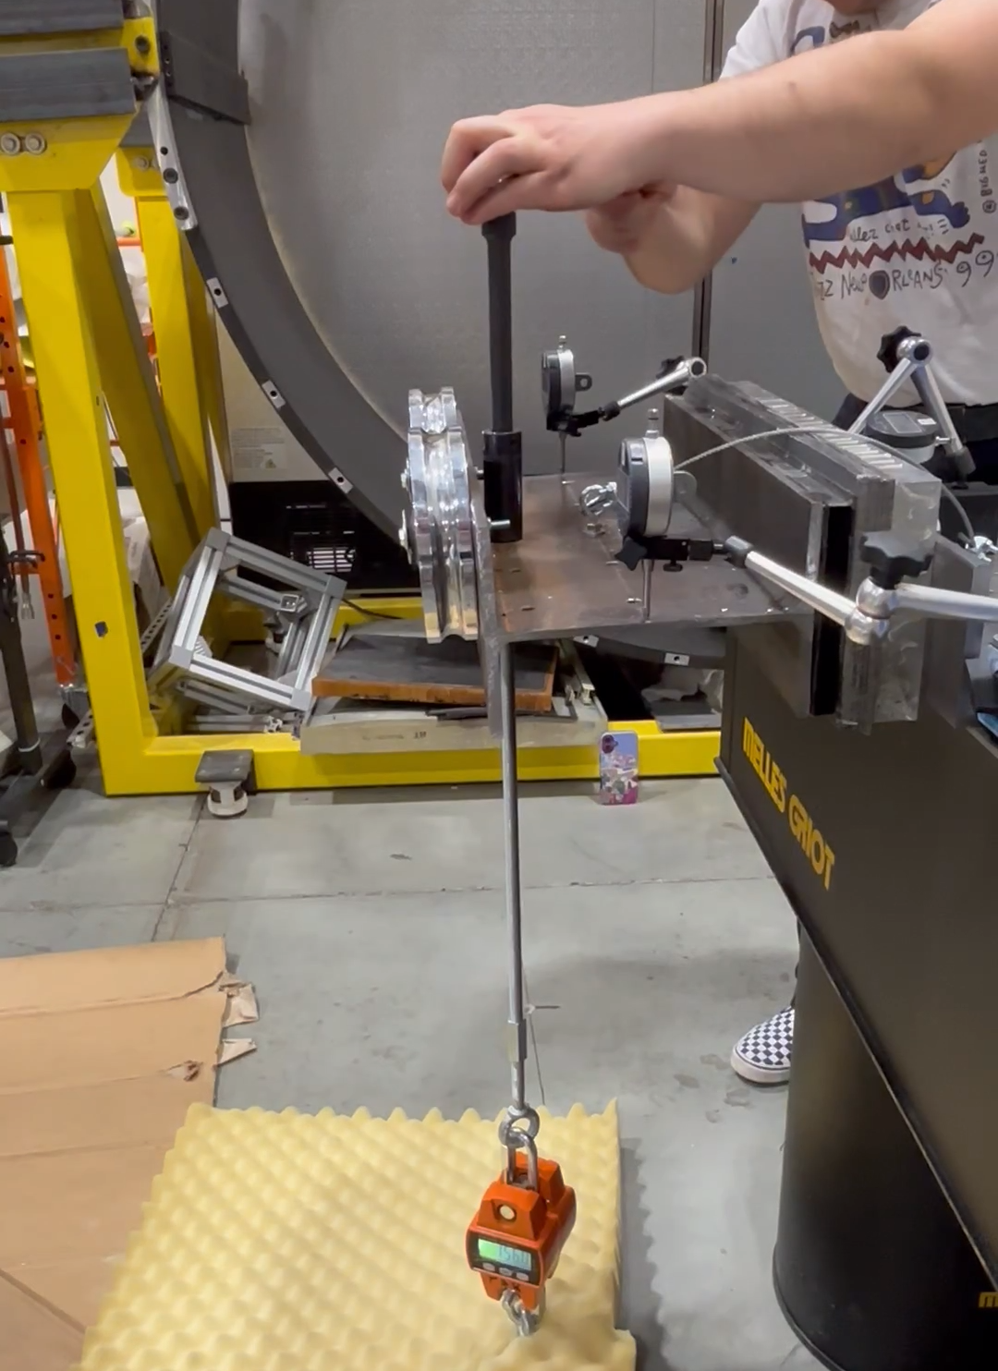
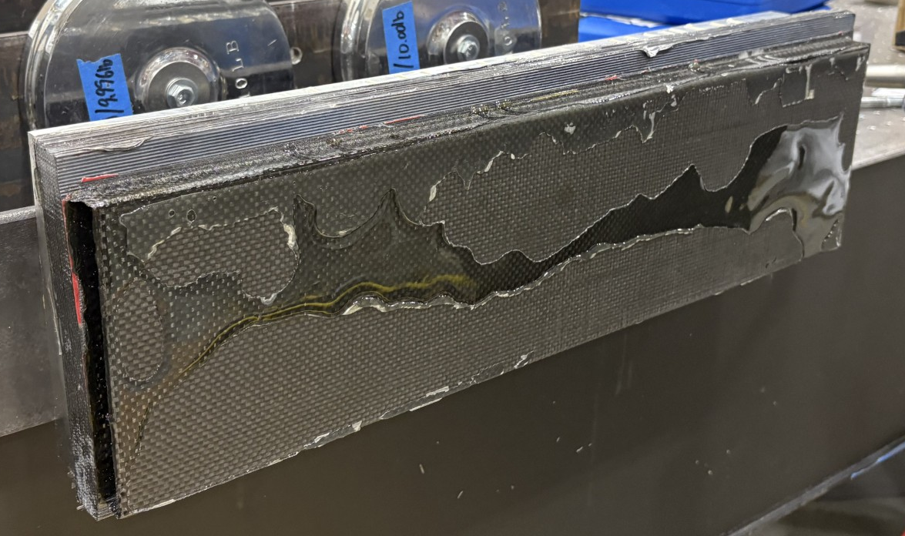
Loading Test 1-part drawer – Threaded Rod
New setup can load 600kg and reach 1090% moment at by applying load further out
364 kg (3571 N) at farther hole
+31.1 kg base load = 462% mass, 675% moment
Heard cracking noise at ~300 kg applied load
Failure at bonded steel I-beam to drawer interface. NO VISIBLE LEAD OR CFRP FAILURE
Only ~70% of interface had adhesive connection
Next test will be better
MM N-m
Shiny section didn’t bond to I-beam
FF N
XX m

Slide 8
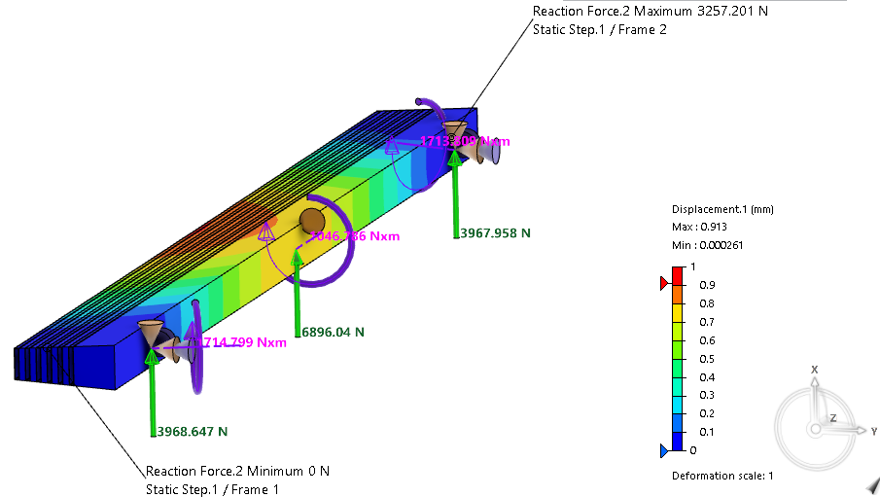
Full Sector Simulation Update
One example of possible sector handling boundary conditions
NOTE: TESTS SO FAR ISOLATE 0.5M (11%) OF SECTOR
FEA (OR ANALYSIS) HIGHLIGHTS MAX LOADS AND MOMENTS FOR FULL SECTOR
Boundary conditions (BCs) at proposed C supports
Tx=Ty=0, Tz fixed at center, Ry=Rz=0
Summed reaction at aluminum to lead interface
Vertical/shear 7kN
Moment about Z 1100N-m
Reaction at each BC, Z+ and Z-
Vertical force 4kN
Moment 1700N-m
Y component 1600N-m
Z component 620N-m
0.5m ISOLATED section tested to
Vertical load 3571N
Moment about Z of 807N-m

Slide 9
Full Sector Load and Moment Analysis
Approximate analytical loads and moments for “n” supports
Summed reaction at aluminum to lead interface
Vertical/shear 7kN
Moment about Z 1100N-m
Reaction at each BC, Z+ and Z-
Vertical force 4kN
Moment 1700N-m
Y component 1600N-m
Z component 620N-m
Vertical, shear force max near n boundary conditions
(Sector mass) / (n supports) , so
n=2→~4kN, 3 →~2.7kN, 4→~2kN
Moment about Z axis at aluminum-lead interface also approximately (total) / (n) x (dist. to center of mass 0.16m)
n=2→~620N-m, 3→~430N-m, 4→~320N-m
Moment about Y axis function of unsupported mass between n supports and separation of supports
n=2→~1600N-m, 3→~?N-m, 4→~?N-m
n=2, separated less →~?N-m
0.5m ISOLATED section bond failed at:
Vertical load 3571N
Moment (about Z) of 807N-m

Slide 10
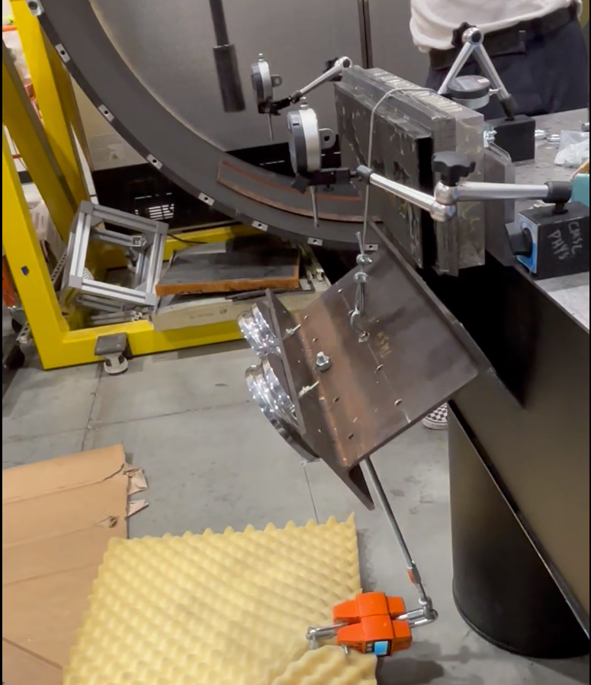
Sector Handling Failure Experiment Conclusions
WHEN VIEWED AS ISOLATED 0.5m LENGTH (SUPPORT ALUMINUM BACKING PLATE EVERY 0.5M)
0.5m sector surrogate failed at
3571 N vertical shear load (462% of nominal)
807 N-m moment at aluminum-lead interface (675% of nominal)
714 N-m moment at lead-drawer interface (2080% of nominal at lead bulk-first drawer)
May need more “C” supports
What number, locations acceptable?
Poor adhesive bond at I beam – drawer interface failed first
Unknown additional strength in drawer/lead/aluminum structures and interfaces
Will bond next drawer-lead better to I-beam
Next test with near final drawer design
Initial test was with 1-piece continuous drawer

Slide 11
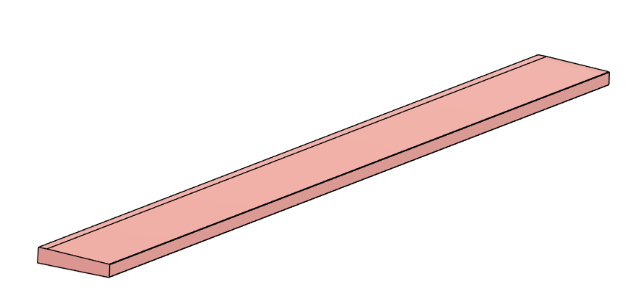
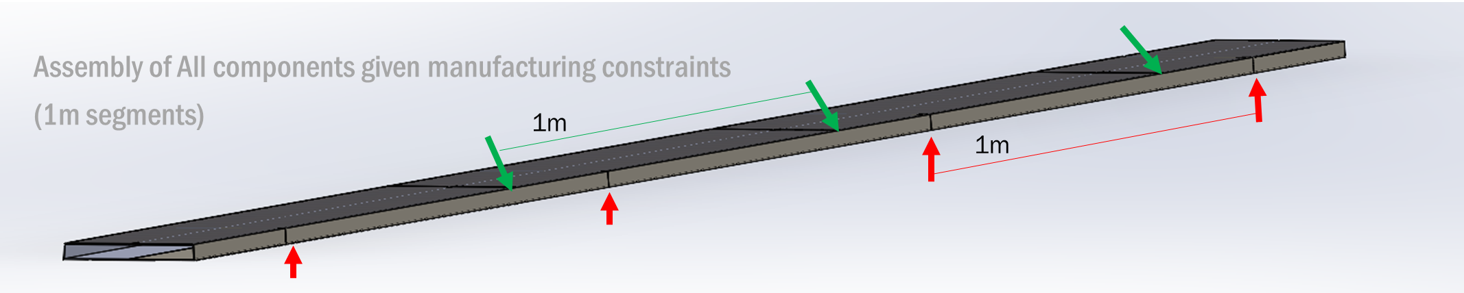
Next Steps
Longer (June/July)
1m tool ordered for composites sections
Test staggered length assembly (alternating butt joints every 0.5 or 0.25m)
Likely able to use 0.5m long assembly jig
Thicker (July/August)
Fabricate different drawer widths (minor CNC trim adjustments only)
Have ANL assemble taller lead-drawer-lead-etc stacks
Measure all drawer assemblies
Test tray sliding, positioning designs (Jun-Aug)
Validate stiffness and strength against FEAs, incorporate lessons in larger models
1 m spring-in compensated tool

