Slide 1
Zr-96 and Ru-96 Preparation
D. Raparia
August 9, 2017
RHIC Retreat

Slide 2
Outlines
Requirements
Zirconium-96
Ruthenium-96
Conclusion

Slide 3
Acknowledgements
E. Beebe, S. Ikeda, T. Kanesue, M. Okamura
C. Carlson, D. Steski, P. Thieberger
C. Gardner, W. Fischer

Slide 4
Requirements for Zr-96 and Ru-96
1.3E9 ion per bunch at the beginning of the store, with this bunch intensity we can have >~10 h stores with L(t) > 22E26 cm⁻²s⁻¹ for the whole store and thereby filling the STAR bandwidth completely (Wolfram)
=> 1.5E9 ions per bunch out of the AGS for both Zr-96 and Ru-96 (Wolfram)

Slide 5
Sources for Zr-96 and Ru-96
=> 0.625E9 ion per pulse for Zr-96 at booster input from EBIS¹ with 12-6-2 bunch merge scheme (Gardner)
=> 1.1E9 ion per pulse for Ru-96 at booster input from Tandem² with 8-4-2 bunch merge scheme (Gardner)
¹ Zr-96 will be provided by LION-EBIS
² Ru-96 will be provided by Tandem

Slide 6
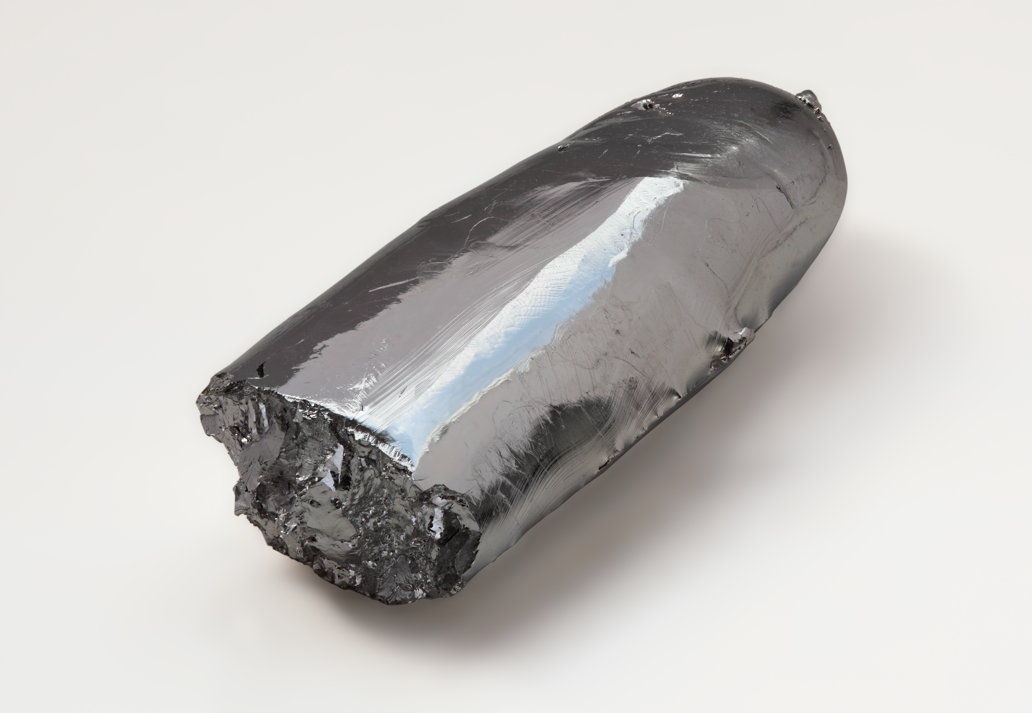
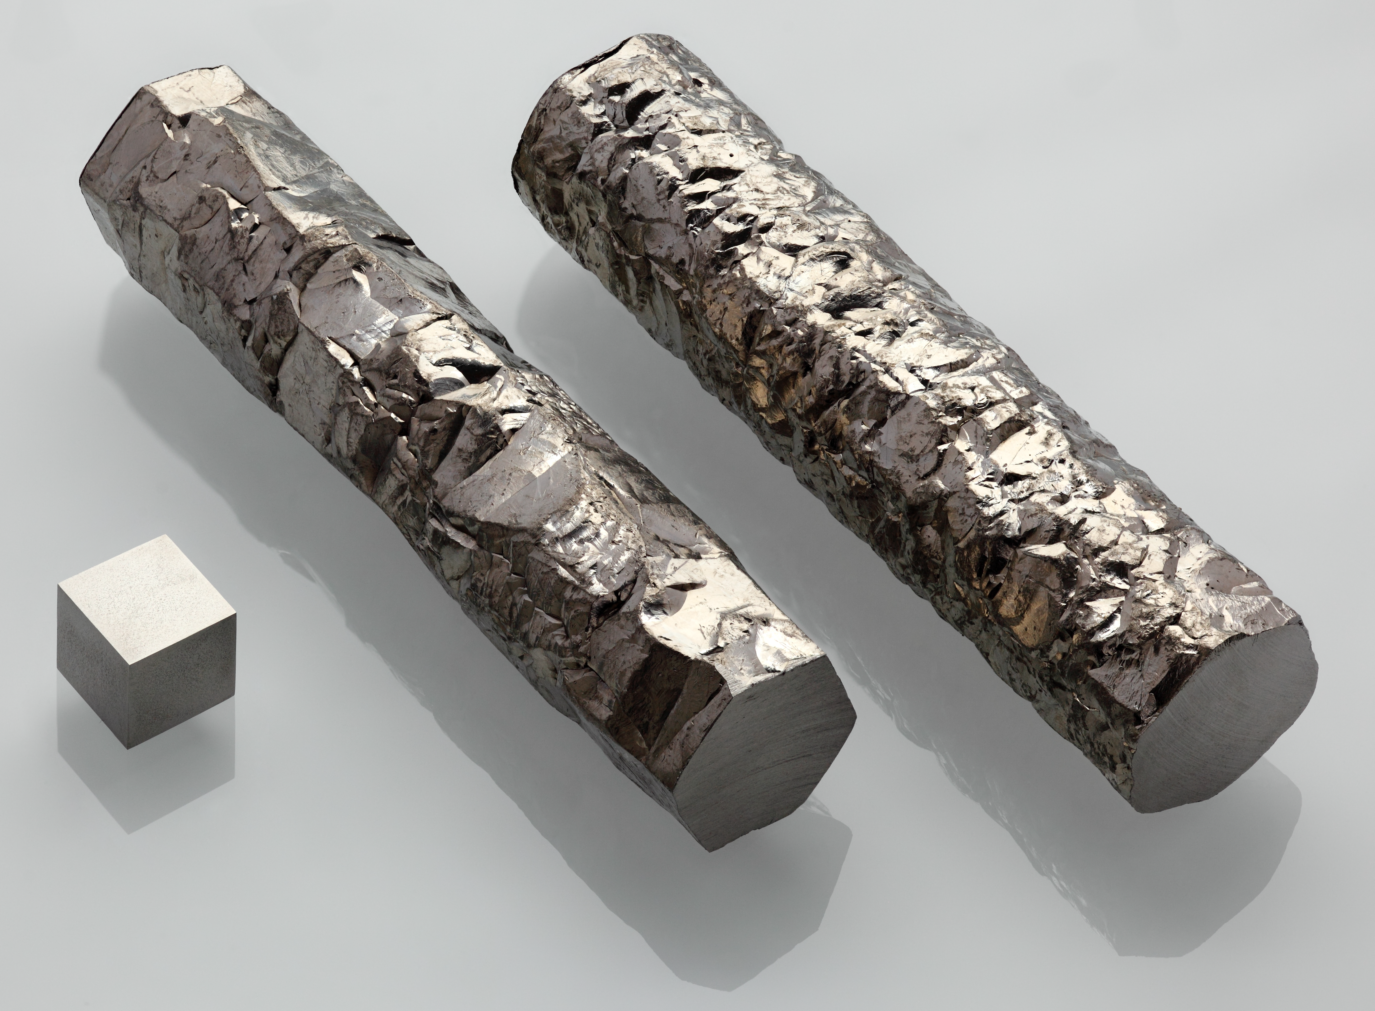
Natural Abundance of Zr and Ru
Zirconium | Abundance (%) | Ruthenium | Abundance (%)
Zr-90 | 51.45 | Ru-96 | 5.54
Zr-91 | 11.22 | Ru-98 | 1.87
Zr-92 | 17.15 | Ru-99 | 12.76
Zr-93 | trace | Ru-100 | 12.60
Zr-94 | 17.38 | Ru-101 | 17.06
Zr-96 | 2.80 | Ru-102 | 31.55
 |  | Ru-104 | 18.62
Q/M: ₉₆Zr¹⁶ = ₉₀Zr¹⁵
₉₆Ru¹²= ₁₀₄Ru¹³

Slide 7
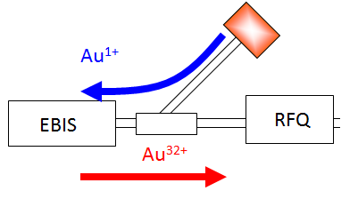
Zirconium
E. Beebe, S. Ikeda, T. Kanesue, M. Okamura
EBIS
LION
RFQ
IH
ETB
Target must be ₉₆Zr.
x
x
Plasma formed
x
Plasma expands
Laser
z
z
Ion beam
z
Target
20~30 deg.
Drift length
Extraction field
~ns
~ a few ns
∼μs
Primary ions are provided by laser ion source (LION)

Slide 8
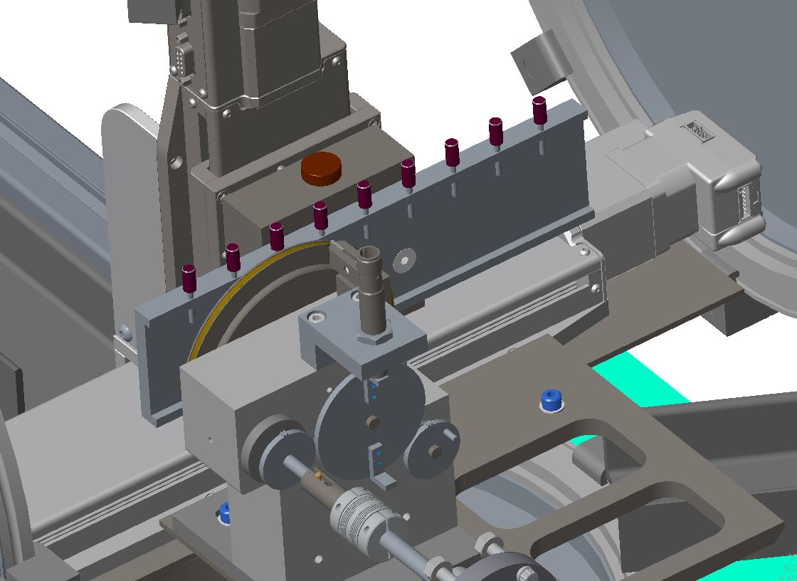
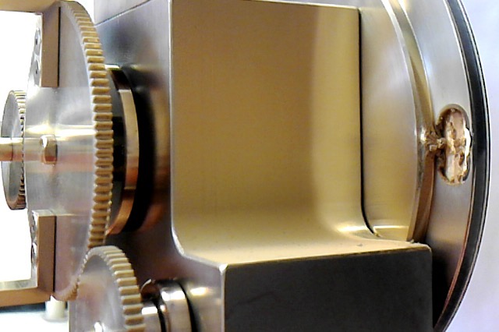
Laser Ion Source (LION)
Laser for NSRL
NASA target – Array of flat targets
(B, Ca, Au, O, Si, Ti, Fe, Ta, C ..)
Laser for RHIC
RHIC target – Spinning gold disk

Slide 9
Zr-90 Test EBIS/ Booster
 | (16:28) | (16:36) | (17:05) | Au (6/6 13:05)
Target | Zr metal | ZrO₂ | ZrO₂ | Au from rotary
M/Q | 90, 16+ | 90, 16+ | 90, 16+ | 197, 32+
Laser P (mJ) | 270 | 270 | 120 | 240
XF 14 | 13.2 nC | 7.7 nC | 6.4 nC | 17.2 nC
XF 108 | 4.8 nC | 2.7 nC | 2.0 nC | 6 nC#
# Ions | 1.9E+9 | 1.1E+9 | 7.8E8 | 1.2E+9
Required | 0.625e9 | 0.625e9 | 0.625e9
Booster early | 1.2e+09 | 7.8e+08 | 6.9e+08 | 1.4e+10 (12p) = 1.2e+9 (per 1p)
Booster late | 4.2e+08 | 2.6e+08 | 2.6e+08 | 1.3e+10 (12p) = 1.1e+9 (per 1p)
(1) Zr and ZrO₂ of natural abundance were used. 51.45% of Zr is mass 90.
(2) For Au 1.25E9 ion per pule gives about after bunch merge about 3.E9 ions per bunch at AGS extraction and 2.6E9 per bunch at RHIC collision

Slide 10
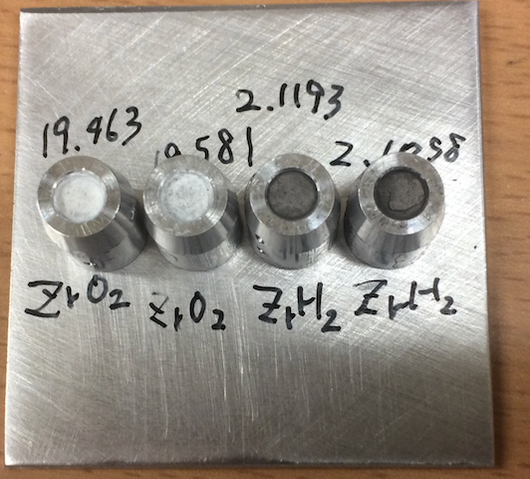
Zirconium Tests at EBIS
Acceleration test using ₉₀Zr (not ₉₆Zr) with natural abundance metal sheet – Confirmed good performance
Laser irradiation condition survey within current setup – 240 mJ laser energy with high enhancement of solenoid
Laser polarization test – No significant effect
Target scanning optimization – in progress
Laser spot size optimization – in progress
Target consumption measurement using metal sheet – 0.15 μg/shot (140 mJ), 0.53 μg/shot (385 mJ)
Enriched ₉₆Zr sheet test – Only 12 shots at a spot
Compressed powder target test (ZrO₂ and ZrH₂) – ZrO₂ failed, ZrH₂ OK.
Sintering at 1000 ℃ and 1300 ℃ (at RIKEN)– Need 1300C at least
Sintering ZrO₂ (round shape at RIKEN) – Sintering procedure established

Slide 11
Zirconium Tests at EBIS
Sintering ZrO₂ (strip shape at RIKEN) – Successful
Sintering on site - Oven and dies to be procured
Recycling process for used sintered ZrO₂ –Successful in RIKEN, trying to be done on site
Target consumption measurement using sintered ZrO₂ – 1.6 μg/shot (240 mJ)
Reduction of ZrO₂ consumption– Need more time
Sintering metal powder – More investment, no vender
High temperature sintering – to be tested
Collecting sputtered ZrO₂ – to be tested
Design of new XY movement mechanism – Necessary for compatible operation for NSRL and RHIC, in progress

Slide 12
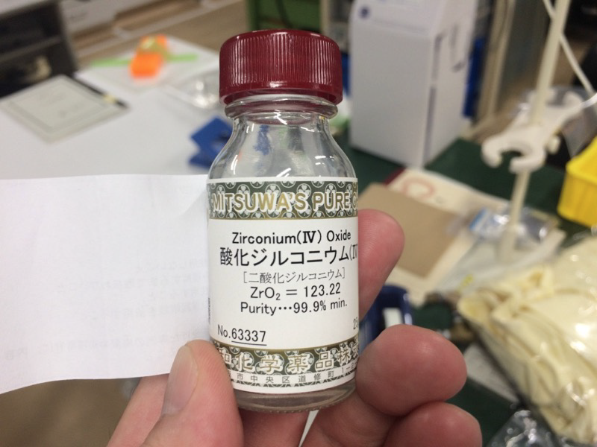
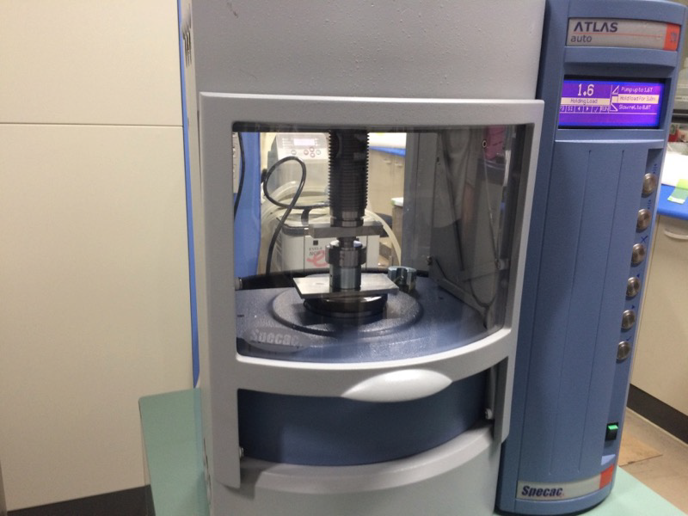
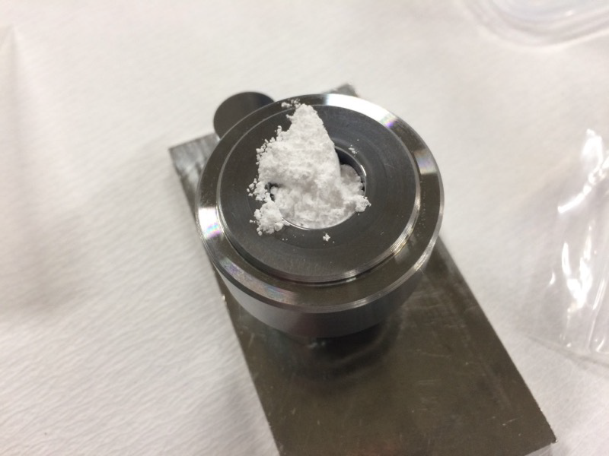
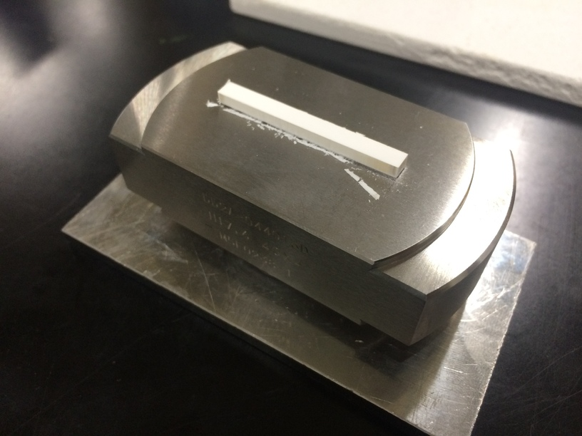
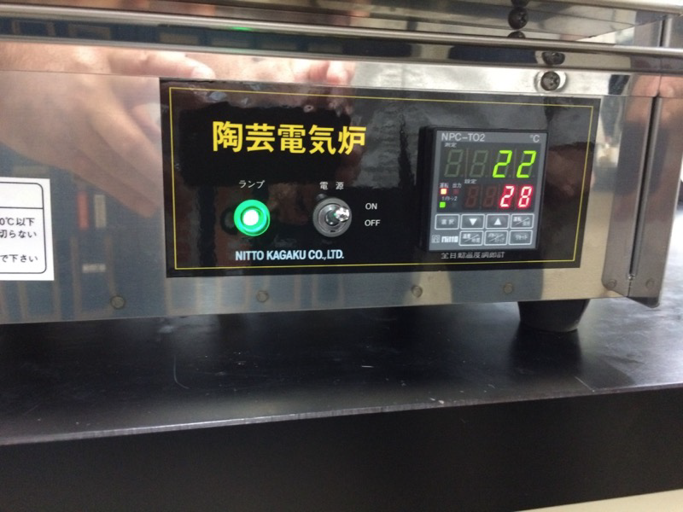
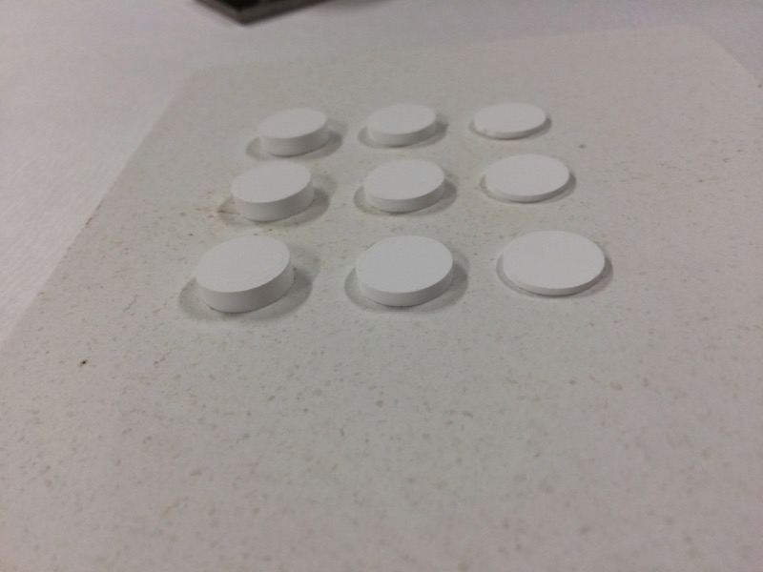
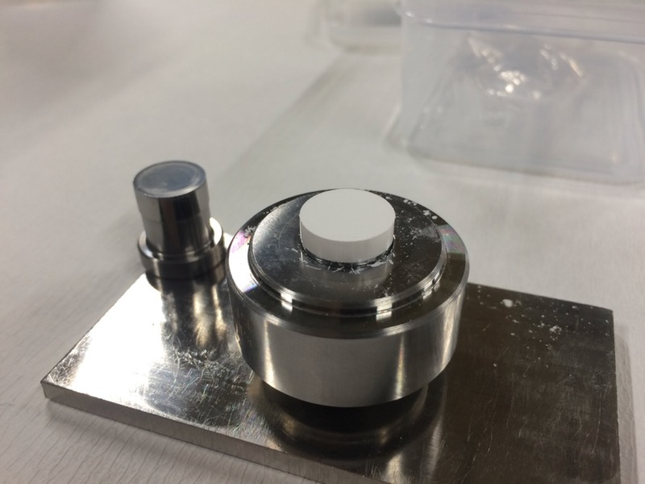
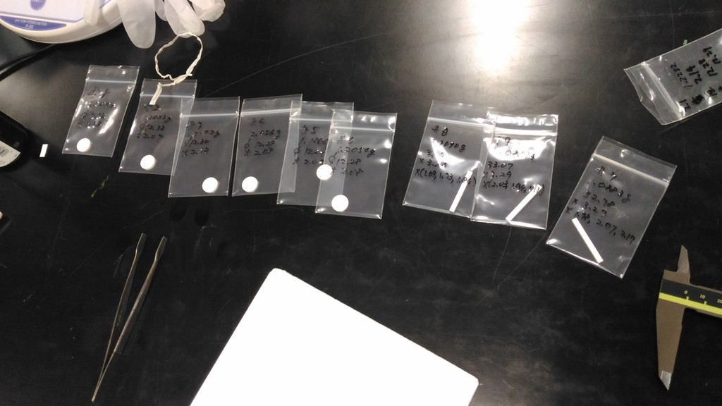
Sintering ZrO₂
Natural ZrO₂ power
Die , ~ $2000, need to be polished
after several ten of presses
Programmable press machine 1.6 ton
The target temperature was set to 1300C.
It was programmed to take 5 hour
from room temperature to 1300C and
hold for 2 hours and take 5 hours to
cool down. Furnace ~ $3000
1, 2 and 3 mm, 15 mm
of diameter. The sintered sample were measured as from 12.27 to 12.39. Almost no weight loss.

Slide 13
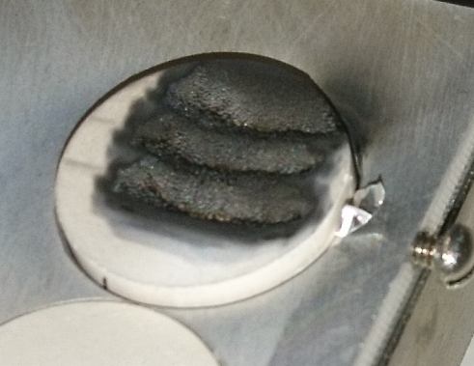
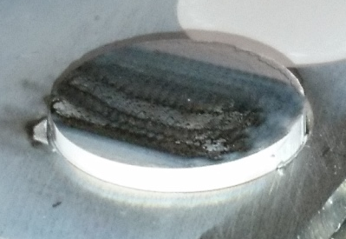
Target after Laser Irradiation
Target ID: 3mm-1R
Laser1
Total 8861 shots
11.5 microgram/shot
Target ID: 3mm-1
Laser1 and Laser2
Total 73178 shots
1.8 microgram/shot

Slide 14
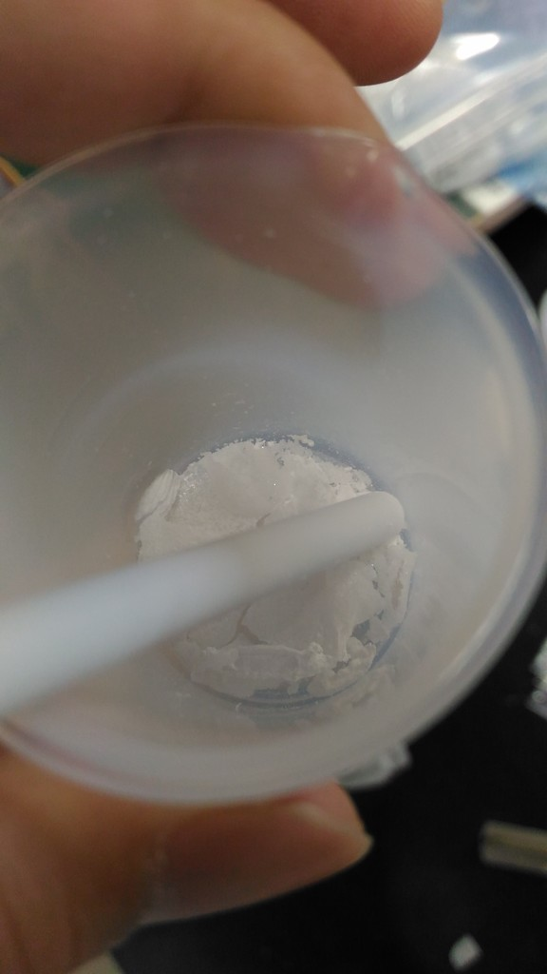
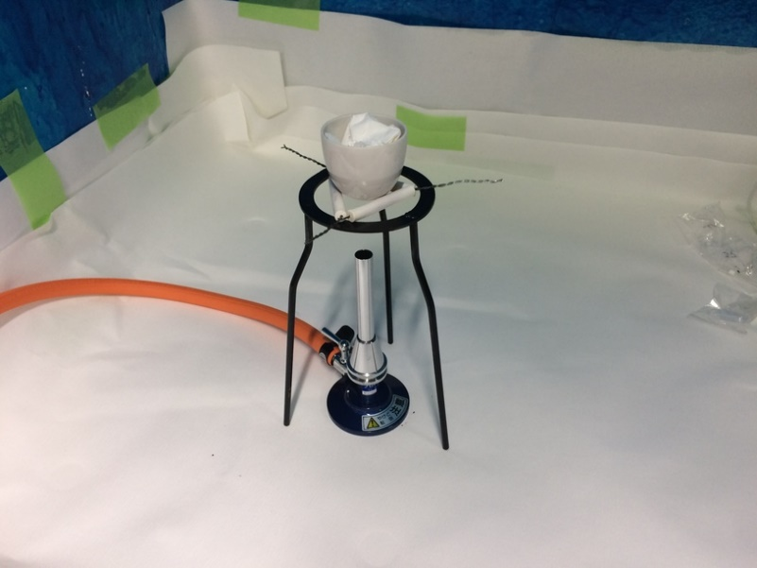
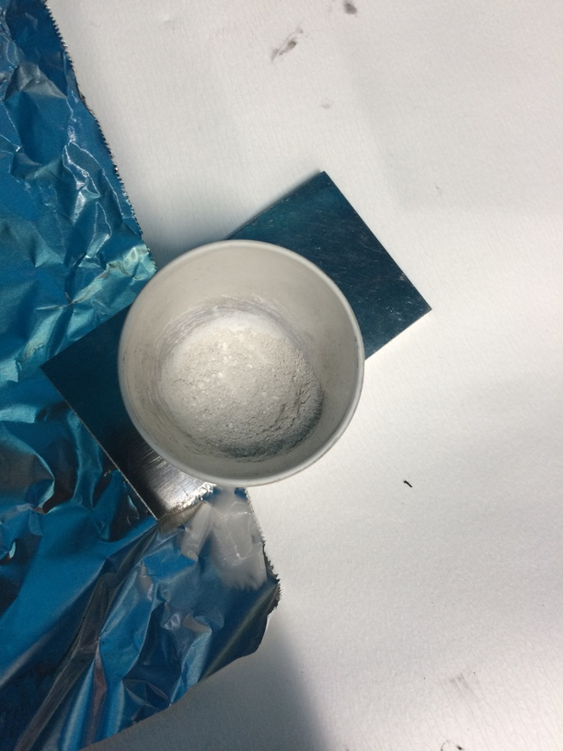
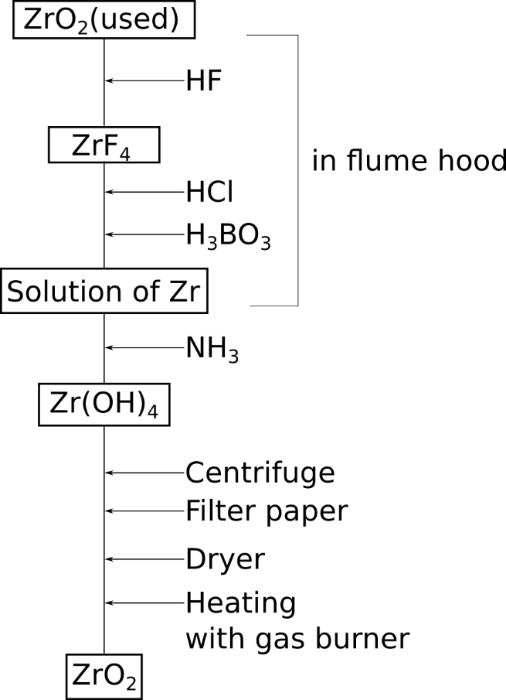
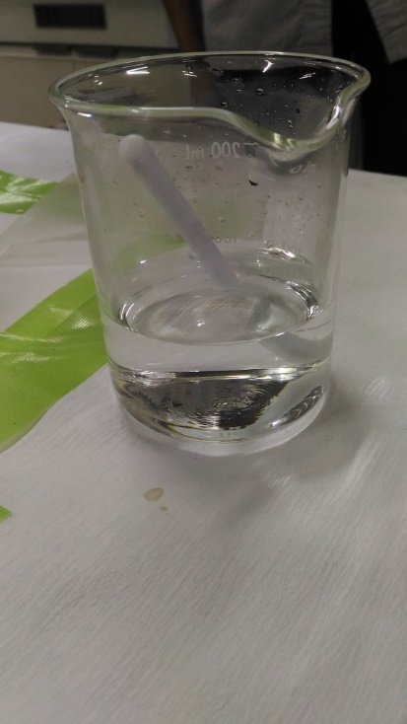
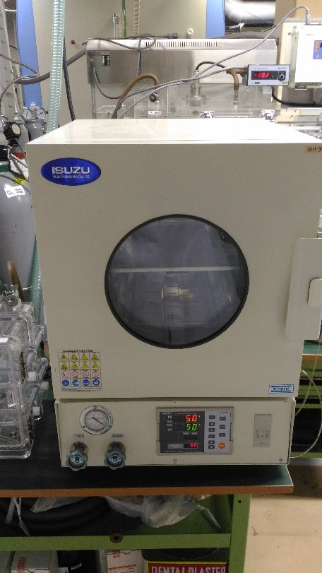
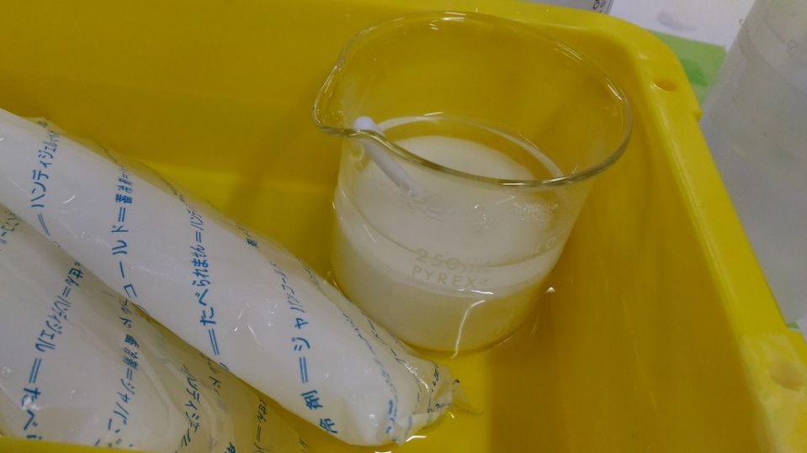
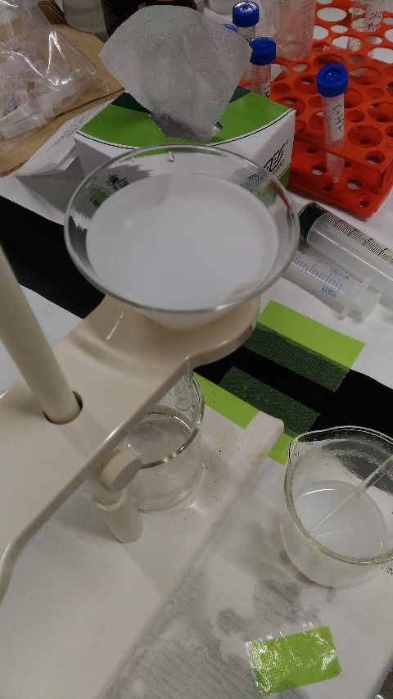
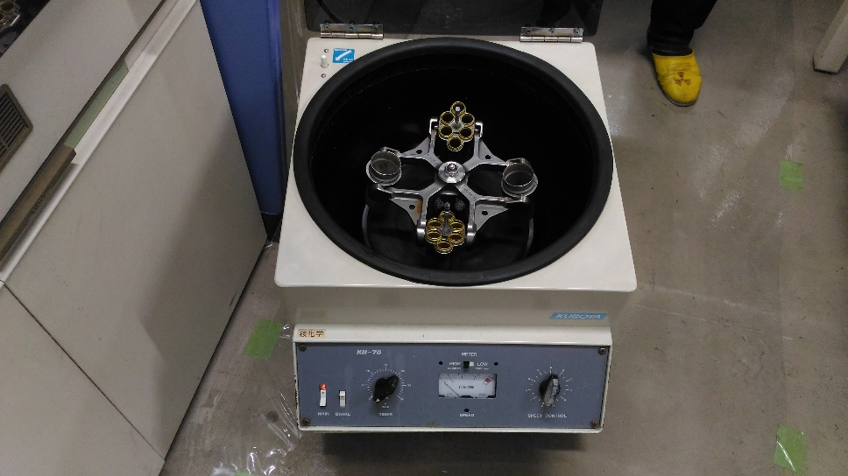
Recycling of ZrO₂ Target
1.1891 g
6 Hrs
20 cc HCL + 4 g H₃BO₃
Heating over night
150 CC water + NH₃

Slide 15
Zr-96 Schedule
Target |  |  | July | Aug | Sep | Oct | Nov | Dec | Jan | Feb
 | ZrO₂
 |  | 1300C sintering. | Done
 |  | 1700C sintering. | Test | Test & mea
 |  | Recycle process. | Test | Establish in BNL
 |  | Target shape. | Test | Mea
Laser irradiation condition survey.
 |  | Laser intensity. | Done
 |  | Spot size. | Test | Test
 |  | Scanning speed. | Test | Test | Test
 |  | Overwrap of the spots. | Test | Test | Test
 |  | Polarization. | Done
 |  | Laser angle and scanning | Done
Final test |  |  |  |  |  | Test & Mea
Stage develop |  |  |  | Design | Order | Fabri |  | Install
Enriched target |  |  |  |  |  |  | Order | Fabri

Slide 16
Estimated Zr Target Consumption
 | Shots before first P store | From | To | Shots after first physics | From | To | Day | Shots per day | Store length
 | M shots |  |  | M shots |  |  |  | shots
Run-16 Au-Au at 100 GeV/nucleon | 2.0 | 20151123 | 20160207 | 2 | 20160207 11:15 | 20160627 | 49 | 41000 | 6
Run-17 Au-Au at 27.2 GeV/nucleon | 0.5 | 20170411 | 20170603 | 0.95 | 20170603 10:50 | 20170621 08:18 | 18 | 52800 | 3.5
Measured average target consumption for ZrO₂: 1.6μg/shot
For 30 days of operation for 2 rings,
From Run-16 data, 2.0 M + 41000*30 = 3.2M shots →5.1 g
From Run-17 data, 0.5 M + 52800*30 = 2.1M shots → 3.4 g
Estimated target weight is from 7 to 10 g

Slide 17
Estimated Target Cost
Less consumption mode is being searched.
Pilot species may reduce the cost dramatically. (₉₀Zr¹⁵)
Efficient machine tuning also reduce the cost a lot.
Recycle process is being examined.
In case of 10 g
150K USD

Slide 18
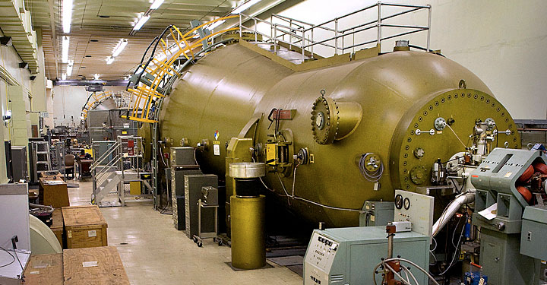
Ruthenium
C. Carlson, D. Steski, P. Thieberger

Slide 19
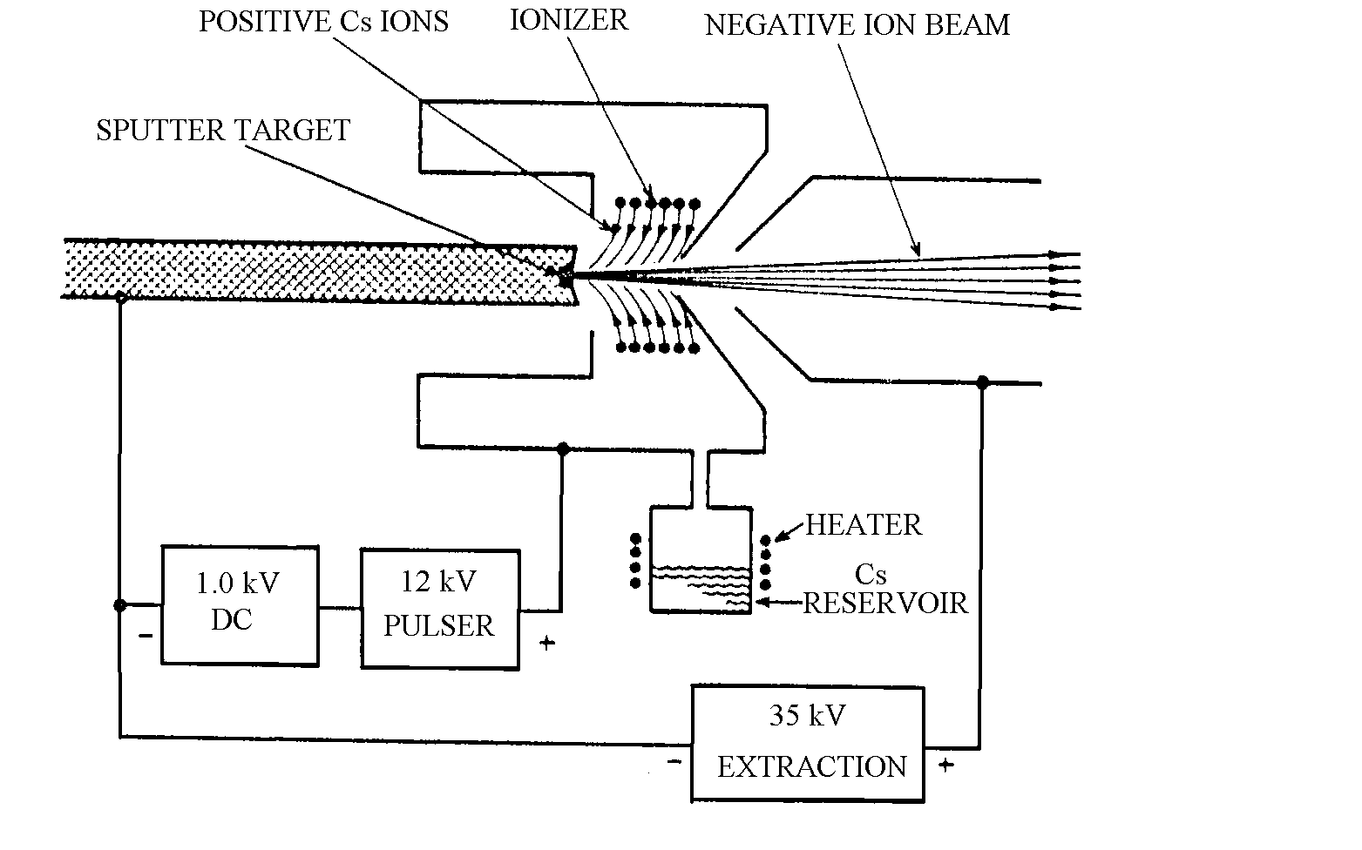
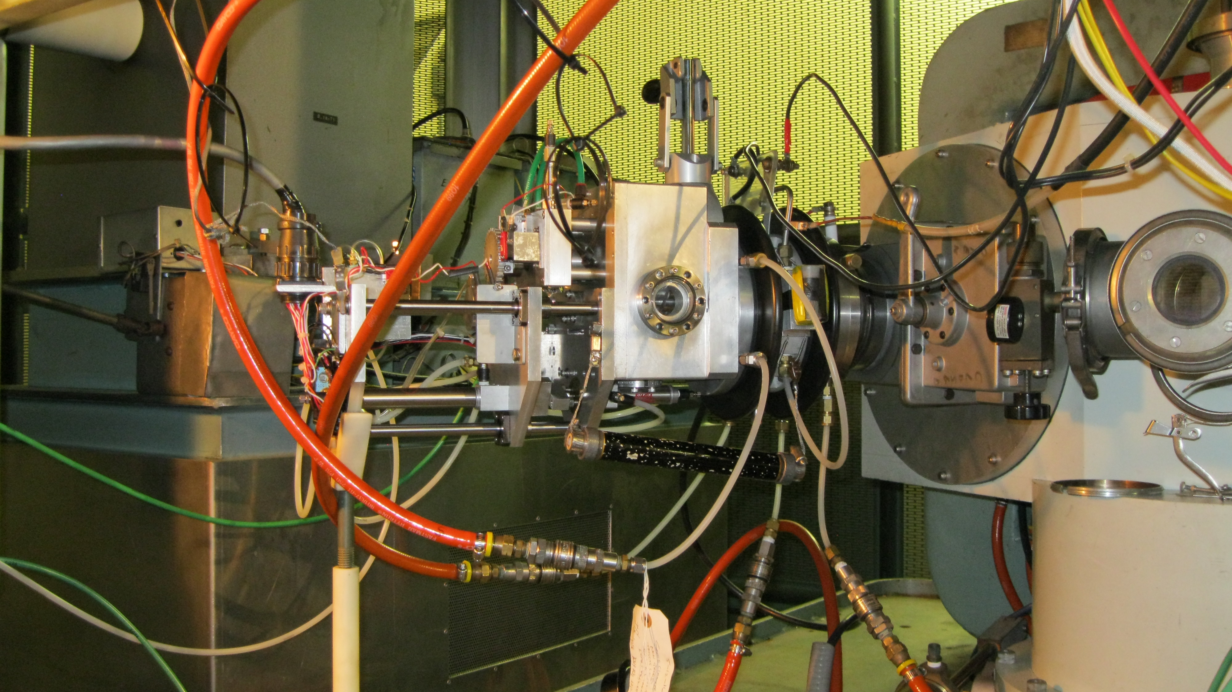
Source
Cs
Extractor
Target Changer
IS Chabber

Slide 20
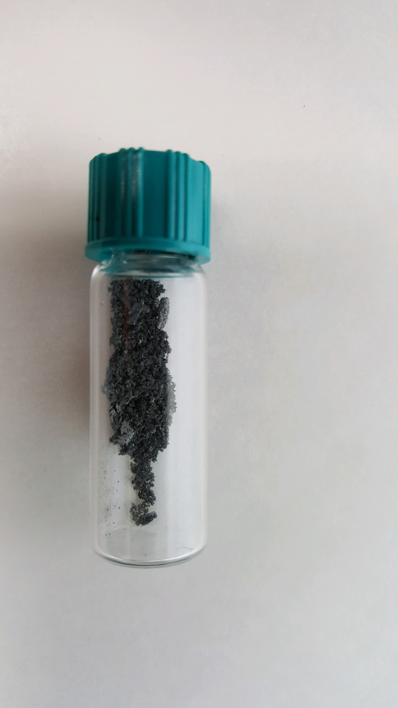
Ruthenium from Tandem
Enriched Ru-96 is not available commercially
We will get about 500 mg Ru-96 (79%) from ORNL,

Slide 21
Ruthenium Tests at Tandem
Dec 2015: Analyzed ₁₀₂Ru¹² and ₉₆Ru¹² from Natural RuO
-₁₀₂Ru 29.2 μA (7.7e9) and ₉₆Ru 5.7 μA (1.5E9)
March 2016: Using natural RuO, eight pulses per SC of ₉₆Ru¹² were delivered to Booster. The SC length was 5.4 sec and pulse width was 600 us. Single pulse at 11/30 FC was 1E9 & 0.76E9 ion per pulse at booster input and 1.07E9 ion per bunch at extraction of AGS, with 8-4-2 merge scheme in AGS.
Feb 2017: Compared Natural RuO 100%, 50/50% and 25/75 % with Ag
- ₁₀₂Ru; 100% 18 μA (4.7E9), 50/50% 15.8μA (4.1E9), 25/75 % 15.2 μA (4.0E9)

Slide 22
Ru Tests at Tandem (Cont.)
June 17: Compared natural Ru Metal 100%, 50/50% and 20/80% with Al.
-₁₀₂Ru 100% - 26.8 μA (7 E9), 50% - 16 μA(4.2E9), 25% - 15.2μA (4.0E9)
July 2017: Ru metal target analyzed. The analyzed beam intensity from the Ru metal was slightly better than 50% of the intensity from RuO targets. ORNL claim to convert Ru to RuO , 40-50 % material will be lost. The decision to go with Ru metal was based on ample intensity for the run as the enriched isotope is made in the metal form and material losses would occur during the oxide process. It appears at this time that the metal targets have a longer lifetime.

Slide 23
Ru Metal with Different Percentage of AL
 | Ru 100% |  |  | Ru 50% Al 50% |  |  | Ru 20% Al 80%
Mass | 102 Ru | 118 RuO | 16 O | 102 Ru | 118 RuO | 16 O | 102 Ru | 118 RuO | 16 O
Le Cup μA | 88 | 132 | 472 | 108 | 118 | 740 | 60 | 70 | 608
11/30 FC μA | 18 (4.7E9) | 26.8 (7E9) |  | 16 (4.3E9) | 24 (6.3E9) |  | 13 (3.4E9) | 10.5

Slide 24
Ru tests at Tandem
July 2017: Target lifetime tests are ongoing with 25%Ru 75% Al using 6 pulses 600 μsec wide every 2.5 sec. The source runs 24 hour/day with analyzing being done during the day in MP6 bypass line.
Aug 2018: Will continue to evaluate target life times, and optimize target sample volume, size and shape. Investigate best dilution material and percentage. This work will probably continue through to the end of year.
Jan 2018: When available try enriched ₉₆Ru at determined percentage to see if intensities correspond to results from ₁₀₂Ru.

Slide 25
Summary
We have established that tandem and EBIS can satisfy RHIC requirements for Ruthenium-96 and Zirconium-96.
Zirconium and NSRL ion species compete for same physical space in LION => schedules conflicts.
Life time test and cost minimization will continue till end of the year.

