Slide 1
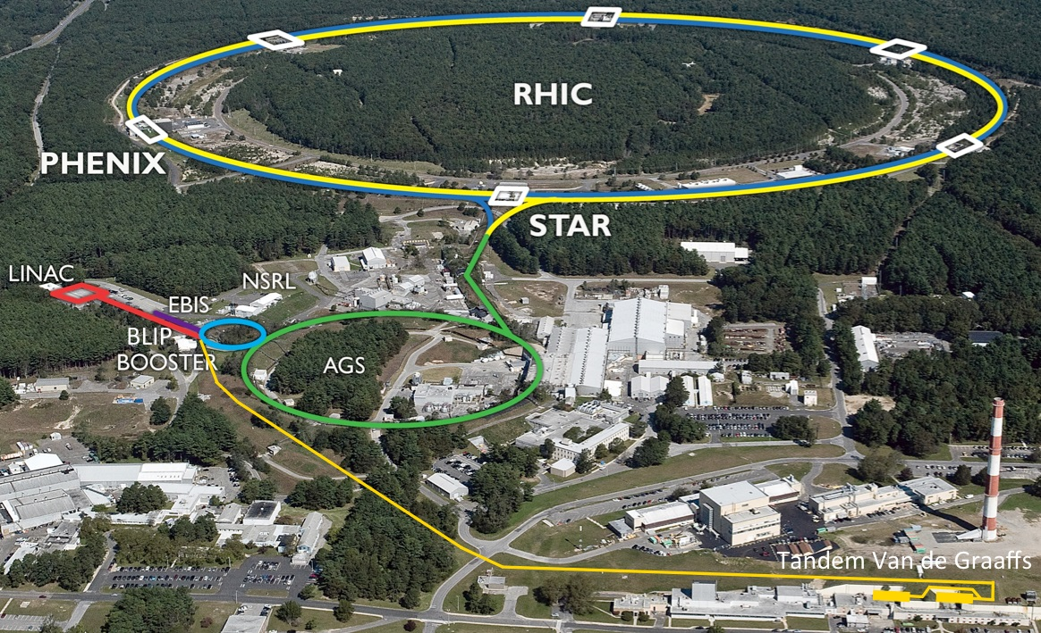

Projections for Run-18 and BES-II
Wolfram Fischer
8 August 2017
RHIC Retreat, BNL
Notes:
09:20, 20 min (incl. questions), 15 slides

Slide 2
Contents
Performance in Run-17
p↑+p↑ 255 GeV, RHICf
Au+Au 27.2 GeV/nucleon
CeC and LEReC commissioning
Projections for Run-18 and Run-19/20
Run-18 (Zr+Zr, Ru+Ru, Au+Au 100 GeV/nucleon)
Run-19/20 (Au+Au 3.85 – 9.8 GeV/nucleon)
→ Beam Energy Scan II (BES-II); most of BES-I in Run-10
Ongoing and planned upgrades
RHIC 9 MHz RF, LEReC, Extended EBIS
Linac (vacuum, Intensity Upgrade Phase II)

Slide 3
Run-17 p↑+p↑ at 255 GeV ∫Ldt and P
Run Coordinator: Vahid Ranjbar
STAR L_{max} limited to ≈ 1.4x10³² cm⁻²s⁻¹ => 1st p↑+p↑ run with L-leveling
L_{avg} = 0.83 L_{max} with β*-squeeze 2.0→1.5 m after 3 h
(L_{avg} = 0.90 L_{max} planned)
Run-13: P_{avg} = 53%
Run-17: P_{avg} = 55%
(H-jet average over intensity,
time, stores, Blue and Yellow)
ramp-up
faster than planned
slope
as planned
Special run
for RHICf:
5 stores with
β* = 8.0 m

Slide 4
Run-17 p↑+p↑ at 255 GeV Notable items
all DX magnets moved back to symmetric position
only one experiment STAR (PHENIX being converted to sPHENIX)
STAR experimental beam pipe changed (from 4 cm ID Be NEG coated to 8 cm ID Be without coating; adjacent Al pieces are NEG coated on both cases); PHENIX experimental beam pipe changed (from 4 cm ID Be to 12.2 cm ID SS, both NEG coated)
1 of 3 new 9 MHz cavities installed in each ring and made operational
(60 kV/cavity design, operated at 26 kV/cavity)
new ion optical system increases OPPIS beam by 20% (03/01/2017)
lens cryo upgrade - both superconducting solenoids run stably at 6 T
use of dual harmonic acceleration in AGS to reduce space charge near injection
MPS upgrade with additional permit inputs: RF, orbit correctors, 10 Hz orbit feedback, fast BPM readings (coherence signal); also lowered BLM thresholds at store
only transversely polarized beams at IP6 (no rotators)
8 h nominal store length
many Yellow quenches after 4 of 5 new mechanical serial switches failed to close after beam dump (03/13/2017); as a result yi7-d6 shows small bypass current in a quench protection diodes - reduced ramp rate by factor of 2 to reduce the bypass current
β* squeeze from 1.5 to 1.2 m nominally 3 h into the store (beginning 03/13/2017)
special Yellow Au ramp for CeC PoP (γ = 29.229); 90 h or dedicated CeC PoP time
beam from LEReC DC gun to gun line beam dump

Slide 5
Run-17 Au+Au at 27.2 GeV/nucleon ∫Ldt
Run Coordinator: Greg Marr
Operation concurrent with CeC commissioning
used 197 MHz RF,
no stochastic cooling (only 18 d of physics – too short)
bunch intensity limit from Landau cavities at transition
resolved => presentation by Darryl Goldberg
slope
as planned

Slide 6
Operational efficiency availability reported to DOE
Availability = beam time / scheduled beam time
(denominator excludes scheduled maintenance)
Availability goal: 80%
Typical times:
50K to 4K cool-down : 0.5 weeks
Initial set-up : 2 weeks
Changing species : 0.5 weeks
Beam studies (APEX): 16h / 2 weeks
Maintenance : 14h / 2 weeks
Warm-up : 0.5 weeks
=> Met availability goal now 6 years in a row

Slide 7
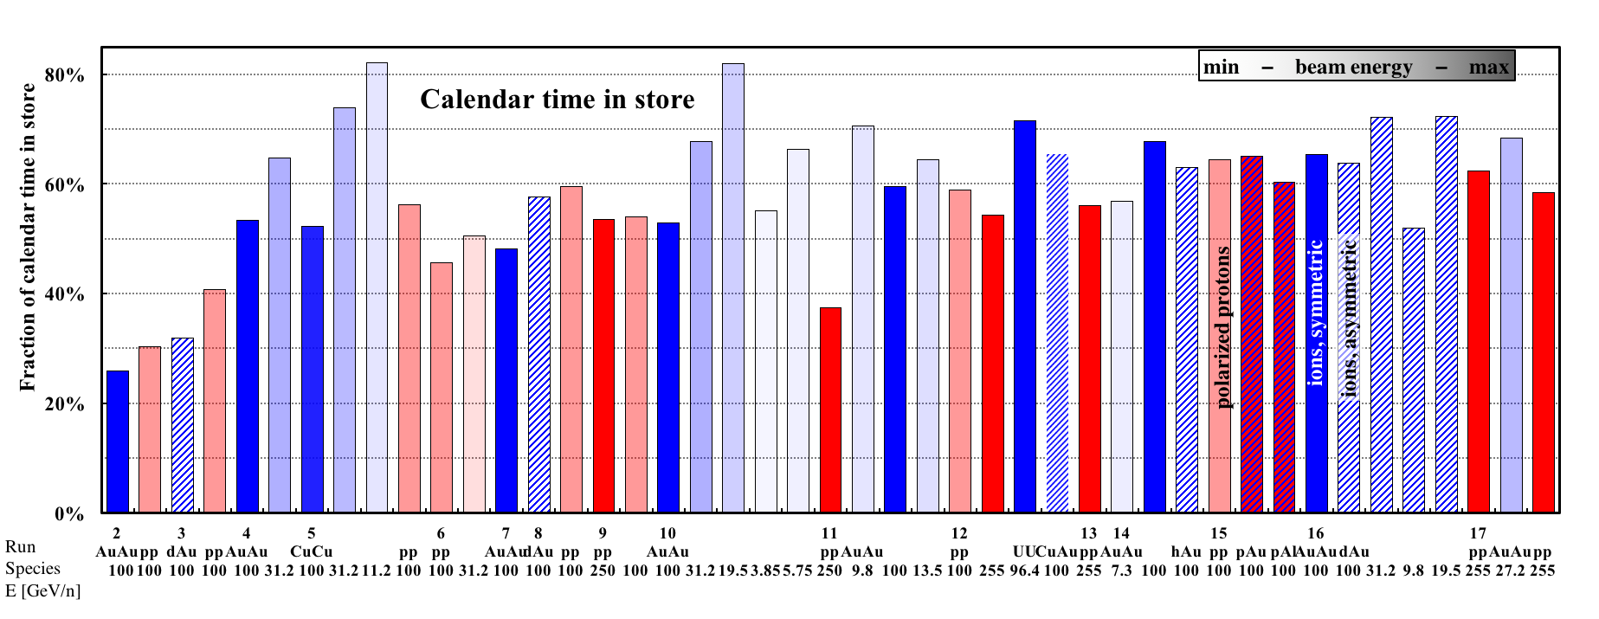
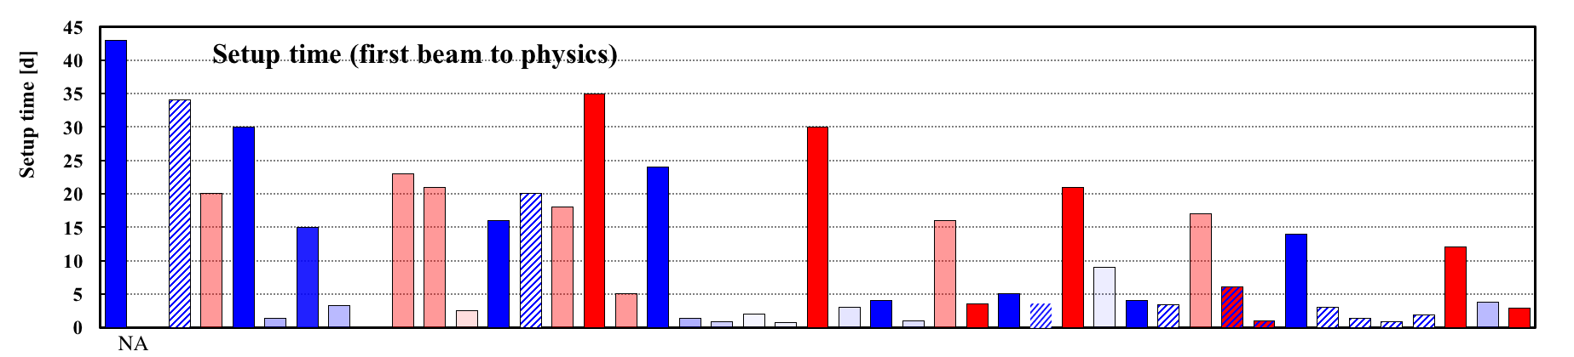
Operational efficiency setup time
Setup time:
- for 1st species in run: from both rings cold to 1st physics store
- for following species: from beginning of setup to 1st physics store
Run-17
12 days for p↑+p↑
≤ 3.8 days for Au+Au
TRANSPARENT: low energy
BLUE: heavy ion runs
INTRANSPARENT: high energy
RED: polarized proton runs

Slide 8
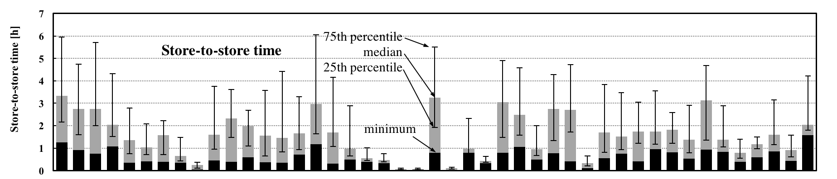
Operational efficiency store-to-store, time in store
Run-17
Time in store = store time / calendar time Goal: 60%
(denominator includes scheduled maintenance, failure, setup, beam experiments)
TRANSPARENT: low energy
BLUE: heavy ion runs
INTRANSPARENT: high energy
RED: polarized proton runs

Slide 9
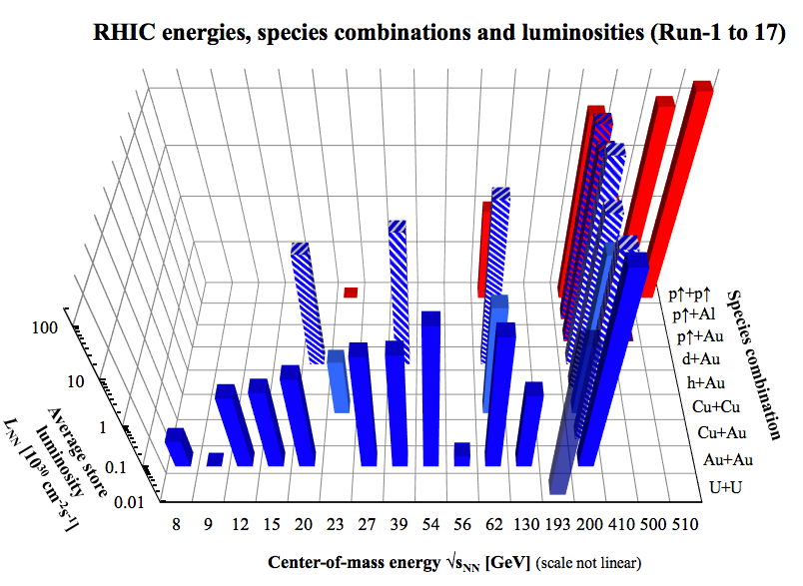
RHIC – all running modes to date 2001 to 2017
2017
2017
2019/20
BES-II with
LEReC
2000
2018
nominal injection energy

Slide 10
Outlook RHIC Run-18 and Run-19/20
PAC recommendations (STAR only while PHENIX => sPHENIX):
Run-18
Zr+Zr 100 GeV/nucleon 3.5 wks
Ru+Ru 100 GeV/nucleon 3.5 wks
Au+Au 13.6 GeV/nucleon 3.0 wks
Au+Au 3.85 GeV/nucleon 2 days (fixed target)
LEReC and CeC commissioning
STAR Spokespeson Zhangbu Xu, 05/09/2017:
“STAR is interested in looking into the luminosities at BES energies for isobars: Zr and Ru.

Slide 12
Run-18 Zr+Zr, Ru+Ru, Au+Au
Run Coordinator: Greg Marr
Important issues in Run-18:
Sources for Zr-96 and Ru-96
=> presentation by Deepak Raparia
Stochastic cooling
=> essential, intensity low compared to Au
Fast setup and reliable operation
=> only a few weeks in all modes
MPS upgrades
=> minimize downtime due to commissioning
LEReC and CeC commissioning in parallel

Slide 13
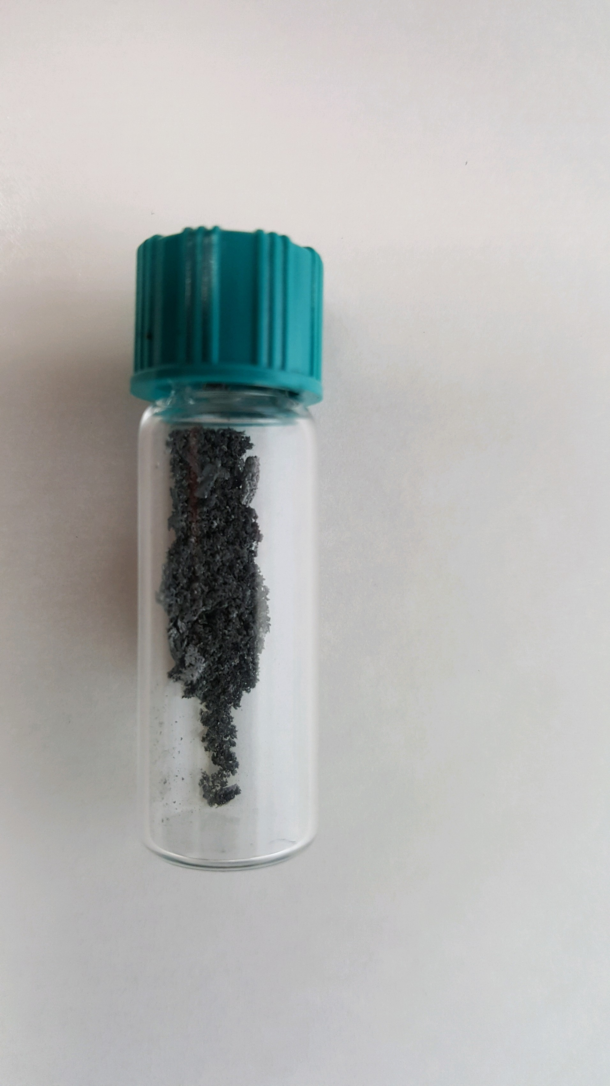
Run-18 Ru-96 and Zr-96
Why Ru-96 and Zr-96?
Same number of nucleons => same Quark-Gluon-Plasma system
Different number of charges => different magnetic field
Zr-96
natural abundance: 2.78%
From LION/EBIS (sintered ZrO₂) => M. Okamura et al.
Enriched ZrO₂ commercially available,
processing using RIKEN technology
Ru-96
natural abundance: 5.52%
From Tandem (metallic) => P. Thieberger et al.
Provided by DOE using new isotope separation facility at ORNL
More details by Deepak
ZrO₂ tablet made at RIKEN
Ru-96 metal flakes
from DOE inventory

Slide 14
Run-18: ⁹⁶Zr + ⁹⁶Zr, ⁹⁶Ru + ⁹⁶Ru Luminosity estimates
Based on 2016 and 2017 tests at EBIS and Tandem,
and note by C. Gardner (08/03/2017)
2x the L that
fills the STAR
bandwidth

Slide 15
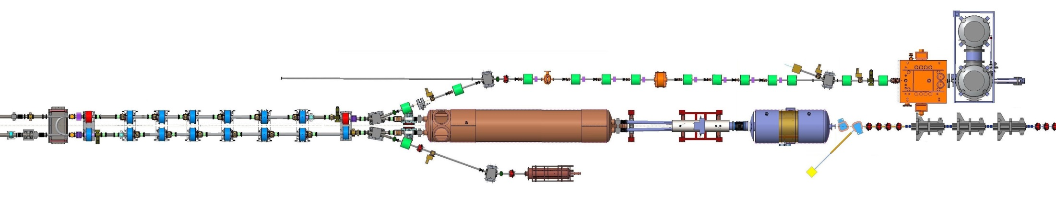



Low Energy RHIC electron Cooling (LEReC)
A. Fedotov
64 m to IP2
(not to scale)
Commissioning
Diagnostic Line 1
704 SRF
Booster Cavity
Commissioning
Diagnostic Line 2
704 MHz
Cu Cavity
9 MHz
Cu Cavity
2.1 GHz
Cu Cavity
DC
e⁻ Gun
e⁻
COOLING
in Yellow RHIC ring
e⁻
RHIC TRIPLET
RHIC DX
e⁻
COOLING
in Blue RHIC ring
LEReC Solenoids
Compensating (LF)
Matching (HF)
Merger/Transport
180° Bending Magnet
20° Bending Magnets
Beam Dump
Energies E : 1.6, 2.0 MeV
Avg. current I_{avg} : 27 mA
Momentum δp/p : 5×10⁻⁴
Luminosity gain : 4×
1st bunched beam electron cooler
planned operation in 2019/2020

Slide 16
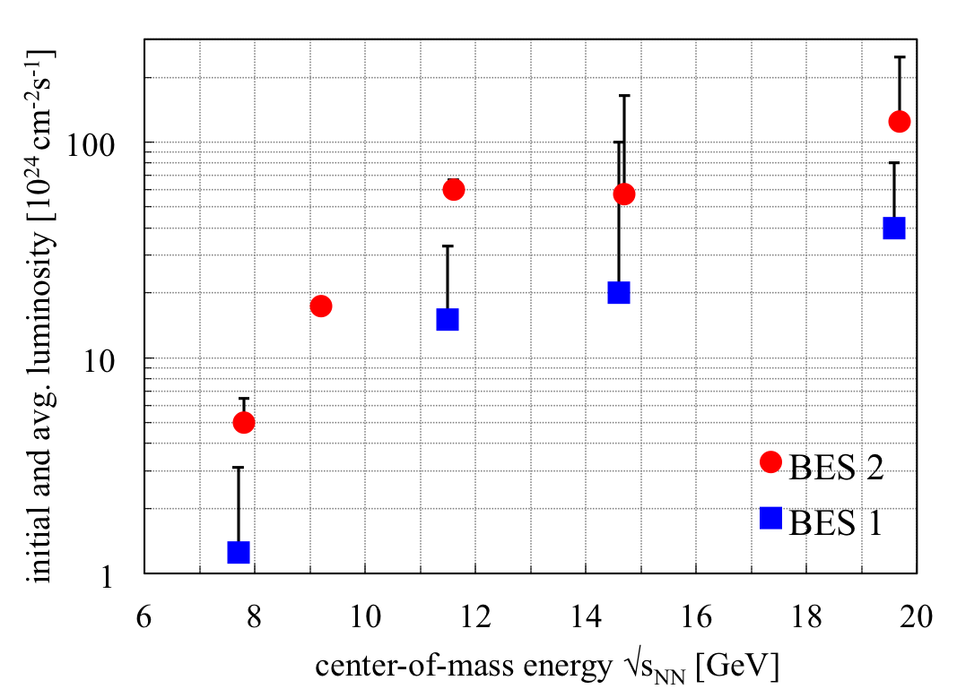
BES-II 2019/2020 BES-I and BES-II luminosities
4x increase in L_{avg}
with e-cooling
3x increase in L_{avg}
without e-cooling

Slide 17
LEReC Physics integration BES-II required events
RHIC Beam Energy Scan II (BES-II)
for search of critical point in QCD phase diagram
center-of-mass energy √s_{NN} | GeV | 7.7 | 9.1 | 11.5 | 14.6 | 19.6
events BES-I, actual | M | 4.3 |  | 11.7 | 24 | 36
events BES-II, min goal | M | 80 | 100 | 150 | 200 | 300
events BES-II, full goal | M | 100 | 160 | 230 | 300 | 400
General strategy to maximize integrated luminosity:
Cooling at the 3(2) lowest energies (4x gain in L_{avg}),
no cooling at the 2(3) highest energies (3x gain in L_{avg})
=> demonstrated at √s_{NN} = 19.6 GeV in Run-16
Increase cryo-time from 22 to 24 weeks/year
Start BES-II at highest energies (machine ready w/o cooling)
Interleave cooling commissioning with physics operation
Finish BES-II at lowest energies (largest gain in L_{avg} and time)
Notes:
STAR vertex acceptance: +- 1m
STAR contacts: Zhangbu Xu (spokesperson), Bill Christie, Paul Soerensen, Daniel Cebra

Slide 18
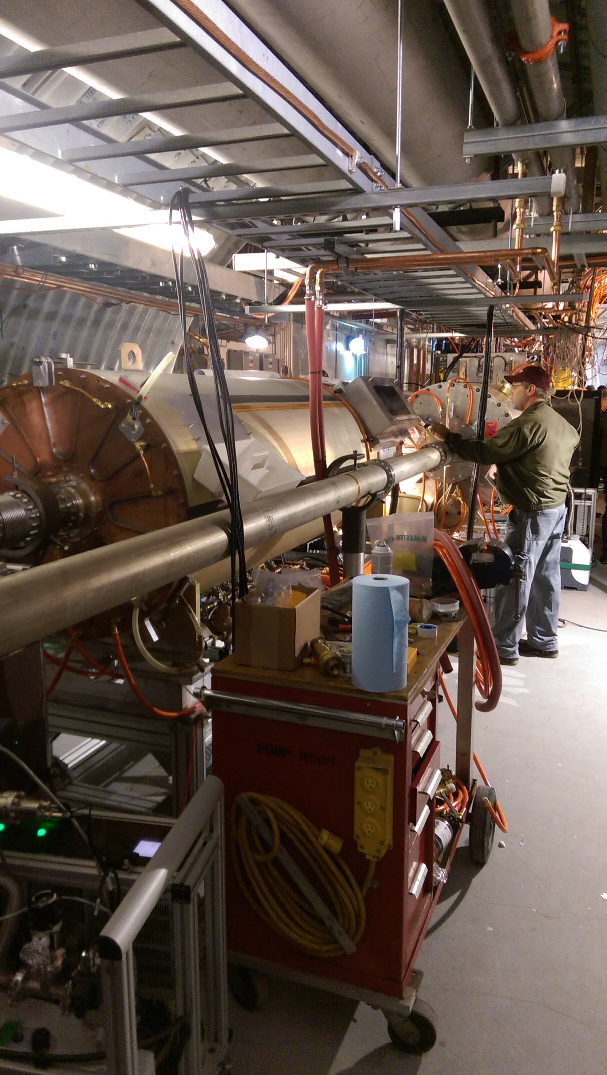
RHIC Upgrades Overview
Low-Energy RHIC electron Cooling (LEReC)
Details in presentation by Alexei Fedotov
RHIC 9 MHz RF Upgrade
1/3 cavities per ring in Run-17 (60 kV/cavity)
2/3 in Run-18, 3/3 in Run-19
Extended EBIS
2nd superconducting solenoid
completion for Run-19/20
Linac Upgrades
Vacuum upgrade
Intensity Phase II: 2x pulse length (for BLIP, applied for funding)
=> received funding for PS prototypes
trap length
extension

Slide 19
RHIC hadron complex infrastructure 25+ years
Need to update list of upgrades to maintain RHIC
hadron complex for 25+ years
(last time done for all areas in 2011 for 10+ years)
What systems? When? How much?
Basic assumptions for estimate (reality will differ):
RHIC operation with A+A, p+A, p+p until 2024
eRHIC construction for 3 years, followed by
15 years of operation
Only the Yellow RHIC ring and 2 Blue arcs are maintained operationally for eRHIC
(also have a rough estimate for both rings maintained)
RHIC modifications for eRHIC excluded

Slide 20
Summary
Run-17
met L and P goals for p↑+p↑ 255 GeV
first p↑ run with leveled L (β* squeeze)
quench protection diode damage again
met L goals for Au+Au 27.2 GeV/nucleon
Maintained high operational efficiency
reduced p↑+p↑ 255 GeV setup time again (2013: 21 d → 2017: 12 d)
86% availability (goal: 80%),
62% of calendar time in store for all p↑+p↑ 255 GeV, 68% for Au+Au 27.2 GeV/nucleon
Preparation for next runs
Run-18: Zr+Zr, Ru+Ru 100 GeV/nucleon, Au+Au 13.5 GeV/nucleon
LEReC beam commissioning, CeC commissining
Run-19/20: Beam Energy Scan II (5 energies, 2 lowest with LEReC)
Ongoing and planned upgrades
RHIC 9 MHz RF, LEReC, Extended EBIS, Linac (vacuum, Intensity Phase II)
P_{avg} = 55%

Slide 22
RHIC ultimate luminosity and polarization goals
parameter | unit | achieved |  | goals
Au-Au operation |  | 2016 |  | ≥ 2021 56 MHz SRF + AGS + 9 MHz RF
energy | GeV/nucleon | 100 |  | 100
no colliding bunches | … | 111 |  | 111
bunch intensity | 10⁹ | 2.0 (1.6) |  | 2.5 (2.0)
avg. luminosity | 10²⁶ cm⁻²s⁻¹ | 87 |  | 175 2× achieved
p↑-p↑ operation |  | 2015 |  | ≥ 2021 OPPIS + 9 MHz RF + e-lenses
energy | GeV | 100 | 255 | 100 | 255
no colliding bunches | … | – 111 – |  | – 111 –
bunch intensity | 10¹¹ | 2.25 | 1.85 | 3.0 | 3.0
avg. luminosity | 10³⁰ cm⁻²s⁻¹ | 63 | 160 | 175 2.8× achieved | 600 3.8× achieved
avg. polarization* | % | 55 | 52 | 60 | 55
*Intensity and time-averaged polarization as measured by the H-jet. Luminosity-averaged polarizations, relevant in single-spin
colliding beam experiments, are higher.

Slide 23
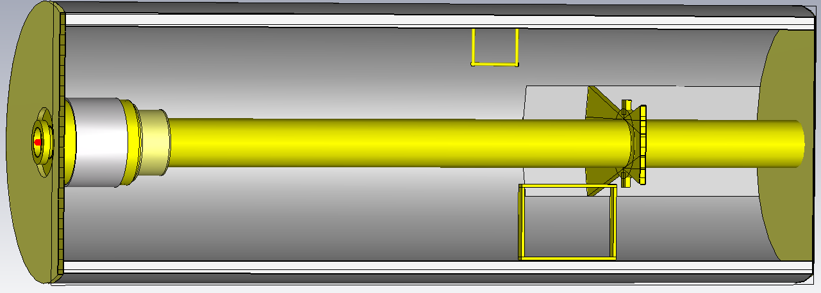
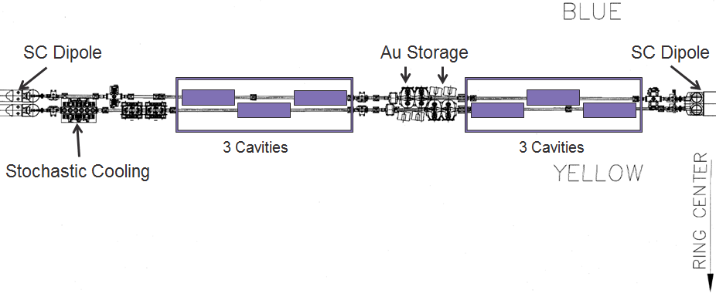
RHIC 9 MHz RF Upgrade
A. Zaltsman, S. Polizzo
Scope
3 cavities per ring (60 kV per cavity)
[existing 9 MHz RF: 22 kV (p↑+p↑)]
3 areas of benefit:
Larger bucket and ramp speed for protons
(avoids squeeze out on early part of ramp, faster crossing of spin resonances)
Lower peak current for transition crossing (increase in bunch intensity)
Operation with long bunches at low energy ions (enhancement to LEReC)
Cost and funding
Schedule
started: 08/2013
planned completion: 12/2018 (begin of beam commissioning)
Status
installation of 1 cavity per ring for Run-17,
Installation of 2 cavities per ring for Run-18, and 3 per ring for Run-19
FY2014 | 2015 | 2016 | Total
$675k (A) | 700k (A) | 625k (A) | 2.0M
Notes:
Mar-2015: install first article in RHIC ring
Nov-1016: complete installation in RHIC
Oct-2017: start commissioning with beam

Slide 24
STAR luminosity request
Dependence of useful event rate R(t) on instantaneous luminosity L(t):
R(L(t)) = if (L < 22x10²⁶ cm⁻²s⁻¹) { L(t) * 4.3x10⁻²⁴ cm² * 0.16 }
else { 1500 Hz }
General RHIC setup strategy:
(Long) stores with L(t) > 22x10²⁶ cm⁻²s⁻¹ throughout the store
=> STAR bandwidth always filled
Initial luminosity L_{init} = 3x22x10²⁶ cm⁻²s⁻¹ = 66x10²⁶ cm⁻²s⁻¹
=> stochastic cooling ensures L(t) > 22x10²⁶ cm⁻²s⁻¹
Initial bunch intensity N_{b} ≥ 1.3x10⁹ for both ⁹⁶Zr and ⁹⁶Ru
=> can be done with enriched ⁹⁶Zr and ⁹⁶Ru
⁹⁶Zr natural abundance 2.81%
=> 50% enriched ⁹⁶Zr available, ops from EBIS
⁹⁶Ru natural abundance 5.54%
=> DOE working on finding/producing enriched ⁹⁶Ru
10% abundance sufficient in target material, ops from Tandem

Slide 25
Run-18: ⁹⁶Zr + ⁹⁶Zr, ⁹⁶Ru + ⁹⁶Ru – at lower energies
Zhangbu Xu, 05/09/2017:
“STAR is interested in looking into the luminosities at BES energies for isobars: Zr and Ru.
At: 39, 27, 19.6 and 14.6”
Response, 06/15/2017:
We should not run lower than sqrt(sNN) = 39 GeV. At this energy stochastic cooling still works.
If we don’t have stochastic cooling, the source consumption goes up significantly, which is particularly problematic for Ru-96.
Using the same bunch intensity as we project for sqrt(sNN) = 200 GeV the luminosity would drop by a factor ~20 going from 200 GeV to
39 GeV.

