Slide 1
C-AD Staff Planning
Diane R. Hatton, Director
Office of Project Planning & Oversight – Accelerator Projects
NPP Directorate
August 8, 2017

Slide 2
Observations and Assumptions
Nature of work in C-AD evolving
Increasing number of projects are putting pressure on C-AD operations resources (staff)
Many projects are relying on C-AD resources being available when they need them
Staff planning based on people v. requirements
Currently no easy way to determine when resources are needed by
  Projects that plan to pay for the resources
  Projects and other endeavors that are planning on contributed resources
Currently no easy way to determine the impacts of operations on projects and projects on operations

Slide 3
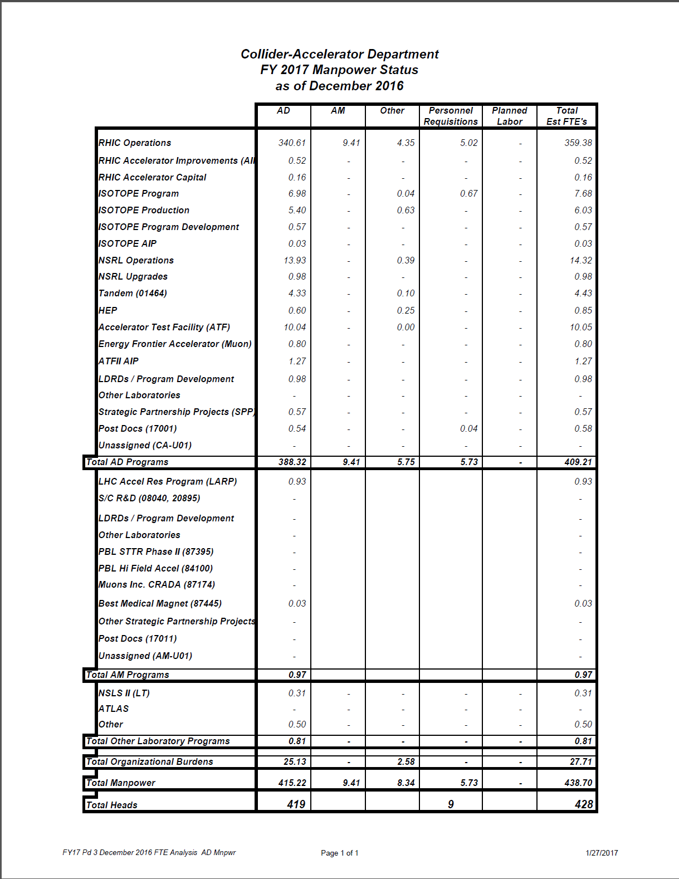
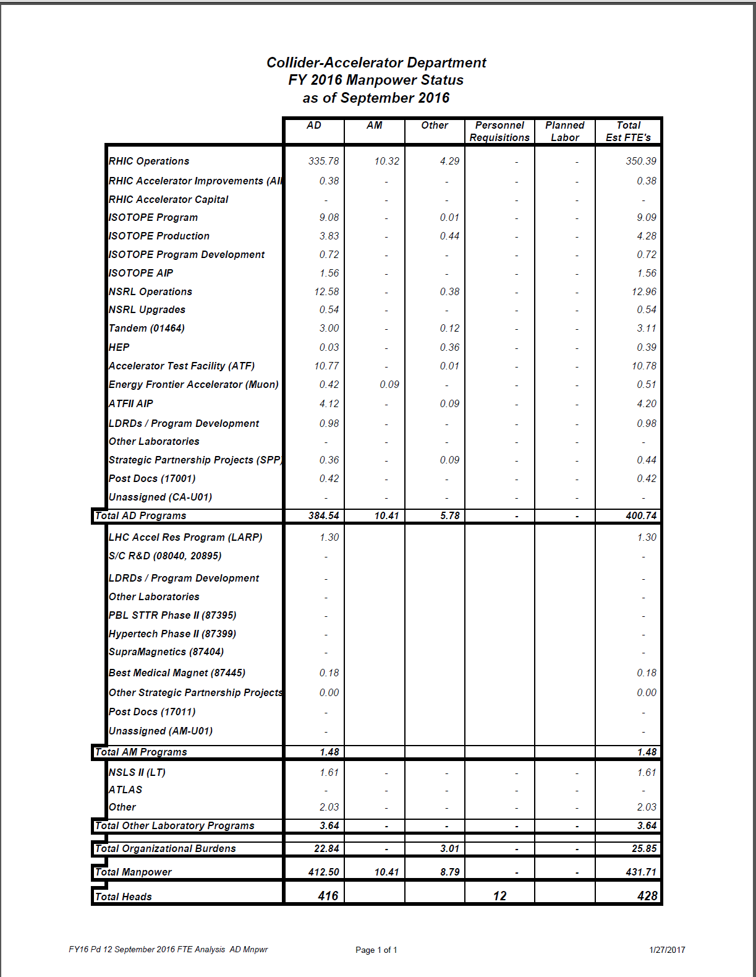
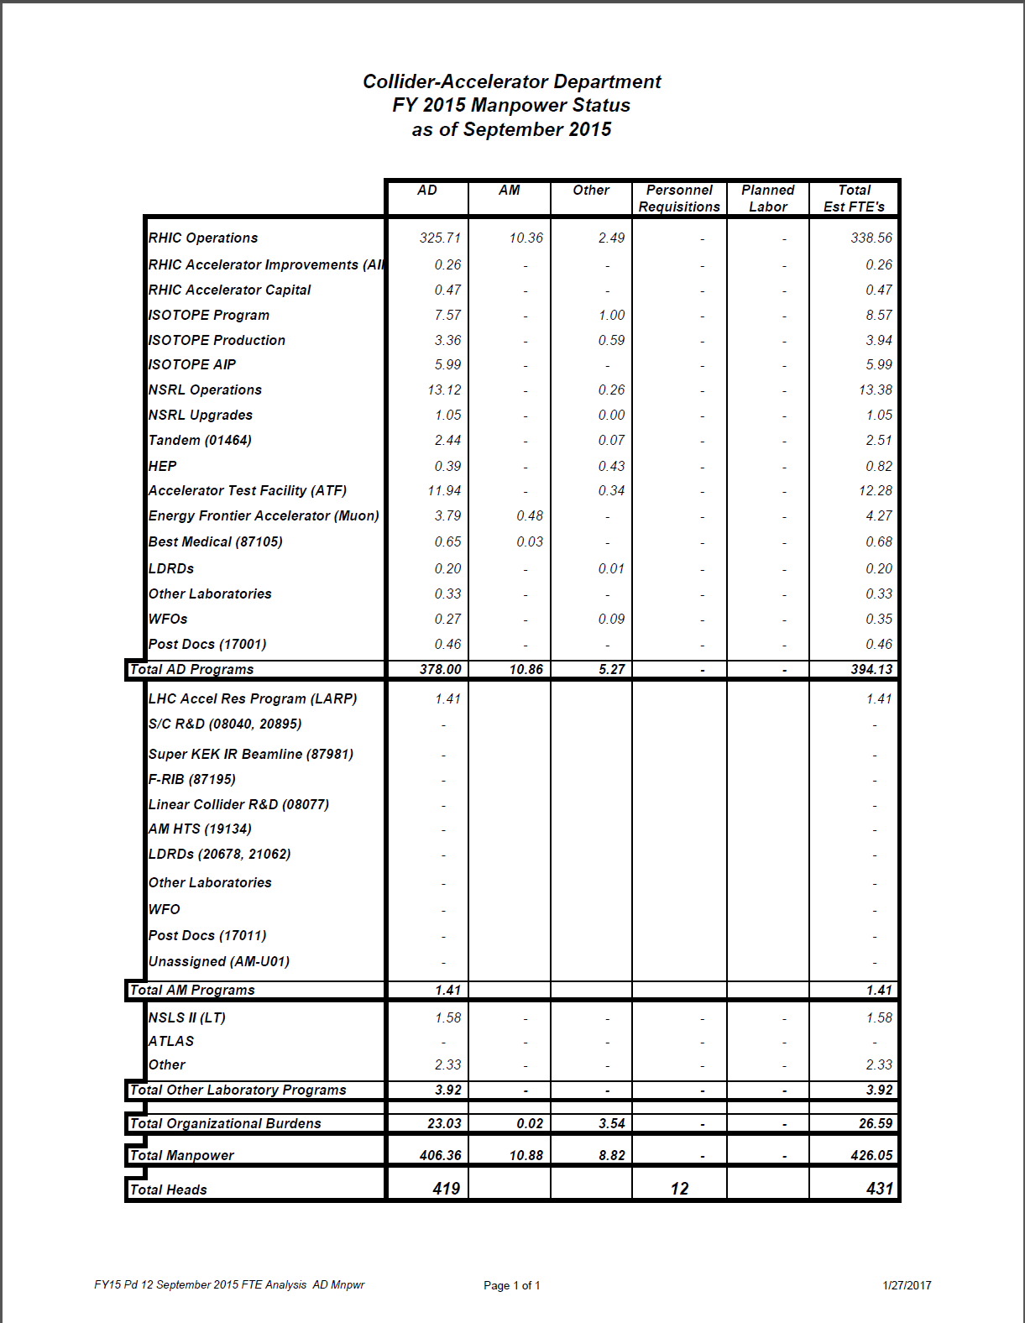
Current State Examples

Slide 4
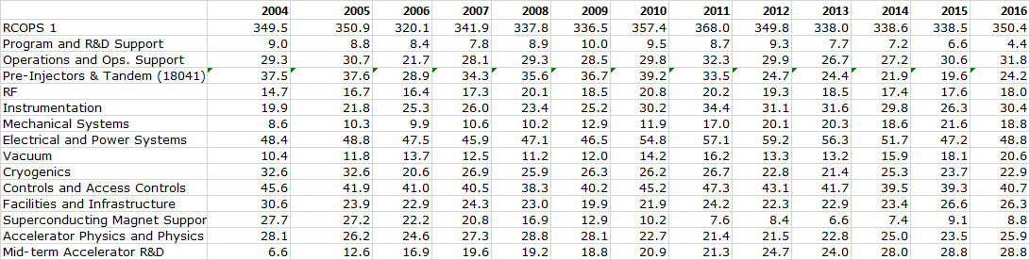
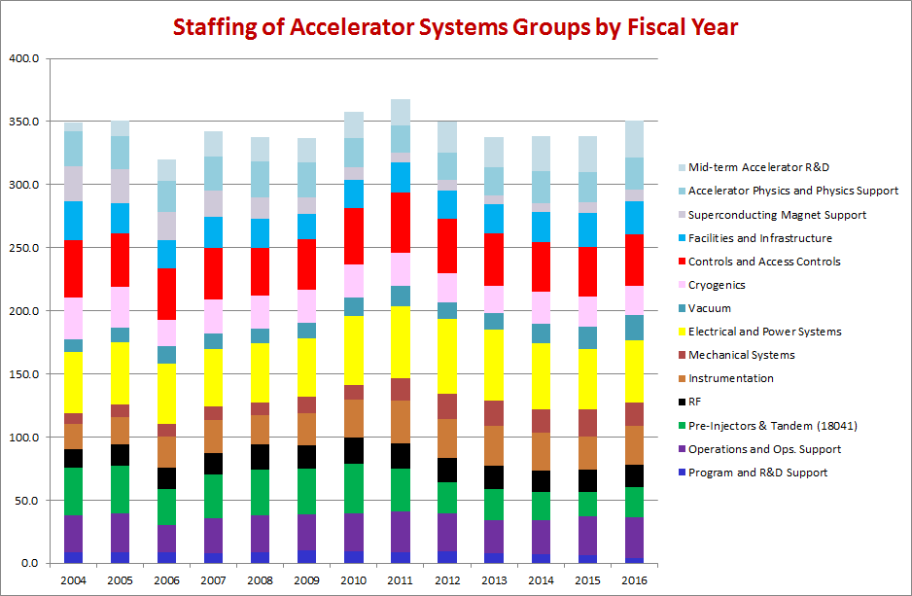
Current State Examples

Slide 5
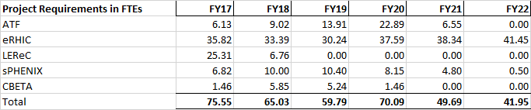
Project Requirements being met by C-AD Staff
Excludes “contributed” and unaccounted for support

Slide 6
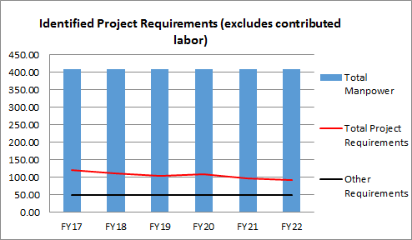
Identified requirements – Impact on Total C-AD labor

Slide 7
NSLS-II Project Example of Staff Planning

Slide 8
Staff Requirements
Requirements – resource needs, estimated in hours, by labor category (Scientist, Management, Engineer, Technician, Post Doc, Admin) for each component of a portfolio
  NSLS Operations
  NSLS-II Project
  ABBIX
  NEXT
  NSLS-II Ops
  NSLS Decommissioning
  NxtGen
  NEXT-II
  BER Beamlines
  NIH/BER Operations

Slide 9
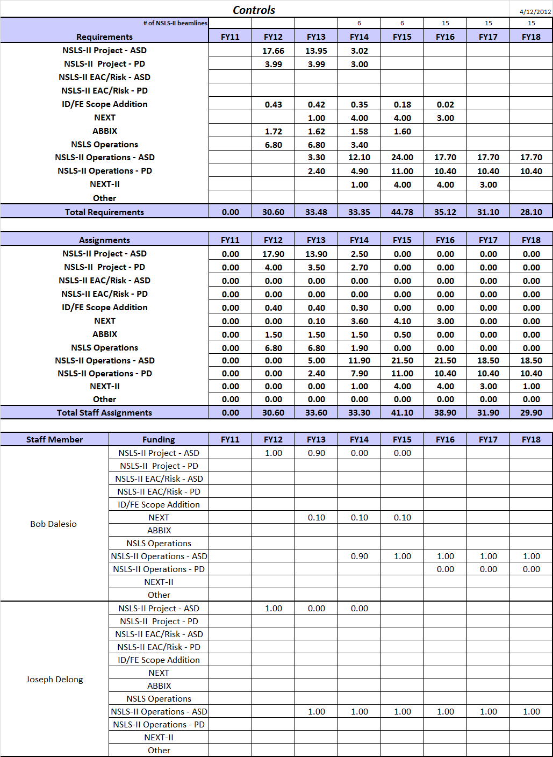
Assigning Staff
Based on requirements, Group Leaders assign staff to work on identified requirements

Slide 10
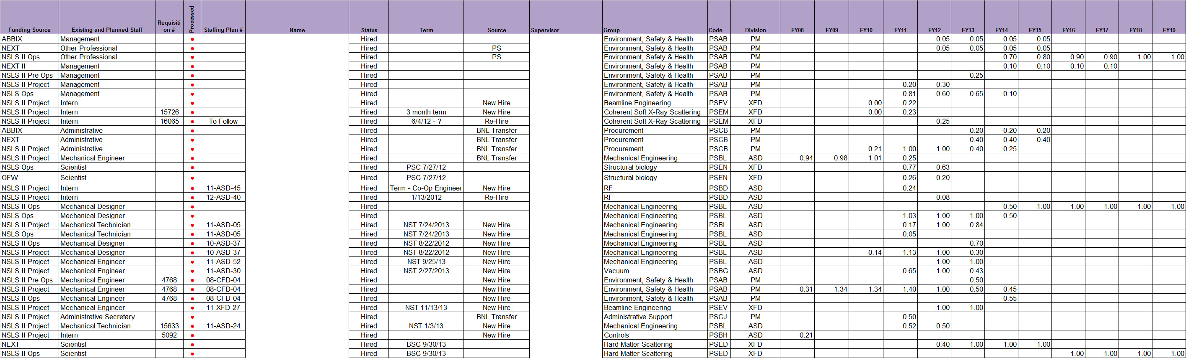
Integrated Staffing Plan
Each employee, job shopper, MOU staff member and expected new hire planned against a funded staff requirement
Areas of overstaffing identified
Areas requiring new hires identified
Continuously managed and updated

Slide 11
Challenges
Annual planning was not enough to see and track
  Increased requirements due to operations issues
  Delay of work
  Work that took more labor than anticipated
Plan used Excel exclusively and was very labor-intensive and manual
One FTE to manage
Regular meetings with Group Leaders
Frustration when it was automated
Fragile

Slide 12
More Sophisticated Example of Staff Planning

Slide 13
How it works….
Requirements are collected for all work with phasing over the time when the work needs to occur
Actual labor effort is brought in through BNL’s financial system
Available labor pool is added
Reports and graphs generated for analysis

Slide 14
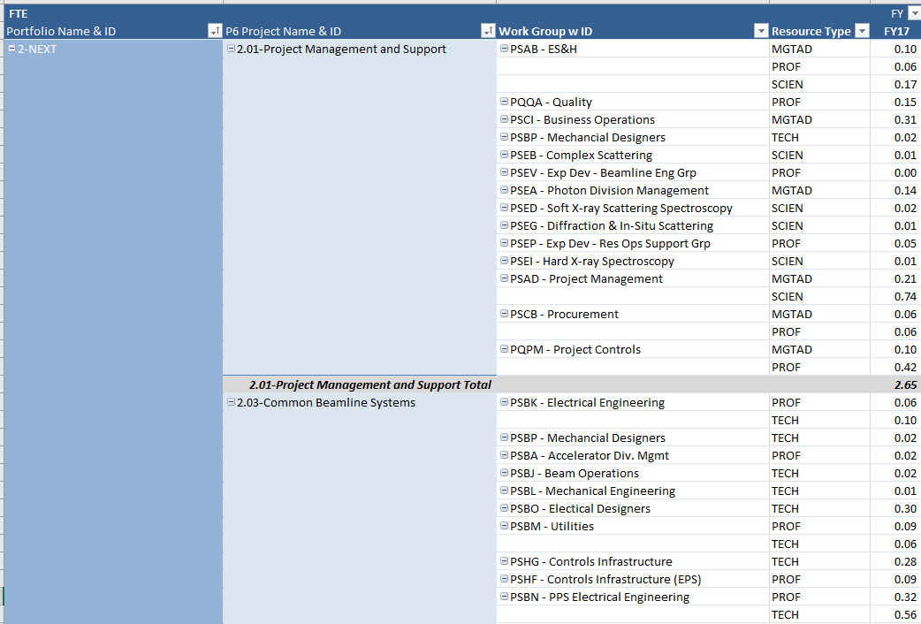
Reports – Requirements by Project

Slide 15
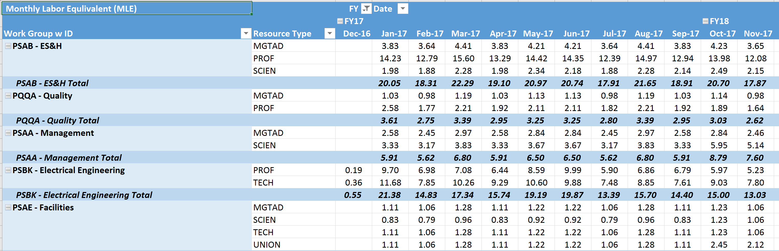
Reports - Requirements by Group by Month

Slide 16
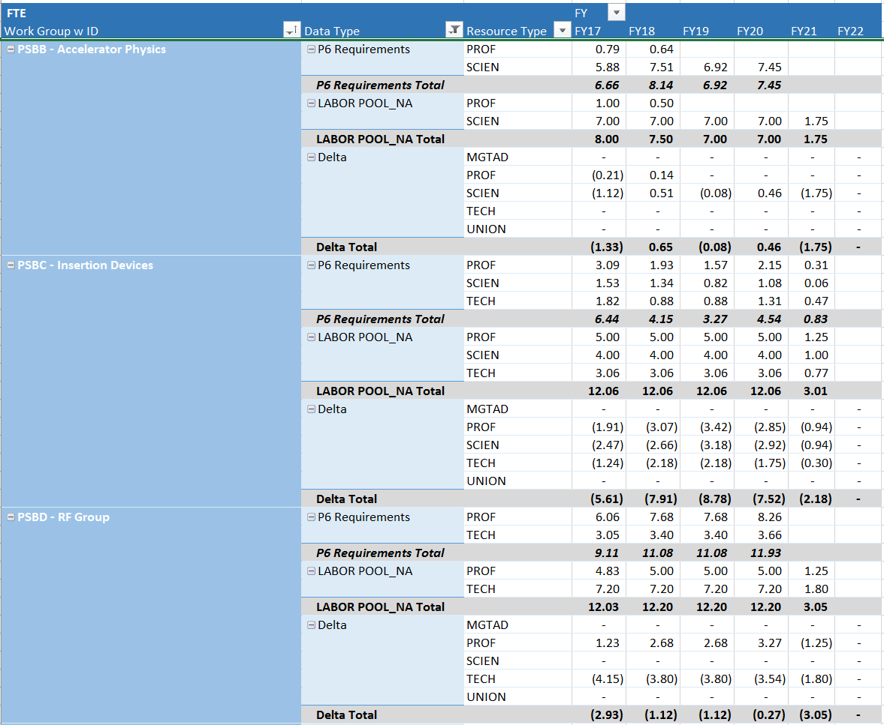
Reports – Requirements v. Labor Pool

Slide 17
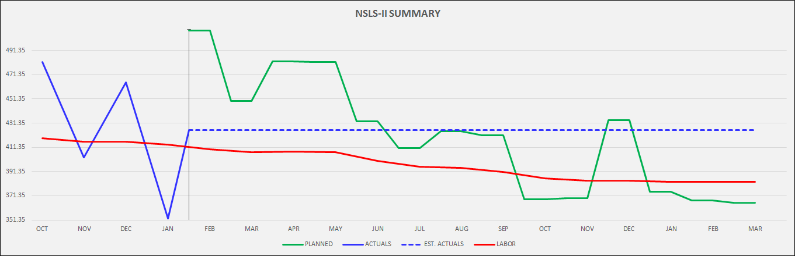
Graphs – Entire Organization in the Short Term

Slide 18
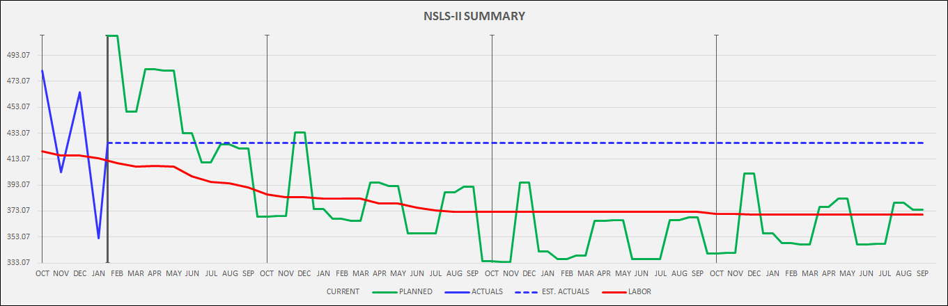
Graphs – Entire Organization over the Longer Term

Slide 19
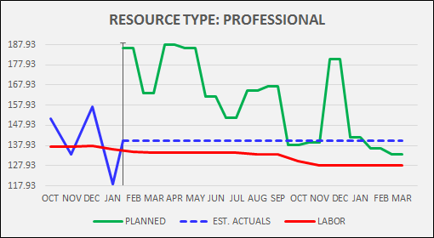
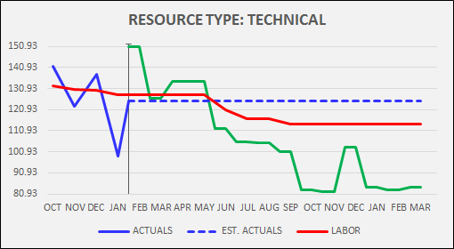
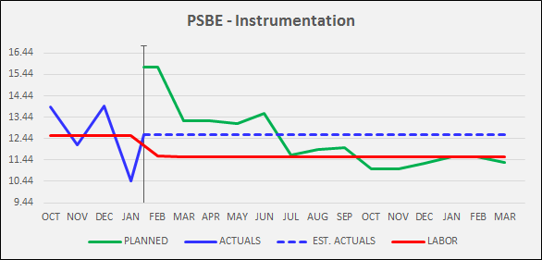
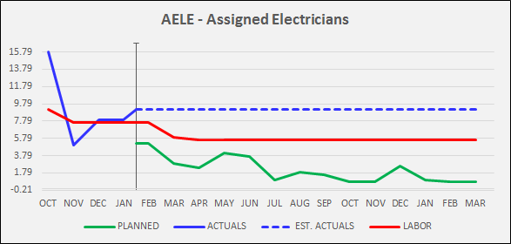
Graphs
By Staff Type
By Group

Slide 20
C-AD Plan
Gather C-AD staffing requirements in one place.
Put requirements into a schedule format
Use less rigor on operations but will need a WBS
Must charge labor that is contributed from C-AD to a separate account so that it can be tracked
Have a “Requirements” report by the end of the Fiscal Year
Start tracking actuals against the plan in FY18

Slide 21
Status
All project requirements that rely on C-AD staff now pulled into Primavera for this exercise
  sPHENIX
  ATFII
  LEReC
  CBETA
  eRHIC R&D and Design
In the process of gathering the Operations Requirements
  In WBS format
  Gathering information by facility (Linac, Booster, AGS, RHIC, etc.)
  Being separated by
    Management
    Operations
    Maintenance
    Minor Repairs
    Improvements/Replacements
On track for a requirements report by the end of FY17
Plan to start tracking actuals against the plan in FY18

Slide 22
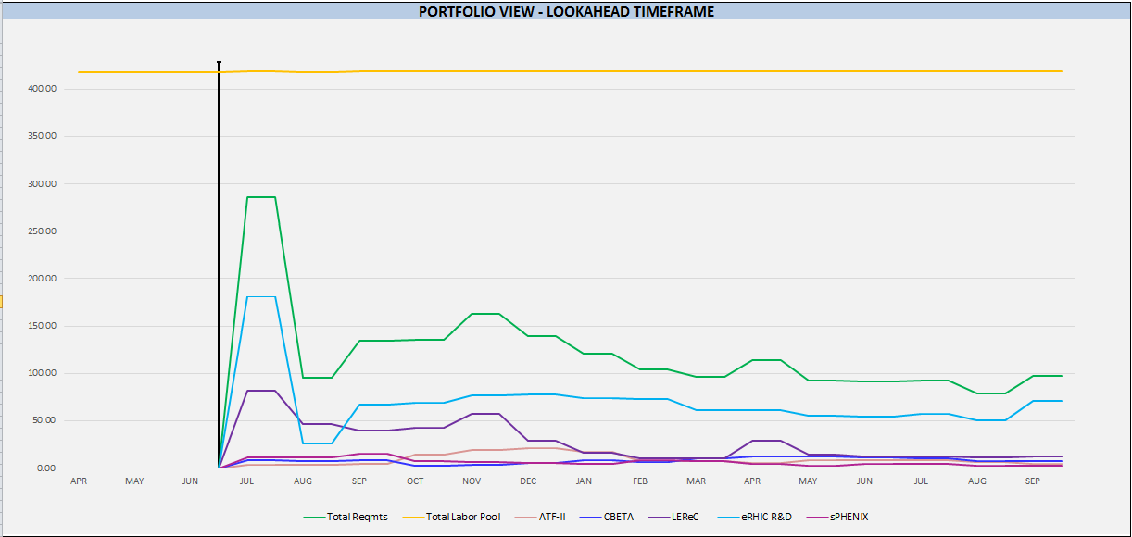

Slide 23
Questions?

