Slide 1
Cec PoP in Run-17 and plans for Run-18
Vladimir N. Litvinenko - PI
Igor Pinayev – Project physicist
Joseph Tuozzolo – Project Engineer
Results of Run 17 and plans for Run 18

Slide 2
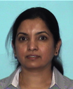



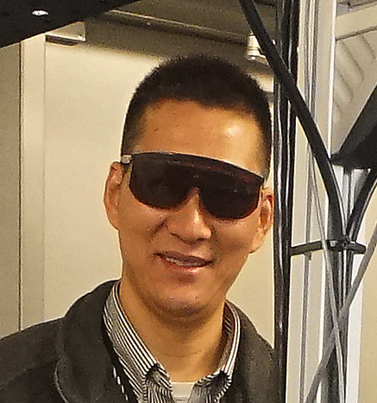




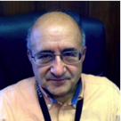

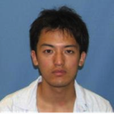






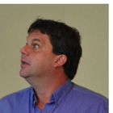




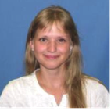











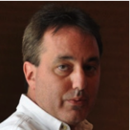






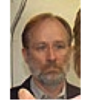


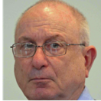
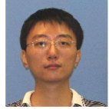

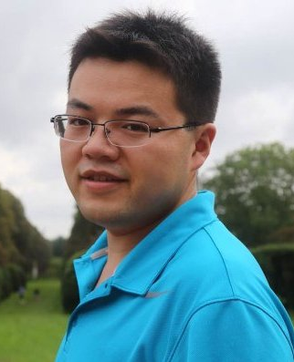
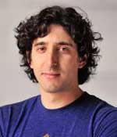
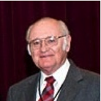
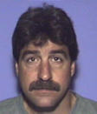




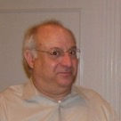
It take the village… the CeC team – never can get all your pictures but really appreciates all your efforts

Slide 3
Content
Why we doing it?
Run 17
  Main achievements
  What worked and what did not?
Plan for Run 18
  Shutdown jobs
  Plan for demonstrating CeC
Q&A

Slide 4
It is all about future
CeC effect on eRHIC design
Short term:
If CeC is successful and is fully operational, eRHIC LR could reach 2x10³³ luminosity with 5 mA polarized electron current.
It removes main uncertainties in LR design of 50 mA of polarized e-beam
  5 mA, 0.5 nC/bunch
  100x lower HOM power
  10x lower TBBU threshold
  3x shorter hadron bunches
  3x higher frequency of crab cavities -> 1/3 of the voltage
  Up to 3x smaller β*
  10x lower SR losses
  10x lower SR back-ground
  and many positive effects for EIC detector
Final goal: eRHIC/EIC with 2x10³⁴ luminosity

Slide 5
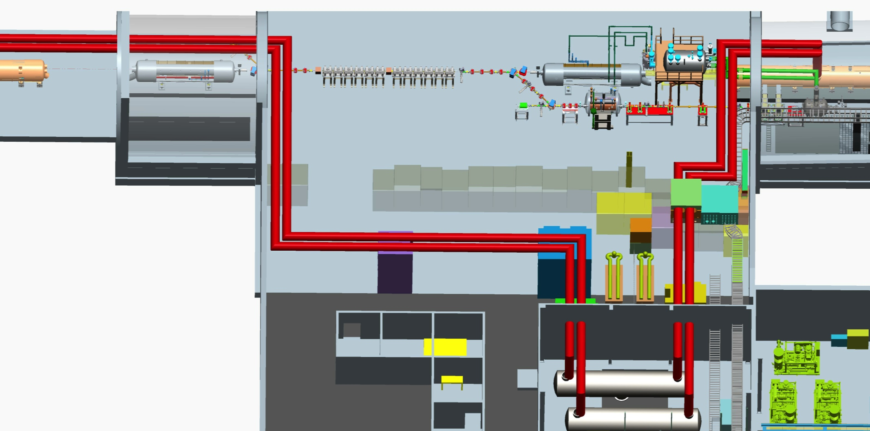
Test: Coherent electron Cooling (CeC) Demonstration Experiment

Slide 6
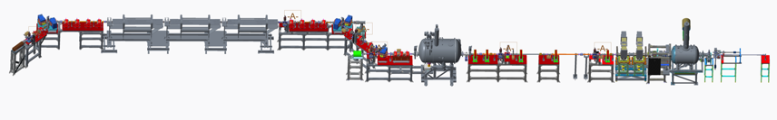
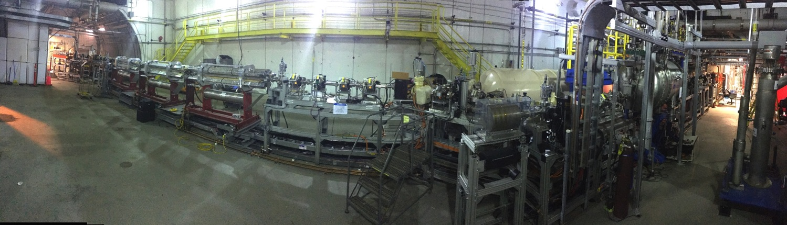
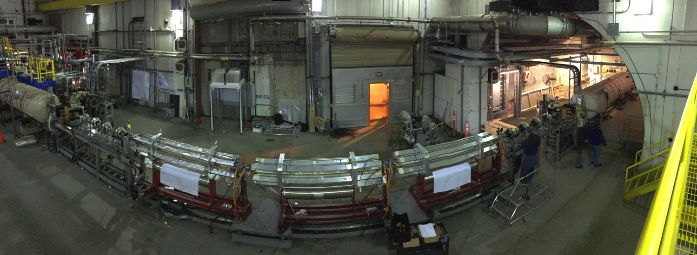
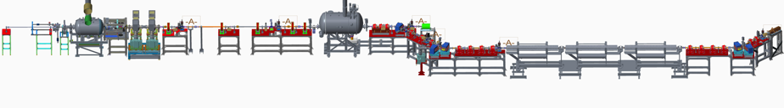
Panoramic views (before LEReC installation)
From inside RHIC ring
From outside RHIC ring

Slide 7
Main achievements
CeC SRF accelerator is fully commissioned. Electron beam at full power was propagated through the entire system to the high power beam dump with low losses
Beam diagnostics is fully commissioned and beam dynamics is well understood
Electron bunches are compressed and desirable level of peak current is demonstrated
Synchronization of electron and ion beams was established and interaction between the beams was detected
The system is ready for demonstration of coherent electron cooling during RHIC Run 18

Slide 8
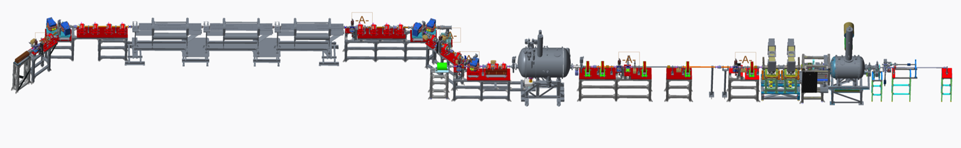
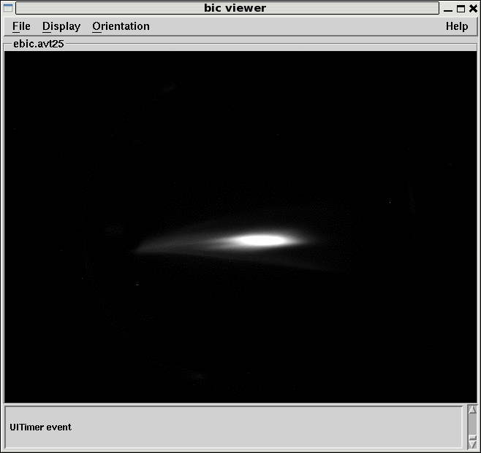
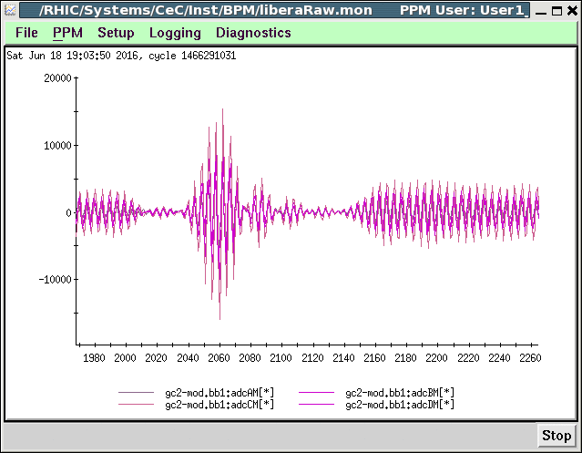
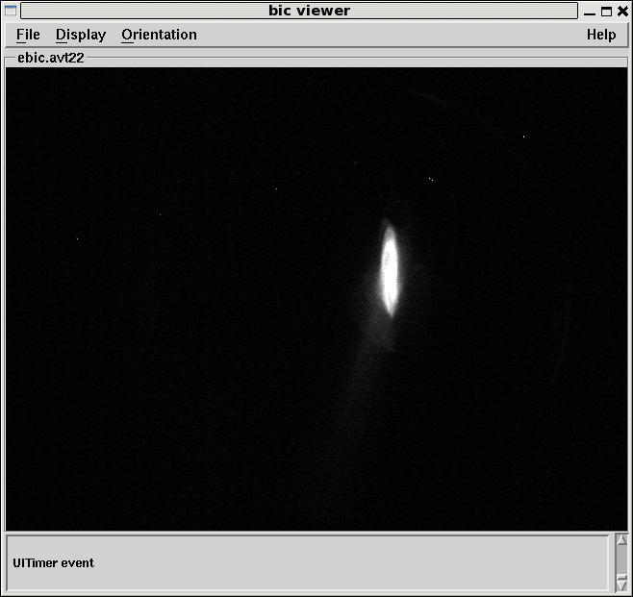
The CeC system commissioning
Common section with RHIC
1.05 MV
SRF photo-gun
and cathode
manipulation system
CeC “kicker”
4 quads
CeC FEL amplifier
3 helical wigglers
CeC modulator
4 quads
Dog-leg:
3 dipoles 6 quads
Bunching
RF cavities
Low power
Beam dump
High power beam dump
2 dipoles
4 quads
13.5 MeV
SRF linac
Low energy transport beam-line
with 5 solenoids
Beam at the end of the
system
BPM signal in the common section
Compressed beam
in the dogleg

Slide 9
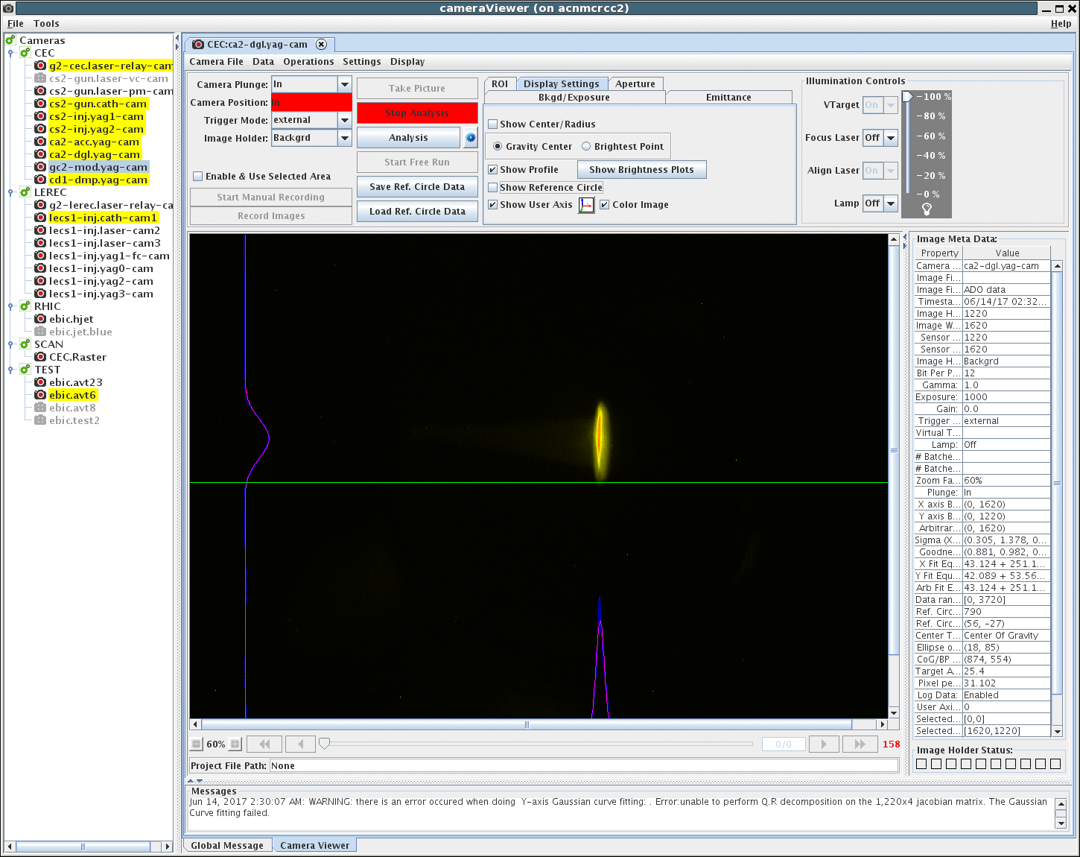
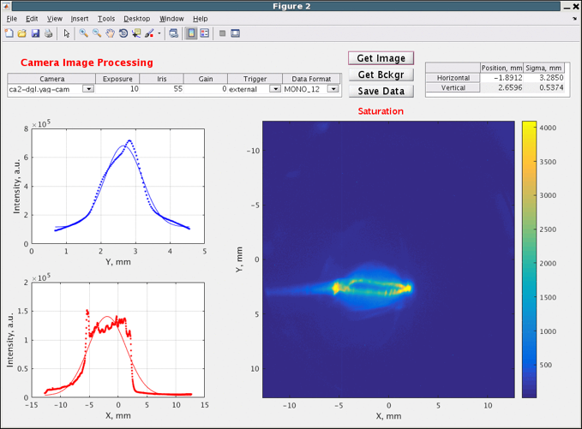
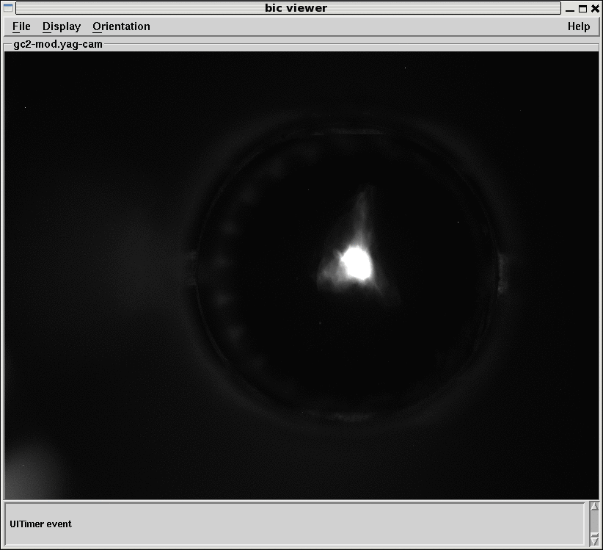
Main advances
We were able to generate electron beam with quality sufficient for the CeC experiment and FEL amplification
  0.5 nC, 50 A bunches were generated, accelerated and propagated through the system
  What is needed is to improve stability of all subsystems, task for this shutdown
We identified a number of problems (insufficient number of trim coils, need to compensate stray fields of DX and D0 magnets, error with helicity of 3rd wiggler, need for temperature controlled RF cables….) and are pursuing implementation of this plan
Sub 0.1% energy spread 40 A peak current in the bunch Low emittance beam in FEL

Slide 10
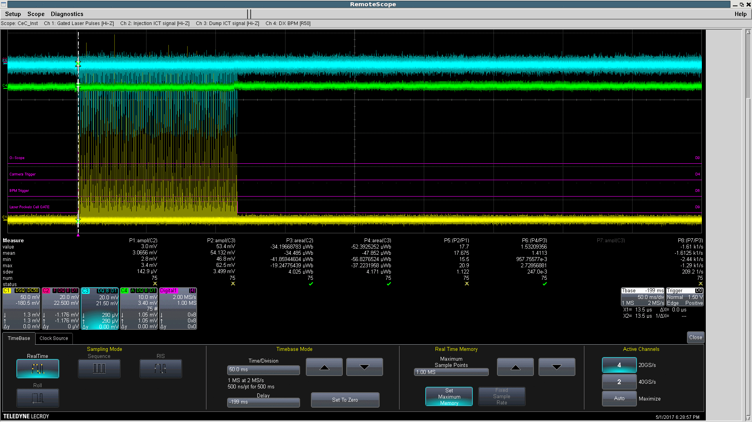
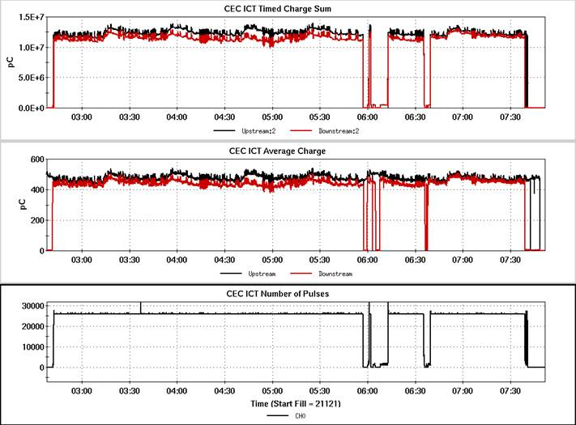
Operating in CW mode

Slide 11
Accelerator Physics highlights
113 MHz SRF gun with room-temperature CsK₂Sb cathodes demonstrated excellent performance
  CsK₂Sb cathodes survived for months of operation (and exhibit QE improvement during operation)
  Beam with charge up to 4 nC per bunch were demonstrated
  Projected normalized emittance of 0.32 mm mrad was demonstrated for 0.5 nC bunches
  Multipacting is well understood and a process of avoiding it is developed, tested and implemented
World’s first 2K cryostat with superfluid heat exchanger (used for 5-cell 704 MHz linac) demonstrated excellent performance and good microphonics isolation (Δf~10 Hz pk-to-pk)
Beam-based alignment using solenoids was demonstrated with full restoration of the beam trajectory
A self-consistent simulations of Debye shielding in finite electron beam propagating in the modulator with quadrupoles

Slide 12
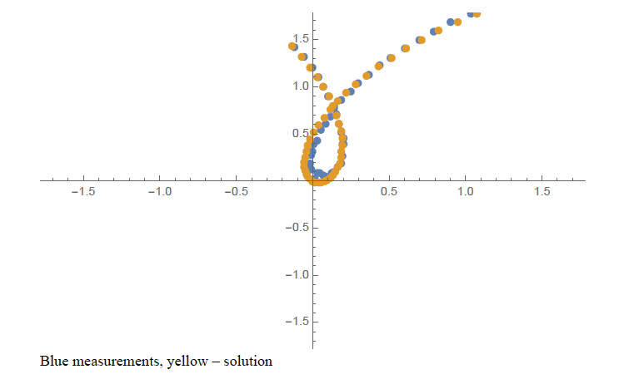
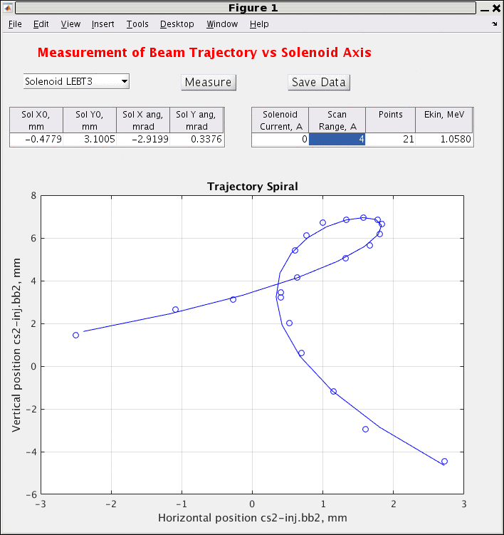
Solenoid BBA: gives x,x’,y,y’

Slide 13
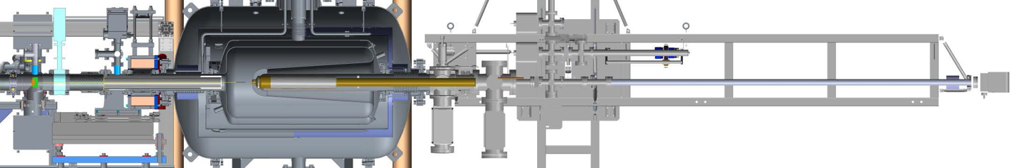
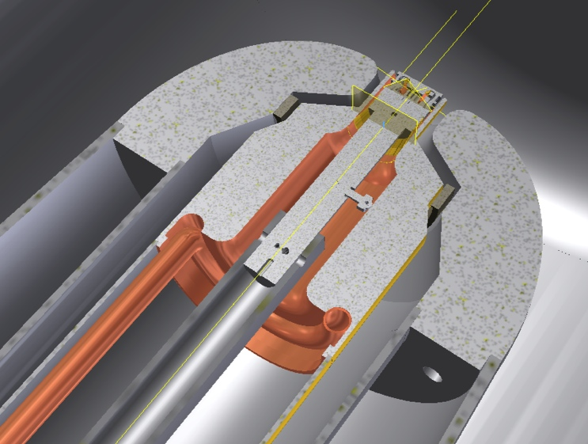
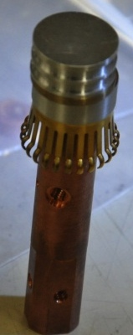
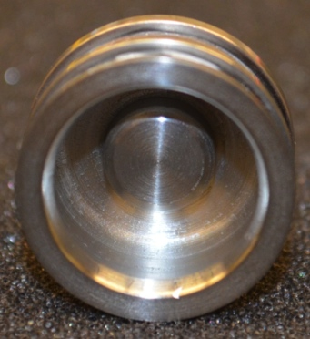
CeC SRF Gun with CsK₂Sb photocathode
FPC
Cathode
Garage
Cathode insertion manipulator
Cavity
Laser cross
Solenoid
Shields
Stalk
Because of low energy if the e-beam, the SRF gun was operating at harmonic of 3rd sub-harmonic of RHIC revolution frequency for 26.5 GeV/u , e.g. 26 kHz
Will be retuned in few weeks to operate on harmonic of RHIC revolution frequency for 26.5 GeV/u , e.g. 78 kHz
Photocathode end assembly

Slide 14
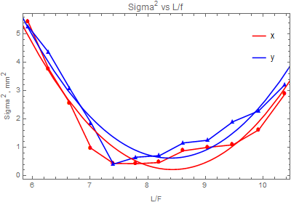
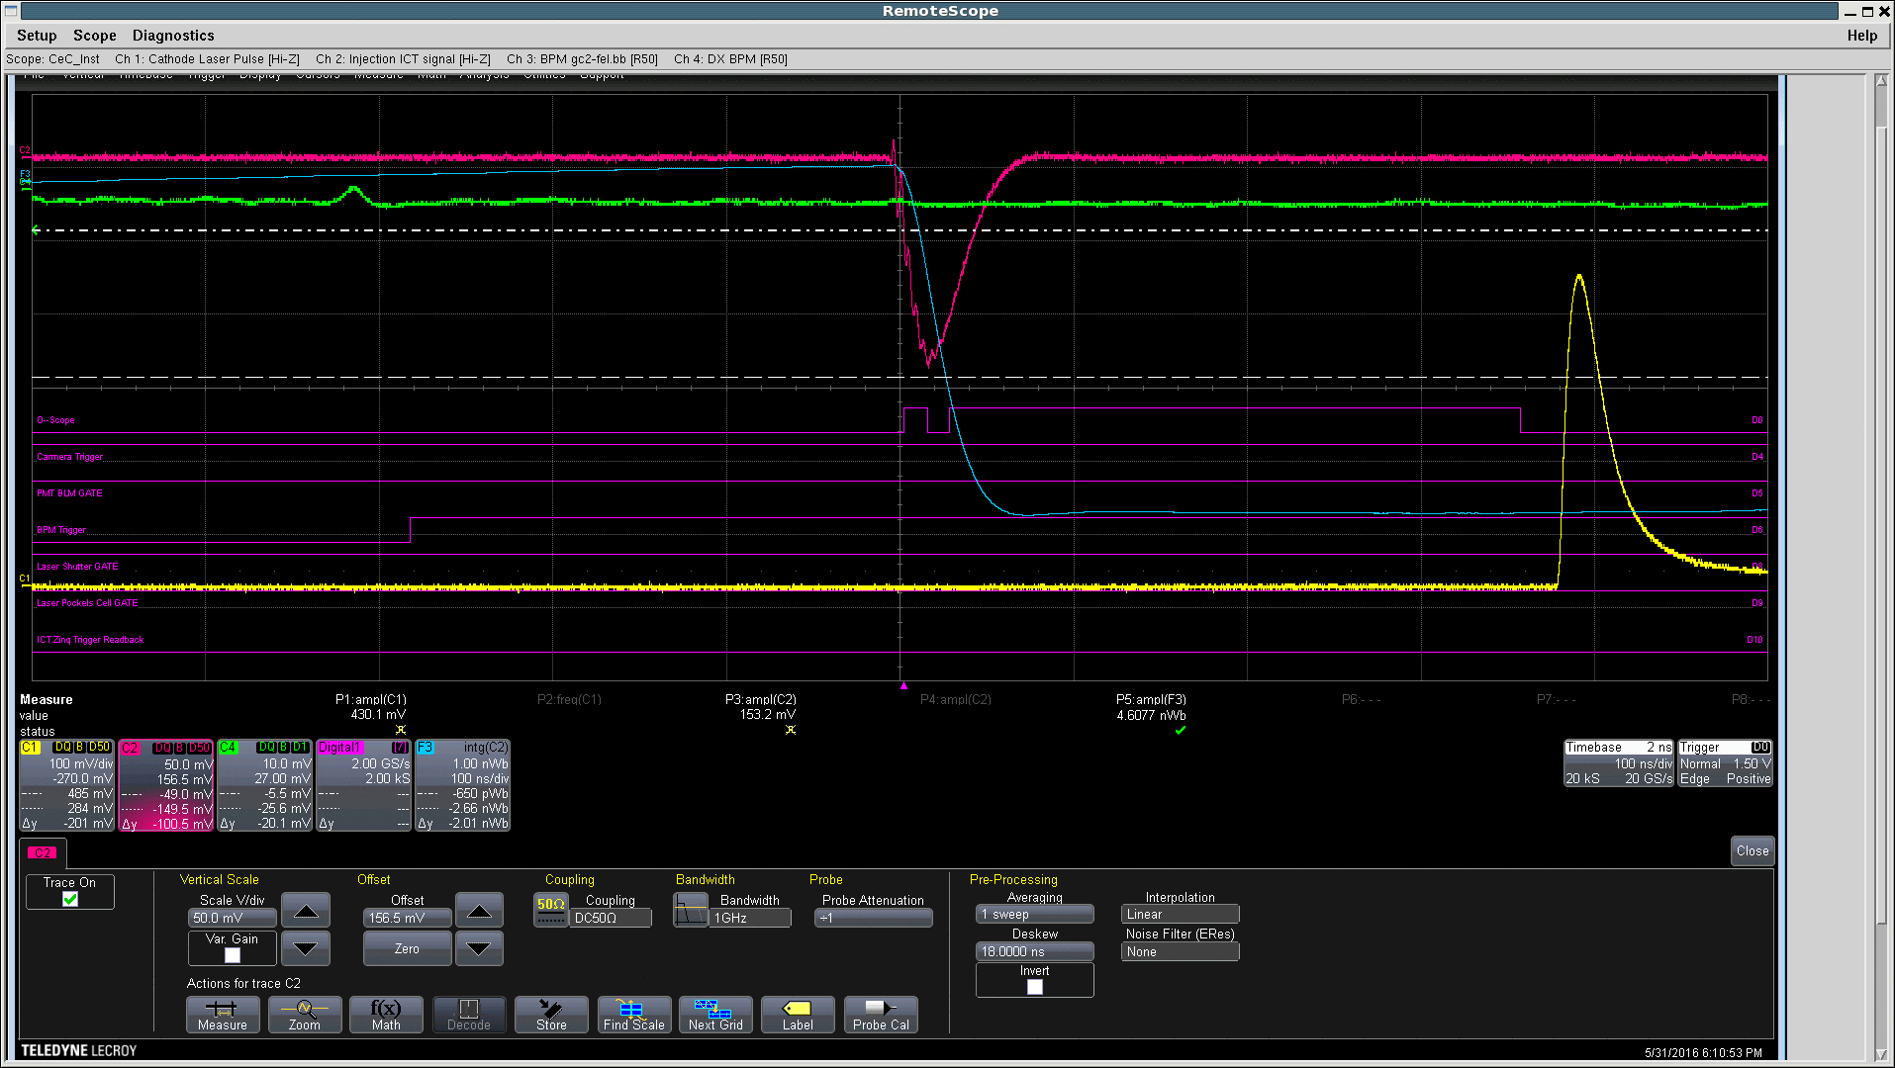
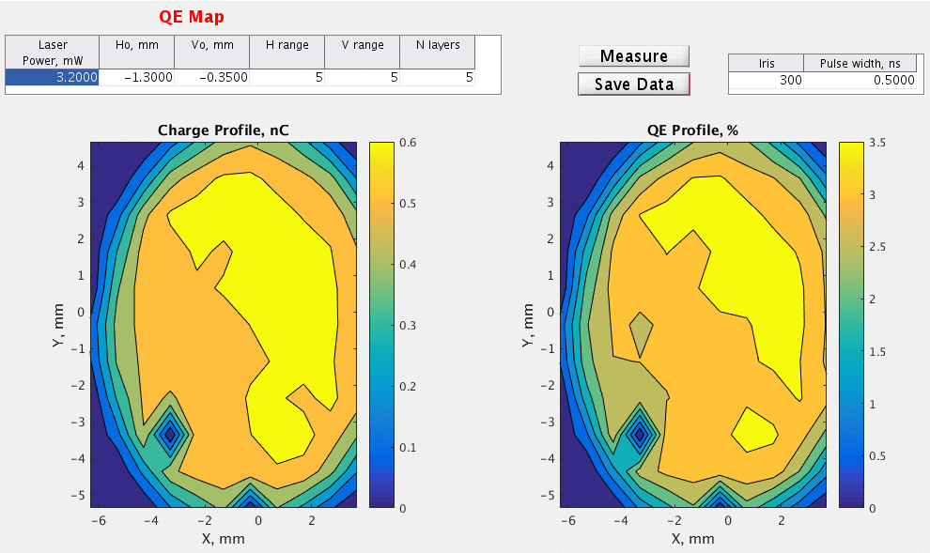
Record performing 113 MHz SRF photo-electron gun: now cathodes keep high QE for months
3.7 nC
Preliminary
Best result so far:
Gun Solenoid and YAG1 profile monitor
0.32 mm mrad normalized emittance at 0.5 nC/bunch

Slide 15
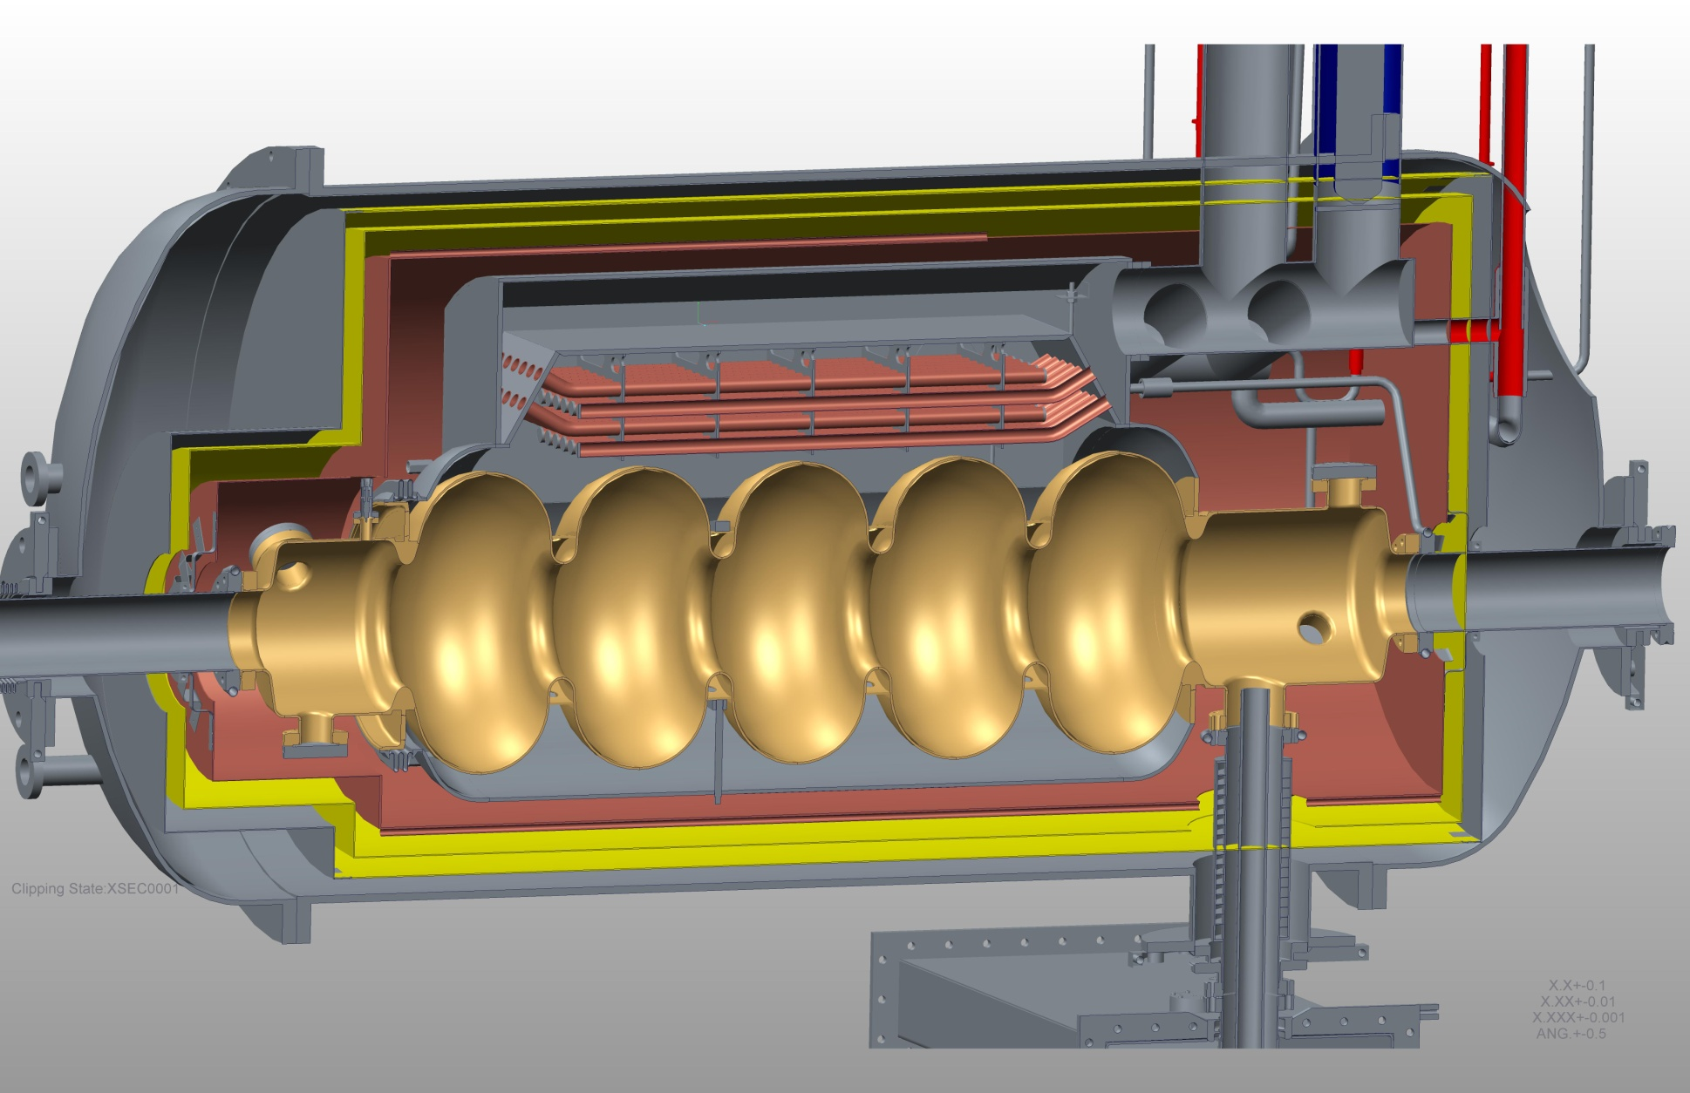
704 MHz 5-cell linac cryostat with superfluid heat exchanger: microphonics < 10 Hz p-to-p
Magnetic shields
Thermal shield
Superfluid Heat exchanger
Niobium Cavity
Titanium Helium vessel
Stainless Steel vacuum vessel
Power Coupler

Slide 16
What worked and what did not?
Main points
SRF gun working very well
SRF5-cell linac was cleaned and re-commissioned
All three RF system in CeC accelerator are operation and phase locked with RHIC
e-Beam was propagated through the CeC system with low loss
Electron and ion beams were synchronized and we detected their interaction
SRF linac did not reached design accelerating of 20 MV, but only 13.5 MV
e-beam energy limit to below 15 MeV moved the FEL from 13 to 30 μm rendering IR diagnostics completely unusable – hence making FEL commissioning into a “blind-folded” contest
Pulse-to-pulse stability of the system (both laser and RF) did not allow us to use energy spread at the beam-dump as a measure of FEL lasing
Laser system was unreliable

Slide 17
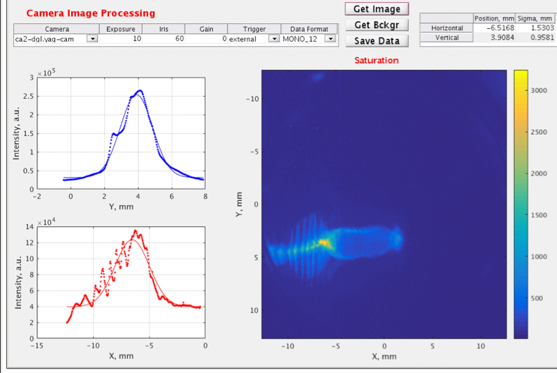
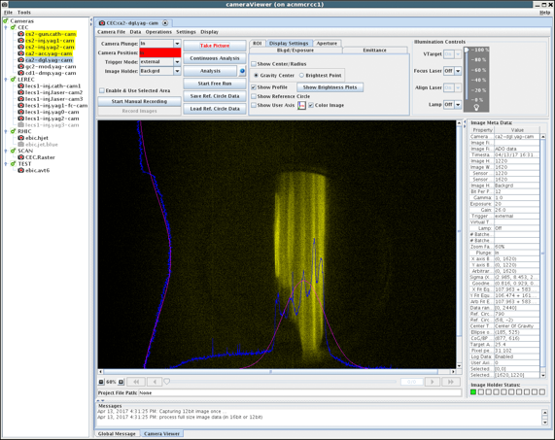
Additional challenges
Time, phase and amplitude stability of the subsystem is not to the specification. Making reproducible set-ups was prevented by uncontrollable variation in the subsystems
  Plan to install temperature controls of the loop-back and a monitoring scope for LLRF and laser systems
Laser system had very large fluctuations of power and time structure, making reliable bunch compression very difficult and some time impossible
  Replacing the laser
“Perfect liars” – systems which measuring their own performance and “always correct” – example, power supply which suddenly doubled the current, while reporting exactly what it was asked for…
  Trying to figure out how to solve this without major rebuilding
Huge RFI noise in IR2, impeding high precision beam parameters measuring and controls
  SOLUTION IS UNKNOWN
….. list is rather long
5 micro-bunches inside 300 psec bunch

Slide 18
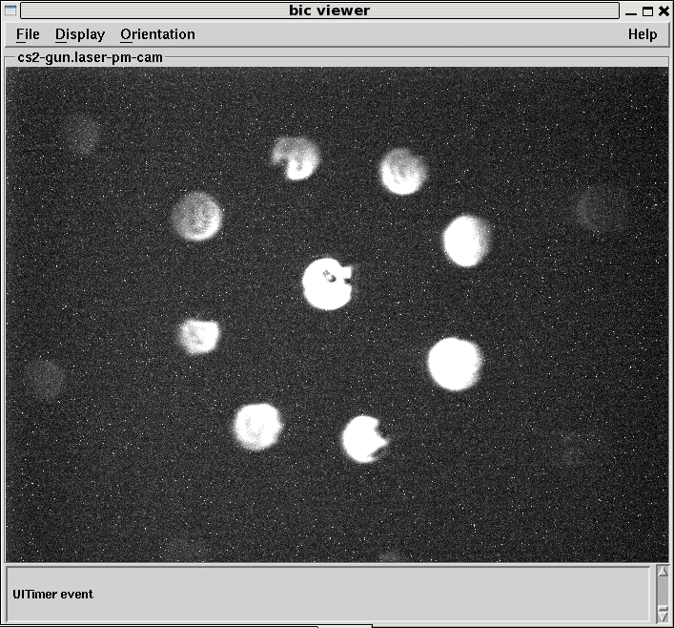
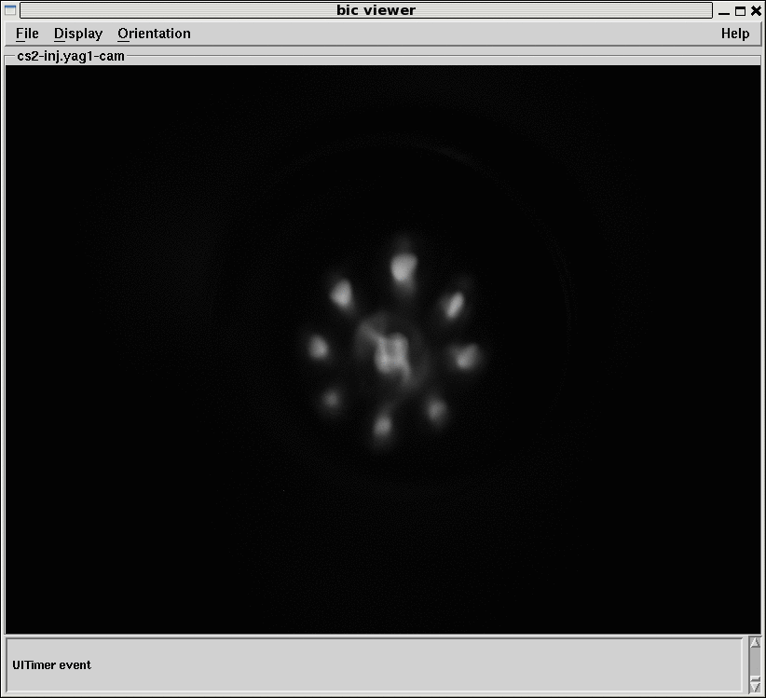
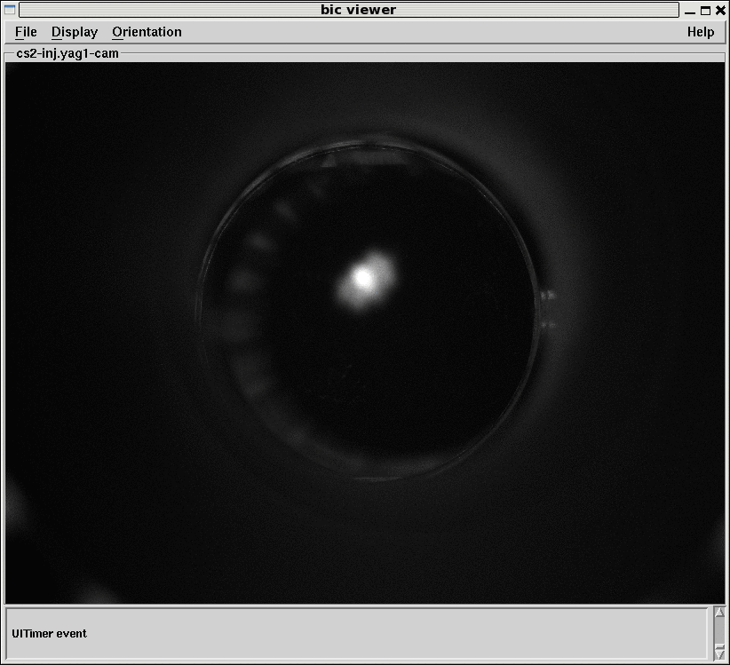
Mystery of June 27
Laser
spots
Simple system: SRF gun, 1 solenoid, YAG screen
With 2 systems reporting perfect performance images taken at the same solenoid setting of 8.05 A and the same gun voltage 1.05 MV
noon
4 pm
No explanation found yet…

Slide 19
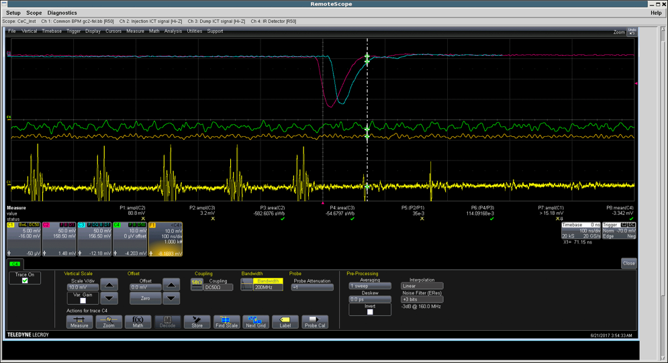
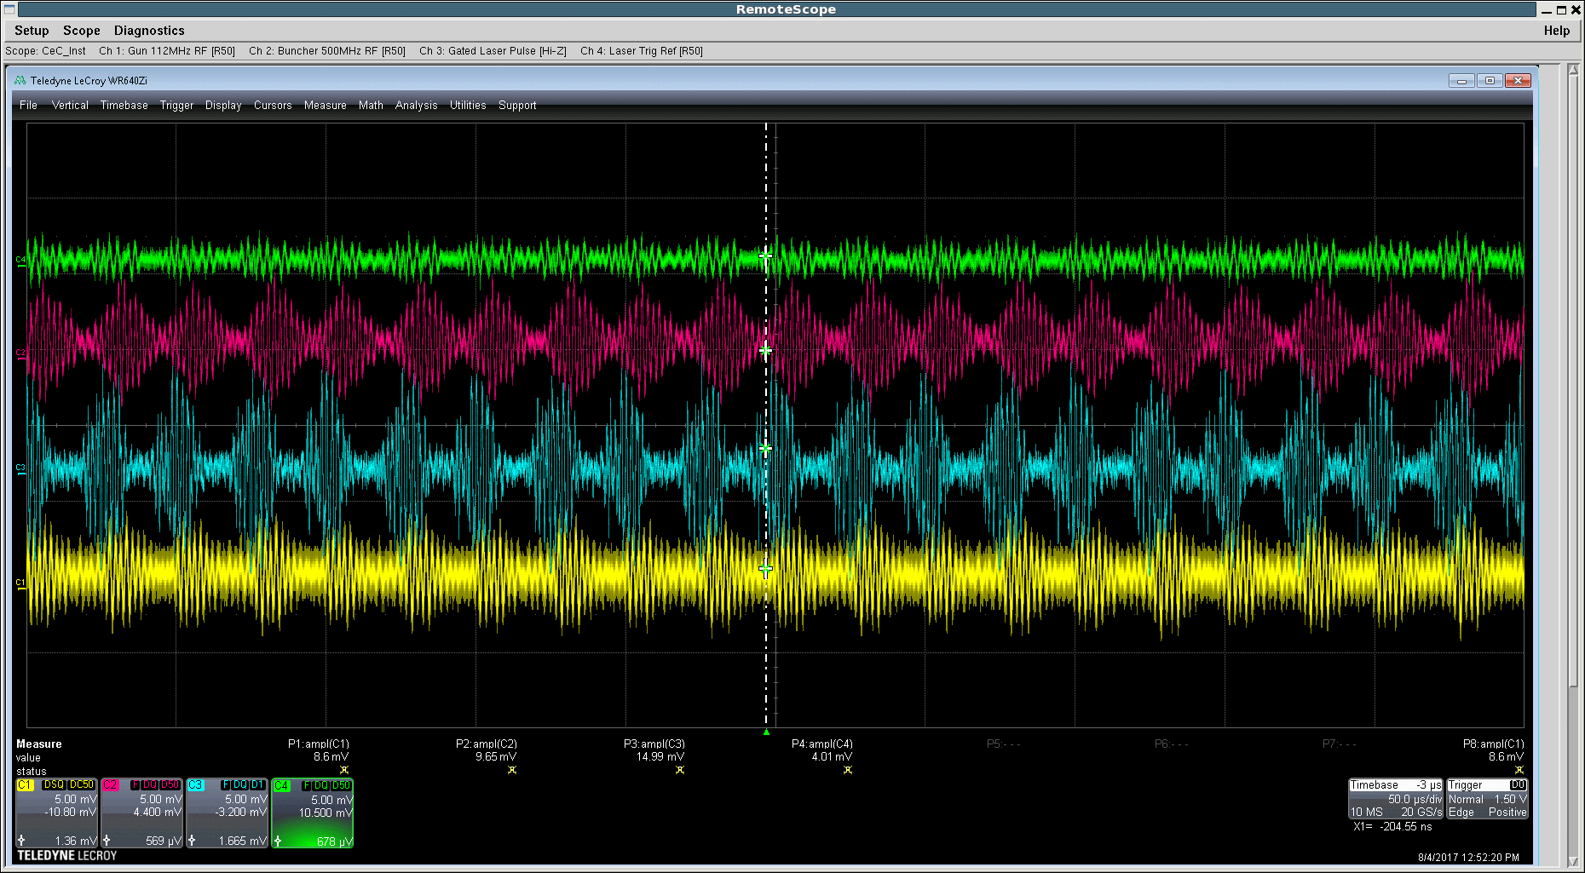
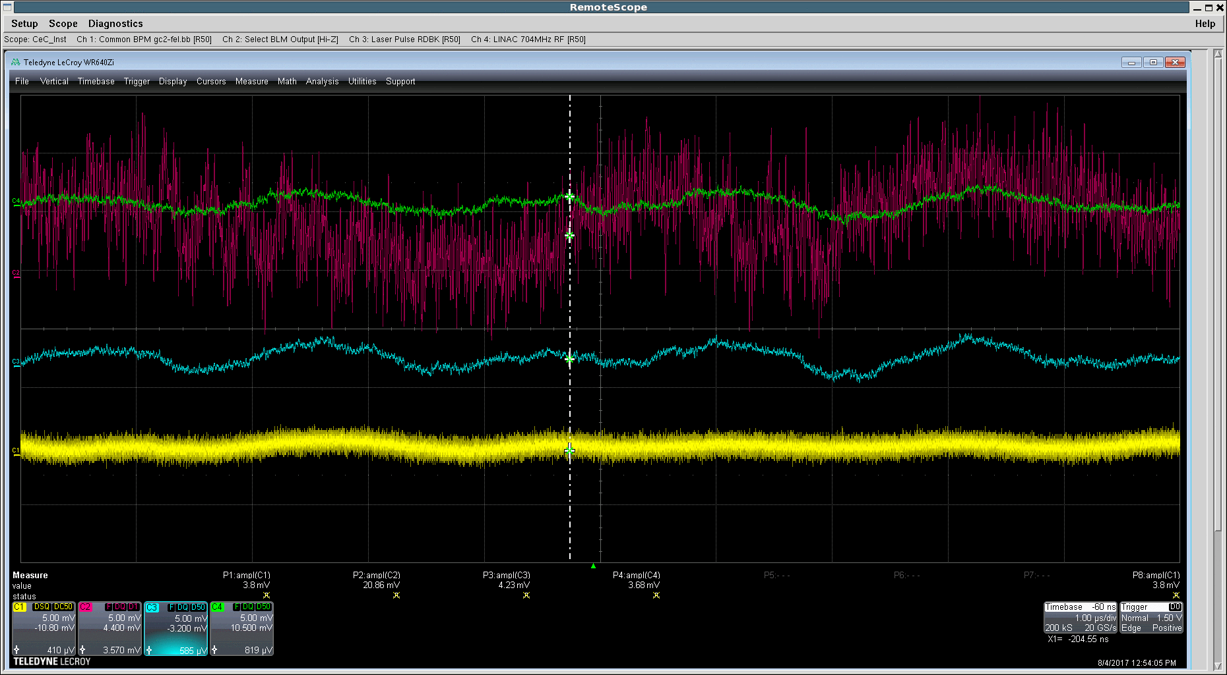
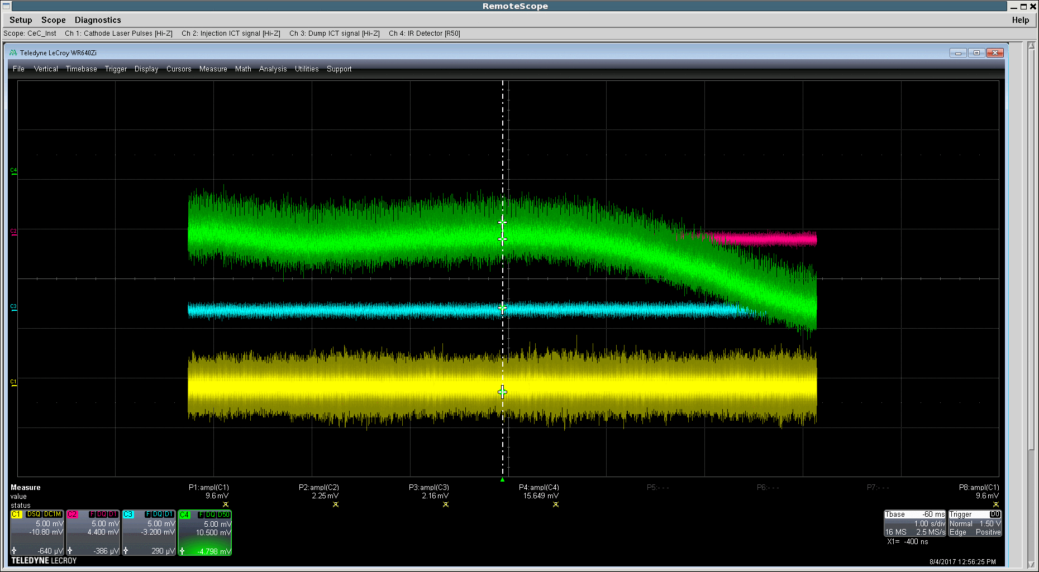
RFI – noise in each and every cable
RFI at IP2 generates broad-band noise in each and every CeC cable, making measuring of weak signals impossible, and measuring large signals inaccurate.
RUN 17
Now
Now
Now

Slide 20
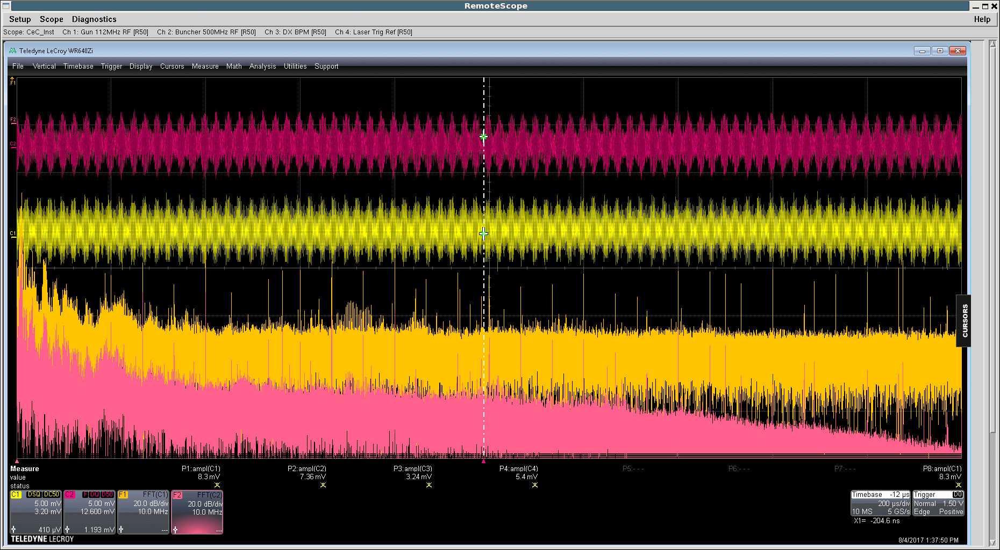
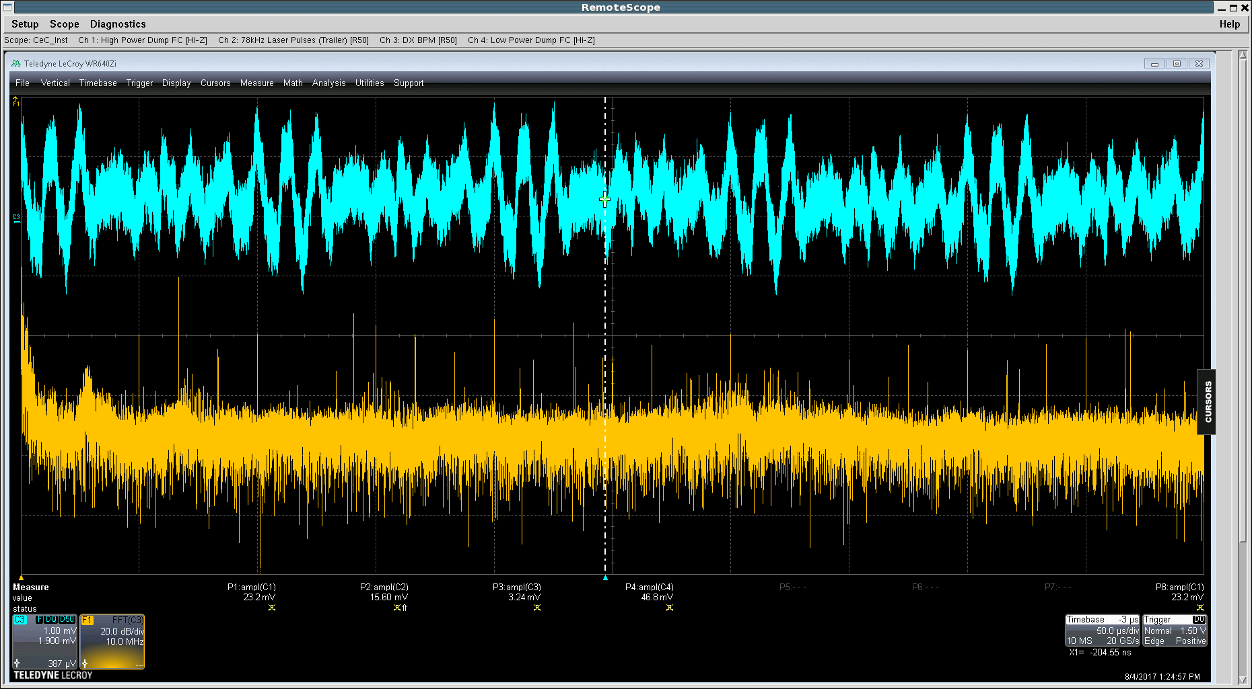


Now RHIC off, LEReC off: a lot of frequencies plus broad-band noise
More at CeC elog, August 4, 2017: http://elog.pbn.bnl.gov:8080/elogs/entryList.jsp?DATABY=day&ELOG=CeC_2017&DATE=08/04/2017&PAGE=1&DIR=forward&AUTO=yes
Identifying and eliminating sources of noise
will be critical to any high precision measurements

Slide 21
Beam parameters
Parameter | Design | Status | Comment
Species in RHIC | Au⁺⁷⁹, 40 GeV/u | Au⁺⁷⁹ 26.5 GeV/u | To match e-beam
Particles/bucket | 10⁸ - 10⁹ | 10⁸ - 10⁹ | ✔
Electron energy | 21.95 MeV | 15 MeV | SRF linac quench
Charge per e-bunch | 0.5-5 nC | 0.1- 4 nC | ✔
Peak current | 100 A | 50 A | Sufficient for this energy
Pulse duration, psec | 10-50 | 12 | ✔
Beam emittance, norm | <5 mm mrad | 3 - 4 mm mrad | ✔
FEL wavelength | 13 μm | 30 μm | New IR diagnostics
Rep-rate | 78.17 kHz | 26 kHz** | Temporary**
e-beam current | Up to 400 μΑ | 40 μΑ | Temporary**
Electron beam power | < 10 kW | 600 W | Temporary**
**Will be changed to 78 kHz after retuning the gun frequency
Beam parameters are sufficient for the CeC demonstration experiment

Slide 22
Next step: demonstrating CeC

Slide 23
Preliminary plan for CeC experiment during Run 18
Has to be coordinated with LEReC commissioning
Activity | Aggressive schedule | Conceivable Schedule
Re-establish CeC accelerator operation | 1/8– 2/3 | 1/8– 2/15
Establish required e-beam parameters CeC FEL commissioning | 2/4 – 3/5 | 2/16 – 3/15
Establishing CeC system operations at various RHIC settings, compensating stray magnetic fields | 3/5 – 3/21 | 3/16 – 3/30
Co-propagate, align and synchronize electron and ion beams, match relativistic factors of two beams | 3/22 - 4/7 2 days dedicated | 3/31 – 4/15 2 days dedicated
Develop control of the FEL amplification, observe amplification of density modulation induced by ions | 4/8 – 5/5 2 days dedicated | 4/16 – 5/10 2 days dedicated
Refine tools for observation of ion beam cooling, observe cooling/anti-cooling via CeC | 5/6 – 5/25 3 days dedicated | 5/11-5/30 3 days dedicated
Develop various CeC accelerator settings (charge, peak current, FEL gain) and characterize CeC cooling | 5/26 -6/15 4 days dedicated | 5/31 -6/15 4 days dedicated

Slide 24
Conclusions
During Run 17 the CeC was given an excellent opportunity and plenty of time to make as much progress as it was technically and physically possible
The CeC accelerator is fully commissioned
  But low energy gain of the SRF linac prevented us from demonstrating the FEL amplification and the CeC cooling – it is my main disappointment
We defined and are implementing all necessary step for demonstration CeC experiment during RHIC Run 18
The fact that LEReC program requires earlier delivery of LiHe to IP2, will give CeC extra time to re-commission the accelerator
Coordination with LEReC installation and operation will be critical for CeC successful demonstration
During RHIC Run 18 we plan to involve RHIC operators in CeC operations, for example in testing its accelerator settings

Slide 25


CeC remains popularity at C-AD

Slide 26
Back-up

Slide 27
Main disappointment
We were unable to see signal from CeC FEL
  SRF linac failed to reach design accelerating voltage of 20 MV, making our IR FEL diagnostics useless and us “blind-folded”
  We were unable to see radiation at 3rd harmonic of FEL radiation (which was weak to start from) because of strong RFI
  Laser/RF system stability was insufficient to measure energy spread increase by FEL interaction

Slide 28




Interaction with ion bunches: June 19
Preliminary

Slide 29


Stability of the beam
Remaining hope for a “blind-folded” team (never tried by any FEL team) was to observe fluctuations of the energy spread at the exhaust of the FEL, e.g. in front of the power dump
It would require a stable – bunch to bunch- electron beam, e.g. a repeatable operation of laser (pulse energy, time of arrival and position), RF phases and amplitudes of 3 RF systems (the gun, the bunching cavities and linac) and magnets
Igor Pinayev created a script which allowing tracking the energy spread in the front of the dump and we attempted to observe the energy spread dependence on the phases between three undulators, but also no luck. Pulse to pulse variations were too large to detect influence of the FEL lasing/phasing
YAG2: 50 μm center of gravity and 5% r.m.s. size variations
YAG at the beam exhaust: shot to shot variation are too large to detect FEL action
LEBT
Beam dump

Slide 30


Mystery of June 27
Generated laser pattern to pin the SRF gun optics
Made system as simple as focusing: source (SRF gun), gun solenoid and e-beam profile monitor (YAG screen)
Fixed gun voltage. Focused e-beam on the YAG screen by adjusting gun solenoid
Target Laser spots e-beam image

Slide 31



IR diagnostics for 30 μm: critical
Procure and install new IR SVD diamond window
Upgrade the IR diagnostics detector system to be sensitive at 30 μm
This diagnostics is critical for all steps beyond accelerator commissioning:
Optimizing phasing of FEL wigglers
Aligning the e-beam on the FEL axis
Establishing FEL lasing/amplification
Establishing interaction with ions and fining the matched energies
Observing CeC action (cooling/heating)

Slide 32
CeC Shutdown 2017 To Do List
RE-Polish cathode pucks (if needed)
Add bellow/port-aligner for the cathode launcher alignment
Re-tune gun to the required frequency, place cathode stalk in correct position
Adjust gun solenoid transversely
Align laser cross mirrors (need to move temporarily the laser table off the way)
Finalize the laser delivery line
Measure laser pulse temporal profile using streak-camera (with ATF folks)
Replace laser (regenerative amplifier) and commission the laser prior operation start
Replace lens for gun cathode camera with longer focal length, fix other cameras (small changes)
Install BPM (352 MHz) between two 500 MHz cavities, procure 352 MHz BPM electronics
Replace broken BPM feed through on the first LEBT BPM, check cables for the rest of BPMs for kinks/bad contacts
Install and test compensation coils around DX and D0 magnets
Rework and add new air-core corrector, install double μ-metal shielding where is appropriate
Procure and install power supplies for new trims
Put extension and move lower vacuum pumps in low energy beam transport
Modify the end of the LEBT by putting BPM2 at the end of the beamline, move Solenoid 5 upstream
Fix the helicity of the third helical wiggler (replacing the pin-holding plates)
Alignment survey of common section elements
Modify or replace phase shifters (at least one)
Re-configure trims in the kicker section
Replace failed ICT in front of the high power dump, find the reason of the fault
Procure and install new IR SVD diamond window
Upgrade the IR diagnostics detector system to be sensitive at 30 μm
Improve phase, timing and amplitude stability of RF and laser systems,
Stabilize temperatures of RF cables and LLRF rack
Finish controls (pet-pages, MATLAB applications)
CLEAN THE AREA – DONE

Slide 33
PLAN FOR RHIC RUN 18
Start operation of all room temperature systems prior to RHIC start
  RHIC 18 run is short and we can not afford months of delay with some of critical systems as it happened during Run 17
Start operation of CeC system as soon as our SRF cavities are cold
Establish stable phase, amplitude and timing (RF and laser) to deliver stable reliable electron beam, synch electron beam with ion beam with 26.5 GeV/u
Commission new IR diagnostics and establish FEL operation
Align electron and ion beams transversely
Synchronize the ion and electron beams energies using IR diagnostics
Establish interaction of electron and ion bunches
Test Coherent electron Cooling
Characterize Coherent electron Cooling

