Slide 1
RHIC Abort Kicker Relays and QP Diode Damage
J. Sandberg
August 8, 2017

Slide 2
I wish to thank the following people:
D. Bruno, K. Drees, J. Escallier, W. Fischer, G. Ganetis, H. Hahn, K. Hartmann, G. Heppner, Al Marusic, C. Mi, J-L Mi, J. Morris, V. Schoefer, R. Schoenfeld, C. Schultheiss, Y. Tan, C. Theisen, W. Zhang,,

Slide 3
Abort Kicker Upgrades
Description of the system and why changes are necessary
Addition of a Mechanical Switch in series with the Thyratron
New operating Sequence
Why the New System Failed and is Unacceptable with a 30 msec time delay
Some Test results increasing the speed of the present relay

Slide 4
Original Kicker Requirements
5 Kickers per Ring
Beam Should be aborted if one kicker fails to fire
Typical Voltage ~27 kV
Typical Current peak 21 kA
Current Rise Time to minimum Kick 900ns
Bunch Revolution Time 12.86 us
Abort Pulse Length min ~13 us
Abort Gap 1us
Beam must be aborted within 4 turns, 52 us
Maximum delay for redundant trigger 0.7 us
Minimum Jitter 10 ns
These Parameters dictated the use of a Thyratron

Slide 5
Trigger

Slide 6
Thyratron Prefires
The voltage on the abort kickers’ PFNs is ramped up to match the energy of the RHIC beam and is maintained at high voltage (27 kV) during each RHIC store
A prefire is defined as a Thyratron spontaneously discharging a PFN through an abort kicker magnet unintentionally.
Given the right conditions even one prefire has the potential to cripple a detector or damaging a bypass diode.
There are 5 kicker modules in each ring. Over a ten year period there have been an average of 8 prefire per ring each year
Even after a great deal of effort there were 7 yellow prefires and 6 blue prefires ( + 4 caused by a bad trigger card) in 2017.

Slide 7
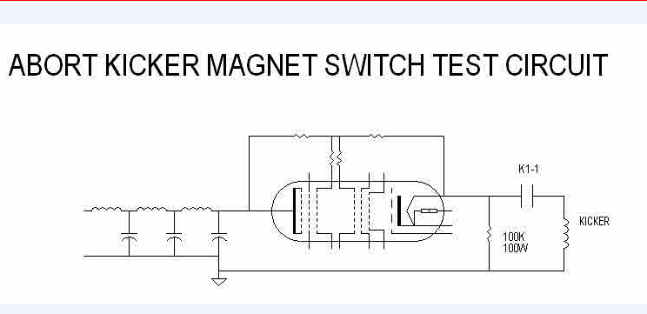
Thyratron Prefires
A solution to this problem would be to put another switch in series with the Thyratron whose prefiring characteristics is decoupled from that of the Thyratron

Slide 8
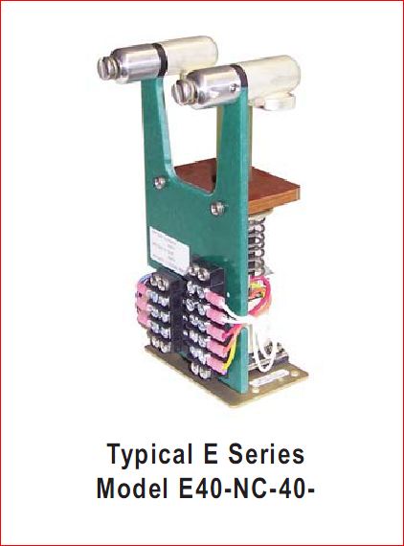
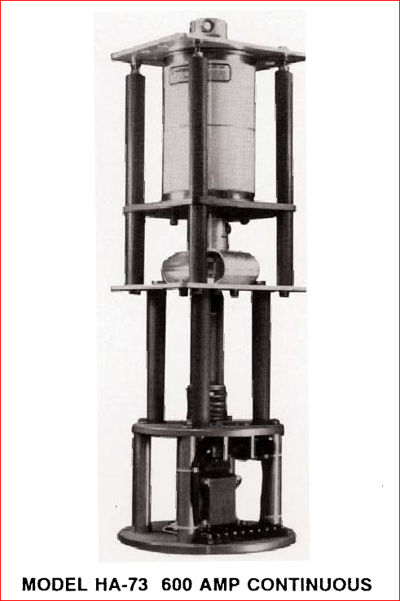
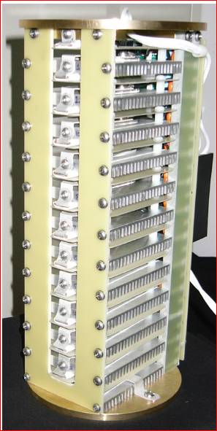
Three Proposed Solutions
Conventional High Voltage Relay in Air
High Speed Vacuum Relay
Solid State Switch
+ Inexpensive, readily available easy to mount, good history in ring
- 40 msec to reliably close
+ 5 msec to reliably close?
- Expensive ($17,500 ea), hard to mount, long lead time, radiation resistance of trigger circuit unknown
+120 nsec to operate
- Expensive ($22,800 ea), hard to mount, long lead time, radiation resistance unknown

Slide 9
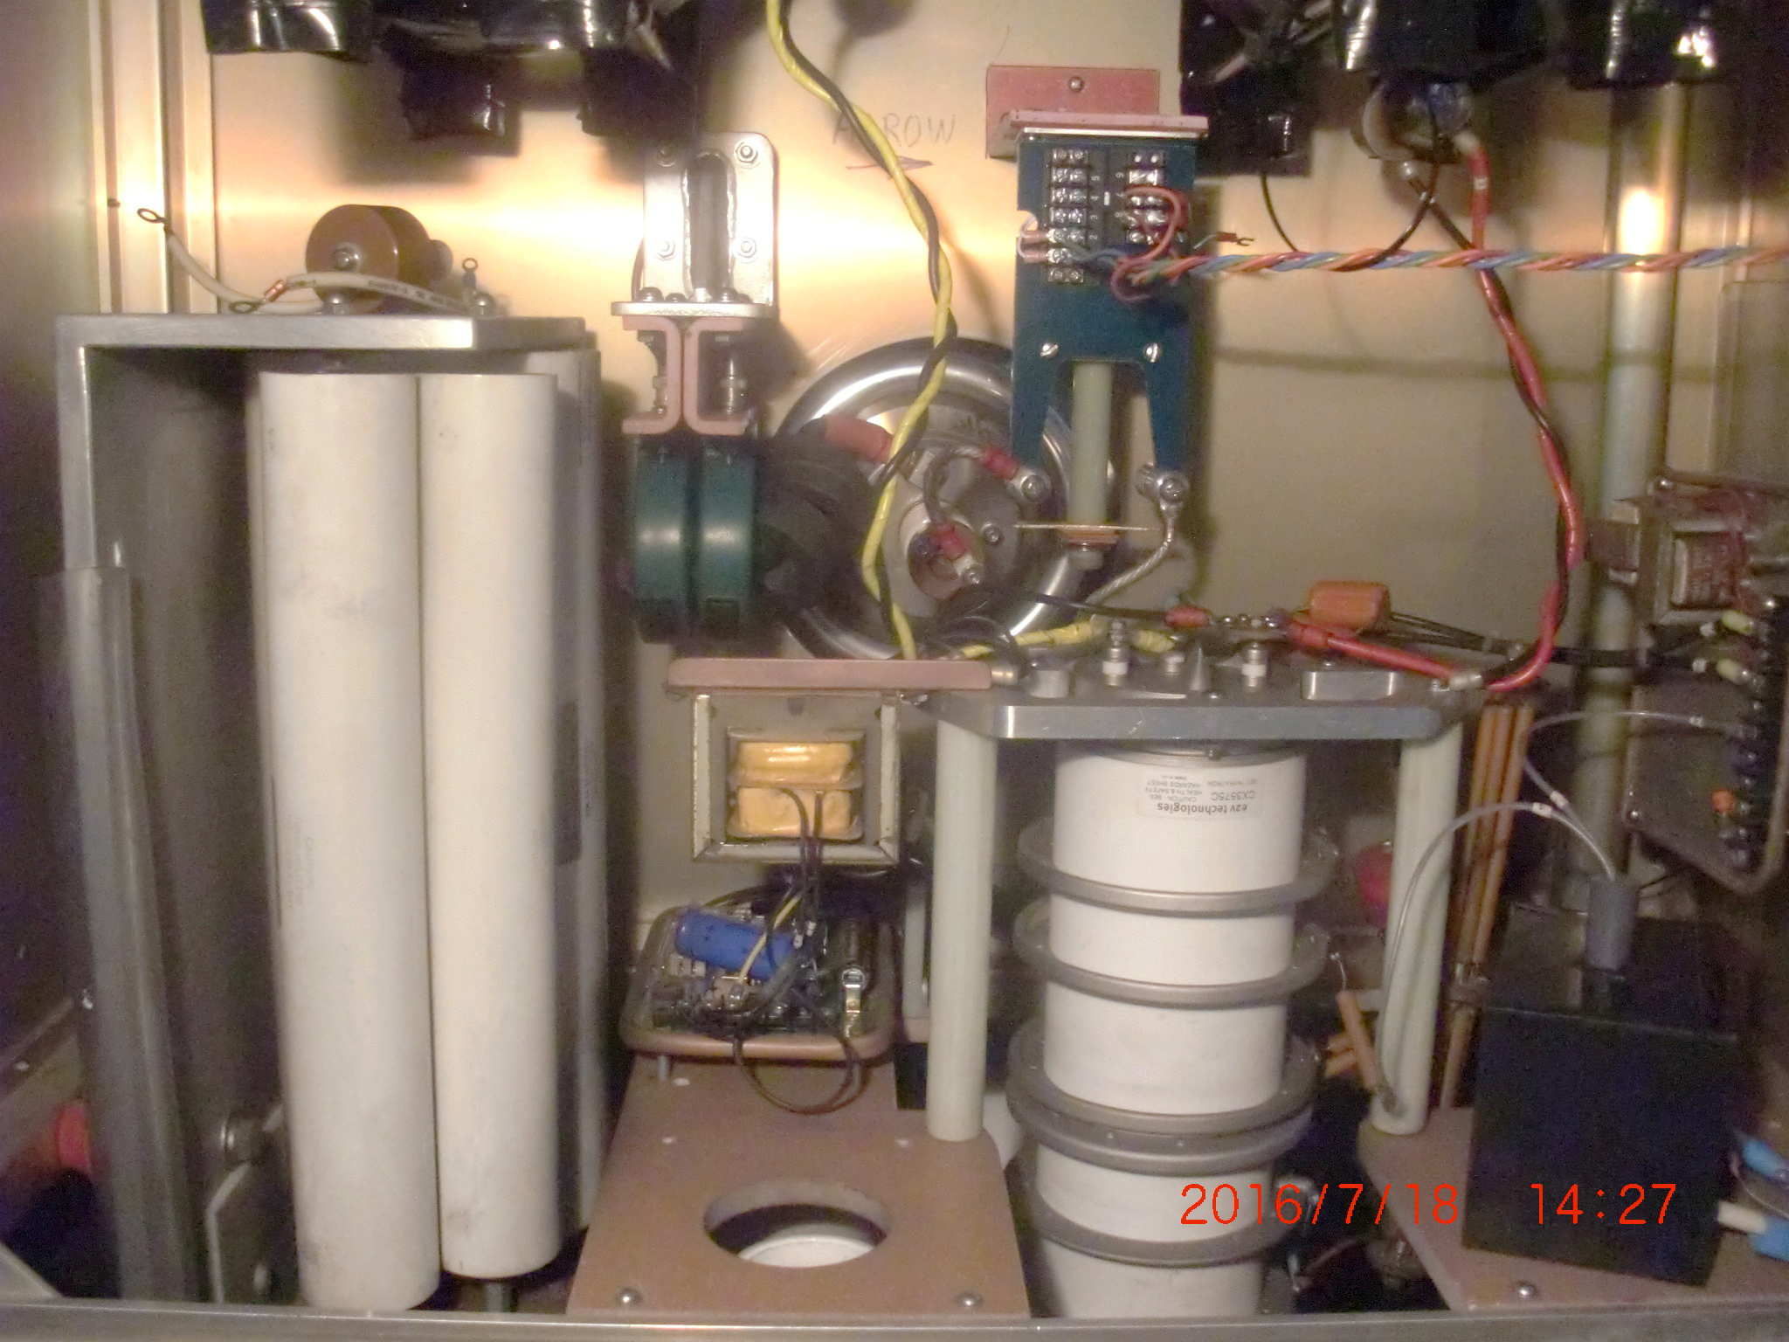
Relay

Slide 10
Modified Ross Relay Test
Relay current
Abort current
Modified Ross relay using a DC pulse to drive the solenoid

Slide 11
Operational Sequence
At low PFN Voltages the Relay will be closed and fast Aborts will be possible. (Normal Mode)
When in store the relay will be opened and a fast Abort will no longer be possible (Delayed Mode)
When in the delayed mode the Thyratron cannot be fired until the relay is closed, a delay of ~30 msec
After the 30 msec delay a signal to stop charging the PFN will be given and then a signal to fire the Thyratron, synchronized with an abort gap, may be given.
In order to reduce the closing time of the relay its coil is pulsed by a capacitive discharge circuit. It requires 10 seconds to charge the capacitor. Once fired the relay cannot reliably be fire again for 10 seconds.

Slide 12
What Went Wrong
While making this system operational two major dirty Dumps occurred.
The first was caused by a noise susceptibility problem with the circuitry which closes the relays. This fault was responsible for damaging a superconducting bypass diode in the Yellow ring. This problem occurred during a normal beam abort at the end of a store.
The second event occurred after a power supply malfunctioned and pulled the quench link. This type of event is not rare and causes the current in the Main Ring Dipoles to start decaying within 1.3 msec of issuing an abort command. Nothing was damaged in this event but much time was lost recovering.

Slide 13
What Went Wrong
Although the system was extensively tested a flaw in the firing circuitry was uncovered when the system was made operational.
During a normal abort the Blue Kickers are commanded to fire 1 second before the Yellow Kickers
The noise from the firing of the Blue Abort Kickers caused the the capacitive discharge circuitry in Yellow Kickers to fire prematurely closing the relays in Yellow.
The Relay capacitive discharge circuitry requires 10 second to charge up reliably after it is fired. When Yellow was asked to fire only 1 or 2 Yellow kickers fired resulting in an extremely dirty abort. Diode Y7D6 experienced high radiation levels while Quenching(?) and was damaged. This occurred on March 11, 2017. Over 83 magnets Quenched.

Slide 14
What Went Wrong
When the Quench Detector detects a quench it pulls the quench link and the beam permit link.
This very quickly (<1.3 msec) fires the Quench switches in 4B and 10A
When these switches are fired the current in the Main Ring Magnets quickly decays and the beam will be sprayed all over the
This occurred on May 14, 2017
Many magnets quenched but fortunately none were damaged. Many hours were lost in recovery.
The abort must happen before the Quench switches are fired

Slide 15
Plan Going Forward
Maximum Closing time for the relays must be reduced to 5 msec
Operating Time for the 4B and 10A Quench Switches must be increased to 10 msec
Triggering circuits for the Relay Circuits must be Redundant and confirmed to be armed during operations. (completed for original circuit)
The system must be exhaustively tested under operating conditions (completed for original circuit)
The scopes recording kicker currents should be triggered when any kicker is fired

Slide 16
How to Obtain 5 msec Closing Time
Modify the existing relay to close faster
Replace the existing relay coil with a lower resistance coil (17.6 ohms to 1 ohm)
Increase capacitive discharge voltage from 120Vdc to 350Vdc
Thoroughly test the modified relay for reproducibility and reliability, the closing forces will increased.
Obtain a Vacuum relay which can operate in under 5 msec
The most attractive choice is to modify the existing Relay

Slide 17
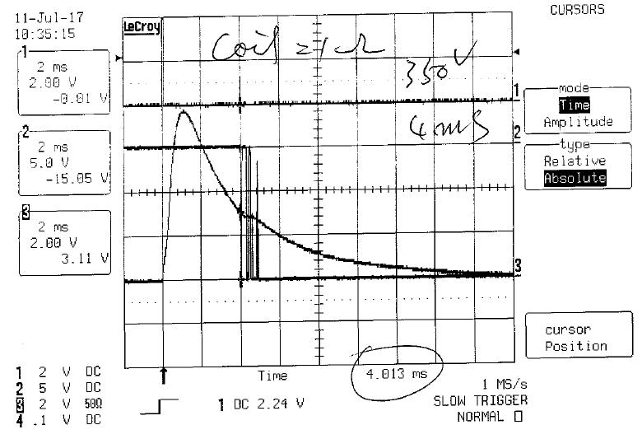
Modified Relay closing time test waveforms PFN voltage = 350V
Solenoid resistance = 2.6 ohm
Close time = 4.2mS
Bouncing time =1mS
Solenoid resistance = 1 ohm
Close time = 4mS
Bouncing time =1mS

Slide 18
E40 ROSS Relay Closing Time Test

Slide 19
Present Status
We have tested several different relay coils and can achieve closing times, including bounce time of 5 to 6 msec.
We are running a life test on the modified relay and have achieve 5000 operations without a mechanical failure
We are modifying additional relays with low resistance coils to determine reproducibility between relays
We are in the process of procuring a high speed vacuum relay to test

Slide 20
Superconducting Protection Diode Failure

Slide 21
Why Diodes?
Each magnet (except the DX dipole) is capable of dissipating its own stored energy without being damaged
The purpose of the diodes is to bypass the current from the other superconductive magnets in a string around a quenching (resistive) magnet
When cold the diodes have a high forward break over voltage, in RHIC, 3 to 10 volts.
During normal operations (25 amps/sec) the forward voltage across an arc dipole never exceeds 0.625 volts
If a magnet becomes resistive this voltage quickly rises and the diode conducts
Once the diode conducts it heats up in milliseconds and its forward voltage drop decreases

Slide 22
Superconducting Protection Diodes
Diodes in Service
Diodes in Arc Dipoles 264
Diodes in Arc Quads 274
Insertion Components 362
Total= 900
Spare Diode Assemblies
Type 01 26
Type 02 2

Slide 23
What Happens if a Diode Fails
Diode Opens
The field is unaffected and machine runs normal. If other magnets Quench things behave normally but if the magnet with the open diode Quenches its coils can be severally damaged. In all the testing done for RHIC a diode has never opened.
Diodes Forward Voltage Increases
This is the known effect of radiation damage to such diodes. As the forward drop increases the power dissipated in the diode increases, this may cause the diode to short. If the effect is not uniform across the diode small sections of the diode might turn on first and over current. This is one explanation for what may have happened to the diode which failed in 2016

Slide 24
What Happens if a Diode Fails
Diode Shorts
Because of the inductive voltage drop across the magnet current is shared between the diode and the magnet coil when ramping. This will dramatically reduce the rate at which the magnet can be ramped. In 2016 (B10D19) the ramp rate was reduced by a factor of 6 and the magnet could still not be ramped.
Diodes Forward Voltage Decreases
During normal ramping the voltage across a dipole magnet is less than a volt. As long as the forward voltage drop of the diode remains above this value, Ramping will remain unaffected. It is not understood why the forward voltage drop of a diode should be reduced. The present case with Y7D6.

Slide 25
Diode Failure History
There have been two known diode failures in RHIC and one diode discovered with a reduced forward voltage drop. (1 out of 168 tested)
In 2016, B10D19 failed partially shorted. This failure occurred after a massive QLI in which this magnet probably quenched while being sprayed with beam. The magnet was able to be ramped after this event one time but failed shorted afterwards during another QLI. (Type 2 Diode)
In 2017, Y7D6 failed partially shorted. This occurred after a massive QLI in which the magnet probably quenched while being sprayed with beam. This was caused by the failure of the delayed abort system. We were able to run with the diode in this condition from March 11, 2017 to the end of the run in early July. (Type 1 Diode)

Slide 26
How do we tell if a Diode is Partially shorted
We can tell by changes in the voltage tap readbacks across a string of magnets during a Quench or normal shutdown. If a diode is conduction current the voltage drop across the magnets will change. Associated changes in voltage can be seen by analyzing dv/dt plots.
If a diode is partially conducting less current will be flowing through the magnet and so its field will be reduced. This can be detected by changes in the correction magnet currents around the effected magnet. This has proven to be a very sensitive indication of the current diverted by the Y7D6 diode.
A diode conducting current produces additional heat loads on the cryogenic system. These changes were observed on each QLI near Y7D6 after the events of 3/11/17.
We can make measurement in the ring at local voltage taps

Slide 27
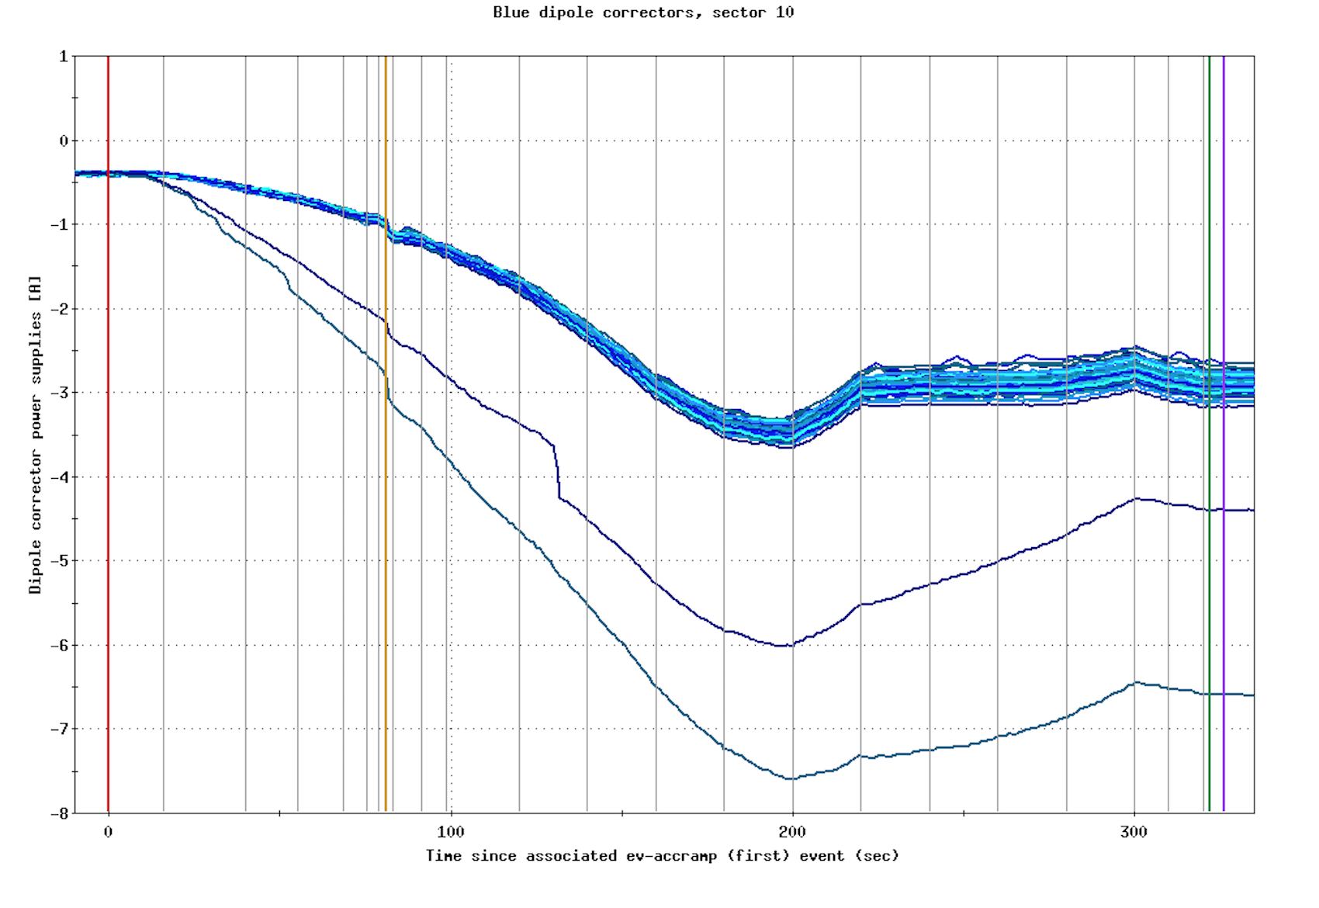
Diode Failure History (2016)

Slide 28
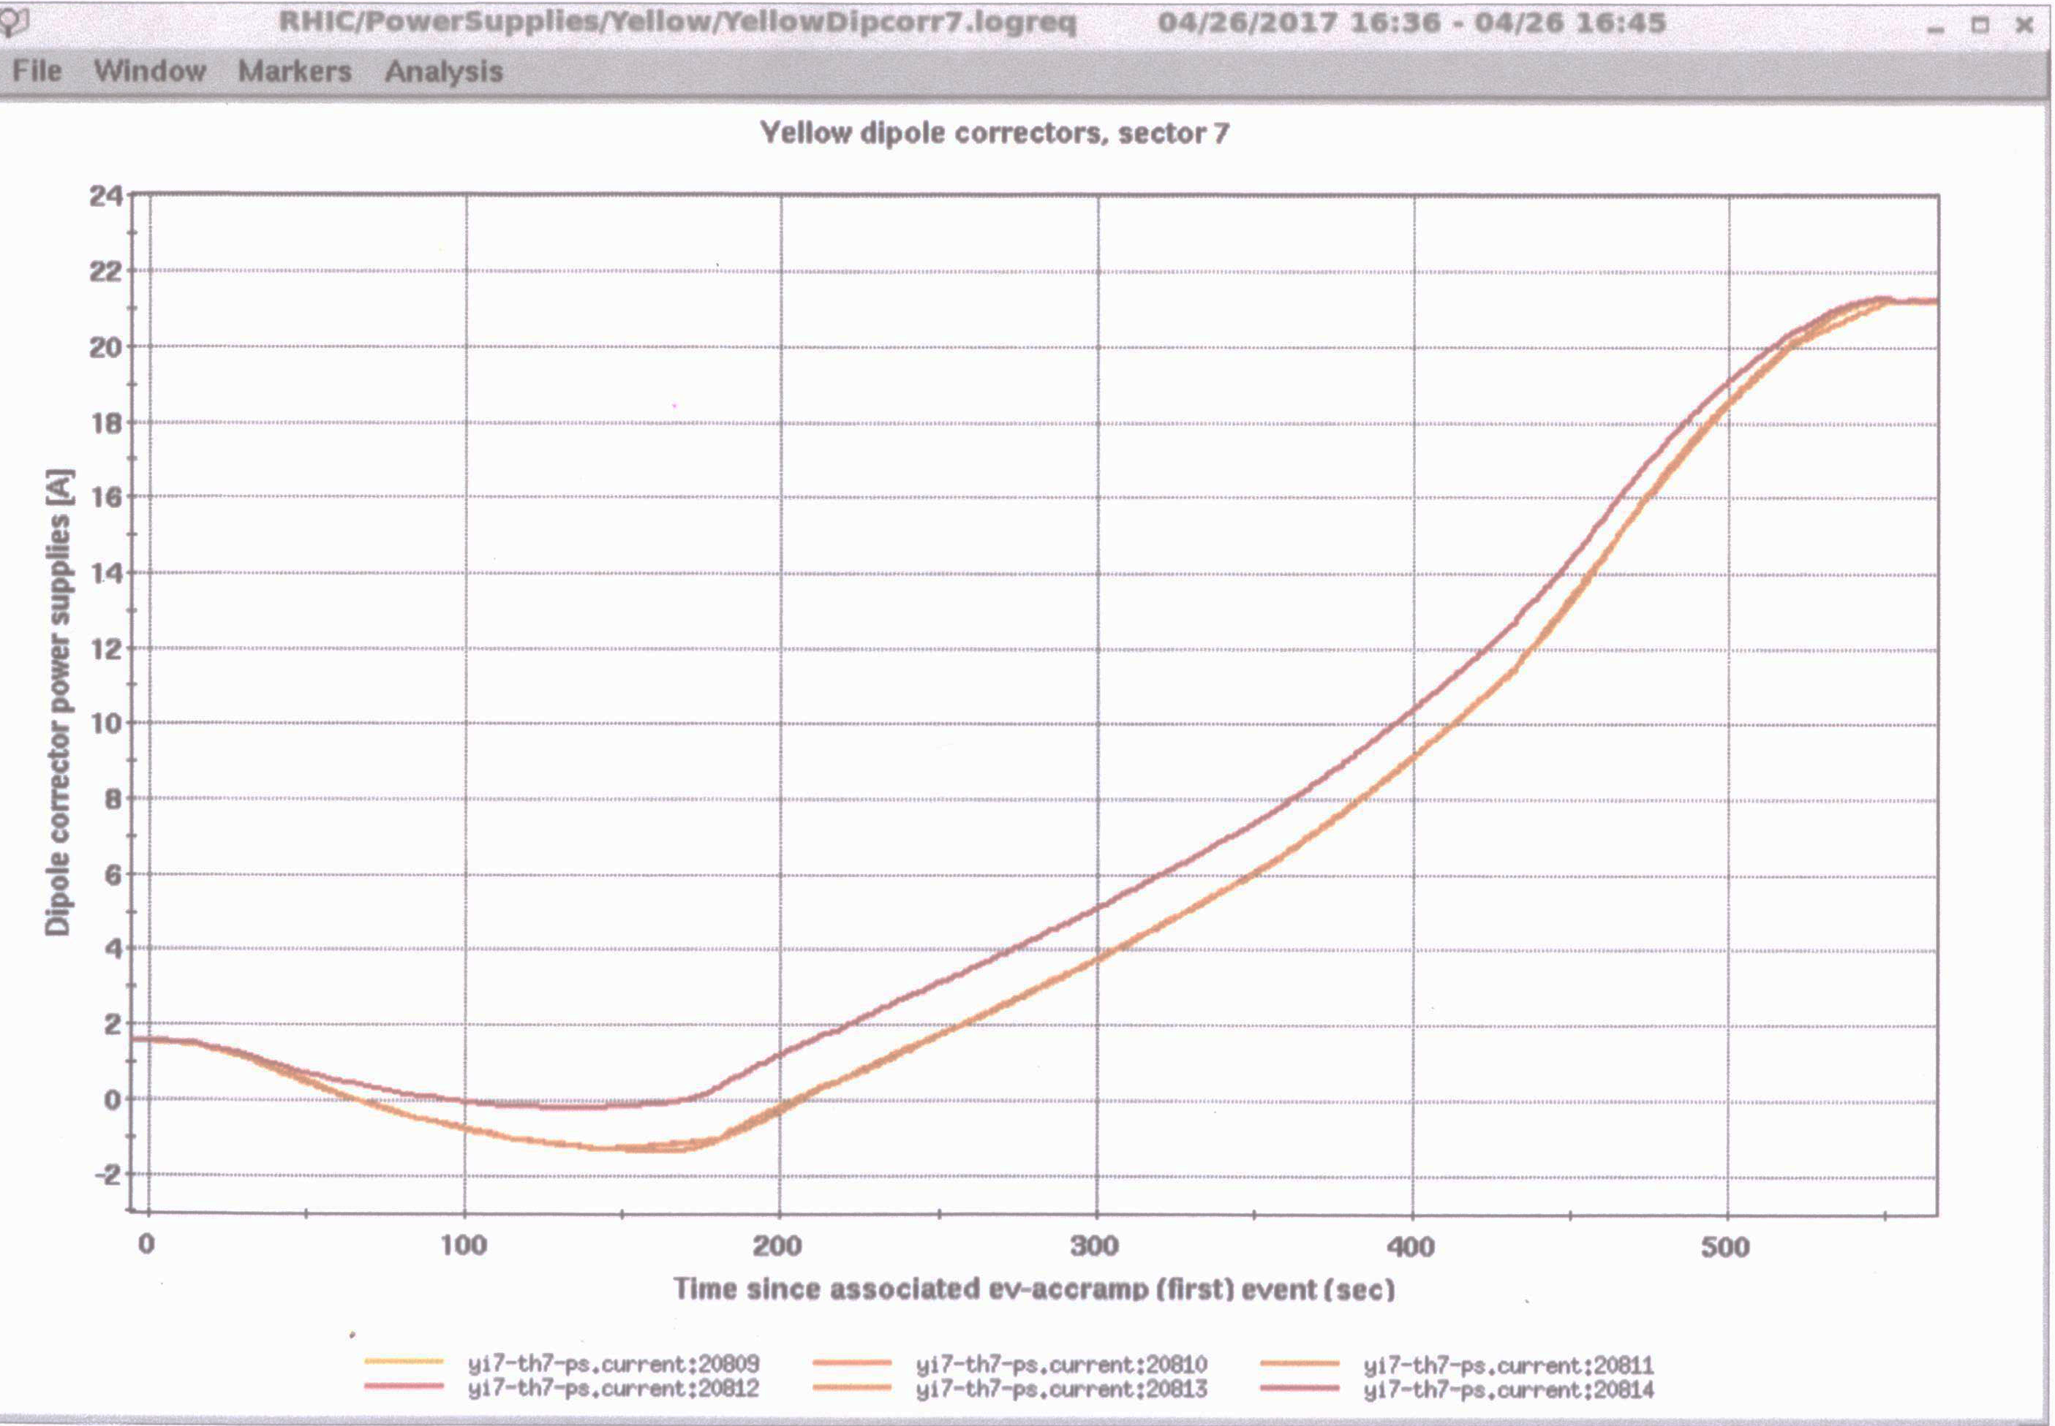
Changes in yi7-th7 corrector (2017)

Slide 29
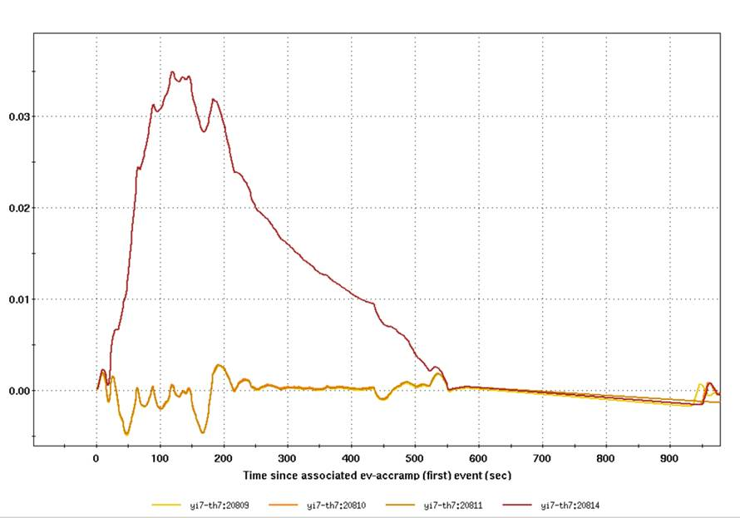
Changes in yi7-th7 corrector (2017)
mrad

Slide 30
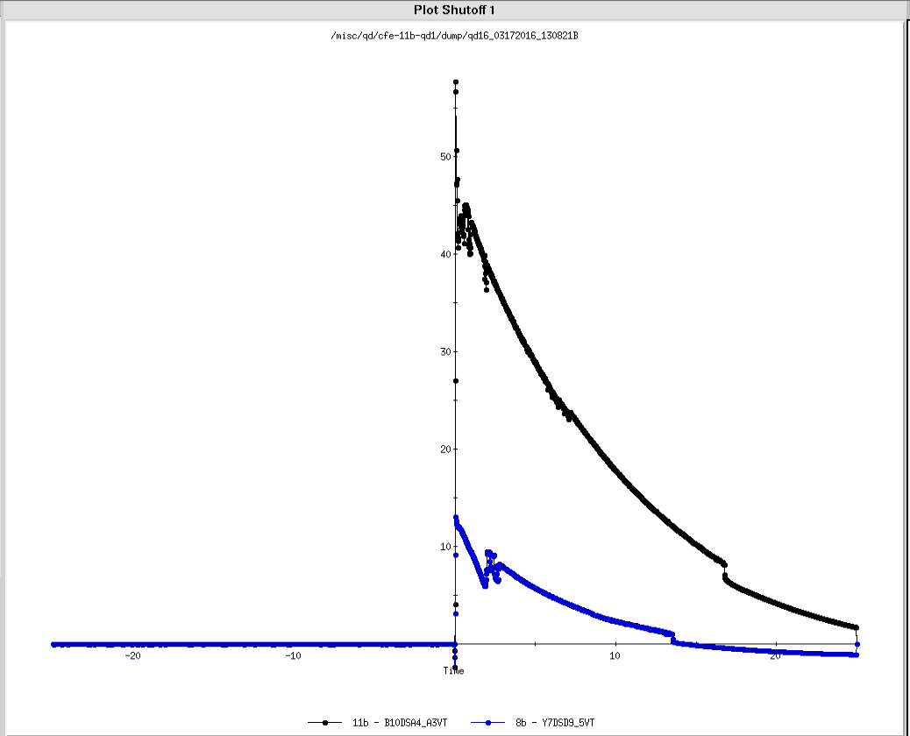
Comparing B10D19 to Y7D6 VT’s beam induced quenches that caused diodes Failure
Black trace B10D19 3/17/17 13:08
Blue Trace Y7D6 3/11/17 03:35

Slide 31
Tests Made in the Ring
100A-180A-100A Ramp

Slide 32
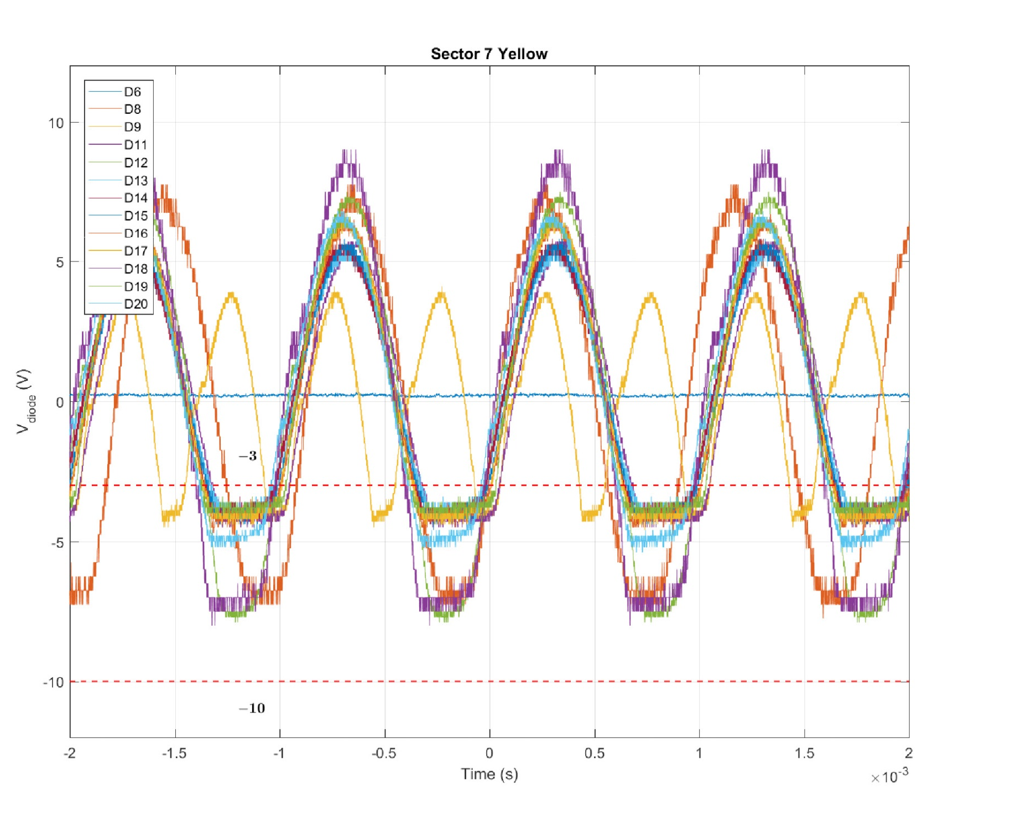
YI7-D6

Slide 33
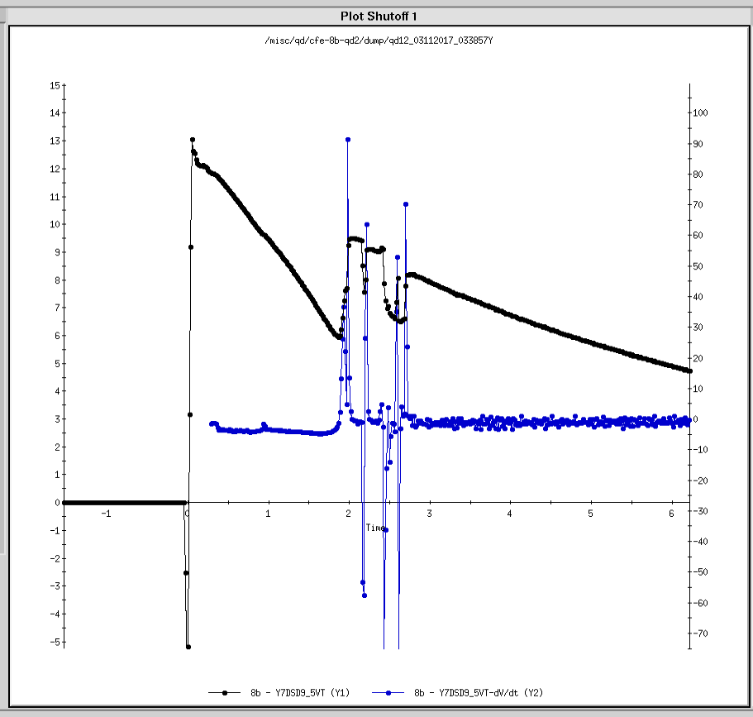
Y7DSD9_5VT Shutoff and dv/dt
Blue trace dv/dt
Black Trace Y7D6 3/11/17 03:35

Slide 34
Observations of Yi7-Th7
The correction strength of Yi7-Th7 was monitored after every QLI after 3/11/17. The current through the diode was estimated based on this correction
After the event 54 amperes out of approximately 1000 amperes was going through the diode at SF 1
At SF2, 9 amperes went through the diode
It was observed that after clean quenches the current through the diode decreased and after dirty quenches it increased ?
Concerns were either we would run out of correction or the correction would go to zero possibly indicating an open diode.
The magnet will be opened and the Diode in Y7D6 will be replace in the upcoming months

Slide 35
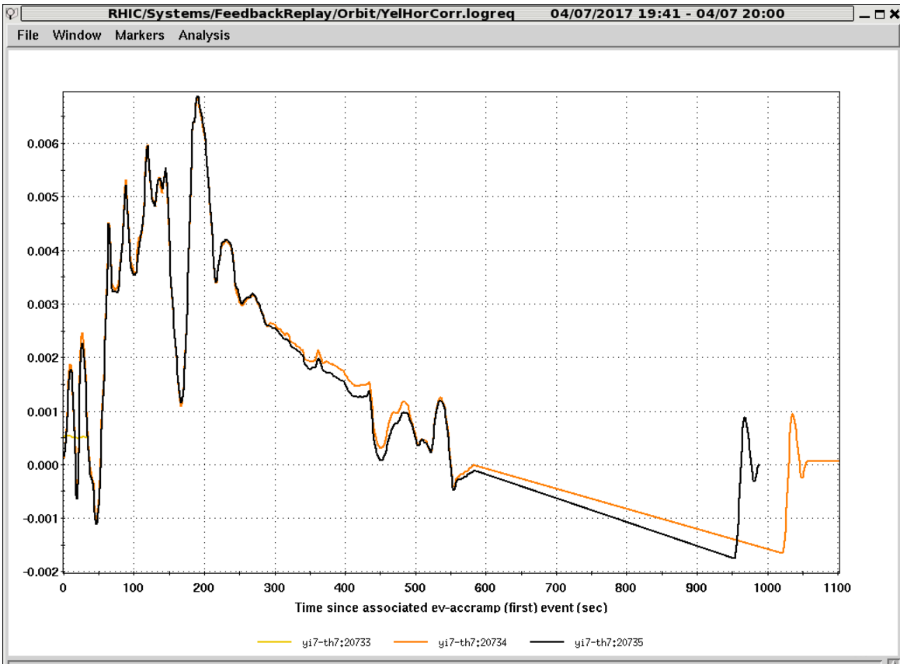
yi7-th7 check after each ramp

Slide 36
Diode with Reduced Forward Voltage Drop B10 D9
RHIC diodes were specified and tested to have forward voltage drops of between 3 and 10 volts when cold
This is specified at a particular forward current
Of 168 diodes tested only one B10D9 was outside this limit with a Forward Voltage Drop of 2 volts (@100 mA)
!00% of all diodes were tested before being installed at 1 ampere into the magnets and samples from each batch were tested at low currents. This Diode may not have been tested at low currents. It is extremely unlikely that a diode with a forward voltage drop of less than 3 volts was used.

Slide 37
Blue-Forward Voltage Drop BO10-D9 only reads 2V

Slide 38
Typical Cryogenic Diode
~ 4 K

Slide 39
Facts about Diode B10 D9
These Forward Voltage Drop Measurements have not been made since the magnets were installed. There is no way of knowing how long this diode has been like this.
This measurement was made at 100 mA
The voltage across this diode is 0.2 volts during normal ramping
There is no orbit distortion in this area
The radiation levels in this region are low.
We have records which show B10 D9 quenched four times in run 14 and has not quenched since

Slide 40
Back Up

Slide 41
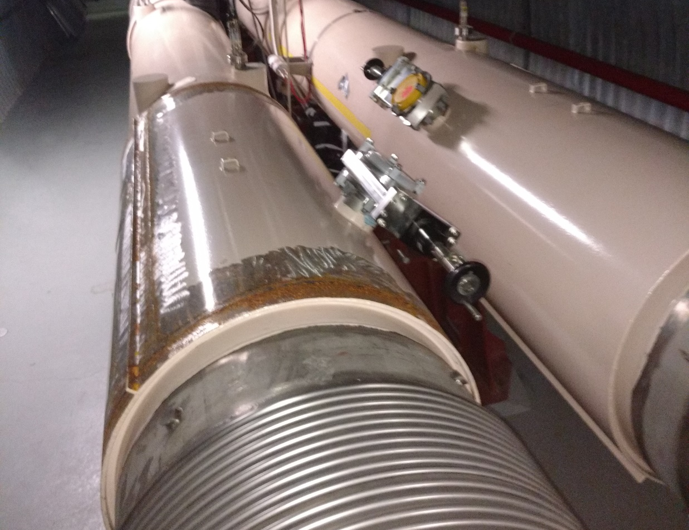
Dipole -- Sector 10 D19
Loss Monitor
Diode

Slide 42
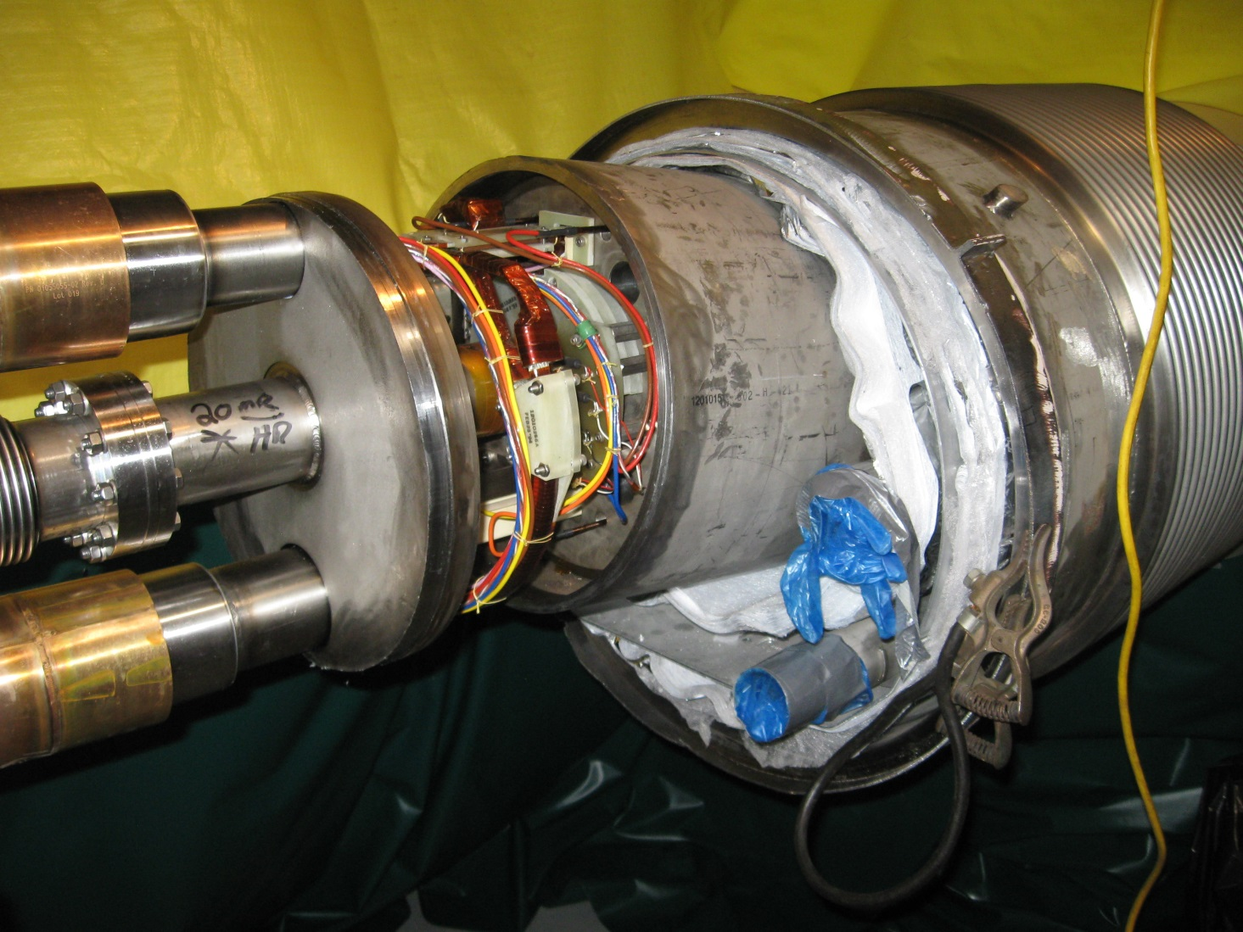
Diode Location End Volume

Slide 43
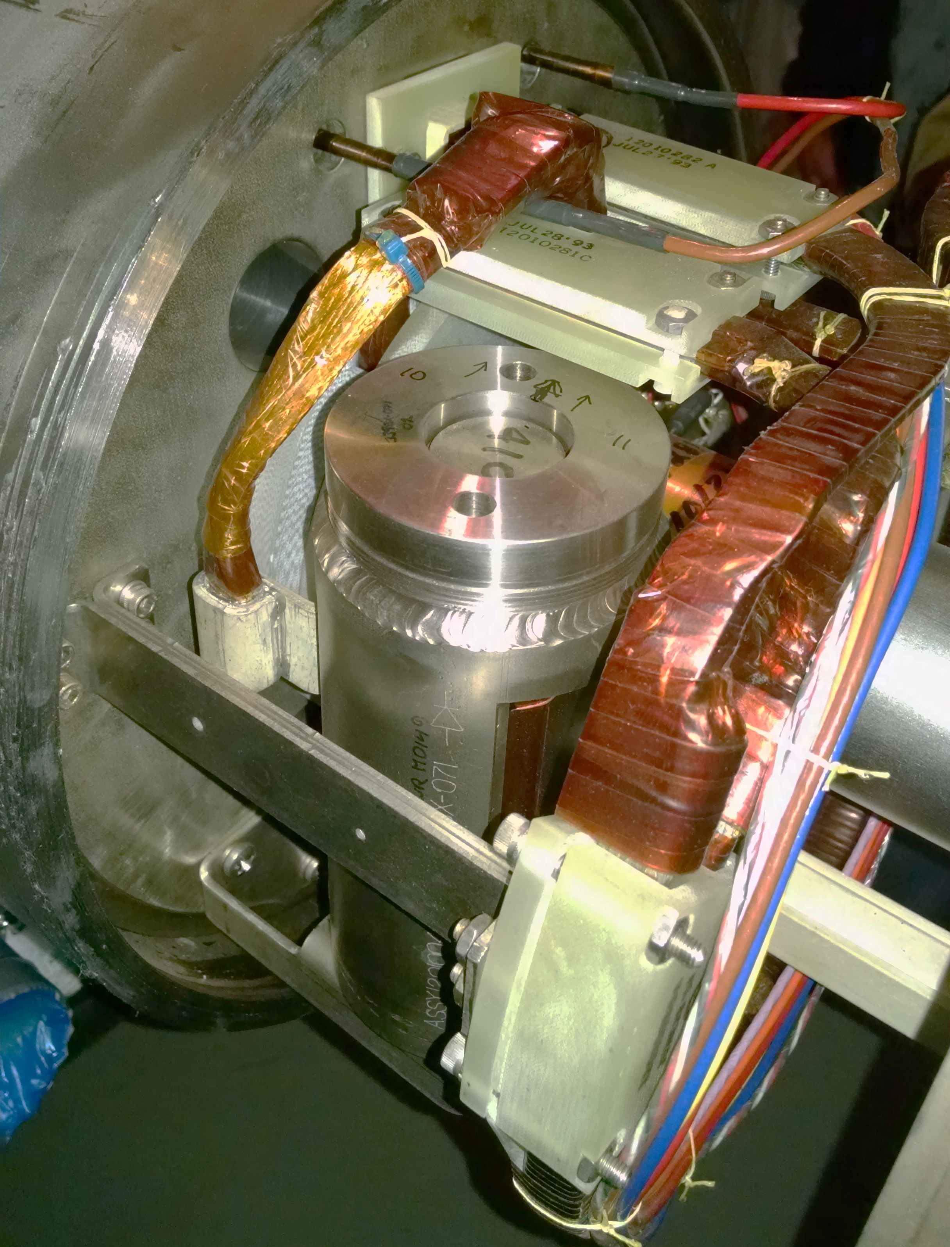
Diode Assembly
Beam pipe
175 mm X 80 mm dia.
(6.9 in.) (3.15 in.)

Slide 44
Inductances
B10DSA4_A3VT contains 6 dipoles that are about 25mH each
(25mH/150mH)*100=17%
Y7DS9_5VT contains 4 magnets. D9=7mH, D8=23mH, D6=7mH, D5I=17mH
(7mH/54mH)*100=13%

Slide 45
VFM Increase
Powerex Proposal for RHIC Diodes

Slide 46
Radiation Effects on Cold Diodes
Radiation effects may not be uniform across the diode -- “Gradient Effect”
A gradient of different FVD may cause current crowding across the diode worsening the effect
There is an annealing process whereby warming the diode up reverses some of the radiation damage. Maybe as much as 80%
One of the only ways to determine the health of a diode is to study its FVD at high current when cold

Slide 47
Radiation Exposure
The estimated integrated lifetime exposure of RHIC diodes from the specification to procure the diodes was:
2 x 10¹² neutrons/cm²
Pre-RHIC BNL Testing showed problems with similar diodes at:
5 x 10¹² neutrons/cm²
Integrated exposure at ionization chamber closest to diode this run:
0.1 kGy
Estimated integrated diode exposure extrapolating from ionization chamber for this run:
11 kGy
(difficult to relate to neutron flux)

Slide 48
What Can be Done
Compare present data to original diode data
So far a dead end but still looking
Develop a diagnostic to Identify Unusual Wave shapes during turn offs
In Progress……J. Laster & D. Bruno
Reassemble original test facility and retest some diodes
Do we want to open more magnets in the ring?
What will tests tell us?
Run Tests on the Diode that failed
How severe is the gradient FVD
Run Low Current Tests on the Cold system and measure FVD. Develop a history on our diodes
Try to determine actual Diode exposure

Slide 49
Failed Diode at Sector 10
Edge closest to beam
230 uR/Hr In April
67 mm
After 3 months cool down
65 ur & 39 uR/Hr
2.88 mm thick
Edge furthest from beam
100 uR/Hr in April

Slide 50
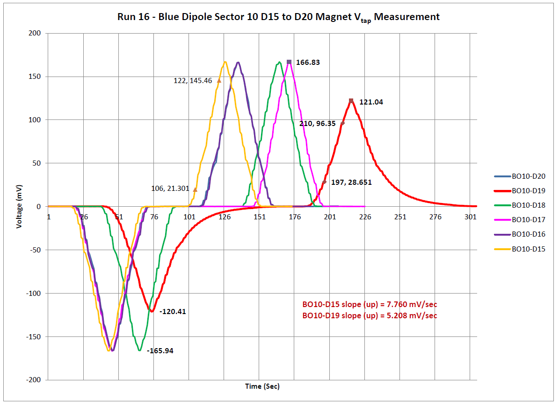
Local Measurements to Determine B10 D19 Sat 3/19/16
Ramped blue main quad current in 100A steps at 3A/s up to Injection
All peaks the same except B10D19
Tail is seen on B10D19 only

Slide 52
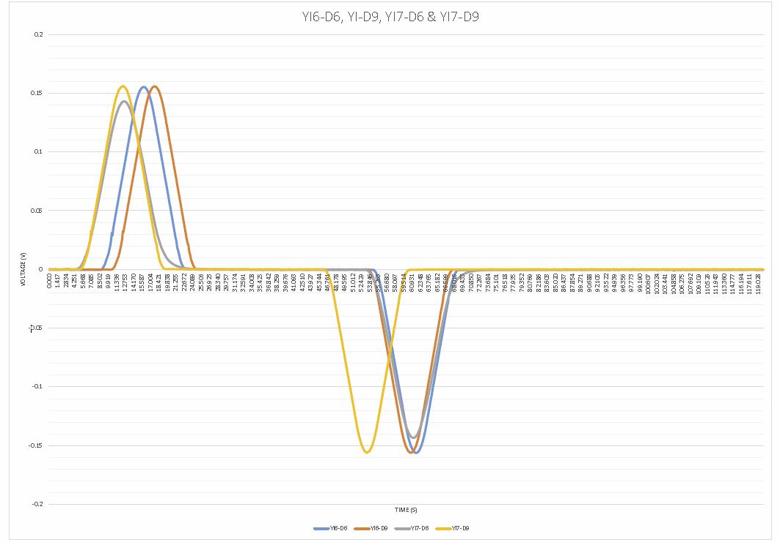
Local Measurements to Determine Y7D6 diode bad – Al ramping YDmain
Ramped yellow main dipole current from 50A to 180A and back down to 50A at 18A/s
All peaks the same except Y7D6
Tail is seen on Y7D6 only

Slide 53
Modified Relay Under test

Slide 54
Yellow-Forward Voltage Drop A good diode should reads between 3V to 10V YI7-D6 reads zero volts.

