Slide 1
Low Energy RHIC electron Cooling
(LEReC)
Commissioning progress and future plans
Alexei Fedotov
on behalf of LEReC team

Slide 2
Outline
LEReC DC gun tests:
Successes & Issues
Commissioning of other systems
Future plans

Slide 3
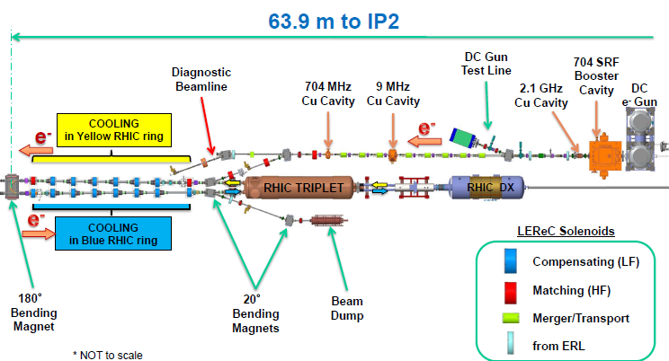
LEReC accelerator (100 meters of beamlines with the DC Gun, 5 RF systems, many magnets and instrumentation devices)
Injector section installed
January 2017 (without SRF)
Installed January 2016
Remaining components
will be installed in 2017

Slide 4
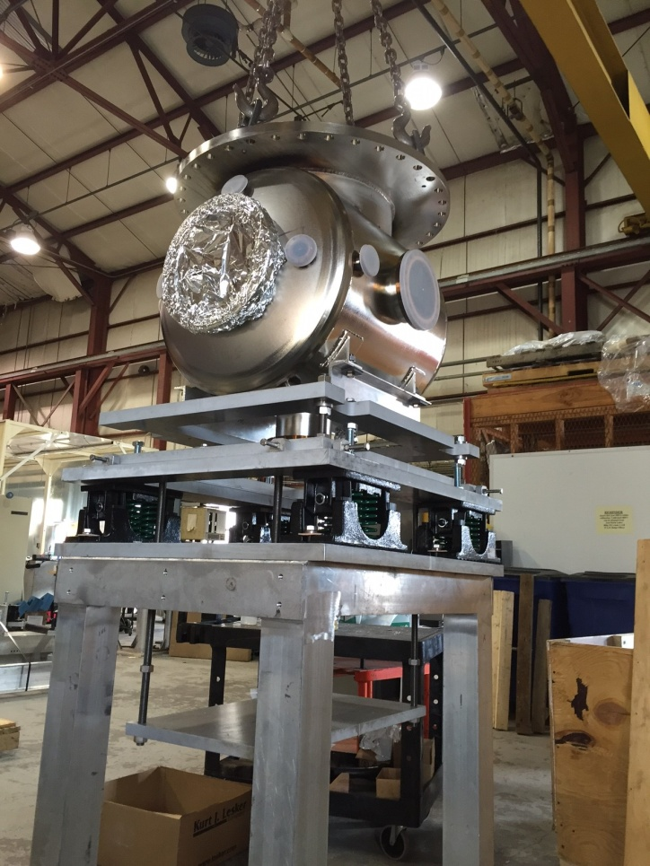
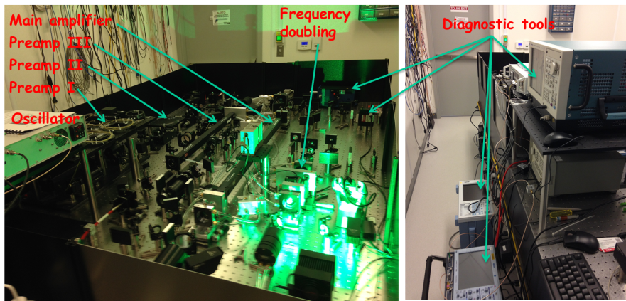
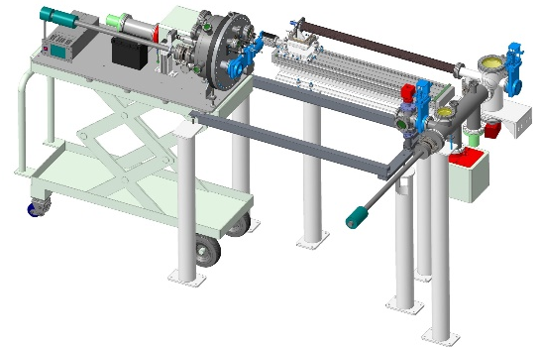
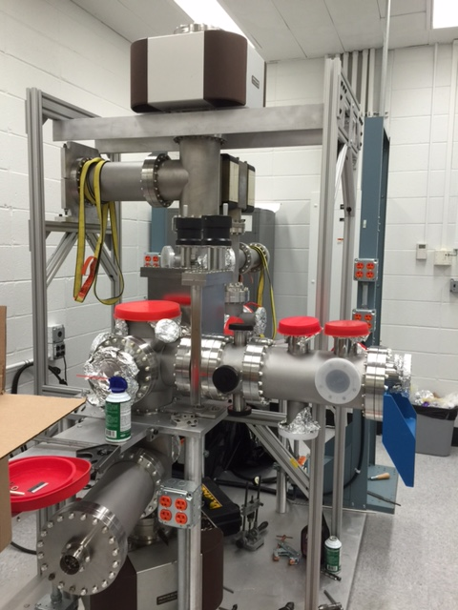
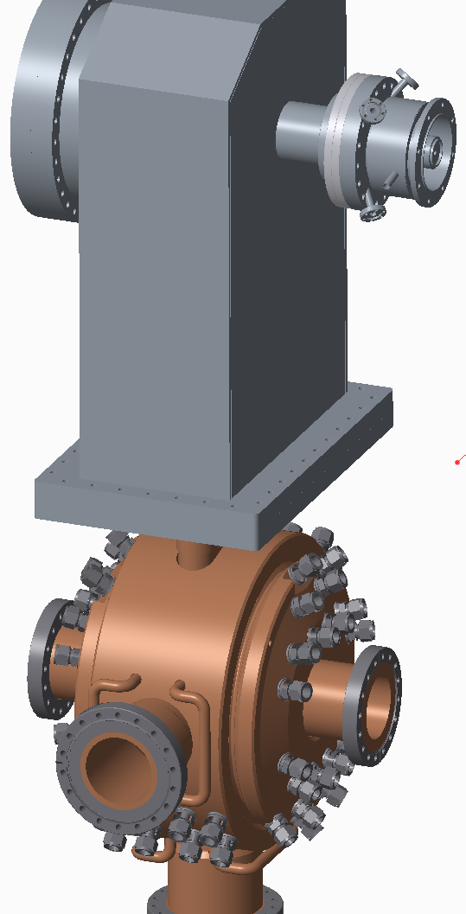
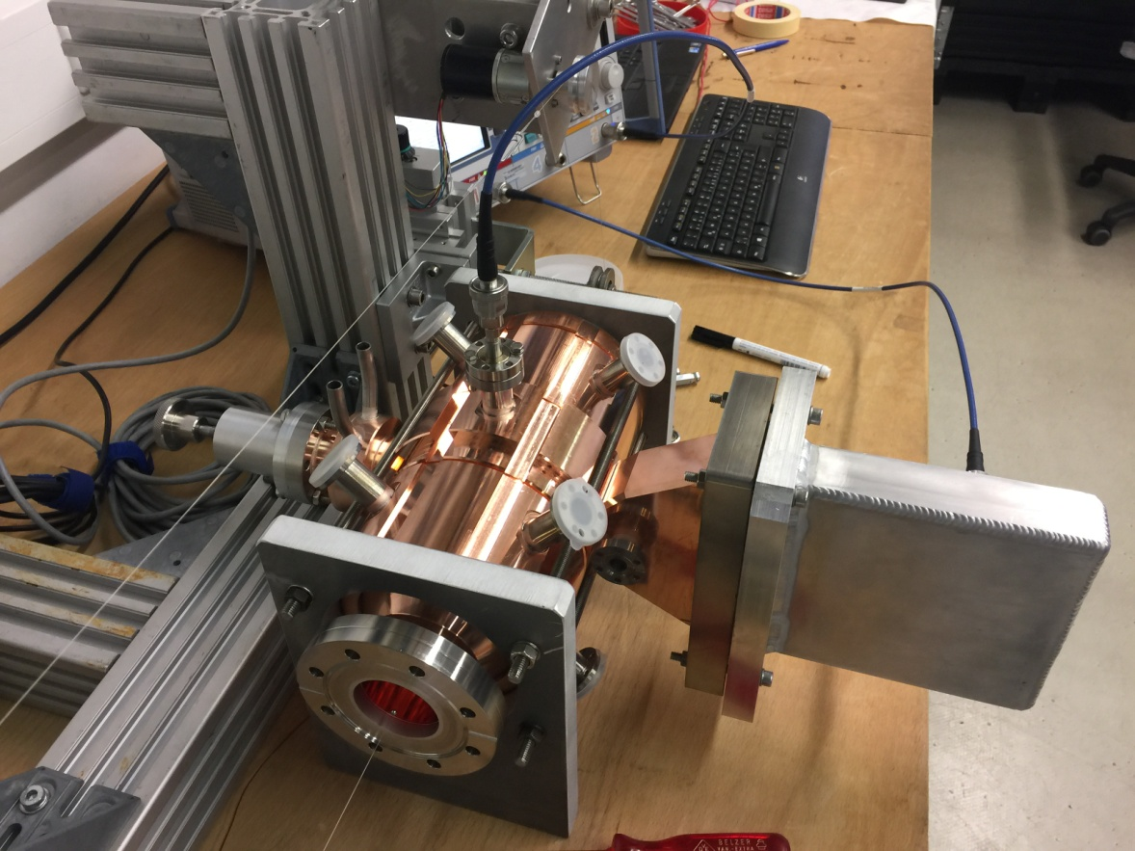
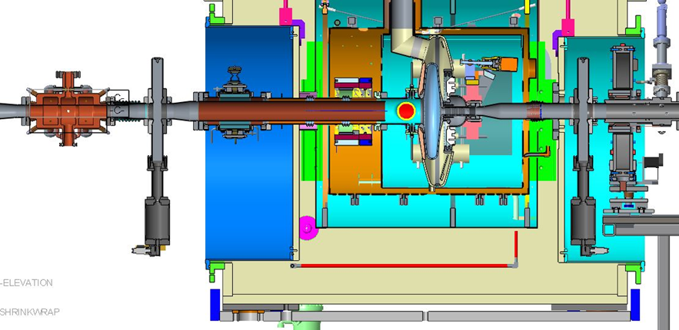
LEReC Critical Technical Systems
1. DC photocathode electron gun and HV PS.
2. High-power fiber laser system and transport
3. Cathode production deposition and delivery systems
4. SRF Booster cavity
5. 2.1 GHz and 704 MHz warm RF cavities
1
2
3
5
4
3

Slide 5
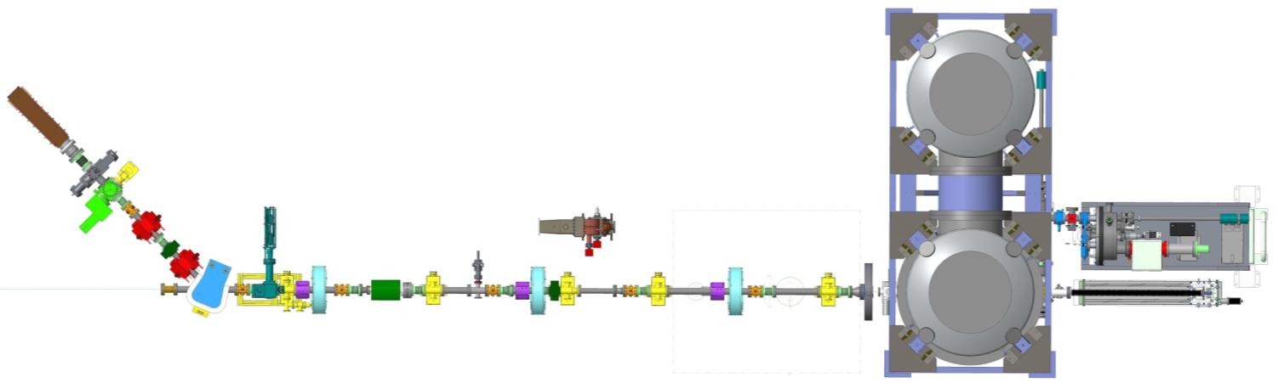
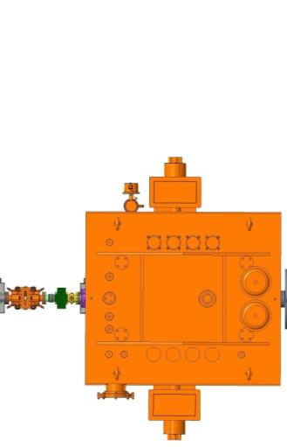

LEReC Injection section (zoom in), 2018
Beam Dump
ERL Halo Monitors
Profile Monitor (ERL LE)
e-beam direction
FCT
ERL Quadrupole
Cathode Suitcase
BPM
ERL Quadrupole
ERL Emittance Slit
2.1 GHz Cavity
H/V Corrector
ERL DCCT & ICT
BPM
BPM
BPM
Profile Monitor
H/V Corrector
ERL Solenoid
ERL Solenoid
Cathode Insertion
45°dipole (CeC)
DC e⁻ Gun
Transport Solenoid
7 m
704 SRF Cavity

Slide 6
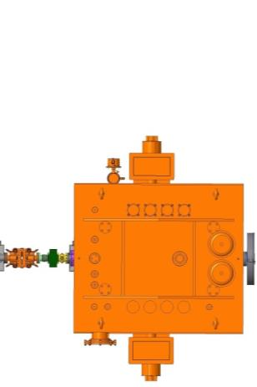
Gun Test setup 2017
(no RF components in beam line)
2.1 GHz warm cavity:
The cavity was installed outside of beamline to decouple its commissioning from the DC gun commissioning.
Beam Dump
ERL Halo Monitors
Profile Monitor (ERL LE)
FCT
ERL Quadrupole
2.1 GHz Cavity
Cathode Suitcase
BPM
ERL Solenoid (temporary)
ERL Quadrupole
ERL Emittance Slit
e-beam
direction
H/V Corrector
No SRF Cavity
ERL DCCT & ICT
BPM
BPM
BPM
BPM
Faraday Cup
Profile Monitor (
H/V Corrector
ERL Solenoid
ERL Solenoid
H/V Corrector (temporary)
Cathode Insertion
BPM (temporary)
45°dipole (CeC)
FCT (temporary position)
DC e⁻ Gun
7 m

Slide 7
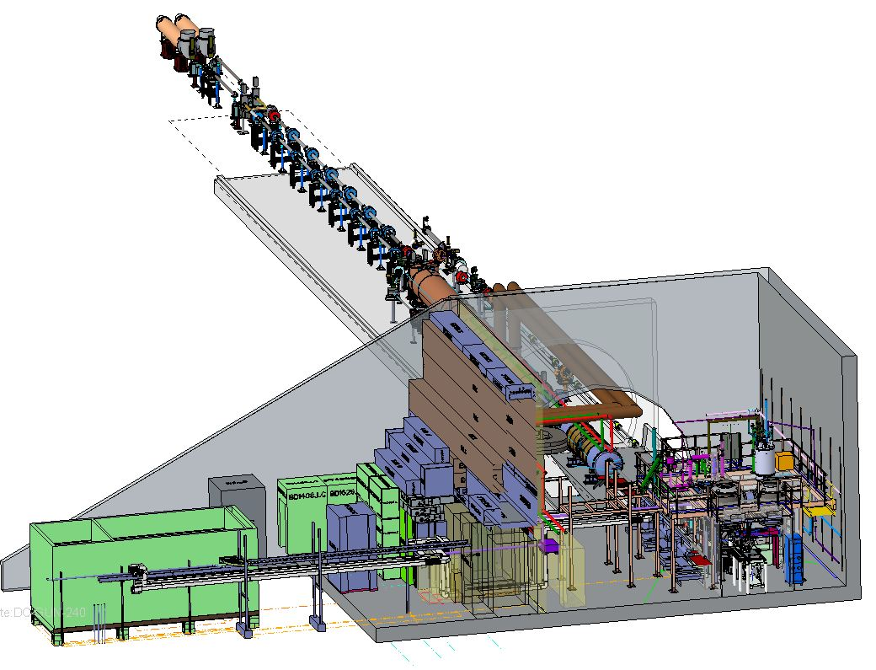
3D LEReC layout in RHIC tunnel at IR2
Cooling sections
Injection Section
(Gun Test beamline)
Laser

Slide 8
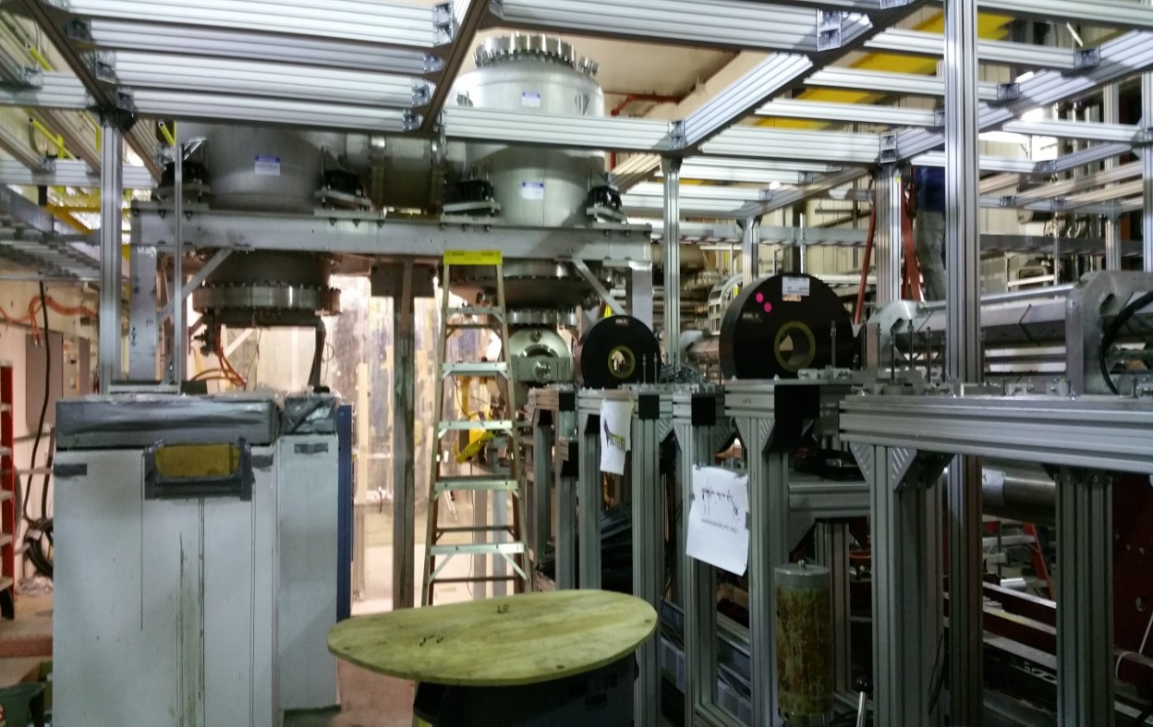
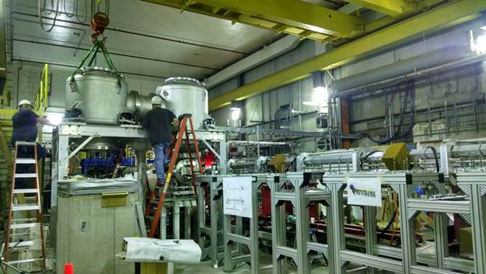
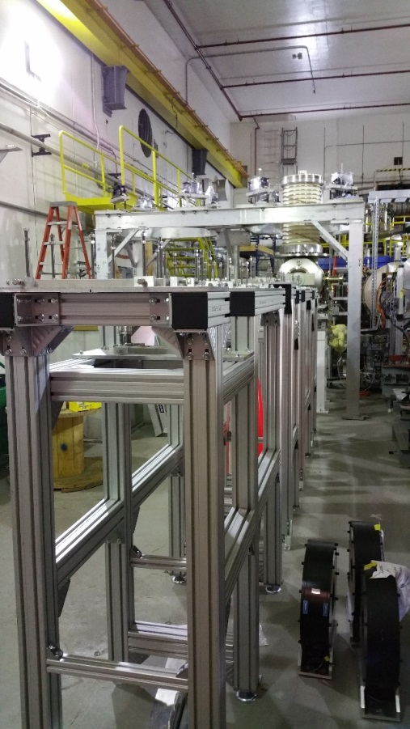
LEReC Gun Test beamline under construction (2016)

Slide 9
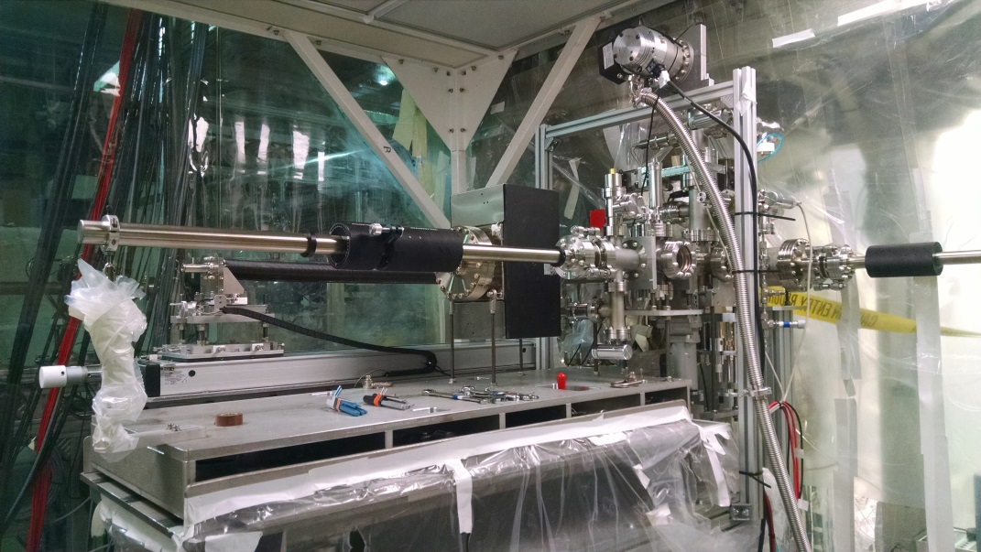
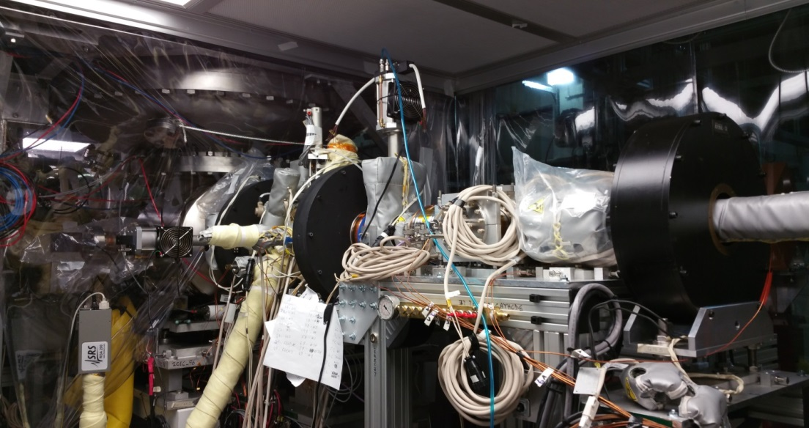
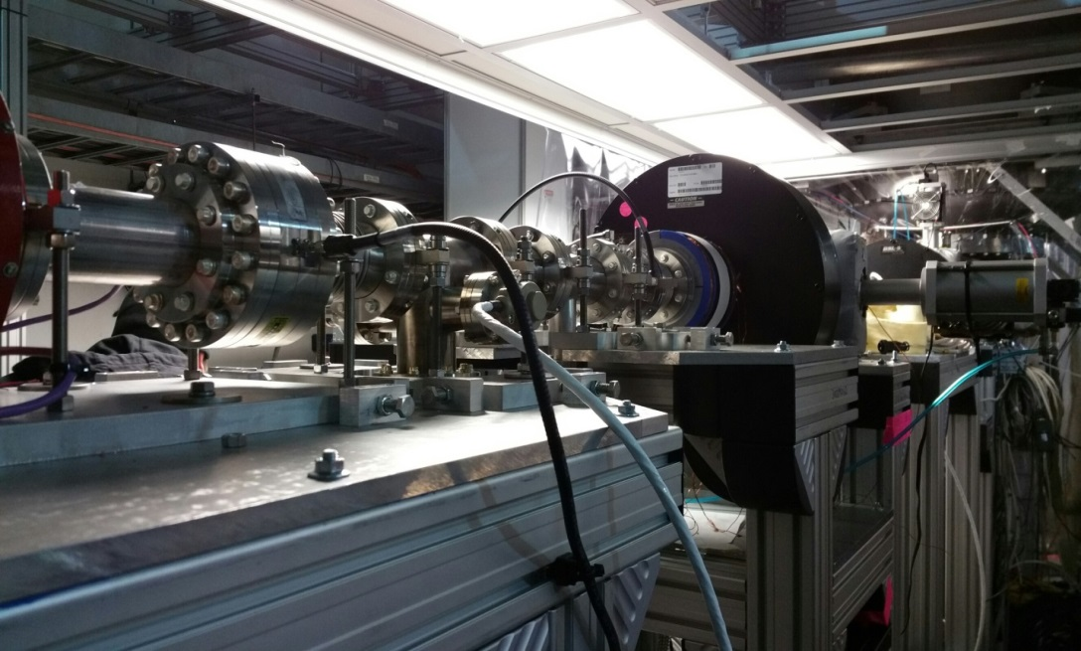
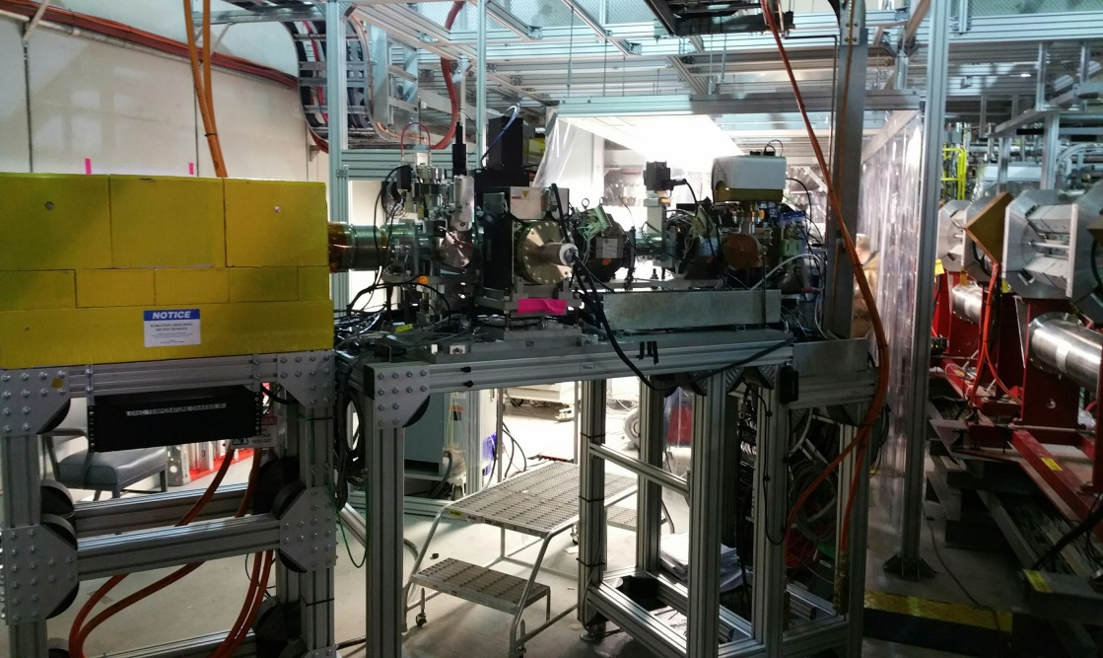
LEReC DC Gun test beamline (installed in RHIC IR2)
Cathode insertion system
Gun transport section
Transport beamline
Extraction line and beam dump

Slide 10
LEReC Gun test is the first stage of LEReC configuration.
The goal : test critical LEReC equipment in close to operation condition.
Components tested:
Laser beam delivery system (laser, laser shaping, laser transport, laser pulse stability, etc.)
Vacuum components with controls
Cathode delivery and manipulation systems
DC gun characterization (stability, ripple, maximum operation voltage)
Magnets, power supplies.
Beam instrumentation: charge and current measurements, beam position measurements, beam loss monitor detectors, beam profile and loss measurements
Control system (timing system, machine protection system, laser controls, gun power supply, magnets power supplies, beam instrumentation)
High average power beam extraction and beam dump system.
Start exploring high current operation issues

Slide 11
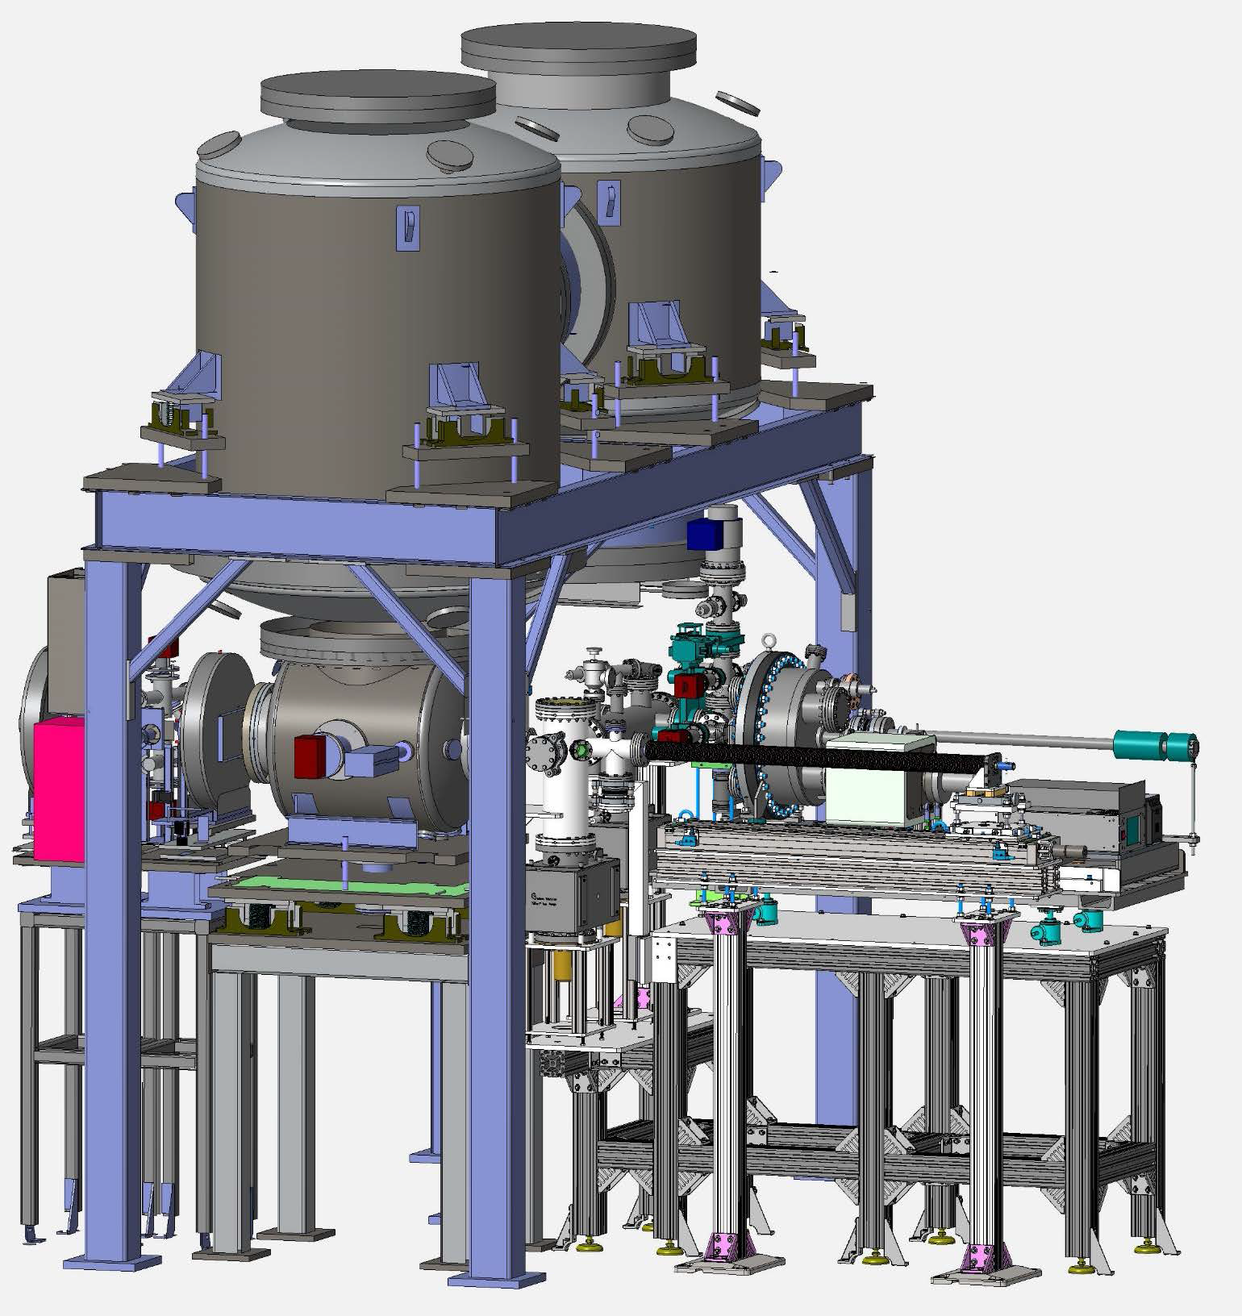
LEReC Gun Test (2017) Critical Technical Systems
HV DC photocathode electron gun
High-power fiber laser system
Cathode production deposition and
delivery systems:
- single cathode suitcase and
manipulation system
- multi-cathode (up to 12 cathodes) vacuum
suitecase

Slide 12
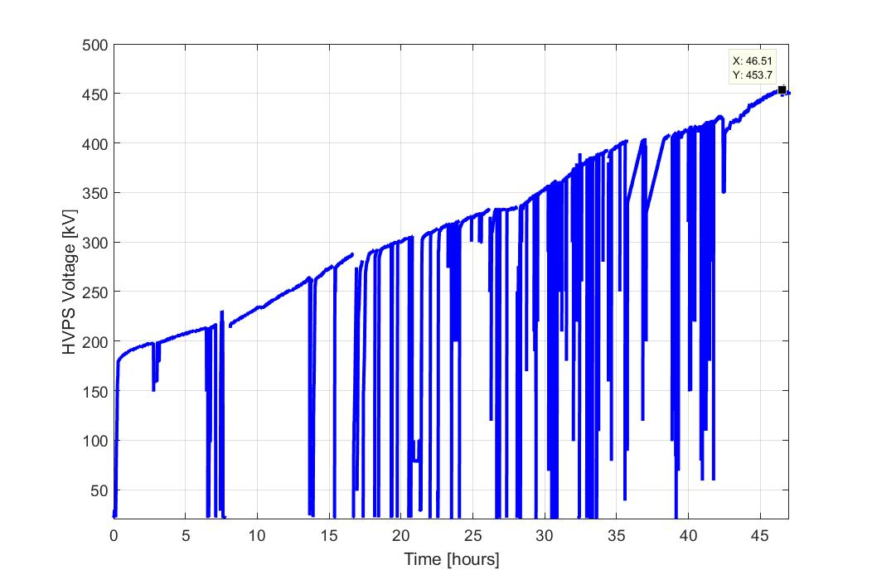
Gun conditioning at BNL
DC gun has been tested up to 430kV at Cornell (Oct 2016)
DC gun HV conditioning starts at BNL Nov. 28, 2016
DC gun reached 456kV by Dec 7, 2016; Stable at 450kV.

Slide 13
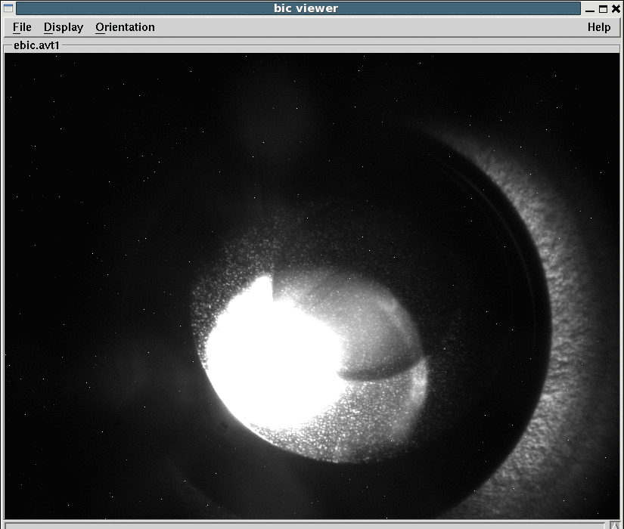
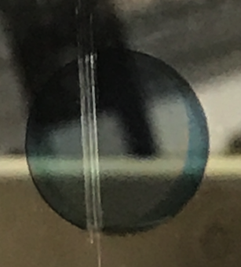
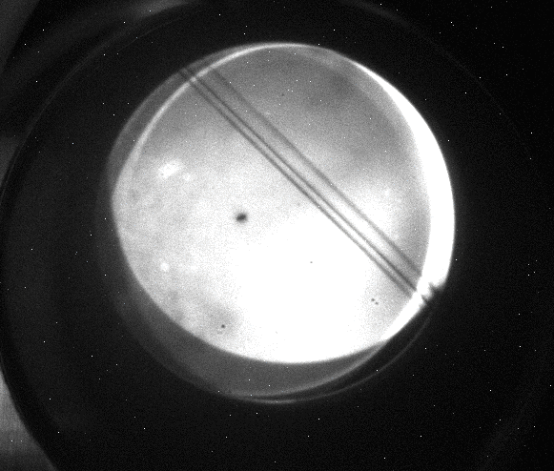
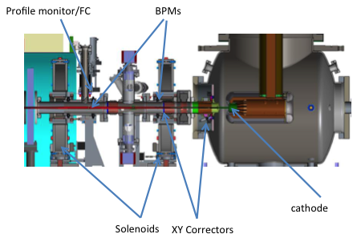
First photocurrent (DC) observed (April 18, 2017)
Photo cathode visible light image before installation
Cathode camera image with LED lamp on
Photocurrent image result of LED (beam profile monitor)

Slide 14
LEReC beam structure in cooling section
Example for γ= 4.1 (E_{ke}=1.6 MeV)
Ions structure:
120 bunches
f_rep=120x75.8347 kHz=9.1 MHz
N_ion=5e8, I_peak=0.24 A
Rms length=3.2 m
Electrons:
f_SRF=703.5 MHz
Q_e=100 pC, I_peak=0.4 A
Rms length=3 cm
1.42 nsec
9 MHz RHIC RF
Electron macro-bunch
30 electron bunches per ion bunch
110 nsec,
f=9.1 MHz
Ion bunch

Slide 15
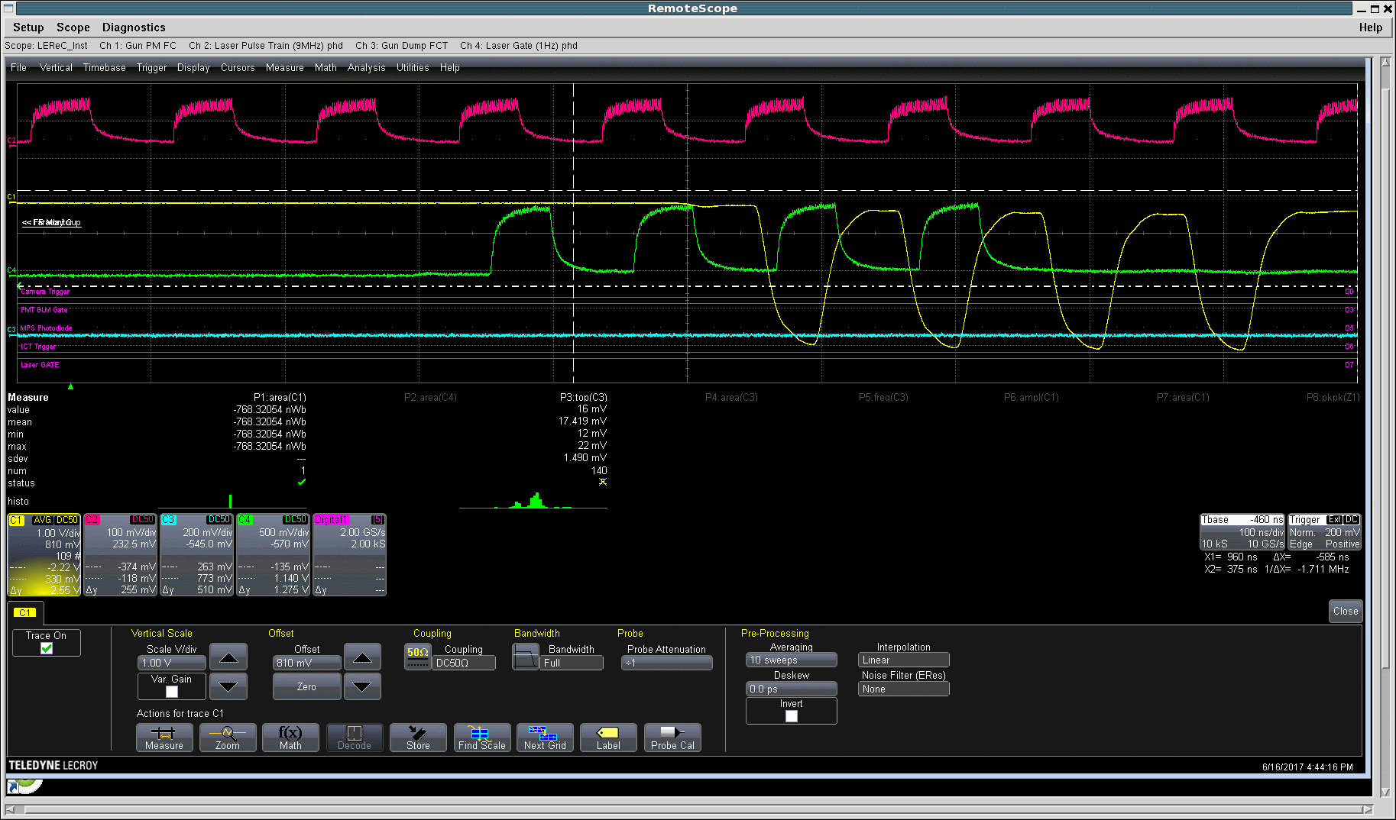
Pulsed beam operation (June 16)
9 MHz laser pulses
4 laser pulses at 1Hz
Faraday Cup signal
Charge per MB 4nC (30 electron bunches), bunch charge 130 pC

Slide 16
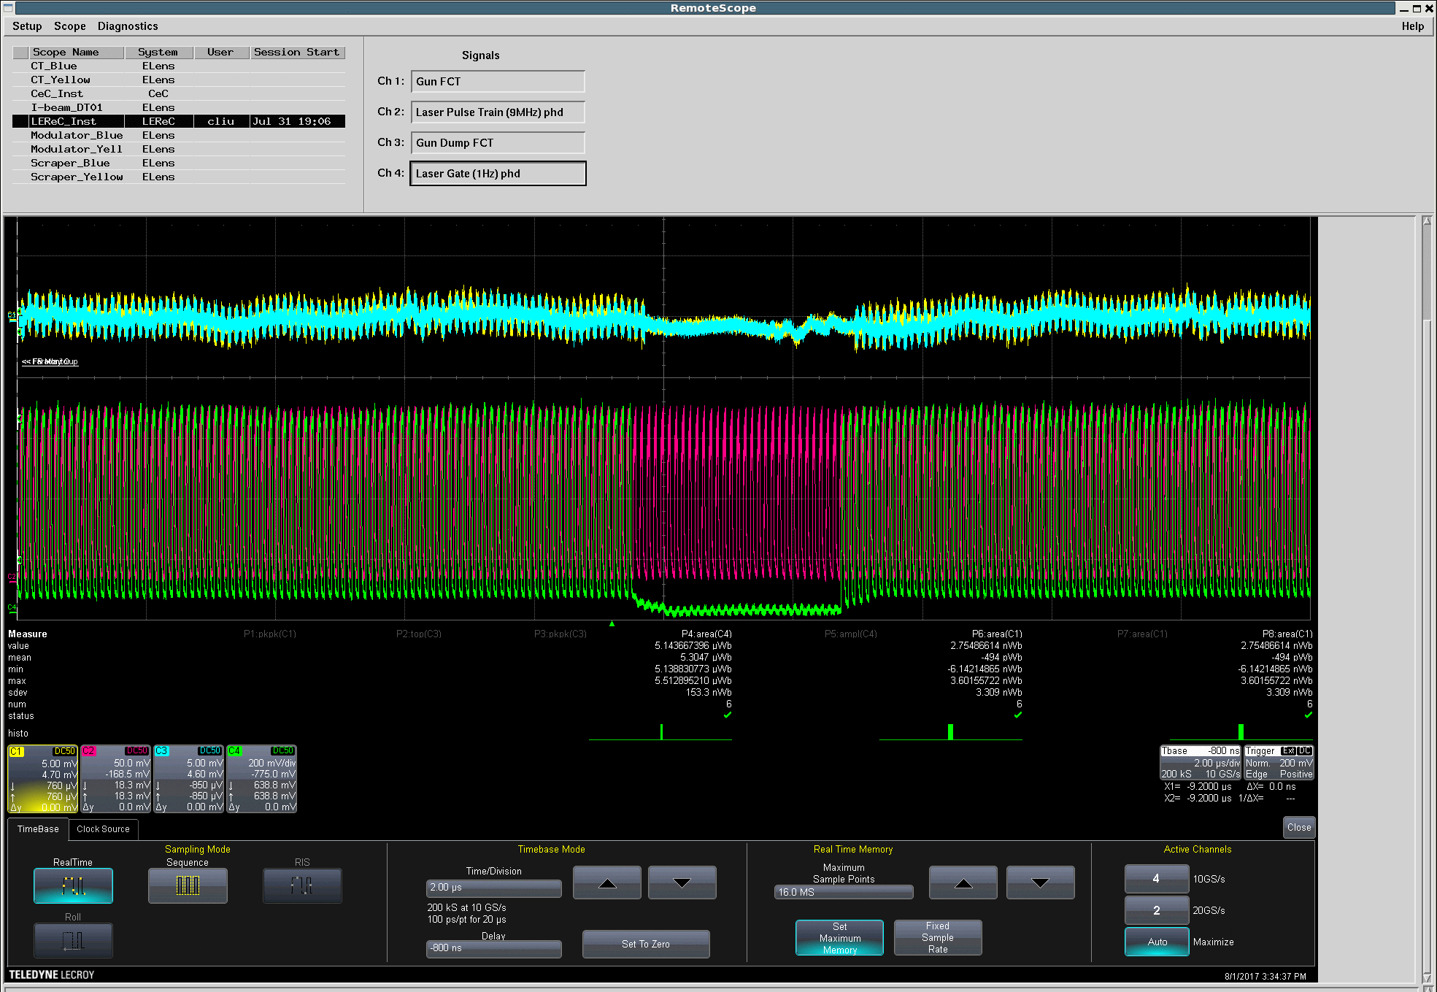
First CW operation (August 1)
Gun and Dump FCT signal
gap in
laser pulses

Slide 17
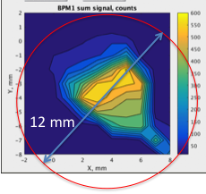
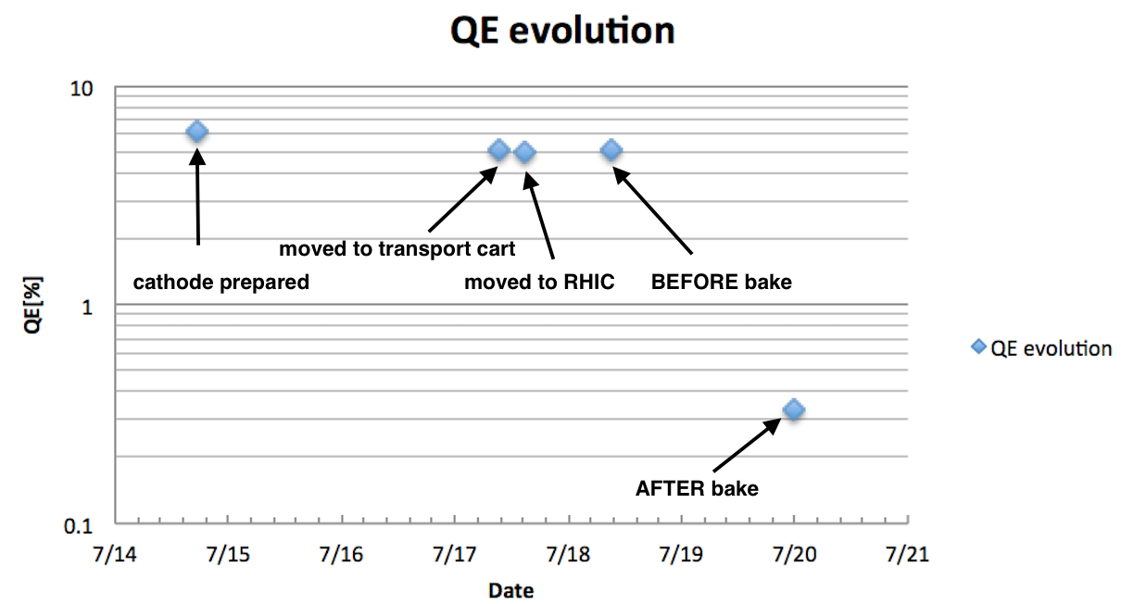
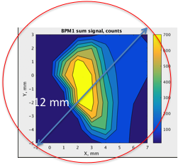
LEReC Cathodes operations summary
 | Material | Grow | Inserted | Bunch Charge maximum | Lab QE | In Gun QE initial
Cath#1 | NaKSb | Jan 30 | Apr 17 | 25 pC | 1.7% | 0.1%
Cath#2 | NaKSb | May 17 | June 2 | 30-40 pC | 7% | 0.3%
Cath#3 | NaKSb | June 13 | June 16 | 130 pC | 4% | 1.2%
Cath#4 | CsKSb | July 15 | Jul 20 | 40pC | 5% | 0.3%
Cath#4:
QE=0.3%
12 mm
QE scan in BPM sum signal
QE=1.2%
#3

Slide 18
LEReC DC Gun tests Highlights
December 2016: DC Gun was conditioned to 455kV with stable operation at 400kV, which is design goal.
April 18, 2017: first electron beam (DC)
May 5: First pulsed electron beam using high-power green laser; beam propagated all the way to the beam dump
June 16: Delivered cathode with design QE value (>1%) inside the gun
June 16: Demonstrated LEReC design electron bunch charge (3.5-4nC per macro-bunch, 130pC/laser pulse)
August 1: First CW operation (at 9MHz)
August 1: Achieved 1mA CW current

Slide 19
LEReC DC Gun beam tests summary
DC gun tests Summary (April-August, 2017):
DC gun routinely operated at nominal voltage of 400kV with processing resistor (presently requires some re-conditioning)
- Operated with running resistor which allows CW operation
Laser beam of 10W green power on the cathode was provided routinely
in pulsed mode.
Beam instrumentation commissioned and calibrated
(BPMs, Faraday Cups, ICT, DCCT, FCTs, BLMs, Capacitor Pick Up)
- MPS commissioned
4 cathodes were tested in beam operations
Major goals for the DC tests were successfully achieved!
This includes testing LEReC equipment in close to operation condition, commissioning of Instrumentation and MPS systems.

Slide 20
LEReC DC Gun beam tests
DC Gun beam tests AP shift leaders:
D. Kayran, A. Fedotov, X. Gu, J. Kewisch, C. Liu, V. Ptitsyn, S. Seletskiy
LEReC laser:
Z. Zhao, P. Inacker, M. Minty
MCR support, especially during RHIC summer shutdown:
P. Adams, A. Burkhart, H. Lovelace, B. Martin
Successful commissioning of LEReC injector became possible as a result of hard work and help of people from various groups!
Z. Altinbas, D. Beavis, S. Bellavia, D. Bruno, K. Brown, M. Costanzo, A. Curcio, C. Degen, L. DeSanto, J. Drozd, W. Fischer, J. Fite, C. Foltz, D. Gassner, J. Halinski, K. Hamdi, L. Hammons, R. Hulsart, J. Jamilkowski, S. Jao, P. Kankiya, D. Lehn, E. Lessard, C-J. Liaw, G. Mahler, M. Mapes, K. Mernick, C. Mi, T. Miller, S. Nayak, P. Oddo, M. Paniccia, W. Pekrul, D. Phillips, T. Rao, T. Samms, J. Sandberg, C. Schultheiss, T. Shrey, L. Smart, Z. Sorrell, C. Theisen, P. Thieberger, J. Tuozzolo, D. Vonlintig, J. Walsh, E. Wang, D. Weiss and many others
Thank You!

Slide 21
Issues/Concerns
Work became very slow once the RHIC tunnel was closed:
-February 14: DC gun test beamline (Gun to beam dump) vacuum closed.
-March 1: baking of cathode and gun-to-booster sections completed
-March 9: valves upstream and downstream of the Gun opened for the first time.
At the start of LEReC commissioning, the DC Gun Power Supply inverters had problems. Both inverters were successfully repaired by the C-AD Power Supply group, which allowed for successful commissioning of LEReC:
- March 29: PS spare inverter was installed.
-April 3: PS tests completed. Gun is ready for beam.
Readiness of various systems during DC gun commissioning was delayed due to availability of resources:
-April 12: Suitcase with active cathode was moved to the Gun
-April 17: Active cathode was moved inside the Gun
-May 5: First pulsed electron beam. Delays caused by required resources to support CeC.

Slide 22
Issues/Concerns
Commissioning and readiness of various systems took significantly more time than anticipated. Many LEReC systems are complex and unique. Finding problems and understanding how to fix them results in time during commissioning (days vs actual shift time).
- First 18 shifts were spread over 6 weeks.
As a result of DC gun tests, many issues were identified and already addressed. However, many will still need to be addressed, including
- Stability of laser power (requires better temperature control)
- Reliable production and routine delivery of cathodes inside the gun without QE degradation
- Interference of beam instrumentation with noise from 704MHz RF
- HV PS voltage regulations; etc.
To commission full LEReC accelerator and achieve parameters and stability required for cooling will require dedicated resources from various C-AD groups with highest priority in 2018.
With many critical systems to be commissioned we cannot afford delays as in 2017.

Slide 23
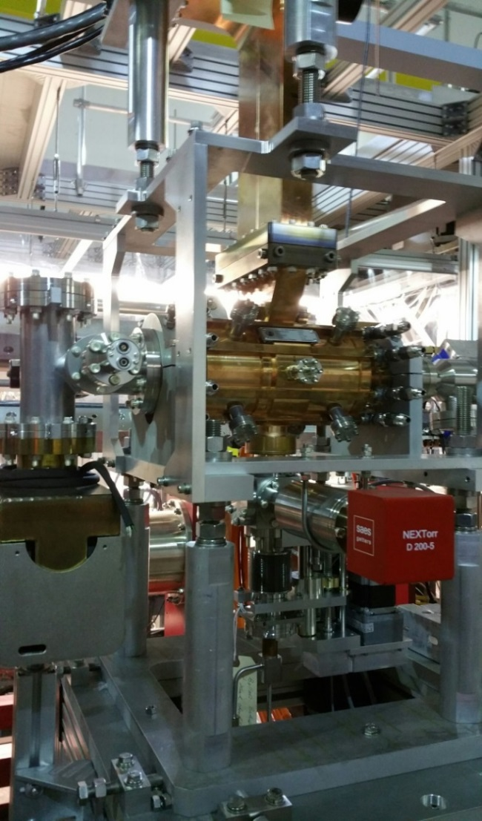
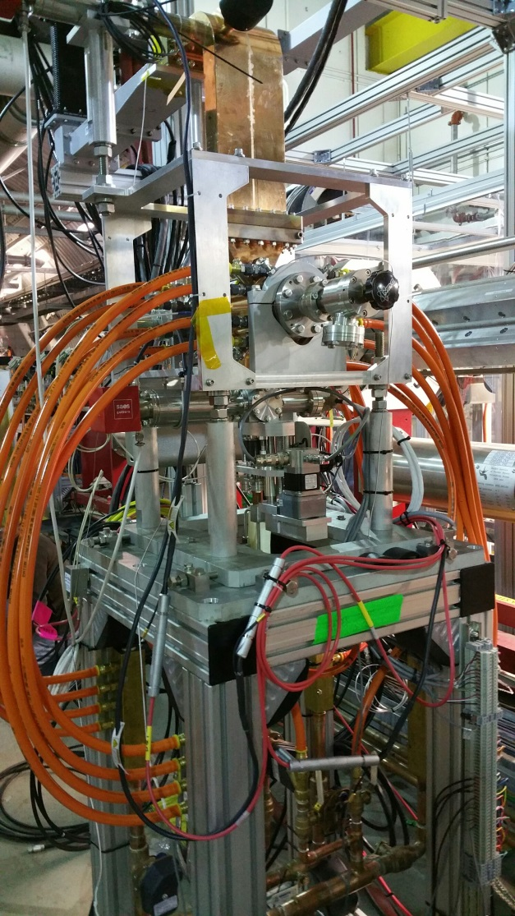
2.1 GHz warm RF cavity
(installed and tested at high power)
The cavity successfully achieved 220 kV in CW mode (design value 250kV; limited by amplifier which is being repaired, due back in October)

Slide 24
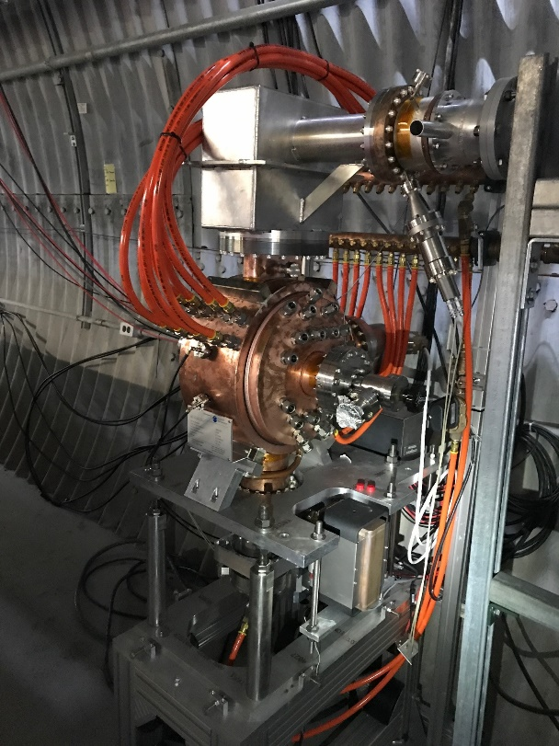
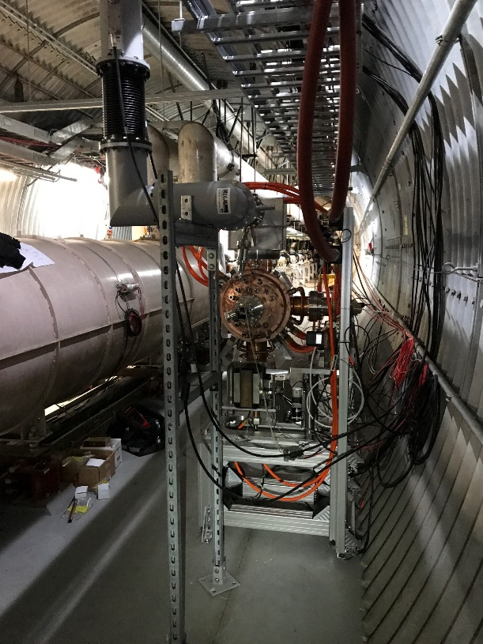
704 MHz warm RF cavity
(installed and tested at high power)
Tested to 250kV (design value 400kV, will need 250kV for operation; limited by cavity cooling which is presently being repaired by the company)

Slide 25
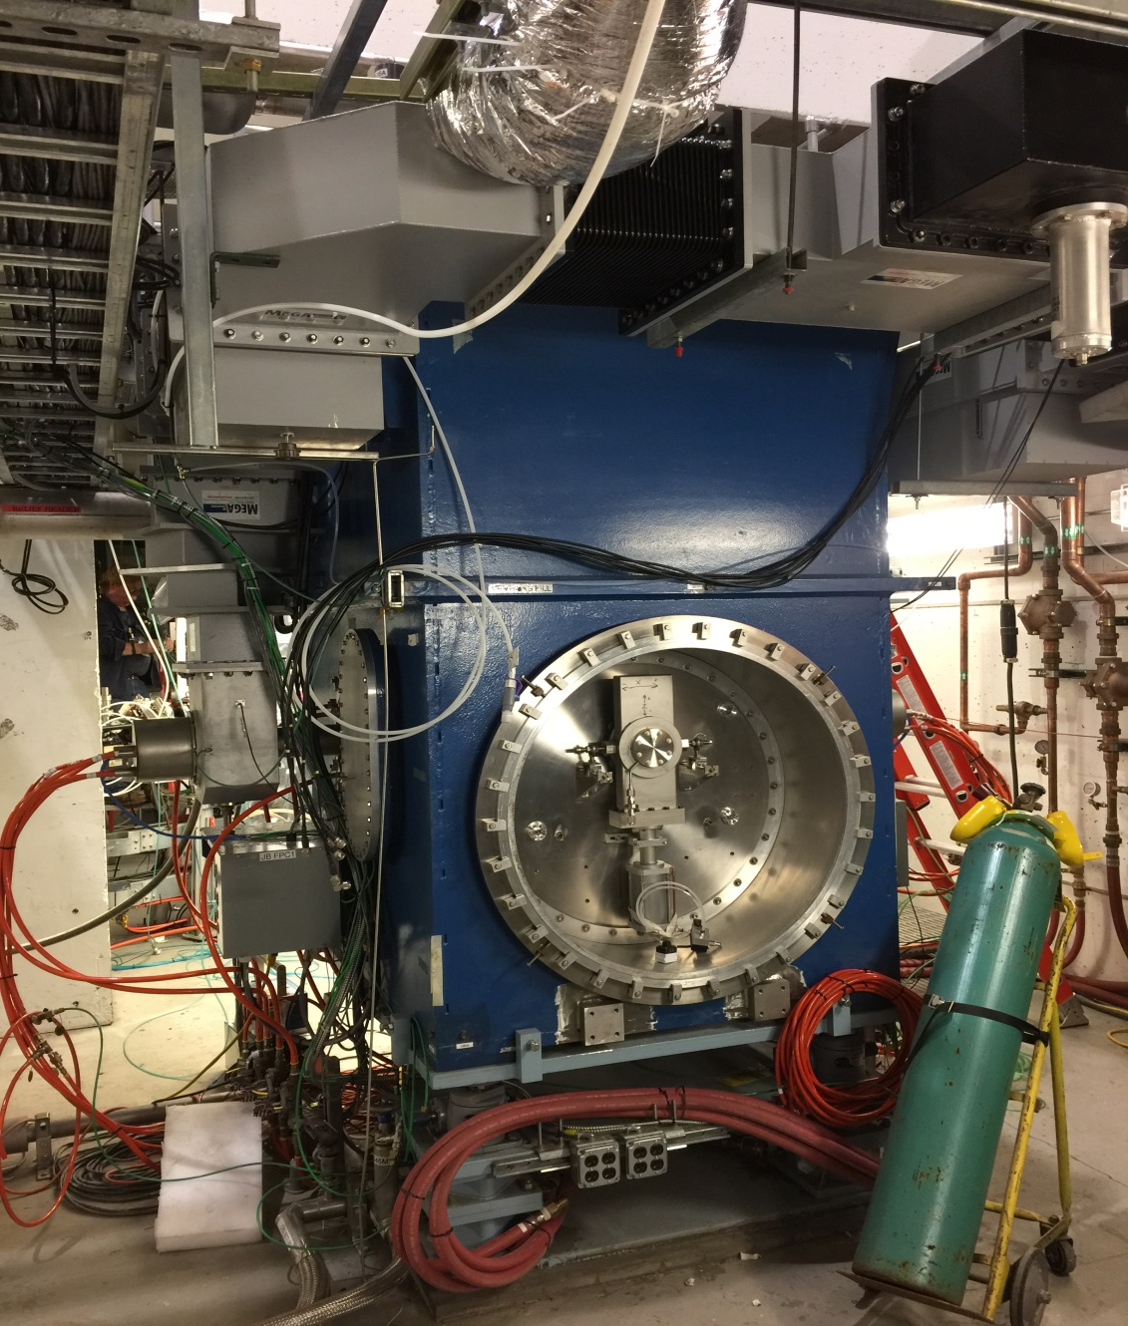
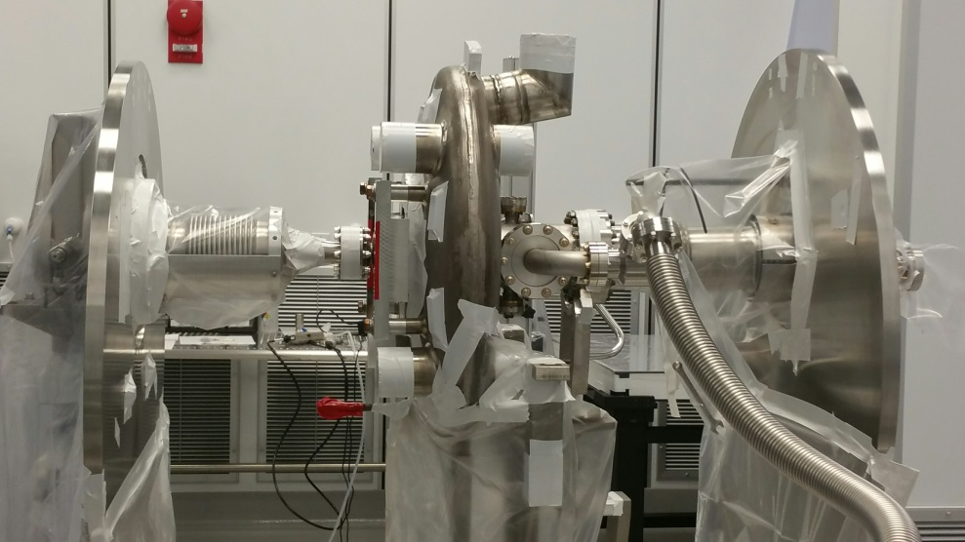
LEReC SRF booster cavity
SRF Booster cavity assembled and RF tests started in June:
- The general behavior of the cavity has been excellent.
- Based on the FPC Qext calibration and forward power achieved CW voltage is 2.2MV (maximum required for LEReC). Note that voltage calibration is at best accurate to +/-10% at this point.
- Once the downstream HOM damper insert is ready (August), additional cavity tests will be performed to verify no degradation of RF performance (September).
Cavity inside cryostat
Cavity string assembly in clean room

Slide 26
LEReC project timeline
May 2015: Project approved by DOE for construction
January 2016: Cooling section magnets installed
April 2016: Laser assembled, commissioning started
September 2016: DC gun assembled at Cornell
October 2016: DC gun delivered to BNL
November 2016: Approval from DOE for DC Gun Tests received
December 2016: DC gun successfully conditioned in RHIC IR2
February 2017: DC Gun Test beamline and laser transport installed in RHIC
April 2017: DC gun tests/commissioning with beam started
July-Dec. 2017: Install all remaining components including SRF and cryogenic, RF cavities, high-power beam dump, diagnostics, transport, extraction beam line, etc.
Dec.’17-Feb. 2018: Systems commissioning (RF, SRF, cryogenics, etc.)
Feb. -March 2018: Start commissioning of full LEReC accelerator with e-beam
September 2018: Early project finish date (electron beam parameters needed to start commissioning of cooling process demonstrated). Commissioning of cooling with Au ion beams during RHIC Run-19 (2019).

Slide 27
Near term schedule
December 2017: DC Gun conditioning resumes
December 2017: Conditioning/testing of RF cavities starts
December 18, 2017: LEReC installation complete
December 18, 2017: IRR Review
January 2018: DC Gun tests with beam resume
January 10, 2018: SRF booster cavity at 2K
January 11, 2018: SRF booster RF conditioning starts
January 15-17, 2018: ARR review
February 2018: ARR approved
February 2018: start of full LEReC commissioning with beam as soon as DOE approval received (expected mid February)

Slide 28
2018 Commissioning goals
Commission full LEReC accelerator which includes 5 RF cavities (one SRF), RF diagnostics beam line, spectrometer magnet, high-power beam dump, numerous instrumentation devices and feedback systems.
Achieve all project Key Performance Parameters (KPP),
which require achieving stable high-current operation of LEReC
accelerator with electron beam parameters suitable for cooling.
Commissioning of cooling process of Au ions is a goal for RHIC Run-19.

Slide 29
Commissioning planning for 2018
(detailed plan is being developed)
In 2017 (started in late April) commissioning was done mostly with a single shift per day. Sometimes extended 12-hour shift based on availability of support from various groups. No running on weekends.
In July-August we ran mostly evening shifts 5-11pm.
Starting March 2018, we expect to transition very quickly to full two shifts per day operation including weekends, provided experts from various groups are available (with 3 shifts per day when practical).
When RHIC is not running we will most likely require similar support. Commissioning is expected to continue through the summer.

Slide 30
Summary
DC gun tests and initial commissioning of LEReC systems
was a great success of the LEReC project!
LEReC project greatly benefits from help and expertise of many people:
Z. Altinbas, D. Beavis, S. Bellavia, M. Blaskiewicz, M. Brennan, D. Bruno, K. Brown, C. Brutus, M. Costanzo, A. Curcio, C. Degen, L. DeSanto, J. Drozd, A. Fedotov, W. Fischer, J. Fite, C. Foltz, D. Gassner, X. Gu, J. Halinski, K. Hamdi, L. Hammons, J. Hock, R. Hulsart, P. Inacker, J. Jamilkowski, S. Jao, J. Kewisch, P. Kankiya, D. Kayran, D. Lehn, E. Lessard, C-J. Liaw, C. Liu, G. Mahler, R. Maier, M. Mapes, G. McIntyre, K. Mernick, C. Mi, K. Mirabella, R. Michnoff, T. Miller, M. Minty, C. Montag, S. Nayak, P. Oddo, C. Pai, M. Paniccia, W. Pekrul, D. Phillips, I. Pinayev, V. Ptitsyn, T. Rao, T. Samms, J. Sandberg, C. Schultheiss, S. Seberg, S. Seletskiy, T. Shrey, L. Smart, K. Smith, Z. Sorrell, R. Than, C. Theisen, P. Thieberger, J. Tuozzolo, R. VanWormer, D. Vonlintig, J. Walsh, E. Wang, D. Weiss, K. Williams, B. Xiao, T. Xin, W. Xu, A. Zaltsman, Z. Zhao and many more
with numerous help from many others from various groups of the Collider-Accelerator and other Departments of the BNL. As well as FNAL, ANL, JLAB and Cornell University.

