Slide 1
9MHz System Performance & Update
Salvatore Polizzo
FY17 RHIC Retreat
8/8/17

Slide 2
Presentation Overview
New 9MHz Systems
Cavity Design Basics (Visual Overview)
FY17 Performance Review (Polarized Proton Operation Mode)
Current Efforts (Extending the high end voltage margin)
Conclusions

Slide 3
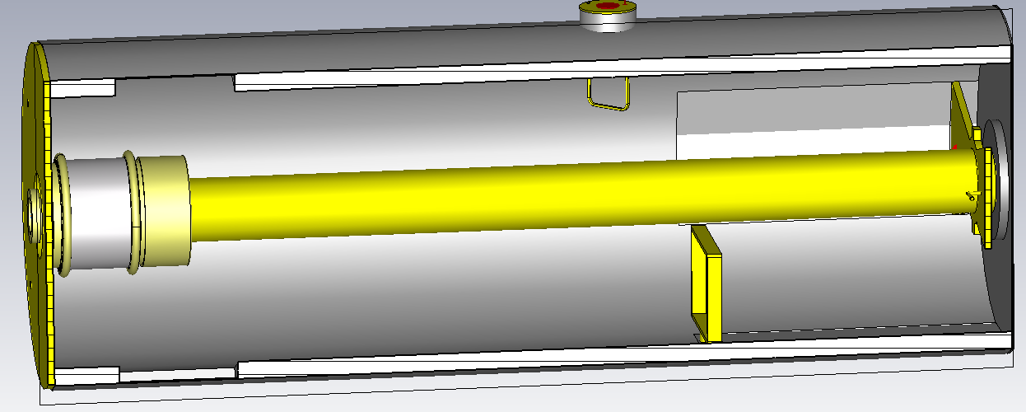
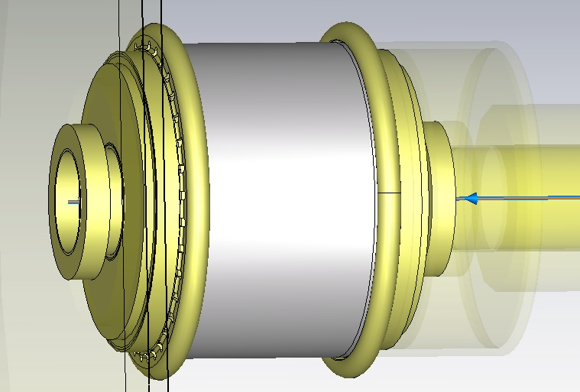
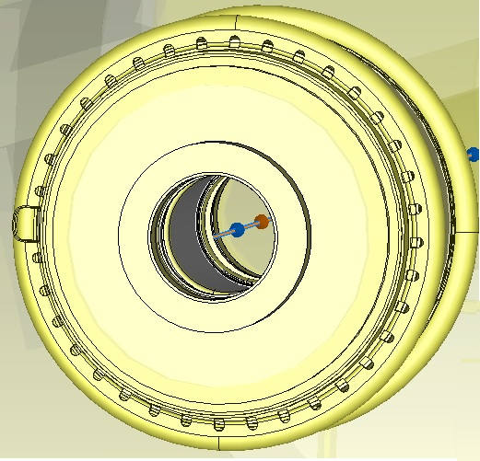
9MHz Cavity Design Overview
Air
Drive Loop
Coarse Tuning
60kV
Fine Tuning
Gap Cap
Cavity Length ≈ 3m
Cavity Radius = .45m
The resulting gap capacitor assembly is the product of an ongoing collaboration between BNL and Comet Technologies.

Slide 4
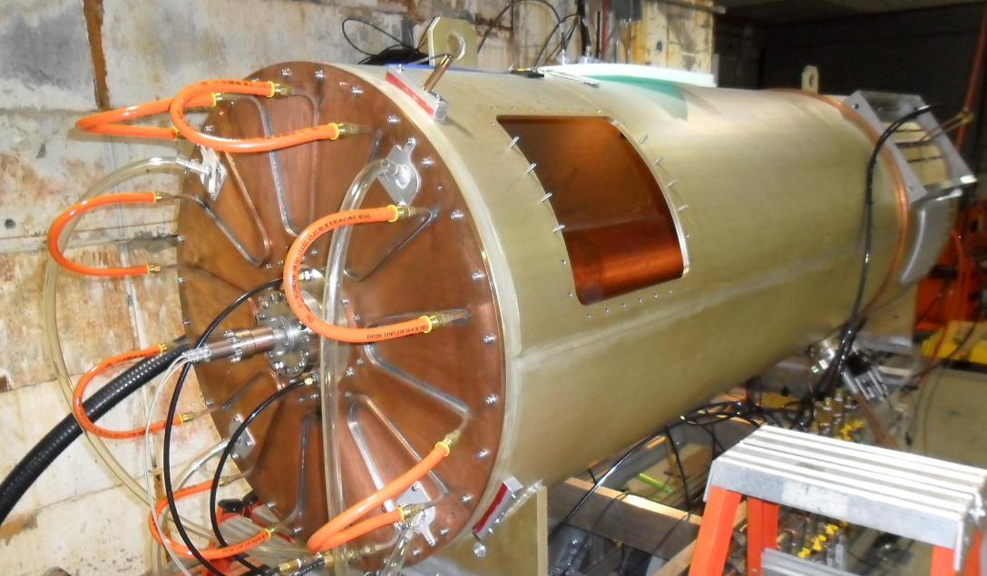
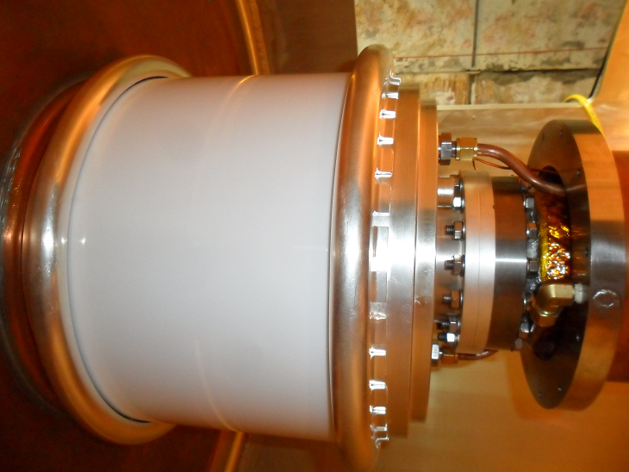
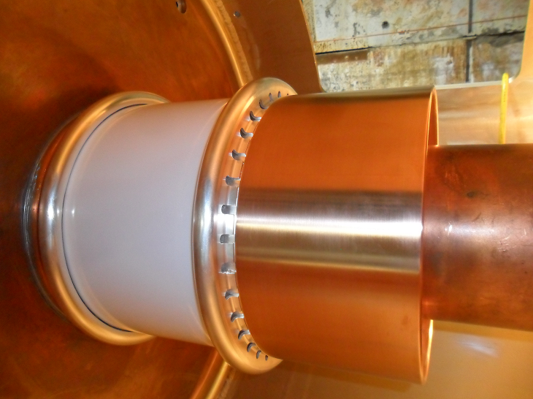
9MHz Cavity Design Overview
Internal Beam Pipe View
Bell Housing Installed

Slide 5
9MHz Cavity Performance Review (Polarized Proton Operation Mode)
Cavity Voltage
32kV Peak
60kV Max Design Voltage (53.4kV LEReC Design Requirement)
Frequency
9.376MHz – 9.384MHz
8.7MHz – 9.8MHz (LEReC Design Requirement)
Drive Power
≈ 8.2kW Peak for ≈ 32kV (Acceleration ø =33°, β_{fpc} ≈ 2)
≈ 5.4kW Peak for ≈ 32kV (Acceleration ø =16.5°, β_{fpc} ≈ 2)
≈ 7kW for 60kV (LEReC Design Requirement β_{fpc} ≈ 1)

Slide 6
9MHz Cavity Performance Review
Making voltage is not the challenge in the PP operation mode
The challenge is to provide enough power to the beam during acceleration (max($\dot{B}$)) while maintaining sufficient power margin to fight transients.
Fast Ramp (øacc @ max($\dot{B}$) = 33°)
Fill Number = 20595
Bunch Intensity ≈ 2e11 protons
Ramp Time ≈ 4.5 minutes
Gap Voltage = 32kV
Drive Power ≈ 8.2kW
Slow Ramp (øacc @ max($\dot{B}$) = 16.5°)
Fill Number = 20865
Bunch Intensity ≈ 2.07e11 protons
Ramp Time ≈ 9 minutes
Gap Voltage = 32kV
Drive Power ≈ 5.4kW
Simplified post transition phasor plots
Real(Ib)
ø =33°
Ib
Real(Ig)
Ig
Real(Ib)
ø =16.5°
Ib
Real(Ig)
Ig

Slide 7
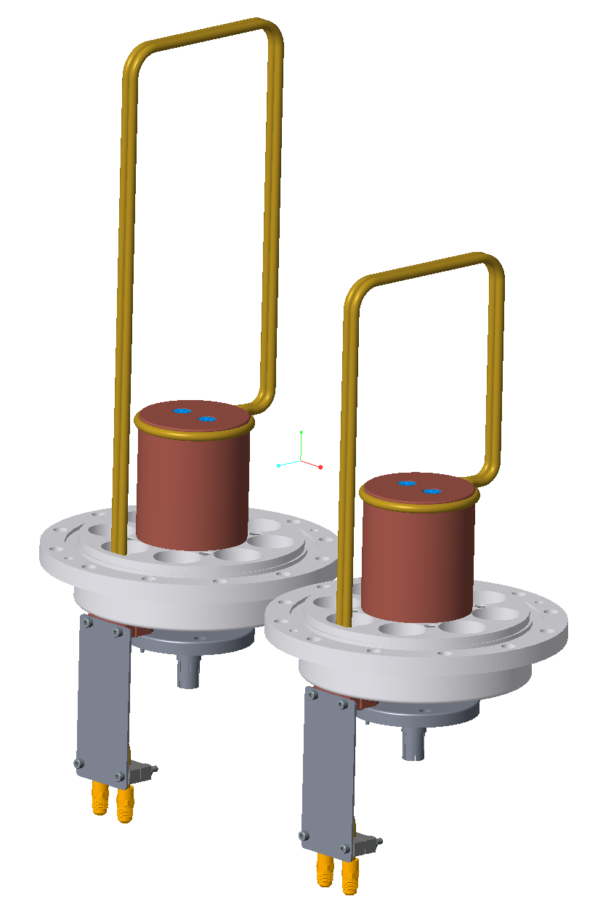
9MHz Cavity Performance Review
Assuming we were able to push the beam intensity to peak FY15 levels (≈ 2.6e11 protons/bunch)
Estimated Drive Power > 10kW
Estimated Reflected Power > 1.2kW
We may have wanted a bigger stick
Leverage the configurability of the cavity design to
further optimize β_{fpc} thus minimizing Preflected @ max($\dot{B}$)
Peak Forward Power Reduction ≈ 10%

Slide 8
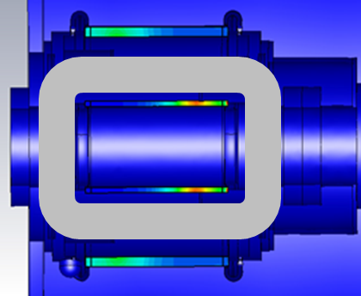
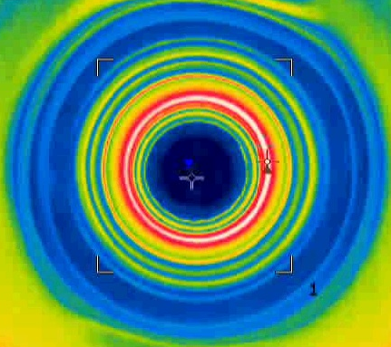
New 9MHz System Current Efforts
Before ordering the balance of the gap cap devices we are working to improve the cavities high voltage margin by replacing the inner ceramic RF window with a higher performance alumina.
Dielectric loss profile inside alumina window
Thermal image taken through CaF2 window
Max calibrated internal temp ≈ 70C @ 55kV
End result of window heating is cavity Q degradation and thermal runaway above 72kV

Slide 9
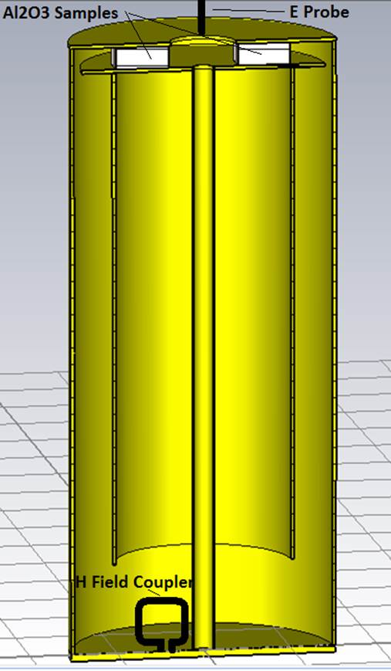
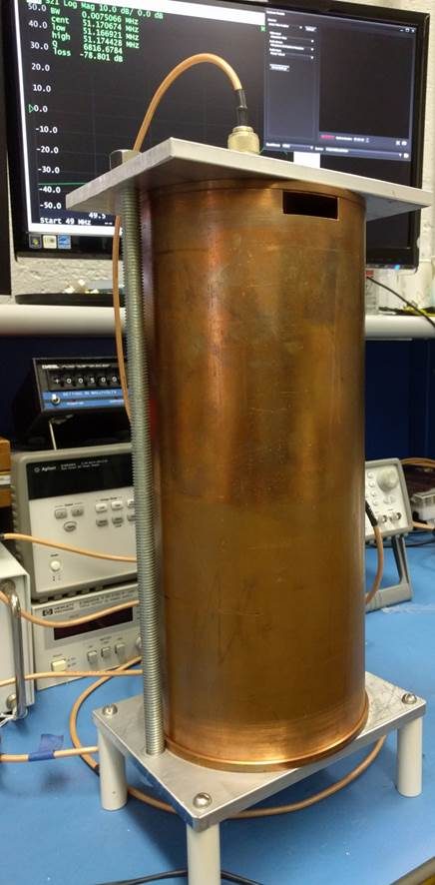
New 9MHz System Current Efforts
Dielectric Material Test Cavity (50MHz)
tanδ
Temperature (°C)

Slide 10
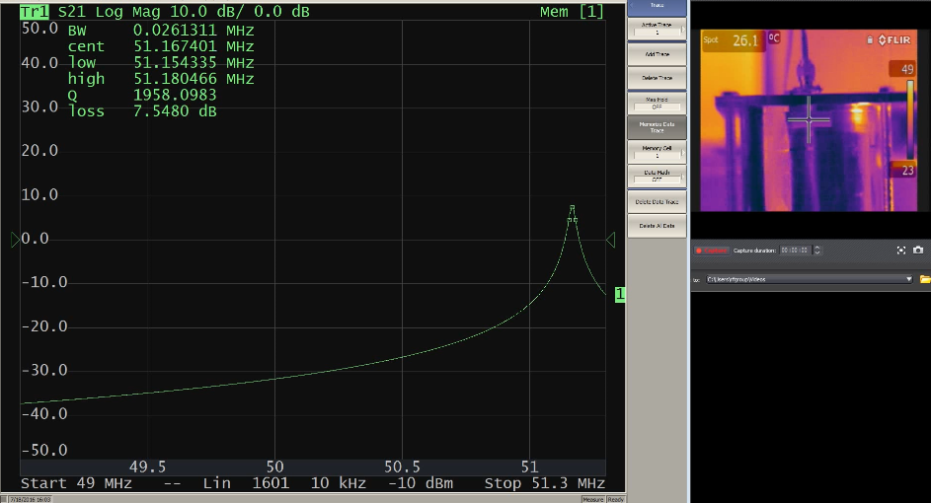
New 9MHz System Current Efforts
Dielectric Material Test Cavity (50MHz)
Bare Cavity (Picture)
Pertinent Parameters

Slide 11
New 9MHz System Current Efforts
Dielectric Material Test Cavity (50MHz)
Testing RF1080 Sample 2 (Video)
Pertinent Parameters

Slide 12
New 9MHz System Conclusions
Summary
Overall the new 9MHz systems performed reliably during the FY17 PP run
High intensity fast ramping fills provided a good test of system design margins
Current efforts are focused on the enhancement of peak voltage margin
LEReC CW Voltage Requirement = 53.4kV (160kV per ring)
Current CW Voltage Limit ≈ 72kV CW (Goal = 80kV)

Slide 13
New 9MHz System Conclusions
Summary
Overall the new 9MHz systems performed reliably during the FY17 PP run
High intensity fast ramping fills provided a good test of system design margins
Current efforts are focused on the enhancement of peak voltage margin
LEReC CW Voltage Requirement = 53.4kV (160kV per ring)
Current CW Voltage Limit ≈ 72kV CW (Goal = 80kV)
This is for if when we find ourselves in a bind.

Slide 14
Thank you

