Slide 1
FY17 Landau System Update
Darryl Goldberg
RF Group
August 8, 2017

Slide 2
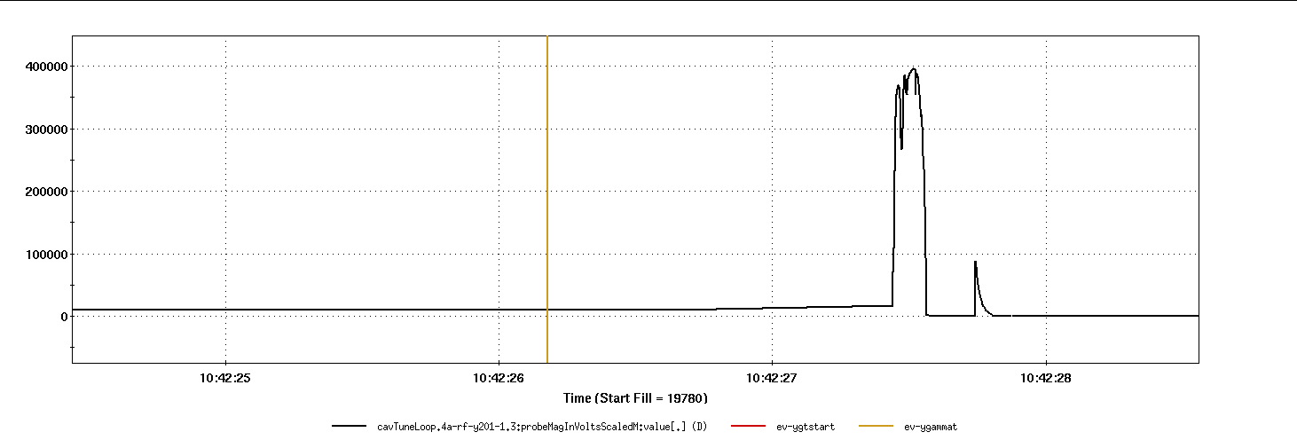
Landau Cavity issues with higher beam intensities
Beam Loading
Beam current “overpowers” the cavity
Over 400kV induced on the gap by the beam
10kV command from the LLRF
400kV
10kV

Slide 3
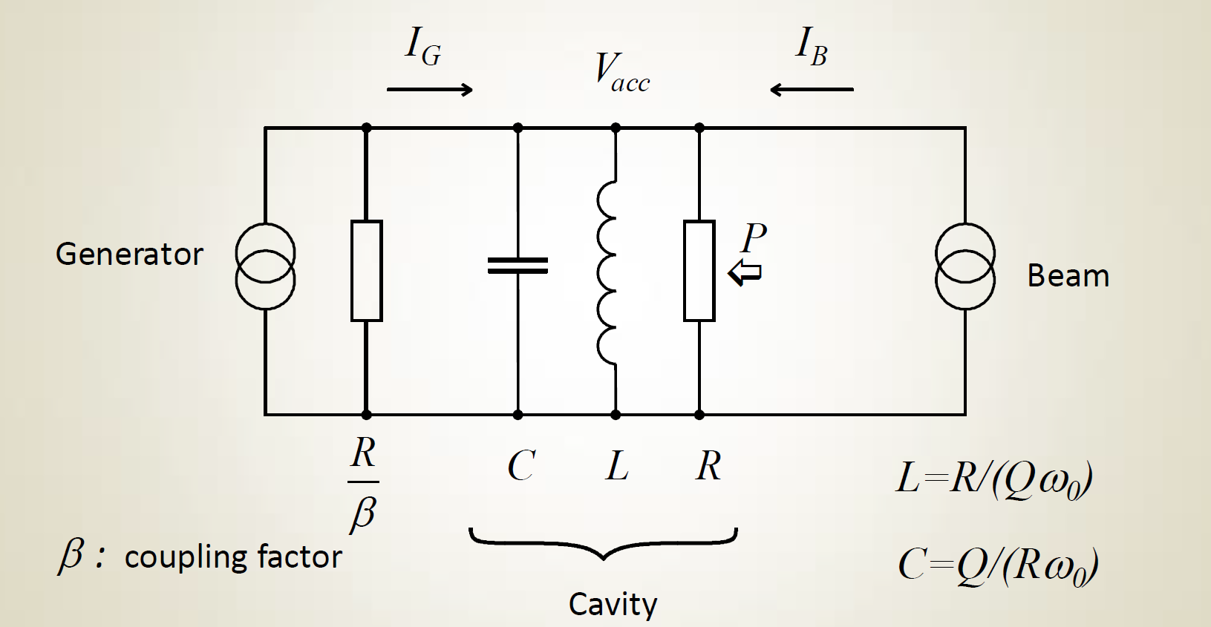
Possible solution using existing hardware
Existing configuration is critically coupled (β = 1)
Rotating the drive loop will increase the coupling factor to a potential β=6
β of 6 coupling factor will potentially reduce the effect of the beam on the cavity by a factor of ~4 allowing us to run higher intensities

Slide 4
Chosen Solution:
External Loading Network
No vacuum work required
Can modify impedance on the fly
Reduces stress on existing circulator
Made from off-the shelf components

Slide 5
External Loading Network
Parameter | Critically Coupled | Ideal Externally Loaded
𝛃 | 1 | 5
Q_{L} | 22,000 | 8,000
R_{SL} (MΩ) | 3.63 | 1.21
Z_{in} (Ω) | 50 | 10
FFB Gain (dB) | 40 | 33
PA
Z0=50Ω
12.5Ω
Z0=50Ω
𝓵=ƛ/2
Cavity
Z0=50Ω
𝓵=ƛ/4

Slide 6
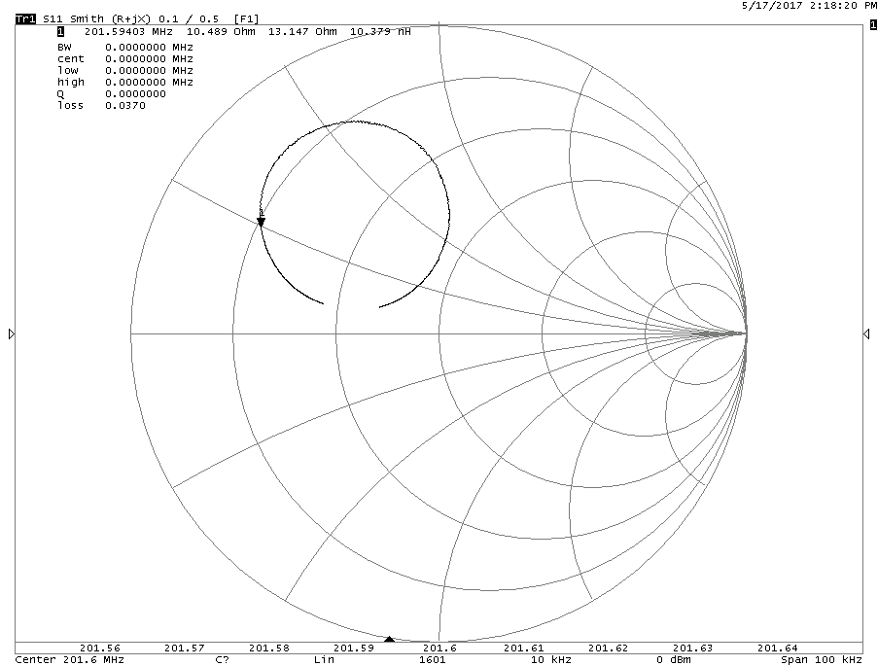
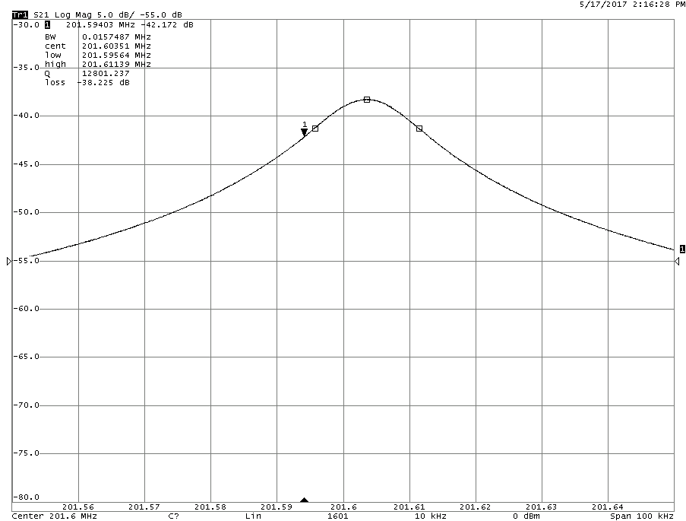
Measured Parameters
15 Ω
Network not yet fully optimized
β only 2.6
Q_{L}=12000

Slide 7
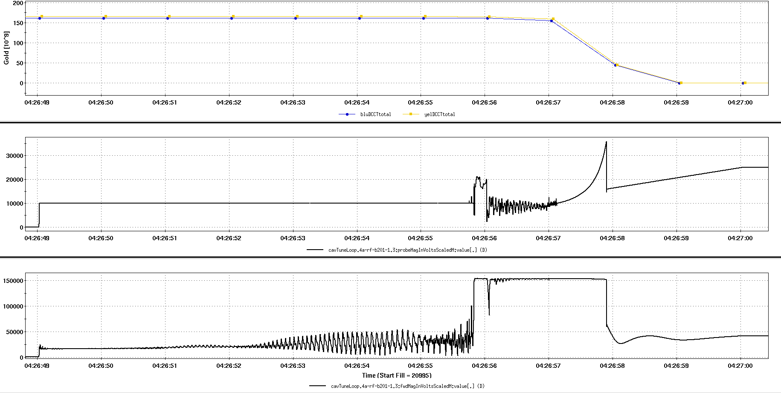
Blue Landau System FY17 Au Run
Early Au Run Performance
At the higher intensities the landau cavities were tripping at transition causing beam aborts.
After both cavities were optimized the Blue Landau continued to struggle with the blue rings transient beam loading at transition.
Beam Lost at Transition (1.5e9/bunch)
Gap Voltage (Out of Regulation)
Drive Power ≈ 1.7kW

Slide 8
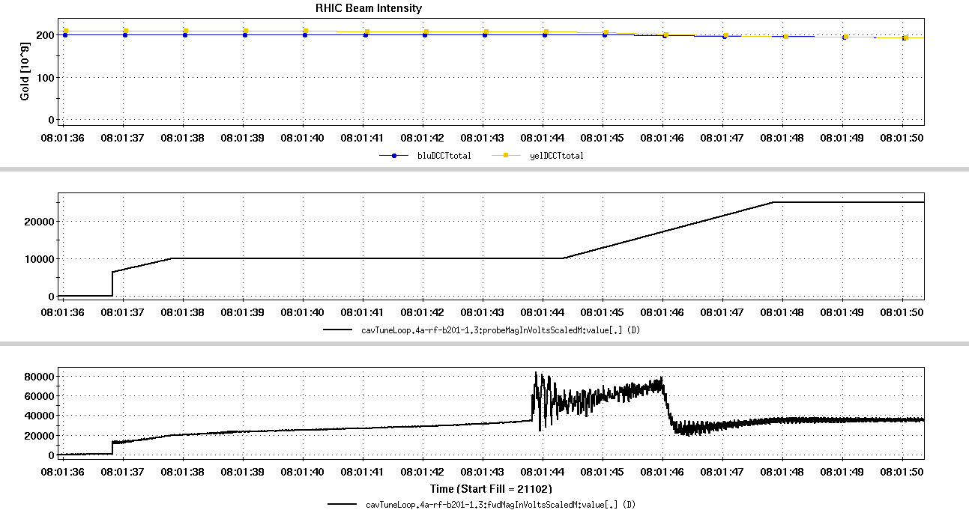
Blue Landau Optimization
Machine Development (6/8/17)
After much system performance characterization, it was concluded that the source of gap voltage non-compliance was due to early saturation of the systems fast feedback loop and subsequently the IQ loop.
Beam Intensity ≈ 2e9/bunch
Gap Voltage
Drive Power ≈ 525W

Slide 9
Blue Landau Optimization
Resulting actions:
Replace faulty PA in the driver amplifier
Fast Feedback ϴ Reset
Tuning Loop Optimization
Beam Intensity ≈ 2e9/bunch
Gap Voltage
Drive Power ≈ 525W

Slide 10
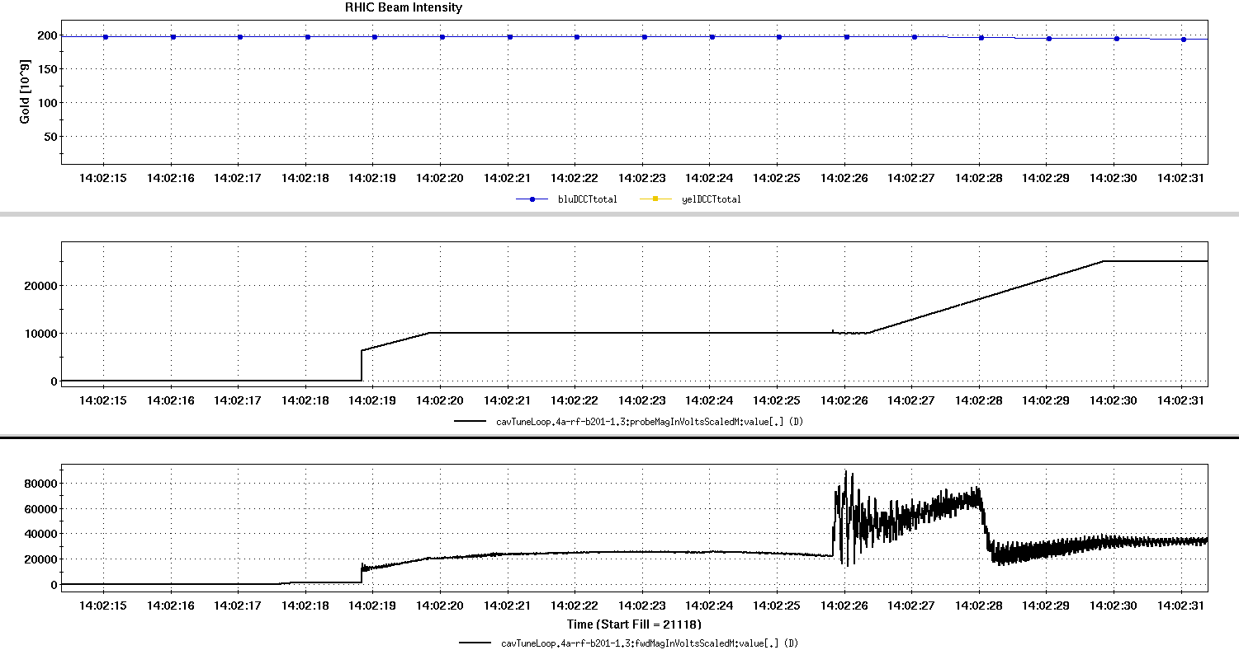
Testing Blue Landau’s Limits
Efforts were made to test higher beam intensities
The machine could not provide high intensity so bunch patterns were modified to simulate higher beam intensity at landau harmonic
Drop every 16th Bunch, Drive Power up 10%
Beam Intensity ≈ 1.95e9/bunch
Gap Voltage
Drive Power ≈ 575W

Slide 11
Blue Landau Conclusions
Extrapolating from FY17 Au data, the forward power requirement for 3.0 x 10^9 is approximately 1200w
Landau power amplifier capable of 2000w linear
Even with a β of only 2.6 proof of principle a success!

