Slide 1
The View from Operations
RHIC Retreat FY2017

Slide 2
Contact During Off Hours
Some call-in lists do not update weekly
Contacts have cell phone listed but never set up voicemail
Pump Room and Vacuum personnel
Explicitly listed as a problem by almost all OC’s
Ops group floated the notion of the top on-call person having a duty to be available – no drinking, having a designee for unavailable time

Slide 3
Contact During Off Hours
RHIC PS – members are always available for help, stayed many hours to get the program back on
Controls – often pointed out problems before we knew we had them
PP source – Anatoli and Grigor were great this run
Instrumentation – fast scope repairs, always helpful in troubleshooting

Slide 4
APEX
More beam condition information
Giving Ops a fill pattern isn’t sufficient if you are also going to ask for more intensity than the machine is set up for
Planning sessions should include a preinjector representative to speak to ion needs for that day and any compatibilities issues with NSRL operations
Recovery from APEX
Each study leader should record modifications to the machine and it should be their responsibility to ensure that those settings are restored.

Slide 5
CeC
OPM 2.11 – Conduct of Operations
Too many times a change was made without informing the OC
‘This can’t possibly have an effect on the ion beam’
Dog leg magnets cause orbit distortion and tune shift
Manageable by feedback systems IF WE KNOW THEY ARE BEING CHANGED
Stores lost due to electron beam work
All of these items were resolved by the end of the run – the hope is LEReC folks learn from their CEC colleagues
One standout was RF work for CeC – always had good communication regarding the status of RF testing and configuration

Slide 6
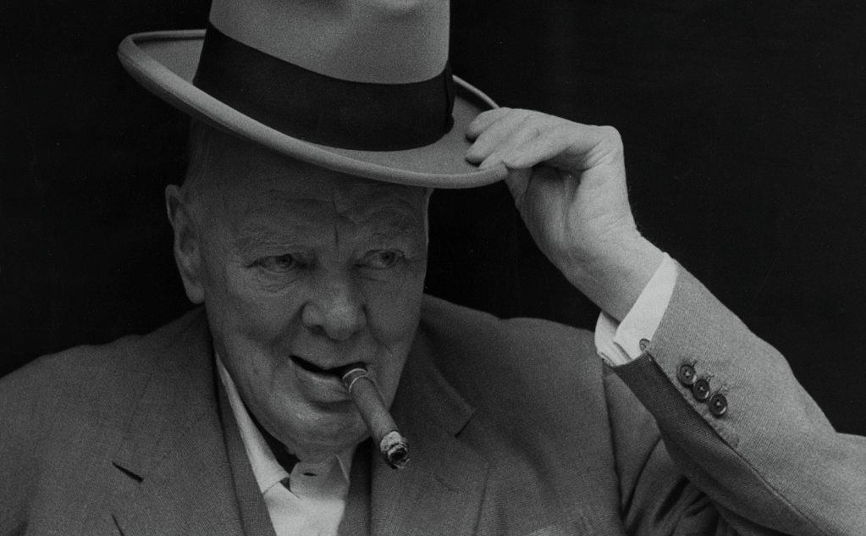
Upper Level Communications
Bill Christie
MCR always felt that they knew the overall schedule and what was expected
It was pointed out that having the Scheduling Physicist be the same person as the only operating Experimental leader may have made this job easier, but he still gets the hat tip.

Slide 7
PASS
Logger for Booster
AGS MMPS trips
AGS Sweep drops
‘Anti-LLRF’ philosophy
LLRF group has worked to make their systems perform and behave the same across all of the machines. PASS development has been the opposite, with each new machine having new idiosyncrasies to learn (even for ACS personnel)
Gate phones
Repairs/replacements needed

Slide 8
Maintenance
Laser LOTO
Personnel were not always available – the number of people who can perform this needs to be increased
Several times this run Maintenance was declared to be over by the acting MC and they left
Sweeps were outstanding
Maintenance related work required more accesses after sweeps
Ops view is that Maintenance is not over until there is beam in the injectors and RHIC has survived a hysteresis ramp

Slide 9
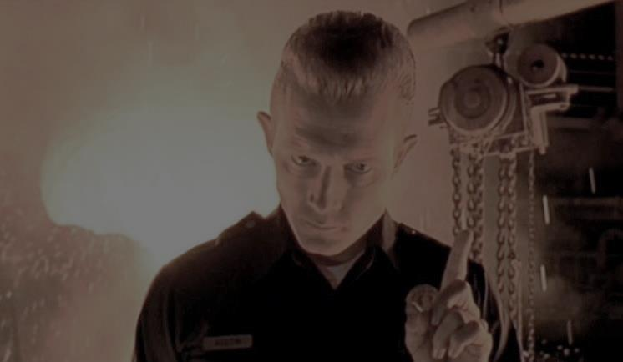
Training
Specifically Ring & Cave
Particularly bad during RHICf Operations
Experimenters did not know the procedure for getting through a door
Experimenters could not tell the gate watch where they were going
Experimenters could not tell the gate watch where they were
Diode sweepers were mentioned as well for gate operation
We have loss countless man-hours and cryo-hours re-sweeping for blown gate watches
There is no remediation for those that deliberately, negligently, or unknowingly mess up a gate entry
The training is so monotonous, unfocused, and scattershot that one cannot possibly believe that it is sufficient to train personnel to enter the ring – especially with the divergent PASS systems at various gates
Gate watch should not have to be doing OJT for entrants, but that is what is happening now
What should be required is 1) a practical portion to the access training, with 2) remedial training for personnel that blow our sweeps or are otherwise obviously dumbfounded at the time of gate entry

Slide 10
Setup
Setup work was accomplished exceptionally fast when failures were removed
The switch to the short gold run in particular was fantastic. We had six ramps accomplished with only 5 hours of beam (non-failure) time.
Shout-outs go to the usual suspects that work heavily with with Ops during setup periods
Al Marusic
Kevin Mernick

Slide 11
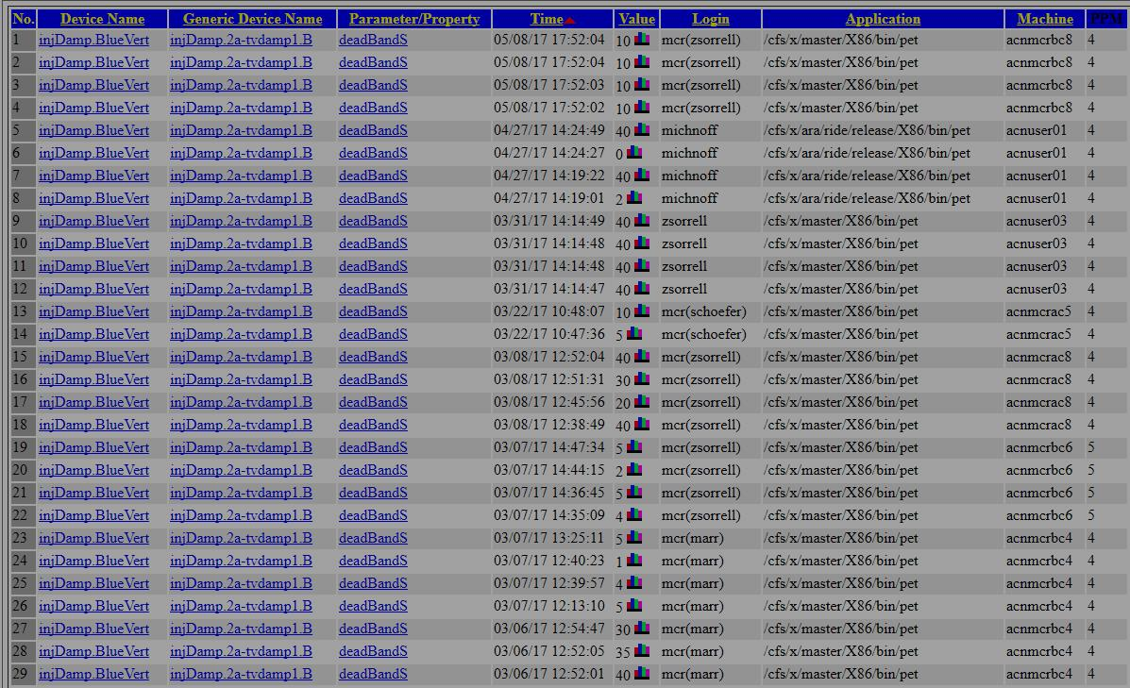
RHIC Injection Dampers
Three months into the run there was still an argument going on between machine and instrumentation people
Things were broken that were fixed AFTER Marr, Schoefer or Shrey presented a pile of evidence – that shouldn’t be required
With the CeC beampipe in place proper operation of the dampers is essential in minimizing lost fills due to undulator loss monitor permit pulls

Slide 12
Fire/AED Alarm Testing
Fire/Rescue group communication with MCR was very poor this run
MCR used to call when we got an alarm to verify it was real (years ago)
Fire/Rescue did not want the interruption if it was real so we were told to listen to the radios
Fire/Rescue now has private radios which we can’t hear

Slide 13
Misc
ESR Checklists left in MCR without notification
OC’s were not always made aware of End of Store experiments until they were about to dump the beam
Proton run coordinator live interaction with MCR was minimal (and missed)
MCR console issues – Screenlock, freezing, etc
STAR collision targets at the start of a store
Different STAR crews gave different information

Slide 14
Individual Tips o’ the Hat
R Kuruca – Linac Operations
J Butler – RHIC RF
D Goldberg – Injector RF
Collider Accelerator Support staff
Al Marusic (without an accompanying finger wag this year!)

Slide 15
Good run
Can always be better

