Slide 1
Injectors: Run17 and Beyond
Haixin Huang
with inputs from Kip, Keith, Vincent
August 9, 2017
RHIC Retreat2017

Slide 2
Outline
Dual Harmonics in the early part of AGS
Jump quads timing derivation algorithm
Source intensity vs. Polarization
AGS Polarization performance
Plan for next a few runs

Slide 3
Setup This Year
Dual harmonics (h=6 and h=12) in the early part of ramp (144-230ms) and h=6 the rest of ramp. It was h=8 in last pp run.
The offset in the AGS MM current regulator has been removed right before run17 started in December. This affected the energy ramp: the timing of resonances on the ramp was shifted earlier by a few ms. This had impact on deriving JQ timing.
The JQ timing derivation algorithm was changed: it was purely based on asymmetry measurement on the energy ramp.
AGS eIPM worked after eliminated the timing noise. It was used to provide emittance information for most RHIC fills.
The Booster input intensity was lowered from 9E11 to 7E11 for the whole run, as both 200MeV polarization and AGS extraction polarization is higher.
Physicists only on shifts for first a few weeks. The machine tuning and setup were done mainly by Keith. Majority of polarization measurements (6000 in total) were carried out by operators (THANK YOU!).

Slide 4
Polarized Proton Setup Timeline
Dec. 12-22, 2016: Setup both Booster and AGS with weekday only. On Dec. 22, a quick JQ timing scan shown benefit of JQ on (1.8E11 bunch intensity with 72% polarization.
Jan.9, 2017: injector pp setup resumed.
Jan. 20: first ramp asymmetry for after transition part JQ timing was put into use.
Jan. 26: the first JQ timing file purely based on ramp asymmetry was put into use.
Jan. 30: AGS h=6 setup was done (was h=8 in run15).
Feb. 6: AGS eIPM gives believable profiles after they were timed in properly and gain calibration was done (thanks to efforts by Chuyu, Steve, Craig, Vincent).
Feb. 22: A new JQ timing based on ramp asymmetry measurement was derived. This one was used throughout the rest of the run.
Mar 10: Dual harmonics in AGS has been used for RHIC injection. On user2 with 2E11 intensity, the polarization is around 70% compared to 65-67% before.

Slide 5
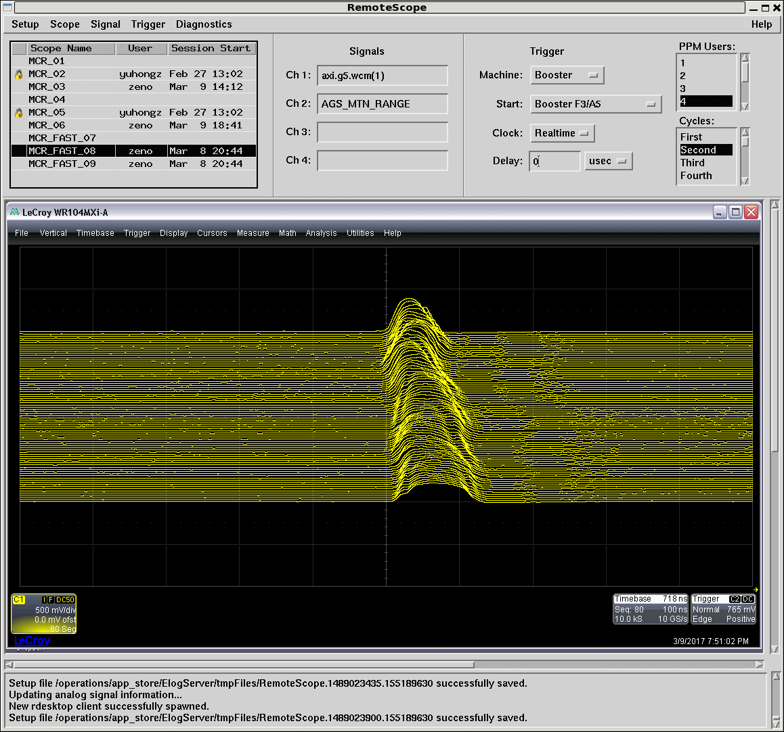
AGS Mountain Range Plots of Dual Harmonics
144-154ms.
224-234ms.
Dual harmonics in the early part of AGS ramp was successfully tested in the AGS. The 2nd harmonic cavities (h=12)are used for 144-230ms.

Slide 6
First Turn Profiles in Two States
Wider bunch and less peak current at injection. Transverse emittance is smaller in this mode.

Slide 7
Polarization and Intensity for RHIC Fills around 20604
Source polarization
AGS polarization
AGS late intensity
Dual harmonics has been used since 20604. On average, higher polarization after.

Slide 8
Old IPM Emittance Comparison
(analyzed by Keith)
There is not much difference in horizontal, but vertical is better with user2 (dual harmonics).

Slide 9
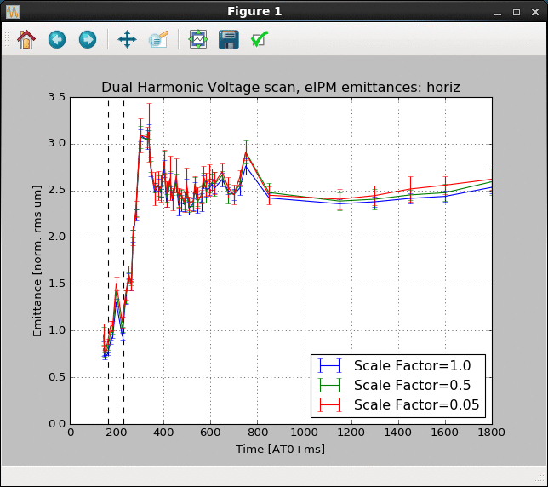
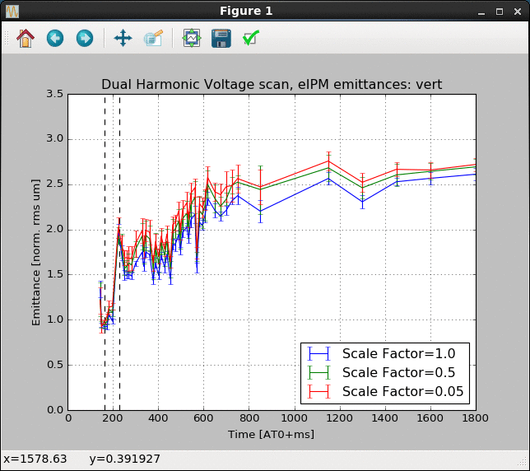
Transverse Emittance Reduction with Dual Harmonics RF
(analyzed by Vincent)
The results of the scan of the 2nd harmonic voltage. The dashed lines indicate the interval over which the 2nd harmonic voltage was changed. Each trace corresponds to a scaling of the voltage function (1.0 indicates the nominal setup with the longest bunches, 0.05 indicates that the dual harmonic is essentially off). The horizontal profile is affected by the voltage while it is on, but it has little lasting effect. On the vertical, there is about a 15% change in the emittance that persists throughout the cycle.

Slide 10
JQ Timing from Asymmetries on the Ramp
It took longer time to get JQ timing work this year. The offset in the AGS MM current regulator has been removed right before run17 started in December. This affected the energy ramp: the timing of resonances on the ramp was shifted earlier by a few ms. This had impact on deriving JQ timing.
Two other efforts: 1) centering the horizontal orbit in the jump quads to prevent the systematic error of the radial loop from affecting the jump quad measurements and 2) the R0 parameter scan (generating times under different assumptions about the 'true' AGS radius). That showed no response (polarization flat over a substantial range), but that is useful information.
There were also MM function issue in Jan., when wrong MM function was loaded outside MCR, which also had impact on JQ effect.
The first set of JQ timing based purely on ramp asymmetry was put in use on Jan. 26. that set was improved prior to transition because Tom Hayes helped Kin Yip add the frequency dependent phase delay to the polarimeter timing.
In general, overall timing scans show a systematic offset of -100us for the peak polarization. It is consistently there for all five timing files generated (about one per month).

Slide 11
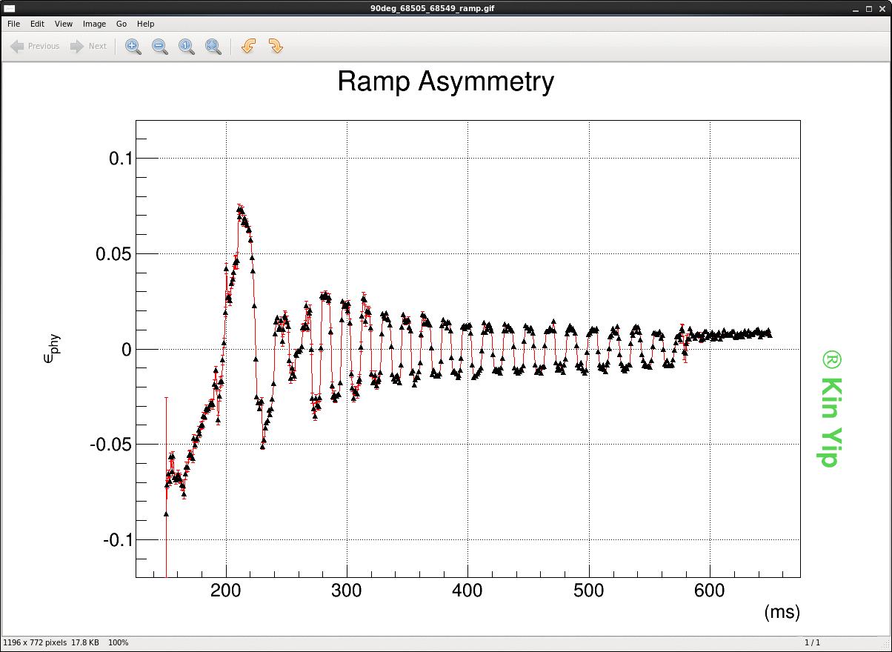
Much Better Ramp Measurement after RF Change
Better, smooth asymmetries measured at low energies.

Slide 12
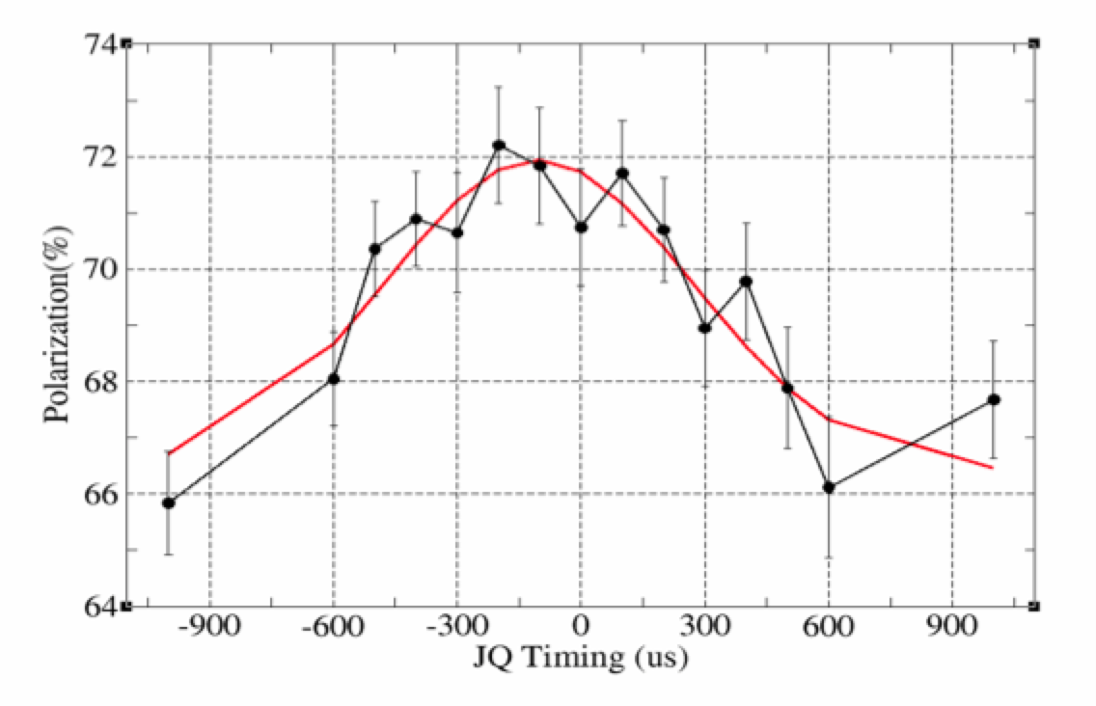
Example of JQ Timing Scan (Mar 17 Timing File)
The gain with JQ on vs. off : 67%->72% (a gain factor of 1.075), consistent with direct JQ on/off measurements.

Slide 13
Source Polarization Lower with High Intensity
Boost input intensity
Source polarization and average
The source intensity was kept at 7E11 throughout the RHIC operation.

Slide 14
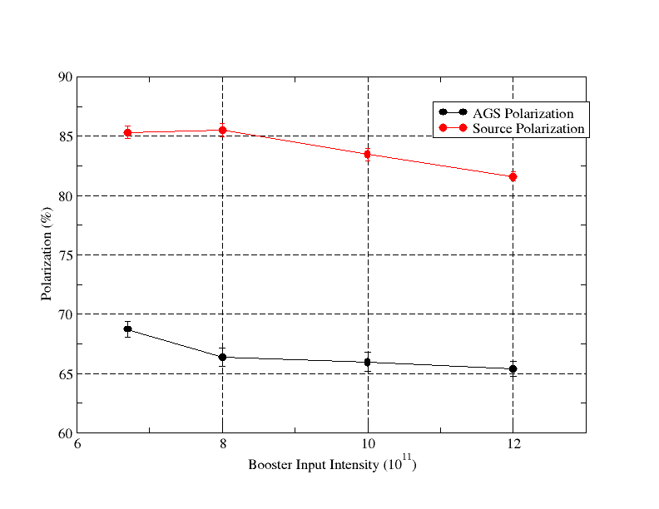
Polarization vs. Booster Input Intensity
Source polarization is 4% higher at low input intensity. Heavier scraping does not necessarily give higher polarization(maybe smaller emittance), because source polarization is lower.

Slide 15
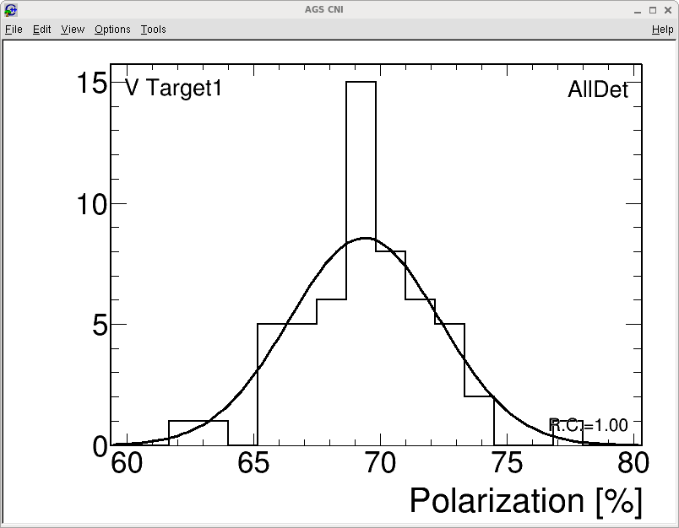
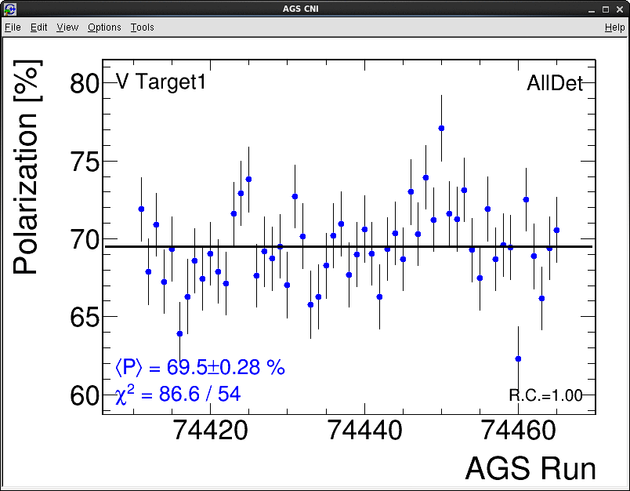
Average Polarization @ AGS Ext.
Average over 4 hours (55runs) with 2E11.

Slide 16
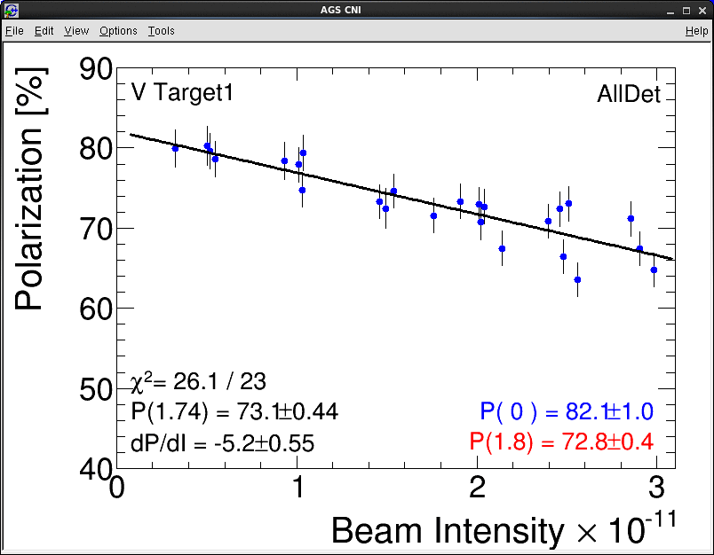
One AGS Polarization vs. Intensity

Slide 17
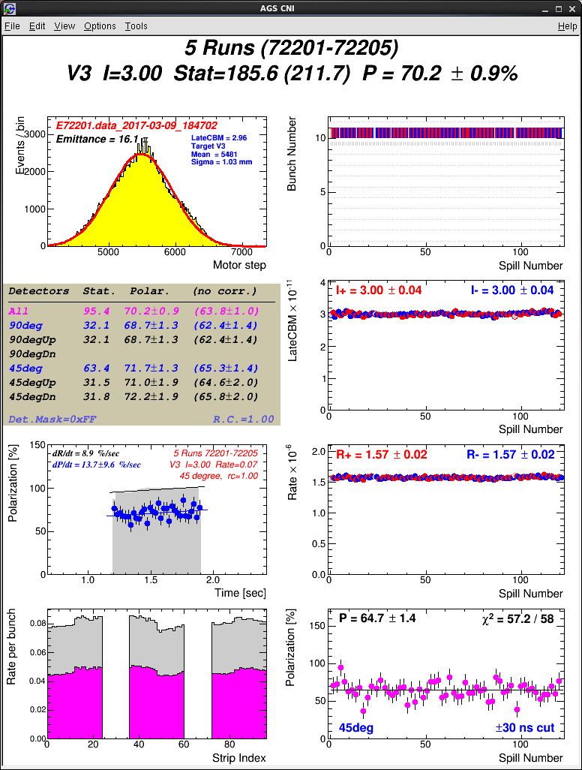
AGS Polarization on User2 is Higher
Left: user4; right: user2(dual harmonics). 70% polarization at 3E11 is a record.

Slide 18
Polarization for RHIC Fills vs. Intensity
The bunch intensity was higher in run17, while the polarization remained the similar level.

Slide 19
Horizontal Polarization Profile

Slide 20
Vertical Polarization Profile
P₀= 79.65+-0.86%. The projected source polarization from these two sweep measurements is 80.42+-0.87%. The source polarization reports as 83-84%.

Slide 21
Polarization Profile Development on the Ramp
The polarization profiles at various energies with 2E11 intensity:
Ggamma R_x R_y Date of data taking
4.5 0.003+-0.002 -.011+-0.004 1/15
13.5 0.009+-0.006 0.035+-0.006 2/23
31.5 0.041+-0.011 0.075+-0.012 2/5
40.5 0.061+-0.013 0.088+-0.013 2/6
45.5 0.078+-0.008 0.099+-0.010 4/8-6/22
Above are the polarization profiles measured so far at various energies. The profile evolution is gradual on the ramp. In addition, vertical is worse in all energies after injection. Further analysis will be carried out to see how we can improve the vertical polarization profile. Current ZGOUBI simulation can not explain such a large vertical polarization profile.

Slide 22
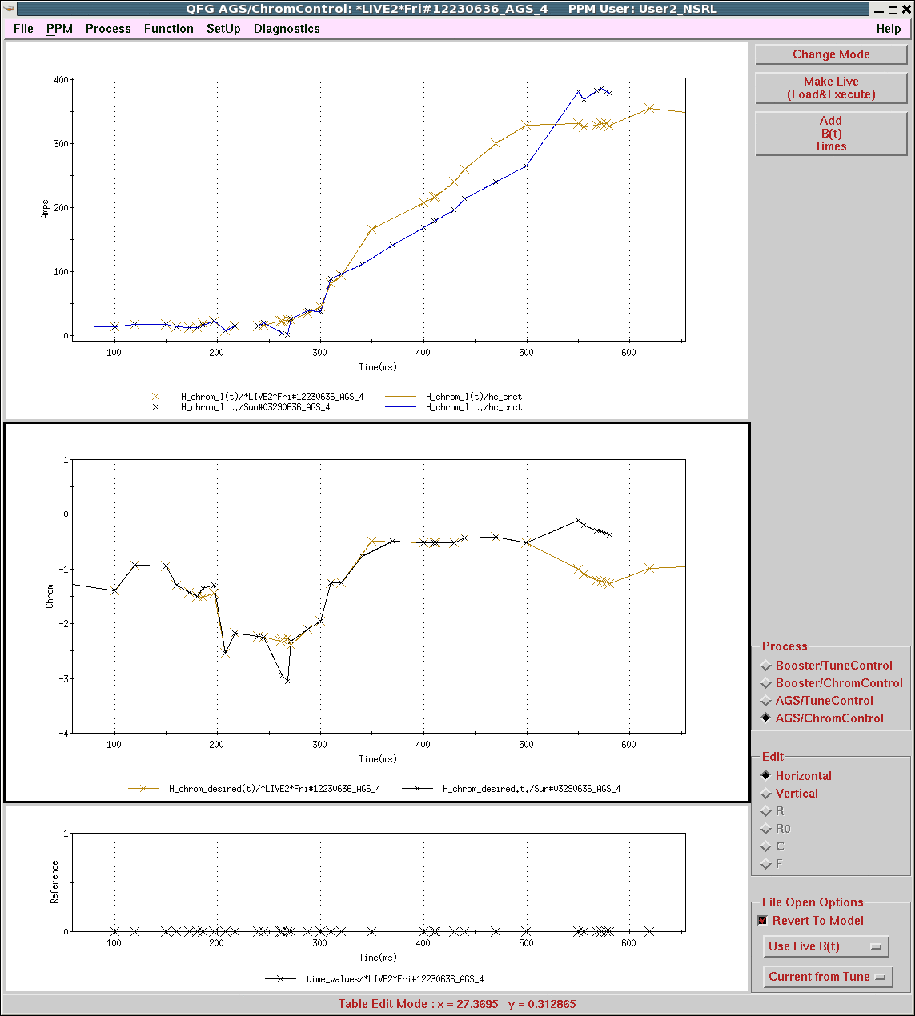
Vertical Sextupole Runs Higher This Year
Horizontal
Vertical
3/29/15 vs. this year
Similar horizontal chrom (middle plot) but somewhat different currents.
We have to run vertical sextupole twice the current to reach long coherence this year.

Slide 23
Higher AGS Vertical Sextupole Current This Year
The AGS vertical sextupole current has to be higher by about 100A this year to reach same chromaticity as in the past.
Sextupole PS test was carried out with back EMF measurement (2/28 and 3/7). All are working fine. There is no expected >100A difference seen in any of them.
The low frequency test with all AGS sextupoles were done 3/21. All magnets look similar. Still no explanation for higher vertical sextupole currents this year.
A shorted turn on a sextupole magnet produces a noticeable change in magnet voltage at low currents of approximately 7.4% (tested in June). The conclusion is that all horizontal and vertical sextupoles are functional.
Beam test at injection was done with various radii and sextupole currents. But the original radius function was used at the beginning of the run. So this is not likely the explanation (see next page).

Slide 24
Beam Test at Injection without Snakes
(analyzed by Keith)
With the H. chromaticity set to zero and the vertical set to +3.0, the horizontal chromaticity is still close to zero, and the measured V. chromaticity is +1.5 (~50A horizontal & ~75A vertical). The time it takes the beam to decohere is longest when the radius is close to zero:
Radius (mm) | X decoherence time (turns) | Y decoherence time (turns)
-2.0 | 950 | 65
-0.4 | >6000 | 525
+0.4 | 6000 | 525
+4.8 | 250 | 270
Roughly the same radial vertical coherence dependence exists when either of the 2 strings is powered separately (there’s no data available for the horizontal).
Chrom Current | Radius (mm) | Y decoherence time (turns)
+40A vertical | -2 | 250
+40A vertical | -0.3 | 425
+40A vertical | +4 | 350
+40A horizontal | -2 | 325
+40A horizontal | -0.3 | 500
+40A horizontal | +4 | 350
The radial dependence suggests that the actual chromaticites may depend on the radius. So, if the radius was different in Run 15 than 17 than different currents in the sextupoles might be required to reach zero chromaticity. The radius was changed during Run 17, but the need for more vertical sextupole current existed before that change, when the radius was the same as in Run 15. So, this is probably not why they need more current.

Slide 25
Modification and Upgrade
One cold head of AGS cold snake stopped working after switched to Au-Au operation in late May. The refilling time interval shrank from two days down to about one day. The 5th cold head will be added in the next two summer shutdowns for the system to be ready for run19, if running is desired.
H10/G10 extraction has frequent failures. Can we upgrade the system?
AGS vertical damper: it does not have alarm on its status (control system is too old). It was physically checked every Monday. Its control needs to be upgraded.
AGS frequency meter sometimes failed silently(no measurement or junk). How can we get it working reliably?
AtR flag/camera replacement. For low energy operation in 2019-2020, the AtR beamline setup is critical.
Automatic chromaticity measurement in the AGS. The vertical sextupole strength mystery would be easier to work on if we could measure the chromaticity in the AGS easily.
Automatic orbit correction in the AtR. Maintaining the AtR has been a long term issue. There is some tedious controls work and polarity checking to be done. The algorithm itself is pretty straightforward.

Slide 26
Preparation for Run18
RHIC required bunch intensity is about 1.5E9 at AGS extraction for both Zr and Ru.
Ru is coming from tandem and Zr is coming from EBIS. 12 pulses are expected from both sources.
Zr: The inexpensive 50% enriched Zr would be sufficient. This would yield up to 3e9 out of the AGS (based on the Au beam from EBIS).
Ru: Enrichment from 5.54% to ~10% would be sufficient. This would yield ~2e9/bunch out of the AGS (based on beam test in run16: 1E9 with 5.54% natural Ru).
There is enough room to reach the required intensity for both Zr and Ru.
Au beam for STAR and CeC should be no issue.
A new request from STAR to switch back and forth between Zr and Ru. Since we only have one x-y stage, NSRL can’t be run in parallel with Zr beam from EBIS. Currently, NSRL is scheduled to wait till Zr is done in March. Either we put in manpower to build another stage including control, or we say no to STAR/NSRL.

Slide 27
Preparation for Run19-20
The lower energy Au run requires better optics control in the AtR line.
The AtR line survey was done in last summer shutdown. The data will be analyzed to see if further alignment is needed or not. This needs to be done before run19.
AtR flags need to be repaired. This requires work from both instrumentation and control groups.
Polarized helion may require an AC dipole in the Booster to overcome the 12-ν_{y} resonance so that the injection energy can be raised to reduce optics distortion due to cold snake. The beam test can be done with proton for 0+ν_{y} (similar rigidity and required AC dipole strength) in run19, if the AC dipole can be built before then. The detail of the proposal will be discussed separately.
Polarized helion beam may be available in 2020. The beam test in injectors is planned.

Slide 28
Summary
The dual harmonics is used in AGS early cycle on top of change of harmonic number from 8 to 6. The effect on vertical emittance is visible.
The JQ timing derivation algorithm has been modified to use just ramp asymmetry measurement. The ramp asymmetry measurement has been improved, too. There is no issue of JQ timing drift throughout the long run. We derive JQ timing every month and they show that there is no JQ timing drift. The benefiting factor is about 1.07.
AGS eIPM gives believable profiles after they were timed in properly and gain calibration was done. It was used since Feb. 6 for AGS normal operation.
Run18: there is enough room to reach the desired RHIC bunch intensity for both Zr and Ru.
Run19 low energy run: AtR flags, controls need to be repaired and upgraded.
Behind the low energy run, we may use the polarized proton beam to test AC dipole in the Booster, which is planned for polarized helion operation. No cold snake is needed for this operation: only polarimeter is needed at AGS injection energy.
Run20, polarized helion beam is available and development is planned in both Booster and AGS.

