Slide 1
Polarization: Run 17 and Beyond
V. Ranjbar

Slide 2
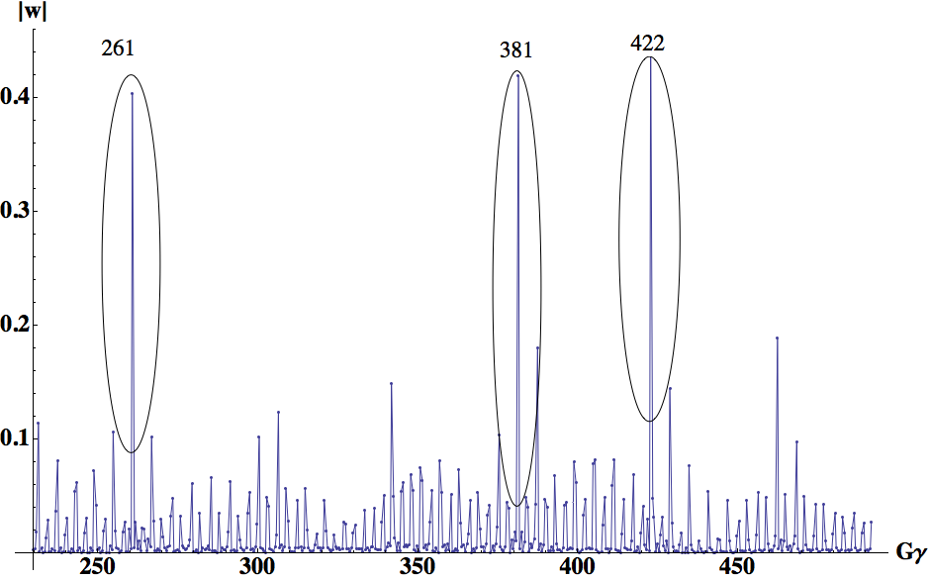
Drivers of Polarization Loss on Ramp

Slide 3
APEX Studies
During the final days of the run Al, Haxing and I were able to perform a very significant study of polarization loss on the RHIC ramp.
This was done using a slow factor of x10 and thus permitted time for CNI measurements along the ramp.
However the machine seemed to be in a degraded state with efficiencies ~60 - 70%

Slide 4
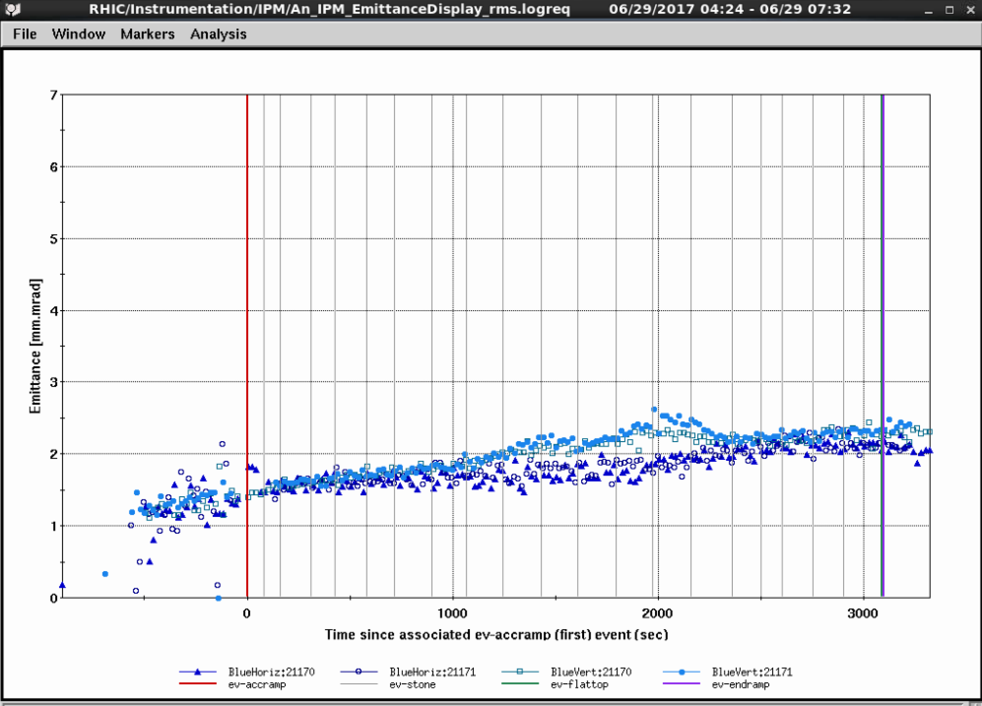
Emittance on Slow Ramp

Slide 5
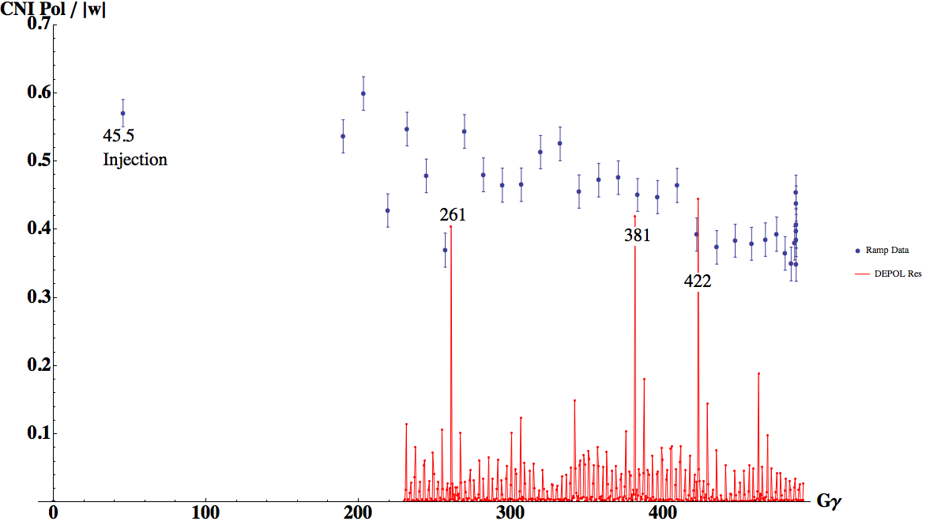
CNI Measurement on Ramp

Slide 6
This Ramp measurement in the Blue Lattice confirms our general suspicion that losses if they occur are due to crossing one of the three strong resonances
For this particular Ramp we measure a 70% relative transmission efficiency. This is much lower than the average 92% efficiency we had throughout the run. So unfortunately this is not a good characterization of a ‘typical’ ramp. Break down estimate of losses are:
260: ~8% loss
381: ~10% loss
422: ~14% loss

Slide 7
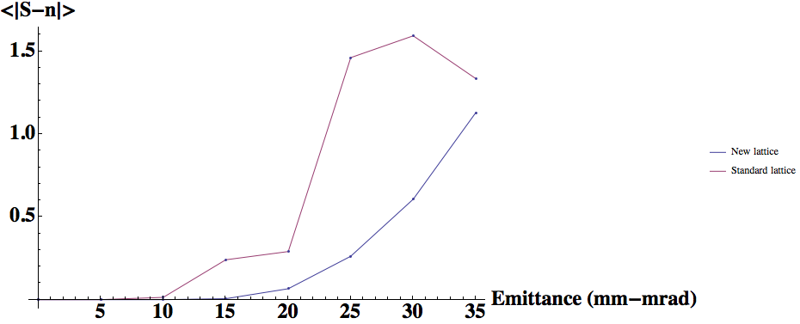
What Does Simulation Say? Losses for 2 mm-mrad rms beam
Ggamma | Old Lattice Blue (loss) | New Lattice Blue (loss) | Old Lattice Yellow (loss) | New Lattice Yellow (loss)
260 | < 0.1% | < 0.1% | < 0.1% | < 0.1%
381 | < 0.1% | < 0.1% | 0.58% | < 0.1%
422 | 1.4% | 0.13 % | 0.66% | <0.1%

Slide 8
Orbit or Coupling?
In the absence of orbit or coupling effects we are entitled to 98% transmission on the ramp for an emittance of 2 mm-mrad rms. This is true for the old Ramp and even more for the new ramp.
We must conclude that Imperfection or Coupling effects are what is driving our losses in excess of 98%.
There is strong circumstantial evidence for this:
The fact that our lattice went from 92% to 70% efficiency without any change in the applied base lattice
Large Spin tilt suggests a very strong imperfection

Slide 9
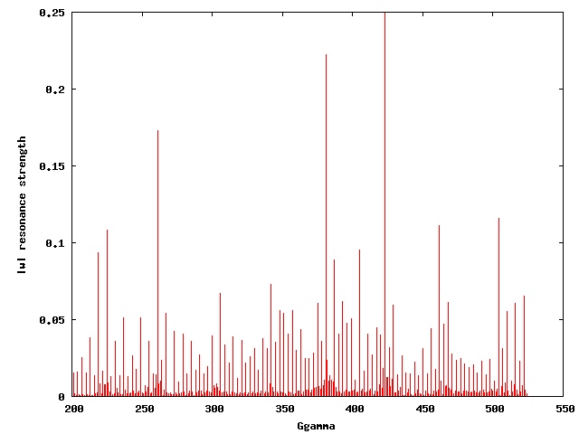
Application of Cos(3*theta) Harmonic Bump Imperfection Resonance
Ggam=423
Ggam=381
Ggam=261

Slide 10
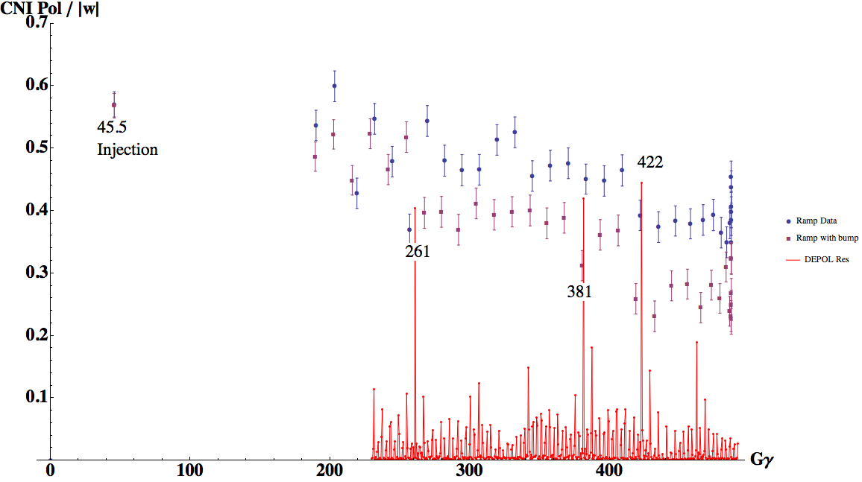
Effect of Imperfection Bump

Slide 11
Result was that ramp efficiency was dropped to 48% a from 70%. (20% drop).
The breakdown of the losses are:
260: ~ 28% (additional 20% with ~ 0.17 Imperfection)
381: ~ 12% (additional 2% with ~ 0.23 Imperfection)
422: ~ 22% (additional 8% with ~ 0.25 Imperfection)
Losses not necessarily proportional to change in Imperfection

Slide 12
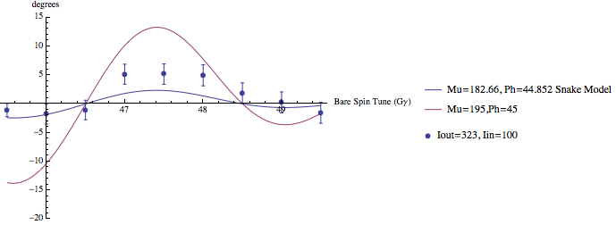
Anomalous SpinTilt
Energy scans of the projection of average spin tilt into horizontal plane at Injection (top) and at store (bottom) in Blue ring. We compared response to simple model with snakes at settings based on model value for Iin=100 and Iout=323 amps and with detuning of snakes and a strong imperfection source. In our model using a singular imperfection at Ggama=487 of 0.2 could work.

Slide 13
Effect of Imperfections
Preliminary studies of simple 2 resonance models show losses at 2 mm-mrad rms are as follows:
0.2 → 6.6%
0.15 → 0.6%
0.1 → 0.08%
This needs to be done using direct tracking with constructed Imperfection bumps still
However to match our observed losses we probably need Imperfections ~ 0.2 which is consistent with the spin tilt study.

Slide 14
Mining Spin Tilt data?
Along with the ramp measurements we have spin tilt measurements on the ramp with and without the bump
I have a vague hope that by matching our spin tilt values along the ramp we could back out a plausible Imperfection resonance structure. However this data might be too noisy

Slide 15
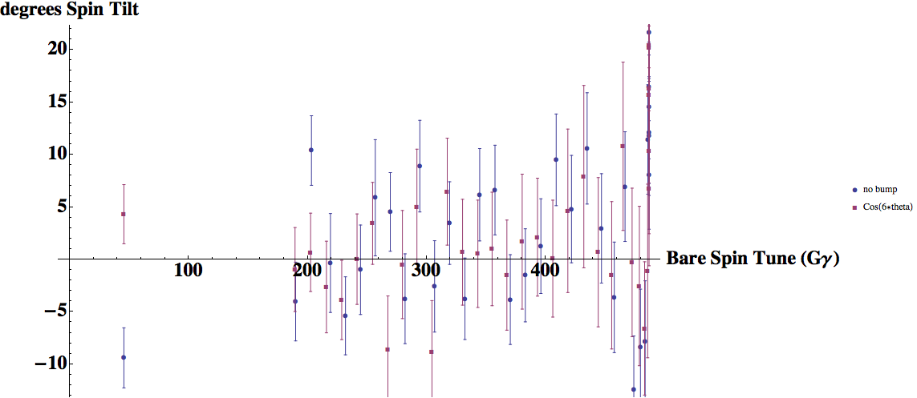
Spin Tilt on the Ramp

Slide 16
Conclusion and Future Prospects
With Emittances well controlled down to 2 mm-mrad any losses above 2% are probably due to Imperfections or Coupling effects. I strongly suspect the later
To make progress on polarization:
I would advise that we make a ‘heroic’ effort to enhance our ability to control the orbit relative to the quads in the lattice.
Consider methods like beam based alignment except for all quads?
Spend time using artificial Imperfection bumps to ‘knock’ out Imperfections
This is time consuming though

