Slide 1
Run-17 Au+Au Review Run-18 Zr+Zr, Ru+Ru Plans
Run Coordinator: Gregory Marr

Slide 2
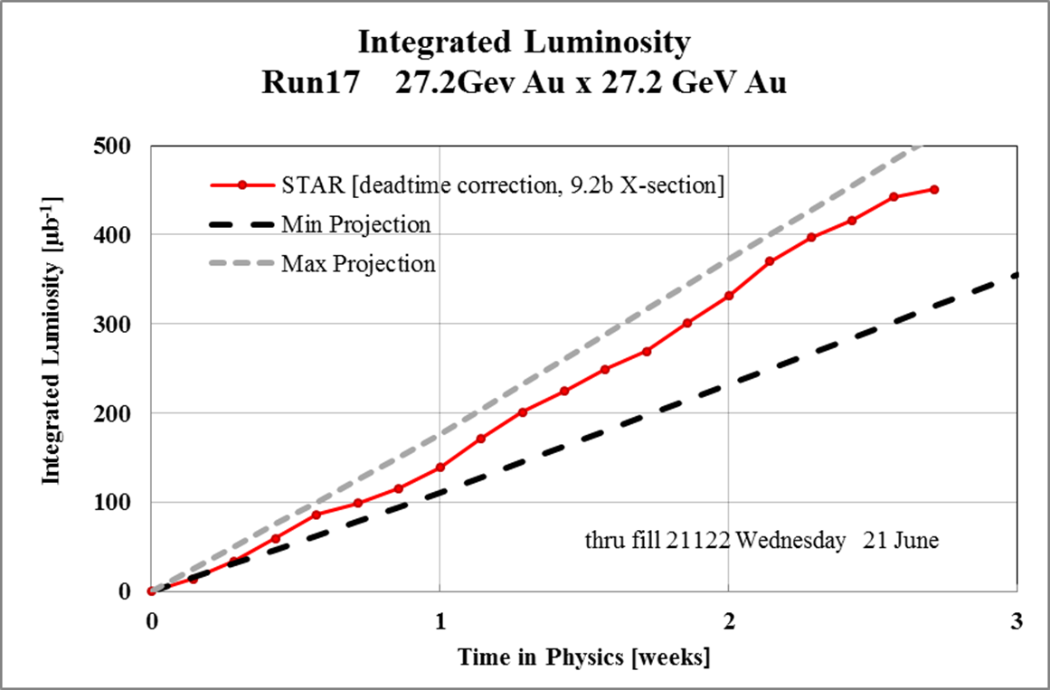
Run-17 Overview: Au+Au Performance
At CeC energy: 27.2 GeV
No stochastic cooling
We were able to meet our projected luminosity performance goals.

Slide 3
Run-17 Overview: Au+Au Challenges
Start-up: consecutive failures
5/30-6/3/17: Equal time failure, machine setup:
BMMPS
A5 kicker delay module (multiple times)
Booster RF driver amplifier (multiple times)
AGS RF station tuning
RHIC smoke detector
BTA vacuum interlocks
Cryo lead flow
RHIC RF storage cavities
Yellow dipole feedback memory issue
EBIS trips
RHIC Landau cavity trips
Landau cavity stability
Good news: largely solved
Unsolved issues
Yellow debunching at injection
Yellow Booster noise at injection & store
Blue ramp tune feedback issues
Multiple species changes in Collider
Somewhat more automated this run
Seemed fraught with random failures
Limited transmission efficiency.
Not on par with Run 16, considering beam intensity.

Slide 4
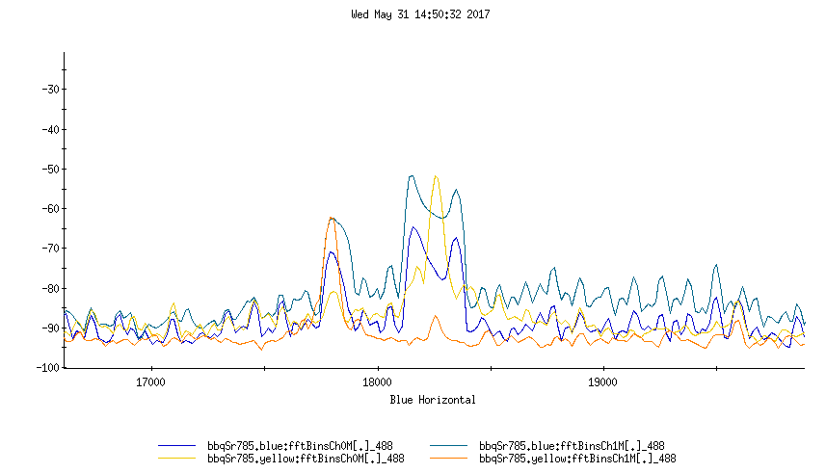
Blue ramp: tune issues
Anomalous peaks in BBQ tune caused lock issues and ramps failed when tune feedback ran away.
Target tunes were same as previous runs, but had to be changed (+0.004) to avoid this.
Cause was never identified.

Slide 5
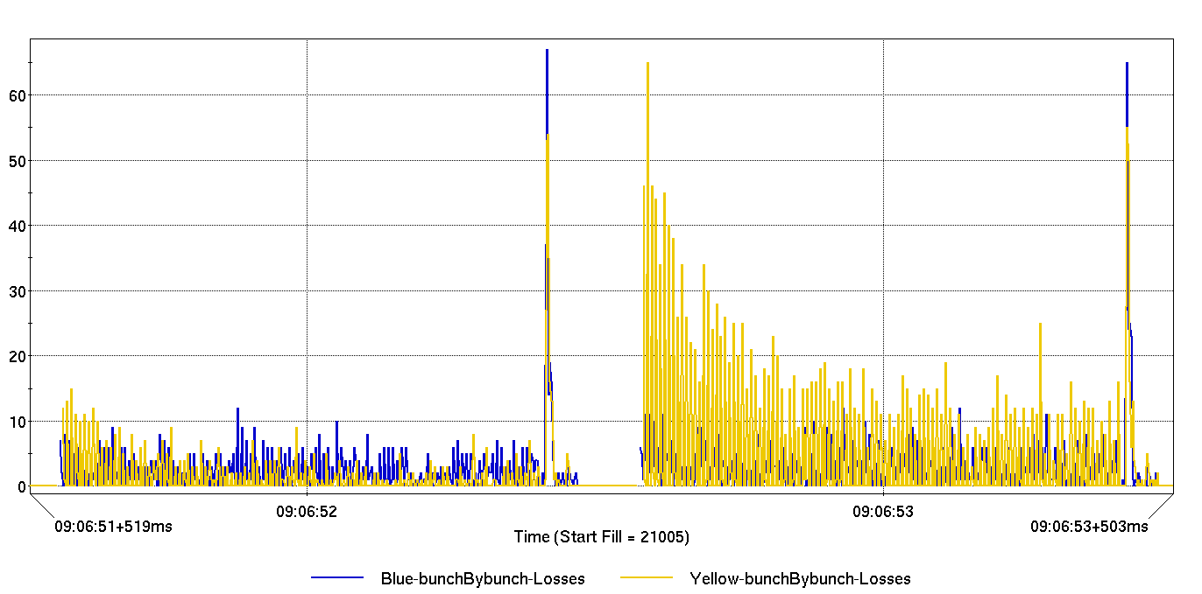
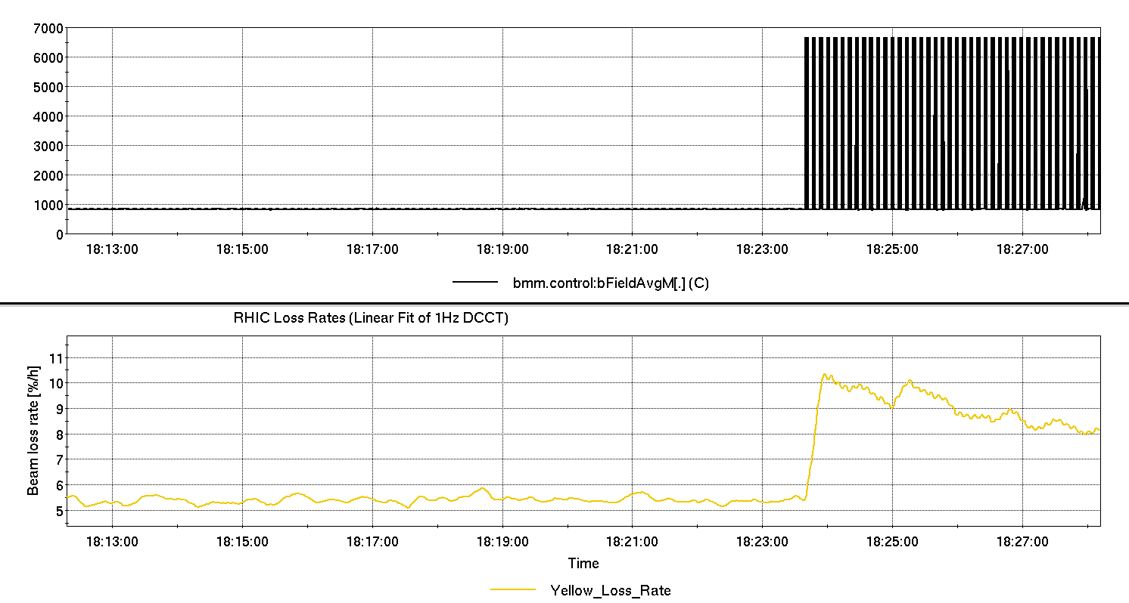
Yellow noise, losses
Yellow loss rates increase when Booster Main Magnet is pulsing. Blue beam did not see similar effect.
We were unable to find a cause or tune around the effect.

Slide 6
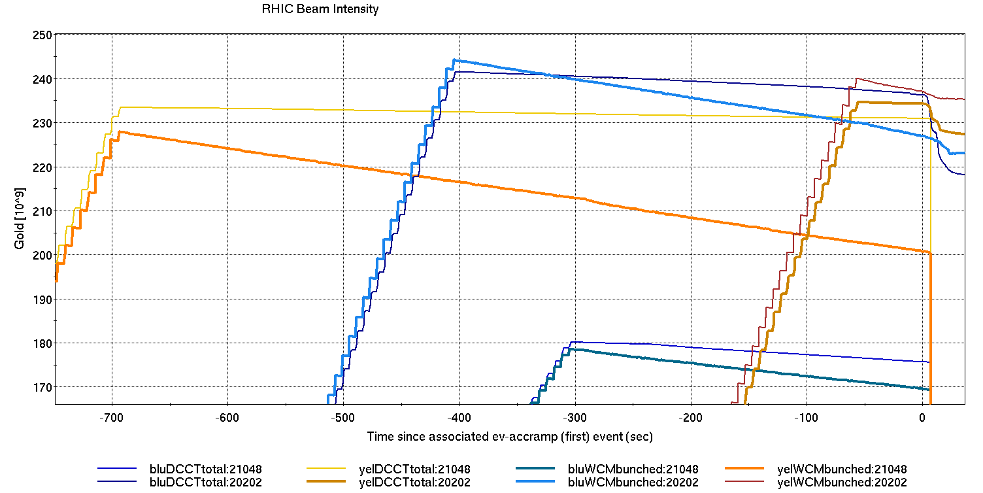
Yellow injection: debunching
Run 17
Run 16
At injection, Yellow beam was debunching more quickly than Blue.
Rate was worse this run compared to Run-16 Au.
Run 17
Run 16

Slide 7
Run-17 Coordination Notes: CeC
It’s not an experiment. It’s not an operational system either.
We struggle to manage this third category at the outset (e.g. elens, 56MHz, etc.). It gets better with time. Time remains a limited resource, however.
Lives at the perimeter of Run Coordinator and Scheduling Physicist’s purview.
They often couldn’t specify what their needs were or when they wanted them. Not unusual for a developing project, but it was difficult to anticipate and schedule.
Did CeC make the most efficient use of their time?
I don’t think we (Operations) helped them improve. Could we have been of greater service?
I’m not sure CeC staff knew the extent of our tools/expertise, or knew to ask questions (ask the right questions).
With STAR ahead of some goals, would dedicated beam time have been appropriate?

Slide 8
Run-18 Planning: Zr+Zr, Ru+Ru
Ramp/Lattice
Beam energy 100 GeV/N, ($\sqrt{sNN}=200$ GeV)
Stochastic cooling
Do we need β* < 1m?
Likely determined by Ru achievable luminosity…
No less than 0.7m
Equal lattice/beam conditions desired for Zr, Ru

Slide 9
More (even more?) mode switches
Warning: species switches = less integrated luminosity.
CeC will require periods of Au-Au
As presently scheduled, we must switch the Collider species more than any species or energy change in any past run.
(Au?)->Zr->Au->Zr->Ru->Au->Ru->Au->low energy Au
Mode switching in the injectors is commonplace. Is it time to make it so in RHIC?
Additional setup effort – and time – required.
Tandem will need to change schedule to provide Ru at beginning of run.
Zr not compatible with NSRL running (EBIS LION issues)?

Slide 10
Run-18 Challenges: Intensity
Source limited. Will tuning time be limited due to availability of enriched source material?
See following talk (Raparia).
Should we set up with Au in beginning?
Previously achieved (courtesy Gardner, Kling)
Zr: ~5x10⁶ ⁹⁶Zr¹⁶⁺ transported through Booster (with ⁹⁰Zr¹⁵⁺) to NSRL line target with naturally abundant (~2-3%) Zr source
Ru: ~1x10⁹ ⁹⁶Ru⁴⁴⁺ ions/bunch at AGS extraction (from Tandem) with naturally abundant (~5.5%) Ru source and 8-4-2 merge in injectors
Projected
Zr: Enriched source should provide more ions than Ruthenium, approaching Gold-like intensities (2x10⁹ or better).
12 EBIS/Booster cycles, 6-3-1 merge in AGS
Ru: Estimate ~1.5x10⁹ ions/bunch available
8 Tandem/Booster pulses, 8-4-2 merge in AGS

Slide 11
Run-18 Planning: Challenges
Zr yet to be transported to/accelerated in AGS
Biggest hurdle will be selecting proper isotope & charge state in BTA downstream of stripping foil.
Machine/experiment protection
This storage Bρ could be susceptible to prefires.
See previous talk (Drees).
Concurrent project commissioning
LEReC and CeC: only one at a time? (cryo).
You can’t start beam while you finish installations…
If access is already predicted to be more frequent, it behooves us to make it more streamlined than the present awkward circus. Fugit inreparabile tempus.

Slide 12
Run-18 Planning: Au-Au
Medium Energy for STAR
Beam Energy 13.5 GeV ($\sqrt{sNN}=27$ GeV)
Below transition
β* = 3m?
Previously set up in Run-11, 8 day run
Used “IBS suppression lattice” Au11v6
~1 hour stores
No stochastic cooling
Au for CeC
Uses previously established Au17 ramp
Low intensity, bunch number

Slide 13
Run-18 Planning: Low energy Au
Fixed target at STAR
Beam energy 3.85 GeV
Can this be done with CeC beampipe? It won’t be as easy as last time.
Run-10: It wasn’t easy last time.
49 hours setup
Sextupole polarity reversal
6m β* at IP6
h=369
10 min stores
Broke the vacuum at the yellow injection kicker
Intensity 0.5x10⁹/bunch, loss-limited in ATR.

Slide 14
Summary
The Run-17 heavy ion program was a successful, albeit short, run.
The short program did not afford us much time to investigate or address a number of issues that appeared during the run. We should be prepared for their possible recurrence in Run-18.
Run-18 will be challenged with numerous species changes. Efficient use of setup time will be important.
My thanks to Operations, CAS and all support groups and specialists for their effort in Run-17, and for their upcoming work towards a successful Run-18.

