Slide 1
Cluster update

Slide 2
What’s new
Current (Old):
Pixel pitch is 1/5 physical size.
GEANT -> Reco algorithm is just taking pixel center + random time smearing.
Why change: Want to return to realistic pixel pitch
Proposed (New):
Pixel pitch is the physical size.
GEANT -> Reco algorithm is GEANT->Charge sharing->Clustering->Reco
Compare efficiency and resolution of the “new” cluster algorithm

Slide 3
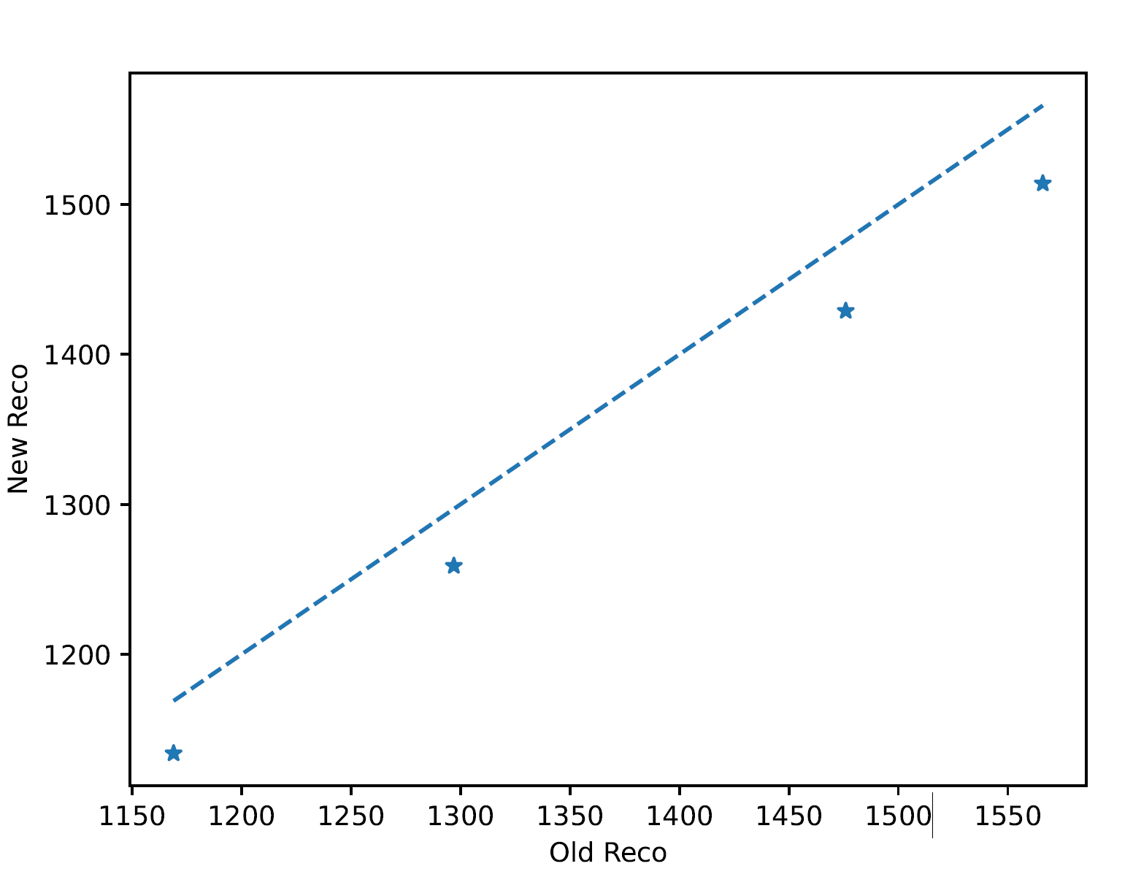
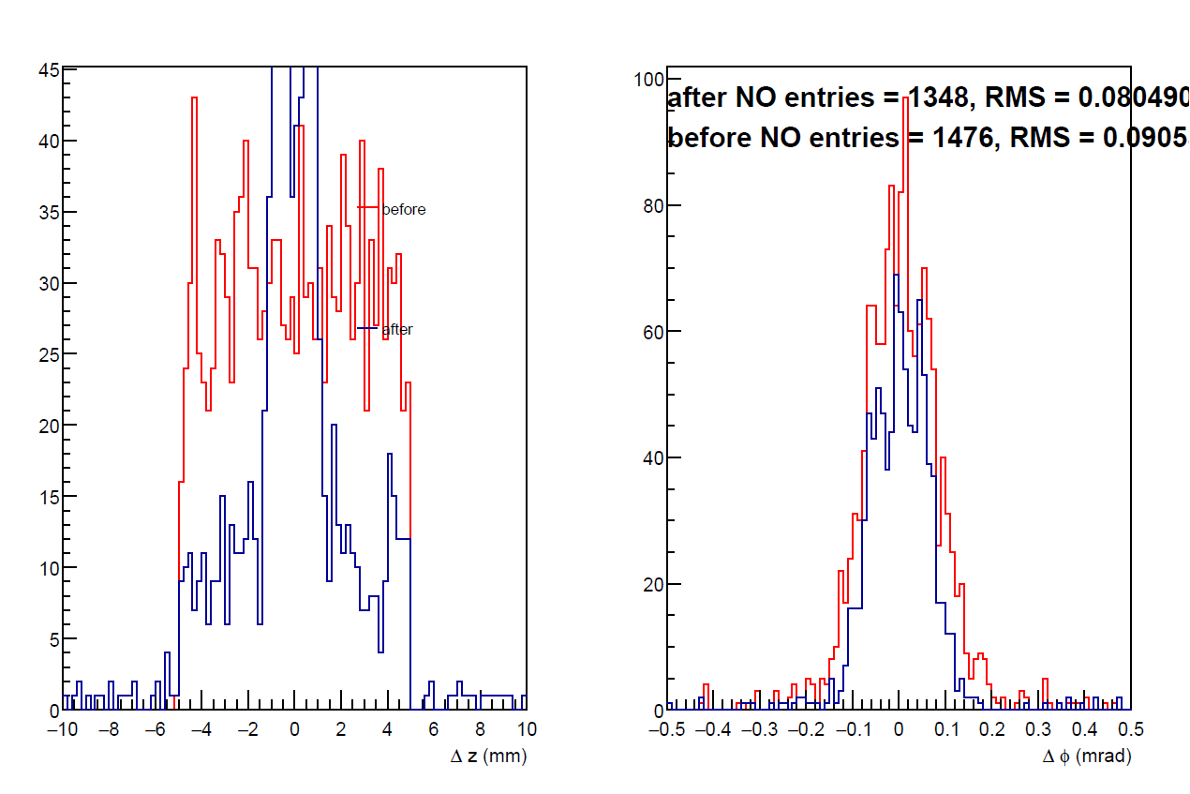
Efficiency
Old algorithm discard hits if edep < threshold.
Default threshold = 6 keV
Before: Narrow pixel, old algorithm. After: wide pixel, new clustering
Total number of clusters in all events
Threshold = 3keV
Threshold = 6keV
Threshold = 12keV
Threshold = 18keV

Slide 4
Efficiency
Old algorithm discard hits if edep < threshold.
Default threshold = 6 keV
Before: Narrow pixel, old algorithm. After: wide pixel, new clustering
Why do we get less clusters in the new algorithm?
Total number of clusters in all events
Threshold = 3keV
Threshold = 6keV
Threshold = 12keV
Threshold = 18keV

Slide 5
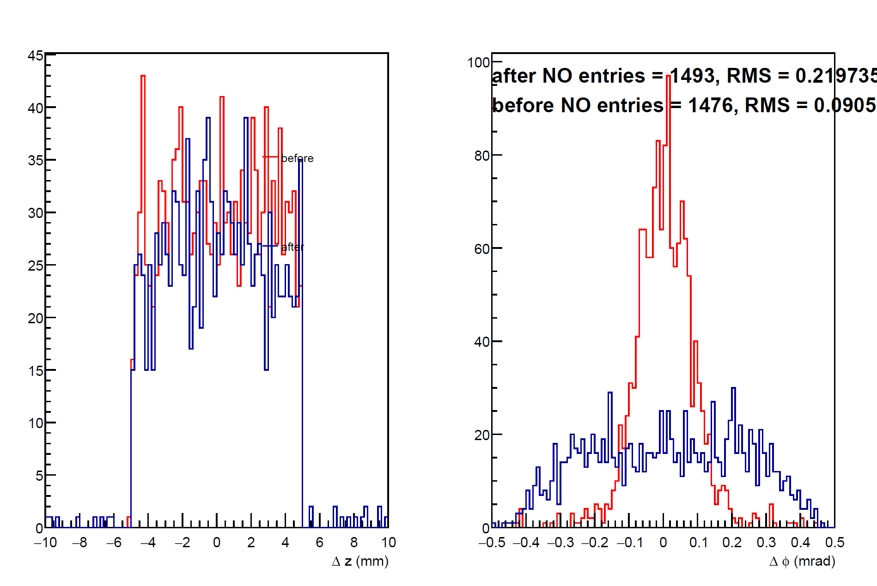
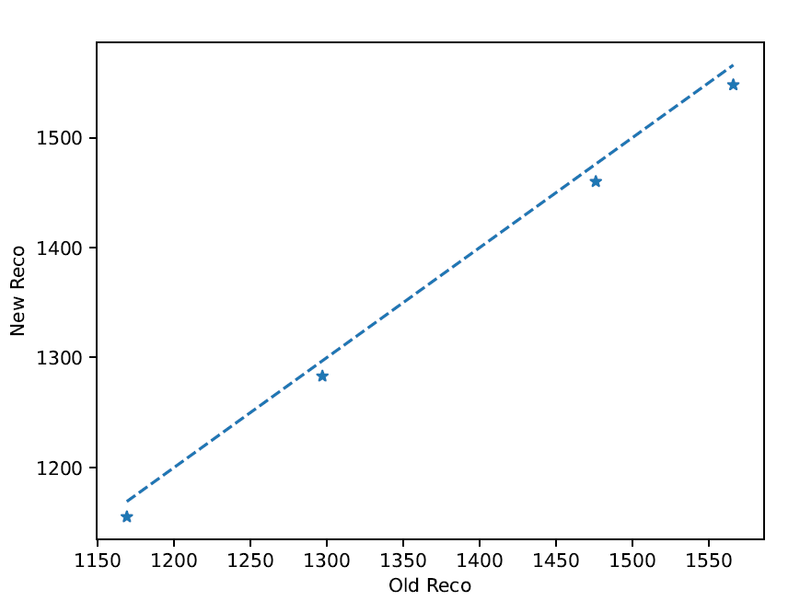
Efficiency (cont.)
Cluster lost due to overlapping clusters being merged into 1.
New result if sigmax=sigmay= 0 (no charge sharing)
Total number of clusters in all events
Threshold = 3keV
Threshold = 6keV
Threshold = 12keV
Threshold = 18keV

Slide 6
Conclusion
Resolution of new algorithm (with realistic pixel width) = that of old algorithm (but with wrong pixel width)
Source of efficiency lost is NOT understood.
Propose that we replace the old clustering algorithm with the new one.

Slide 7
Update 4/11/2026

Slide 8
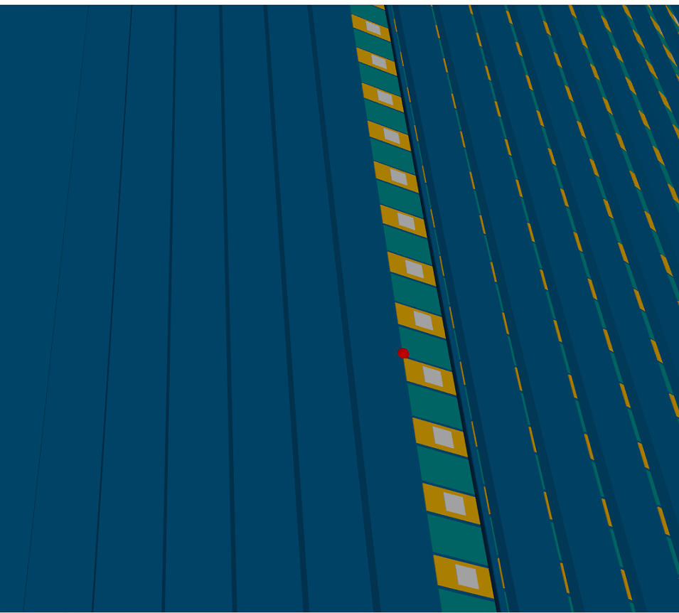
Reason for missing clusters: Cell segmentation with wrong offset
When I increase the pixel size to be the sensor size (i.e. each sensor has only one pixel), offset were incorrect.
Hits are located at the corner, which confuses neighbor finder.

Slide 9
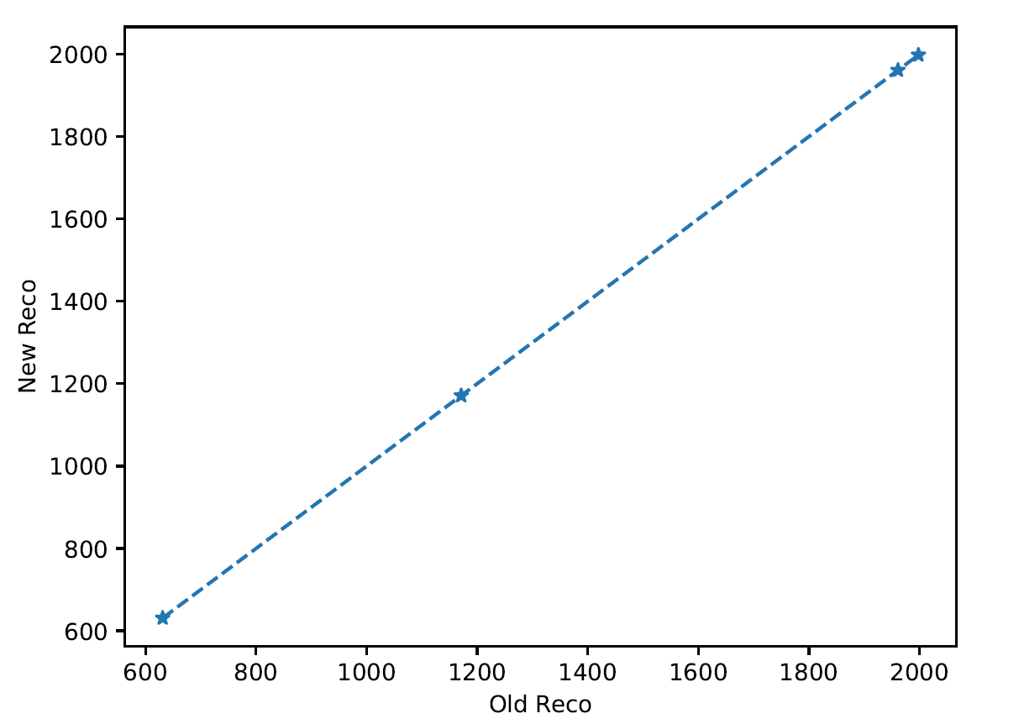
No cluster lost after fixing offset
One sensor only has one pixel.
Thresholds are applied BEFORE charge sharing.
Total number of clusters in all events
Threshold = 30keV
Threshold = 60keV
MC particle gun:
1 < theta < 2
2pi azimuth uniform
0.1 < |p| < 1 GeV/c
Pi+ only
Reco thresholds:
Before charge sharing = (see plot)
After charge sharing = 0 (no threshold)
Not threshold applied before charge sharing ONLY to verify if there are bugs in the program, NOT to realistically simulate detector response
Threshold = 120keV
Threshold = 180keV

Slide 10
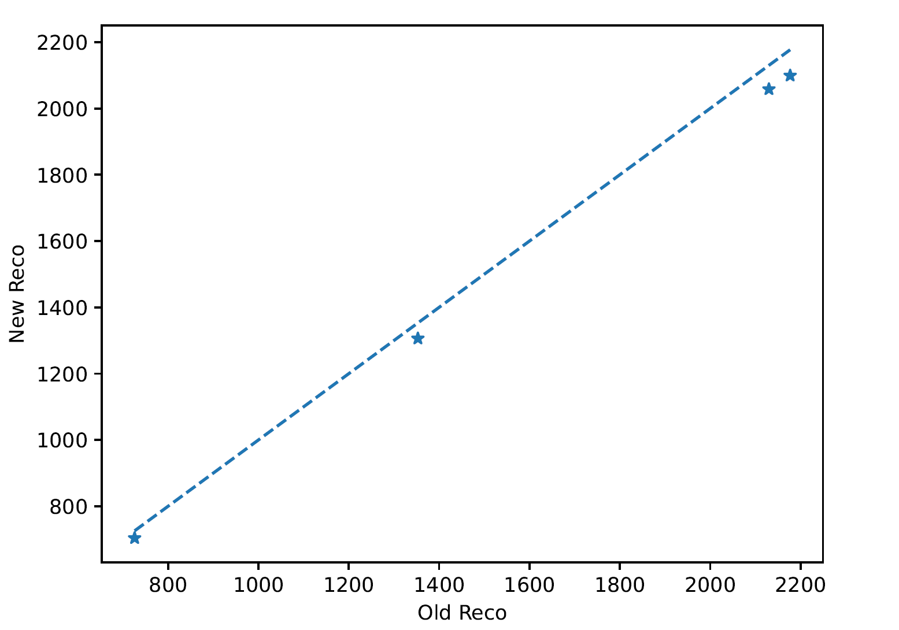
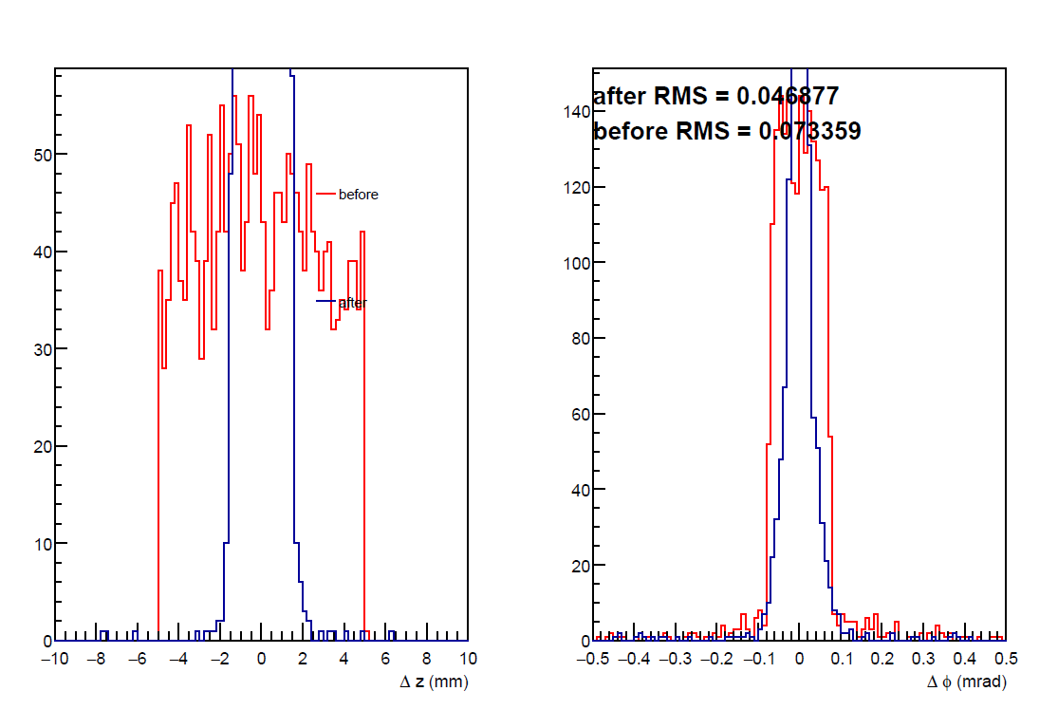
Cluster performance after correction
MC particle gun:
1 < theta < 2
2pi azimuth uniform
0.1 < |p| < 1 GeV/c
Pi+ only
Reco thresholds:
Before charge sharing = (leftmost: see plots. Right 2 figures: 60keV)
After charge sharing = 6keV (all 3 plots)
Charge sharing:
Sigmax = 0.5 mm = pixel pitch
Sigmay = 0.5 cm = 0.5*pixel width
Phi resolution is too good.
Ave. NO pixel per hit = 3.25
Charge sharing still too wide?
Total number of clusters in all events
Threshold = 30keV
Threshold = 60keV
Threshold = 120keV
Threshold = 180keV

Slide 11
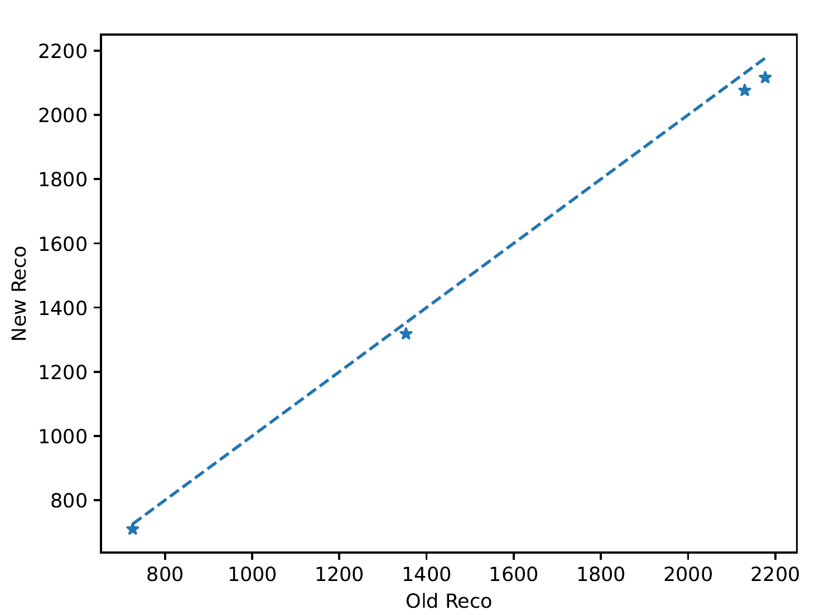
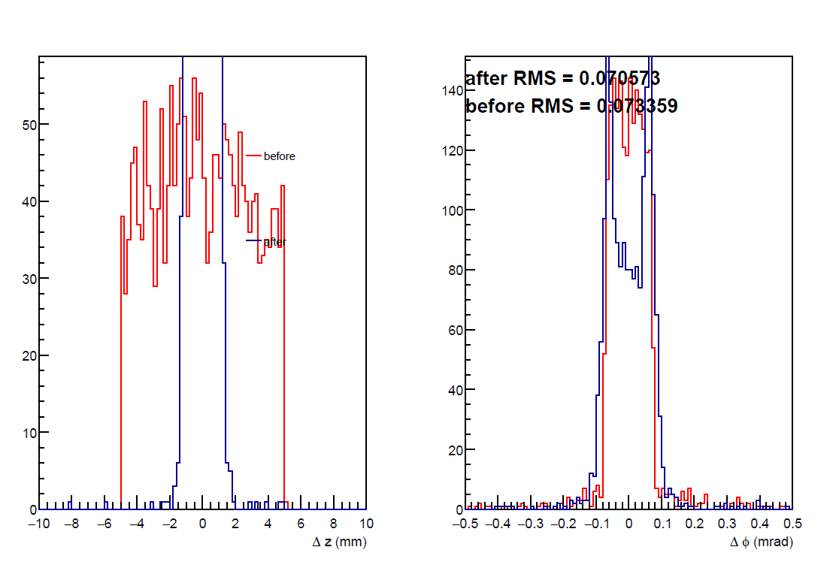
Cluster performance after correction
MC particle gun:
1 < theta < 2
2pi azimuth uniform
0.1 < |p| < 1 GeV/c
Pi+ only
Reco thresholds:
Before charge sharing = 0keV (no threshold)
After charge sharing = 6keV
Charge sharing:
Sigmax = 0.25 mm = 0.5*pixel pitch
Sigmay = 0.5 cm = 0.5*pixel width
Sigmax is varied to match expectation
Total number of clusters in all events
Threshold = 30keV
Threshold = 60keV
Threshold = 120keV
Threshold = 180keV

Slide 12
Conclusion
Proposed:
Fix pixel offset.
Revert pixel size to realistic size (0.5mm * 1 cm)
Enable clusters with sigmax = 0.4 mm
Upload them in a pull request.
To be done:
Same analysis on ETOF.

