Slide 1
ESR Polarization
Matt Signorelli
Postdoctoral Research Associate
Brookhaven National Laboratory
Increasing ESR Polarization Meeting
May 14th, 2026

Slide 2
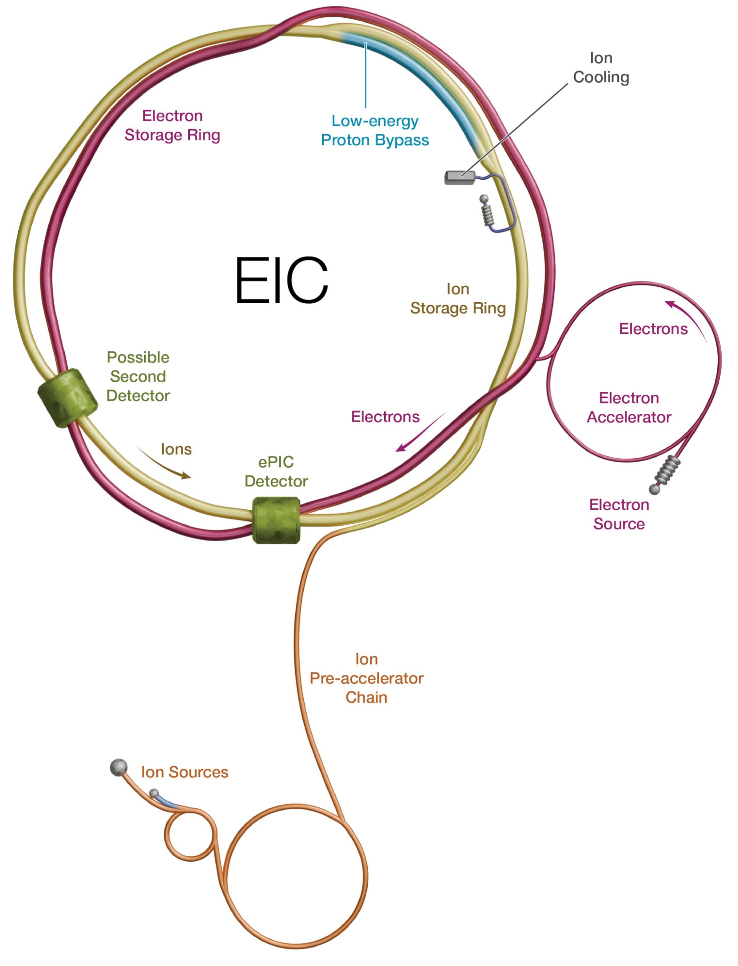
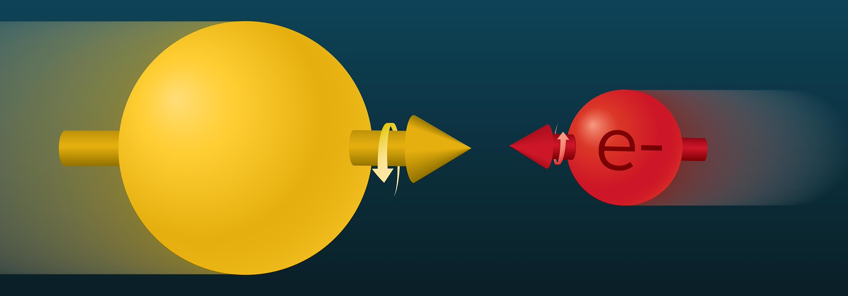
Overview
Electron-Ion Collider (EIC)
Hadron Storage Ring (HSR)
41, 100, and 275 GeV
Electron Storage Ring (ESR)
5, 10, and 18 GeV
IP6
Rapid Cycling Synchrotron (RCS)
Accelerates electrons from 750 MeV to 18(??) GeV
The point of this meeting
2

Slide 3
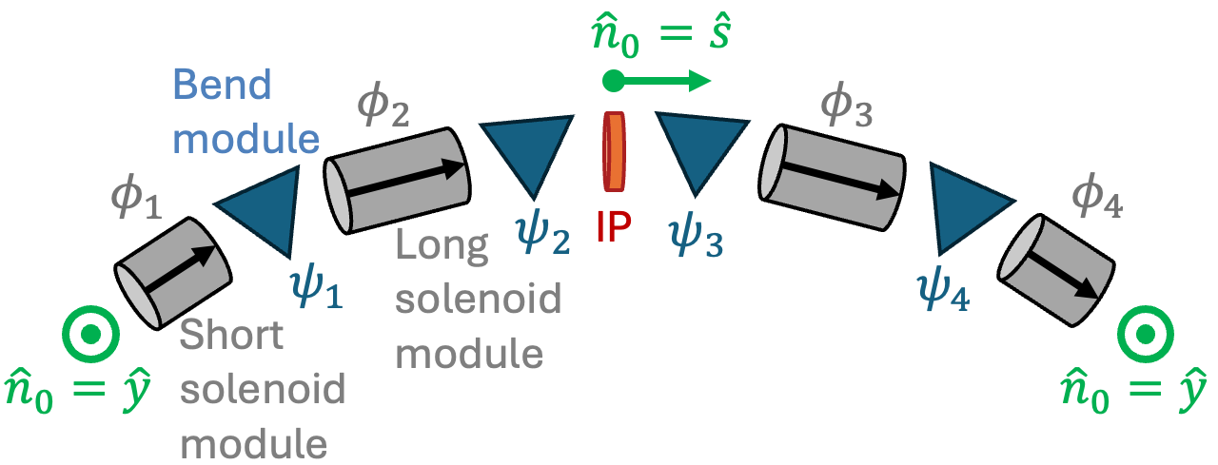
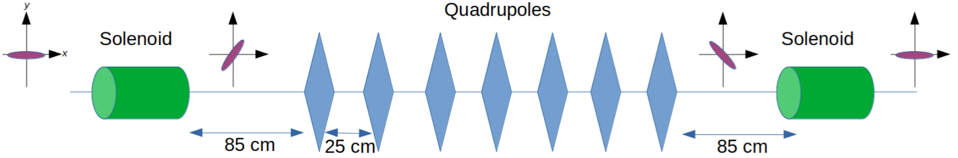
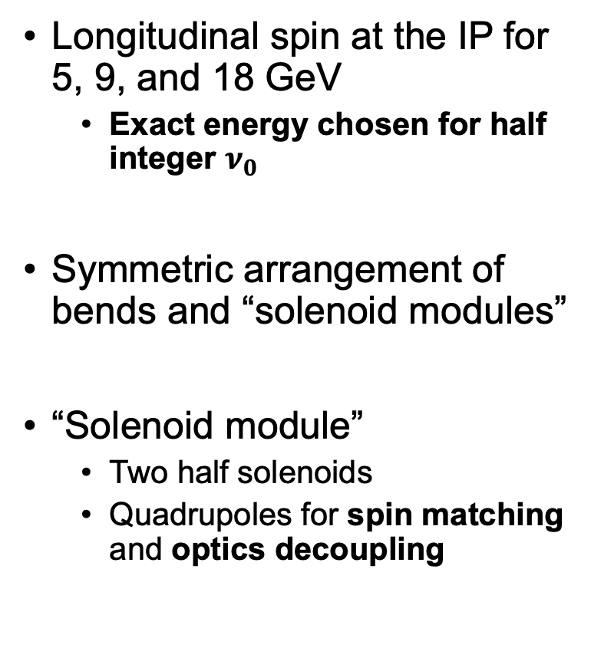
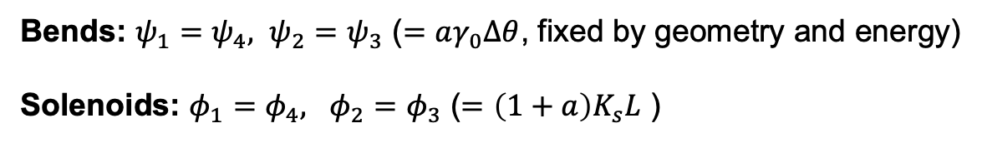
Spin Rotator
Longitudinal spin at the IP for 5, 9, and 18 GeV
Exact energy chosen for half integer $ν_{0}$
Symmetric arrangement of bends and “solenoid modules”
“Solenoid module”
Two half solenoids
Quadrupoles for spin matching and optics decoupling
Bends: $ψ_{1}=ψ_{4}, ψ_{2}=ψ_{3}$ ($=aγ_{0}Δθ$, fixed by geometry and energy)
Solenoids: $φ_{1}=φ_{4}, φ_{2}=φ_{3}$ ($=\left(1+a\right)K_{s}L$ )

Slide 4
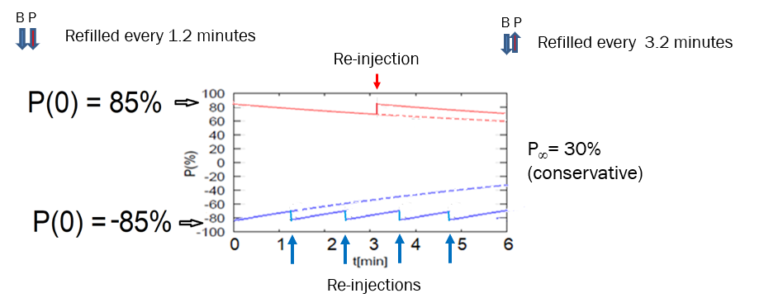
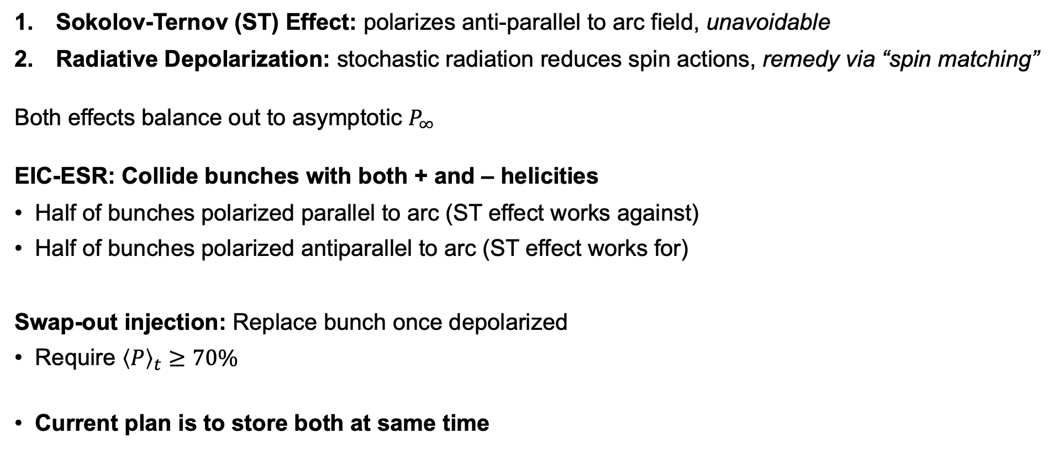
Spin Configurations
Sokolov-Ternov (ST) Effect: polarizes anti-parallel to arc field, unavoidable
Radiative Depolarization: stochastic radiation reduces spin actions, remedy via “spin matching”
Both effects balance out to asymptotic $P_{∞}$
EIC-ESR: Collide bunches with both + and – helicities
Half of bunches polarized parallel to arc (ST effect works against)
Half of bunches polarized antiparallel to arc (ST effect works for)
Swap-out injection: Replace bunch once depolarized
Require ${\left\langle P\right\rangle }_{t}≥70\%$
Current plan is to store both at same time

Slide 5
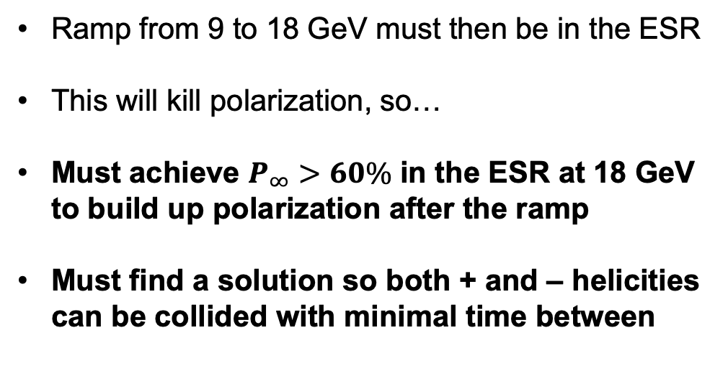
The Cost-Saving Idea
Pro:
Lots of money saved
Con:
Can only ramp up to 9 GeV
Rapid Cycling Synchrotron (RCS)
Ramp from 9 to 18 GeV must then be in the ESR
This will kill polarization, so…
Must achieve $P_{∞}>60\%$ in the ESR at 18 GeV to build up polarization after the ramp
Must find a solution so both + and – helicities can be collided with minimal time between
IP6
Move the RCS into the AGS tunnel
5

Slide 6

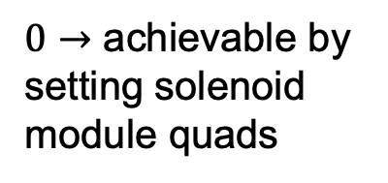

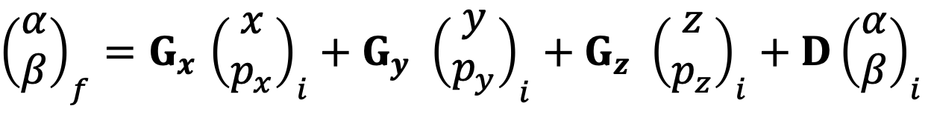



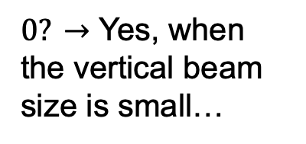

What has been done?
$${\hat{n}}_{0}$$
$$\vec{S}$$
$${\hat{l}}_{0}$$
$$β$$
$$α$$
From arc to arc:
$${\hat{m}}_{0}$$
Horizontal
Vertical
Longitudinal
${\left(\begin{matrix}α \\ β\end{matrix}\right)}_{f}=G_{x}$ ${\left(\begin{matrix}x \\ p_{x}\end{matrix}\right)}_{i}+G_{y} {\left(\begin{matrix}y \\ p_{y}\end{matrix}\right)}_{i}+G_{z} {\left(\begin{matrix}z \\ p_{z}\end{matrix}\right)}_{i}+D{\left(\begin{matrix}α \\ β\end{matrix}\right)}_{i}$
$0→$ achievable by setting solenoid module quads
$0? →$ Yes, when the vertical beam size is small…
It’s complicated…

Slide 7
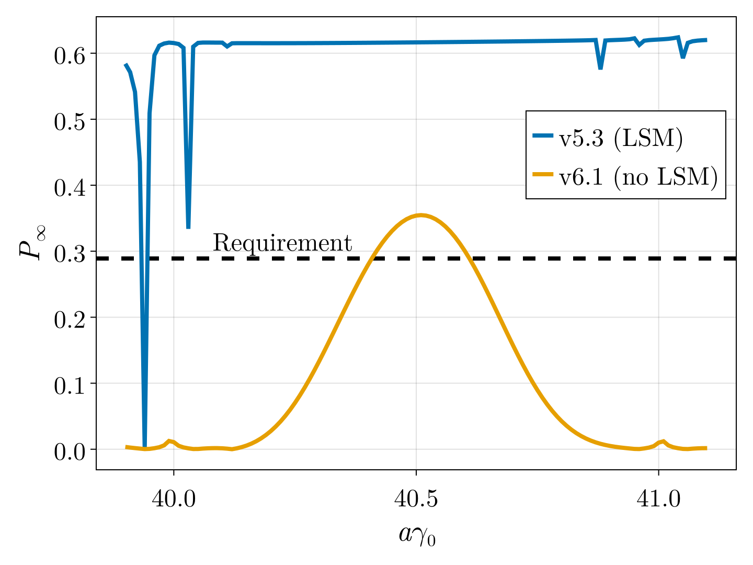
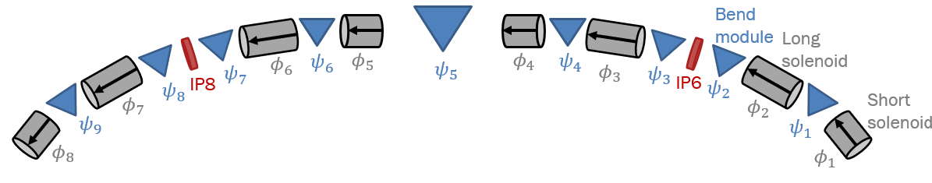
Longitudinal Spin Match
5, 9 GeV do not require longitudinal spin match (LSM)
At 18 GeV, the effect on polarization is significant
But, would need 11 Tesla solenoids. Not feasible
Attempted “partial” LSM using 2nd IR:
Marginal improvements, still insufficient
No LSM
(Partial) LSM??

Slide 8
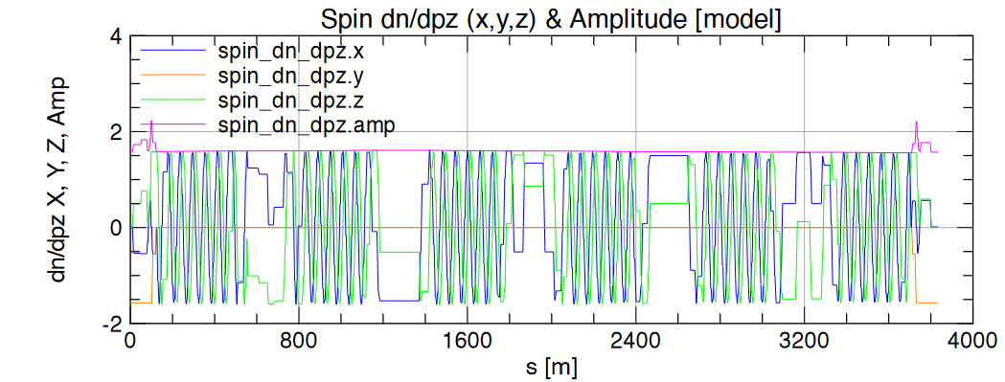
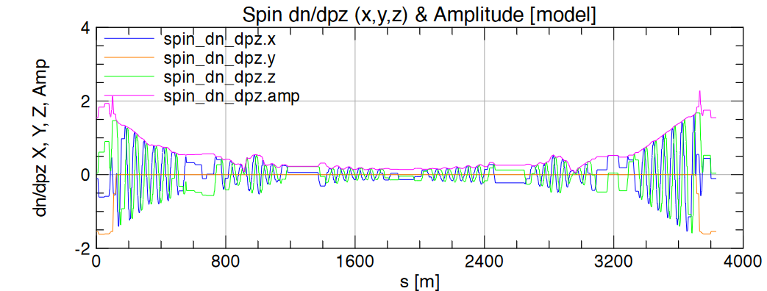



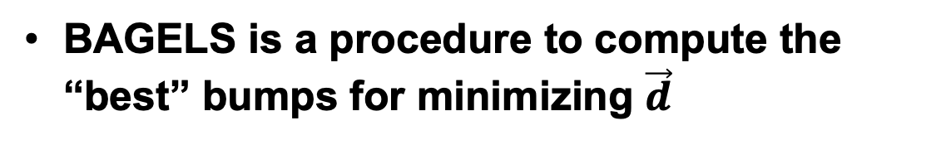
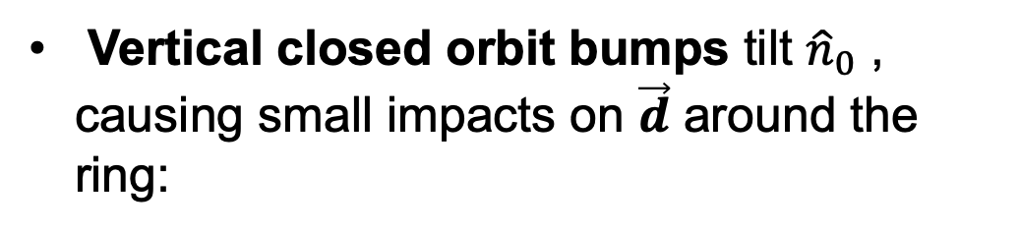
Best Adjustment Groups for ELectron Spin
$\vec{d}=\frac{∂\hat{n}}{∂δ}=\text{"}\text{spin}\text{−}\text{orbit} \text{coupling} \text{function}"=$the bad thing!
Without a longitudinal spin match,
Vertical closed orbit bumps tilt ${\hat{n}}_{0}$ , causing small impacts on $\vec{d}$ around the ring:
4 BAGELS bumps
$${\hat{n}}_{0}$$
Turn on bump magnets
$$θ_{i}$$
BAGELS is a procedure to compute the “best” bumps for minimizing $\vec{d}$

Slide 9
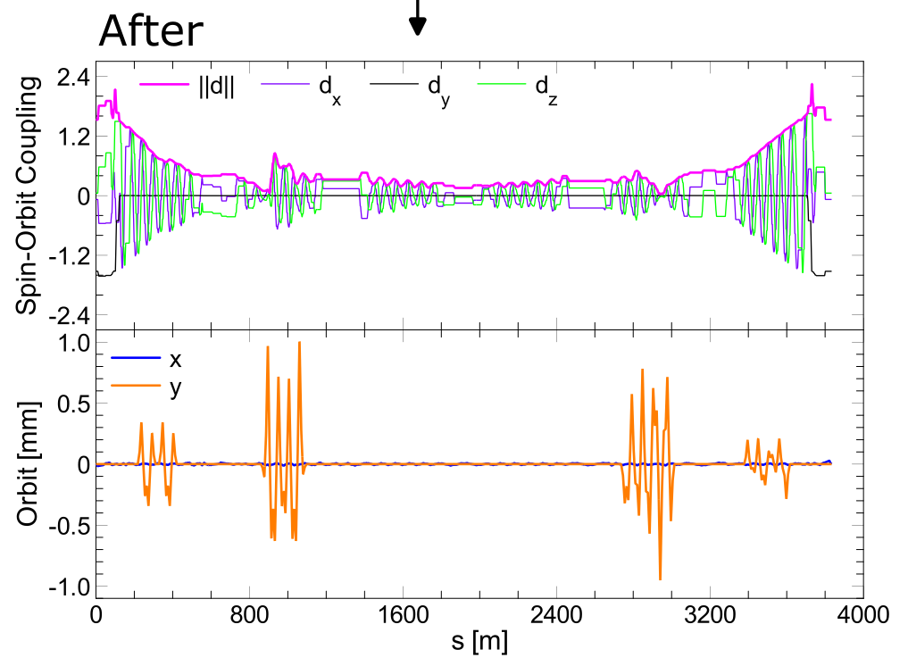
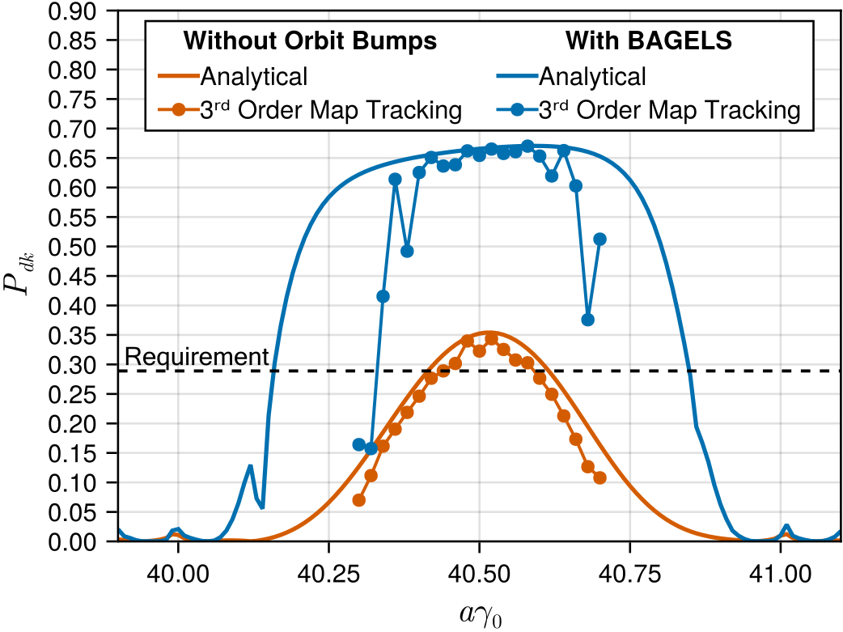

BAGELS in the 18 GeV ESR
Turning only 4 BAGELS knobs in the ideal 1-IP 18 GeV ESR:
“Analytical” = first-order, Map Tracking = Monte Carlo simulation (nonlinear)
Good result in the ideal (no errors) lattice, $P_{∞}≈65\%$

Slide 10
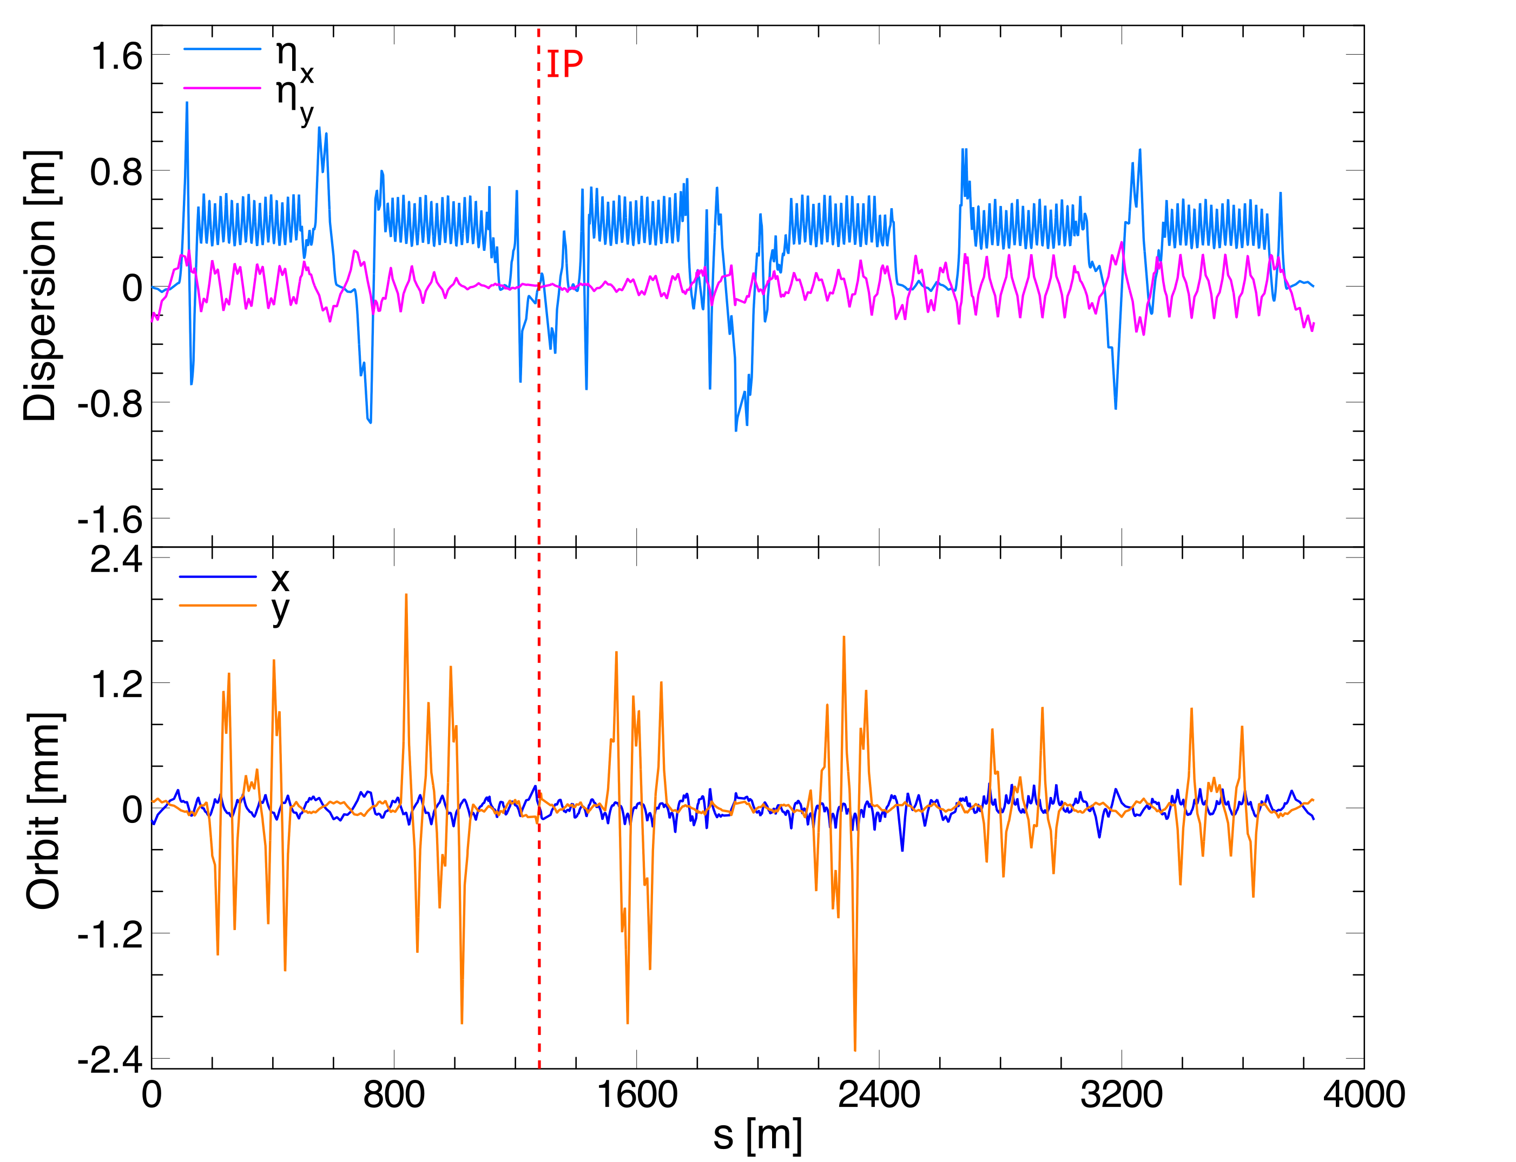
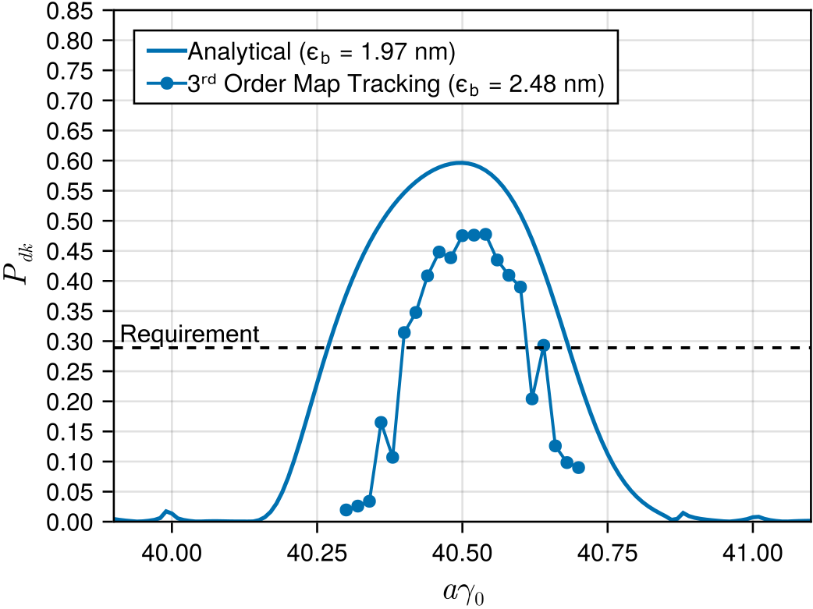

However…
Need to intentionally create vertical emittance to match the hadron beam size
In the ideal 18 GeV lattice with a special BAGELS vertical emittance bump:
$P_{∞}≈48\%$ in the ideal case! Add errors, $≥60\%$ is unlikely w/ BAGELS alone

Slide 11
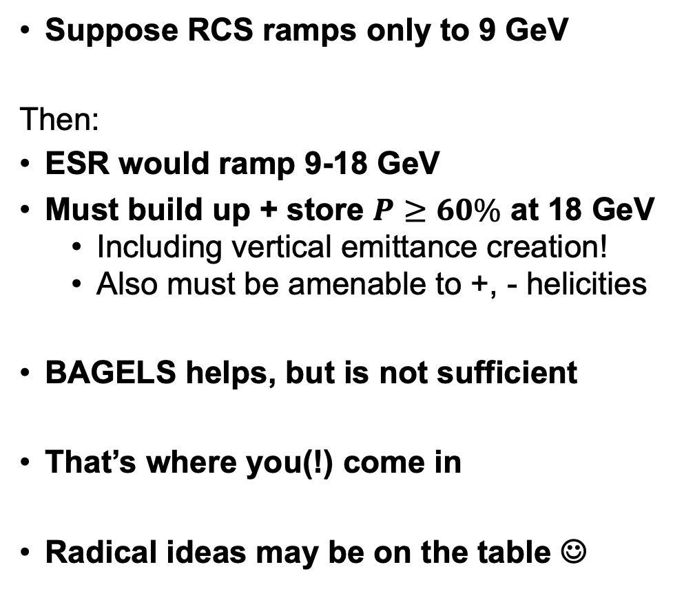
Summary
Suppose RCS ramps only to 9 GeV
Then:
ESR would ramp 9-18 GeV
Must build up + store $P$ $≥60\%$ at 18 GeV
Including vertical emittance creation!
Also must be amenable to +, - helicities
BAGELS helps, but is not sufficient
That’s where you(!) come in
Radical ideas may be on the table ☺
Rapid Cycling Synchrotron (RCS)
IP6
Move the RCS into the AGS tunnel

