Slide 1
Particle Accelerators:
What they are, how do they work and why are they important to us
Wolfram Fischer
Deputy Associate Lab Director for Accelerators, Nuclear and Particle Physics
Chair, Collider-Accelerator Department
22 June 2022
Notes:
~15-20 slides only per instruction, undergraduate level, senior year, mostly physics

Slide 2
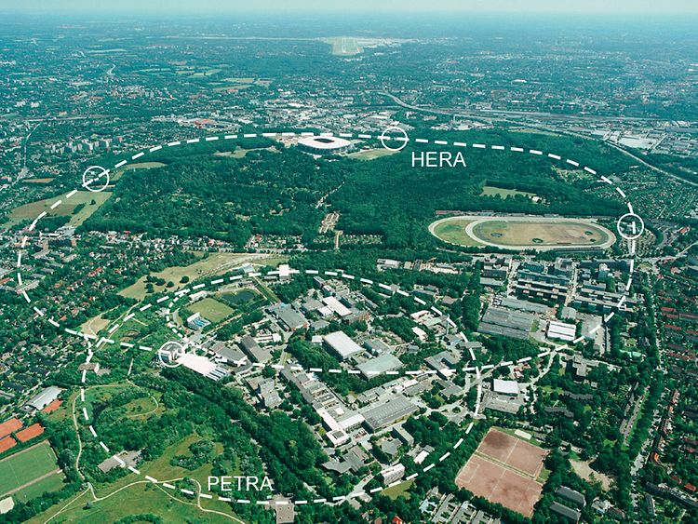
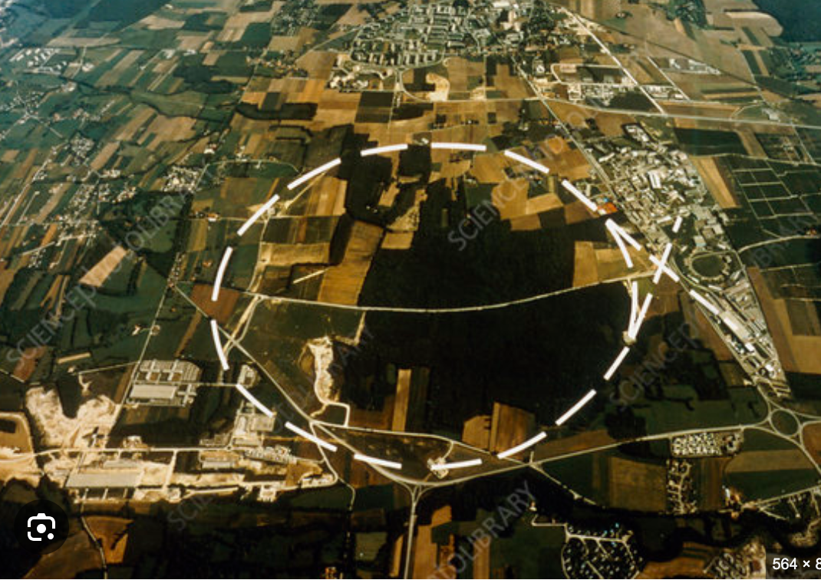
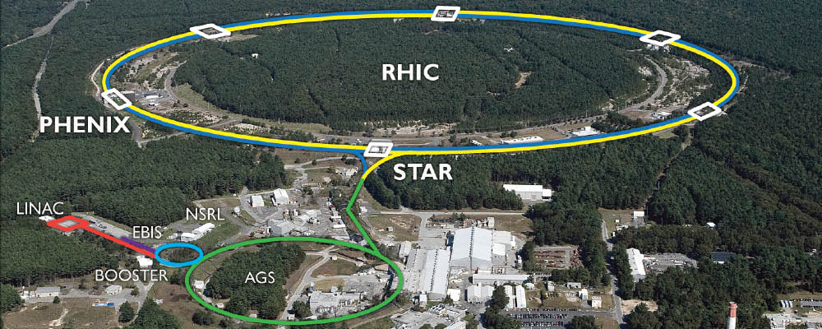
How did I get into accelerators?
DESY, Hamburg
Germany
CERN, Geneva
Switzerland/France
BNL, Upton
USA
Grew up in Germany
Studied physics (U Leipzig)
Summer student at DESY
Master thesis at DESY
PhD student U Hamburg
Work at CERN – SPS
Work at DESY – HERA
Joined BNL as post-doc
Work on RHIC and injectors
Now shift to EIC

Slide 3
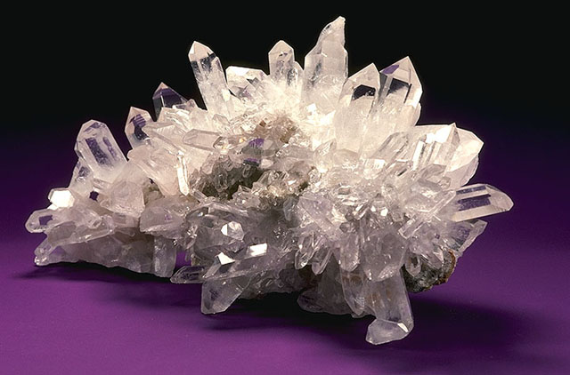
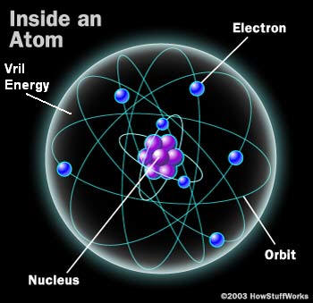
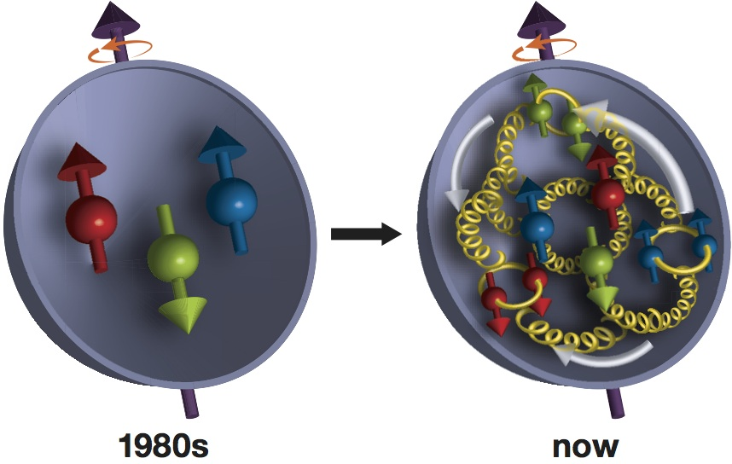
Proton
The matter we know is only 5% of
all matter/energy in the universe.
Notes:
Crystal: from Wikipedia
Atom: http://vrilology.org/gods_dwell_within_us______ev1.htm
Proton: https://phys.org/news/2016-02-physicists-gluons-contribution-proton.html

Slide 4
Problem:
Have a sack and want to know what’s inside.
Not allowed to open
Shoot projectile
into sack

Slide 5
Possible outcome 1:
Absorbed
Projectile
=> Increase energy

Slide 6
Possible outcome 2:
Goes through
Projectile
=> Inside soft,
Little resistance

Slide 7
Possible outcome 3:
Projectiles deflected
Projectile
=> Inside hard,
Changes projectile path

Slide 8
Possible outcome 4:
Projectiles deflected
by large angle
Projectile
=> Inside really hard
in some locations

Slide 9
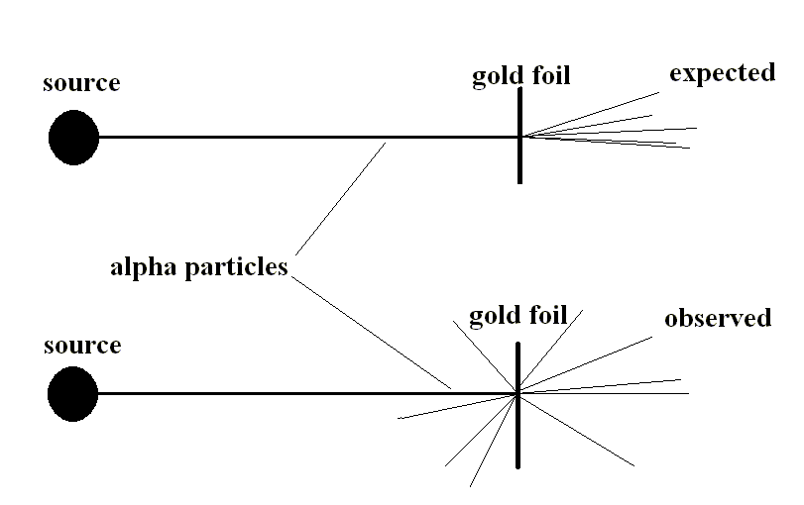
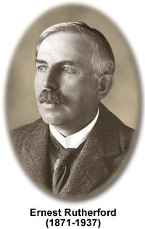
The Quest for High Luminosity in Hadron Colliders
Early accelerator – radioactive material
radioactive
radioactive
Geiger, Marsden, Rutherford 1909

Slide 10
Accelerators for nuclear and high-energy physics
How can we increase the collision energy?
How can we increase the number of collisions?

Slide 11
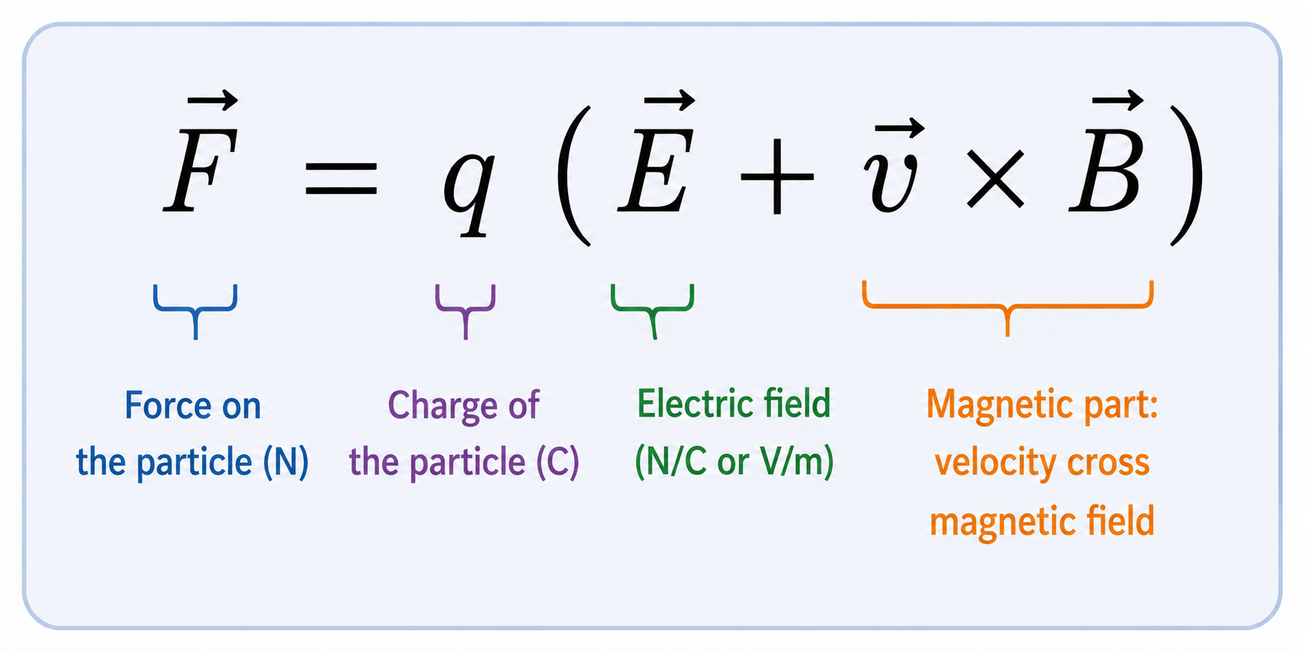
Accelerators use charged particles
Electrons, protons, ions
Forces on charged particles
change
of direction
(bending &
focusing)
energy
gain
Notes:
Graphic made with ChatGPT

Slide 12
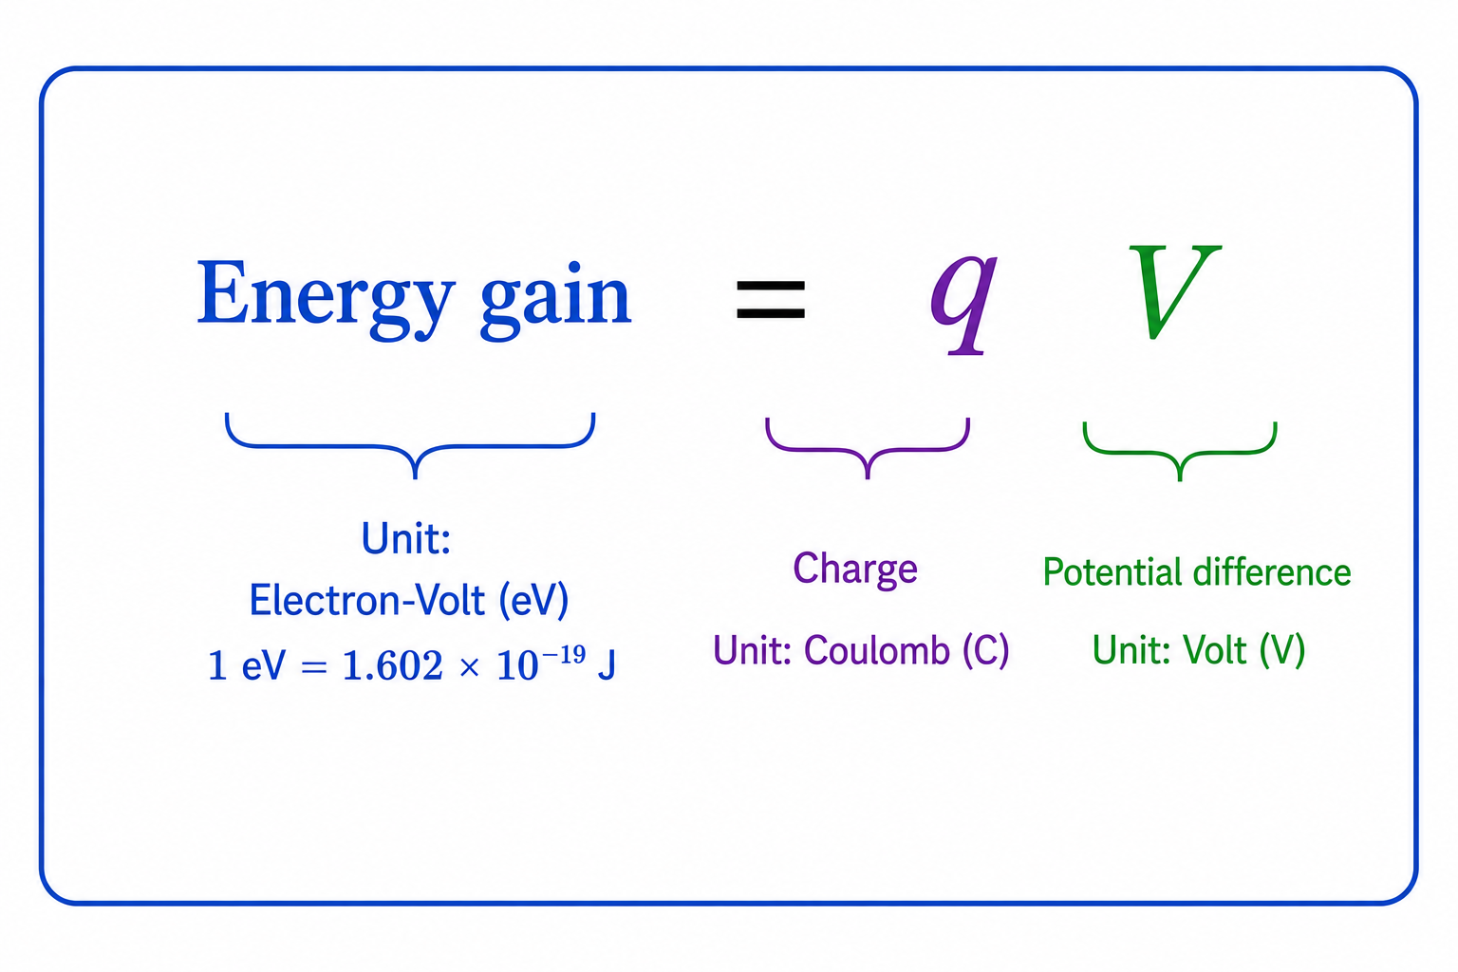
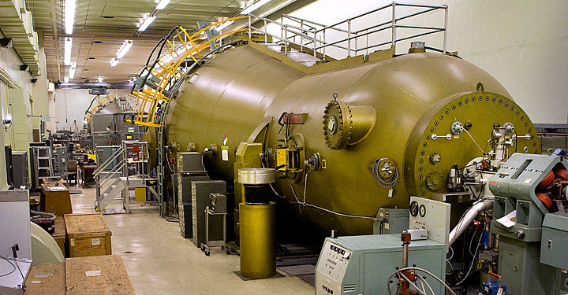
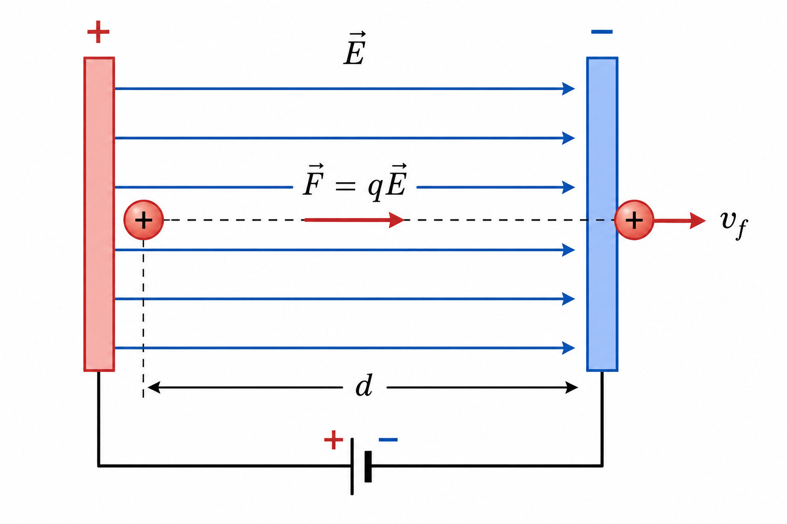
Acceleration with voltage
BNL Tandem Accelerator – 16 MV
One of the highest voltage operating in the world (~JAEA, ~ANU)
Open to the public on 2 August 2026
What is the voltage/energy limit?
Notes:
Graphic made with ChatGPT

Slide 13
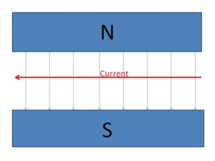
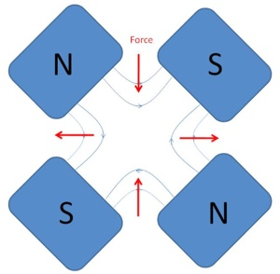
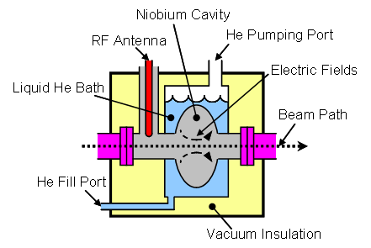
How to build a circular accelerator
1. Bend particles
onto circular path
=> dipole magnet
Force
2. Focus particles
(like light) to keep
them together
=> quadrupole magnet
3. Accelerate particles
to give them more energy
(will not become faster than light)
=> radio-frequency cavities

Slide 14
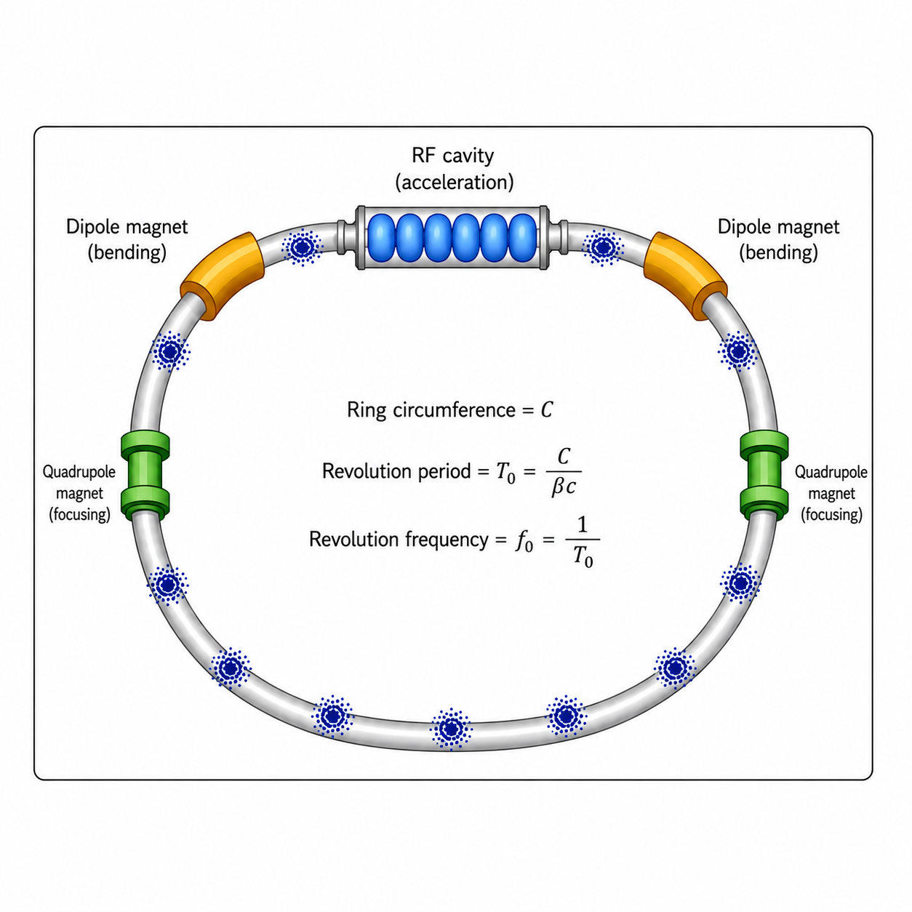
RF cavities create bunched beams
Notes:
Graphic by ChatGPT

Slide 15
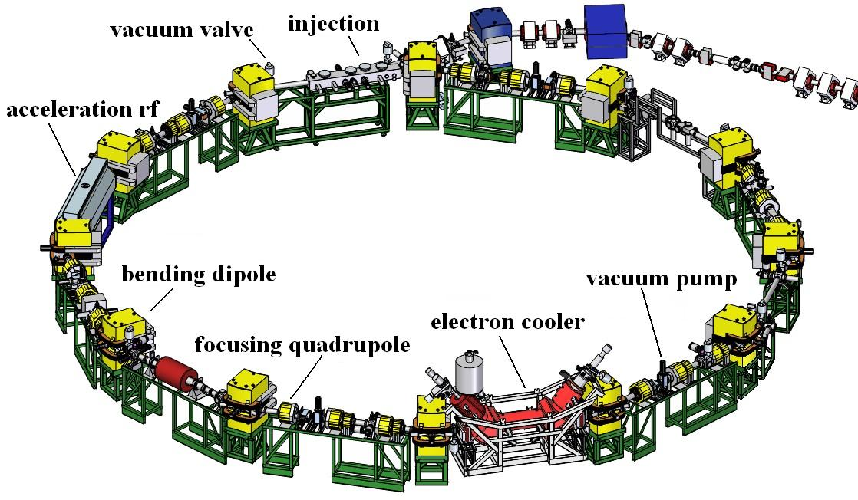
Small accelerator: CRYRING
(Uppsala, Sweden, 1992-2009; now at GSI, Germany)

Slide 16
The Quest for High Luminosity in Hadron Colliders
How can we increase the collision energy?
Center-of-Mass Energy E_{cm}
Fixed target
Collider
m, at rest
m, E
m, E
m, E
E_{cm} ≈ √2 E mc²
E_{cm} = 2E
2000 TeV p on p at rest 1 TeV p on 1 TeV p

Slide 17
The Quest for High Luminosity in Hadron Colliders
Event rate of colliders is much lower than
event rate of fixed target experiments
Fixed target
Collider
solid Au target
projectile
beam
projectile
beam
Au⁷⁹⁺ target
beam
target density
ρ ≈ 5×10²⁸ nuclei/m³
target density
ρ ≈ 10¹⁶ nuclei/m³
Density of a beam target is many orders of
magnitude lower than density of a fixed target

Slide 18
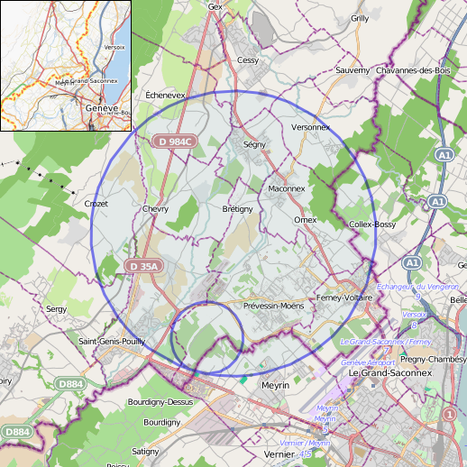
Why do colliders get so large?
Energy ~ magnetic dipole field strength
Energy ~ circumference
Highest energy collider LHC
(CERN, Switzerland/France) has
Highest dipoles bending field: 8.3 T
Largest circumference: 27 km

Slide 19
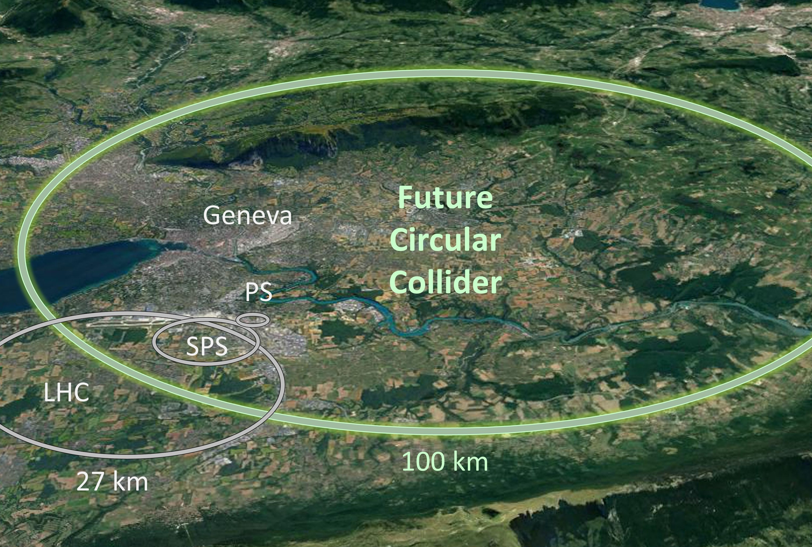
Why do colliders get so large?
Plans for
Future Circular Collider
at CERN:
~100 km circumference

Slide 20
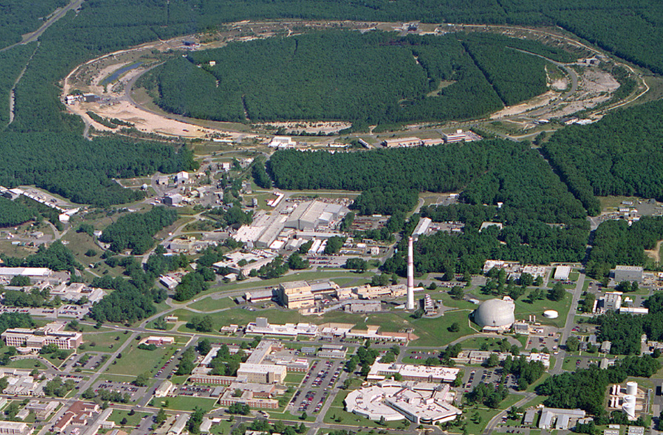
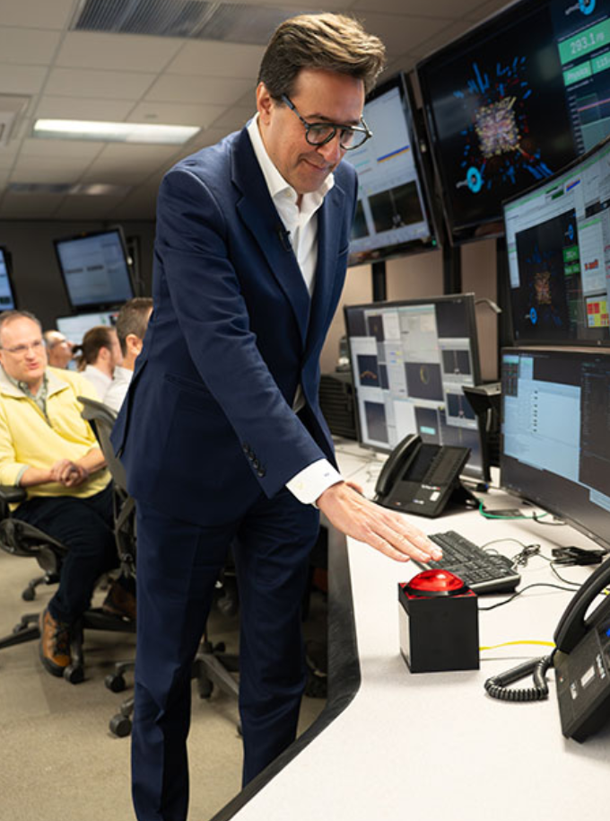
Relativistic Heavy Ion Collider – main parameters
Polarized Jet Target
(PHOBOS)
Electron lenses
RHIC
(BRAHMS)
Electron cooling
(s)PHENIX
RF
STAR
Collisions : 12 Jun 2000 – 6 Feb 2026
Circumference : 3.8 km
Max dipole field : 3.5 T
Energy : 255 GeV polarized p
: 100 GeV/nucleon Au
Species : ph to U (incl. asymmetric)
Experiments : BRAHMS, PHOBOS, pp2pp, AnDY,
RHICf, PHENIX, STAR, sPHENIX
LINAC
NSRL
EBIS
Booster
BLIP
AGS
TPL
Tandems
DOE Under Secretary for Science
Dario Gil ending last RHIC store
(oxygen-oxygen)

Slide 21
The Quest for High Luminosity in Hadron Colliders
How do we increase the number of collisions?
no of bunches
particles per bunch
rms beam size,
shrinks with √γ
f₀ – revolution frequency (constant for given machine)

Slide 22
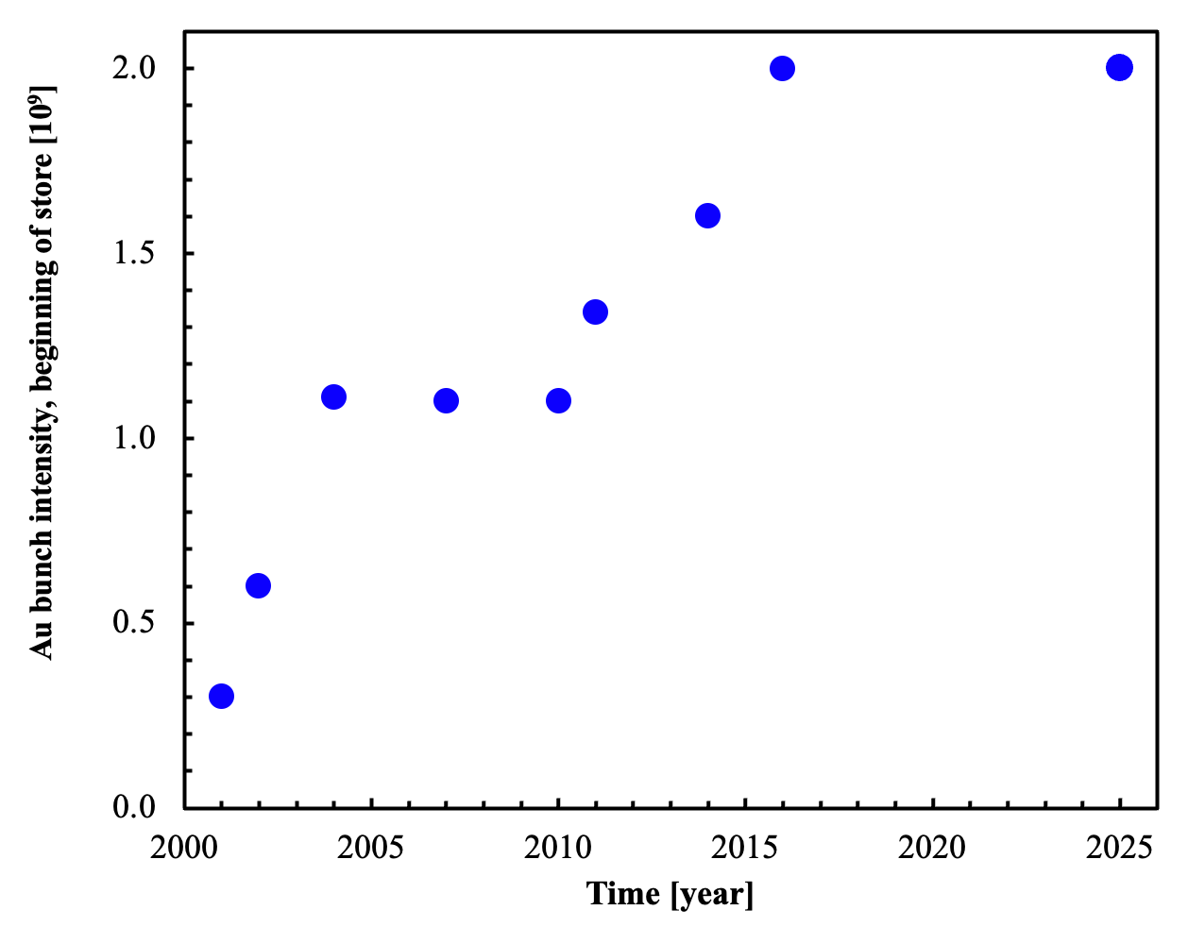
Au bunch intensity evolution
γ_{t}-jump, octupoles at transition
111 bunches
scrubbing with protons
43 bunches
EBIS, Booster 4g2g1, AGS 8g4g2 merge
AGS 12g6g2 merge
Conclusion of RHIC Run-25
main limits:
- injectors output
- e-cloud in RHIC
- transition instability
in RHIC

Slide 23
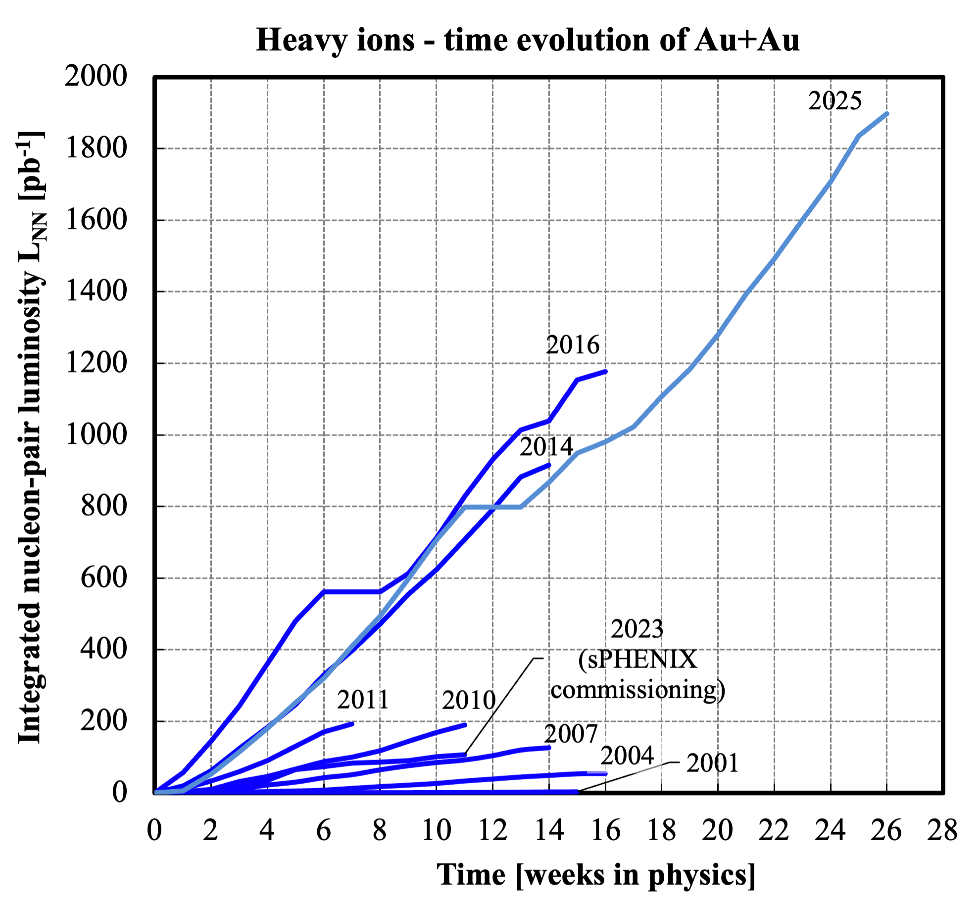
RHIC Au+Au operation at full energy
Effect of stochastic cooling + bunch intensity increase
Au-Au luminosity (store avg) reached 44x design
Could be done in ~1/2 day
at end of RHIC (~200x faster)

Slide 24
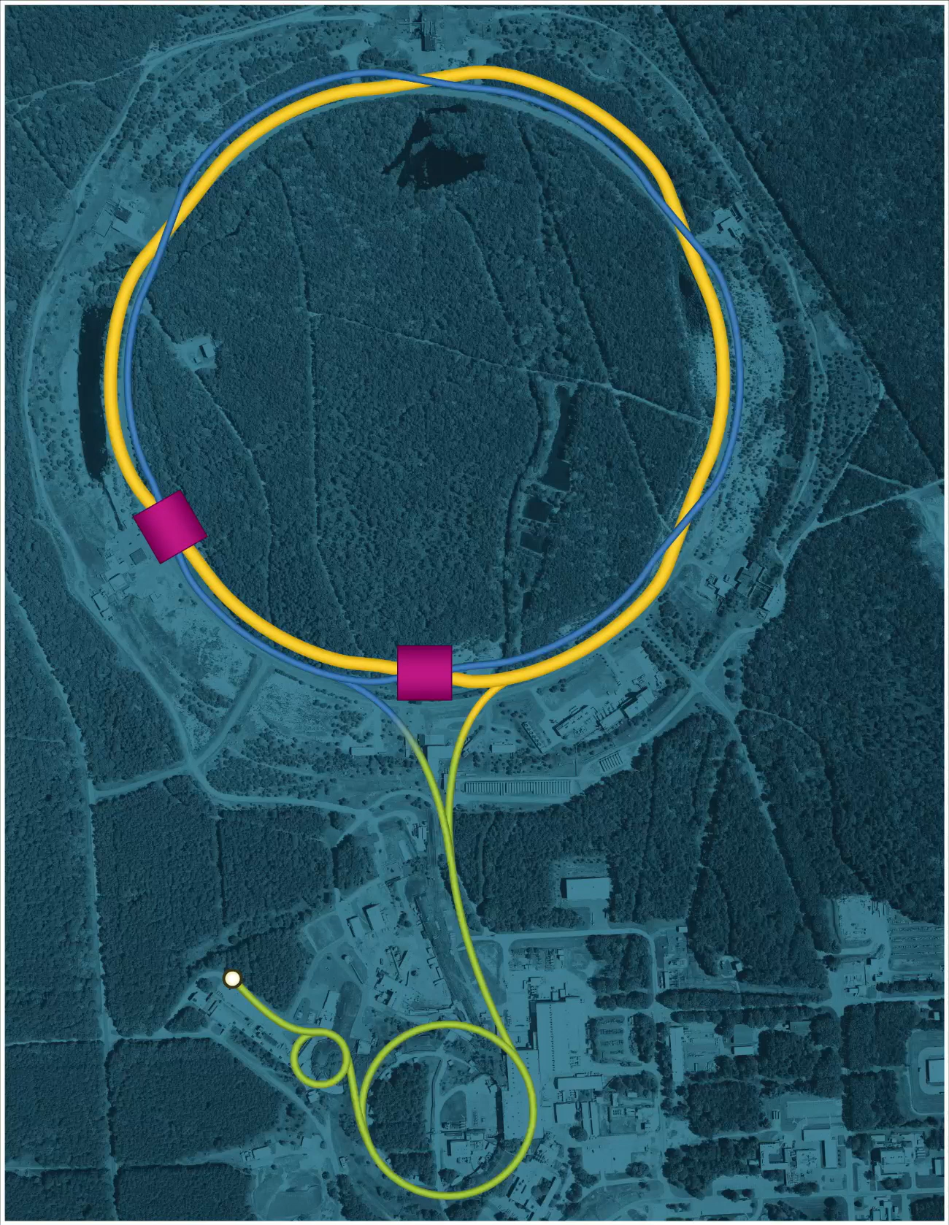
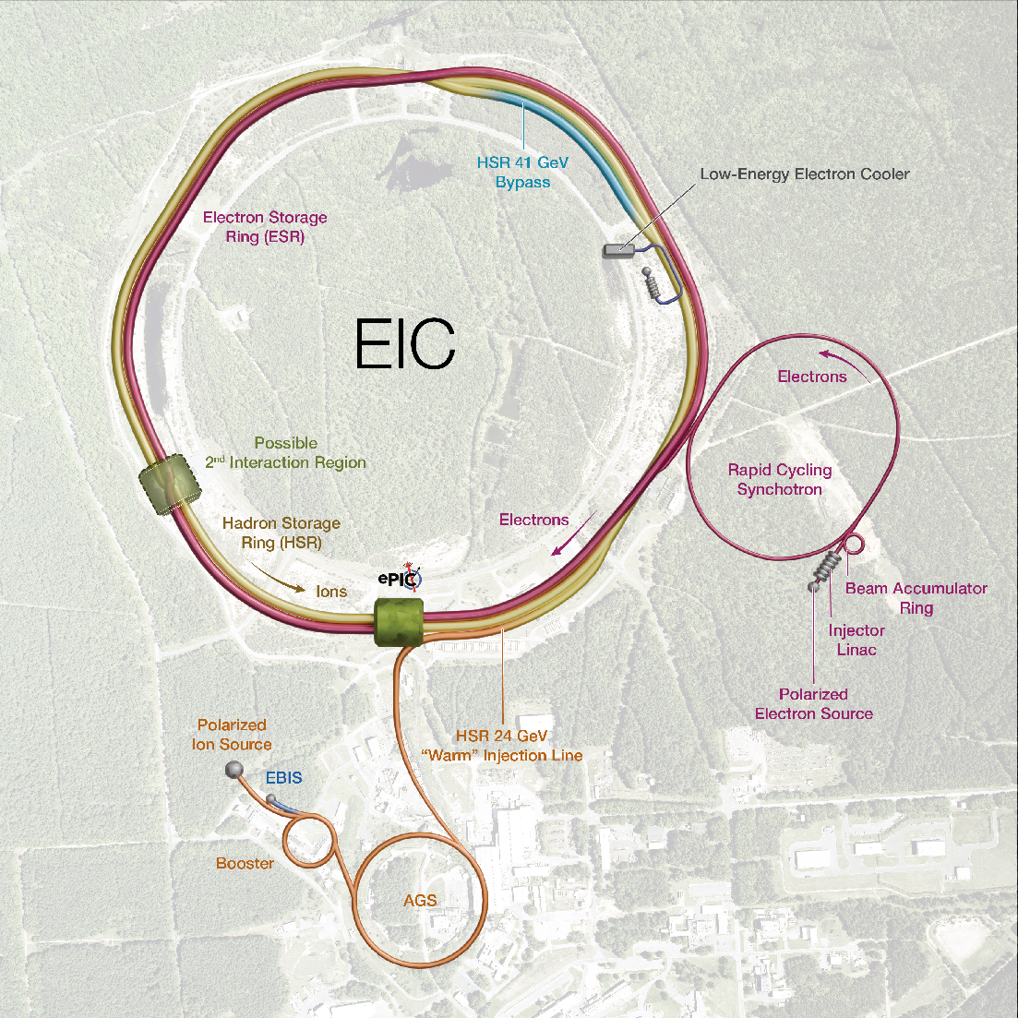
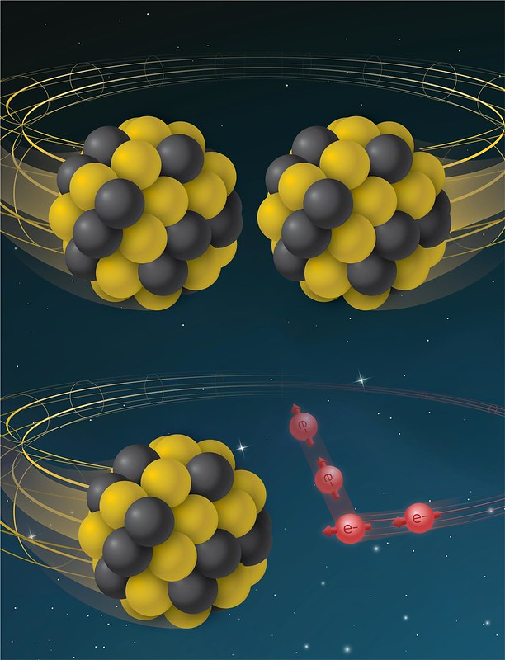
From RHIC to EIC
[Sergei Nagaitsev, EIC Technical Director, NAPAC’25]
RHIC
RHIC
Ion species:
proton – Uranium
60% p polarization
EIC
Protons: ~40 – 275 GeV
Electrons: 5 – 18 GeV

Slide 25
Accelerators applications research and everyday life
Synchrotron light sources (BNL NSLS-II, …)
Drivers for spallation neutron sources (LANL, ORNL SNS, …)
Isotope production (BNL BLIP)
Space radiation testing (BNL NSRL)
Ion implantation (BNL Tandem)
Cancer treatment
Sterilization
…

Slide 26
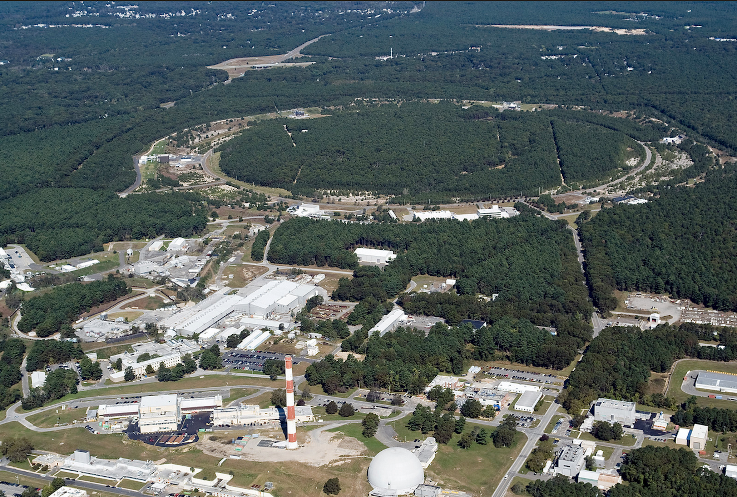
Particle accelerators
Invented to probe matter
Particle beams
  Electric fields accelerate
  Magnetic fields bend and focus
Colliders increase the collision energy over fixed targets
Accelerators now have many other applications

Slide 28
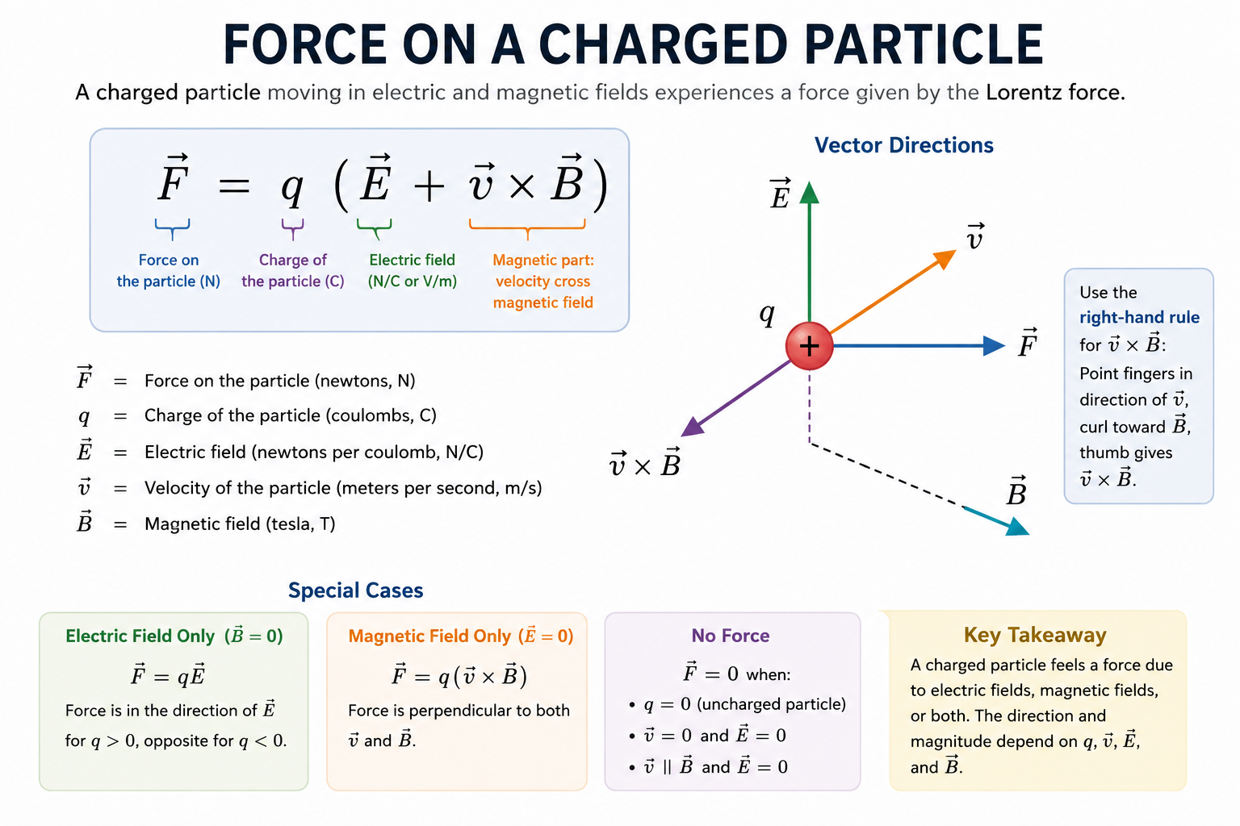
Notes:
ChatGPT

Slide 29

Relativistic Heavy Ion Collider
New York City

Slide 30
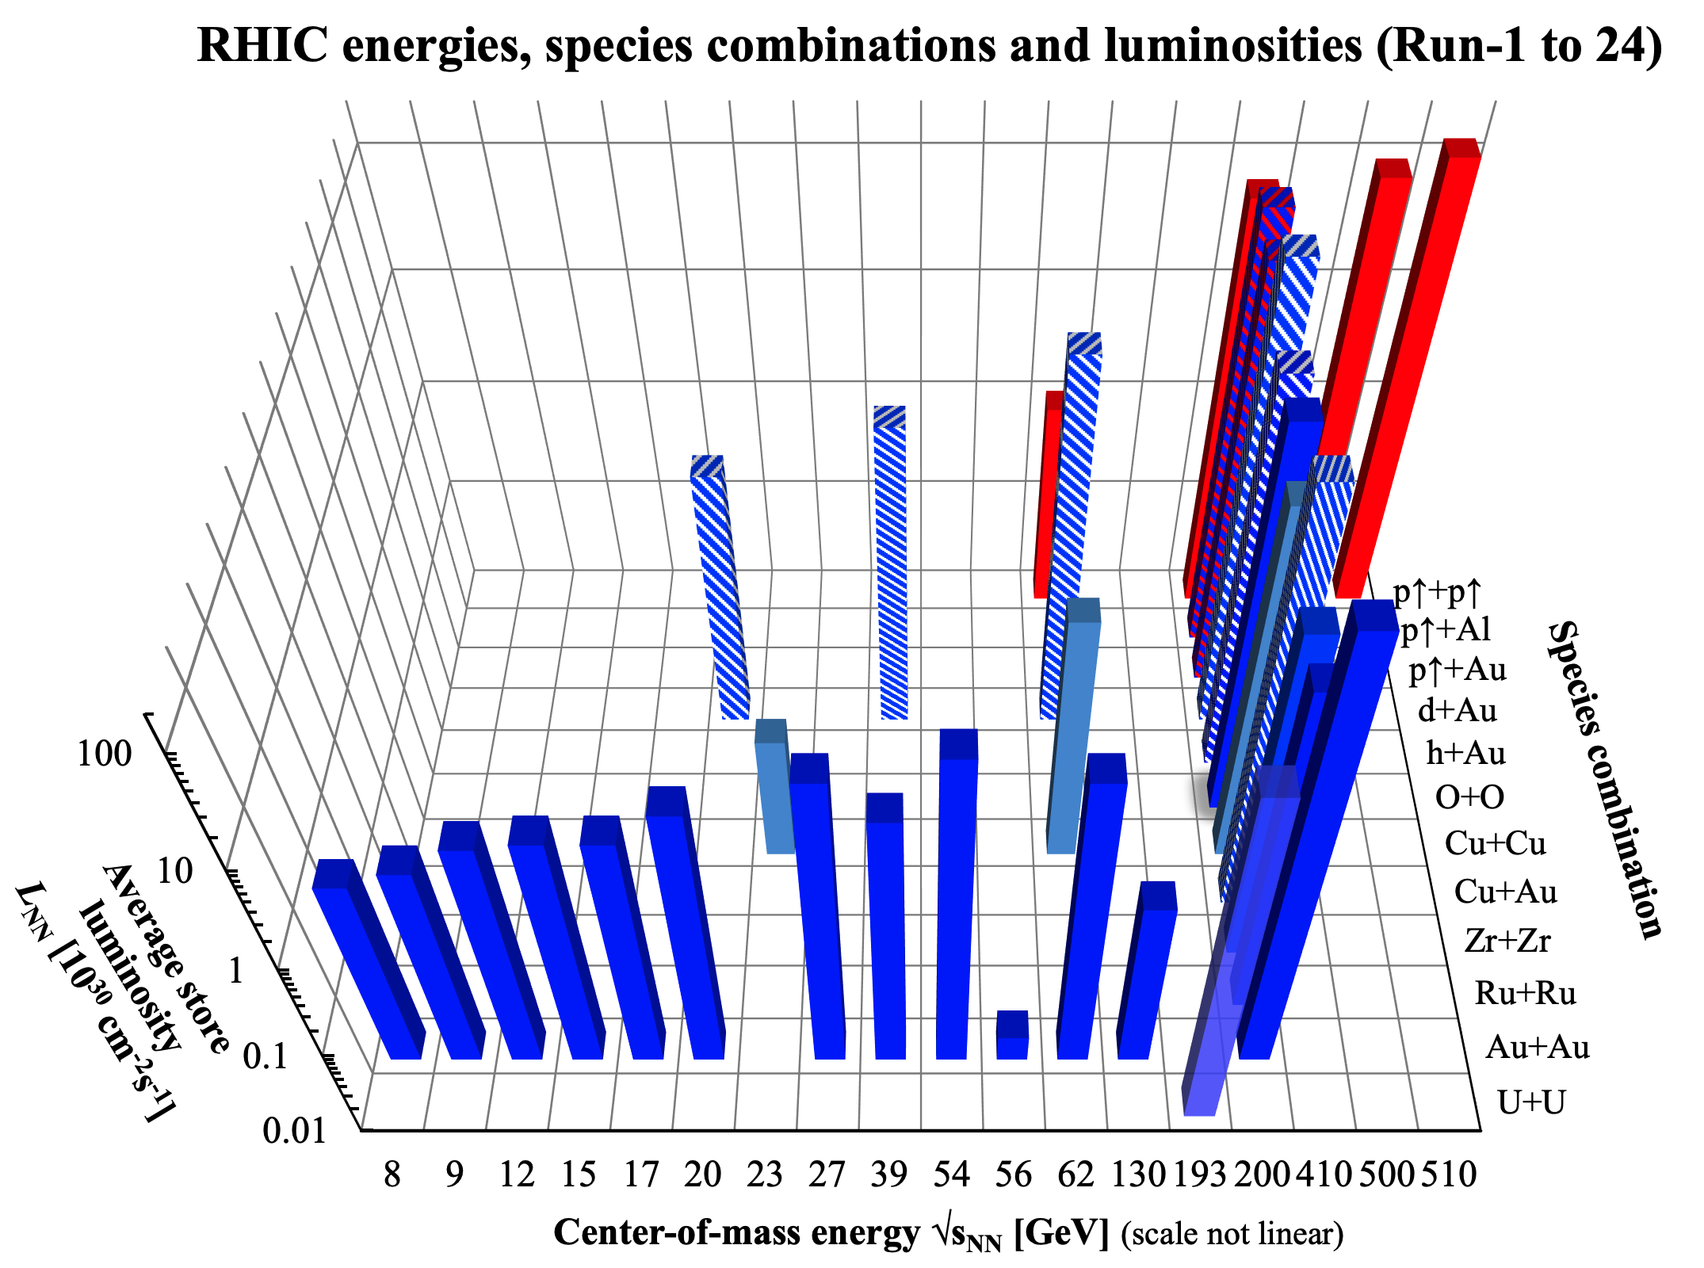
Used stochastic or
electron cooling in
1 or 2 beams
L design
L design
nominal injection

