Slide 1





Creating the smallest fluid in the universe with a single photon
Blair Seidlitz
Columbia University
Thesis work at University of Colorado Boulder
Sambamurti Lecture July 30th , 2026

Slide 2
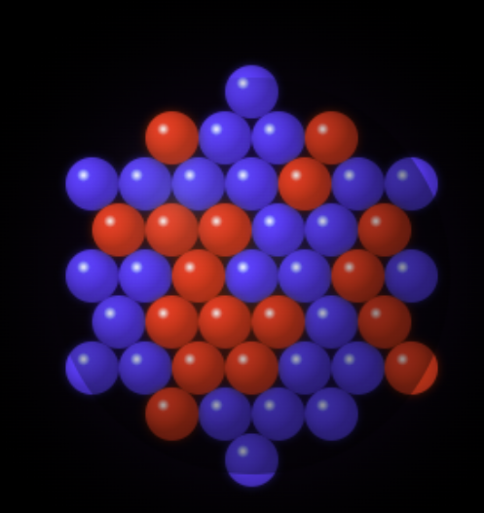
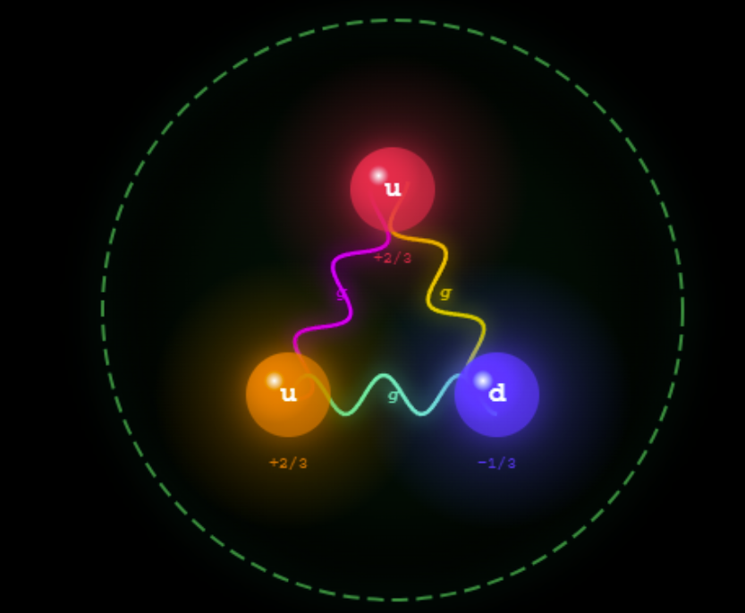
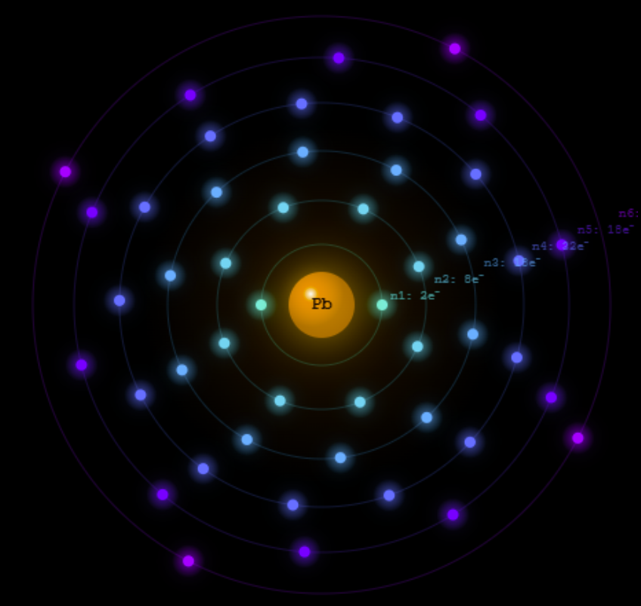
Pb atom
Pb nucleus
Proton
Quarks (q)
Gluon (g)
Contains electrons and a nucleus
Contains nucleons (protons and neutrons)
Contains quarks and gluons
Quark content dictates whether it’s a proton, neutron or other hadron
Gluons are the glue which binds the quarks together

Slide 3
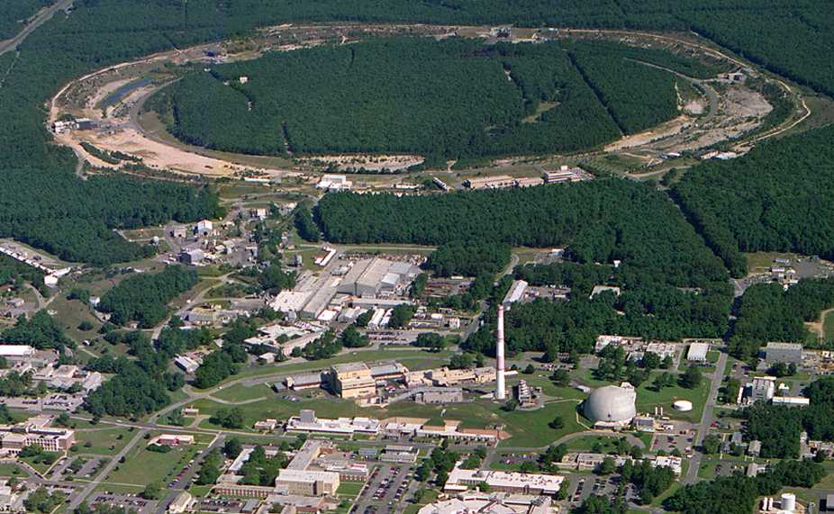
1 km
PHOBOS
BRAHMS
RHIC
sPHENIX
STAR
v = 0.99995⋅c = 186,000 miles/sec
AGS
TANDEMS
3
2
Notes:
https://www.flickr.com/photos/brookhavenlab/sets/72157613690851651/

Slide 4
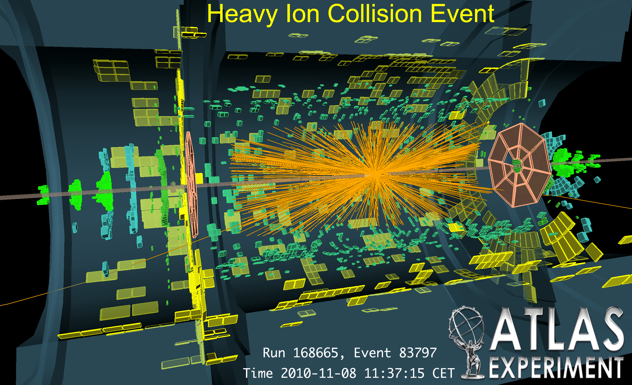

Slide 5
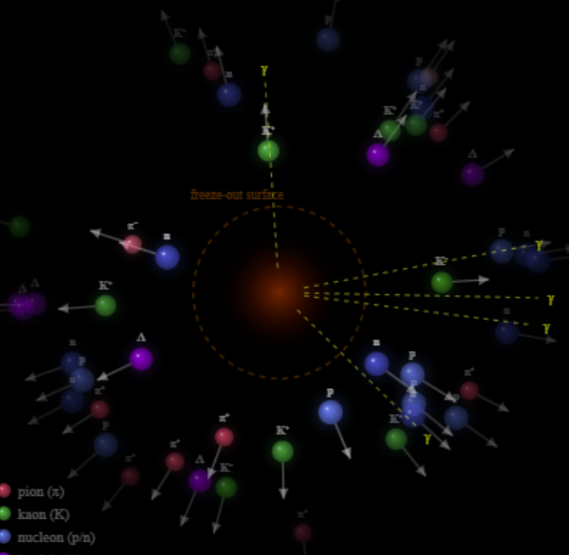
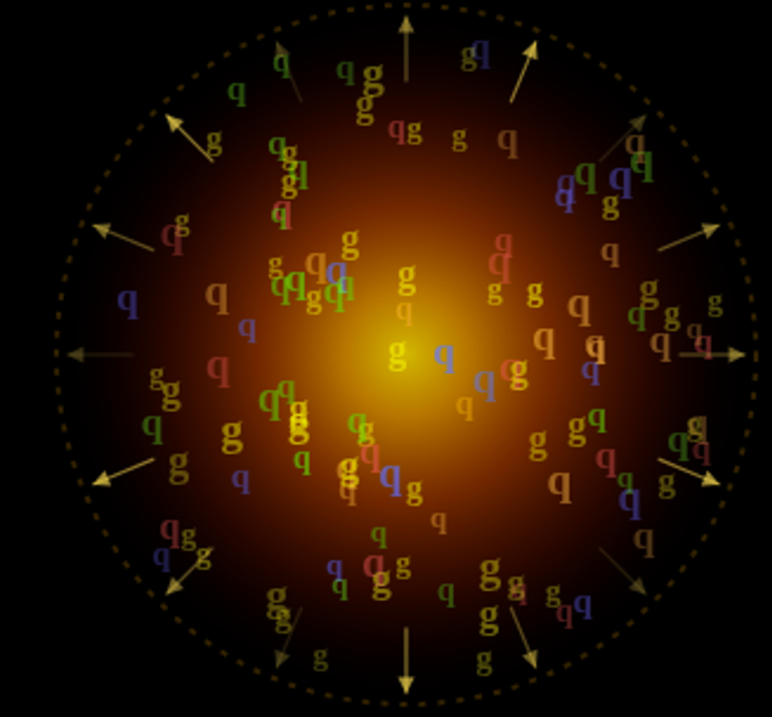
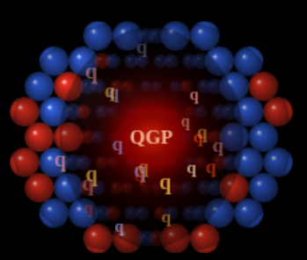



Reaches the critical temperature and forms back into hadrons like protons
Quark gluon plasma (QGP) expands and cools
Collision!
Nucleons melt into
quarks and gluons
1 x 10⁻²³ seconds
5 x 10¹²${}^{∘}C$

Slide 6
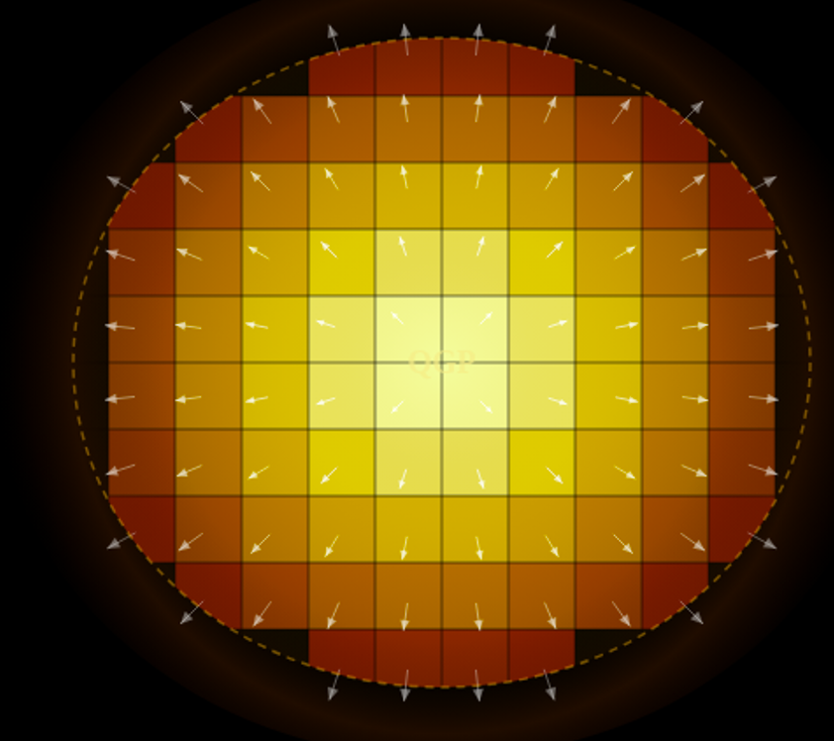
The QGP expands like a fluid!
A fluid flows and equalizes internally — fast
  particles interact so frequently that local temperature & pressure are fully descriptive
Not all matter is a fluid — it depends on how often particles collide
  few interactions → non-interacting gas
  many interactions → liquid
The same math that describes ocean currents describes the QGP
A fluid cell has,
a pressure, temperature and velocity.

Slide 7
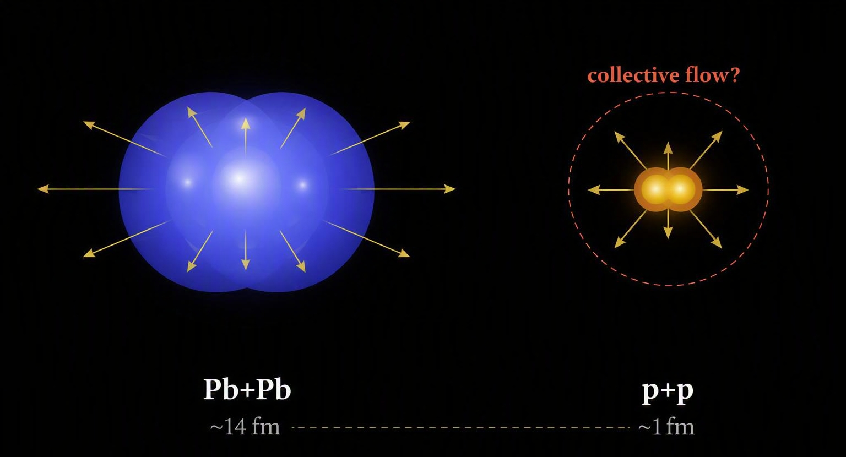
Do small systems flow?
Large systems (Pb+Pb) clearly form QGP and flow collectively
Small systems are a stress test of everything we think we know
If hydro works here, why? If it doesn't, where does it break?

Slide 8
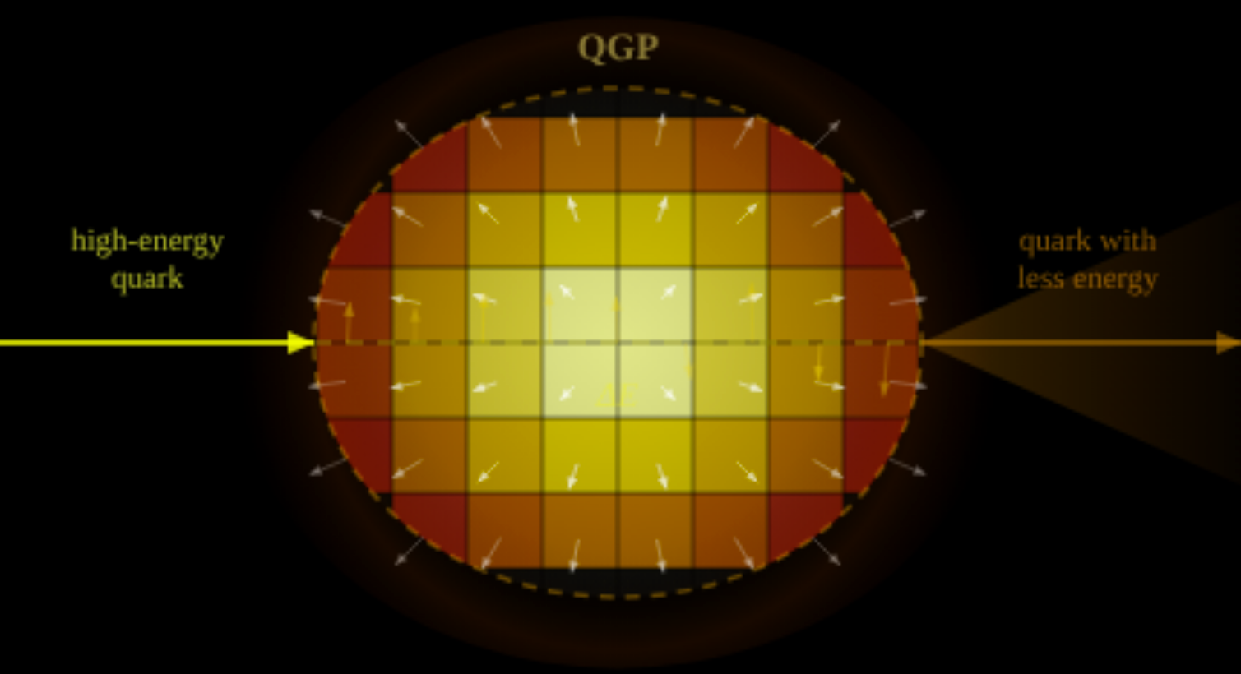
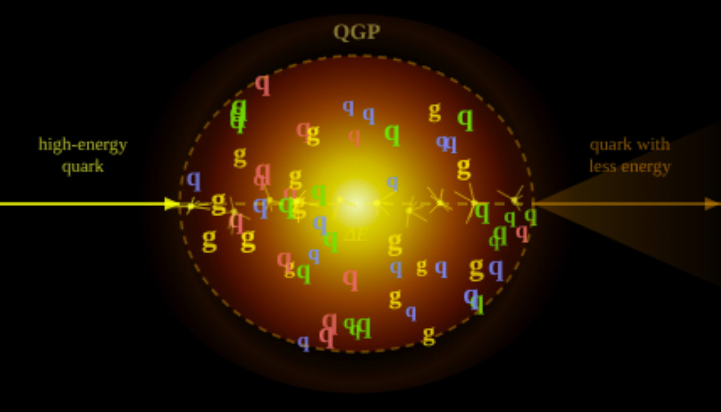
Probing the QGP with high energy quarks
High-energy quarks lose energy traversing the QGP
Fluid picture
Like a bullet through water, they smoothly lose energy
Particle picture
Loses energy in discrete collisions with the quarks/gluons of the QGP

Slide 9
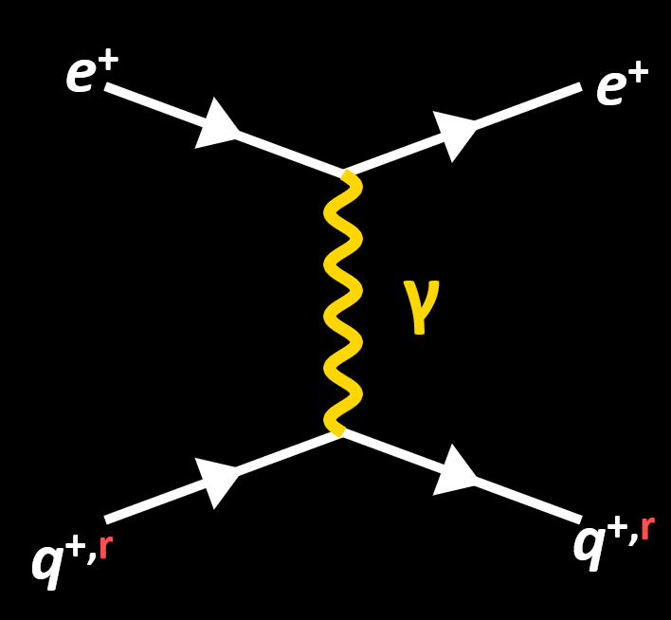
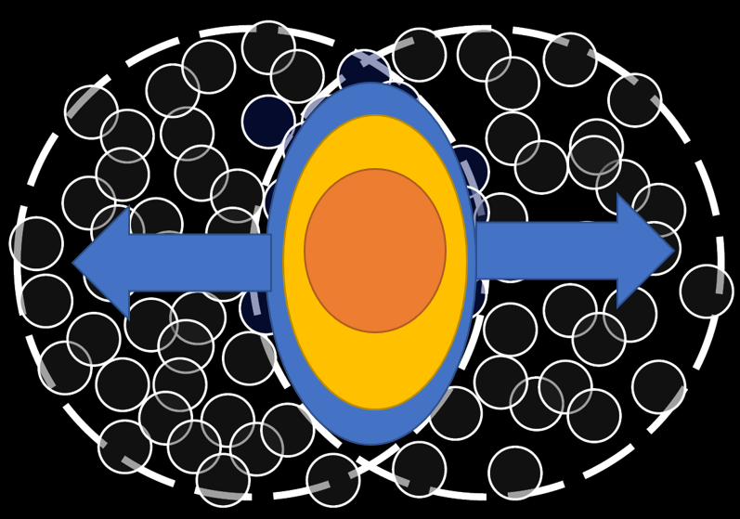
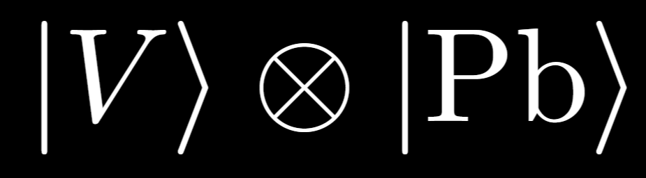
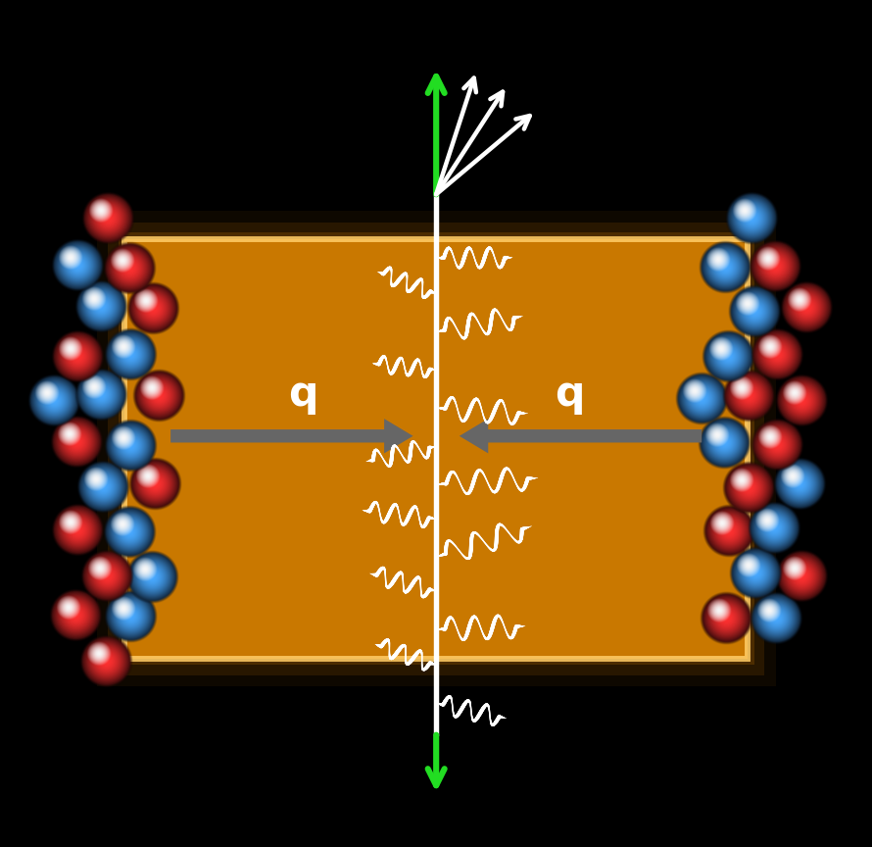
Today’s roadmap
Particle physics background
  Quarks and gluons are strongly coupled making theory challenging
Relativistic heavy ion collisions and the QGP
Photonuclear and other ultraperipheral collisions
  ATLAS measurement of photonuclear
Probing the QGP with high energy quarks
γ

Slide 10
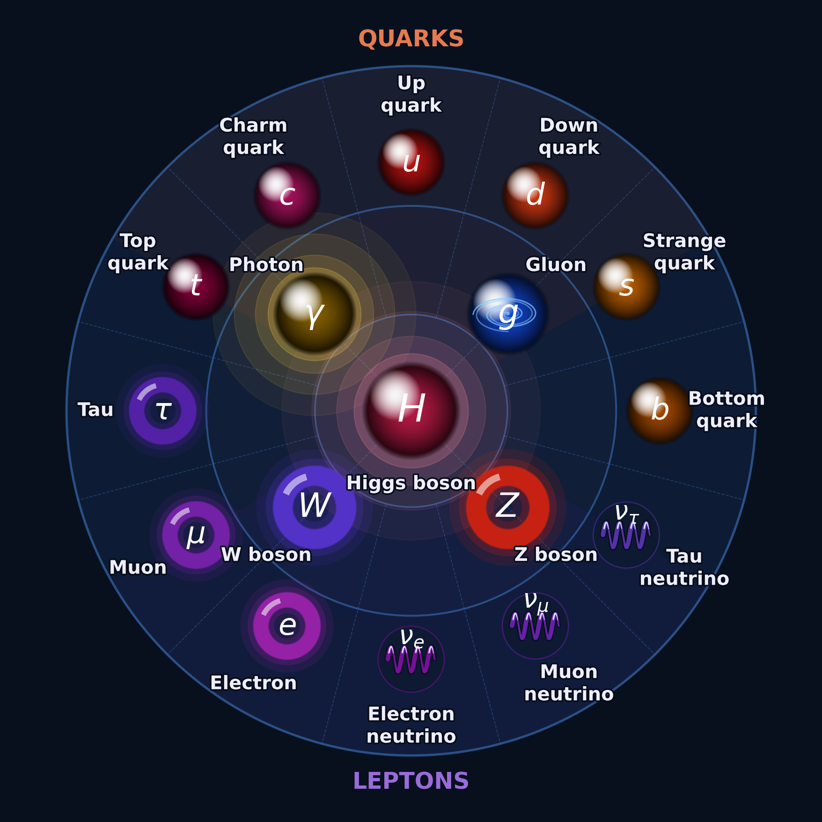
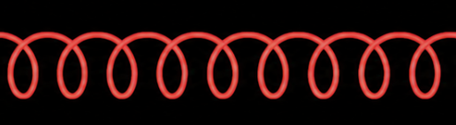
Standard model
What we need for today
e: electron
q: any quark
g: gluons
γ: photon
e⁺
q⁺
g
γ

Slide 11
Four fundamental forces
e⁺ or q⁺
e⁺ or q⁺
Electromagnetic force
  Photons and particles with electric charge
Strong nuclear force
  Gluons and quarks which both have “color” charge (red, blue, and green)
Weak force
Gravity
Interaction strength
α_{EM}
γ
q^{+,r}
q^{+,r}
g
α_{s}

Slide 12
Quantum field theory and Feynman diagrams
The most precise and straightforward tool for calculations of phenomena in the standard model and beyond
Many allowed diagrams
↓
Add amplitudes
↓
Square
↓
Probability
An interaction
Interaction must obey things like
✓ Energy conserved
✓ Momentum conserved
✓ Charge conserved
✓ Spin conserved
Incoming particles
Outgoing particles

Slide 13
Feynman Diagrams
Electromagnetic force
Strong nuclear force
e⁺
e⁺
q^{+,r}
q^{+,r}
γ
g
q^{+,r}
q^{+,r}
q^{+,r}
q^{+,r}

Slide 14
Vertex Factors & Probability
Electromagnetic force
Strong nuclear force
e⁺
e⁺
q^{+,r}
q^{+,r}
γ
g
q^{+,r}
q^{+,r}
q^{+,r}
q^{+,r}
↳ Each vertex contributes one factor of the coupling constant
↳ Each vertex contributes one factor of the coupling constant
P ∝ α² (α ≈ 1/137, so α² ≈ 5×10⁻⁵)
P ∝ αs² (αs ≈ 1 at low energy!)

Slide 15
Higher-Order Interactions (adding amplitudes)
Electromagnetic force
Strong nuclear force
e⁻
e⁻
e⁻
q
q
q
+
+…
γ
+
+…
g
q
q
q
q
q
q
∝ α_{EM}²
∝ α_{EM}⁴
∝ α_{s}²
∝ α_{s}⁴
α_{EM} ≈ 1/137 ≪ 1 → each new order is ~(1/137)× smaller → series converges!
α_{s} ≈ 1 → every order contributes equally → series does NOT converge!

Slide 16
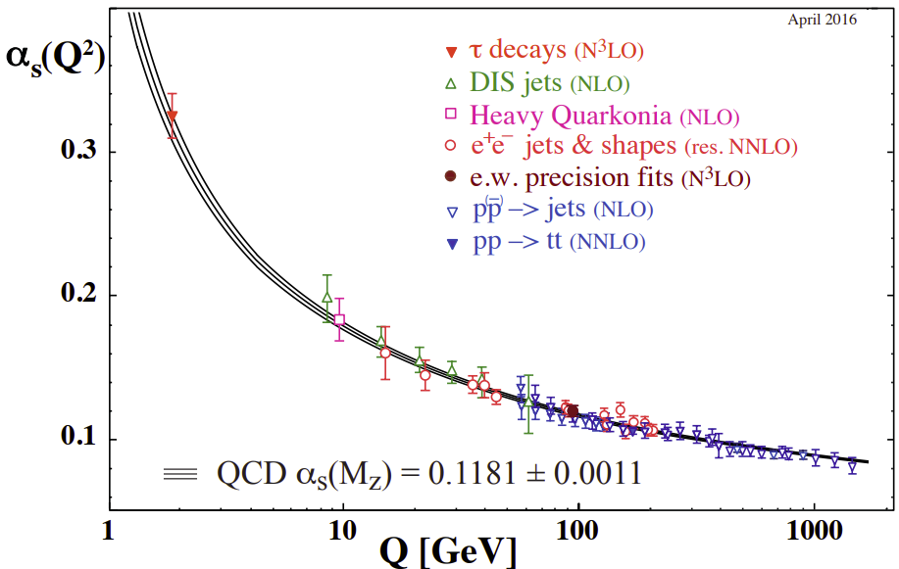
Important phenomena are challenging theoretically
At low momentum transfers α_{s} is large making perturbative calculations impossible
Strong coupling
Weak coupling
Low energy gluons in the proton
Homogeneous sea of quarks and gluons over a wide temperature range
A high energy quark shooting through this sea
Why we are building the EIC
Why we built RHIC
Why we built sPHENIX

Slide 17
Heavy ion collisions
The creation of the flowing quark gluon plasma

Slide 18
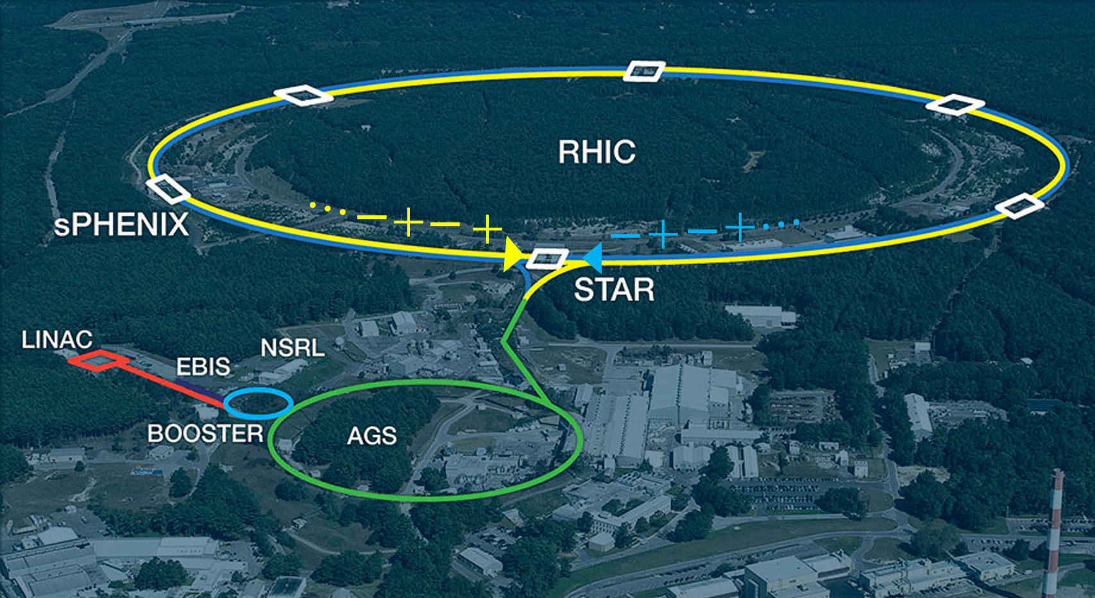
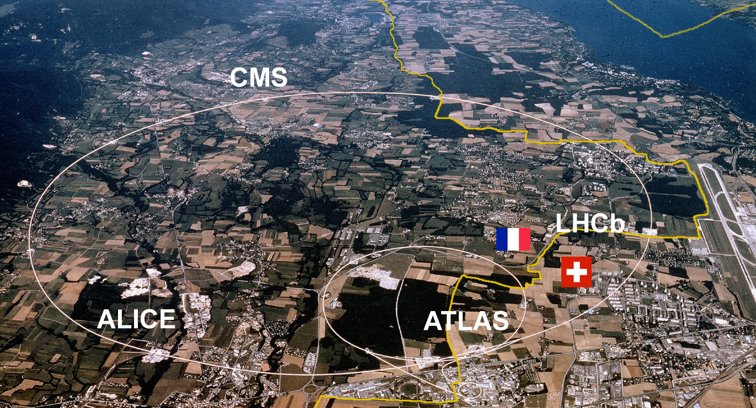

    High Energy Heavy Ion Colliders around the world
    BNL RHIC
CERN LHC

Slide 20
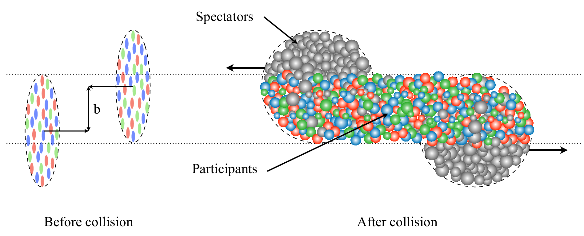


Slide 21

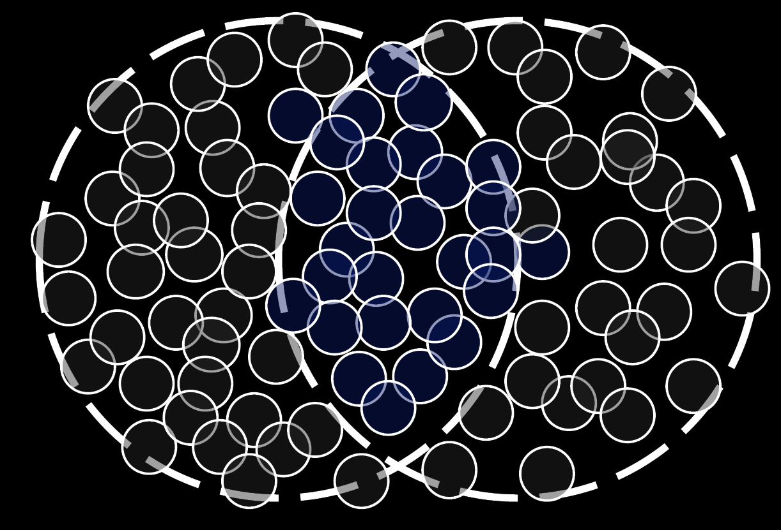
Z
X
Y

Slide 22
Spectators
Participants

Slide 23
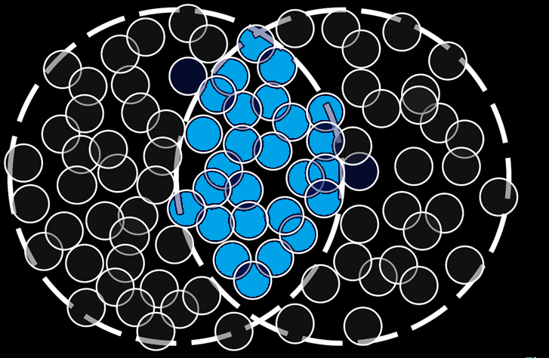
Initial state

Slide 24
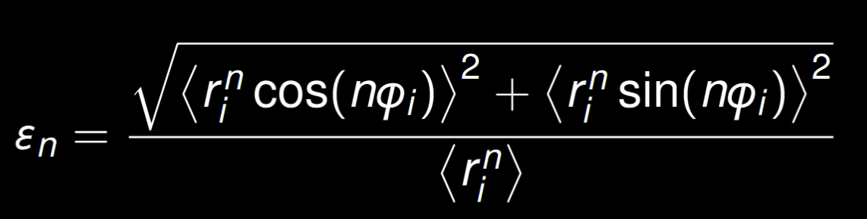
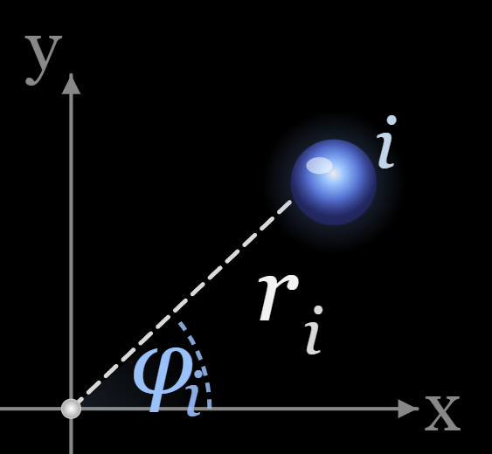

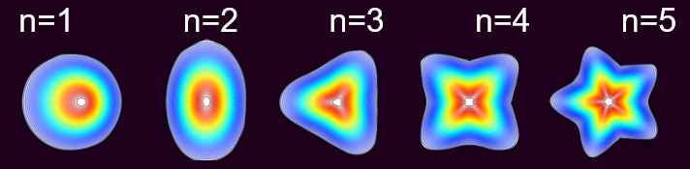
Initial state of heavy ion collisions
Parametrize spatial anisotropy
The “eccentricity”
= ε₁ + ε₂ + ε₃ +…

Slide 25
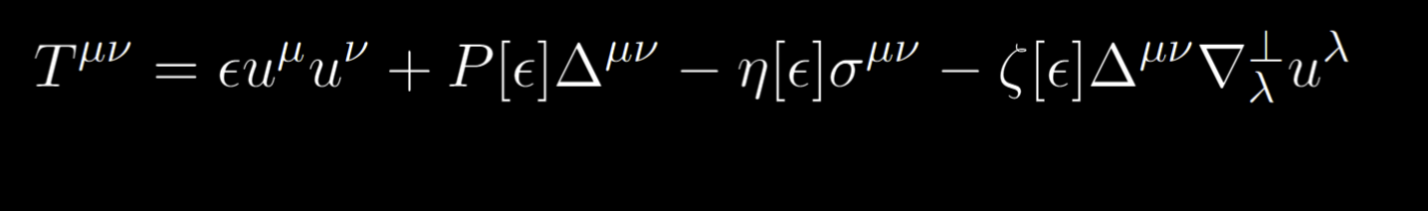
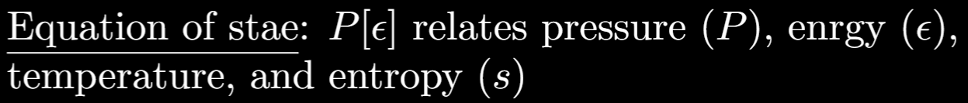
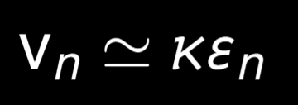
Parametrize spatial anisotropy
The “eccentricity”
Viscous Hydrodynamics
Initial state
Hydrodynamic expansion

Slide 26
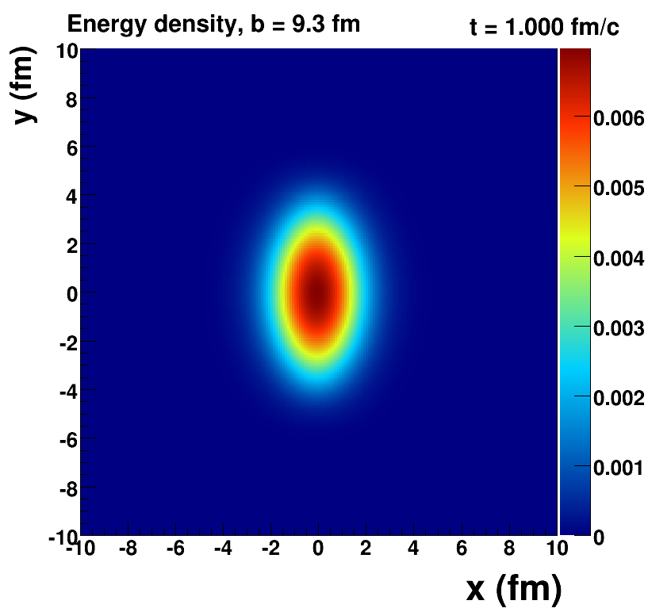
Parametrize spatial anisotropy
The “eccentricity”
Viscous Hydrodynamics
All we need for hydro
Initial conditions
Fluid properties
A fluid cell has,
a pressure, temperature and velocity (u).
P[e] & shear/bulk viscosity
u(t=0) = 0

Slide 27
Parametrize spatial anisotropy
The “eccentricity”
Viscous Hydrodynamics
Initial state
Hydrodynamic expansion

Slide 28
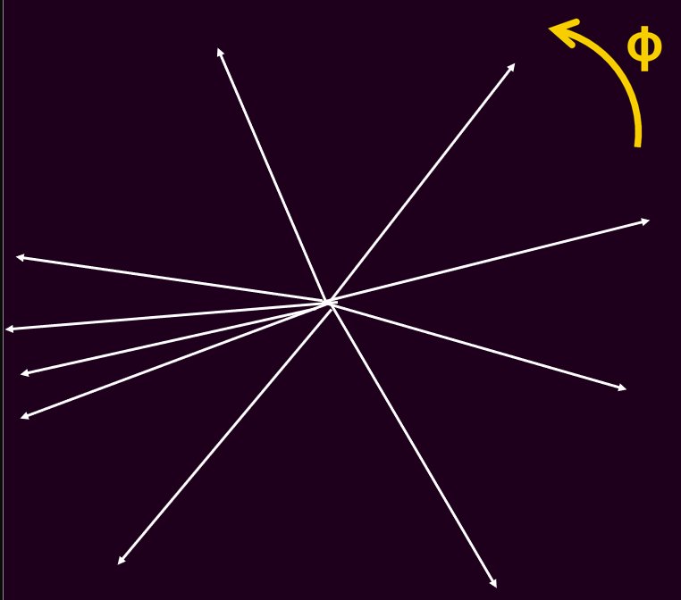
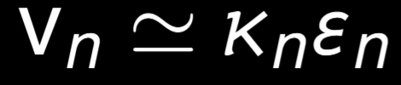
Parametrize spatial anisotropy
The “eccentricity”
Viscous Hydrodynamics
Azimuthal Momentum anisotropy
dN
α 1 + 2v₁cos(φ) + 2v₂cos(2φ) + 2v₃cos(3φ) +…
dφ
Momentum
anisotropy
Initial state
Hydrodynamic expansion

Slide 29
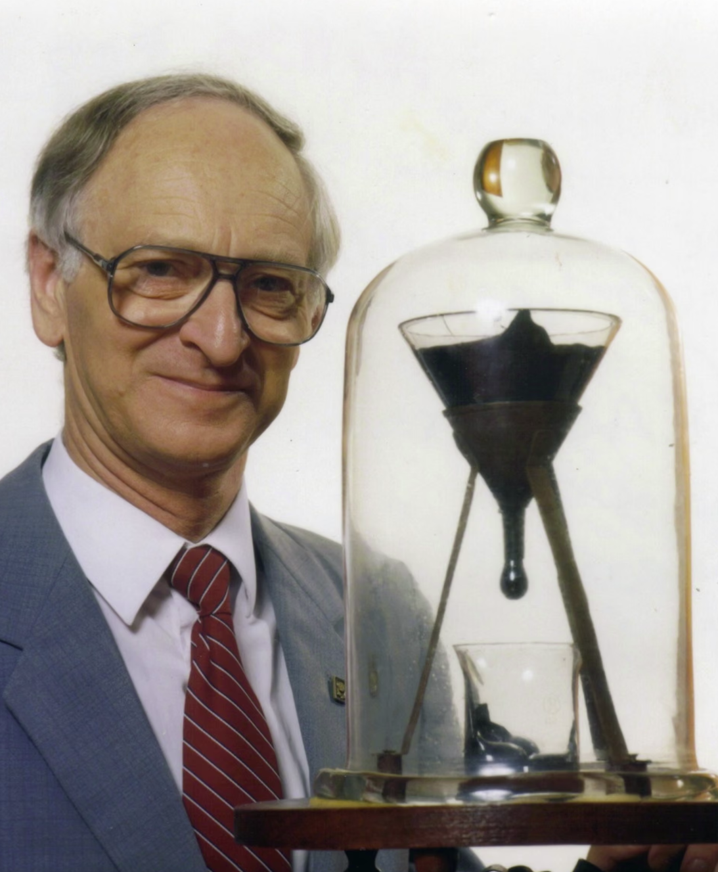
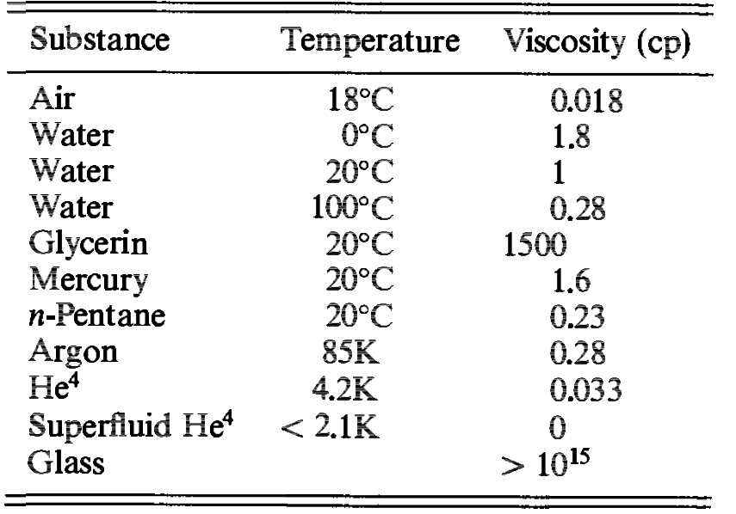
Hydro can model lots of things!
Many things can be described by hydro: water, billiard balls, glass, pitch tar, etc. That doesn’t prove we have created a QGP
World's longest-running lab experiment: Set up by Thomas Parnell in 1927
Pitch, a tar-derived resin that looks solid — is actually a fluid roughly 230 billion times more viscous than water
Only nine drops in ~95 years: Drops have fallen in 1938, 1947, 1954, 1962, 1970, 1979, 1988, 2000, and 2014

Slide 30
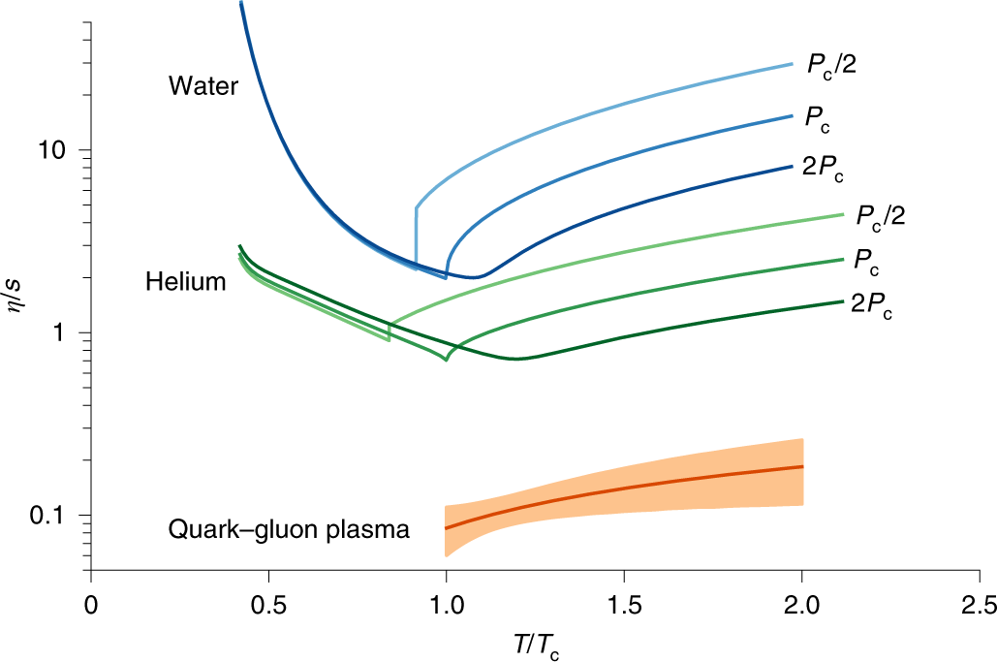
Measured QGP viscosity
Measured η/s: the smallest suitably normalized shear viscosity
  Need to divide by something like the density, s (entropy)
Measured viscosity is in line with expectations for QGP
One of the main pillars supporting confidence in creating the QGP in heavy ion collisions

Slide 31
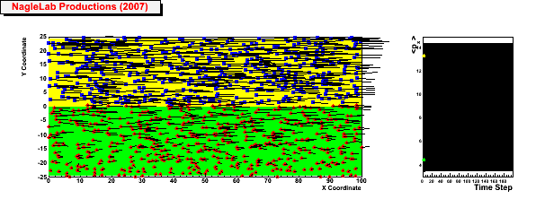
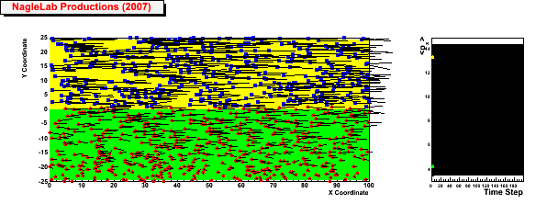
Why a low viscosity
Weak coupling = Large viscosity
Inhibited
diffusion
↓
Small
viscosity
↓
Perfect fluid
↓
Strongly Coupled QGP
<p_{x}> top region
<p_{x}> bottom region
Strong coupling = Small viscosity

Slide 32
How small a system can flow?
+…
Zeroth order hydro
Perfect fluid
First order hydro
Heavy ion collisions are large enough to be well modeled by first order hydrodynamics
The smaller the system, the larger the corrections at first order, second order, …
Does the series converge?
This is the fundamental question of small systems

Slide 33
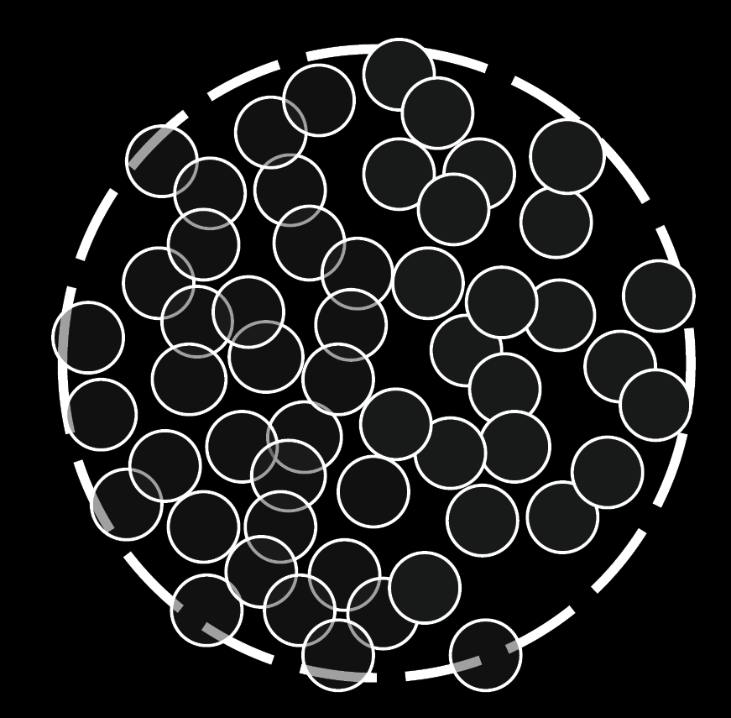
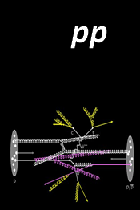
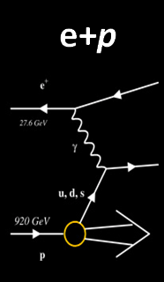
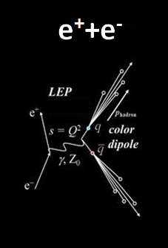
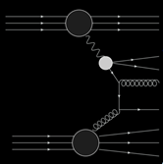
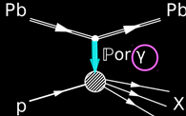
System size
Pb+Pb
p+Pb
γ+p
γ+A

Slide 34
Ultra-peripheral collisions

Slide 35
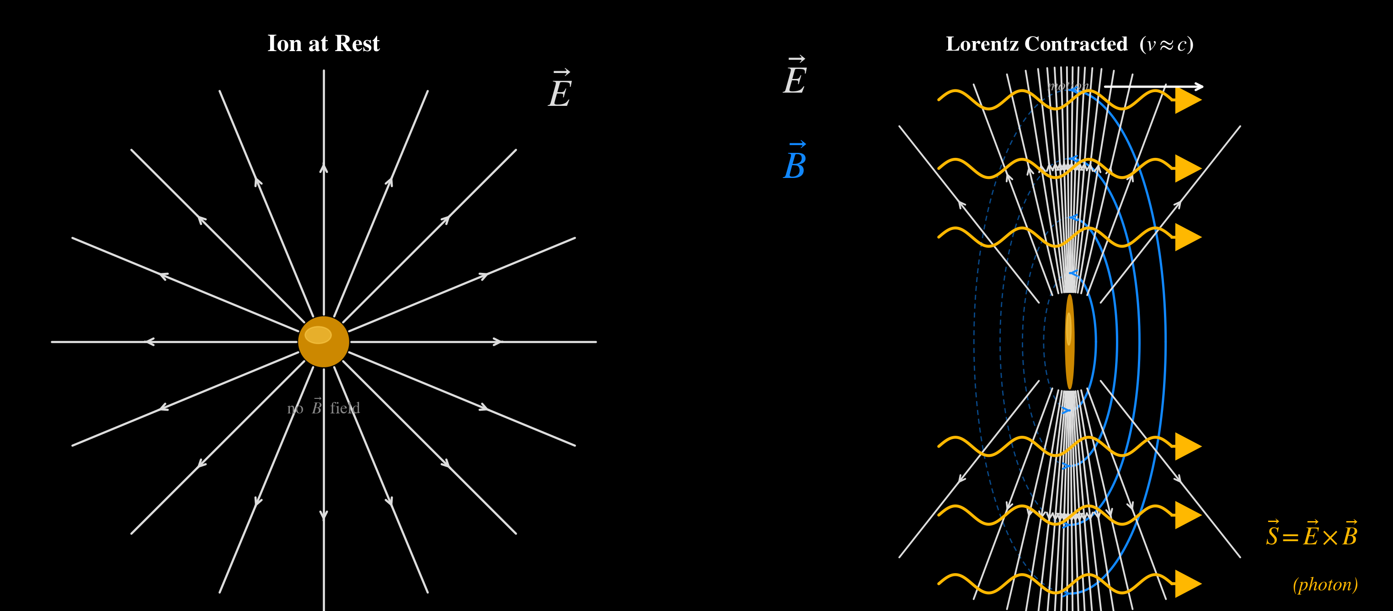
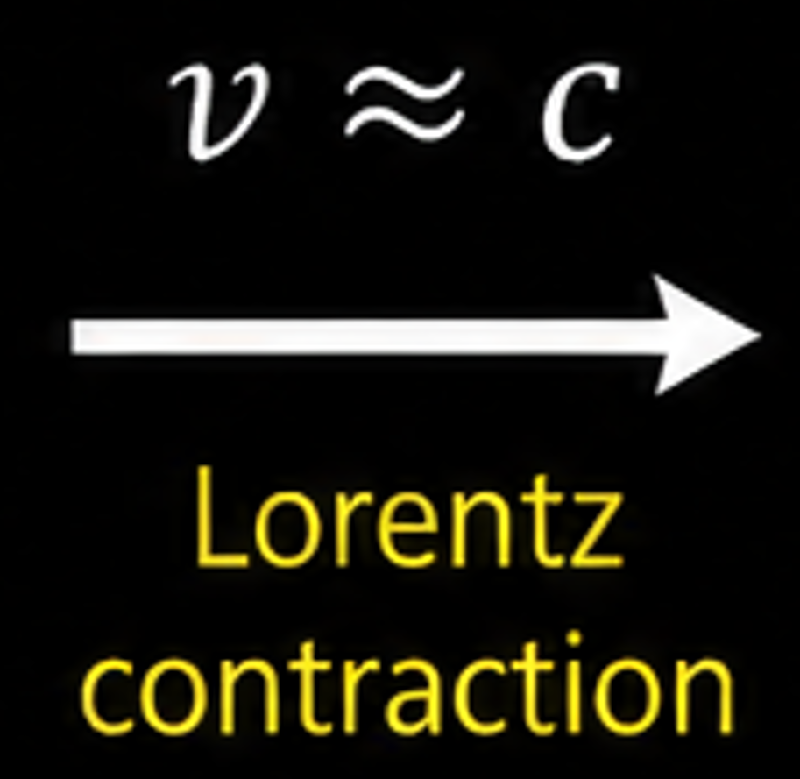
Electromagnetic fields of Relativistic ion

Slide 36
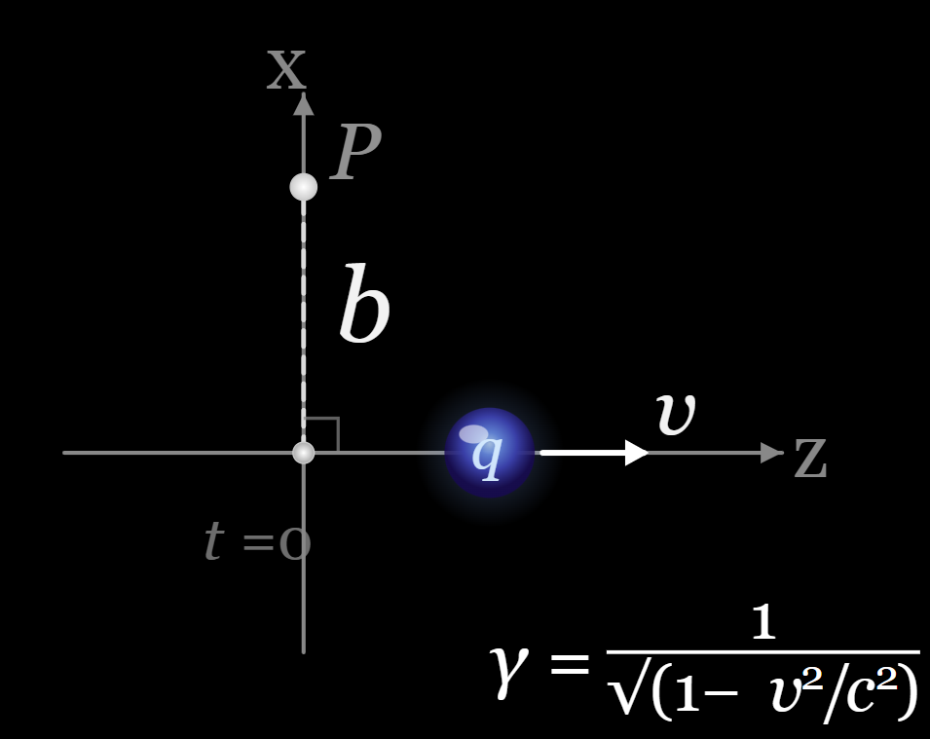
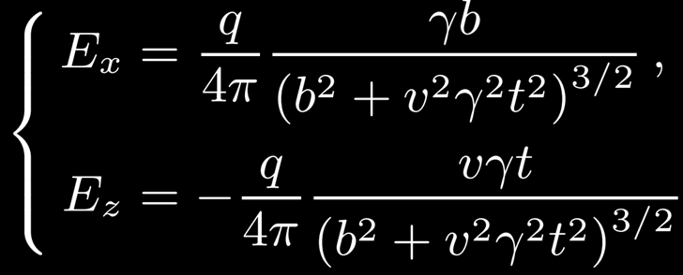
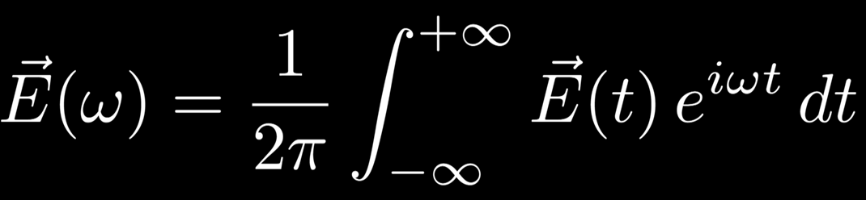
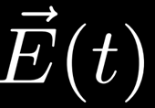





EM fields of moving charges
EM field a distance b away as the charge q passes
Fourier transform: express the E(t) as set of waves with frequency ω
Calculate energy per unit frequency
Convert into number density of photons
Full photon flux where K_{1,0} are Bessel’s functions
Very accurate description of photon energy spectrum from “basic” E&M

Slide 37

EM fields in collision
Equivalent photon approximation (EPA)
EM field is a flux of quasi-real photons
Developed by Fermi, Weizsäcker, and Williams
Implemented in STARLIGHT, SuperChic
 | E_{γ} proj. frame | E_{γ} lab frame | W_{γN}
Eq. | 1/(2*1.2 A^{1/3} fm) | γ/(1.2 A^{1/3} fm) | √(4E_{γ}E_{N})
LHC | 30 MeV | 160 GeV | 1.7 TeV
RHIC | 30 MeV | 6 GeV | 50 GeV
At the LHC/RHIC we can study the most energetic photon interaction in the world

Slide 38





The structure of the photon
The photon can undergo quantum fluctuations into other states
Quantum doesn’t mean there are no rules!!
Consider two
Charge conservation
Angular momentum conservation
Which hadrons can a photon fluctuate into?
Vector mesons
m = 938.3 MeV/c²
J = ½ ħ
m = 939.6 MeV/c²
J = ½ ħ
m = 3096.9 MeV/c²
J = 1 ħ
m = 775.3 MeV/c²
J = 1 ħ

Slide 39






Photon wave function
Low (Q² = 0) virtuality photons
Where
Total wave function
e⁺
Bare photon
Vector meson component
γ
e⁻
f_{v}
from experiment
γ
γ
Two-photon interactions
Photon-nucleus interactions

Slide 40



Two-photon interactions
e⁻
γ
γ
e⁺

Slide 41

Two-photon interactions

Slide 42


Two-photon interactions
Pure EM interactions
Back-to-back products
Good agreement with EPA
  γγ →ee arXiv:2207.12781

Slide 43

Other photon-photon interactions
γγ →ee, and many others
Not been measured
Not been measured
Pure EM measurements by ATLAS
  γγ → γγ arXiv:1904.03536 & arXiv:2008.05355
  γγ → μμ arXiv:2011.12211
  γγ → ττ arXiv:2204.13478
  γγ →ee arXiv:2207.12781
  γγ →MM arXiv:2408.11035

Slide 44

Comparing photonuclear interactions
Resolved photonuclear collision
Direct photonuclear collision
γ
q^{+,r}
γ
q+^{-,r}
q^{-,r}
q^{+,r}
g
g
Pb nucleon
Pb nucleon
q^{+,r}
Probability ∝ α_{s}² α_{EM}
Probability ∝ α_{s}α_{EM}
Both processes contribute a similar order of magnitude

Slide 45
Measuring photonuclear events with ATLAS

Slide 46

A Toroidal LHC ApparatuS (ATLAS)
Tile calorimeter |η| < 1.7
LAr EM calorimeter |η| < 3.2
Charged-particle
Tracker |η| < 2.5
ZDC
ZDC
Zero-degree
Calorimeter
|η| > 8.3
Hadronic endcap 1.5 < |η|< 3.2
Forward calorimeter 3.2 < |η| < 4.9

Slide 47

_{Trackers of charged particles}

Slide 48


Pb
going
direction
photon
going
direction
Pb

Slide 49
Pb
going
direction
photon
going
direction
Pb
Sparse particle production

Slide 50





Charge particle η distribution and N_{ch}
Pb
Photonuclear events have less particle production in the photon-going direction and a steeply falling multiplicity distribution.
arXiv:2101.10771

Slide 51



Two-particle correlation
For the purposes of this talk
All charged particle tracks
rapidity
$$\frac{{dN}_{pair}}{d\text{Δφ}}$$
α 1 + 2v_{2,2}cos(2Δφ)+ .
Enhancement at
Δφ = 0 and π

Slide 52


Two-particle correlations and non-flow
Momentum conservation
Jets & particle decays
Termed “nonflow”
Not collective phenomenon
arXiv:2101.10771

Slide 53





Non-flow removal in γPb correlations
High-multiplicity (HM) correlation data
Low multiplicity (LM)
template for jet/non-flow correlation
Nonflow subtraction
HM fit with LM data and flow coef.
HM and LM assumed to have same flow shape
Different LM selection leads to similar results
After nonflow subtraction clear cos(2Δφ) modulation
arXiv:2101.10771

Slide 54

v_{n} in photonuclear collisions
Significant nonzero v₂ and v₃ in photonuclear collisions
Flat v₂(N_{ch}) within statistical precision
Nonzero triangularity, v₃
System with 20-30 particles shows hydrodynamic response
arXiv:2101.10771

Slide 55

γ+Pb theory comparisons
Nonzero γPb v₂
comparison to hydrodynamics
“3DGlauber + MUSIC +UrQMD”
Using shear viscosity = 0.08
All we need for hydro
Initial conditions
Fluid properties
P[e] & shear/bulk viscosity
?
u(t0) = 0
arXiv:2203.06094
arXiv:2101.10771
Great hydrodynamic description of γ+Pb with QGP fluid properties

Slide 56
The Electron Ion Collider at BNL
Even smaller QGP?
With even more precision?

Slide 57

The Electron Ion Collider
First collisions and early physics around 2034/5
Big physics questions
What happens to the gluon density in nuclei?
How do the nucleon properties (mass & spin) emerge?
See Abhay Deshpande’s summer lecture talk

Slide 58
Comparing photonuclear interactions
γA at LHC and RHIC
eA at the EIC
e⁻
e⁻
Pb
Pb
γ
q^{-,r}
γ*
q^{-,r}
q^{-,r}
q^{-,r}
DETECTED
DETECTED
g
g
Nucleon
Nucleon
We can select varying mixtures of
direct/resolved with detected electron

Slide 59

Initial state geometry in eA collisions?
Point-like interaction region would suggest little geometry
provides an energy deposit with a transverse extent and possible elliptic geometry.
?

Slide 60


3+1D Hydrodynamic model comparison in γA
Q²
q
q
q
q
ε₂ ellipticity
Changes in probe virtuality affect the shape of initial energy density
No direct access to Q² in UPC γA
Example: 100 GeV e on 2.5 TeV Pb
Q² = 0.25 – 0.04 GeV²
Deflection angle 0.0014 – 0.00056

Slide 61
The sPHENIX Experiment
Studying the QGP with high-energy quarks & gluons

Slide 62

Source of high-energy quarks and gluons
Rare hard energetic scattering leading to high energy particles
Energy loss occurs while traversing through the medium

Slide 63
High-energy quarks/gluons and the QGP
Jet
Rare hard energetic scattering leading to high energy particles
Energy loss occurs while traversing through the medium

Slide 64


MAGNET
sEPD
oHCAL
MVTX
EMCAL
TPC
iHCAL
MinBIAS
INTT
TPOT

Slide 65


sPHENIX jet event
Event recorded last year
Jet₁
Jet₂ p_{T}
Jet₁ p_{T}
Higher energy jet in the denominator, x_{J} < 1
Jet₂

Slide 66

sPHENIX p+p jet x_{J}
Where p_{T1} is the leading jet
No QGP effects in pp
x_{j} close to 1

Slide 67

sPHENIX Au+Au jet x_{J}
Where p_{T1} is the leading jet
x_{j} around 0.5
sPH-CONF-JET-2025-05
High-energy quarks/gluons lose energy in the QGP

Slide 68




Au+Au dijet x_{J} centrality dependence
sPH-CONF-JET-2025-05
IS Talk Link
Centrality

Slide 69
Conclusion
Results
Photonuclear collision measurements show evidence of hydrodynamic flow of the QGP
Many measurements in small systems show this
Future/current theoretical and experimental questions
Why is hydrodynamics accurate in this extreme scenario?
Can we measure a breakdown?
First measurements of jet energy loss from sPHENIX
γ

Slide 70
Thank you

Slide 72

Au+Au dijet x_{J}
Consistent with all hybrid model predictions with various forms of medium response
All of these calculations, with various physical effects turned on and off, agree within the uncertainties (red shaded bands) of the data
  We need more precise data
  or
  Need a different observable where the physical phenomena make more of an impact.
sPH-CONF-JET-2025-05
IS Talk Link
Motivates additional measurements

Slide 73


Momentum conservation
Jets & particle decays
Termed “nonflow”
Not collective phenomenon
System size
Δφ =π
Pb+Pb
p+Pb
Δφ < 2
Δη < 2

Slide 74


Two-particle correlations and non-flow
Momentum conservation
Jets & particle decays
Termed “nonflow”
Not collective phenomenon
arXiv:2101.10771

Slide 75
Two-particle correlations and non-flow
Momentum conservation
Jets & particle decays
Termed “nonflow”
Not collective phenomenon
No clear nearside ridge
Need to remove nonflow
arXiv:2101.10771

Slide 76

v_{n} in photonuclear collisions
Similar trend in v₂(p_{T}) as other hadronic systems.
Similar low-p_{T} behavior as pp and p+Pb but systematically lower.
High-p_{T} v₂ is falling to large negative values (see backup) which is from the over-subtraction of nonflow. This effect is present in pp but is larger and sets in at lower p_{T} in γA (ATLAS-CONF-2020-018)
arXiv:2101.10771

Slide 77

CGC model comparison
Color Glass Condensate model calculation containing initial-state correlations which gives rise to nonzero v₂
A (nuclear target)
B_{P} (projectile size)
Larger number of domains struck →lower v₂
Quasi-real photon is predicted to have large B_{P}
Correlated color domain size is ~ 1/Q_{s}
arXiv:2101.10771

Slide 78

(3+1)D hydrodynamic model comparison
Initial state
Final state
Viscous Hydrodynamics
(3+1)D MUSIC+UrQMD
Rho Wave function:
Gaussian hot spots
Rho PDF:
Defines the longitudinal extent of energy deposition
q
<size> is ~ 1/Q
q

Slide 79




Recent measurements
Today
γ+A
γ+p
ICHEP22 talk
Preliminary
QM22 talk
γ+p collectivity
arXiv:2204.13486
arXiv:2106.12377
γ+A collectivity
arXiv:2101.10771

Slide 80

Sum of gaps

Slide 81





Photonuclear collisions
Direct γA collisions Photon couples directly to nuclear parton
Resolved γA collisions photon virtually resolved into hadronic state
0n
Pb
Pb
vector meson
Pb
Xn
Xn
Pb
ρ₀
Select events based on primarily
  Single-sided nuclear breakup “0nXn” (zero-degree calorimeter ZDC)
  Rapidity gaps
Minimum bias selection includes both but is dominated by resolved events.
Pb

Slide 82

Rapidity gaps Σ_{γ}Δη and N_{ch}
Pb+Pb
Photonuclear
Sum of rapidity gaps between particles greater than 0.5
Photonuclear events have large rapidity gaps in the photon-going direction and a steeply falling multiplicity distribution.
arXiv:2101.10771

Slide 83


dN_{ch}/dη in γA collisions
Pb
dN_{ch}/dη of photonuclear events - very similar shape with N_{ch} ≥ 10
MC comparison shows 200 GeV to 1 TeV CM energy (W_{γN})
W_{γN}(N_{ch}) trend comports with N_{ch} trend in data dN_{ch}/dη
arXiv:2101.10771

Slide 84

Why is γPb v₂ smaller
Correlations in small systems are performed with a rapidity gap between the particles
The event plane can fluctuate between these rapidities, which decreases the observed v₂
This effect is larger at forward rapidities.
Because γPb is so boosted the "forward rapidities” are probes relative to other systems with the ATLAS detector.

Slide 85

Rapidity gap comparison to MC
DPMJET-III γ+A
  Photon flux generated by STARLIGHT
  DPMJET simulates γA collision
DPMJET-III γ+p
  Utilizes a Pb+Pb photon flux from STARLIGHT
  Serves as a comparison to PYTHIA8
PYTHIA8 γ+p
  Reweighted to STARLIGHT flux
HIJING Pb+Pb background MC
MC normalized to data in control regions
Qualitative agreement with MCs, PYTHIA being the most compatible
Indicates high purity γ+A sample for Σ_{γ}Δη > 2.5
arXiv:2101.10771

Slide 86
Collecting photonuclear events
Trigger name: HLT_trk25_FgapC5_L1_TE3_ZDC_A_VZDC_C_VTE200 ???
Level 1
Xn
0n
Rapidity gap
Select photonuclear events based on
Single-sided nuclear breakup
Upper and lower bound on event activity
  Personally tuned for high-multiplicity γA
Presence of rapidity gaps (FCAL_{γ} < 5 GeV)
ZDC
ZDC
FCAL_{Pb}
FCAL_{γ}
Signal
Background

Slide 87

Why is γPb v₂ smaller
Correlations in small systems are performed with a rapidity gap between the particles
The event plane can fluctuate between these rapidities, which decreases the observed v₂
This effect is larger at forward rapidities.
Because γPb is so boosted the "forward rapidities” are probes relative to other systems with the ATLAS detector.
EPJ Web of Conferences 276, 01002 (2023) SQM22

Slide 88



Comparison to DPMJET-III
DPMJET-III predicts the photon energy changes by about 1-2 standard deviations over the multiplicity range of the measurement and a doubling of the mean W_{γN} for 10 to 60 N_{ch}^{rec}.
Large difference between measured v_{n,n} before and after template nonflow subtraction for data and DPMJET-III.
Small negative v_{2,2} after template fit
CERN-EP-2020-246

Slide 89

DPMJET-III 2PC example
More jet-like away side in DPMJET-III than in data. This produces the larger unsubtracted v_{2,2} seen on the previous slide. Small remaining modulation after nonflow subtraction seen in the lower panel. DPMJET-III is of limited use in modeling the soft correlations in photonuclear events.

Slide 90

Purity of the photonuclear selection
A two-component fit was performed (signal MC) + (background MC) to data distributions to determine the purity.
The N_{ch} and Σ_{γ}Δη distributions were used.
A conservative approach was taken and the worst purities were used to assess possible effects.
A pp Δφ correlation with the same selections was subtracted (according to the bins purity) from the photonuclear data as a systematic variation and the sensitivity is included in the final result.

Slide 91


Factorization v₂(N_{ch})
v₂(N_{ch}) shows insensitivity to associated particle p_{T} range. This is consistent with a hydrodynamic paradigm where particle anisotropies are generated from a single-particle flow vector for all p_{T}.

Slide 92

Measurements of longitudinal decorrelation
F_{n} is the fractional change in v_{n,n} per a unit rapidity
It characterizes longitudinal decorrelation effects well
This class of measurements probes the shape of the initial state energy density
First decorrelation measurement in small systems
arXiv:2308.16745

Slide 93






Strangeness enhancement in γA
Strangeness enhancement, baryon anomaly, baryon stopping…
Novel incoming quantum numbers in γPb
Plots of displaced vertex identified particle candidates in γPb

Slide 94

Identified particle <pT> in γA
<pT> with _{Nch}
  Higher energy density achieved in higher multiplicity collisions leads to stronger radial expansion.
  Thought of as a signature of QGP formation
Larger <pT> in the Pb-going direction
Qualitative agreement with the Hydro model excluding K_{S}⁰
  Common in these new data-model comparisons
Pb
arXiv:2503.08181
Behavior in data is consistent with qualitative picture of radial flow

Slide 95

Baryon anomaly in γA
Phys. Rev. Lett. 111, 222301
Larger hydrodynamic push to baryons as the QGP velocity field cools into hadrons
Observe large baryon enhancement at mid-pT in γA, similar to pPb
Possibly see larger baryon enhancement in the Pb going direction

Slide 96

Single-photon interactions V+A
ρ⁰
ρ⁰
ρ⁰
Elastic scattering: V + A → A + V
Example measurement of vector meson production

Slide 97



Baryon anomaly in γA
arXiv:2503.08181
Phys. Rev. Lett. 111, 222301
Larger hydrodynamic push to baryons as the QGP velocity field cools into hadrons
Observe large baryon enhancement at mid-pT in γA, similar to pPb
Possibly see larger baryon enhancement in the Pb going direction
Observe large baryon enhancement at mid-pT in γA, similar to pPb

Slide 98

MAGNET
sEPD
oHCAL
MVTX
EMCAL
TPC
iHCAL
MinBIAS
INTT
Large, 2π $\left|η\right|<1.1$ acceptance
High DAQ rate (Triggered + Streaming)
TPOT

Slide 99
MVTX
TPC
Multi-subsystem tracking for precision vertexing, timing, and momentum resolution
INTT
TPOT

Slide 100
MAGNET
MAGNET
Full electromagnetic + hadronic calorimetry for unbiased jet reconstruction and triggering
oHCAL
oHCAL
EMCAL
EMCAL
iHCAL
iHCAL

Slide 101


MAGNET
MAGNET
oHCAL
oHCAL
EMCAL
EMCAL
iHCAL
iHCAL
EMCal
ΔϕxΔη: 0.025x0.025
Tungsten-scintillating fiber sampling calorimeter
Projective geometry
Calibration: 𝛑⁰→ɣɣ mass peak to match between data and simulation

Slide 102
MAGNET
MAGNET
oHCAL
HCal
ΔϕxΔη: 0.1x0.1
Steel-plate scintillating-tile sampling calorimeter
Projective geometry
Calibration: compare measured MIP peak from cosmic ray muons in data to simulation
EMCAL
iHCAL
EMCal
ΔϕxΔη: 0.025x0.025
Tungsten-scintillating fiber sampling calorimeter
Projective geometry
Calibration: 𝛑⁰→ɣɣ mass peak to match between data and simulation
Phys. Rev. C 112, 024908

