Slide 1
Logistics and Run Preparation Workflow
Prep at BNL (Now – beginning of May)
  Plan: what do we want to accomplish at CERN (characterize performance of a pfRICH mock-up to demonstrate working principle)
  Understand the mechanical/space constraints of the beam test area (contacted CERN experts for details: DESY XY-stage table, dimensions of area, beam position, etc., transferring equipment)
  Design model of full pfRICH-HRPPD mock-up assembly
  Procurement of parts needed for assembly: Velmex stages, 8020 rails, hardware, shipping crates, 3D printed parts, etc
  Pre-test components: HRPPD tiles, GEM layers, Sinct Counters, MCP-PMTs, All HV & LV w/ cables, Electronics (CAEN digitizers, NIM crates + modules, DREAM) ONGOING
  Assemble 8020 chassis and mount components, including cabling, gas panel/lines, and other infrastructure ONGOING
  Goal is to make assembly as “plug and play” as possible to reduce assembly time and have everything mostly ready and in working condition on installation day PLAN COMPLETE
Shipping (May 5th)
  Main assembly will be packed in a semi-custom crate so that it can shipped in an almost ready-to-go state Crates Ordered
  Generate Equipment list: Test Beam Personnel - Google Sheets
  Generate Shipping memo (allow time for export control review, BNL barcoded items need to be put on a property pass; SM will be prop. pass for all other equip.)
  Need 230VAC to 120VAC transformer for some equipment Components work with 220VAC/Ordered some 220/120VAC Transf.
  HRPPDs should be sent out early to account for issues with export control Shipping Memo Complete
  Everything else is to be shipped on May 5th, allowing for a 2 week delivery time (even though quoted delivery time is 4 days)
  Need to pre-order Ar:CO2 (70:30) premix gas for GEMs
  Need to coordinate with Matt for getting the aerogel tiles to BNL ONGOING
  Need to coordinate with SBU for getting the mirror panels to BNL ONGOING

Slide 2
Logistics and Run Preparation Workflow Cont…
CERN User Registration (more from Brian)
  Each onsite worker must pre-Register as CERN (ATLAS) User; Get CERN computer account; Do required training; Book room at CERN hotel ; Check in at the Users Center onsite to get CERN ID Progress made, more needed
Prep at CERN SPS (May20 – May27)
  Equipment will be delivered from US to CERN/Switzerland (Meyrin Shipping and Receiving building)
  Must ask local CERN contacts to organize a CERN internal transport from Meyrin to SPS North area, Prevesin (FR) (with a CERN common light procedure with authorities)
  Alexander and Martin will be available around May 20th to find our crates at the SPS and start unpacking them to stage the equipment (Bob available on May 26th)
  Assemble “test stand” to test as much of the setup as possible before installation day (use LED light source) ONGOING
  Track down premix ArCO2 (70:30) bottles Gas ordered
  230VAC to 120VAC? Components compatible with 220VAC and120-220VAC transformers ordered
  Safety pre-Inspection (ask safety people in advance what we need to do to pass on installation day) To be Done
  Learn how to use beamline Cherenkov counter To be Done
Installation Day at SPS (May27)
  Transfer assembly into test area, cable up systems, set up sub-net, do quick test; prep for data taking
  Safety inspection
Data Taking Run at SPS (May 28 – June 3rd)
  24/7 shifts (?), 2 people min. per shift (?) Must finalize schedule
  Take lots of high-quality data with online and offline monitoring, data QA from remote shifters (remote shifters need CERN computer accounts to access data on internal CERN network)

Slide 3
Logistics and Run Preparation Workflow Cont…
Down-Time between SPS and PS Runs
  After the North area run, must organize an internal transport of equipment to PS Switzerland (Meyrin) for PS run
  ONGOING
  If possible, it would be beneficial to set up a test stand well in advance of the installation day
  Safety pre-Inspection (ask safety people in advance what we need to do to pass on installation day) To be Done
  Learn how to use beamline Cherenkov counter To be Done
Installation day at PS (June 10)
  Transfer assembly into test area, cable up systems, set up sub-net, do quick test; prep for data taking
  Safety inspection
Data Taking Run at SPS (June 11– June 24)
  24/7 shifts (?), 2 people min. per shift (?) Must finalize schedule
  Take lots of high-quality data with online and offline monitoring, data QA from remote shifters
Un-installation day at PS (June25)
  Pack equipment into crates
  Organize shipment of equipment from Switzerland (Meyrin) back to US (BNL)

Slide 4
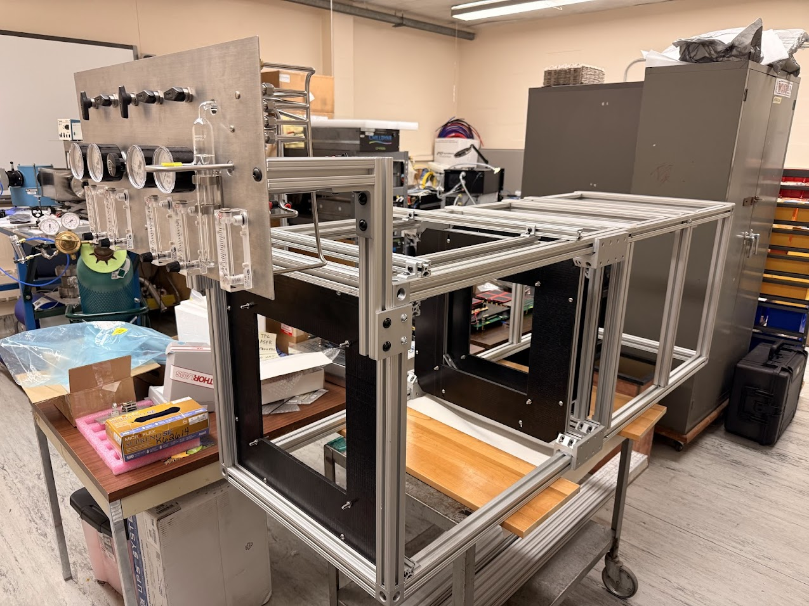
Photo of Assembled 8020 Chassis
Progress on assembling 8020 pfRICH mock-up chassis

Slide 5
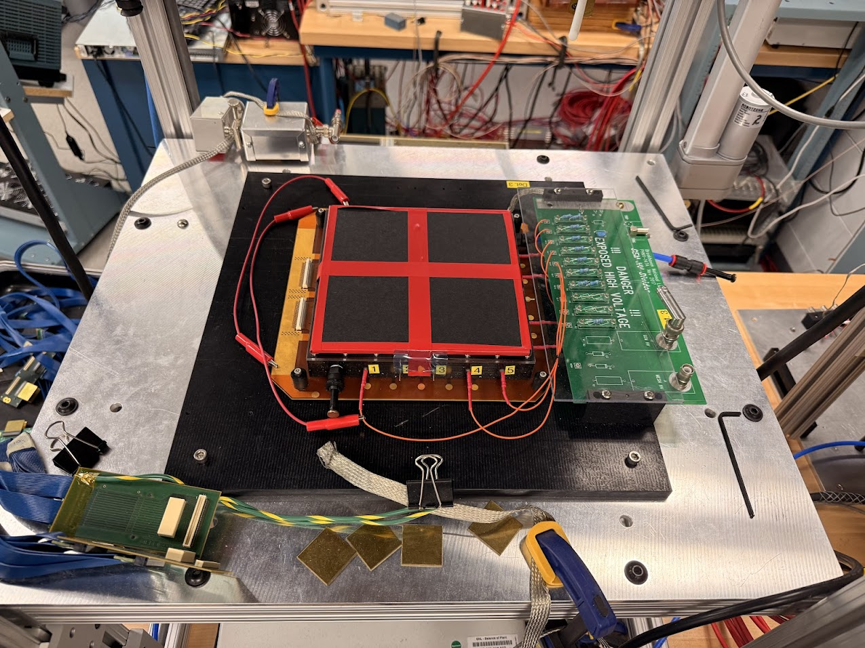
Photos of GEM Layers ready to be tested at BNL
Prep GEM layers for testing in the lab

