Slide 1
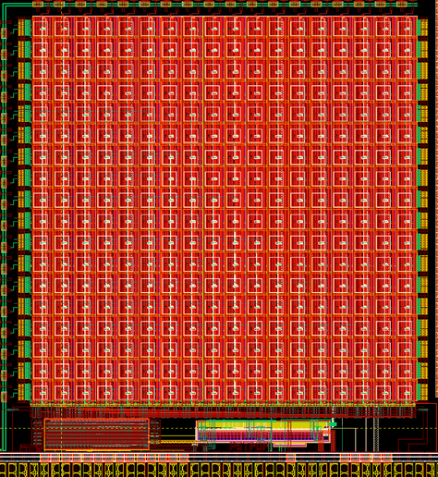
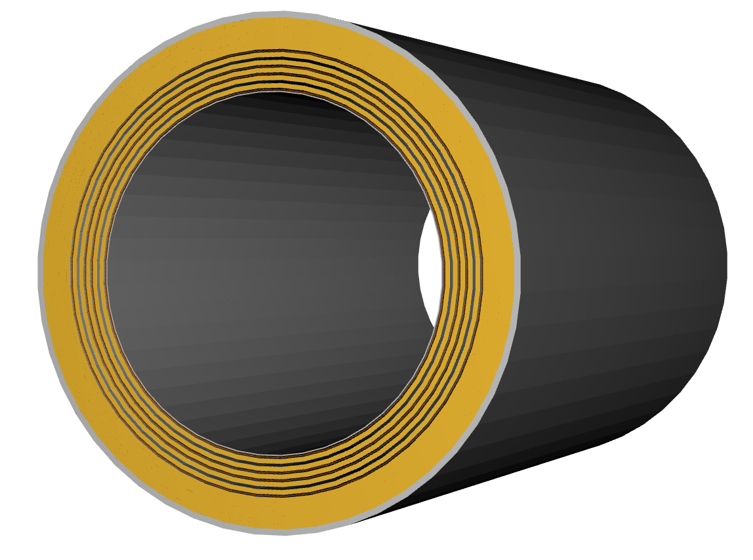

News
The ePIC Barrel Imaging Calorimeter
Jessica Metcalfe
BIC General Meeting
Argonne National Laboratory
April 24, 2026

Slide 2
News
Updated BIC org chart
June workshop
publication policy
Project funding for FY26
AstroPix update?
QC documents
bubble charts

Slide 3
BIC Organization Chart
New and reorganized GTL Deputies
Thank you!

Slide 4
BIC Project Phases
BIC Project Phases
PED: Preliminary Design
PED: Final Design
Preproduction
Production
Preliminary Design Review
Sept 2025
Final Design Review
Late 2026
Need CD3 approval to start production articles
2027/2028 Production Readiness Review
Ready for installation
~Dec 2031
Preliminary Design Review, 60% design completion
AstroPix v3 (and v4)
BabyBCal & Lanky BCal
Individual components
First (second) test articles
AstroPix v5
One full sector
Final designs (90%)
Production style procedures
AstroPix v6 validation tests
AstroPix v6
48 sectors

Slide 5
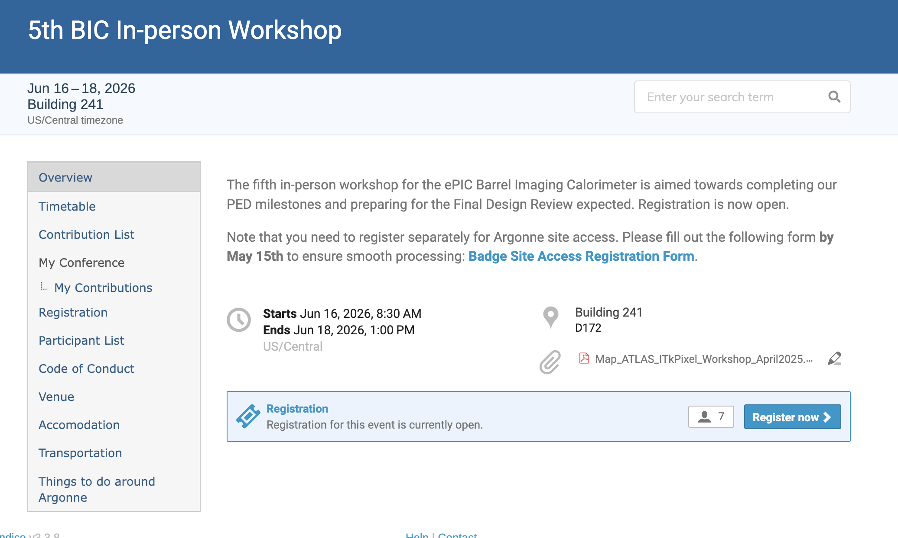
JUNE BIC Workshop at Argonne
https://indico.bnl.gov/event/31519/

Slide 6
Presentation/Paper Review Process
For ALL BIC (or ePIC/EIC) related presentations or paper that will be shared outside the collaboration:
review process to ensure the quality and consistency of results
Instructions:
submit document via zenodo
request approval in zenodo and send an email notification
approvers for BIC should include relevant Green Team Leader(s) and Purple Team Leader(s)
Want to be inclusive in the author list → paper drafts should be circulated to the BIC collaboration list and ask for anyone that feels they should be included on the author list can ‘opt in’
If the paper involves AstroPix, the AstroPix mailing list should also be notified with a request for potential authors to opt in
Should cite relevant published work
ePIC publication policy: https://zenodo.org/records/15874182

Slide 7
Project funding
Project funding for BIC for FY26 was reduced compared to the request
Request was based on a technically driven schedule (doing work as fast as reasonably possible)
Received 33% of request for FY26 from EIC project → work proceeding more slowly
Working with project to get next allotment

Slide 8
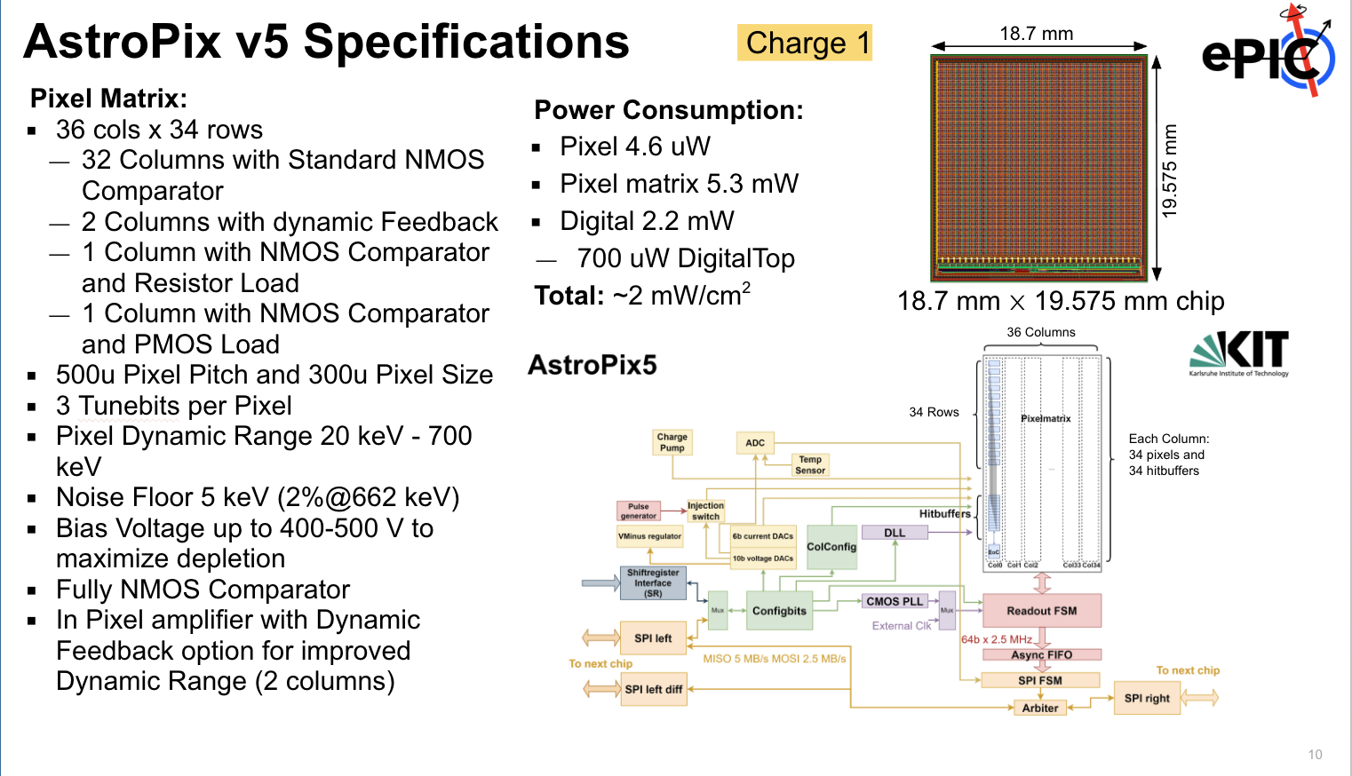
AstroPix
AstroPix v5 is set to be delivered ~end of August from AMS
Now the AstroPix program is also pursuing a fabrication run with LFoundry
Full size, could even go to a 2 cm x 3 cm design
Process the backside for backside bias and more complete depletion

Slide 9
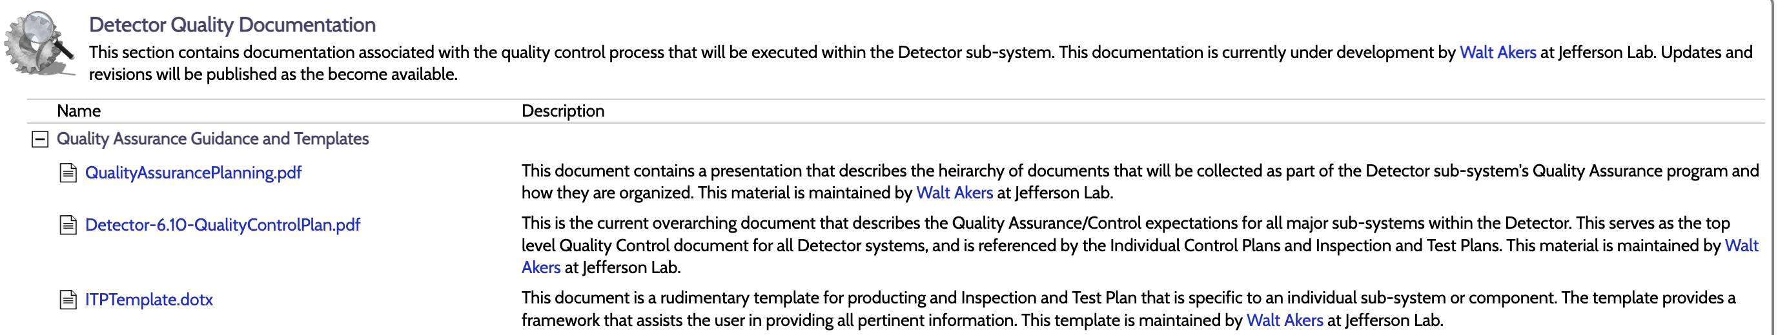
QC Documents
Requested by the project for CD2 → not everything will be final, but we should fill out what we do know
Fibers –Zisis, Sylvester
Wafer QC -Sanghoon
Module/Tray QC -Manoj
AstroLinx -Oklahoma-Blake (TBC)
Trays/Module bases –Korea (TBC)
Tracker mechanics/sectors -Sylvester
Light Monitoring System -Shinhyung
SiPM’s -Zisis
ESB mechanical -Aram
CaloRoc -Norbert
ETC-Regina
Link to QC docs: https://eic.jlab.org/Detector/

Slide 10
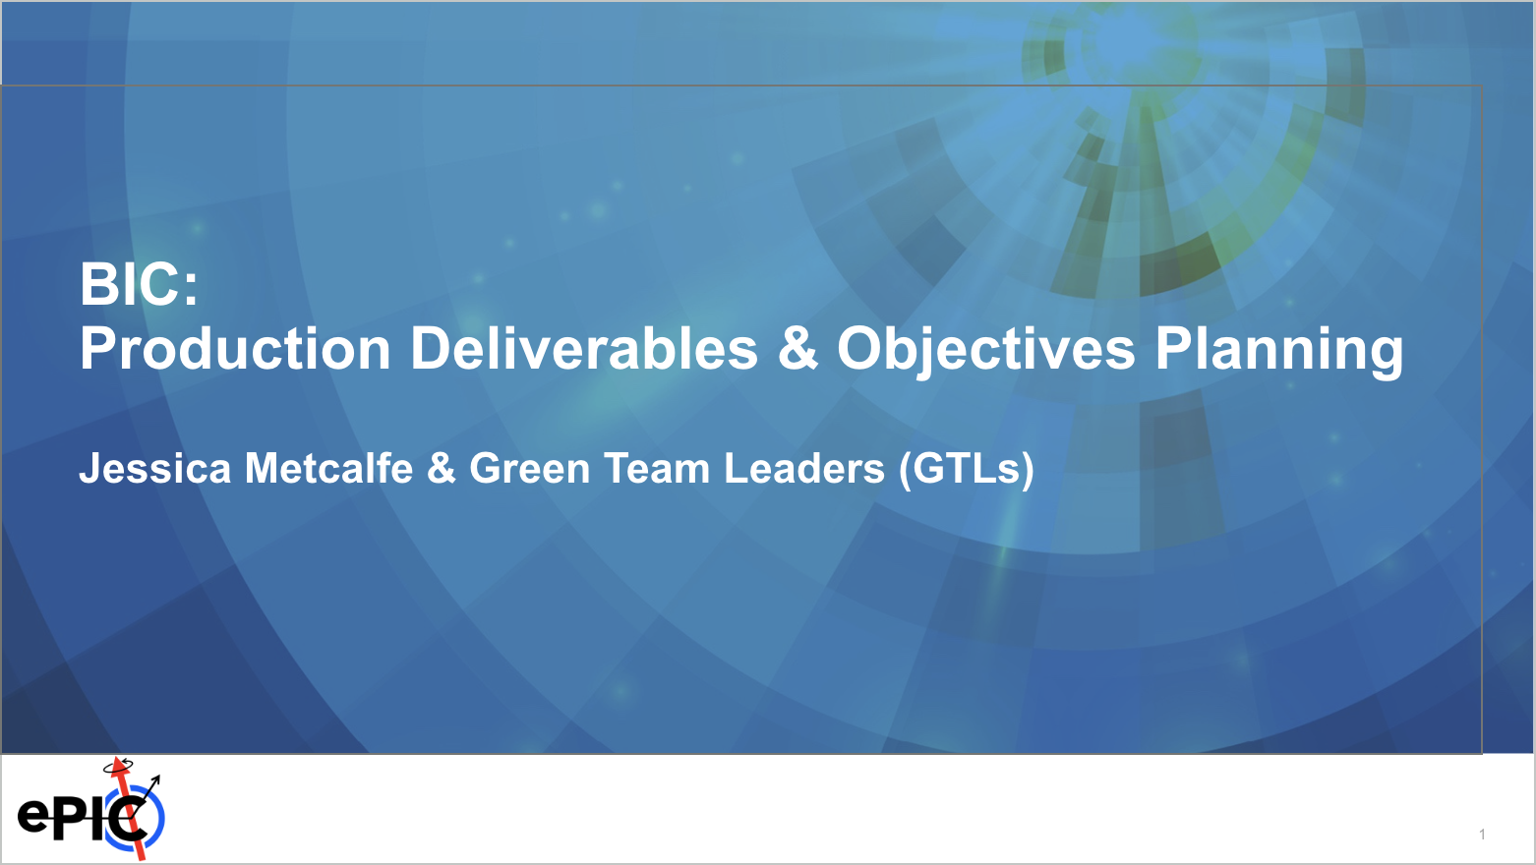
Orgazinational Planning aka Bubble Charts
Purpose: To allow BIC collaborators to pick up responsibilities in areas that will benefit the project
→Avoid putting effort into things that won’t benefit the project. There is plenty to do!
Some areas already have responsible institutes/people (but there could still be room to contribute)
Contact GTL (Green Team Leader: Manoj, Sylvester, Zisis, Maria) to discuss your potential contribution

Slide 11
Backup

Slide 12
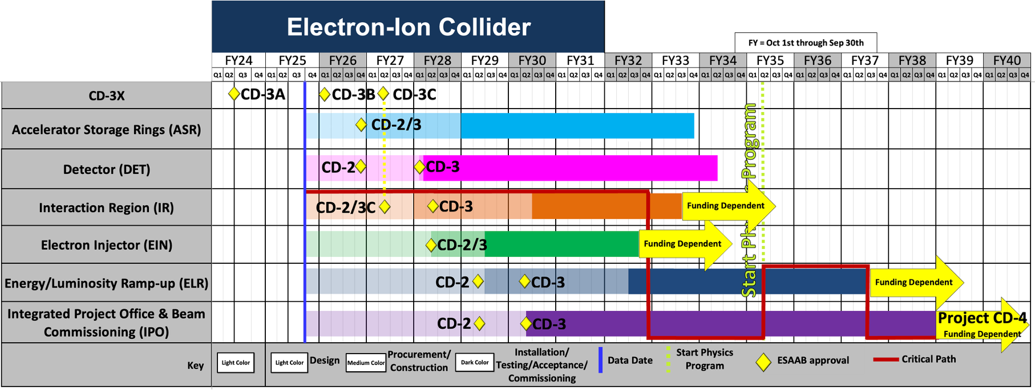
EIC Project Schedule

Slide 13
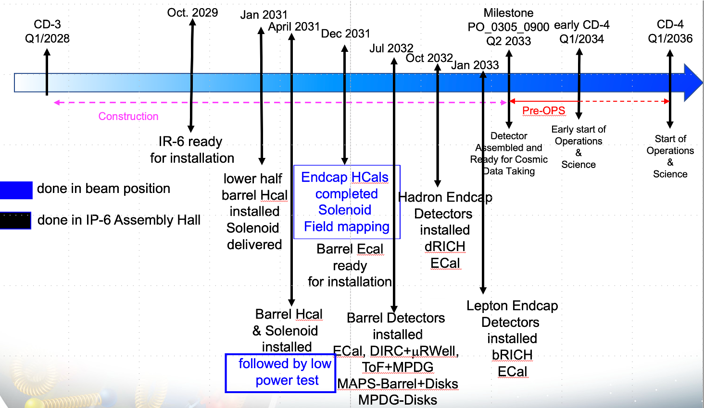

ePIC Schedule

Slide 14
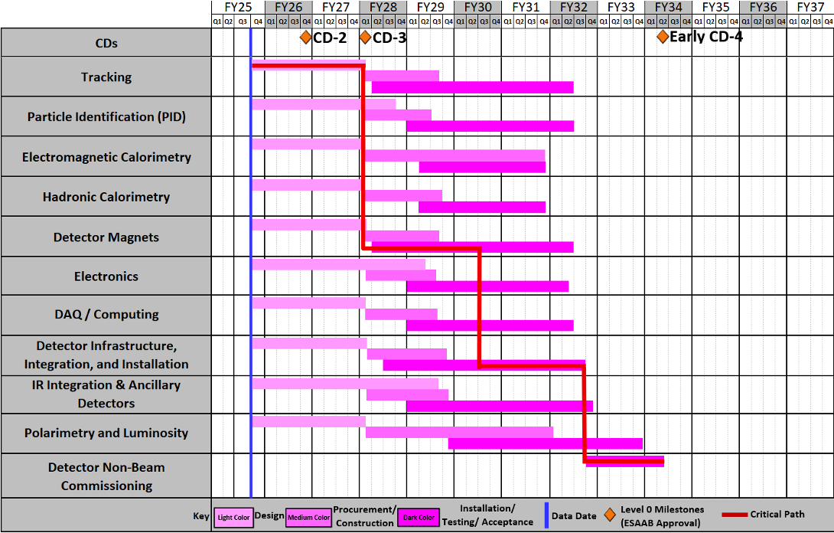
EIC Project Dates

Slide 15
BIC Organization

Slide 16
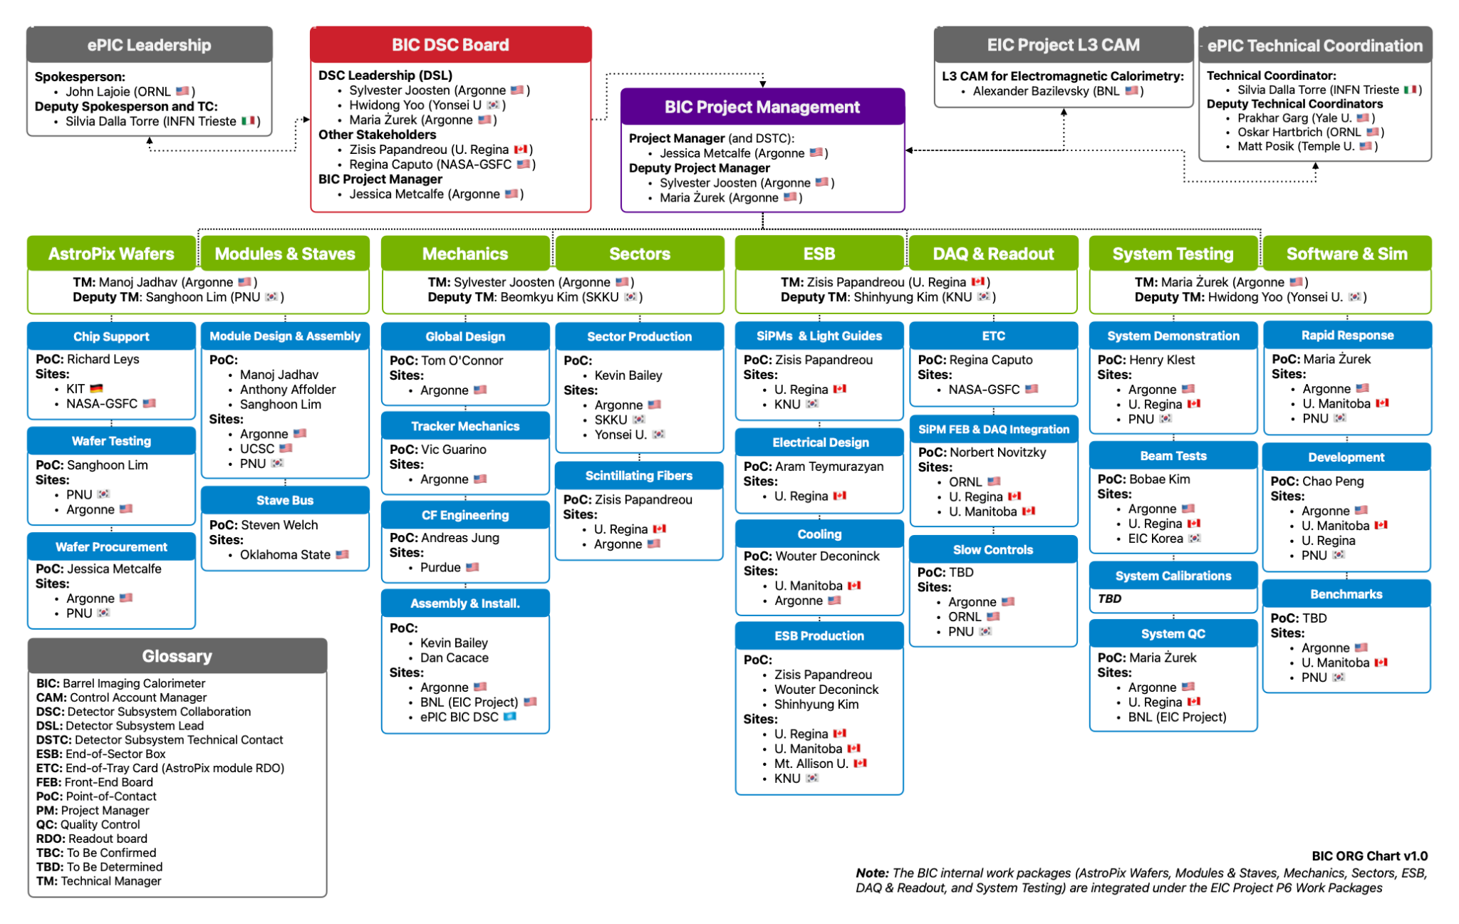
BIC Organization Chart

Slide 17
BIC Organization Chart
ePIC Collaboration:
international user organization
responsible for community needs, physics performance
Detector Subsystem Collaboration → Red Team
DSL’s Detector Subsystem Leads
provide oversight to the BIC collaboration
Detector Subsystem Technical Contact
also BIC project manager

Slide 18
BIC Organization Chart
EIC Project:
DOE funded project
accelerator & detector
responsible for building/delivering
US funds for the project are controlled by the Project
BIC reports to the EM Calorimeter Control Account Manager (CAM)
Institutes receive funds via a contract with Statement of Work (SOW)

Slide 19
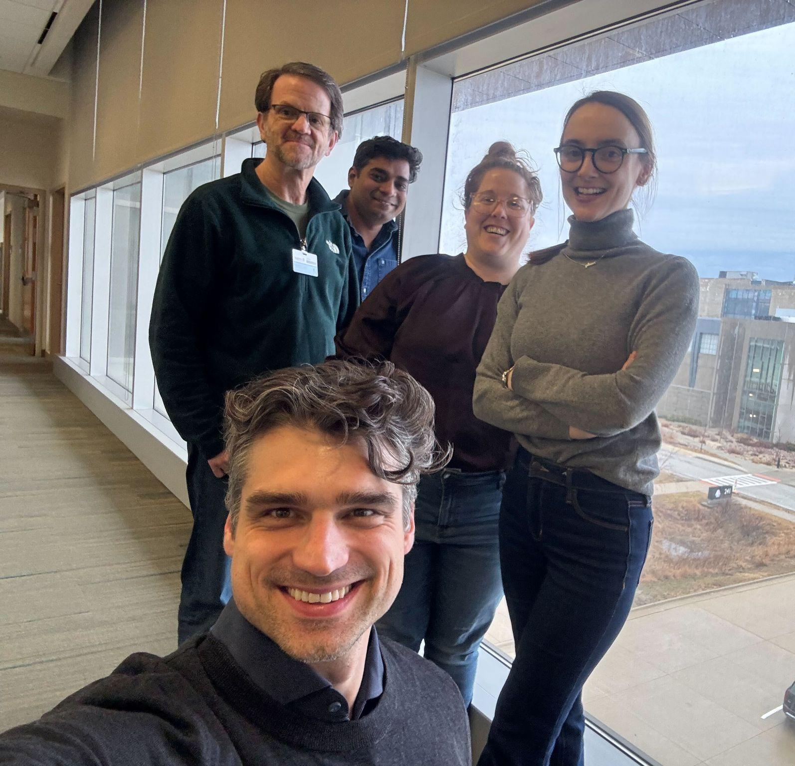
BIC Project Management Team
BIC Project Management Team
Purple Team:
manage and support the BIC community
deliver the BIC detector
Green Team Leaders:
manage a major technical area
contact for the BIC community in that technical area
meet key deliverables and milestones within their area
BIC Management Roles & Responsibilities

Slide 20
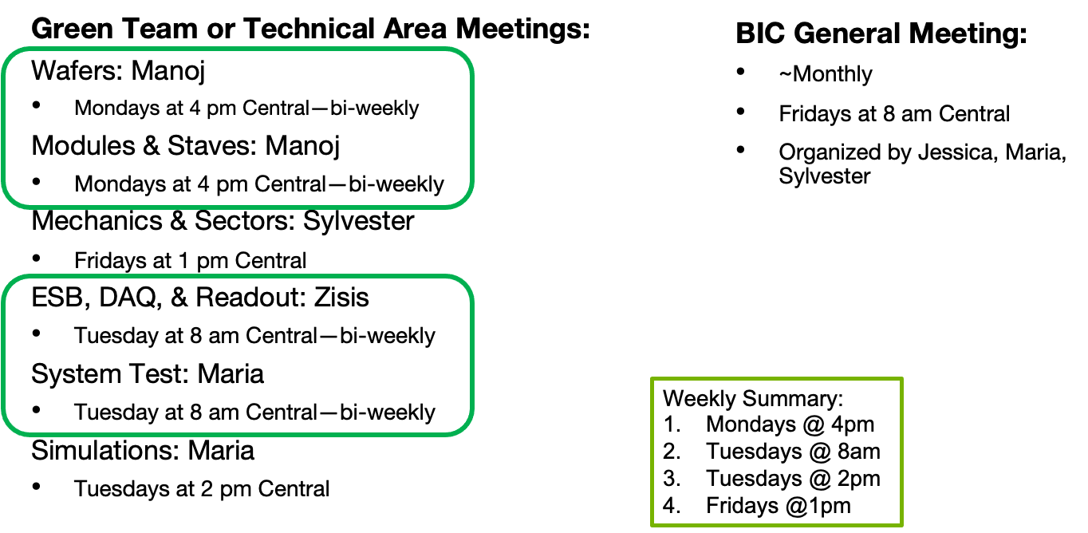
Meeting Schedule

Slide 21
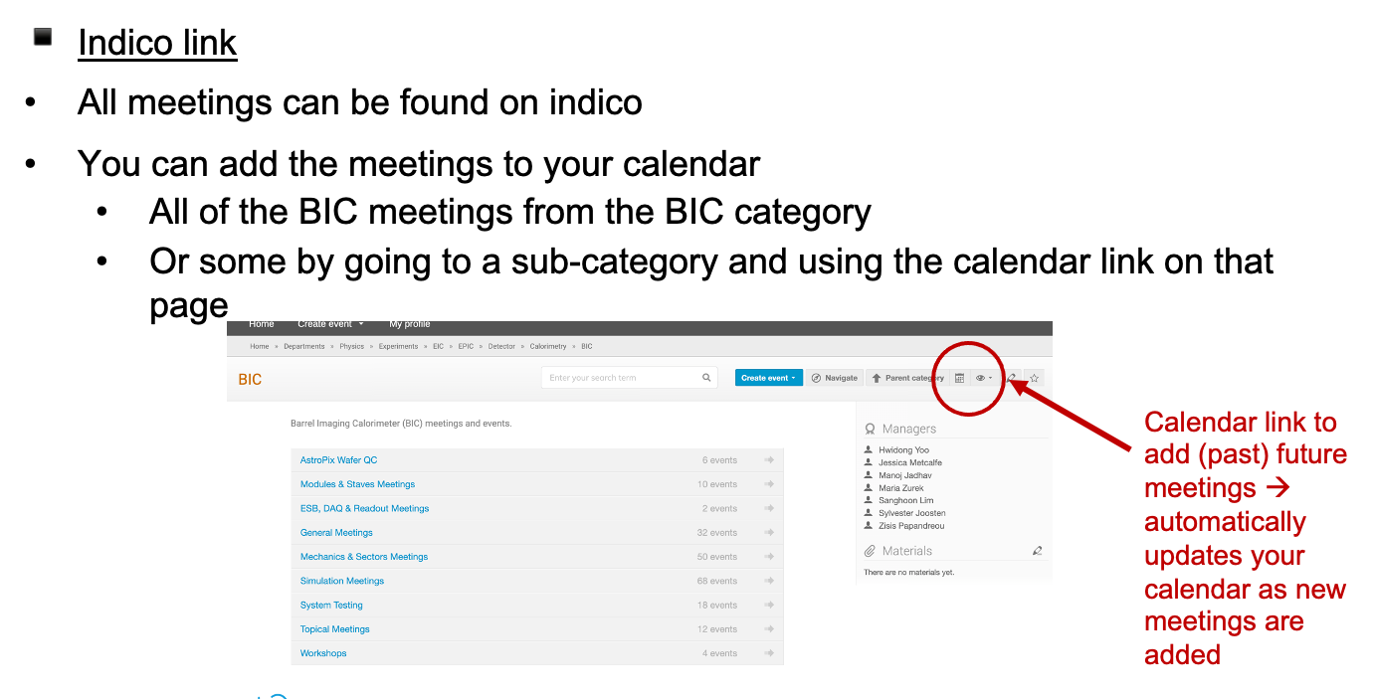
BIC Meeting Indico Calendar

Slide 22
Documents
Zenodo
BOX
Google Drive
-ePIC endorsed file management system hosted by CERN
-version controlled
-share with collaboration
-searchable by keywords
-critical to get correct keywords
-epic-eic & bic
-BOX folder for sharing technical drawings
-Argonne hosted
-request access permissions to anyone in the Purple Team
-collaborative documents → shared editing
-presentations for reviews
-reference documents
-photos

Slide 23
Design Document Review/Approval
Review key designs before fabrication
Review/Approval Log
1) Make the design available on the google drive and fill in description, links, and deadline in the log. Define required approvers.
2) Present at a relevant meeting that is announced 1 week in advance (prefer if documents ready in advance, but not required)
3) Email BIC list and required approvers with request to review by deadline (minimum 1 week after presentation). Provide links to documents, presentation, comment collection document
4) Respond to comments
5) Final approval is logged

Slide 24
Presentation/Paper Review Process
For ALL BIC (or ePIC/EIC) related presentations or paper that will be shared outside the collaboration:
review process to ensure the quality and consistency of results
Instructions:
submit document via zenodo
request approval in zenodo and send an email notification
approvers for BIC should include Green Team Leader and/or Purple Team
Want to be inclusive in the author list → paper drafts should be circulated to the BIC collaboration list and ask for anyone that feels they should be included on the author list can ‘opt in’
If the paper involves AstroPix, the AstroPix mailing list should also be notified with a request for potential authors to opt in

Slide 25
Reference Documents
BIC Management Roles & Responsibilities
Interface Document
Organization Chart
Risk Register/RAID log
Presentation/Paper Approval Instructions
Design Review/Approval Log

