Slide 1
pfRICH Beam Test Mirror
Simon Snydersmith, Sushrut Karmarkar, Andreas Jung
20 April, 2026

Slide 2
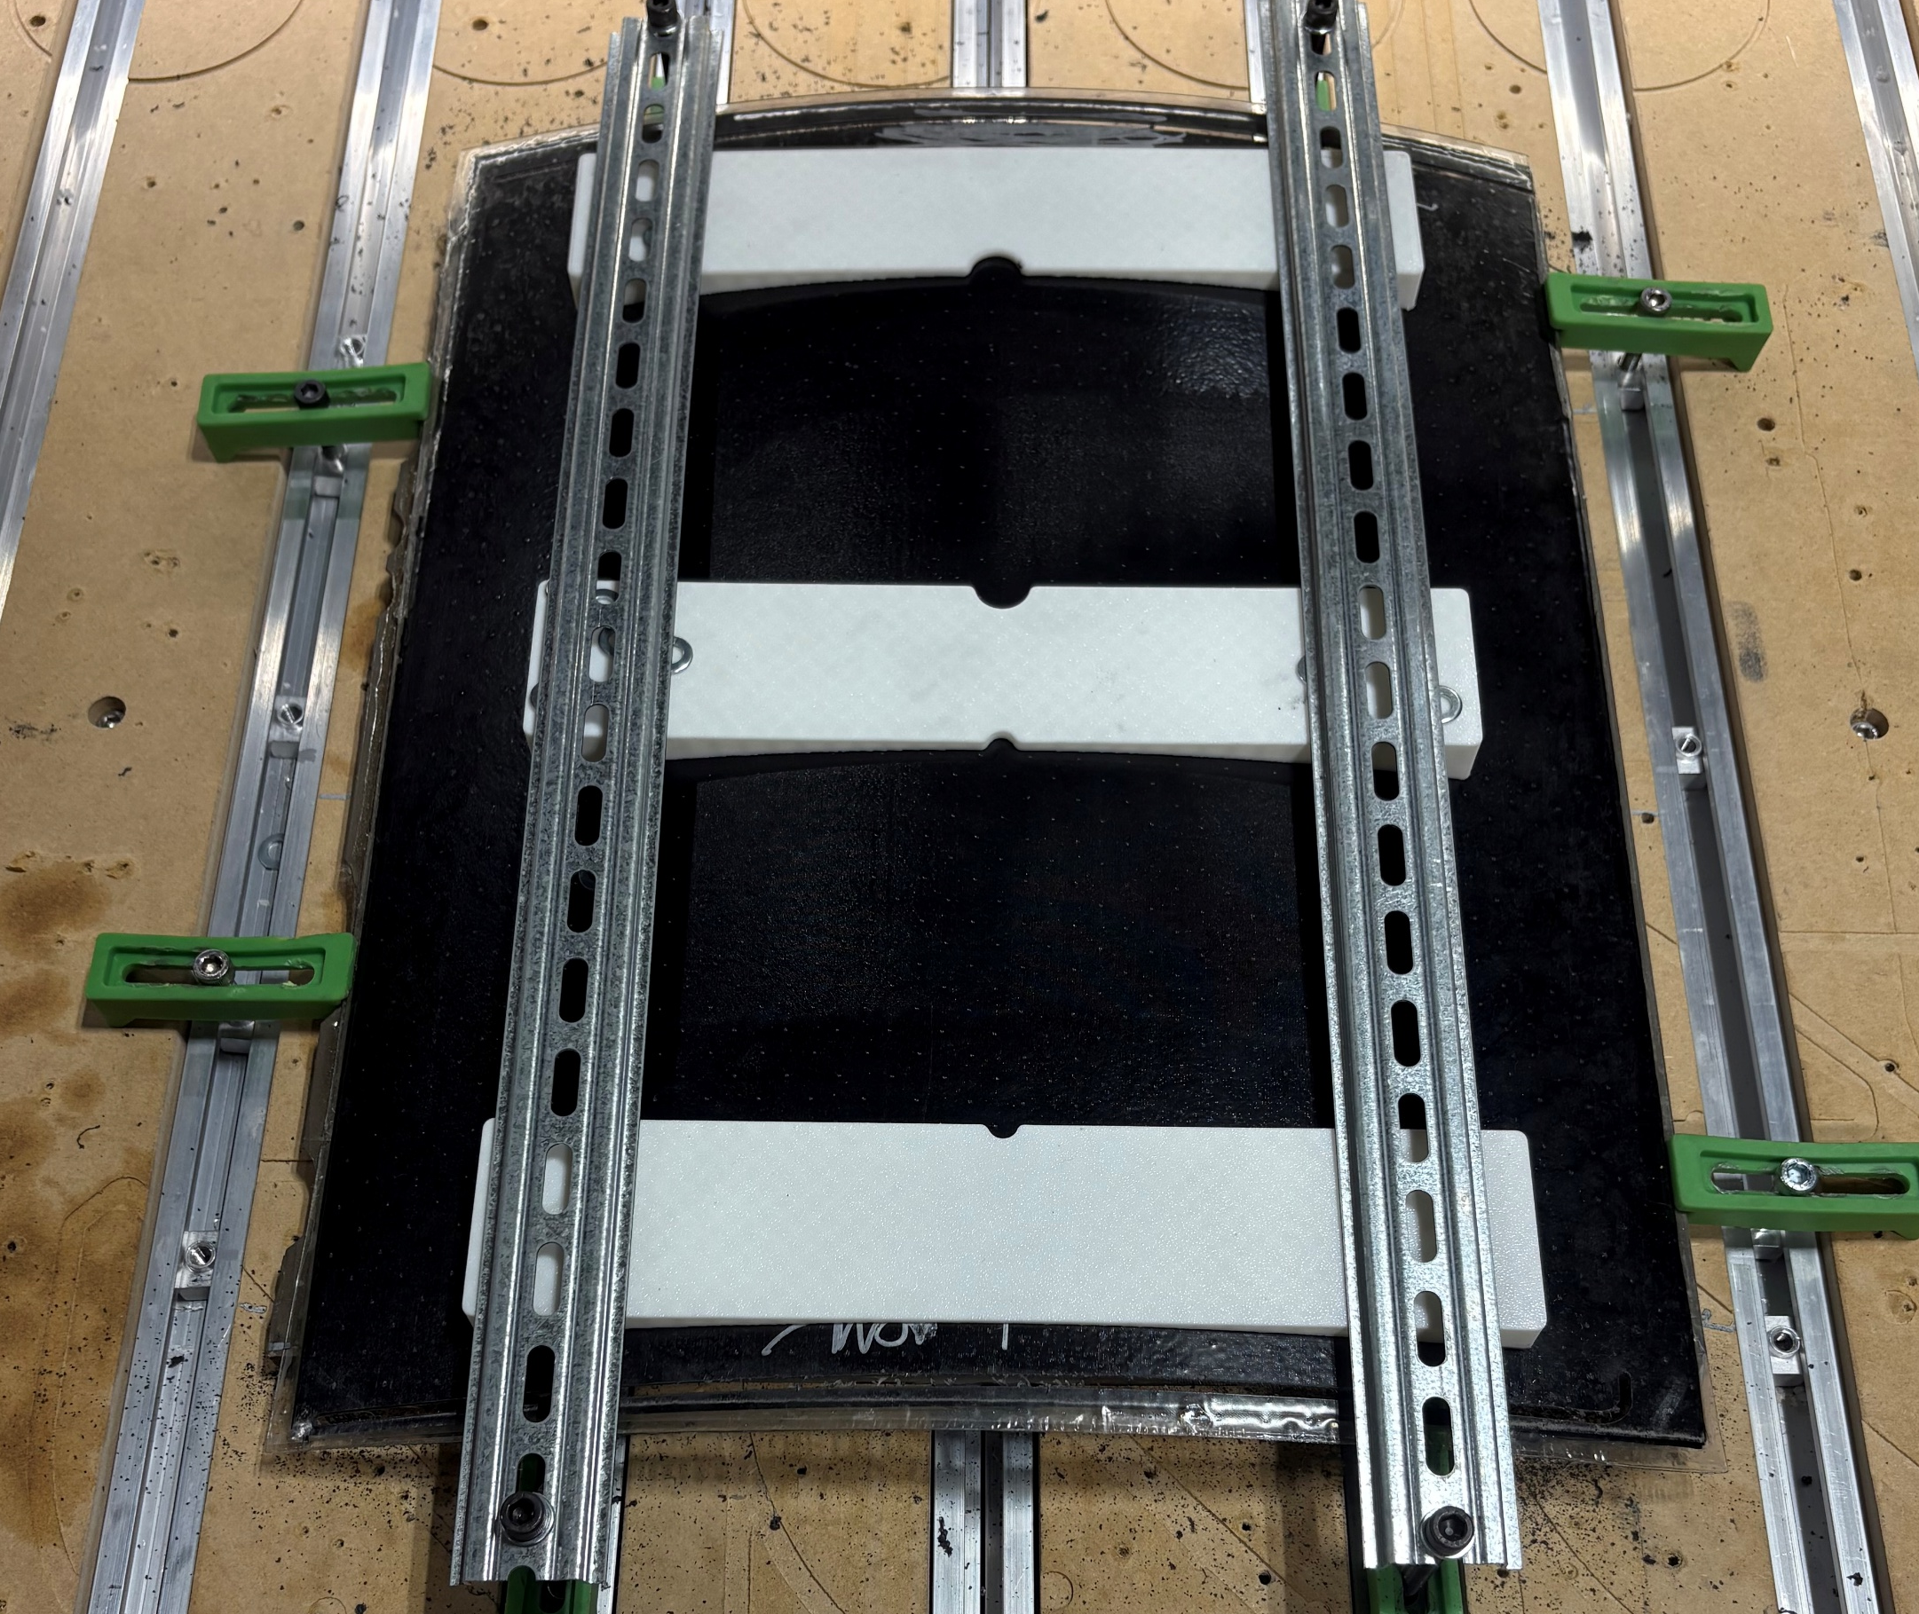
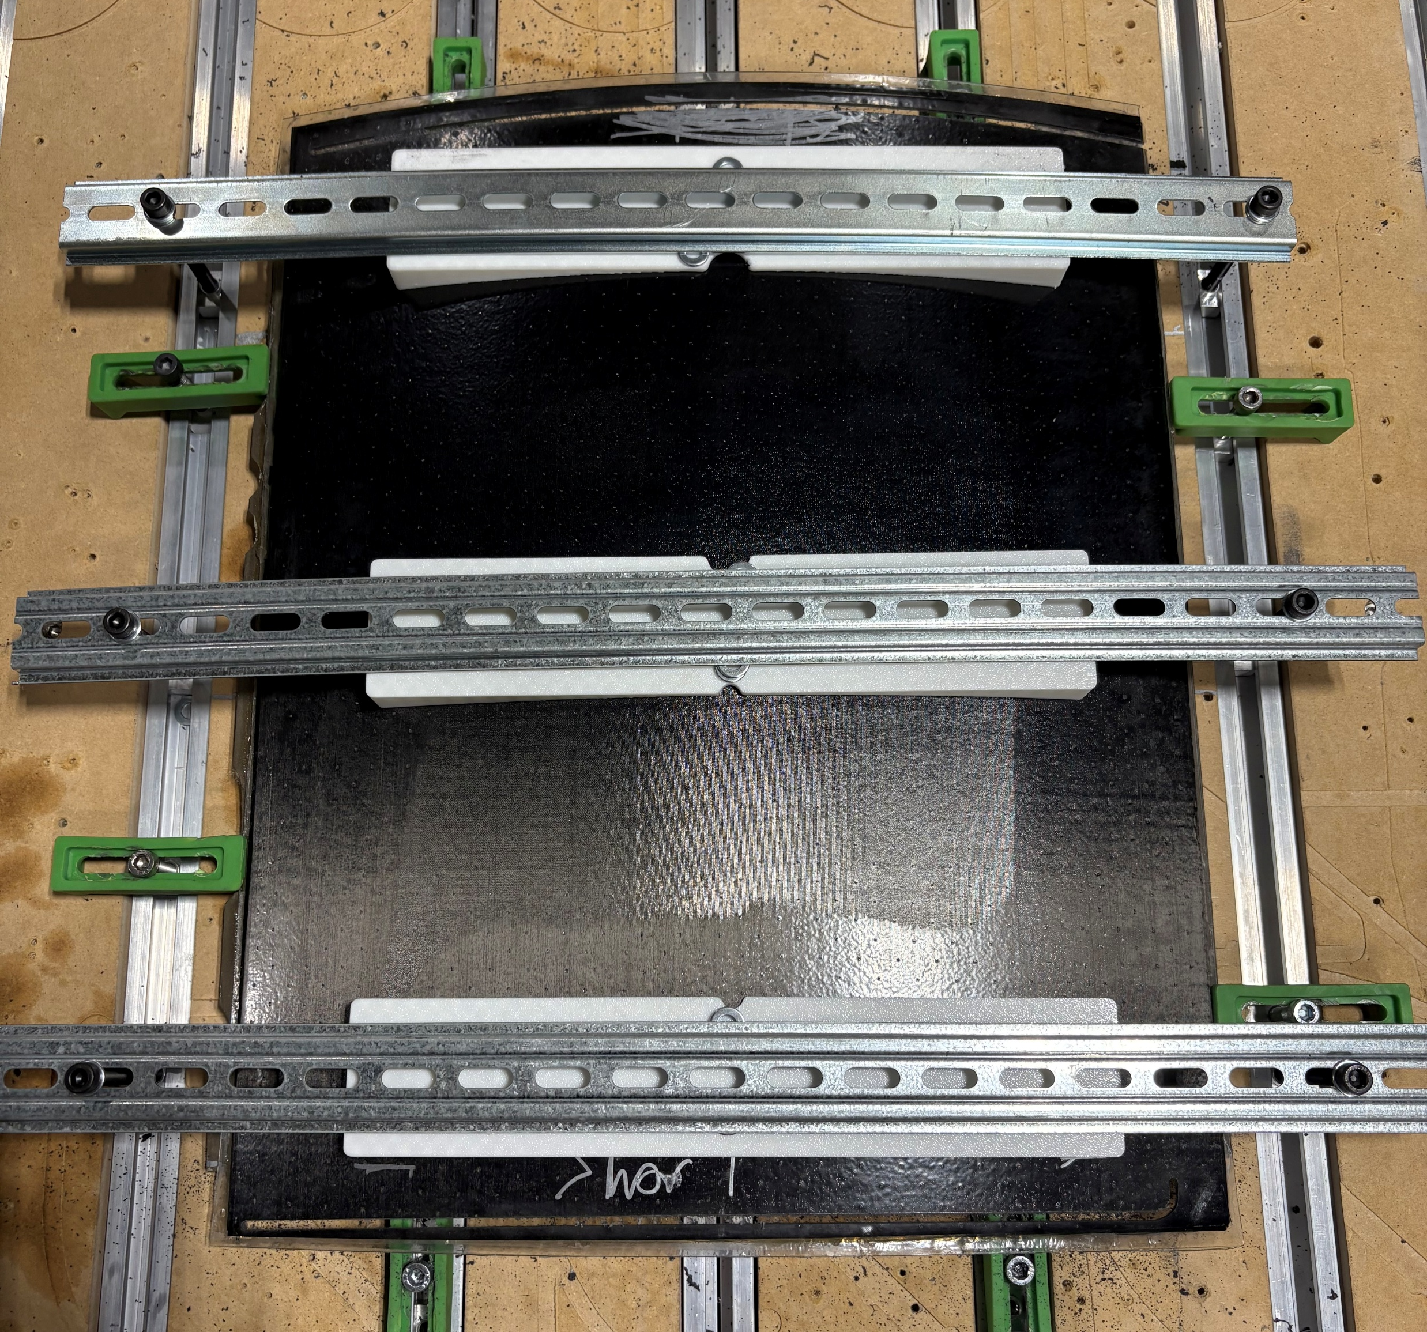
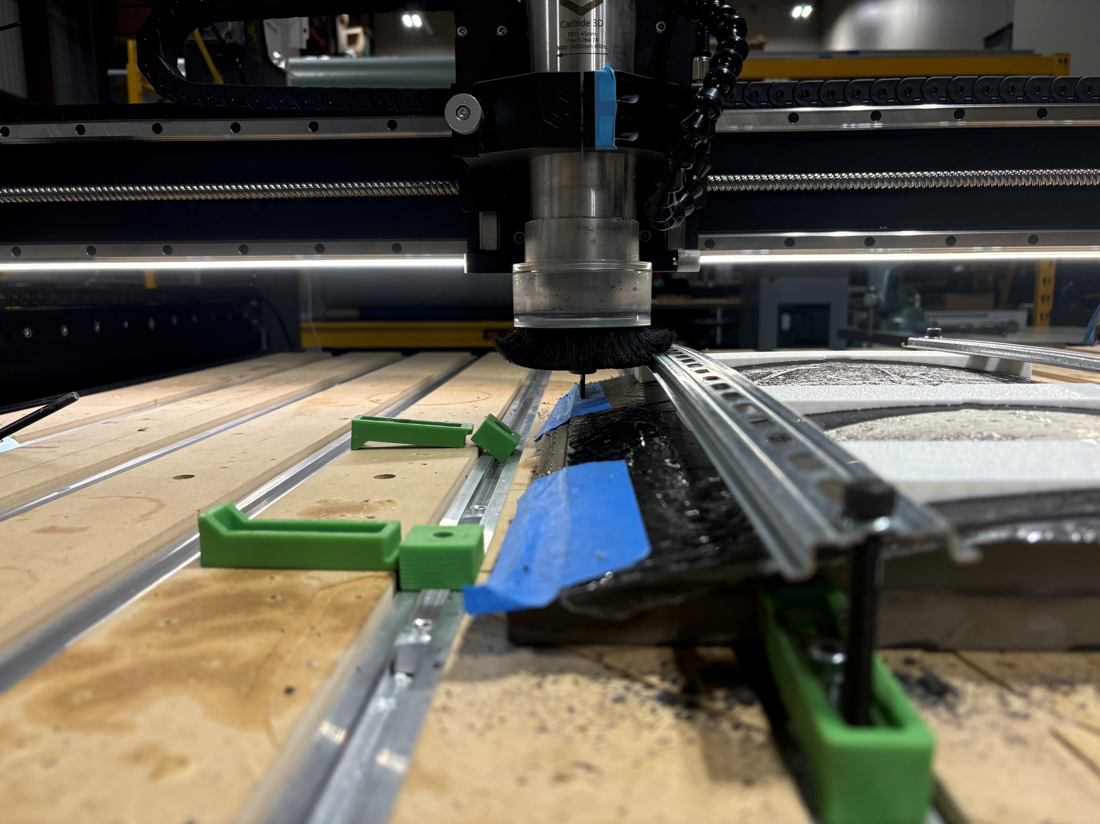
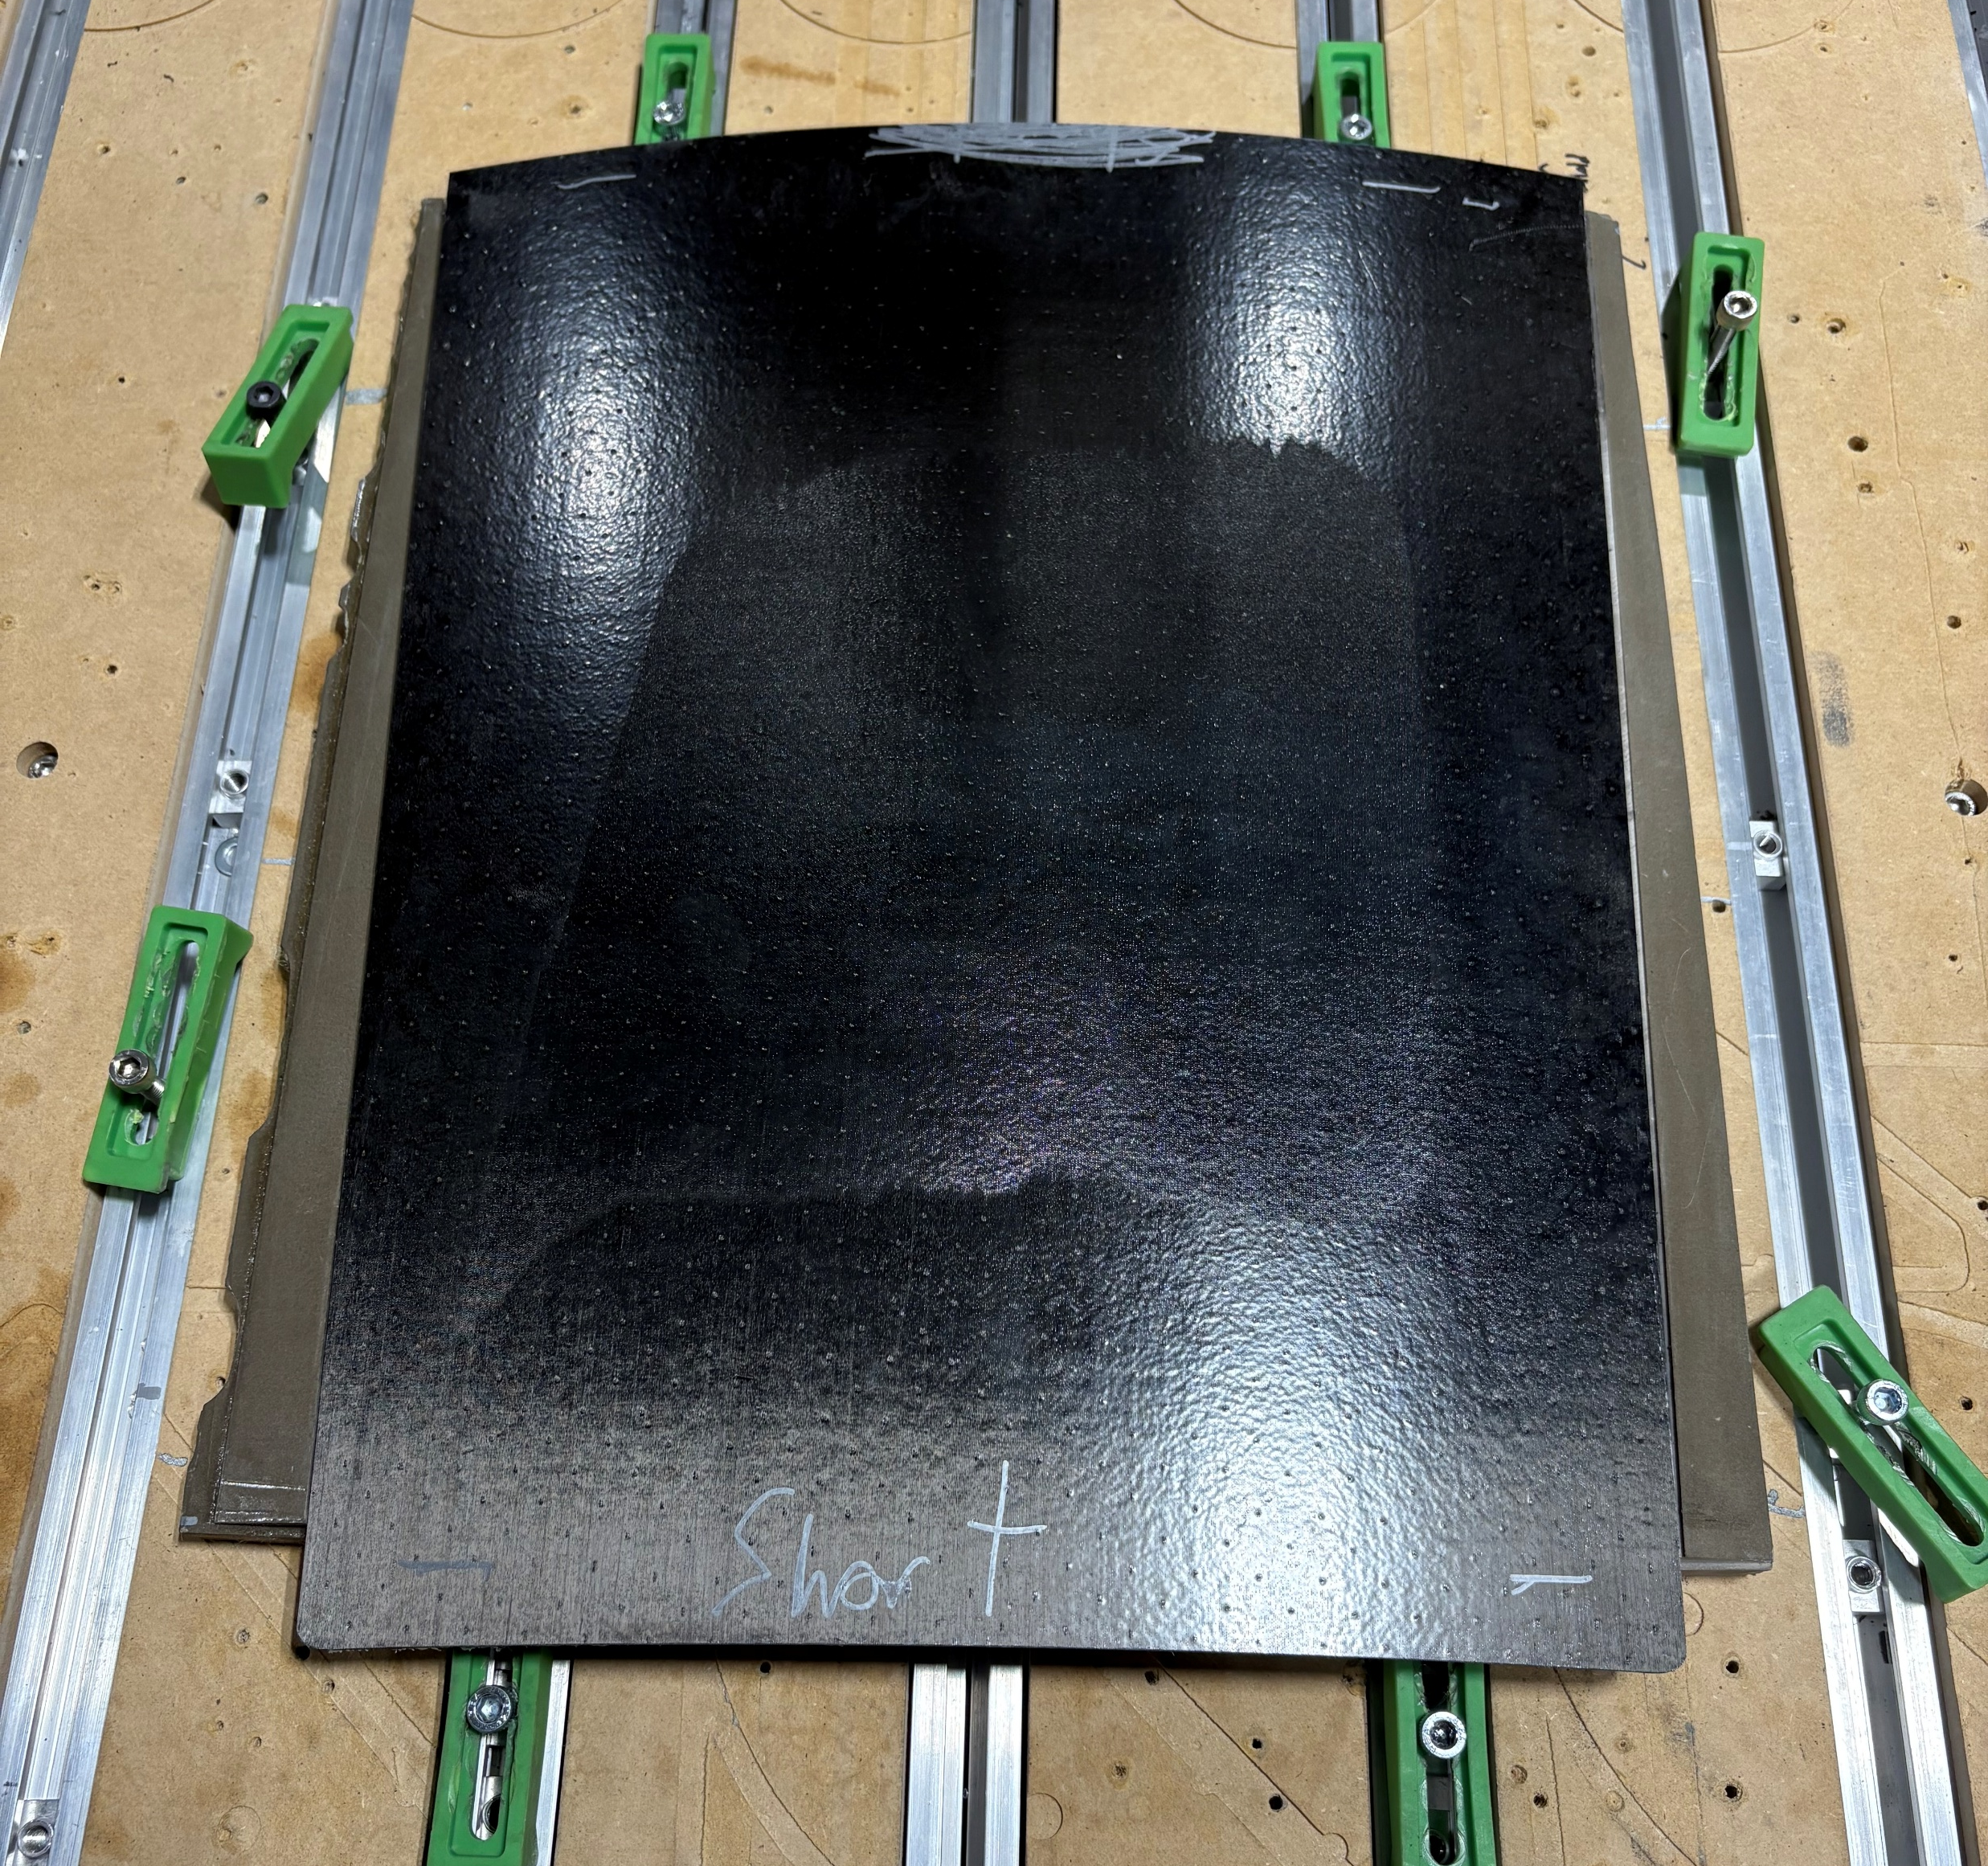
Carbon Mirror Machining
Machined after bonding Lexan to carbon
Previous mold used to support carbon on machine
Used 1/8 inch burr end mill

Slide 3
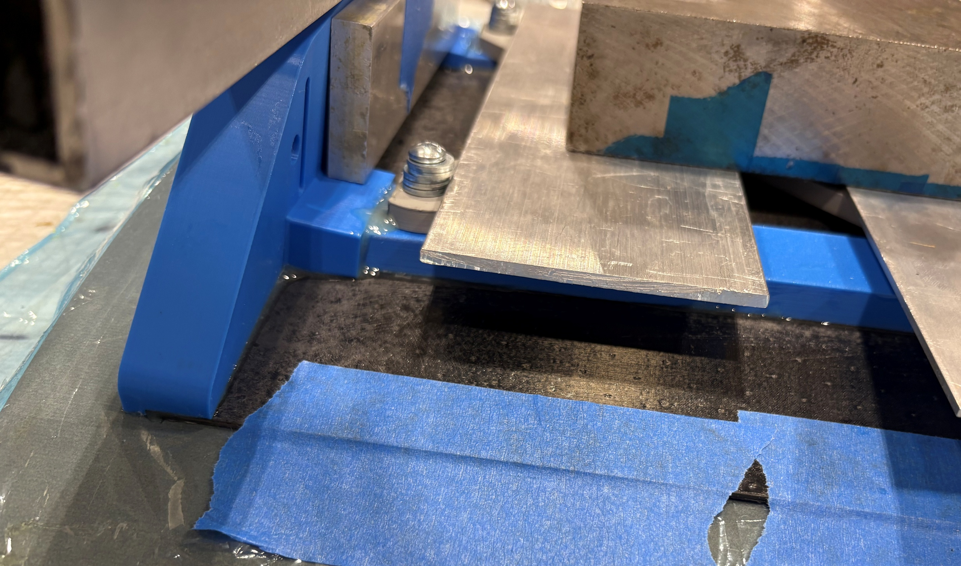
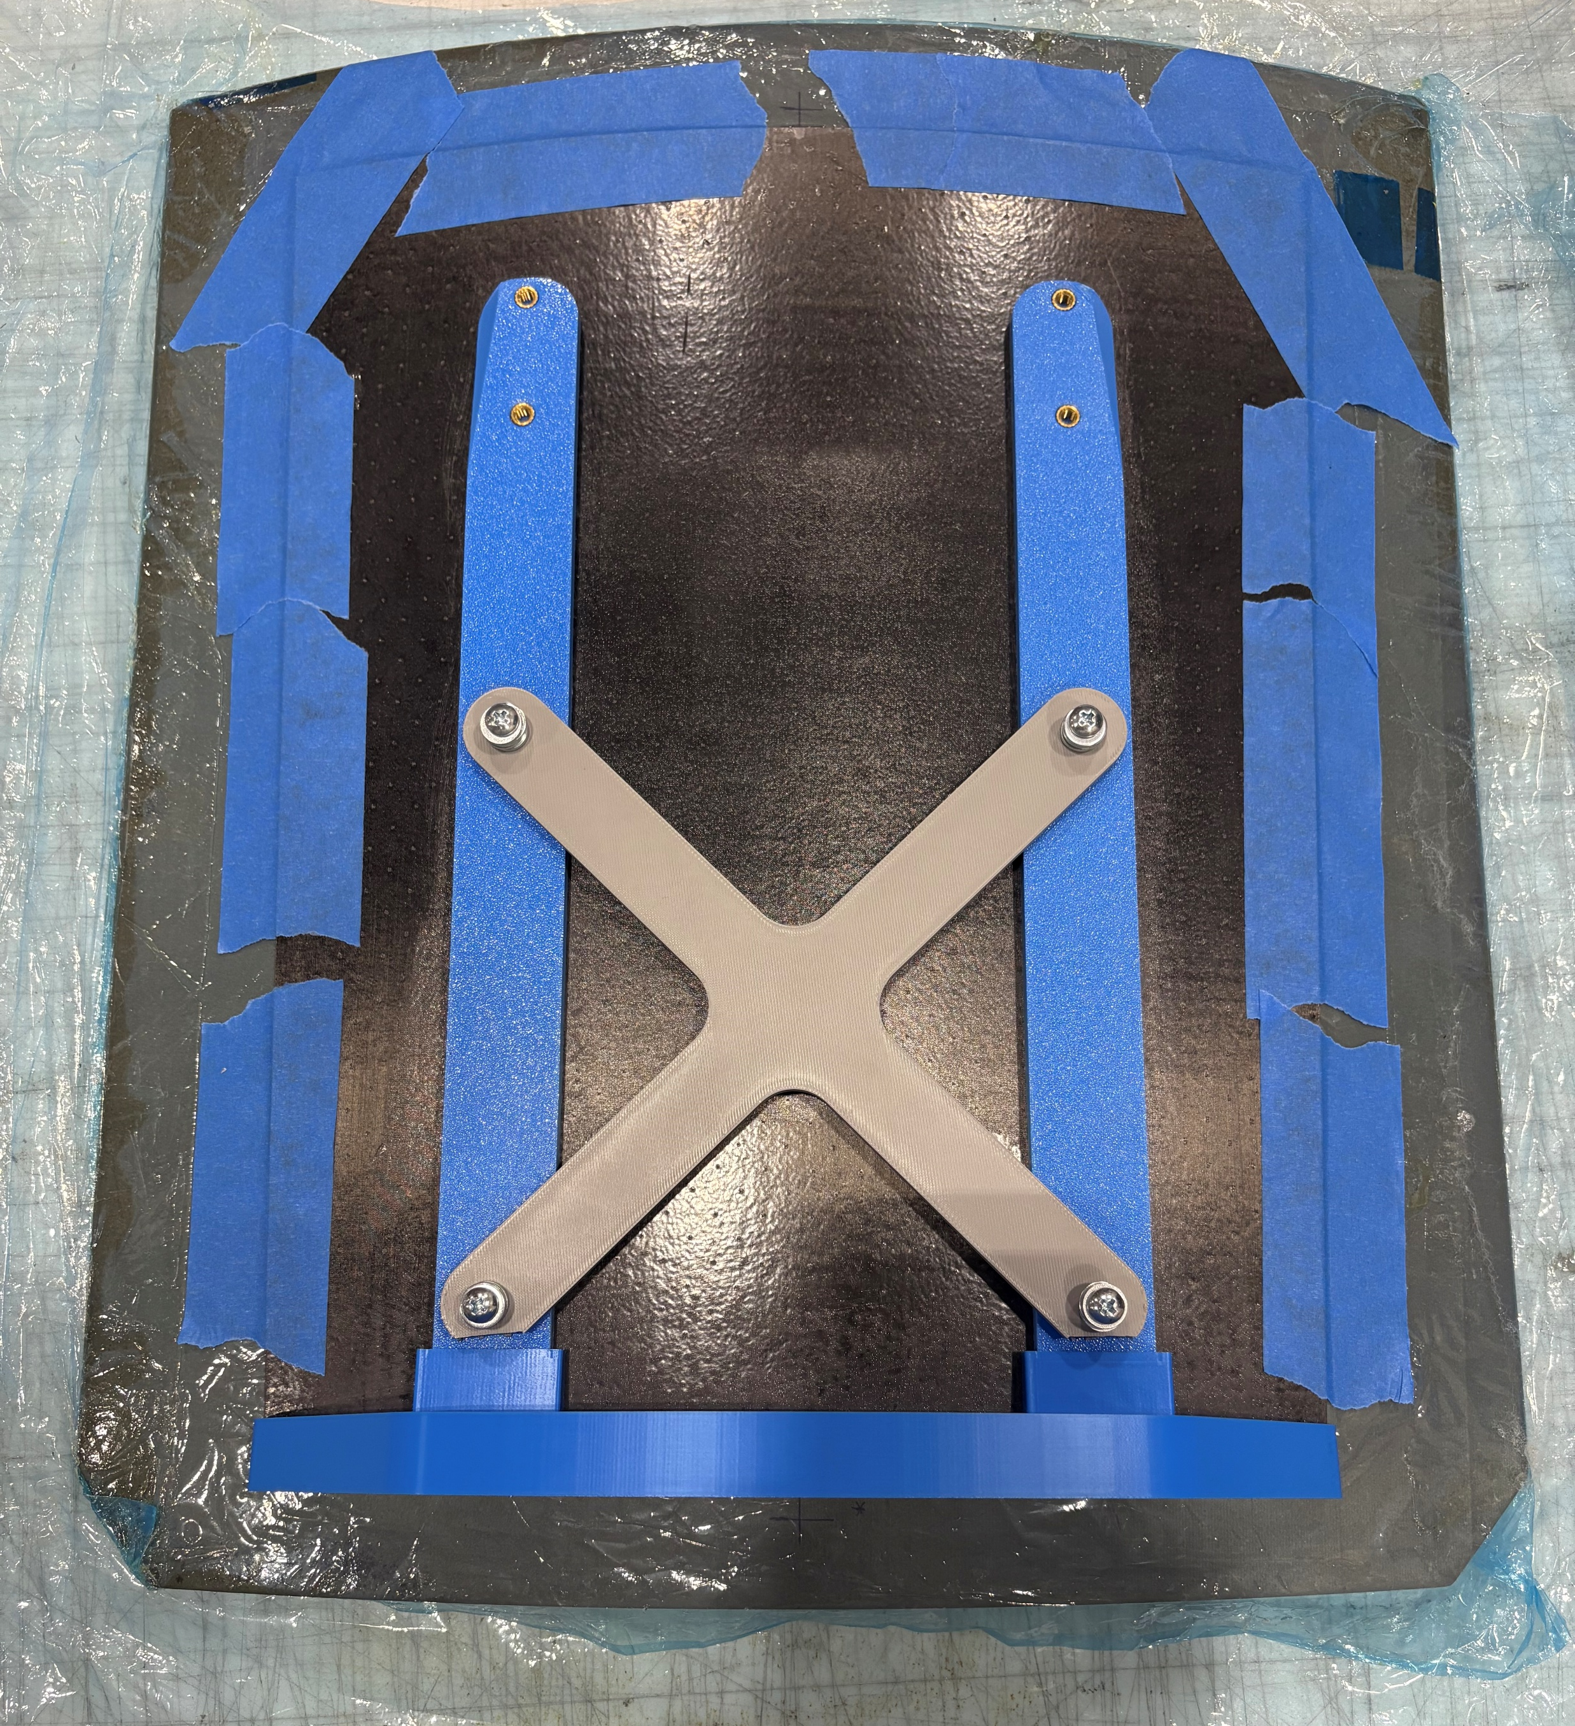
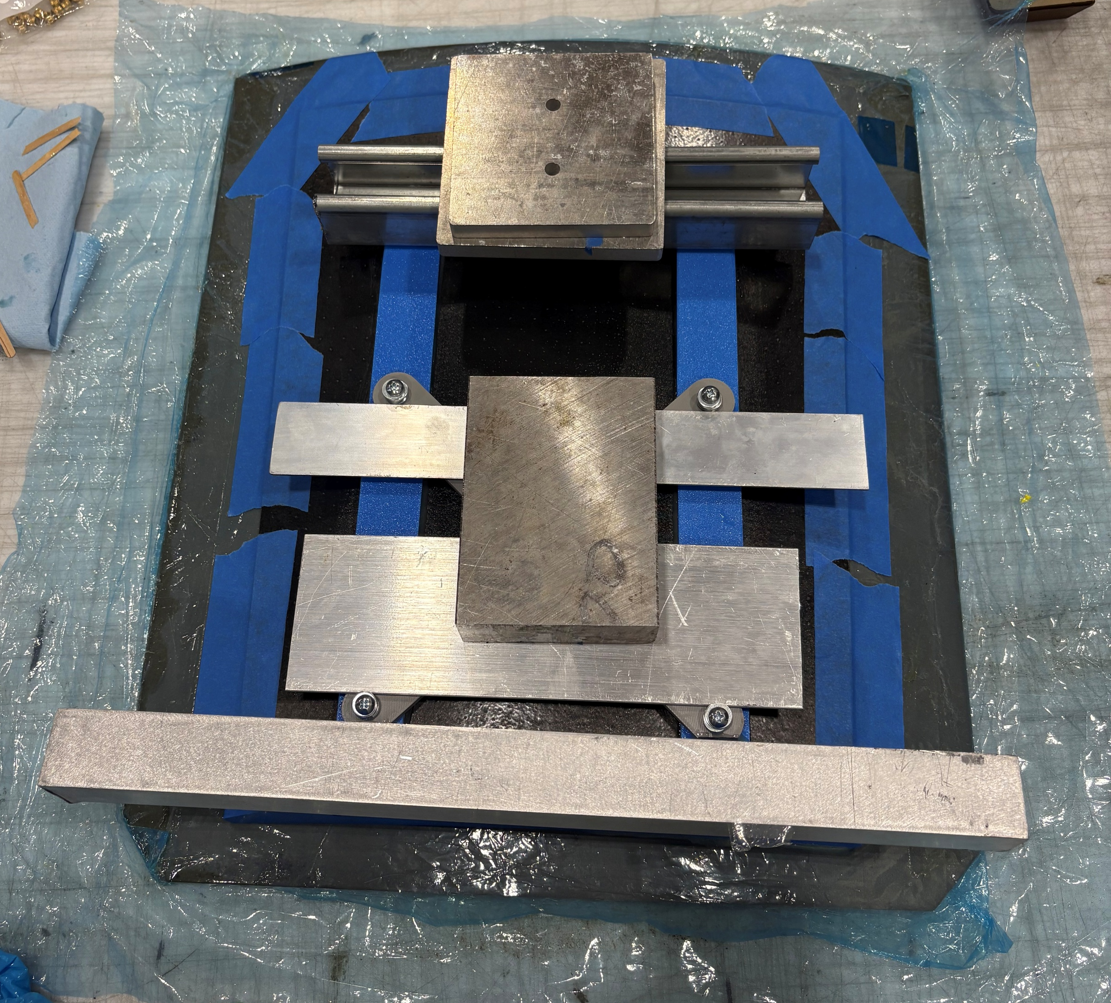
Backing Bonding
Bonded with mirror taped to layup tool
Machined edge used to align foot to mirror
X support keeps uprights aligned
Uprights slide into foot
Bonding steps:
Araldite 2011 applied to all bonding surfaces on printed parts
Uprights slid into foot
Backing placed onto mirror using foot as alignment
Weights added to apply pressure
Cleanup and radiusing of adhesive

Slide 4
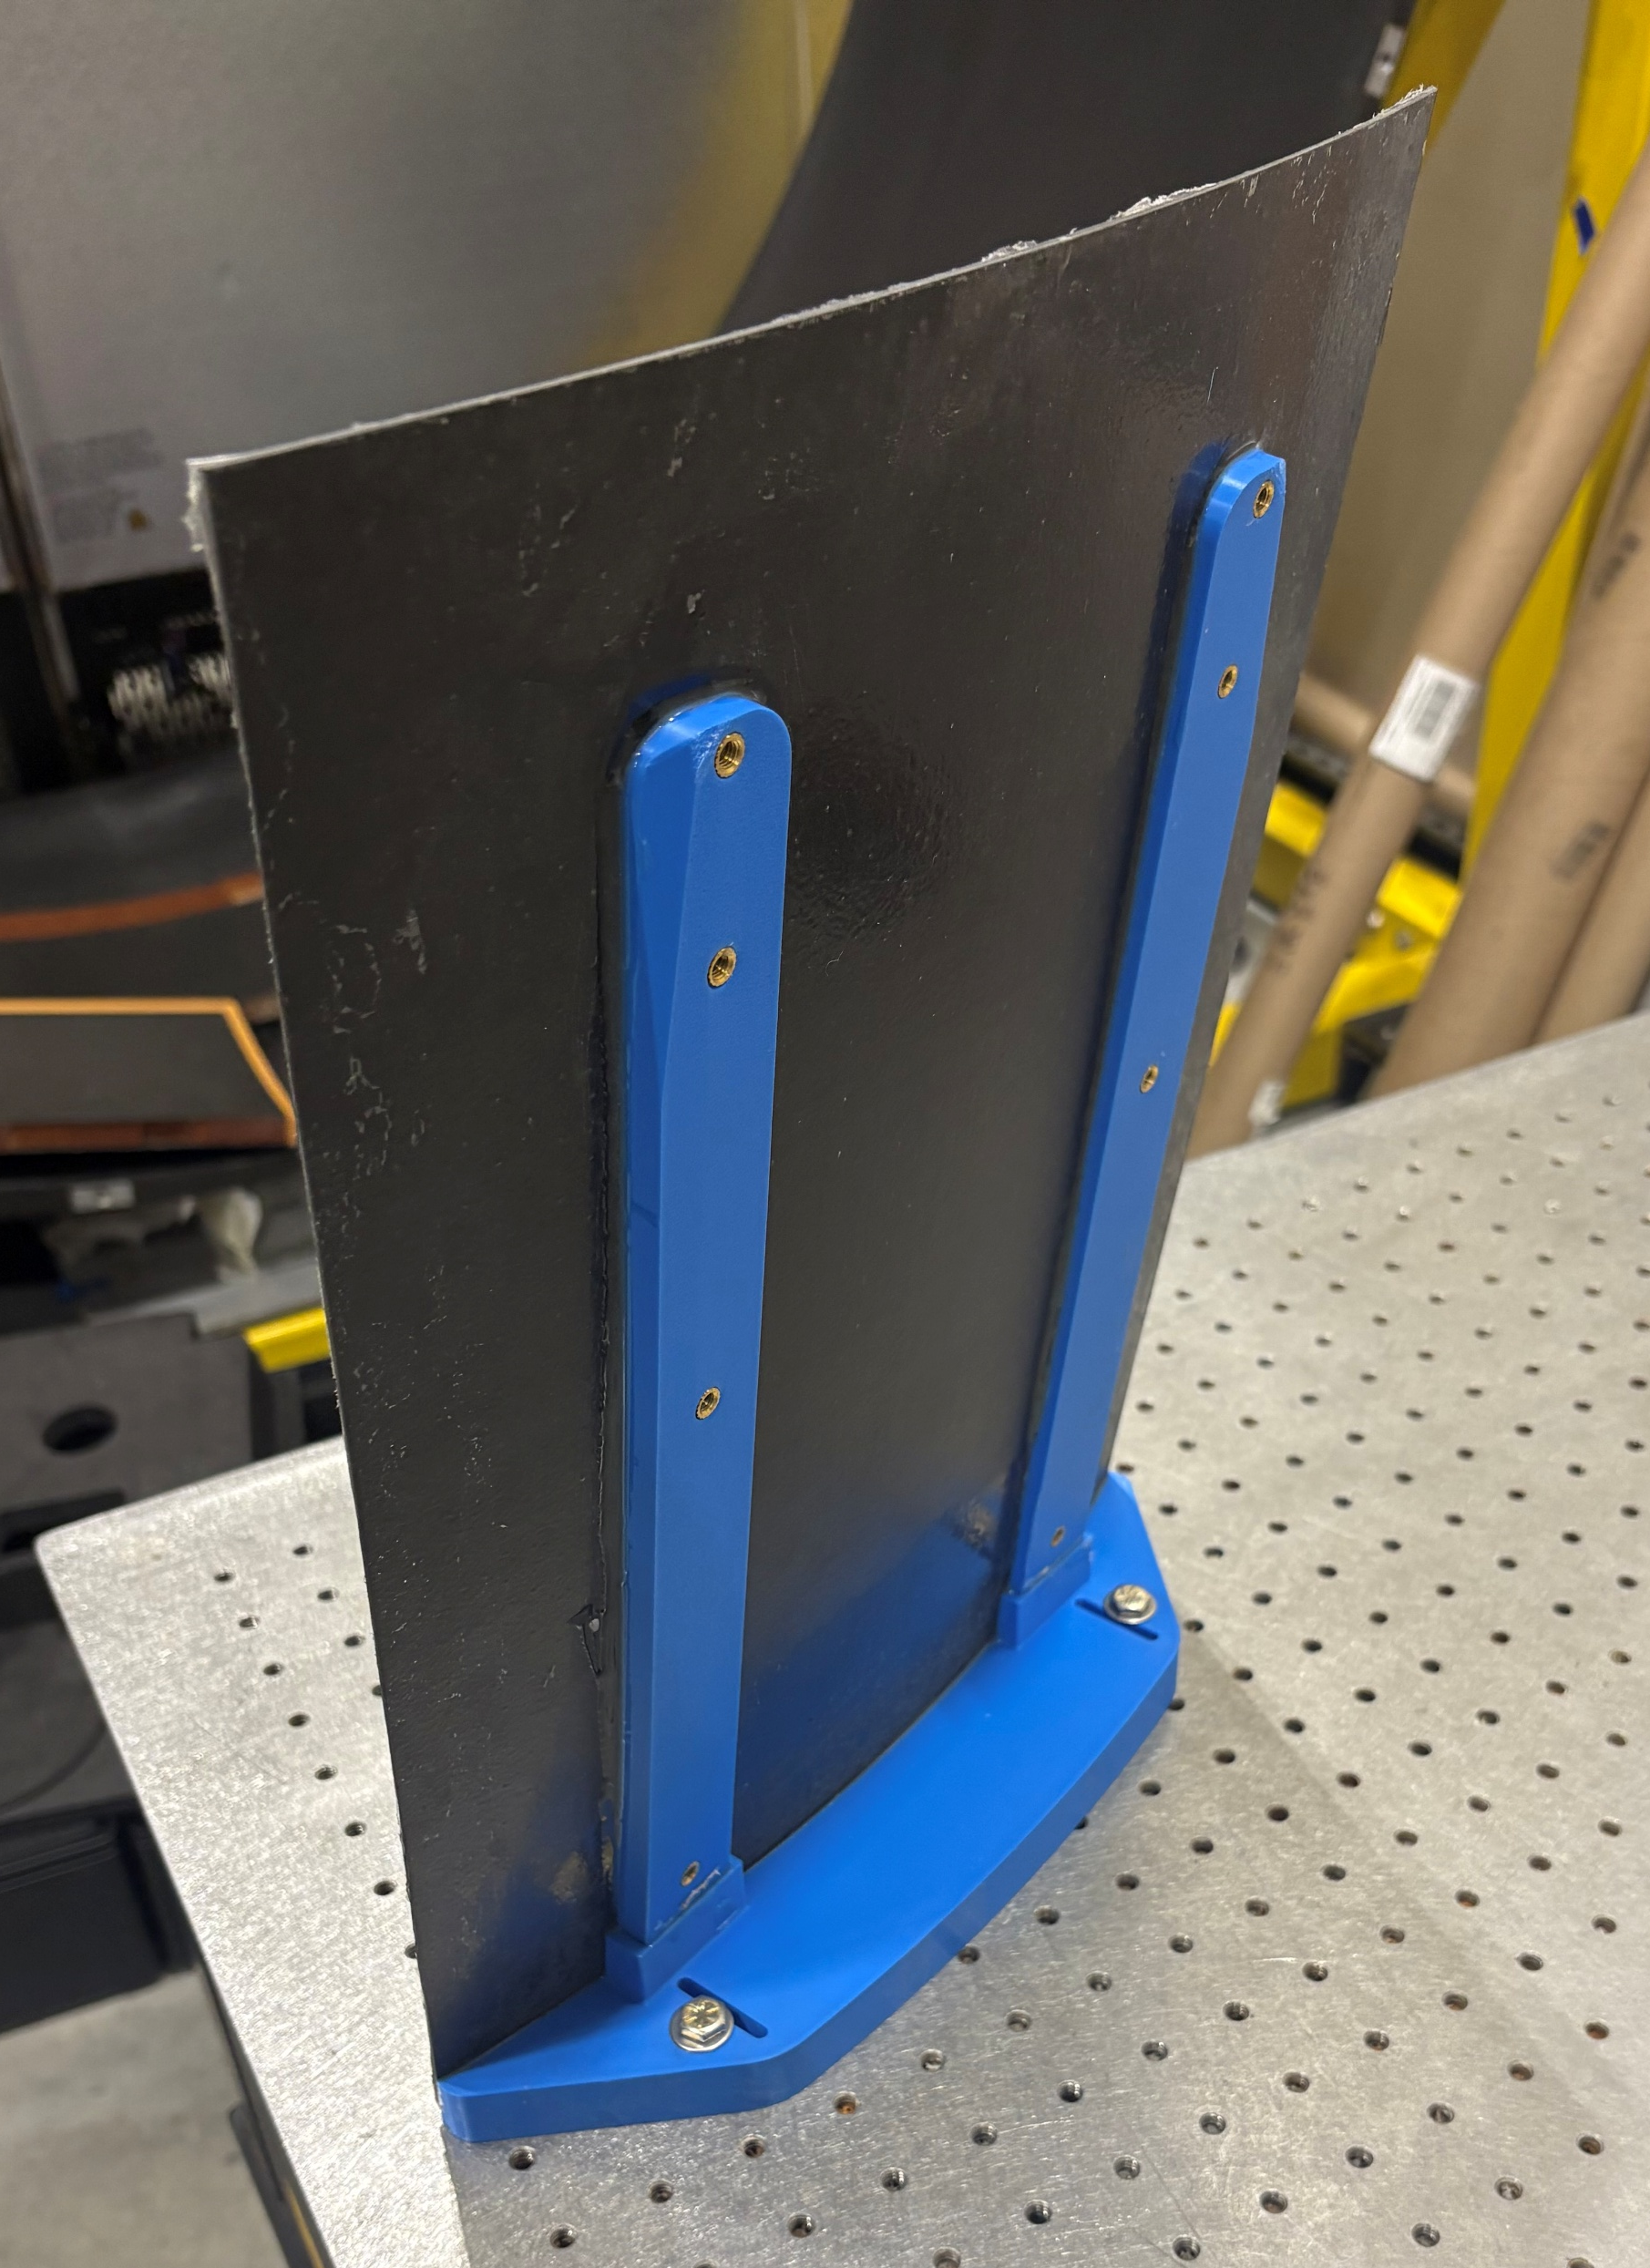
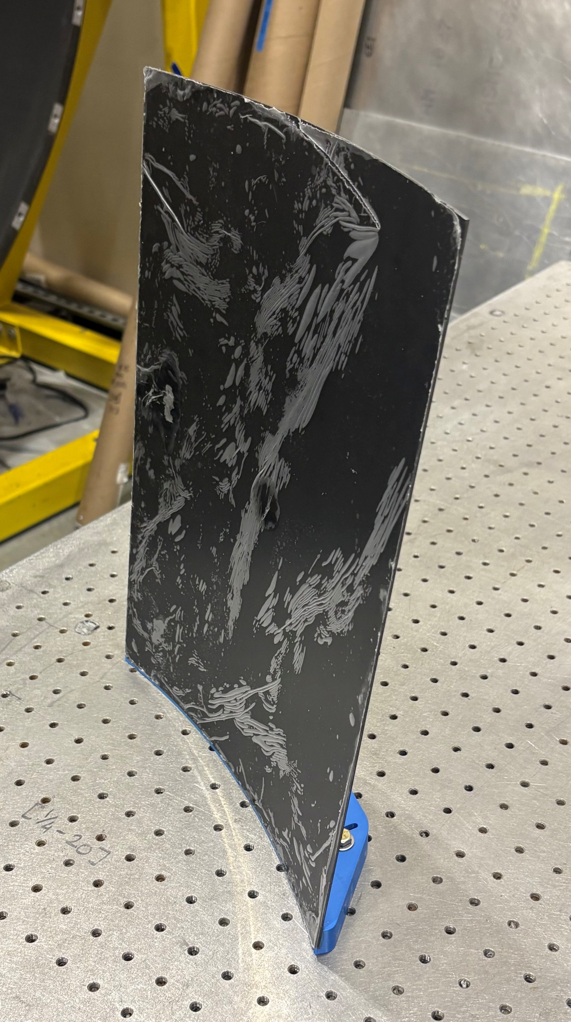
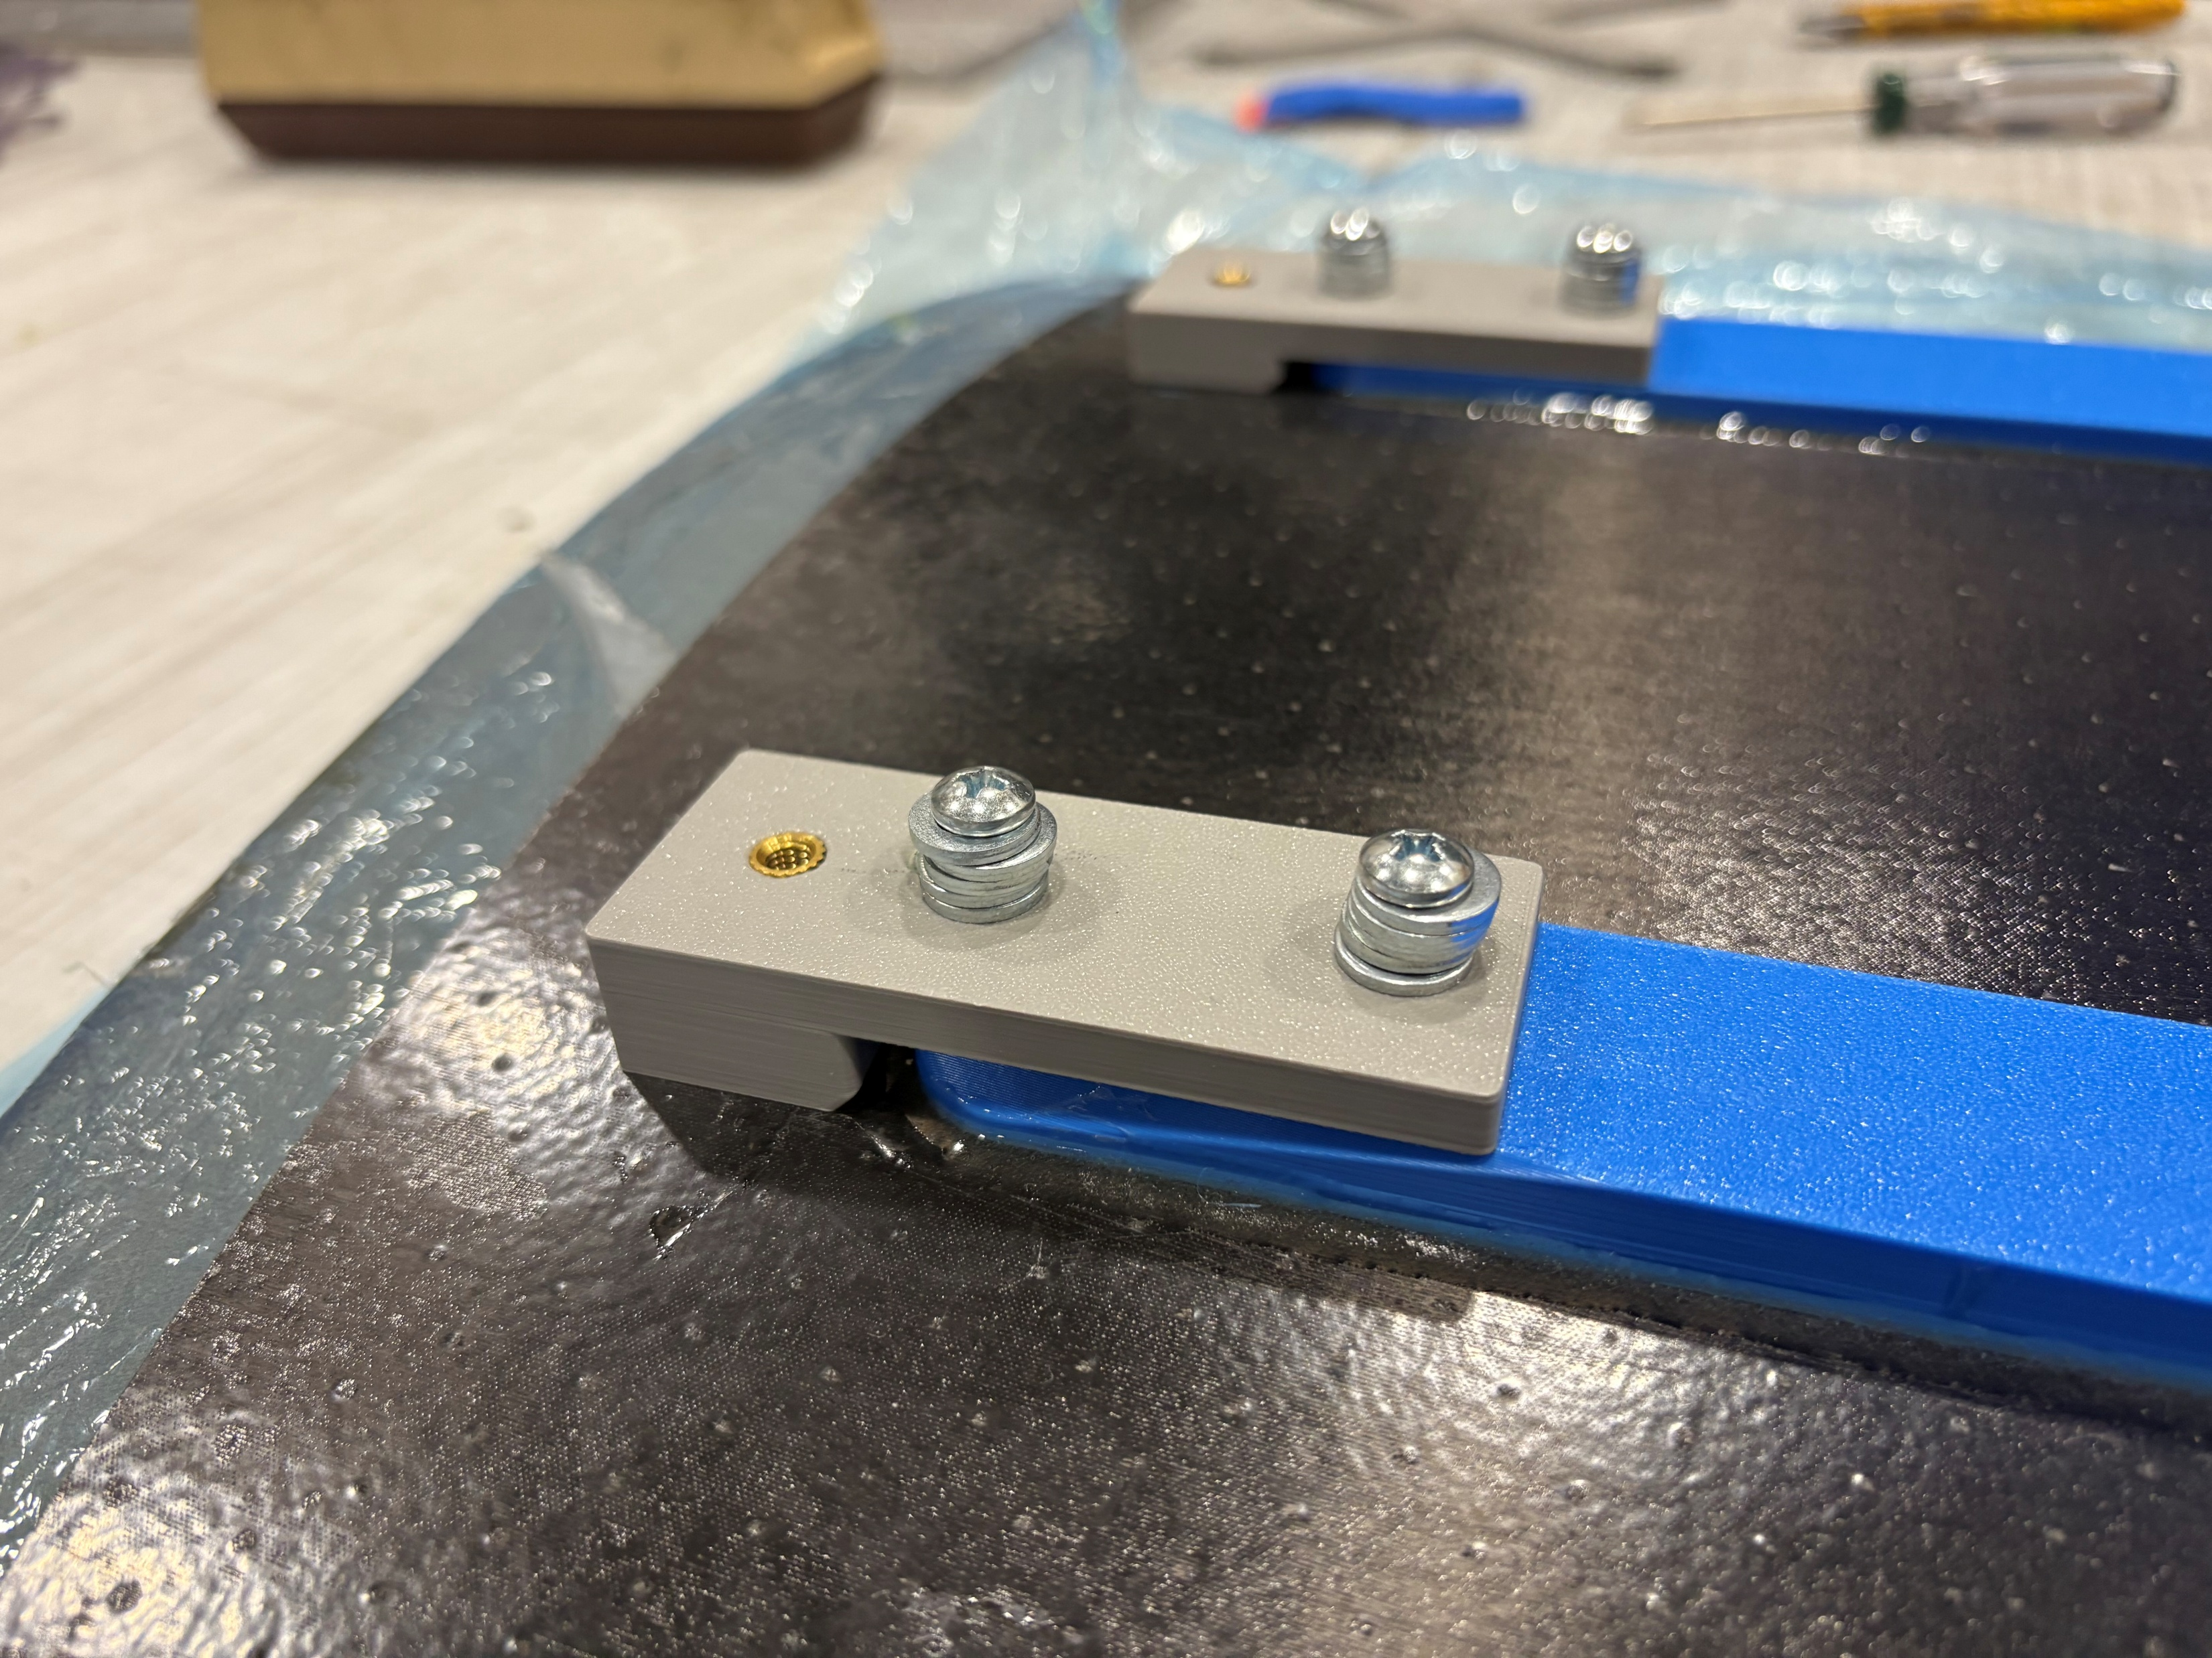
Finished product
Laser scanned to compare shape to nominal (analysis still to be done)
Foot fits on 1-inch spaced optical table diagonally
Estimated delivery Wednesday 4/22

