Slide 1





AC-LGAD Study in Japan
Satoshi Yano
Hiroshima University & RIKEN
AC-LGAD meeting
2026/05/01

Slide 2
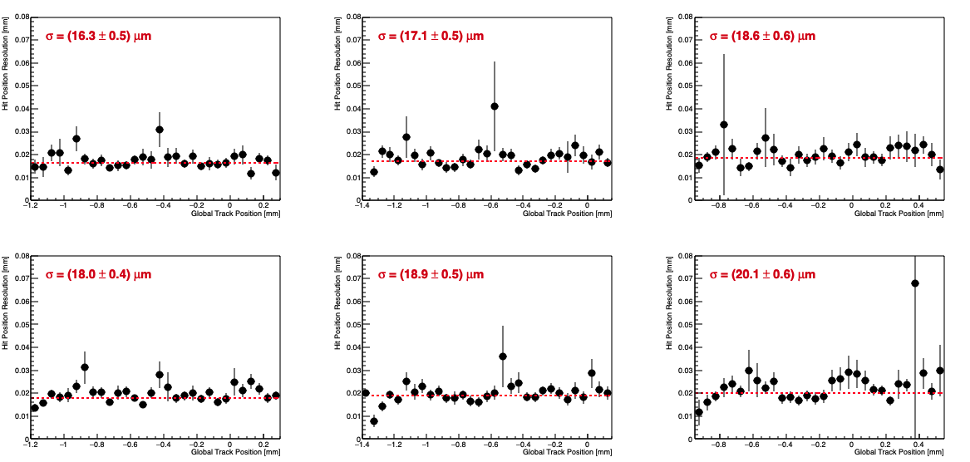
Positioning Resolution of BTOF Sensor
The first test of BTOF sensor (real full-size strip sensor) at DESY shows nice positioning resolution of σ < 20 um (3 sensors x 2cols each = 6 areas)
A long-standing question for BTOF sensor: “How much positioning accuracy is required?”
Sensor#0 - col0
Sensor#1 - col0
Sensor#2 - col0
Sensor#0 – col1
Sensor#1 – col1
Sensor#2 – col1

Slide 3
Signal Delay (Charge Sharing Time)
We observed large signal propagation time, a few μm/ps at middle of strips
This includes not only sensor but also readout board delay
This means ”Hit position determination on sensor surface is crucial for timing measurement”
Leading Strip
Sub-leading Strip

Slide 4
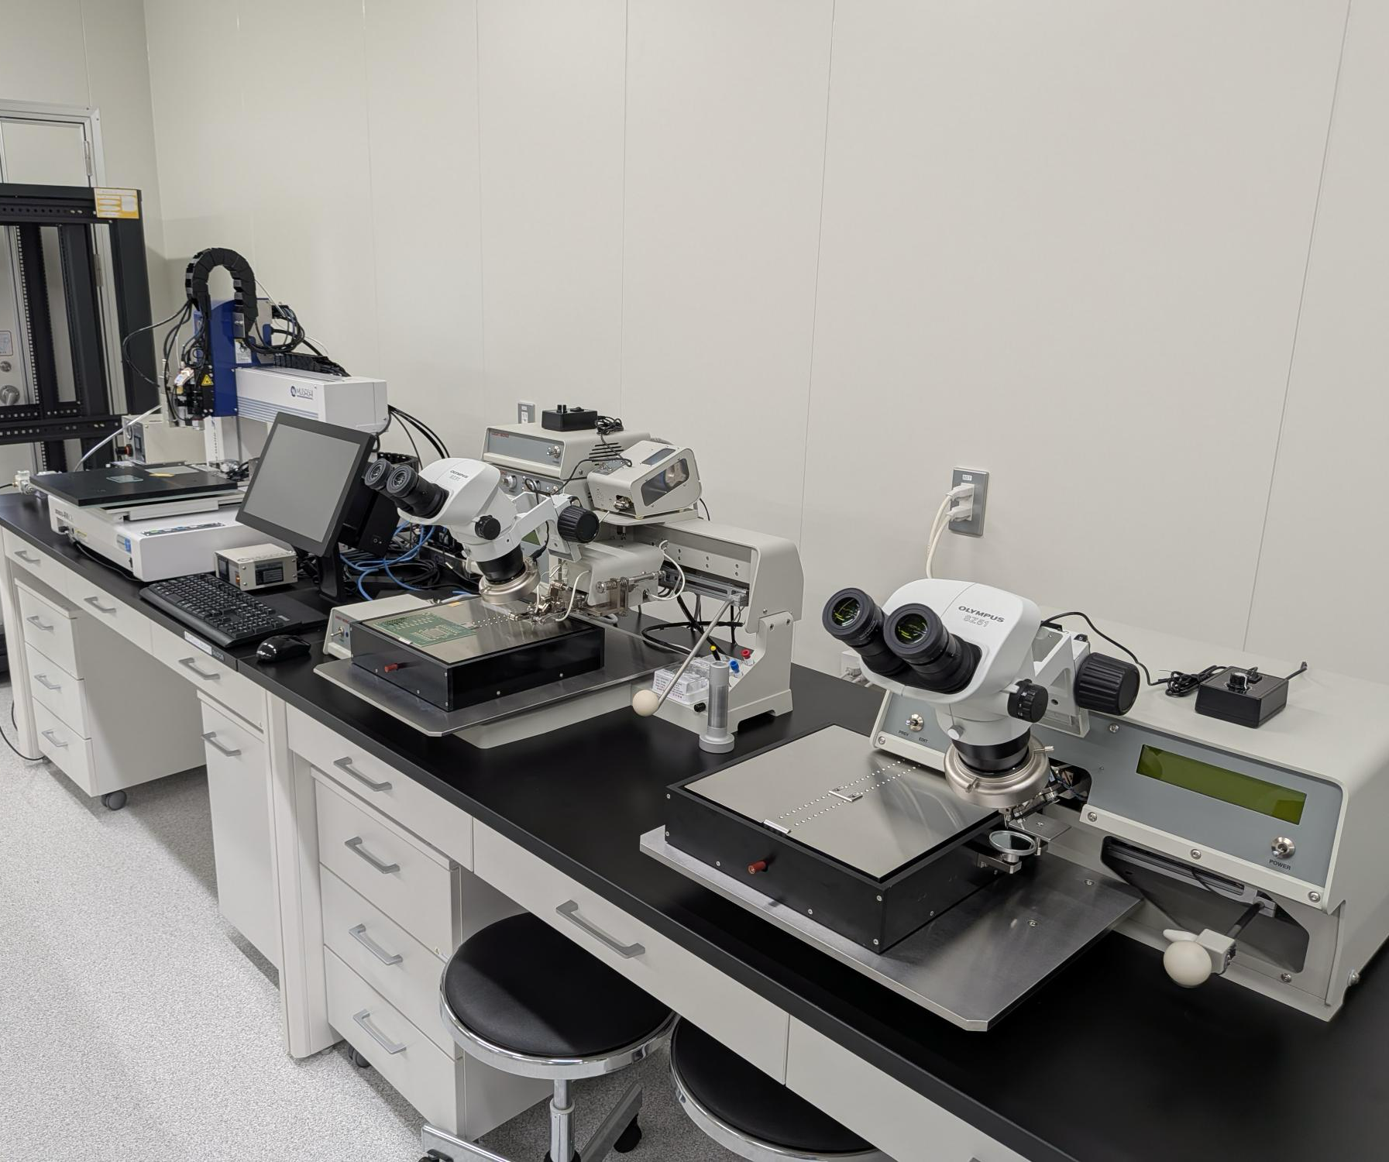
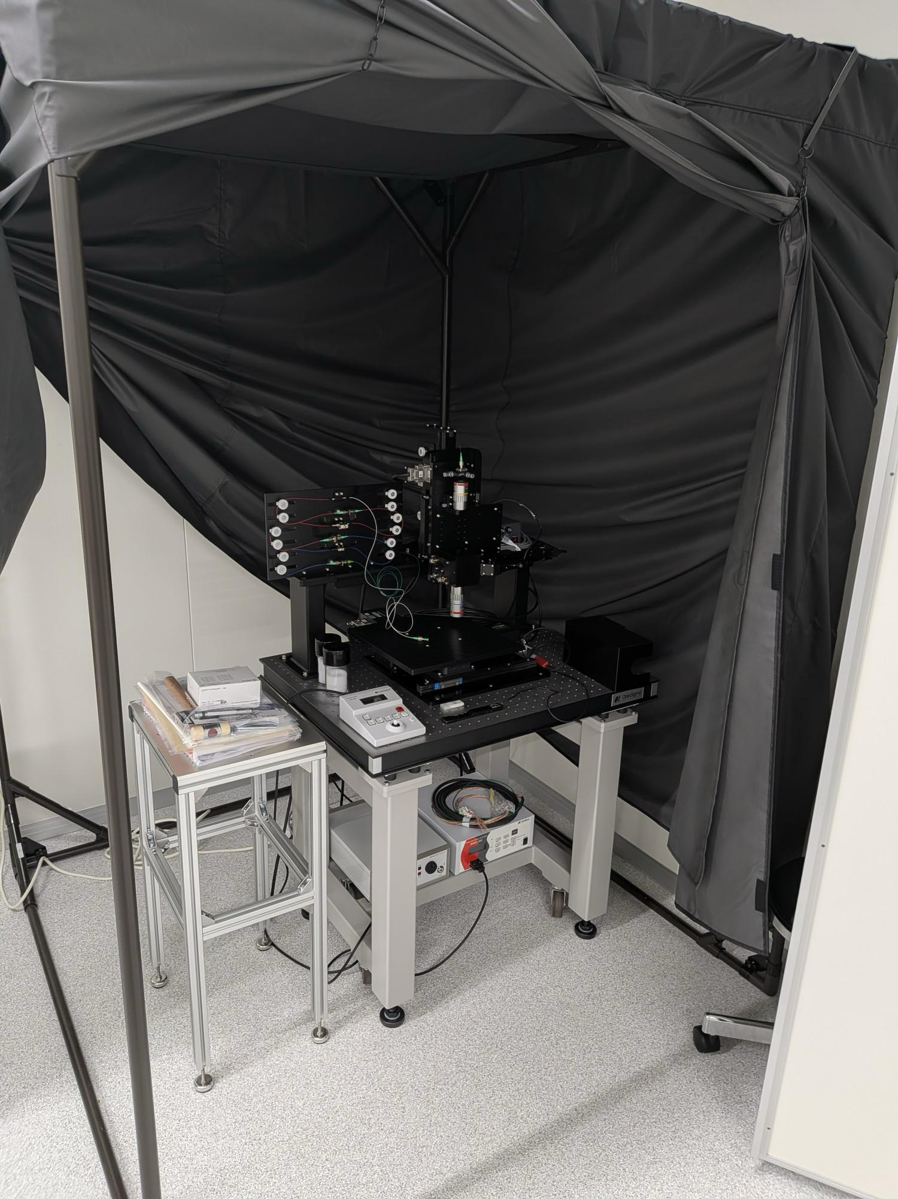

Assembly Site Preparation
Many equipment have been installed in Hiroshima University and RIKEN
Clean room at Hiroshima University will be ready in May

Slide 5
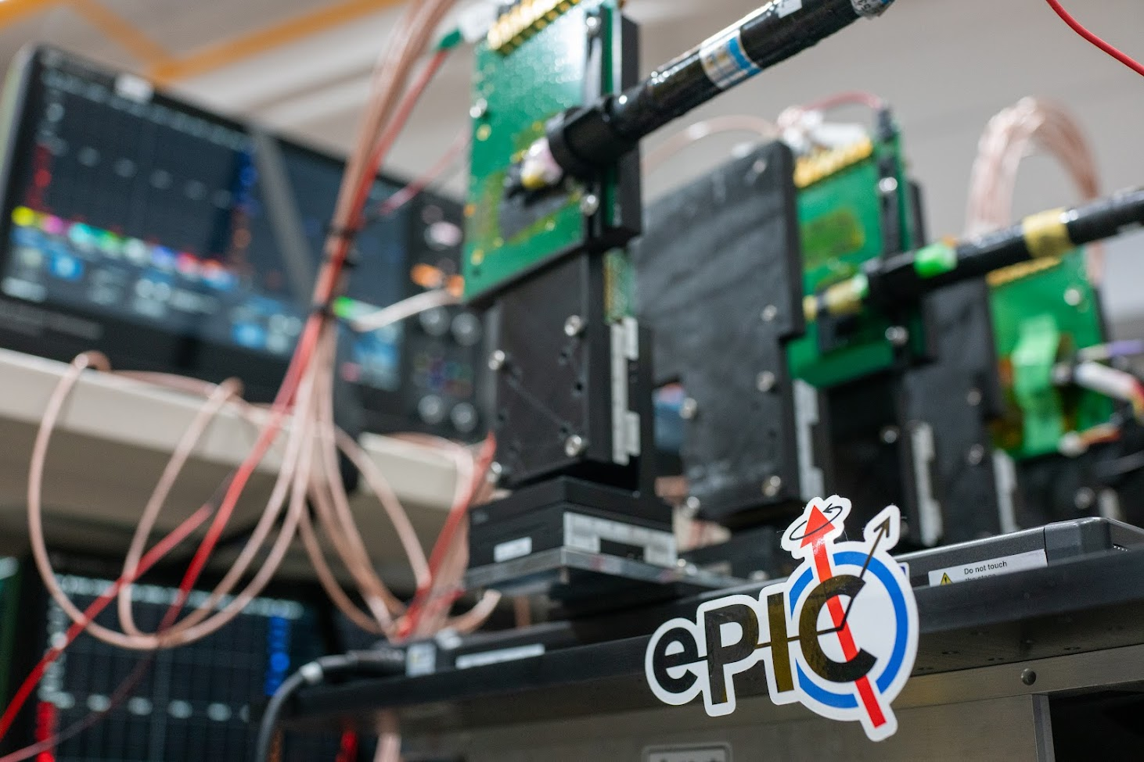
Extra

Slide 6
Setup for Strip-Type AC-LGAD
EUDRBs
Telescope DAQ PC
DUT DAQ PC
20 mm
DIGITIZER
DIGITIZER
32 mm
~11 mm
~4 mm
BUSY
AC-LGAD
TRIGGER
Scintillator
AC-LGAD
Scintillator
AC-LGAD
Scintillator
Wire-Bonded Area
MIMOSA Area Tracker
COINCIDENCE
Used fully independent DAQ is used
Synchronized them by NIM Modules
TLU
TRIGGER

Slide 7
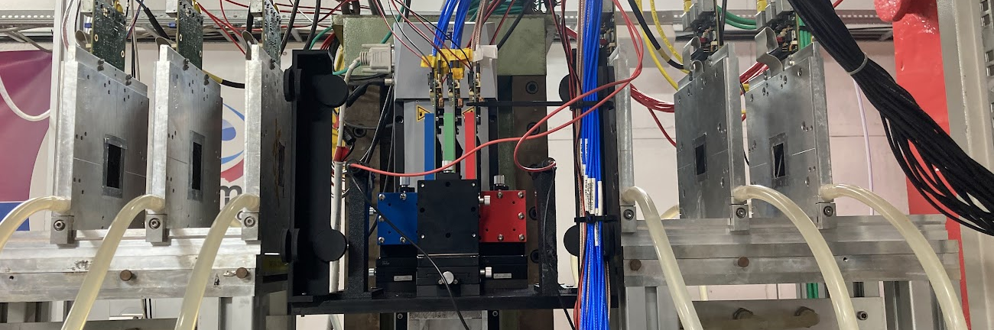
Beam
TRIGGER2＆3
MIMOSA26
DUT
MIMOSA26
TRIGGER1

Slide 8
Readout Strategy
2 configuration modes are used for focusing on hit position resolution and timing resolution measurements, respectively
Timing resolution mode (pattern-1): use three sensors with 10 (5+5) channels each
Positioning resolution mode (pattern-2): use two sensors with 15 (7+8) channels each readout
(Rough) Timing reference: Trigger raw signal into each digitizer
Pattern-1
Timing Measurement
Digitizer1
Pattern-2
Positioning Measurement
Digitizer1
7 rows
5 rows
Digitizer0
Digitizer0
8 rows
5 rows
Beam penetrates one digitizer
↓
Remove jitter between two digitizers
One sensor readout by one digitizer
↓
Remove mis-calibration between two digitizer

Slide 9
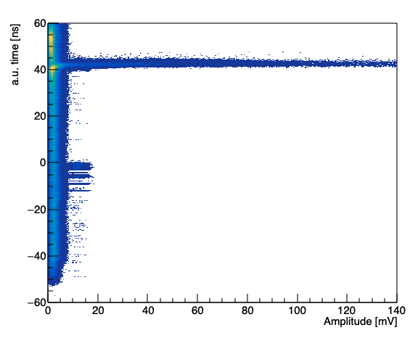
Clustering
Exclude event with the leading strip on edge
Hit beam outside of the acceptance
Timing calibration is not enough for timing resolution measurement
Trigger signal is used as timing reference
Cut for leading strip
After leading strip cut
Timing Window
Pedestal Peak
Noise

Slide 10
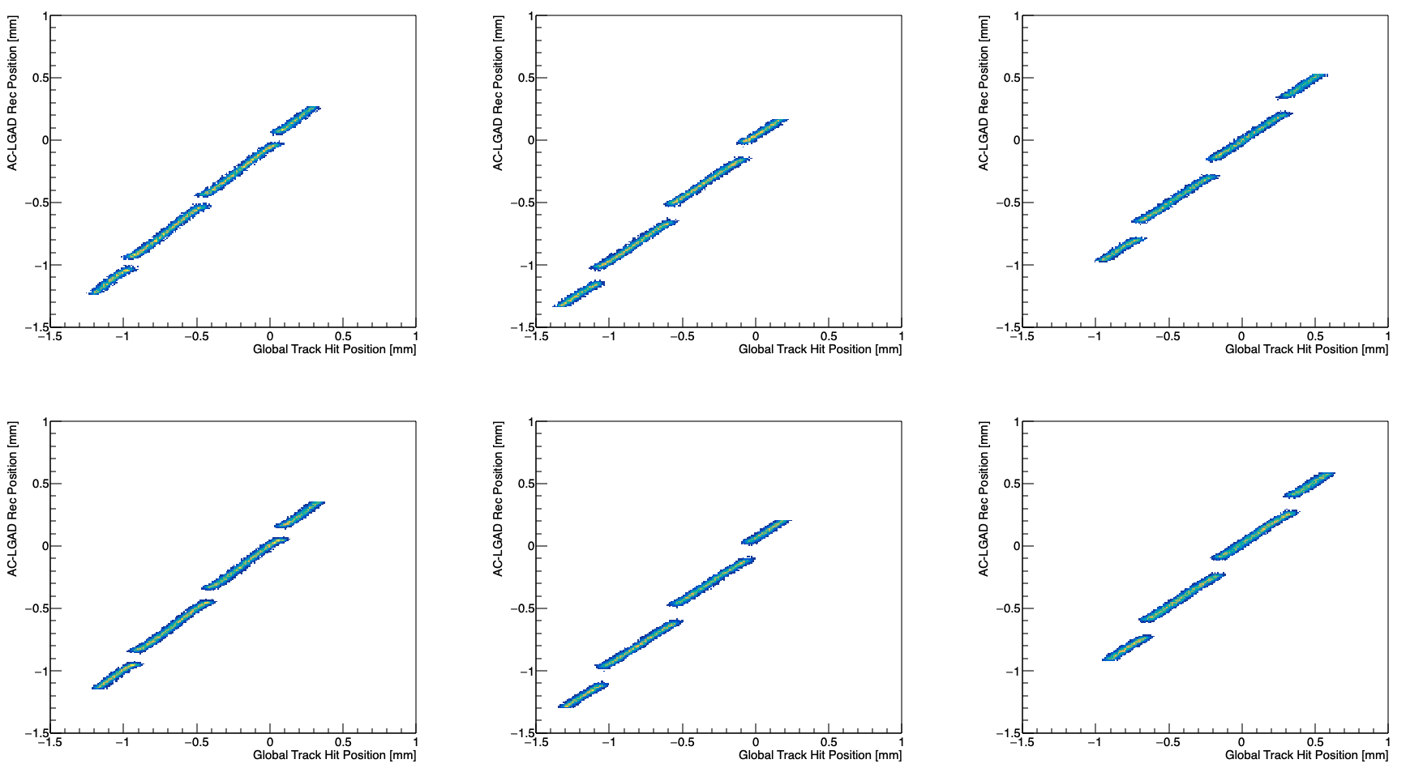
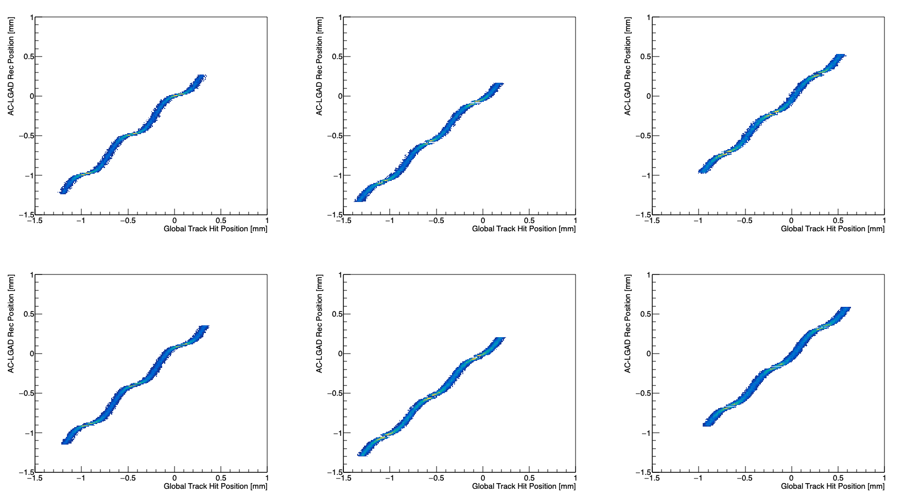
Simple Hit Position Reconstruction
Weighted (Σwx/Σw) and Squared-weighted (Σw²x/Σw²) method has been performed
Top-2 amplitude (leading and sub-leading) strips are used
Weighted
Squared-Weighted
Sensor#0 - col0
Sensor#1 - col0
Sensor#2 - col0
Sensor#0 - col0
Sensor#1 - col0
Sensor#2 - col0
Sensor#0 – col1
Sensor#1 – col1
Sensor#2 – col1
Sensor#0 – col1
Sensor#1 – col1
Sensor#2 – col1
The charge distribution is not linear with respect to the distance to the strip!!!!

Slide 11
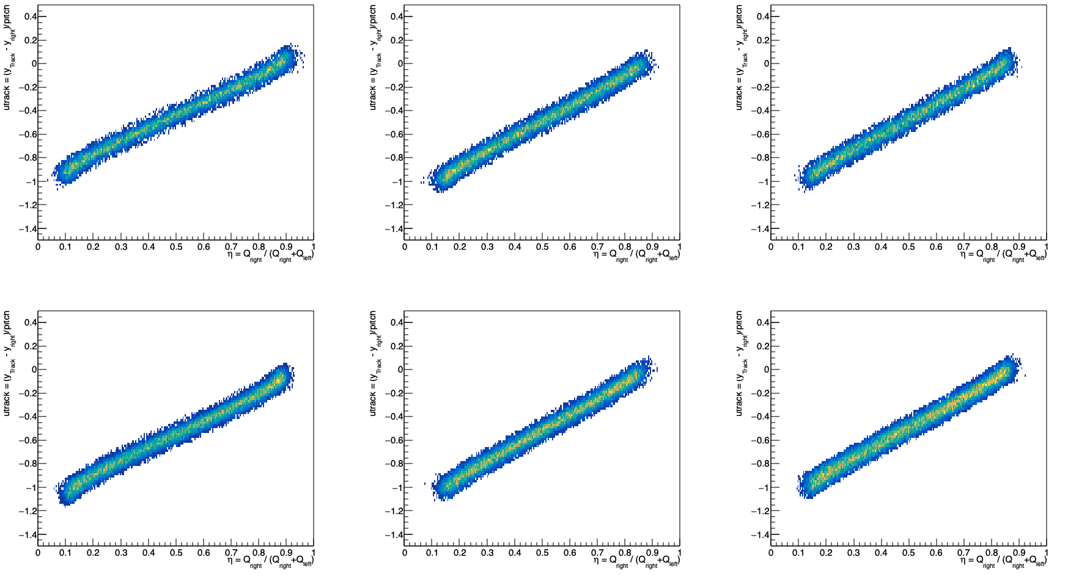
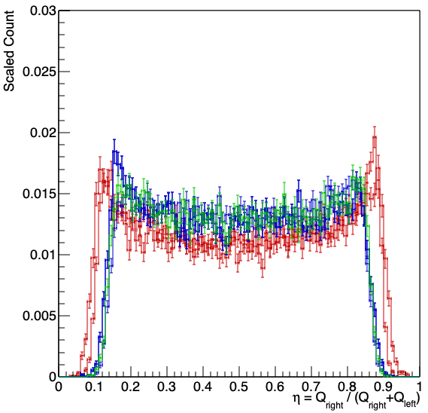
Track-Based η Correction
y_{left}
y_{track}
y_{right}
Charge share is not linear → Simple-weighting method doesn’t work
Eta v.s. utrack (leading and sub-leading strips)
η = Q_{right} / (Q_{left} + Q_{right})
utrack = (y_{track} - y_{right}) / strip-pitch
Q_{left}
Q_{right}
Strip Pitch
Sensor#0 - col0
Sensor#1 - col0
Sensor#2 - col0
Sensor0
Sensor1
Sensor2
Sensor#0 – col1
Sensor#1 – col1
Sensor#2 – col1

Slide 12
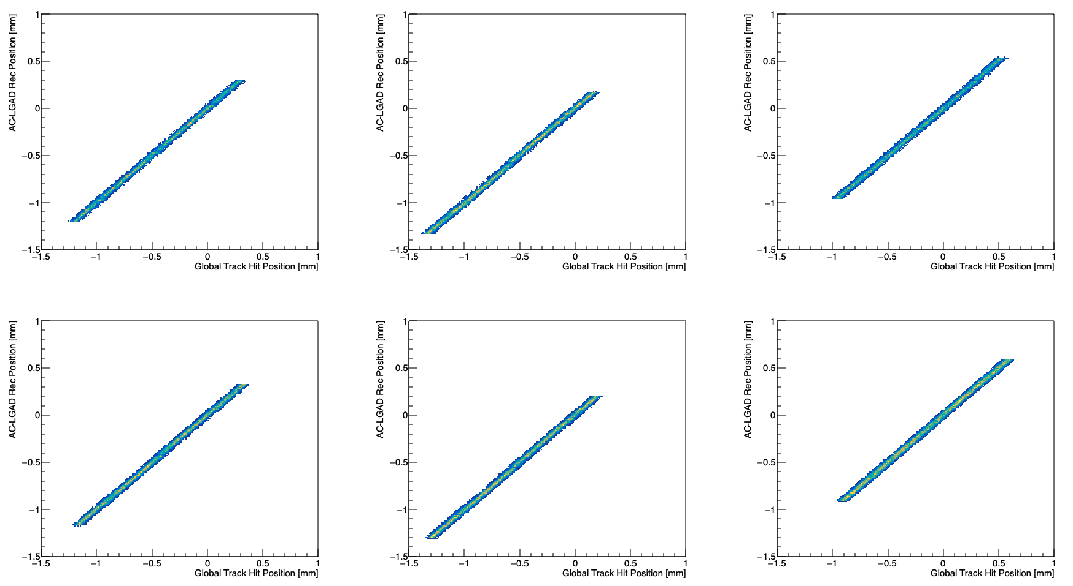
Reconstructed Hit Position
Sensor#0 - col0
Sensor#1 - col0
Sensor#2 - col0
Sensor#0 – col1
Sensor#1 – col1
Sensor#2 – col1

Slide 13
Hit Positioning Resolution
Residual (Track position – ACLGAD position) as a function of global position has been calculated
Track-Based η correction has been applied
Positioning resolution (including tracking resolution) achieves <20 um
Resolution of Sensor0 > Sensor1 > Sensor2 due to multiple scattering in the front DUTs
Sensor#0 - col0
Sensor#1 - col0
Sensor#2 - col0
Sensor#0 – col1
Sensor#1 – col1
Sensor#2 – col1

Slide 14
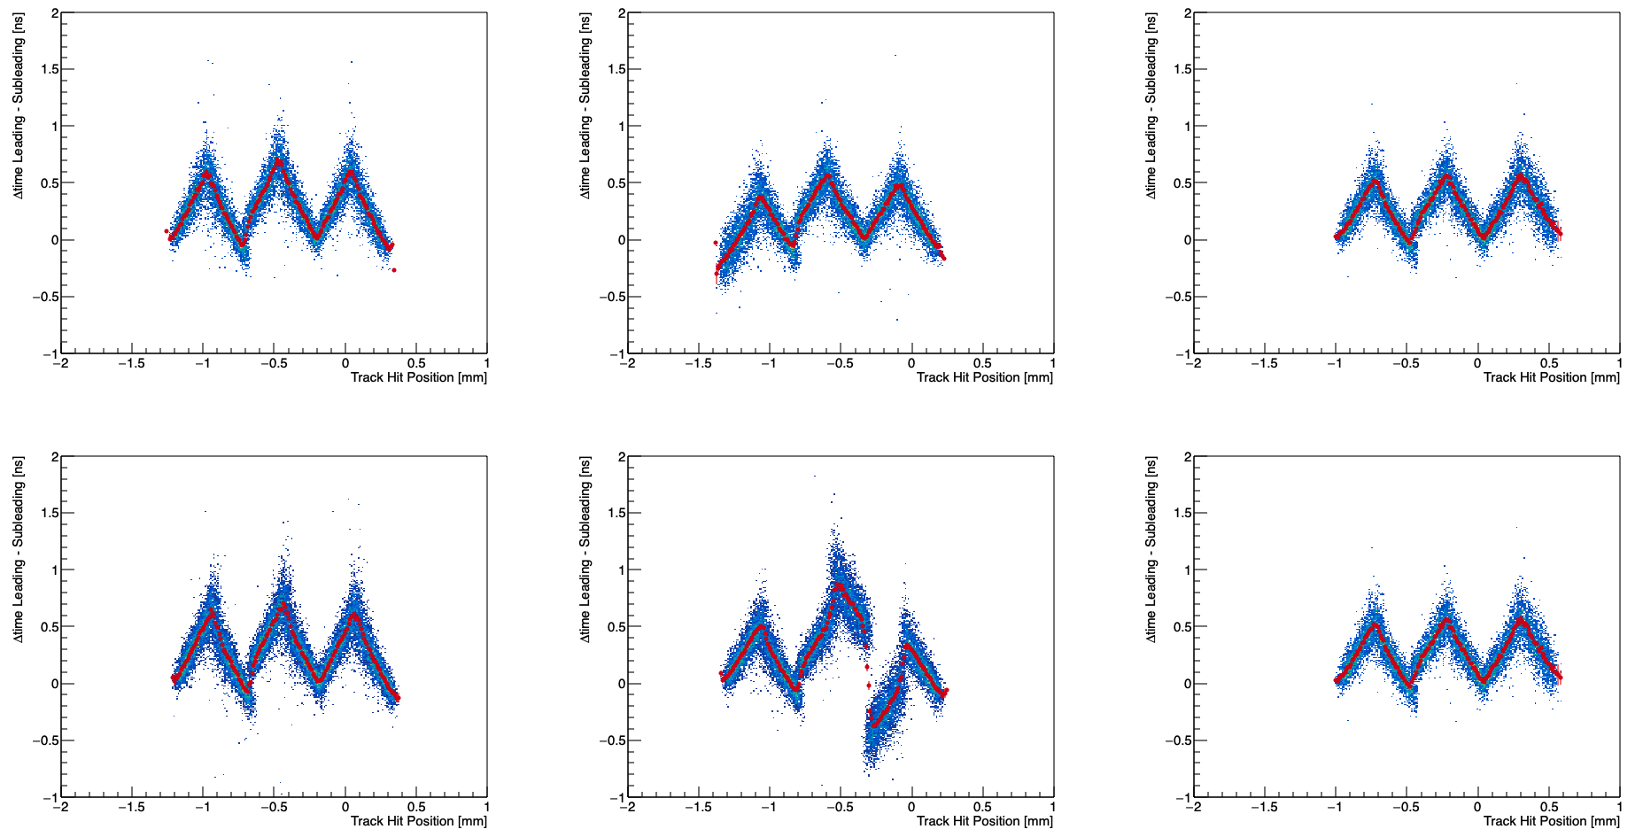
Signal Arrival Time Delay Inter Strips
Signal delay is observed in row direction
Between Leading and Sub-leading is ~0.5 ns delay
Sensor#0 - col0
Sensor#1 - col0
Sensor#2 - col0
y_{leading}
y_{track}
y_{sub-leading}
TOA_{leading} - TOA_{sub-leading} [ns]
Sensor#0 – col1
Sensor#1 – col1
Sensor#2 – col1
TOA_{leading}
TOA_{sub-leading}
Y_{track} [mm]

