Slide 1
CERN
Test Beam: Construction and Installation
4/22/2026
Bob Azmoun, BNL

Slide 2
Updates
Progress on items this past week…
Velmex motors/stages
Diving board
HRPPD base plate
GEM layer testing in progress
Paddle counter (thick and thin)
Bracket for mounting 8020 chassis to DESY table
Cable stress relief
Must reconfigure crates on top of 8020 chassis to include NIM crate for trigger timing purposes
LED fiber + diffuser: route fiber to interior of dark box, mount fiber+diffuser combo
Route N2 gas line interior to dark box
Logistics
Shipping date: May 6 (need to schedule riggers)
Gas ordered thru CERN
Internal CERN shipment from SPS to PS in progress
Must adapt to Swiss power outlet receptacles (all devices are compatible with 230VAC)
Will bring a few high power 230VAC →120VAC step down transformers

Slide 3
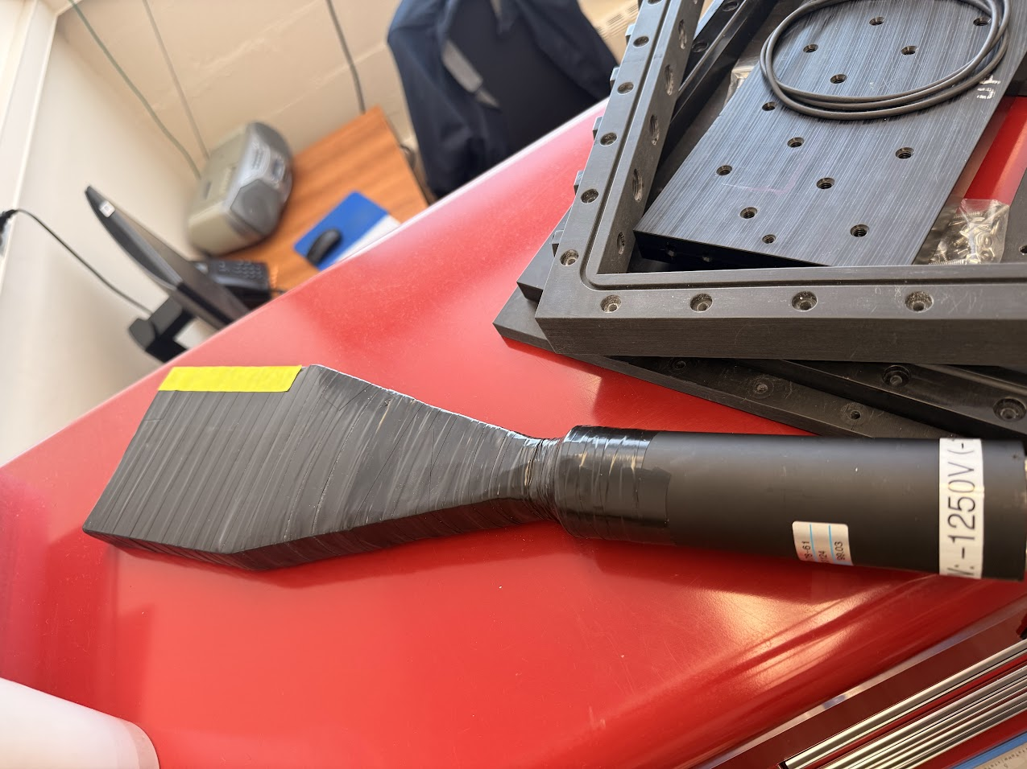
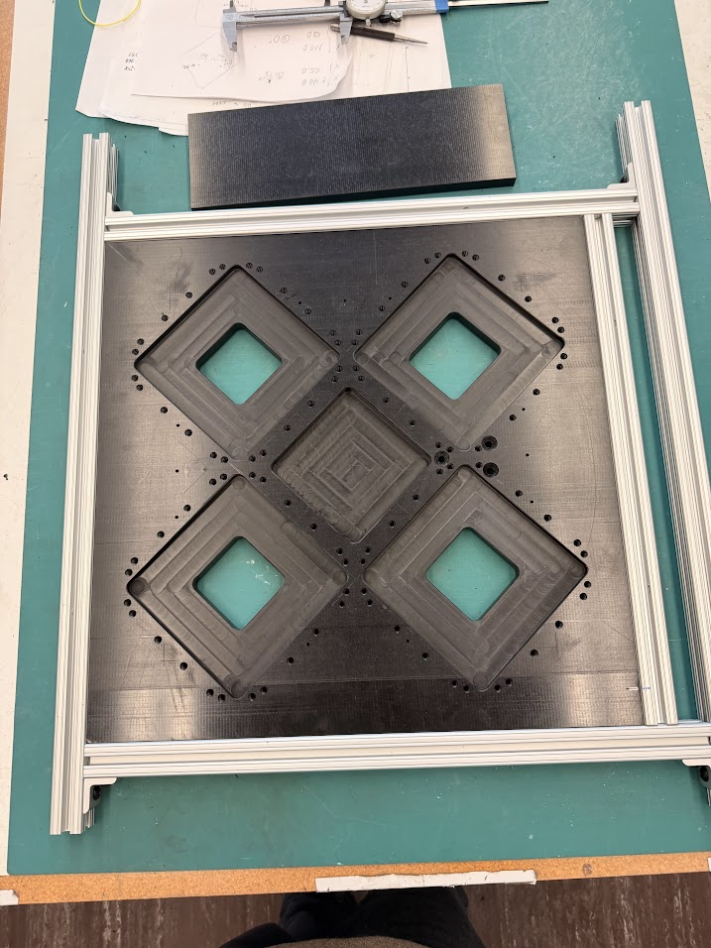
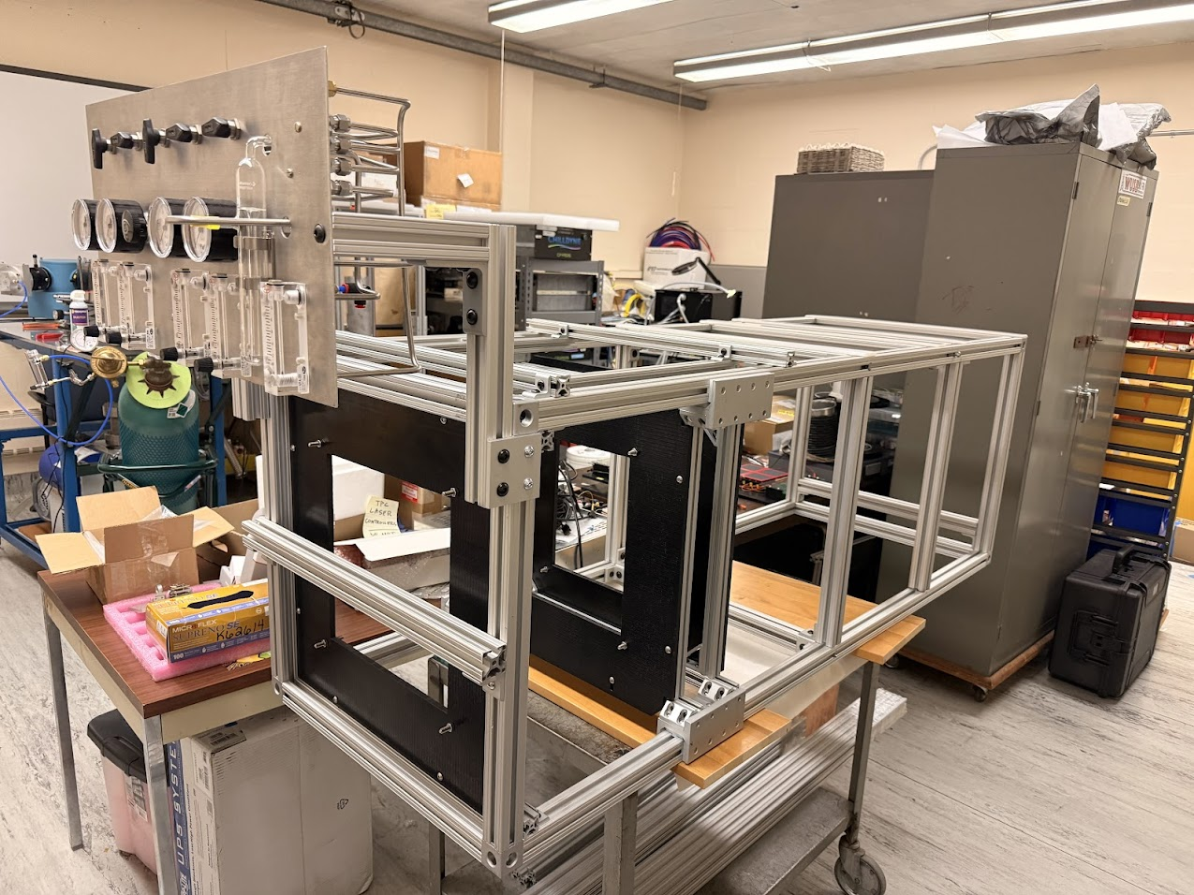
8020 Chasis
Thick paddle counter
Assembly of chassis is more or less complete; need to add place for NIM crate and add additional brackets for paddle counters
All holes drilled and tapped for HRPPD baseplate

Slide 4
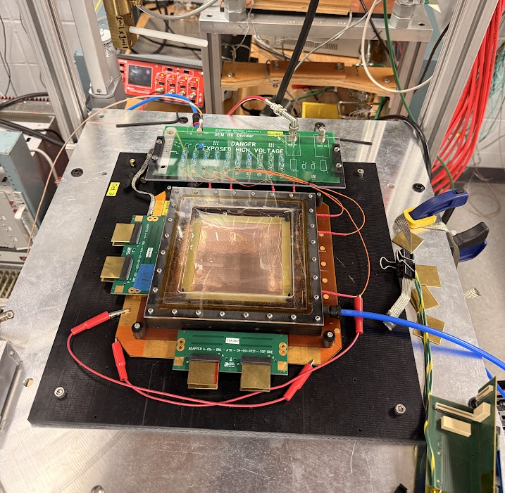
GEM Layers
1st GEM layer is set up on test bench (gas flowing, HV connected, DAQ working)
Will start tests today to verify operation

Slide 5
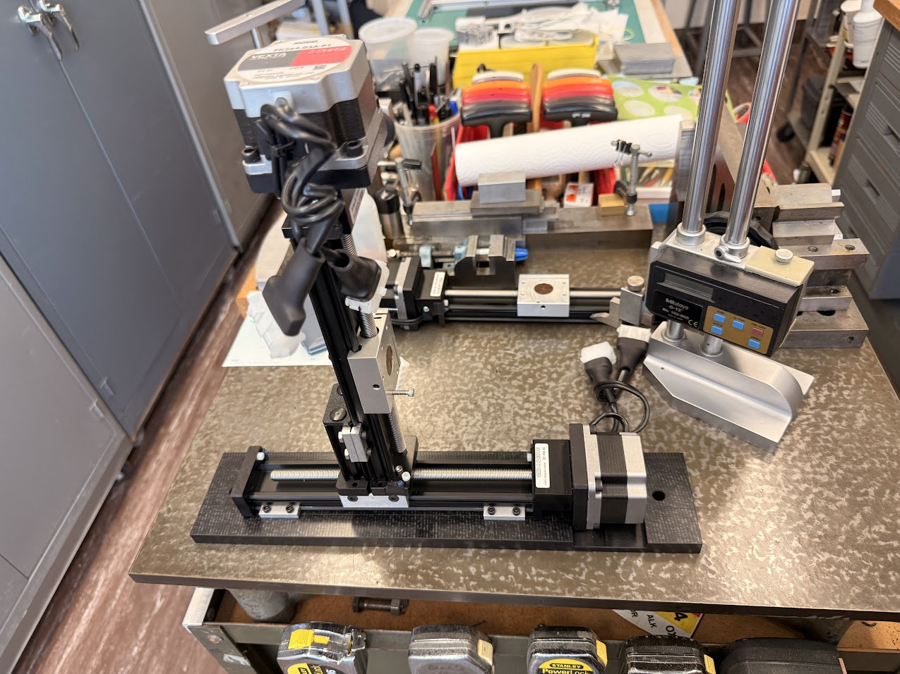
Velmex stage assembled
The Velmex XY-stage for moving positioning the HRPPD+(MCP-PMT x 2)+Finger counter assembly in the beam is complete
Need to assemble the detector assembly on a base plate and mount to stage

Slide 6
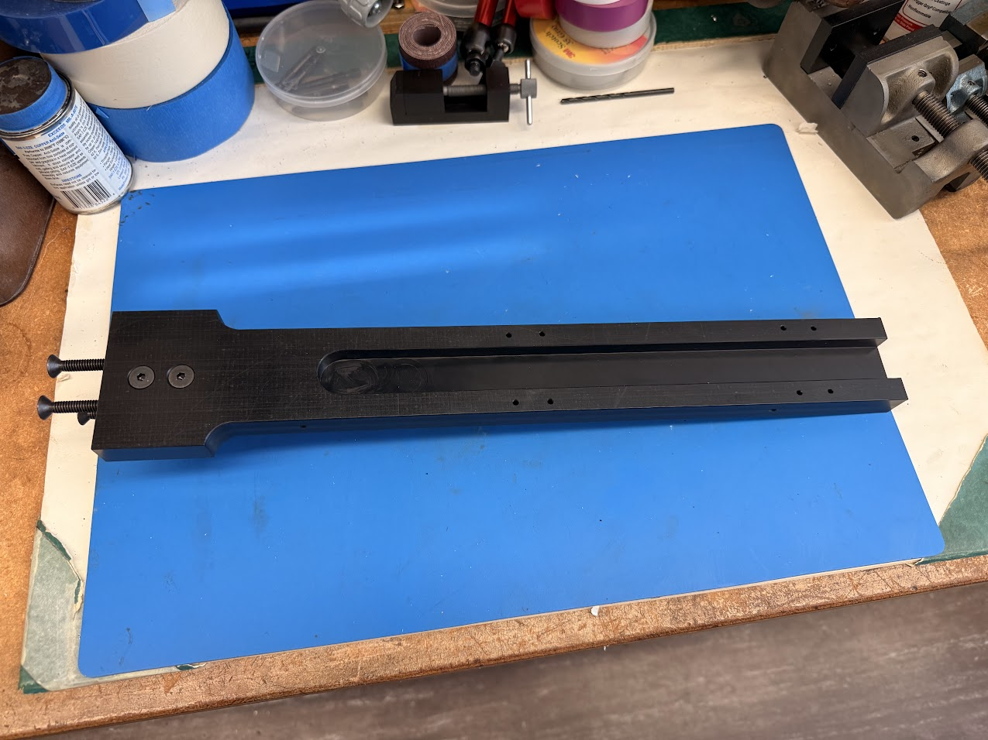
“Diving board” for Aerogel assembly
The fixture that holds the motor stage which moves the aerogel tile longitudinally in the expansion volume is complete
Required some engineering to be sturdy enough to minimize sagging

Slide 7
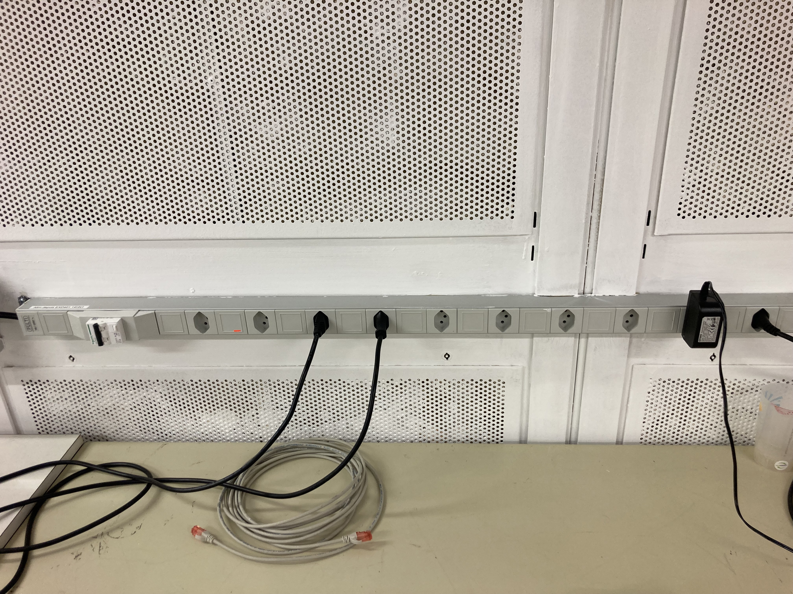
CERN “Swiss” Outlets
Will purchase adaptors to plug our equipment into Swiss outlets
Waiting on CERN safety office to confirm this is Ok

