Slide 1

ASIC Requirement for BTOF
Satoshi YANO
Hiroshima University & RIKEN

Slide 2
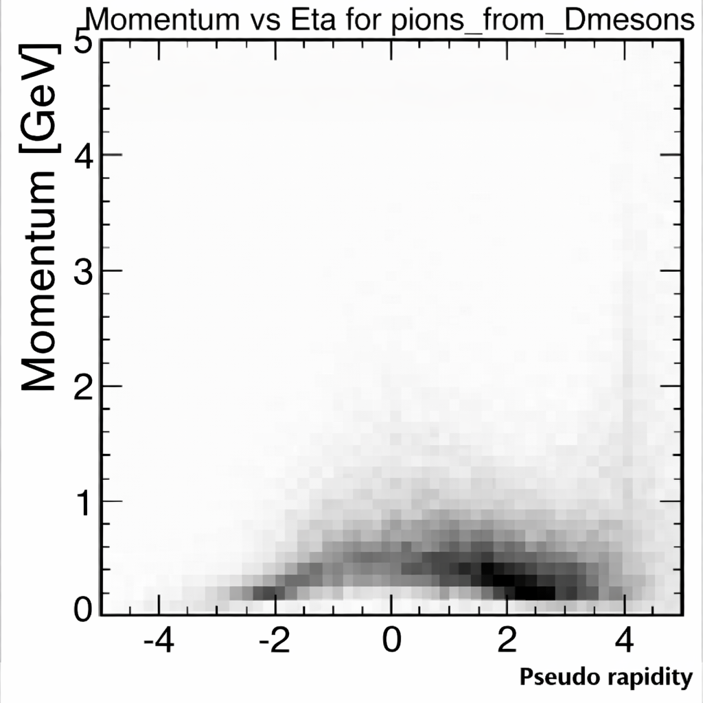
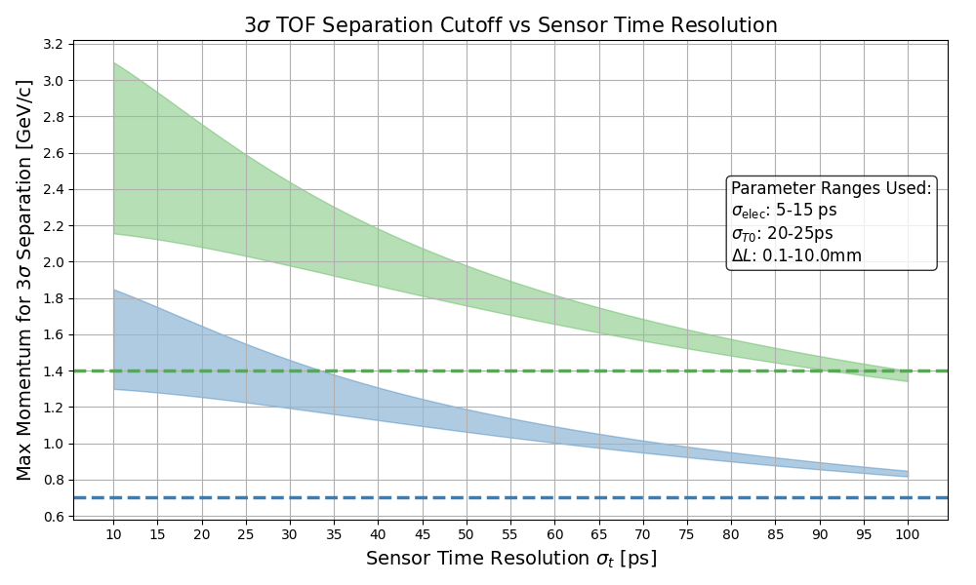
Impact on the ePIC PID Performance
Focus of TOF PID region is below p = 1.2 GeV/c for mid-rapidity
PID hole will be eliminated by combining other PID detectors
σ_{sensor} = 35 ps is required to get sufficient overlapping with hpDIRC in worst scenario (σ_{total} = 46 ps, σ_{elec} = 15ps, σ_{T0} = 25ps, σ_{L} = 1 cm)
hpDIRC
dRICH
Worst scenario
pfRICH
FTOF
hpDIRC 3σ K/p sep. limit
HRPPD
BTOF
hpDIRC 3σ π/K sep. limit
Decay products from D-meson in ep DIS @ √s = 141 GeV

Slide 3
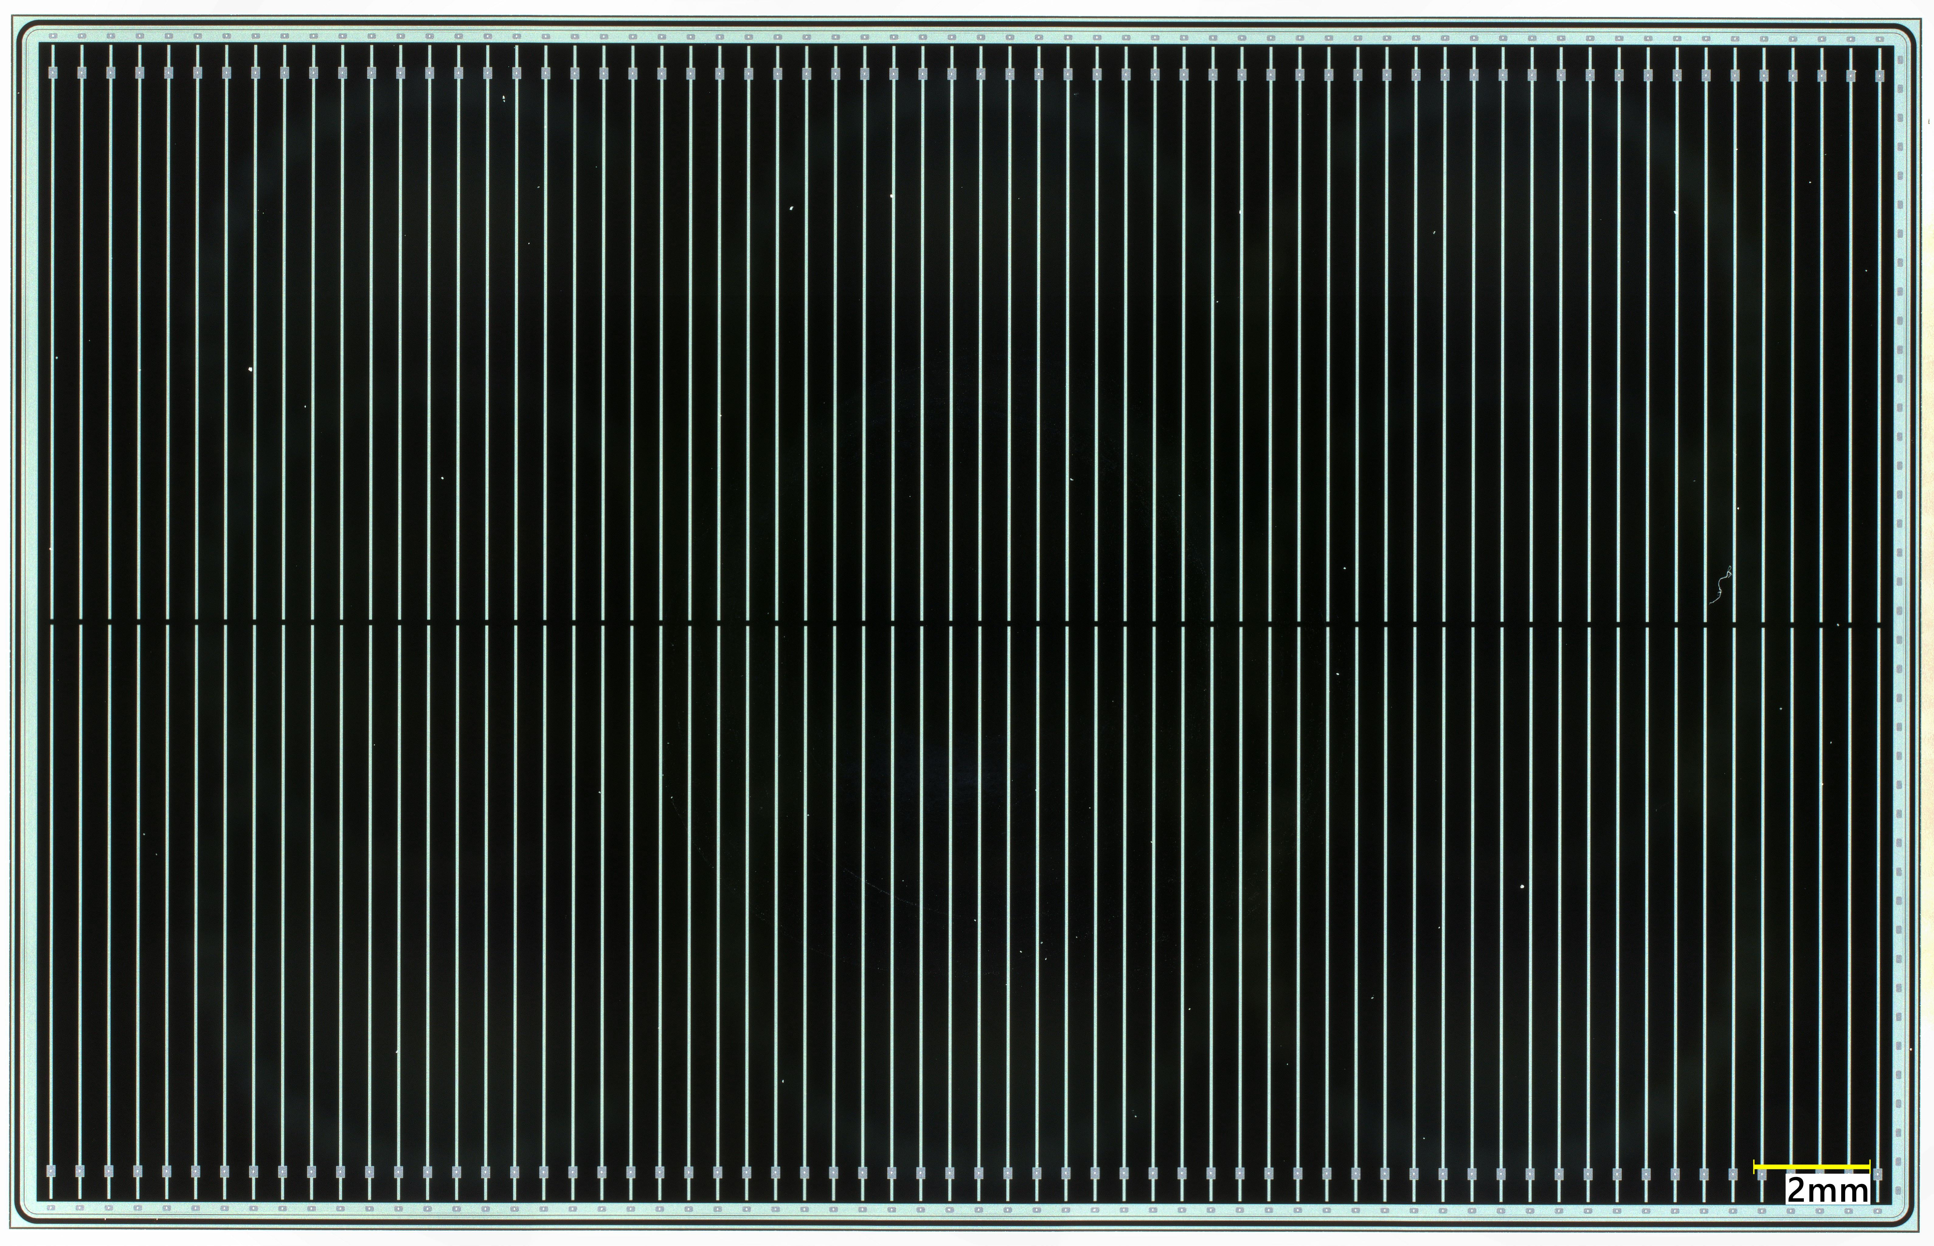
Strip-Type AC-LGAD Sensor
”Baseline” sensor parameters
  Manufactured by Hamamatsu Photonics
  Size: 32x20 mm²
  Strip-size / Pich: 10x0.05 mm² / 500 μm
  Strip geometry: 64x2=128 ch
  Active thickness: 50 μm
  Detector capacitance: ~10 pF
  Leasing strip charge: >6 fC (MPV: ~12 fC)
Types of Data Required
  ADC for hit position reconstruction
    Charge sharing technique is used
  TOA for timing measurement
    Several tens of picoseconds are required
32 mm
20 mm
Row1 ~ 64
col1
col2
# sensors: ~18.4K
# channels: ~2.4M
Area: ~12 m²

Slide 4
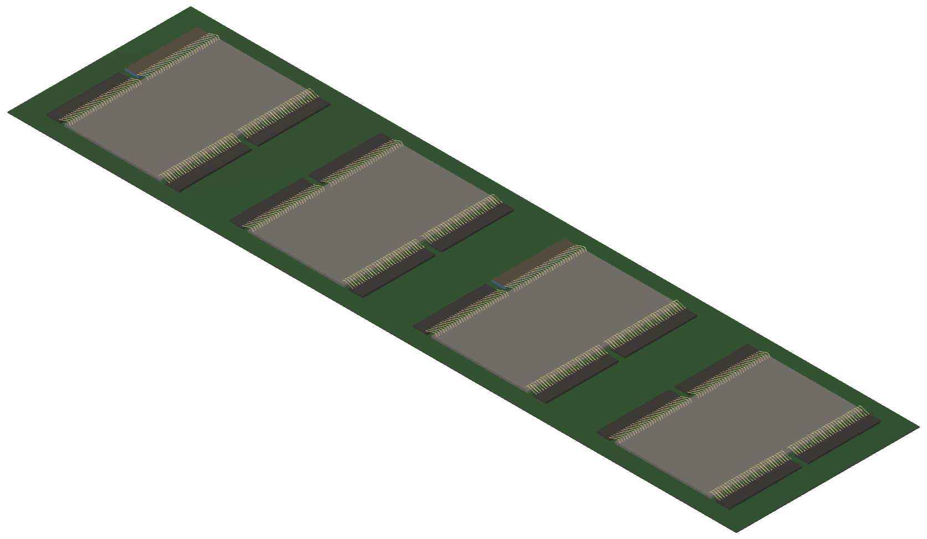
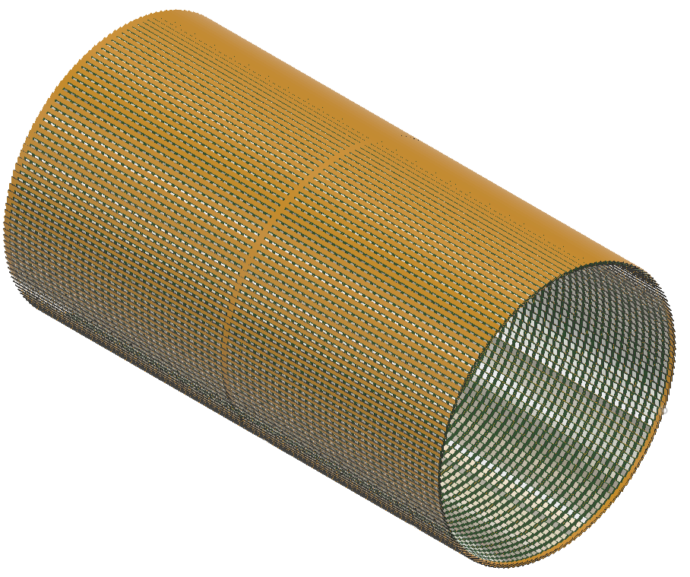
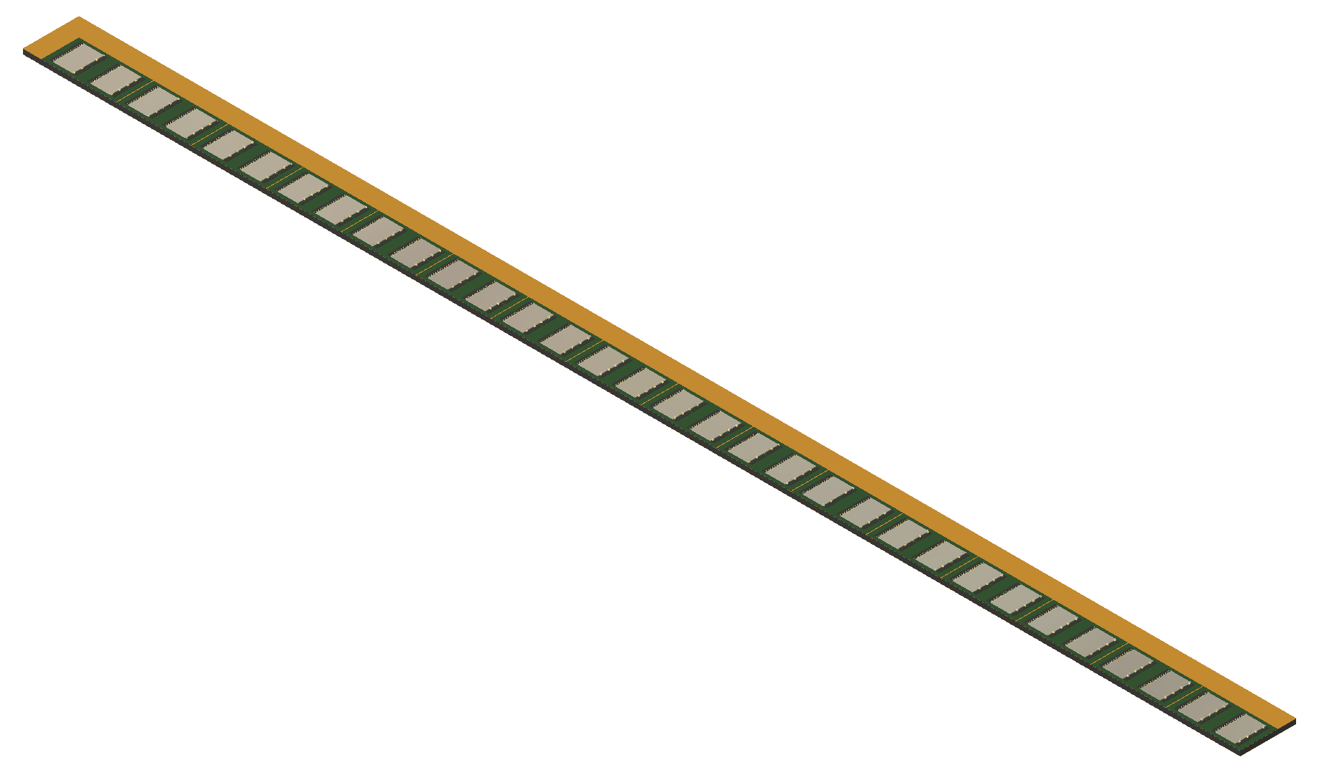
Detector Design
Stavelet
16 cm
Half-Stave
ASIC
Interposer
Sensor
1.3 m
2.6 m
0.64 m
FPC

Slide 5
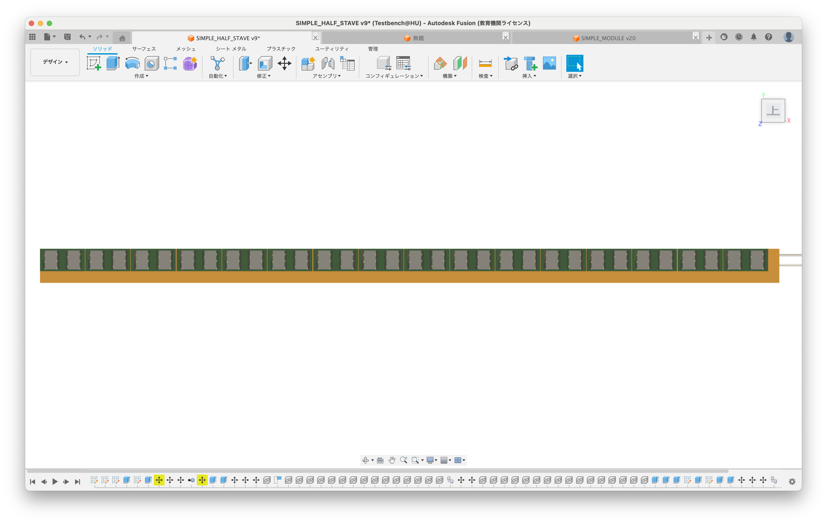
Data Rate (WORK-IN-PROGRESS)
32 sensors (one side) ~1300 mm
VTRx
lpGBT
60 mm
DCDC
DCDC
DCDC
x4
Stavelet
Data rate: ~2 Mbps per sensor (top ep collisions)
  Signal: ~20 kbps
    5 charged particle (per DIS) x 500 kHz collisions = 2.5M Hz
    1 Hz hit per channel
    Charge share in 3 strips
    32 bits header, 32 bits trailer, 32 bits hit information (ADC, TDC, Channel ID)
      7 bits channel ID, 10-12 bits TDC, 8-10 bits
  BG: ~2 Mbps (WORK-IN-PROGRESS)
    Synchrotron radiation = ~1 GHz
    ~460 Hz hit per channel
    No charge sharing?
    Possibly energy cut works to remove SR hits
4 x lpGBTs are used to treat 32 sensors
  8 sensors x 2 Mbps = 16 Mbps per lpGBT (Maximum allowable uplink: 5.12Gbps)
WORK-ON-PROGRESS
Provided by Takuya Kumaoka (Tokyo)

Slide 6
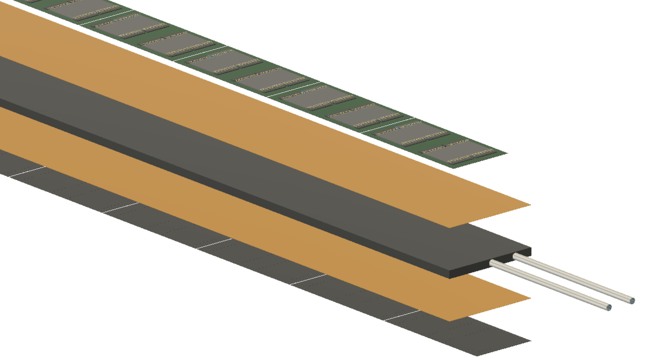
FPC (link)
~ 56 mm is needed to 32 DataOut lines
FPC
6 cm
If we need more than 32 DataOut lines per half-stave, additional layer is needed

