Slide 1
Integration, Installation and Infrastructure (Triple I Group)
TIC Update
Roland Wimmer

Slide 2
Detector Updates
Model Updates
1006 Floor status
Services Mock-up

Slide 3
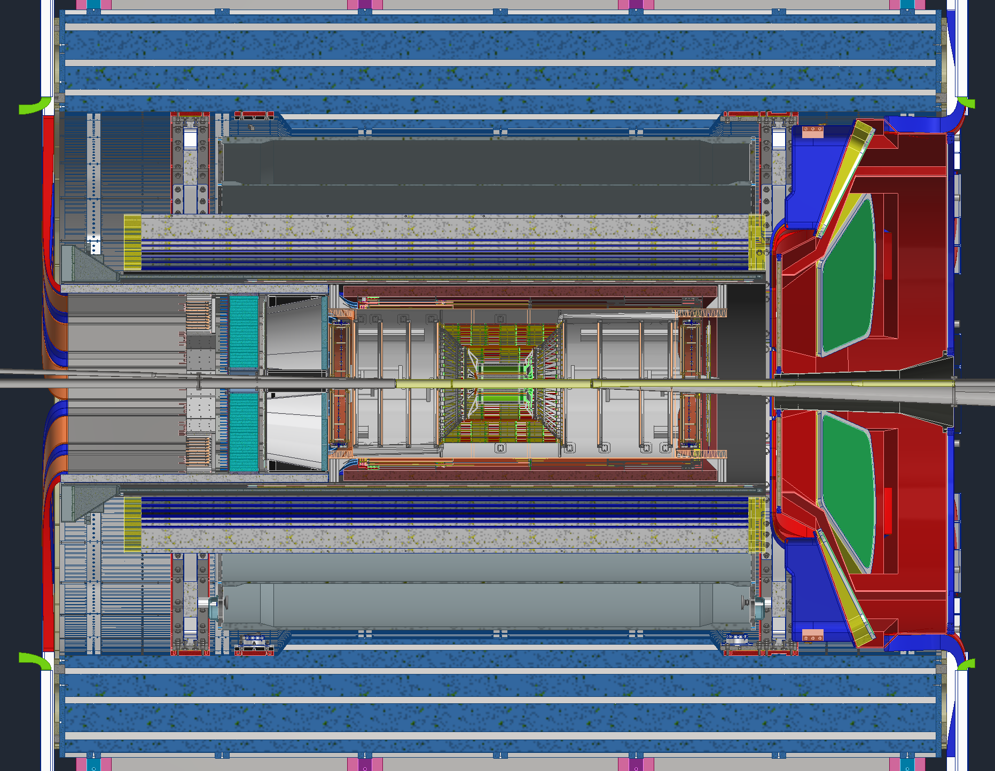
Model Updates
New EEEMCal Model
New MPGD disks Model
Updated PST
Updates GST

Slide 4
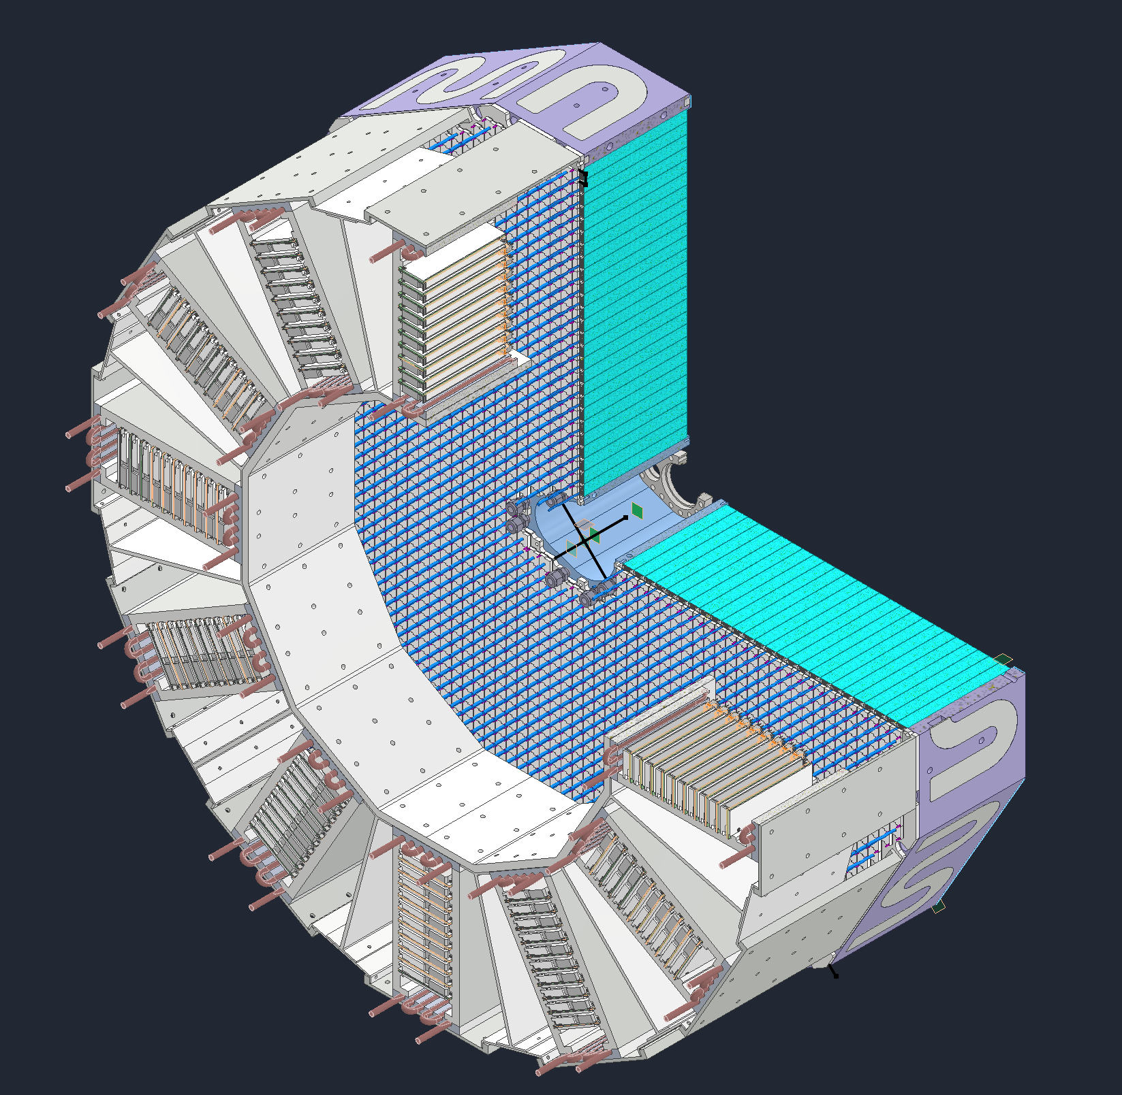
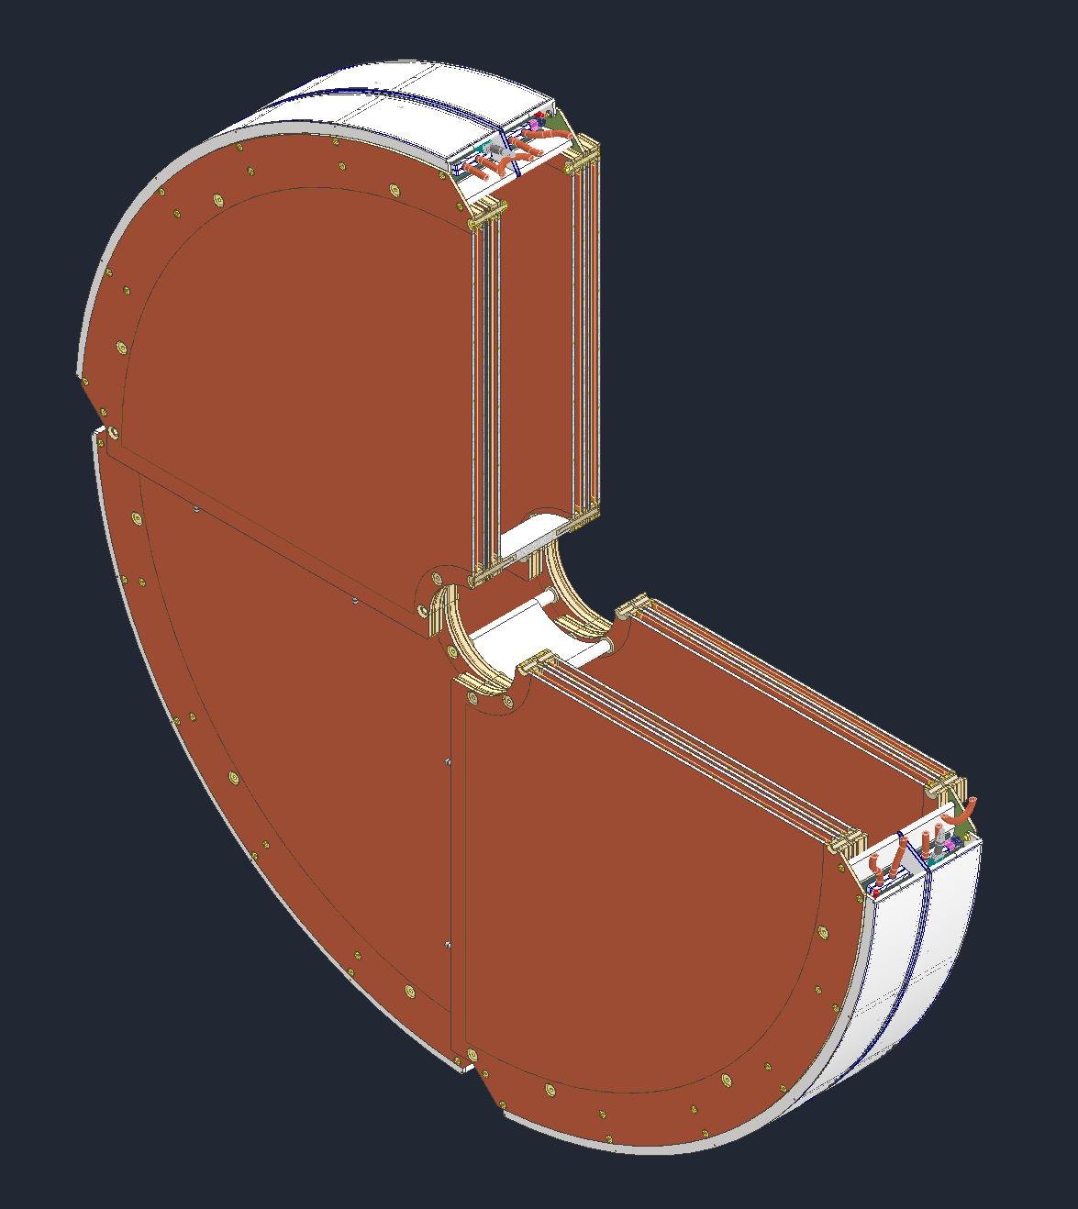
Model Updates

Slide 5
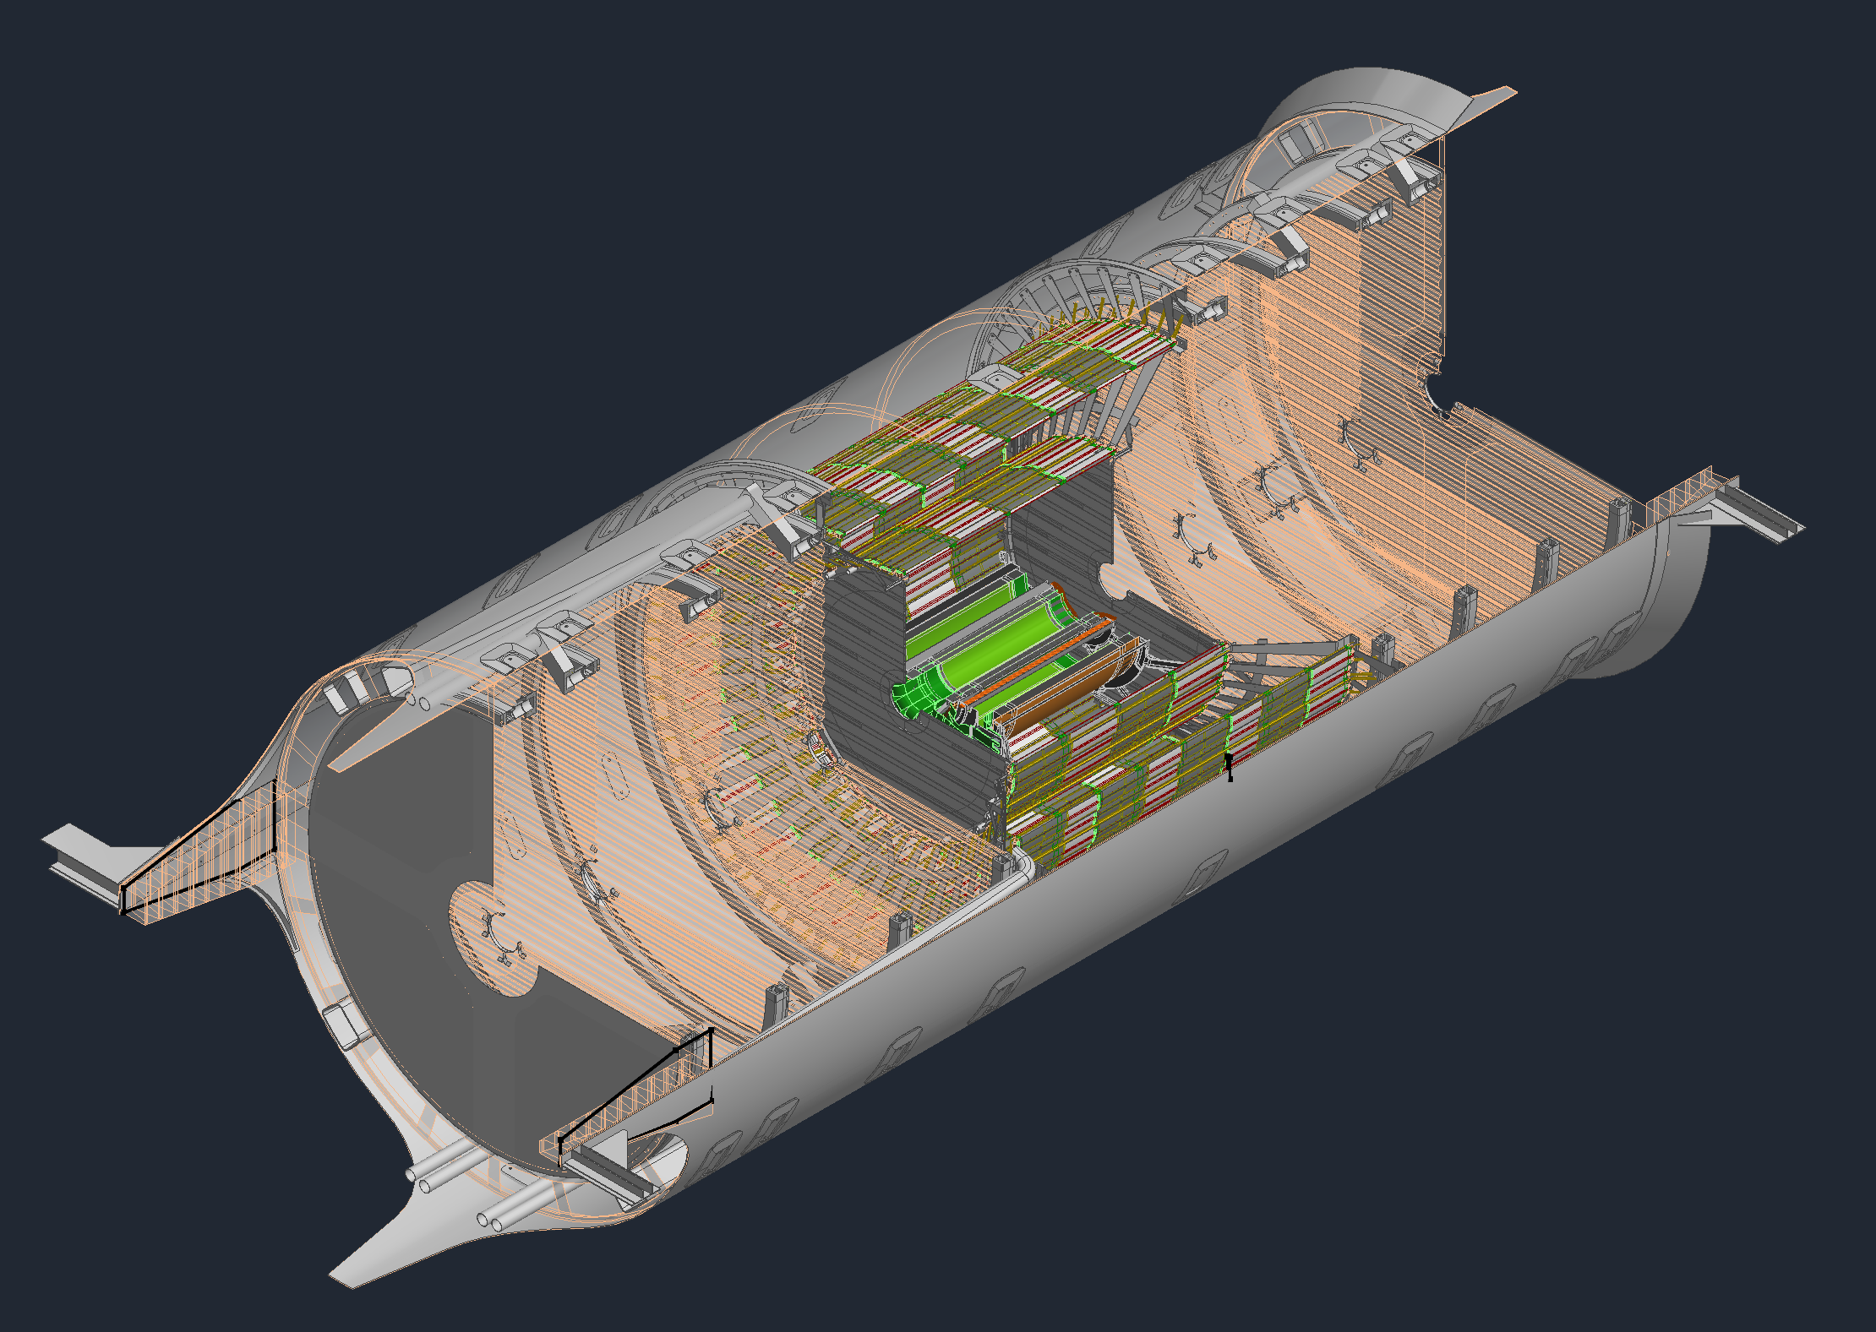
Model Updates

Slide 6
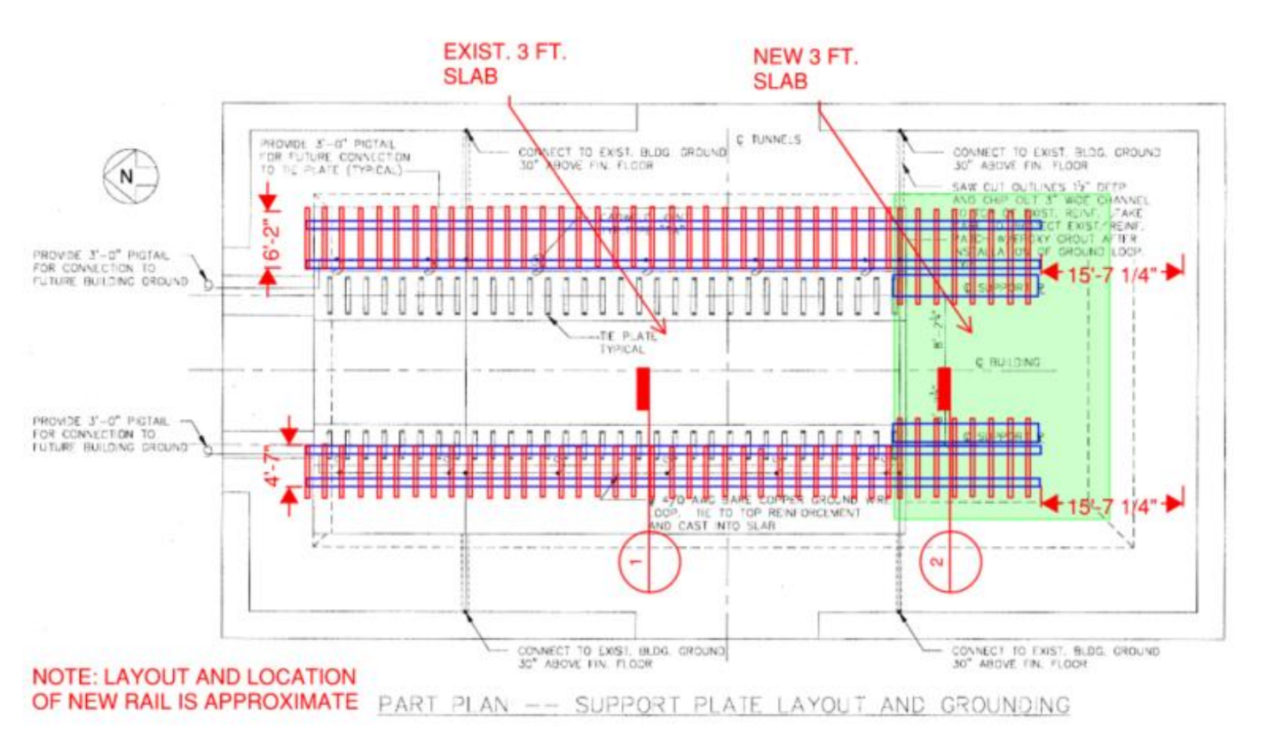
1006 Floor
The south end of the floor in the experimental hall needs to be thickened to accommodate the new endcaps. The old slab was only 1ft thick but needs to be 3ft to match the rest of the hall.

Slide 7
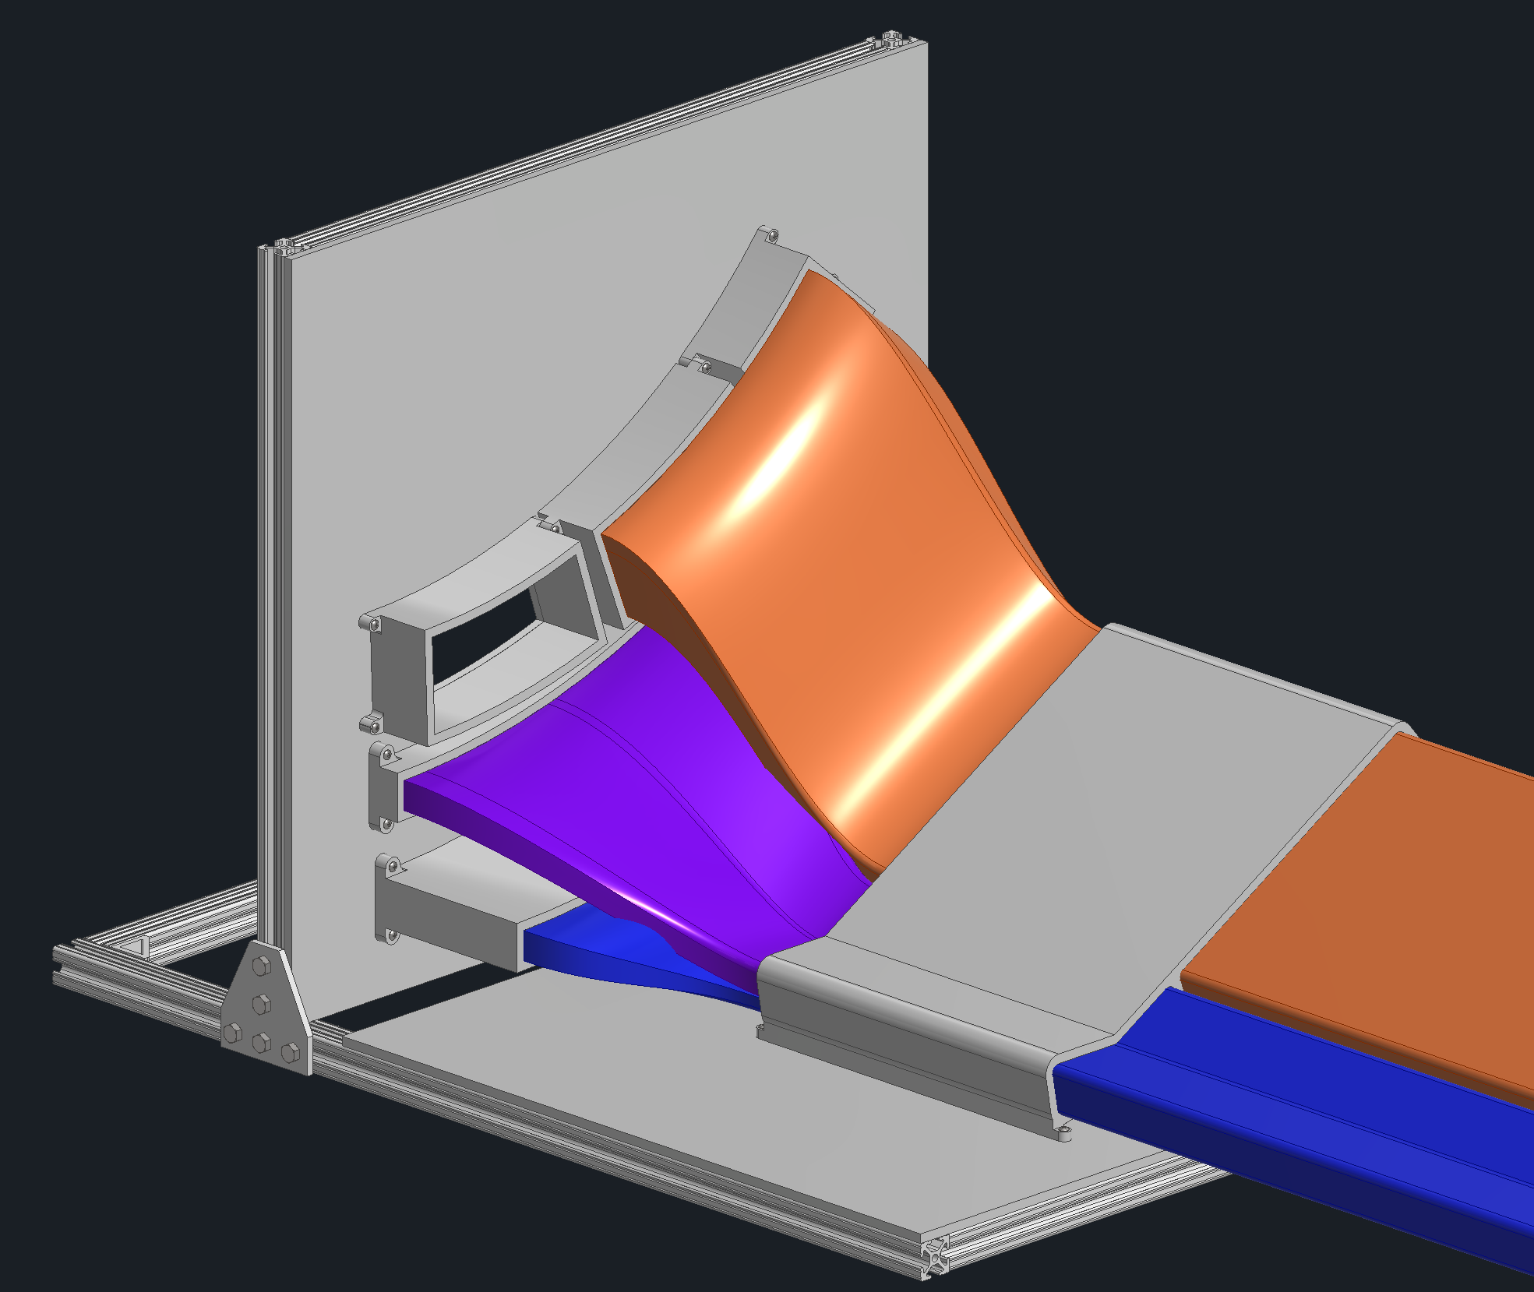
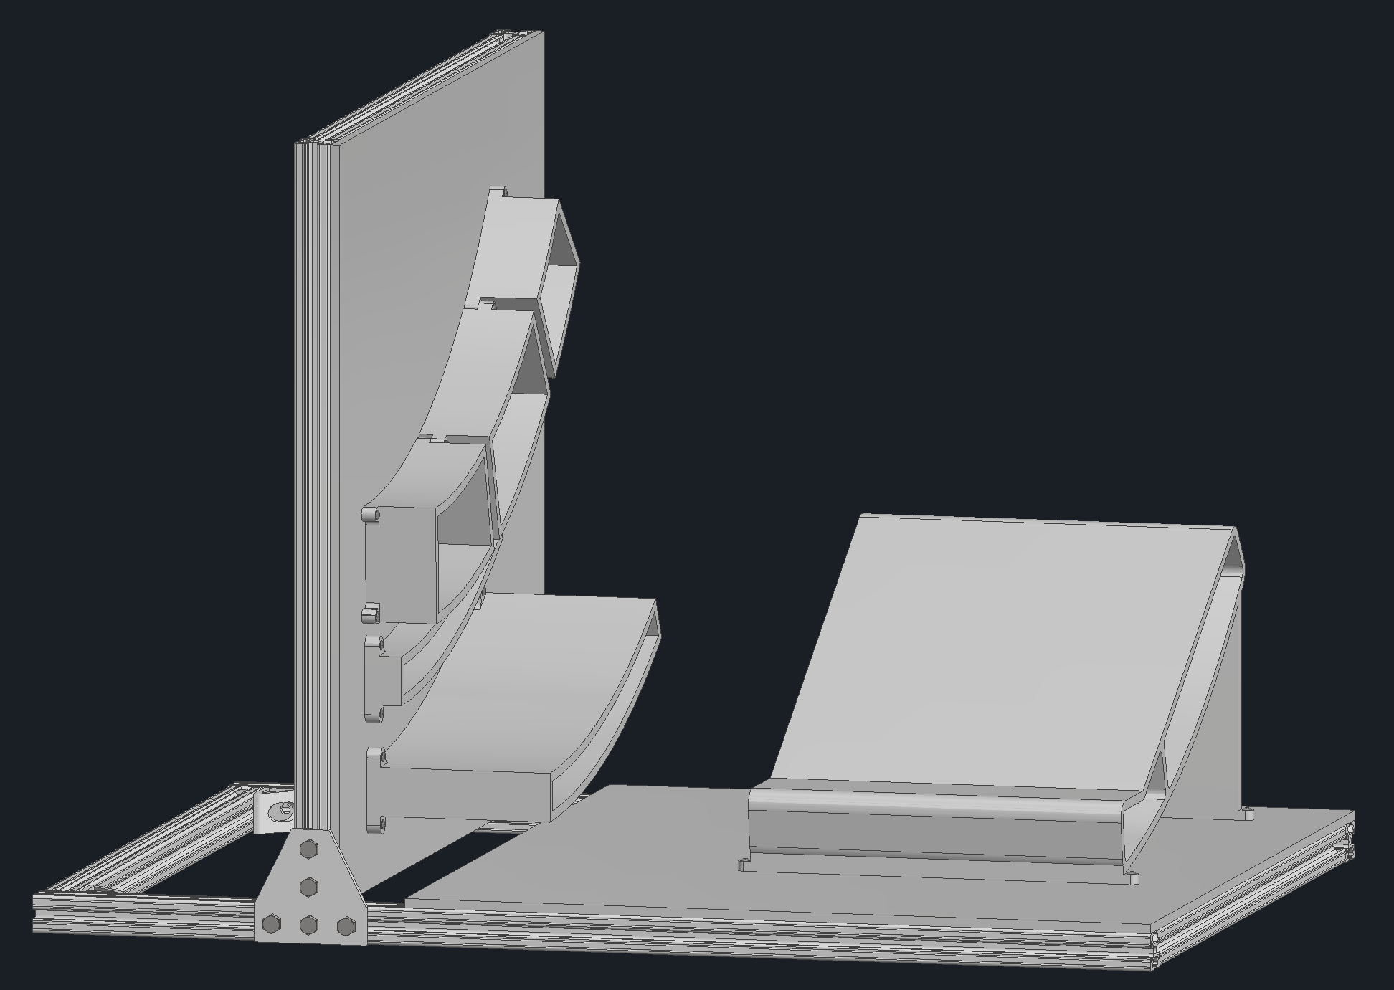
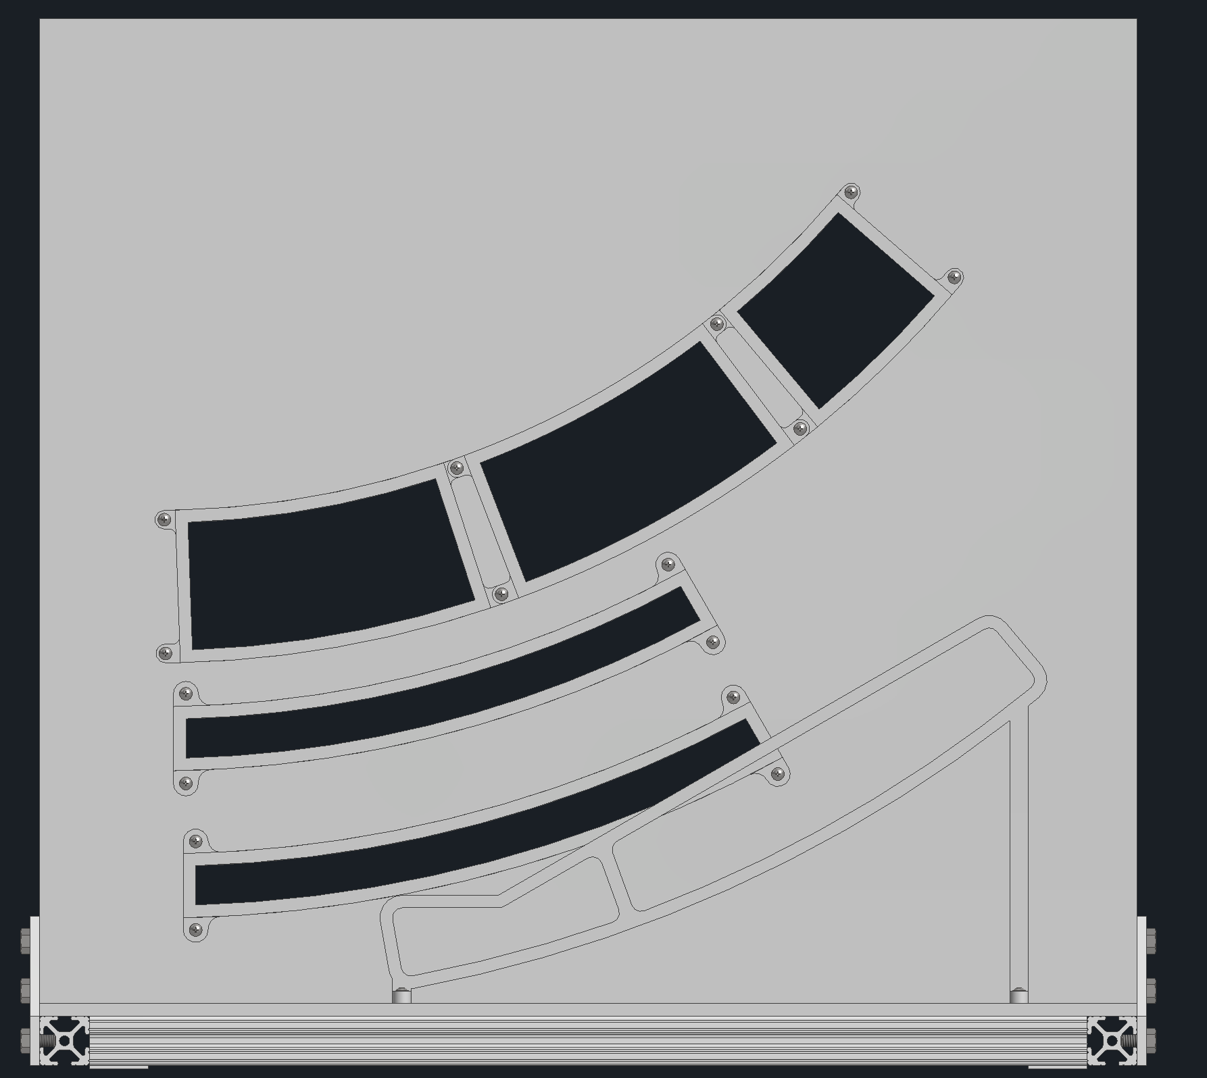
Backwards Services Mock-Up
The ends of the detectors will be 3d printed and attached to an 80/20 frame
1/12th of the services coming out of the inner trackers will be mocked up
Will use old cables from sPHENIX which are similar to what will be used for EIC
Will be checking amount of space used by the services along with bend radii
End of PST
Inner Tracker Services
End of CYMBAL
End of ToF
Service Trays

Slide 8
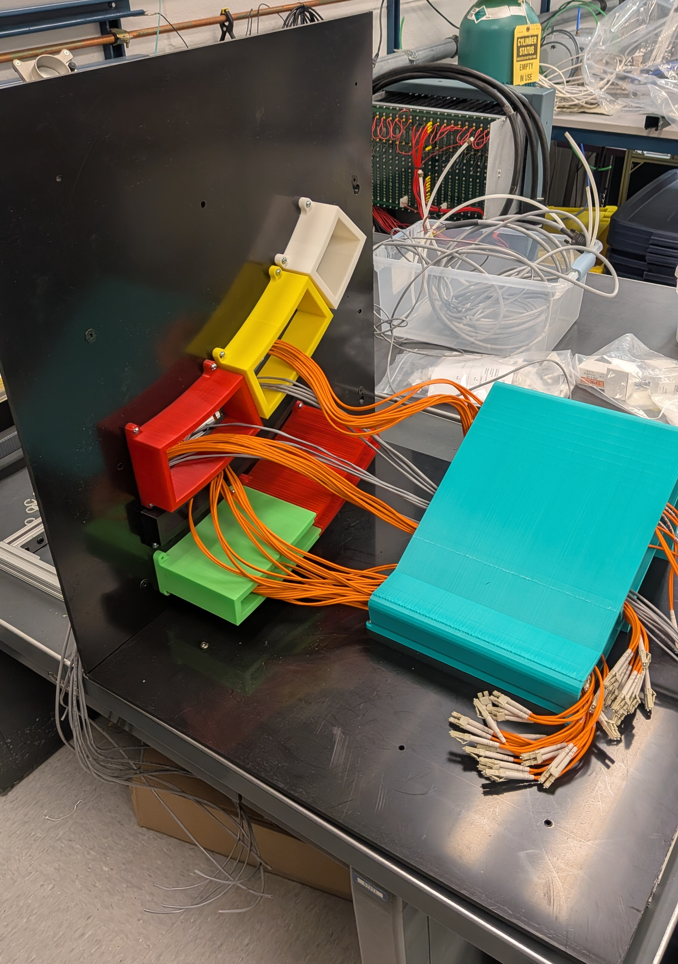
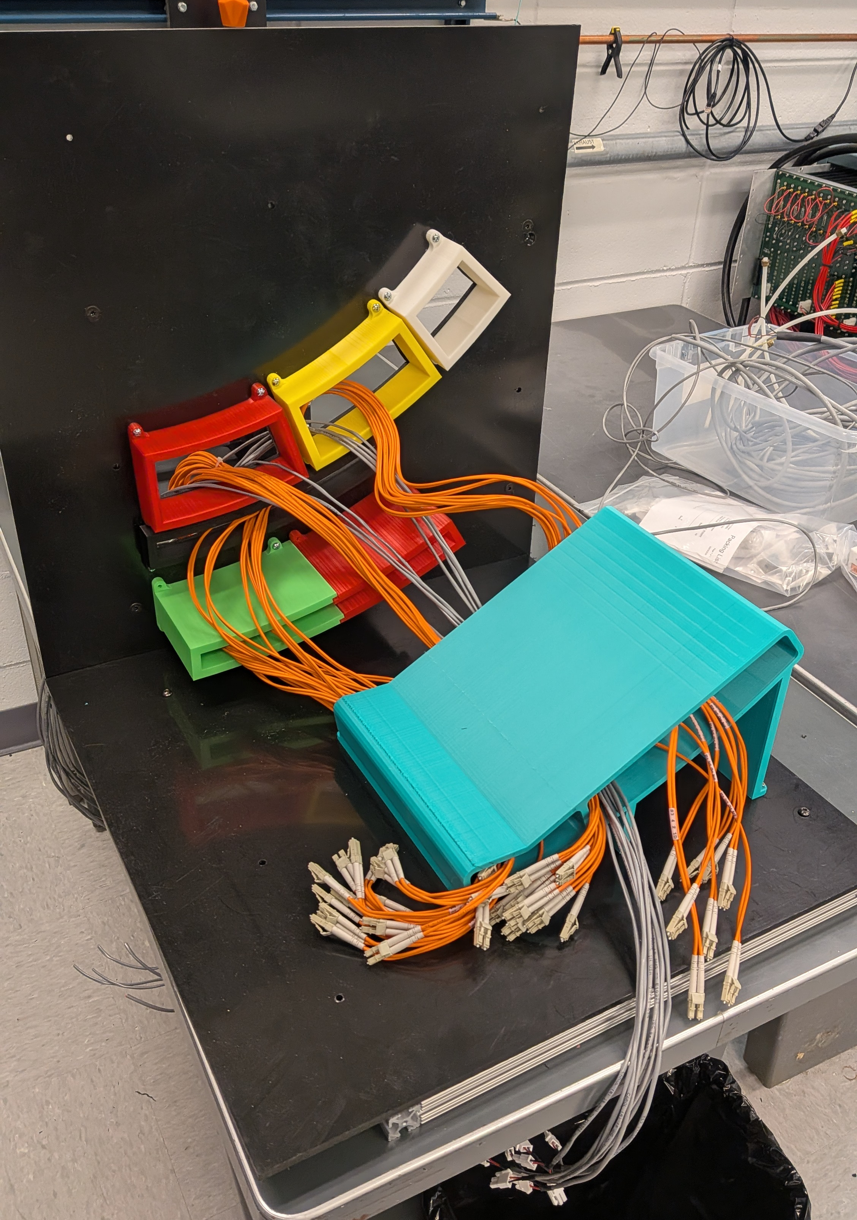
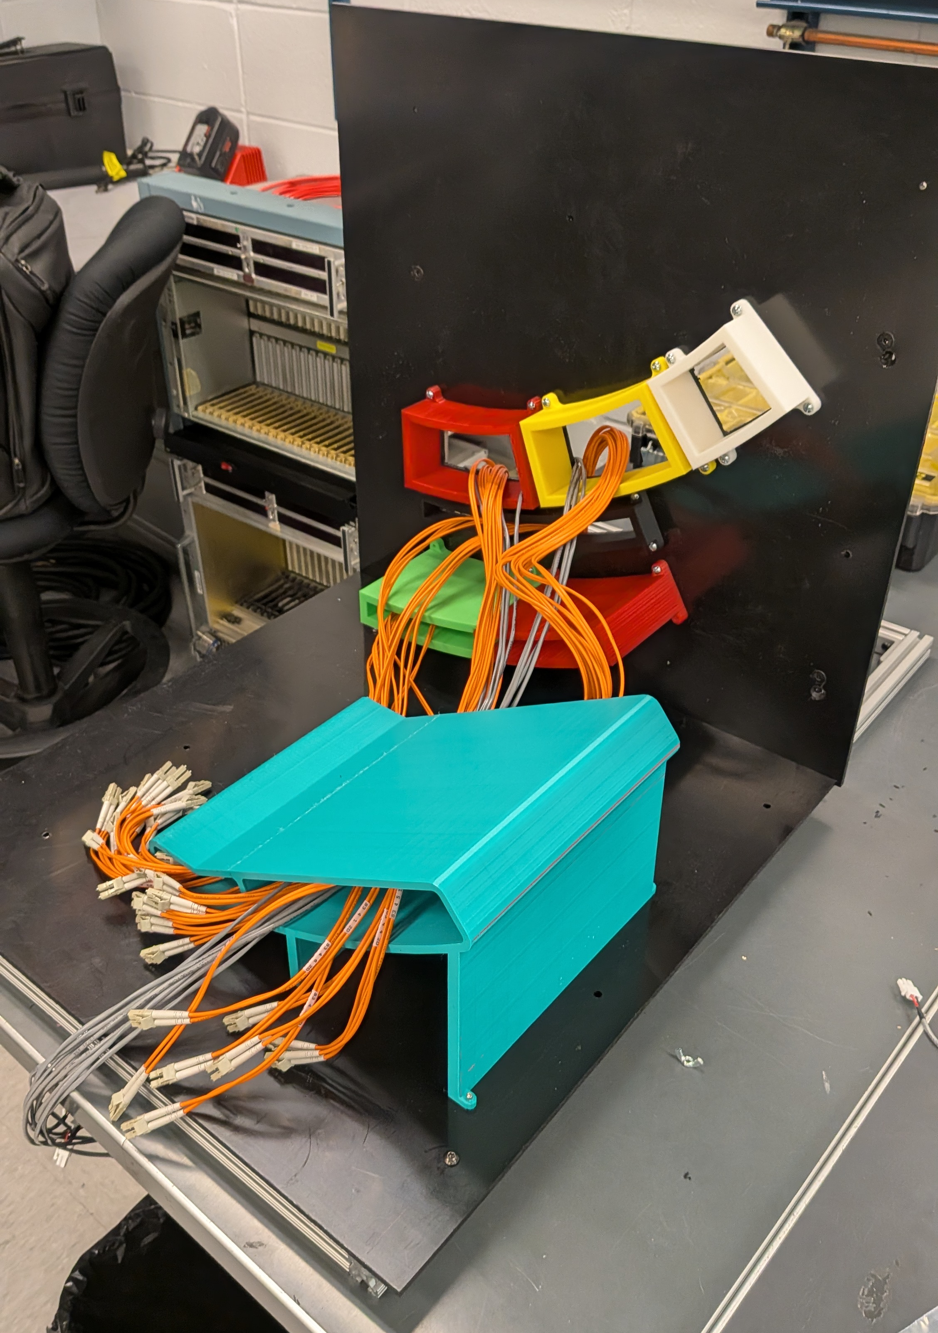
Services Mock-up

Slide 9
Backup Slides

