Slide 1
Data volume documentation proposal

Slide 2
Goal?
Rate limitations are very complicated (generally, and in particular for ePIC) and there is uncertainty!
Simplest plan is:
  Refine below table
  Add columns for expected rates from detectors
This may be as far as we go at this time (for example for preTDR)… Further estimation may not give better numbers due to various uncertainty, but I’ll give my wishlist (for FDR Level)
ASIC | Charge Share | Times Readout | Formula | Bits / Hit FEB | Old HitSize | Bits / Noise FEB | Bits / DAQ Output | Max Rate
ITS-3 | 4 | 1 | 16 x (C+3) | 112 | 128 | 64 | 128 | Not simple
Discrete (FECAL) | 4 | 5 | 12 x C x (5 x T + 7) | 576 | 144 | 144 | 128 | 50 kHz / ch
CALOROC | 4 | 5 | 32 x T x (4 + C) | 1280 | 480 | 800 | 128 | 50 kHz / ch
EcalBarrelScFi | 4 | 5 | 2 x ( 32 x T x (4 x C) ) | 2560 | 960 | 800 | 128 | 50 kHz / ch
EICROC1 | 128 | 8 | (T x 24 + 8) x C | 25600 | 576 |  |  | 12 hz / ch
EICROC2 | 9 | 5 | (60 + T x 8) x C | 900 | 576 | 900 | 128 | 350 hz / ch
FCFD | 4 | 5 | 32 x T x (4 + C) | 1280 | 192 | 800 | 128 | 50 kHz / ch
ALCOR | 1 | 1 |  | 64 | 64 | 64 | 64 | 300 kHz / ch
SALSA | 4 | 5 | C * (T + 4) * 32 | 1152 | 320 | 288 | 128 | 25 kHz / ch

Slide 3
Info for E&DAQ to provide
Data Rate limits in (ie. gb/s) for each asic/readout chain
Maximum Hit Rate/Ch Estimate (While segmenting matters, can typically assume uniform channel occupancy at the ASIC level and quote per-channel rates)
  Assumes bits/hit (daq specifies assumption and configurable by ASIC)
  Assuming charge sharing accounted in the simulated data (or explicity noted)
    A track whose hit tickles 3 channels in a plane, should count as producing 3 hits in that plane, not one
  Assuming simulation to detector response / electronics response handled properly
  Limited by data volume for most (All?) of our ASICs, so equivalent to data rate (with conversion factor)
Minimum time separation between two distinguishable hits
  Sensor technology
  Shaping impact
  Digital deadtimes
  Digital hit definitions (when applicable)
    Eg. Caloroc1b w/gain switching, gain resets
  Clustering algorithms
  Overshoot/undershoot can lead to hits been distinguishable, but suffering degradation when close together
Aggregation limits for each chain
Particularly important for specific detectors:
  Lumi Detector
  Polarization Detectors
    Where data can arrive each bunch crossing

Slide 4
Info for Detector Groups to Provide
Expected Hit Rates
  Organized around physical readout element (Channels, or sensor, or ASIC, or Tile, etc…)
  Ideally presented as Histogram of rate in readout elements
  If this not possible at least:
    Max/Average rate through readout elements
    Number of readout elements with hits (as cross-check, should match channel counts)
    Total hit rate for all readout elements
  Preferably broken down at least to Physics / Synchrotron Radiation / Other background

Slide 5
Readout Limitations / Simulated Rates Table (1)
Readout Limitations |  |  |  |  |  | Simulated Rates
Detector | Readout Element | Max Data Rate (mbps) | Max Hit Rate / Element (kHz) | Min Hit Separation Time | Aggregation limit (mbps) | Max Hit Rate (physics) | Max Hit Rate (SR) | Max Hit Rate (Background) | Max Data Rate
Si Tracking IB (L0) | Mosiax Sensor
Si Tracking IB (L1) | Mosiax Sensor
Si Tracking IB (L2) | Mosiax Sensor
Si Tracking OB (L3-4) | Mosiax LAS
Si Tracking E-Endcap | Mosiax LAS
Si Tracking W-Endcap | Mosiax LAS
dRICH | ALCOR (64) | 5,000 | 78,400 | 2ns | 950
(or) dRICH | Ch (1) | 78 | 1,225 | 2ns | 14.8
(or) dRICH | RDO (256) | 20 | 313,600 | 2ns | 3,800
(…)

Slide 6
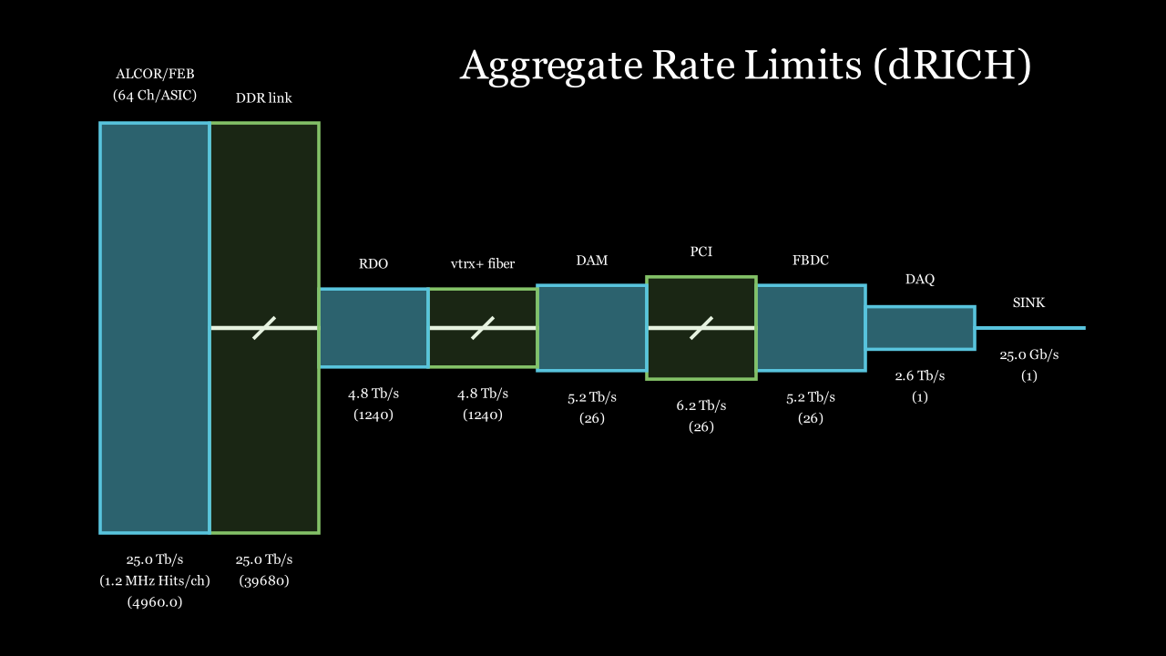
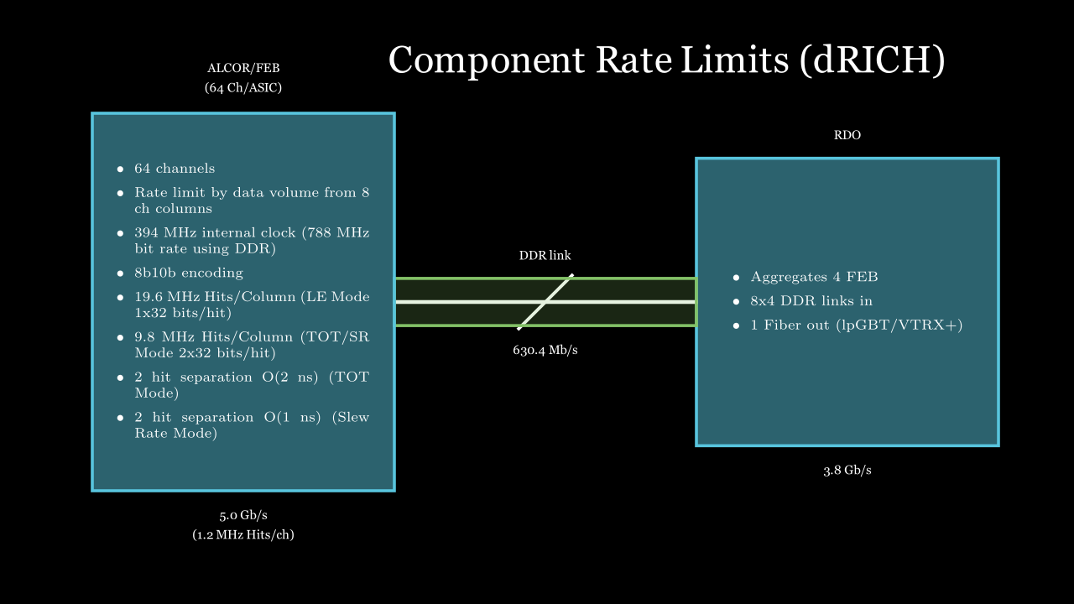
Documentation (From E&DAQ) (2)

Slide 7
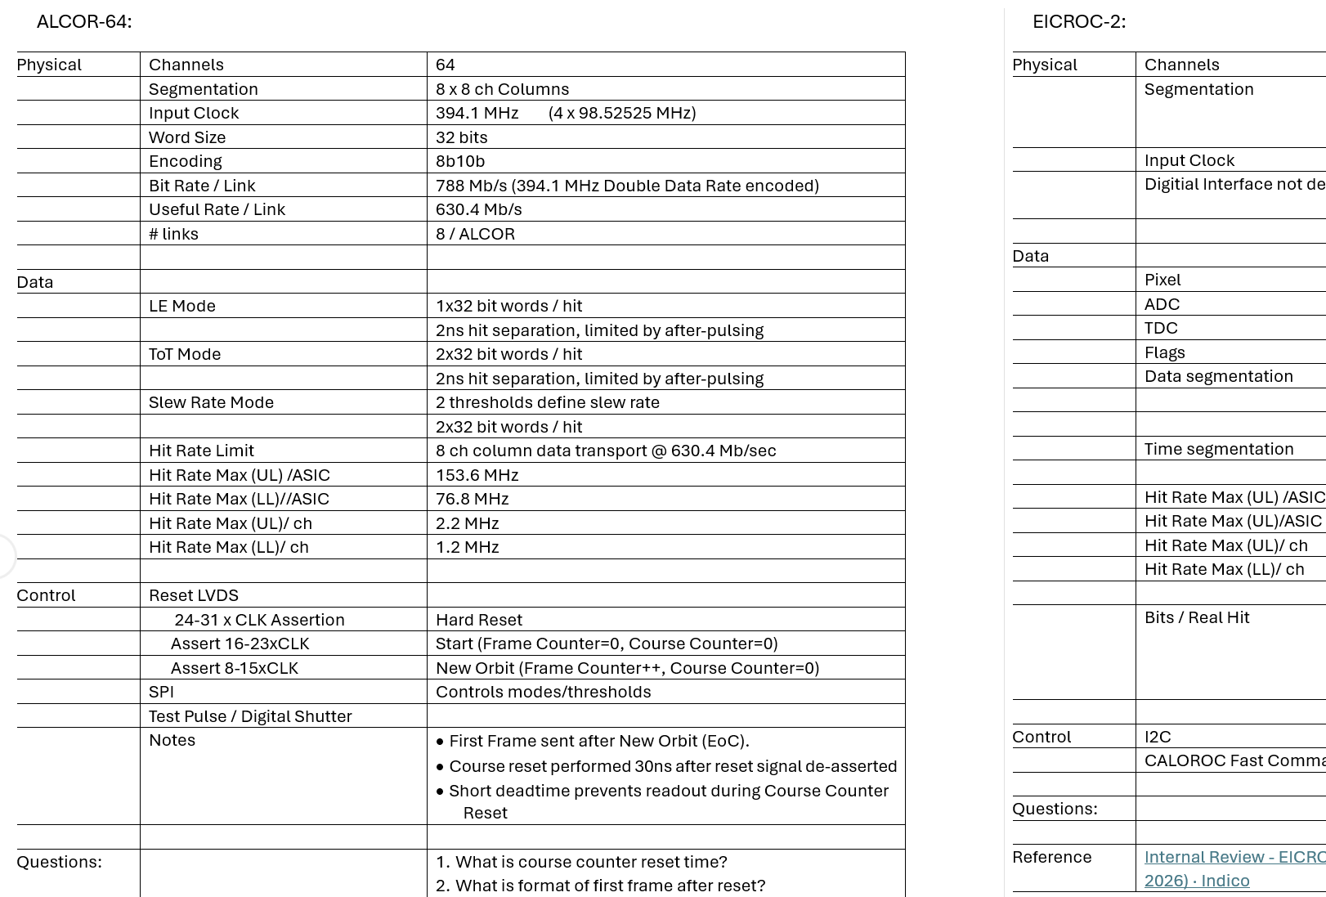
Documentation (from E&DAQ) (3)
Datasheet / Text Description
Include clocks / encodings
Include modes of readout
Include configurable aspects of hit descriptions leading to data size calculations
Include details of segmentation, which lead to potential restrictions on rates for correlated hit patterns
Include any other special effects imposed by readout ASIC/architecture

Slide 8
Documentation (from Detector Groups) (4)
Histograms of hit rate per readout element
Text description
  Assumptions (e.g. for charge sharing)
  Detector specific issues
    Different running conditions for different beam (e.g. excluding detector at high background, plans to lower gains, etc…)
    The effect of radiation damage on readout (e.g. dRICH & the annealing plan)
    Specific requirements

