Slide 1
Beam Test Installation/Construction Update
5/7/2026
B. Azmoun, BNL

Slide 2
Updates
Progress on items this past week…
All components for the HRPPD beam test apparatus are complete: 4-HRPPD RICH, 5th indep. HRPPD (TOF), MCP-PMT x2 + Finger Counter, 2 Large Paddle counters), 4-Layer GEM tracker
Successful test fit HRPPD mounting fixtures on HRPPD Delrin base plate
SHV to HRPPD HV pigtail patch panels complete
Velmex XY stage for MCP-PMT x2 + Finger counter + 5th HRPPD
Velmex stage for Aerogel (diving board)
Dark box feed-throughs (Velmex, gas, fiber, pressure)
Indep. HRPPD platform
3D printed PMT holders for 2 paddle counters
4 GEM layers tested and mounted to 8020 chassis
All 8020 brackets complete (gas panel, paddle counters. NIM bin, stress relief for MCX & SHV cables)
Implemented fiber + diffuser setup inside dark box to deliver light from either LED and Pilas laser
Logistics
Packed 6 large wooden crates with all of our equipment; will ship out today; arrives at CERN on or before May 18th
One more crate with 5 HRPPD tiles and 2 aerogel tiles to be sent out on Monday
Start to setup at SPS on Wednesday the 20th, before our scheduled installation day on the 27th to give us a head start
Gas ordered thru CERN (N2 for RICH, ArCO2 for GEMs)
Internal CERN shipment from Meyrin to SPS done
In contact with local organizers at CERN to make sure we are well prepared for all the little issues that may arise (ie layout of the beam test area with location of the racks, DESY table, power outlets, etc.)

Slide 3
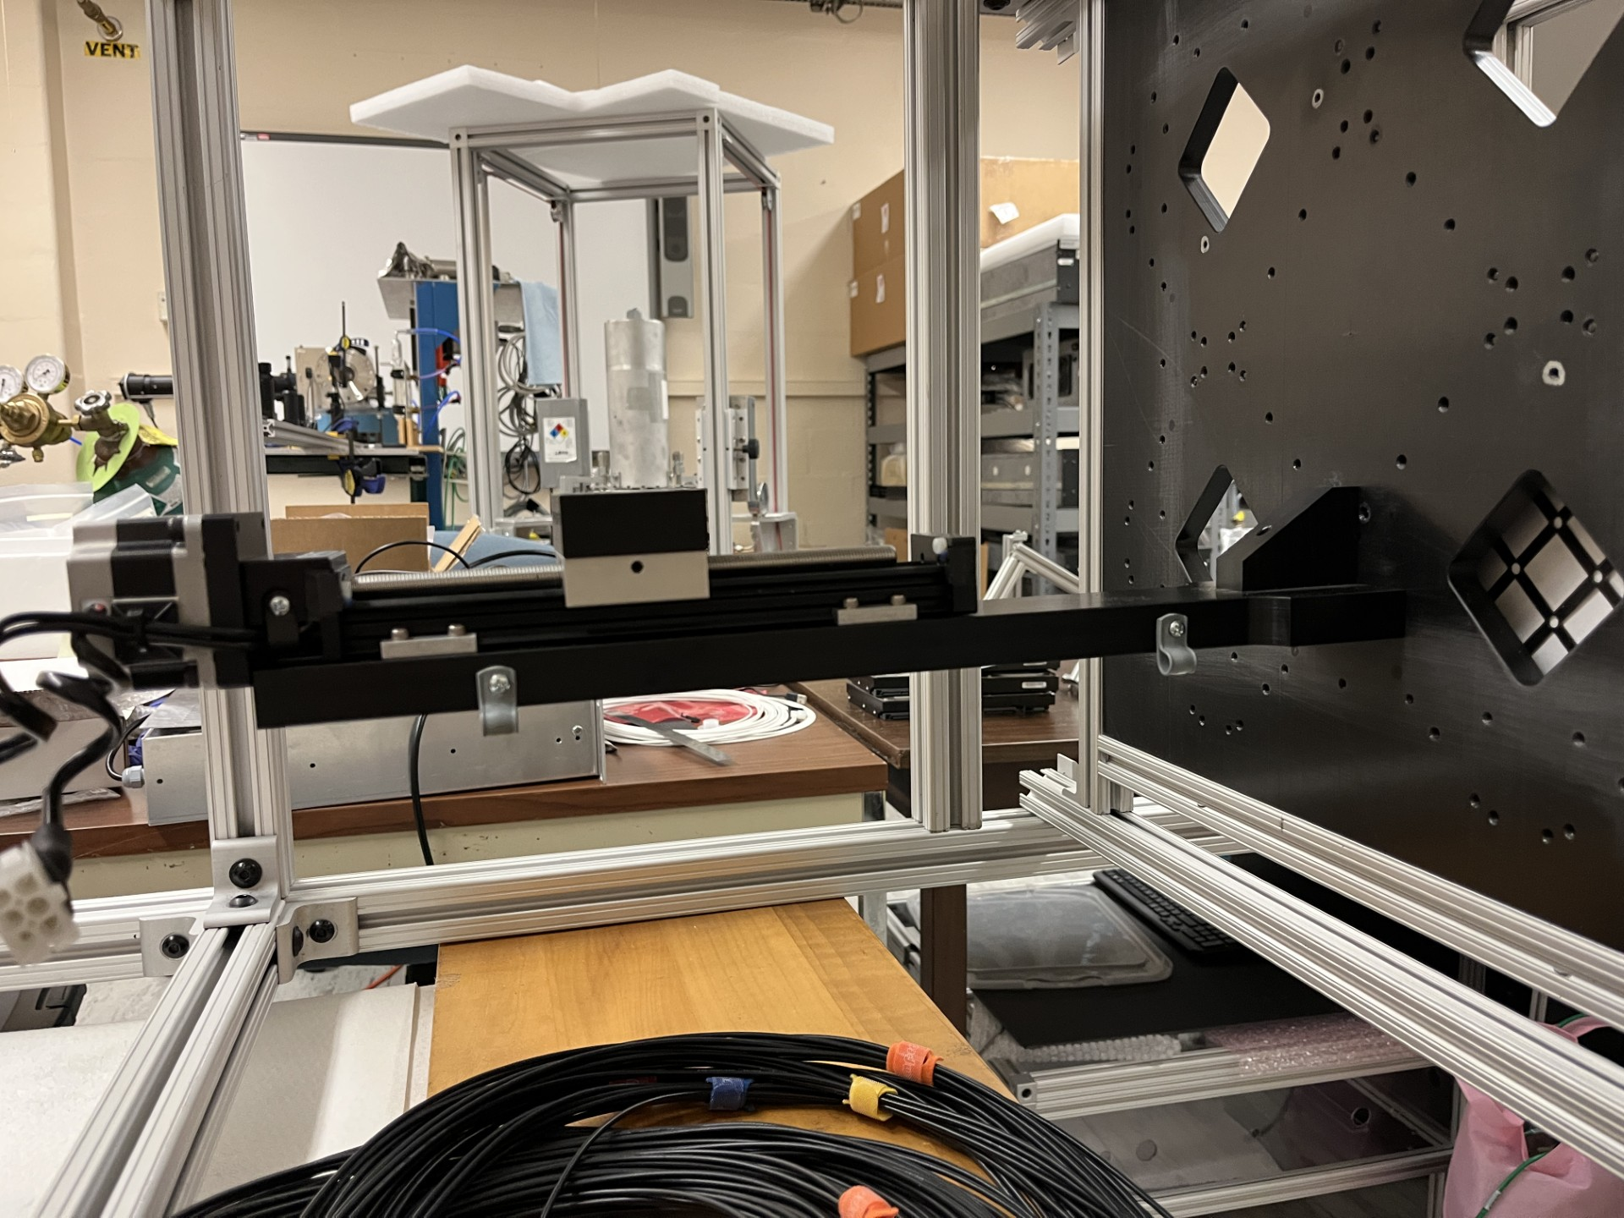
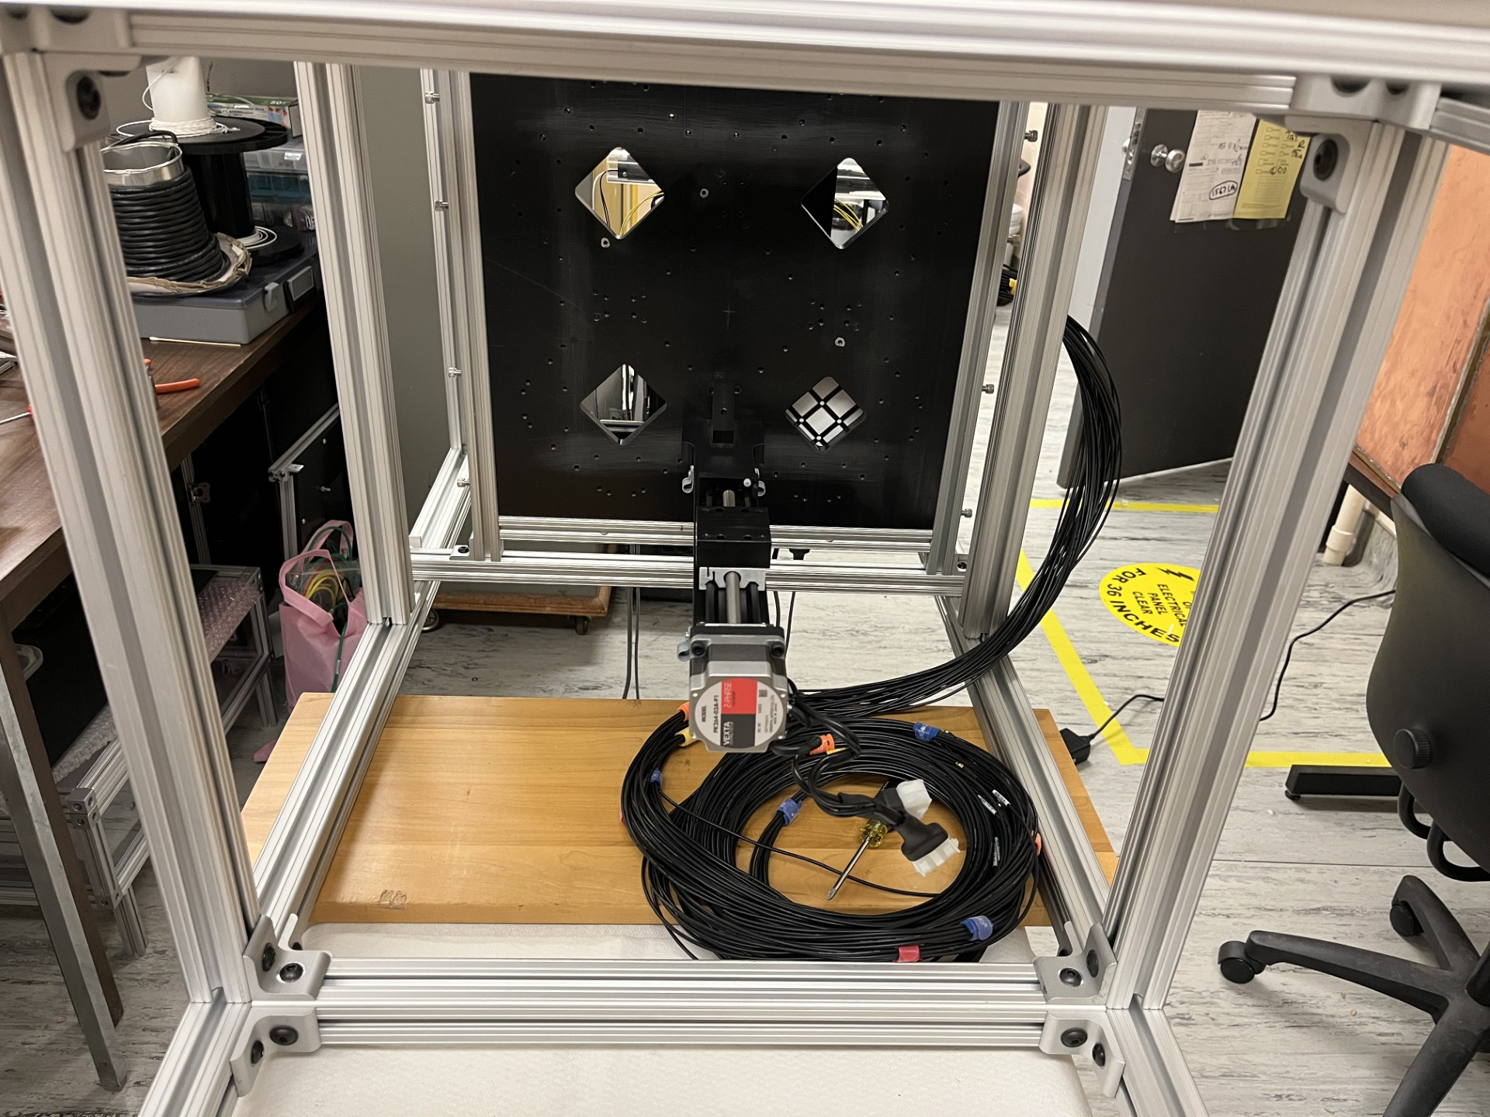
Dark box diving board
Diving board with Velmex Motor/stage
Diving board
HRPPD Base Plate

Slide 4
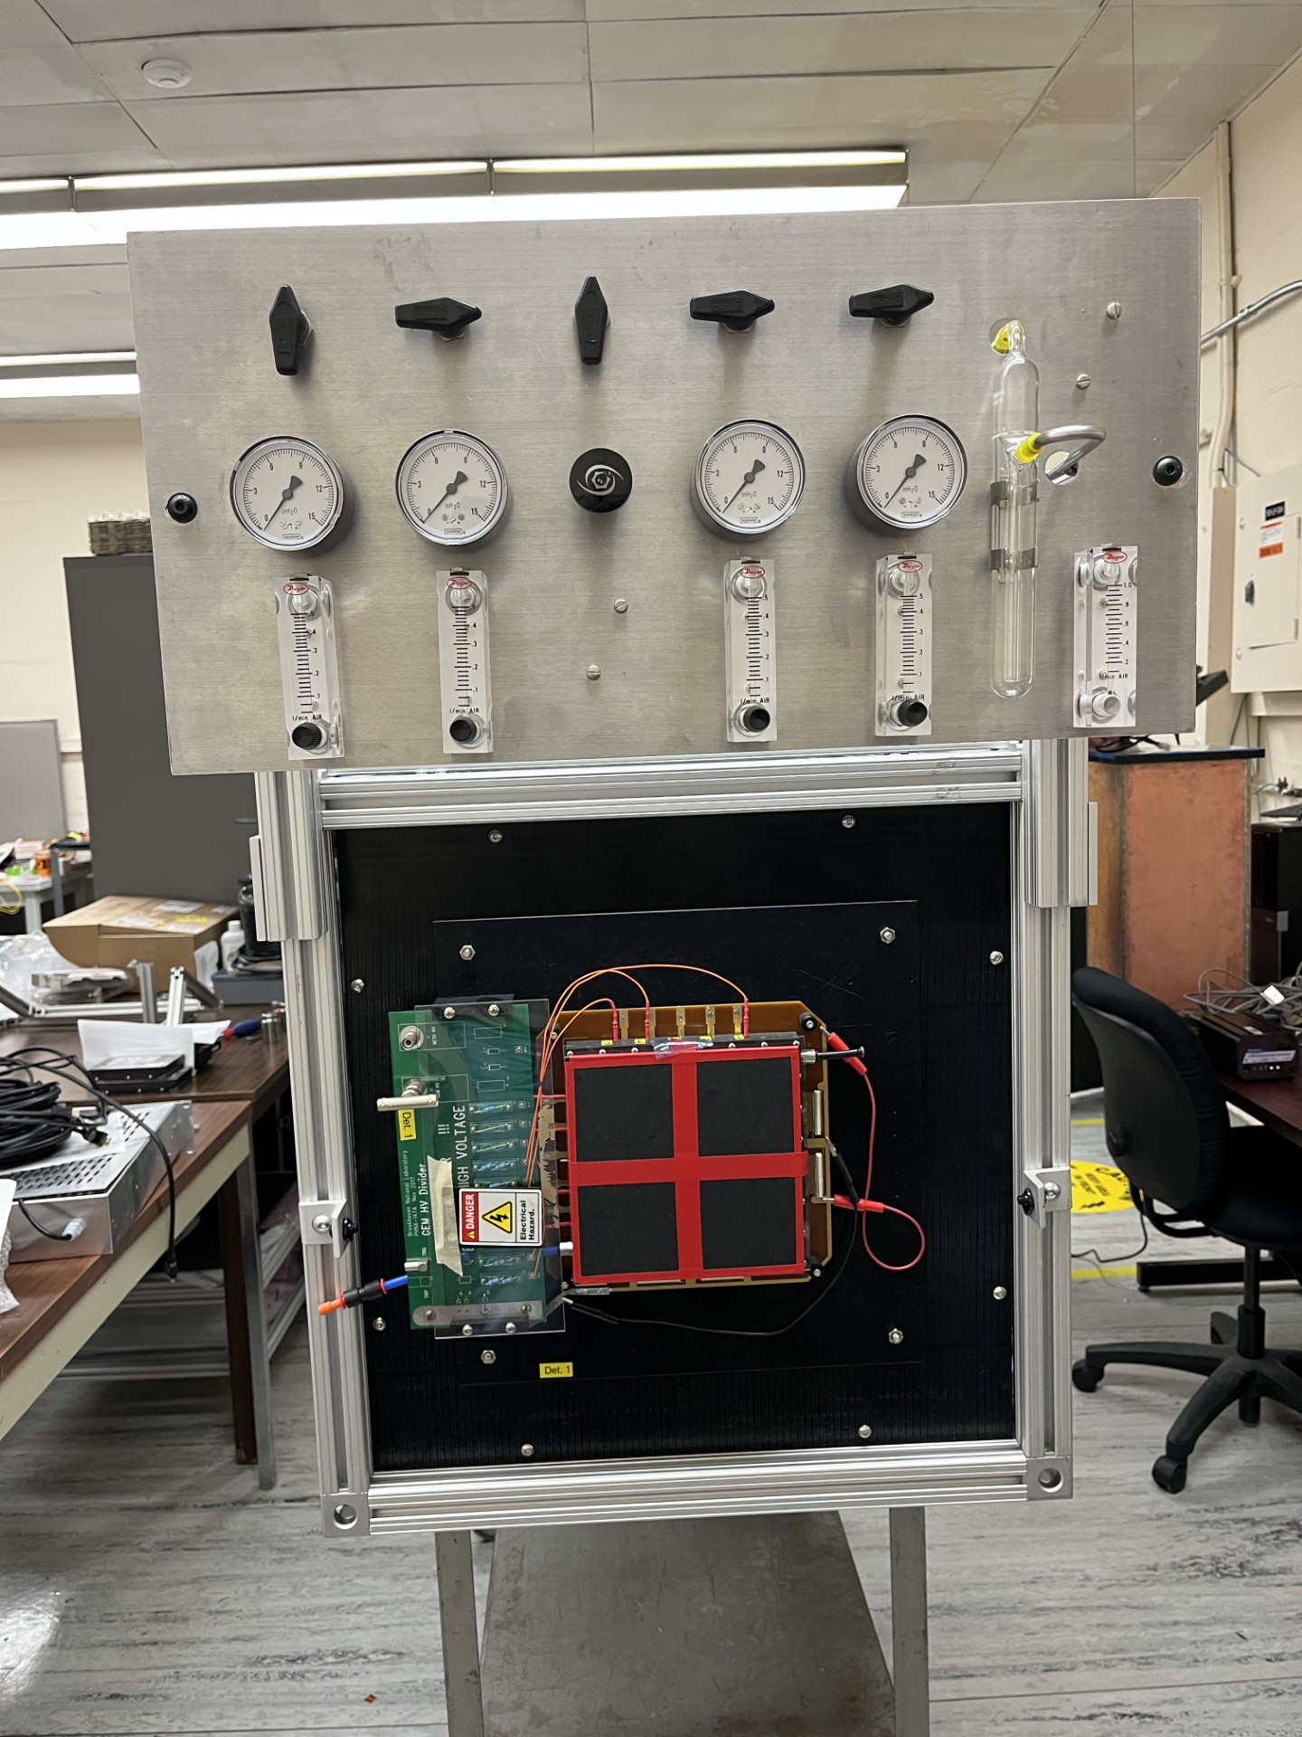
GEM layer mounted to 8020 Chassis
GEM gas panel mounted to back end of 8020 chassis
GEM layers tested and mounted prior to shipment
Upstream GEM layer

