Slide 1




BOTF production plans
Dr. Simone M. Mazza (SCIPP, UC Santa Cruz)

Slide 2
This is an assessment of the readiness of these detectors towards the upcoming project reviews for Critical-Decision 2 (baselining) anticipated to be late 2026/early 2027. The expected design maturity at that stage is 60% or higher, with still some 1-1.5 years for design completion remaining before start of construction anticipated in 2028.
You are asked to address the following questions:
Are the technical performance requirements appropriately defined and complete for this stage of the project?
Are the plans for the various sub-systems appropriately documented and complete for this stage of the project?
Are the current plans for the detector likely to achieve the technical performance requirements, with a low risk for cost increases, schedule delays, and technical problems?
Are the schedule assumptions for the fabrication of the various sub-systems and assembly plans reasonable and consistent with the overall detector schedule?
Have ESH&Q and QA considerations been adequately incorporated into the plans at their present stage?
Have the recommendations from previous reviews been adequately addressed?

Slide 3
Assembly procedure

Slide 4
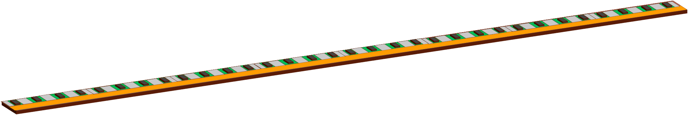
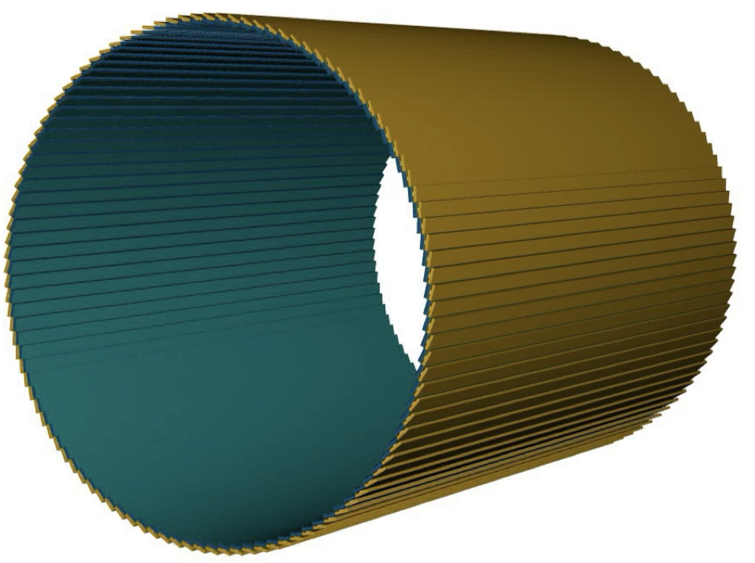
The assembly procedure and sites
The assembly is divided in modules (stavelets) assembly, stave assembly (stave) and final integration
Stavelets’ assembly sites: UCSC, Hiroshima, Riken
Staves’ assembly sites: Purdue, BNL
Final integration: BNL
Stavelets modular design was decided ~1.5 years ago for these reasons
Allow multiple sites which can assemble small (~3x16cm) components with complicated loading and wire-bonding using existing ATLAS/CMS equipment
Increase assembly yield with modular design
Ease of shipment to Staves assembly sites
QA and QC is done at different levels
At sensor and ASIC single dies level, simple electrical (e.g. sensor IV)
FPC and interposer, trace impedance etc.
On assembled stavelet, electrical and telemetry
On assembled stave, electrical and telemetry
0.64 m
~2.8 m

Slide 5
The stave
The stave is double-sided (components on both faces) to have 100% coverage
Inner core is carbon honeycomb with steel pipes for cooling
Carbon plies and epoxy form the support for FPC which is co-cured on the hard support
Each side is fabricated and co-cured separately
Sensors and ASICs are glued and wire bonded to interposer boards (green)
ASIC have an opening under it in the FPC to allow direct thermal connection with thermal paste
Interposers boards are glued and wire bonded to FPC
The two sides of the stave are sandwiched with pipe to fabricate final stave

Slide 6
Double-sided stave design
Wire bonds
Sensor
*ASICs
Stavelet
Interposer
Glue
Service Hybrid
Stave Front
Glue
Half-stave
Co-cure
Cooling pipe and return (10-20C)
FPC
Carbon fiber
Co-bond
Co-bond
Service Hybrid
Carbon fiber
Co-cure
Glue
Stave Back
FPC
Half-stave
*ASICs placement is slightly different after update in baseline

Slide 7
Assembly steps
Wire bonds
Sensor
*ASICs
Interposer
Step 1: Assemble stavelets
Glue
Stavelet
Service Hybrid
Stave Front
Glue
Co-cure
Cooling pipe and return (10-20C)
FPC
Carbon fiber
Co-bond
Co-bond
Service Hybrid
Carbon fiber
Co-cure
Glue
Stave Back
FPC
*ASICs placement is slightly different after update in baseline

Slide 8
Assembly steps
Sensor
*ASICs
Step 2: co-cure FPC and carbon fiber
Stavelet
Service Hybrid
Glue
Stave Front
Glue
Co-cure
Cooling pipe and return (10-20C)
FPC
Carbon fiber
Co-bond
Co-bond
Service Hybrid
Carbon fiber
Co-cure
Glue
Stave Back
FPC
*ASICs placement is slightly different after update in baseline

Slide 9
Assembly steps
Sensor
*ASICs
Step 3: assemble stavelets on FPC
Stavelet
Service Hybrid
Glue
Glue
Stave Front
Co-cure
Cooling pipe and return (10-20C)
FPC
Carbon fiber
Co-bond
Co-bond
Service Hybrid
Carbon fiber
Co-cure
Glue
Stave Back
FPC
*ASICs placement is slightly different after update in baseline

Slide 10
Assembly steps
Sensor
*ASICs
Step 4: assemble final sandwich
Stavelet
Service Hybrid
Glue
Stave Front
Glue
Co-cure
Cooling pipe and return (10-20C)
FPC
Carbon fiber
Co-bond
Co-bond
Service Hybrid
Carbon fiber
Co-cure
Glue
Stave Back
FPC
*ASICs placement is slightly different after update in baseline

Slide 11
Assembly steps
Step 5: assemble staves in trays
Step 6: assemble BTOF
5
Barrel-TOF (BTOF)
6
0.64 m
*Outdated, see Andy’s talk
~2.8 m
-1.33<η<1.74

Slide 12
Details of stavelet assembly
Step 1: Glue deposition on the interposer is done with glue robot (gantry with precision deposition, same as ATLAS)
Glue: either UV or bi-component silver epoxy, TBD
Step 2: Components (ASICs, sensors) are picked up with precision vacuum jigs and deposited on interposer, jigs close and set aside for curing
Hole under ASIC filled with thermal paste for better thermal connection
Step 3: After curing, telemetry to verify components position
Step 4: Sensors are ASICs are wire bonded to interposer, optional encapsulation or potting
Step 5: QC on testing station (verify ASIC, charge collection)
Step 6: Ship to stave assembly site

Slide 13
Stavelet jigs and equipment
Precision pin
ASIC
sensor
Vacuum nozzles
Slots
Precision pin
Slots
Precision pin
Precision pin
Set aside for curing
Vacuum nozzles
glue
interposer

Slide 14
Details of stave assembly
Step 0: prepare stave (co-cure or co-bond FPC with stave support), load Service Hibrid
Step 1: received assembled stavelets
Step 2: glue stavelets on half stave
Step 3: final wire bonds (~20 per stavelet) (or using connector)
Step 4: QC on half stave, telemetry, electrical
Step 5: sandwich stave
Step 6: QC on full stave, telemetry, electrical
Step 7: ship to final integration site (BNL)

Slide 15
Stave jigs and equipment
Thermal paste
Glue? Screw?
Full stave

Slide 16
Database and stored information
Database being configured with central ePIC database
Each assembled stavelet will have an entry with:
Sensor IV
ASIC electrical tests (e.g. power draw)
Telemetry results (crucial for final alignment)
Pictures of assembly and components
Results of QC on assembled stavelet
Add picture from Grigory

Slide 17
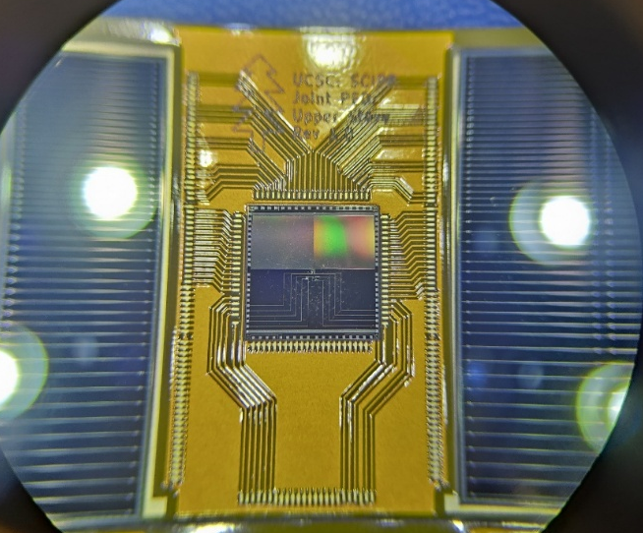
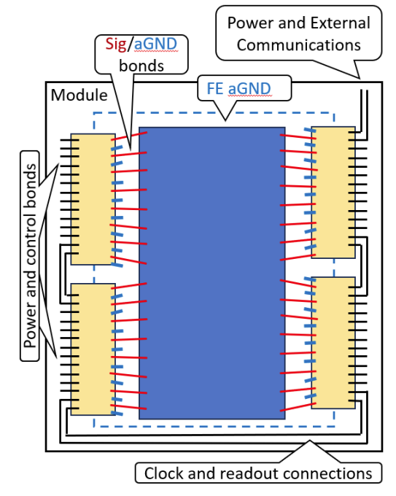
Update on FCFD design
Issue: interposer fan-in lines can be an issue for the chip readout, degrade the signal and introduce extra capacitance
Solution: use 4 chips per 2 half-sensors, long and narrow with same pitch as sensor
Direct wirebond to sensor
4 chips will be condensed in only one set of lines, no increase in FPC lines (already at limit)
Stavelet design and assembly remains roughly the same
If split is between ASICs there’s not gap due to the half sensors
Interposer slightly larger to have traces in between chips
Potential idea of 8 chip to 1 to reduce FPC lines
See: https://indico.bnl.gov/event/32008/

Slide 18
Volume and timeline

Slide 19
Stavelet production volume
Volume: 144 staves, 288 half staves made of 16 stavelets (top and bottom)
Wirebonds per stavelet: ((128 + 128)x2 (sensors-> interposer ->chip) + ~20(chip))x4 -> ~2000 bonds.
4608 stavelets +10-20% yield adjustment, ~5300 to assembly in 2 years
Assuming 3 BTOF assembly sites: ~2000 stavelets per site in 2 years, around 3 stavelet per day -> possible

Slide 20
Assembly time of one stavelet
Glue placement: 20 minutes
Component placement: 20 minutes
Glue cure: UV 5-10 minutes, bi-component 12h, thermal ~1h
QC on glued component: 30 minutes (metrology)
Wire bonding: 20 minutes
Full time: ~2-3h per stavelet (minus long glue cure time)
Can organize work with high parallelization (e.g. glue deposit on a jig with multiple stavelets).
QC on full stavelet: few hours. Likely QC will be most time consuming.
Might need other institutes involved in stavelet QC

Slide 21
Assembly time of one stave
Glue placement: 60 minutes
Component placement: 30 minutes
QC on glued component: 120 minutes (metrology)
Wire bonding: 60 minutes
Full time: ~4-5h per stave (minus long glue cure time), one per day?
144 staves (160 with yield) → ~1 year

Slide 22
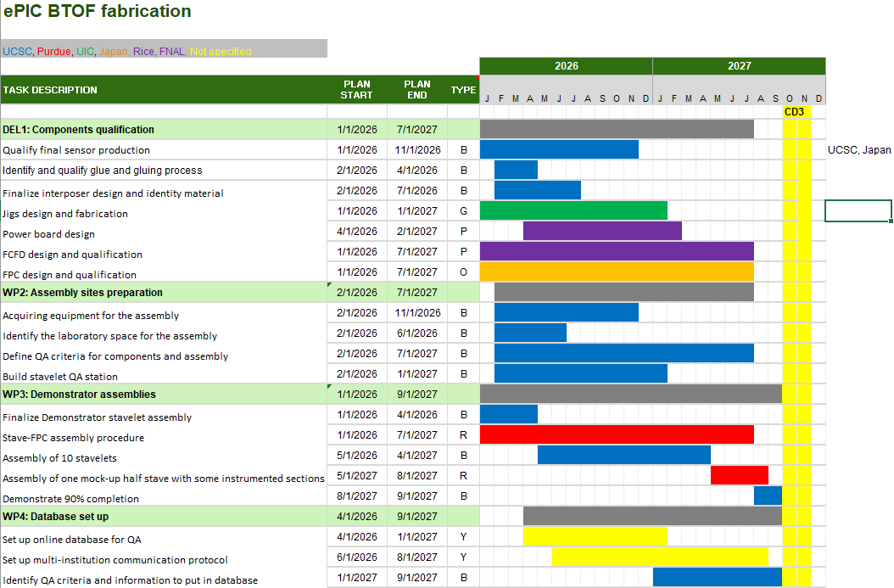
Path to CD3

Slide 23
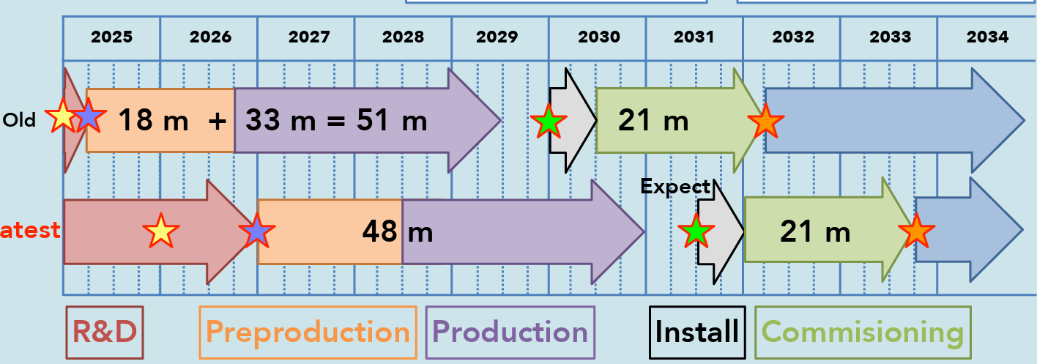
BTOF road-to-assembly
Demonstrator assembly
Develop tooling
Pre-production: assembly N stavelets
Full assembly
ITk (ATLAS) assembly
Having issues

Slide 24
Prototyping status

Slide 25
Prototyping status
Fabricated first interposer prototype ✓
Fabricated first short FPC with connections ✓
Co-cured and Co-bonded FPC prototype with carbon fiber ✓
Fabricated first jigs for loading (3D printed) ✓
Identified a few glues and performed gluing trials ✓
Loaded first interposer with few components and mockup ASIC, thermal tests ✓
Fabricated first long FPC (?) ✓

Slide 26
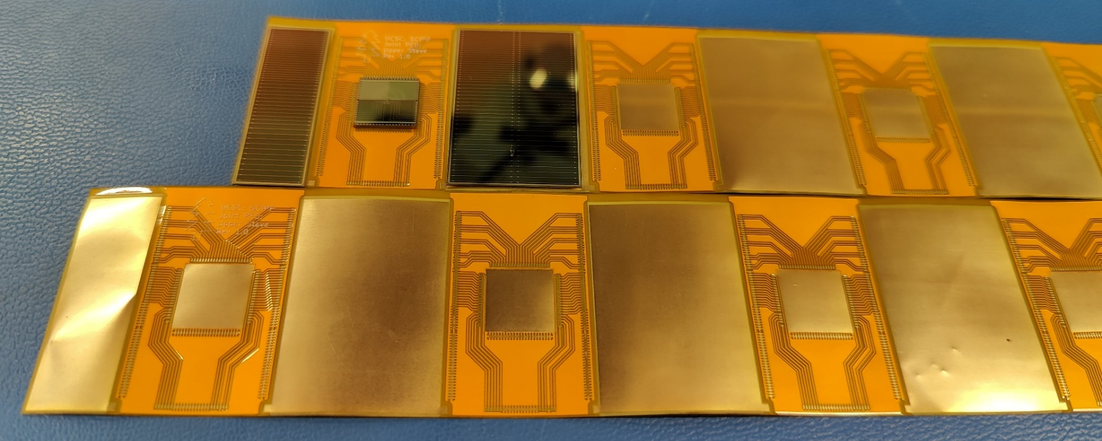
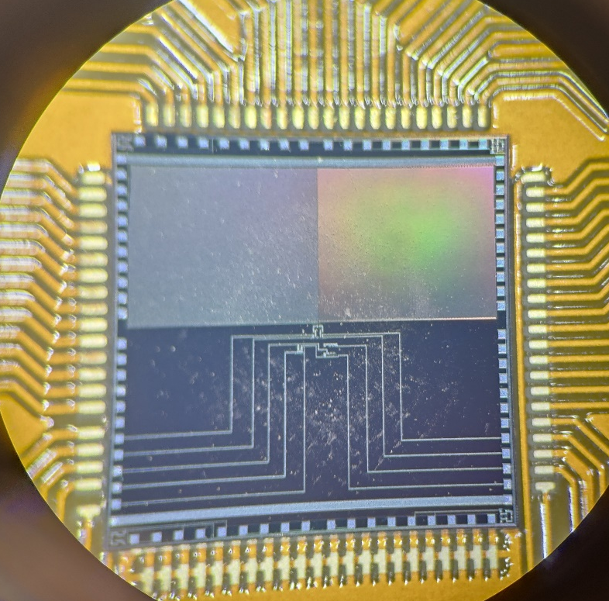

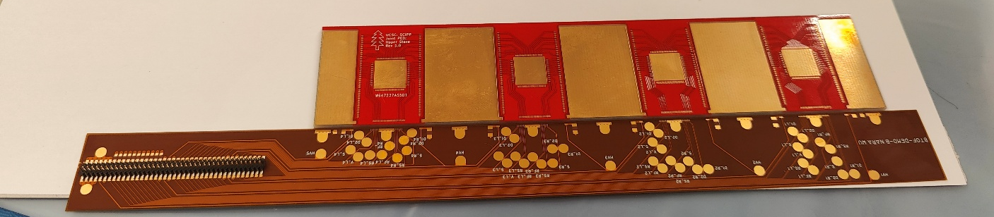
Stavelet demonstrator
First prototype of interposer board produced
Using non-working detectors from the HPK production
Si heaters to simulate ASIC
Goal: fully load a double-sided stavelet with active pipe cooling and check thermal dissipation in prototype
Perform telemetry on the stavelet

Slide 27
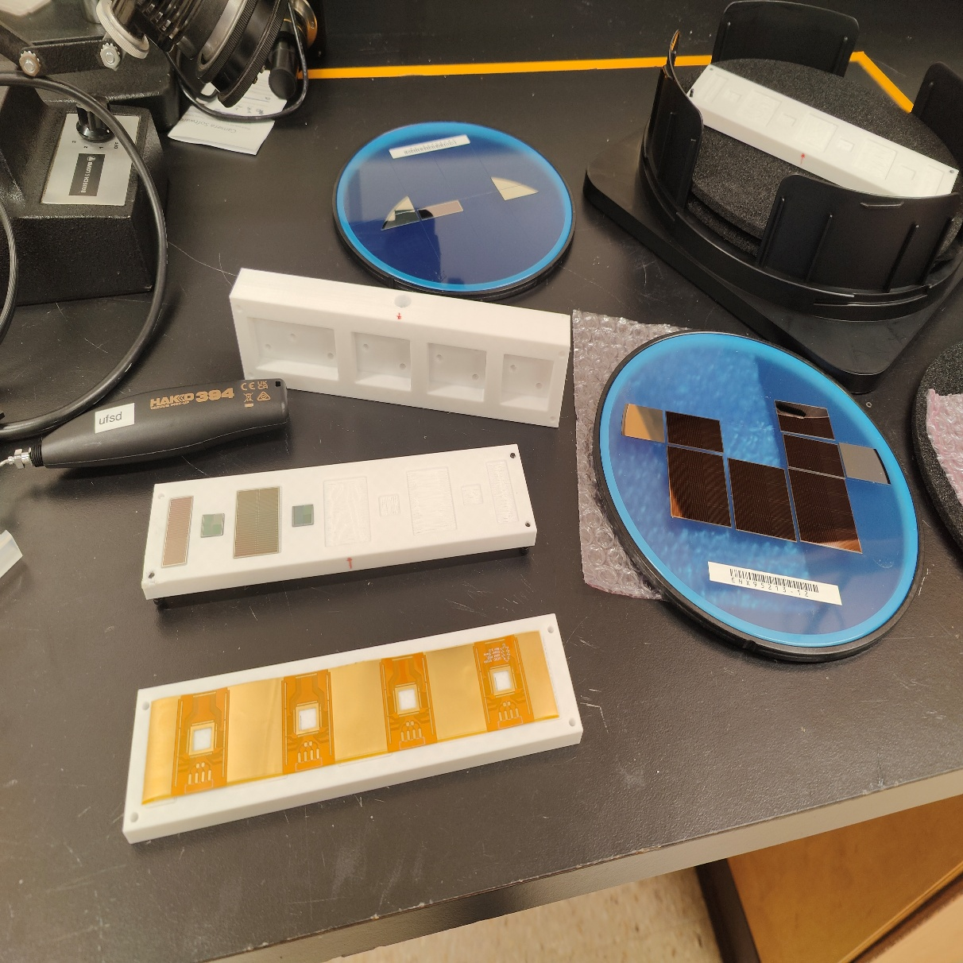
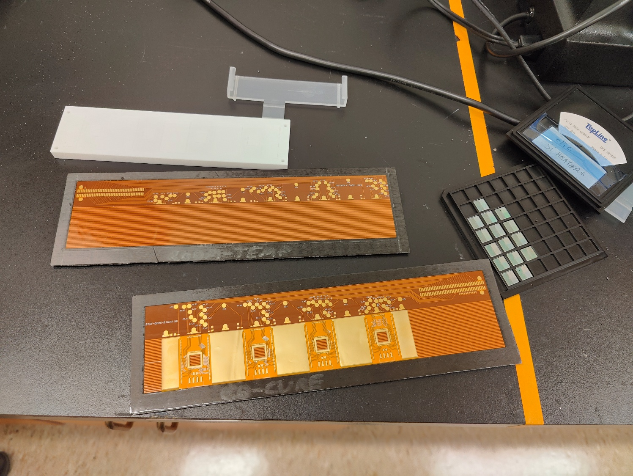
Loading jigs and co-cured FPC and stave

Slide 28

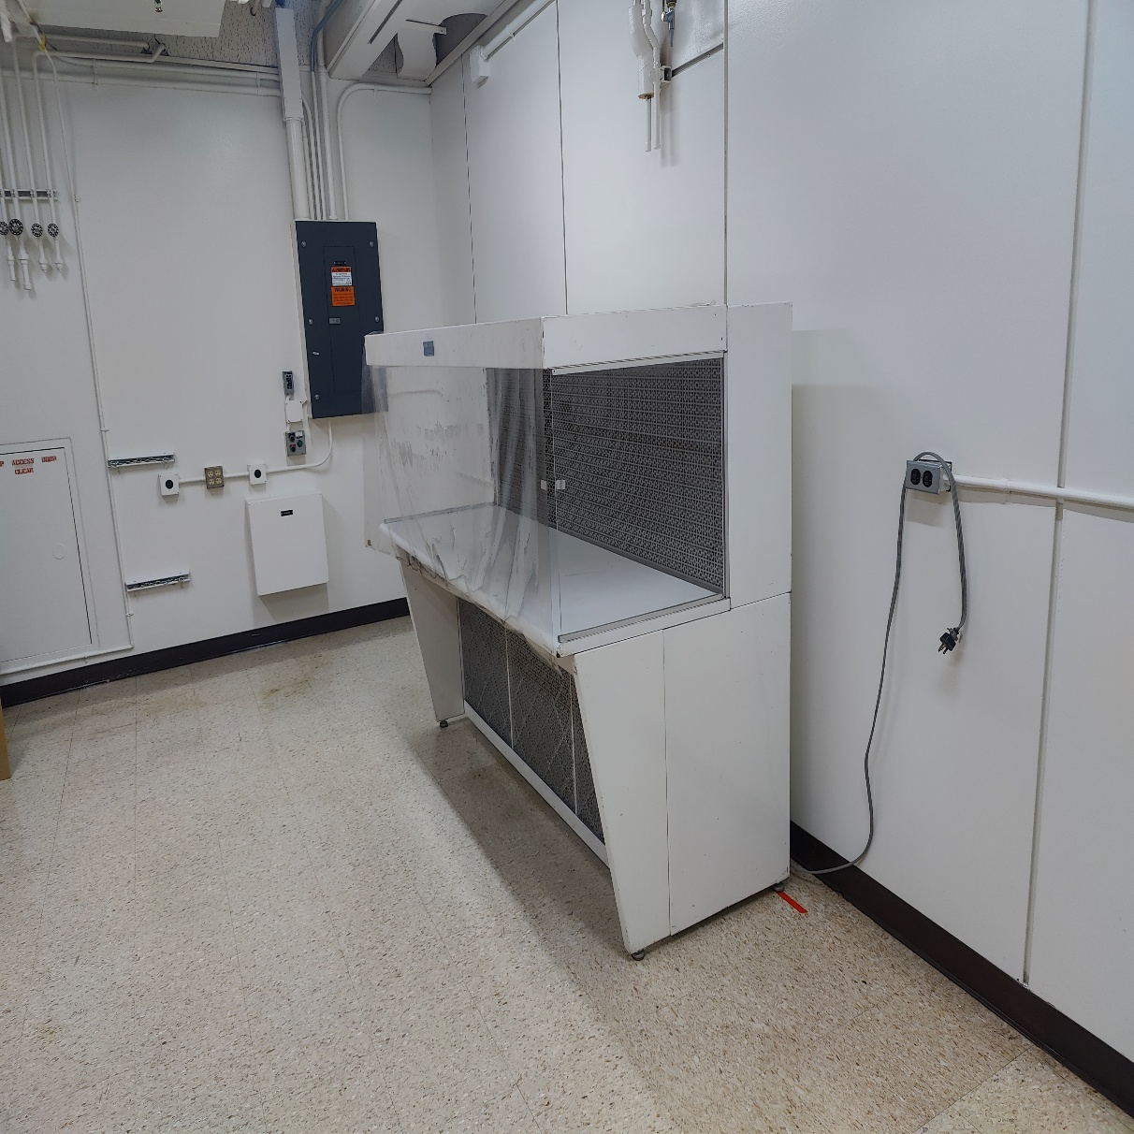
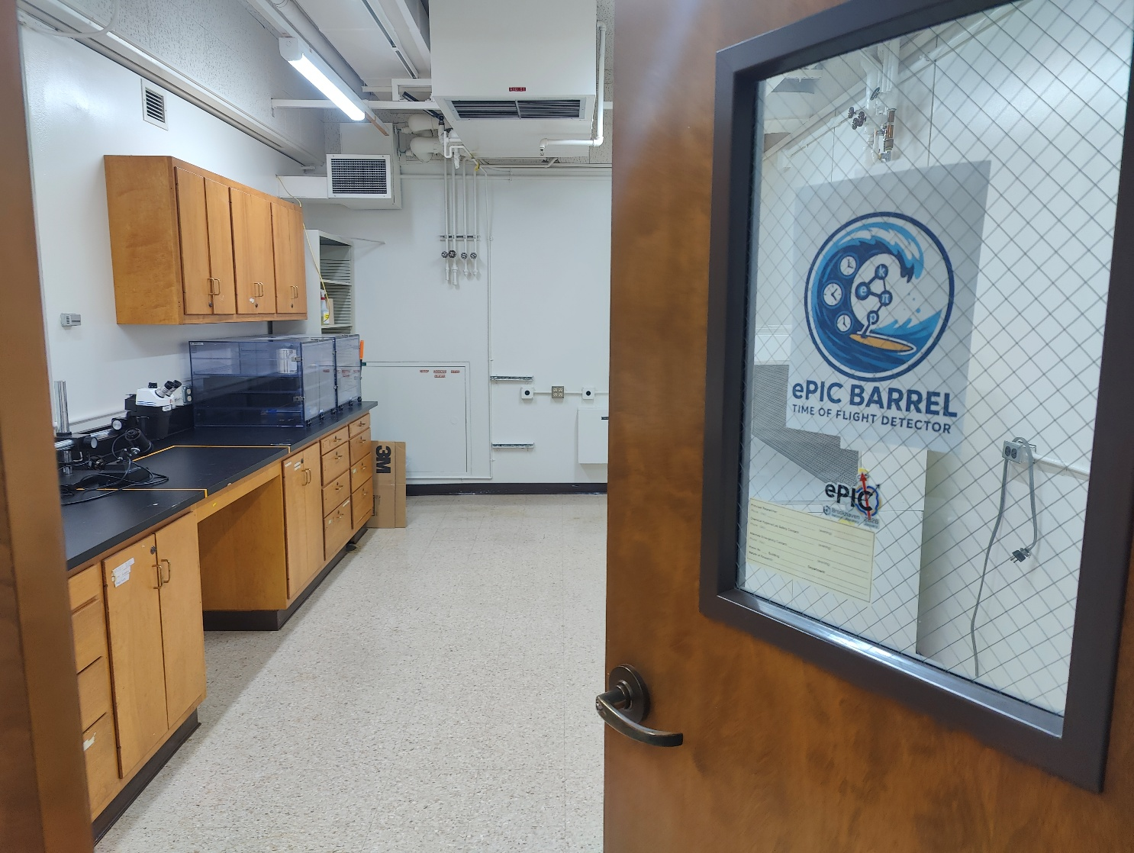
UCSC ePIC room

Slide 29
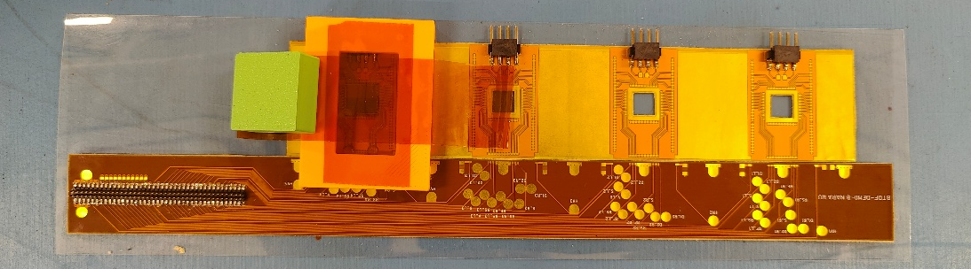
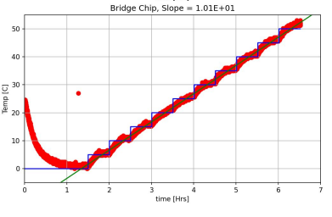
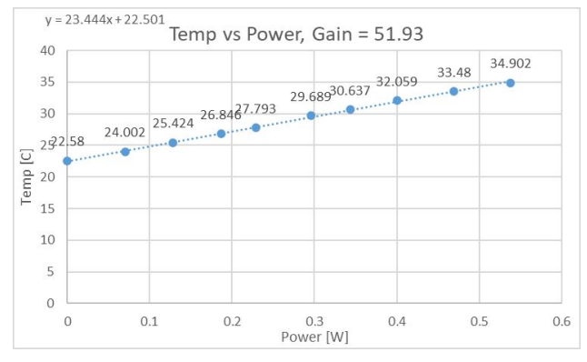
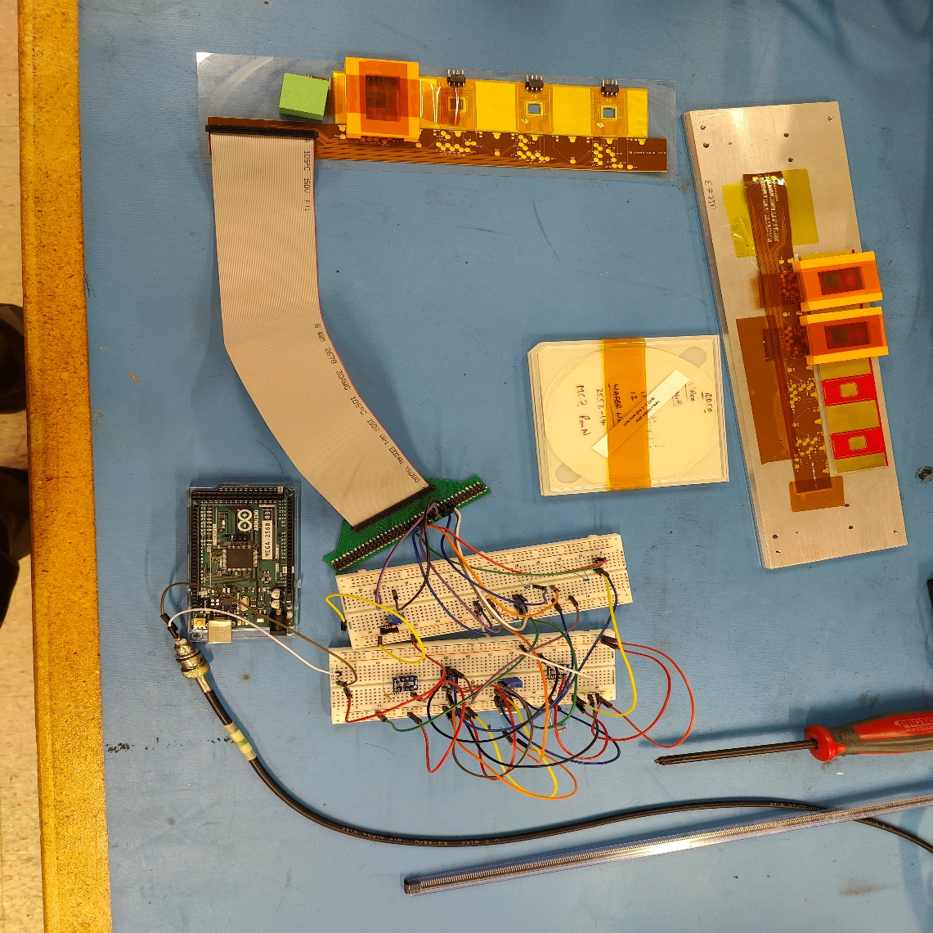
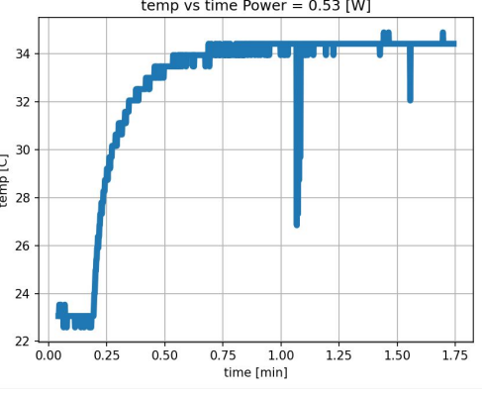
Thermal tests with mock-up ASIC

Slide 30
Insert pics Japanese institutes

Slide 31
Institute roles

Slide 32
Institutes involved and roles – pre-assembly
Hiroshima – define FPC QC/QA, define interposer QC/QA. Wirebond and assembly tests
Riken – design FPC, define FPC QC/QA. Wirebond and assembly tests
UCSC – Identify glue, define needed machines (glue robot, storage), design interposer. Wirebond and assembly tests
UIC – holding jigs, shipping jigs, gluing jigs
FNAL – design FCFD, test FCFD
Purdue – Test stave production, test assembly, define supports
UCSC, ? – stavelet QA development (PCB design and test station)
UIC – database set up

Slide 33
Institutes involved and roles - assembly
Hiroshima – ASIC, sensor, FPC QC, assembly
Riken – ASIC, sensor, FPC QC, assembly
UCSC – ASIC, sensor QC, assembly
? – assembly (4th site?)
UCSC, Riken, Hiroshima, Others? – stavelet QA, ASIC QA/QC
Purdue, BNL? – Stave production, final stave assembly and double-side gluing
Purdue, BNL? – Stave QC
BNL – Final tray assembly

Slide 34


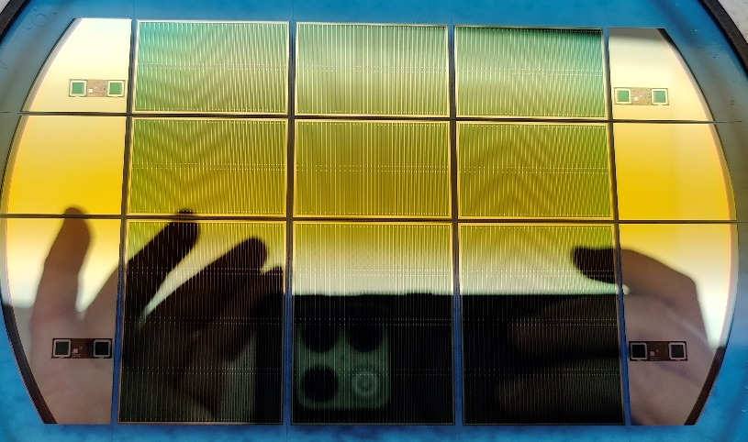
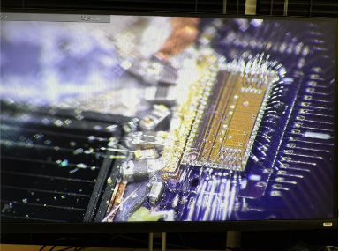
Conclusions
The loading procedure is outlined, and institutes roles are defined
Might need more institutes for the final assembly and QC
ePIC BTOF module assembling is proceeding with multiple prototypes
Gluing trials
Jigs design
Assembly procedure tests
Thermal tests
Expect a first ‘demonstrator’ soon and will repeat the process afterwards for multiple stavelets and a full stave
Working on setting up the database

Slide 35
Backup

Slide 36
Detector Assembling Workflow
Interposer
Production
Company C
Sensor Production
HAMAMATSU
ASIC Production
TSMC
FPC Production
Company D
RB Assembling
Company E
PB Assembling
Company E
Interposer QA
Hiroshima
Interposer QA
RIKEN
Interposer QA
UCSC
Sensor QA/QC
Hiroshima
Sensor QA/QC
RIKEN
Sensor QA/QC
UCSC
ASIC QA
Institute A
ASIC QA
Institute B
FPC QA
Hiroshima
FPC QA
RIKEN
FPC QA
UCSC
RB QA
Rice
PB QA
Rice
SH Assembling
Rice
SH QA
Rice
Module assembling
Hiroshima
Module assembling
RIKEN
Module assembling
UCSC
Mechanical
Production
Purdue/Academia Sinica
Module QA
Hiroshima
Module QA
RIKEN
Module QA
UCSC
Mechanical QA
Purdue/Academia Sinica
Module
Check
Purdue /BNL
Stave assembling
Purdue/BNL
Stave QA
Purdue/BNL
BTOF construction
BNL
BTOF QA
BNL
Install to ePIC
BNL

Slide 37
Discussion with FCFD developers
Fan-in lines can be an issue for the chip readout, degrade the signal and introduce extra capacitance
Solution: use 4 chips per 2 half-sensors, long and narrow with same pitch as sensor
Direct connection to sensor
4 chips will be condensed in only one set of lines, no increase in connections
Stavelet design remains the same, we can’t split in the middle the interposer (need lines between chips)
FCFD
To FPC

Slide 38
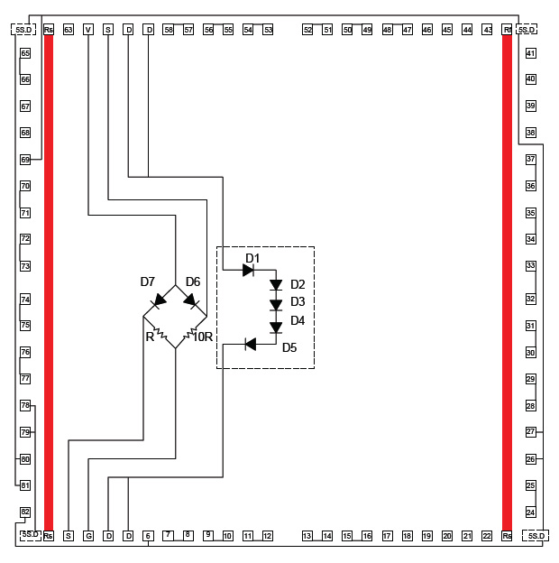
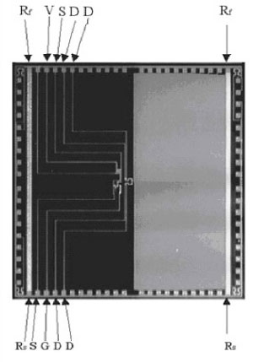
Test Si heater
1x1 cm size, 20 in SC right now
9 needed for the design
Each one need 1 line for heaters and 5 (?) for sensors
Has 2 sensors, one for absolute (less precise) and one for relative (more precise)

Slide 39
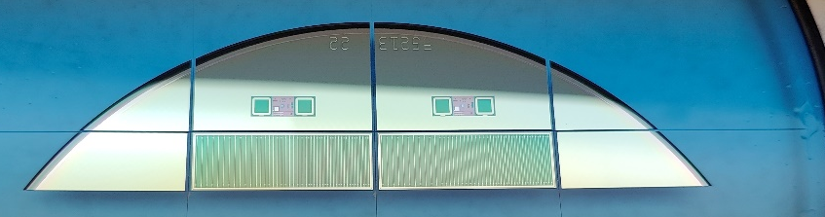
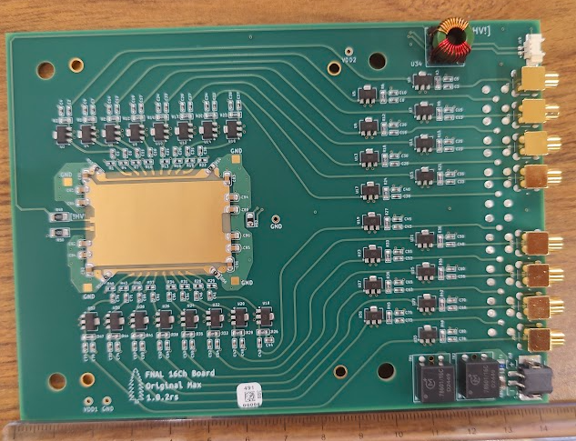
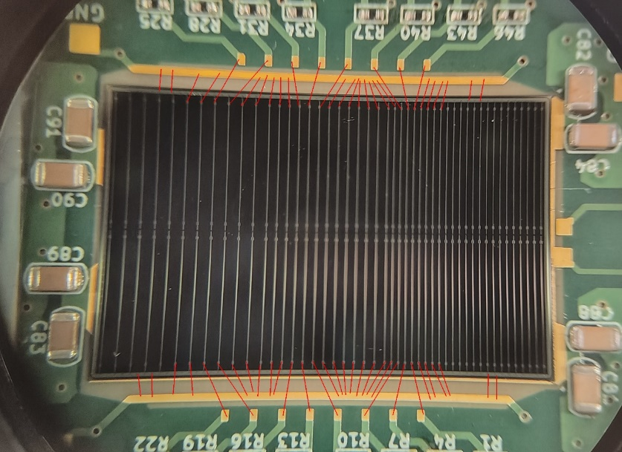
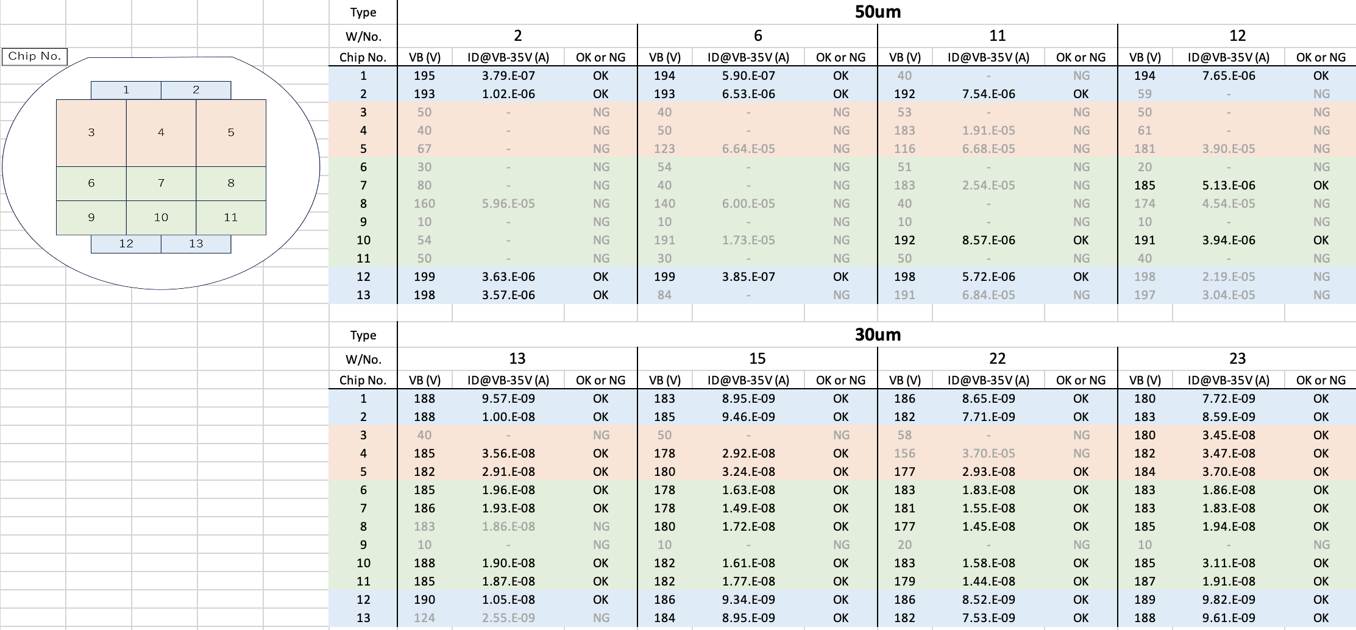
HPK AC-LGAD strip production
Half sensors
ePIC full-size production of HPK strip AC-LGADs with devices up to 3.2x4.2 cm
Nominal size 3.2x2.2 cm with 1cm strip ‘segments’
Strip width: 40-50um, strip pitch 500, 750, 1000 um
8 wafers in hand, four 50um thick and four 30um thick
Full sensors
Double sensors

Slide 40
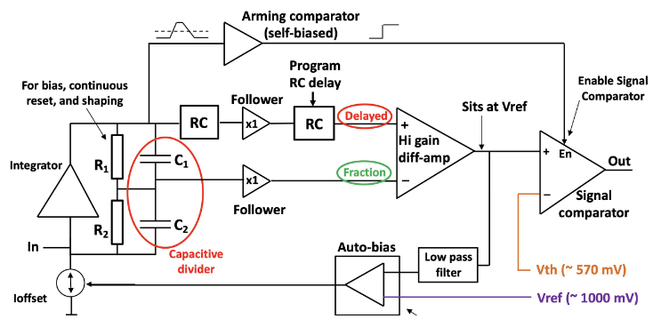
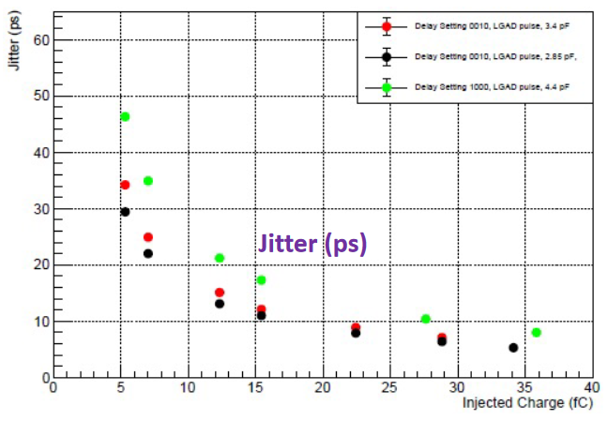
AC-LGAD strip readout – FCFD (FNAL)
AC-LGAD strip readout developed at Fermilab
Can accept high input capacitance o(10pF)
Target Jitter <10ps
FCFDv1 – 6 channel received Jan 2024.
Tested at FNAL in May/June 2024, AC & DC-LGAD (1 mm):
DC-LGAD @ 50 ps; AC-LGAD @ 52 ps
AC-LGAD should get ~35 ps with improved comparator.
FCFDv1.1 – TSMC May 2025; DESY tests in July 2025.
128 ch strip readout
65 nm CMOS
Constant Fraction Discriminator
Plus TDC, ADC, interfaces
Cdin: <15 pF
Dynamic Range: 5-40 fC
Timing: 10-30 ps
Links: ~Gbps, multiple
Radiation tolerant.
40

Slide 41
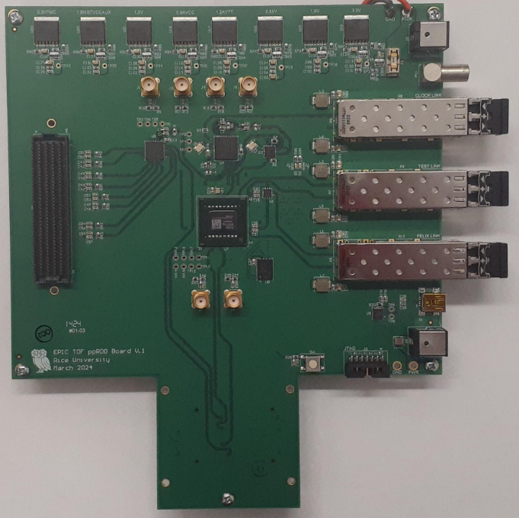
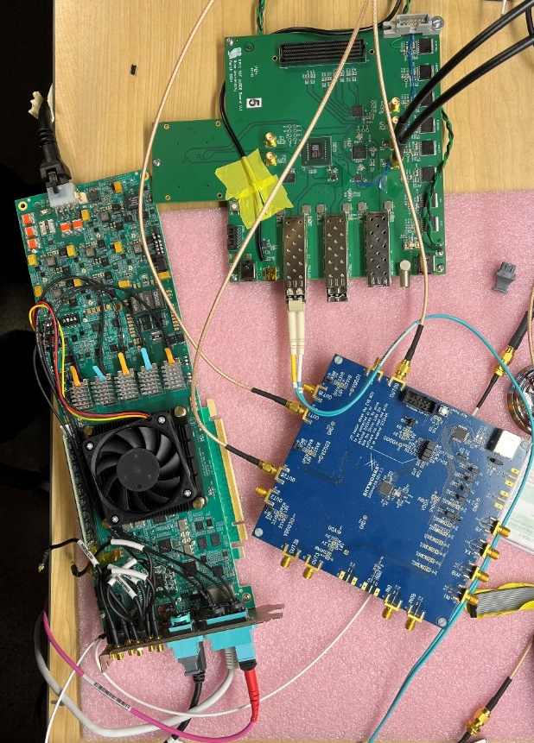
High Precision Clock Distribution
ppRDO – pre-prototype Readout Board:
Generalized to allow readout from various ASICs – FMC connector
Xilinx Artix+ FPGA (low cost, CERN TCLink compatible)
Clock Jitter cleaner – 5 ps
Clock recovery on Rx of SFP or direct clock on dedicated fiber
Establish procedures to readout ePIC’s ASICs prototype PCBs
Develop common streaming readout scheme with DAQ’s protocols
Platform for radiation tests (SEU measurement and handling)
Produced and tested 6 PCBs.
Jitter measured at 3 ps (Ref clock – FLX182 Tx serializer – ppRDO)
ppRDO
(ADCLK944)
Si5344H
(ref Clock)
FLX182
41

Slide 42
Data Transmission
Half-Stave = 8 x Modules = ~ 1320 [mm]
Front-side
Back-side
Module (Stavelet) ~ 160 [mm]
3 x 8 x 2 x 288
=13824
8 x 2 x 288 =4608
2 x 8 x 2 x 288
=4608

Slide 43
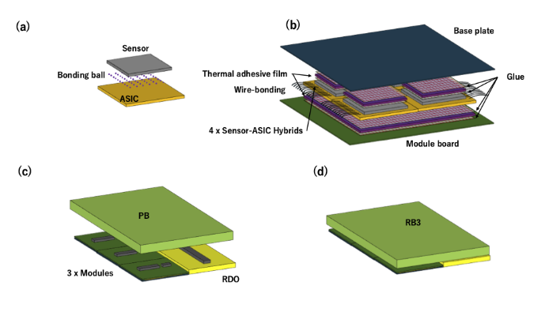
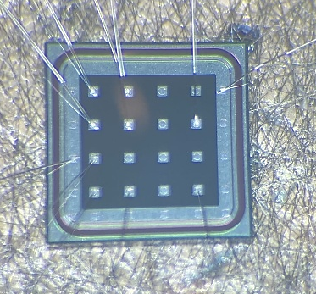
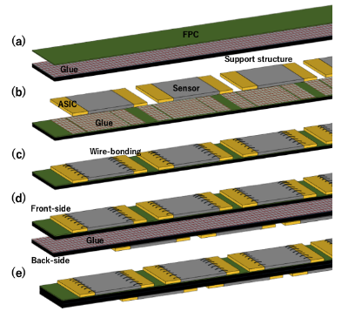
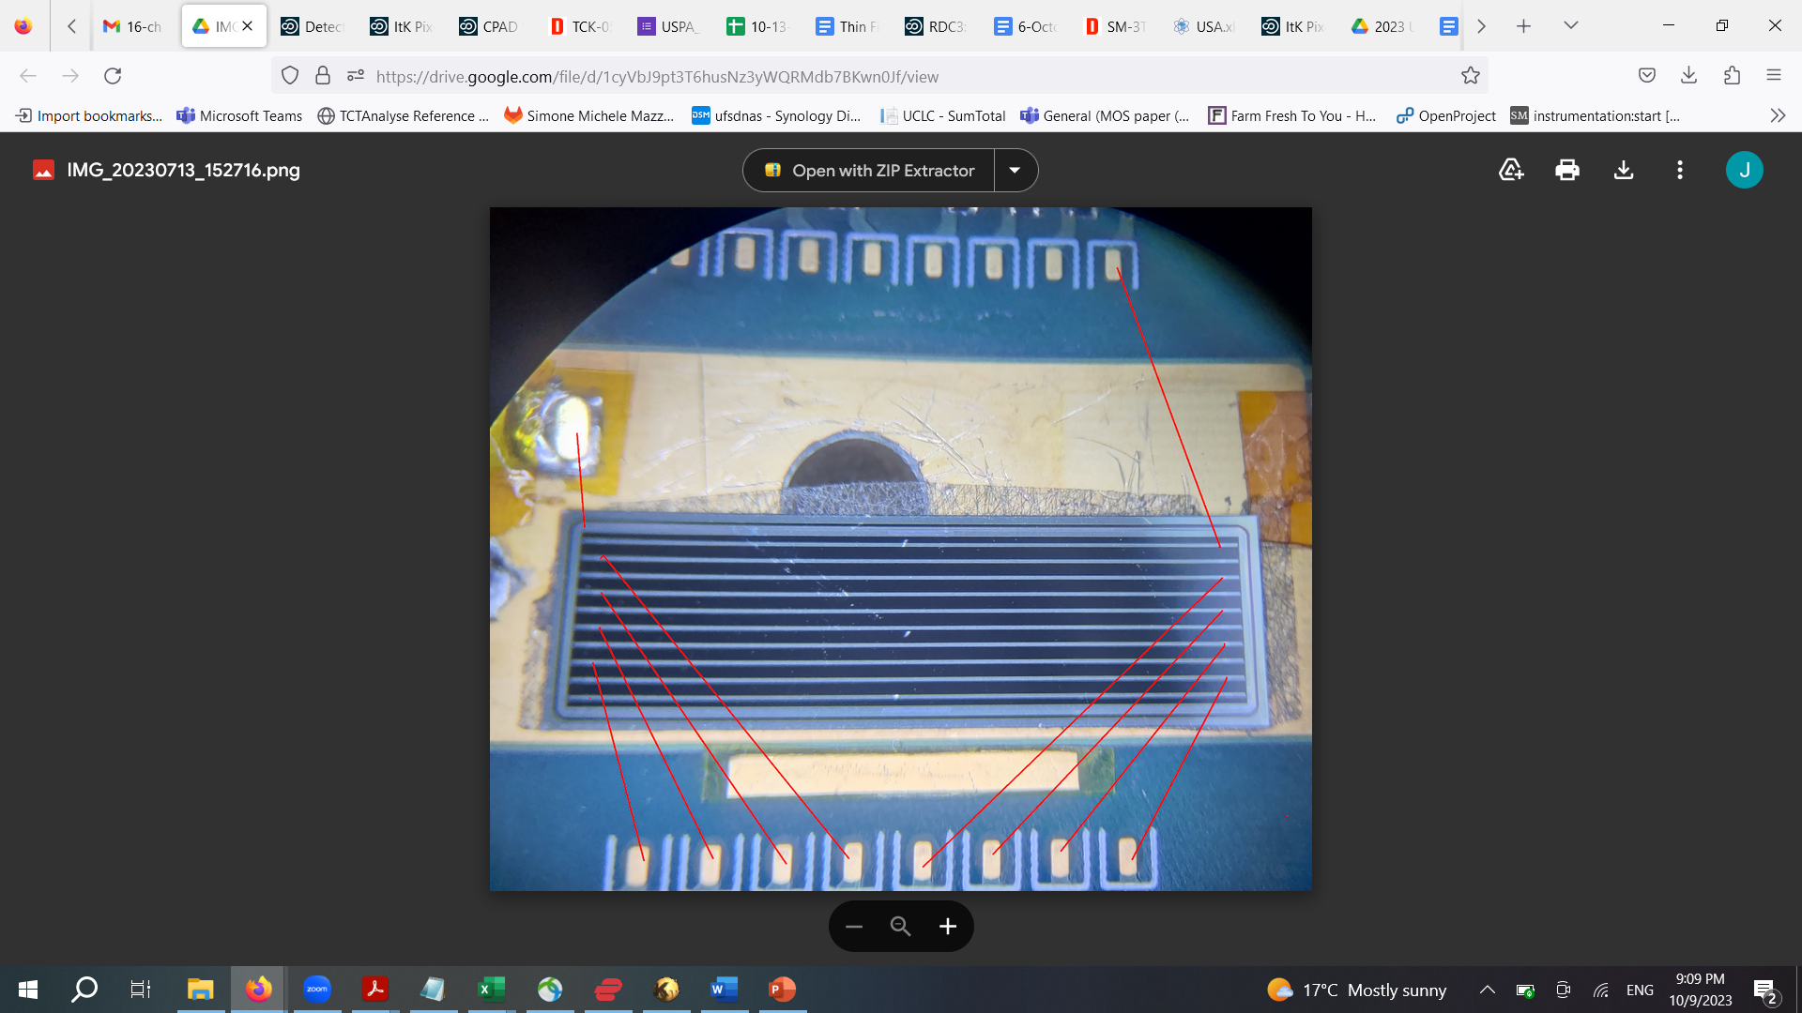
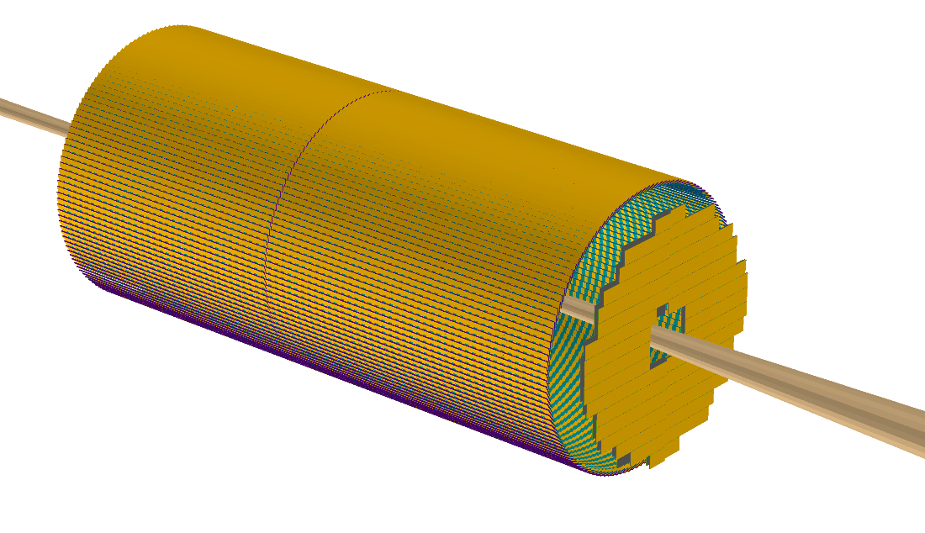
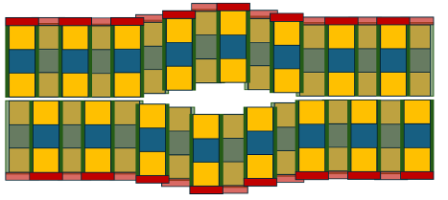
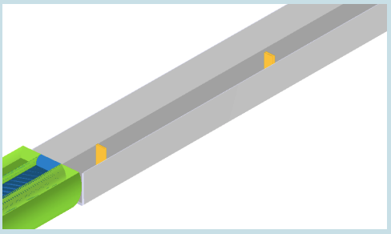
TOF layout in ePIC
Sensors: pixels
Readout: EICROC
Divided in two halves
Sensors: strips
Readout: FCFD
Sensors: pixels
Readout: EICROC
Off-Momentum Detectors (OMD)

Slide 44
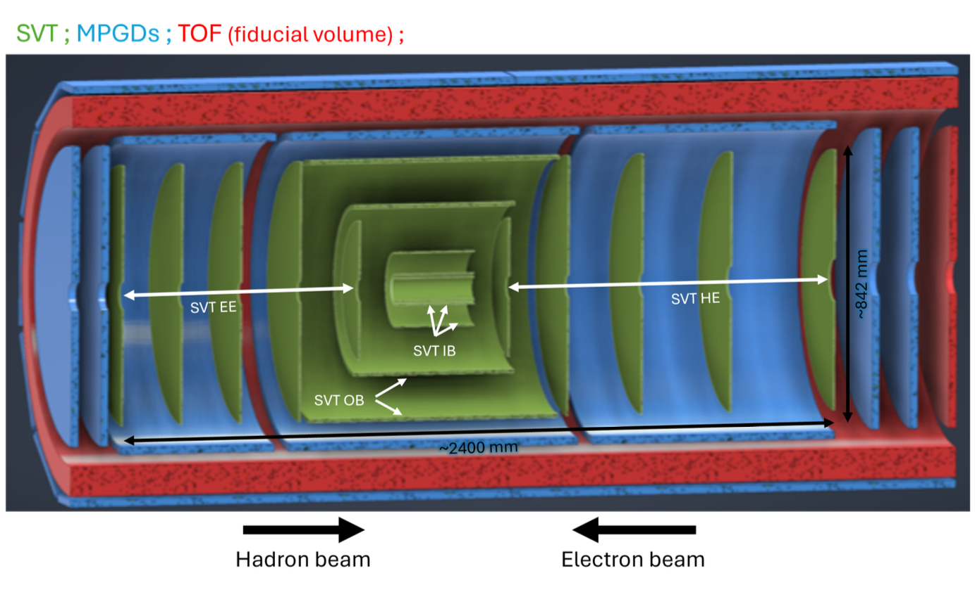
Barrel-TOF
Staves mounted in ‘trays’ that can be removed for servicing
Barrel-TOF (BTOF)
144 x Staves
0.64 m
~2.8 m
-1.33<η<1.74
The ePIC AC-LGAD TOF is PID, tracking and background rejection detector for mid-rapidity (BTOF: -1.33<η<1.74)
Cylindrical shape is composed of 144 tilted staves (288 half-staves)
Strip-type AC-LGAD sensor is used to meet the requirement of ~35 ps and ~30 um timing and spatial resolution respectively

Slide 45
Stave Assembling Steps (Opt1)
Sensor + ASIC
Module Assembly Site
Glue dispenser
Wire bonding
Interposer
FPC
Support structure (Carbon fiber)
FPC
Module-to-Module bonding machine
Cooling pipe and return (10-20C)
Stave Front/Back
Final Construction Site
Glue dispenser

Slide 46
Crucial activities for the next year or two
Interposer board finalized design, to do when FCFD is available
Interposer board simulation in HFSS to understand transient signal effects
Identification of correct glue (UV or bi-component), viscosity, thermal conductivity
It might be necessary to use two different types of glue: thermally conductive glue for ASIC, electrically conductive for sensor
If UV glue, design of UV curing box. If bi-component glue, glue robot calibration vs viscosity. If thermal cure, check effects on components
Identification of glue robot configuration or glue panning with jigs
Define QC procedure before assembly
Define QC during assembly (metrology)
Define QC procedure after assembly (DAQ?) and testing PCB
Design jigs for stavelet assembly, movement and shipping
Define wire bond encapsulation needs and procedure
Define and build database
To identify the correct components, it might be useful to go to fairs, like Semiconductor West

Slide 47
Plans
Thermo mechanical test – 2025
Ongoing with PED funds 2025, production of a simple 1 stavelet demonstrator front and back mounted on a carbon fiber support with cooling pipe. ASICs are mimicked with Si heathers.
Assembly R&D - 2026
Define glue and first version of Jigs. Define assembly procedure and QC procedure before assembly
Prototype 1 – 2026
Production of a full stave demonstrator front and back mounted on a carbon fiber support with cooling pipe. ASICs are mimicked with Si heathers.
Assembly R&D – 2027
Shipping tests, finalize assembly and identify assembly machines, finalize jigs. QC procedure before-after assembly. Build first QC test station for stavelet
Prototype 2 – 2027
Production of a full stave rack demonstrator (4 staves) front and back mounted on a carbon fiber support with cooling pipe. ASICs are mimicked with Si heathers. Production of a stavelet with working ASIC and development of PCB for stavelet testing.
Pre-production – 2028
10% of production, 500 stavelets
Production – 2028-2030
Remaining 90% of production, 5000 stavelets

