Slide 1


First studies with dRICH prototypes
Fateme Farokhi

Slide 2
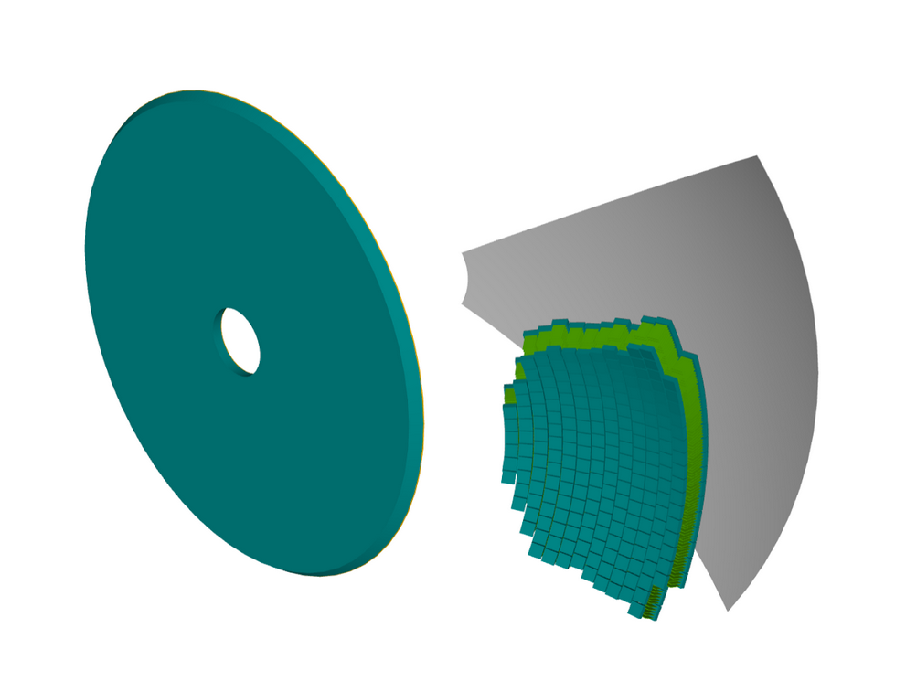
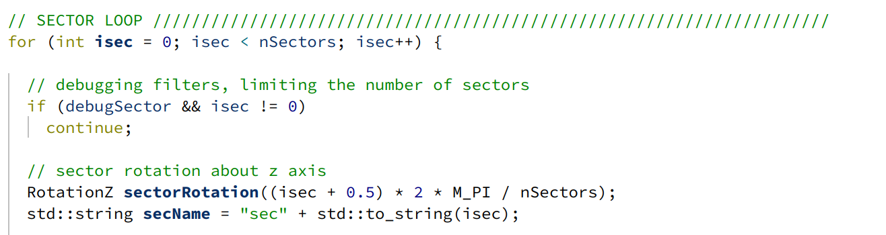
Single sector geometry:
DRICH_geo.cpp:
For a single sector:
nSectors=1 and isec= 0 so:
Phi = (0 + 0.5)* 2 * M_PI / 1 = 180 deg ,
so in 1-sector geometry, the single sector is centered at 180 deg.
For whole sectors:
nsectors = 6 and isec=0 phi = 30
But in the normal 6-sector geometry, sector 0 is centered at 30 deg.

Slide 3
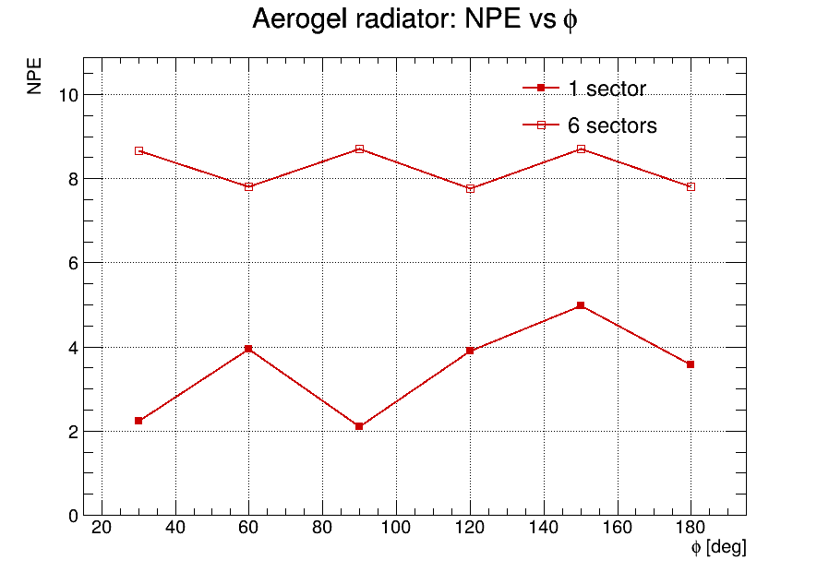
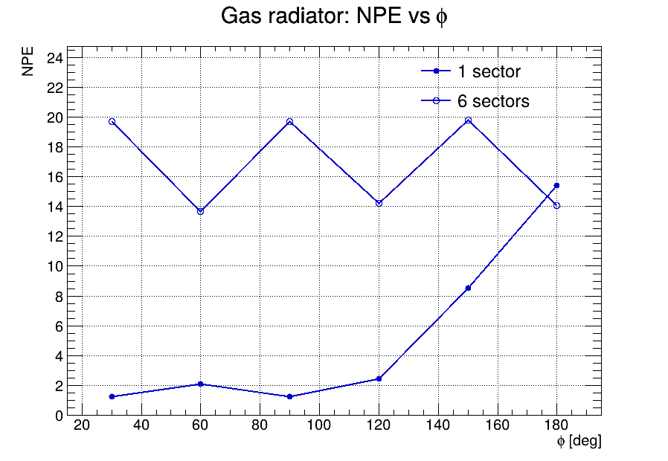
NPE vs phi (comparing two geometry single sector and whole sector):
2000 proton ,
p = 180 GeV/c,
eta = 3,
Phi values: 30, 60, 90, 120, 150, 180 deg

Slide 4
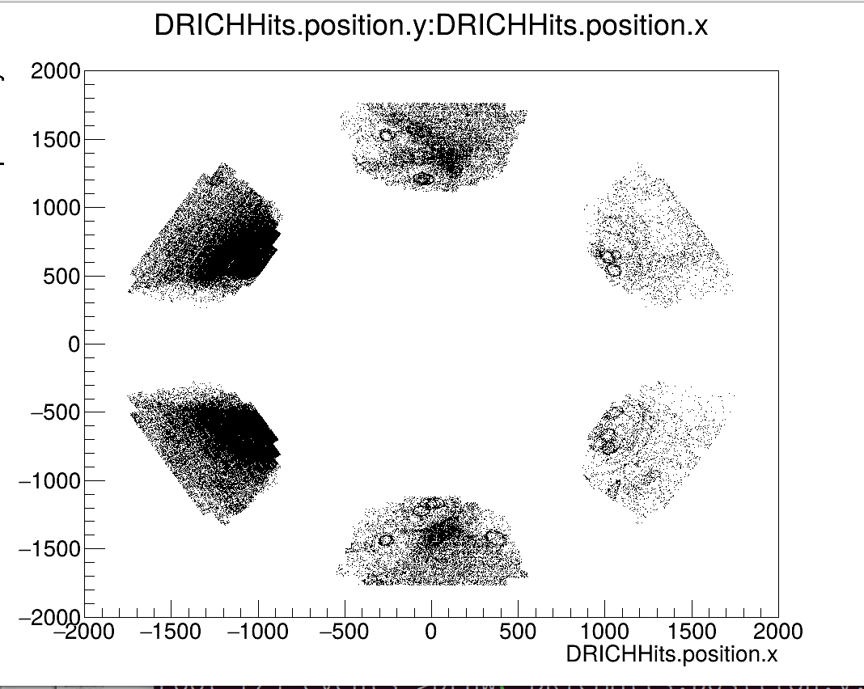
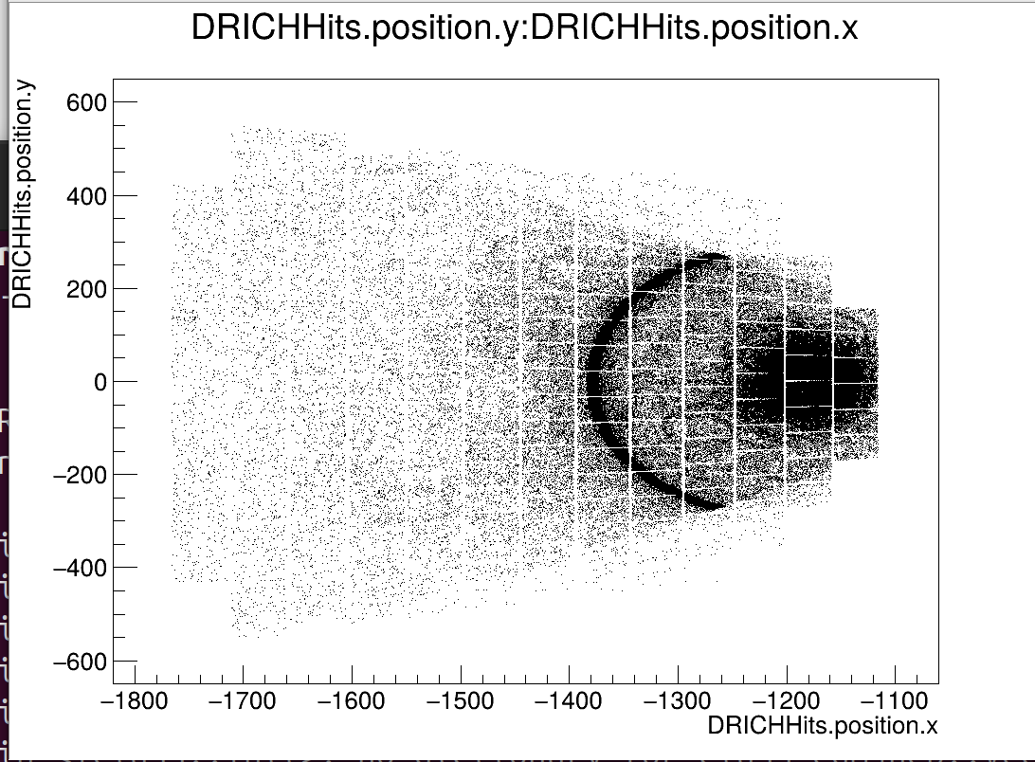
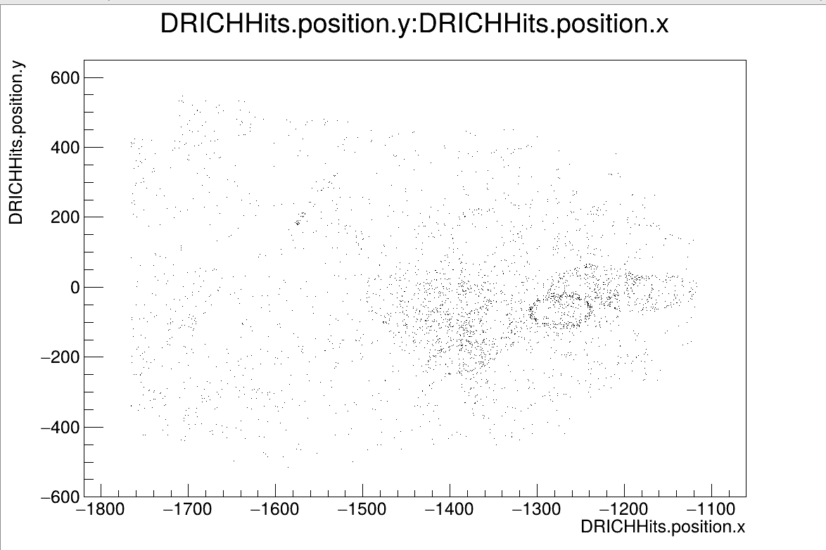
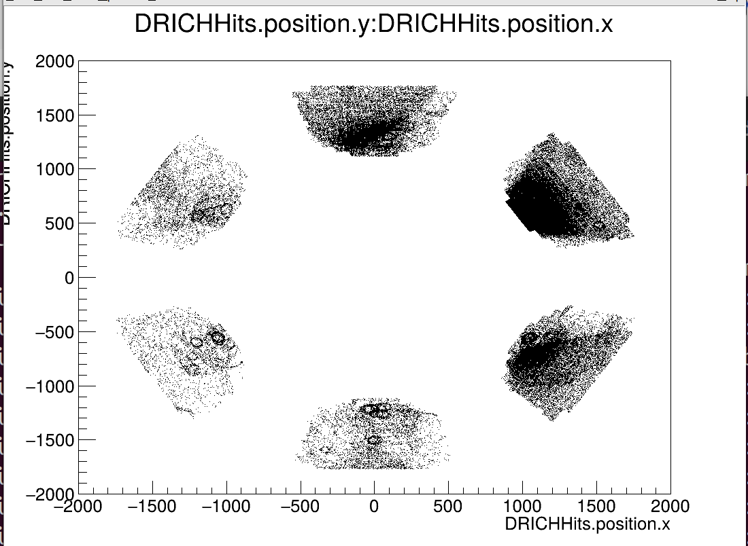
Hitting position for:
single sector at phi= 180 deg
whole sector at phi= 180 deg
single sector at phi= 30 deg
whole sector at phi= 30 deg

Slide 5
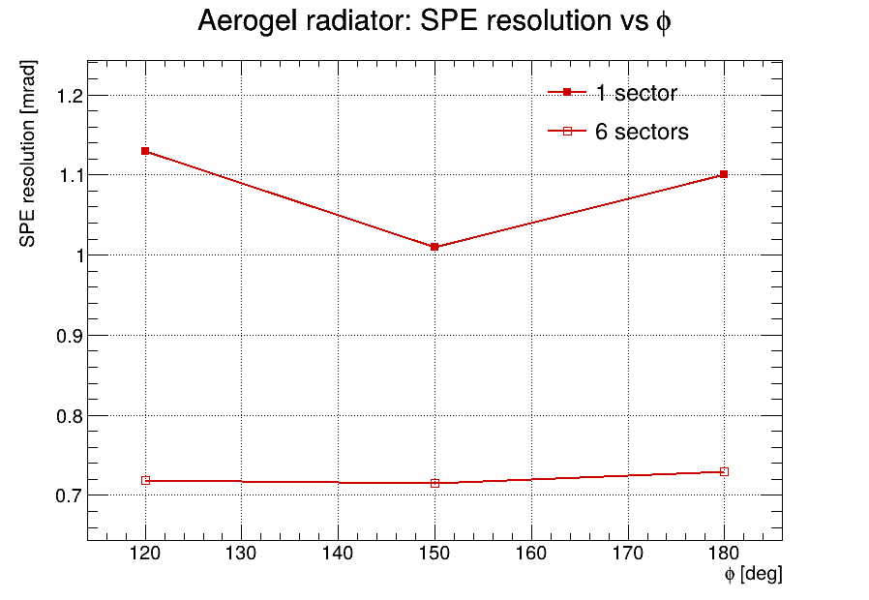
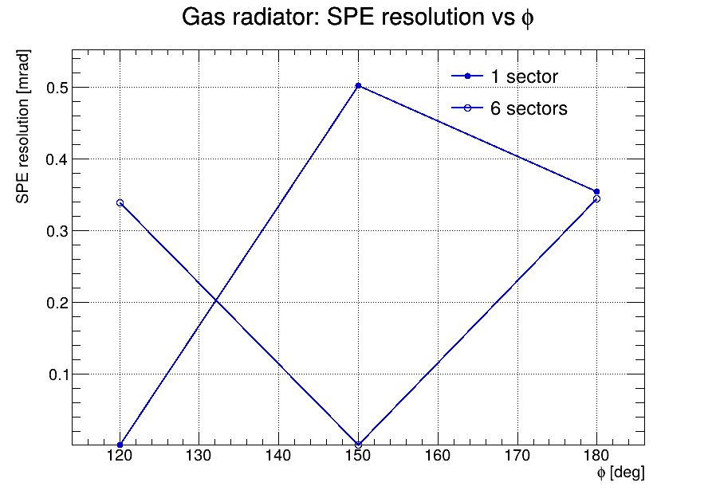
SPE vs phi :

