Slide 1
pfRICH Beam Test Mirror scanning
Simon Snydersmith, Sushrut Karmarkar, Andreas Jung
4 May, 2026

Slide 2
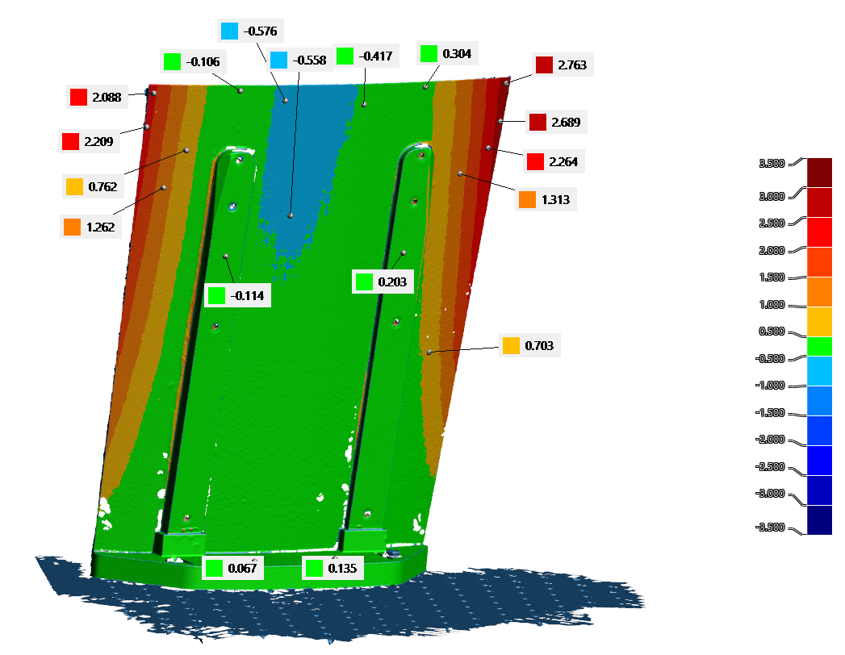
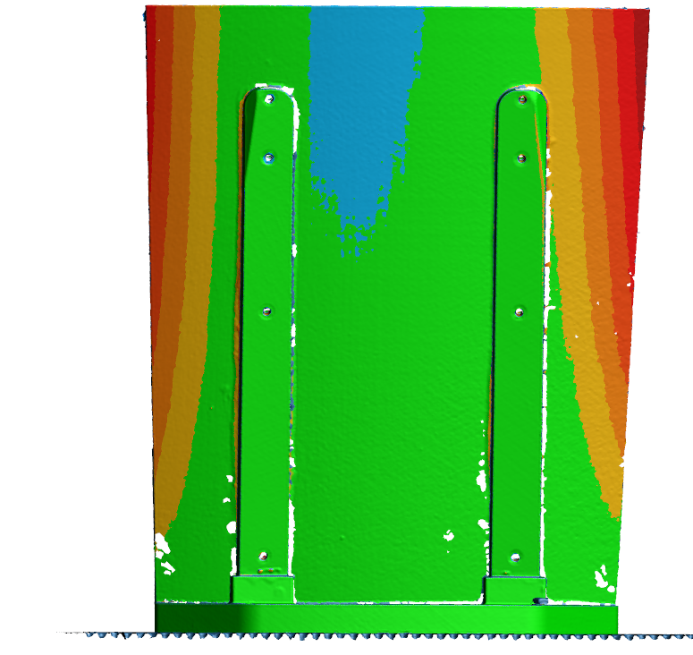
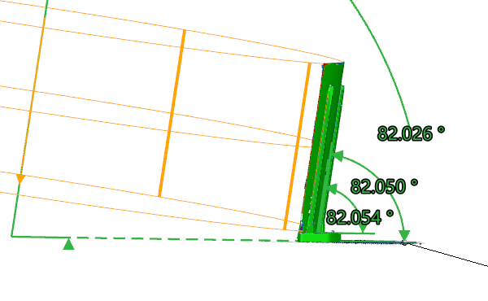
Back face results
Upright planes
Cylinder axis to optical table
Upright plane to mirror foot
Upright plane to optical table

Slide 3
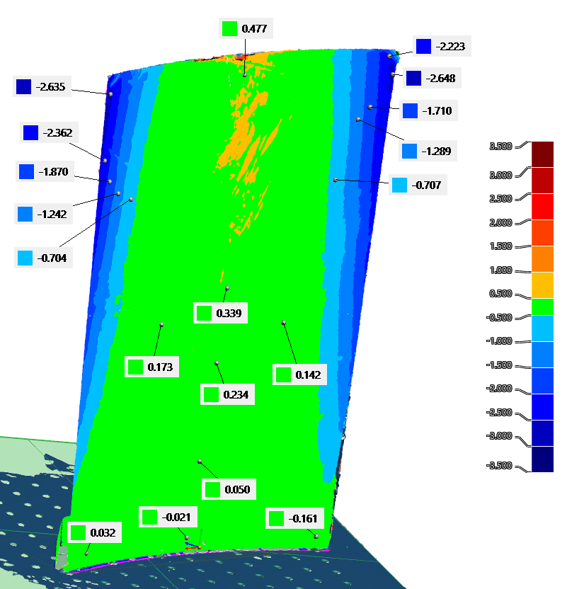
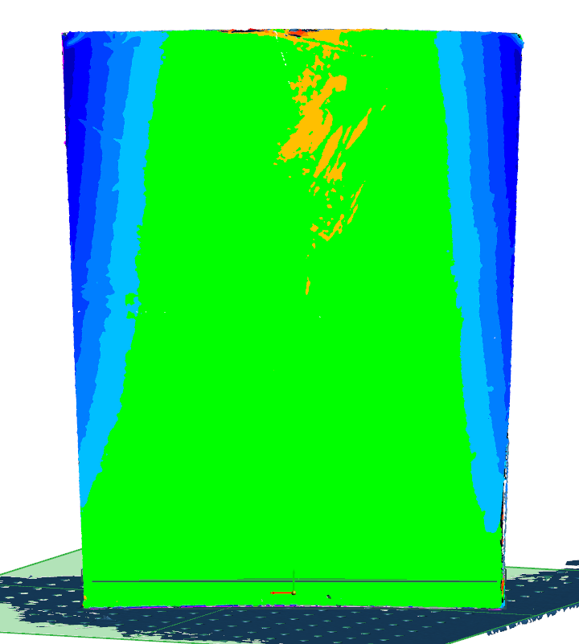
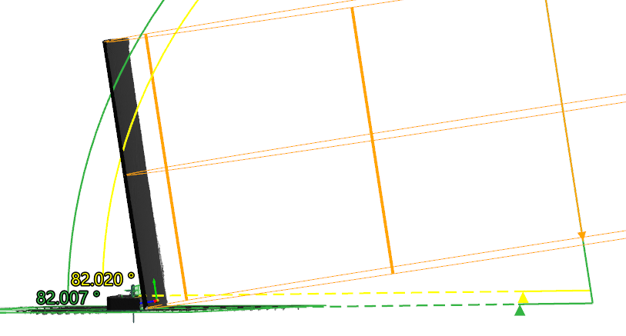
Front face results
Cylinder axis to mirror foot
Cylinder axis to optical table

Slide 4
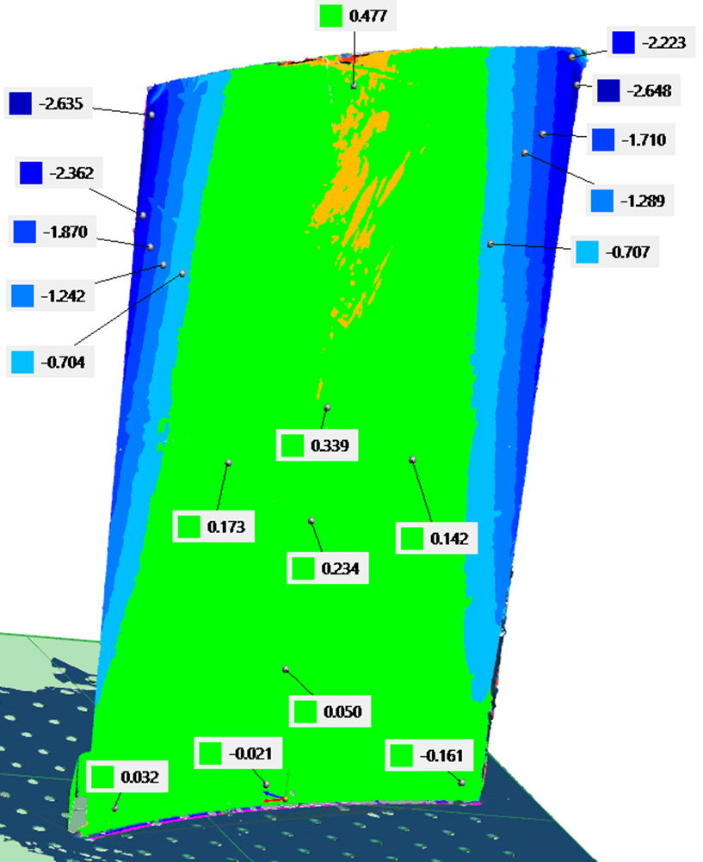
Data Summary
Best-fit cylinder used to get orientation of mirror, upright back planes used to verify
Angles to optical table:
  82.5° nominal
  82.026° measured from back face
  82.007° measured from front face
  ~0.49° deviation from nominal
Will scan next foot to check 3d-print angle
Likely due to adhesive being pushed toward the top of foot during gluing
0.5-0.6 mm deviation toward center of vessel at top center of mirror
2.5-2.8 mm deviation away from center of vessel at corners
Connector pieces likely necessary to correct curvature at corners, curvature between uprights good

Slide 5
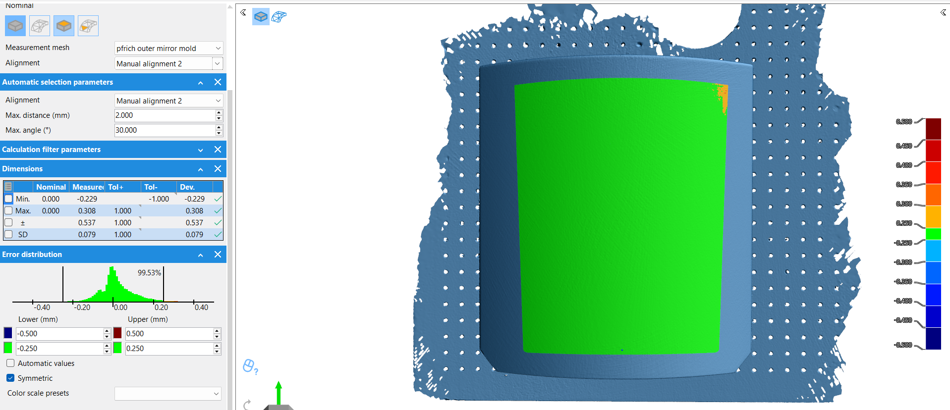
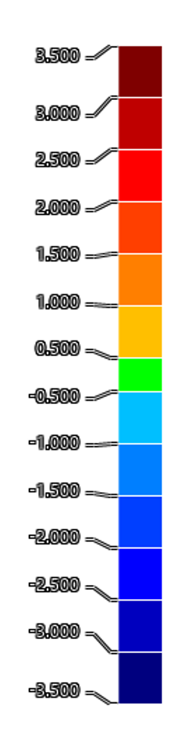
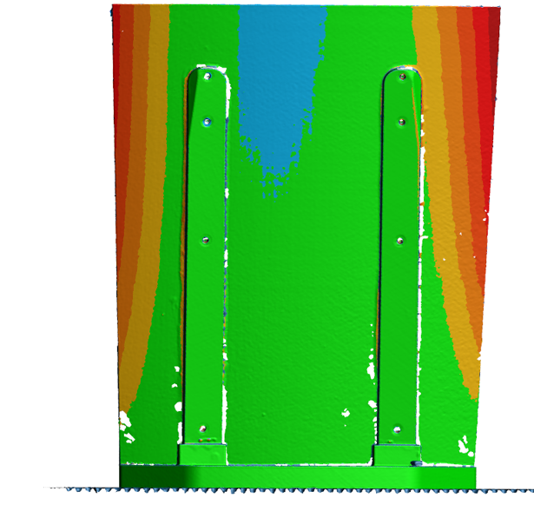
Tool Scanning
Shape is within 0.3 mm of nominal
No tool shape compensation
3 mm deformation seen on mirror likely due to tool interactions, could be amended by new, compensated tool

Slide 6
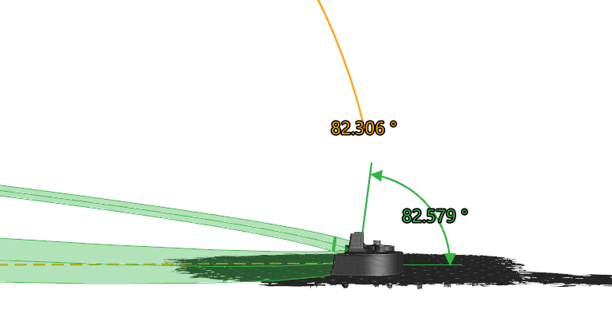
3D print angle scan
82.31 degrees between cylinder and table
82.58 degrees between flat upright faces and table
+-0.2 degrees 3D print accuracy
Bonding mirror precisely at 82.5 degrees will require machined bonding fixture

