Slide 1
EPIC Sims Integration and Fitting
Bennett Lamb and Professor Xiaochao Zheng
University of Virginia

Slide 2
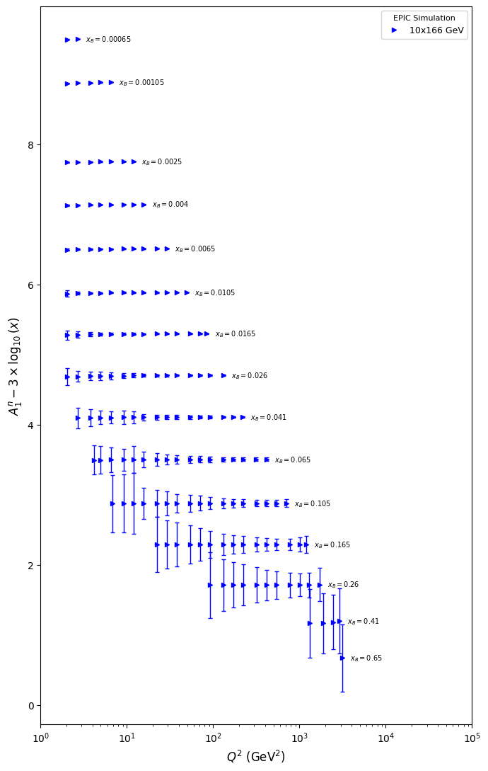
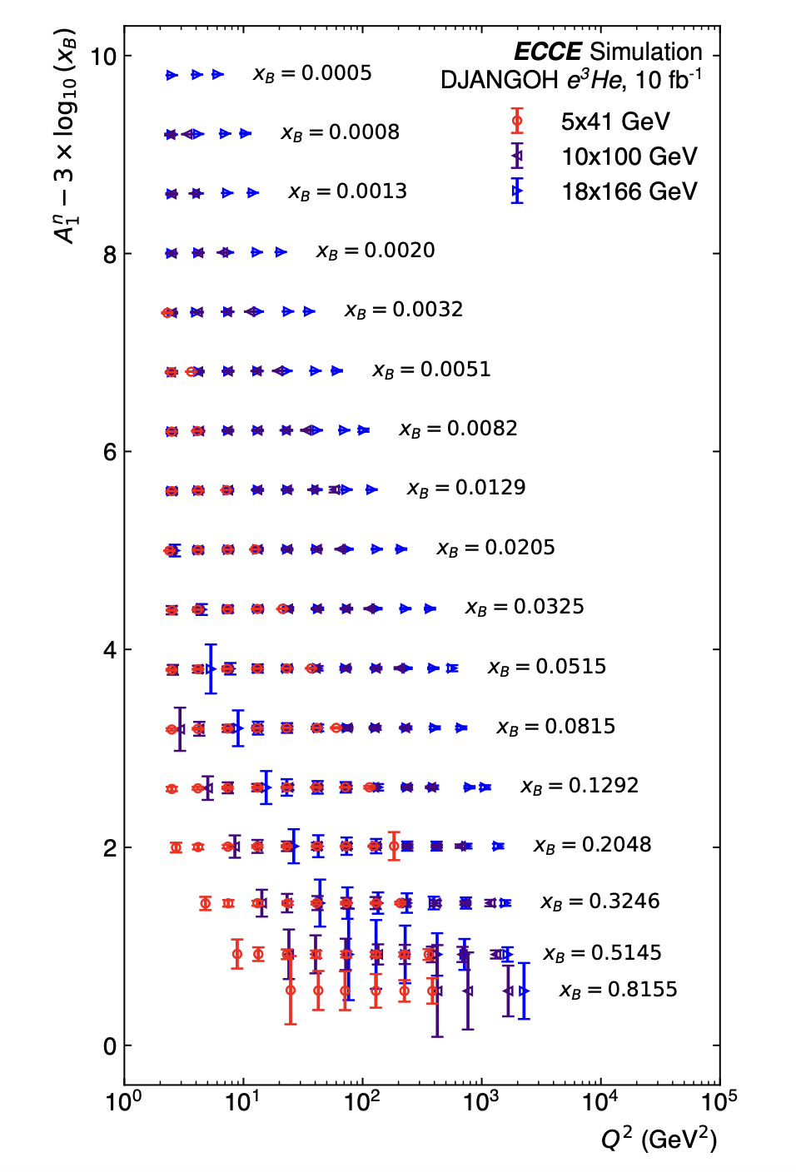
EPIC A1p_phys neutron data
ECCE Sim for comparison

Slide 3
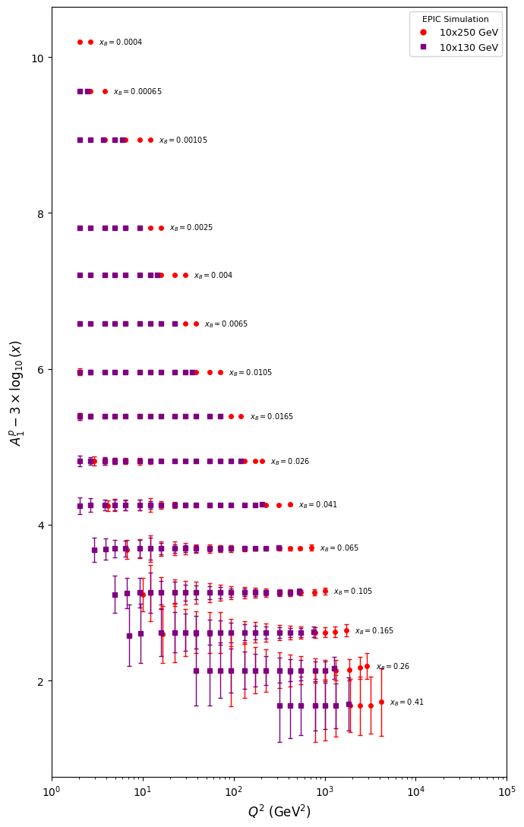
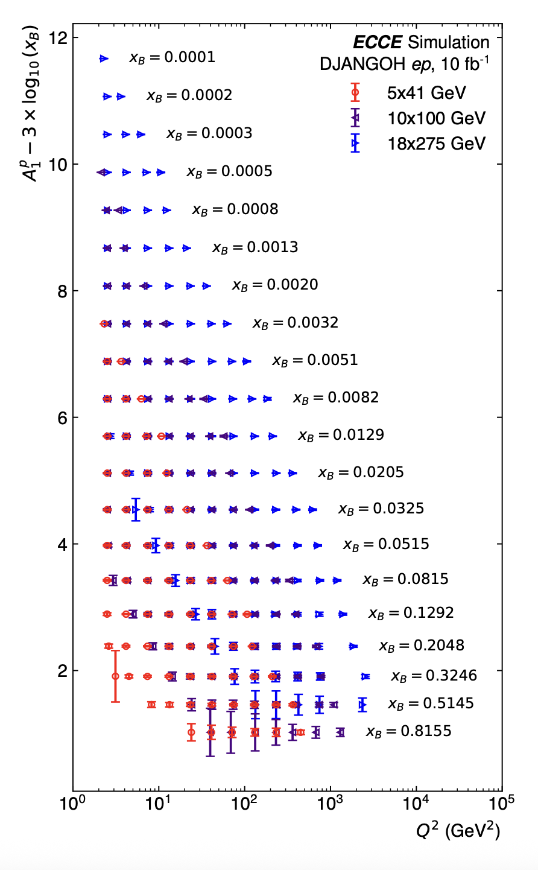
EPIC A1p_phys proton data
ECCE Sim for comparison

Slide 4
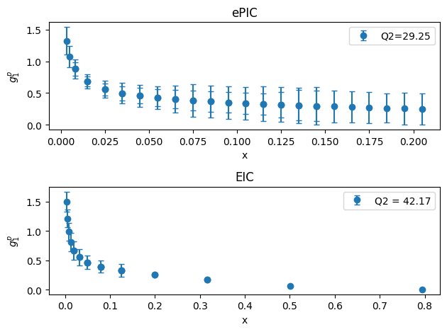
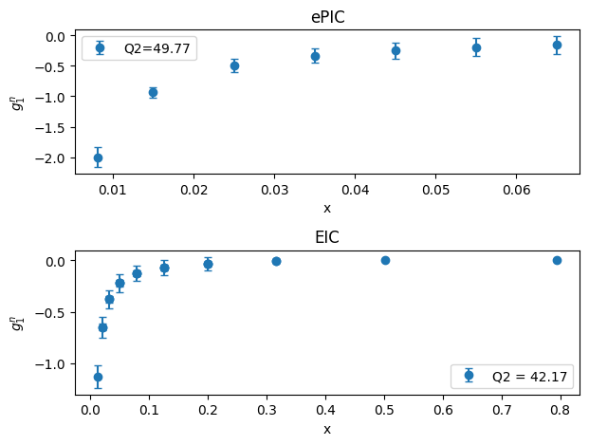
Comparison of g1 to EIC sims
Using g1~A1*F1, obtained similar functional form as EIC sims

Slide 5
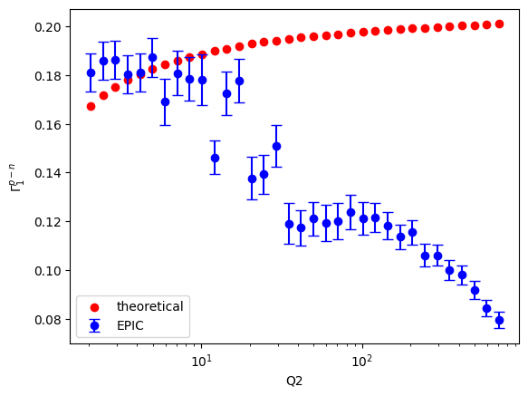
Integration
Graph shows EPIC + model vs theoretical Bjorken Sum with statistical uncertainty

Slide 6
Monte Carlo Simulations
Systematic uncertainties were estimated with 3% correlated and 1.5% uncorrelated error
Model fill-in was used when calculating the Bjorken sum and its uncertainty

Slide 7
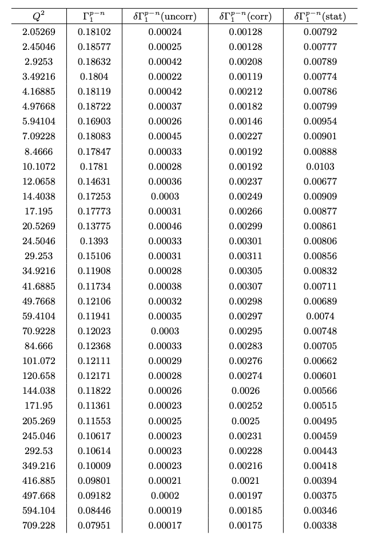
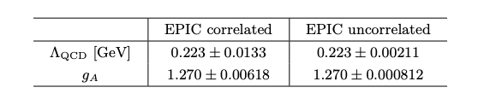
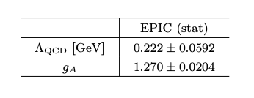
MC and Fitting Results

Slide 8
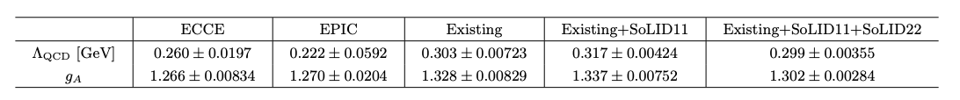
Other Fitting Results (statistical uncertainties)

Slide 9
Next Steps
Repeat fitting procedure with Existing, Existing + SoLID11, etc., with EPIC added

